Slide 1
The 2021 Workshop on CEPC Detector & MDI Mechanical Design
Closing Remarks
Jie Gao
October 22-23, 2021
IHEP CSNS, Dongguan ( A102 )

Slide 2
Observation:
Since the CEPC MDI workshop in 2020, there has been many important progresses which are reflected by the 20 talks:
MDI is an important and complex system with each subsystem design goal and requirements coming from overlapping subsystems, more efforts are needed to guarantee the smooth progress of CEPC MDI studies
https://indico.ihep.ac.cn/event/14392/other-view?view=standard

Slide 3
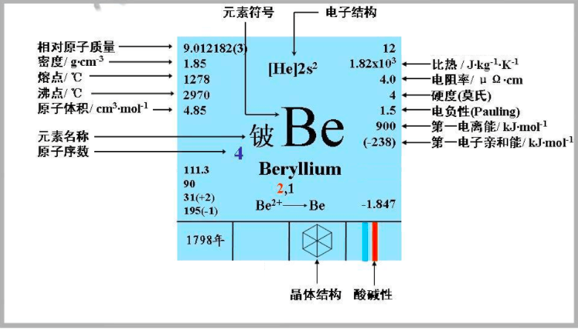
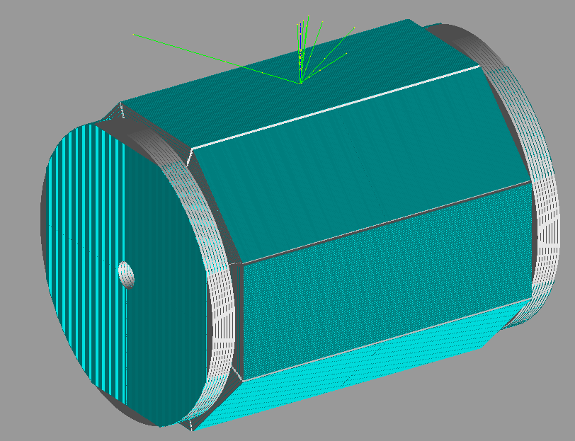
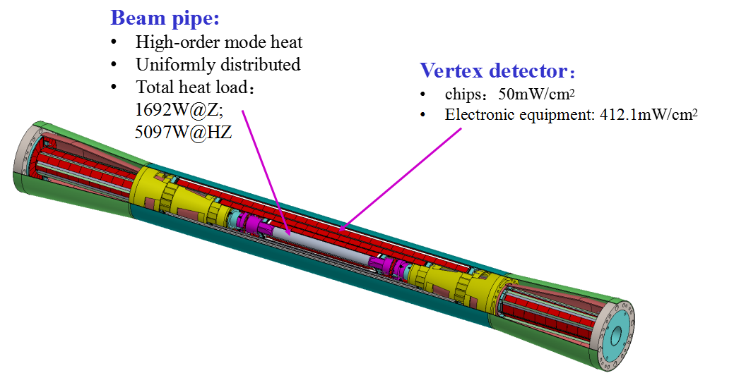
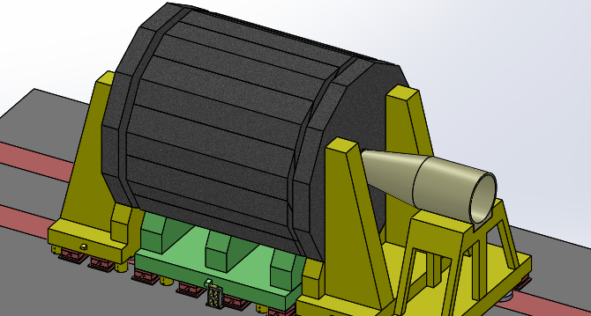
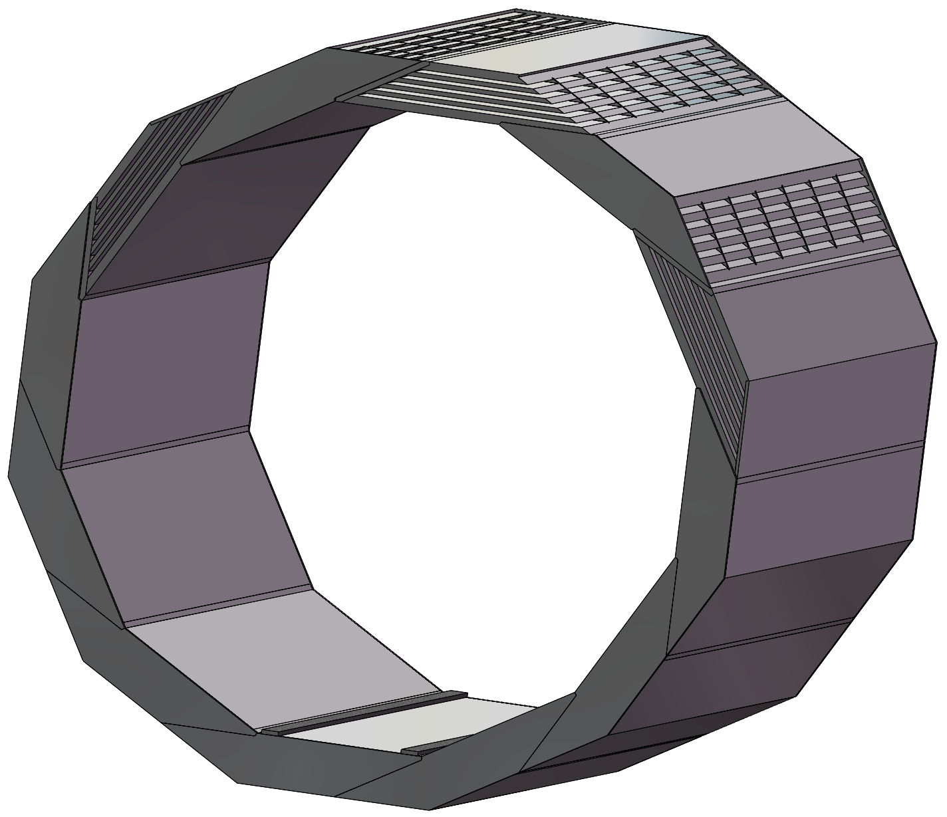
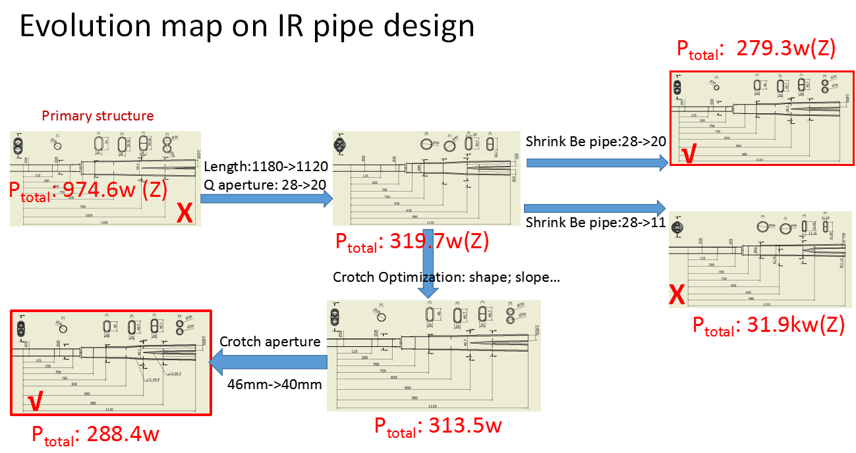
CEPC MDI subsystem and related issues

Slide 4
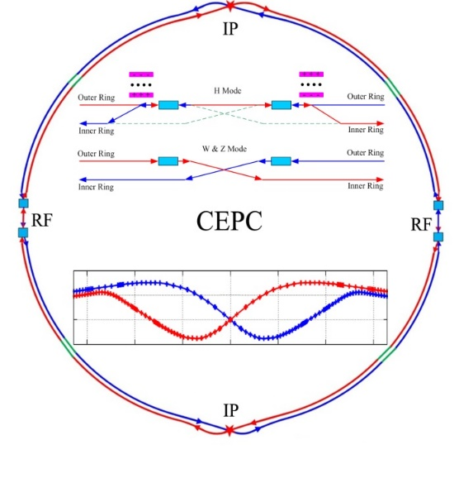
Map of the CEPC MDI Study Issues
IP Feedback
BG Simulation
LumiCal
HOM absorber
Vacuum Chamber
SR Masks
QD0/QF1
Anti-Solenoid
Cryostats
BPMs
Instability&Impendance
Cooling
Shielding
Assembly&Supporting
Alignment
Connecting System
Vacuum pumps
Last Bending Magnet
Collimators
Control
Dump near detector
Collider ring
H.Y. Shi
Central Beam Pipe
Vertex Detector
LumiCal
Silicon Tracker
TPC
Hcal
Ecal
Solenoid
Yoke
Muon Detector
Hall
BG Simulation&Shielding
Software Geometry
Alignment&Assembly
Electronics
Cryogenic
Radiation Protection
Detector
Accelerator
The CEPC MDI Map’s contents should be continuiously
updated when necessary to avoid dark sector
Adding necessary
issue when necessary.
For example,
dumps near IPs,

Slide 5
CEPC Accelerator Parameters (CDR/TDR)
 | CDR Parameters |  |  |  | High Luminosity Parameters (TDR)
 | Higgs | W | Z（3T） | Z（2T） | tt | Higgs | W | Z
Number of IPs | 2 |  |  |  | 2
Beam energy (GeV) | 120 | 80 | 45.5 |  | 180 | 120 | 80 | 45.5
Circumference (km) | 100 |  |  |  | 100
Synchrotron radiation loss/turn (GeV) | 1.73 | 0.34 | 0.036 |  | 8.53 | 1.73 | 0.34 | 0.036
Half Crossing angle at IP (mrad) | 16.5 |  |  |  | 16.5
Piwinski angle | 2.58 | 7.0 | 23.8 |  | 1.16 | 4.87 | 7.25 | 24.9
Number of particles/bunch N_{e} (10¹⁰) | 15.0 | 12.0 | 8.0 |  | 20.1 | 16.3 | 15.0 | 15.2
Bunch number (bunch spacing) | 242 (0.68μs) | 1524 (0.21μs) | 12000 (25ns+10%gap) |  | 37 (4.45μs) | 214 (0.7us) | 1230 (0.27μs) | 3816 (86ns)
Beam current (mA) | 17.4 | 87.9 | 461.0 |  | 3.5 | 16.8 | 88.6 | 278.8
SR power /beam (MW) | 30 | 30 | 16.5 |  | 30 | 30 | 30 | 10
Bending radius (km) | 10.7 |  |  |  | 10.7
Momentum compact (10⁻⁵) | 1.11 |  |  |  | 0.71 | 0.71 | 1.43 | 1.43
β function at IP β_{x}* / β_{y}* (m) | 0.36/0.0015 | 0.36/0.0015 | 0.2/0.0015 | 0.2/0.001 | 1.04/2.7 | 0.33/1 | 0.21/1 | 0.13/0.9
Emittance e_{x}/e_{y} (nm) | 1.21/0.0031 | 0.54/0.0016 | 0.18/0.004 | 0.18/0.0016 | 1.4/0.0047 | 0.64/0.0013 | 0.87/0.0017 | 0.27/0.0014
Beam size at IP s_{x} /s_{y} (μm) | 20.9/0.068 | 13.9/0.049 | 6.0/0.078 | 6.0/0.04 | 39/0.113 | 15.0/0.036 | 13/0.042 | 6.0/0.035
Beam-beam parameters ξ_{x}/ξ_{y} | 0.031/0.109 | 0.013/0.106 | 0.0041/0.056 | 0.0041/0.072 | 0.071/0.1 | 0.015/0.11 | 0.012/0.113 | 0.004/0.127
RF voltage V_{RF} (GV) | 2.17 | 0.47 | 0.10 |  | 10 | 2.2 | 0.7 | 0.12
RF frequency f _{RF} (MHz) (harmonic) | 650 (216816) |  |  |  | 650 (216816)
Natural bunch length σ_{z} (mm) | 2.72 | 2.98 | 2.42 |  | 2.23 | 2.25 | 2.7 | 2.75
Bunch length σ_{z} (mm) | 3.26 | 5.9 | 8.5 |  | 2.66 | 4.42 | 5.4 | 9.6
Natural energy spread (%) | 0.1 | 0.066 | 0.038 |  | 0.17 | 0.19 | 0.12 | 0.12
Energy acceptance requirement (%) | 1.35 | 0.4 | 0.23 |  | 2.3 | 1.6 | 1.2 | 1.3
Energy acceptance by RF (%) | 2.06 | 1.47 | 1.7 |  | 2.6 | 2.2 | 2.5 | 1.7
Lifetime (hour) | 0.67 | 1.4 | 4.0 | 2.1 | 0.3 | 0.205 | 0.917 | 1.34
Luminosity/IP L (10³⁴cm⁻²s⁻¹) | 2.93 | 10.1 | 16.6 | 32.1 | 0.5 | 5.0 | 16.0 | 115.0
Each study should indicate clearly the initial paramters based on to avoid ambiguities
Next step: TDR MDI,
based on the CDR MDI
Notes:
需要改进排版

Slide 6
CEPC MDI Study Status
H.Y. Shi
IP Feedback | Not Covered
BG Simulation | Doing
LumiCal | Doing
HOM absorber | No Need
Vacuum Chamber | Done
SR Masks | Done
QD0/QF1 | Doing
Anti-Solenoid | Doing
Cryostats | Doing
BPMs | Doing
Instability&Impendance | Done
Cooling | Done
Shielding | Doing
Assembly&Supporting | Doing
Alignment | Doing
Connecting System | ?
Vacuum pumps | Doing
Last Bending Magnet | Done
Collimators | Doing
Control | Not Covered
Central Beam Pipe | Done
Vertex Detector | Doing
LumiCal | Doing
Silicon Tracker | Doing
TPC | Doing
Hcal | Doing
Ecal | Doing
Solenoid | Doing, strength Fixed
Yoke | Doing
Muon Detector | Doing
Hall | ?
BG Simulation&Shielding | Doing
Software Geometry | Done, check needed
Alignment&Assembly | Doing
Electronics | ?
Cryogenic | ?
Radiation Protection | Not Covered
Collider | Not Covered
Clear CEPC MDI specified subsystem target goal parameter tables should be established to guide the evaluation of the status of each subsystem and MDI as a whole one
Accelerator
Detector

Slide 7
CEPC MDI Subsystem Task Forces
H.Y. Shi
MDI__Accelerator | Person
IP Feedback | J.H. Yue/C.H. Yu/Y.W. Wang
BG Simulation | H.Y. Shi/S. Bai
LumiCal | Suen Hou/Ivanka/Phillipe
HOM absorber | Y.D. Liu/J.Y. Zhai
Vacuum Chamber | H.J. Wang
SR Masks | H.Y. Shi
QD0/QF1 | Y.S. Zhu
Anti-Solenoid | Y.S. Zhu
Cryostats | M.F. Xu/T.X. Zhao
BPMs | Y.F. Sui
Instability&Impendance | Y.D. Liu/N. Wang
Cooling | Q. Ji/H.J. Wang
Shielding | H.Y. Shi/Z.J. Ma/S. Bai
Assembly&Supporting | H.J. Wang/Q. Ji
Alignment | X.L. Wang/Q. Ji/H.J. Wang
Connecting System | H.J. Wang
Vacuum pumps | Y.S. Ma
Last Bending Magnet | Y.W. Wang
Collimators | S. Bai/H.J. Wang
Control | G. Li
MDI__Detector | Person
Central Beam Pipe | Q. Ji
Vertex Detector | Z.J. Liang
LumiCal | Suen Hou/Ivanka/Phillipe
Silicon Tracker | H. Fox
TPC | H.R. Qi
Hcal | Y. Liu
Ecal | Y. Liu
Solenoid | F.P. Ning
Yoke | F.P. Ning
Muon Detector | X.L. Wang
Hall | Z.A. Zhu
BG Simulation&Shielding | H.Y. Shi
Software Geometry | C.D. Fu
Alignment&Assembly | Q. Ji/H.J. Wang/X.L. Wang
Electronics | W. Wei
Cryogenic | T.X. Zhao
Radiation Protection/dumps | Z.J. Ma
Collider ring | Y.W. Wang
Clear CEPC MDI subsystem overlapping working relation and communication table(s) should be established to improve the communication among colleageus in MDI as a whole team

Slide 8
Suggestions:
A complete design goal and requirements parameter table(s) for any MDI subsystem and MDI as whole should be established by MDI colleageus in order to evaluate MDI status qualitatively
A CEPC MDI subsystem overlapping and parameter constrain relation should be established more clearly (including also people working relationship)
A MDI coherent study should be given a version name equiped with a complete documents in order to avoid any confusion in a complex system such as MDI

Slide 9
Acknowledgements
Thanks to all speakers and participants both on site and on line
Thanks for organizing committee and CSNS local supports
Have a safe trip back!
Looking forwards to meet you in the next CEPC Detector and MDI workshop

