Slide 1


Muon detector
XiaoLong Wang
Fudan University
东莞CEPC探测器与MDI机械设计研讨会
散列中子源园区， 10/22/2021

Slide 2
Outline
Belle II Muon detector
G4 simulation on CEPC Muon detector
Status of hardware R&D

Slide 3
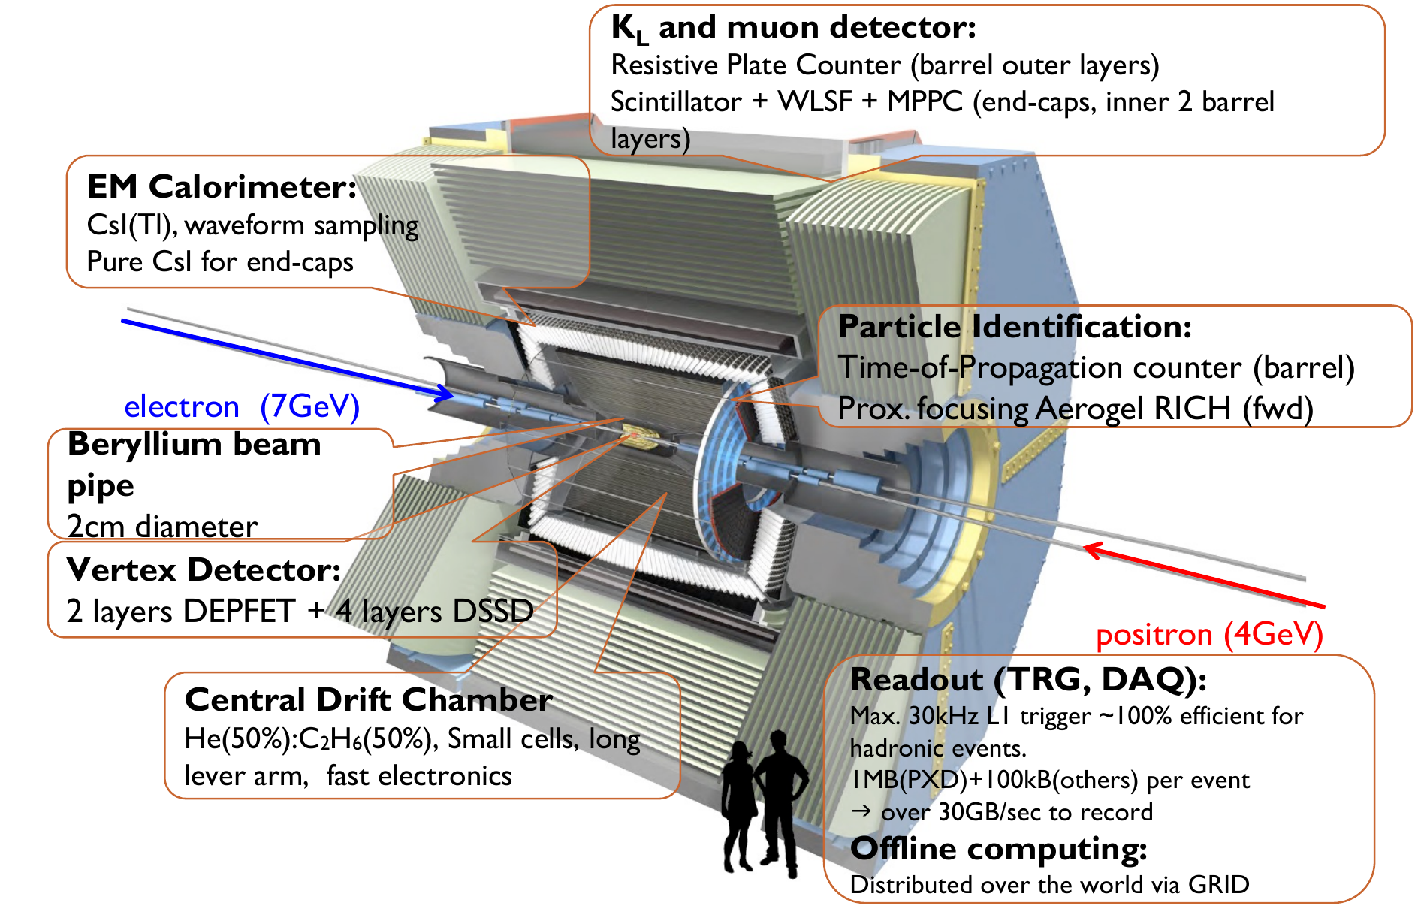
Belle II muon detector
-a good reference
H=7.1m, L=7.4m
W=1400t
B=1.5T
经验与教训
🙂 ☹

Slide 5
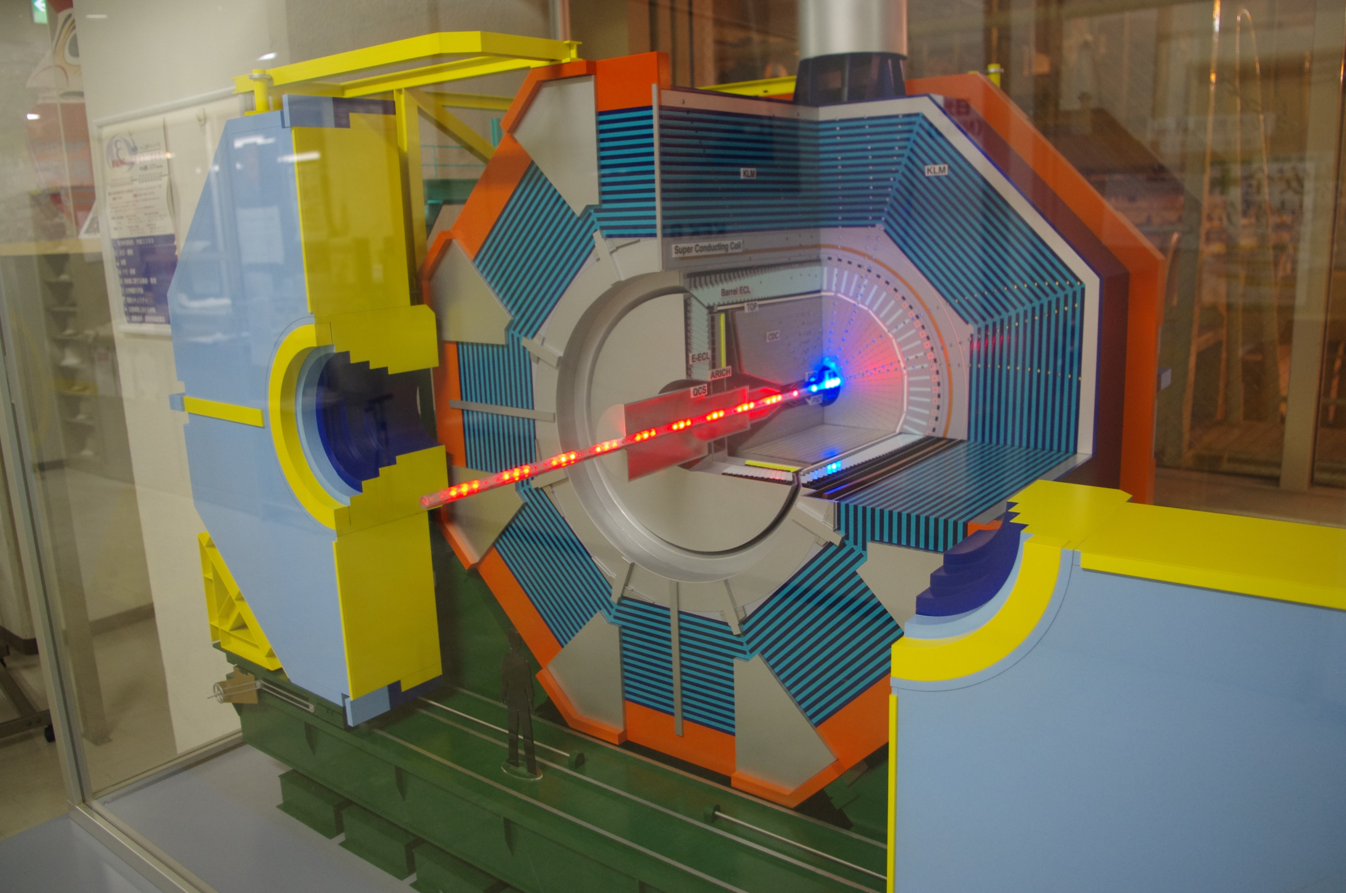

Slide 6
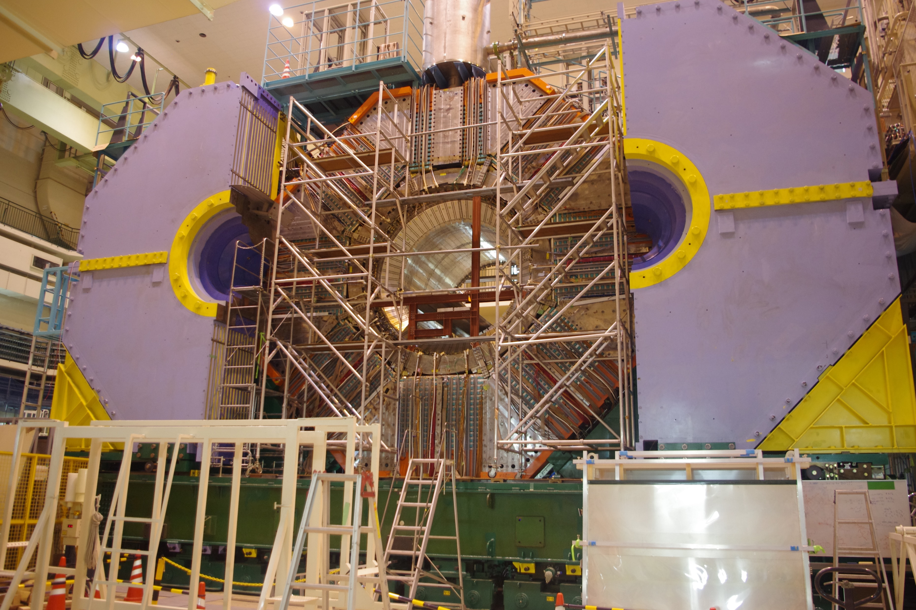

Slide 7
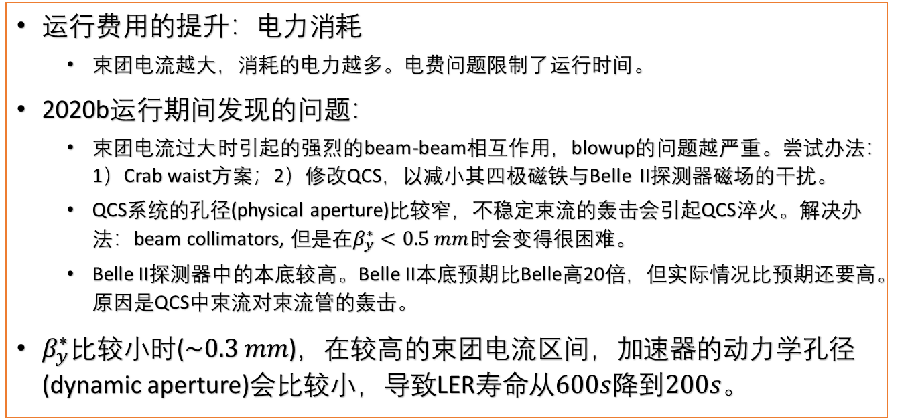
实验运行中发现的问题
运行费用的提升：电力消耗
  束团电流越大，消耗的电力越多。电费问题限制了运行时间。
2020b运行期间发现的问题：
  束团电流过大时引起的强烈的beam-beam相互作用，blowup的问题越严重。尝试办法：1）Crab waist方案；2）修改QCS，以减小其四极磁铁与Belle II探测器磁场的干扰。
  QCS系统的孔径(physical aperture)比较窄，不稳定束流的轰击会引起QCS淬火。解决办法：beam collimators, 但是在$β_{y}^{∗}<0.5 mm$时会变得很困难。
  Belle II探测器中的本底较高。Belle II本底预期比Belle高20倍，但实际情况比预期还要高。原因是QCS中束流对束流管的轰击。
$β_{y}^{∗}比较小$时($\sim 0.3 mm$)，在较高的束团电流区间，加速器的动力学孔径(dynamic aperture)会比较小，导致LER寿命从$600s$降到$200s$。

Slide 8
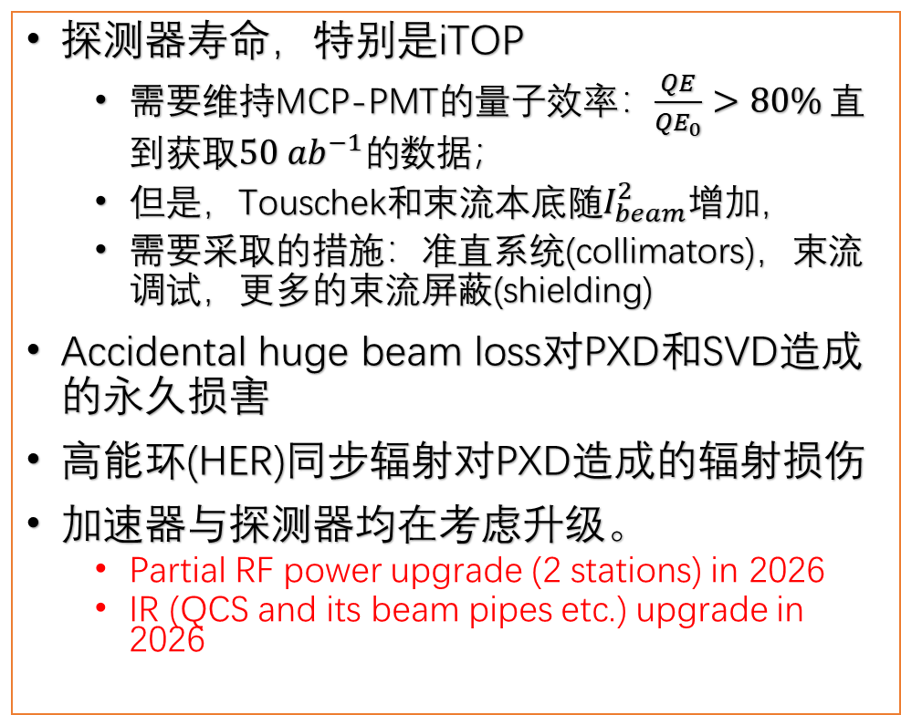
Belle II运行的主要问题
探测器寿命，特别是iTOP
  需要维持MCP-PMT的量子效率：$\frac{QE}{{QE}_{0}}>80\%$ 直到获取$50 {ab}^{−1}的$数据；
  但是，Touschek和束流本底随$I_{beam}^{2}增加$，
  需要采取的措施：准直系统(collimators)，束流调试，更多的束流屏蔽(shielding)
Accidental huge beam loss对PXD和SVD造成的永久损害
高能环(HER)同步辐射对PXD造成的辐射损伤
加速器与探测器均在考虑升级。
  Partial RF power upgrade (2 stations) in 2026
  IR (QCS and its beam pipes etc.) upgrade in 2026

Slide 9
Detector simulation
The detector simulation using Geant4 started in the early 2021.
CEPCSW installed, but G4 simulation has not been implemented yet.
  The implementation should be done recently.
The next step is testing with a high energy muon track.
The number of layers is not determined, 3 or 8?

Slide 10

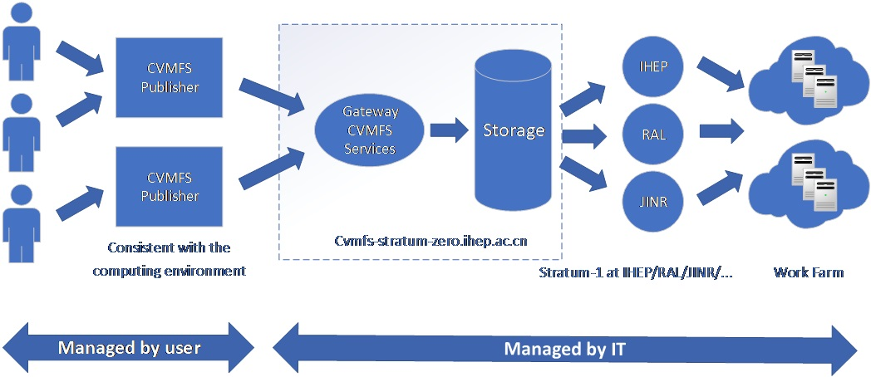
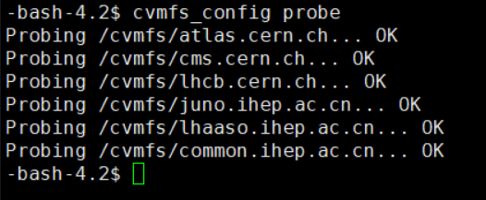
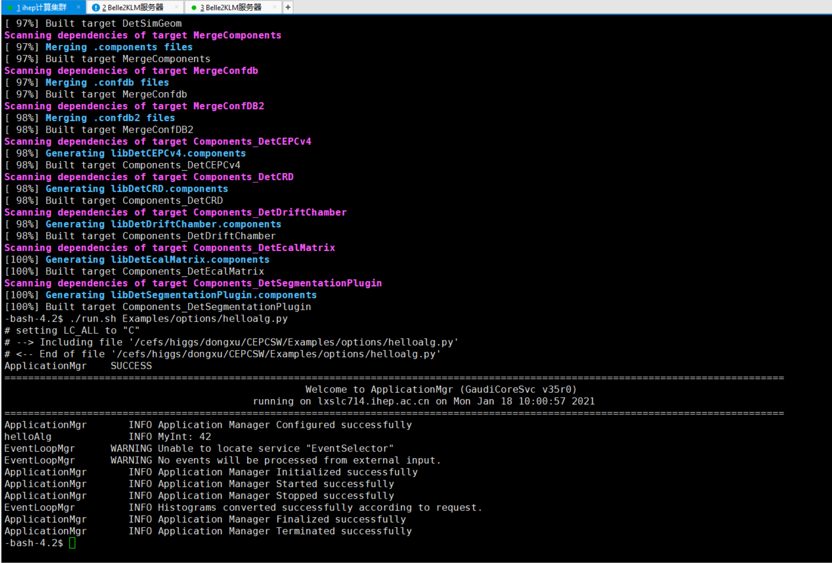
CEPCSW on cluster
check CVMFS
$ git clone git@github.com:cepc/CEPCSW.git
$ cd CEPCSW
$ git checkout master # branch name
$ source setup.sh
$ ./build.sh
$ ./run.sh Examples/options/helloalg.py
CEPCSW installed
Notes:
在高能所计算集群使用CernVM File System(CVMFS)安装新版本CEPCSW

Slide 11
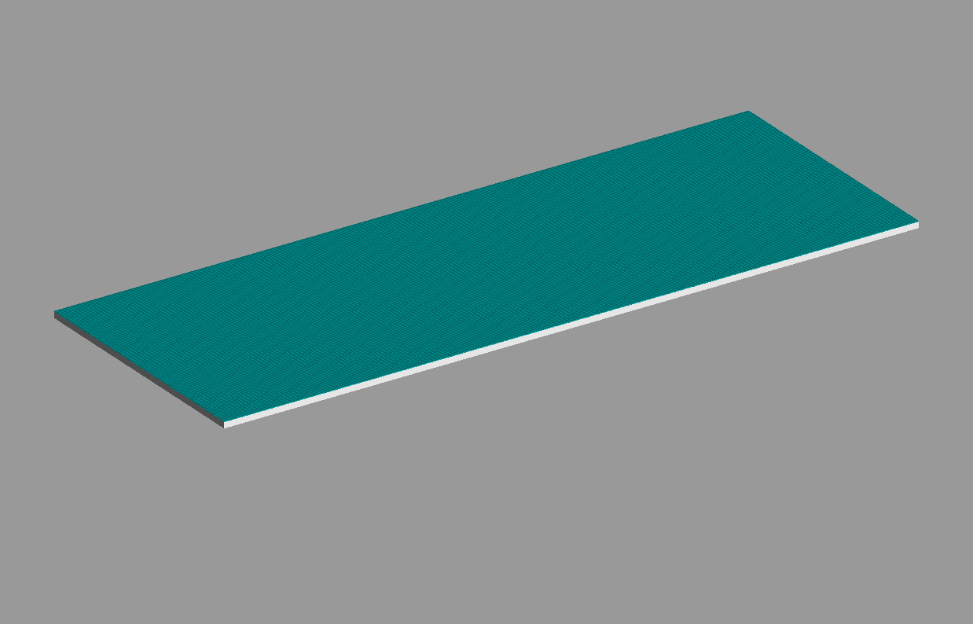
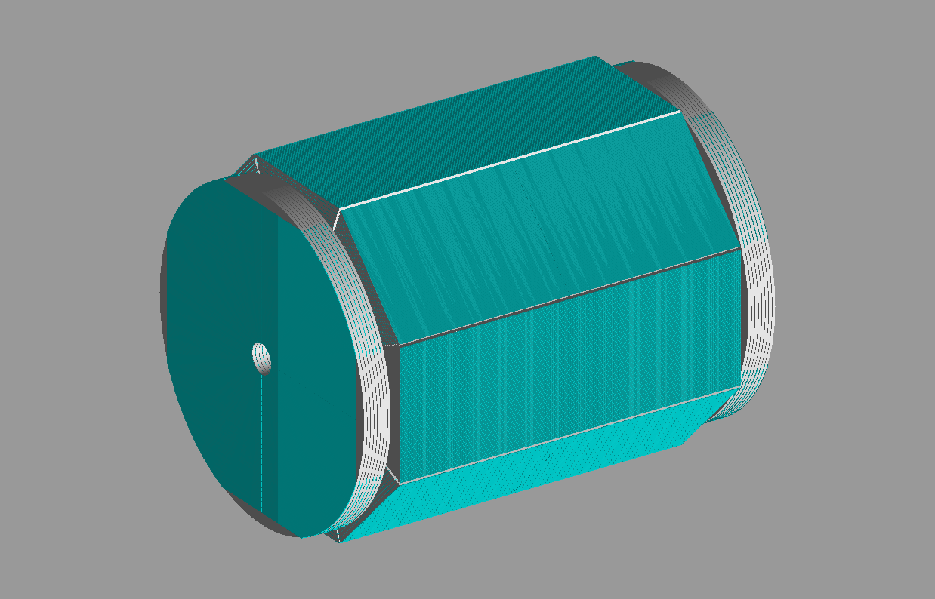
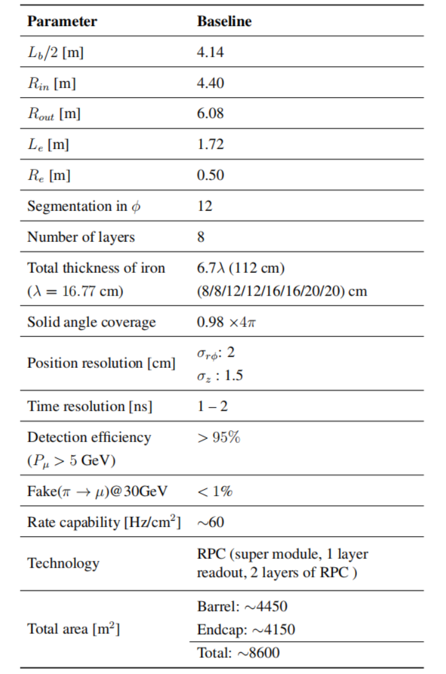
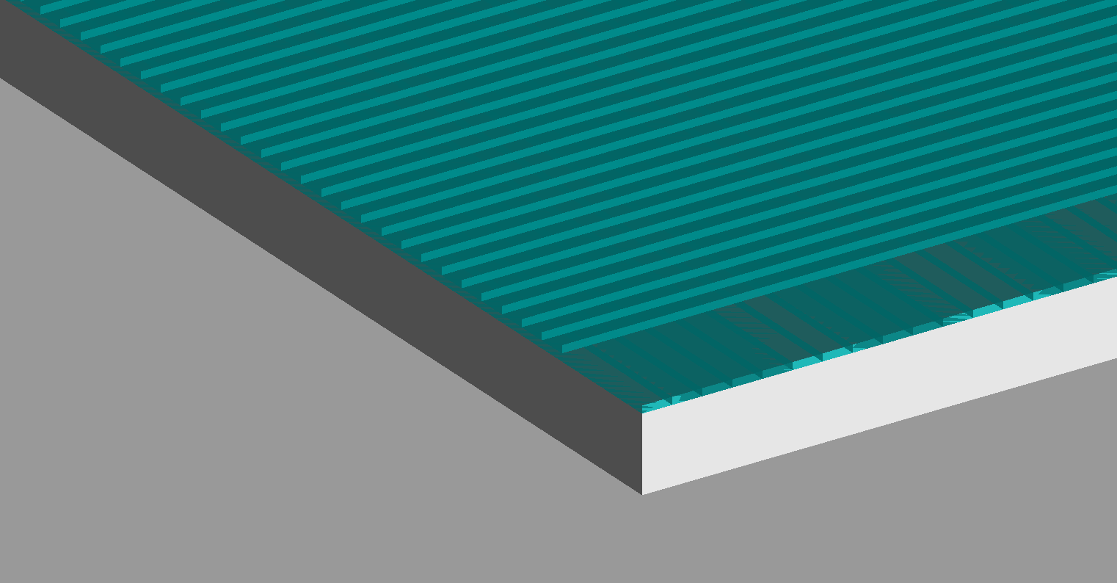
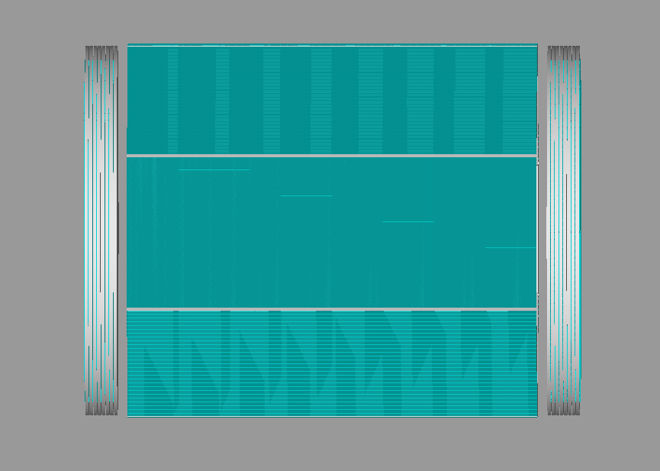
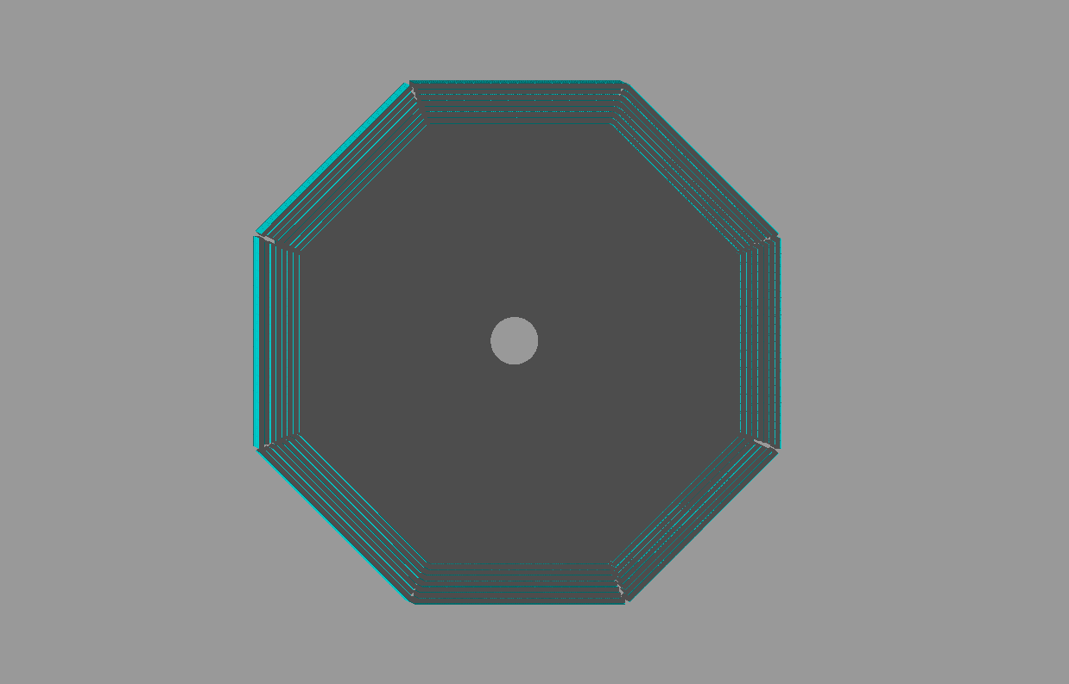
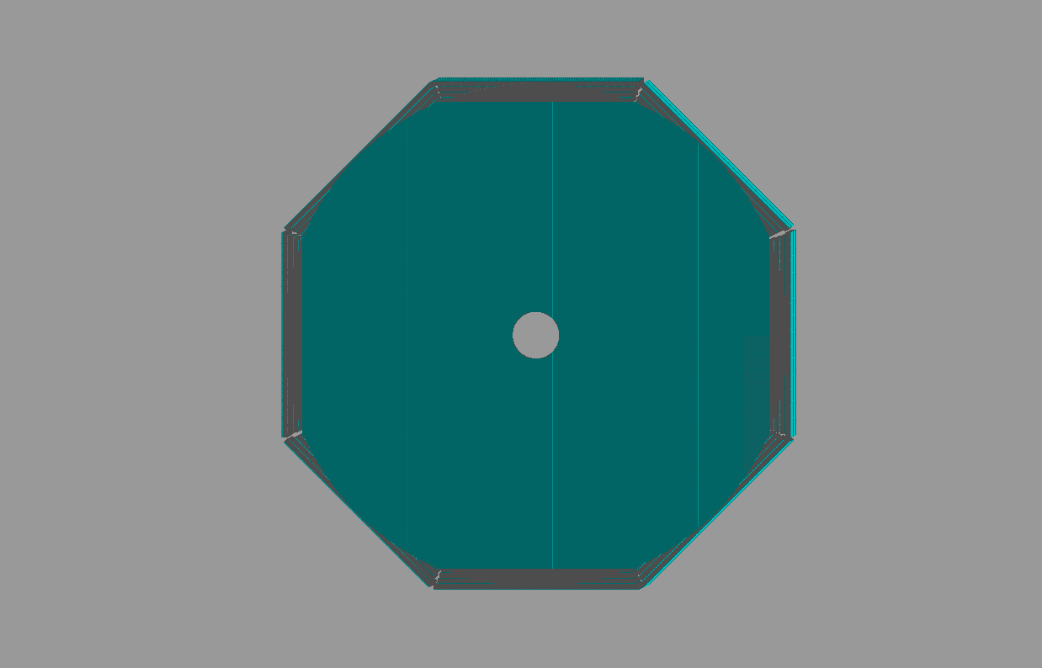
CEPC CDR 2018
superlayer
10cm
9m
Magnetic field would be quite strong in muon detector.
12m

Slide 12
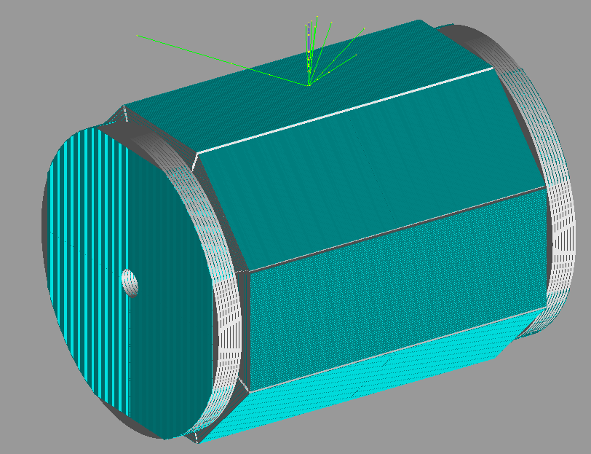
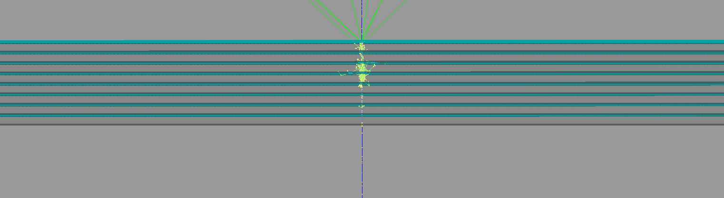

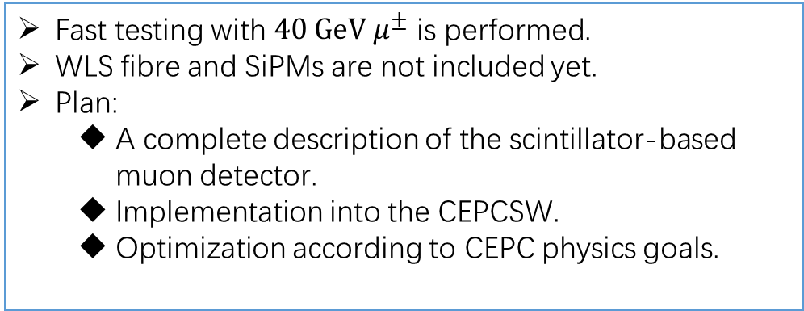
$40 GeV μ^{±}$ hits
Fast testing with $40 GeV μ^{±}$ is performed.
WLS fibre and SiPMs are not included yet.
Plan:
  A complete description of the scintillator-based muon detector.
  Implementation into the CEPCSW.
  Optimization according to CEPC physics goals.
Will be ready for G4 testing soon.

Slide 13
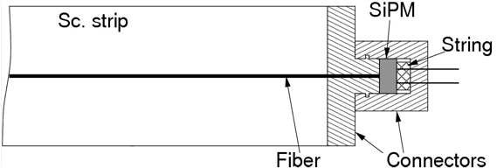
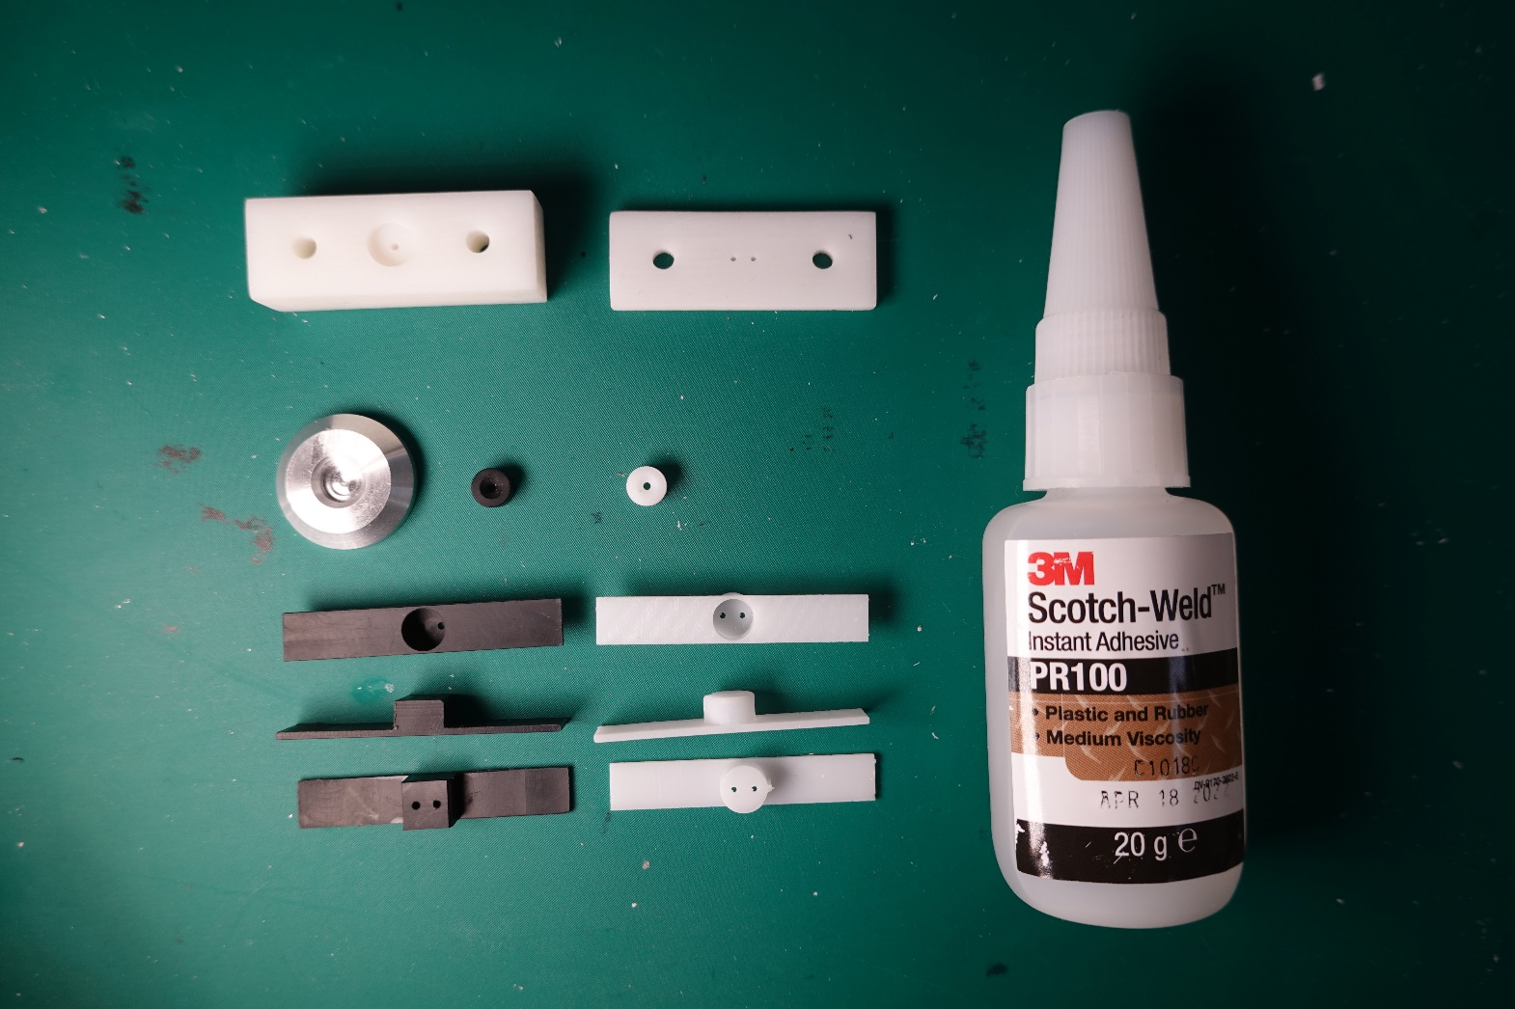
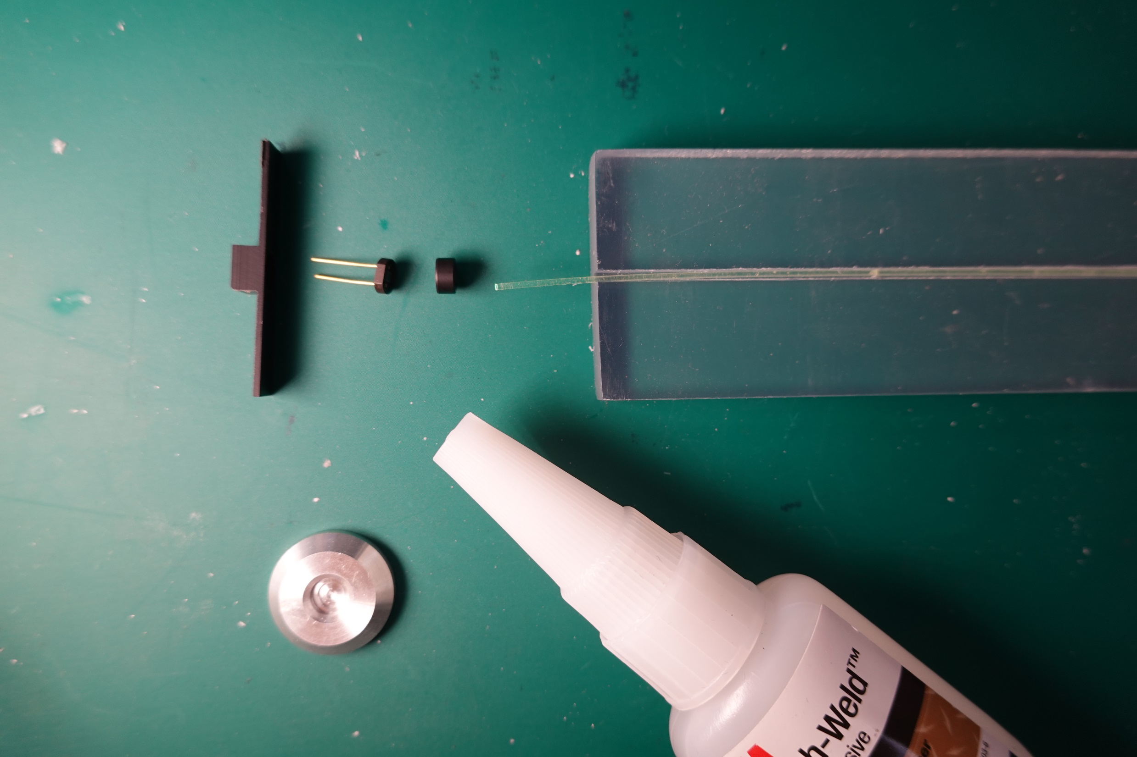
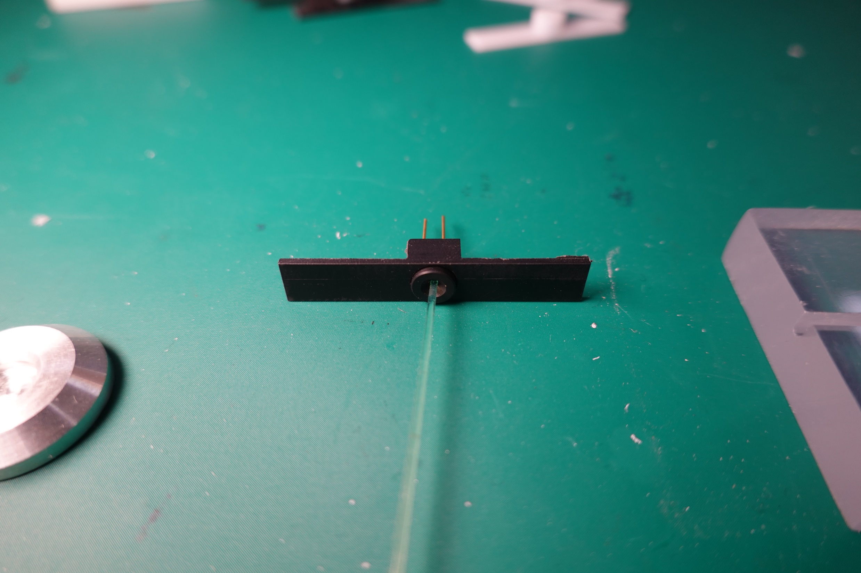
Optical coupling
From Belle II
Get closer to improve the light collection.
Firm coupling to avoid the damage on the MPPC sensor surface.
Studying the coupling between scintillator strip and fibre with optical glue.

Slide 14
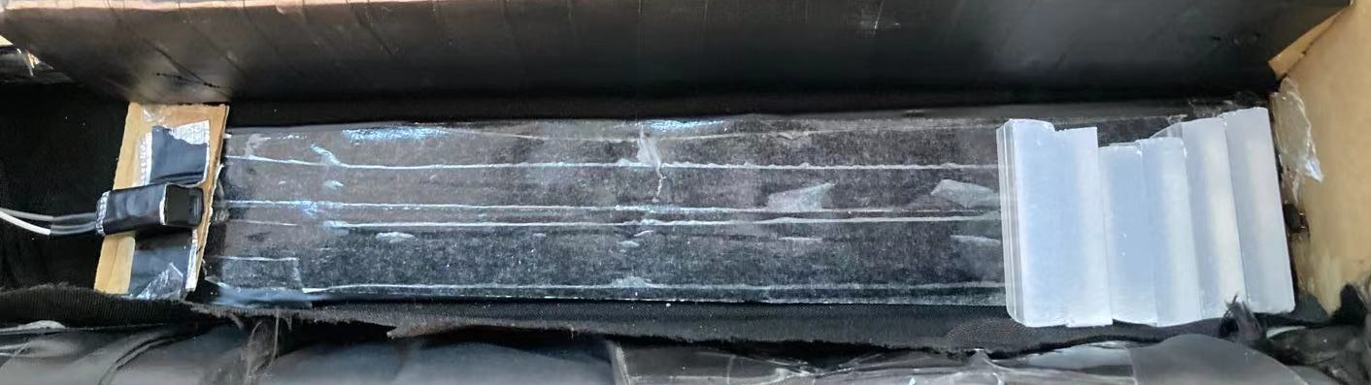
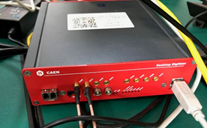
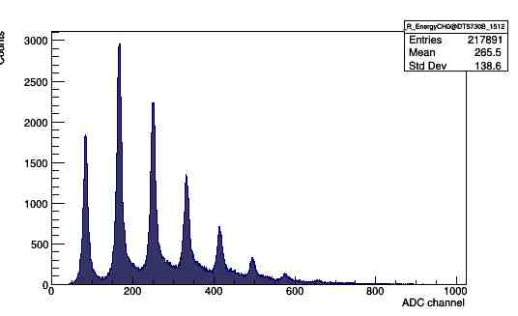
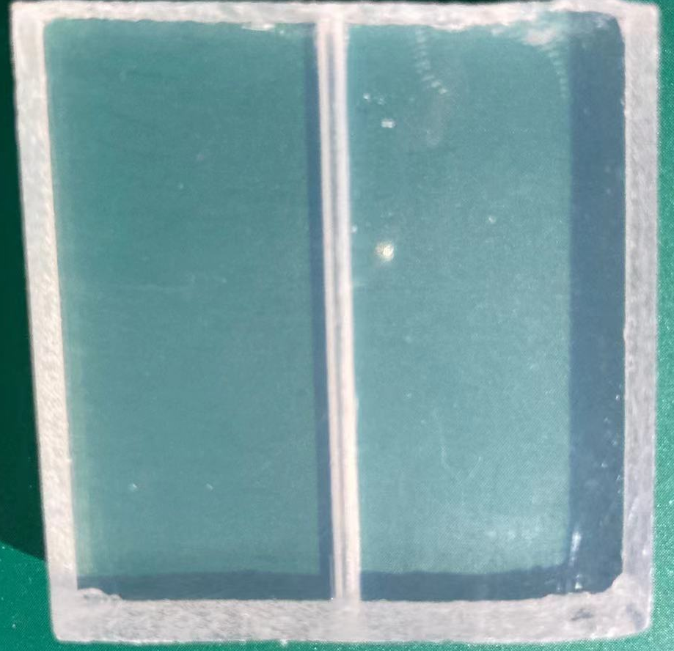
Attenuation length of Scintillator
Add scintillator between LED and MPPC
oscilloscope
light
Pulse generator
LED
light
scintillator
MPPC
Digital analyzer
DT5725
Scintillator blocks
LED
x
MPPC
Trigger:
2 channel coincidence
reduce dark count
Smooth surface
Multiphoton spectrum from MPPC

Slide 15
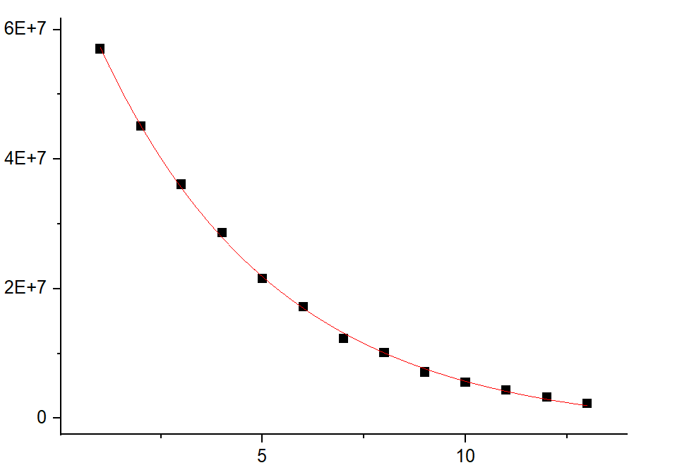
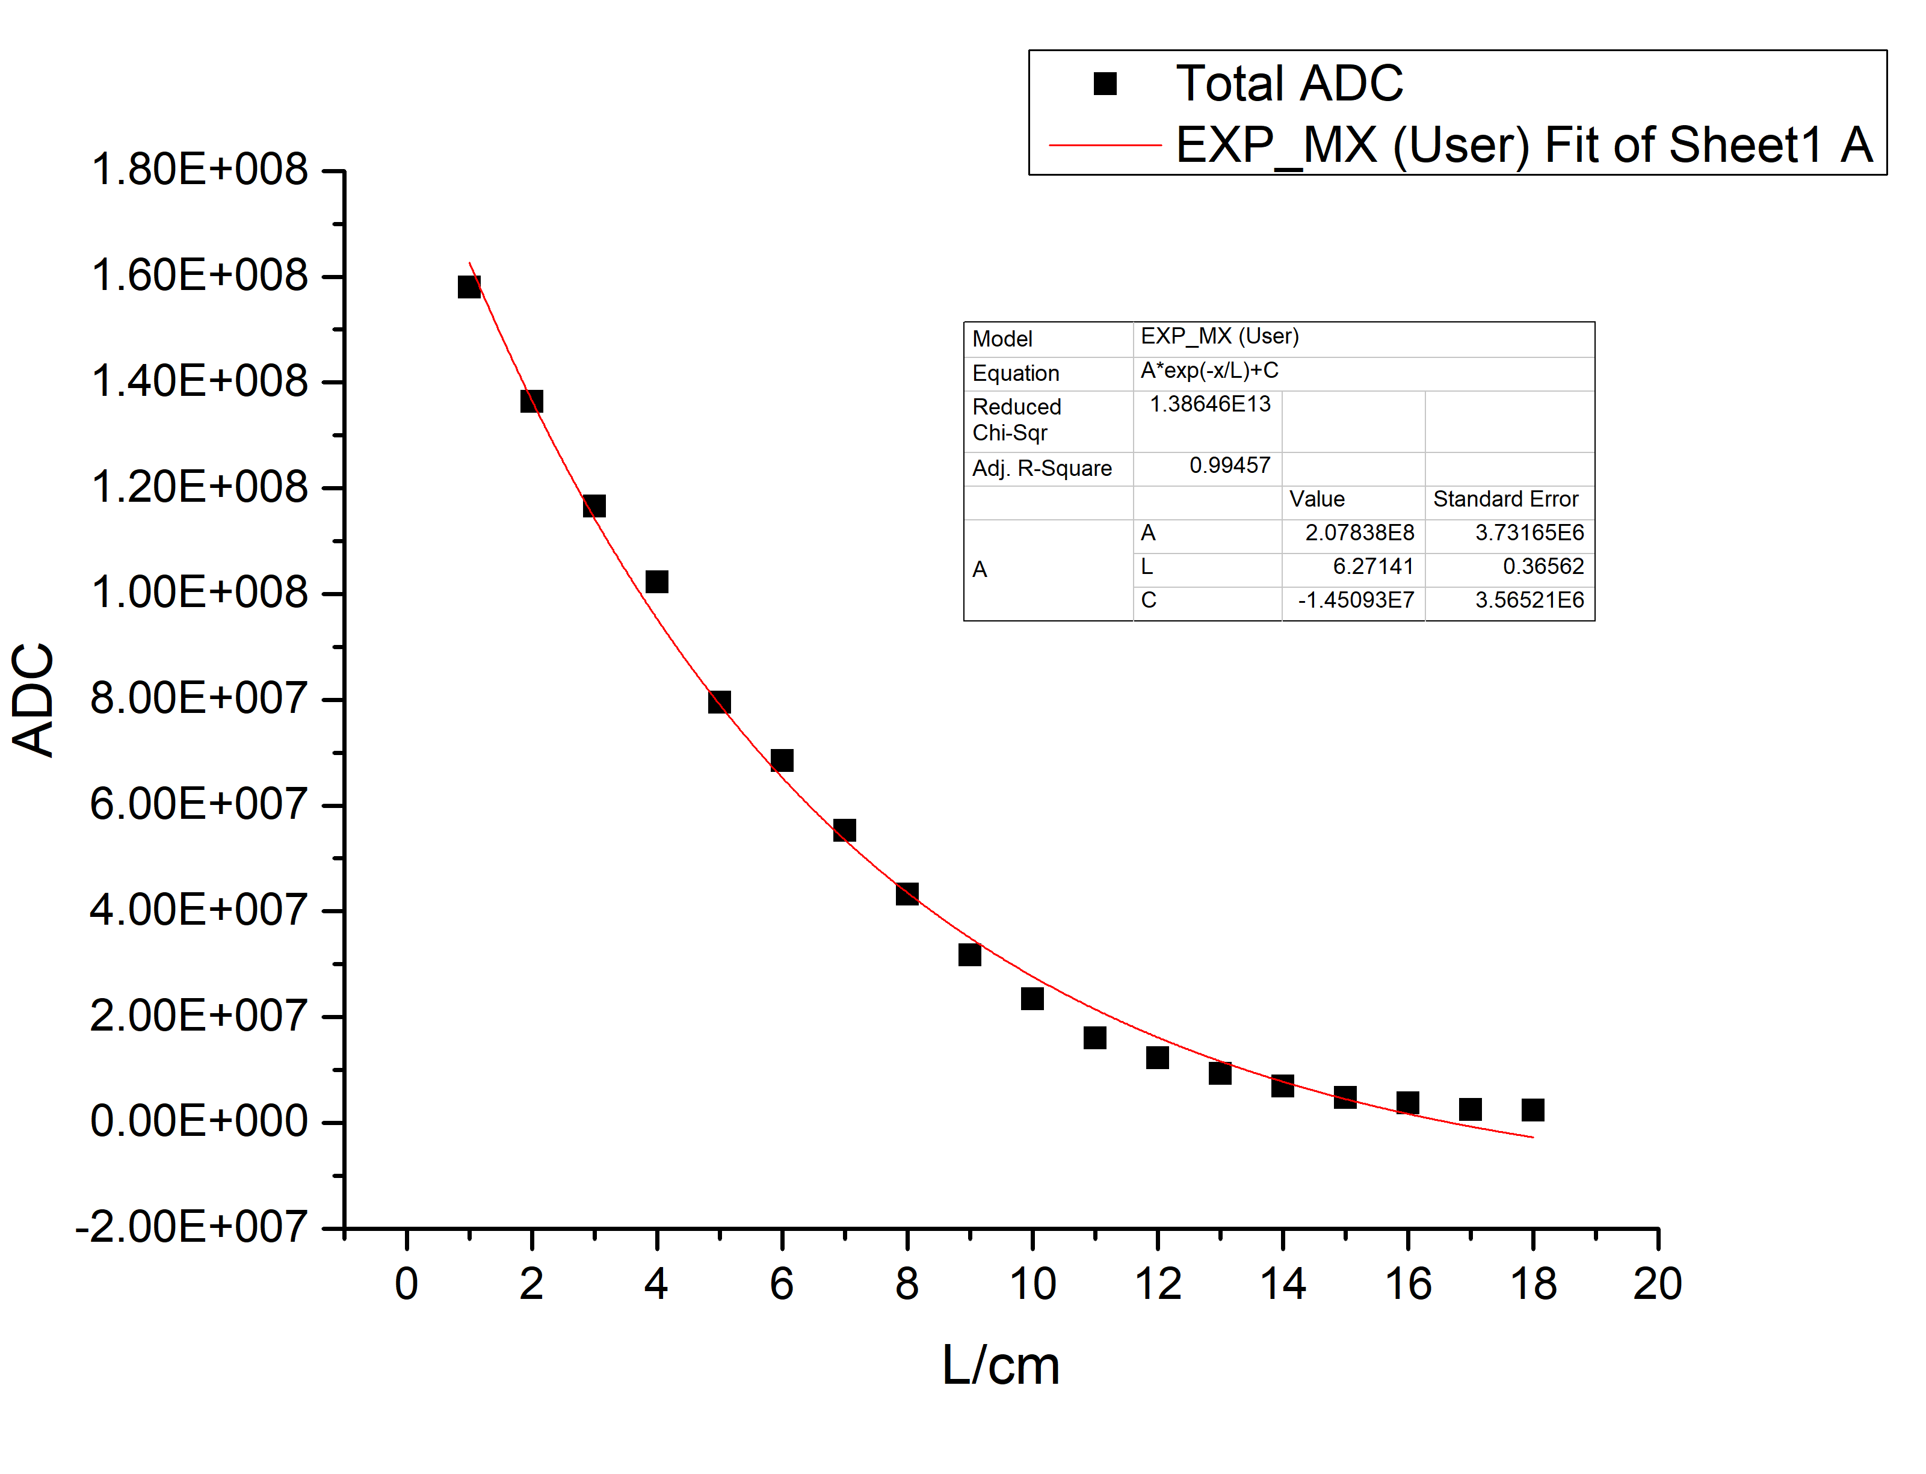


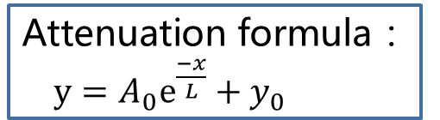
Attenuation length
Attenuation formula ：
$y=A_{0}e^{\frac{−x}{L}}+y_{0}$
With optical glue between blocks
$$L=\text{(4.37}\text{±}\text{0.11) }\text{cm}$$
$$L=\text{6.27 }\text{cm}$$
Attenuation length should be optimized at the production.
Light lost between blocks is not taken into account…

Slide 16
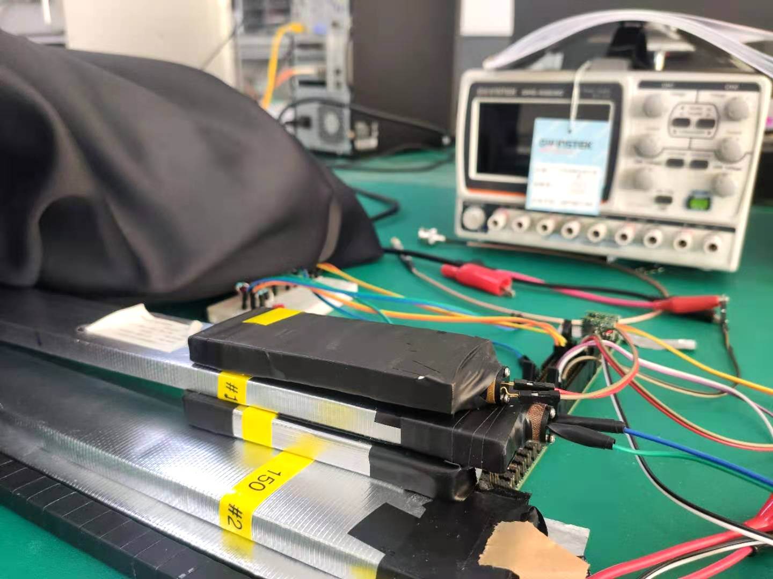
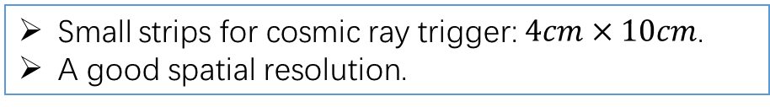
Photon collection and efficiency vs. length
1
2
3
Small strips for cosmic ray trigger: $4cm×10cm$.
A good spatial resolution.

Slide 17

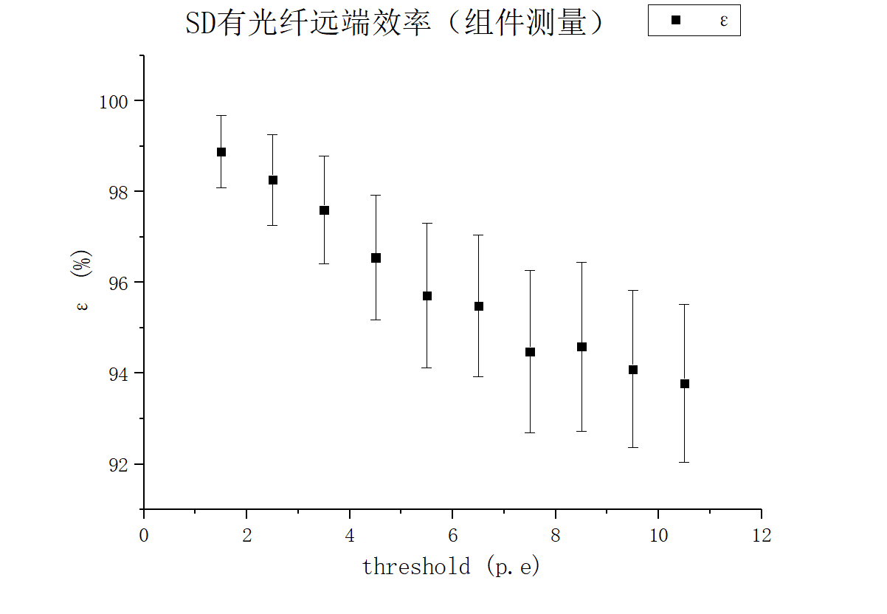
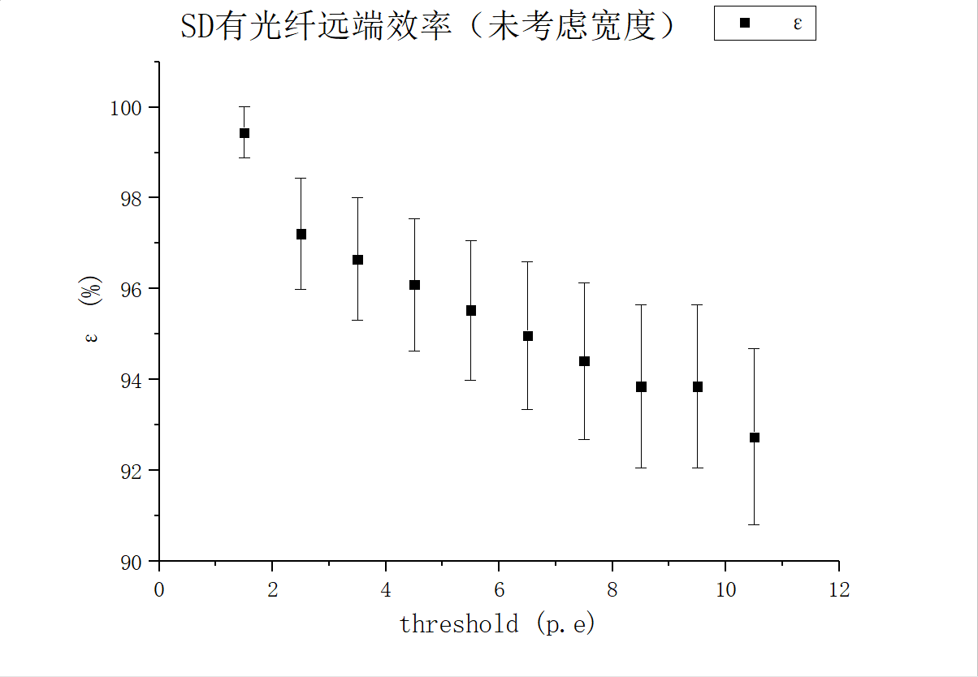
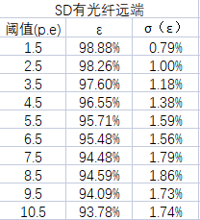
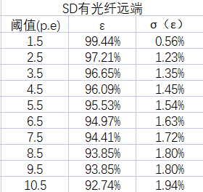
Efficiency
Comparison of two method
Consistent results

Slide 18
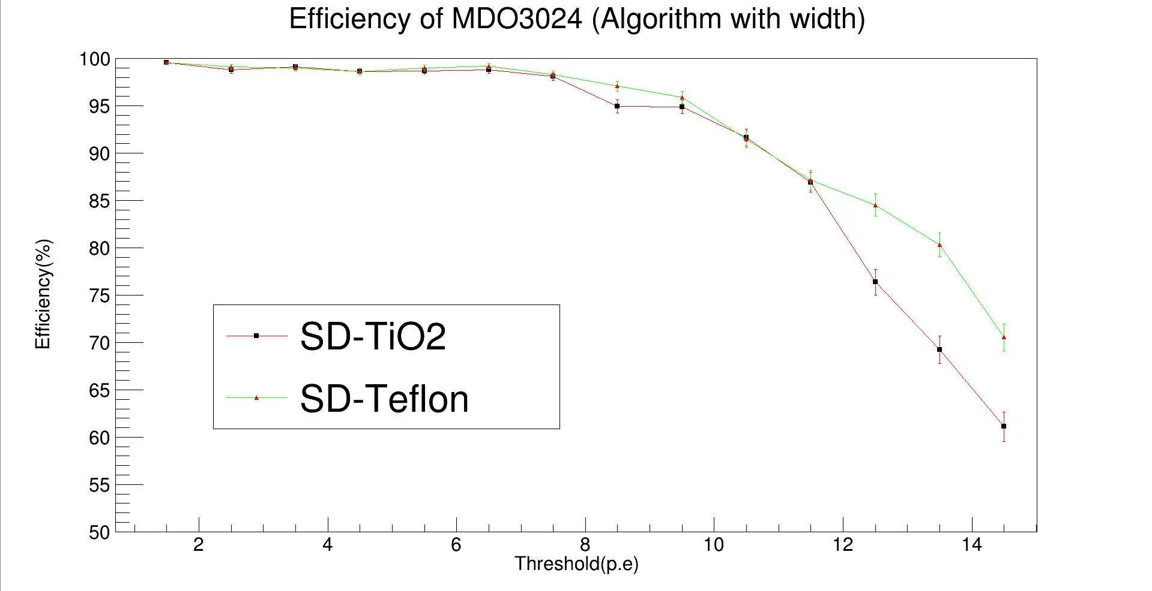
Efficiency
Efficiency of two scintillator with different reflective layer

Slide 19
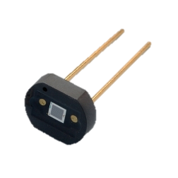
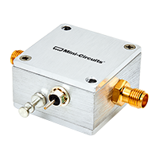
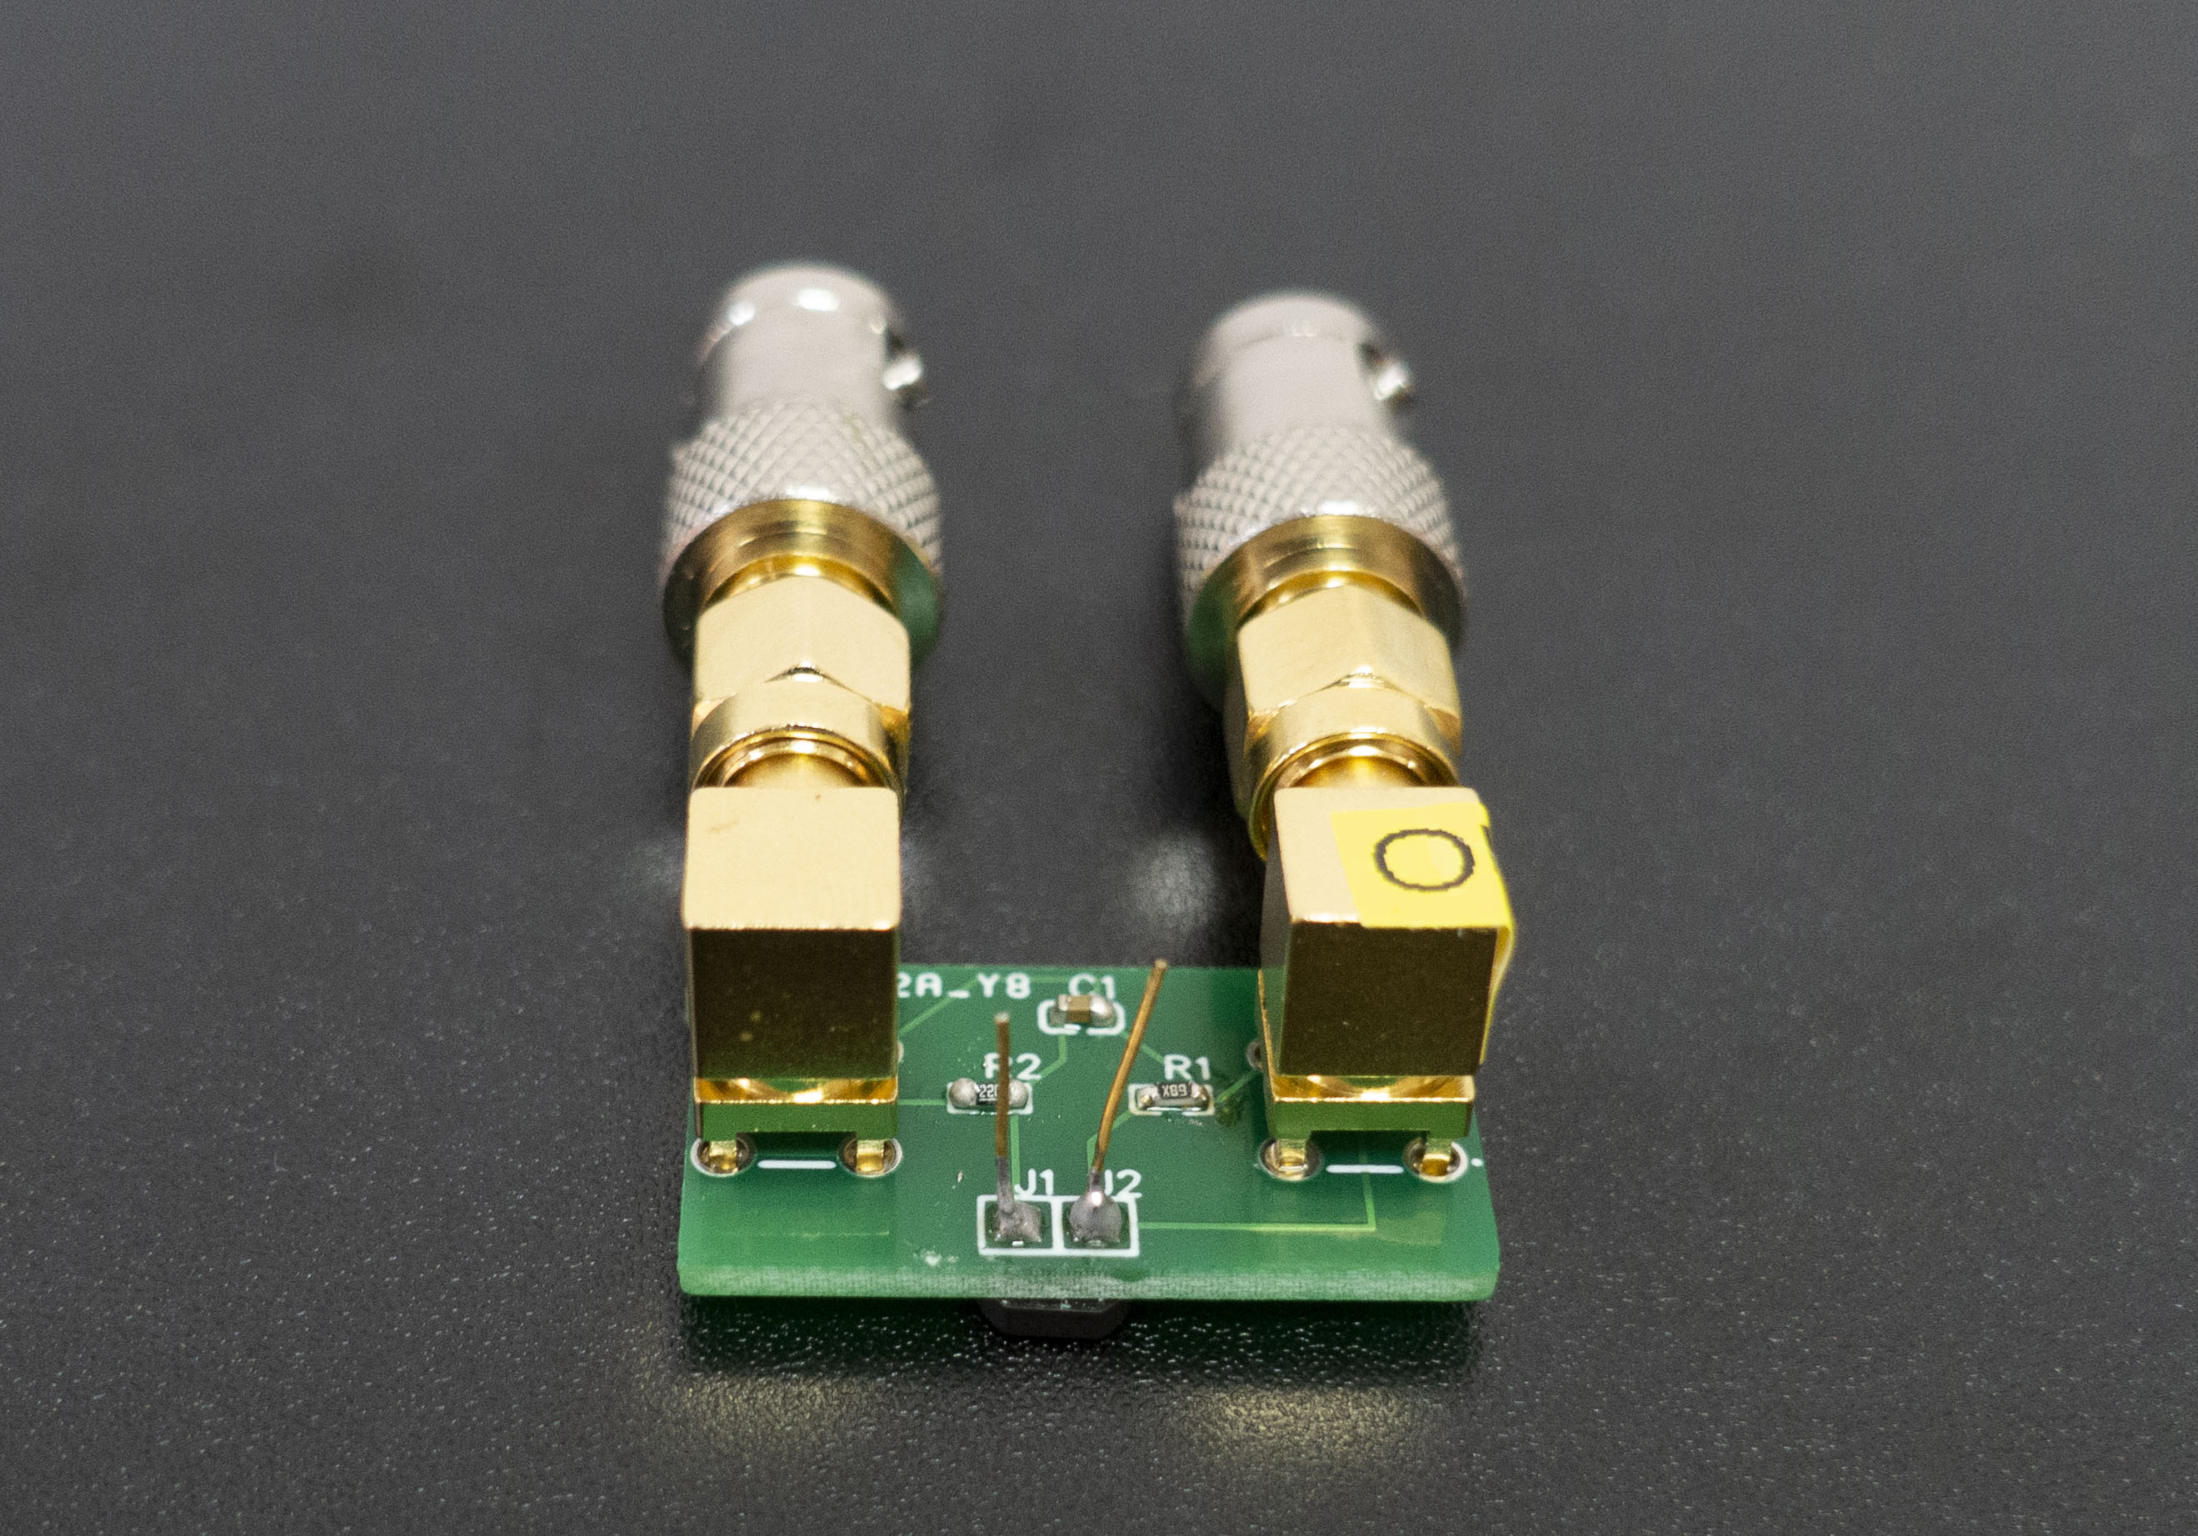
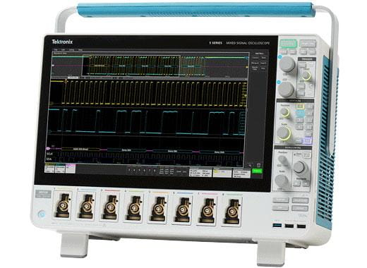
Time resolution: scintillator+PCB+ MPPC+ZFL
Set up for time resolution
Black Box
with copper foil shielding
Scintillator1+KURARAY1
MPPC1
Scintillator2+KURARAY2
MPPC2
output circuit 1
output circuit 2
ZFL-1000LN+
Low Noise Amplifier 1
ZFL-1000LN+
Low Noise Amplifier 2
Signal 1
Signal 2
MSO 56 Oscilloscope

Slide 20
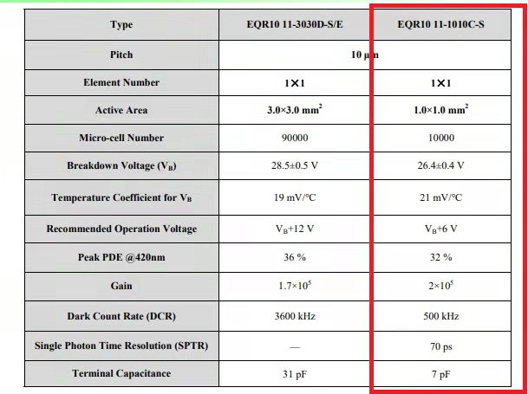
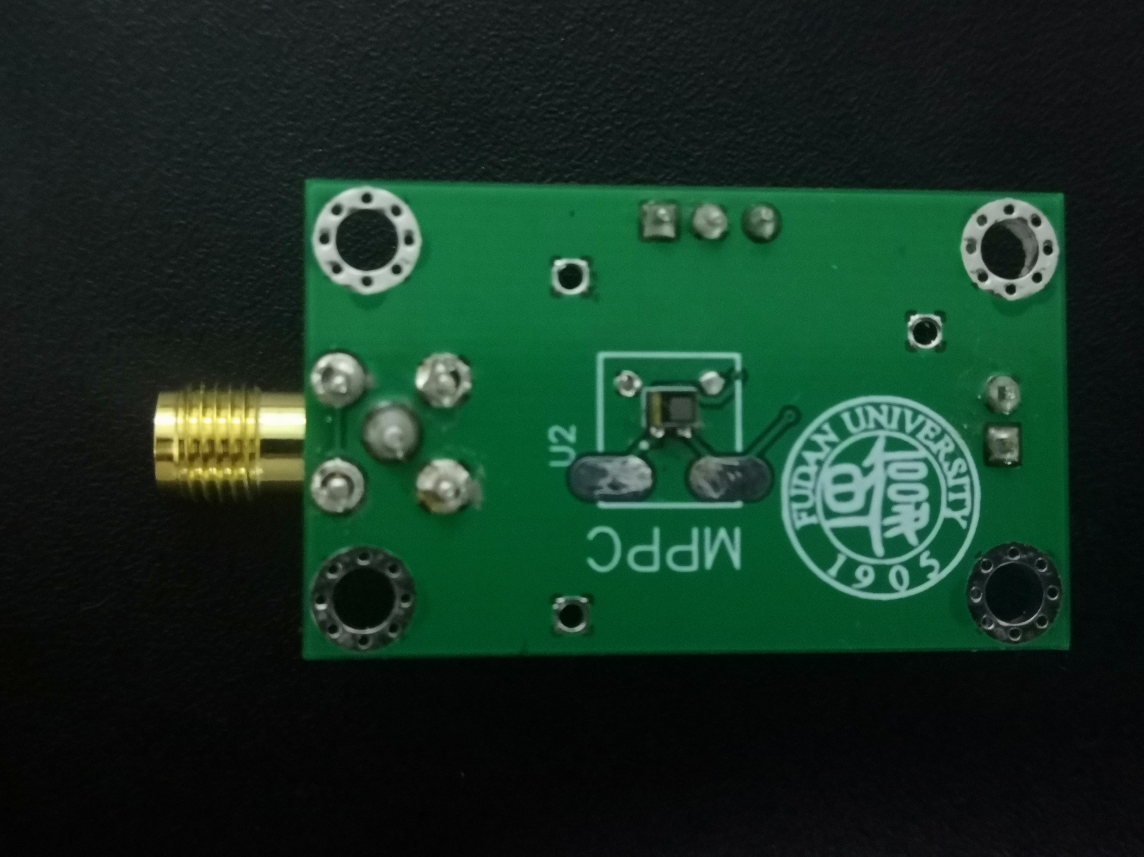
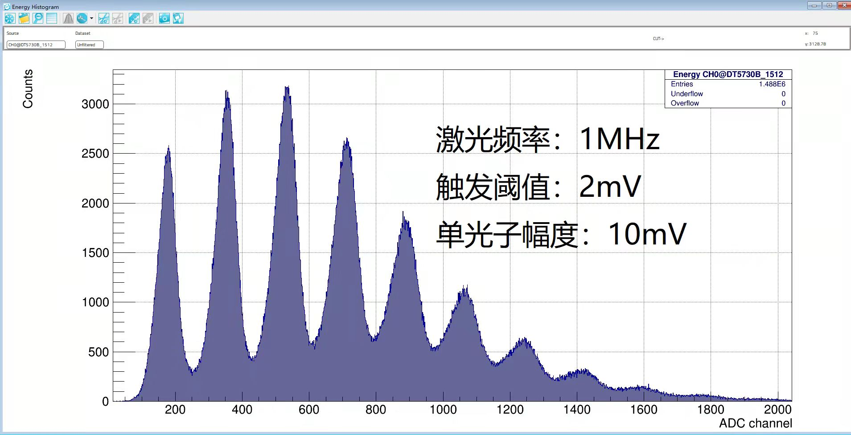
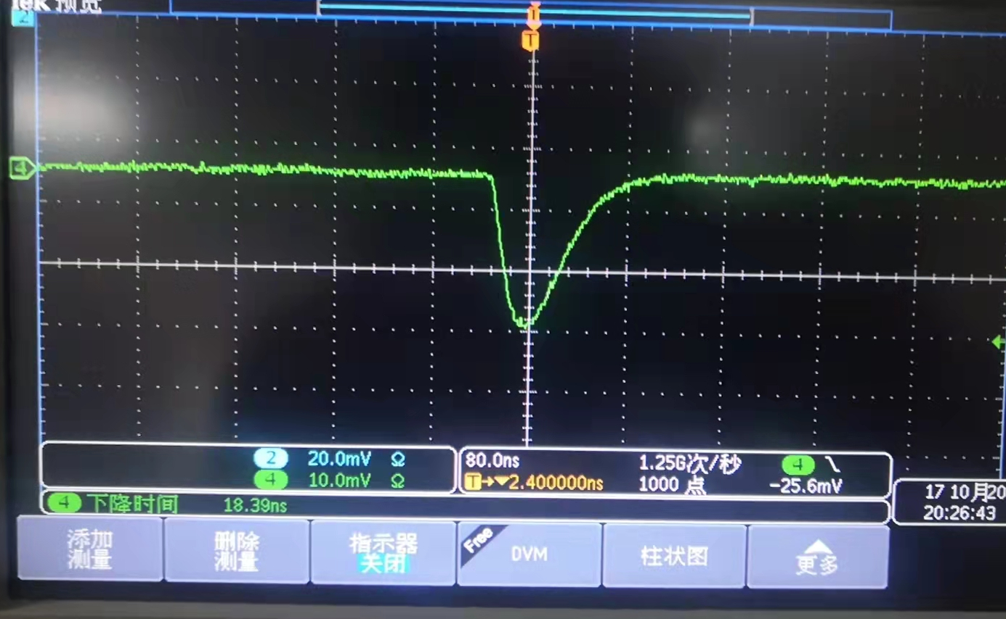
New pream for NDL SiPM
New pream designed for NDL SiPM
Good performance!
Gain~10.
Mad in China: scintillator and SiPM!!!
  How about WLS fibre in the future?

Slide 21
Summary
Belle II detector is a good reference.
Preliminary work on G4 simulation for muon detector has been done.
There is a question of how many layers of CEPC muon detector?
R&D of muon detector is ongoing well.
  Made in China: scintillator+SiPM
  New FEE designed.
  Good efficiency: >90%
  Time resolution: < 2ns.
One comment: how about good time resolution in muon detector?
  Extend the performance to search for Long-Live Particle with the large size of muon detector.
Thank you!

