Slide 1
CEPC mechanics system
Haijing Wang
The 2021 Workshop on CEPC Detector & MDI Mechanical Design
October, 2021

Slide 2
Outline
Progress on MDI mechanics
  MDI Layouts
  Remote vacuum connector
  SC magnet support system
Progress on collimators and machine protection scheme
  Collimators for background decreasing
  Beam loss failure
  Preliminary design on machine protection
Supports for regular magnets

Slide 3
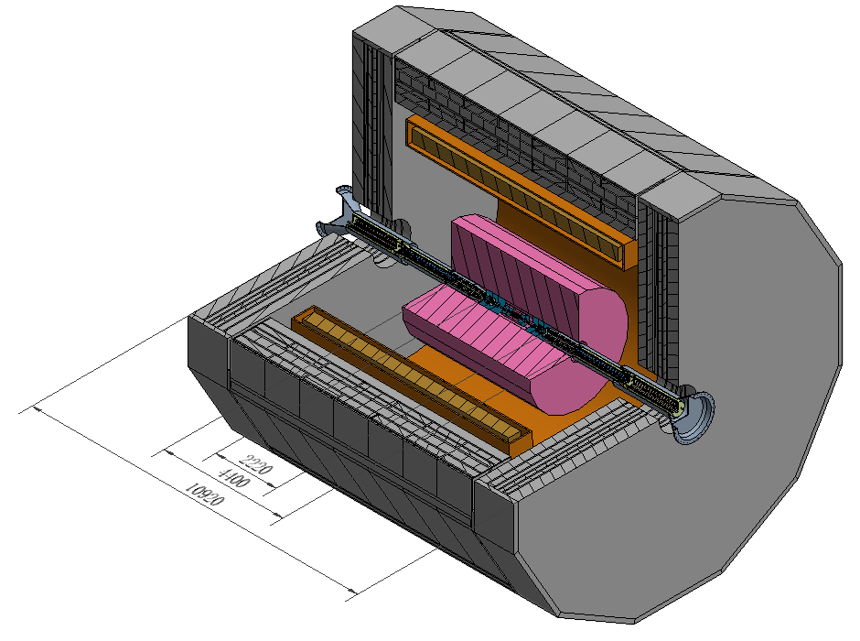
MDI Layouts
Yoke
Solenoid
Detectors
QD0 & QF1
IP

Slide 4
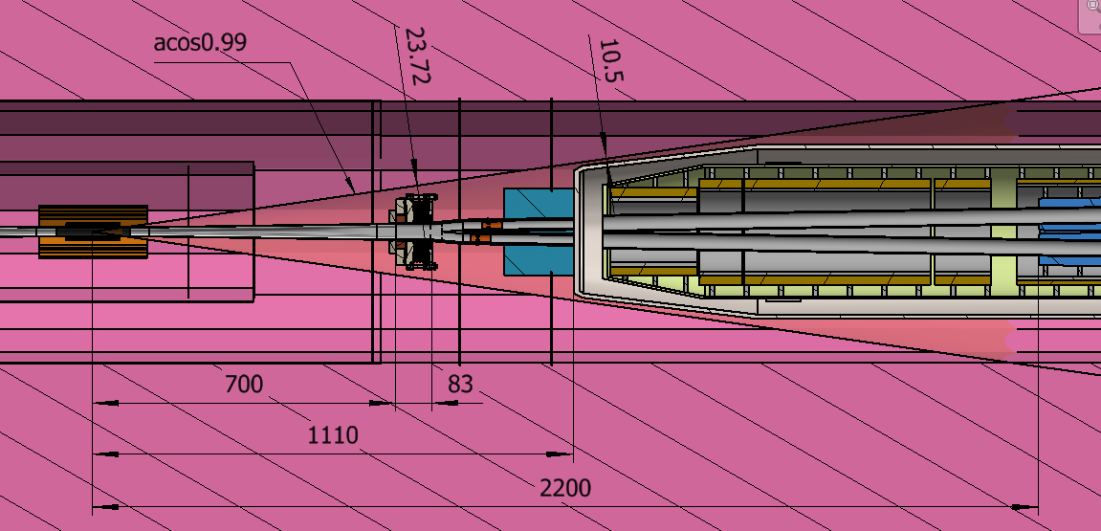
MDI Layouts
IP
Be-Al chamber
Z: -700~700mm
Remote Vacuum Connector
Z: 700~783mm
Y-shape chamber
Z: 783~855mm
IP BPMs
Z: 855~950mm
Lumical body
Z: 950~1110mm
QD0
Z: 2200~4200mm
All the devices are within the detective angle, acos0.99.

Slide 5
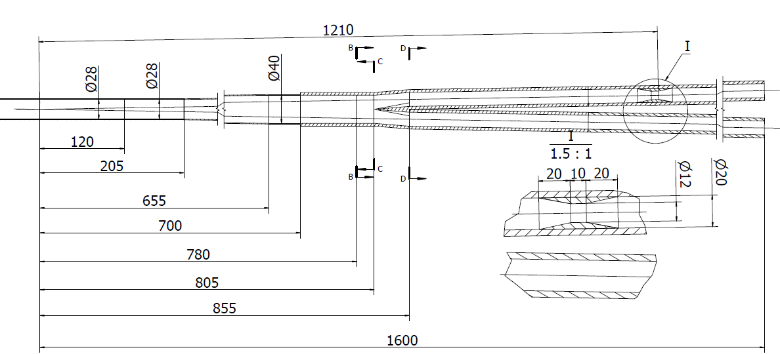
MDI Layouts
Vacuum layout
  Inner diameter at IP: 28 mm
Vacuum connector
Y-shape
chamber
Cryostat chamber
IP chamber
Paraffin cooled
Water cooled
No forced cooling
Water cooled
Be
Al
RF bellows
Cu
IP
IP BPM
Lumical

Slide 6
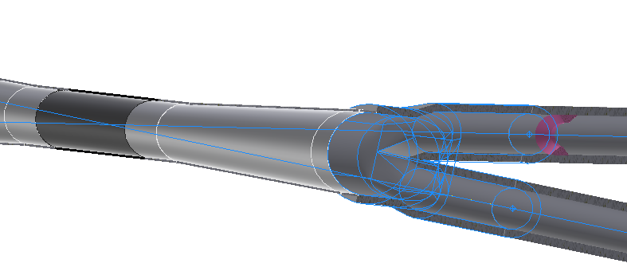
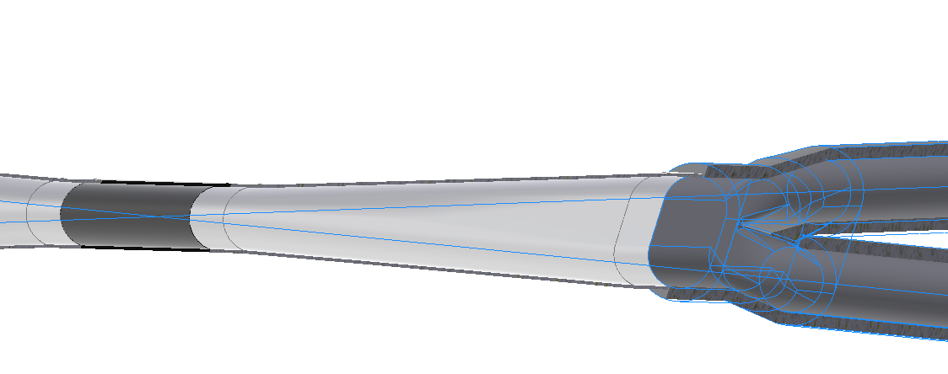
MDI Layouts
Vacuum layout
  Inner diameter at IP: 28 mm
  X direction: 28-40-(2-20)mm; Y direction: 28-40-20mm;
A new version is under design
  Inner diameter at IP: 20 mm
  X direction: 20-35-(2-20)mm; Y direction: 20-20-20mm;

Slide 7
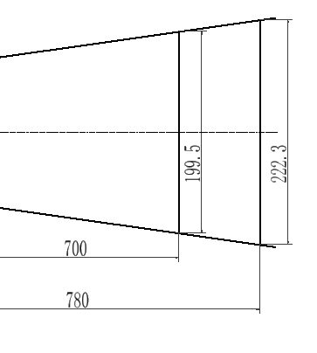
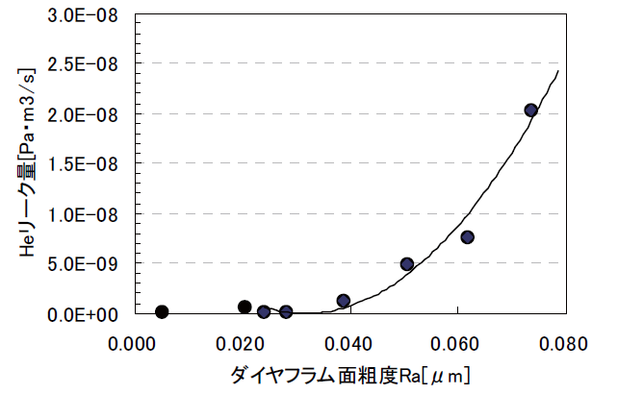
Progress of remote vacuum connector
Difficulties:
  Space limitation, leak rate, thermal dissipation…
Sealing methods | Within detection angle | Leak rate estimation | Remarks
RVC | NO |  | Successful used in S-KEKB
Remote chain | Yes |  | Eliminated
Inflatable seal* | Yes |  | Experience from CSNS
Improved inflatable seal | Yes |  | Mainly focused on
Our experience:
    Single-layer → double layer, leak rate can be improved from 1e-6 Pa.m3/s to 8.5e-10 Pa.m3/s.（From D. Zhu）
    Replace membrane sealing by edge sealing

Slide 8
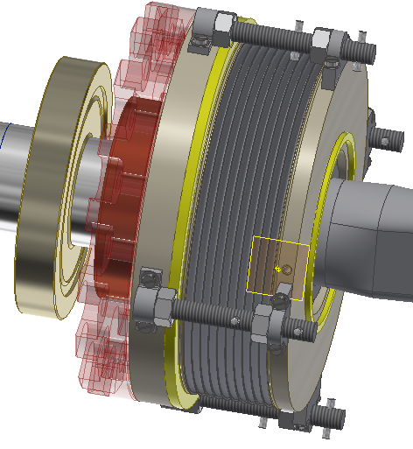
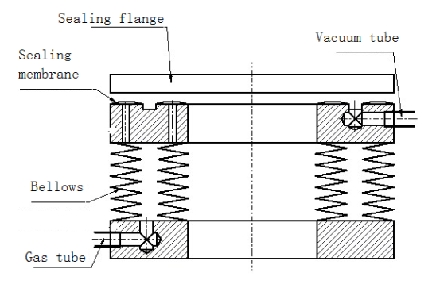
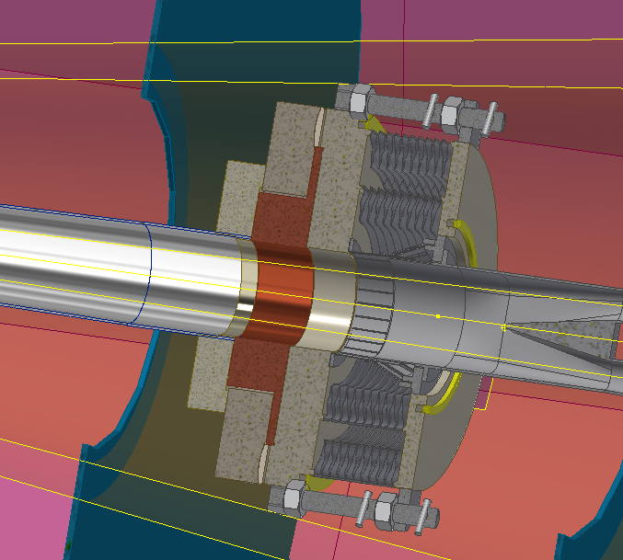
Remote vacuum connector
Improved inflatable seal
Low vacuum
RF finger
Two layers of edge sealing
Dimensions:
Transversal: Max. ϕ174mm
Longitudinal: ~83mm
Replace the sealing membranes by two layers of edge sealing.

Slide 9
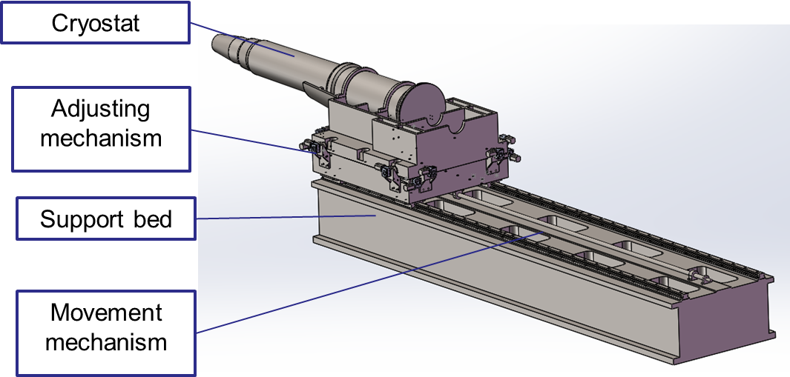
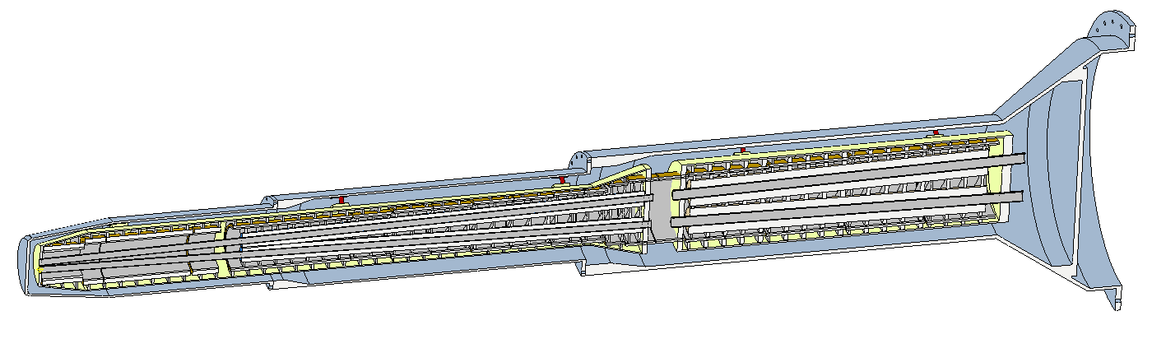
SC magnet support system
The cryostat is about 5.5 m long. The cantilever length is 3.6~5.5 m.
Key points
  Stability (static and modal)
  Accuracy
  Easy-operating
  Dimensions
Helium vessel
Vacuum vessel
QF1
QD0
Support rods
Anti-solenoid

Slide 10
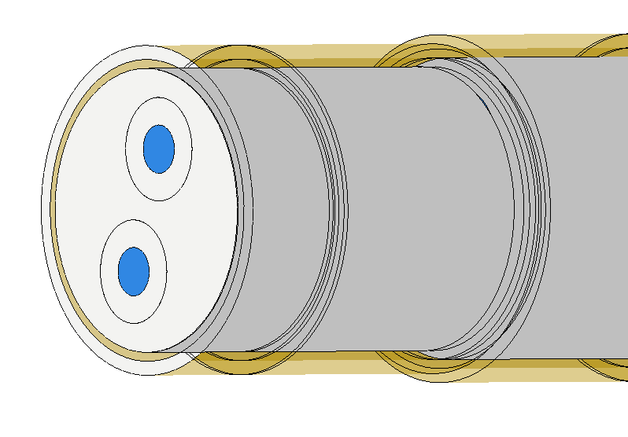
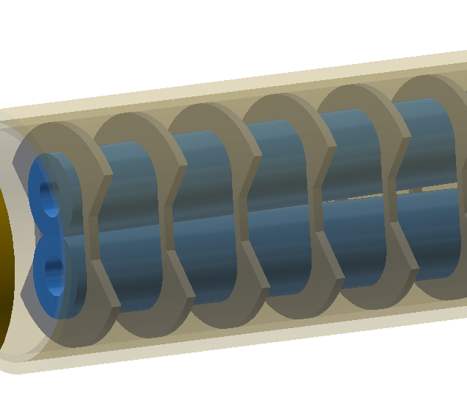
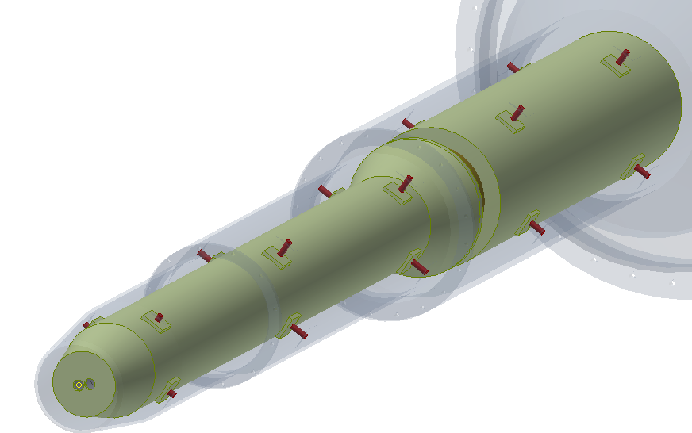
SC magnet support system
Magnets to helium vessels
  Two kinds of magnet supports are considered.
  Solid support similar to SKEKB.
  Skeleton support to minimize weight.
Helium vessel to vacuum vessel
  Support rods, diameter 20mm.
Aim: minimize the SC magnets deformation, enhance stability.
Sketch of solid support
Sketch of skeleton support
Models | materials
QD0/QF1 | Fe-Co-V
Anti-solenoid | Fe
Anti-solenoid inner pipe | SS | Can be optimized
Vessels | SS
Magnet supports | Ti-6Al-4V
Sketch of support rods

Slide 11


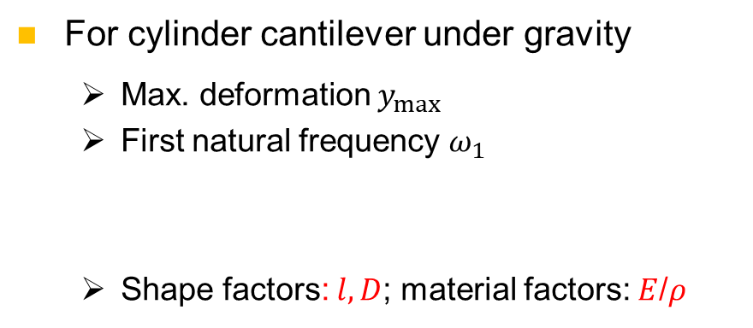
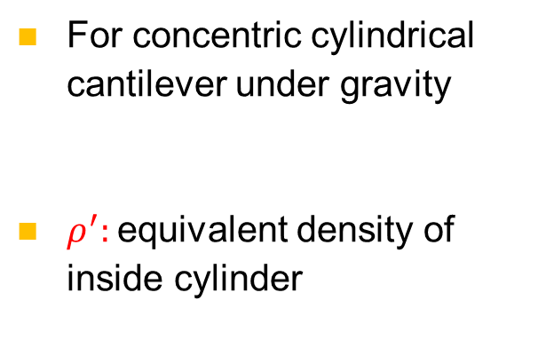
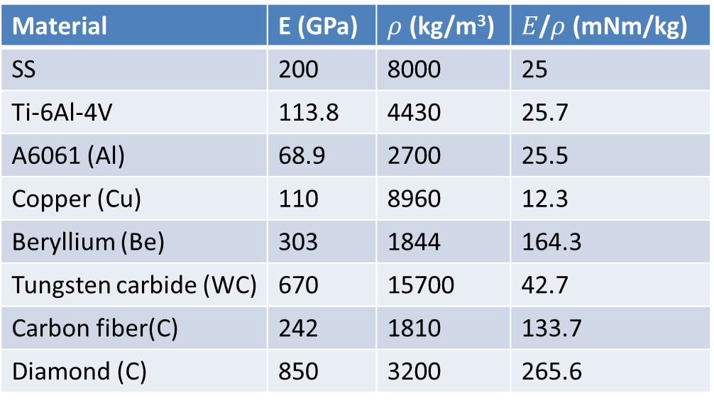
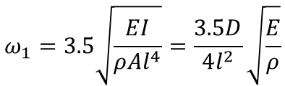
SC magnet support system
For cylinder cantilever under gravity
  Max. deformation $y_{max}$
  First natural frequency $ω_{1}$
  Shape factors: $l, D$; material factors: $E$/$ρ$
For concentric cylindrical cantilever under gravity
$ρ^{′}:$equivalent density of inside cylinder
$$y_{max}\sim \frac{ρl^{4}}{32EI}(D^{2}−d^{2}+\frac{ρ^{′}}{ρ}d^{2})$$
$$y_{max}=−\frac{ql^{4}}{8EI}=\frac{64l^{4}ρ}{πED^{2}}$$
$$ω_{1}=3.5\sqrt{\frac{EI}{ρAl^{4}}}=\frac{3.5D}{4l^{2}}\sqrt{\frac{E}{ρ}}$$
Material | E (GPa) | $ρ$ (kg/m³) | $E$/$ρ$ (mNm/kg)
SS | 200 | 8000 | 25
Ti-6Al-4V | 113.8 | 4430 | 25.7
A6061 (Al) | 68.9 | 2700 | 25.5
Copper (Cu) | 110 | 8960 | 12.3
Beryllium (Be) | 303 | 1844 | 164.3
Tungsten carbide (WC) | 670 | 15700 | 42.7
Carbon fiber(C) | 242 | 1810 | 133.7
Diamond (C) | 850 | 3200 | 265.6
Flexible
easy to machine
Inexpensive
Brittle
Hard to machine
Expensive

Slide 12
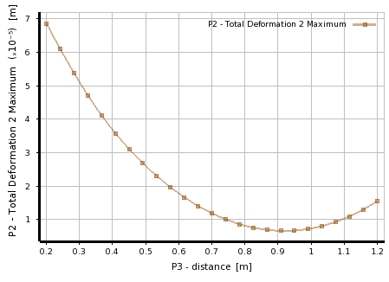
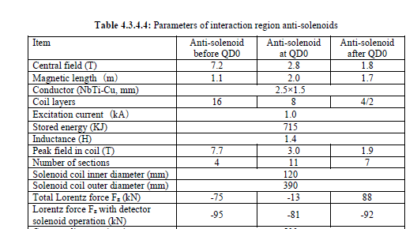
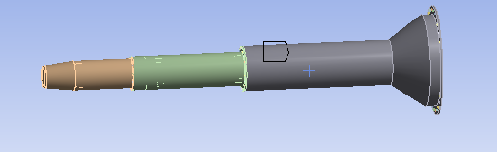
SC magnet support system
Location optimization of support rods under gravity
Magnet | Support | Optimized uneven deformation (um)
QD0 | Skeleton | 2.1
 | Solid | 3.2
QF1 | skeleton | 0.8
Integral FEA
  Loads：gravity, Lorentz force Fz with detector solenoid operation
Loads | Displacement (mm)
 | Cryostat | QD0 | QF1
Gravity | V: -2.774 | V: 1.251 | V: 0.588
Gravity + Fz | V: -2.774 H: 1.195 | V: 1.252 H: 0.073 | V: 0.588 H: 0.054
Fz1
Fz2
Fz3
G

Slide 13
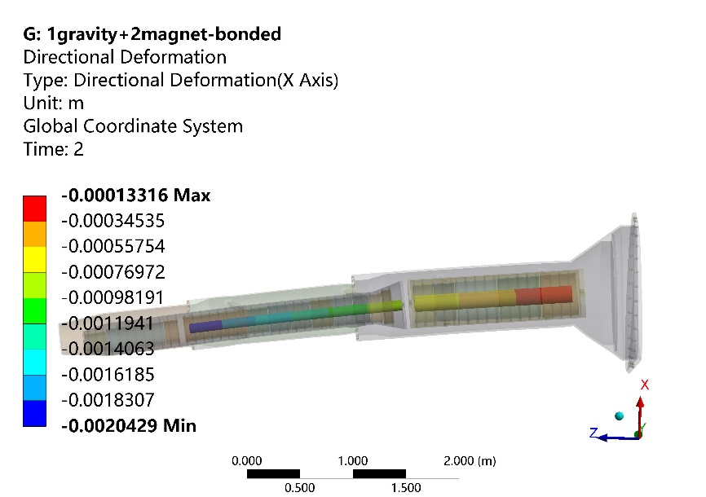
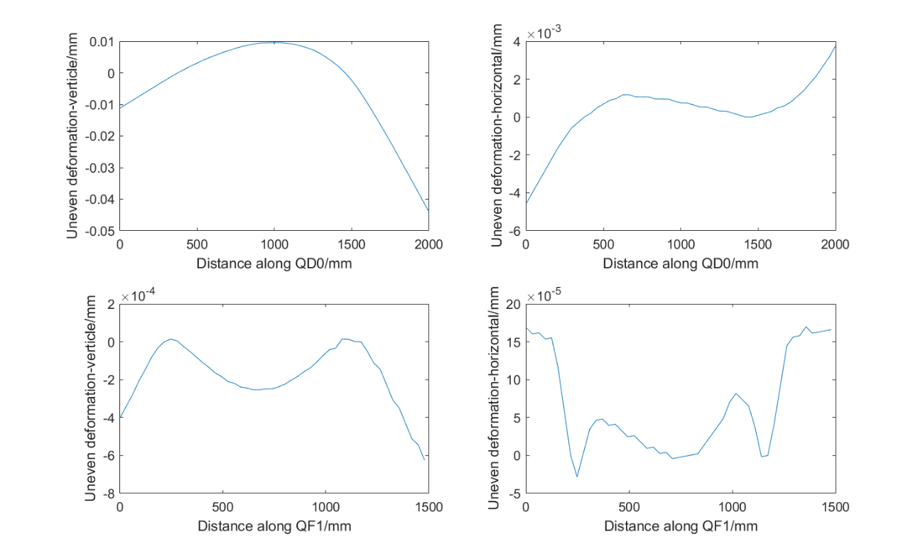
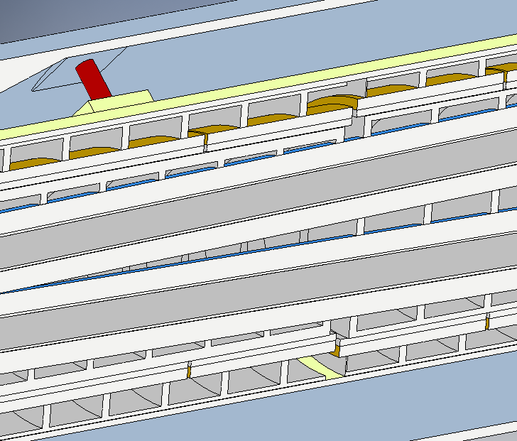
SC magnet support system
Integral FEA
  Alignment cannot based on the displacement.
  To pre-align the magnet to compensate the absolute displacement.
Outer ring
Magnet support | uneven deformation in QD0 (um) |  | uneven deformation in QF1 (um) |  | Frequency of 1st mode (Hz)
 | Vertical | Horizontal | Vertical | Horizontal
Skeleton | 44 | 5 | 0.6 | 0.2 | 12.7
Solid | 7.3 | 0.6 | 0.3 | 0.2 | 11.3
S-o support | 27 | 1.6 | 0.7 | 0.5 | 13.7

Slide 14
SC magnet support system
Material comparisons
  The tendency is roughly accord with deduction.
  Complicated structure, complicated loads, FEA is more effective.
Material | Uneven deformation in QD0 (um) | Uneven deformation in QF1 (um) | Max. Y displacement of cryostat (mm) | Max. Z displacement of cryostat (mm) | Natural frequency (Hz)
All: A6061 | 45.4 | 1.1 | 3.77 | 1.39 | 10.9
All: Ti-6Al-4V | 34.4 | 0.8 | 3.01 | 0.95 | 12.3
All: SS | 27.6 | 0.61 | 2.62 | 0.67 | 13.1
Vessels: SS Others: Ti-6Al-4V | 26.9 | 0.7 | 2.43 | 0.67 | 13.7
Vessels: SS Others: A6061 | 26.8 | 0.72 | 2.33 | 0.68 | 14.0
Next step
  More detailed optimization
  Design of cryostat supports and integral simulation

Slide 15
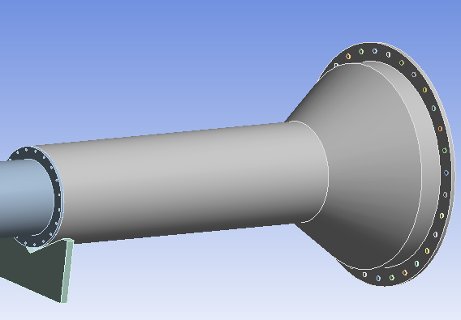
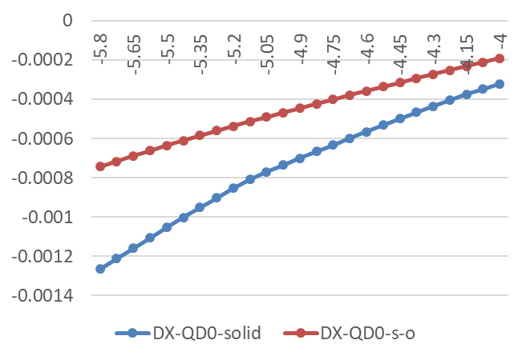
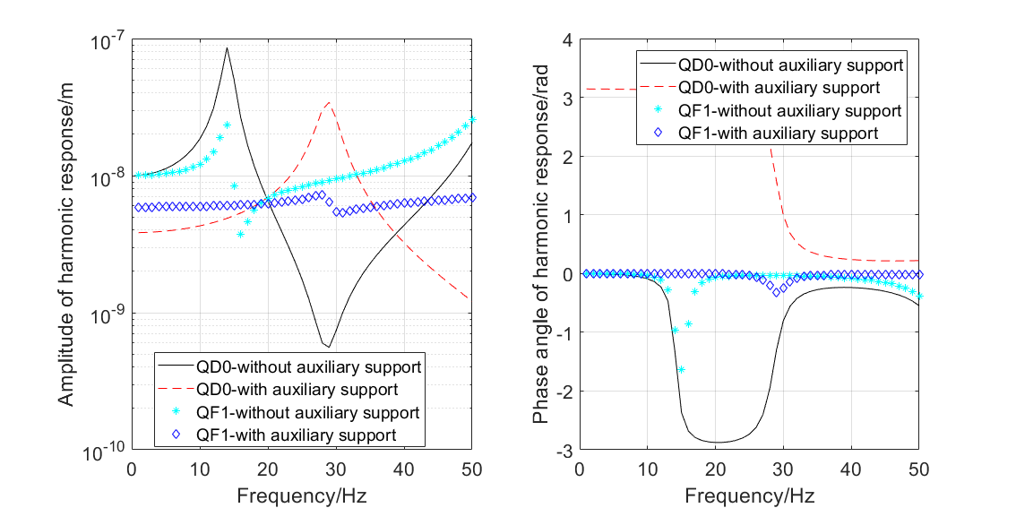
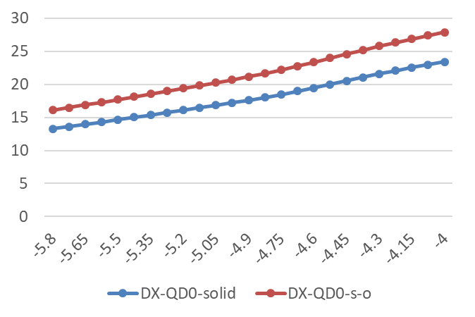
SC magnet support system
Auxiliary support of cryostat
  Auxiliary constraint: V groove, translational in beam direction
  Range: 4 m to 5.9 m from IP (on inner wall of detector yoke)
  Can decrease the uneven deformation as well as enhance natural frequency largely.
Uneven deformation VS support location
Harmonic response
  Frequency 1~50 Hz.
  The auxiliary support can reduce the response amplitude largely.
Natural frequency VS support location

Slide 16
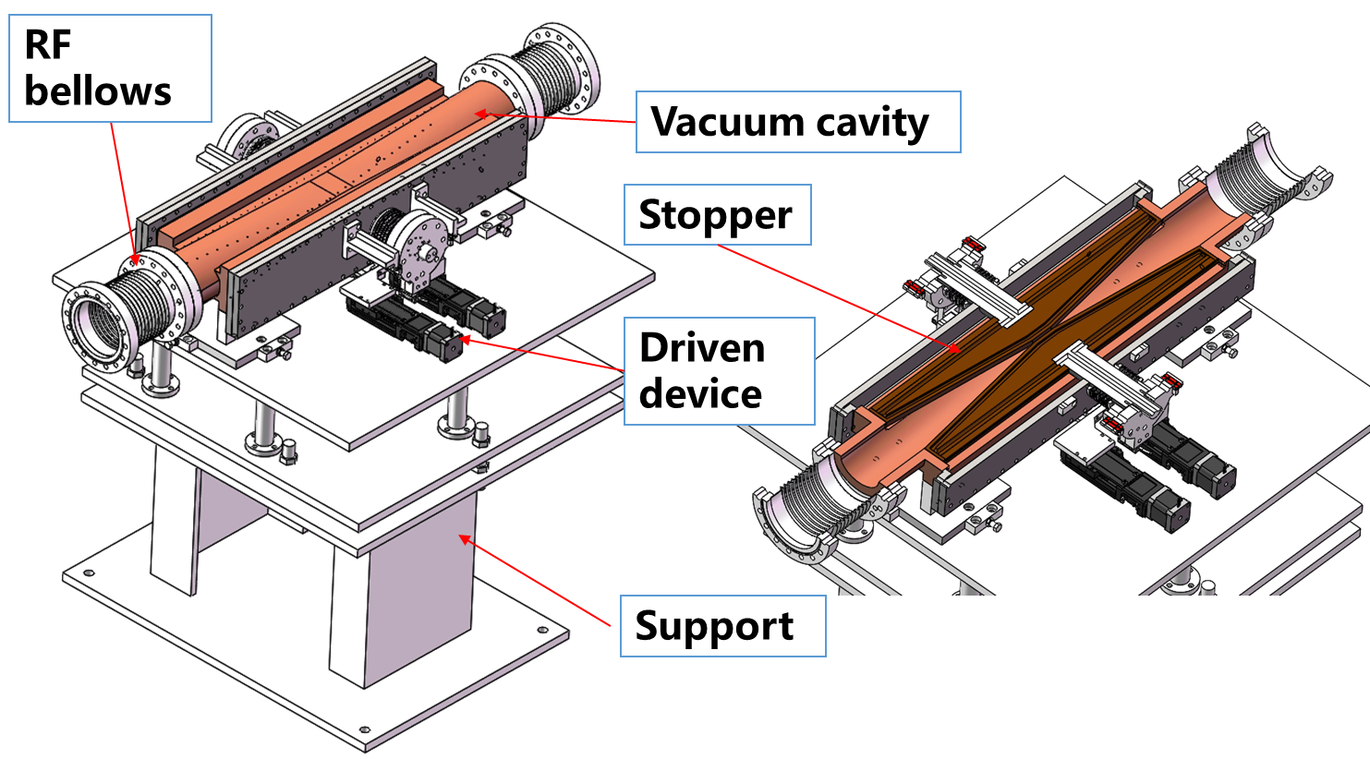
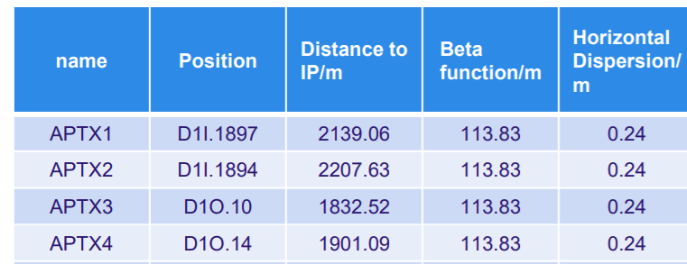
Collimators for background decreasing
4 collimators per IP per ring
Horizontal aperture
  4.4 mm~20 mm
Chamber aperture
  CDR: Elliptical, 75-56 mm
  Now: circle, d56mm*
  The design is based on the CDR chamber, and will be updated to circle one.
28mm
28mm
37.5mm
28mm
* From Y. Liu, report on CEPC DAY, March 25th, 2021

Slide 17
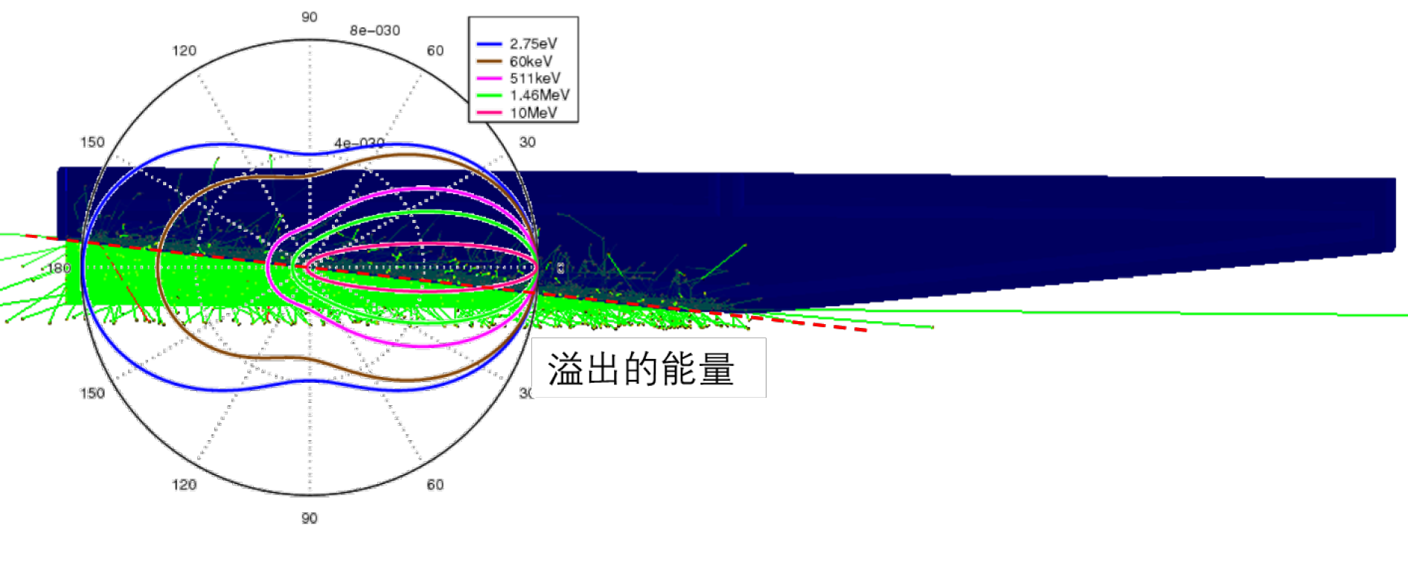
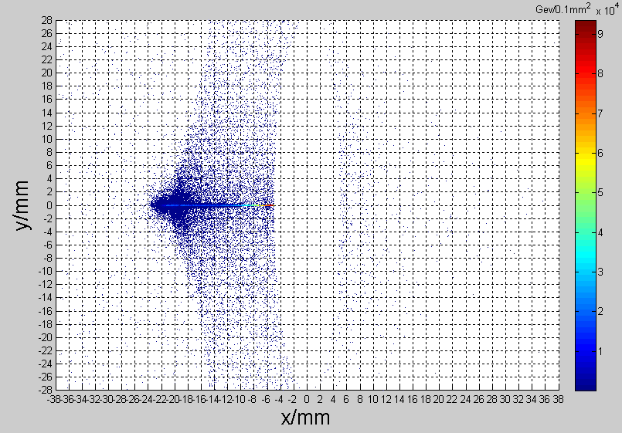
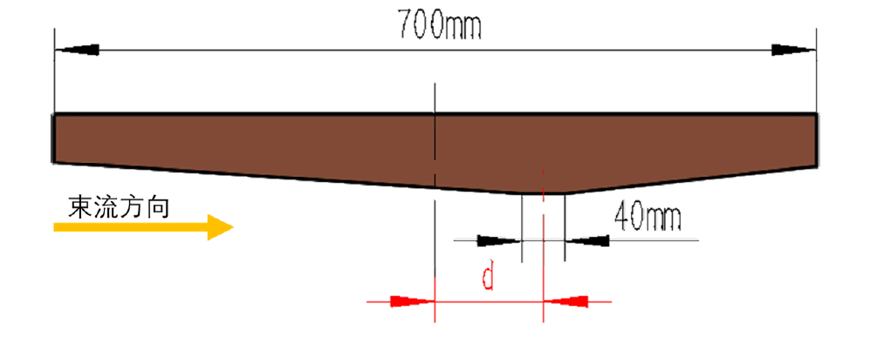
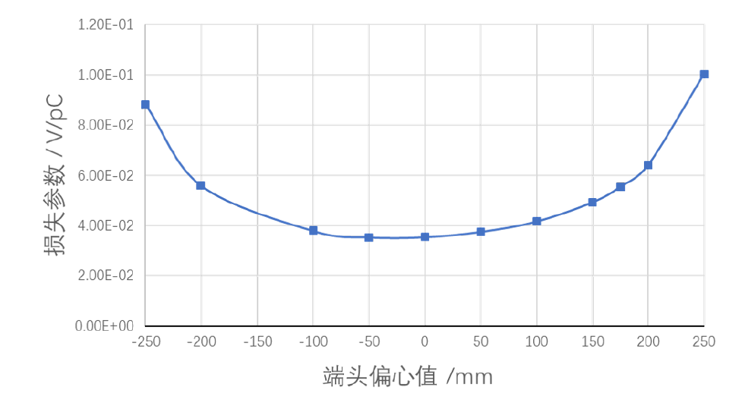
Collimators for background decreasing
Particle deposition
  Jaw material: Cu
  Total heat generation: 91.6 W
  Maximum temperature raise by particle-material reaction: 2℃
SR load
  9.3 kW@30 MW, Higgs
  Main power for collimator
Impedance load
  Loss factor can be optimized with tip offset ~ negligible power

Slide 18
Collimators for background decreasing
Highest temperature in jaws: 183 ℃
Highest temperature in chamber: 143 ℃

Slide 19
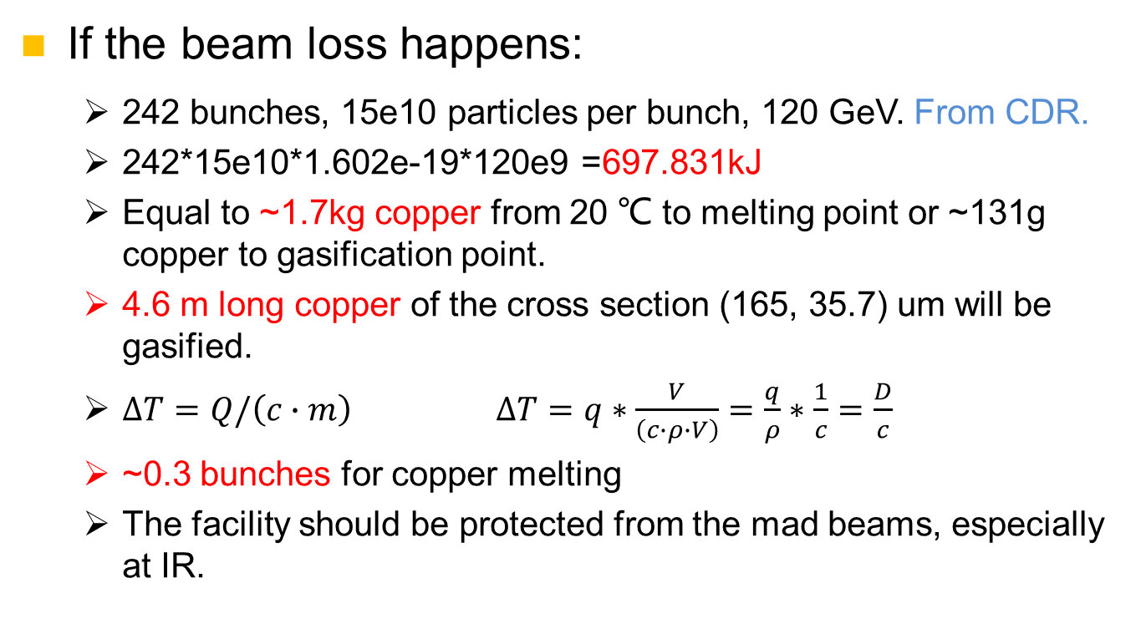
Beam loss failure
If the beam loss happens:
  242 bunches, 15e10 particles per bunch, 120 GeV. From CDR.
  242*15e10*1.602e-19*120e9 =697.831kJ
  Equal to ~1.7kg copper from 20 ℃ to melting point or ~131g copper to gasification point.
  4.6 m long copper of the cross section (165, 35.7) um will be gasified.
  $∆T=Q/\left(c∙m\right)$ $∆T=q∗\frac{V}{\left(c∙ρ∙V\right)}=\frac{q}{ρ}∗\frac{1}{c}=\frac{D}{c}$
  ~0.3 bunches for copper melting
  The facility should be protected from the mad beams, especially at IR.
Beam
Target

Slide 20
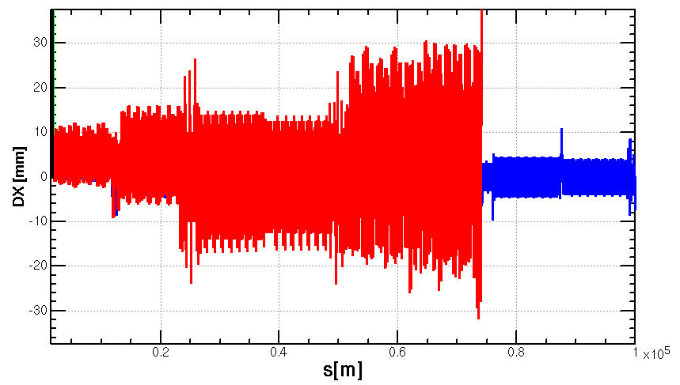
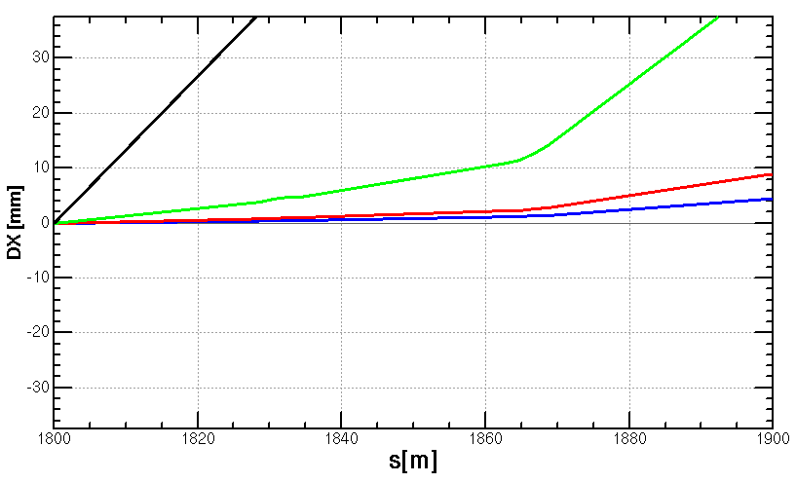
Beam loss failure
Beam loss failure of CEPC
  Bunch distance: 207 m or 0.7 us (242 bunches in 50 km)
  The beam will not be lost in 1 turn if the dipole field descends 1%.
  Supposing the magnet field loss is linear, and all the dipoles have powering failure. Total time is 1ms (about 3 turns). Then 1% descend equals to 3km.→The beam will be lost in 1 turn, on collimators or on vacuum chamber.
-B=99% B0
-B=98% B0
-B=90% B0
-B=0
  w/o strength difference of the bends
    more perturbation if included
  w/o synchrotron radiation effect which is corrected with tapering in the normal status
  From Y. Wang.

Slide 21
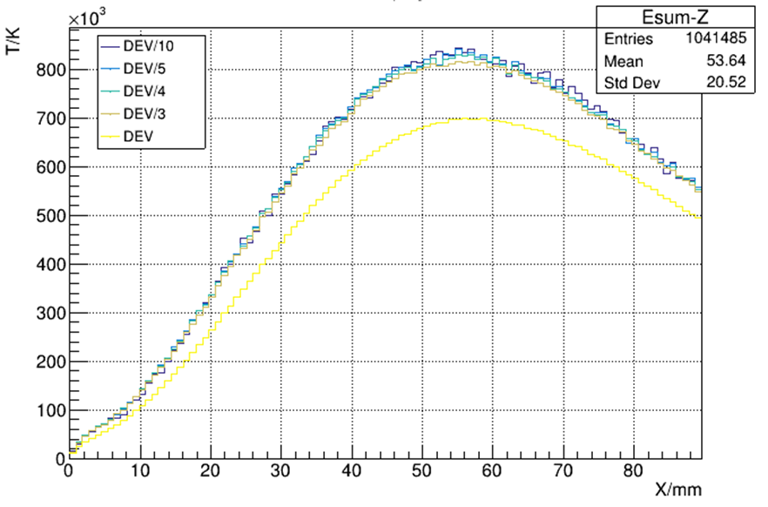
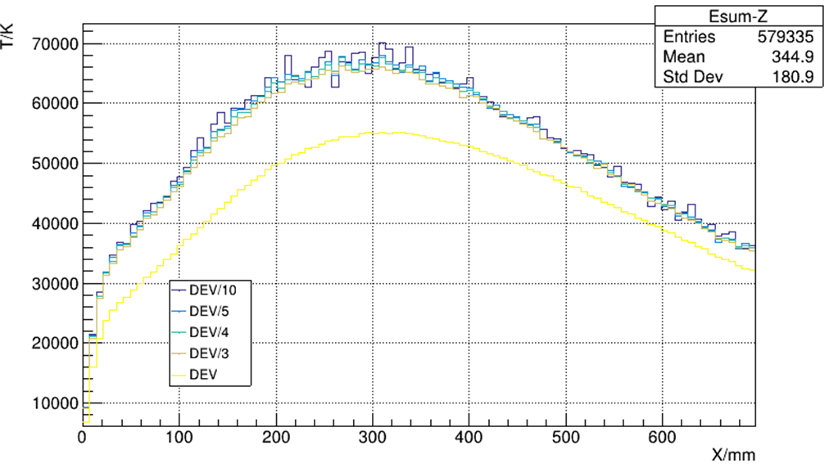
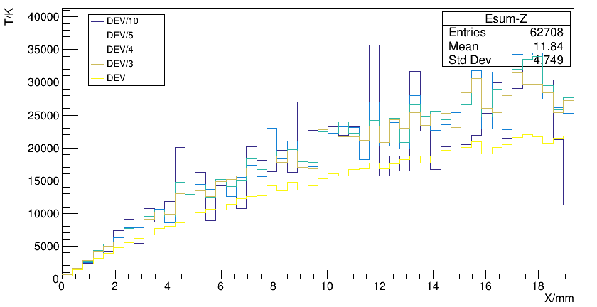
Beam loss failure
If the beam loss happens:
  Supposing all the particles shoot on the collimator.
Crazy beam
Crazy temperature
Material: Cu
Material: C
Maximum temperature
Cu: ~840e3 ℃ in at 55 mm
C：~70e3 ℃ in at 300 mm
Phase transitions are neglected.

Slide 22
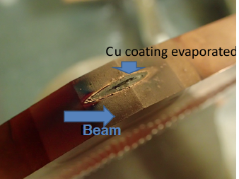
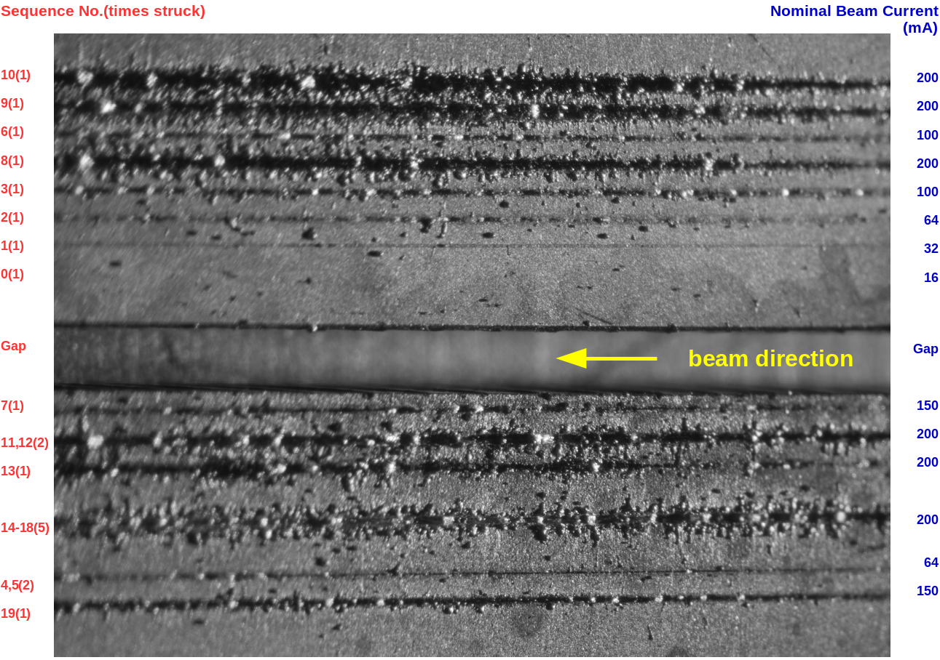
Beam loss failure
May the collimators be broken by the lost beam?
  Yes, very possible. Happened in KEKB, Super KEKB, APS.
  Potential threats for APS-U, HEPS.
May the lost beam shoot the vacuum tube or the magnets?
  Rarely reported. Should be avoided.
Broken collimator of KEKB
Broken collimator of Super KEKB
Experiments of APS-U
Experiments of LHC

Slide 23
Preliminary design on machine protection
Machine protection—KEKB
  Beam abort system, to avoid direct hit on movable collimators.
  Response time: ~100 us (~10 turns).
Machine protection —Super KEKB
  Deliver the stored beam into a beam dump and prevent spewing beam everywhere in the ring.
  Response time: less than 20 us. (~2 turns)
Machine protection-LHC
  Collimators are used for passive protection. 99.99% of the lost protons were intercepted. 100 collimators.
  Dump delay: 270 us (3 turns)
Abe, Tetsuo, et al. "Achievements of KEKB." Progress of Theoretical and Experimental Physics 2013.3 (2013).
Akai, Kazunori, Kazuro Furukawa, and Haruyo Koiso. "SuperKEKB collider." Nuclear Instruments and Methods in Physics Research Section A: Accelerators, Spectrometers, Detectors and Associated Equipment 907 (2018): 188-199.
Mimashi, Toshihiro, et al. "SuperKEKB beam abort system." Proc. IPAC 14 (2014): 116.
Wenninger, Jörg. "Machine protection and operation for LHC." arXiv preprint arXiv:1608.03113 (2016).

Slide 24
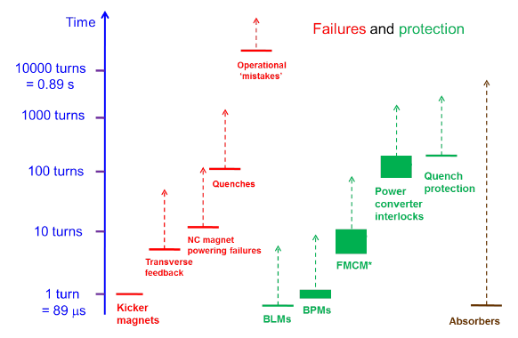
Preliminary design on machine protection
Preliminary scheme
2700 turns
270 turns
Beam abort system, to beam dump
27 turns
2.7 turns
Passive protection
Collimators
Reverse switching solenoids
…
0.27 turns
Picture from: Wenninger, Jörg. "Machine protection and operation for LHC." arXiv preprint arXiv:1608.03113 (2016).

Slide 25
Preliminary design on machine protection
If the lost beam hit on collimators
  The lost beam will hit on the same longitudinal location.
  Primary collimator: diamond, 1 mm in thickness
  Secondary collimator: graphite, 200 meters after
  The collimators can endure the 242 bunches without melting.
  Collimator distribution and impedances haven’t been studied.
Temperature in 1 mm diamond
Temperature in graphite

Slide 26
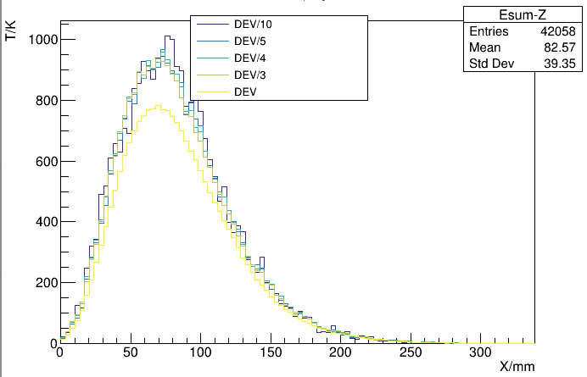
Preliminary design on machine protection
If the lost beam hit on vacuum chambers
  The lost beam will hit on different longitudinal locations.
  Scale up the beam size of (165, 35.7)um three times to (495, 107) um, the copper chamber will not melt.
  Auxiliary solenoids on the vacuum chamber with a reverse switching with dipoles may be used to dilute each bunch.
  Response time and technical flexibility should be studied.
Material: Cu

Slide 27
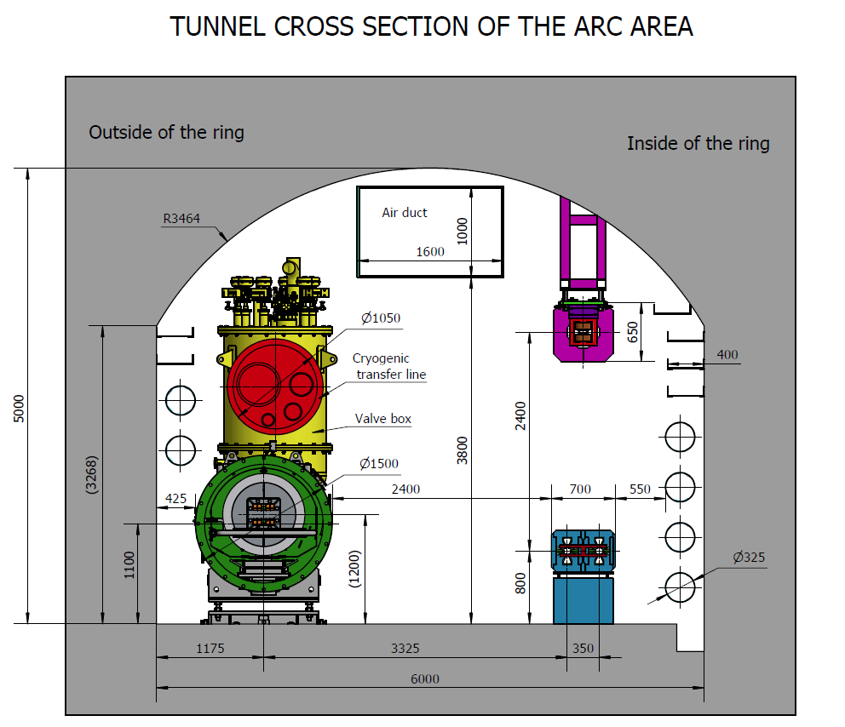
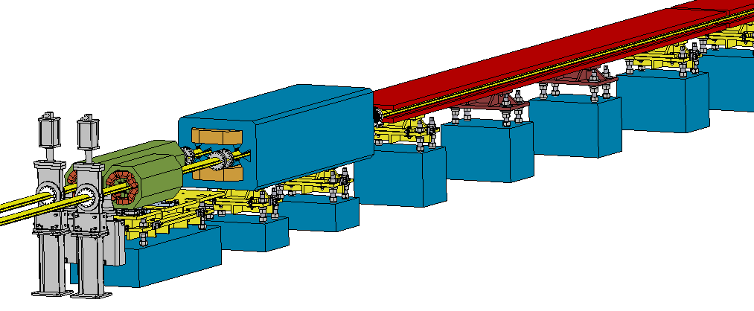
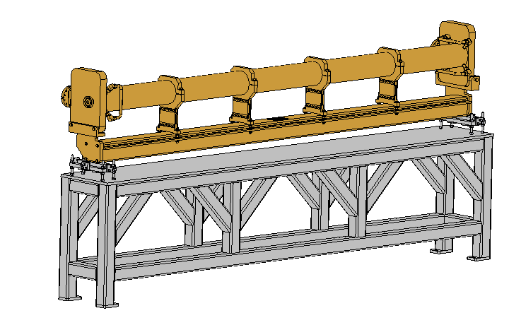
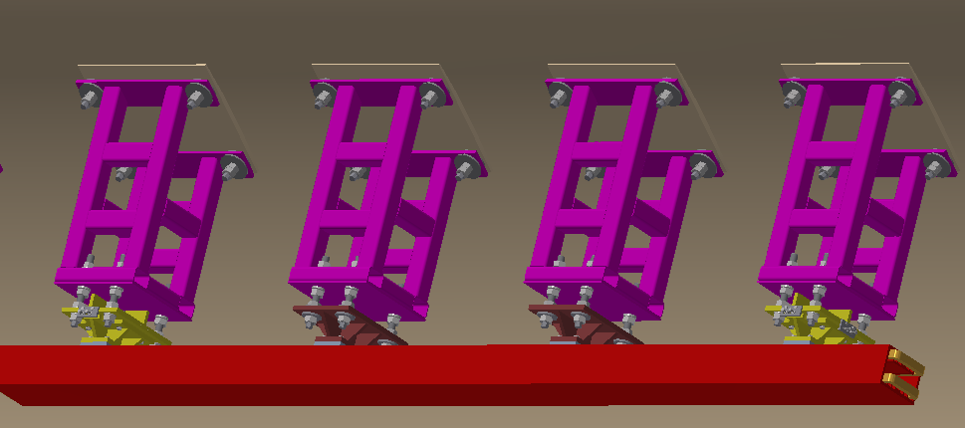
Supports for regular magnets
Over 80% of the length is covered by magnets of about 138 types.
Adjustment Ranges of magnets
X | ≥±20 mm | Δθx | ≥±10 mrad
Y | ≥±30 mm | Δθy | ≥±10 mrad
Z | ≥±20 mm | Δθz | ≥±10 mrad
Booster
Collider

Slide 28
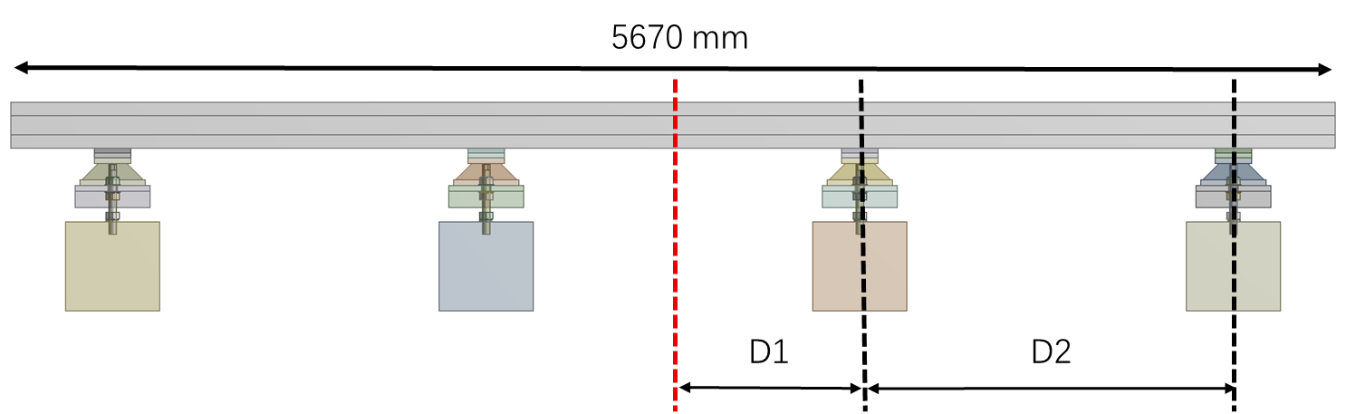



Supports for regular magnets
Optimization for dipole supports
No. of supports | Max. deformation (um)
3 | 19
4 | 7
5 | 5
Other magnet girders will be renewed too.
  Simple & flexible structure.
  Small deformation & good stability
  Low cost
  Detailed structure for typical supports are under design.
  * Cooperate with Keye co., Ltd

Slide 29



Supports for regular magnets
Flexible load support for “long” devices and “short” devices
Transportation and coarse location of magnets in Booster
Transportation and coarse location of magnets in Collider
  * Cooperate with Beijing North Vehicle Group Corporation.

Slide 30
Conclusion
We have made a workable MDI layout. Some key devices such as remote vacuum connector are designed.
The SC magnet supports inside the cryostat are under design and optimization. Integral FEA with cryostat will be studied next step.
The collimators for background decreasing are designed. The beam loss failure has been considered and preliminary protection scheme with abort system, collimators and reverse switching solenoids are considered.
Preliminary design for typical regular magnet supports are undergoing, more detailed work will be done.

Slide 31
Thanks for your attention!

