Slide 1
Light materials in beam pipe
Shaohong Wei， Quan Ji
2021.10
MDI mechanical design workshop meeting, Dongguan, 2021.10.21-23

Slide 2
Outline
Introduction
Be pipe
Carbon fiber
Mg-Li alloy
Conclusion

Slide 3
1. Introduction
e/P
e/P
In order to reduce the loss of light and improve the detection efficiency, many light materials need to be used in the beam tube collision area.
Beam pipe
Be ------1.85g/cm³
Structural materials:
Carbon fiber-----1.5-1.8g/cm³
Mg-Li-----1.38-1.85g/cm³

Slide 4
2. Be pipe
Be pipe: inner Be/ Outer Be
Function: Maintain a high vacuum environment
Environments：
Requirements：
The smaller the diameter, the better；
The thinner the pipe wall, the better；
Temperature（RT-50℃）
Vacuum（10⁻⁶Pa ---10⁻⁸Pa)
Leakage rate（5*10⁻¹¹Pa m³/s）
Medium cooling（water or other)
Irradiation(Irradiation damage)

Slide 5
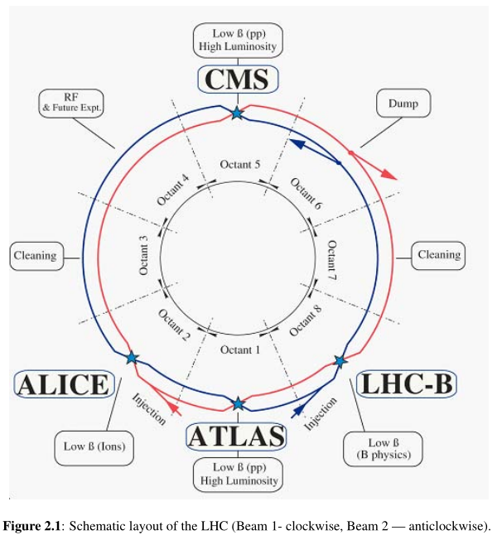
Beryllium beam tubes for various devices in the world—LHC（2008年）
ALICE（2008）
Ф--58mm，Thickness--0.8mm；
K. Aamodt ea al. The ALICE experiment at the CERN LHC, Journal of Instrumentation 3 , 2008,S08002
ATLAS（2008）
Ф--58mm，Thickness--0.8mm；
G.Aad ea al. The ATLAS Experiment at the CERN Large Hadron Collider, Journal of Instrumentation 3 , 2008,S08002

Slide 6
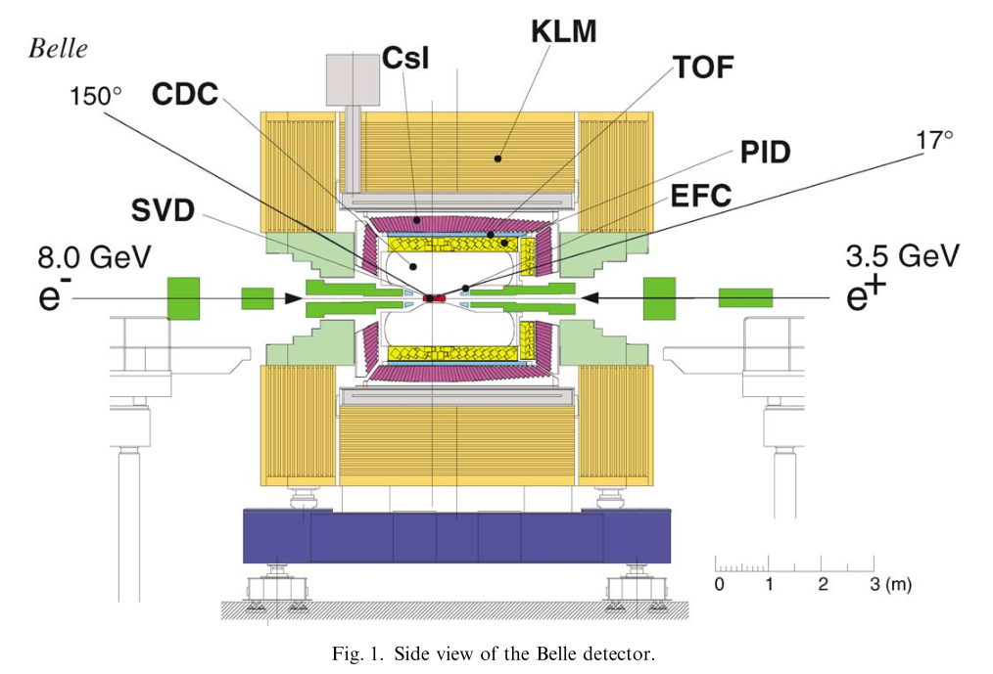
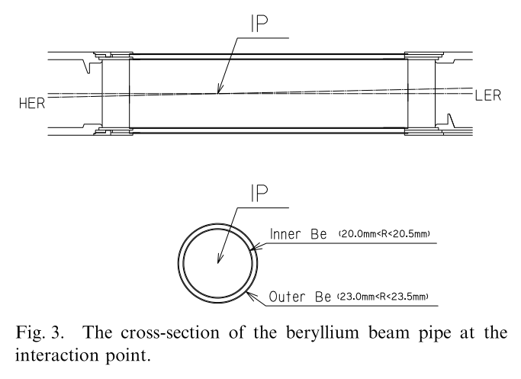
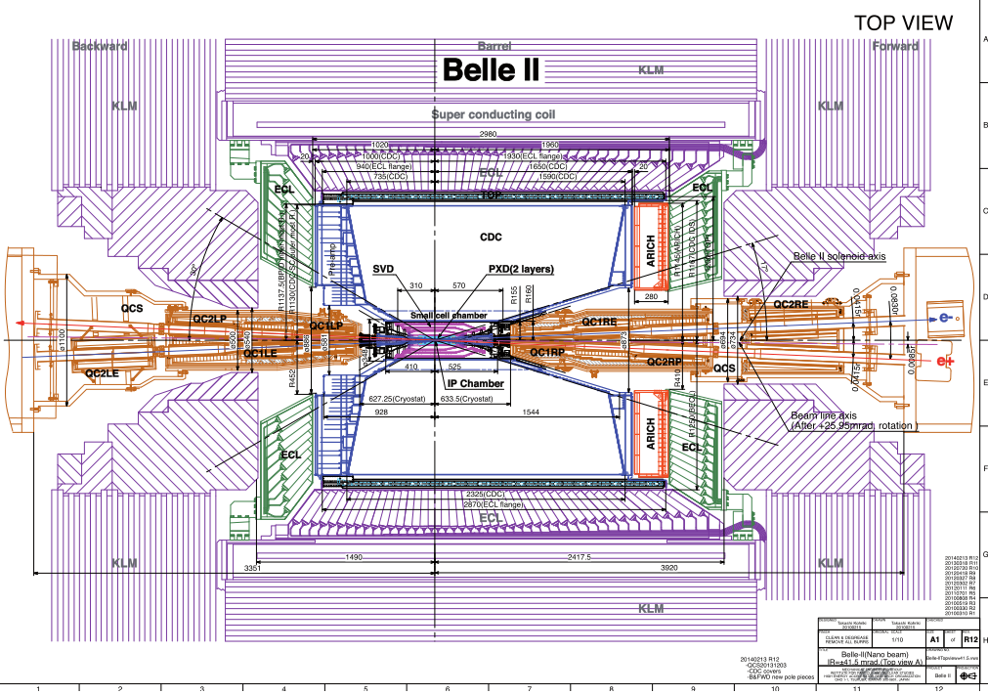
Beryllium beam tubes for various devices in the world—KEK
Bell-I（2001年）
Inner : Ф--40mm，Thickness--0.5mm；
Outer: Ф-- 46mm， Thickness-- 0.5mm;
A.Abashian et al. Nuclear Instruments and Methods in Physics Research A 479(2002) 117-232,
Bell-II（2017年）
Inner : Ф--20mm，Thickness--0.6mm；
Outer: Ф– 23.2mm， Thickness-- 0.4mm;
Prog. Theor. Exp. Phys. 2019, 123C01,

Slide 7
Beryllium beam tubes for various devices in the world—BEPC-II
BEPC -II
Inner Be：Ф--63mm
T --0.8mm
L--320mm
Outer Be：Ф--66.2mm
T --0.6mm
L--226mm
CEPC
Inner Be：Ф --28mm
T --0.5mm
L --240mm
Outer Be：Ф--30mm
T --0.35mm
L --230mm
Goal
Ф ：20--30mm
T ：0.15--0.30mm
L ：160--200mm
2008
2020.8
Vacuum
Strength
Deformation
Uniformity
corrosion
Manufacturing of ultra thin beryllium tube
Be-Al welding;
？
Challenge

Slide 8
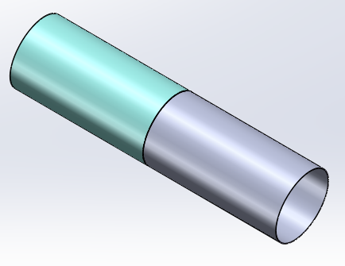
Exploration on manufacturing of ultra thin beryllium tube
Objective
Obtaining the processing and performance data of thin-walled beryllium tube;
Providing a basis for the design of beryllium tube of CEPC;
Cultivate potential manufacturers ；
合作厂家：
西北稀有金属材料研究院；
北京航天控制仪器研究所；
9院10所；
Program
Based on engineering application, small samples of beryllium tubes are processed and welded, and various indexes of beryllium tubes are tested.
Be
Welding
Al
Beryllium tube manufacturing
0.60mm 0.15mm
short long
Welding：plate pipe
Test：Strength; Deformation; Vacuum; Leakage rate

Slide 9
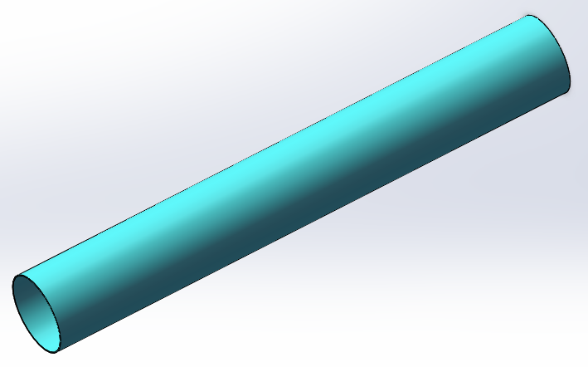
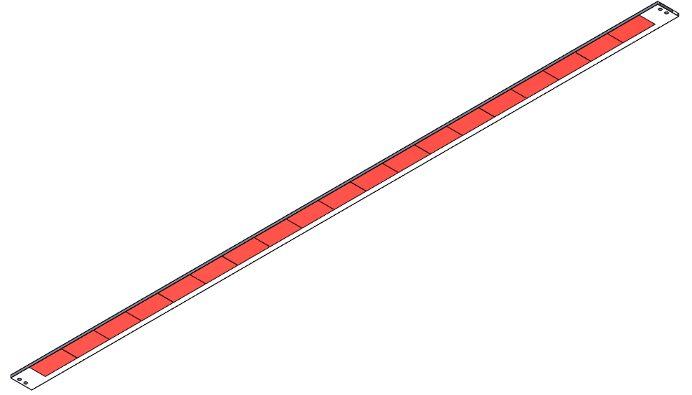
3. Carbon fiber
Advantages of carbon fiber：Light，High strength，High E
Carbon fiber products can be used in many parts of CEPC
Three type, 51 pieces
Diameter:121mm
Thinkness:1.5mm
Long:856mm
Si chip support
Be pipe support cylinder
S W. Xiao, The design of CEPC beam pipe、SIT and the connection structure 2020.8

Slide 10
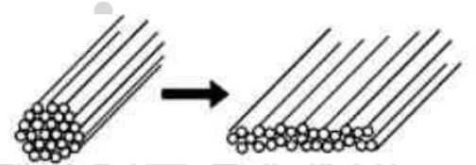
Manufacturing process of carbon fiber
Raw material preparation
项目 | 典型值
0°拉伸强度 | 2400MPa
0°拉伸弹性模量 | 120GPa
90°拉伸强度 | 42MPa
90°拉伸弹性模量 | 8GPa
0°压缩强度 | 1000MPa
0°压缩弹性模量 | 100GPa
90°压缩强度 | 100MPa
90°压缩弹性模量 | 8GPa
纵横剪切强度 | 55MPa
纵横剪切弹性模量 | 4 GPa
短梁强度 | 75MPa
弯曲强度 | 1200MPa
弯曲弹性模量 | 100GPa
纤维面密度（FAW） | 50g/m²
T700 carbon fiber(12k) prepreg was used
Layer thickness is 0.05mm
Flattening
12000 bunch of carbon fibers
合作厂家：无锡启康航空航天科技有限公司

Slide 11
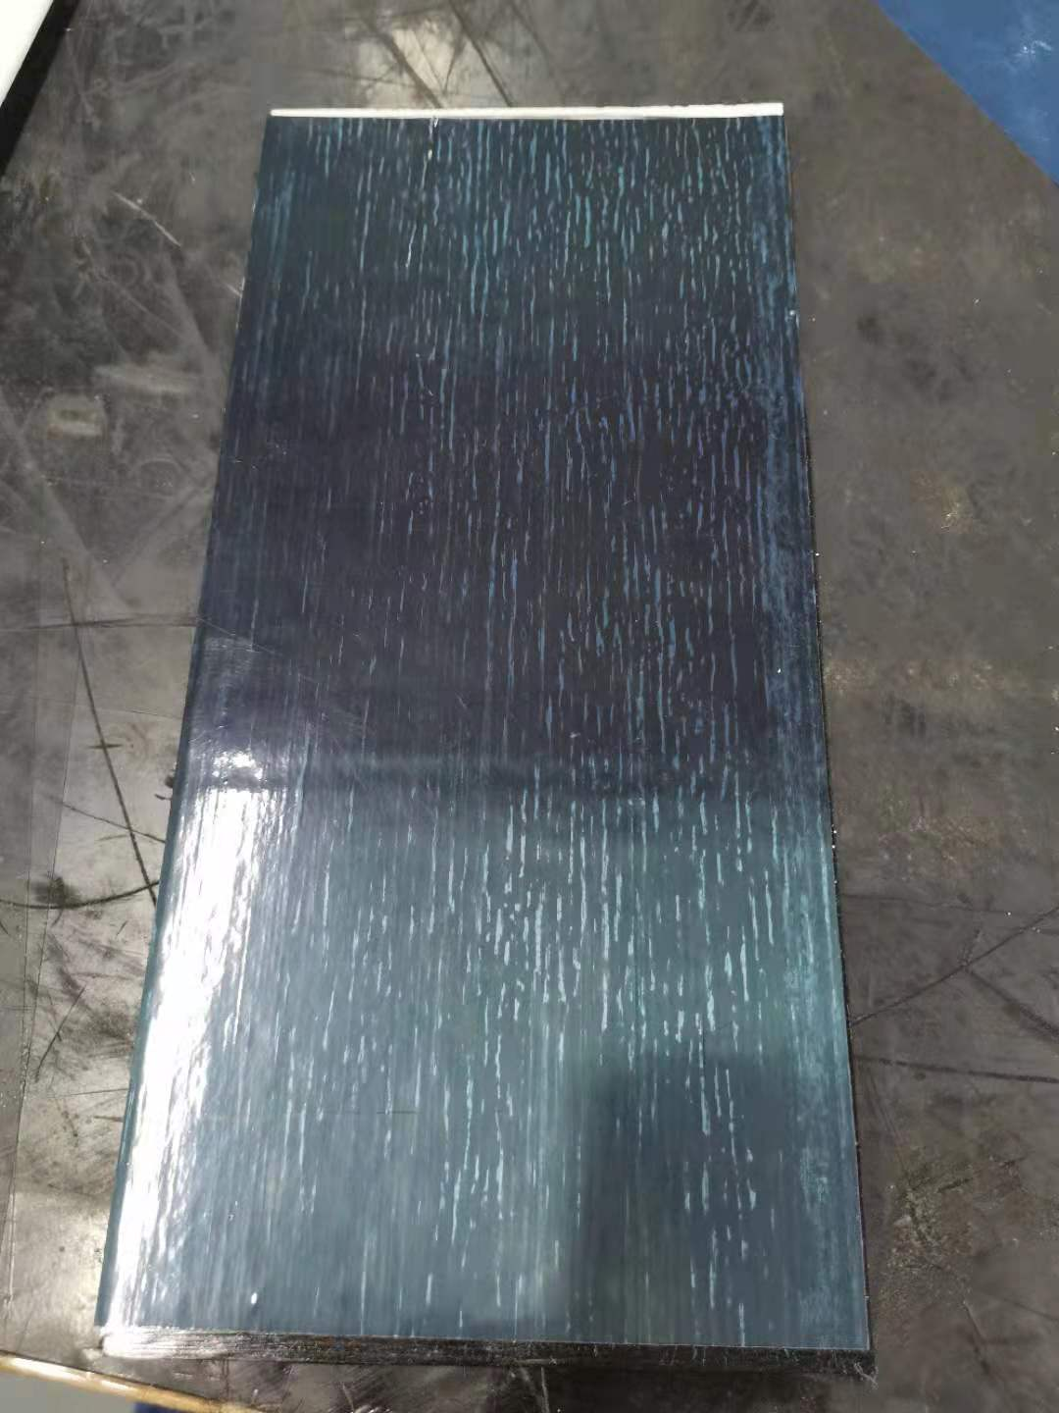
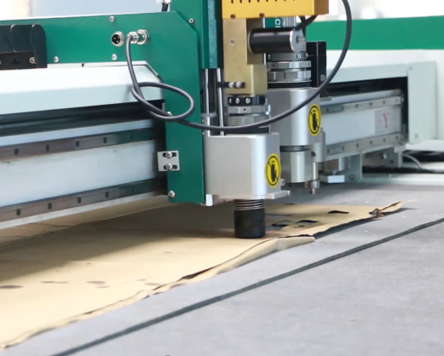
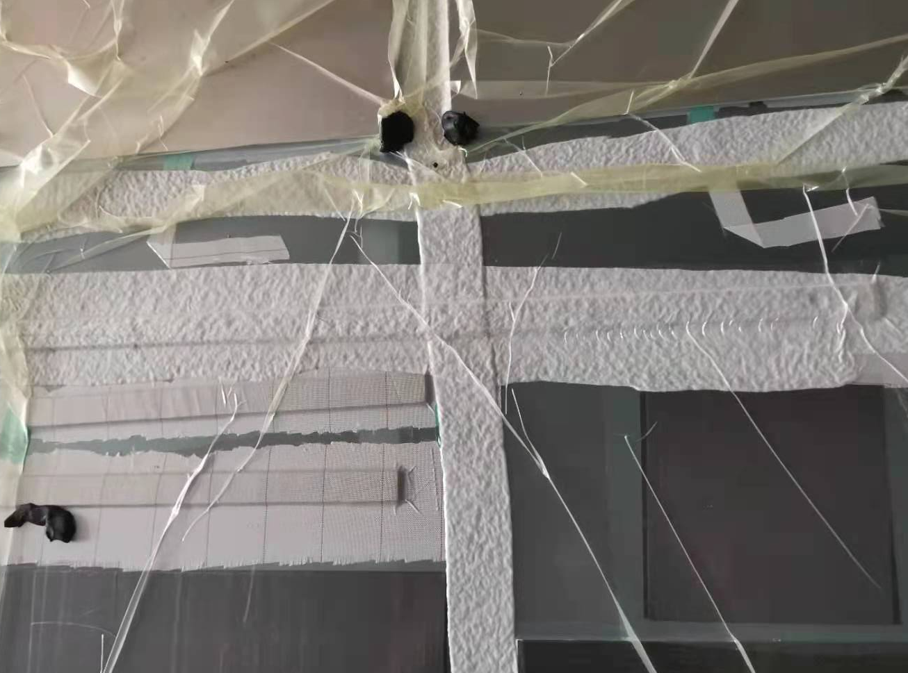
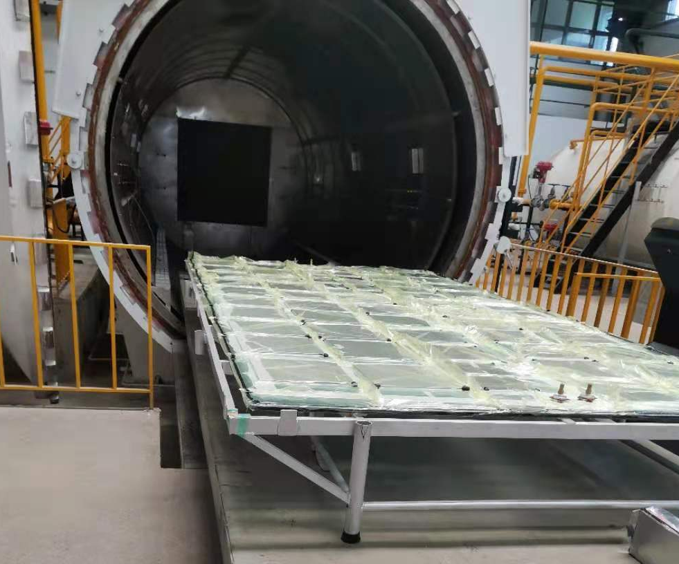
Manufacturing process of carbon fiber
Prepreg cutting
Paving
Paving
Temperture:150℃
Hold time:2h
Solidification
Bag making

Slide 12
Manufacturing process of carbon fiber
0.1mm
0.1mm
0.2mm
CF
CF
①
②

Slide 13
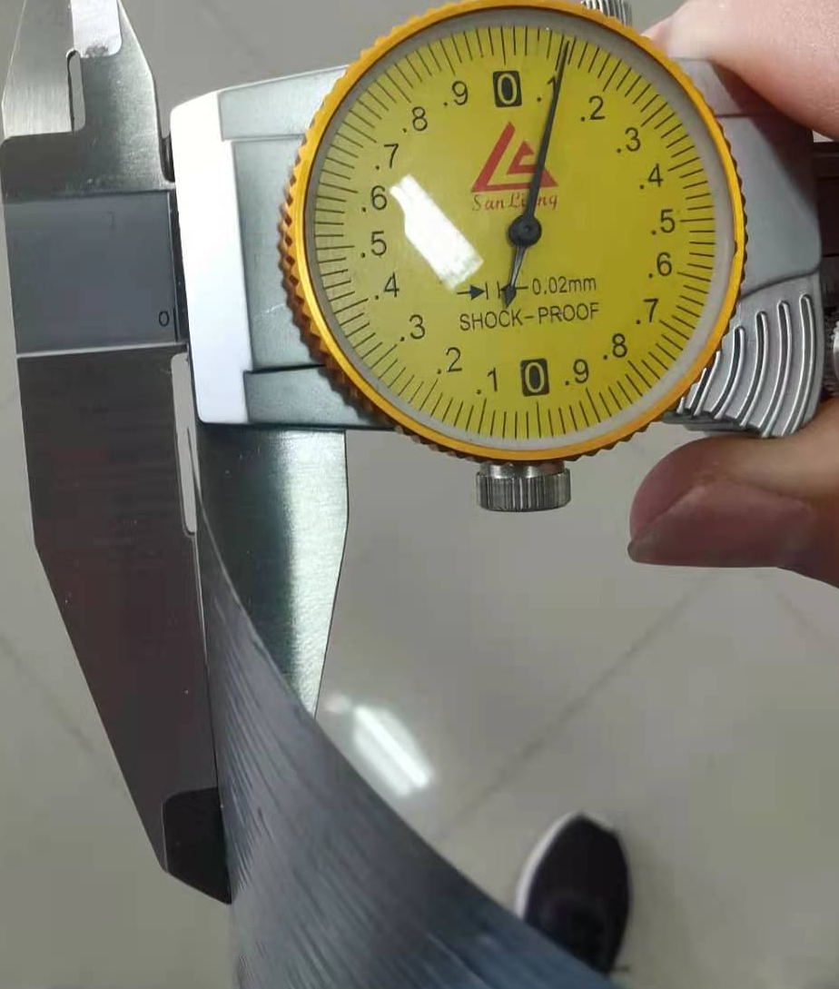
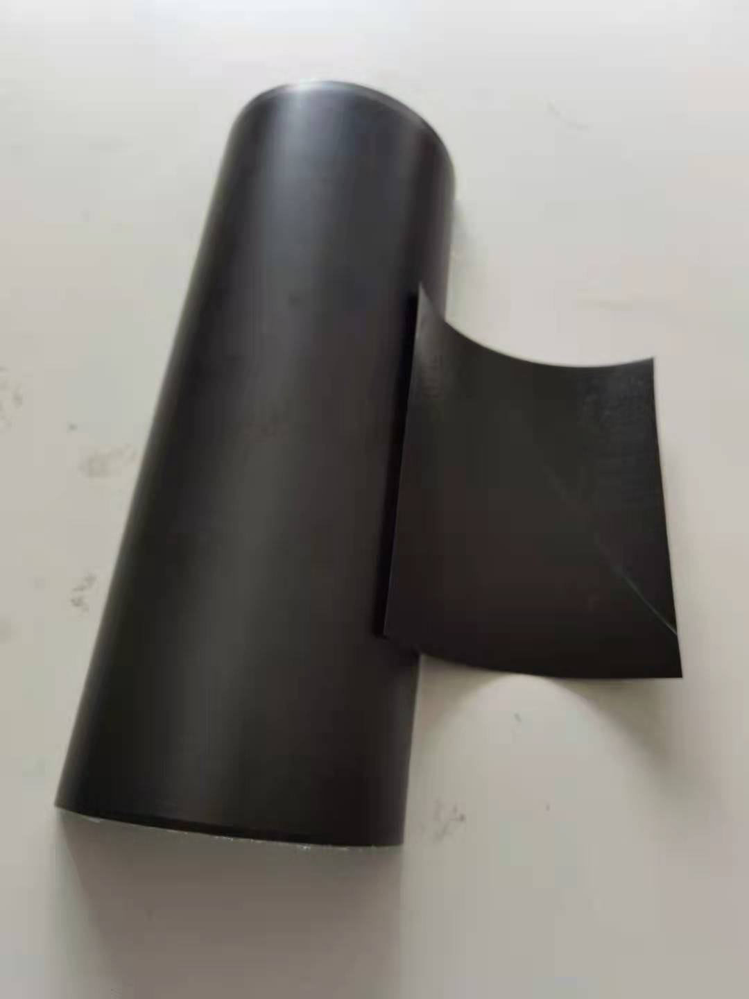
Results
①
CF(0.1)
Density:2.1g/cm3
Flatness:5.0mm
0.1mm carbon fiber composite was successfully prepared.
The flatness of the carbon fiber composite is not good, Warping serious.

Slide 14
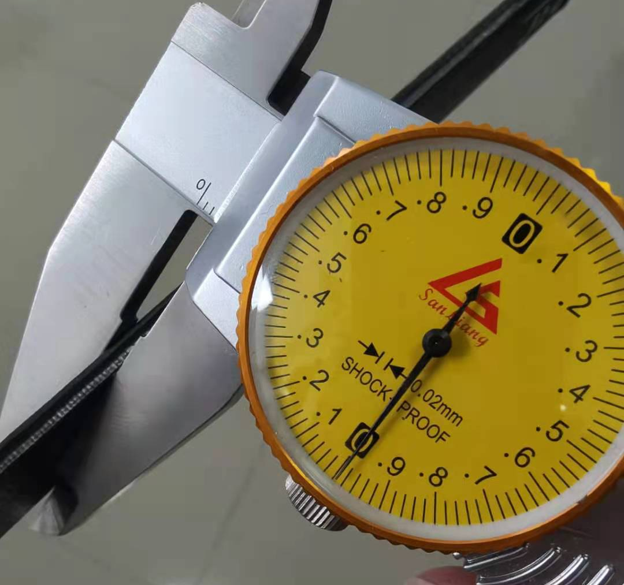
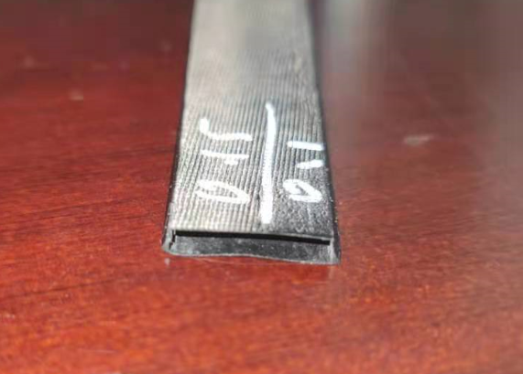
Results
②
CF(0.1+0.1+0.2+0.2)
0.1mm
0.2mm
Flatness:0.40mm;
Density:2.1g/cm3
0.1mm thick hollow carbon fiber was successfully prepared.
The internal shape changes after solidification, process need to be optimized.

Slide 15
Results
PMI-Polymethacrylimide
Characteristic：Light
Density: 0.075g/cm³
Sandwich materials suitable for Composites
PMI--0.8mm
0.1mm
0.1mm
0.1mm
PMI--1.8mm
PMI--1.8mm
CF+PMI+CF
CF+PMI+CF
CF+PMI+CF
③
④
⑤

Slide 16
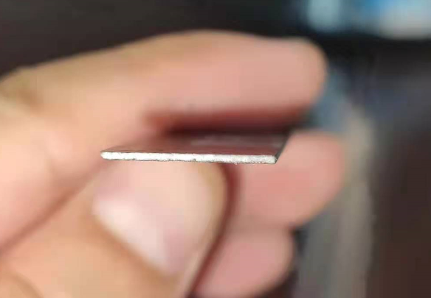
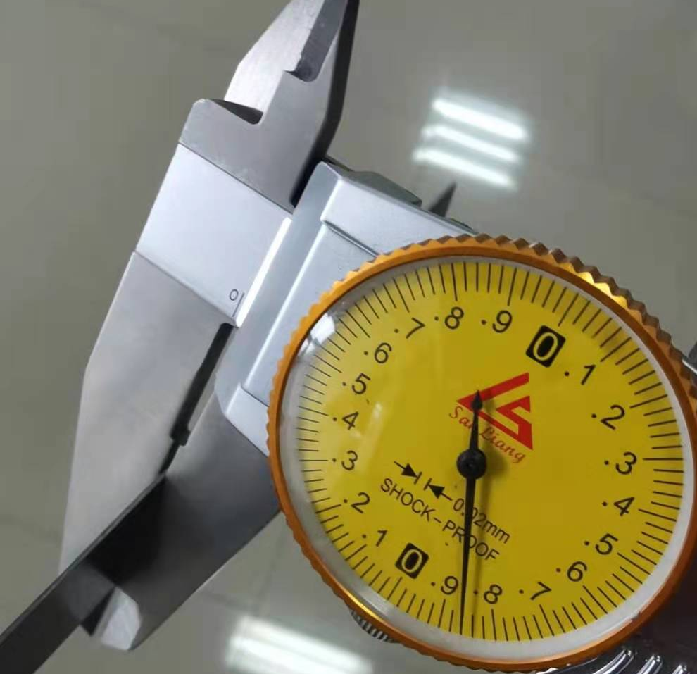
Results
③
CF(0.1)+PMI(0.8)+CF(0.1)
PMI--0.8mm
0.1mm
CF+PMI+CF
Flatness:1.2mm;
Density:0.503g/cm3
A carbon fiber composite with a thickness of 0.86mm was obtained. Thickness becomes thinner after solidification, and uniformity is good .
The thickness of the surface carbon fiber is 0.1mm.
The cross section keeps a good rectangle

Slide 17
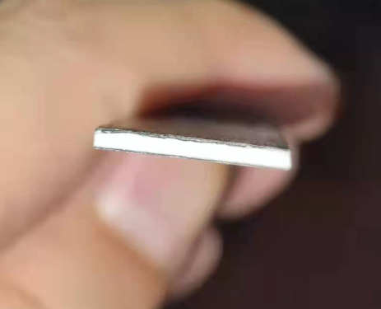
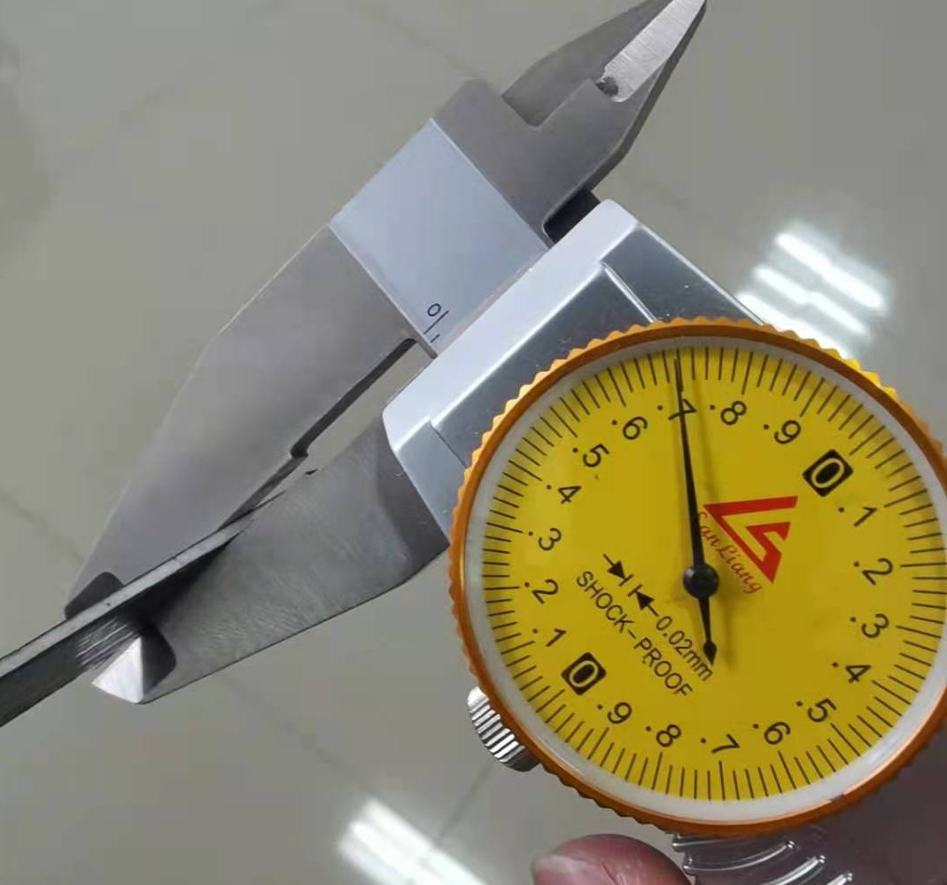
Results
④
CF(0.1)+PMI(1.8)+CF(0.1)
PMI--1.8mm
0.1mm
CF+PMI+CF
Flatness:0.48mm;
Density:0.286g/cm3
A carbon fiber composite with a thickness of 1.7mm was obtained. Thickness becomes thinner after solidification, and uniformity is good .
The thickness of the surface carbon fiber is 0.1mm.
The cross section keeps a good rectangle.

Slide 18
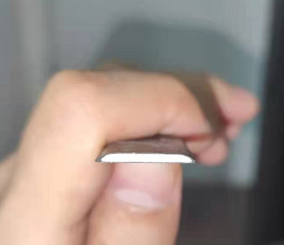
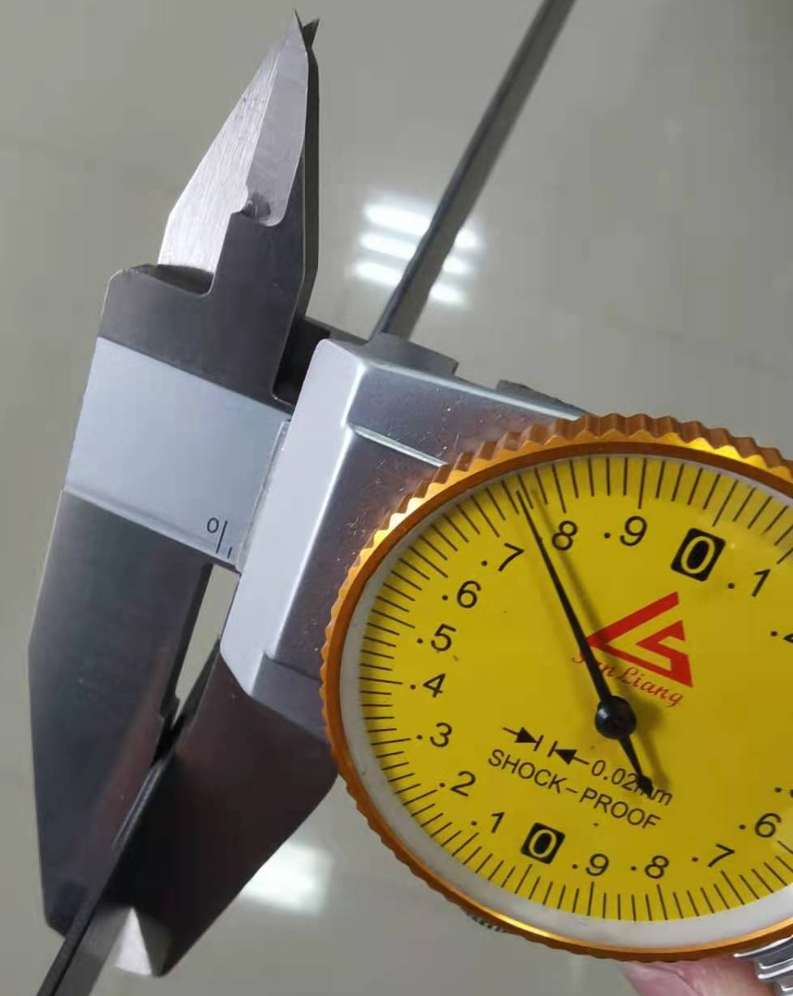
Results
⑤
CF(0.1)+CF(0.1)+PMI(1.8)+CF(0.1)+CF(0.1)
PMI--1.8mm
0.1mm
CF+PMI+CF
Flatness:0.36mm;
Density:0.378g/cm3
A carbon fiber composite with a thickness of 1.75mm was obtained. Thickness becomes thinner after solidification.
The thickness of the surface carbon fiber is 0.1mm.
The shape of the cross section changes after solidification.

Slide 19
Results
Samples | Quality(g) | Volume(cm3) | Density (g/cm3) | Flatness/mm | Manufacturing difficulty
① CF（0.1） | 0.7732 | 24.3*1.5*0.01=0.3645 | 2.121 | 5 | Easy
② CF（矩形） | 2.2799 | 24.3*1.7*0.32=13.2192 | 0.172 | 0.20 | Difficult
③ CF+PMI（0.86） | 1.5773 | 24.3*1.5*0.086=3.1347 | 0.503 | 1.20 | Easy
④ CF+PMI（1.7） | 1.7734 | 24.3*1.5*0.17=6.1965 | 0.286 | 0.48 | Easy
⑤ CF+PMI（1.75封边） | 2.6085 | 24.3*1.65*0.172=6.89743 | 0.378 | 0.36 | Medium
Conclusion
0.1mm carbon fiber composite material can be prepared, but the strength is not enough;
Carbon fiber +MPI composite material can improve the deformation resistance of carbon fiber material
The flatness of carbon fiber composites should be considered;

Slide 20
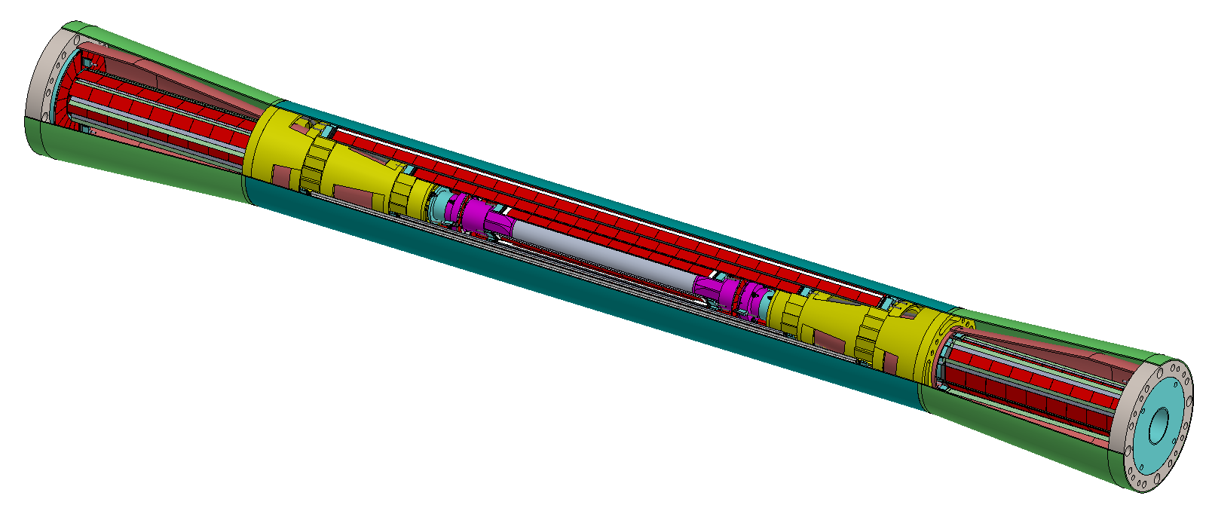
4. Mg-Li alloy
SS
Al
Be
Carbon fiber
束流管涉及材料

Slide 21
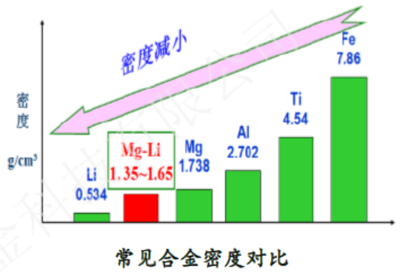
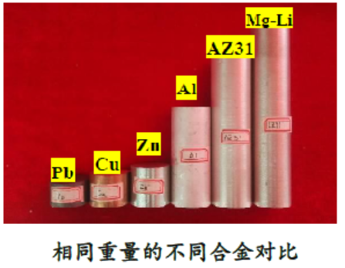
4. Mg-Li alloy
Magnesium lithium alloy is the lightest metal structural material in the world；
Density is 1.35-1.65g/cm3, which is 1 / 4-1 / 3 lighter than ordinary magnesium alloy and 1 / 3-1 / 2 lighter than aluminum alloy;
supper light；
High strength ；
Mg-Li合金： Li --- Lightest metal;
Mg--- Lightest structural material
Characteristic
Application area ：
Aerospace
Military project
Civil 3C
Manufacturer ：
中铝郑州轻金属研究院；
东北轻合金有限公司；

Slide 22
4. Mg-Li alloy
牌号 | 成分 | 密度 g/cm3 | 弹性模量 GPa | 比刚度 | 导热系数 W/(mk) | 力学性能 |  |  |  | 使用温度 ℃ | 特点
 |  |  |  |  |  | 硬度 HV | 抗拉强度 Rm/MPa | 屈服强度 R0.2/MPa | 断后延伸率 A%
LA141 | Mg85-Li14-Al1 | 1.35 | 43 | 31 | 约55 | 40-70 | 110-140 | 100-120 | 10-40 | 80℃以内 | 密度低，韧性好
LA91 | Mg90-Li9-Al1 | 1.45 | 43 | 29 | 约80 | 45-75 | 140-180 | 110-130 | 10-40 | 100℃以内 | 密度低，中等强度
LZ91 | Mg90-Li9-Zn1 | 1.48 | 43 | 29 | 约55 | 40-75 | 140-180 | 110-130 | 15-40 | 100℃以内 | 密度低，中等强度，塑性好，耐腐蚀性好
LAZ931 | Mg85-Li9-Al3-Zn1 | 1.52 | 43 | 28 | 约80 | 50-75 | 180-220 | 150-180 | 10-20 | 100℃以内 | 综合力学性能好
LAZ933 | Mg85-Li9-Al3-Zn3 | 1.56 | 43 | 27 | 约80 | 50-80 | 190-230 | 150-190 | 10-20 | 100℃以内 | 综合力学性能好
MA18 | Mg-Li10-Al1-Zn2.5-Mn0.4-Ce0.35 | 1.48 | 43 | 29 | 约80 | 45-65 | 150-220 | 110-140 | 15-40 | 80℃以内 | 密度低，中等强度，耐腐蚀性好
MA21 | Mg-Li8.1-Al5.2-Cd4.7-Zn1.38 | 1.6 | 43 | 27 | 约80 | 50-80 | 200-280 | 130-200 | 6-25 | 120℃以内 | 强度高，耐腐蚀性好

Slide 23
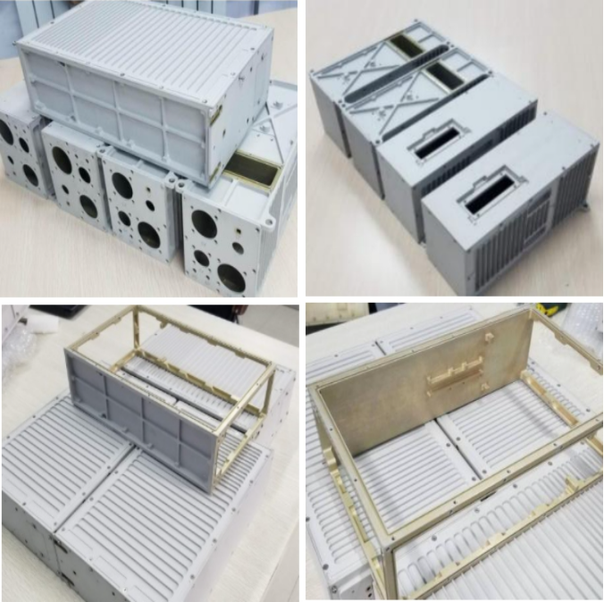
4. Mg-Li alloy
Aerospace chassis
Structural parts
Advantage
Light,
Machin-able special-shaped structural parts;
Disadvantage
Poor corrosion resistance
表面微弧氧化后192天盐雾环境未见明显腐蚀

Slide 24
5. Conclusion
The search for ultra-thin beryllium pipe is about to begin;
Thin carbon fiber +MPI composite can improve the dimensional accuracy and deformation resistance of carbon fiber;
Other light alloys for beam pipe, such as Mg-Li and Al-Li alloy are under investigation

Slide 25
Thanks for your attentions

