Slide 1
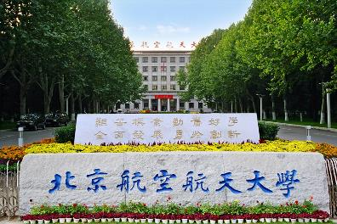
第七届手征有效场论研讨会
高精度相对论手征核力
陆俊旭 @ 北京航空航天大学
合作者: 王春宣博士, 肖杨博士, 耿立升教授
Notes:
Good evening! I am very honored to be invited to the this international workshop. Today I will present our recent achievements on the accurate relativistic chiral nuclear force. I am Junxu Lu from Beihang university. This work is completed cooperated Chunxuan wang, yang xiao and professor li-sheng geng.

Slide 2
纲要
核力简介
理论框架: 手征核力
结果与讨论
总结与展望
高精度相对论手征核力
Jun-Xu Lu
Notes:
Here is the outline of my talk today. First comes a short introduction of the historical story of nuclear forces. Then I will explain the framework for our relativistic nuclear force. In the third section I will show the results obtained with the relativistic nuclear forced. And finally a short summary and prospect

Slide 3
核力简介
核物理研究的关键
核物质、核反应、核结构、天体物理
+
氘核
+
氚核
+
+
氦核
高精度相对论手征核力
Jun-Xu Lu
Notes:
目前，标准模型已被物理学家们广泛接受。再标准模型中，构成物质世界的基本粒子是夸克。夸克之间通过交换胶子进行相互作用，也就是强相互作用，并形成核子，包括质子跟中子。这些核子进一步相互作用，束缚成性质各异的原子核。可以说，准确理解核子-核子间的相互作用，也就是核力，对理解这些原子核的性质至关重要。此外，核力也是我们开展核物质，核反应、和结构以及天物理研究的关键输入，对他的研究具有十分重要的意义。而且，随着研究的不断深入，对核力的精度也提出了很高的要求。

Slide 4
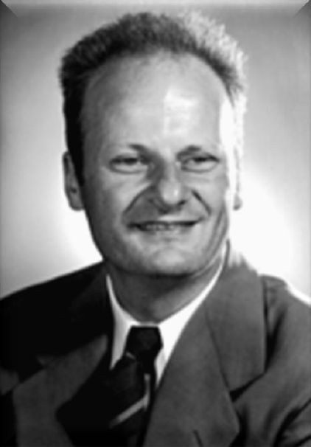
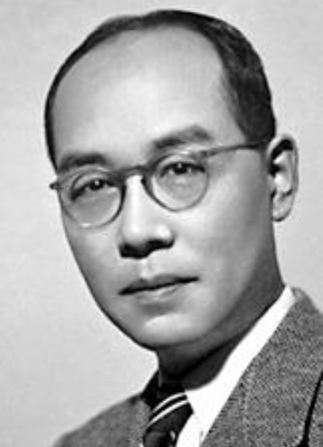
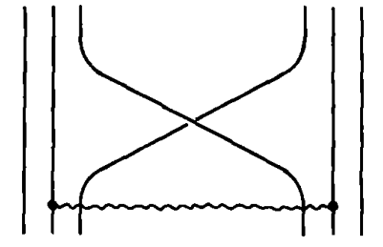
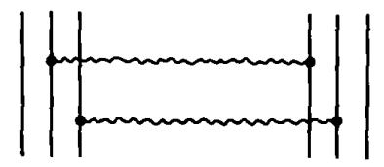
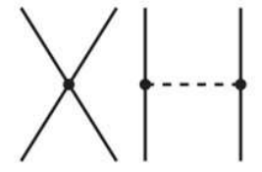
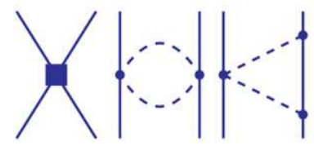
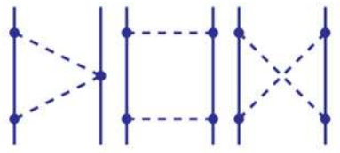
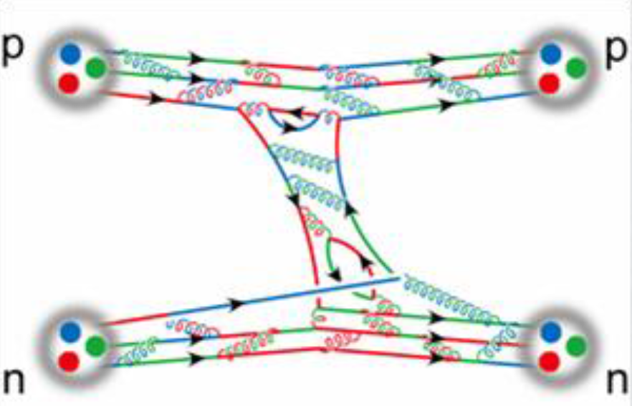
核力简介
物理学研究中最为困难的问题之一
1935
Yukawa, Meson theory
1950’
1960’
One pion exchange, One boson exchange
Hans Bethe
Yukawa
QCD
Nobel Prize 1967/1949
1980’
夸克模型
1990’
Weinberg, 手征有效场论
S. Weinberg, PLB1990
现代核力
$$+$$
$$+$$
······
1994
高精度 唯象模型: AV18、Reid93 （算符因子化）
V. Stoks, PRC1994
$V_{NN}=V_{c}\left(r\right)\hat{1}+V_{σ}\left(r\right)σ_{1}∙σ_{2}+ V_{LS}\left(r\right) L∙S+V_{T}\left(r\right) σ_{1}∙qσ_{2}∙q+$ ······
R. Wiringa,PRC1994
2001
高精度 唯象模型: CD-Bonn （介子交换）
R. Machleidt, PRC2001
2006
完整动力学的Lattice QCD
S.R.Beane PRL2006
High-precision relativistic chiral nuclear force up to NNLO
Jun-Xu Lu
Notes:
然而对于核力的研究也是物理学中最为困难的问题之一。早期的研究可以追溯到上世纪30年代yukawa提出的介子理论，到50，60年代，随着pi介子等一系列玻色子的发现，已经能够初步描述核力乃至氘核。到了70年代，物理学家们发现了强相互作用的基本理论量子色动力学QCD，这下之前的理论就都变成模型，要推到重来了。受到QCD的启发，80年代人们提出了一种从夸克层次描述核力的方法，不过其本质上仍然是模型。终于到90年代，人们对于核力的研究取得了重大突破，weinberg提出有效场论研究核力，将核力按照手征阶数展开。这也是我们的研究中要用的方法，之后会有进一步的阐述。在人们从QCD出发取得重大进展的同时，唯象模型也获得了长足进步，在94年跟01年，出现了三种代表性的唯象模型。其中AV18跟Reid93基于算符因子化也就是张量展开，CD-Bonn则基于介子交换。这三中唯象模型均实现了对于数千个核子散射数据的高精度描述。最后值得一提的是格点QCD，因为核力是夸克间相互作用的剩余相互作用力，类似范德瓦尔斯力，从夸克层次计算十分复杂。直到2006年，考虑的完整动力学的格点计算才最终完成。

Slide 5
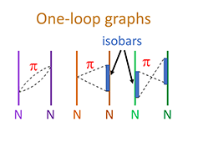
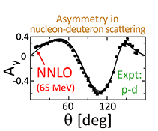
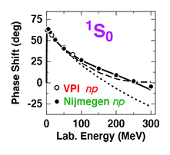
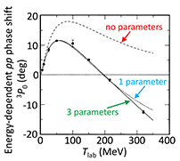
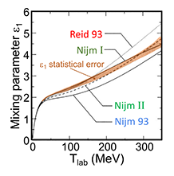
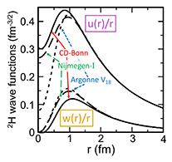
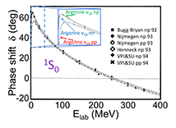
核力简介
PHYSICAL REVIEW C 50th Anniversary Milestone papers(41)
“remain central to developments in the field of nuclear physics”
Chiral EFT sparked a renaissance in low-energy nuclear theory over the past quarter of a century
Chiral EFT
Partial wave analysis
C.Ordóñez, L.Ray, and U.van Kolck
E. Epelbaum, A. Nogga, W. Glöckle, H. Kamada, Ulf-G. Meißner, and H. Witała
D. R. Entem and R. Machleidt
Phys. Rev. C 53, 2086 (1996)
Phys. Rev. C 66, 064001 (2002)
Phys. Rev. C 68, 041001 (2003)
the basis of numerous significant few-body calculations
Phenomenology
V. G. J. Stoks, R. A. M. Klomp, M. C. M. Rentmeester, and J. J. de Swart
Phys. Rev. C 48, 792 (1993)
V. G. J. Stoks, R. A. M. Klomp, C. P. F. Terheggen, and J. J. de Swart
R. B. Wiringa, V. G. J. Stoks, and R. Schiavilla
R. Machleidt
Phys. Rev. C 49, 2950 (1994)
Phys. Rev. C 51, 38 (1995)
Phys. Rev. C 63, 024001 (2001)
高精度相对论手征核力
Jun-Xu Lu
Notes:
核力的研究一直是核物理领域关注的焦点之一。这张PPT展示了PRC创刊50周年时，收录的具有里程碑意义的文章。总共有41篇，其中，核力的研究，占了其中7篇。上面这三篇粉笔是van kolck，epelbaum machleidt等人在基于手征有效场论的框架构建的两体以及三体核力，可以说在过去25年间，手征有效场论以及手征核力引领了低能核物理理论研究的复兴。下面三篇是基于未向模型，分别是之前提到的Reid93,AV18，以及CD bonn。他们是很多关键少体研究的基础。最后一个是Nigmegen合作组基于6000多个数据开展的分波分析，是开展核力研究的基础。

Slide 6
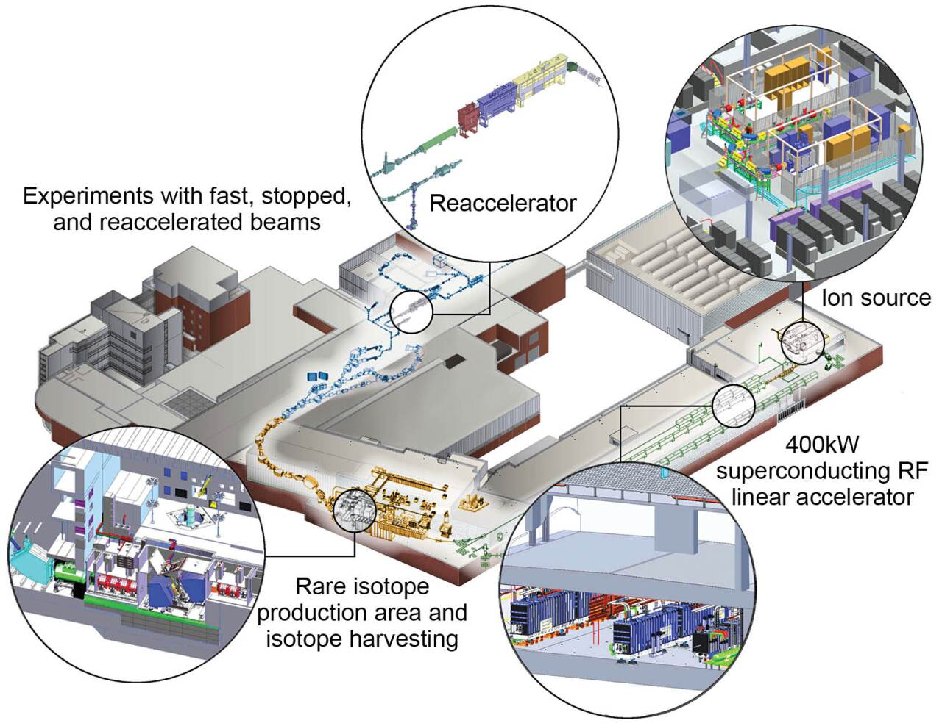
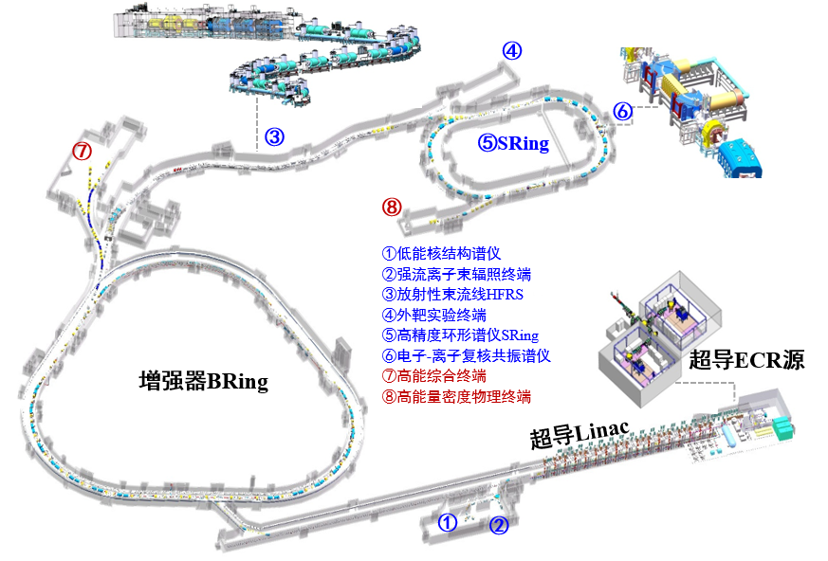
核力简介
实验物理前沿
强流重离子加速器装置（HIAF）
Facility for Rare Isotope Beams(FRIB)
认识原子核内有效相互作用。
探索宇宙中从铁到铀元素的来源
粒子辐照应用研究
Map the nuclear landscape,
Understand the forces that bind nucleons into nuclei
…
高精度相对论手征核力
Jun-Xu Lu
Notes:
核力的研究同样也是实验物理的前沿问题之一。左边这张图展示的我们国家的强留重离子加速器装置HIAF，他的研究内容之一就是认识原子核内核子的有效相互作用。右边这张图是密歇根州立大学的西游同位素束流装置，他们的研究内容包括理解核力在将核子束缚成原子核中发挥的作用。
High Intensity Heavy-ion Accelerator Facility

Slide 7
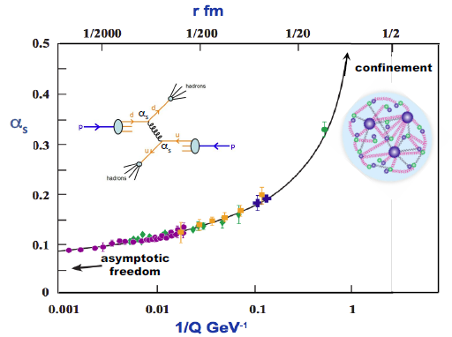
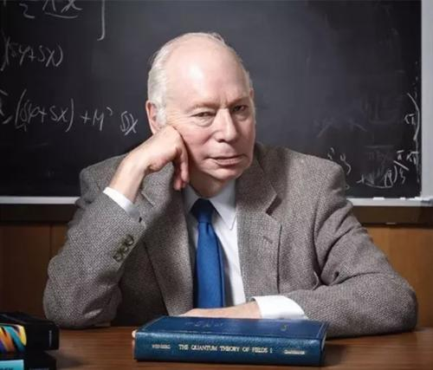
QCD 与手征有效场论
QCD: 渐近自由与色禁闭
高能区：
“自由” 夸克
低能区：
非微扰特性
强子 成为强相互作用自由度
手征有效场论——QCD低能区近似
One has to write the most general Lagrangian consistent with the assumed symmetry principles, particularly the (broken) chiral symmetry of QCD.
与QCD紧密相关
$$ℒ_{QCD}→ℒ_{χEFT}=\sum{c_{i}O_{i}}$$
自由度
夸克、胶子$→$ 强子
Steven Weinberg
构建展开小量
Nobel Prize 1979
$$Q/Λ≪1$$
硬能标 $Λ$
软能标 $Q$
高精度相对论手征核力
Jun-Xu Lu
Notes:
In the standard model, the fundamental theory for the strong interaction is QCD. It has two features, that is, the asymptotic freedom and confinement. In higher energy regions, quarks are approximately free and a perturbative treatment is applicable. However in the lower energy region, the QCD coupling constant increase rapidly as is shown in the right figure and it is in a strong coupled regime with non-perturbation nature. Quarks are confined into color singlet hadrons and hadrons instead of quarks and gluons become the degrees of freedoms for strong interactions.
In this situation, the effective field theory which is the approximation of QCD in lower energy region, has become one of the most successful approach. Based on the EFT, Weinberg further proposed that one has to write the most general lagrangian consistent with the assumed symmetry principles, particularly the chiral symmetry of QCD. This is the chiral EFT. Clearly, chiral EFT is closely connect to the QCD due to the chiral symmetry and its spontaneously breaking. Besides, the building blocks for the effective lagrangians are hadrons, actually pions or nucleons. It is interesting at this point as quoted in prof machleidt’s review that now we go back to yukawa;s meson theory except that we have finally established a clear connection to QCD and learned that the chiral symmetry controls the dynamics. Finally, as an EFT, one can construct a small quantity with the hard scale and soft scale for an expansion.
我们可以看到，在yukawa提出。。。

Slide 8
QCD 与手征有效场论
低能区强相互作用的微扰处理
手征阶数：外场动量、轻夸克质量的幂次——记阶规则（power counting rule）
$$p_{i}→α p_{i}$$
$$m_{q}→α^{2} m_{q}$$
$$𝒜\left(αp_{i},α^{2}m_{q}\right)=α^{D}𝒜(p_{i}, m_{q})$$
$$D=4L+\sum_{n}{n V_{n}}−2N_{M}−N_{B}$$
D: 手征阶数
L : 圈个数
$V_{n}$: n阶顶点的个数
$N_{M}$: 介子传播子的个数
$N_{B}$: 重子传播子的个数
手征有效场论的优势
与QCD紧密关联
系统提高描述精度
估计理论误差
自洽三体力
高精度相对论手征核力
Jun-Xu Lu
Notes:
With the expansion parameter in the last slide, we are allowed to treat the low-energy strong interaction perturbatively. With the soft scale, usually the external momenta and light quark masses, we can construct a power counting rule and then evaluate the importance of each pieces of contribution a priori. As is demonstrated below, the order for a certain Feynman diagram can be counted with the number of loops, meson and baryon propagators, and the order of vertices. As a short summery, the chiral EFT has obvious advantages at three points: it possesses a closer connection to QCD, one can systematically improve the description with the guide of power counting rule and estimate theoretical uncertainties accordingly.

Slide 9
QCD 与手征有效场论
低能区强相互作用的微扰处理
手征阶数：外场动量、轻夸克质量的幂次——记阶规则（power counting rule）
$$p_{i}→α p_{i}$$
$$m_{q}→α^{2} m_{q}$$
$$𝒜\left(αp_{i},α^{2}m_{q}\right)=α^{D}𝒜(p_{i}, m_{q})$$
$$D=4L+\sum_{n}{n V_{n}}−2N_{M}−N_{B}$$
D: 手征阶数
L : 圈个数
$V_{n}$: n阶顶点的个数
$N_{M}$: 介子传播子的个数
$N_{B}$: 重子传播子的个数
手征有效场论的优势
与QCD紧密关联
系统提高描述精度
估计理论误差
自洽三体力
重子系统—— 记阶规则破坏(PCB)
手征极限下重子质量不为0
Heavy baryon (HB)
Infrared regularization (IR)
Extended-on-mass-shell (EOMS)
Jenkins and Manohar, PLB 255 (1991) 558.
Becher and Leutwyler, EPJC 9 (1999) 643
Gegelia, Fuchs et al. in PRD60(1999), PRD68 (2003)
Heavy static nucleon
高精度相对论手征核力
Jun-Xu Lu
Notes:
The Chiral EFT succeeded for the full mesonic systems. However, when dealing with baryons, it is faced with a well-known problem that is, power counting breaking. This is because baryon masses do not vanish at chiral limit. So far 3 approaches are available, they are heavy baryon, infrared regularization and the extended-on-mass-shell scheme. The last two are covariant. In the first scheme, the nucleon are set to heavy static limit, which restore the power counting though at a cost of covariance. It finally leads to the HB chiral perturbation theory and the non-relativistic chiral nuclear force.

Slide 10
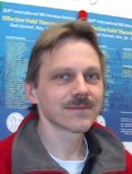
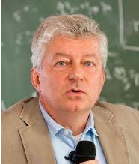
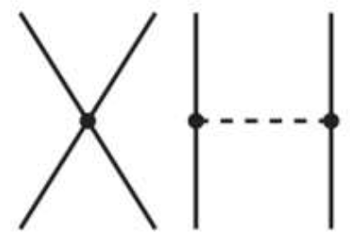
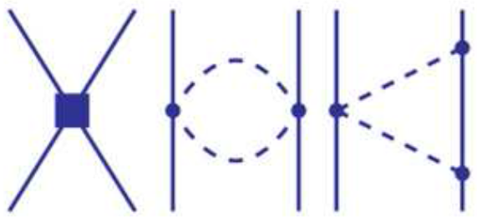
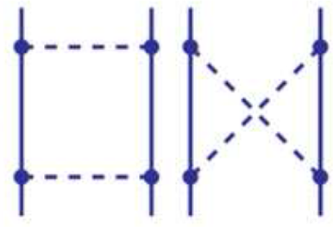
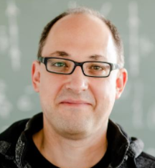
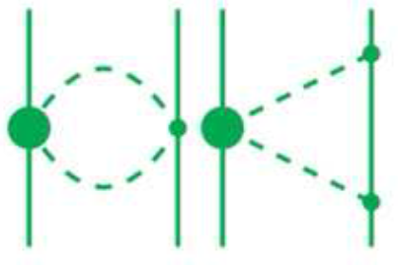
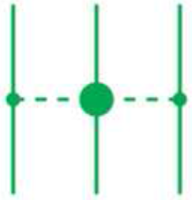
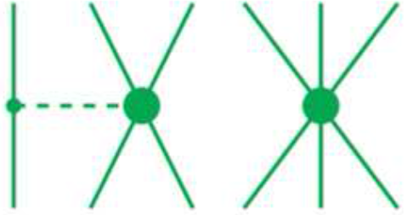
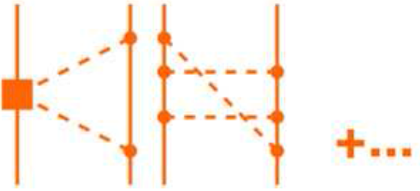
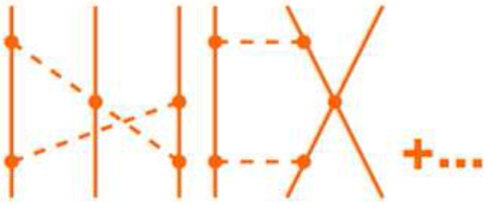
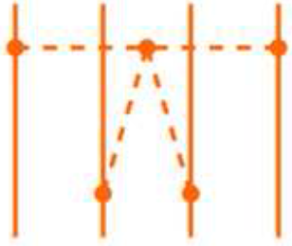
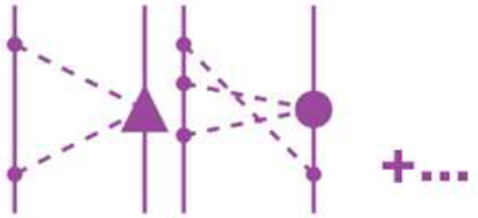
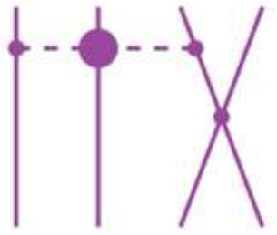
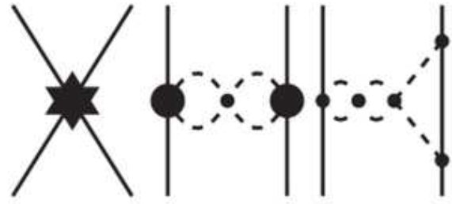
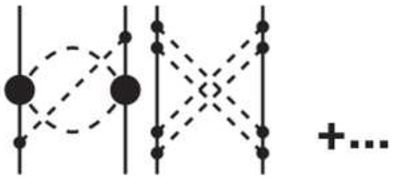
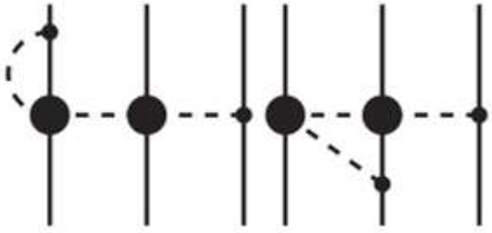
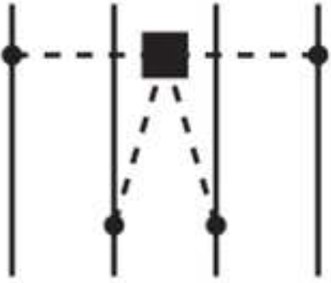
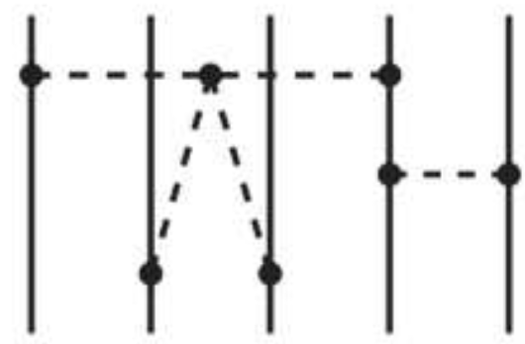
手征核力
非相对论手征核力
2NF
1990 2N LO
$LO$($Q^{0}$)
S. Weinberg
(since1990)
Ulf-G Meissner
Ubirajara
van Kolck
S. Weinberg, PLB1990, NPB1990
1994 3N LO
1997 2N $NLO$
$NLO$($Q^{2}$)
U. Van Kolck et al, PLB1992, PRL1994
3NF
N. Kaiser et al, NPA1997
2000 2N $N^{2}LO$
E. Epelbaum
R. Machleidt
$N^{2}LO$($Q^{3}$)
U. Van Kolck et al, PRC1994
U. Van Kolck et al, PRC1994
4NF
2003 2N $N^{3}LO$
E. Epelbaum et al, NPA1998,2000
$N^{3}LO$($Q^{4}$)
2007 3N $N^{3}LO$
R. Machleidt et al. PRC2003
S. Ishikwas et al. PRC2007
E. Epelbaum EPJA2007
E. Epelbaum et al. NPA2005
V. Bernard et al. PRC2007
2015 2N $N^{4}LO$
$N^{4}LO$($Q^{5}$)
R. Machleidt et al. PRC2015
H. Krebs et al, PRC2012,2013
5NF
E. Epelbaum et al. PRL2015
NOT COMPLETE
$N^{5}LO$($Q^{6}$)
R. Machleidt et al. PRC2015
NOT COMPLETE
Adopted from D.R. Entem et al Front.in Phys. 8 (2020) 57
高精度相对论手征核力
Jun-Xu Lu
Notes:
Here is the hierarchy of the non-relativistic chiral nuclear force up to sixth order of the chiral expansion according to the Weinberg’s power counting rule which is based on naïve dimensional analysis. In 1990, Weinberg first introduce the use of chiral EFT in two nucleon systems. He proposed to calculate the potential perturbatively according to the chiral order and then insert it into Lippmann-schweiger equation to take into account the non-perturbation nature. Although the leading order non-relativistic nuclear force barely describe the scattering data, the non-perturbation approach is inspiring and encouraging. Following the approach, with the unremitting efforts of a variety of scientists, non-relativistic chiral nuclear force has been improved order by order. In 2000, the first momentum space potential up to N2LO was derived, 2003 the N3LO and then in 2015, the N4LO. Meanwhile in 2007, the 3N force up to N3LO were finished. Besides The simple and transparent expressions obtained makes the chiral potentials even popular and has been successfully applied in the nuclear physics such as few body interaction, structure of nuclei and infinite matter.

Slide 11
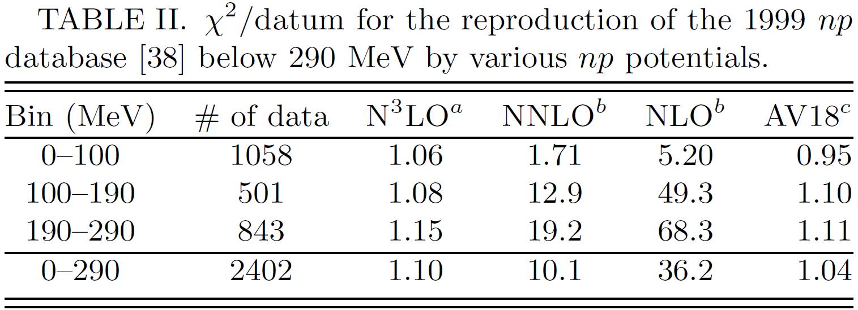
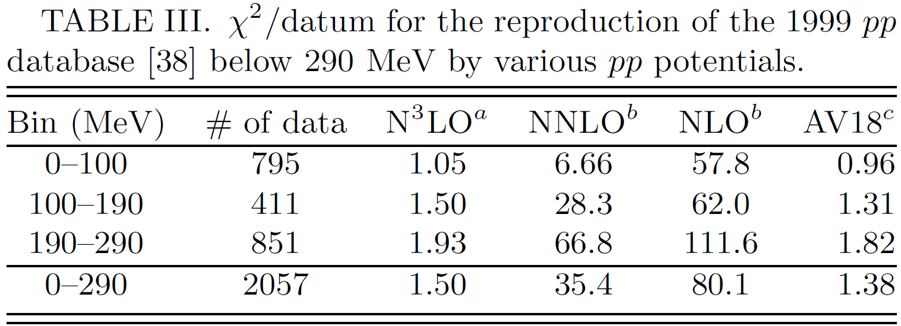
手征核力
非相对论手征核力
2NF
1990 2N LO
$LO$($Q^{0}$)
S. Weinberg
(since1990)
Ulf-G Meissner
Ubirajara
van Kolck
S. Weinberg, PLB1990, NPB1990
1994 3N LO
1997 2N $NLO$
$NLO$($Q^{2}$)
U. Van Kolck et al, PLB1992, PRL1994
3NF
N. Kaiser et al, NPA1997
2000 2N $N^{2}LO$
E. Epelbaum
R. Machleidt
$N^{2}LO$($Q^{3}$)
U. Van Kolck et al, PRC1994
U. Van Kolck et al, PRC1994
4NF
2003 2N $N^{3}LO$
E. Epelbaum et al, NPA1998,2000
$N^{3}LO$($Q^{4}$)
2007 3N $N^{3}LO$
R. Machleidt et al. PRC2003
S. Ishikwas et al. PRC2007
E. Epelbaum EPJA2007
E. Epelbaum et al. NPA2005
V. Bernard et al. PRC2007
2015 2N $N^{4}LO$
$N^{4}LO$($Q^{5}$)
D.R. Entem, R. Machleidt et al. PRC2003
R. Machleidt et al. PRC2015
H. Krebs et al, PRC2012,2013
5NF
E. Epelbaum et al. PRL2015
$N^{3}LO$:非相对论手征核力媲美高精度唯象模型
NOT COMPLETE
$N^{5}LO$($Q^{6}$)
R. Machleidt et al. PRC2015
NOT COMPLETE
Adopted from D.R. Entem et al Front.in Phys. 8 (2020) 57
高精度相对论手征核力
Jun-Xu Lu
Notes:
Here is the hierarchy of the non-relativistic chiral nuclear force up to sixth order of the chiral expansion according to the Weinberg’s power counting rule which is based on naïve dimensional analysis. In 1990, Weinberg first introduce the use of chiral EFT in two nucleon systems. He proposed to calculate the potential perturbatively according to the chiral order and then insert it into Lippmann-schweiger equation to take into account the non-perturbation nature. Although the leading order non-relativistic nuclear force barely describe the scattering data, the non-perturbation approach is inspiring and encouraging. Following the approach, with the unremitting efforts of a variety of scientists, non-relativistic chiral nuclear force has been improved order by order. In 2000, the first momentum space potential up to N2LO was derived, 2003 the N3LO and then in 2015, the N4LO. Meanwhile in 2007, the 3N force up to N3LO were finished. Besides The simple and transparent expressions obtained makes the chiral potentials even popular and has been successfully applied in the nuclear physics such as few body interaction, structure of nuclei and infinite matter.

Slide 12
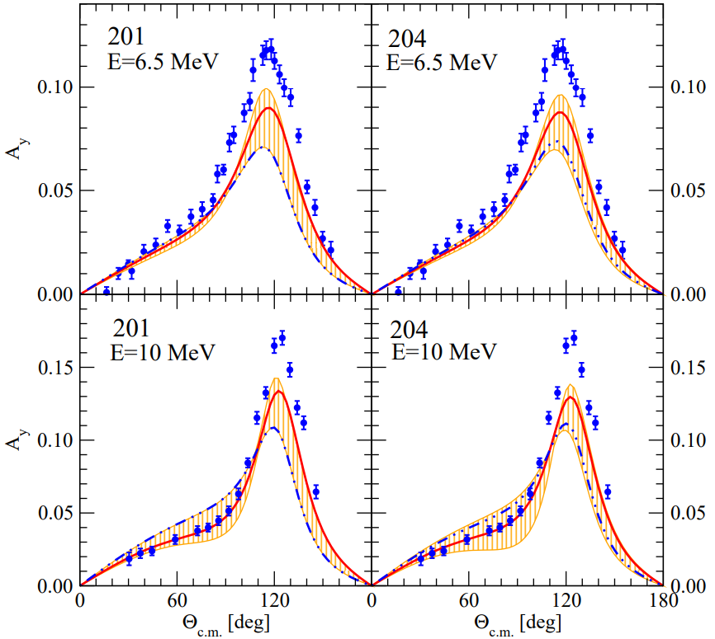
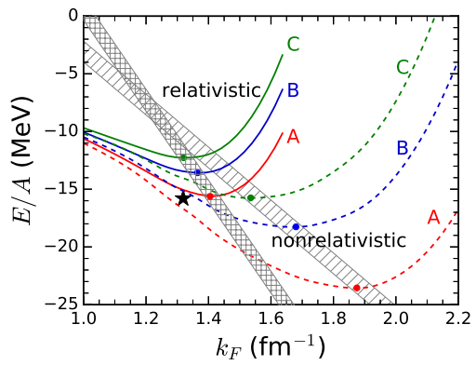
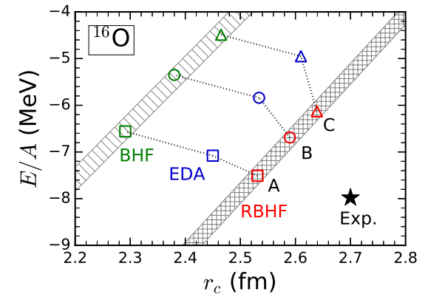
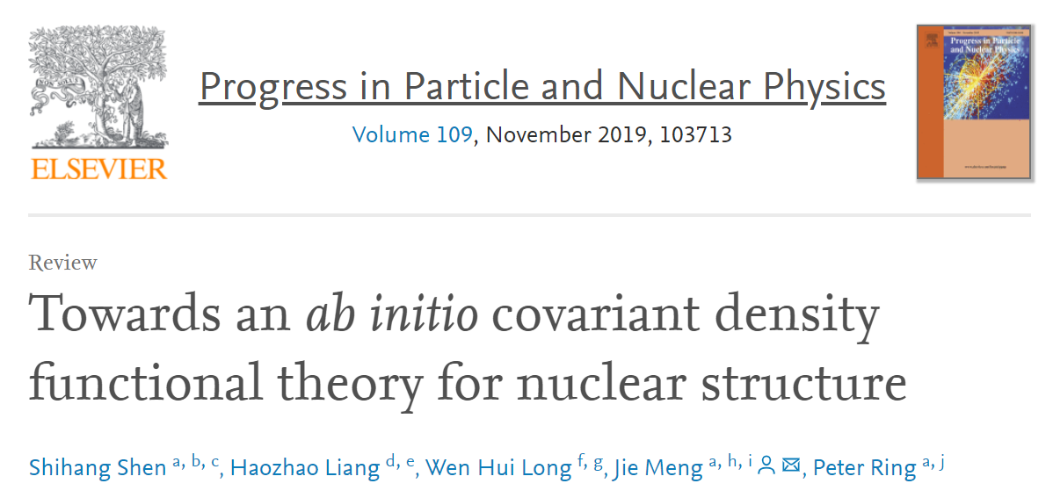
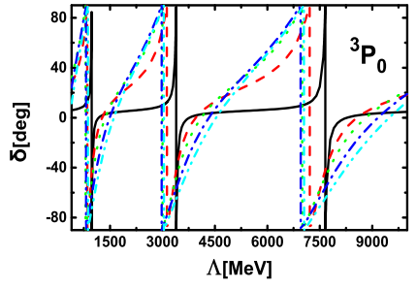
手征核力
非相对论手征核力存在的问题
$A_{y}$ puzzle in N-d scattering
L. Girlanda et al. PRC2019
J. Golak et al. EPJA50,177
N-d 散射中的 $A_{y}$ 疑难
重整化群不变性(RGI)
收敛性
无法应用于相对论核多体计算
Red: N3LO chiral NN potential
Blue: N3LO chiral NN + full 3N potential
renormalization group invariance(RGI)
对称核物质状态方程
每核子结合能
C.X. Wang et al. CPC45,054101
高精度相对论手征核力
Jun-Xu Lu
Notes:
However, there are still several points remain unsolved. For example the well-known Ay puzzle in the Nucleon-deuteron scattering and the renormalization group invariance with weiberg’s power counting rule, as are depicted in the right two figures. And the third point, which may be more important, that the non-relativistic chiral nuclear force cannot be applied in a covariant ab-initial nuclear method, while we are fully aware that the covariant framework show better behaviors in, for example, the equation of state for symmetric nuclear matter or energy for nucleon, which are shown in these two figures. For a review of this, this work is highly recommended.

Slide 13
手征核力
非相对论手征核力存在的问题
$A_{y}$ puzzle in N-d scattering
L. Girlanda et al. PRC2019
J. Golak et al. EPJA50,177
N-d 散射中的 $A_{y}$ 疑难
重整化群不变性(RGI)
无法应用于相对论核多体计算
收敛性
Red: N3LO chiral NN potential
Blue: N3LO chiral NN + full 3N potential
renormalization group invariance(RGI)
对称核物质状态方程
每核子结合能
C.X. Wang et al. CPC45,054101
但是目前相对论核多体计算的裸核力: Bonn potential——唯象
构建高精度的相对论手征核力势在必行!
高精度相对论手征核力
Jun-Xu Lu
Notes:
However, there are still several points remain unsolved. For example the well-known Ay puzzle in the Nucleon-deuteron scattering and the renormalization group invariance with weiberg’s power counting rule, as are depicted in the right two figures. And the third point, which may be more important, that the non-relativistic chiral nuclear force cannot be applied in a covariant ab-initial nuclear method, while we are fully aware that the covariant framework show better behaviors in, for example, the equation of state for symmetric nuclear matter or energy for nucleon, which are shown in these two figures. For a review of this, this work is highly recommended.

Slide 14
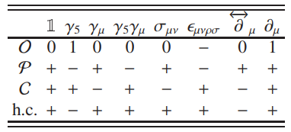
相对论框架
相对论手征核力
动力学&运动学
Dirac 旋量以及 Clifford 代数
Xiao et al PRC99,024004
$u\left(p,s\right)=N_{p}\left(\begin{matrix}1 \\ \frac{σ∙p}{E+m}\end{matrix}\right)χ_{s}$, $N_{p}=\sqrt{\frac{E+m}{2m}}$
PCB项: Extended-on-mass-shell(EOMS) 方法
Gegelia, Fuchs et al. in PRD60(1999), PRD68 (2003)
$$C_{i}=C_{i}^{b}+C_{i}^{d}R+C_{i}^{PCB}$$
$C_{i}$: 物理值
$C_{i}^{b}$: 裸值
$C_{i}^{d}$: 紫外发散
$C_{i}^{PCB}$: PCB项
Blankenbecler-Sugar 方程(BbS 方程)
$$g=\frac{πiδ(k^{0})Λ_{+}^{1}(k)Λ_{+}^{2}(−k)}{2E_{k}(E_{k}^{2}−s/4−iε)}$$
三维约化的传播子
高精度相对论手征核力
Jun-Xu Lu
Notes:
In order to construct a relativistic nuclear force, one needs to handle this issue both dynamically and kinematically. First the heavy static limit is no more appropriate and one should keep the momentum piece of nucleon spinor and the full Clifford algebra in the lagrangians. The power counting ought to be restore with a covariant scheme. We use EOMS scheme in our work. And finally we ought to use the reduced relativistic scattering equation instead of a schrodinger-like equation, such as the BbS equation as is shown here or the kadyshveski equation or Thompson quation which is widely applied when takin into account the medium effect.

Slide 15
相对论框架
相对论手征核力
2018:
Leading order relativistic chiral nucleon-nucleon interaction
2NF
X.L Ren et al CPC42,014103
$LO$($Q^{0}$)
2019:
Covariant chiral nucleon-nucleon contact Lagrangian up to order $𝓞(q^{4})$
X.L Ren, CPC2018
Y. Xiao et al Phys.Rev.C 99,024004
$NLO$($Q^{2}$)
2020:
Pion-mass dependence of the nucleon- nucleon interaction
Y. Xiao, PRC2020
C.X. Wang, 2110.05278
3NF
J.X. Lu, 2111.07766
Q.Q. Bai et al Phys.Lett.B135745
Two-pion exchange contributions to the nucleon-nucleon interaction in covariant baryon ChPT
$N^{2}LO$($Q^{3}$)
相对论手征核力
Y. Xiao, PRC2020
C.X. Wang, 2110.05278
J.X. Lu, 2111.07766
Y. Xiao et al Phys.Rev.C 102,054001
2021:
Non-perturbative two-pion exchange contributions to the nucleon-nucleon interaction in covariant baryon ChPT
$N^{3}LO$($Q^{4}$)
C.X. Wang et al Phys.rev.C 105,014003
An accurate relativistic chiral nucleon-nucleon interaction up to NNLO
$N^{4}LO$($Q^{5}$)
J.X Lu et al Phys.rev.lett. 128,142002
高精度相对论手征核力
Jun-Xu Lu
Notes:
Quite similar to the calculation for the non-relativistic chiral nuclear force, the relativistic nuclear force is also constructed according to the power counting rule. And here is the hierarchy for this. Clearly for now the relativistic nuclear force are not as well-developed as the non-relativistic ones. It is quite recent in 2018 that we complete the LO relativistic nuclear force. Next year in 2019 we construct the covariant lagrangian up N3LO. From 2020 we started to extend the study to higher orders and calculate the two pion exchange contributions either perturbatively or non-perturbatively. And finally we obtain an accurate relativistic nuclear force up to NNLO. Meanwhile the 3NF is not involved yet. So though we have moved a critical step forward, there are of course plenty of work to do.

Slide 16
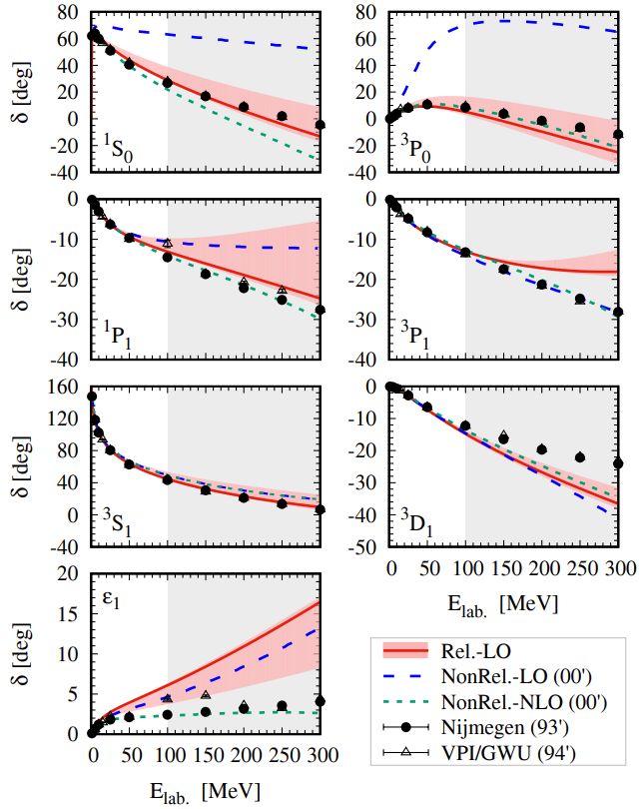
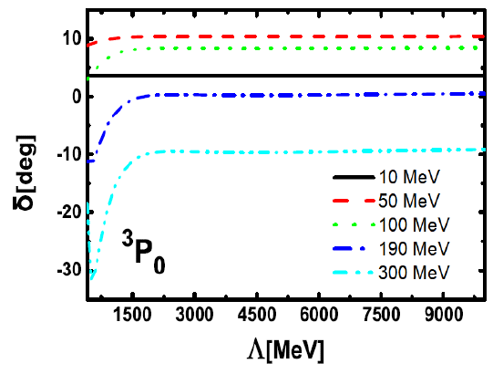
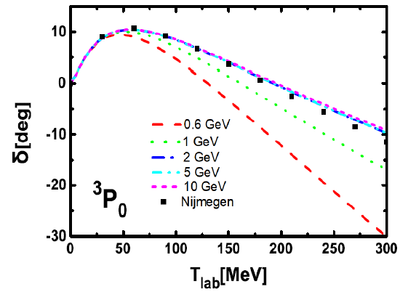
相对论框架
领头阶(LO)相对论手征核力
接触项(4)+单pion交换(OPE)
Ren et al. CPC42,014103
n-p 散射相移
RGI 分析
Wang et al. CPC45,054101
对于J=0,1 分波，与非相对论NLO相当
${}_{}^{3}{S_{1}}$, ${}_{}^{3}{D_{1}}$, ${}_{}^{1}{P_{1}}$, ${}_{}^{3}{P_{0}}$
手征延拓 VS lattice QCD
${}_{}^{3}{S_{1}},$ ${}_{}^{3}{D_{1}}$, ${}_{}^{1}{S_{0}}$
Bai et al. PLB135745
HAL QCD NPA881,28
可行，而且效果很好
高精度相对论手征核力
Jun-Xu Lu
Notes:
Here are the results obtained with the LO relativistic chiral nuclear force. Up to LO, only 4 contact terms and onePE contribute. The figure below show the phase shifts for n-p scattering obtained with different nuclear force with total angular momentum J=<1. The red solid lines are the relativistic LO results, and the blue dashed lines and green short dashed lines are non-relativistic LO and NLO results. The black dots denotes the Nijmegen’s results. Clearly the relativistic LO results are compatible with the NLO non-relativistic results. Besides, we perform a renormalization analysis based on the our LO nuclear force and found that in 3P0 the renormalization group invariance is automatically satisfies while it is not in nonrelativsitic results of Weinberg’s power counting. We also studies the pion-mass dependence to compare to the lattice QCD simuations. They are consistent in 3S1,3D1 and 1S0 partial waves. All the studies above proves the feasibility of our covariant approach.

Slide 17
相对论框架
领头阶(LO)相对论手征核力
接触项(4)+单pion交换(OPE)
Ren et al. CPC42,014103
n-p 散射相移
RGI 分析
Wang et al. CPC45,054101
对 J=2 效果不佳
${}_{}^{3}{P_{1}}$
手征延拓 VS lattice QCD
$ε_{1}$
Bai et al. PLB135745
HAL QCD NPA881,28
Not fully self-consistent
需要更高阶核力!
高精度相对论手征核力
Jun-Xu Lu
Notes:
However, only the leading order seems not enough. For J=2 partial waves, the LO relativistic results are very similar to the LO non-relativistic results and both of them differs from the Nijmegen data sizablely. For the RGI, we find at LO, the RGI are not satisfied in 3P1 partial waves. And for the pion mass dependence, we find the description for mixing angle epsilon1 for unphysical pion masses are not good and besides, the study is not fully self-consistent if we stop at LO. Therefore higher order calculation are strongly needed.

Slide 18
相对论框架
NNLO 相对论手征核力: contact terms
Xiao et al. Phys.Rev.C 99,024004
相对论NLO拉氏量(4+13)
非相对论 $N^{3}LO$ 拉氏量(2+7+15)
低能常数个数：
NR-NNLO < R-NNLO < NR-$N^{3}LO$
高精度相对论手征核力
Jun-Xu Lu
Notes:
Up to NLO or NNLO, we needs the NLO contact terms and the two pion exchange contributions. Below we exhibited the covraint effective lagrangians needed. Up to NLO, we have in total 17 terms, 4 at LO and 13 at NLO. Compared to 9 in non-relativistic NLO and 24 of N3LO.

Slide 19
相对论框架
NNLO 相对论手征核力: two-pion exchange(TPE)
非相对论 NLO TPE
相对论 NLO TPE
$$𝒜=$$
Bilinear
$$×$$
Loop integral
核子双线性结构Bilinear(114 terms for planar box diagram)
more...
圈图积分—— 标量及张量积分(29 terms for planar box diagram)
$$A_{0},B_{0},B_{00},C_{0},C_{1},C_{2},C_{00},C_{11},C_{12},C_{22},D_{0},D_{1},D_{2},D_{00},D_{11},D_{12},D_{22},D_{23}$$
高精度相对论手征核力
Jun-Xu Lu
Notes:
接下来来看TPE的贡献。也就是这就个Feynman图的贡献。不得不说，相对论框架下的TPE要比非相对论框架下的复杂很多。在非相对论框架下，NLO的TPE可以用这样一个简单的形式表示出来。
不得不说，相对论手征核力的复杂形式，是的他的进一步应用来说不是特别友好。

Slide 20
相对论框架
不确定度分析
贝叶斯(Bayesian)截断误差
对可观测量 X 的有效场论展开
R.J.Furnstahl et al. PRC2015, PRC2019
E. Epelbaum et al. PRL2015,EPJA2019
P. Maris et al. PRC2021
k 阶截断误差
贝叶斯模型：将展开系数 $c_{i}$ 写成某种先验分布 $pr(c_{i}|\overline{c})$
置信度
贝叶斯模型的优势
基于严格的统计学推导
可以估计至任意阶的截断误差，而非局限于已知的有限阶
高精度相对论手征核力
Jun-Xu Lu
Notes:
最后，让我们来看一下不确定度分析。之前提到，有效场论的一大优势在于可以估计理论误差。

Slide 21
拟合结果
NLO/NNLO 相对论手征核力的结果
相对论 NNLO 可以与 非相对论$N^{3}LO$ 结果媲美
NR-$N^{3}$LO-Idaho: R. Machleidt and D. R. Entem, Phys.Rev.C(2003), Phys.Rept.(2011)
NR-$N^{3}$LO-EKM: E. Epelbaum, H. Krebs, and U. G. Meißner, Eur.Phys.J.A(2015), Phys.Rev.Lett. (2015).
J=0 分波相移
低于200MeV时， NNLO, NR-$N^{3}$LO-Idaho, NR-$N^{3}$LO-EKM 几乎重合
低于200MeV时， NLO 与 NNLO 相当
在 ${}_{}^{1}{S_{0}}$， NR-$N^{3}$LO-EKM对 [100,200]MeV区间的相移描述略差
Maybe because of the p-p data
高精度相对论手征核力
Jun-Xu Lu
Notes:
Now let me show the results of NLO and NNLO relativist NF. The table here exhibit the chi_square of different chiral forces for partial waves up to J=2. The NLO and NNLO refer to our relativistic results and for comparison we also list the results from the N3LO non-relativistic nuclear force from Idaho group and Bochum group. From the total chi_squre, we can say that our relativistic NNLO results is compatible to the non-relativistic N3LO results. It is also interesting that for different chiral forces, the main sources of chi are quite different. In our relativistic NNLO results, the 3D2 may be the worst while in the EKM results, 1S0 the worst. The two figures below show the phase shifts for the two J=0 partial waves. Here and afterwards, the black dots denotes the nijmegen93 data. The black dotted lines, blue dashed lines, and red solid lines denote our results at LO,NLO and NNLO respectively. The two non-relativistic N3LO results are depicted with green dash-dotted lines and magenta short dotted lines. The bands are the truncation uncertainties for NLO and NNLO results estimated with the Bayesian model. We find that NLO results is compatible with NNLO results below 200MeV which implies a good convergence pattern. In 1S0 The EKM results miss the data between 100 and 200 eMeV maybe because of the p-p data. In 3P0 the NLO data is a little bit worse for higher energy region.

Slide 22
拟合结果
J=1 分波相移
低于200MeV时， NLO 与 NNLO 相当
低于200MeV时， NNLO, NR-$N^{3}$LO-Idaho, NR-$N^{3}$LO-EKM 几乎重合
高精度相对论手征核力
Jun-Xu Lu
Notes:
Here are the phase shifts for J=1 partial waves. Again the NLO results is consistent with NNLO results which indicate the convergence of chiral expansion. Actually the our NNLO results and the two non-relativistic N3LO results almost overlap below 200MeV.

Slide 23
拟合结果
J=2 分波相移
在${}_{}^{1}{D_{2}}$, ${}_{}^{3}{P_{2}}$: NLO 高动量区略差
低于200MeV时， NNLO, NR-$N^{3}$LO-Idaho, NR-$N^{3}$LO-EKM 几乎重合
在${}_{}^{3}{F_{2}}$ : NR-$N^{3}$LO-Idaho 最好，但是调整了 $c_{2,3,4}$
高精度相对论手征核力
Jun-Xu Lu
Notes:
For J=2 partial waves, we find the NLO is slightly worse for higher kinetic energies in 1D2, and 3P2 partial waves but for NNLO, it overlaps with the two non-relativistic results except in 3F2 partial waves. In this partial wave, none of the chiral force could fully reproduce the Nijmegen’s data. Idaho’s results behave the best but with 3 fine-tuned pion-nucleon LECs.

Slide 24
拟合结果
对 $J≤4$ & $L≤4$ 分波相移的理论预言
至NNLO没有接触项
高角动量分波：相对论 NNLO 优于非相对论 $N^{3}LO$
NNLO 在${}_{}^{3}{D_{3}}$, ${}_{}^{1}{F_{3}}$ 明显较好但是在${}_{}^{3}{F_{4}}$略差，预言结果高于Nijmegen数据
在${}_{}^{1}{G_{4}}$, ${}_{}^{3}{G_{4}}$, $ε_{3}$: NR-$N^{3}$LO-Idaho 在高能区偏离 Nijmegen 数据
高精度相对论手征核力
Jun-Xu Lu
Notes:
In this slide we further compare the phase shifts of different chiral forces for partial waves with J<=4 L<=4. Note in these partials no contact terms contribute up to NNLO. Thus the phase shifts here are prediction once the cutoff is fixed. In the table we exhibited the chi of different chiral forces. From the total chi, It is obviously our relativistic NNLO nuclear force is better. Among the partial waves, NNLO result is obviously better in 3D3, 1F3 but worse in 3F4. besides Idaho results tend to yield smaller values at higher energies in 1G4,3G4 and mixing angle e3. So In general for the higher partial waves, the relativistic NNLO behaves better.

Slide 25
拟合结果
相对论手征核力 vs Bonn potential
R. Machleidt et al, Phys.Rept.1987
S-H. Shen et al, Prog.Part.Nucl.Phys.2019
1980年代发展的 Bonn 势仍然是目前相对论核多体计算中应用最为广泛的核力
相对论NNLO明显优于Bonn势
高精度相对论手征核力
Jun-Xu Lu
Notes:
Finally we compare our NNLO relativistic chiral potential with the Bonn potential, which is applied in the present relativistic many-body studies. It is obvious that our NNLO potential leads to better descriptions in 1S0,3P0,ep1,3D3 partial waves but slightly worse in 3F2 and 3F4 partial waves. As for even higher partial waves, our NNLO results are in better agreement with the Nijmegen data. As a conclusion ,we can say that the relativistic NNLO potential are better compared to the bonn potential.

Slide 26
总结与展望
我们将相对论手征核力构建至NNLO
对于$J≤2$的分波相移，与非相对论 $N^{3}$LO 结果相媲美
相对论性
更少的低能常数
更低的手征阶数
对于高角动量分波相移的描述更好
比Bonn势对相移的描述更好
我们已经初步构建完成高精度相对论手征核力，并准备将其应用于核物质与核反应研究中
接下来的工作
三体核力与Ay 疑难
次次领头阶的RGI 分析
SU(3)味空间…
高精度相对论手征核力
Jun-Xu Lu

Slide 27
High-precision relativistic nucleon force up to NNLO
Thanks for your attention
高精度相对论手征核力
Jun-Xu Lu

Slide 28
相对论框架
NLO/NNLO 相对论手征核力: contact terms
Xiao et al. Phys.Rev.C 99,024004
相对论NLO拉氏量(4+13)
非相对论 $N^{3}LO$ 拉氏量(2+7+15)
低能常数个数：
NR-NNLO < R-NNLO < NR-$N^{3}LO$
高精度相对论手征核力
Jun-Xu Lu
Notes:
Up to NLO or NNLO, we needs the NLO contact terms and the two pion exchange contributions. Below we exhibited the covraint effective lagrangians needed. Up to NLO, we have in total 17 terms, 4 at LO and 13 at NLO. Compared to 9 in non-relativistic NLO and 24 of N3LO.

Slide 29
相对论框架
NLO/NNLO 相对论手征核力: two-pion exchange(TPE)
非相对论 NLO TPE
相对论 NLO TPE
$$𝒜=$$
Bilinear
$$×$$
Loop integral
核子双线性结构Bilinear(114 terms for planar box diagram)
more...
圈图积分—— 标量及张量积分(29 terms for planar box diagram)
$$A_{0},B_{0},B_{00},C_{0},C_{1},C_{2},C_{00},C_{11},C_{12},C_{22},D_{0},D_{1},D_{2},D_{00},D_{11},D_{12},D_{22},D_{23}$$
数值问题以及运算精度
高精度相对论手征核力
Jun-Xu Lu
Notes:
And here is the TPE contributions. I have to say that The expressions for the TPE in relativistic framework is much more complicated compared to the Non-relativistic ones, as is shown here. Take the planar box diagram as an example. The relativistic formula could be roughly divided into two parts. First is the Bilinear, which contain over 100 different combinations. The second part is the loop integral, which possess 29 different terms including scalar and tensor ones. Besides we are also faced with numerical singularities and the problems of operation accuracy when treating the off-shell elements.

Slide 30
Covariant framework
Blankenbecler-Sugar equation(BbS quation)
Solution: difficult
3D reduction
$$g=\frac{πiδ(k^{0})Λ_{+}^{1}(k)Λ_{+}^{2}(−k)}{2E_{k}(E_{k}^{2}−s/4−iε)}$$
3D propagator
Ultraviolet divergence: Regulator
Iterated OPE
Planar box diagram and once-iterated OPE: double counting
High-precision relativistic nucleon force up to NNLO
Jun-Xu Lu

Slide 31
Fitting results
High-precision relativistic nucleon force up to NNLO
Jun-Xu Lu

Slide 32
Covariant framework
fitting
n-p phase shifts for partial waves with $J≤2$ and $T_{lab}∈${1,5,10,25,50,100,150,200} MeV
Function to be minimized:
PWA93: V. G. J. Stoks et al, PRC1993
Fixed input: LECs $c_{1,2,3,4}$ from $𝓛_{MB}^{(2)}$
Covariant NNLO $πN$ scattering
Y.-H. Chen et al. PRD2013
NNLO
Parameters and regulators
CO-NNLO | 19 | 4(LO) + 13(NLO) + 2(promoted) | Sharp cutoff
NR-$N^{3}$LO-Idaho | 29 | 2(LO) + 7(NLO) + 15($N^{3}$LO) + 2(Charge) + 3($c_{2,3,4}$ semi-free) | $e^{−p^{n_{1}}}$(S), $e^{−p^{n_{2}}}$(L)
NR-$N^{3}$LO-EKM | 26 | 2(LO) + 7(NLO) + 15($N^{3}$LO) + 2(Charge) | $e^{−p^{n_{1}}}$(S), ${\text{(}1−e^{−r^{2}}\text{)}}^{n_{2}}$(L)
NR-$N^{3}$LO-Idaho: R. Machleidt and D. R. Entem, Phys.Rev.C(2003), Phys.Rept.(2011)
NR-$N^{3}$LO-EKM: E. Epelbaum, H. Krebs, and U. G. Meißner, Eur.Phys.J.A(2015), Phys.Rev.Lett. (2015).
Bayesian truncation uncertainties instead of residue cutoff dependence
The expansion for an observable of chiral EFT
E. Epelbaum et al. PRL2015,EPJA2019
P. Maris et al. PRC2021
Bayesian model: encode the expectation of the chiral expansion coefficients in a “prior pdf”
DoB
High-precision relativistic nucleon force up to NNLO
Jun-Xu Lu

Slide 33
Covariant framework
Observables
High-precision relativistic nucleon force up to NNLO
Jun-Xu Lu

Slide 34
Covariant framework
Observables
High-precision relativistic nucleon force up to NNLO
Jun-Xu Lu

Slide 35
Covariant framework
High-precision relativistic nucleon force up to NNLO
Jun-Xu Lu

