Slide 1

对称性与中微子振荡
周顺
（高能所&国科大）
周顺
（中科院高能所）
首届西藏高能物理论坛，西藏大学，
拉萨，2021-07-15

Slide 2
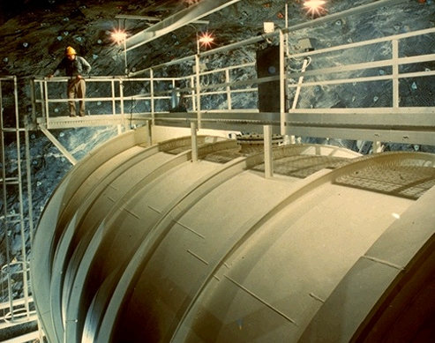
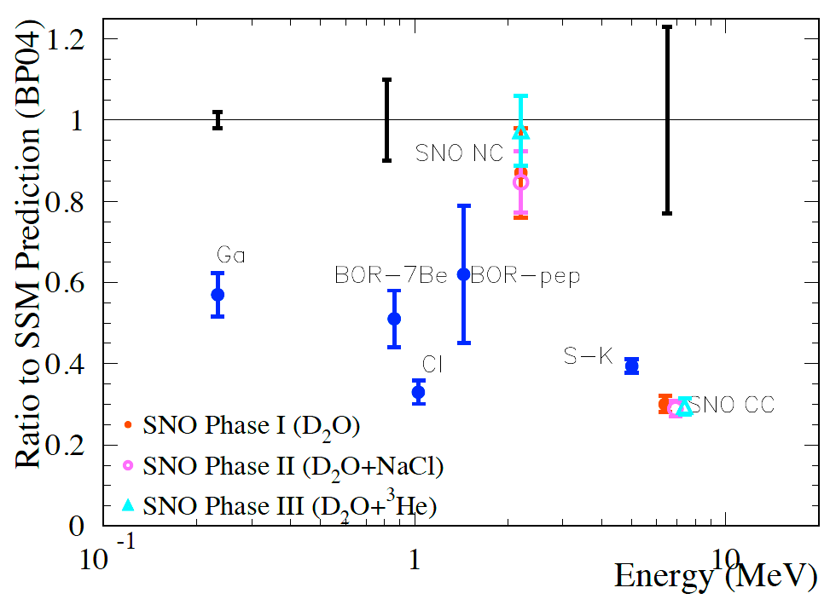
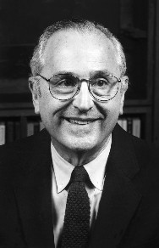
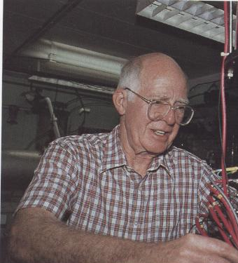
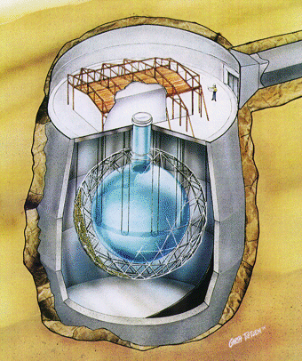


Solar Neutrino Oscillations
all ν_{x}
Homestake
ν_{e}only
J. N. Bahcall
R. Davis Jr.
Discovery of solar
neutrino oscillations
supported by
KamLAND
Phys. Rev. Lett. 55 (1985) 1534
Herbert H. Chen
陈华森
（1942-1987）
A. B. McDonald
SNO

Slide 3
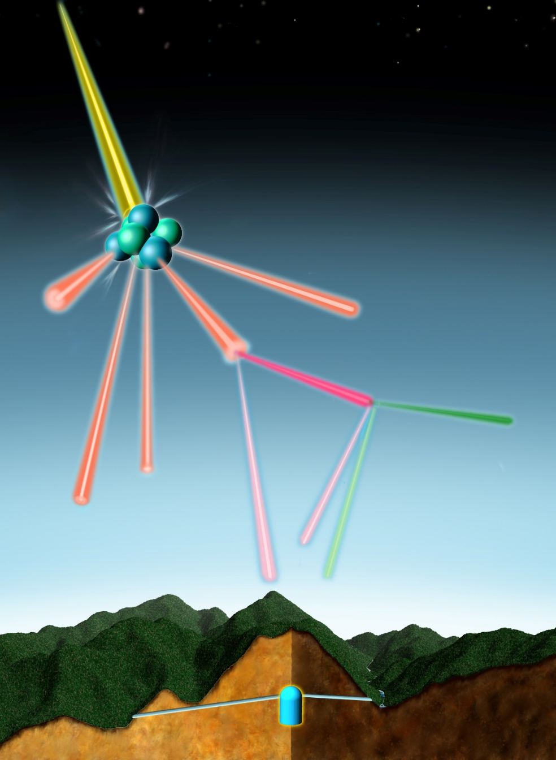
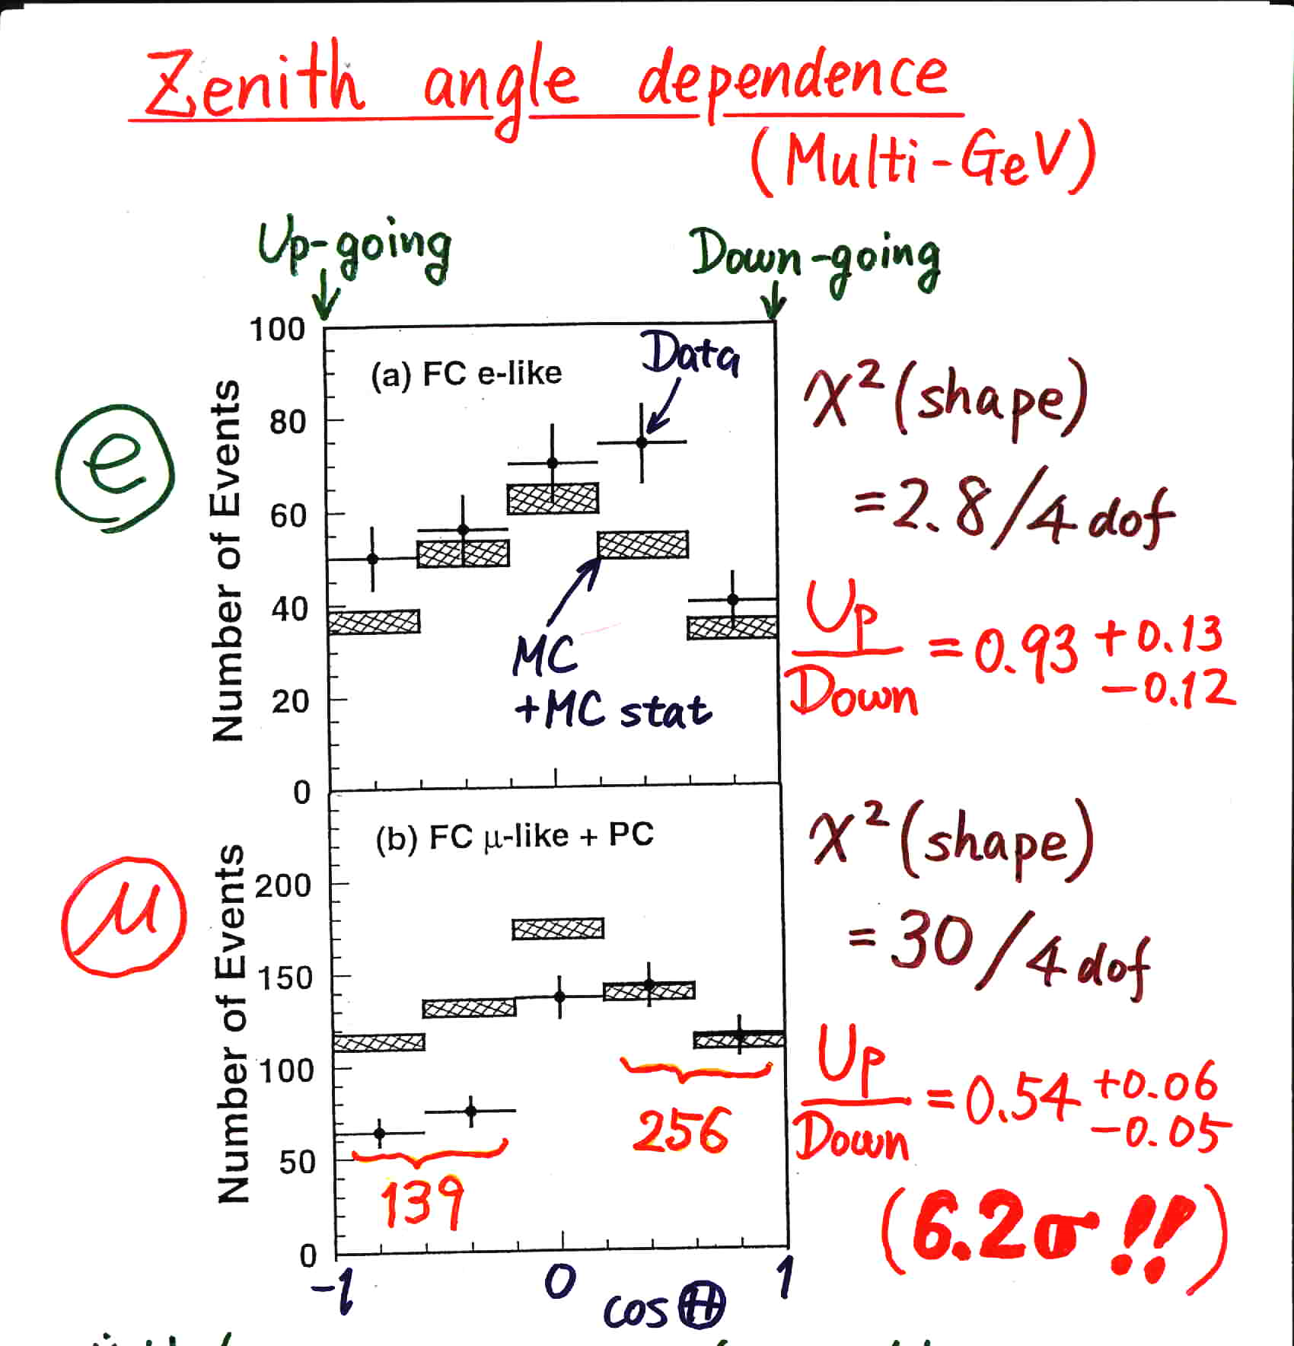
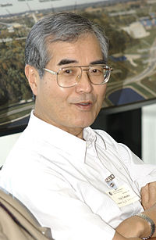
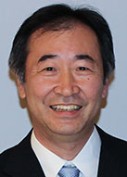
Atmospheric Neutrino Oscillations
Super-Kamiokande @ Neutrino 98
COSMIC RAY
AIR NUCLEUS
PION
MUON
ELECTRON
2 muon-neutrinos
1 electron-neutrino
Discovery of atmospheric
neutrino oscillations
supported by
K2K, MINOS, T2K, NOνA
From Kajita, ICHEP 16
Yoji Totsuka
(1942-2008)
T. Kajita

Slide 4
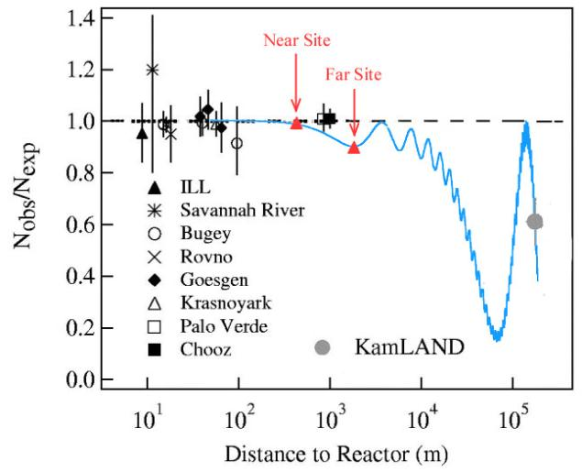
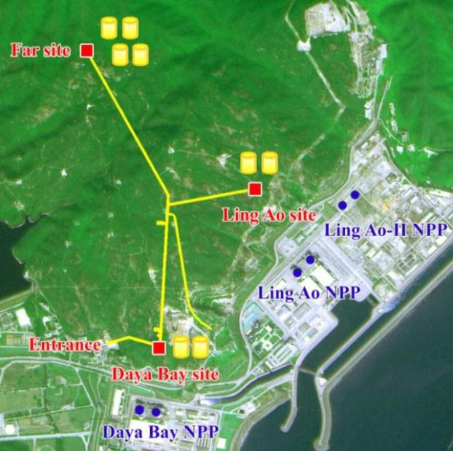
Reactor Neutrino Oscillations
Daya Bay
Double Chooz (far detector):
sin² θ₁₃ = 0.022 ± 0.013
Daya Bay (near + far detectors):
sin² θ₁₃ = 0.024 ± 0.004
RENO (near + far detectors):
sin² θ₁₃ = 0.029 ± 0.006
Dec. 2011
1.7σ
Mar. 2012
5.2σ
Discovery of reactor
neutrino oscillations
Apr. 2012
4.9σ
A complete picture of three-flavor neutrino oscillations!

Slide 5
Current Status of Neutrino Oscillations
Basic neutrino parameters
Esteban et al., 2007.14792, NuFIT 5.0 (2020)
Future neutrino oscillation experiments will measure the octant of θ₂₃, the CP-violating phase δ, and the neutrino mass ordering
The most restrictive bound on absolute neutrino masses is coming from cosmological observations: m₁ + m₂ + m₃ < 0.12 eV (Planck)

Slide 6

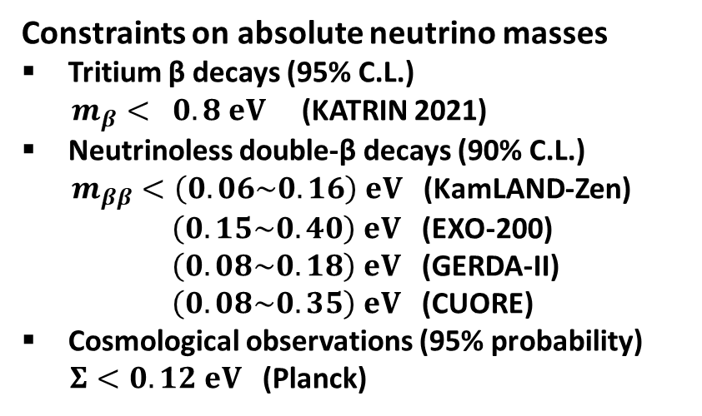


Current Status of Absolute Neutrino Masses
m₁ < m₂ < m₃ (NO) or m₃ < m₁ < m₂ (IO)
$m_{β}={\left(Σ_{i}{\left|U_{ei}\right|}^{2}m_{i}^{2}\right)}^{1/2}$ [eV]
Constraints on absolute neutrino masses
Tritium β decays (95% C.L.)
$m_{β}< 0.8 eV$ (KATRIN 2021)
Neutrinoless double-β decays (90% C.L.)
$m_{ββ}<\left(0.06\sim 0.16\right) eV$ (KamLAND-Zen)
$\left(0.15\sim 0.40\right) eV$ (EXO-200)
$\left(0.08\sim 0.18\right) eV$ (GERDA-II)
$\left(0.08\sim 0.35\right) eV$ (CUORE)
Cosmological observations (95% probability)
$Σ<0.12 eV$ (Planck)
Tritium β decays (KATRIN)
IO
Cosmological Bound
NO
Capozzi et al., 2003.08511
$m_{ββ}=\left|{Σ_{i}U}_{ei}^{2}m_{i}\right|$[eV]
Abazajian et al., 1907.04473
Neutrinoless double-β decays
IO
Cosmological Bound
NO
$Σ=m_{1}+m_{2}+m_{3}$ [eV]

Slide 7
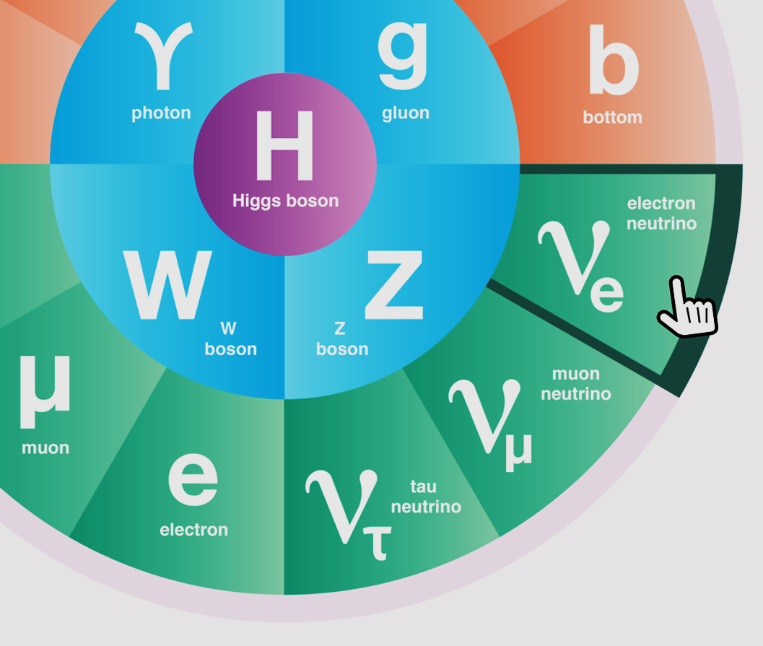
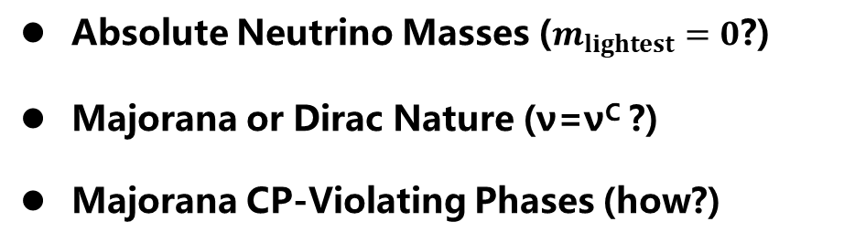
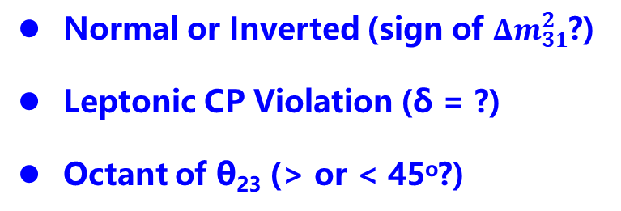
Open Questions in Neutrino Physics
Normal or Inverted (sign of ${Δm}_{31}^{2}$?)
Leptonic CP Violation (δ = ?)
Octant of θ₂₃ (> or < 45º?)
Absolute Neutrino Masses ($m_{lightest}=0$?)
Majorana or Dirac Nature (ν=ν^{C} ?)
Majorana CP-Violating Phases (how?)
Extra Neutrino Species
Exotic Neutrino Interactions
Various LNV & LFV Processes
Leptonic Unitarity Violation
Origin of Neutrino Masses
Flavor Structure (Symmetry?)
Quark-Lepton Connection
Relations to DM, BAU, or NP

Slide 8
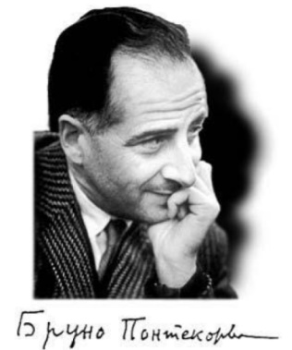
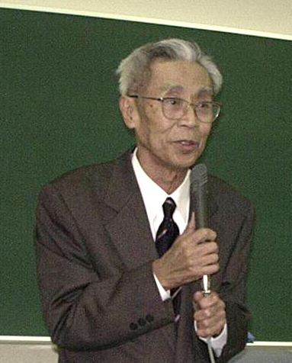
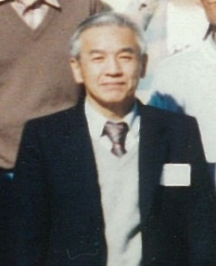
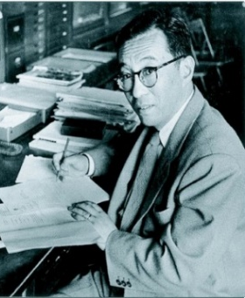


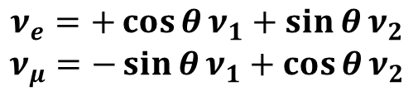

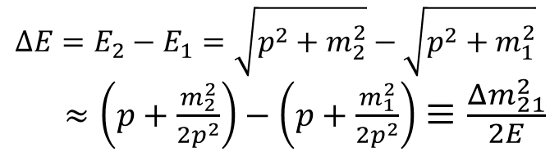
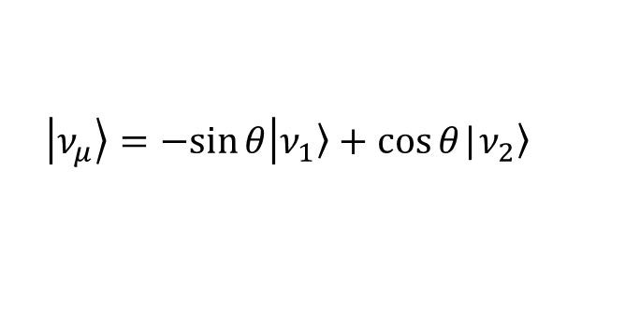

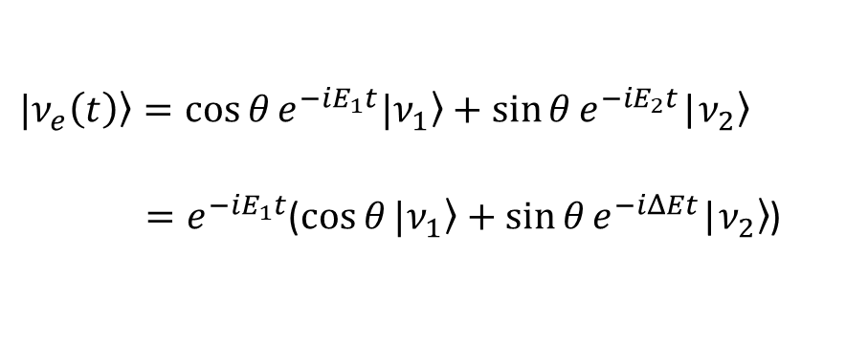
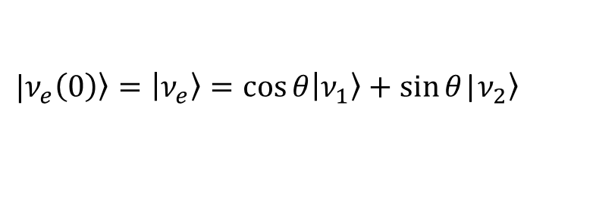
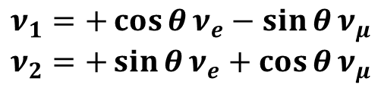


Oscillations in Vacuum：two flavors
7
$$ν_{e}$$
$$ν_{μ}$$
$$ν_{1}$$
P
M
N
S
$$ν_{2}$$
$$ν_{e}=+\cos{θ}ν_{1}+\sin{θ}ν_{2}$$
$$ν_{μ}=−\sin{θ}ν_{1}+\cos{θ}ν_{2}$$
$$ν_{1}=+\cos{θ}ν_{e}−\sin{θ}ν_{μ}$$
$$ν_{2}=+\sin{θ}ν_{e}+\cos{θ}ν_{μ}$$
The oscillation probability in the plane-wave approximation: simple & useful
$|\left.ν_{e}\left(0\right)\right\rangle =\left|\left.ν_{e}\right\rangle =\cos{θ}\right|\left.ν_{1}\right\rangle +\sin{θ}$|$\left.ν_{2}\right\rangle$
$$ΔE=E_{2}−E_{1}=\sqrt{p^{2}+m_{2}^{2}}−\sqrt{p^{2}+m_{1}^{2}}$$
$≈\left(p+\frac{m_{2}^{2}}{2p^{2}}\right)−\left(p+\frac{m_{1}^{2}}{2p^{2}}\right)≡\frac{Δm_{21}^{2}}{2E}$
$|\left.ν_{e}\left(t\right)\right\rangle =\cos{θ}e^{−iE_{1}t}|\left.ν_{1}\right\rangle +\sin{θ}e^{−iE_{2}t}$|$\left.ν_{2}\right\rangle$
$=e^{−iE_{1}t}$($\cos{θ}|\left.ν_{1}\right\rangle +\sin{θ}e^{−iΔEt}\text{|}\left.ν_{2}\right\rangle$)
$$Δm_{21}^{2}≡m_{2}^{2}−m_{1}^{2}$$
$$E≃p≫m_{1},m_{2}$$
The transitional amplitude
$$A=\left\langle ν_{μ} | ν_{e}(t)\right\rangle =e^{−iE_{1}t}\sin{θ}\cos{θ}\left(e^{−iΔEt}−1\right)$$
$\left|\left.ν_{μ}\right\rangle =−sin{θ}\right|\left.ν_{1}\right\rangle +\cos{θ}$|$\left.ν_{2}\right\rangle$

Slide 9

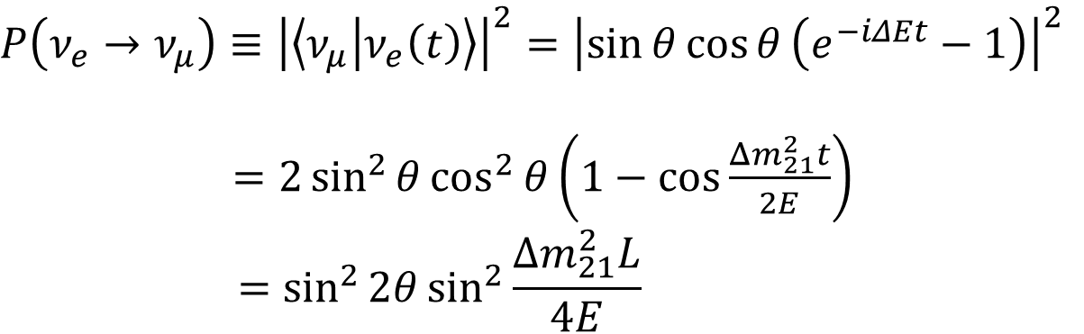







Oscillations in Vacuum：two flavors
8
The oscillation probability for the appearance channel
$$P\left(ν_{e}→ν_{μ}\right)≡{\left|\left\langle ν_{μ} | ν_{e}\left(t\right)\right\rangle \right|}^{2}={\left|\sin{θ}\cos{θ}\left(e^{−iΔEt}−1\right)\right|}^{2}$$
$=2\sin^{2}{θ\cos^{2}{θ\left(1−\cos{\frac{Δm_{21}^{2}t}{2E}}\right)}}$
$$=\sin^{2}{2θ}\sin^{2}{\frac{Δm_{21}^{2}L}{4E}}$$
P
$L≈t$ for neutrinos in
the relativistic limit
The oscillation probability：
Probability ν_{e} → ν_{μ}
$$θ→θ−\frac{π}{2}$$
$$m_{1}⟷m_{2}$$
sin²(2θ)
$$cosθ→+sinθ$$
$$cos2θ→−cos2θ$$
$$sinθ→−cosθ$$
$$sin2θ→−sin2θ$$
z
$$Δm_{21}^{2}→−Δm_{21}^{2}$$
Oscillation Length
Oscillation probability: Invariant

Slide 10

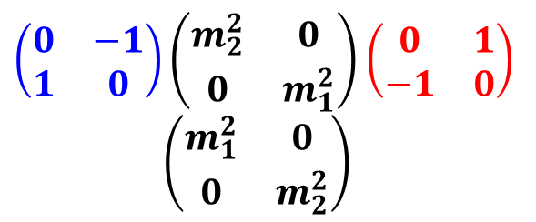


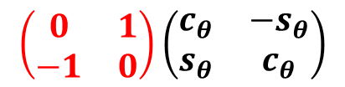


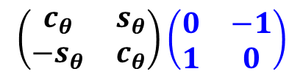

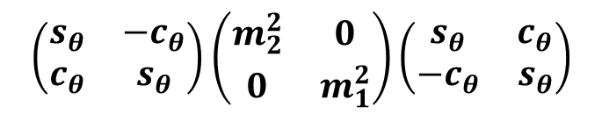

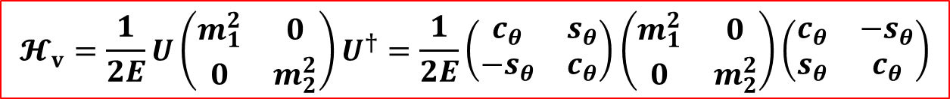
Oscillations in Vacuum：two flavors
9
The Hamiltonian for two-flavor neutrino oscillations in vacuum:
$$𝓗_{v}=\frac{1}{2E}U\left(\begin{matrix}m_{1}^{2} & 0 \\ 0 & m_{2}^{2}\end{matrix}\right)U^{†}=\frac{1}{2E}\left(\begin{matrix}c_{θ} & s_{θ} \\ −s_{θ} & c_{θ}\end{matrix}\right)\left(\begin{matrix}m_{1}^{2} & 0 \\ 0 & m_{2}^{2}\end{matrix}\right)\left(\begin{matrix}c_{θ} & −s_{θ} \\ s_{θ} & c_{θ}\end{matrix}\right)$$
$$θ→θ−\frac{π}{2}$$
$$m_{1}⟷m_{2}$$
$$\left(\begin{matrix}s_{θ} & {−c}_{θ} \\ c_{θ} & s_{θ}\end{matrix}\right)\left(\begin{matrix}m_{2}^{2} & 0 \\ 0 & m_{1}^{2}\end{matrix}\right)\left(\begin{matrix}s_{θ} & c_{θ} \\ {−c}_{θ} & s_{θ}\end{matrix}\right)$$
$$cosθ→+sinθ$$
$$cos2θ→−cos2θ$$
$$sinθ→−cosθ$$
$$sin2θ→−sin2θ$$
$$Δm_{21}^{2}→−Δm_{21}^{2}$$
$$\left(\begin{matrix}c_{θ} & s_{θ} \\ −s_{θ} & c_{θ}\end{matrix}\right)\left(\begin{matrix}0 & −1 \\ 1 & 0\end{matrix}\right)$$
$$\left(\begin{matrix}0 & 1 \\ −1 & 0\end{matrix}\right)\left(\begin{matrix}c_{θ} & {−s}_{θ} \\ s_{θ} & c_{θ}\end{matrix}\right)$$
Hamiltonian in vacuum: Invariant
$\left(\begin{matrix}0 & −1 \\ 1 & 0\end{matrix}\right)\left(\begin{matrix}m_{2}^{2} & 0 \\ 0 & m_{1}^{2}\end{matrix}\right)$ $\left(\begin{matrix}0 & 1 \\ −1 & 0\end{matrix}\right)$ $\left(\begin{matrix}m_{1}^{2} & 0 \\ 0 & m_{2}^{2}\end{matrix}\right)$
The symmetry of the Hamiltonian manifests itself in the oscillation probabilities/physical observables

Slide 11

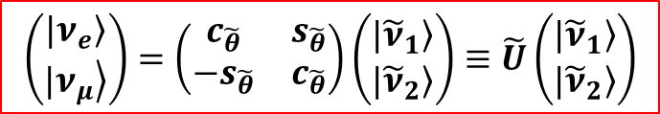
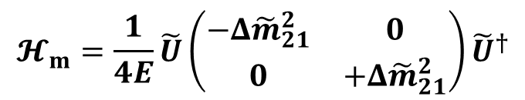
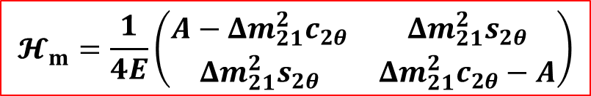
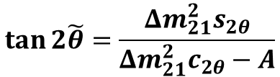
Oscillations in Matter：two flavors
10
The Hamiltonian for two-flavor neutrino oscillations in matter:
$$𝓗_{m}=\frac{1}{2E}U\left(\begin{matrix}m_{1}^{2} & 0 \\ 0 & m_{2}^{2}\end{matrix}\right)U^{†}+\left(\begin{matrix}V_{e} & 0 \\ 0 & 0\end{matrix}\right)=\frac{1}{2E}\left[U\left(\begin{matrix}m_{1}^{2} & 0 \\ 0 & m_{2}^{2}\end{matrix}\right)U^{†}+\left(\begin{matrix}A & 0 \\ 0 & 0\end{matrix}\right)\right]$$
$$θ→θ−\frac{π}{2}$$
S
$$m_{1}⟷m_{2}$$
M
W
$$𝓗_{m}=\frac{1}{4E}\left(\begin{matrix}A−{Δm}_{21}^{2}c_{2θ} & {Δm}_{21}^{2}s_{2θ} \\ {Δm}_{21}^{2}s_{2θ} & {Δm}_{21}^{2}c_{2θ}−A\end{matrix}\right)$$
$$cosθ→+sinθ$$
$$cos2θ→−cos2θ$$
$$sinθ→−cosθ$$
$$sin2θ→−sin2θ$$
$$Δm_{21}^{2}→−Δm_{21}^{2}$$
$$𝓗_{m}=\frac{1}{4E}\tilde{U}\left(\begin{matrix}−Δ{\tilde{m}}_{21}^{2} & 0 \\ 0 & +Δ{\tilde{m}}_{21}^{2}\end{matrix}\right){\tilde{U}}^{†}$$
Hamiltonian in matter: Invariant
Neutrino oscillations in matter of
a constant density are completely
determined by
$$\left(\begin{matrix}\left.|ν_{e}\right\rangle \\ \left.|ν_{μ}\right\rangle \end{matrix}\right)=\left(\begin{matrix}c_{\tilde{θ}} & s_{\tilde{θ}} \\ {−s}_{\tilde{θ}} & c_{\tilde{θ}}\end{matrix}\right)\left(\begin{matrix}\left.|{\tilde{ν}}_{1}\right\rangle \\ \left.|{\tilde{ν}}_{2}\right\rangle \end{matrix}\right)≡\tilde{U}\left(\begin{matrix}\left.|{\tilde{ν}}_{1}\right\rangle \\ \left.|{\tilde{ν}}_{2}\right\rangle \end{matrix}\right)$$
$$Δ{\tilde{m}}_{21}^{2}=\sqrt{{\left({Δm}_{21}^{2}c_{2θ}−A\right)}^{2}+{\left({Δm}_{21}^{2}s_{2θ}\right)}^{2}}$$
$$\tan{2\tilde{θ}}=\frac{{Δm}_{21}^{2}s_{2θ}}{{Δm}_{21}^{2}c_{2θ}−A}$$

Slide 12



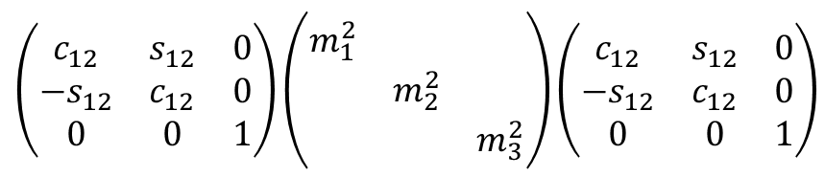


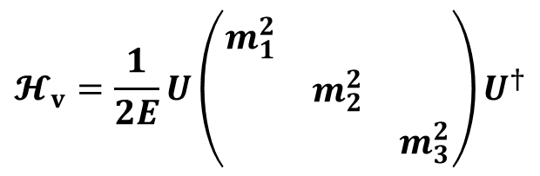



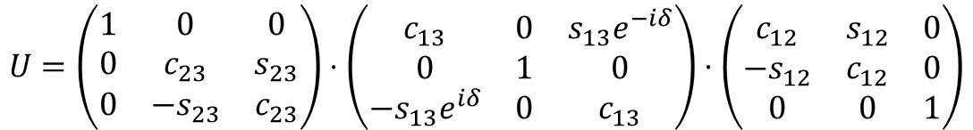
Oscillations in Vacuum：three flavors
11
The Hamiltonian for three-flavor neutrino oscillations in vacuum:
$$U=\left(\begin{matrix}1 & 0 & 0 \\ 0 & c_{23} & s_{23} \\ 0 & −s_{23} & c_{23}\end{matrix}\right)⋅\left(\begin{matrix}c_{13} & 0 & s_{13}e^{−iδ} \\ 0 & 1 & 0 \\ {−s}_{13}e^{iδ} & 0 & c_{13}\end{matrix}\right)⋅\left(\begin{matrix}c_{12} & s_{12} & 0 \\ {−s}_{12} & c_{12} & 0 \\ 0 & 0 & 1\end{matrix}\right)$$
$$c_{ij}≡\cos{θ_{ij}}$$
$$s_{ij}≡\sin{θ_{ij}}$$
$$𝓗_{v}=\frac{1}{2E}U\left(\begin{matrix}m_{1}^{2} & & \\ & m_{2}^{2} & \\ & & m_{3}^{2}\end{matrix}\right)U^{†}$$
$$θ_{12}→θ_{12}−\frac{π}{2}$$
$$m_{1}⟷m_{2}$$
$$cosθ_{12}→+sinθ_{12}$$
$$cos2θ_{12}→−cos2θ_{12}$$
Such a 1-2 interchange symmetry
seems to be trivial, but
For oscillation probabilities in
vacuum, keep such a symmetry
could be very useful
For oscillation probabilities in
matter, it will be important to
derive accurate and compact
(approximate) formulas
$$sinθ_{12}→−cosθ_{12}$$
$$sin2θ_{12}→−sin2θ_{12}$$
$$Δm_{21}^{2}→−Δm_{21}^{2}$$
Hamiltonian in vacuum: Invariant
$$\left(\begin{matrix}c_{12} & s_{12} & 0 \\ {−s}_{12} & c_{12} & 0 \\ 0 & 0 & 1\end{matrix}\right)\left(\begin{matrix}m_{1}^{2} & & \\ & m_{2}^{2} & \\ & & m_{3}^{2}\end{matrix}\right)\left(\begin{matrix}c_{12} & s_{12} & 0 \\ {−s}_{12} & c_{12} & 0 \\ 0 & 0 & 1\end{matrix}\right)$$

Slide 13
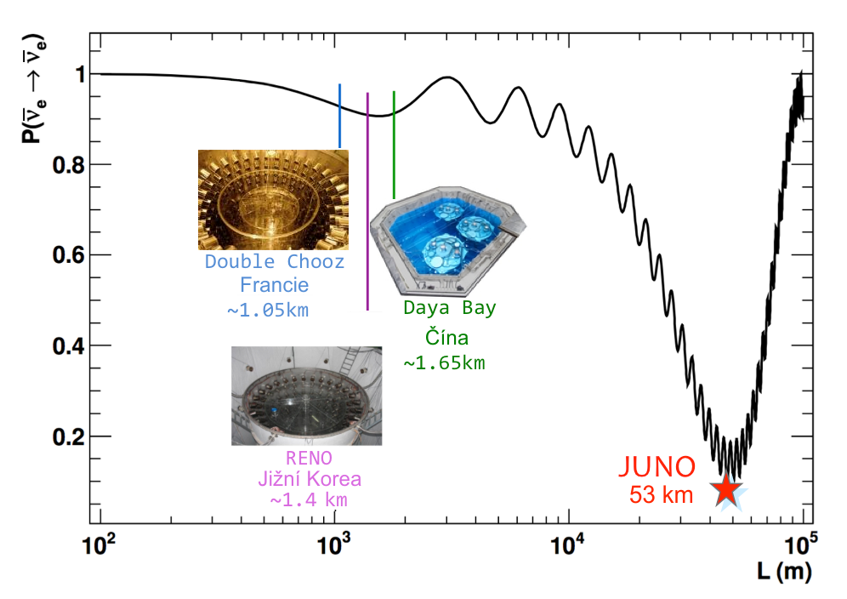

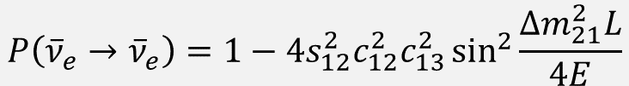
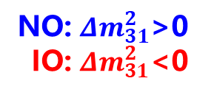
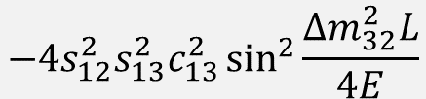
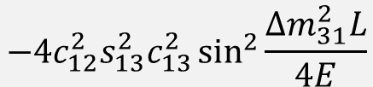

Oscillations in Vacuum：three flavors
12
Probability for three-flavor neutrino oscillations in vacuum: JUNO
$$P\left({\overline{ν}}_{e}→{\overline{ν}}_{e}\right)=1−4s_{12}^{2}c_{12}^{2}c_{13}^{2}\sin^{2}{\frac{Δm_{21}^{2}L}{4E}}$$
$$−4{c_{12}^{2}s}_{13}^{2}c_{13}^{2}\sin^{2}{\frac{Δm_{31}^{2}L}{4E}}$$
$$−4{s_{12}^{2}s}_{13}^{2}c_{13}^{2}\sin^{2}{\frac{Δm_{32}^{2}L}{4E}}$$
Invariant under
$$θ_{12}→θ_{12}−\frac{π}{2}$$
$$m_{1}⟷m_{2}$$
NO: $Δm_{31}^{2}$>0
IO: $Δm_{31}^{2}$<0

Slide 14
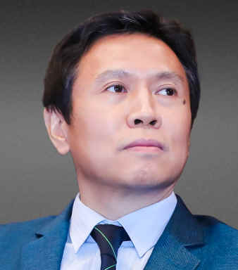

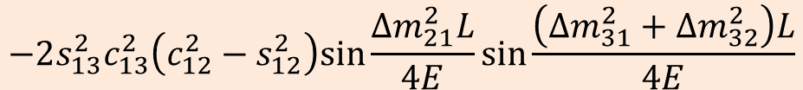


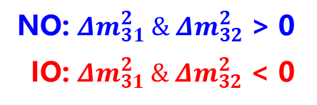


Oscillations in Vacuum：three flavors
13
Probability for three-flavor neutrino oscillations in vacuum: JUNO
$$P\left({\overline{ν}}_{e}→{\overline{ν}}_{e}\right)=1−4s_{12}^{2}c_{12}^{2}c_{13}^{4}\sin^{2}{\frac{Δm_{21}^{2}L}{4E}}−2s_{13}^{2}c_{13}^{2}\left(\sin^{2}{\frac{Δm_{31}^{2}L}{4E}}+\sin^{2}{\frac{Δm_{32}^{2}L}{4E}}\right)$$
$$−2s_{13}^{2}c_{13}^{2}\left(c_{12}^{2}−s_{12}^{2}\right)sin\frac{Δm_{21}^{2}L}{4E}sin\frac{\left(Δm_{31}^{2}+Δm_{32}^{2}\right)L}{4E}$$
1808.02256
physically equivalent
but
more transparent
$$+$$
NO: $Δm_{31}^{2} \& Δm_{32}^{2}$ > 0
IO: $Δm_{31}^{2} \& Δm_{32}^{2}$ < 0
positive
$$−$$
negative
What can we learn from this example?
The symmetries of the Hamiltonian must manifest themselves in the physical observables, e.g., oscillation probabilities.
Maintaining the symmetries in each term of physical observables may make the underlying physics more transparent:
KamLAND：long-baseline &${ s}_{13}^{2}→0$
Daya Bay：short-baseline
$$P\left({\overline{ν}}_{e}→{\overline{ν}}_{e}\right)=1−4s_{12}^{2}c_{12}^{2}\sin^{2}{\frac{Δm_{21}^{2}L}{4E}}$$
$$P\left({\overline{ν}}_{e}→{\overline{ν}}_{e}\right)=1−2s_{13}^{2}c_{13}^{2}\left(\sin^{2}{\frac{Δm_{31}^{2}L}{4E}}+\sin^{2}{\frac{Δm_{32}^{2}L}{4E}}\right)$$

Slide 15
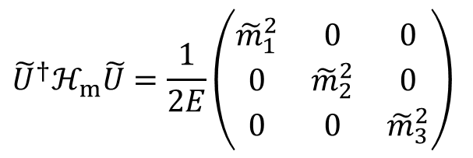
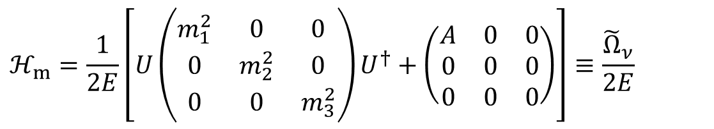
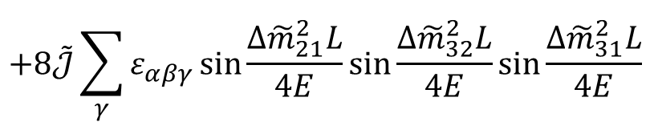
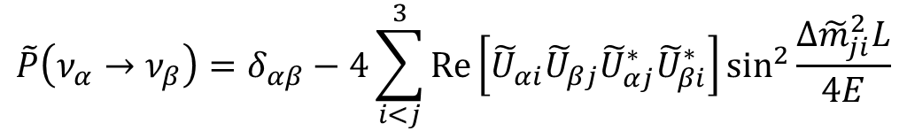

Oscillations in Matter：three flavors
14
The Hamiltonian for three-flavor neutrino oscillations in matter:
$$ℋ_{m}=\frac{1}{2E}\left[U\left(\begin{matrix}m_{1}^{2} & 0 & 0 \\ 0 & m_{2}^{2} & 0 \\ 0 & 0 & m_{3}^{2}\end{matrix}\right)U^{†}+\left(\begin{matrix}A & 0 & 0 \\ 0 & 0 & 0 \\ 0 & 0 & 0\end{matrix}\right)\right]≡\frac{{\tilde{Ω}}_{ν}}{2E}$$
Diagonalize the effective Hamiltonian in matter
$${\tilde{U}}^{†}ℋ_{m}\tilde{U}=\frac{1}{2E}\left(\begin{matrix}{\tilde{m}}_{1}^{2} & 0 & 0 \\ 0 & {\tilde{m}}_{2}^{2} & 0 \\ 0 & 0 & {\tilde{m}}_{3}^{2}\end{matrix}\right)$$
Parametrize $\tilde{U}$ in the standard way by three mixing angles ${\tilde{θ}}_{ij}$ and one CP-violating phase $\tilde{δ}$ in matter
Oscillation probabilities in matter of a constant density
$$\tilde{P}\left(ν_{α}→ν_{β}\right)=δ_{αβ}−4\sum_{i<j}^{3}{\text{Re}}\left[{\tilde{U}}_{αi}{\tilde{U}}_{βj}{\tilde{U}}_{αj}^{∗}{\tilde{U}}_{βi}^{∗}\right]\sin^{2}{\frac{Δ{\tilde{m}}_{ji}^{2}L}{4E}}$$
$$+8\tilde{𝒥}\sum_{γ}{ε_{αβγ}}\sin{\frac{Δ{\tilde{m}}_{21}^{2}L}{4E}}\sin{\frac{Δ{\tilde{m}}_{32}^{2}L}{4E}}\sin{\frac{Δ{\tilde{m}}_{31}^{2}L}{4E}}$$
The oscillation probabilities for antineutrinos can be obtained by $U⇒U^{∗}$ and $A⇒−A$

Slide 16



Oscillations in Matter：three flavors
15
Basis transformation:
Introduce a gauge parameter $η$
Just find eigenvalues/vectors of the Hermitian matrix？
$${\hat{A}}_{∗}=\frac{A}{Δ_{∗}}$$
$$α_{∗}=\frac{Δ_{21}}{Δ_{∗}}\sim 0.03$$
But series expansion in terms of $α_{∗}$ may violate symmetries of the Hamiltonian

Slide 17


Oscillations in Matter：three flavors
16
Choose a proper gauge parameter $η$ to retain the 1-2 interchange symmetry
S. Zhou, J. Phys. G 44 (2017) 044006
Without symmetry: $η=1$
$${\hat{A}}_{∗}=\frac{A}{Δ_{∗}}$$
$$α_{∗}=\frac{Δ_{21}}{Δ_{∗}}\sim 0.03$$
with both zeroth- and first-order terms
With 1-2 symmetry: $η=\cos^{2}θ_{12}$
where the first-order term vanishes
with higher-order corrections

Slide 18

Summary and Outlook
17
arXiv: 2106.12436
arXiv: 2106.11472

