Slide 1
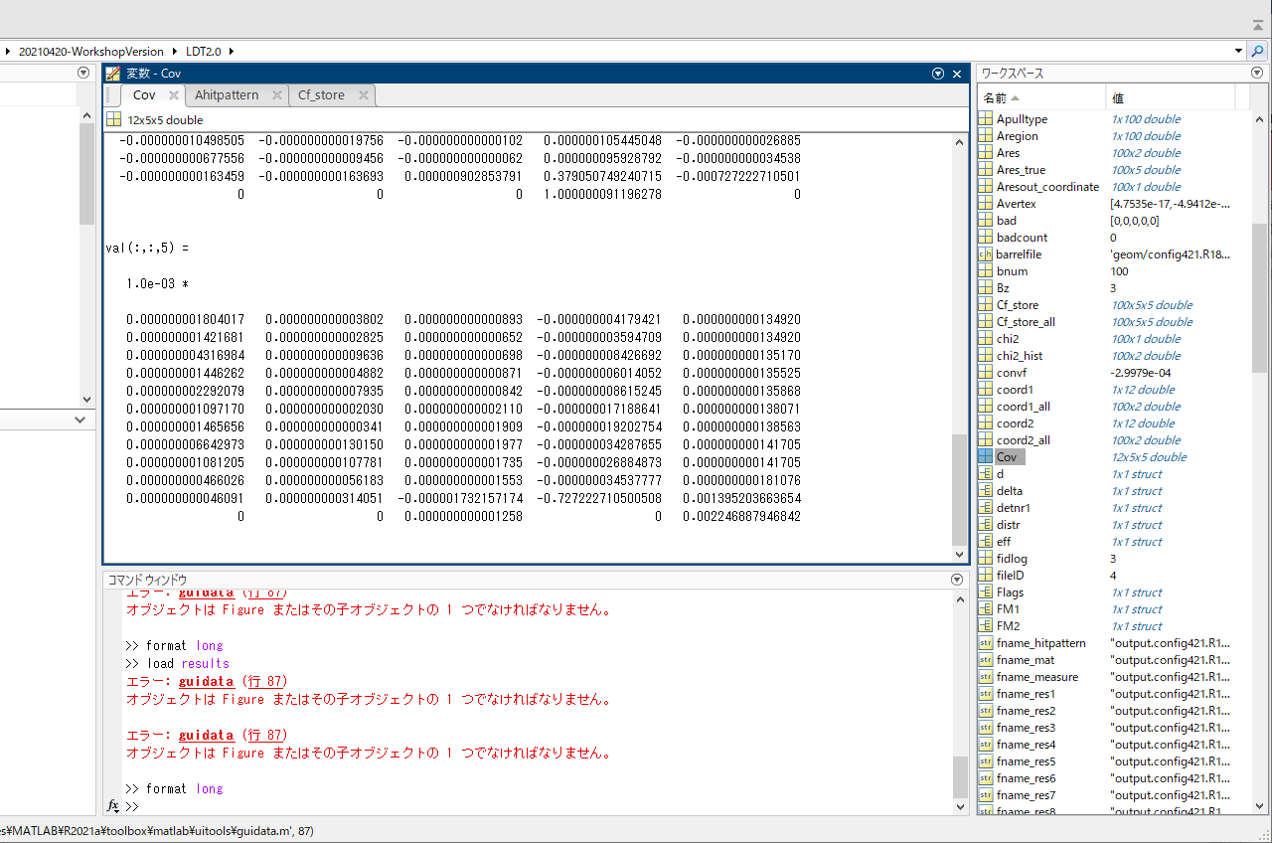
Covariance Matrix Information
val(:, :, 5) represents the errors of “Omega”
(∝ 1/pt )
# might need further confirmation

Slide 2
Default, 3SIT, w Material
wo Material
VTX
SIT
DCH
SET
## Pt = 3GeV

Slide 3
w Material, wDCH (default)
w Material, wo DCH
VTX
SIT
SET
## Pt = 3GeV

