Slide 1
TaichuPix2—LDO测试
王 佳
jwang@nwpu.edu.cn
西北工业大学 计算机学院 微电子学研究所
2021.5.11

Slide 2
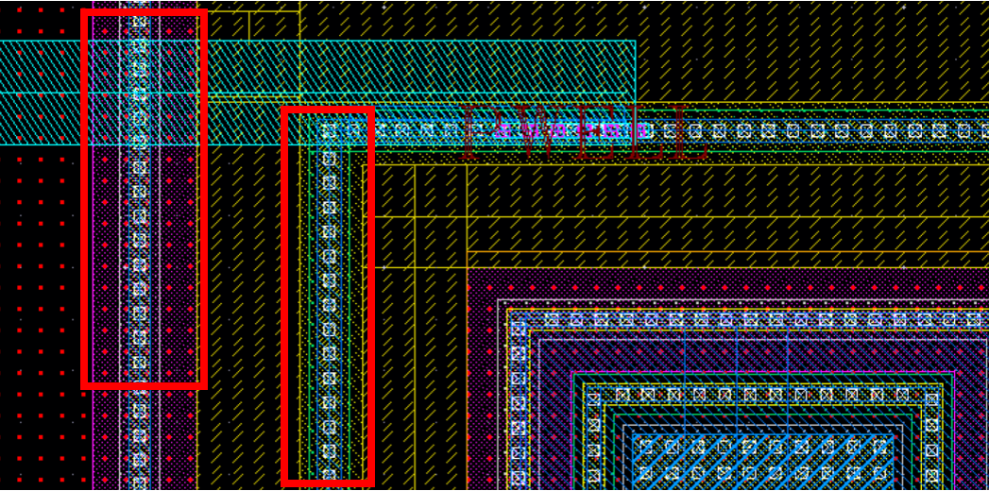
发现的版图问题
1. Bandgap内部的NPN阵列外隔离用的PWELL衬底接触，原来的接触点少，紧挨WN（WB）层上未连接触孔。

Slide 3
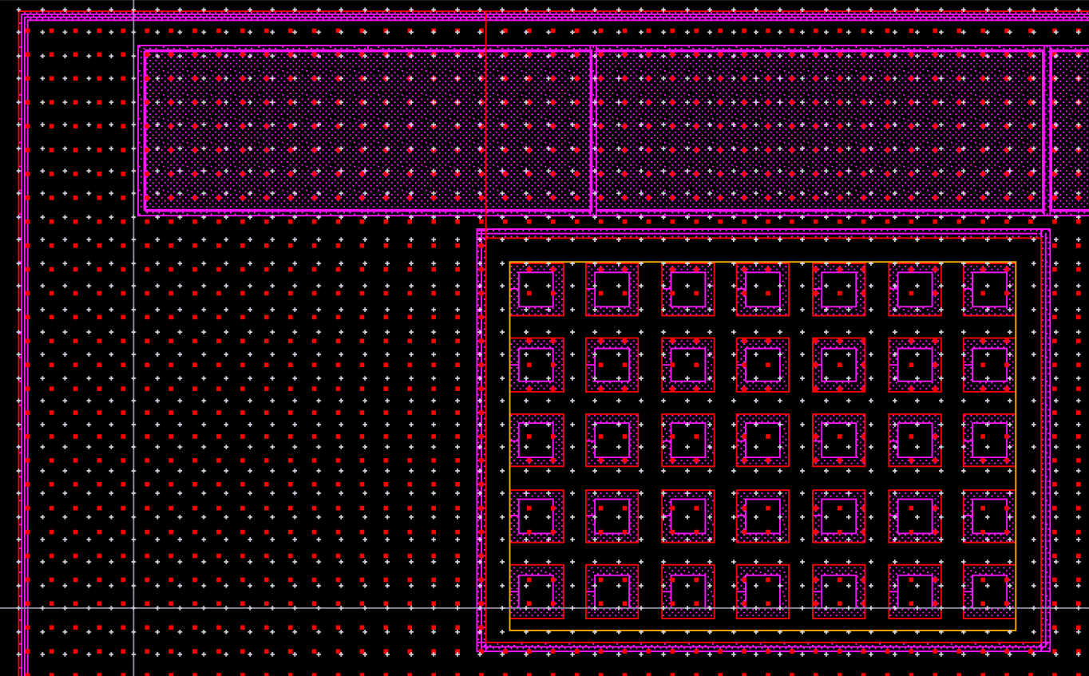
发现的版图问题
PMOS pass transistors
其余WN均接VDD2V
WN处(粉色边框)没有画和VDD的接触。
NPN管阵列

Slide 4
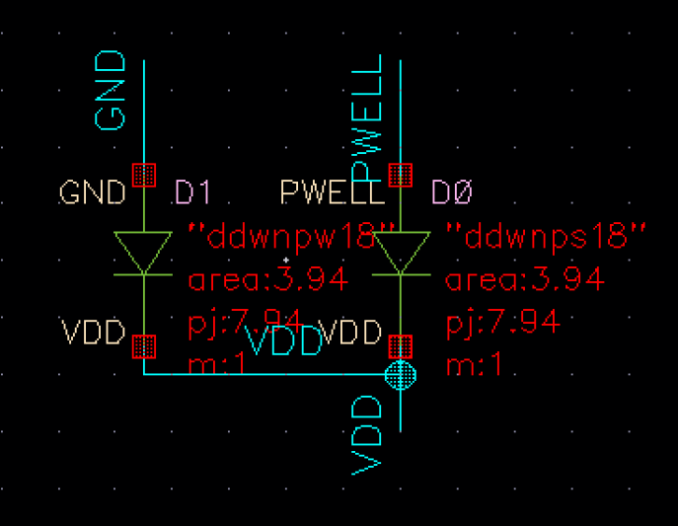
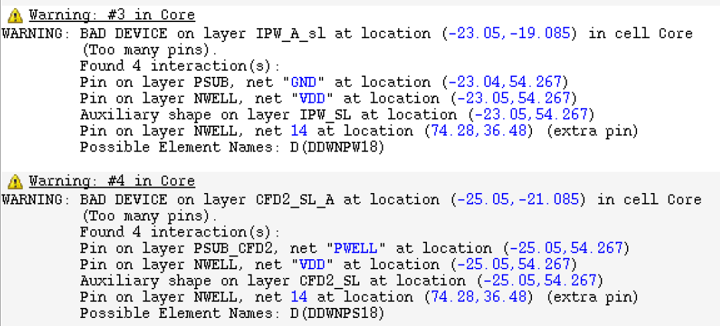
WN处(粉色边框)没有画和VDD的接触。
LVS的extraction报错，错误器件。

Slide 5
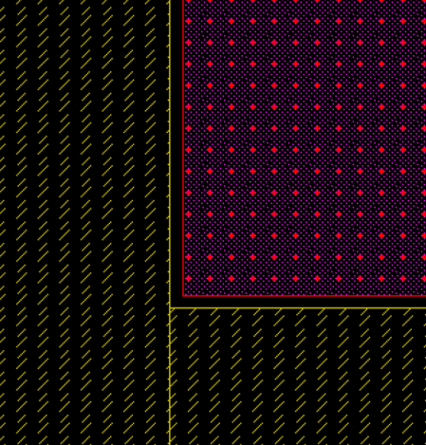
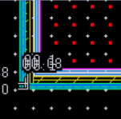
发现的版图问题
2、最外层隔离环，VNN和WN之间有空隙，0.01um宽。

Slide 6
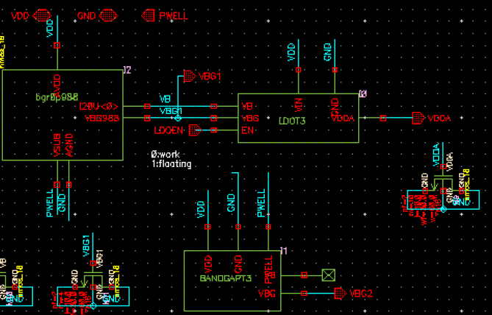
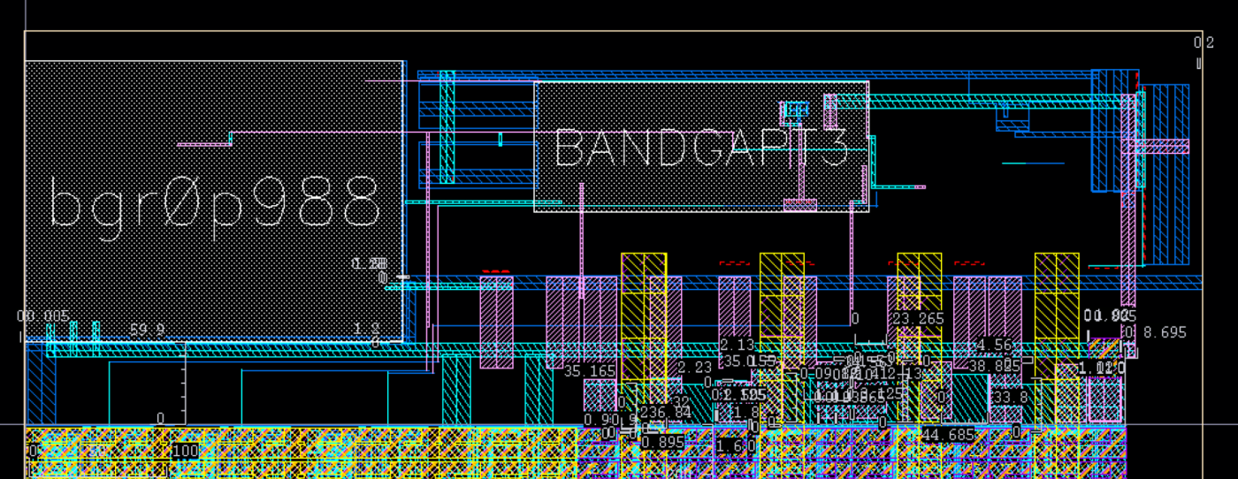
TaichuPix3 design
Bandgap is replaced by the one designed by Liang ZHANG.

Slide 7
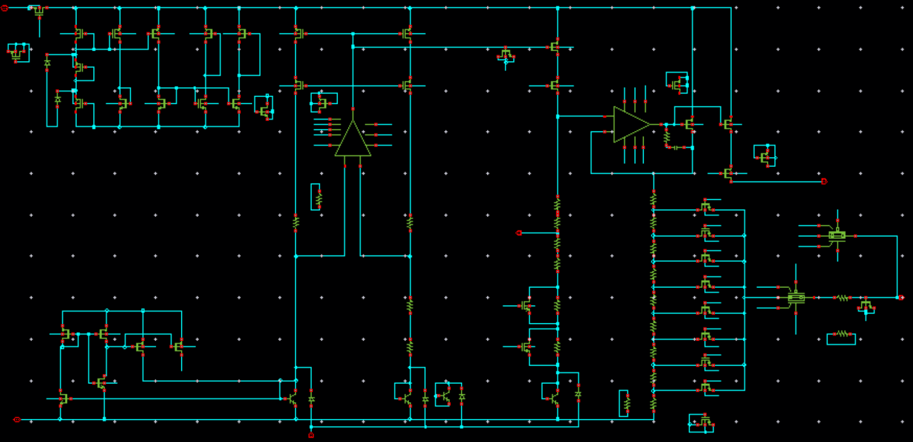
Bandgap in DAC from Liang ZHANG
Vbg=0.989V

Slide 8
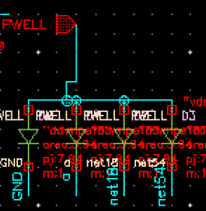
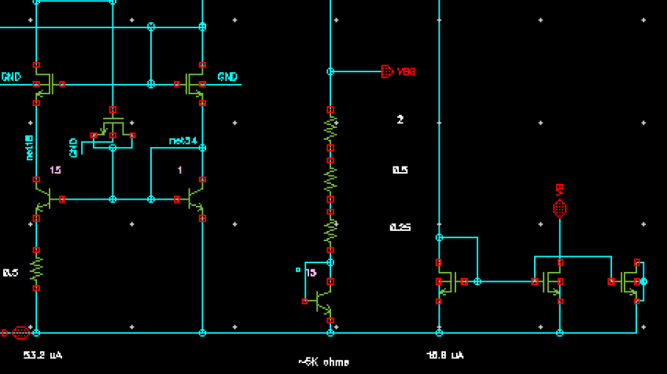
BANDGAP T3 updating
Bipolar transistor are moved to connected with ground to prevent the diode between VBG and PWELL.

Slide 9
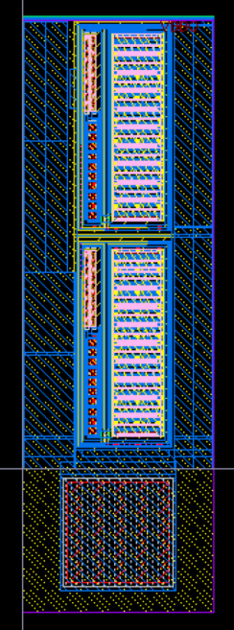
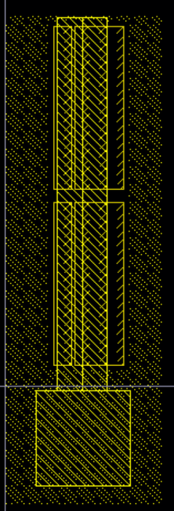
Modified PAD
Vdd2V: PVDF_18_18_WB
VDDA: modified PVDF_18_18_WB
All ESD have been removed. M6 is used for power distributing.

Slide 10
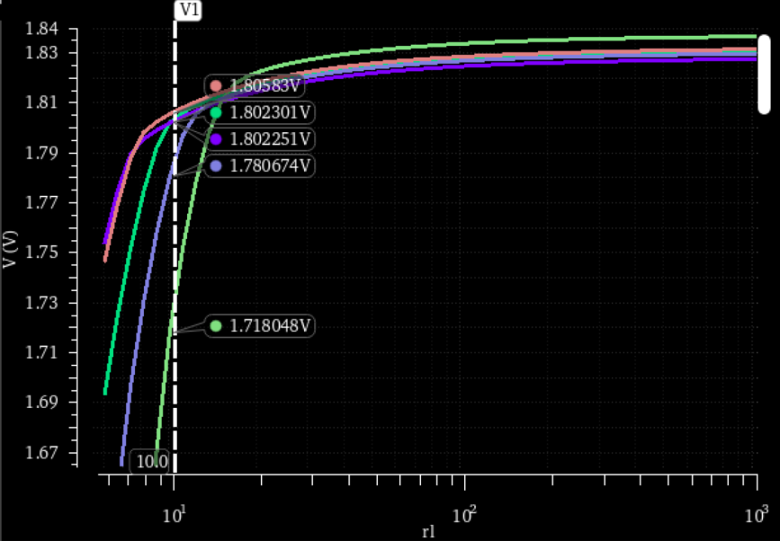
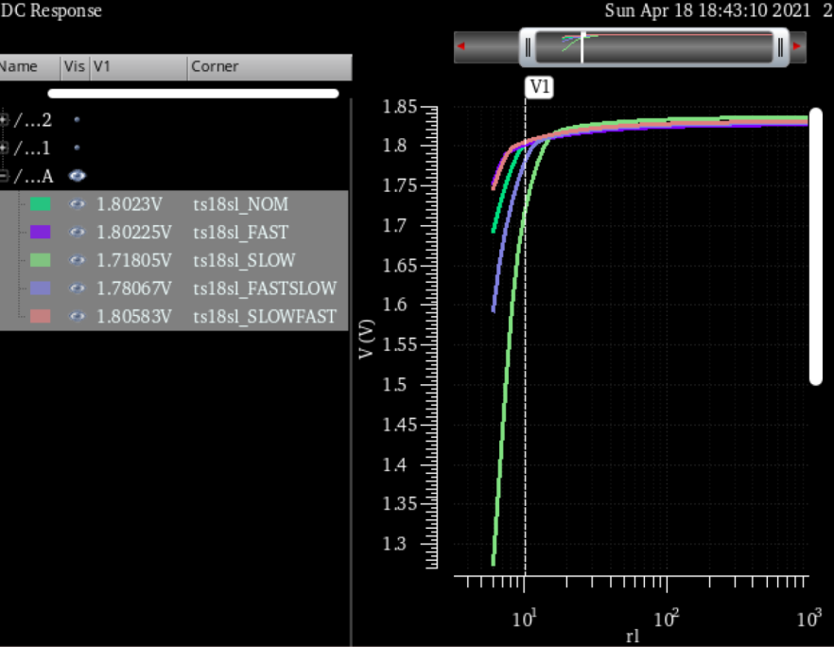
Post-layout simulation with PAD
Load regulation: 160 mA (Maximum load current with all corners)

Slide 11
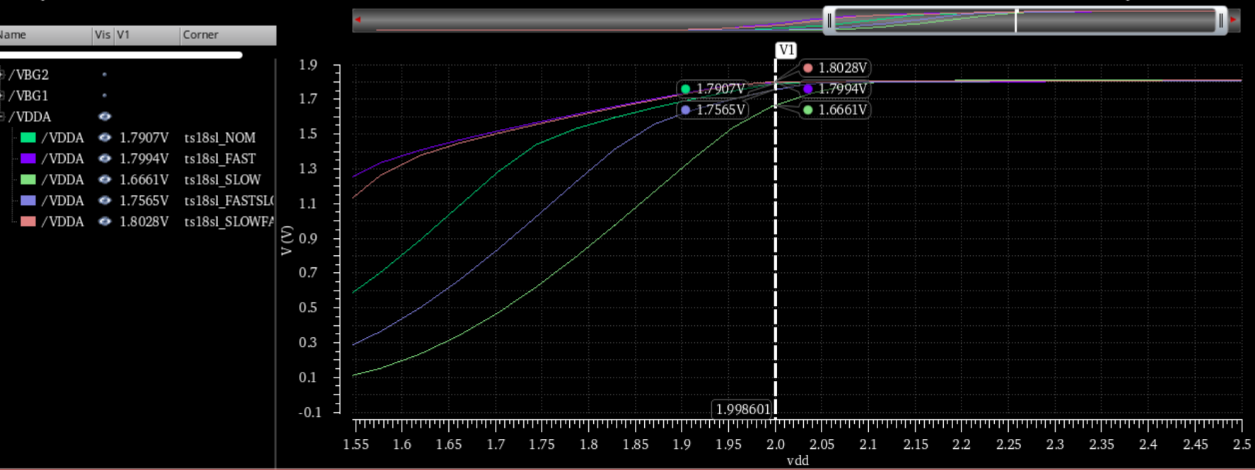
Post-layout simulation
Line regulation @ iload=200mA
SLOW,FS:<1.8V. Since the output transistor is p-channel, the output decreases with slow PMOS transistors.

Slide 12
TaichuPix2—LDO测试
王 佳
jwang@nwpu.edu.cn
西北工业大学 计算机学院 微电子学研究所
辐射探测材料与器件工信部重点实验室

