Slide 1
The Scintillating Glass AHCAL Simulation
Yukun Shi
USTC

Slide 2
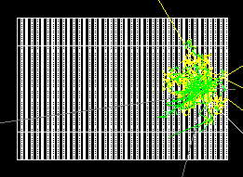
Simulation
Simulation Setup
Stand Alone Geometry
Sensitive material:Scintillating Glass S4
Prototype Transverse size: $72×72{cm}^{2}$
Birks effect isn’t considered
Incident particle: Klong(10 to 80GeV)
Leakage cut: shower start before layer5
No energy threshold for cells
Event display: 1 GeV KL
Single KLong event

Slide 3
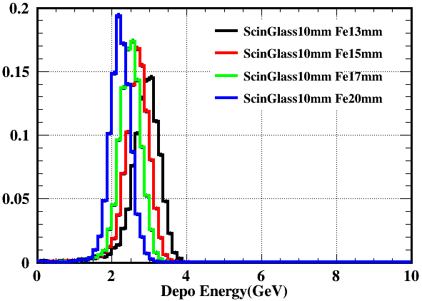
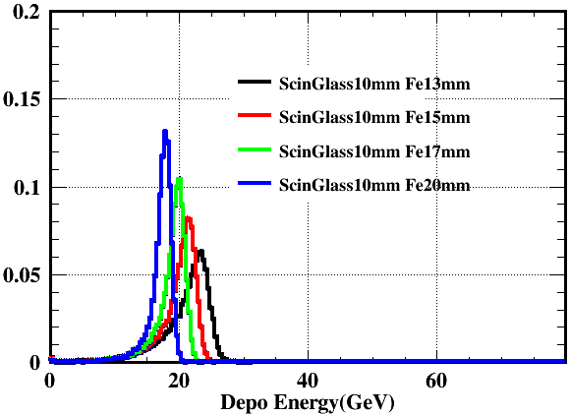
Simulation
Energy deposition
Sampling ratio is around 30% while plastic scintillator AHCAL is 2%
Energy deposition: 10 and 80 GeV KL

Slide 4
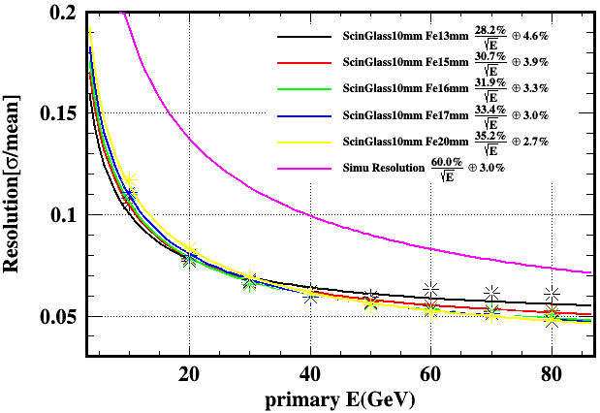
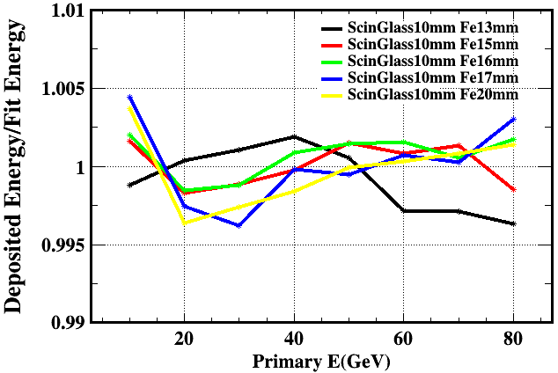
Simulation
Different Steel thickness
Lineaity are all within $±1\%$
Resolution has a statistical term around 30%

Slide 5
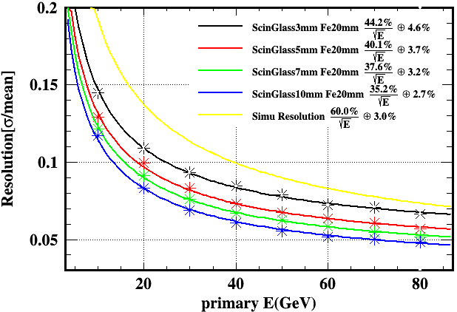
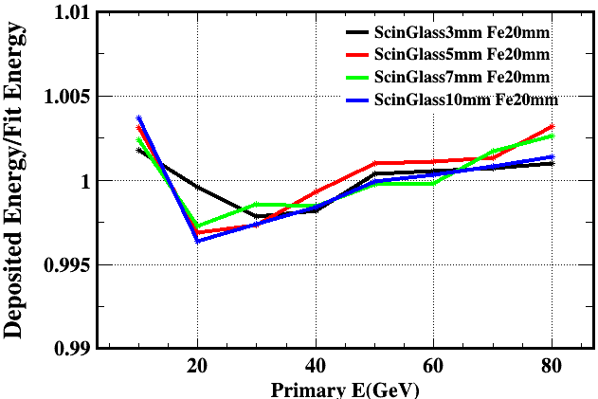
Simulation
Different glass thickness
Lineaity are all within $±1\%$
The statistical term for resolution changes obviously

Slide 6
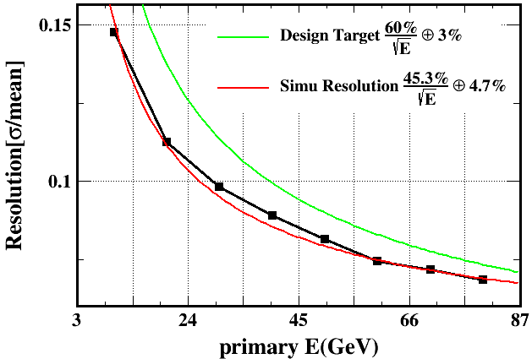
comparison
The 3mm scintillating glass seems similar to plastic scintillator
Thicker scintilling glass has better performance but increases the total calorimeter thickness
scintillating glass AHCAL
Plastic scintillator AHCAL

Slide 7
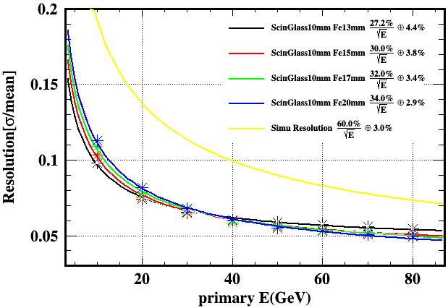
Scintillating Glass 5
Scintillating Glass 5 has the largest density
Differences are not obvious
scintillating glass 4
scintillating glass 5

Slide 8
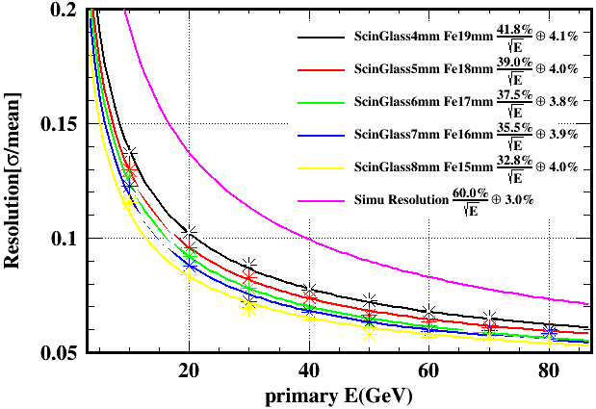
Plastic and glass
Total thickness fixed as 23mm(sensitive material+absorber)
Resolution is not just a matter of thickness, the compensation is also important
scintillating glass AHCAL
Plastic scintillator AHCAL

Slide 9
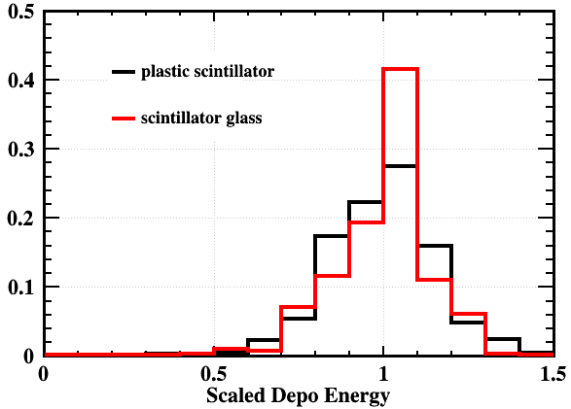
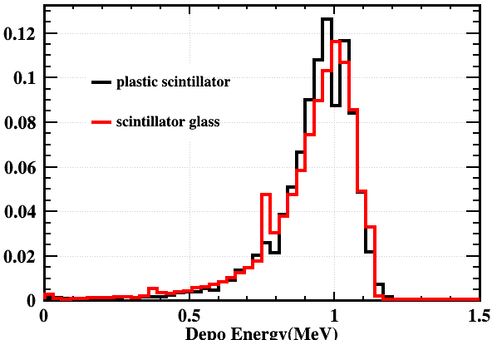
Plastic and glass
6mm glass + 17mm Fe VS 3mm plastic + 20mm Fe
Energy deposition is scaled
Scintillating glass has more advantage at low energy
10 GeV KL
80 GeV KL

Slide 10
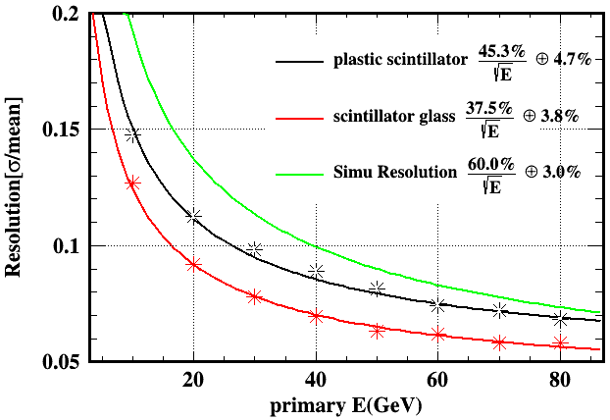
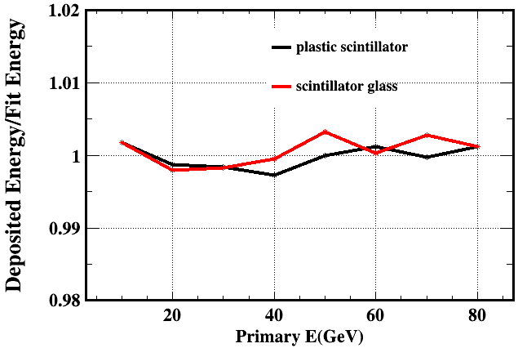
Plastic and glass
The scintillating glass configuration is obviously better
It should be mentioned that the scintillating glass configuration hasn’t considered the birks effect and any thresholds
Resolution
Linearity

Slide 11
Summary and outlook
The scintillating glass ACHAL has better resolution especially at low energy
More simulation based on CEPC environment will be done to see the benefit on physics benchmarks

Slide 12
backup

Slide 13
comparison
The scintillating glass has advantage on statistical term
The scintillating glass’s constant term is not good especially the Birks effect is not considered for the scintillating glass
scintillating glass AHCAL
Plastic scintillator AHCAL

Slide 14
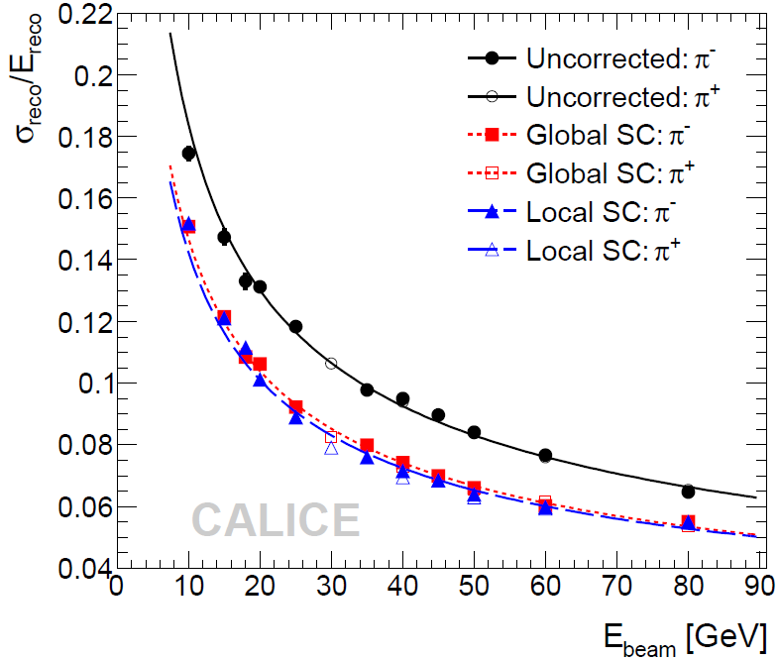
CALICE AHCAL
38 layers
5.3 λ
21mm Steel
5mm plastic scintillator
$0.9×0.9m^{2}$

Slide 15
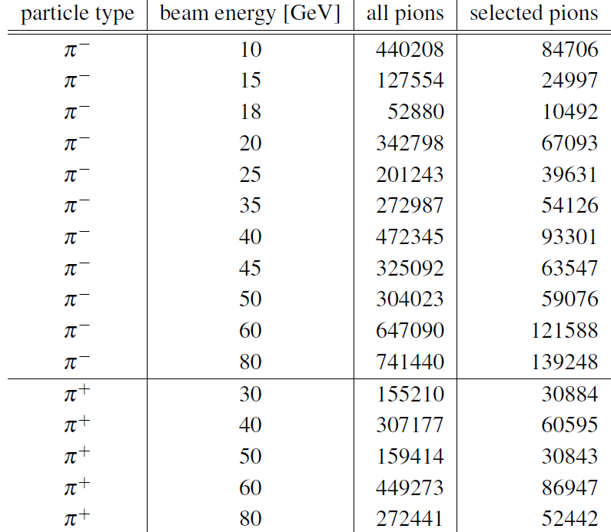
CALICE
Event selection
Shower starts at the first 5 layers
ECAL, TCMT energy limit

