Slide 1
Global determination of two-meson distribution amplitudes
from three-body B decays in the perturbative QCD approach
Da-Cheng Yan （Changzhou University）
in collaboration with: Ya Li, Jun Hua, Zhou Rui, and Hsiang-nan Li
QCD group meeting，Qing Dao

Slide 2
Motivation
01
Outline
Framework
02
Outlook
Numerical results
03
Summary and Outlook
04

Slide 3
Motivation
01

Slide 4
They can help us to test the factorization approach, which have been used in two-body decays successfully.
01
02
They also help us to test SM by measuring the CKM phases.
03
They offer us opportunities to study the line-shape of intermediate states.
04
Combing with the two-body decays, we can try to understand the sources of strong phases.
05
The study of three-body decays help us to test the SU(3) asymmetry.

Slide 5
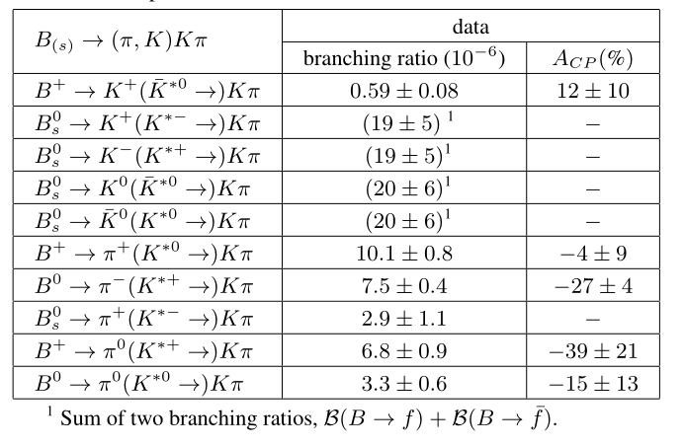
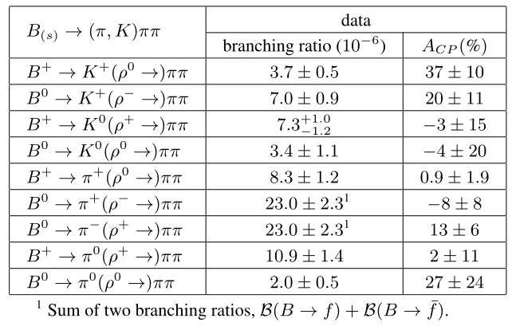
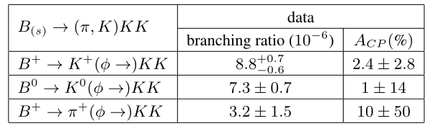
Large amounts of data from LHCb, Belle, BABAR, CDF, D0 etc. Collaborations. (Most with BFs ~ 10⁻⁵)

Slide 6
Why global fitting for a two-hadron DA
A two-hadron DA collects contributions from a series of resonances as well as
nonresonant contributions;
The Gegenbauer moments for a two-hadron DA are ω2-dependent, a feature dramatically distinct from those for a hadron DA ;
To improve the precision of theoretical predictions for multi-body B meson decays.

Slide 7
Framework
02

Slide 8
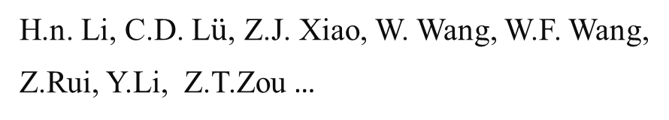
Theoretical approach
H.Y. Cheng, C.K. Chua, Y. Li,…
Factorization Approach
QCD Factorization
A. Furman, B.El Bennich, R. Kaminski, T. Mannel,
X.H. Guo, Y.D. Yang, Z.H. Zhang,…
PQCD
H.n. Li, C.D. L$\ddot{u}$, Z.J. Xiao, W. Wang, W.F. Wang,
Z.Rui, Y.Li, Z.T.Zou …
Symmetry
X.G. Xiao, G.N. Li, D. Xu, J.L. Rosner, M. Gronau,…
Sum rules
Ulf-G. Meißner (Light-cone), A. Khodjamirian (QCD)

Slide 9
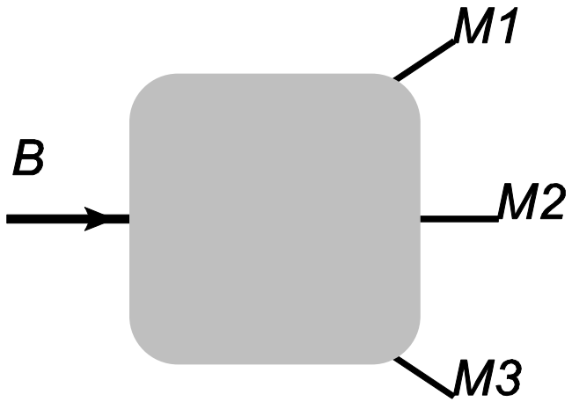
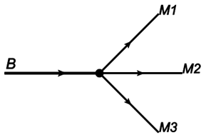
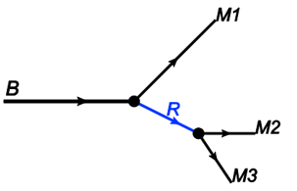
1→3 decay modes
1→2→3 decay mode

Slide 10

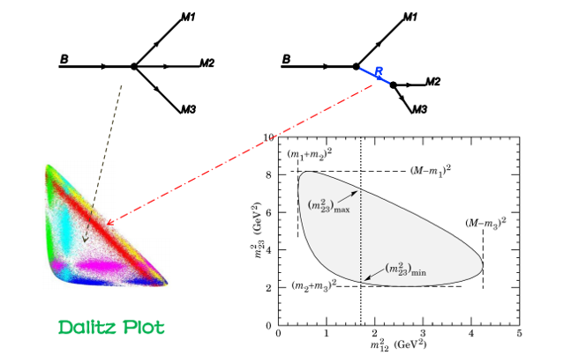
Quasi-two-body decays

Slide 11


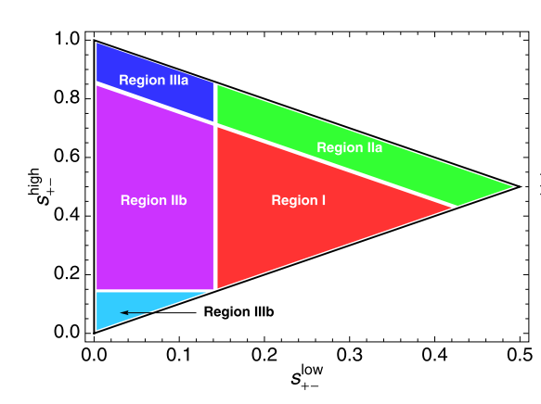

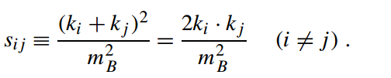


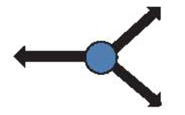






项目背景
Notes:
The Dalitz plot contains different regions with \special" kinematics.
The central region corresponds to the case in which all three final particles fly apart at ∼ 120o angles
with large energy (E ∼ mB=3).
The corners correspond to the case in which one finalstate particle is approximately at rest (i.e. soft), and the other two fly back-to-back with
large energy (E ∼ mB=2).
The central part of the edges correspond to the case in which two particles move collinearly with large energy and the other particle recoils back.

Slide 12
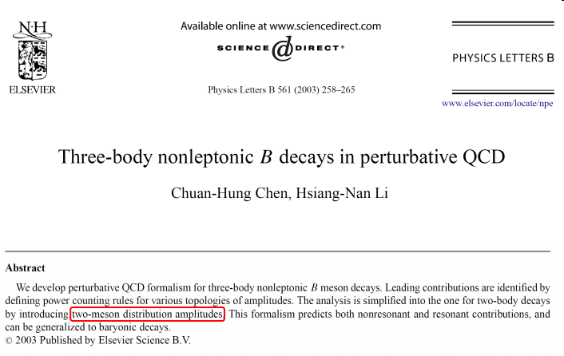
Quasi-two-body decays in PQCD

Slide 13
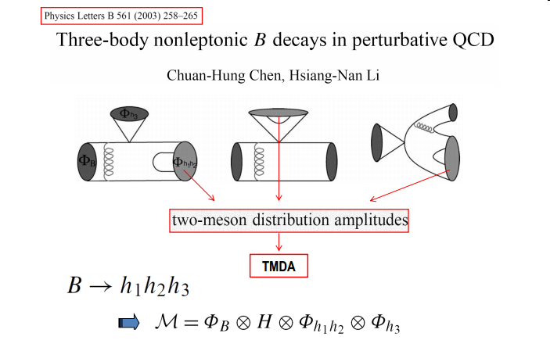

Slide 14
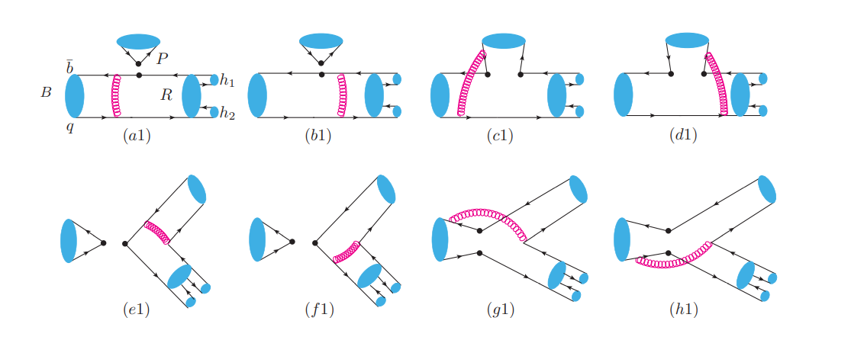

Typical LO diagrams for $B→VP_{3}→P_{1}P_{2}P_{3}$ decays

Slide 15
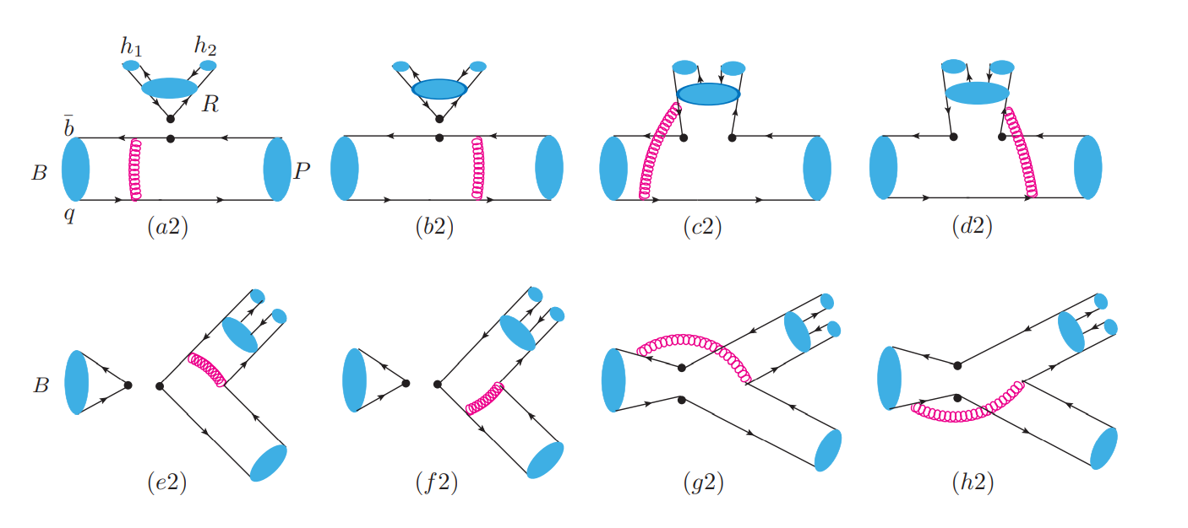

Slide 16
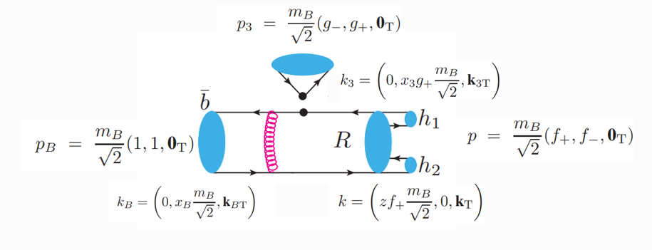
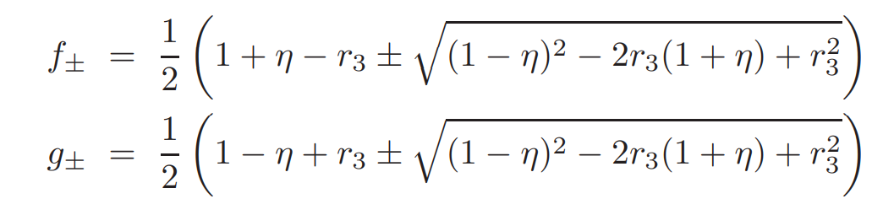

The meson momenta in light-cone coordinates

Slide 17


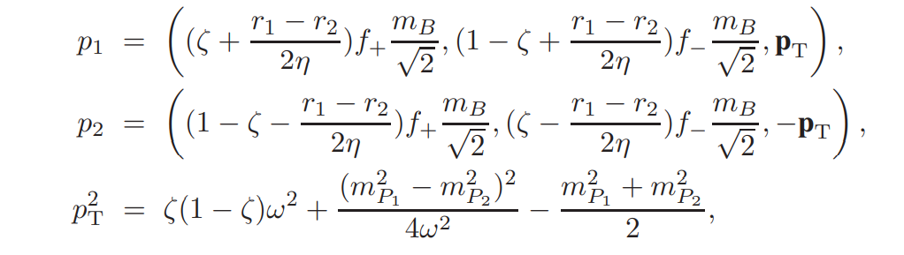
corrections from the
final-state meson masses

Slide 18

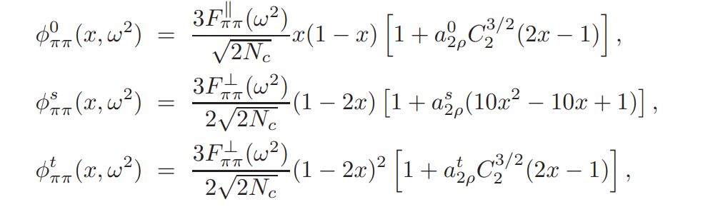
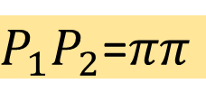
For a P-wave meson pair, we introduce the longitudinal polarization vector
P-Wave (Longitudinal components):
$P_{1}P_{2}$=$ππ$
Twist-2
Twist-3
Twist-3

Slide 19
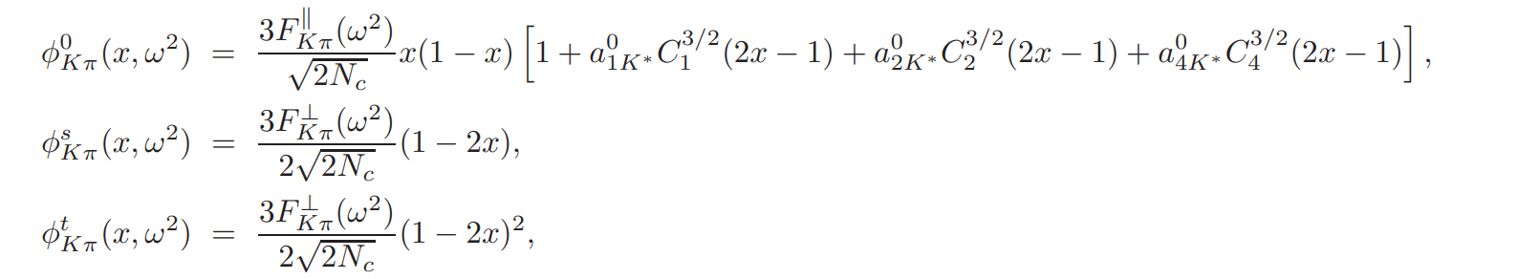
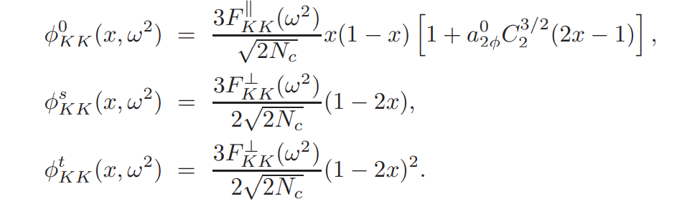
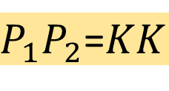
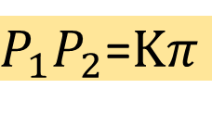
$P_{1}P_{2}$=$Kπ$
$P_{1}P_{2}$=$KK$

Slide 20
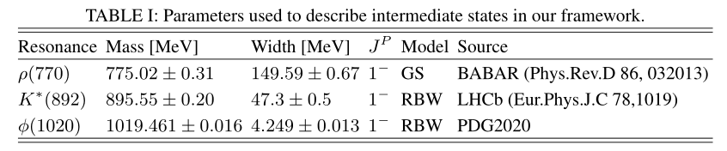




Time-like form factors $F_{P_{1}P_{2}}$

Slide 21
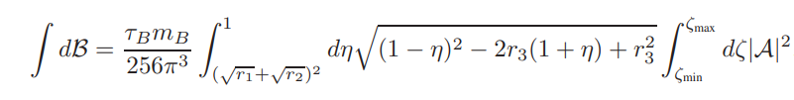

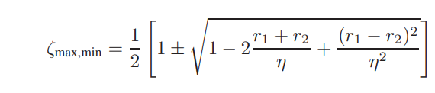
Branching ratio

Slide 22
03
Numerical results

Slide 23
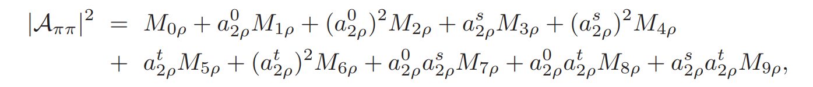
A Gegenbauer-moment-independent database

Slide 24
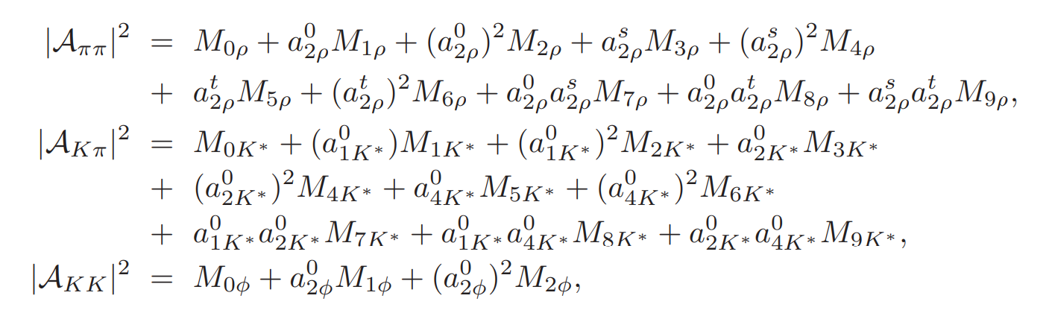
A Gegenbauer-moment-independent database
Fit Gegenbauer moments of the two-meson distribution amplitudes :
$ππ:a_{2ρ}^{0},a_{2ρ}^{s}$, $a_{2ρ}^{t} Kπ:a_{1K^{∗}}^{0}$, $a_{2K^{∗}}^{0}$,$a_{4K^{∗}}^{0} KK:a_{2φ}^{0}$

Slide 25
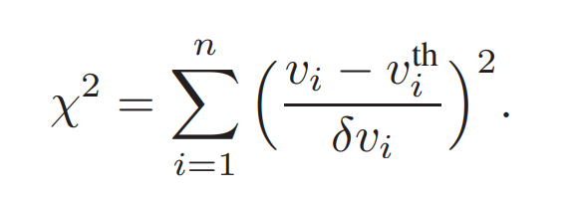


Global fit (lsq)
)
experimental data：
(Measurements with significance larger than 3σ)
fitted values:
P. Lepage and C. Gohlke, gplepage/lsqfit: lsqfit version 11.7, Zenodo.

Slide 26
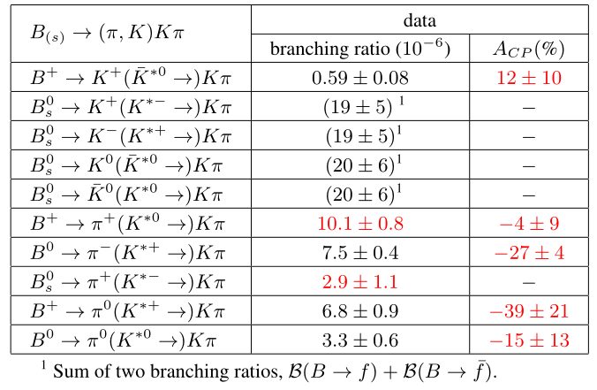
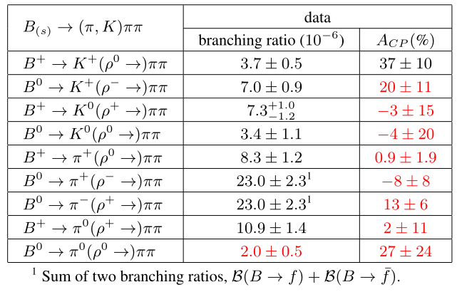
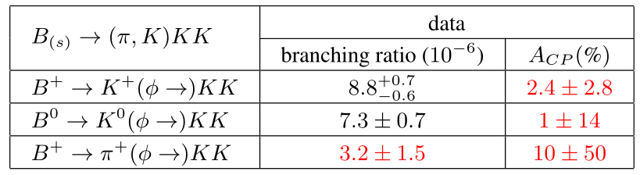
Experimental data used in our fit
Channel:18
Data:16

Slide 27
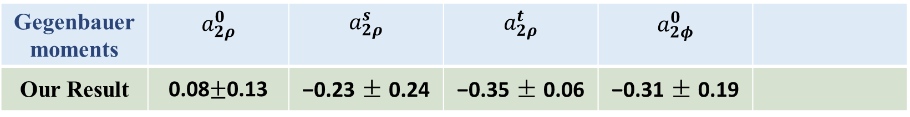
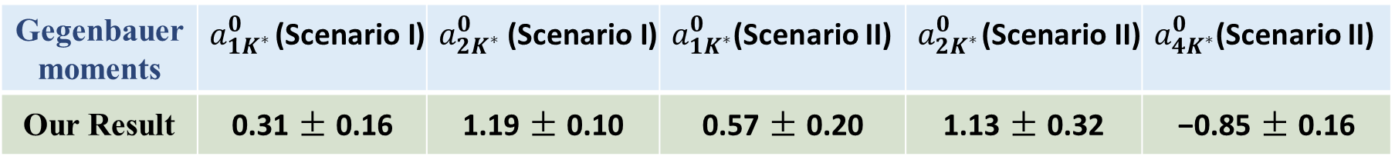
Our fitted Gegenbauer moments of two-meson distribution amplitudes :
Gegenbauer moments | $$a_{2ρ}^{0}$$ | $$a_{2ρ}^{s}$$ | $$a_{2ρ}^{t}$$ | $$a_{2φ}^{0}$$
Our Result | 0.08$±$0.13 | −0.23 ± 0.24 | −0.35 ± 0.06 | −0.31 ± 0.19
Gegenbauer moments | $a_{1K^{∗}}^{0}$(Scenario I) | $a_{2K^{∗}}^{0}$(Scenario I) | $a_{1K^{∗}}^{0}$(Scenario II) | $a_{2K^{∗}}^{0}$(Scenario II) | $a_{4K^{∗}}^{0}$(Scenario II)
Our Result | 0.31 ± 0.16 | 1.19 ± 0.10 | 0.57 ± 0.20 | 1.13 ± 0.32 | −0.85 ± 0.16

Slide 28


Discussions
Our work in PQCD
Part I: B(s)→ Pρ→ Pππ
Part II: B(s)→ P$φ$→ PKK
Part III : B(s)→ P$K^{∗}$→ PKπ
Part Ⅳ: ${\text{ω}}^{2}$-dependent Gegenbauer Moments

Slide 29
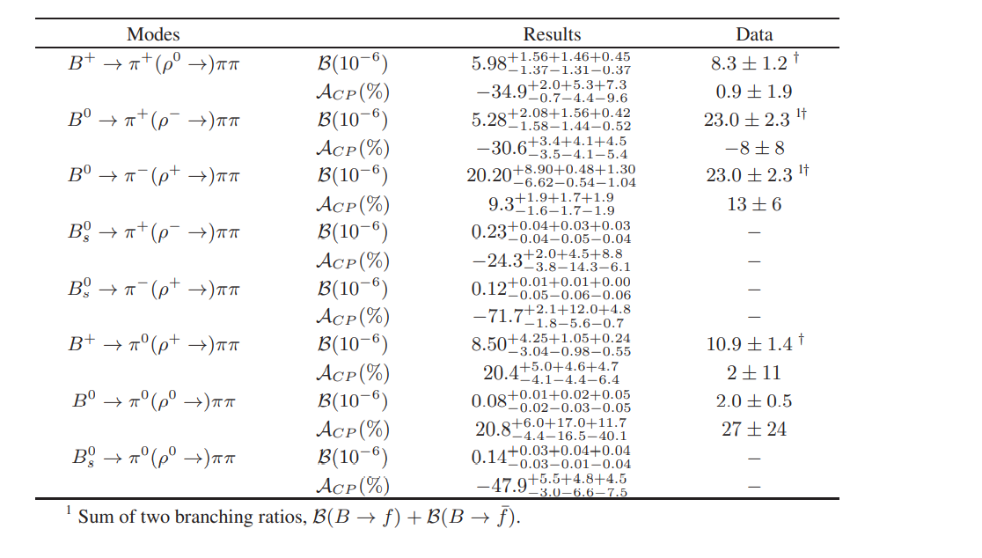
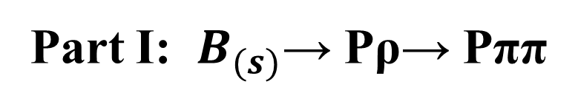
Part I: $B_{(s)}$→ Pρ→ Pππ
Fitted results &
Predicted results
Experimental
Data

Slide 30
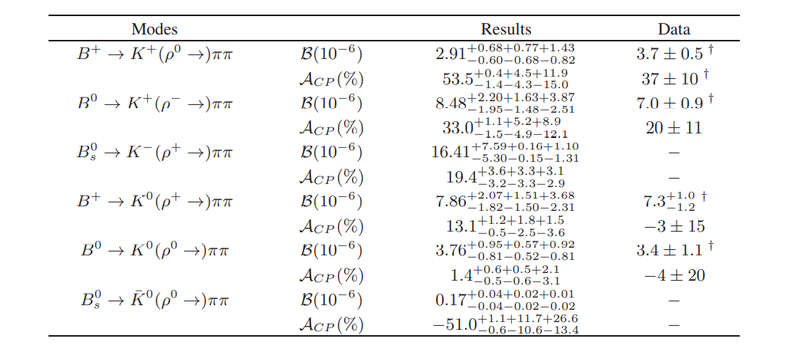

Slide 31
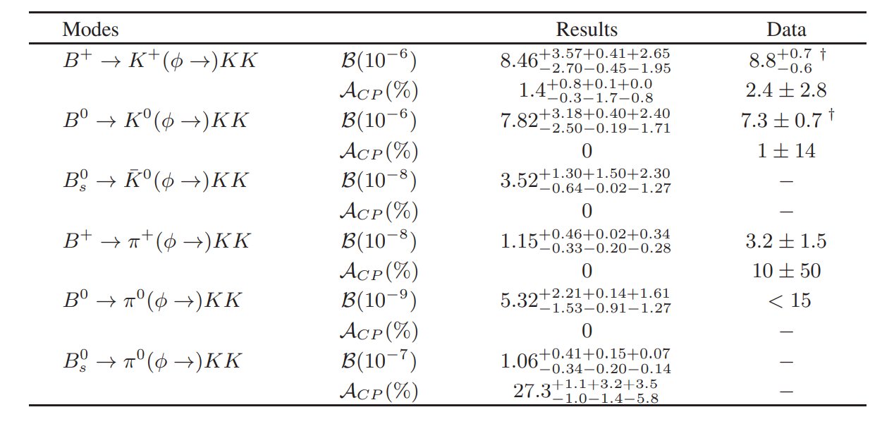

Part II: B(s)→ P$φ$→ PKK

Slide 32
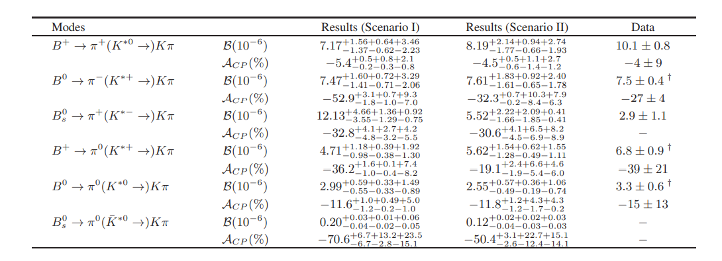
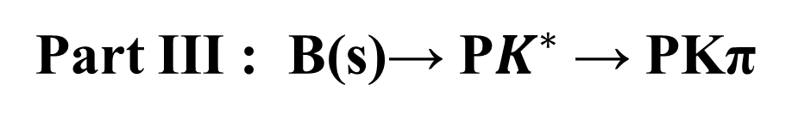
Part III : B(s)→ P$K^{∗}$→ PKπ

Slide 33
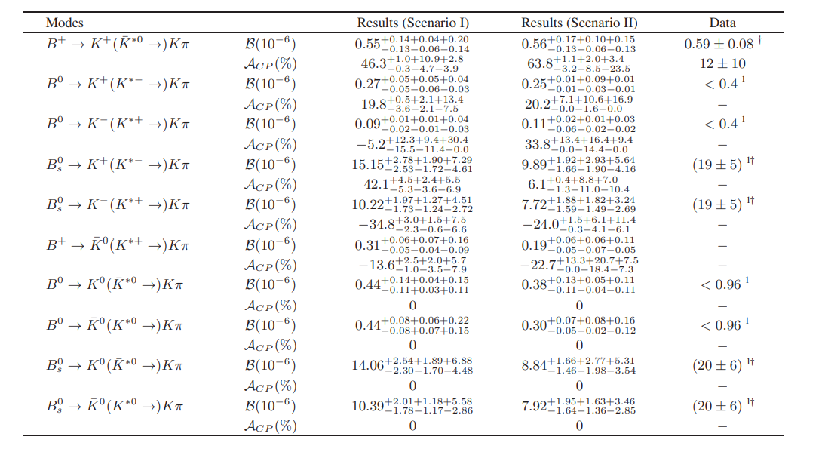

Slide 34
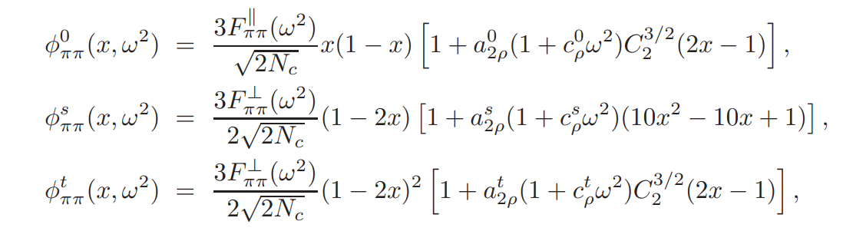

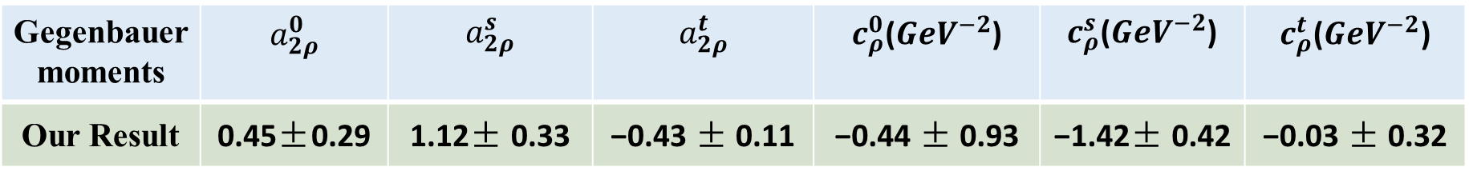
Part Ⅳ: ${\text{ω}}^{2}$-dependent Gegenbauer Moments
We make a more aggressive attempt to determine the dependence of the Gegenbauer moments in the two-meson DAs on the meson pair invariant mass. [Nucl. Phys. B555, 231 (1999)]
Gegenbauer moments | $$a_{2ρ}^{0}$$ | $$a_{2ρ}^{s}$$ | $$a_{2ρ}^{t}$$ | $c_{ρ}^{0}$($GeV^{−2}$) | $c_{ρ}^{s}$($GeV^{−2}$) | $$c_{ρ}^{t}\text{(}GeV^{−2}\text{)}$$
Our Result | 0.45±0.29 | 1.12± 0.33 | −0.43 ± 0.11 | −0.44 ± 0.93 | −1.42± 0.42 | −0.03 ± 0.32

Slide 35
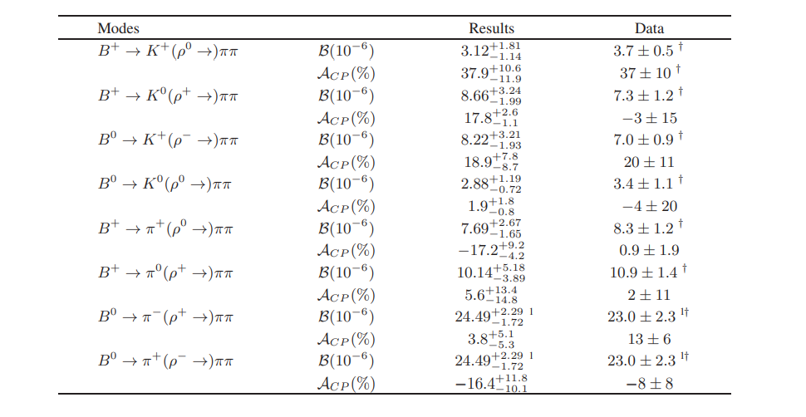



Slide 36
04
Summary and outlook

Slide 37
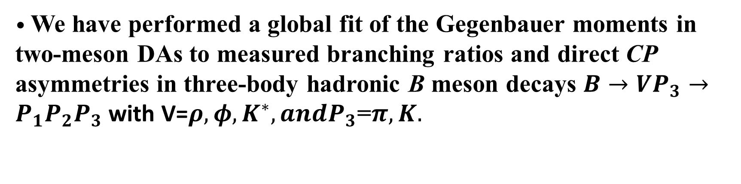
• We have performed a global fit of the Gegenbauer moments in two-meson DAs to measured branching ratios and direct CP asymmetries in three-body hadronic B meson decays $B→VP_{3}→P_{1}P_{2}P_{3}$ with V=$ρ,φ,K^{∗}, andP_{3}$=$π,K.$
•The fitted Gegenbauer moments differ from those adopted in previous PQCD investigations on specific modes. which indicates that the global determination of Gegenbauer moments is essential.
• We have explored the potential to fix the dependence of the Gegenbauer moments on the meson-pair invariant mass.
• The determination of the dependence on the meson-pair invariant mass is promising, when data become more precise

Slide 38

Thank you

Slide 39
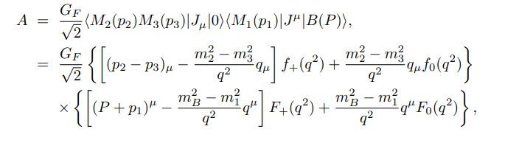

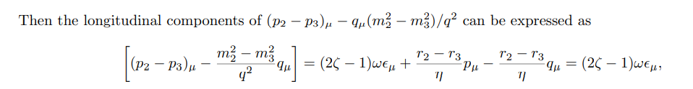

Backup
As parametrizing the two-meson distribution amplitudes (DAs), the vector associated with the longitudinal component should be the polarization vector:

