Slide 1


PQCD研讨会 2021
Rescattering mechanism in
$Λ_{c}^{+}→B_{8}V$decay
Cai-Ping Jia
School of Nuclear Science and Technology Lanzhou University
2021.07.12
Collaboration: Fu-Sheng Yu
Notes:
各位老师同学大家下午好，我是兰州大学的学生贾彩萍，今天我要汇报的是目前正在进行的一个课题，对\Lambda_c衰变到重子八重态和一个矢量介子的研究，主要是通过考虑他们的末态相互作用分析他们的相关观测量。

Slide 2
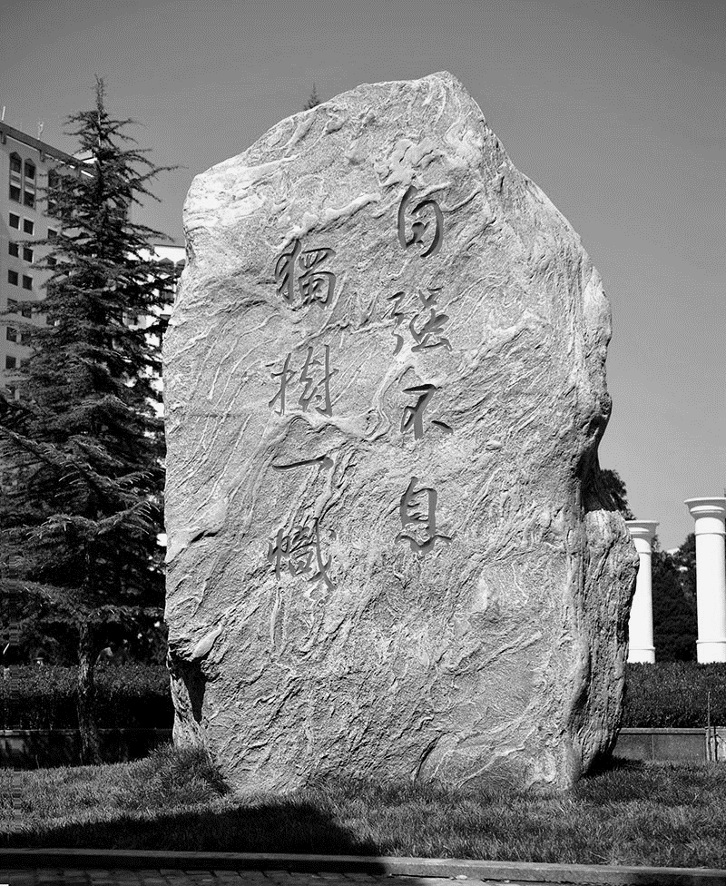


Introduction
Theoretical Frame
Results
Summary
Contents
Notes:
我今天的汇报将从以下几个方面展开。

Slide 3
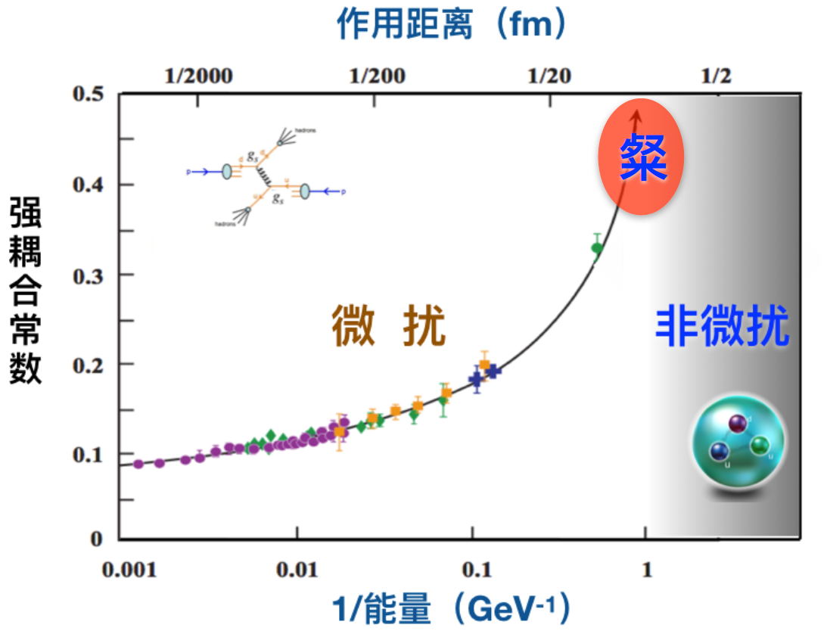
Introduction
The non-perturbative effects——how to understand and calculate?
QCD：Asymptotic freedom, Quark confinement.
Methods：LQCD、ChPT、QCDSR、Inverse problem……
Perturbative theory
Can not be calculated and understood well
Because of much more non-perturbative effects
Asymptotic freedom
Quark confinement
Notes:
首先是我们为什么选择研究这个课题。对于QCD，他是标准模型中描述强相互作用的基本理论，而他有两个非常重要的特征就是渐近自由和夸克禁闭，在大动量转移过程中，夸克之间的相互作用非常微弱，表现为渐近自由，对于这种高能过程，可以用微扰论非常好的描述，而对于中低能过程，夸克之间的强相互作用比较强，夸克被束缚在强子内部以色单态的形式出现，表现为夸克禁闭，此时他们的非微扰效应非常重要，还没有办法对他们更好地理解和计算。目前理解非微扰问题的方法有以及反问题方法。那么除了从方法出发研究非微扰问题之外，我们还可以借助具体的衰变过程研究非微扰的效应。

Slide 4
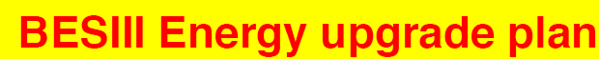
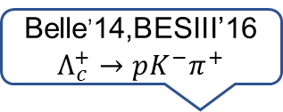
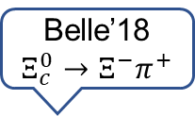
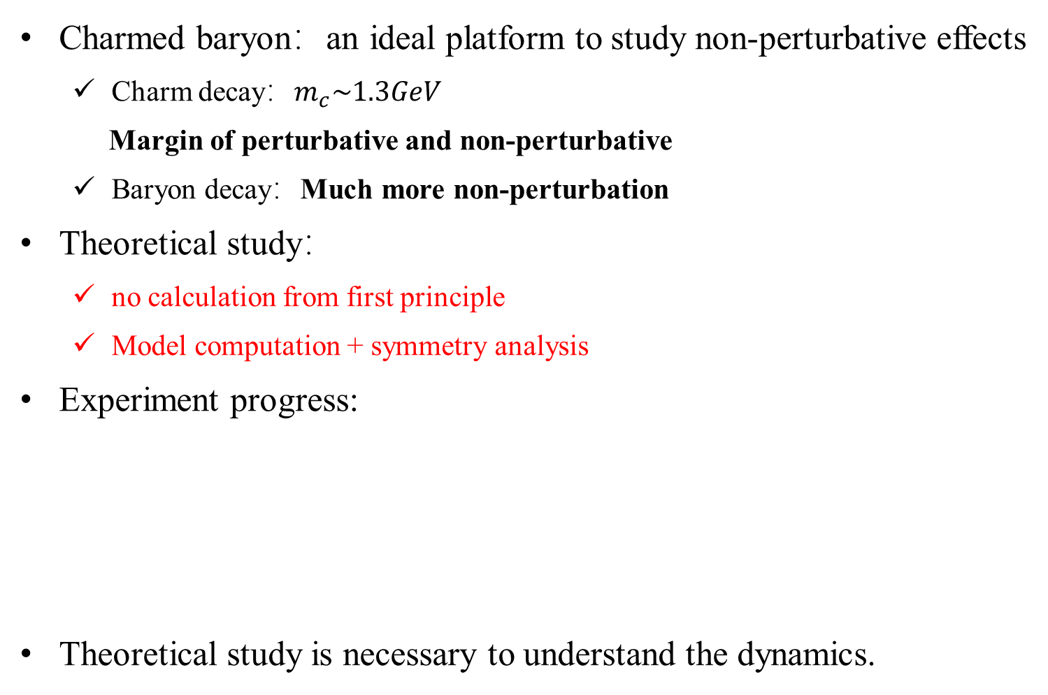

Introduction
Charmed baryon：an ideal platform to study non-perturbative effects
  Charm decay：$m_{c}\sim 1.3GeV$
  Margin of perturbative and non-perturbative
  Baryon decay：Much more non-perturbation
Theoretical study：
  no calculation from first principle
  Model computation + symmetry analysis
Experiment progress:
Theoretical study is necessary to understand the dynamics.
Belle,PRL(2014);BESIII,PRL(2016)
Belle,PRL(2019)
Belle’14,BESIII’16
$$Λ_{c}^{+}→pK^{−}π^{+}$$
Belle’18
$$Ξ_{c}^{0}→Ξ^{−}π^{+}$$
1976
No absolute BRs
Notes:
粲重子的衰变就是研究非微扰效应非常好的平台，粲夸克的质量是

Slide 5
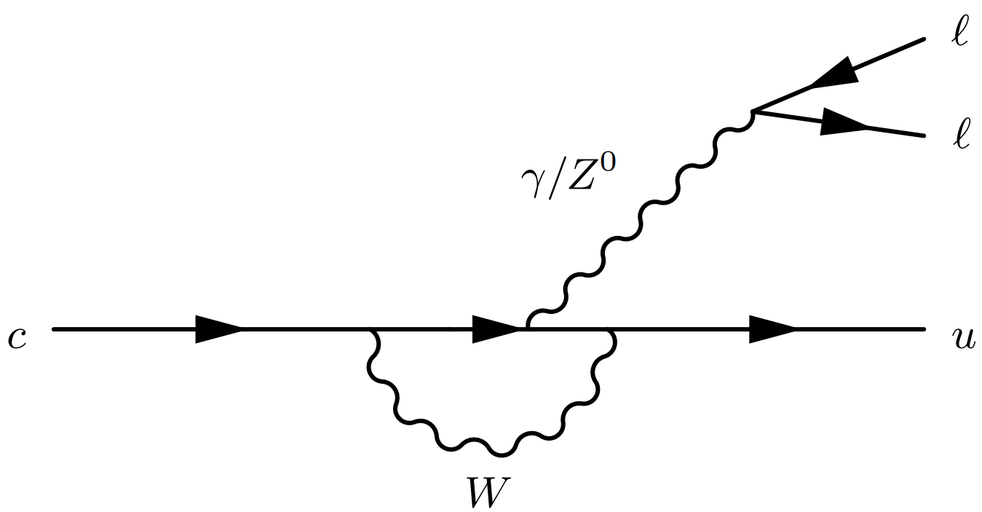
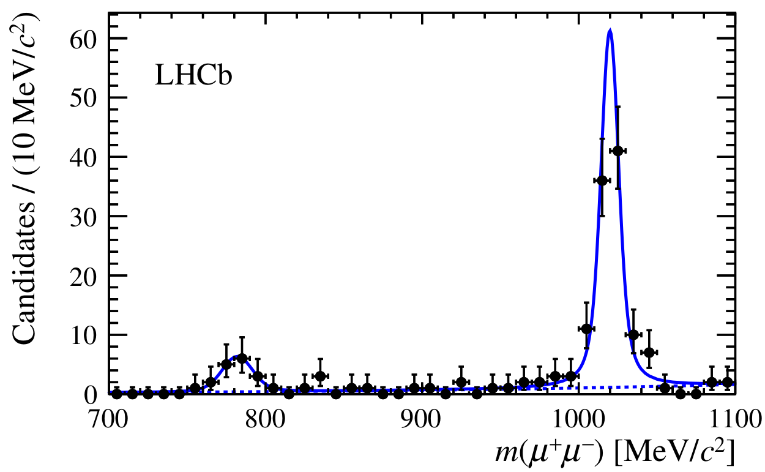
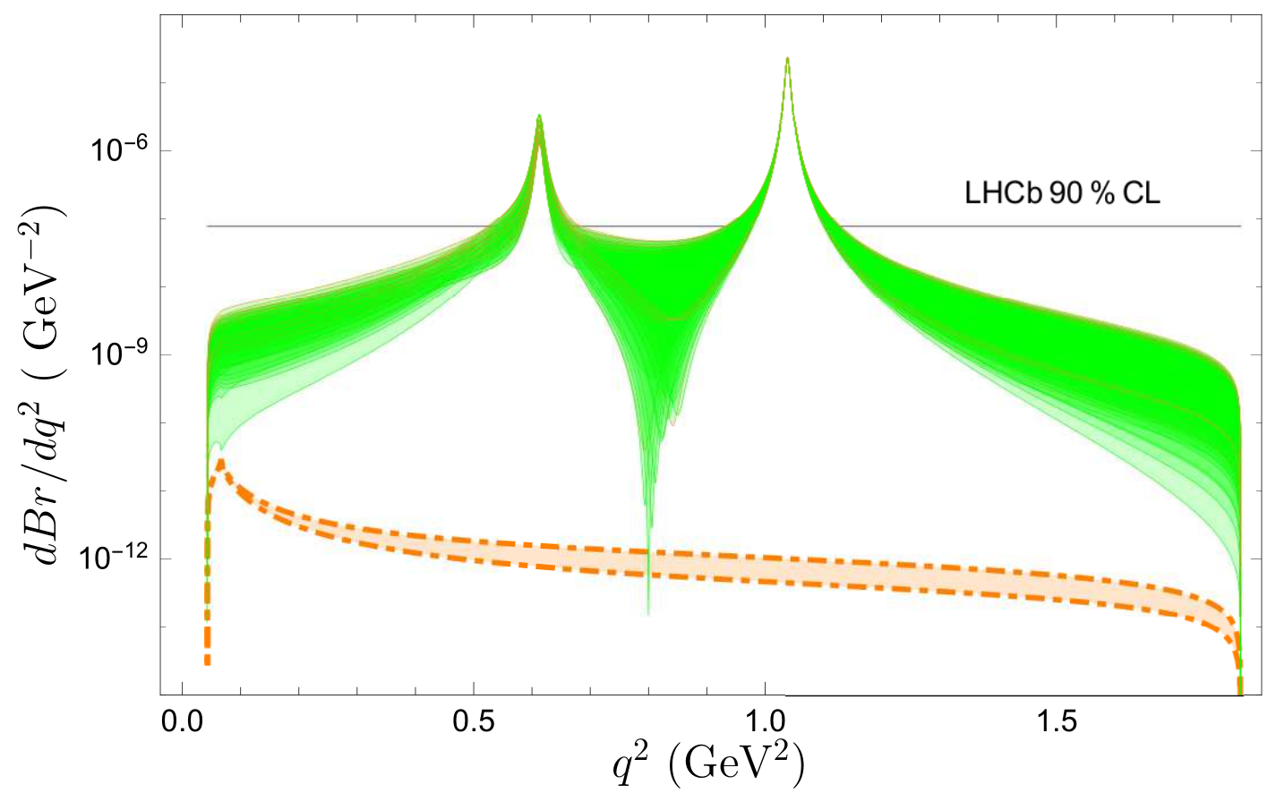



Introduction
$Λ_{c}^{+}→B_{8}V：$Long-distance contribution of FCNC processes;
  $c→ul^{+}l^{−}$: be heavily suppressed in the Standard Model
  Enhancement by effects beyond the SM
  Enhancement by long-distance contributions
  [1] R. Aaij et al. [LHCb Collaboration], PRD 97, 091101 (2018) [arXiv:1712.07938 [hep-ex]].
  [2] R. N. Faustov and V. O. Galkin, EPJC 78, 527 (2018) [arXiv:1805.02516 [hep-ph]].
$φ$ region
$ω$ region
Notes:
我们之所以选择这一类过程还有一个非常重要的原因就是，它是FCNC过程的长程贡献。对于c->ull这类味道改变中性流的过程，其短程贡献在标准模型中是严重压低的，所以他们会对新物理的效应非常敏感，但是呢在分析新物理的效应之前，还有一个不可忽略的贡献就是介子共振态的长程效应，也就是\lambda_c\to p\phi或\omega，\phi\omega再到l^+l^-的这种长程贡献，而且2017年LHCb的实验数据表明，对于\lambda_c\top\mu\mu的过程，没有观测到非共振态的信号，而以phi和omega为中间共振态的这种共振态贡献非常重要，同时，在右边的这张图片中，是夸克模型计算的\Lambda_c\top\mu^+\mu^-这个过程非共振态和共振态的微分衰变分支比，橙色的线就是非共振态的大小，可以看到是在10^-12量级，绿色的线是考虑了共振态的结果，可以看到它们的贡献远大于非共振态的贡献，所以研究清楚共振态的贡献对理解c\to ull的FCNC过程非常重要，同时也可以帮助寻找新物理的效应。

Slide 6
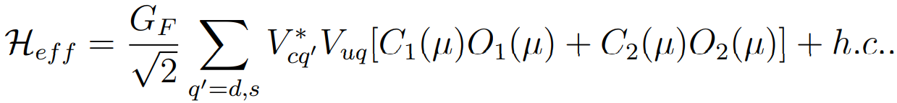
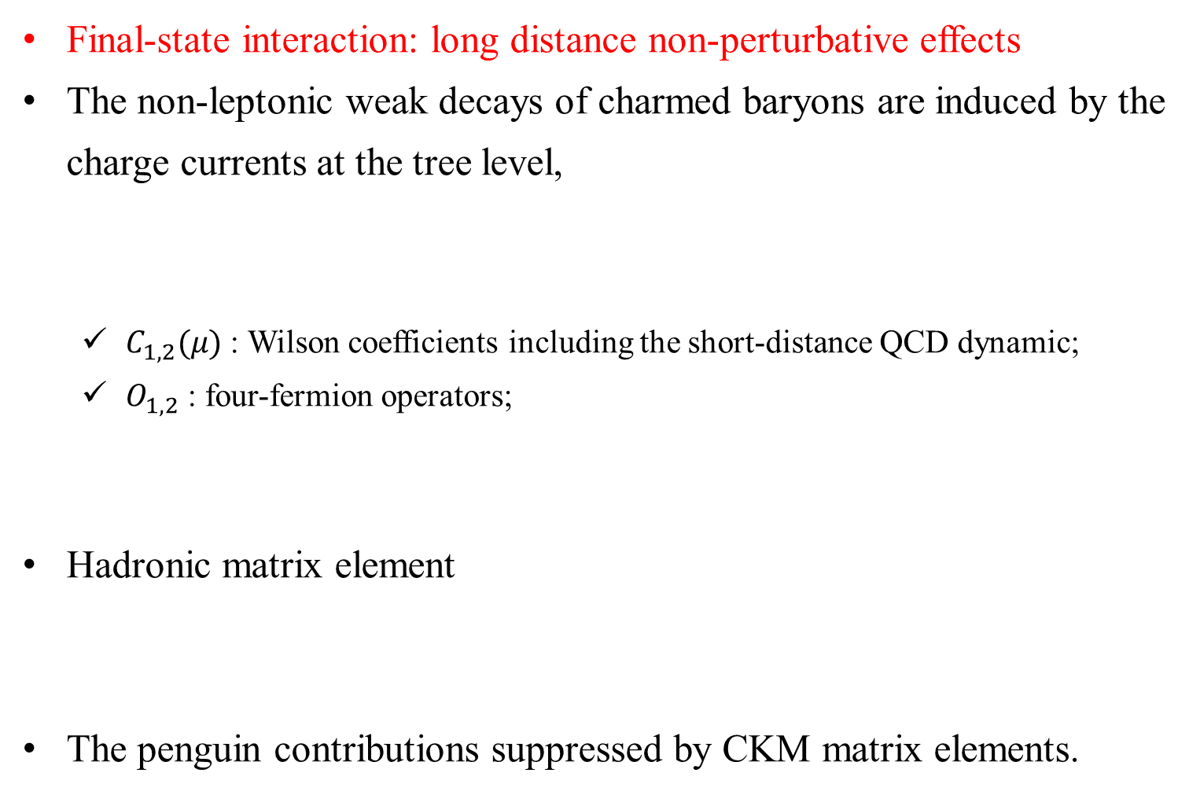
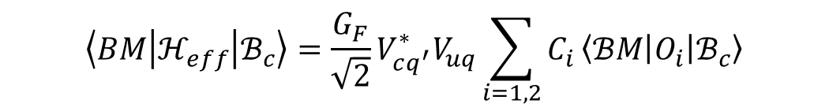
Framework
Final-state interaction: long distance non-perturbative effects
The non-leptonic weak decays of charmed baryons are induced by the charge currents at the tree level,
  $C_{1,2}(μ)$ : Wilson coefficients including the short-distance QCD dynamic;
  $O_{1,2}$ : four-fermion operators;
Hadronic matrix element
The penguin contributions suppressed by CKM matrix elements.
$$\left\langle BM | ℋ_{eff} | ℬ_{c}\right\rangle =\frac{G_{F}}{\sqrt{2}}V_{cq^{′}}^{∗}V_{uq}\sum_{i=1,2}{C_{i}}\left\langle ℬM | O_{i} | ℬ_{c}\right\rangle$$

Slide 7
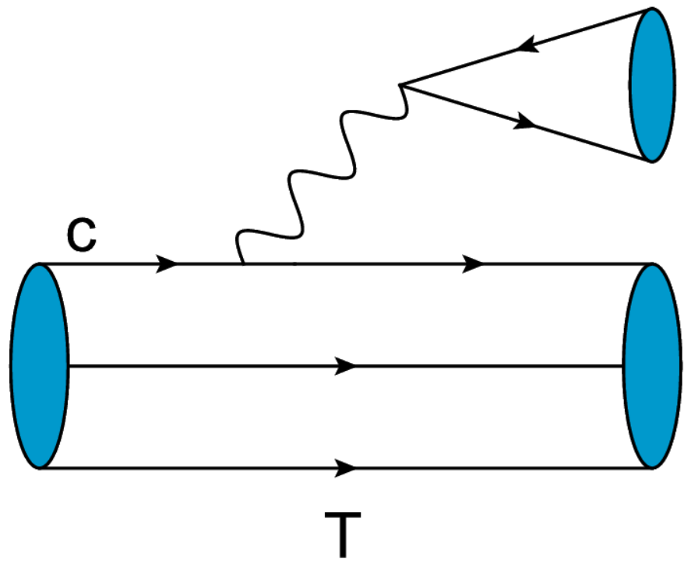
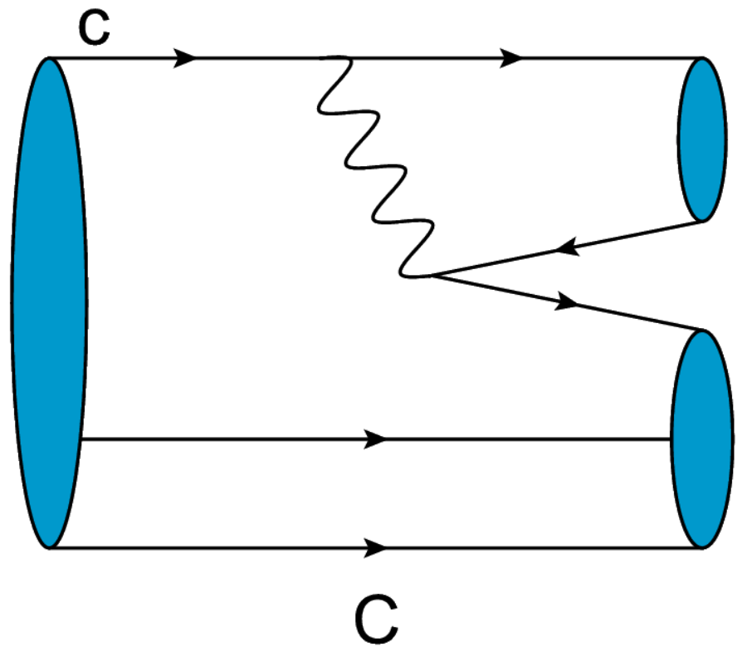
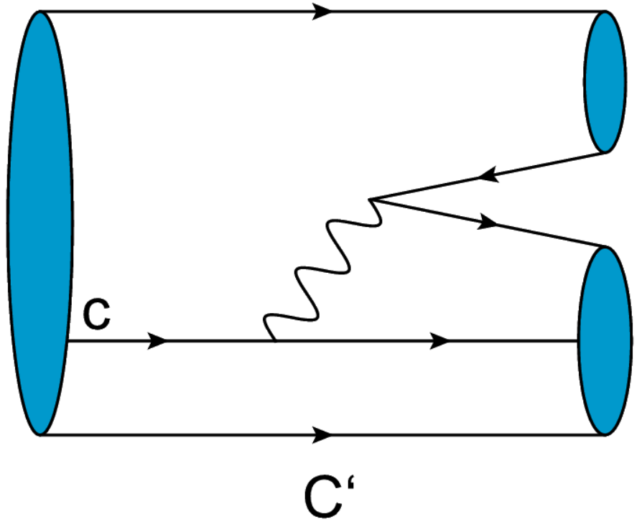
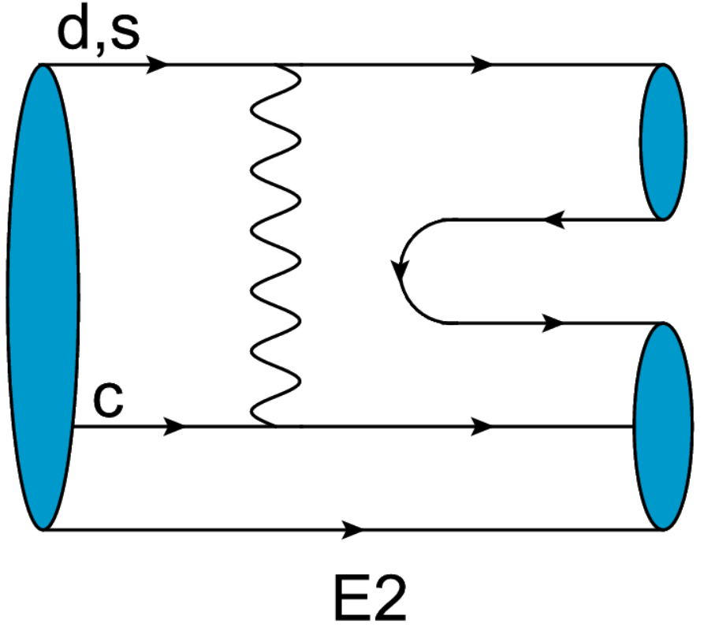
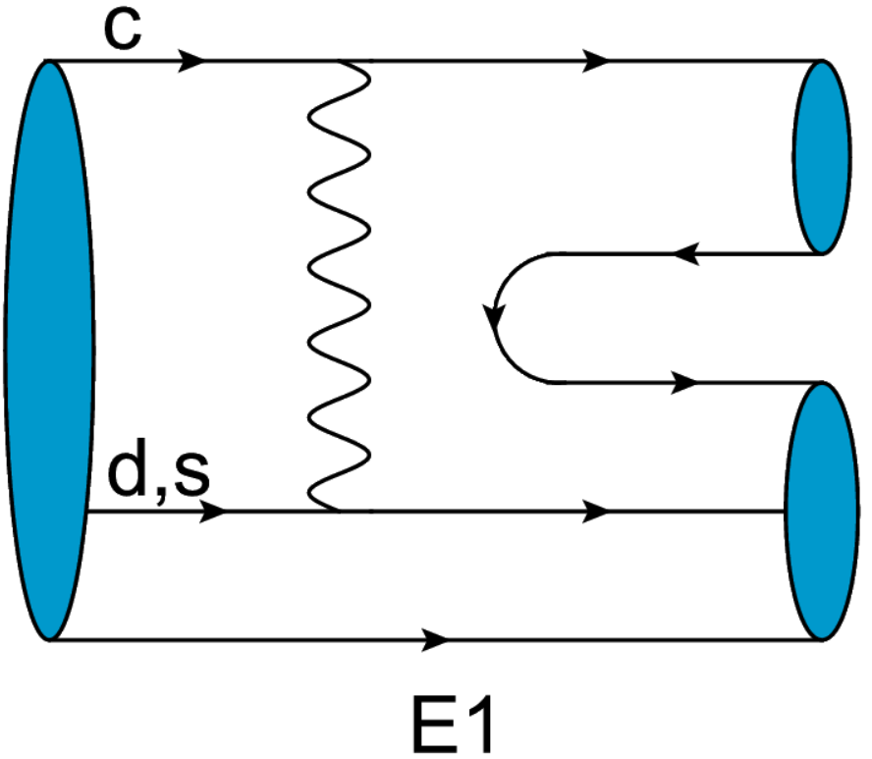
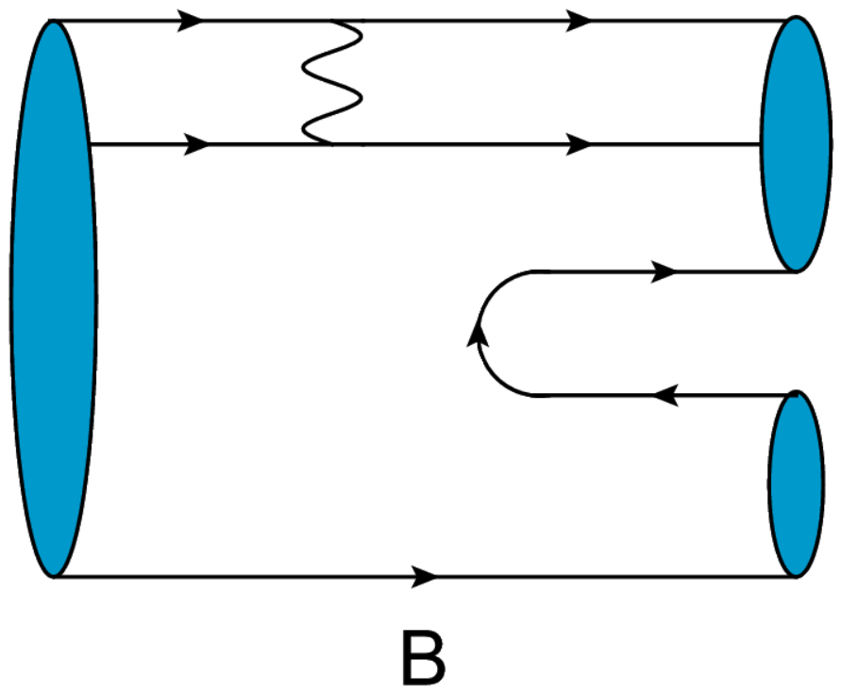
Framework
Tree-level topological diagram for two-body non-leptonic weak decays of charmed baryons two a light-baryon and a meson,

Slide 8
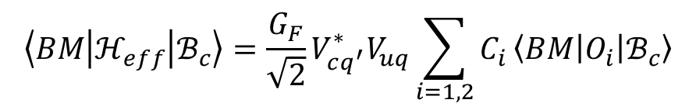
Framework
How to calculate: Short-distance contribution:
  factorization hypothesis;
In general, the weak decay amplitudes have the following parameterization form:
$$\left\langle BM | ℋ_{eff} | ℬ_{c}\right\rangle =\frac{G_{F}}{\sqrt{2}}V_{cq^{′}}^{∗}V_{uq}\sum_{i=1,2}{C_{i}}\left\langle BM | O_{i} | ℬ_{c}\right\rangle$$
factorization hypothesis
$${\left\langle BM | ℋ_{eff} | ℬ_{c}\right\rangle }^{T}=\frac{G_{F}}{\sqrt{2}}V_{cq^{′}}^{∗}V_{uq}a_{1}(μ)\left\langle M | \overline{u}γ^{μ}(1−γ_{5})q | 0\right\rangle \left\langle B | {\overline{q}}^{′}γ_{μ} \left(1−γ_{5}\right)c | ℬ_{c}\right\rangle$$
decay constant
form factors
$$𝒜\left(ℬ_{c}→B_{8}P\right)=i{\overline{u}}_{B_{8}}\left(A+Bγ_{5}\right)u_{B_{c}}$$
$$𝒜\left(ℬ_{c}→B_{8}V\right)=ε^{∗μ}{\overline{u}}_{B_{8}}\left(A_{1}γ_{μ}γ_{5}+A_{2}\frac{p_{μ}(B_{8})}{m_{i}}γ_{5}+B_{1}γ_{μ}+B_{2}\frac{p_{μ}(B_{8})}{m_{i}}\right)u_{B_{c}}$$

Slide 9
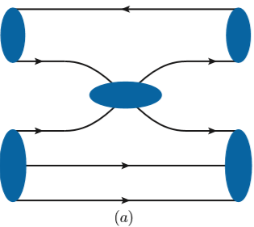
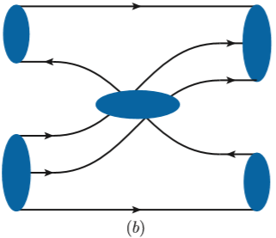
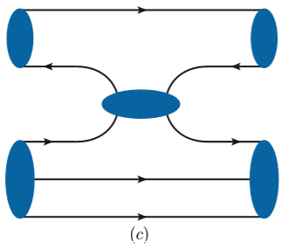
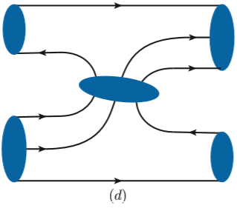
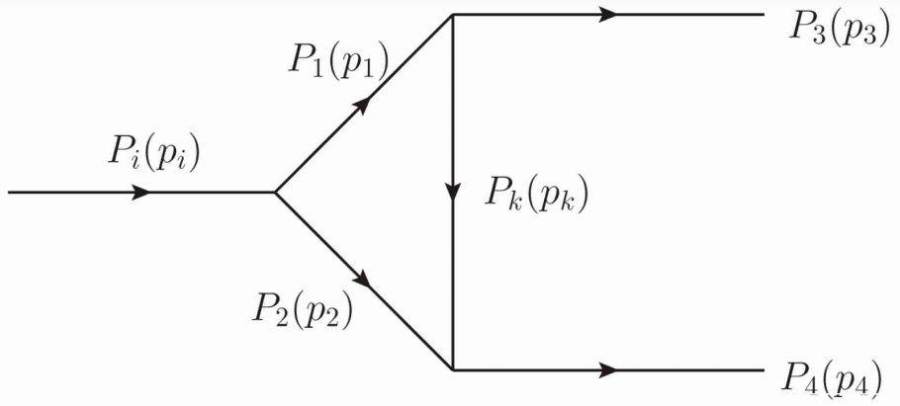
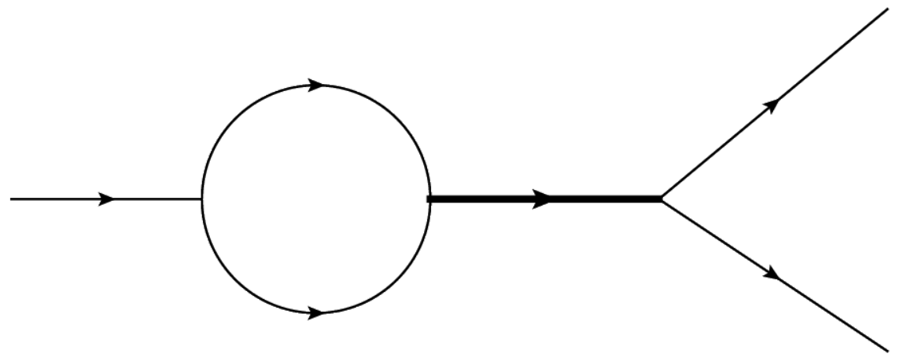
Framework
How to calculate: Long-distance : re-scattering mechanism
  At quark level
  At hadron level
  Adopting optical theorem to calculate the triangle diagrams

Slide 10
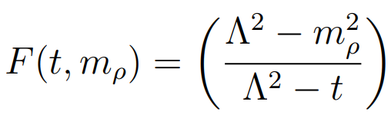

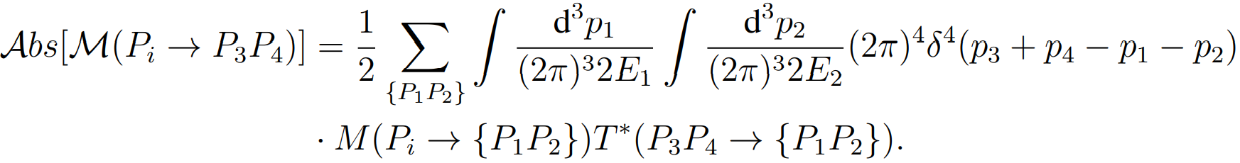
Framework
Long-distance contributions with final-state interactions :
  Adopting optical theorem
  Treat the intermediate particles as on-shell
  Assuming the dominance of absorptive part
  Weak vertex：factorization;
  FSIs effects: the strong-interaction effective Lagrangian

Slide 11
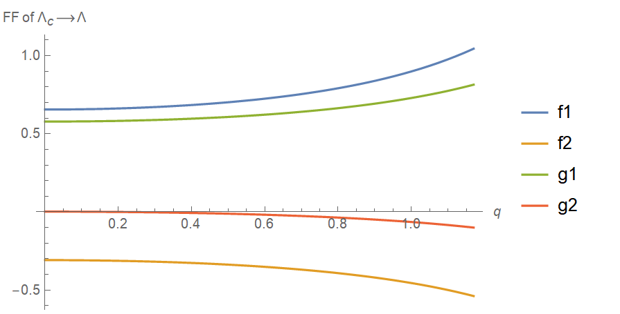
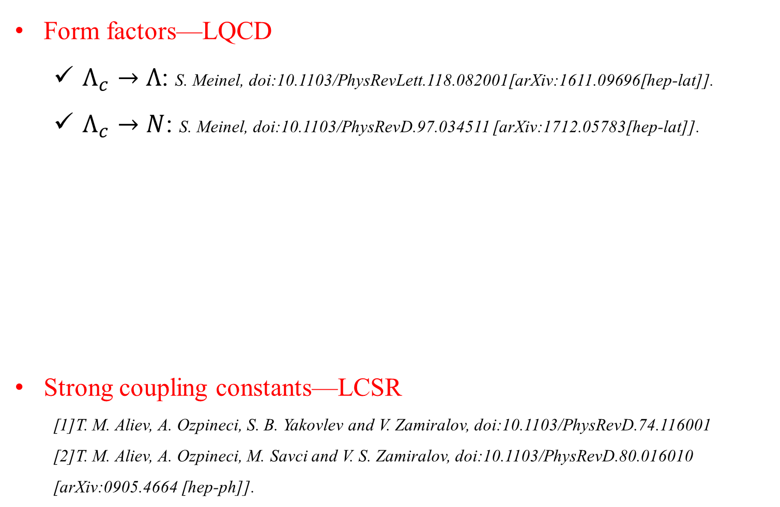
Framework
Form factors—LQCD
  $Λ_{c}→Λ$: S. Meinel, doi:10.1103/PhysRevLett.118.082001[arXiv:1611.09696[hep-lat]].
  $Λ_{c}→N$: S. Meinel, doi:10.1103/PhysRevD.97.034511 [arXiv:1712.05783[hep-lat]].
Strong coupling constants—LCSR
  [1]T. M. Aliev, A. Ozpineci, S. B. Yakovlev and V. Zamiralov, doi:10.1103/PhysRevD.74.116001
  [2]T. M. Aliev, A. Ozpineci, M. Savci and V. S. Zamiralov, doi:10.1103/PhysRevD.80.016010
  [arXiv:0905.4664 [hep-ph]].

Slide 12
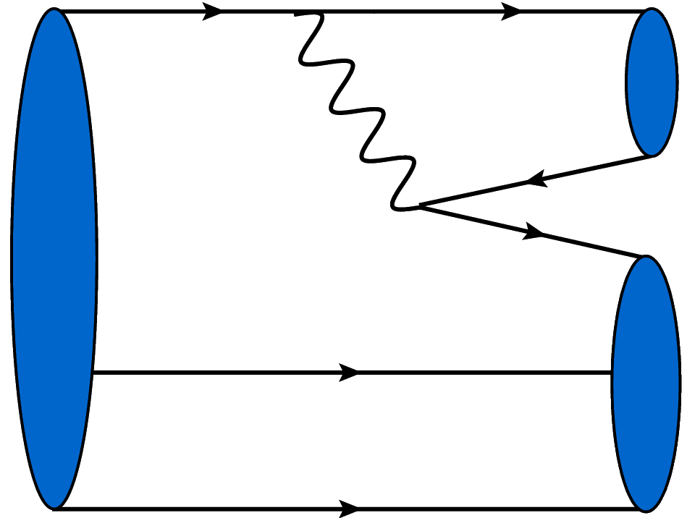
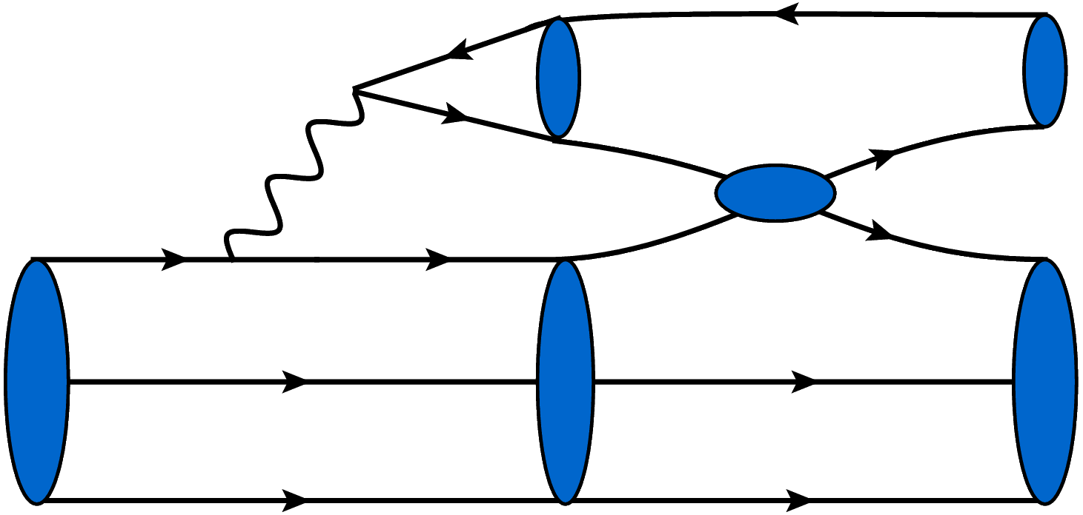
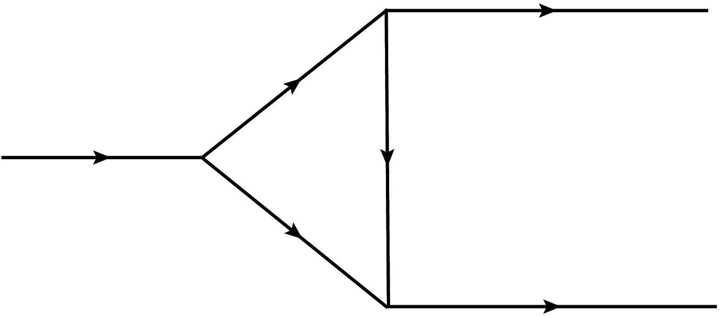
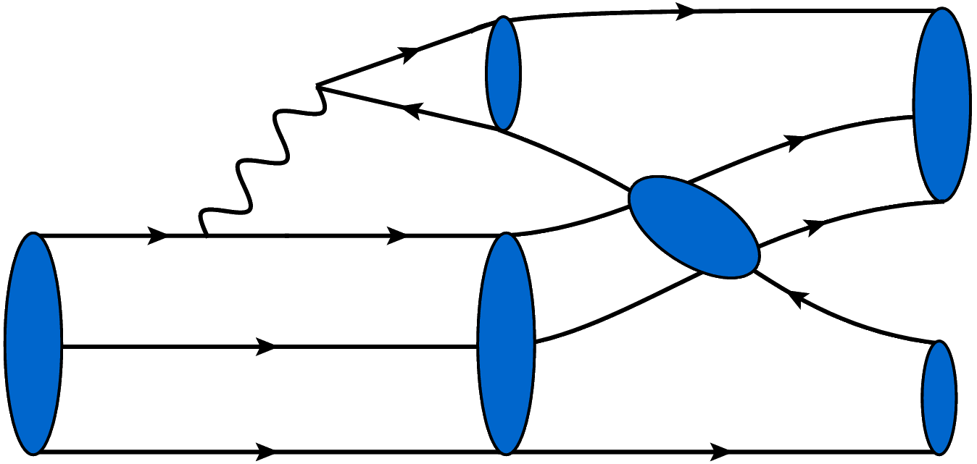
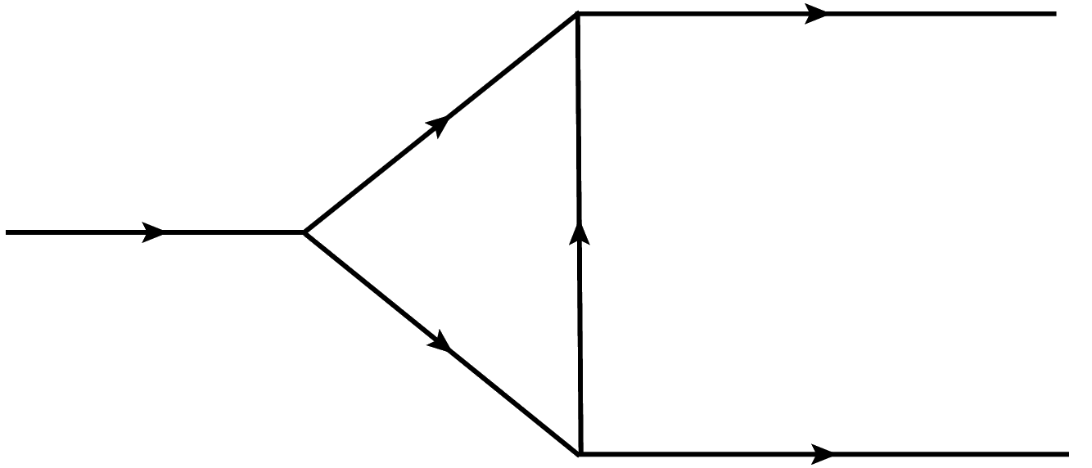





















































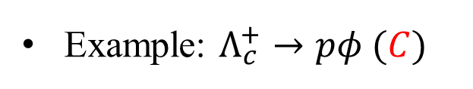








Results
$$s$$
$$φ$$
Example: $Λ_{c}^{+}→pφ (C)$
$$\overline{s}$$
$$Λ_{c}^{+}$$
$$u$$
$$d$$
$$d$$
$$u$$
$$u$$
$$p$$
$$\overline{s}$$
$$\overline{s}$$
$$φ(p_{3},λ_{3})$$
$$φ(p_{3},λ_{3})$$
$$φ$$
$$K^{+} (p_{1})$$
$$K^{∗+} (p_{1},λ_{1})$$
$$s$$
$$u$$
$$c$$
$$s$$
$$K^{+} (k)$$
$$u$$
$$Λ_{c}^{+}(p_{i},s_{i})$$
$$K^{∗+} (k,λ_{k})$$
$$Λ_{c}^{+}$$
$$d$$
$$d$$
$$d$$
$$p$$
$$Λ_{c}^{+}(p_{i},s_{i})$$
$$Λ^{0} (p_{2},s_{2})$$
$$p(p_{4},s_{4})$$
$$Λ^{0} (p_{2},s_{2})$$
$$p(p_{4},s_{4})$$
$$u$$
$$u$$
$$u$$
$$u$$
$$u$$
$$p(p_{3},s_{3})$$
$$p(p_{3},s_{3})$$
$$p$$
$$K^{+} (p_{1})$$
$$K^{∗+} (p_{1},λ_{1})$$
$$u$$
$$c$$
$$\overline{s}$$
$$d$$
$$s$$
$$Λ^{0} (k,s_{k})$$
$$Λ^{0} (k,s_{k})$$
$$Λ_{c}^{+}(p_{i},s_{i})$$
$$Λ_{c}^{+}(p_{i},s_{i})$$
$$Λ_{c}^{+}$$
$$d$$
$$d$$
$$\overline{s}$$
$$φ(p_{4},λ_{4})$$
$$φ$$
$$Λ^{0} (p_{2},s_{2})$$
$$φ(p_{4},λ_{4})$$
$$Λ^{0} (p_{2},s_{2})$$
$$u$$
$$u$$
$$s$$

Slide 13
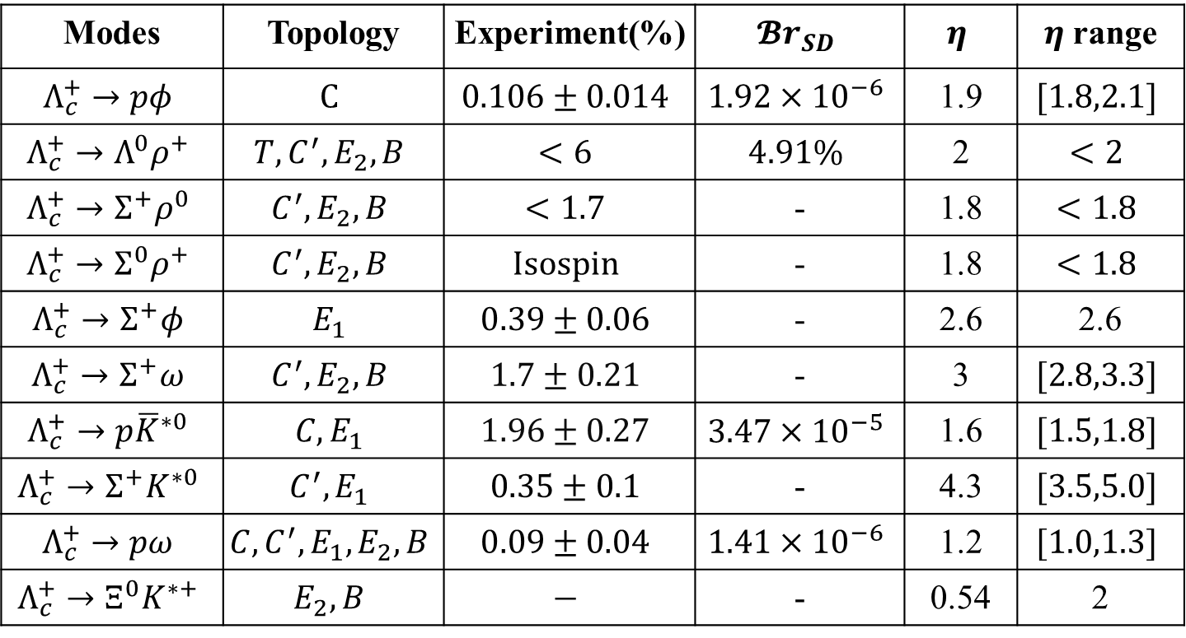
Results
Branching ratios
Modes | Topology | Experiment(%) | $$𝓑r_{SD}$$ | $$η$$ | $η$ range
$$Λ_{c}^{+}→pφ$$ | $$C$$ | $$0.106±0.014$$ | $$1.92×{10}^{−6}$$ | 1.9 | $$[1.8,2.1]$$
$$Λ_{c}^{+}→Λ^{0}ρ^{+}$$ | $$T,C^{′}, E_{2}, B$$ | $$<6$$ | $$4.91\%$$ | 2 | $$<2$$
$$Λ_{c}^{+}→Σ^{+}ρ^{0}$$ | $$C^{′}, E_{2}, B$$ | $$<1.7$$ | - | 1.8 | $$<1.8$$
$$Λ_{c}^{+}→Σ^{0}ρ^{+}$$ | $$C^{′},E_{2}, B$$ | $$Isospin$$ | - | 1.8 | $$<1.8$$
$$Λ_{c}^{+}→Σ^{+}φ$$ | $$E_{1}$$ | $$0.39±0.06$$ | - | 2.6 | 2.6
$$Λ_{c}^{+}→Σ^{+}ω$$ | $$C^{′}, E_{2}, B$$ | $$1.7±0.21$$ | - | 3 | $$[2.8,3.3]$$
$$Λ_{c}^{+}→p{\overline{K}}^{∗0}$$ | $$C, E_{1}$$ | $$1.96±0.27$$ | $$3.47×{10}^{−5}$$ | 1.6 | $$[1.5,1.8]$$
$$Λ_{c}^{+}→Σ^{+}K^{∗0}$$ | $$C^{′},E_{1}$$ | $$0.35±0.1$$ | - | 4.3 | $$[3.5,5.0]$$
$$Λ_{c}^{+}→pω$$ | $$C, C^{′},E_{1},E_{2}, B$$ | $$0.09±0.04$$ | $$1.41×{10}^{−6}$$ | 1.2 | $$[1.0,1.3]$$
$$Λ_{c}^{+}→Ξ^{0}K^{∗+}$$ | $$E_{2}, B$$ | $$−$$ | - | 0.54 | 2

Slide 14
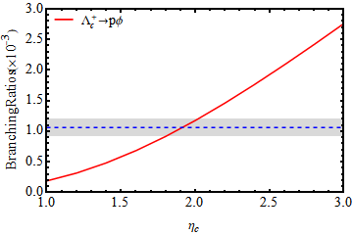
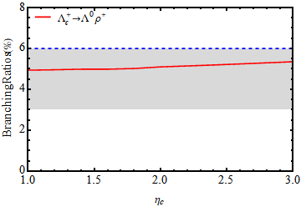
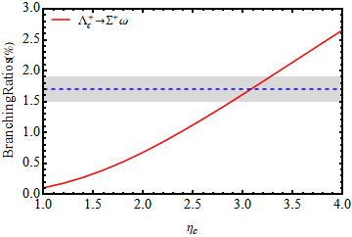
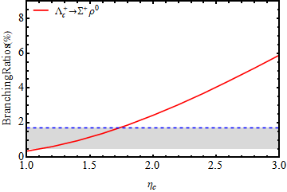





Results
The dependence of η
$$[2,1.2]$$
$$\left[1.8,0.92\right]$$
$$\left[3.3,1.91\right]$$
$$\left[2.8,1.42\right]$$
$$[1.75,1.70]$$

Slide 15

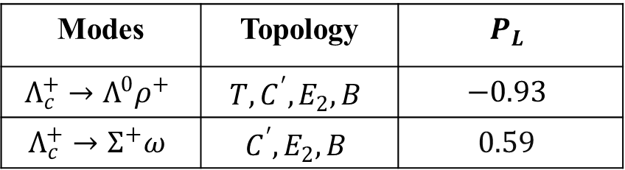

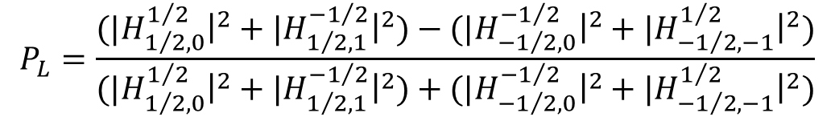
Results
Decay asymmetry
  With partial amplitudes ($S,P_{1},P_{2},D$)
  With helicity amplitudes ($H_{1/2,0}^{1/2}, H_{1/2,1}^{−1/2},{ H}_{{−1}/2,0}^{−1/2}, H_{{−1}/2,−1}^{1/2}$)
  For vector meson: $α_{V}$ 
$$P_{L}=\frac{2E_{V}^{2}Re{\left(S+D\right)}^{∗}P_{1}−4m_{V}^{2}Re(S^{∗}P_{2})}{2m_{V}^{2}\left({\left|S\right|}^{2}+{\left|P\right|}^{2}\right)+E_{V}^{2}({\left|S+D\right|}^{2}+|P_{1}|^2)}$$
$$P_{L}=\frac{{(|H}_{1/2,0}^{1/2}{\left.​\right|}^{2}+{|H}_{1/2,1}^{{−1}/2}{\left.​\right|}^{2})−{(|H}_{{−1}/2,0}^{{−1}/2}{\left.​\right|}^{2}+{|H}_{{−1}/2,−1}^{1/2}{\left.​\right|}^{2})}{{(|H}_{1/2,0}^{1/2}{\left.​\right|}^{2}+{|H}_{1/2,1}^{{−1}/2}{\left.​\right|}^{2})+{(|H}_{{−1}/2,0}^{{−1}/2}{\left.​\right|}^{2}+{|H}_{{−1}/2,−1}^{1/2}{\left.​\right|}^{2})}$$
Modes | Topology | $$P_{L}$$
$$Λ_{c}^{+}→Λ^{0}ρ^{+}$$ | $$T,C^{′}, E_{2}, B$$ | $$−0.93$$
$$Λ_{c}^{+}→Σ^{+}ω$$ | $$C^{′}, E_{2}, B$$ | $$0.59$$

Slide 16
Summary
Finished the calculations of branching ratio and decay asymmetry for several modes.
Next step:
  Long-distance contribution is sensitive to the strong coupling constants but it suffers from large uncertainties.
  —analyze the dependence of strong coupling constants.
  Contributions of excited states.
  —analyze the contributions of excited states.
Thanks for your listening!

Slide 17
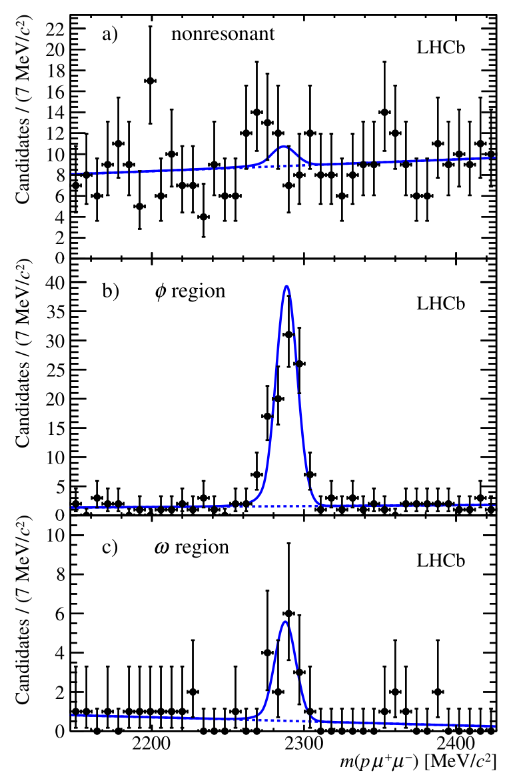
Backup

