Slide 1
Hunt for “light” heavy neutrino at Z-factories
沈胤发 导师：秦溱副教授
华中科技大学

Slide 2

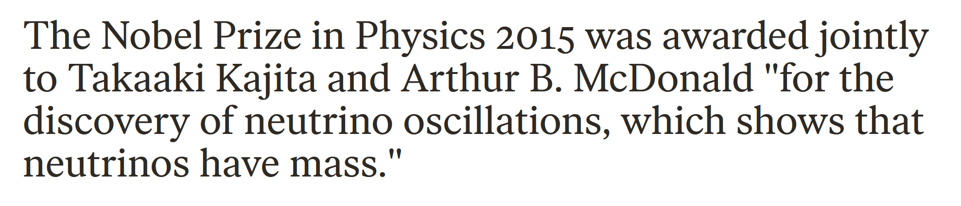
1.Motivation
Nonzero but so tiny compared to other particles

Slide 3
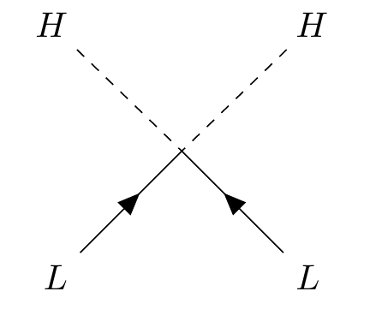
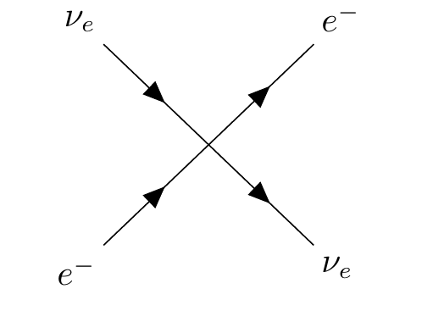
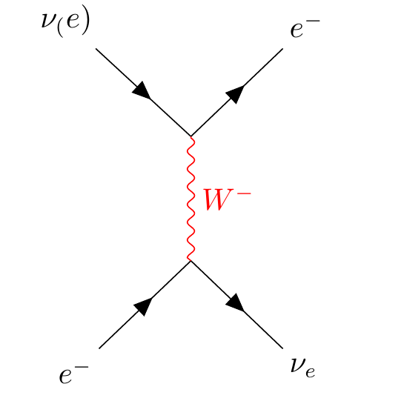
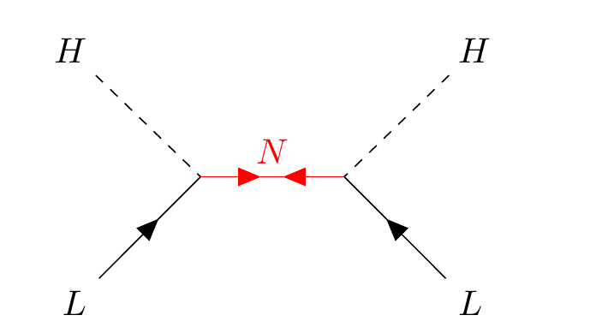

1.Motivation
Weinberg operator (5d):$\frac{Y_{ν}^{2}}{M}(\overline{L}∙\tilde{H})({\tilde{H}}^{T}∙L^{c})$
Fermi four-fermion interaction

Slide 4
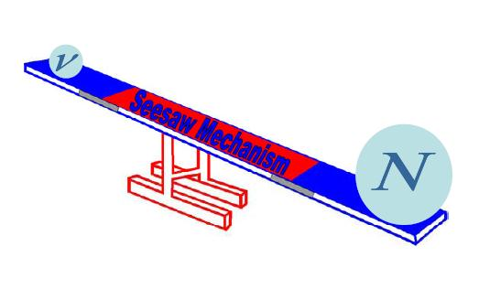
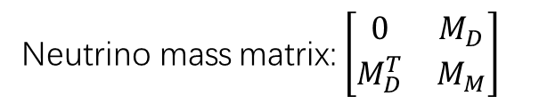


1.Motivation
$ℒ_{neutrino}=\frac{1}{2}i∂\overline{R_{i}^{c}}γ^{μ}∂_{μ}R_{i}+(−Y_{ν}{\overline{E}}_{L}{\left(iσ_{2}^{}φ\right)}^{†}ν_{R}−\frac{1}{2}{\left(M_{N}\right)}_{ij}\overline{R_{i}^{C}}R_{j}+h.c.$)
Neutrino mass matrix: $\left[\begin{matrix}0 & M_{D} \\ M_{D}^{T} & M_{M}\end{matrix}\right]$
Two eigenvalue:$M_{M},\frac{M_{D}^{2}}{M_{M}}$
Diagonalize the mass matrix
Rewrite flavor eigenstates: $ν_{ℓ}=Σ{U_{ℓi}ν}_{i}+ΣV_{ℓi}N_{j}$
Rewrite the weak current:
$$J_{W}^{μ−}=\left(ΣU_{ℓi}^{∗}\overline{ν_{ℓ}}+ΣV_{ℓi}^{∗}\overline{N_{j}}\right)γ^{μ}ℓ_{L}, J_{W}^{μ+}={\left(J_{W}^{μ−}\right)}^{†}, J_{Z}^{μ}=(ΣU_{ℓi}^{∗}\overline{ν_{ℓ}}+ΣV_{ℓi}^{∗}\overline{N_{j}})γ^{μ}(Σ{U_{ℓi}ν}_{Li}+ΣV_{ℓi}N_{Lj})$$

Slide 5
1.Motivation
Neutrino tiny mass
Only participates weak interaction
Dark matter
More CP-violation phases(for matter-antimatter asymmetry )
With so large mass
Majorana fermion
Charge quantization
Two sterile neutrinos with mass in the range : 1-12 GeV
The vmsm, dark matter and baryon asymmetry of the universe. Physics Letters B, 620(1-2):17–26, 2005.

Slide 6
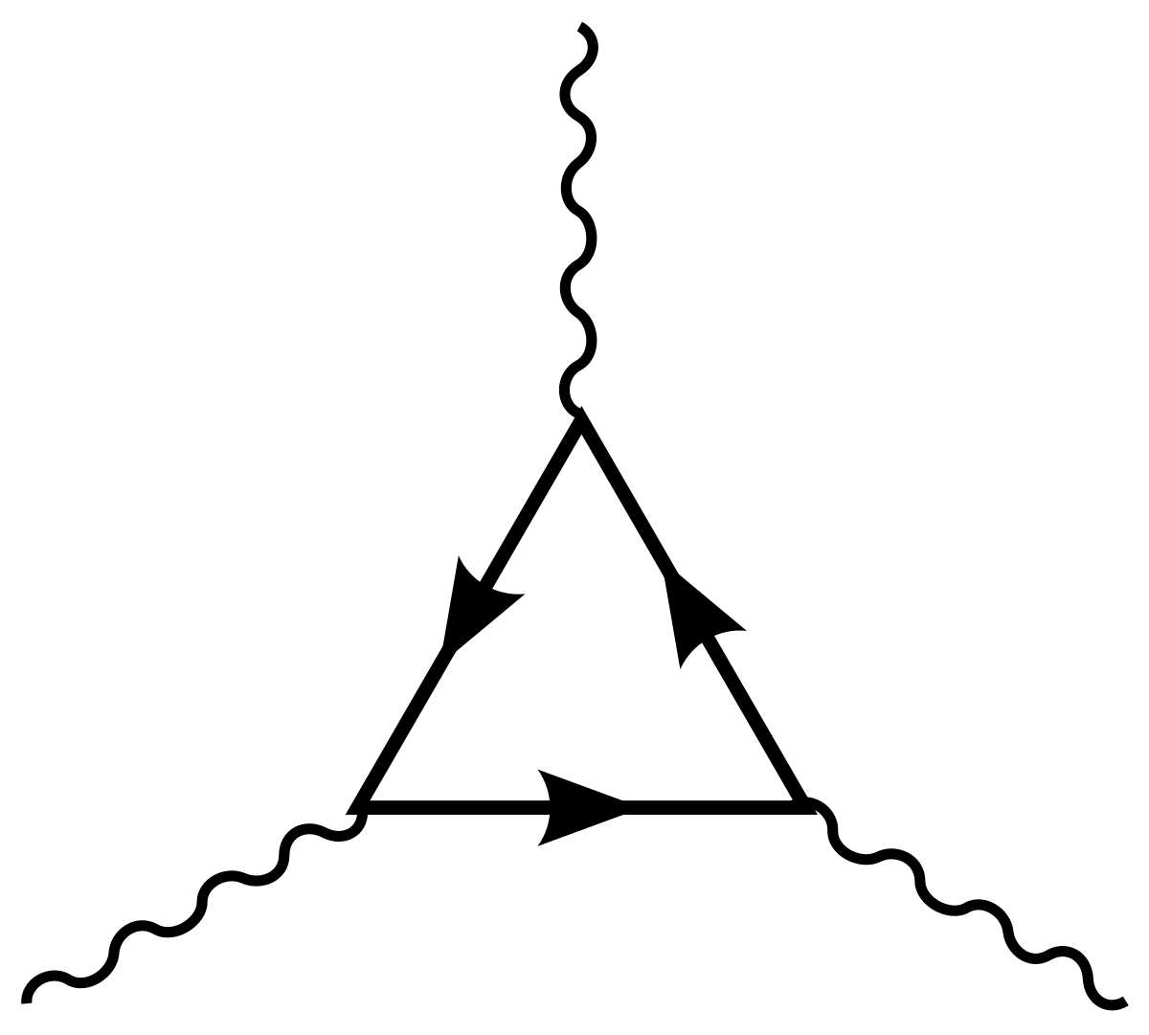
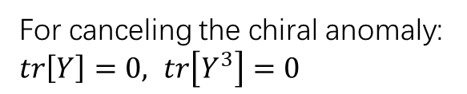
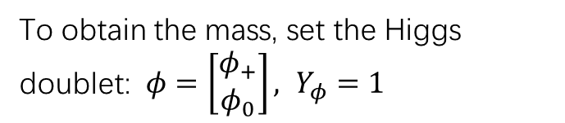

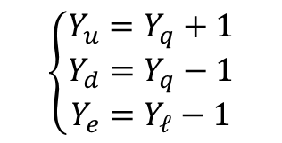
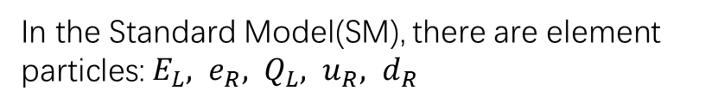
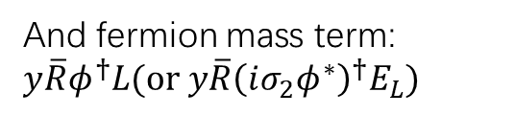
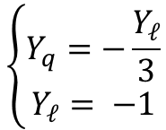
1.Introduction: Charge Quantization?
Gell-mann-Nishijima formula: $Q=T_{3}+\frac{Y}{2}$
In the Standard Model(SM), there are element particles: $E_{L}, e_{R}, Q_{L}, u_{R}, d_{R}$
To obtain the mass, set the Higgs doublet: $φ=\left[\begin{matrix}φ_{+} \\ φ_{0}\end{matrix}\right], Y_{φ}=1$
5 free hypercharge parameters
For gauge invariance
$$\left\{\begin{aligned}Y_{u}=Y_{q}+1 \\ Y_{d}=Y_{q}−1 \\ Y_{e}=Y_{ℓ}−1\end{aligned}\right.$$
And fermion mass term: $y\overline{R}φ^{†}L(or y\overline{R}{\left(iσ_{2}φ^{∗}\right)}^{†}E_{L})$
2 free hypercharge parameters remain
For canceling the chiral anomaly: $tr\left[Y\right]=0, tr\left[Y^{3}\right]=0$
$$\left\{\begin{aligned}Y_{q}=−\frac{Y_{ℓ}}{3} \\ Y_{ℓ}= −1\end{aligned}\right.$$
No free hypercharge parameters remain, so the charge is quantized naturally

Slide 7
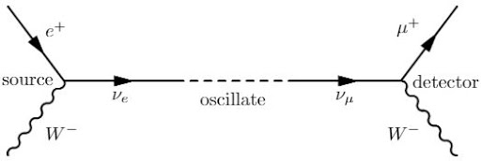
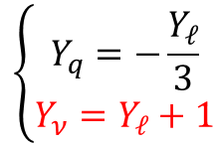
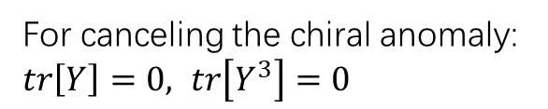
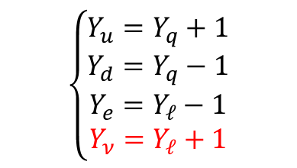
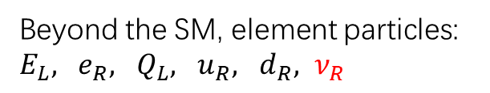
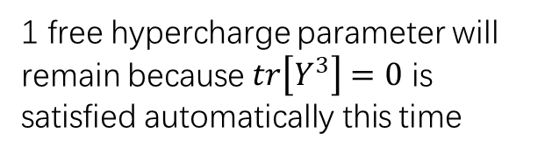
1.Introduction: Charge Quantization?
However, neutrino oscillations have been observed
Beyond the SM, element particles: $E_{L}, e_{R}, Q_{L}, u_{R}, d_{R}, ν_{R}$
6 free hypercharge parameters
$$\left\{\begin{aligned}Y_{u}=Y_{q}+1 \\ Y_{d}=Y_{q}−1 \\ Y_{e}=Y_{ℓ}−1 \\ Y_{ν}=Y_{ℓ}+1\end{aligned}\right.$$
For gauge invariance
Neutrino mass terms: ${y\overline{ν}}_{R}{(iσ_{2}φ^{∗})}^{†}E_{L}$
2 free hypercharge parameters remain
For canceling the chiral anomaly: $tr\left[Y\right]=0, tr\left[Y^{3}\right]=0$
$$\left\{\begin{aligned}Y_{q}=−\frac{Y_{ℓ}}{3} \\ Y_{ν}=Y_{ℓ}+1\end{aligned}\right.$$
1 free hypercharge parameter will remain because $tr\left[Y^{3}\right]=0$ is satisfied automatically this time

Slide 8



1.Introduction: Charge Quantization?
To return the result: $Y_{ℓ}=−1$
$$Y_{ν}=Y_{ℓ}+1$$
$$Y_{ν}=0$$
But how to get it?
The charge is quantized again
If neutrino is Majorana fermion, things will be nature
Is there a connection between quantization of electric charge and a majorana neutrino. Physical Review Letters, 63(9):938–941, 1989

Slide 9
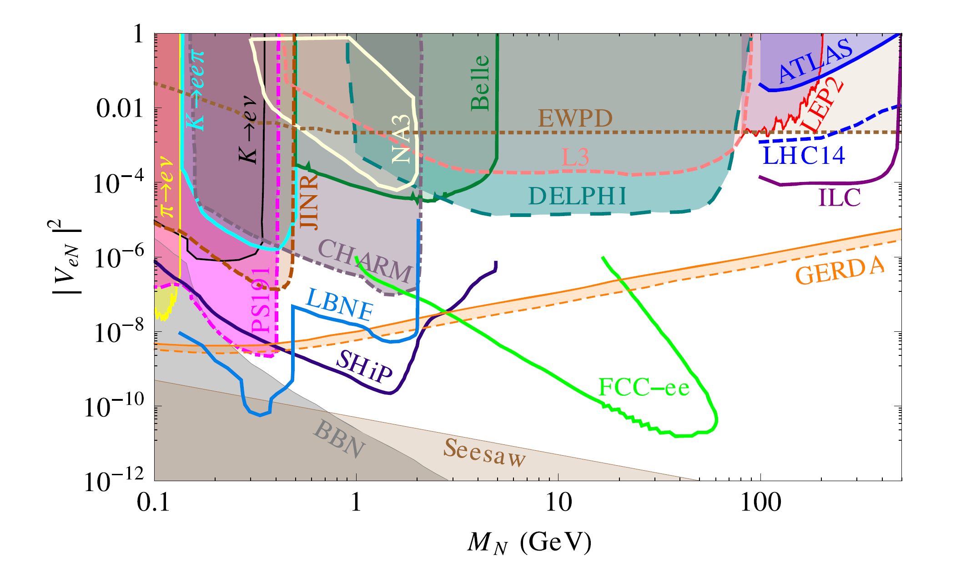
2.Expenrimental searches
Heavy neutrino mass range: 5-15 GeV
Neutrinos and collider physics[J]. New Journal of Physics, 2015, 17(7): 075019.

Slide 10
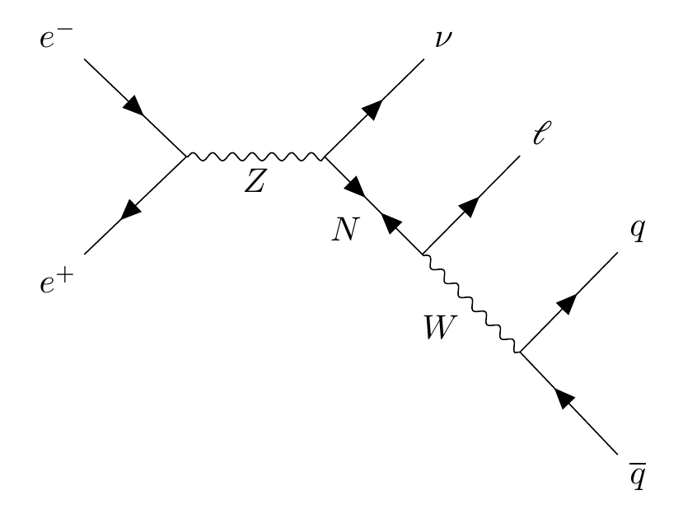



3.Process at Z factories
$$∝$$
$${\left|V_{ℓN}\right|}^{2}$$
$$σ(e^{−}e^{+}→Z→νN→νℓq\overline{q})$$

Slide 11
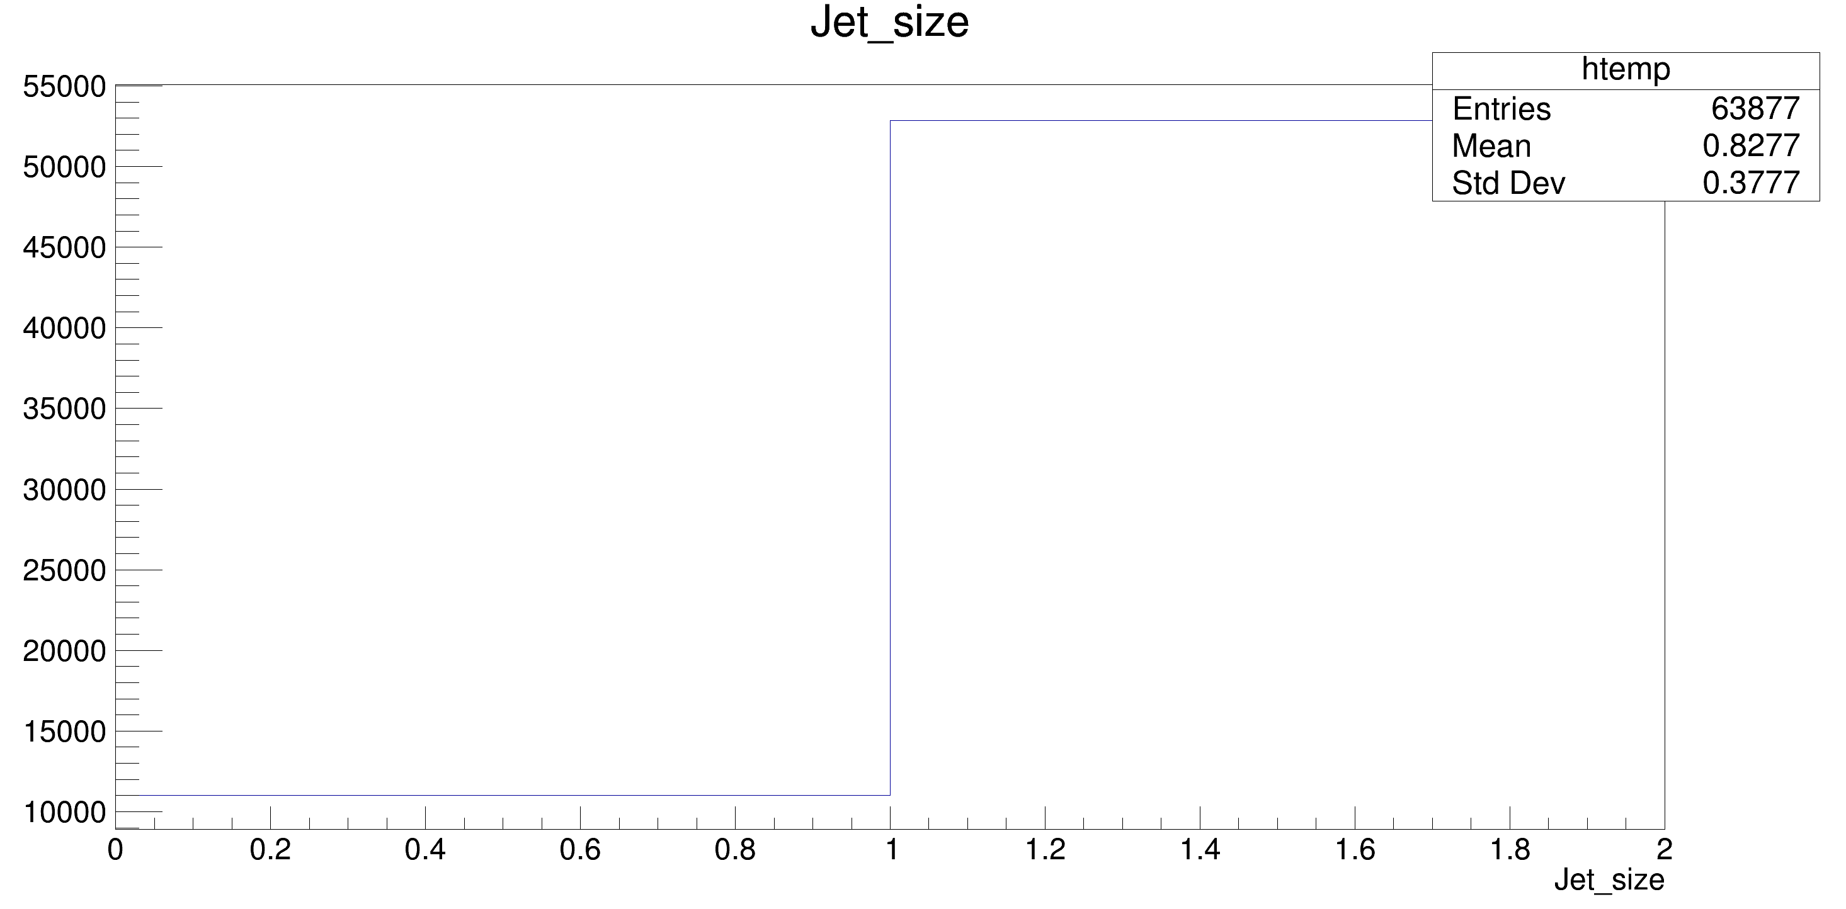
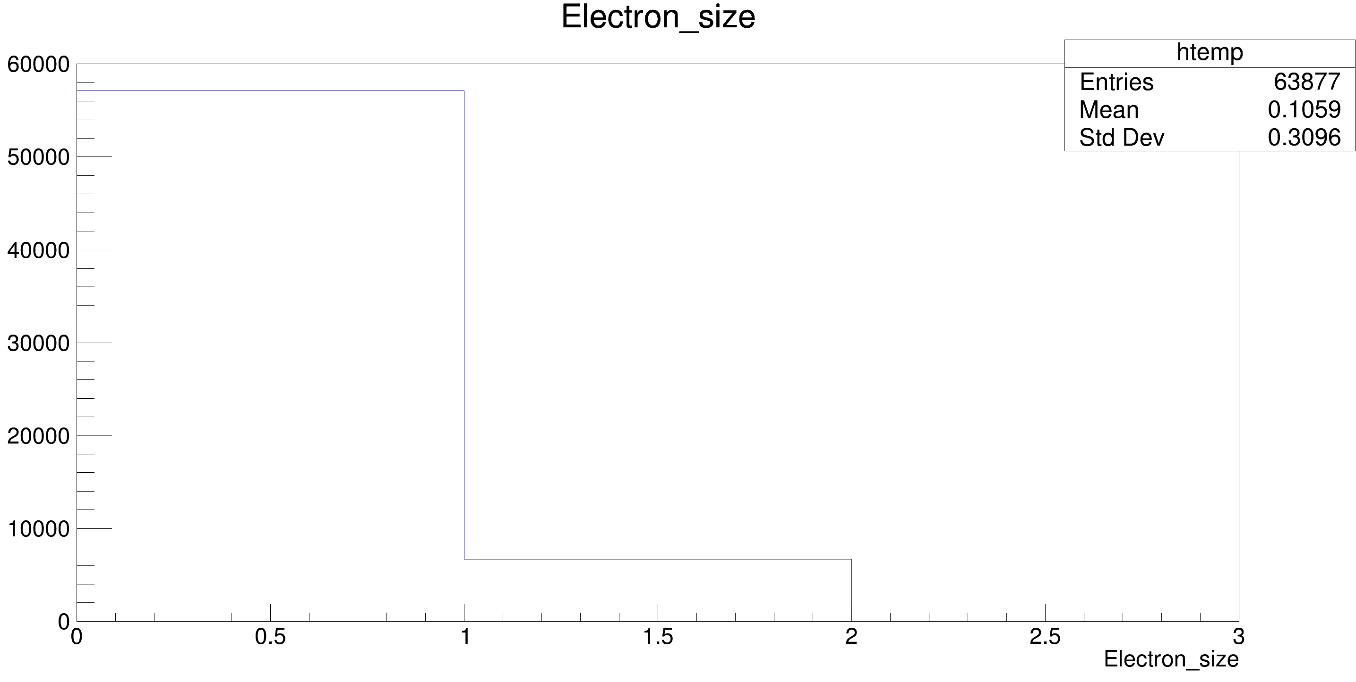
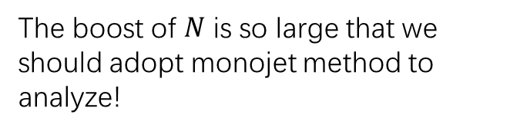
4.Simulation
The boost of $N$ is so large that we should adopt monojet method to analyze!

Slide 12
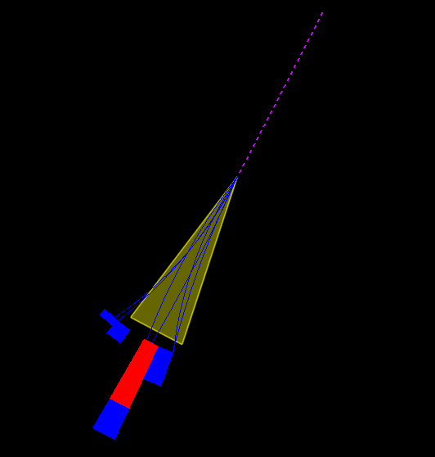
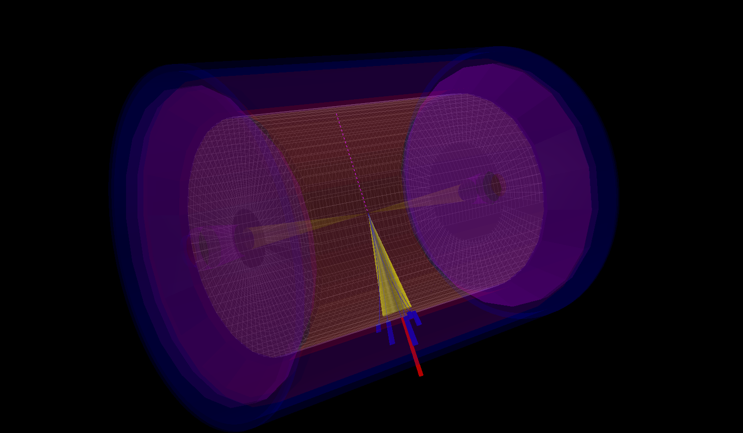



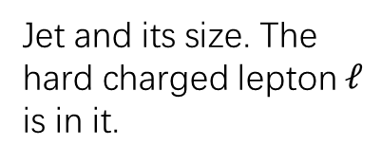
3.Simulation: Signal
Jet and its size. The hard charged lepton $ℓ$ is in it.
$${ΔR}_{ℓj}<3 \& p_{T}>5 GeV$$
Missing energy(mainly neutrinos). It flies back-to-back with the jet .It also looks so “empty”
$${3.1(π)<ΔR}_{νj}<4$$
$${ΔR}_{νp}<2: Σp_{T}+ΣE_{T}<0.3 GeV$$

Slide 13
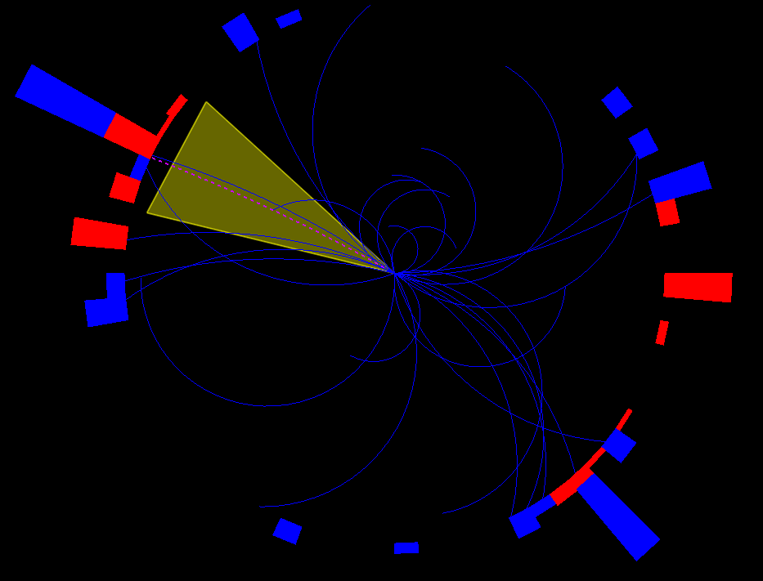

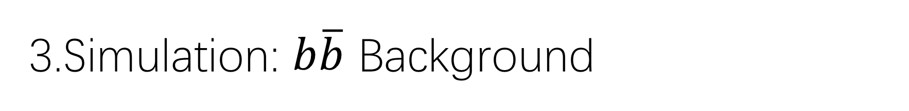
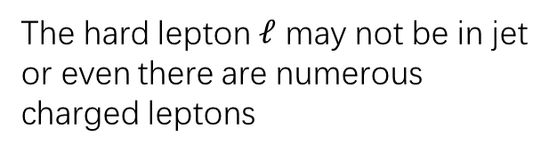
3.Simulation: $b\overline{b}$ Background
$$b\overline{b}$$
signal
It’s so messy compared to signal.
The hard lepton $ℓ$ may not be in jet or even there are numerous charged leptons

Slide 14
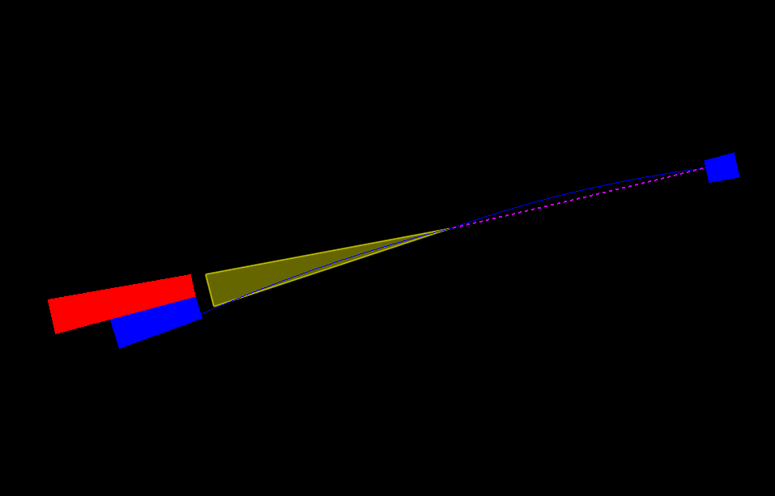


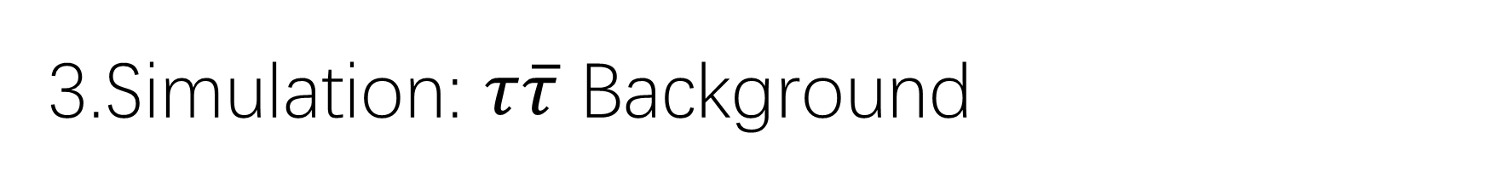
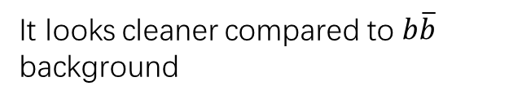

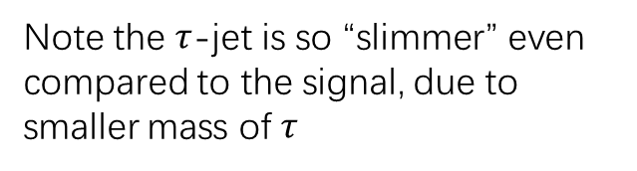
3.Simulation: $τ\overline{τ}$ Background
$$τ\overline{τ}$$
signal
It looks cleaner compared to $b\overline{b}$ background
Note the $τ$-jet is so “slimmer” even compared to the signal, due to smaller mass of $τ$
$$TauTagging=0$$
$${ΔR}_{pj}<0.11: \frac{Σp_{T}+ΣE_{T}}{p_{T}}<0.9$$

Slide 15
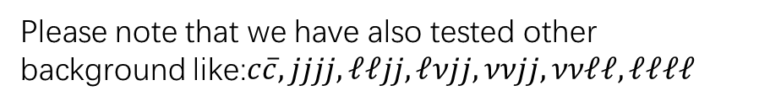
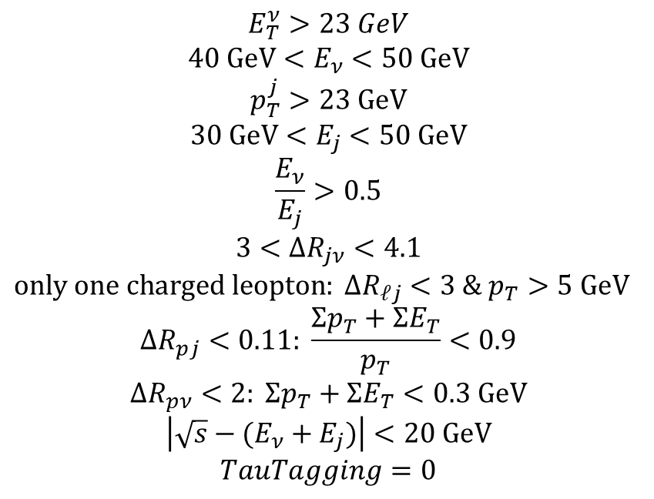
3.Simulation: Selection Conditions
$$E_{T}^{ν}>23 GeV$$
$$40 GeV<E_{ν}<50 GeV$$
$$p_{T}^{j}>23 GeV$$
$$30 GeV<E_{j}<50 GeV$$
$$\frac{E_{ν}}{E_{j}}>0.5$$
$$3<ΔR_{jν}<4.1$$
$only one charged leopton: {ΔR}_{ℓj}<3 \& p_{T}>5 GeV$
$${ΔR}_{pj}<0.11: \frac{Σp_{T}+ΣE_{T}}{p_{T}}<0.9$$
$$ΔR_{pν}<2: Σp_{T}+ΣE_{T}<0.3 GeV$$
$$\left|\sqrt{s}−(E_{ν}+E_{j})\right|<20 GeV$$
$$TauTagging=0$$
Guarantee the processes must be hard enough
Comes from the DELPHI experiment
Fly back-to-back with each other
Substructure of jet
Conservation of energy
Do not use BTagging to protect more signal
Please note that we have also tested other background like:$c\overline{c},jjjj,ℓℓjj,ℓνjj,ννjj,ννℓℓ,ℓℓℓℓ$

Slide 16
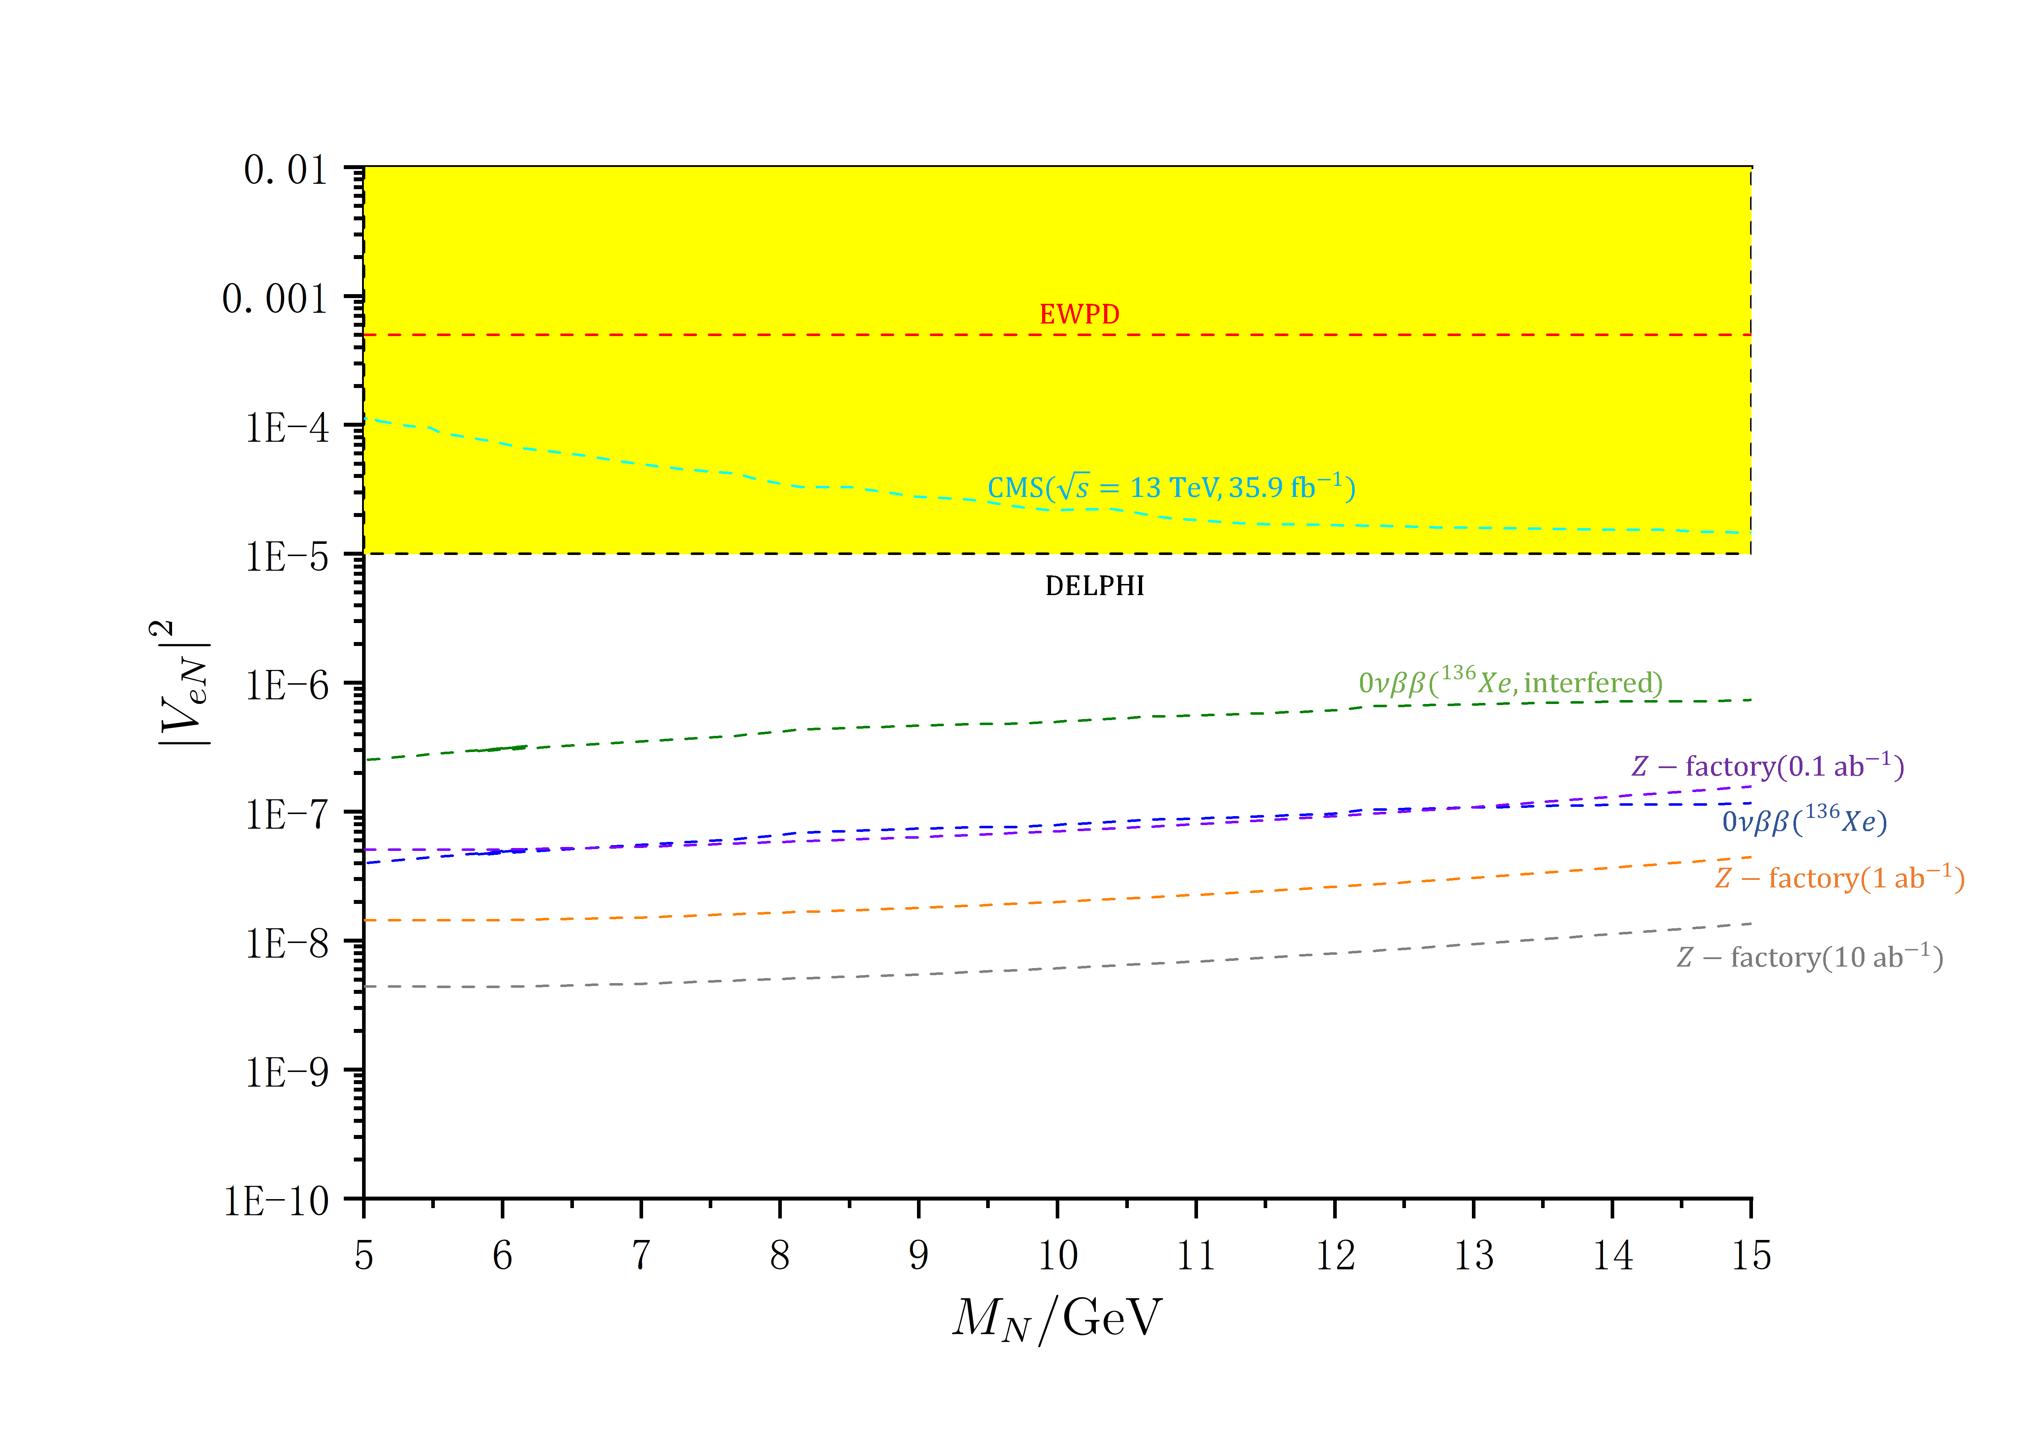
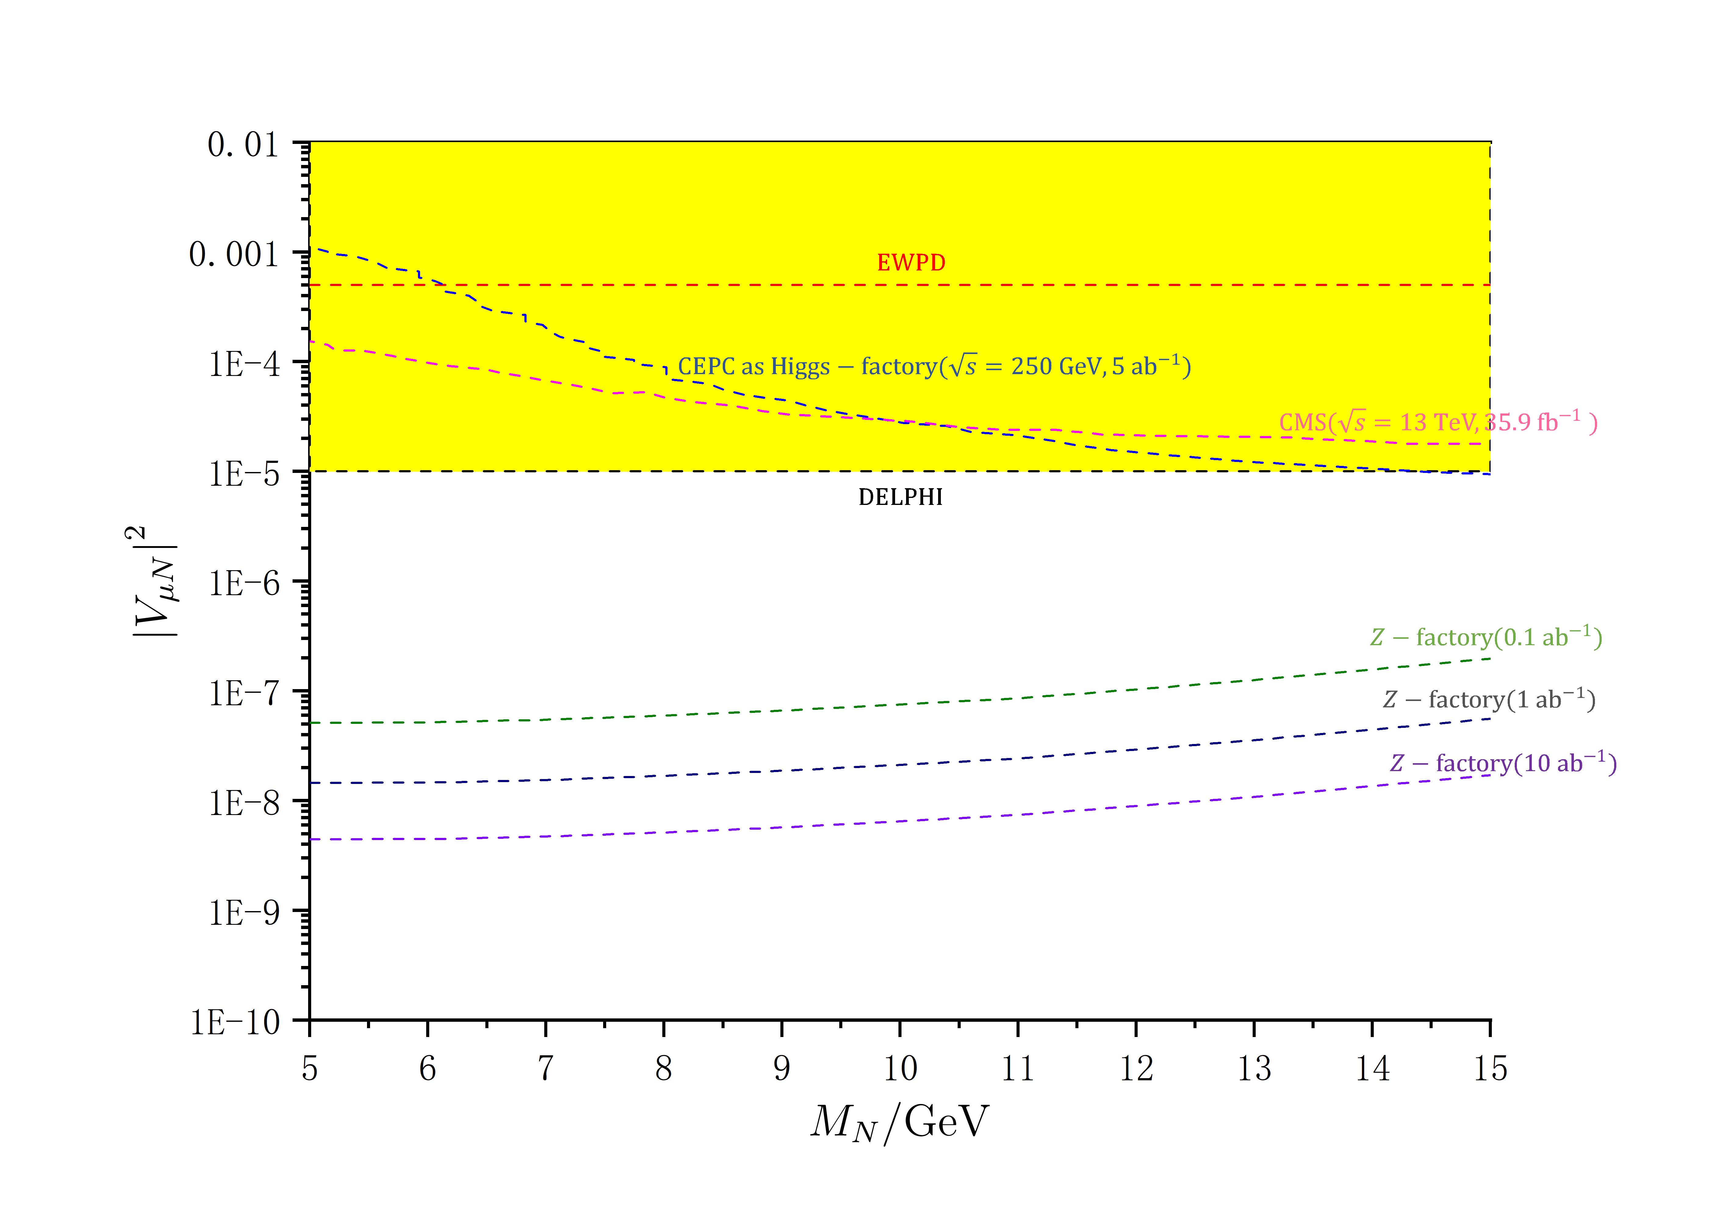
4.Result: Presentation
Z factories will have more potential advantage in searching for such heavy neutrino

Slide 17
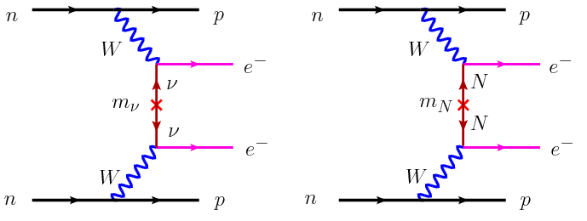
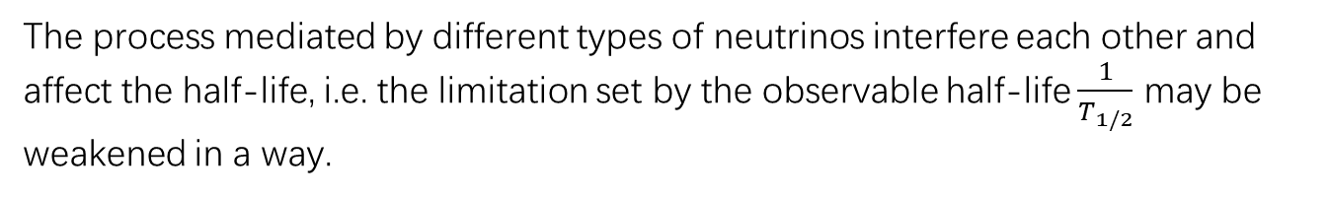
Result: Discussion
The process mediated by different types of neutrinos interfere each other and affect the half-life, i.e. the limitation set by the observable half-life $\frac{1}{T_{1/2}}$ may be weakened in a way.
Effect of cancellation in neutrinoless double beta decay. Physical Review D,90(9):093005, 2014.

Slide 18
Thank you for listening!

