Slide 1
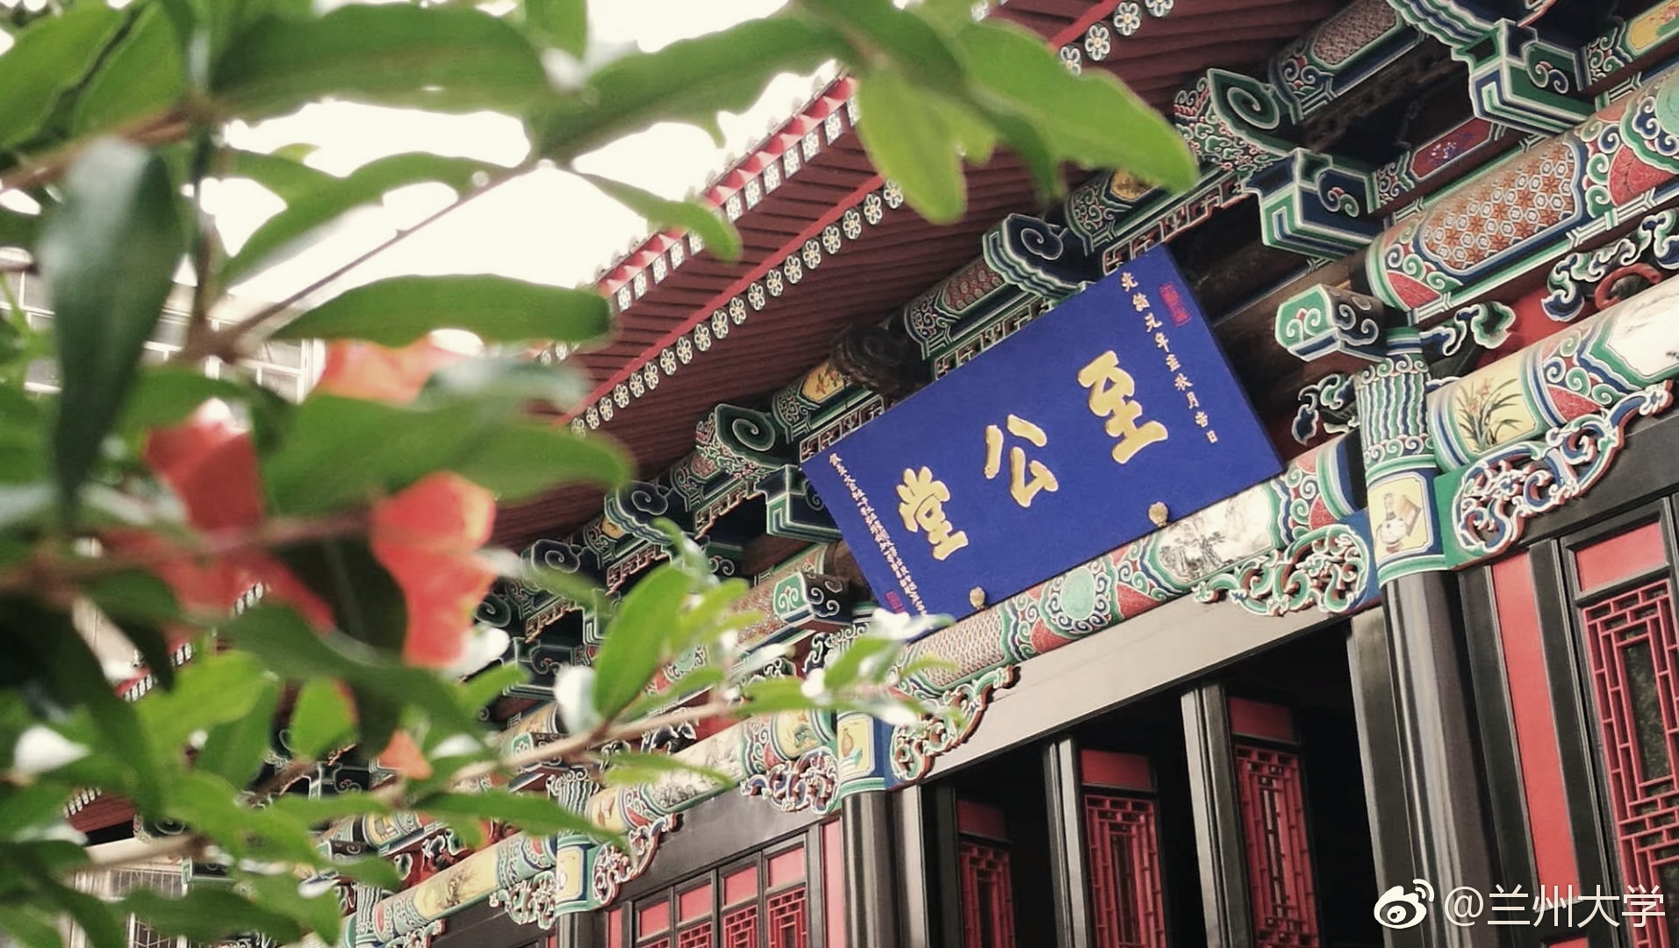

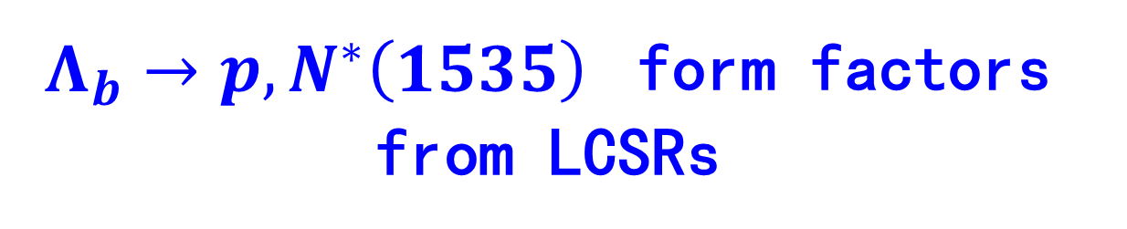
PQCD Group meeting @ Qing Dao July 12 2021
$Λ_{b}→p, N^{∗}\left(1535\right)$ form factors from LCSRs
Ke-Sheng Huang(黄克胜)
Lan Zhou University
In collaborate with Pro. Yue-Long Shen and Pro. Fu-Sheng Yu

Slide 2
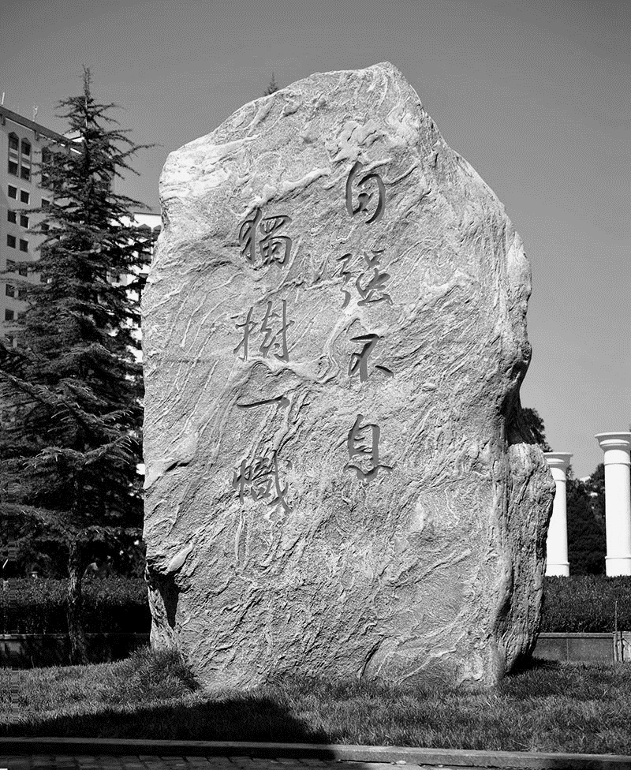
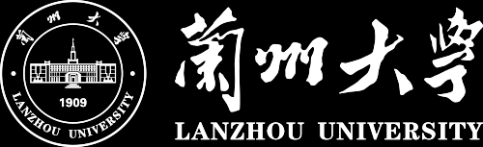

Outline
Motivation
Framework
Numerical Results
Summary

Slide 3
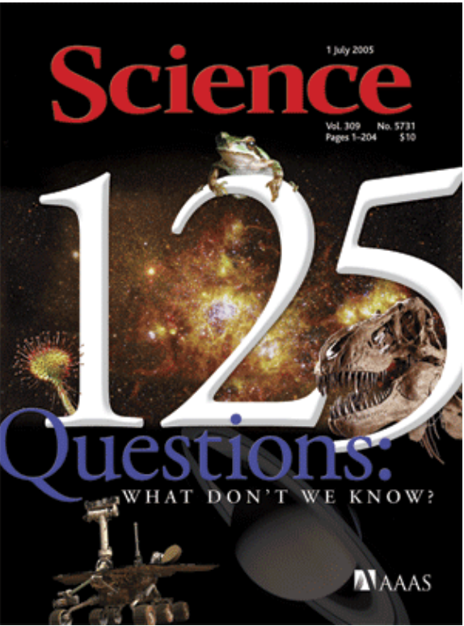
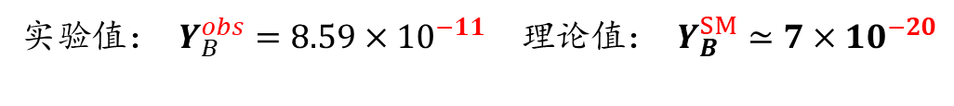
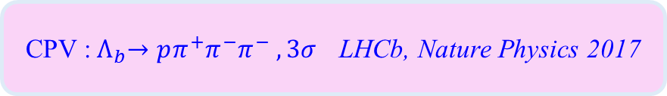
Motivation
Matter-antimatter asymmetry in universe
Sakharov three requirements:
  baryon number violation
  C and CP violation
  Out of thermal equilibrium
CP violation in K-, B-, D-meson have been confirmed by experiments
However, CPV in baryons is not found experimentally by now. Evidence was reported by LHCb
实验值： $Y_{B}^{obs}=8.59×{10}^{−11}$ 理论值： $Y_{B}^{SM}≃7×10^{−20}$
Astron. Astrophys. 594, A13 (2016)
Phys. Rev. Lett. 13(1964) Belle, Phys. Rev. Lett.(2001 LHCb, Phys. Rev. Lett.(2019）
CPV :${ Λ}_{b}→pπ^{+}π^{−}π^{−} , 3σ$ LHCb, Nature Physics 2017

Slide 4
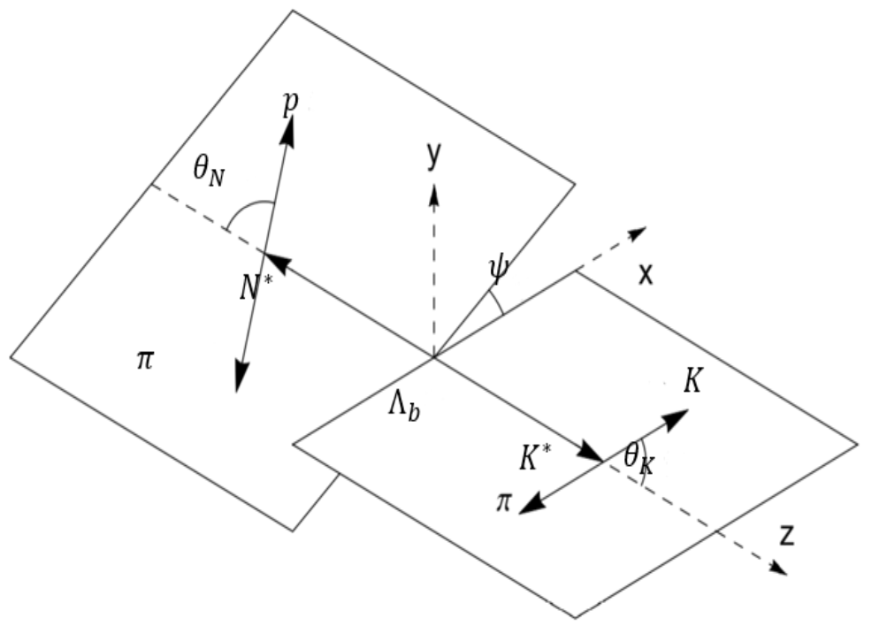
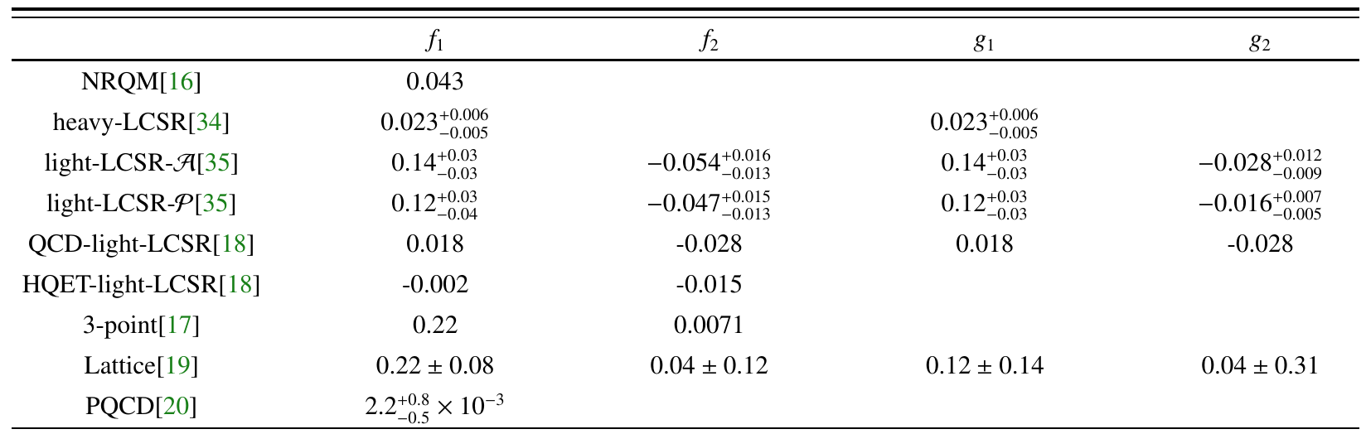
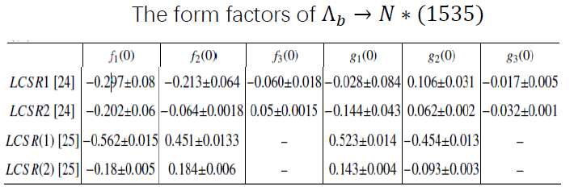

Motivation
Advantages of research of $Λ_{b}$ decay:
  Large experiment data in LHCb
  Easy to construct vast observables
Difficulty in research of $Λ_{b}$ decay:
  Complex dynamics
  Large uncertainty of inputs used in different methods— From factors
Form factors calculated under different approaches:

Slide 5


Motivation
The methods to calculate the from factors
At low recoil region
  LQCD
  HQET
At high recoil region
  pQCD
  LCSR
内插流
$Λ_{b}光锥$分布振幅

Slide 6

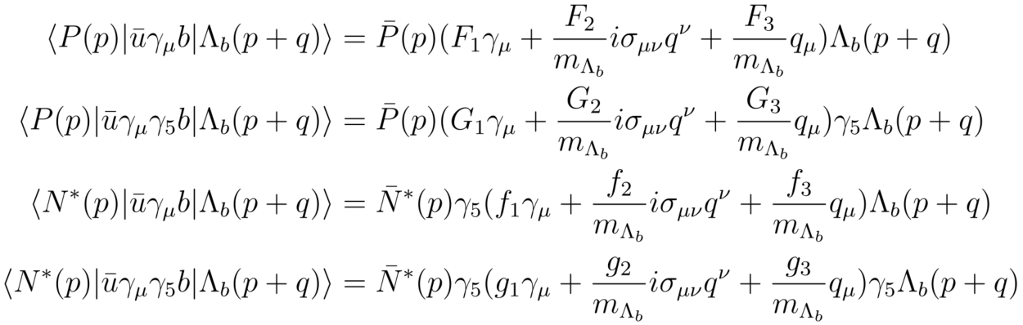
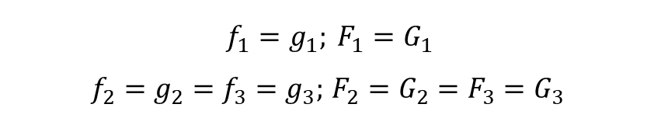
Framework
The hadronic matrixes for $Λ_{b}→p,N^{∗}(1535)$
The parameterization of the hadronic matrixes
Under the heavy-quark limit at low recoil
$f_{1}=g_{1}; F_{1}=G_{1}$
$f_{2}=g_{2}=f_{3}=g_{3};$ $F_{2}=G_{2}=F_{3}=G_{3}$

Slide 7
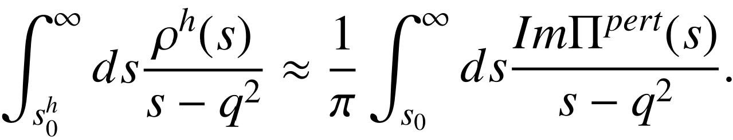
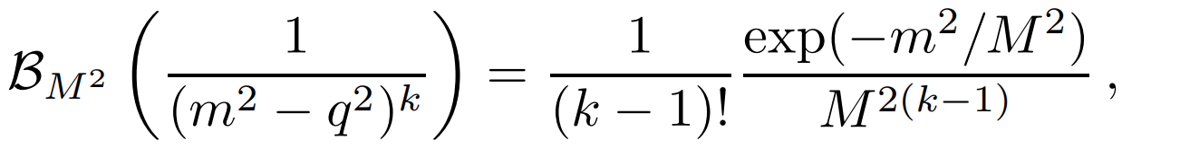
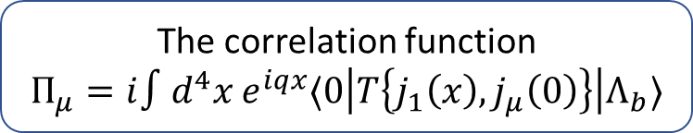
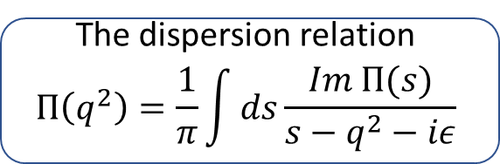

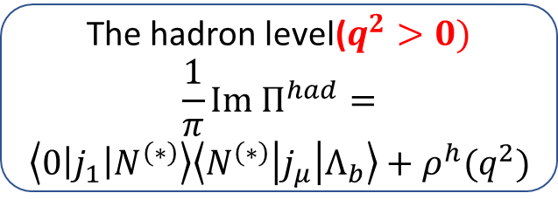

Framework-Light-Cone Sum Rule
Light-Cone Sum Rule(LCSR) is fruitful hybrid of the traditional SVZ sum rule and the theory of hard exclusive process.
The correlation function
$$Π_{μ}=i∫d^{4}x e^{iqx}⟨0\left|T\left\{j_{1}\left(x\right),j_{μ}\left(0\right)\right\}\right|Λ_{b}⟩$$
The quark level$(q^{2}<0)$
Operator product expansion at the light cone $x^{2}=0$
The hadron level($q^{2}>0)$
$$\frac{1}{π}Im Π^{had}=$$
$$\left\langle 0\left|j_{1}\right|N^{\left(∗\right)}\right\rangle \left\langle N^{\left(∗\right)}\left|j_{μ}\right|Λ_{b}\right\rangle +ρ^{h}(q^{2})$$
The dispersion relation
$$Π\left(q^{2}\right)=\frac{1}{π}\int{ds\frac{Im Π(s)}{s−q^{2}−iε}}$$
Spin: $p , N^{∗}(1535)$
Quark-hadron duality
Borel transformation

Slide 8
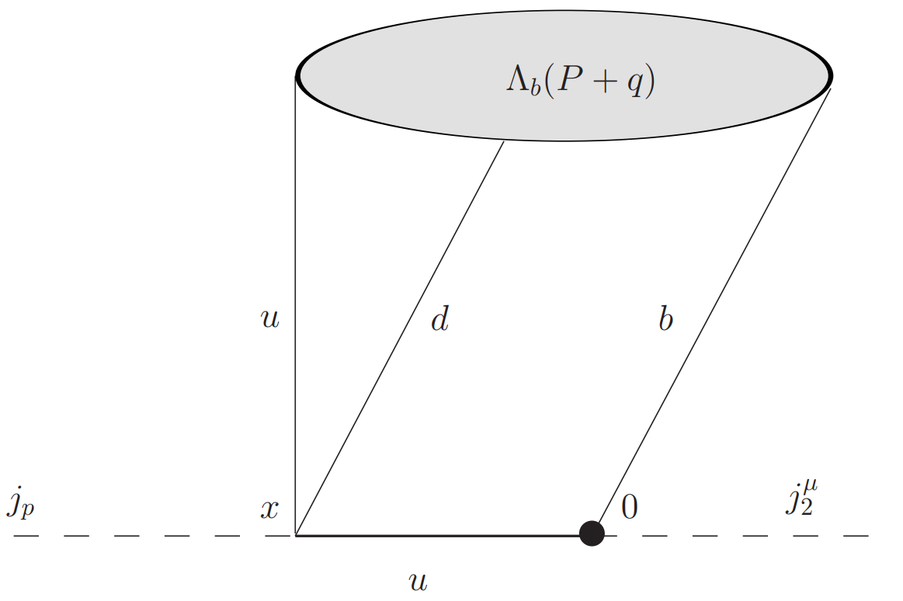
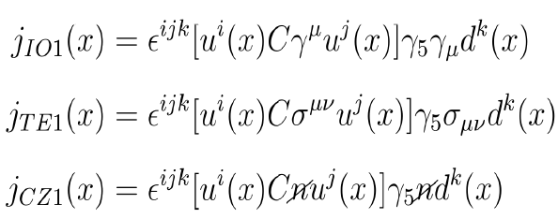
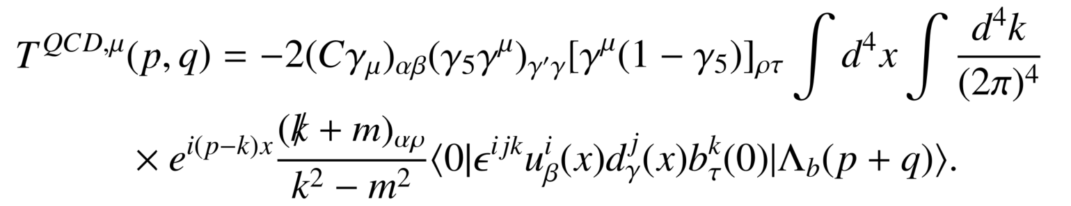
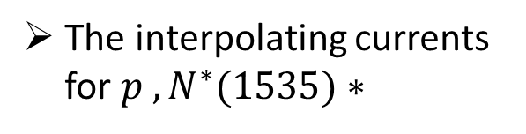
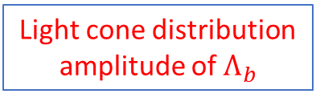


The Correlation function on quark level
The two-point correlation function
$$Π_{μ}=i∫d^{4}x e^{iqx}⟨0\left|T\left\{j_{1}\left(x\right),j_{μ}\left(0\right)\right\}\right|Λ_{b}⟩$$
Interpolating current for light-baryons
Heavy-to-light-weak transition current
$$Π_{μ}=i∫d^{4}x e^{iqx} T_{μ,αβγδ}\left(x\right){ Φ}_{Λ_{b}}^{αβδ}$$
The interpolating currents for $p , N^{∗}(1535)∗$
The results of quark level for Ioffe current by example
Light cone distribution amplitude of $Λ_{b}$

Slide 9
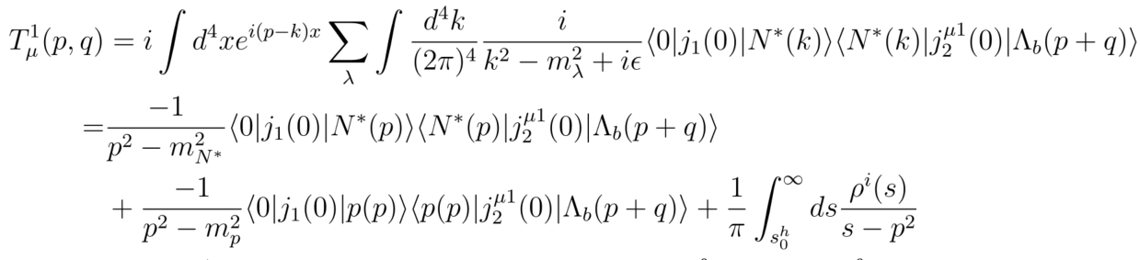
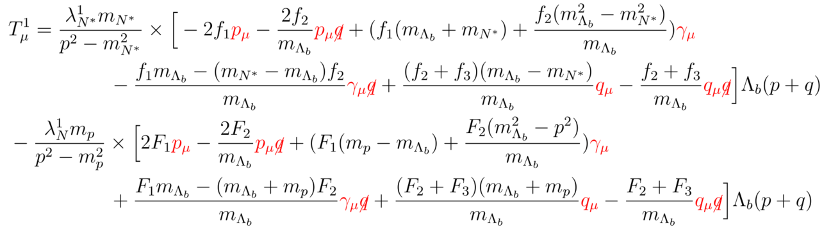

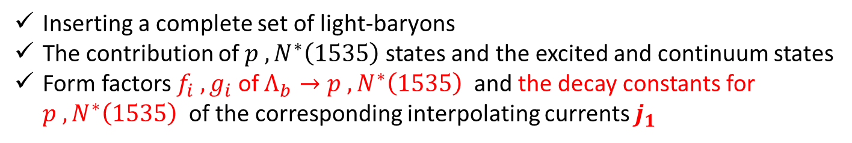
The Correlation function on hadronic level
The hadronic matrixes for $Λ_{b}→p,N^{∗}(1535)$
Inserting a complete set of light-baryons
The contribution of $p , N^{∗}\left(1535\right)$states and the excited and continuum states
Form factors $f_{i} , g_{i}$ of $Λ_{b}→p , N^{∗}\left(1535\right)$ and the decay constants for $p , N^{∗}\left(1535\right)$of the corresponding interpolating currents $j_{1}$
The results of hadronic level for Ioffe current by example
    A. Khodjamirian, Ch. Klein etal JHEP(2016)
    V. M. Braun etal, Phys. Rev. D (2014)

Slide 10
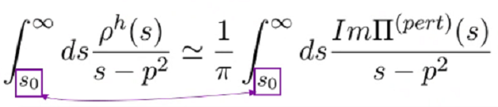
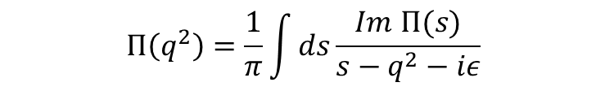
Some Methods in LCSR
The dispersion relation
$$Π\left(q^{2}\right)=\frac{1}{π}\int{ds\frac{Im Π(s)}{s−q^{2}−iε}}$$
Quark-hadron duality
The elimination of the contributions from excited and continuum state and the quark level
Borel Transformation
Borel mass
Suppressing the contribution from higher excited and continuum states exponentially
Reducing the sensitivity of quark-hadron duality

Slide 11
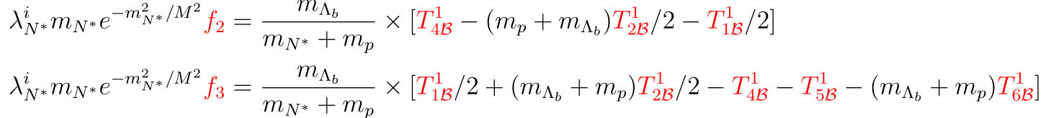
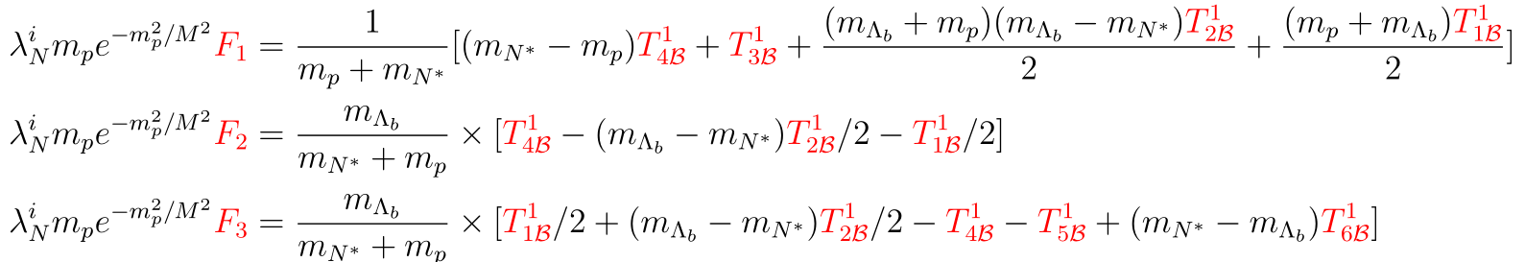
Framework-the expression for form factors
The expression for the form factors $f_{i} , F_{i}$of $Λ_{b}→p, N^{∗}(1535)$

Slide 12
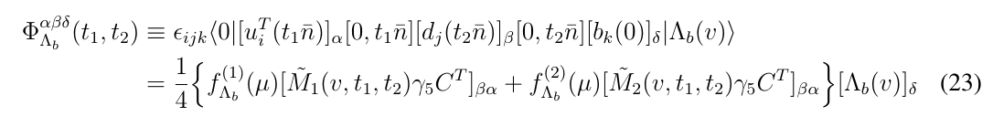
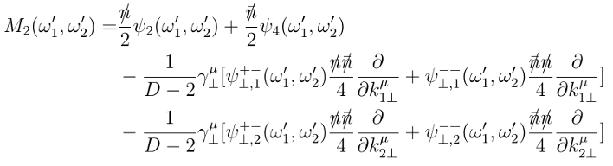
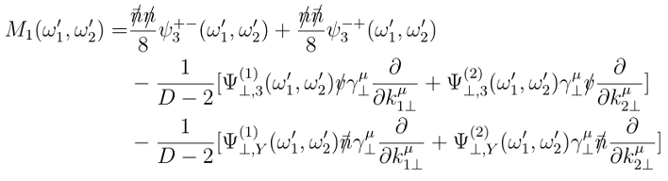
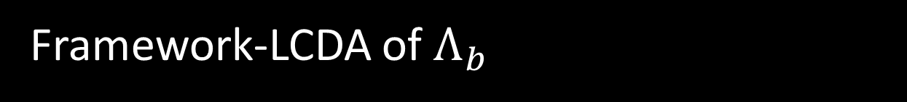

Framework-LCDA of $Λ_{b}$
introduce the general light-cone hadronic matrix element of $Λ_{b}$ baryon
performing the Fourier transformation and including the NLO terms off the light-cone leads to the momentum space light-cone projector
P.Ball, V.M.Braun, E.Gardi (2008)
G.Bell, T.Feldmann, Yu-Ming Wang, M.W.Y.Yip (2013)
Yu-Ming Wang, Yue-Long Shen (2016)

Slide 13
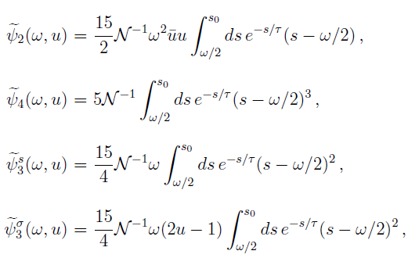

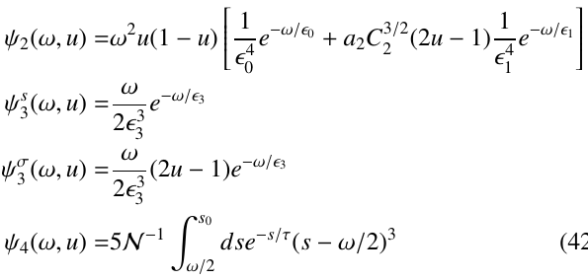
Framework-LCDA of $Λ_{b}$
LCDAs constructed by QCDSR(Model-1)
LCDAs expanded by Gegenbauer polynomial (Model-2)
P.Ball, V.M.Braun, E.Gardi (2008)
P.Ball, V.M.Braun, E.Gardi (2008)

Slide 14
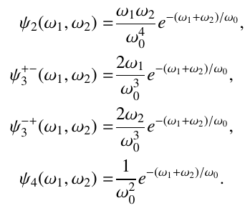
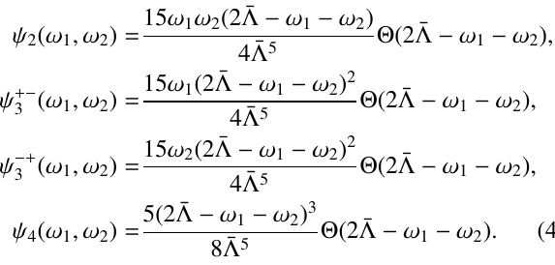
Framework-LCDA of $Λ_{b}$
LCDAs constructed by exponential ansatz ( Model-3)
LCDAs constructed by exponential ansatz (Model-4)
G.Bell, T.Feldmann, Yu-Ming Wang, M.W.Y.Yip (2013)
G.Bell, T.Feldmann, Yu-Ming Wang, M.W.Y.Yip (2013)

Slide 15
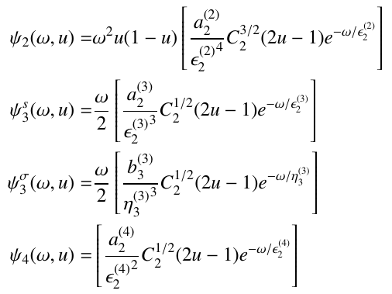
Framework-LCDA of $Λ_{b}$
LCDAs expanded by Gegenbauer polynomial (Model-5)
A.Ali, C.Hambrock, A.Y.Parkhomenko (2012)

Slide 16
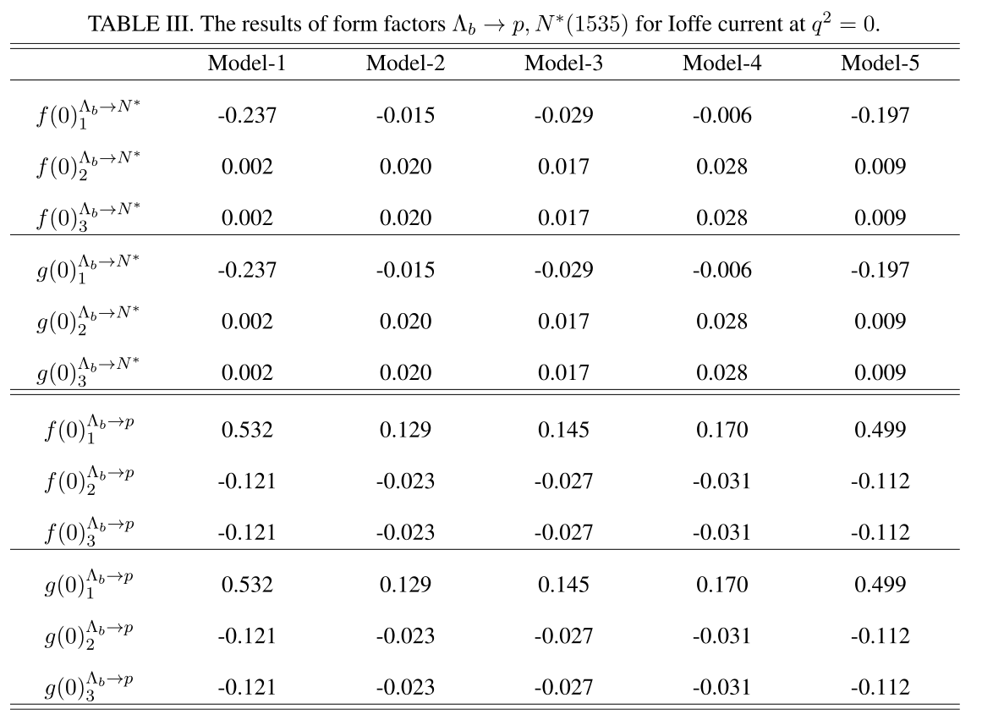
Numerical Results
The results of the form facts of Ioffe current at $q^{2}=0$

Slide 17
Numerical Results
The results of the form facts of Ioffe current at $q^{2}=0$
The results for Model-1 and Model-5 is larger than others !

Slide 18
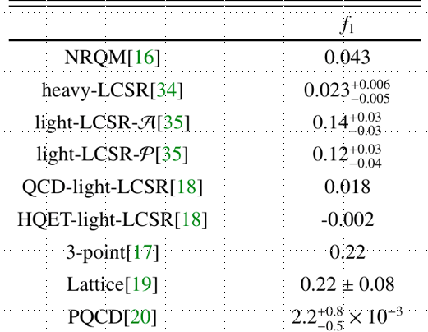
Numerical Results
The results of the form facts of Ioffe current at $q^{2}=0$
The results for $f_{1}\left(0\right)$under Ioffe currents is too small !

Slide 19
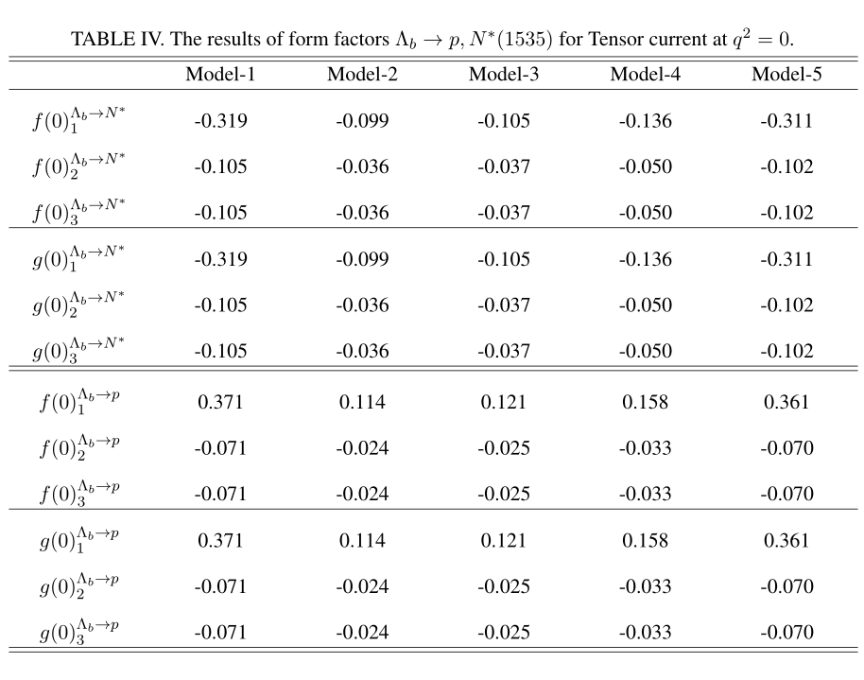
Numerical Results
The results of the form facts of Tensor current at $q^{2}=0$

Slide 20
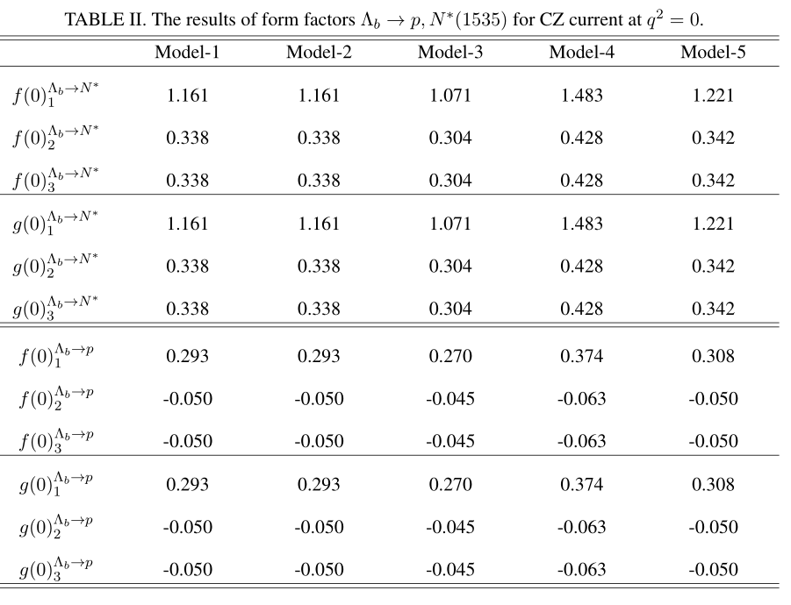
Numerical Results
The results of the form facts of CZ current at $q^{2}=0$

Slide 21
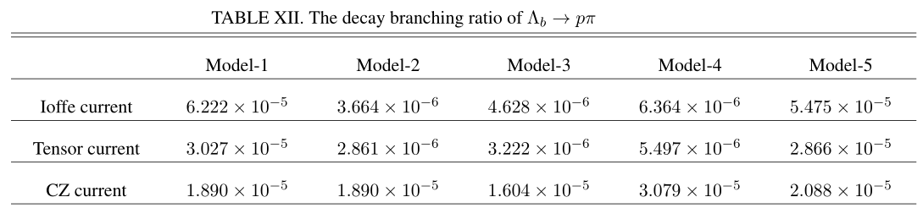
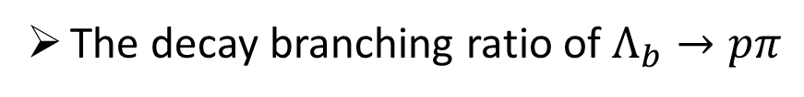

Numerical Results
The decay branching ratio of $Λ_{b}→pπ$
    $$B_{exp}=(4.5±0.8)×{10}^{−6}$$

Slide 22
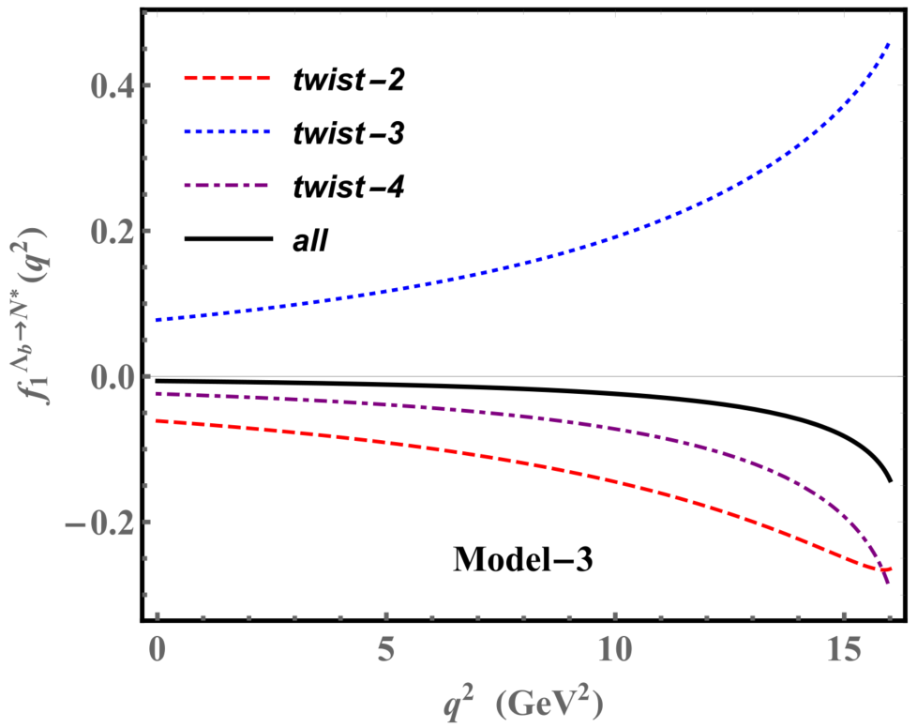
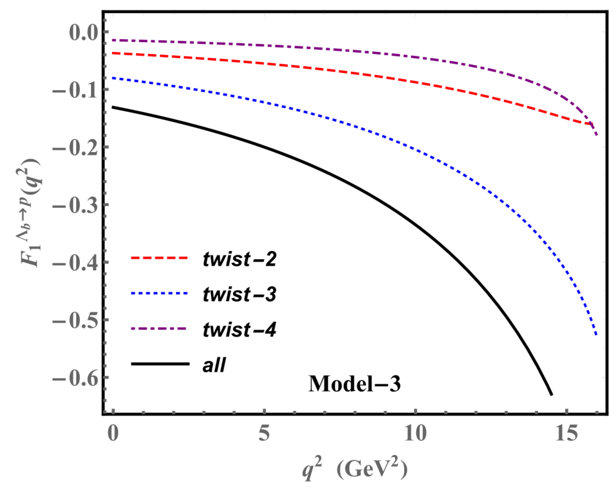
Numerical Results
The results of $f_{1}, F_{1}$ for Ioffe currentunder Model-3

Slide 23
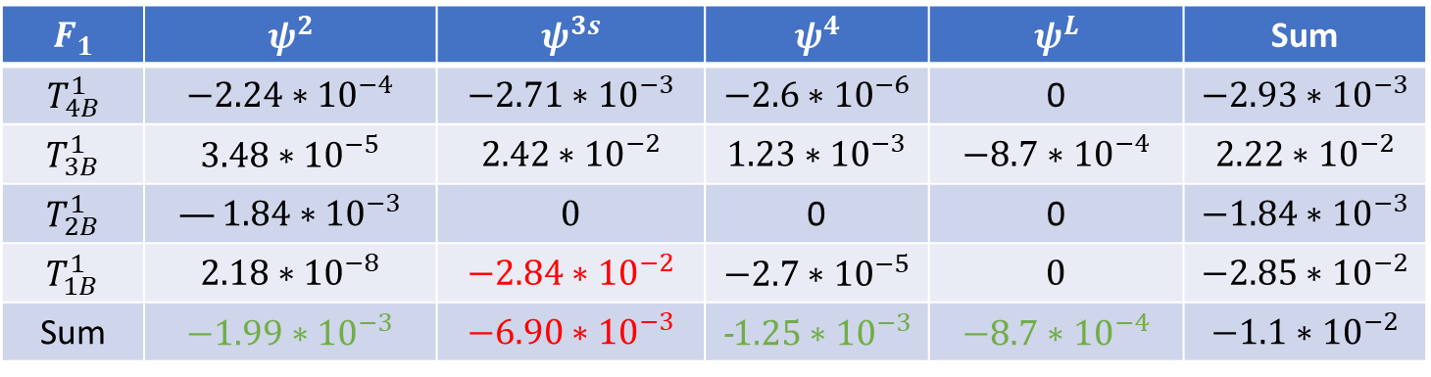

Numerical Results
The results of $f_{1}, F_{1}$ for Ioffe currentunder Model-3
$$f_{1}$$ | $$ψ^{2}$$ | $$ψ^{3s}$$ | $$ψ^{4}$$ | $$ψ^{L}$$ | Sum
$$T_{4B}^{1}$$ | $$−2.24∗{10}^{−4}$$ | $$−2.71∗{10}^{−3}$$ | $$−2.6∗{10}^{−6}$$ | 0 | $$−2.93∗{10}^{−3}$$
$$T_{3B}^{1}$$ | $$3.48∗{10}^{−5}$$ | $$2.42∗{10}^{−2}$$ | $$1.23∗{10}^{−3}$$ | $$−8.7∗{10}^{−4}$$ | $$2.22∗{10}^{−2}$$
$$T_{2B}^{1}$$ | $$−1.84∗{10}^{−3}$$ | $$0$$ | 0 | 0 | $$−1.84∗{10}^{−3}$$
$$T_{1B}^{1}$$ | $$1.35∗{10}^{−8}$$ | $$−1.77∗{10}^{−2}$$ | $$−1.6∗{10}^{−5}$$ | $$0$$ | $$−1.77∗{10}^{−2}$$
Sum | $$−1.99∗{10}^{−3}$$ | $$3.89∗{10}^{−3}$$ | -$1.25∗{10}^{−3}$ | $$−8.7∗{10}^{−4}$$ | $$−2.29∗{10}^{−4}$$
$$F_{1}$$ | $$ψ^{2}$$ | $$ψ^{3s}$$ | $$ψ^{4}$$ | $$ψ^{L}$$ | Sum
$$T_{4B}^{1}$$ | $$−2.24∗{10}^{−4}$$ | $$−2.71∗{10}^{−3}$$ | $$−2.6∗{10}^{−6}$$ | 0 | $$−2.93∗{10}^{−3}$$
$$T_{3B}^{1}$$ | $$3.48∗{10}^{−5}$$ | $$2.42∗{10}^{−2}$$ | $$1.23∗{10}^{−3}$$ | $$−8.7∗{10}^{−4}$$ | $$2.22∗{10}^{−2}$$
$$T_{2B}^{1}$$ | $$—1.84∗{10}^{−3}$$ | $$0$$ | 0 | 0 | $$−1.84∗{10}^{−3}$$
$$T_{1B}^{1}$$ | $$2.18∗{10}^{−8}$$ | $$−2.84∗{10}^{−2}$$ | $$−2.7∗{10}^{−5}$$ | $$0$$ | $$−2.85∗{10}^{−2}$$
Sum | $$−1.99∗{10}^{−3}$$ | $$−6.90∗{10}^{−3}$$ | -$1.25∗{10}^{−3}$ | $$−8.7∗{10}^{−4}$$ | $$−1.1∗{10}^{−2}$$

Slide 24

Summary
The LCDA models of $Λ_{b}$ based on Gegenbauer expansion maybe is not appropriate to calculate the form factors.
The suitable interpolating currents for calculating the form factors of $Λ_{b}→p , N^{∗}(1535)$ is Tensor current and Ioffe Current.
Outlook:
Including the QCD corrections
Calculating the form factors for other $Λ_{b}$-decay processes

