Slide 1
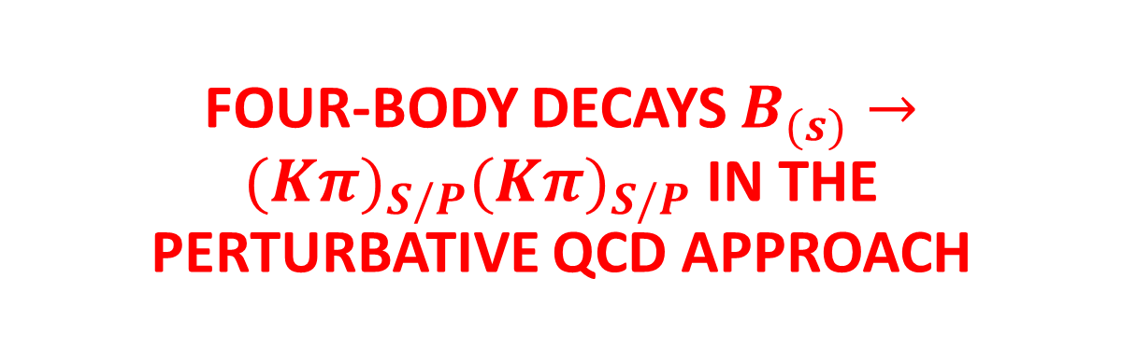
Based on JHEP05(2021)082[arXiv:2103.00642]
Zhou Rui
North China University of Science and Technology
Collaboration with Ya Li and Hsiang-nan Li
PQCD 2021 @ OUC 7.12.2021

Slide 2
Outline
Motivation
Framework
Results
Summary

Slide 3
Motivation
CPV is one of the main contents of particle physics reseach.
In addition to direct and mixing-induced CP asymmetries, triple-product asymmetries (TPAs) can be defined in multi-body B meson decays, which may reveal potential signals of CP violation.
Four-body B meson decays are rich in CP violation phenomena in the quark sector.
Quasi-two-body mechanism and the two-hadron distribution amplitudes (DAs) has been successfully applied to three-body B meson decays in PQCD, which encourages us to extended to the four-body B meson decays.

Slide 4
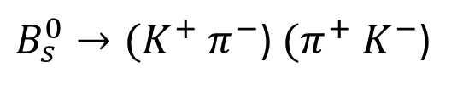
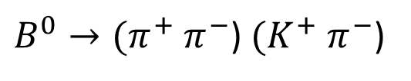
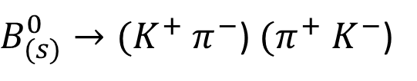
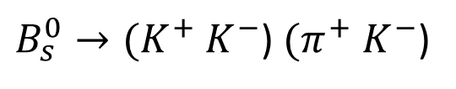
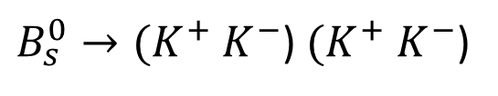
Several Collaborations have observed B meson decays into various four-body charmless hadronic final states in certain two body invariant mass regions.
JHEP03(2018)140
JHEP05(2019)026
JHEP07(2019)032
JHEP11(2013)092
JHEP12(2019)155

Slide 5
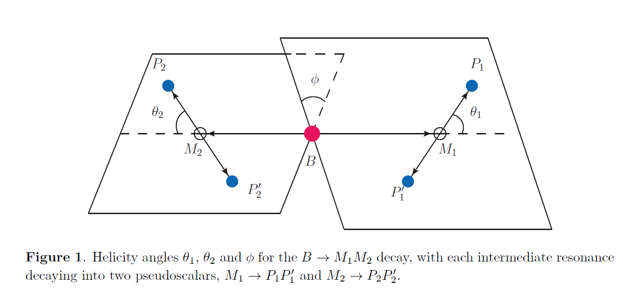
Framework
Based on the quasi-two-body mechanism, four-body processes are assumed to proceed dominantly with two intermediate resonances.

Slide 6
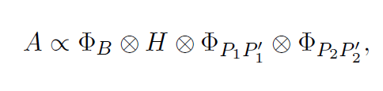
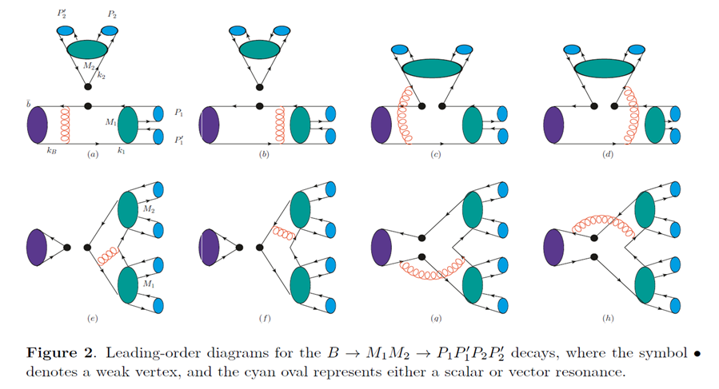
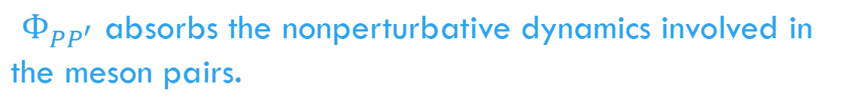
A decay amplitude is then written as
$Φ_{PP^{′}}$ absorbs the nonperturbative dynamics involved in the meson pairs.
The hard kernel H is evaluated at the quark level in perturbation theory.

Slide 7
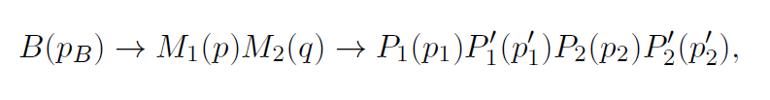

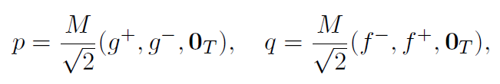

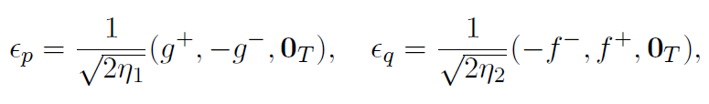

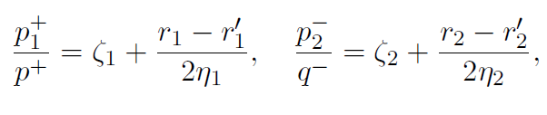

Kinematics including the final state masses
The meson momentum fractions up to corrections from the meson masses

Slide 8
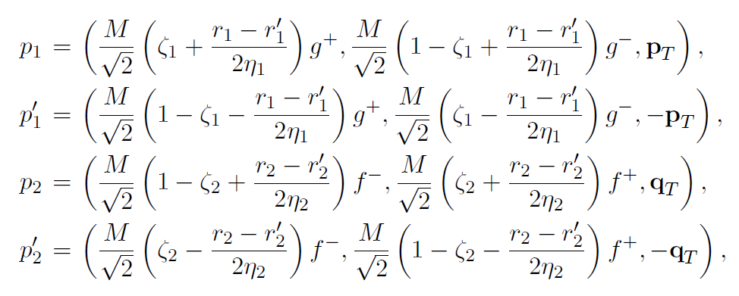


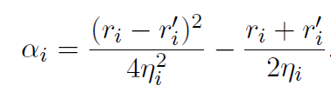

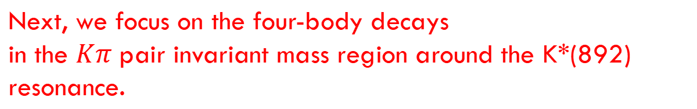
The momentum of each final-state meson
Three valence quarks momenta are parametrized as
Next, we focus on the four-body decays
in the $Kπ$ pair invariant mass region around the K*(892) resonance.
$$B→{(Kπ)}_{S/P}{(Kπ)}_{S/P}$$

Slide 9
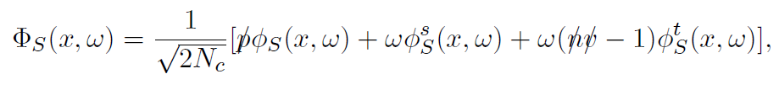
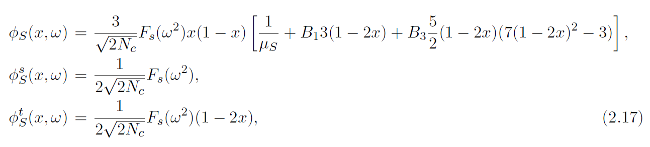



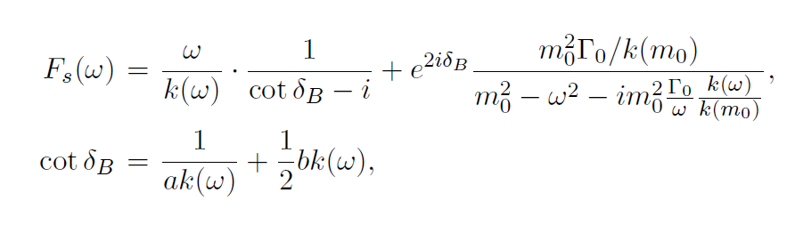

S-wave $Kπ$ DAs
The LASS line shape

Slide 10
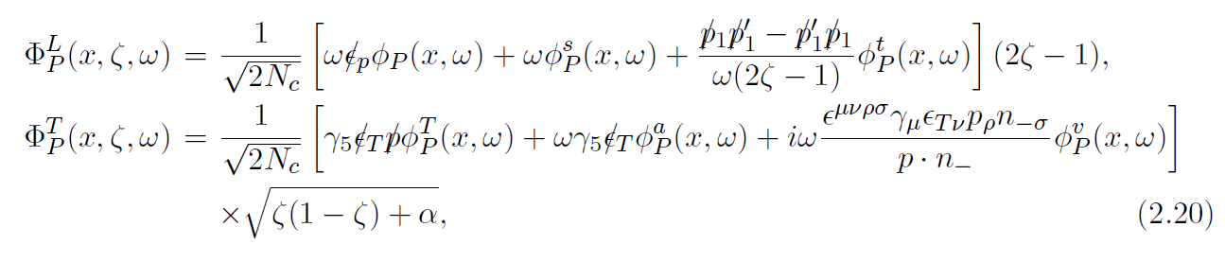
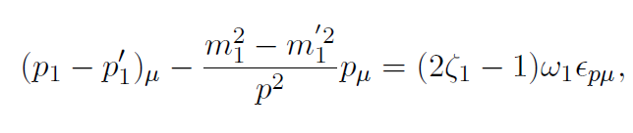
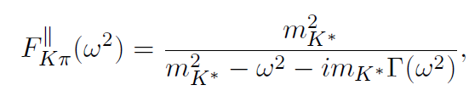


P-wave $Kπ$ DAs
The factor 2zeta − 1corresponds exactly to the structure for a time-like vector form factor
The relativistic Breit-Wigner (RBW) function

Slide 11
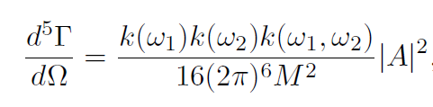

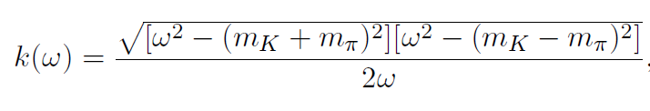
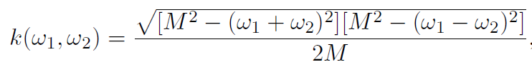

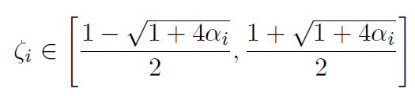
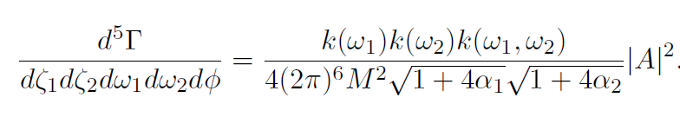
Helicity amplitudes
The differential rate for the decays
The transformation connecting the B meson rest frame and the meson pair rest frame leads to the relations between zeta and theta

Slide 12
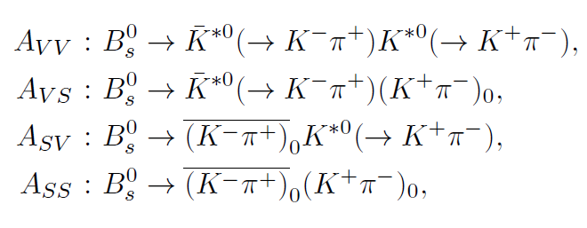
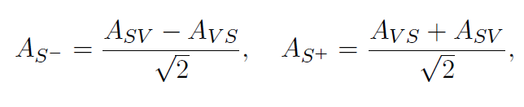

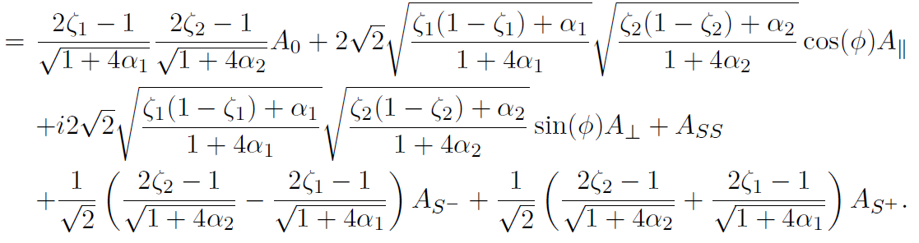
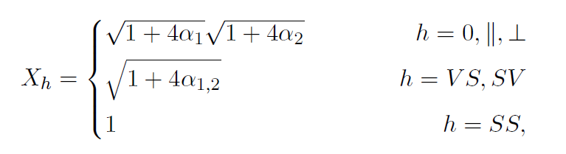

Six helicity amplitudes
$A_{0},A_{∥},$ $A_{⊥}$
The full decay amplitude

Slide 13

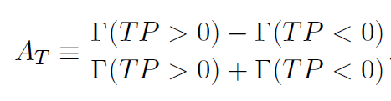
Triple product asymmetries and S-wave-induced direct CP asymmetries
A scalar triple product takes a generic form
A TPA can be defined by an asymmetry

Slide 14
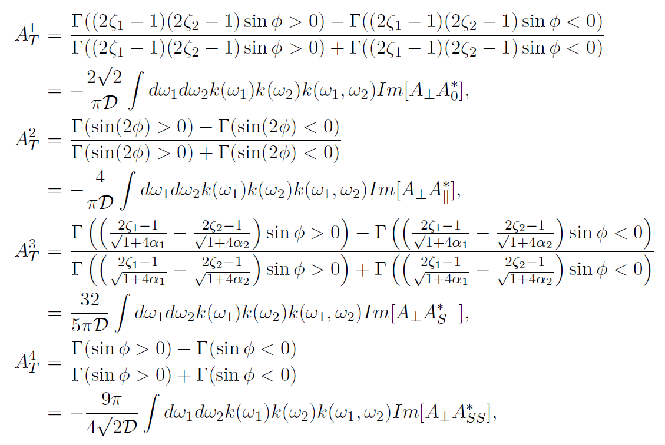

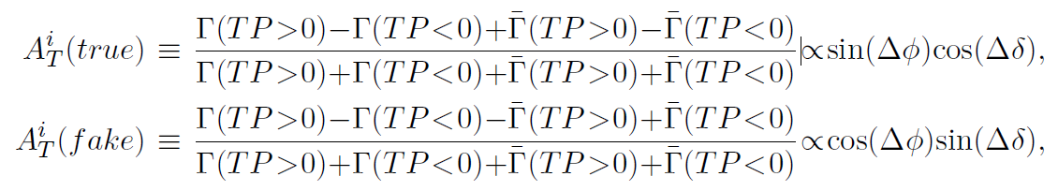
Triple product asymmetries
Strong phases can produce a nonzero value
To identify a true CP violation signal, one has to compare the TPAs in B and Bbar meson decays.

Slide 15
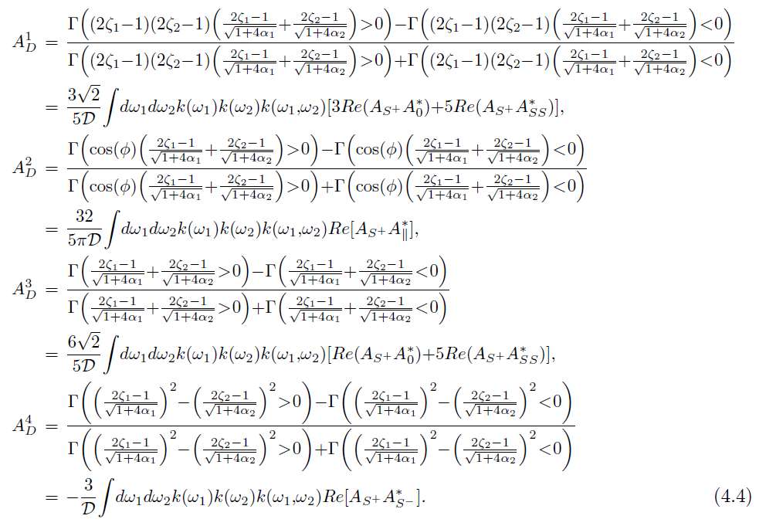

S-wave-induced direct CP asymmetries
Combining the quantities for the corresponding CP-conjugate process, we define the S-wave-induced direct CP asymmetries
It can be measured using untagged samples, in which CP-conjugate processes need not be distinguished.

Slide 16
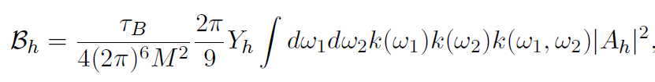
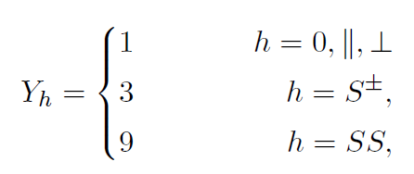
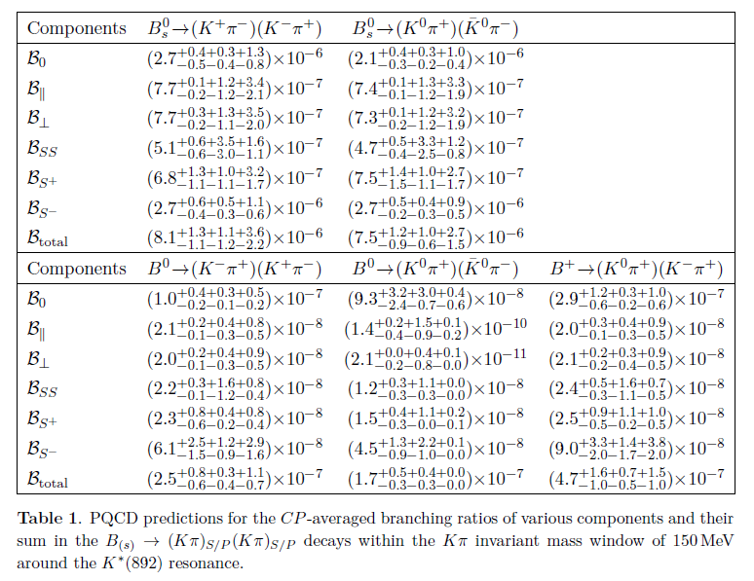


Numerical results and discussions
1. CP averaged four-body branching ratios

Slide 17

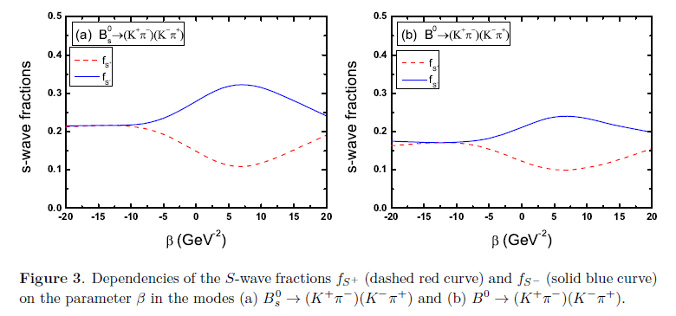
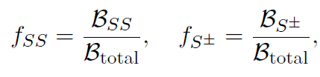

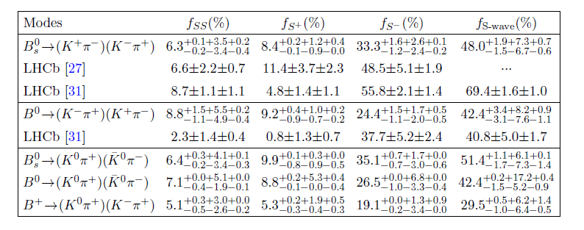
2. S-wave fractions

Slide 18
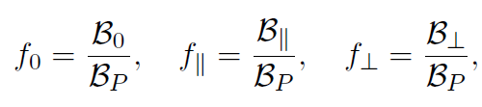

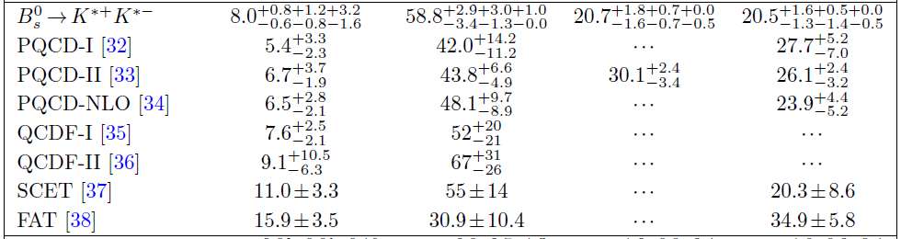
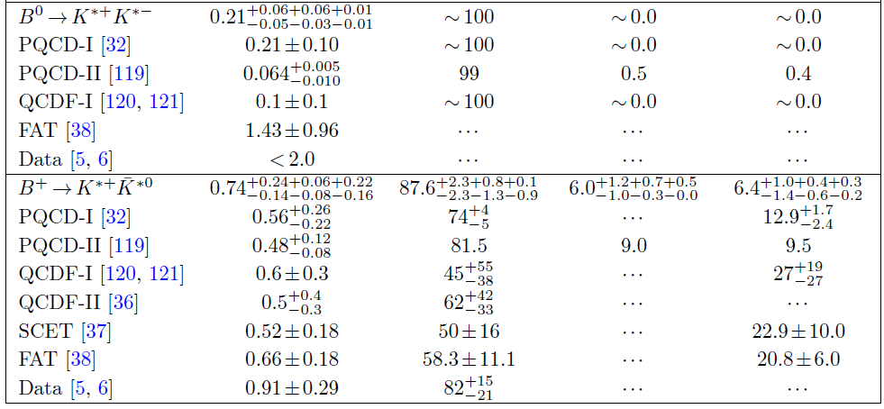
3. Two-body branching ratios and polarization fractions
In the narrow-width limit：

Slide 19
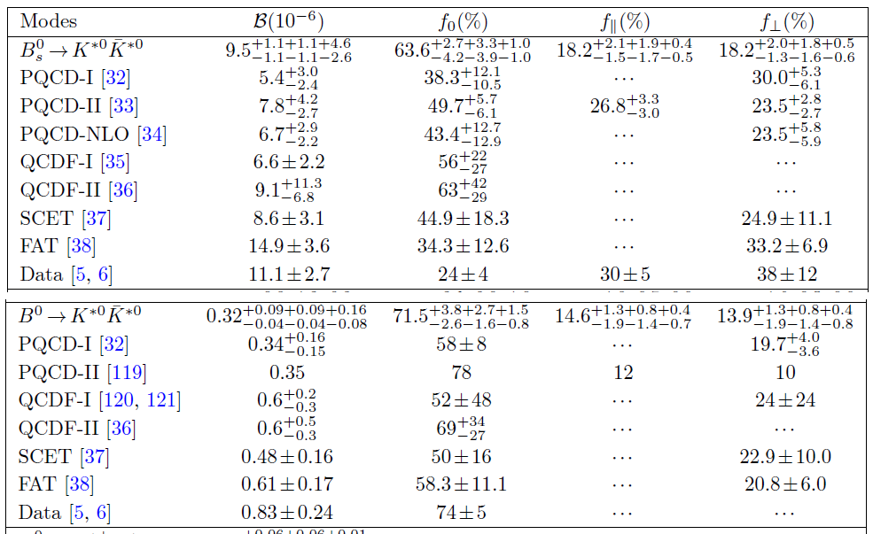
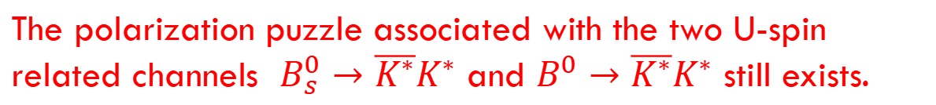
3. Two-body branching ratios and polarization fractions
The polarization puzzle associated with the two U-spin
related channels $B_{s}^{0}→{\overline{K^{∗}}K}^{∗}$ and $B^{0}→{\overline{K^{∗}}K}^{∗}$ still exists.

Slide 20
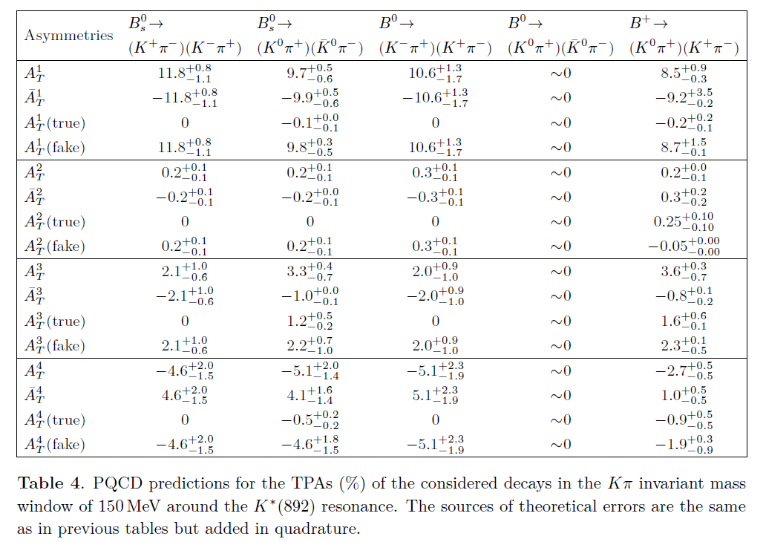

4. Triple product asymmetries
$${\sim 10}^{−2}$$
True TPAs are zero for pure penguin decays.
The tiny transverse polarization component in the pure annihilation mode leads to the negligible TPAs.
The predicted nonvanishing fake TPAs can be tested if flavor tagged measurements are available in the future.

Slide 21
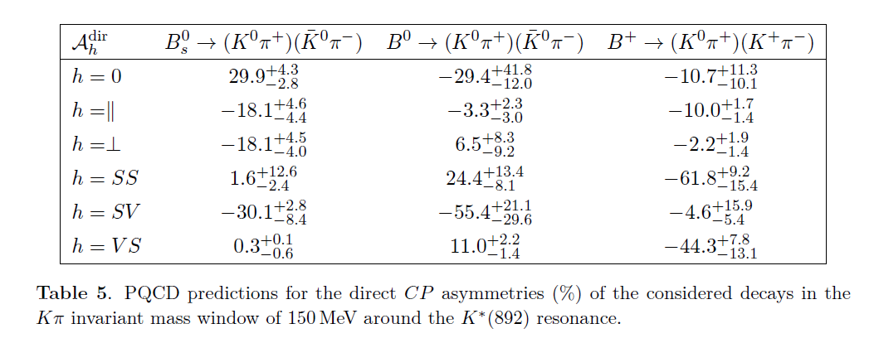

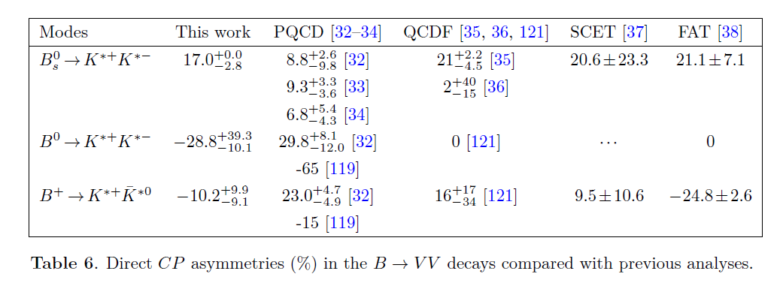
5. Direct CP asymmetries
The rather distinct CPV in our and previous PQCD studies may suggest a stronger sensitivity of direct CP asymmetries to the widths of resonant states.

Slide 22

6. S-wave-induced direct CP asymmetries
The S-wave-induced direct CP asymmetries in the considered decays still acquire less theoretical and experimental attention, we will wait for the confrontation with future data.

Slide 23

Summary
The formalism of four-body hadronic B meson decays in PQCD are presented and have many potential applications.
The branching ratios corresponding to six helicity states in $B→{(Kπ)}_{S/P}{(Kπ)}_{S/P}$ are calculated. The single and double S-wave contributions were found to be substantial in the chosen invariant mass region and consistent with the LHCb data.
The polarization puzzle associated with the two U-spin related channels $B_{s}^{0}→{\overline{K^{∗}}K}^{∗}$ and $B^{0}→{\overline{K^{∗}}K}^{∗}$ still exists.
TPAs, direct CP asymmetries, and S-wave induced direct CP asymmetries are presented. Some of extracted direct CP asymmetries differ from the previous PQCD analyses
in the two-body framework, indicating a strong sensitivity of
direct CP asymmetries to the widths of resonant states.

Slide 24
Thank you

