Slide 1



The Evolution of Primordial Neutrino Helicities
in Cosmic Gravitational and Magnetic Fields
and their Detection
Gordon Baym
University of Illinois
Urbana, Illinois
with Jen-Chieh Peng
PRL 126, 191803 (2021)
PRD (in press)-arXiv:2103:11209v2
Institute for High Energy Physics
北 景 25 May 2021
B
Notes:
Zhi-zhong Xing (邢志忠) = xíng zhì zhōng

Slide 2
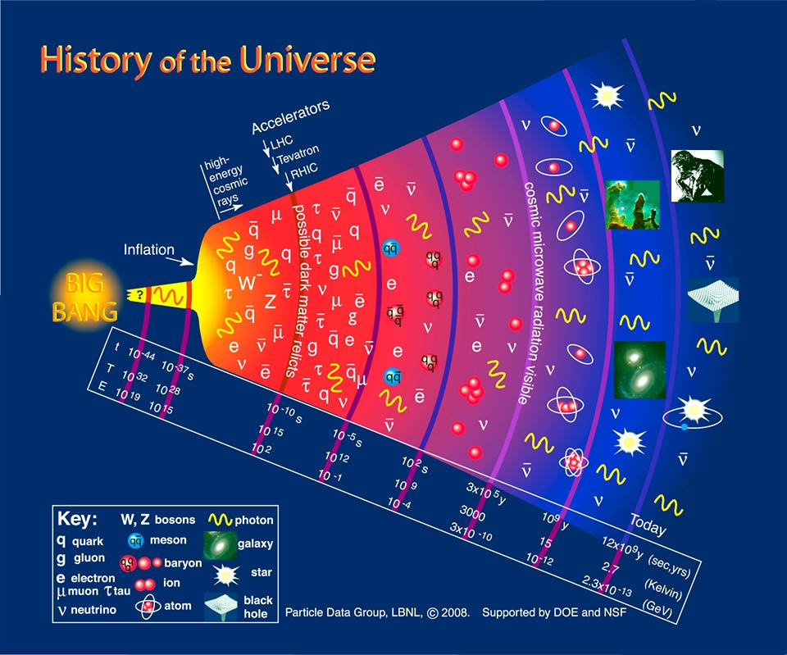
Prior to about one second after the Big Bang neutrinos
(ν_{e}, ν_{μ}, ν_{τ}) and antineutrinos were in thermal equilibrium with electrons and quarks.
Since decoupling neutrinos have been “free streaming” through the cosmos.
Present density
56.25 /cm³ of each
(~100 X solar )
Never detected!!
1 sec
Notes:
20 million relics of early universe in our bodies

Slide 3
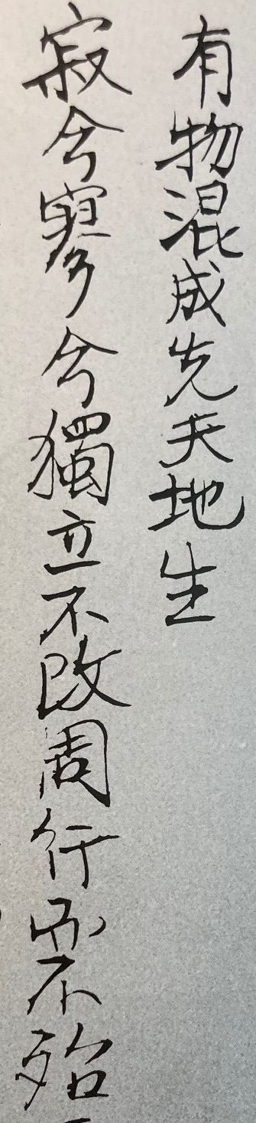

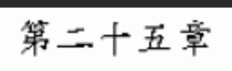
Something mysteriously formed,
Born before heaven and earth.
In the silence and the void,
Standing alone and unchanging,
Ever present and in motion.
Notes:
Yǒu wù hǔnchéng. Xiān tiāndì shēng. Jì xī. Wèi xī dúlì bù gǎi. Zhōu xíng ér bù dài.

Slide 4
What happens to neutrinos between 1 sec and
now, 13.8 billion years later?
Neutrinos have negative helicity: L handed
& antineutrinos positive helicity: R handed
A property of the weak interaction processes,
not an intrinsic property of neutrinos
Both cosmic, and later galactic, magnetic fields as well as
gravitational inhomogeneities can rotate the spins with respect
to the momentum, and thus give neutrinos an amplitude to be
right handed, and antineutrinos left handed!
The helicities of relic neutrinos are a new probe
of cosmic gravitational and magnetic fields.

Slide 5
Neutrinos 101
Neutrino magnetic moments & spin precession
Gravitational inhomogeneities & spin precession
Detection of relic neutrinos
Flammarion 1888

Slide 6
Processes in equilibrium
Scattering
χ = e, μ, τ
Annihilation. For T < m_{μ}= 106 MeV annihilations only to electrons
Charge exchange,
keeps ν_{e} in equilibrium
longer
Decoupling, as densities decrease in expanding universe:

Slide 7
Magnetic field B rotates spins, but not momenta:
Since v have non-zero mass they have a magnetic moment
μ_{ν} = magnetic moment and of neutrino
Gravitational potential Φ rotates momentum and spin:
,
relativistic effect
Spin bending lags momentum bending
(helicity = )
spin
spin
Spin and momentum bent equally for massless particle
(photon); no spin bending of non-relativistic particle
Throw v up, returns
w. opposite helicity

Slide 8
Ex: particle passing star of mass M at impact parameter b
b
b
momentum bending
v → 1 Einstein light bending
spin bending
lag of spin with respect to momentum
Helicity flipping
Neutrino spin
Probability of helicity flip = for small rotation

Slide 9
Evolution of primordial neutrinos from freezeout
Neutrinos produced in flavor
eigenstates, linear
superpositions of mass
eigenstates 1,2,3,
and in wave packets of size
~ electron mean free path ~
and velocity
Velocity dispersion of mass components
>> velocity dispersion of given mass component
Flavor eigenstate (a) arrives at Earth in three well separated mass packets with relativistic thermal distributions:
Pontecorvo–Maki–Nakagawa–Sakata
PMNS mixing matrix

Slide 10
Neutrino masses and thermal distributions
3
2
1
2
1
3
Distributions are fully relativistic even though at least two neutrino
states (i=2,3 in N or 1,2 in I) are non-relativistic now:
= 1.945K = 1.676 x 10⁻⁴ eV
Neutrino
i velocities v/c
(Neutrino temperature < T_{CMB} = 2.725K: neutrinos were not reheated!)
NH: m₁=10⁻⁵ => v₁ ~ 1, v₂ ~1/5, v₃ ~ 1/20
IH: m₁=10⁻⁵ => v₃ ~ 1 , v₁ ~ v₂ ~ 1/20

Slide 11
Neutrino masses and thermal distributions
T_{v0}
Distributions are fully relativistic even though at least two neutrino
states (i=2,3 in N or 1,2 in I) are non-relativistic now:
= 1.945K = 1.676 x 10⁻⁴ eV
Neutrino
i velocities v/c
(Neutrino temperature < T_{CMB} = 2.725K: neutrinos were not reheated!)
NH: m₁=10⁻⁵ => v₁ ~ 1, v₂ ~1/5, v₃ ~ 1/20
IH: m₁=10⁻⁵ => v₃ ~ 1 , v₁ ~ v₂ ~ 1/20

Slide 12
Is 3 heaviest
or lightest?

Slide 13
Electron neutrino distribution at decoupling:
Since p >>> m_{i} have p/T_{e} => relativistic distribution
Does not change since neutrinos are decoupled!
As universe expands:
scale factor a grows from ~10⁻¹⁰ at T =1 MeV to a =1 now
Were neutrinos to have remained in thermal equilibrium,
and distribution would be non-relativistic!
( 0 = now)

Slide 14
Neutrino propagation in an expanding universe
Metric of expanding universe with weak gravitational inhomogeneities:
a = scale factor grows from ~10⁻¹⁰ at T =1 MeV to a=1 now
u = conformal time, dt = a du
x = comoving spatial coordinates
Φ = weak potential, driven by density and pressure fluctuations
Φ(x) independent of a, at long wavelengths
Radiation dominated era ( ) , down to redshift ~ 10⁴ :
Matter dominated era, from redshift ~ 10⁴ to now,

Slide 15
Neutrinos 101
Neutrino magnetic moments & spin precession
Gravitational inhomogeneities & spin precession
Detection of relic neutrinos
Flammarion 1888

Slide 16
Rotation of neutrino spins in magnetic fields
via neutrino magnetic moment
Standard model processes lead to a non-zero
neutrino magnetic moment
Fujikawa-Schrock PRL 1980
= Bohr magneton
But the magnetic moment could be much larger (BSM physics!)
Upper bounds:
GEMMA Kalinin reactor expt (2010)
Borexino (2017, solar )
Theoretical “naturalness” bound:
Bell et al. PRL 2005

Slide 17
Diagonal vs. transition magnetic moments
Diagonal: interaction with magnetic field between
equal mass states (neutrino m₁ = m₂)
Transition: interaction only between different
mass states (m₁ ≠ m₂)
Are neutrinos Dirac or Majorana fermions?
Dirac neutrinos can have both diagonal and transition moments.
Diagonal moments of Majorana neutrinos identically zero;
only transition moments:
Propagation through cosmic and galactic magnetic fields cannot
change neutrino mass state. Too slowly varying.
Only Dirac neutrinos can have helicities changed by magnetic fields.

Slide 18
XENON1T experiment (in Gran Sasso)
One ton TPC of liquid Xe
Sees both electron
& nuclear recoils
Search for WIMPS (weakly interacting massive particles) & other dark matter.
Sensitive to physics beyond standard model: solar axions
bosonic dark matter,
magnetic moments of
solar neutrinos
Excess of low energy electron events
1-7 keV over expected background
Aprile et al. PR D 102, 072004 (2020)

Slide 19
XENON1T low energy electron event excess
Possible explanations:
Large neutrino mag. moment (3.2σ)
Solar axions (3.5σ)
Tritium (in Xe) beta decays
Excess consistent with neutrino
magnetic moment
magnetic
moment
bounds
Beyond Standard Model physics
No information on whether diagonal or transition moment

Slide 20
Spin precesses in magnetic field, but momentum does not
(neutrinos are electrically neutral)
Thus magnetic fields change neutrino helicity:
Spin rotation by angle θ => helicity reversal probability
Define spin in rest frame of neutrino.
Rest frame precession
B_{R} = magnetic field in rest frame
In terms of ”lab” frame magnetic field .
parallel and transverse to v

Slide 21
Bargmann-Michel-Telegdi (BMT) equations of motion:
negligible for small rotation from longitudinal
Cumulative spin rotation along v trajectory:
for small angular changes.
Apply to galaxies, and to cosmic magnetic fields

Slide 22
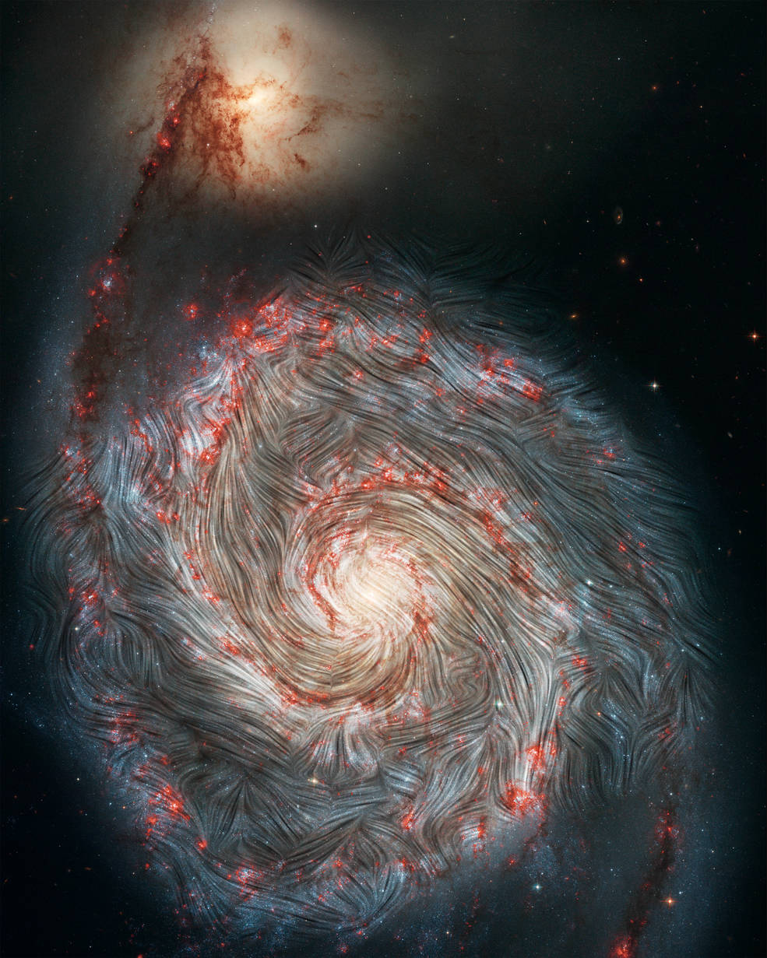
Magnetic field
lines in M51-
Whirlpool Galaxy
SOFIA (on a 747) IR
superimposed on
Hubble image
Notes:
31 million light-years away SOFIA, the Stratospheric Observatory for Infrared Astronomy,

Slide 23
Neutrino spin rotation by galactic magnetic field
For uniform galactic magnetic field:
= mean crossing distance of the galaxy
But galactic fields are uniform only over coherence length ~ kpc
so spin direction does a random walk in magnetic field.
ex., Milky Way with characteristic parameters (spherical cow approx):
: helicity randomizes

Slide 24
Neutrino spin rotation by cosmic magnetic fields
=>
Magnetic field correlation function:
perp to v
k*(t) = max
+ helical part (no role here)
← time
sum rule:
Schematic of P_{B}(k) with increasing
conformal time (η =u): η₀ < η₁ < η₂
T. Vachaspati, arXiv:2010.10525 (ROPP)

Slide 25
Conservation of flux: a²B~ const. =>
(0= now)
( = coherence length of cosmic B field)
Main contribution is from radiation-dominated era (a ~ u):
from neutrino decoupling, u_{d} (a_{d} ~ 10⁻¹⁰ )
to matter-radiation equality, u_{eq} (a_{eq} ~ 0.8 x 10⁻⁴ )
R_{u} = cu₀ = radius of universe
u₀ = 3t₀

Slide 26
Cosmic magnetic field rotation of neutrino spin
A magnetic moment
(naturalness upper bound) would be experimentally significant :
~1% of neutrinos could flip helicity
Effects of standard model magnetic moment insignificant.
If the neutrino is Majorana, no helicity changes from magnetic fields.
To within uncertainties in magnetic fields, correlation lengths, and neutrino masses, spin rotation in cosmic magnetic fields ~ galactic

Slide 27
Neutrinos 101
Neutrino magnetic moments & spin precession
Gravitational inhomogeneities & spin precession
Detection of relic neutrinos
Flammarion 1888

Slide 28
Rotation of neutrino spins by gravitational inhomogeneities
Gravitational potential Φ rotates momentum and spin:
,
Spin bending lags momentum bending
Again, neutrino undergoes a random walk through the inhomogeneities.
Momentum bending angle of massless neutrino:
In terms of gravitational fluctuation power spectrum,

Slide 29
,
Thus
x₃’ integral =>
Relate field fluctuations to density fluctuations
In radiation dominated era
,
In matter dominated era
neglect P,

Slide 30
Density fluctuation spectrum)
P(k) ~ k for k < k_{max}
(Harrison-Zel’dovich)
P(k) ~ k^{-ν} for k > k_{max}
Scales as
a² in matter dom. era
a⁴ in rad. dom. era, k <k_{max}
Planck 2018
At present
h = Hubble parameter ~ 0.7

Slide 31
Include dark energy in matter dominated era
(noticeable for redshifts below 0.5)
Matter w.dark matter fraction
Dark energy fraction
Present Hubble constant
= h/3000 Mpc
= critical density for closure
h = Hubble parameter ~ 0.7
Independent of h
With finite neutrino velocity = present momentum

Slide 32
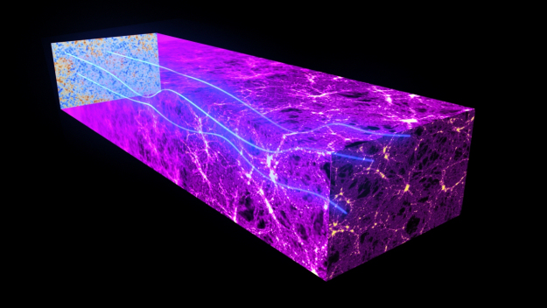
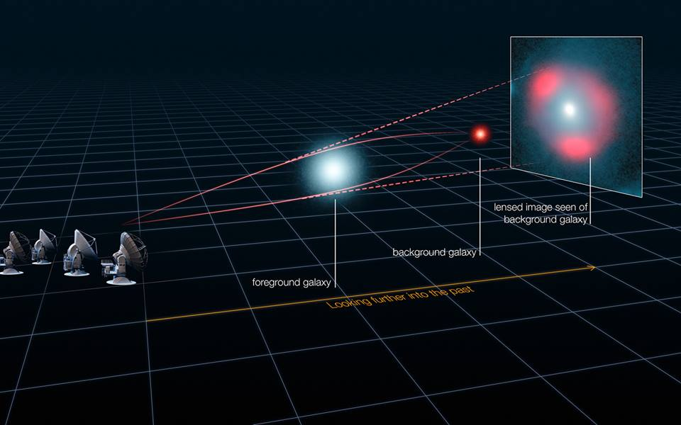
Gravitational lensing of cosmic neutrino background

Slide 33
Gravitational lensing of cosmic neutrino background
(G. Holder)
Planck 2018
RMS momentum bending = lensing of cosmic neutrino background ~ 5.1 arcmin
Lensing of CMB ~ 2.7 arcmin. Most efficient at smaller z (≲10). Reionization of intergalactic H => photon-e scattering.
(Weak electron-neutrino scattering after reionization insignificant)

Slide 34
Gravitational spin rotation with respect to momentum, Θ
Main effect in matter dominated era from redshift ~ 10⁴ to now
Momentum rotation with finite neutrino mass:
Neutrino velocity = present momentum
Spin rotation with respect to momentum.
a-integrand, p₀ = T_{v}
Measure of helicity changes

Slide 35
Bendings vs neutrino mass
momentum
spin
spin relative
to momentum

Slide 36
Spin rotation from gravitational vs. magnetic fields
Rotation in Milky Way
Galactic
Gravitational rotation
GB+JCP arXiv:2103.11209
Rotation in Milky Way
with standard model
magnetic moment
Probability of helicity flip

Slide 37
Neutrinos 101
Neutrino magnetic moments & spin precession
Gravitational inhomogeneities & spin precession
Detection of relic neutrinos
Flammarion 1888

Slide 38
Detection of relic neutrinos
Tritium beta decay
Detect electron neutrinos via
inverse tritium beta decay
(never observed)
KATRIN
Weinberg PR 1962
PTOLEMY experiment
➔ 100 g ³H
inverse β decay
in principal, have 3 peaks at the
3 neutrino masses, weighted by |U_{ei}|²
massless ν
β
decay
PTOLEMY, JCAP 2019
events vs. electron energy

Slide 39
Cross section for ITBD (p = neutrino and p_{e} = electron momena)
(F = f = Fermi)
V_{ud} = CKM matrix element, U_{ei} = PMNS matrix element
= e - ³He Coulomb correction,
= Fermi and = Gamow-Teller nuclear form factors
: only helicity dependence in cross section
Total ITBD rate:

Slide 40
Neutrino dependent part of rate = A_{eff} :
Dirac: neutrinos only, no antineutrinos
T = thermal average plus average of spin rotation in neutrino's history.
Majorana: both neutrinos and antineutrinos contribute:

Slide 41
Neutrino mass and hierarchy dependence in ITBD capture
no helicity flipping
Normal Inverted
T_{ν0}
NH: m₁=10⁻⁵ => v₁ ~ 1, v₂ ~1/5, v₃ ~ 1/20
IH: m₃=10⁻⁵ => v₃ ~ 1 , v₁ ~ v₂ ~ 1/20
But 3 couples most weakly => small mass dependence in IH

Slide 42
With helicity flipping
Relativistic neutrino dominates
Milky Way
Bounded by Dirac NH (no flip)
and Dirac NH (flip) curves
T_{ν0}
Helicity rotation in Milky Way
IH: spin rotation makes tiny difference
NH: spin rotation makes noticeable difference for m₁ ≲ 10⁻² eV
Peaks from small mass neutrinos hard to resolve with present technology

Slide 43
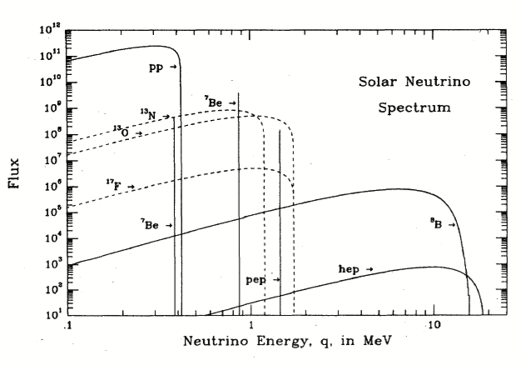
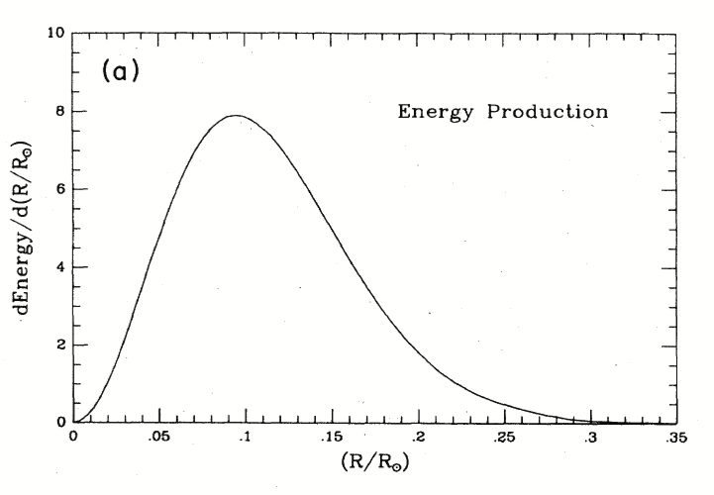
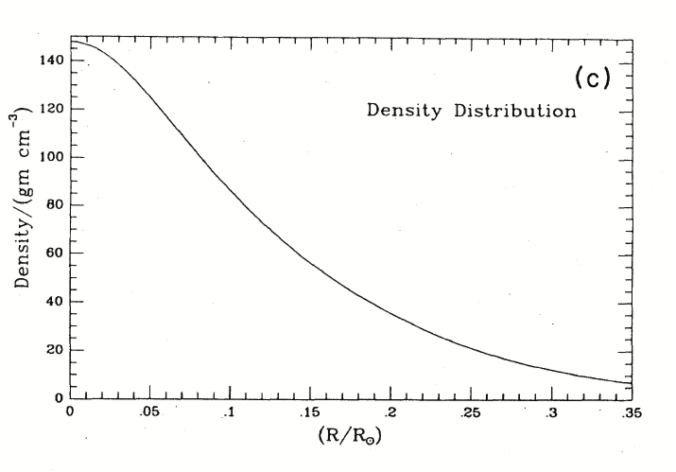
Gravitational helicity modification of solar neutrinos
z
r₀
y₀
dominated by pp neutrinos
emitted at about R_{sun}/10.
Average over spatial
emission and density
distributions in Sun
Significant helicity modification of heavy particles with spin, e.g., dark photons, from Sun.

Slide 44
Magnetic rotation comparable to that in galaxies:
neutron stars rotate spins more than SN
Galaxies: for
Gravitational rotation of spins , negligible since
Neutrinos from neutron stars and supernovae
Spin rotation of MeV neutrinos from the diffuse supernova background and neutron stars potentially detectable. Ex., via ,
using Gd-doped Super-K detector to detect n.

Slide 45
Conclusions
Relic neutrino helicities new probe of cosmic gravitational and magnetic fields
Significant helicity changes of relic neutrinos for neutrino magnetic moment μ_{ν} even three-four orders of magnitude smaller than suggested by XENON1T.
Gravitational helicity changes few orders of
magnitude smaller cf. large μ_{ν} rotations,
but much larger than for μ_{ν} in Standard Model
Need significant improvement in electron energy resolution in ITBD to resolve helicity modifications.
Galactic
Gravitational
Galactic

Slide 46
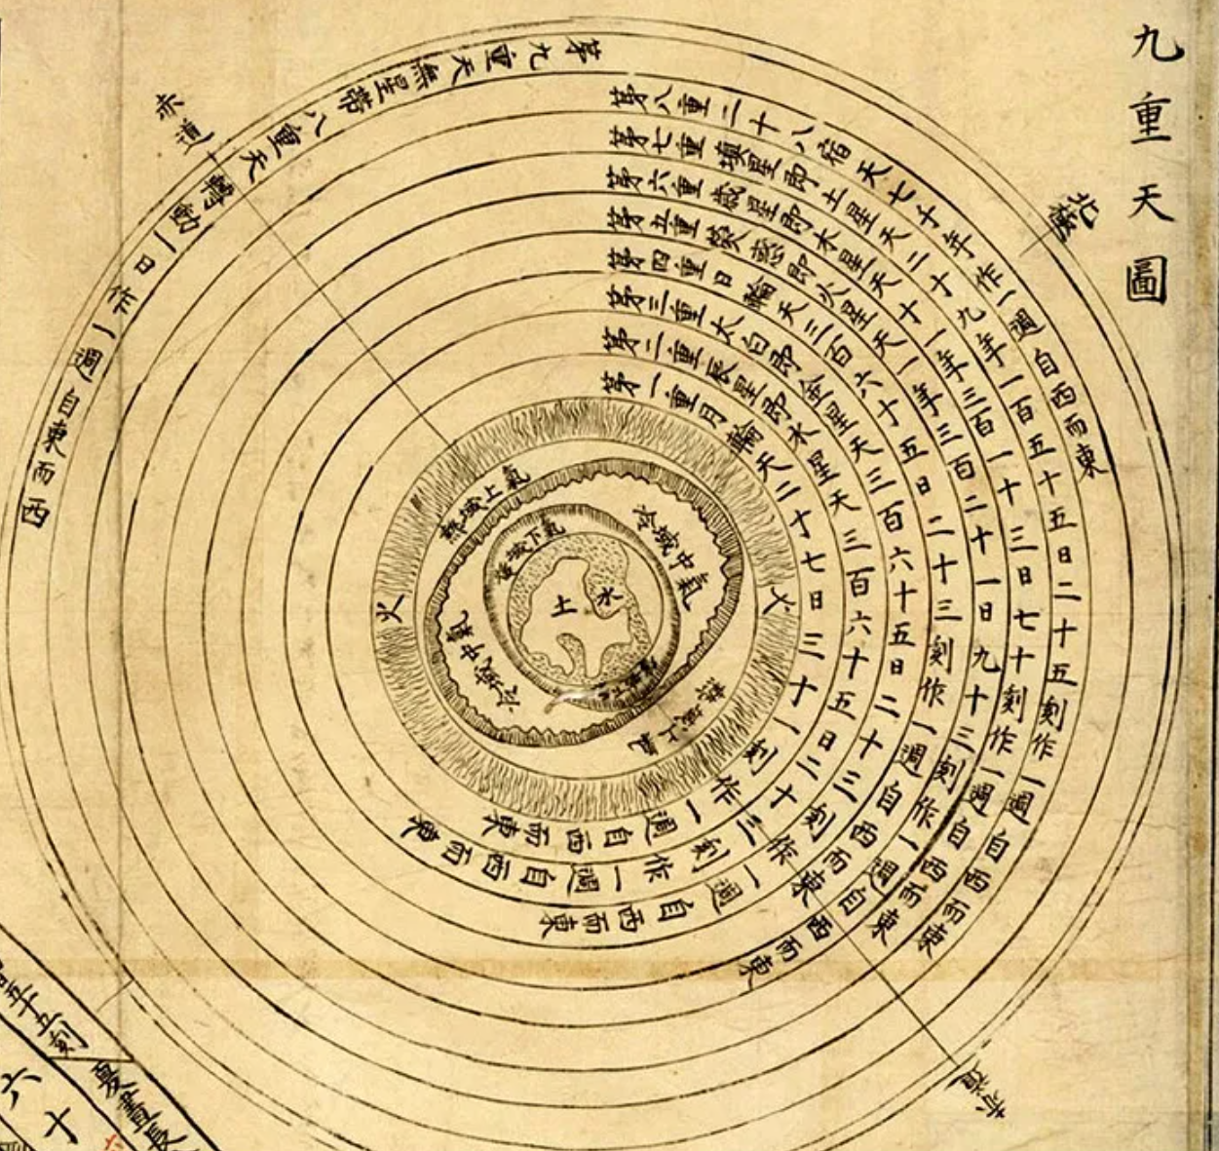
谢谢
Nine layers of the sky

