Slide 1
D_{s} Dalitz Plot Analyses from the B Factories
Mark Convery
representing the BaBar Collaboration
SLAC National Accelerator Laboratory
Charm 2010, Beijing 21 Oct 10

Slide 2
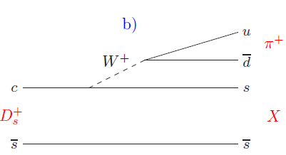
Overview
Three-body D_{s} (and D) decays are dominated by resonant sub-structure
Dalitz plot analysis with coherent amplitude sums necessary to explain observed structures
Interference effects give extra information on:
  Scalar mesons (through e.g. S-wave/P-wave interference)
  K⁺K⁻ S-wave
    Important for e.g. B_{s}→ ψφ (sin2β_{s})
  D⁰ mixing (through Cabibbo-allowed/suppressed interference)
  Measurement of γ/φ₃ in B⁺→D^{(*)}K⁺ (D⁰→K_{s}⁰π⁺π⁻)
In this talk, D_{s}⁺→K⁺ K⁻ π⁺ and D_{s}⁺→π⁺ π⁻ π⁺ from BaBar
π⁺/K⁺
_
K*⁰
W⁺
d
π⁻/K⁻
u
K⁺

Slide 3
Scalar Mesons
46 years after quark model – the scalar meson nonet is still largely unknown
Large widths, difficulty in isolation make assignments controversial
Breit-Wigner description often not appropriate
Situation may be complicated by the presence of 4-quark and/or glueball states
Can use kinematics (i.e. angular distributions) to identify as scalar
Need dynamics (i.e. couplings) to identify as
  qq meson
  4-quark state (meson-meson)
  glueball
 | Quark Content | Estab- lished | ID’d
K*₀(1430) | sd
f₀(980) | ss
a₀(980) | uu-dd
f₀(600)/σ | uu+dd
K*₀(800)/κ | sd
a₀(1450) | uu-dd
f₀(1370) f₀(1710) | ss
_
_
_
_
_
_
_
_
_
_
_

Slide 4
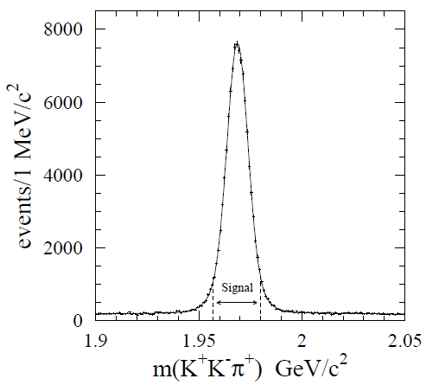

D Dalitz Plot Advantages
Large coupling to scalar mesons
Well-defined initial state (J^{P}= 0⁻)
Final state not constrained by isospin or parity symmetry
Low background
Large samples

Slide 5
D_{s}⁺→K⁺ K⁻ π⁺ Dalitz Plot Analysis
BaBar Preliminary (384 fb⁻¹)

Slide 6
D_{s}⁺→K⁺ K⁻ π⁺ Event Selection
Standard BaBar tracking and particle ID
2σ cut on Δm=m(K⁺K⁻π⁺γ)–m(K⁺K⁻π⁺)
Cut on likelihood ratio based on
  p*(D_{s})
  χ² probability difference due to D_{s} flight length
  Signed decay distance

Slide 7
Background
Combinatorial background found from D_{s}⁺ sidebands
Background from D⁺→K⁻ π⁺ π⁺ included in DP analysis
Background from D*⁺→π⁺D⁰(→K⁻ π⁺ π⁰) removed via kinematics
101K Events
Comb. Bkg. from ±6σ➔±10σ

Slide 8
Efficiency
Taken from flat-generated MC
Fitted to 2-dimensional third order polynomial
χ²/dof = 1133/1140
Projections onto m(K⁻π⁺) and m(K⁺K⁻) look good
Efficiency
Efficiency

Slide 9
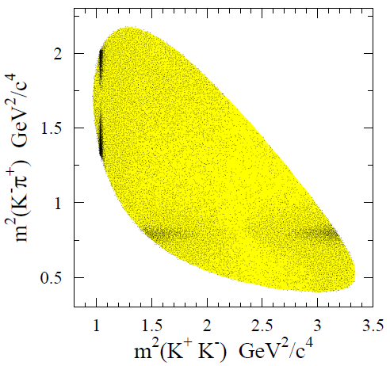
Dalitz Plot Gross Structures
φ(1020) and K*(892) clearly visible
Before doing full DP, find K⁺K⁻ S-wave in threshold region
  No Kπ structure in threshold region
  No D-wave in KK
  Model Independent Partial Wave analysis should work well
φ(1020)
K*⁰(892)

Slide 10
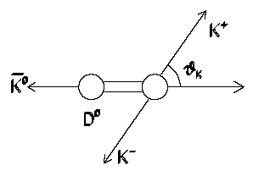
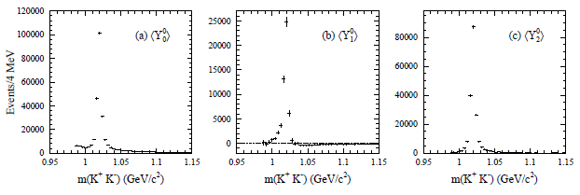
K⁺K⁻ Partial Wave Analysis
Background subtract, efficiency and phase-space correct
Weight cosθ_{KK} distribution by spherical harmonics to get coefficients <Y_{k}⁰>
θ_{KK}
π⁺
D_{s}⁺
<Y₀⁰>
<Y₁⁰>
<Y₂⁰>

Slide 11
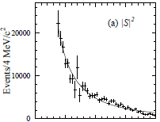
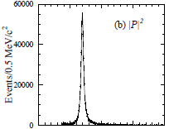
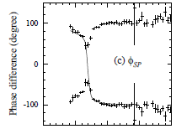


K⁺K⁻ S-Wave
Use <Y_{k}⁰> coefficients to extract S and P amplitudes and relative phase φ_{SP} as a function of m(K⁺K⁻)
Use BW for P-wave and “BW-like” for the S-wave
Phase motion coming from P-wave, S-wave slowly changing

Slide 12
P-wave/S-wave Ratio in φ(1020) Region
D_{s}⁺→φπ⁺ often used as normalization mode
Presence of S-wave must be taken into account
As a service, calculate S- and P-wave contributions and relative overall rate for different cuts on m(K⁺K⁻)

Slide 13
K⁺K⁻ S-wave Comparison
K⁺K⁻ S-wave shape consistent with other charm analyses
For K⁰K⁺ mode would expect a₀ to dominate
For D_{s}, expect f₀
Shape similarity evidence that they are both 4-quark states
_

Slide 14
Dalitz Plot Details
With S-wave empirical parameterization in hand to describe f₀(980), move on to full Dalitz Plot fit
P- and D-waves modeled with sum of resonances
Unbinned maximum likelihood fit with complex amplitudes floating
K*(892) mass and width are floated parameters
χ² computed by adaptive binning algorithm

Slide 15
Dalitz Plot Projections

Slide 16
Dalitz Plot m(K⁺K⁻)Moments

Slide 17
Dalitz Plot m(K⁻π⁺)Moments

Slide 18
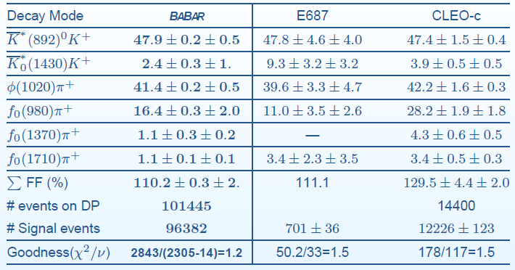
Dalitz Plot Results
Decay dominated by vector resonances
K*0(892) width is 5 MeV lower than PDG ‘08 (consistent with CLEO-c)
Contribution from K*(1410), K*₂(1430), κ(800), f₀(1500), f₂(1270), f₂’(1525), non-resonant, each consistent with zero

Slide 19
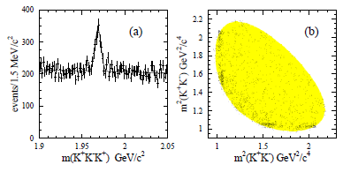
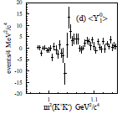
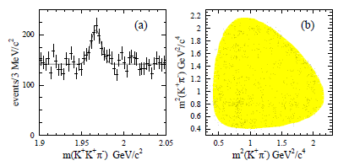
Cabibbo Suppressed Modes
D_{s}⁺→K⁺ K⁻ K⁺
SCS
D_{s}⁺→K⁺ K⁺ π⁻
DCS

Slide 20
D_{s}⁺→π⁺ π⁻ π⁺ Dalitz Plot Analysis
Phys. Rev. D79:032003,2009.(384 fb⁻¹)

Slide 21
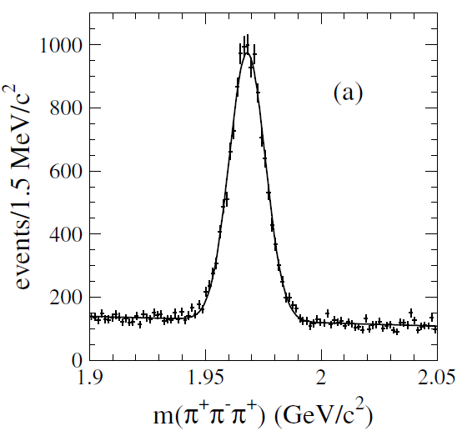
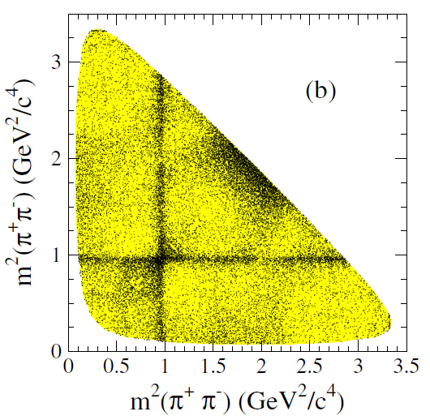
Dalitz Plot Preliminaries
Similar to D_{s}⁺→K⁺ K⁻ π⁺
2σ cut on Δm=m(K⁺K⁻π⁺γ)–m(K⁺K⁻π⁺)
Cut on likelihood ratio based on
  p*(Ds)
  χ² probability difference due to Ds flight length
  Signed decay distance
Symmetrized Dalitz plot
Efficiency and backgrounds modeled similarly
13K events
f₀(980)
f₀(980)

Slide 22
S-wave Modeling
ππ S-wave cannot be modeled as sum of resonances
Instead use MIPWA, as introduced by E791
Split the mass range into 29 slices with free complex amplitudes at each boundary
Interpolate within slice

Slide 23
Dalitz Plot Projections

Slide 24
Dalitz Plot m(π⁻π⁺)Moments

Slide 25
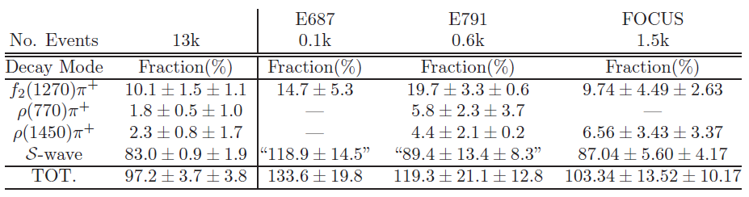
Dalitz Plot Results
χ²/DOF = 437/(422-64)
Interesting to compare different S-wave modeling from E791 (sum of BW’s) and FOCUS (K Matrix formalism)
Large S-wave component
Significant f₂(1270)

Slide 26
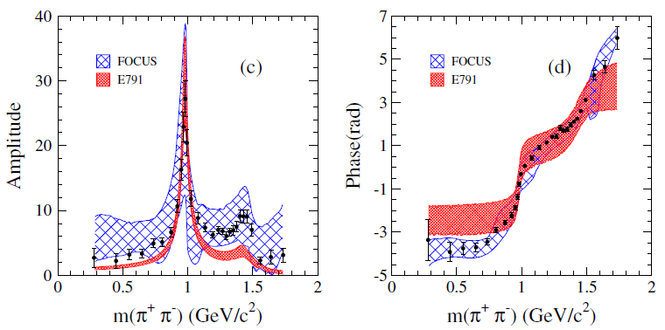
S-wave Comparison
As expected for f₀(980)
Activity at f₀(1370) and f₀(1520)
Small in f₀(600) region

Slide 27
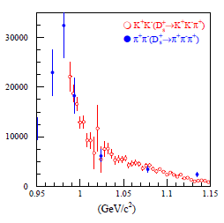
Conclusions
Dalitz plot analyses yield information on structure of scalar mesons
Striking agreement in KK S-wave between f₀ and a₀ modes.
Agreement between K⁺K⁻ and π⁺π⁻ S-waves
Could they be 4-quark modes*?
*L. Maiani, A. D. Polosa, and V. Riquer, Phys. Lett.B651, 129 (2007)

Slide 28
Backup Slides

Slide 29
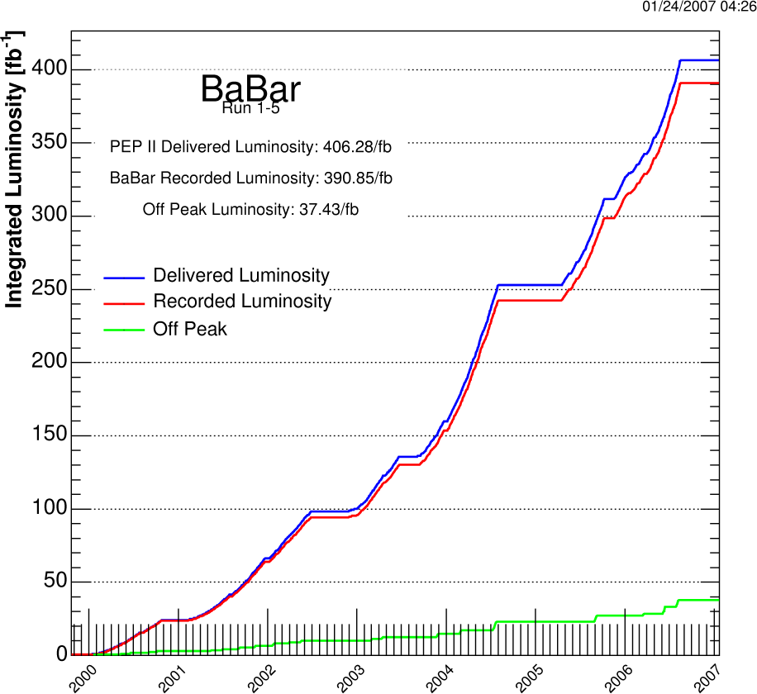
PEP-II
Asymmetric storage rings operating near ϒ(4s) resonance
Peak luminosity 1.21×10³⁴ cm²/s =12 nb⁻¹/s = 1 fb⁻¹/day
Produces B’s in flight with <|Δz|> = 250 μm
Finished data-taking April ‘08
Process effective σ (nb)
e+e-→bb 1.1
e+e- →cc 1.3
e+e- →qq (q=u,d,s) ~2.1
e+e- →τ⁺τ⁻ 0.9
Total Luminosity Recorded=530.82 fb⁻¹

Slide 30
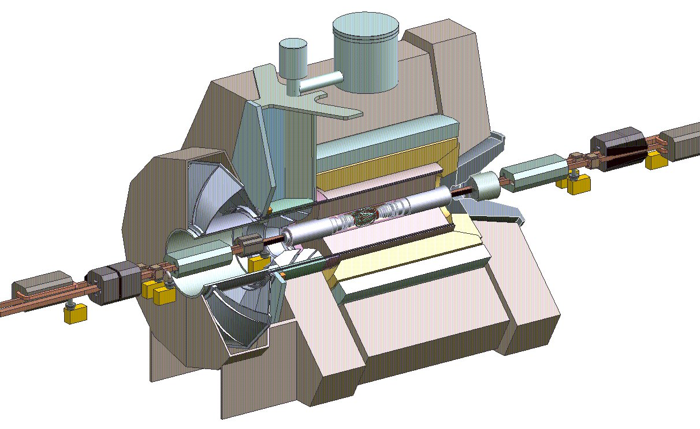
BaBar
5-layer Silicon Vertex Detector
40-layer Drift Chamber for p_{t} and dE/dx
Fused Silica Cherenkov Detector for charged particle PID
CsI (Tl) calorimeter for neutral reconstruction
Instrumented flux return for muon and K_{L} ID

