Slide 1
Recent Progress on Parton Physics From Lattice QCD in Large Momentum Effective Theory
王伟
上海交通大学
2021.05.xx

Slide 2
Outline
Parton Distribution Functions (PDF) and Lightcone Distribution Amplitudes(LCDAs)
Large Momentum Effective Theory (LaMET)
Transverse Momentum Dependent-PDFs: 3D structures
Summary

Slide 3
The Standard Model(SM)
  1960-1970s
  Gauge Field Theory：SU(3)xSU(2)xU(1)
  Fermion：
    quark
    lepton
  Bosons：
    Gauge boson
    Higgs boson

Slide 4
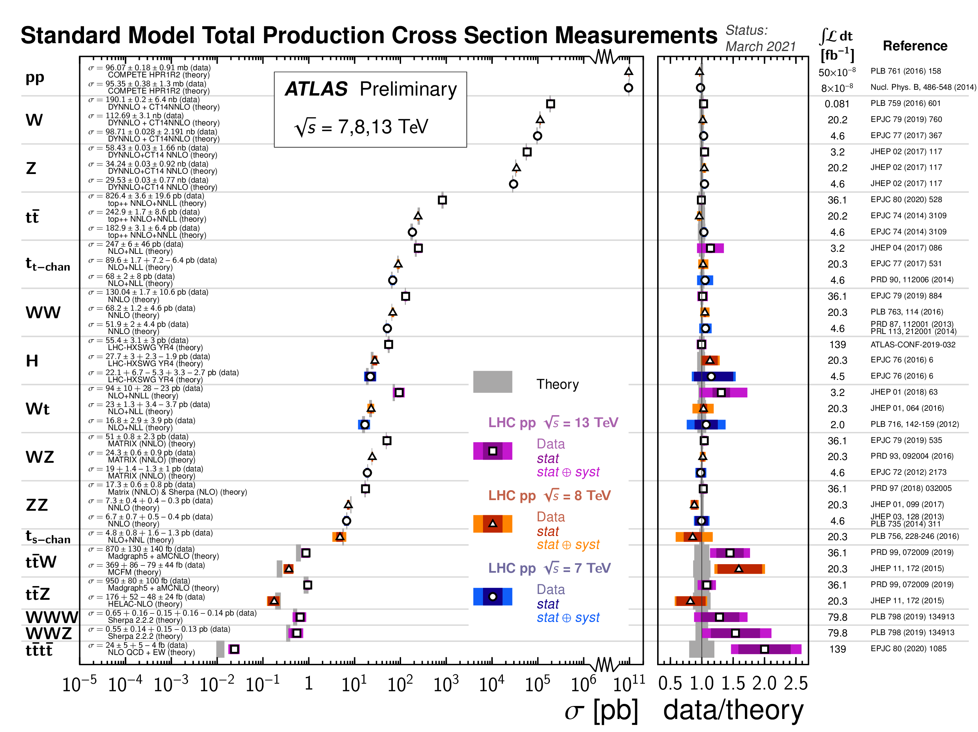
Success of SM
success of EW and flavor sectors but also QCD

Slide 5
Beyond SM
Neutrino: Mass, Dirac or Majorana Fermion
Dark Matter: 27%
Dark Energy
…
Hierarchy problem?
Landau pole vs Triviality
…

Slide 6
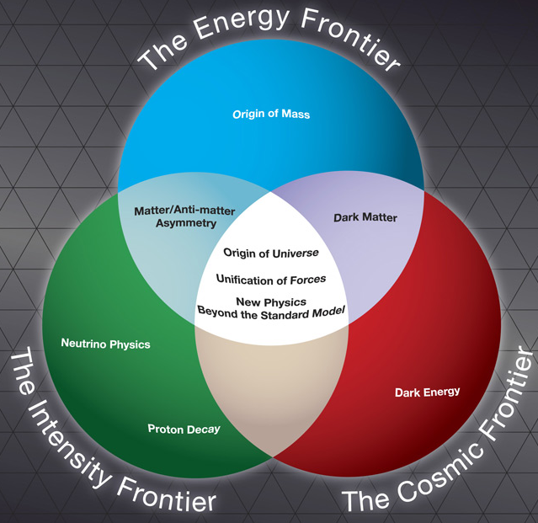
Beyond SM: Three Frontiers
LHC，SPPC
Direct search
g-2
B factories
Tau/charm factory precision
indirect test

Slide 7

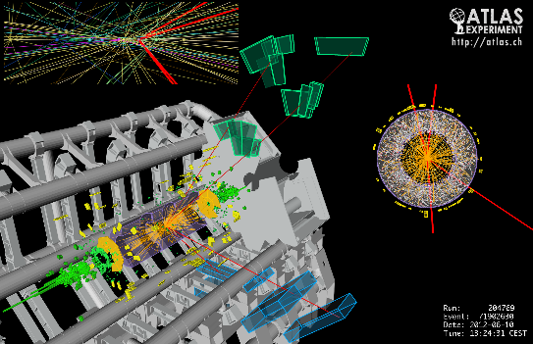
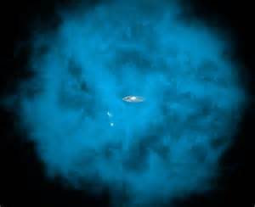
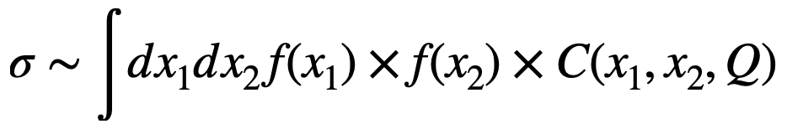

Parton Distribution Function
Collinear factorization
PDF: basic inputs for particle physics at hadron colliders

Slide 8
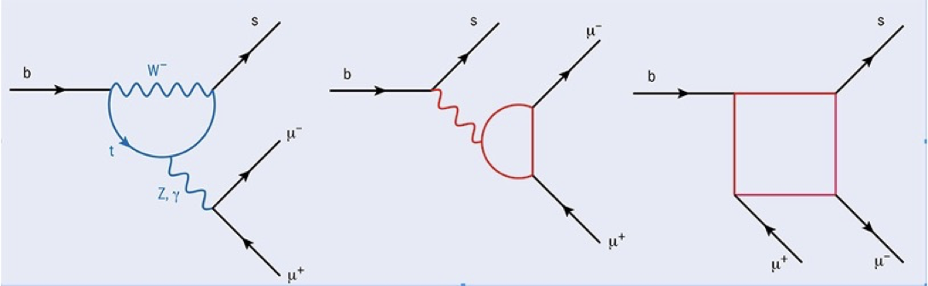
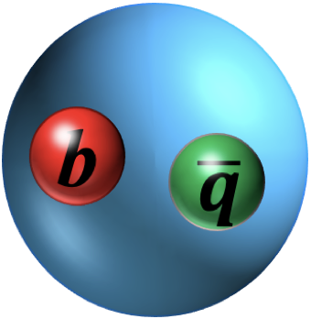
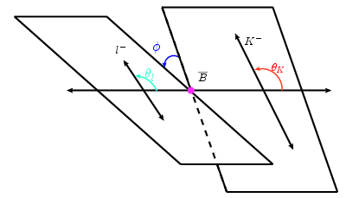

Indirect Search and Heavy Quark Physics
$$B→K^{∗}l^{+}l^{−}→Kπl^{+}l^{−}$$

Slide 9
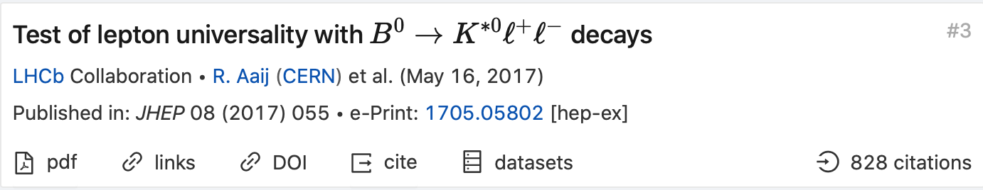

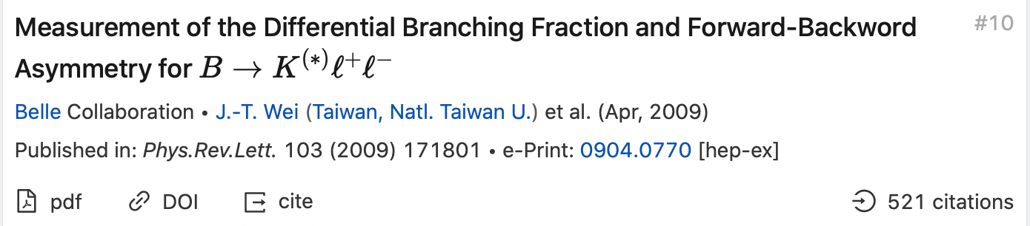

Indirect Search and Heavy Quark Physics
Lepton Flavor Universality
Angular Analysis and $P_{5}^{′}$
Forward-backward Asymmetry

Slide 10
Indirect Search and Heavy Quark Physics
LCSR
Ali, Kramer, Zhu, EPJC47, 625(2006)
B-meson LCSR
Light-cone distribution amplitudes: basic inputs for heavy meson decays

Slide 11
PDF and LCDAs
Similarity:
1. Universal nonperturbative inputs
2. infinite momentum frame, on the light-cone
3. Minkowski space, real time
Difference: (related by GPD)
  PDF: amplitude square
  LCDAs: amplitude

Slide 12
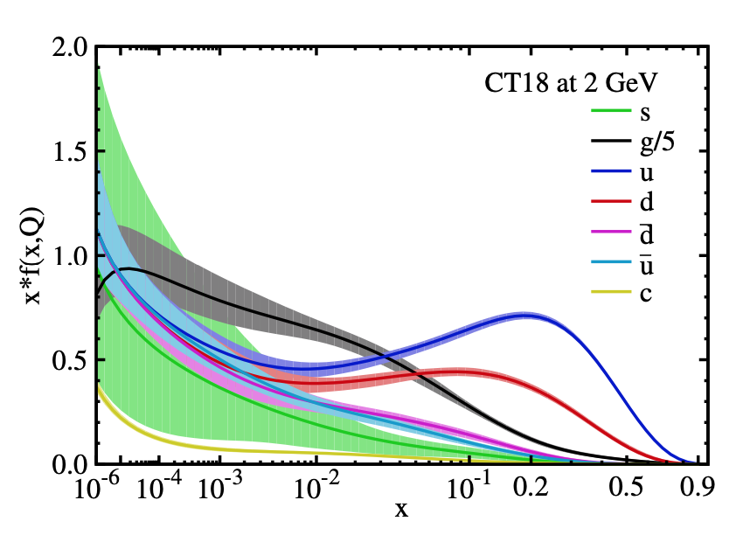

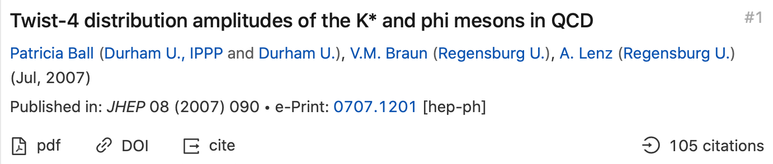
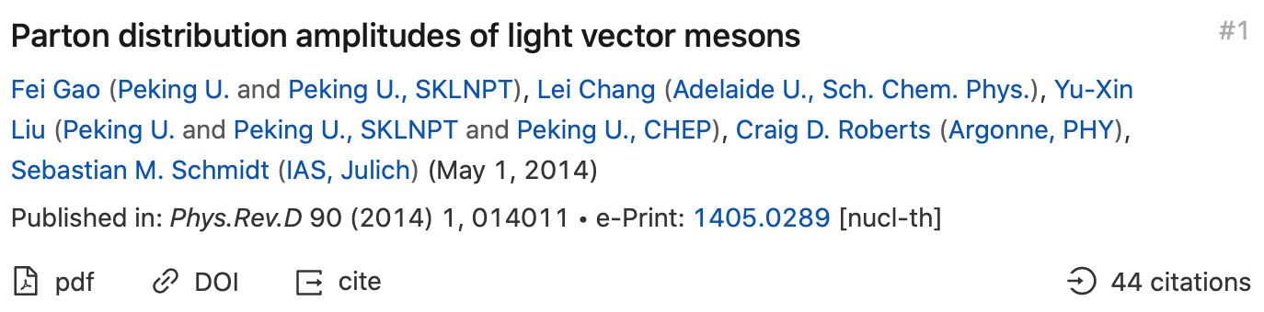
PDF and LCDAs
CTEQ
MSTW
NNPDF
ABM
…
PDF:
1912.10053, T.Hou, J.Gao, et.al
LCDAs:
QCD Sum Rules
Dyson-Schwinger

Slide 13
PDF From First Principle?
Fitting Results rely on data
First-principle calculation can cover regions where experiments cannot constrain so well
The cost of improving calculations could be much lower than building large experiments.
PDF at large x gives dominant errors: important to study heavy particles.
1705.04105v2

Slide 14
Lattice QCD(K.G.Wilson,1974)
Numerical simulation in discretized Euclidean space-time
Finite volume (L should be large)
Finite lattice spacing (a should be small)
Tremendous successes in hadron spectroscopy, decay constants, form factors, etc.

Slide 15
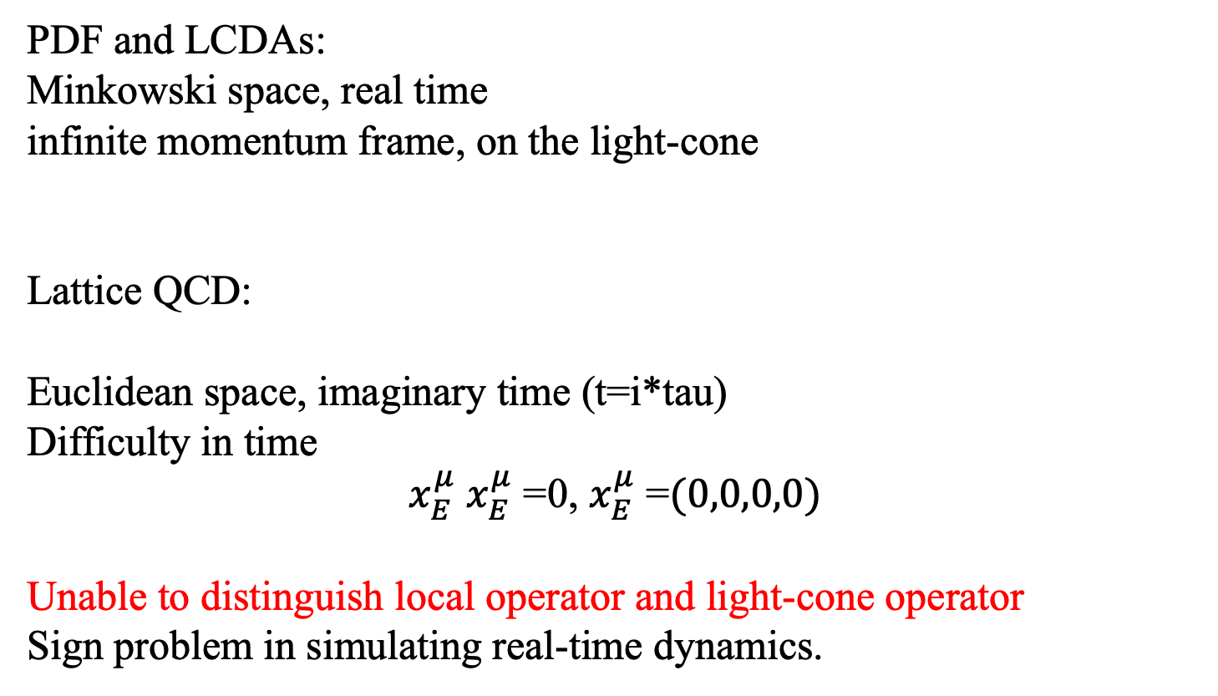
Lattice QCD: PDF?
PDF and LCDAs:
Minkowski space, real time
infinite momentum frame, on the light-cone
Lattice QCD:
Euclidean space, imaginary time (t=i*tau)
Difficulty in time
$x_{E}^{μ}$ $x_{E}^{μ}$ =0, $x_{E}^{μ}$ =$(0,0,0,0)$
Unable to distinguish local operator and light-cone operator
Sign problem in simulating real-time dynamics.

Slide 16

LaMET：
Ji,PRL110, 262002(2013)
PDF:
light-cone separation;
Cannot be calculated on the lattice
Quasi-PDF :
Equal-time correlation;
Directly calculable on the lattice
Lorentz boost

Slide 17
PDF in LaMET
Lattice QCD calculations
Matching: perturbative corrections to Z
Formalism: factorization, renormalization, power corrections
Many Progress has been made on quasi PDFs in the three directions, see Reviews:
Alexandrou et al., 1811.07248, Adv.High Energy Phys. 2019 ,3036904 (2019)
Ji, et al. 2004.03543, to be published in Rev.Mod.Phy.

Slide 18
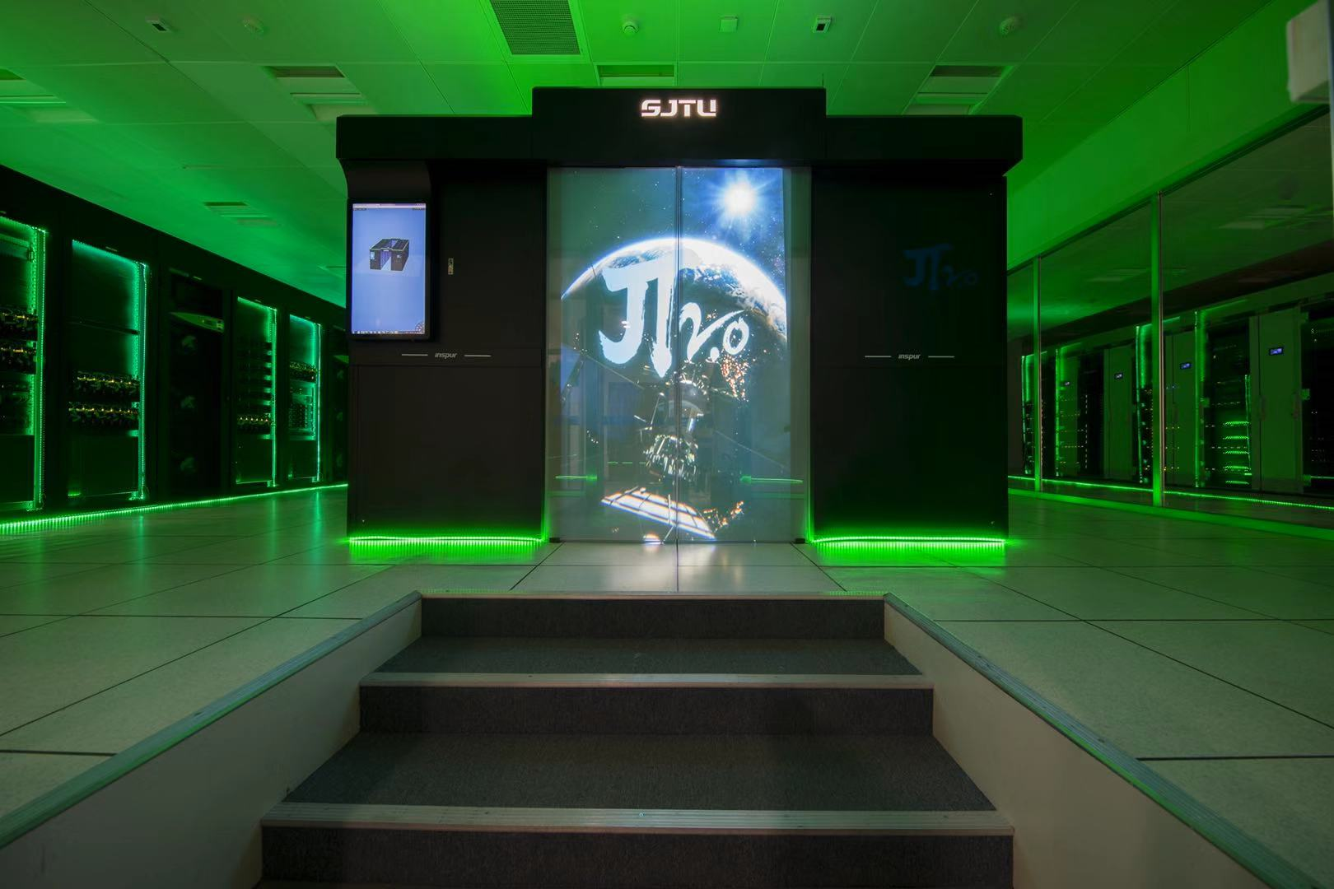
PDF in LaMET
Step 1: LQCD calculation of quasi-PDF/quasi-DAs
Lattice Parton Physics Project (LP3) Collaboration
  J.W. Chen, T. Ishikawa, L. Jin, R.-Z. Li, H.-W. Lin, Y.-S. Liu, A. Schaefer, Y.-B. Yang, J.-H. Zhang, R. Zhang, and Y. Zhao, et al
European Twisted Mass Collaboration (ETMC)
  C. Alexandrou (U. Cyprus) , M. Constantinou (Temple U.), K.Cichy (Adam Mickiewicz U.), K. Jansen (NIC, DESY), F. Steffens (Bonn U.), et al.
DESY, Zeuthen J. Green, et al.
Brookhaven group
  T. Izubuchi, K. Kallidonis, N. Karthik, S. Mukherje, P. Petreczky, C. Schugert, S. Syritsyn.
MSU group
H.-W. Lin
Lattice Parton Collaboration (LPC)
  X.Ji, P.Sun, A.Schafer, W.Wang, Y.Yang, J.Zhang, et al
…

Slide 19
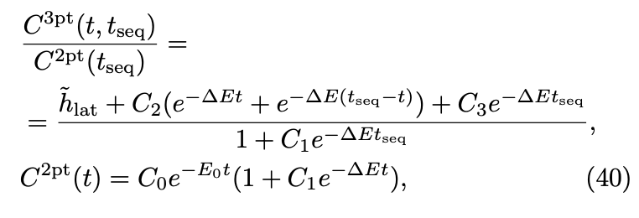
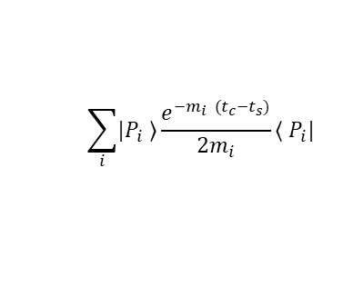
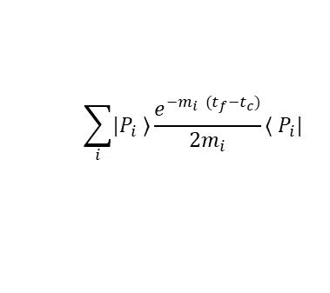
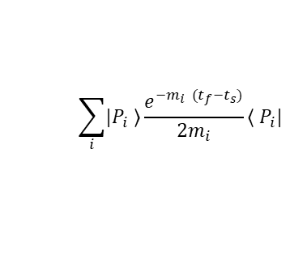
PDF in LaMET
Step 1: LQCD calculation of quasi-PDF
Propagate
Z-direction
gauge link
u
u
d
u
u
d
t=0
t=t_{seq}
u
u
d
u
u
d

Slide 20
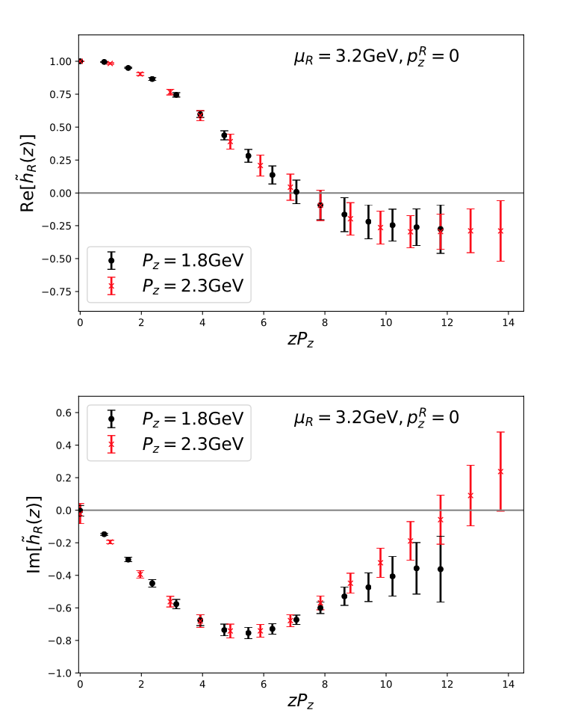
PDF in LaMET
Step 1: LQCD calculation of quasi-PDF
CLS H102: 32³ × 96, 2+1 flavor clover fermion ensemble with Lattice spacing a = 0.086 fm, pion mass Mπ = 356 MeV
LPC:PRD 101,034020(2020)

Slide 21
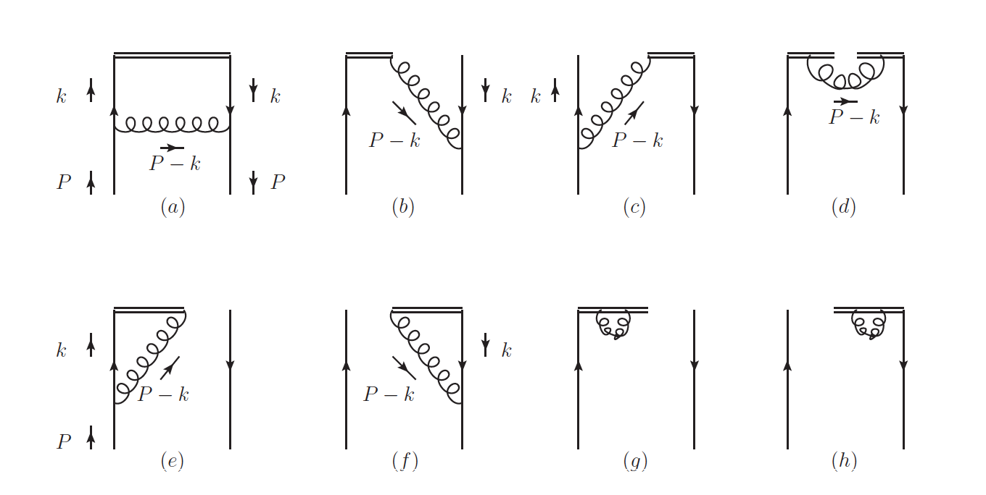
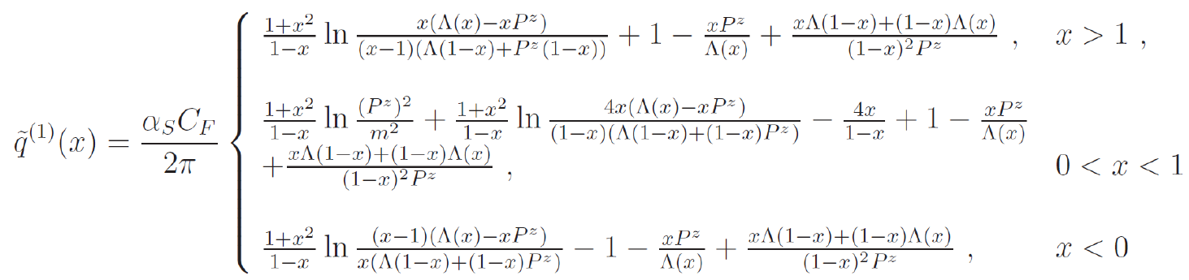

PDF in LaMET
Step 2: Perturbative Hard kernel
Quasi PDF at one loop
Cut off scheme:
(Xiong, Ji, Zhang, Zhao,2013)

Slide 22
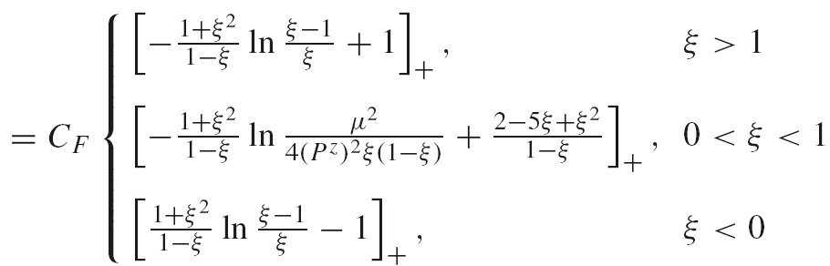

PDF in LaMET
Step 2: Perturbative Hard kernel

Slide 23
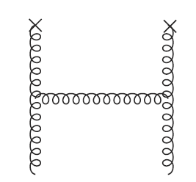
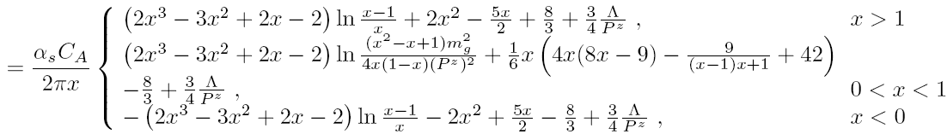
PDF in LaMET
Step 2: Perturbative Hard kernel
Gluon quasi-PDF in cutoff
WW, Zhao, Zhu, EPJC, 78,147(2018)

Slide 24
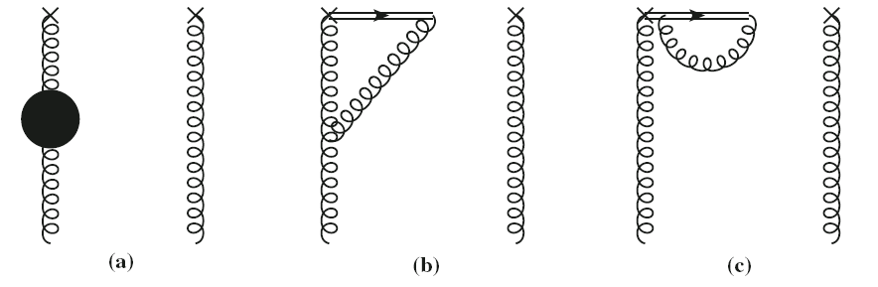
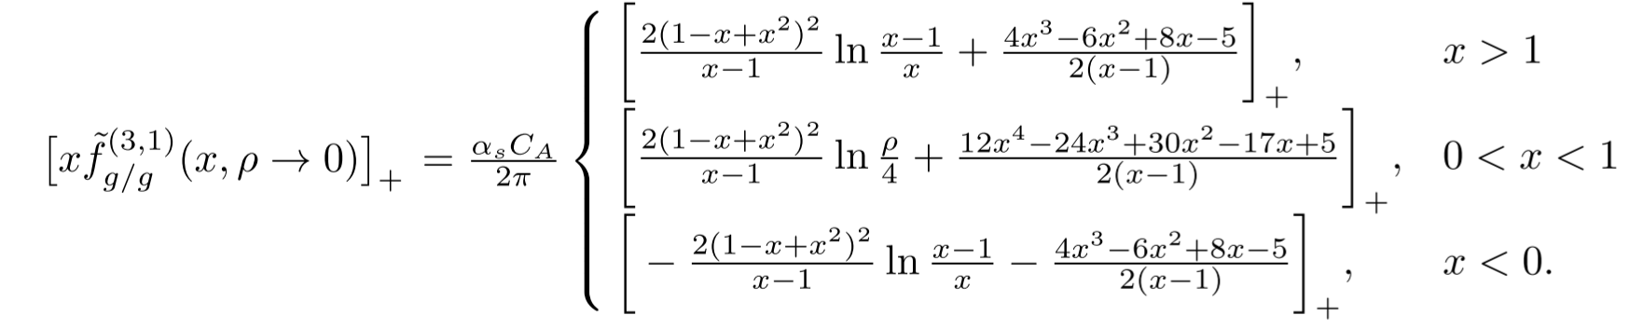
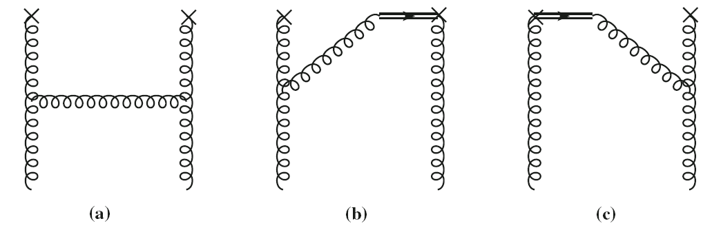
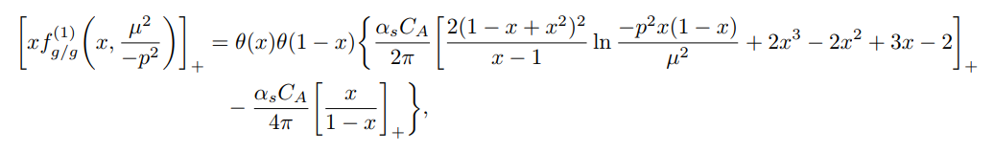
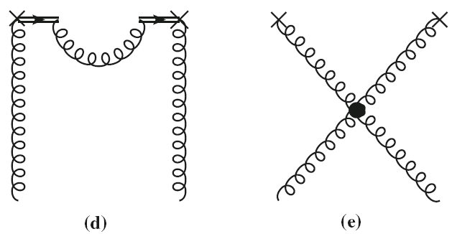
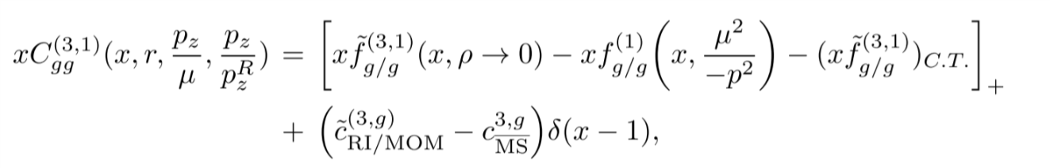
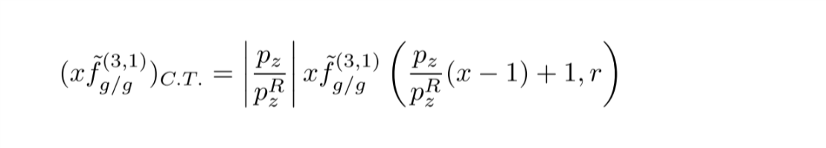
PDF in LaMET
Step 2: Perturbative Hard kernel
Gluon in RI/MOM: offshell regularization, problem?
Bare gluon quasi-PDF
Light-cone PDF
Matching coefficient
WW, Zhang, Zhao, Zhu, PRD100, 074509(2019)

Slide 25
PDF in LaMET
Step 2: Perturbative Hard kernel
Higher order corrections bring about a large number (79+ at NNLO) of Feynman diagrams
2005.13757, PRD RC
2006.10917, JHEP
2006.14825, PRL
Chen, WW, Zhu,
See also Li,Ma,Qiu,2006.12370

Slide 26
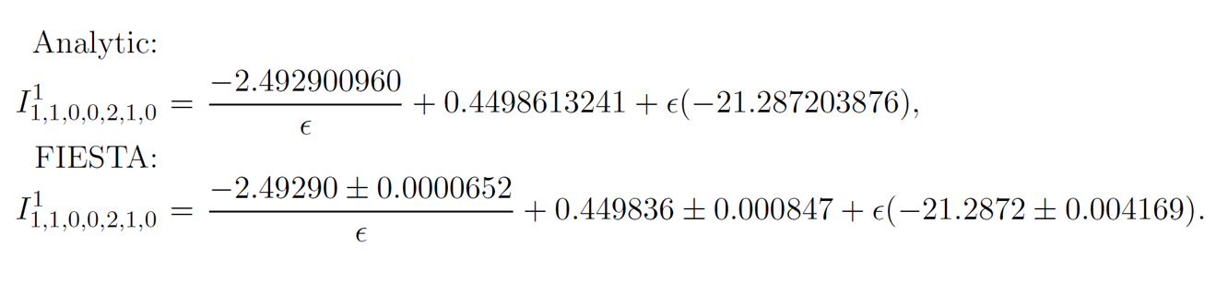
PDF in LaMET
Step 2: Perturbative Hard kernel
Check Master Integrals using the numerical integration package FIESTA
Divergences between quasi and lightcone PDFs cancel!

Slide 27
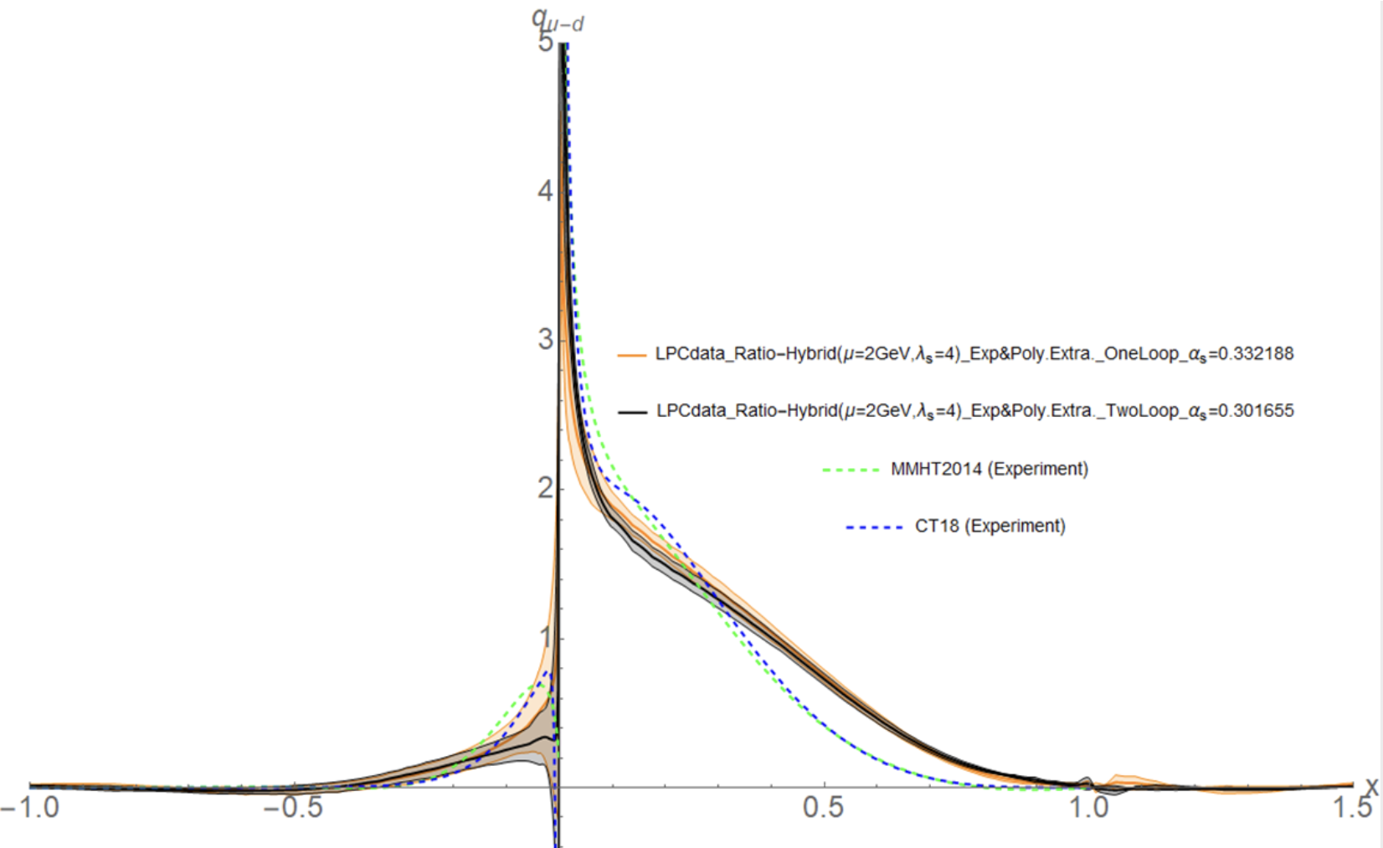
PDF in LaMET
Step 2: Perturbative Hard kernel
using ETMC data (PRD.99.114504(2019)) with zcut = 10a, μ = 2GeV and in modified MS scheme; uncertainty is from lattice data
Chen,WW, Zhu, PRL,125 192001(2021)
Yushan Su, Jian-Hui Zhang, et.al, in preparation

Slide 28
PDF in LaMET
Step 3: Inverse Matching and Extrapolation
Green: varying the truncation from z = 10a to 14a
Blue: derivative method
Hybrid Matching
Ji, Liu, Schafer, WW, Yang, Zhang, Zhao, NPB964, 115311(2021)
LPC:PRD 101,034020(2020)

Slide 29
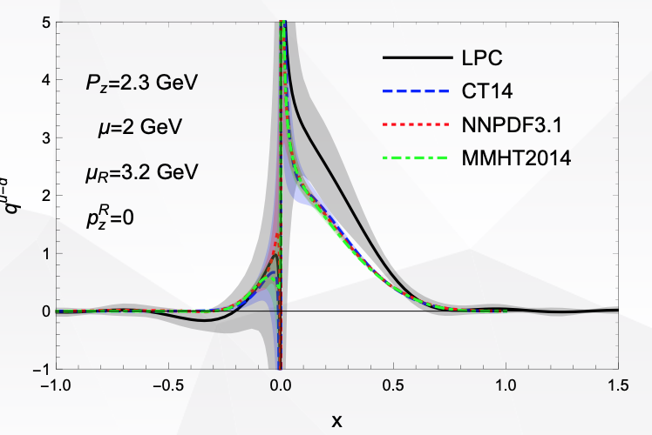

PDF in LaMET: Results
$$u\left(x\right)−d\left(x\right)−\overline{u}\left(−x\right)+\overline{d}(−x)$$
ETMC: PRL 121, 112001(2018)
LPC:PRD 101,034020(2020)

Slide 30
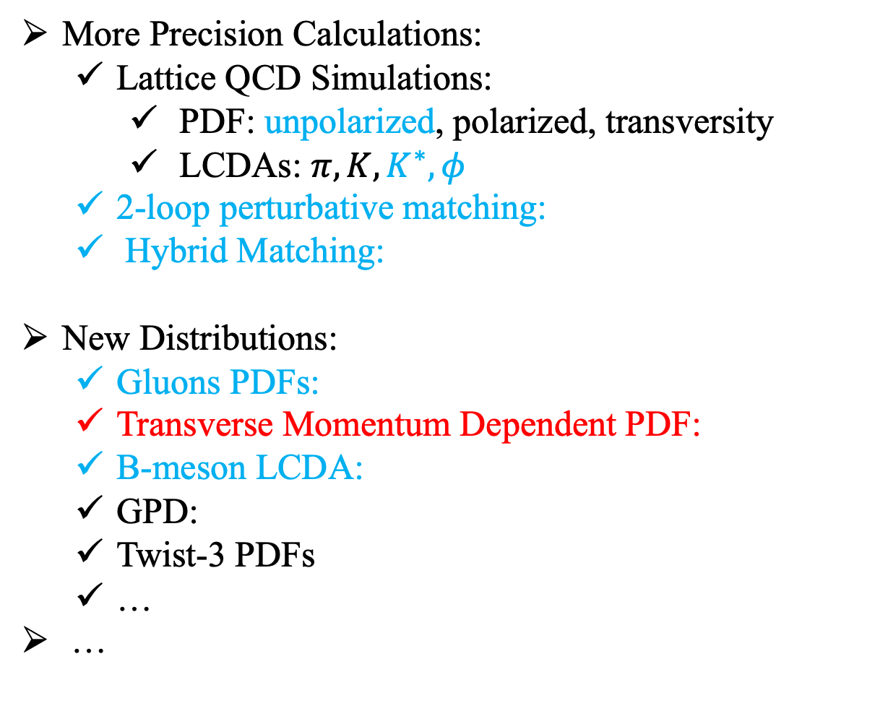
Some recent progress: a very biased personal viewpoint
More Precision Calculations:
  Lattice QCD Simulations:
    PDF: unpolarized, polarized, transversity
    LCDAs: $π,K,K^{∗},φ$
  2-loop perturbative matching:
  Hybrid Matching:
New Distributions:
  Gluons PDFs:
  Transverse Momentum Dependent PDF:
  B-meson LCDA:
  GPD:
  Twist-3 PDFs
  …
…
Alexandrou et al., 1811.07248, Adv.High Energy Phys. 2019 ,3036904 (2019)
Ji, et al. 2004.03543, to be published in Rev.Mod.Phy.

Slide 31
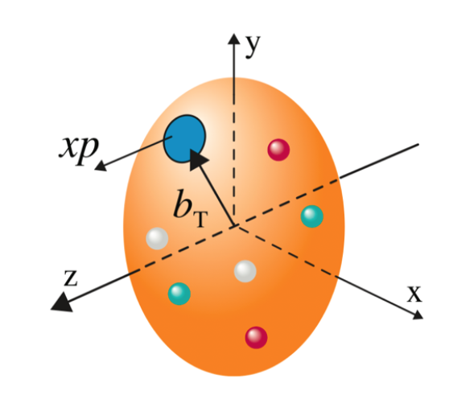
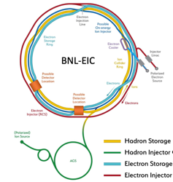
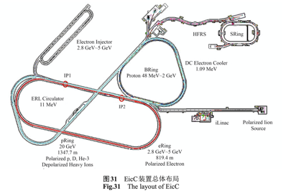
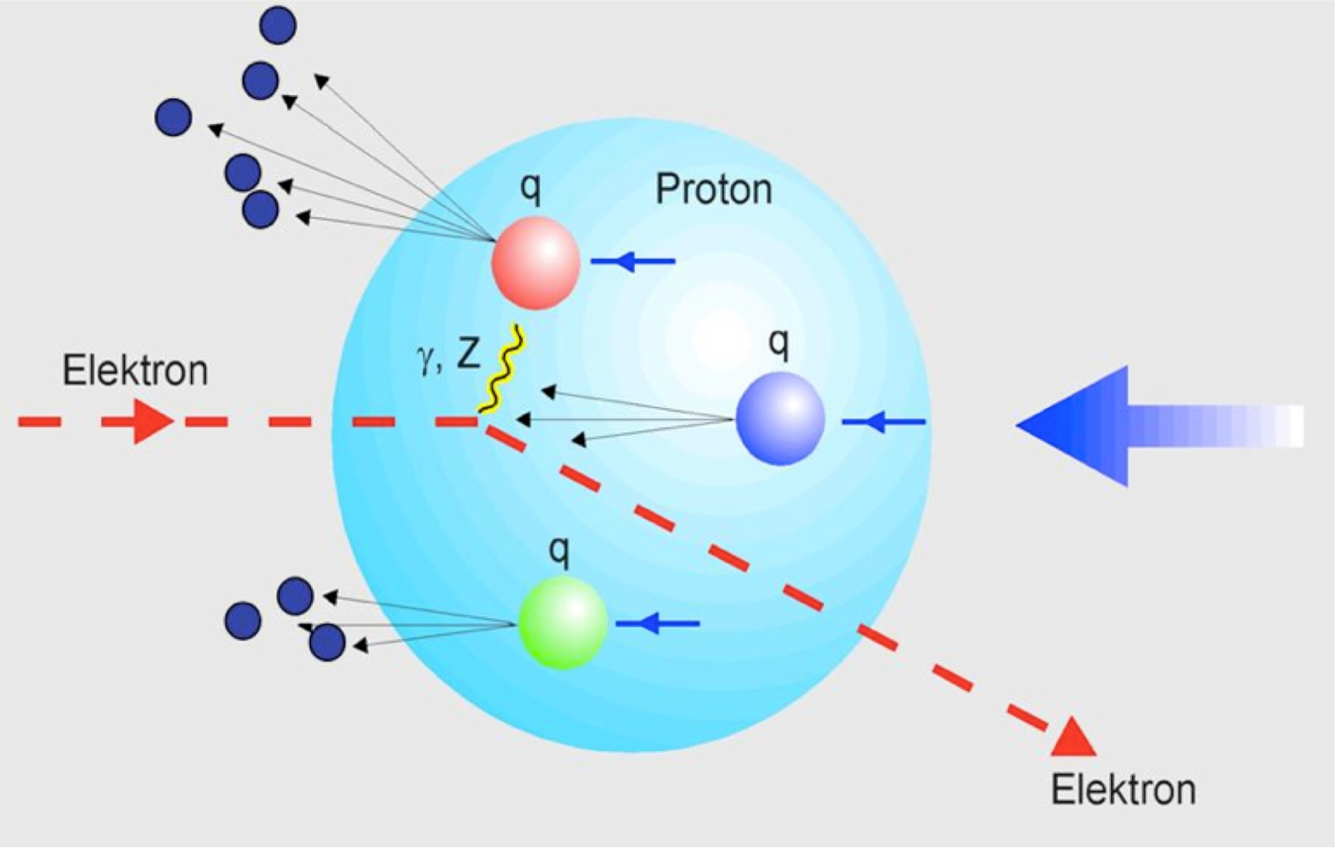


Transverse-Momentum Dependence PDF
EIC
EIcC
3-dimensional structure of the proton

Slide 32
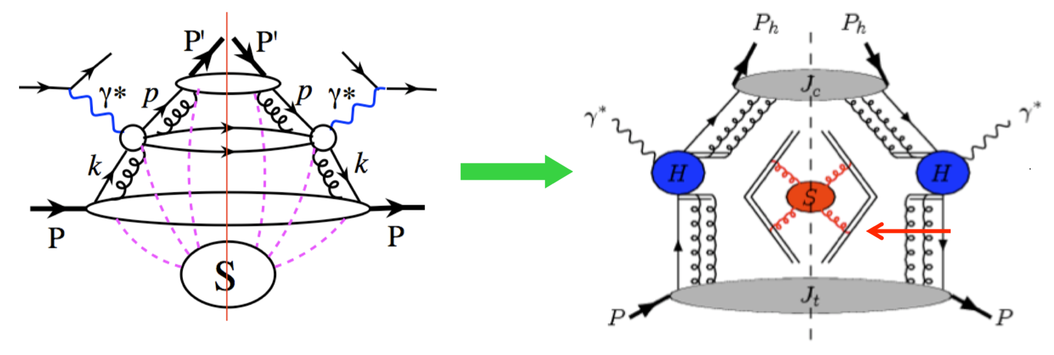
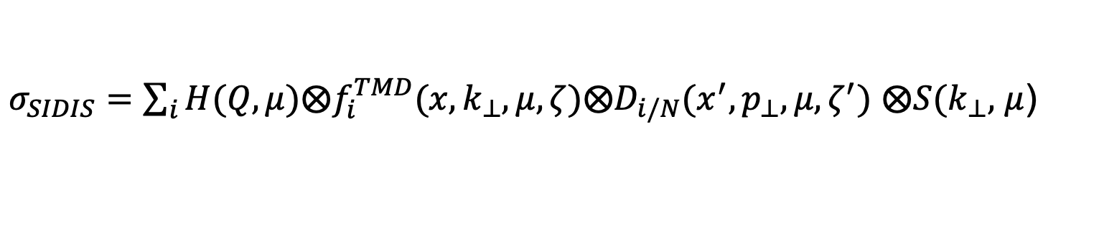
TMD Factorization
Semi-inclusive hadron production in deep inelastic scattering:
e+N -> e+h+X
TMD fragmentation
soft function
TMD parton distribution
$σ_{SIDIS}=\sum_{i}{H(Q,μ)⨂f_{i}^{TMD}(x,k_{⊥},μ,ζ)⨂D_{i/N}(x^{′},p_{⊥},μ,ζ^{′})}$ $⨂S(k_{⊥},$ $μ$)

Slide 33
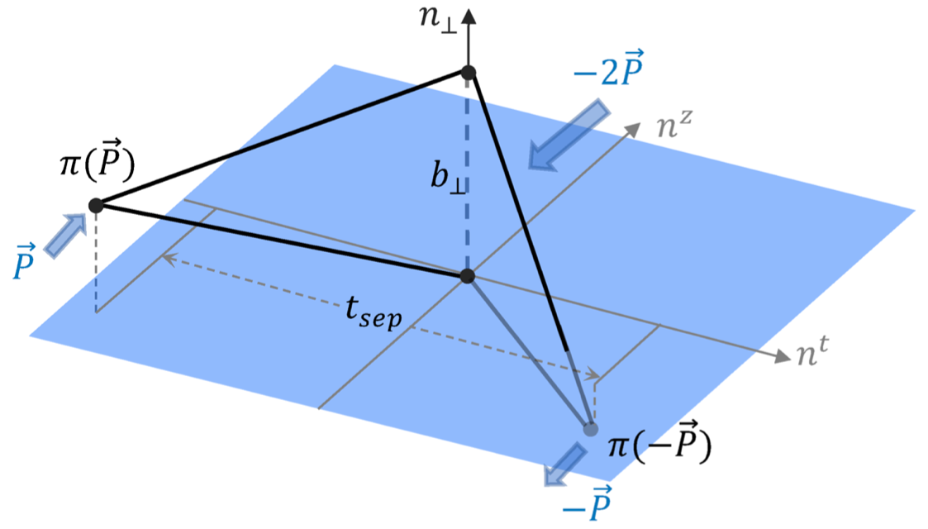

TMD Soft functions on LQCD
  A four-quark form-factor:
  Ji, Liu, Liu, arXiv: 1910.11415
z-direction
gauge link
b-direction
gauge link
z-direction
gauge link
u
$$\overline{d}$$

Slide 34
TMD Soft functions on LQCD

Slide 35
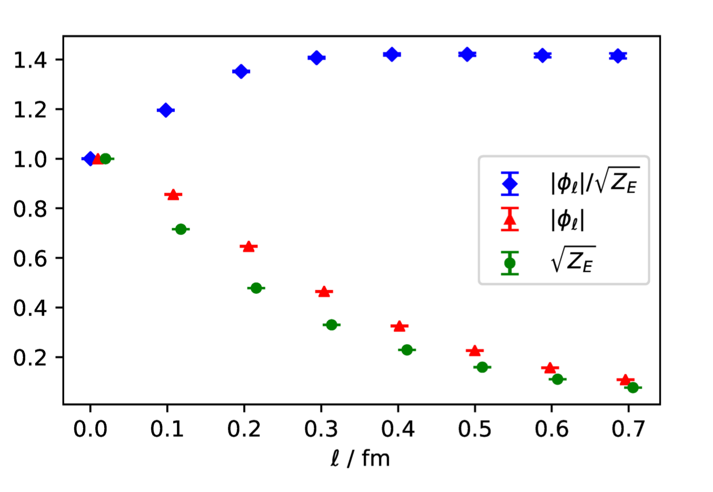


TMD Soft functions on LQCD
$$l$$
b-direction
gauge link
z-direction
gauge link
z-direction
gauge link
u
$$\overline{d}$$

Slide 36
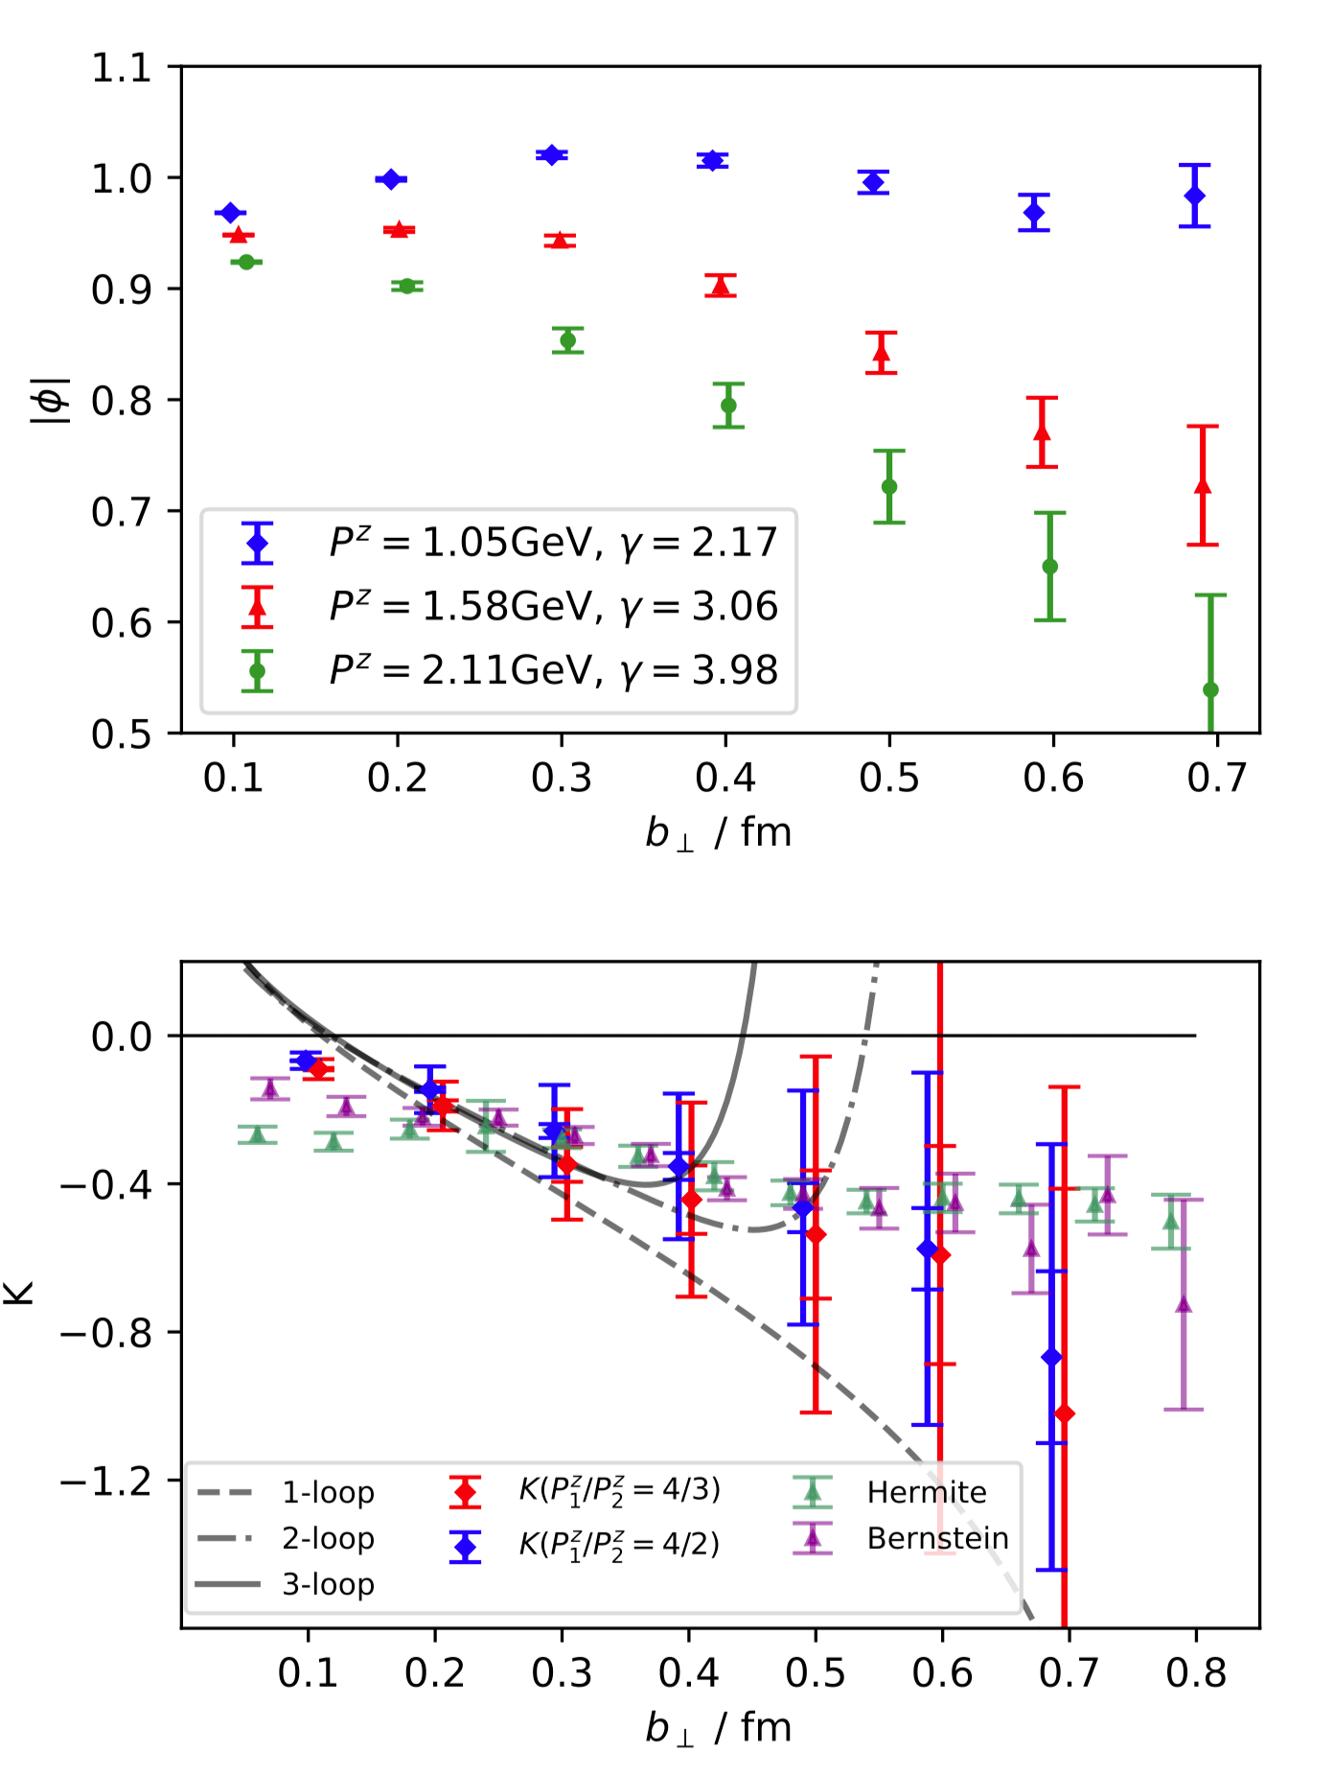
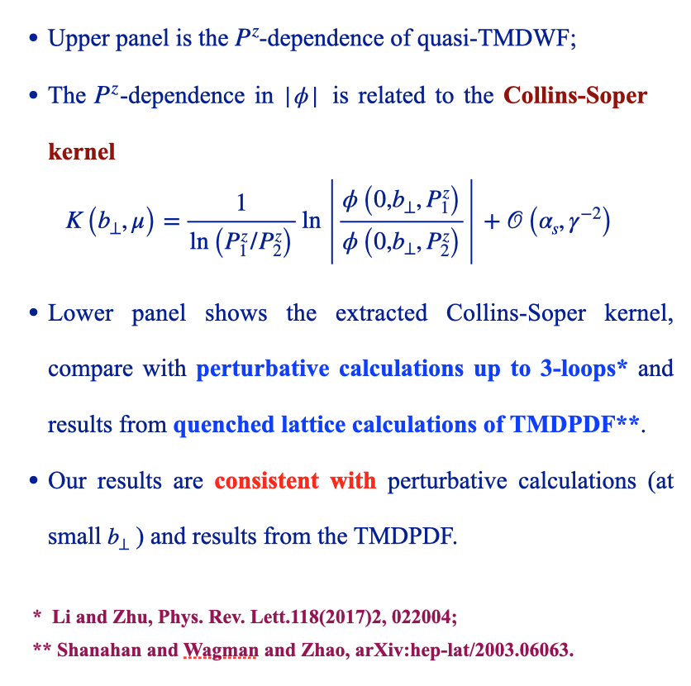
TMD Soft functions on LQCD

Slide 37
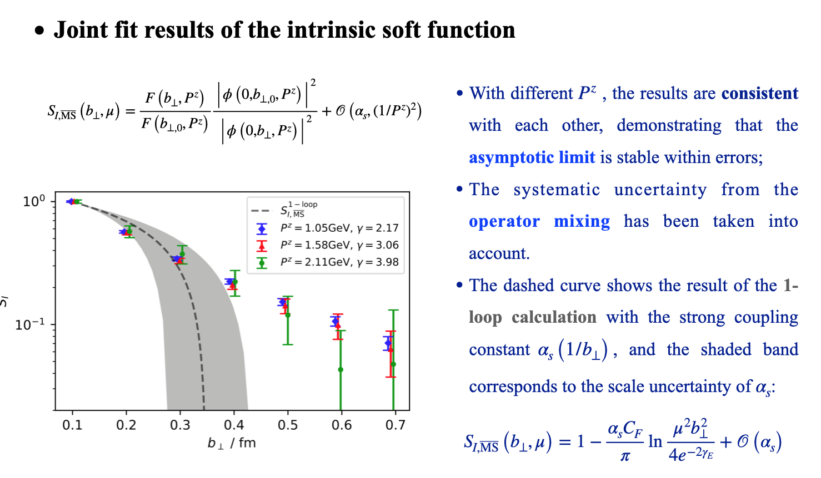
TMD Soft functions on LQCD

Slide 38
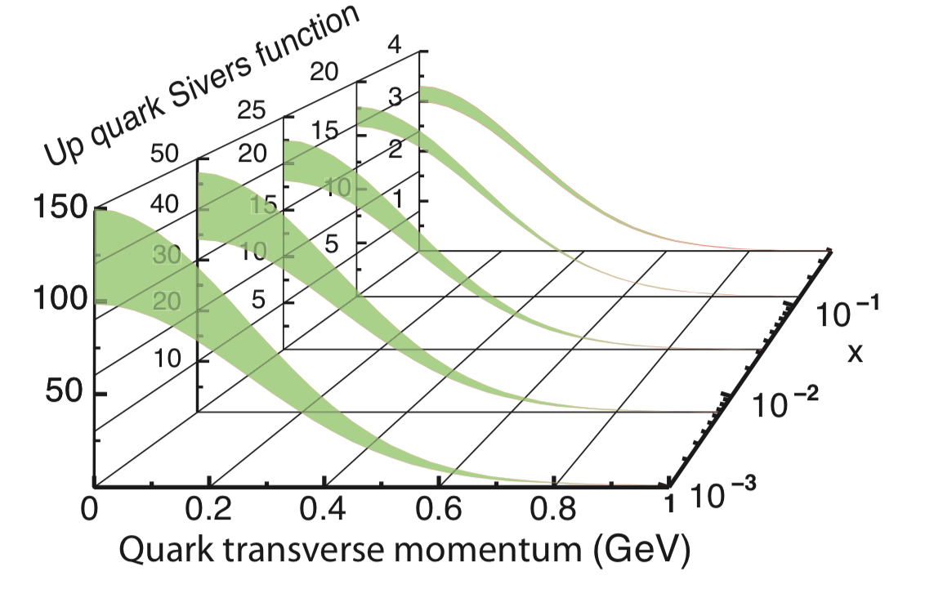
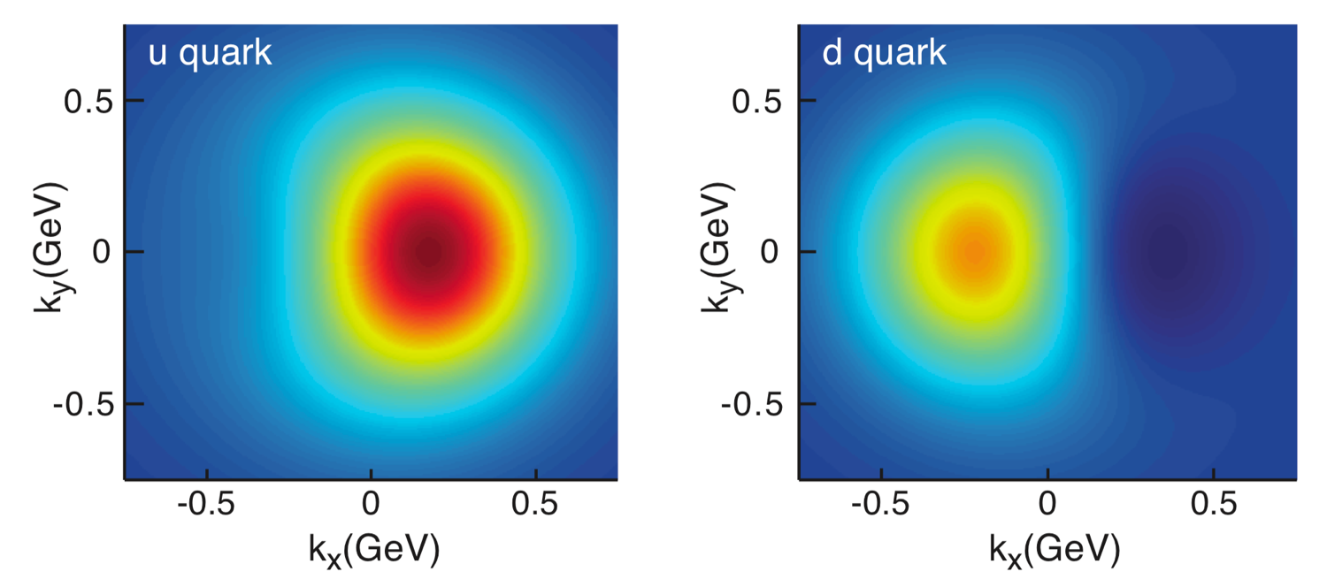
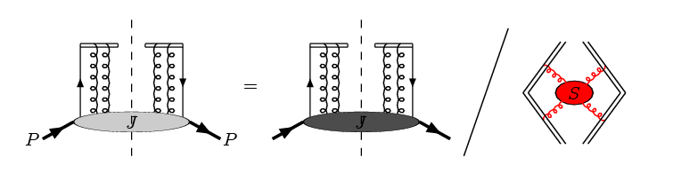
TMD Soft functions on LQCD
b-direction
gauge link
z-direction
gauge link
z-direction
gauge link
u
u
d
u
u
d
中国极化电子离子对撞机计划
核 技 术 2020, 43: 020001

Slide 39
Summary
High Energy Parton Structure (PDFs and LCDAs) are necessary inputs to make predictions at LHC, EIC and in Heavy Meson Decays.
Recent Progress on Parton Structure from LQCD at SJTU:
  Precision:
    2-loop Perturbative Matching
  New Distributions:
    Gluons PDFs
    Transverse Momentum Dependent PDF
    B-meson LCDA
In near future, we expect:
  Lattice calculation of quark PDFs with 2-loop
  New Distributions: TMD-PDF, TMDWF, …
Thank you very much!

