Slide 1
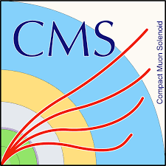
Design of iRPC frond-end electronics emulator
Jia-ning Song*, Zhen-An Liu, Jingzhou Zhao, Hanjun Kou, Qingfeng Hou, Weizhuo Diao, Wenxuan Gong
Trigger and DAQ Group/ IHEP Beijing
2021 CLHCP 27th November

Slide 2
Outline
Background
Emulator architecture
Clock requirement and distribution study
Data transmission mechanism and efficiency study
FEE emulator to BEB test results in Beijing/CERN 904-lab
Summary

Slide 3
Background
Difficulties
How to develop and verify BEB functions in lab without test facility like detector, FEB, or GBTx chip ?
What is the clock requirement of FEE and how to realize?
What is the data transmission mechanism between the frontend and backend?
iRPC software simulation
Clock requirement and distribution study
Data transmission mechanism and efficiency study
iRPC data source
FEE Emulator GBT-FPGA
GBT link
BEB
（GBT-FPGA）

Slide 4
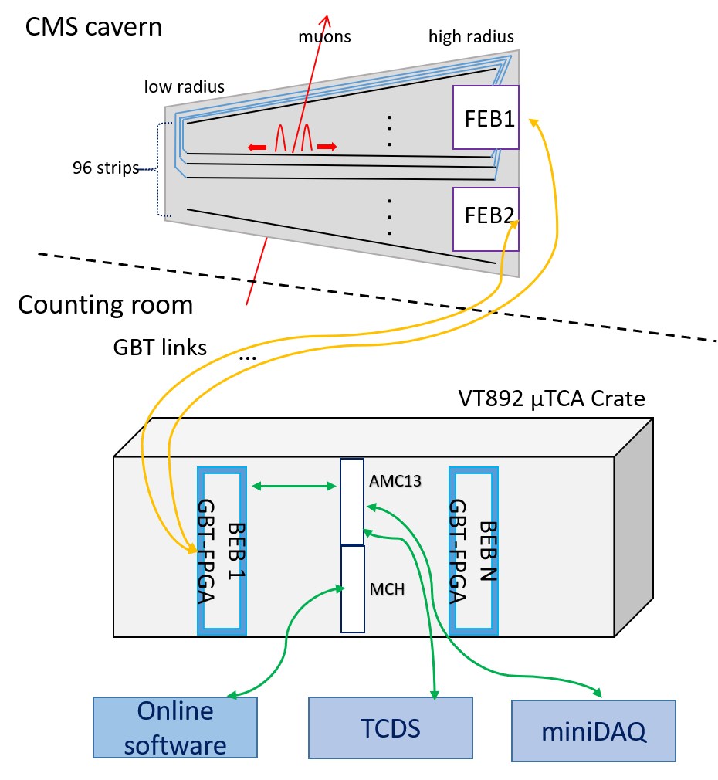
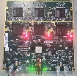
iRPC used in CMS Phase II upgrade
iRPC&FEB
HR side
t2
LR side
strip length L
r
t1
r
_{r =} 1 _{L −} (t2 − t1) _{∗ v}
2 2
Z
iRPC&FEB
One iRPC chamber covers 20°，read out by 2 FEBs through GBT link
One FEB receives signals of 96 channels (48 strips* 2 ends)
Trigger/Backend electronics system (See Hanjun’s talk)
Hit position
Each strip is read out from two ends and r is calculated by the time difference .
Much improved hit localization along the strip can be achieved. –2cm
Backend electronics system

Slide 5
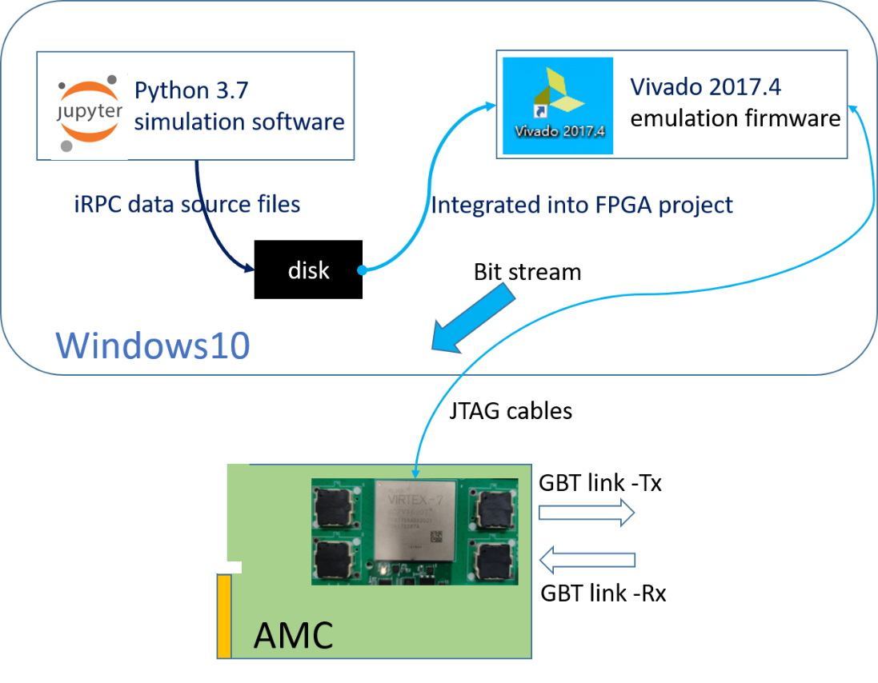
Emulator architecture
Main components
Software
Using python to simulate the hits and generate the FEE TDC data
Studying the data transmission efficiency
Firmware
Adopting GBT-FPGA to emulate GBTx chip on FEB
Communicating with the backend to verify fast/slow control function
Realizing the hit finding and data transmission algorithm
Hardware
An AMC card designed by the lab is chosen
Providing as many as 36 links optical input/output
Replicating the behavior of one or more real-working FEBs based on powerful V7 FPGA

Slide 6
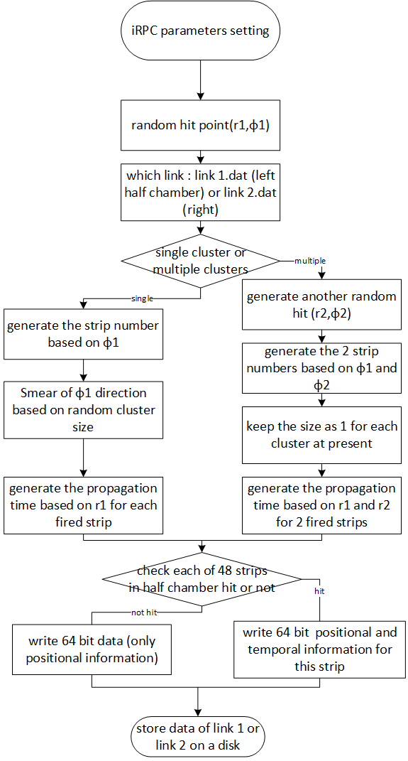
iRPC software simulation
iRPC software simulation
Three main parts
Parameters setting
Detector data generation
FEE TDC emulator
developed by python 3.7
parameters setting
96 strips
data generation
low radius cable
strip
high radius cable
. . .
. . .
FEB TDC emulator
FEB2
FEB1

Slide 7
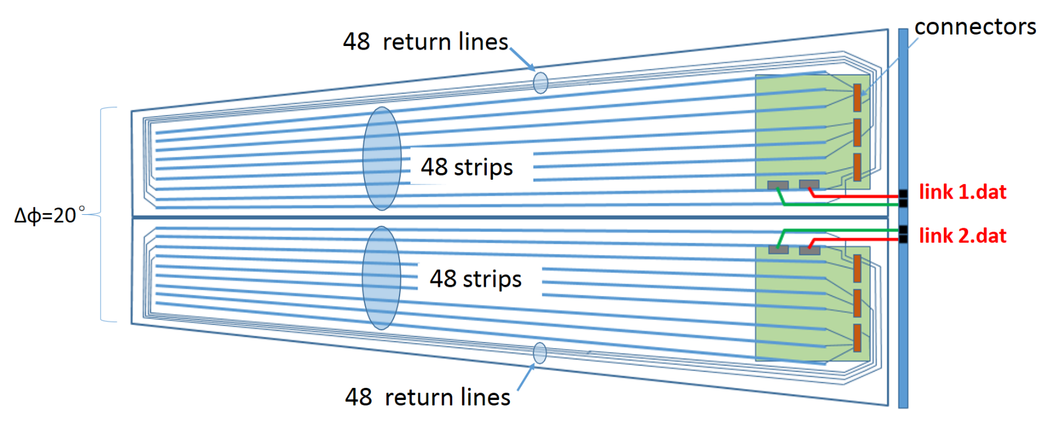
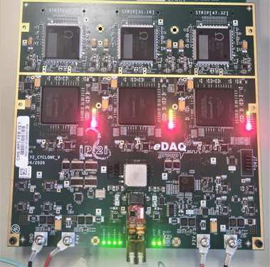
Parameters setting
Virtual RE3/1 iRPC Chamber
For one RE3/1 chamber,$R_{in}$=153cm,$R_{out}$=319cm,Area=1.32m²,covers 20°
contains 96 strips，read out by 2 GBT links.
For one strip ,$length$=166cm, pitch about 0.60cm at low radius(1.23cm at high radius)
connect with a return line (kept as 244cm) within PCB.

Slide 8
Detector data generation
Random hit point(r, φ) in the chamber
r: generates the hit point along strip.
φ: generates the strip number.
Smear of φ direction :
Generates a consecutive set of strips as a cluster.
Cluster size randomization :
1-8,mean is 2.35
Reference : Shchablo Konstantin¹ on behalf of the CMS Muon group, Front-End electronics for CMS iRPC detectors（RPC2020, Roma）
Number of clusters :
1(75% probability),2(25% probability，keep the cluster size as 1)

Slide 9
TDC emulator
TDC Data unit(32 bits)
devAddr | chanAddr | TDC data
 |  | Coarse time | Fine time
2 | 6 | 16 | 8
devAddr ：FPGA ID, totally 3 on 1 FEB chanAddr : channel number, 0~34
Coarse time : the value of an internal counter at 400MHz which gives the coarse time (2.5ns step).
Fine time: corresponding to the fractional part of the coarse time step, 2.5ns/256≈9.7ps
Digitization
For each fired strip, there are always 2 constraint 32-bit TDC data constructed.
Channel-HR Rising Edge (32bit) + Channel-LR Rising Edge (32bit)

Slide 10
Clock requirement and distribution study
For the final System
The backend receives the LHC bunch clock from AMC13 then sends to FEE via GBT links.
The LHC bunch or AMC13 clock is 40.0786MHz ± 0.0037MHz
BEB to FEB/FEE Emulator clock requirement
No bunch clock
GBT REFCLK ppm(parts per million) requirement : ±200 pm => 40MHz * 200/10⁶= ± 0.0080MHz
High accuracy 40.0786MHz oscillator is needed to communicate with FEB GBTx chip/FEE Emulator.
Verification
At IHEP trigger lab
Replace the on board OSC with high accuracy 40.0786MHz±0.002004MHz MHz OSC in IHEP.
No error was found during a 96-hour test.
At CERN
Then we modified the BE boards in CERN with the help of electronics experts in CMS RPC collaboration.
Already verified by joint test with FEB_V2(Lyon Group) .

Slide 11
Clock requirement and distribution study
BEB to FEB clock distribution
Bunch clock or OSC
FEB
BEB
Cyclone V
GBTx
40.0786MHz
CDR
GBT-FPGA TX
PLL
E-LINK SERDES
E-LINK SERDES
GBT SERDES
MiniPOD
MGT TX
SFP
MiniPOD
MGT RX
GBT-FPGA RX
CDR
The system clock is sent to FEE via optical links.
The GBTx chip recovers the bunch clock from input data stream and uses it as system clock for FEE.

Slide 12
Data transmission mechanism and efficiency study
The Check-Sort-Push (CSP) algorithm
proposed by the IHEP trigger lab at first and widely discussed in the CMS RPC collaboration
Became one of the solutions for FEE-BEE data transmission and adopted by FEE Emulator
Details
Checking all the channels every BX (25ns) for new hits
Sorting the new hits if Yes in time sequence with the remaining for transmission
Transmitting them one-by-one in the consecutive BXs to the backend via GBT protocol
An adjustable Tx Latency Window (TxLW) is applied to the transmitter side
The value of the latency informs how many BX a given frame was delayed with respect to the BX from which the TDC data originates.
Making it reliable for the transmission between FEE and BEE
Preventing the buffer from overflowing and achieves system robustness if the hit rate exceeds designed values.) .

Slide 13
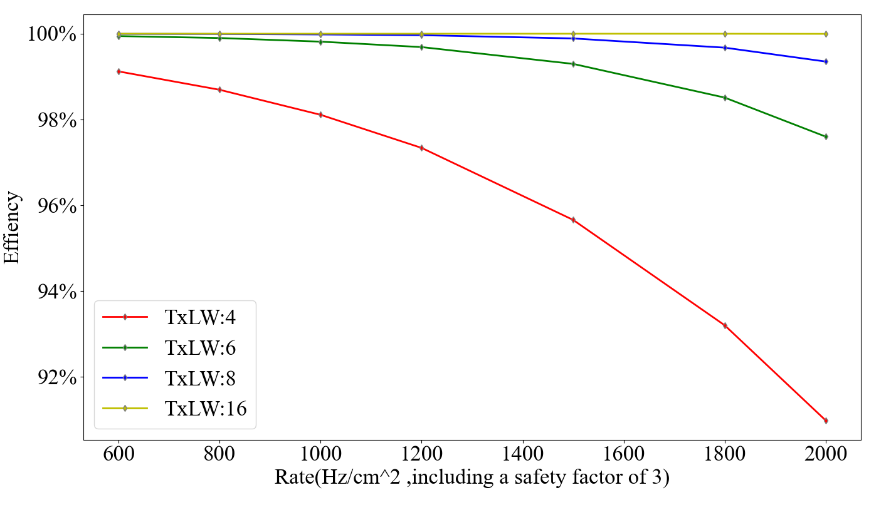
Data transmission mechanism and efficiency study
Efficiency with different Tx Latency Windows(TxLw)
TxLW width settings(BX): 4, 6, 8, 16
hit rate( Hz/cm^2 ,safety factor 3):600, 800, 1000, 1200, 1500, 1800, 2000
Including burst; Mean cluster size:2.35 ; Surface of half chamber :6600cm^2 (1 fiber)
Size of 1 strip(2 channels) information: 64 bits
For maximum rate 2000 Hz/cm^2,1 fiber data rate
Data bandwidth estimation
⁼ ²⁰⁰⁰rate^{*6600}surface^{* 2.35}cluster size ^{*64} 1 strip info
Gb/s
= 1.99 Gb/s(smaller than uplink data bandwidth 3.84Gbps)
The FEE original solution in TDR which sends both the rising and falling edge is replaced by the the collaboration based on our study.
A larger TxLW leads to increased efficiency.
100 % efficiency is measured with a 16-BX wide TxLW in our simulation.

Slide 14
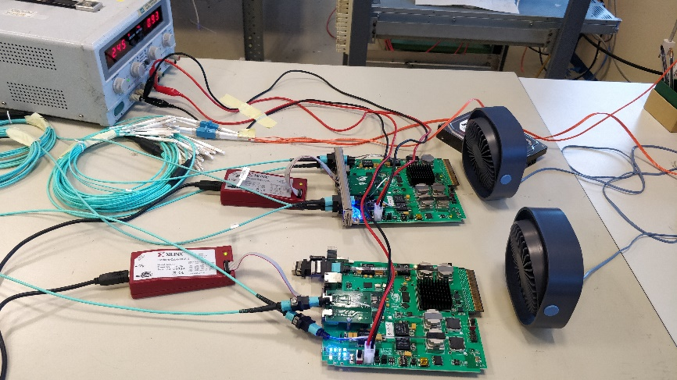
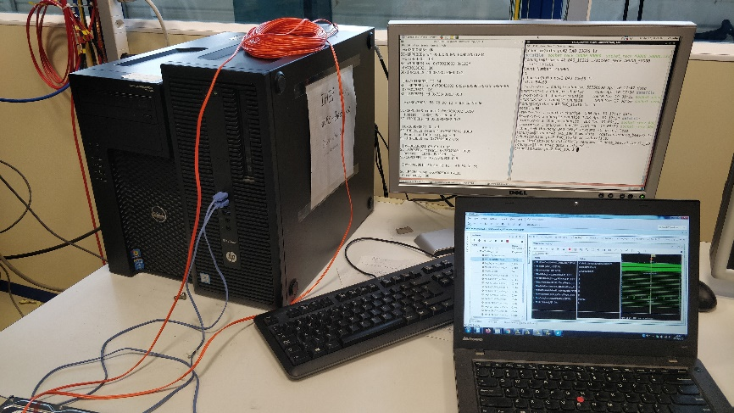
FEE emulator to BEB test system
Purpose：
Understanding the basic requirement of FE Board
Verifying back-end board function
System setup ：
2 boards are used
- one acts as FEB emulator
- one acts as BEB
Power supply
Fan
PC- desktop
- 1Gb-link and 10Gb-link Hardware
- Slow control software
- DAQ software
PC- laptop
- Check firmware algorithm
FEE Emulator
GBT-FPGA
BEB
（GBT-FPGA）
GBT link
12V-DC
BEB
Fan
10Gb-link,DAQ
SC-SW
DAQ-SW
Fiber(MPO-LC)
FEE emulator
1Gb-link,SC
Check Board status

Slide 15
FEE emulator to BEB test results
Test List done in Beijing/CERN
Check GBT link establish status between FEE emulator and BE board √
GBT link Long time stability test( > 2 days) √
Bit Error rate test between FEE emulator and BE board √
FEE emulator send pseudo-random data and BE check the data
BER is better than 8E-16.
Slow control frame write and read check √
Write and read a custom address
Single frame mode
Burst mode
Slow control frame repeatedly write and read check √
GBT SCA write/read test √
Data process algorithm check √
Check DEMUX, cluster finding, and angle conversion algorithm
Check data package and upload algorithm

Slide 16
Summary
Software simulation has been done.
iRPC data source
Clock requirement of FEE has been researched and verified in emulator and joint test.
High precision 40.0786MHz OSC
Clock distribution
Data transmission mechanism and efficiency have been studied based on emulator and become one of the solutions.
Emulator system for iRPC backend system has been successfully tested in Beijing (May) and
CERN 904-Lab (June).

Slide 17
Thanks!

Slide 18
Backup
Joint test roadmap
--Zhen-An Liu et al. Roadmap of Backend Electronics Test and Integration ,RPC Electronics Meeting ZooM,Dec. 22 2020
Emulation test
Board(BE) to Board(FE) Joint test
Board(BE) to Boards(FE) joint test
Moving to MTCA System –board(BE) to Boards(FE) (904)
Moving to MTCA System –board(BE) to Boards(FE) (P5)

Slide 19
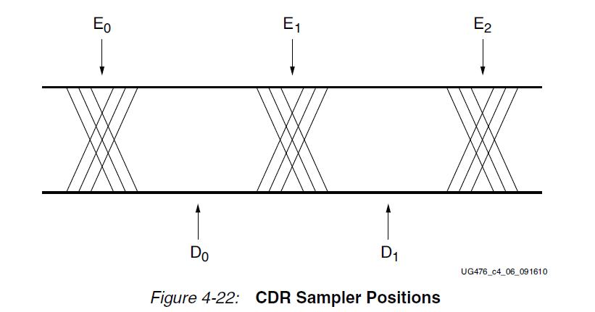
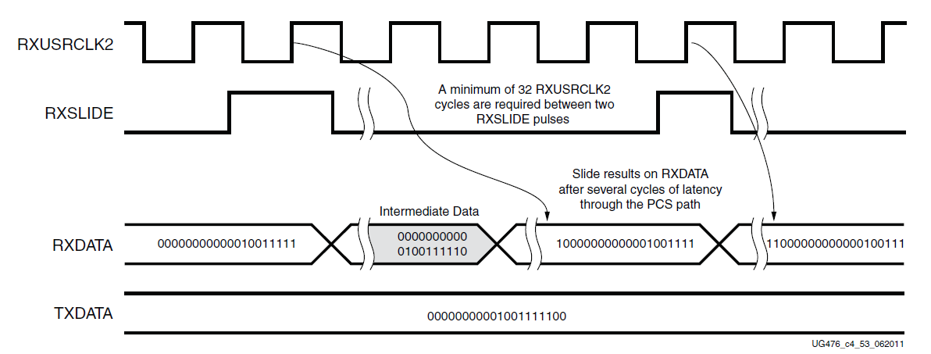
Rx CDR clock introduction
Edge
Data sampler
Alignment Block Finds Comma or Header
RXSlide
The CDR state machine uses the data from both the edge and data samplers to determine the phase of the incoming data stream and to control the phase interpolators (PIs)
The data is shifted right by one bit for every RXSLIDE pulse issued. The GBT receiver searches for the Header in the incoming data and checks it. Link is established after GBT Rx receiving 24 successive Headers(0110/0101). Then use Header flag to align the Rx CDR clock.

Slide 20
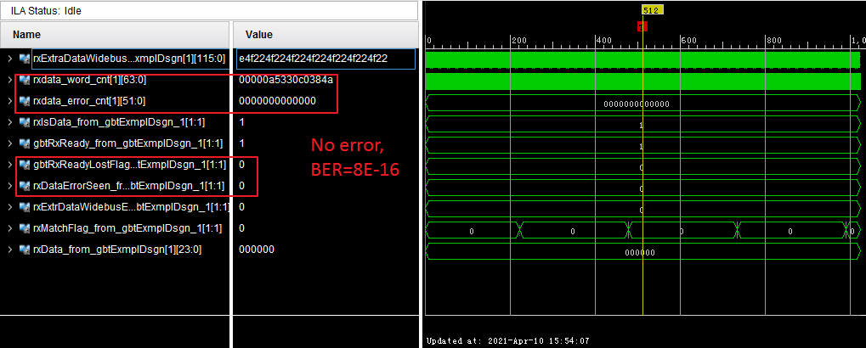
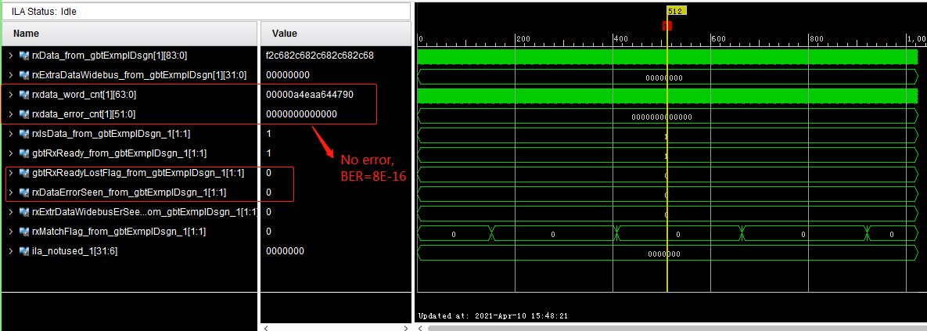
FEE emulator to BEB test results
GBT-link stability and bit error rate ：
The link was established successfully and data
are received correctly on FEB emulator and BEB.
The long time test ( > 2 days) link is stable and
there is no bit error.
The BER is better than 8E-16.
FEE emulator
BEB

Slide 21
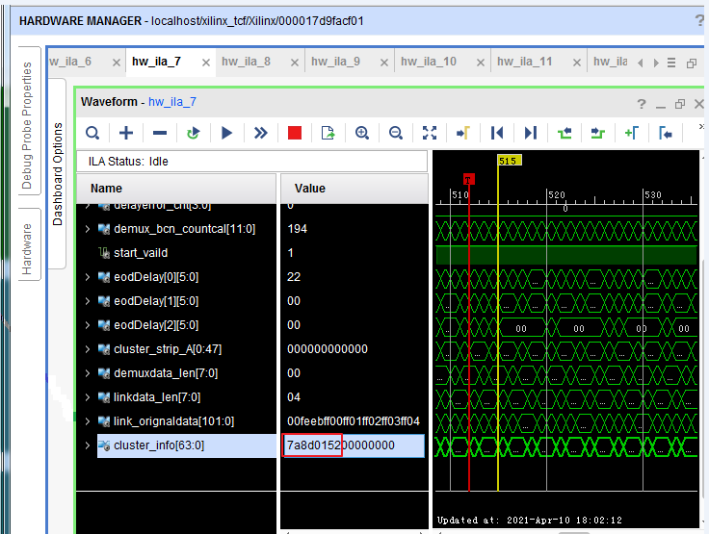
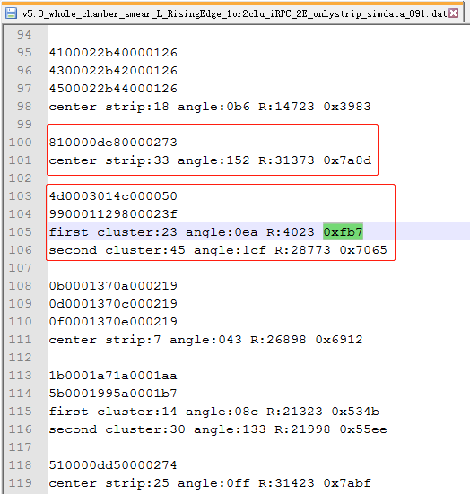
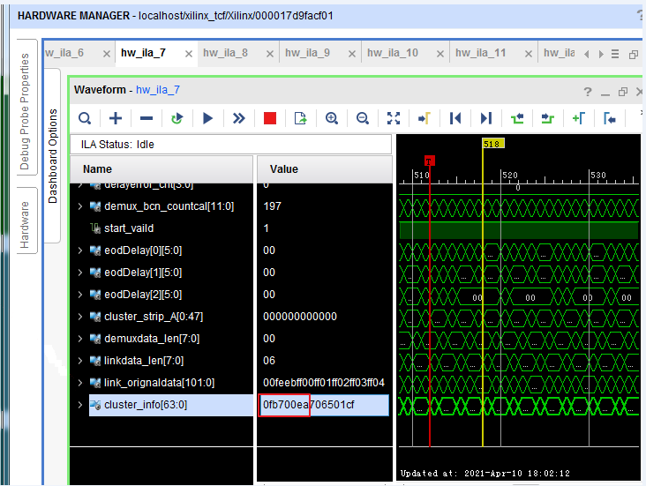
FEE emulator to BEB test results
Clusterization algorithm：
The firmware implementation of the Clusterization algorithm and the software simulation give the same results.
Check the BE Clusterization algorithm step by step, and the result is correct.

Slide 22
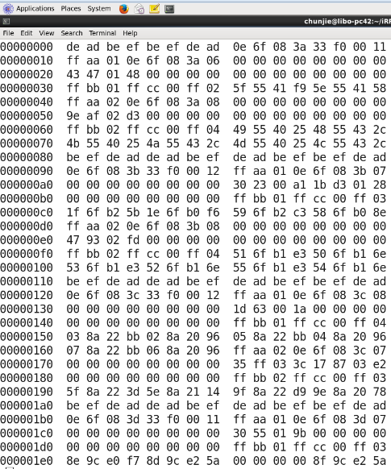
FEE emulator to BEB test results
Readout algorithm：
The PC receives the DAQ data frame uploaded by BE and saves it into a file.
The data in the DAQ file conforms to the custom DAQ data format.
DAQ file

Slide 23
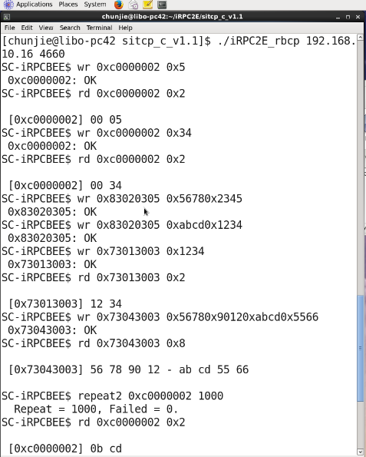
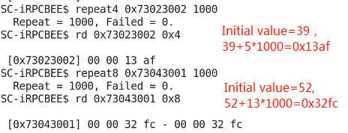
FEE emulator to BEB test results
Slow control：
Slow control of BE board
- Because the FEE emulator does not have a GBT-SCA chip, it cannot perform slow control readback operations.
- FEE emulator received slow control data is correct.
GBT-SCA
FEE slow control
FEE slow control repeat test
Single frame mode and Burst mode;
Successfully read and write thousands of times;
BEE slow control repeat test
Write: address-0x0002, incremental data, repeat the test 1000 times; ok
Read back the last written data, the value is correct.
Initial value=21,
21+3*1000=0xbcd

