Slide 1
Assembly and tests of RPC at USTC for the ATLAS Phase-II Upgrade
Yuexin Ding
USTC

Slide 2
OUTLINE
INTRODUCTION
The ATLAS RPC model
Current RPC systems of the ATLAS detector and the Limitations
Upgrades of RPC detectors for HL-LHC
BIS78 and USTC-cluster’s responsibility
SINGLET ASSEMBLY
Gas gap training & test
FE board soldering & connectivity test
Assembly procedure
TEST RESULTS
Experiment Setup
Efficiency-HV Curves、Cluster Size、Time Resolution
CONCLUSION

Slide 3
CONTENT
INTRODUCTION
The ATLAS RPC model
Current RPC systems of the ATLAS detector and the Limitations
Upgrades of RPC detectors for HL-LHC
BIS78 and USTC-cluster’s responsibility
SINGLET ASSEMBLY
Gas gap training & test
FE board soldering & connectivity test
Assembly procedure
TEST RESULTS
Experiment Setup
Efficiency-HV Curves、Cluster Size、Time Resolution
CONCLUSION

Slide 4
The ATLAS RPC model
Frontend electronics
Ground panel
Readout panel
Readout strip
Phi Panel
Insulating layer
Medium-resistive electrode
Avalanche
Working gas
Spacer
Gas gap
Graphite layer
Readout panel
Eta Panel
Frontend electronics
RPC structure & signal induction
Readout scheme & signal propagation
Key parameters of current RPC detectors
Time resolution | $1.1$ns for gap size = $2mm$
Spatial resolution | $Pitch/\sqrt{12}$ or higher with weighted charge
Rate capacity | $100 Hz/{cm}^{2}$ for the designed lifetime
Efficiency | $\sim 96\%$ during ATLAS operation

Slide 5
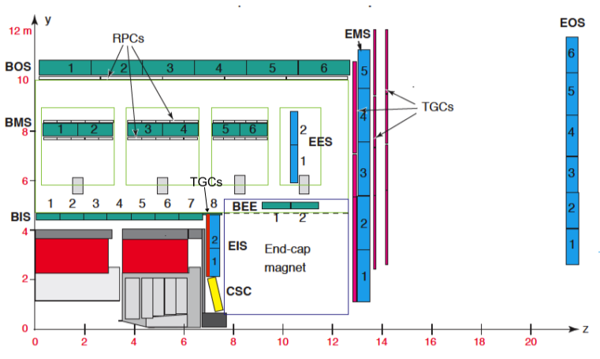
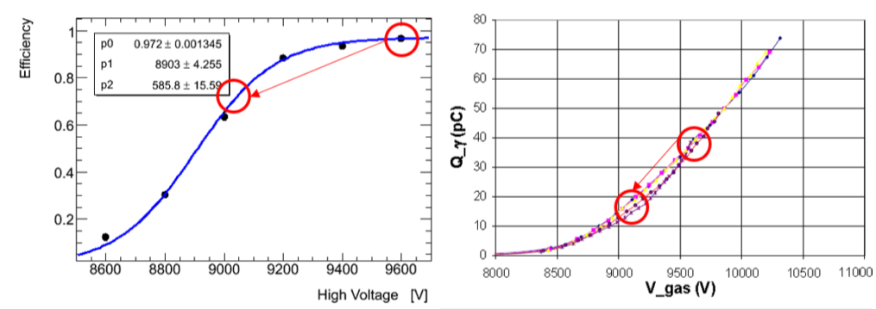
Current RPC systems of the ATLAS detector
Arrangements
One layer of RPC chamber in Barrel Outer
Two layers of RPC chambers in Barrel Middle
No RPCs in Barrel Inner currently
Limitations
Geometrical acceptance
Around 70% for BM/BO RPCs
Due to magnetic coils and supporting structures
Trigger efficiency
HV (total charge delivered per count) must be lowered, to avoid accumulating charge damaging the RPC electrode due to the present RPC longevity
The single-gap efficiency will have to be reduced on average by 15%
Notes:
97_MS_TDR P406

Slide 6
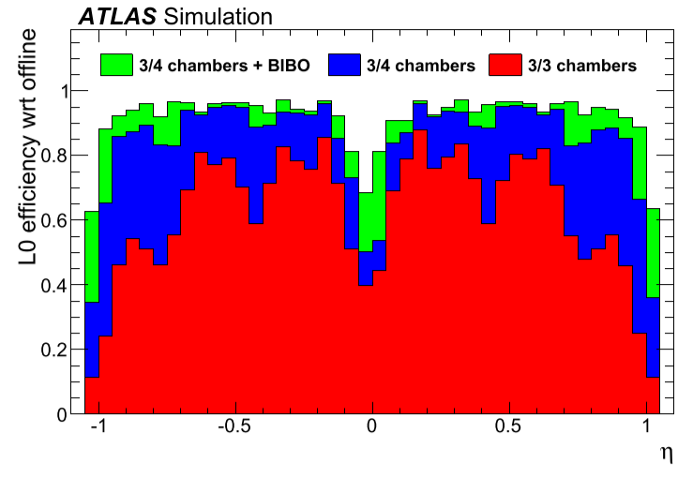
Upgrades of RPC detectors for HL-LHC
Upgrade method
Installing thin-gap RPCs in the BI layer
An additional layer of BI RPCs can …
Keep the high trigger efficiency
Improve trigger selectivity
Reduce trigger fake rate
Increase geometrical coverage
Other improvements
New front-end electronics for amplifying and discriminating the avalanche signals
Eff. $×$ Accept. in worst case for $25 GeV$
Present
present
Notes:
Motivation from P104, MuonPhaseII TDR

Slide 7
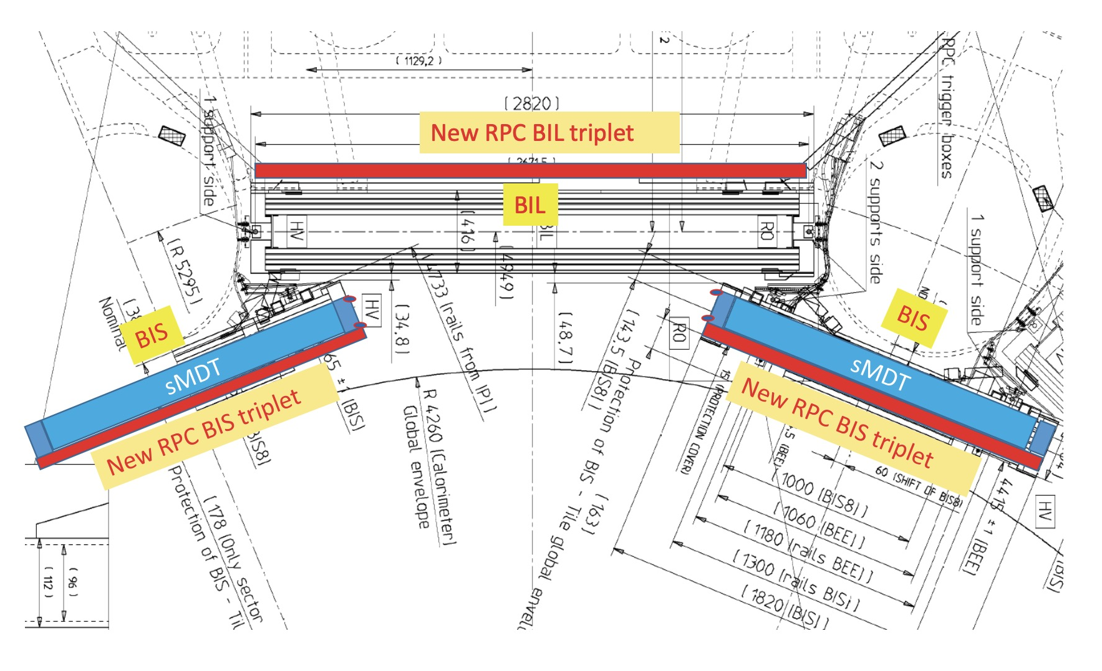
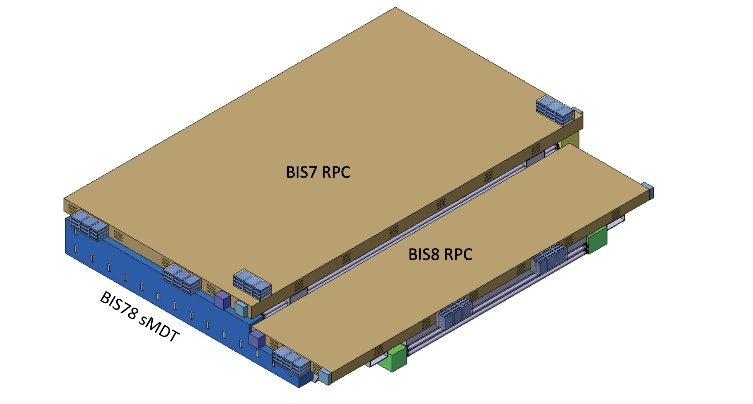
BIS78 RPC
BIS78 RPC
BIS: MDT →sMDT + thin-gap RPC
Covering the area of present BIS7 and BIS8 MDTs
Running in present Phase-I Upgrade to verify the feasibility
New RPC design
Gap size: 2 mm → 1 mm
Electrode thickness: 1.8 mm → 1.2 mm
Advantages
To reduce the required voltage from 9600 V to 5400 V
To reduce the total chamber thickness
To improve the time resolution from about 1.1 ns to 0.4 ns and the signal-to-noise ratio

Slide 8
USTC-cluster’s responsibility
USTC-cluster’s responsibility
R&D for double-end readout
Production of all BIS readout panels: PCB + paper-honeycomb
Assembly and test of all $288$ BIS RPCs
Our finished work
Have Assembled four RPC singlets
BIS7s size, similar to the size of BIS small ones
Readout panels and gas gaps rent from the Phase I upgrade project
Front-end boards designed by Roma II with discrete elements
Have tested the assembly RPC singlets’ performances
Efficiency-HV curves
Cluster Size
Time resolution
To show the assembly ability of USTC for the upcoming mass production

Slide 9
CONTENT
INTRODUTION
The ATLAS RPC model
Current RPC systems of the ATLAS detector and the Limitations
Upgrades of RPC detectors for HL-LHC
BIS78 and USTC-cluster’s responsibility
SINGLET ASSEMBLY
Gas gap training & test
FE board soldering & connectivity test
Assembly procedure
TEST RESULTS
Experiment Setup
Efficiency-HV Curves、Cluster Size、Time Resolution
CONCLUSION

Slide 10
Gas gap training & test
Gas gap training & test
HV (high voltage) training
HV-LC (leakage current) test
LC need to be lower than 3uA
HV-LC test result
Raw Gas Gap

Slide 11
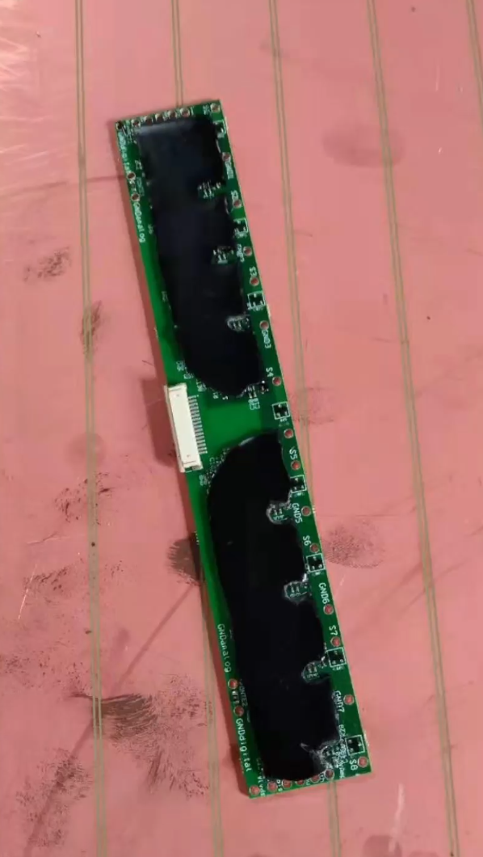
FE Board --- Selection of working points
Version
a discrete-element FE board redesigned by Roma II
One board can cover 8 readout strips
Low voltage supply （five discrete LV）
V_{pu} = 1.2 V
V_{dis} = 2.5 V
V_{LVDS} = 2.4 V
V_{amp} and V_{th} should be scanned to select the best working point
Selection of working points
A wide scan on V_{amp} and V_{th}
fixed FE working point
Phi FE boards: Vamp = 1.5 V, Vth = 3.3 V
Eta FE boards: Vamp = 1.3 V, Vth = 3.45 V
Partial Figure
Full Figure

Slide 12
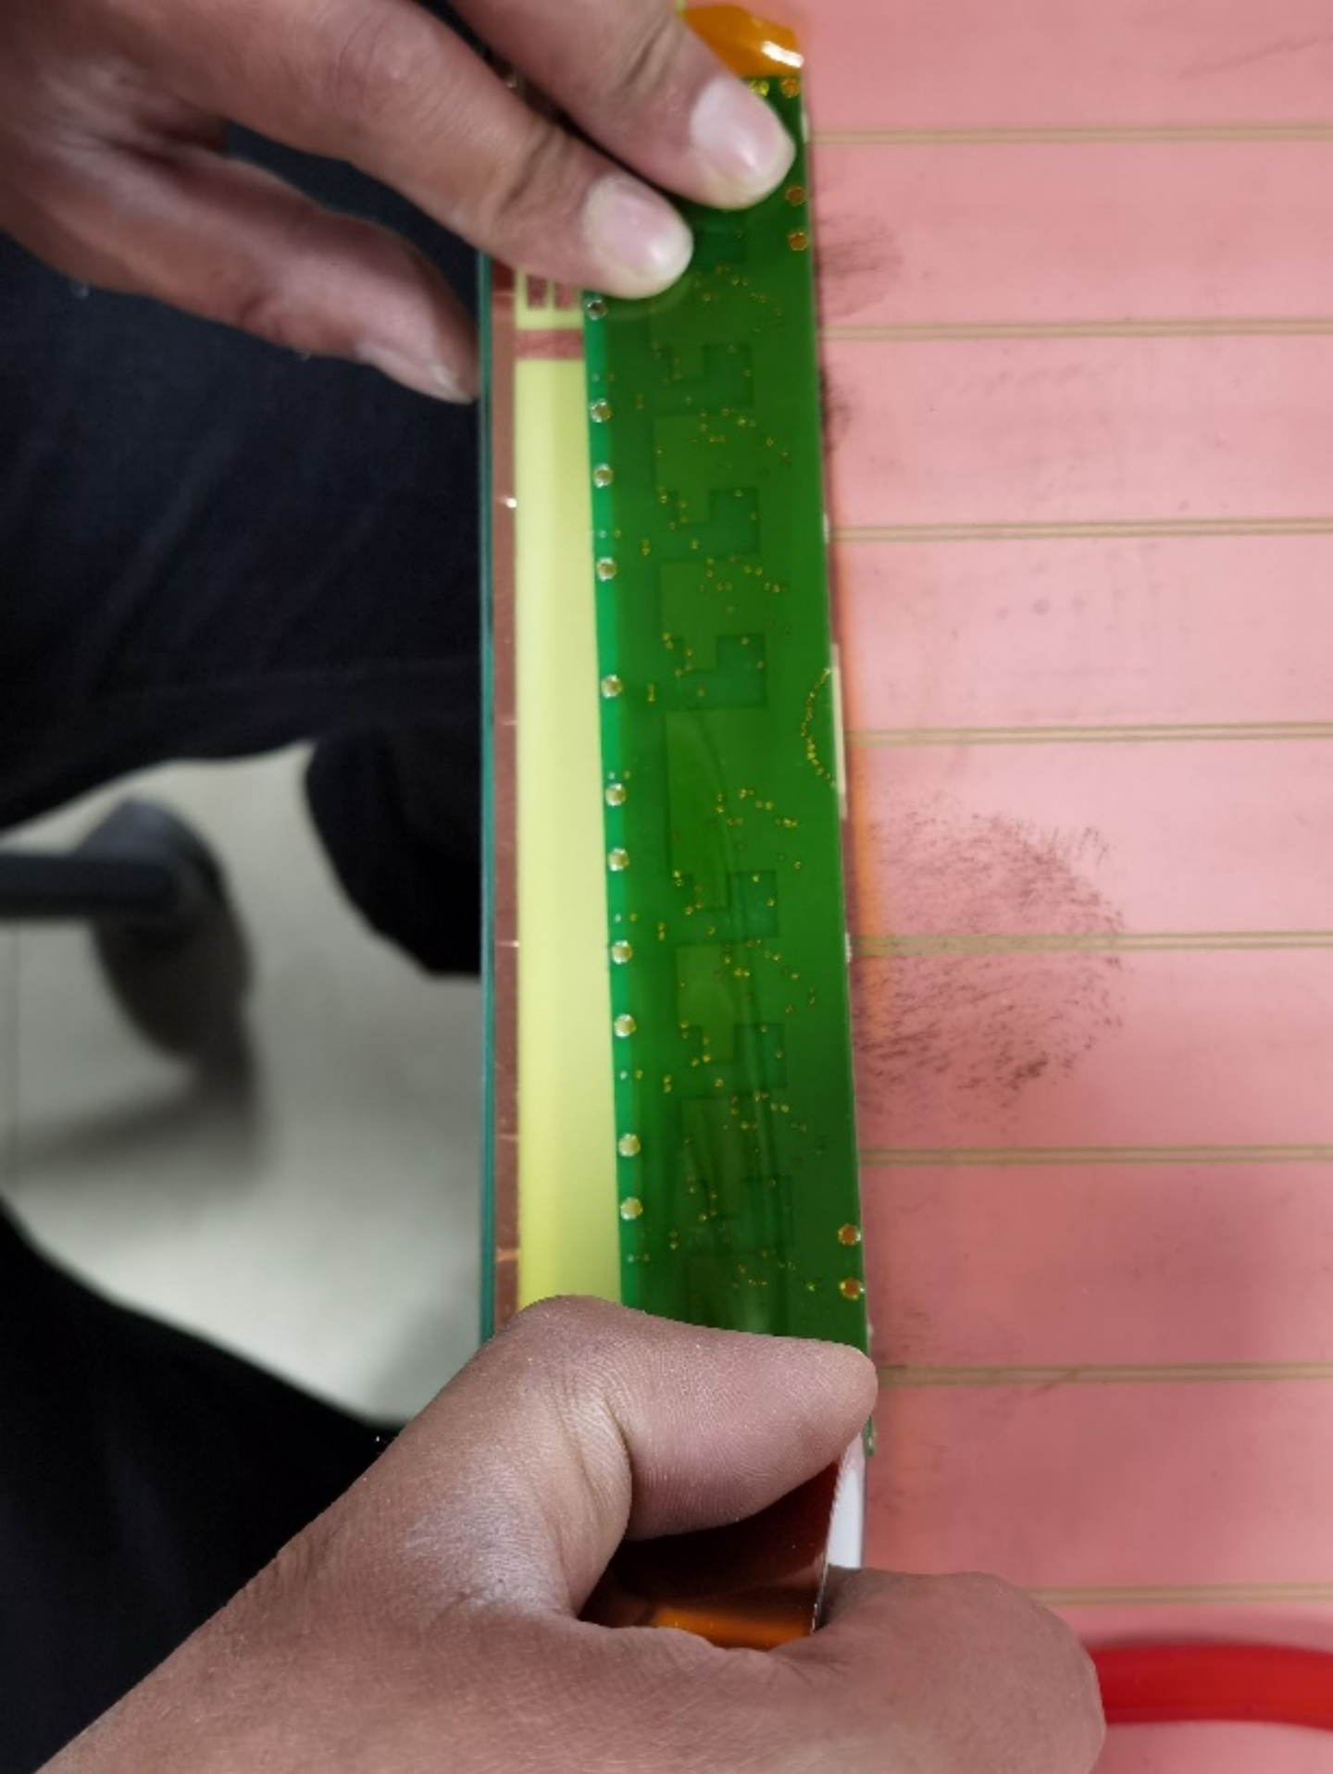
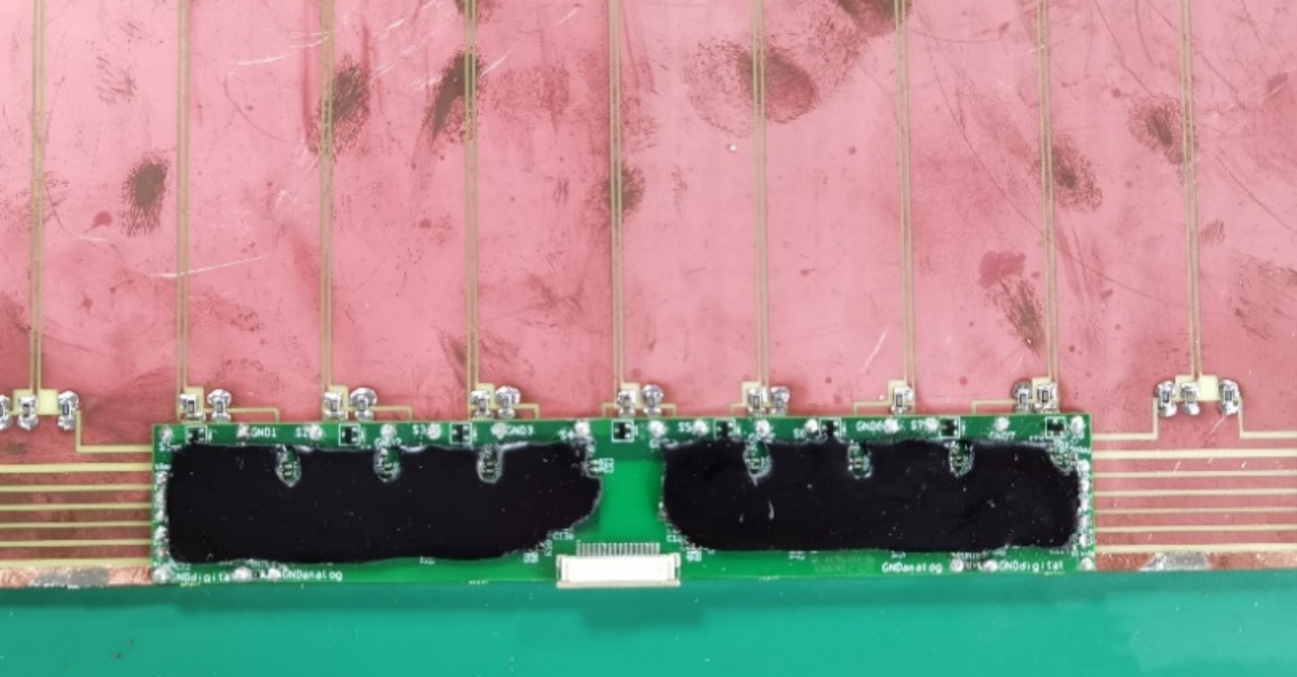
FE board soldering
Insulating
Tape the Mylar on the back of FE boards
Positioning
Align the FE boards with readout strips
Uncover the positioning holes
Soldering
Solder six positioning holes first
Solder the FE and the Signal/Gnd of the readout strips
solder the FE and the LV power supply

Slide 13
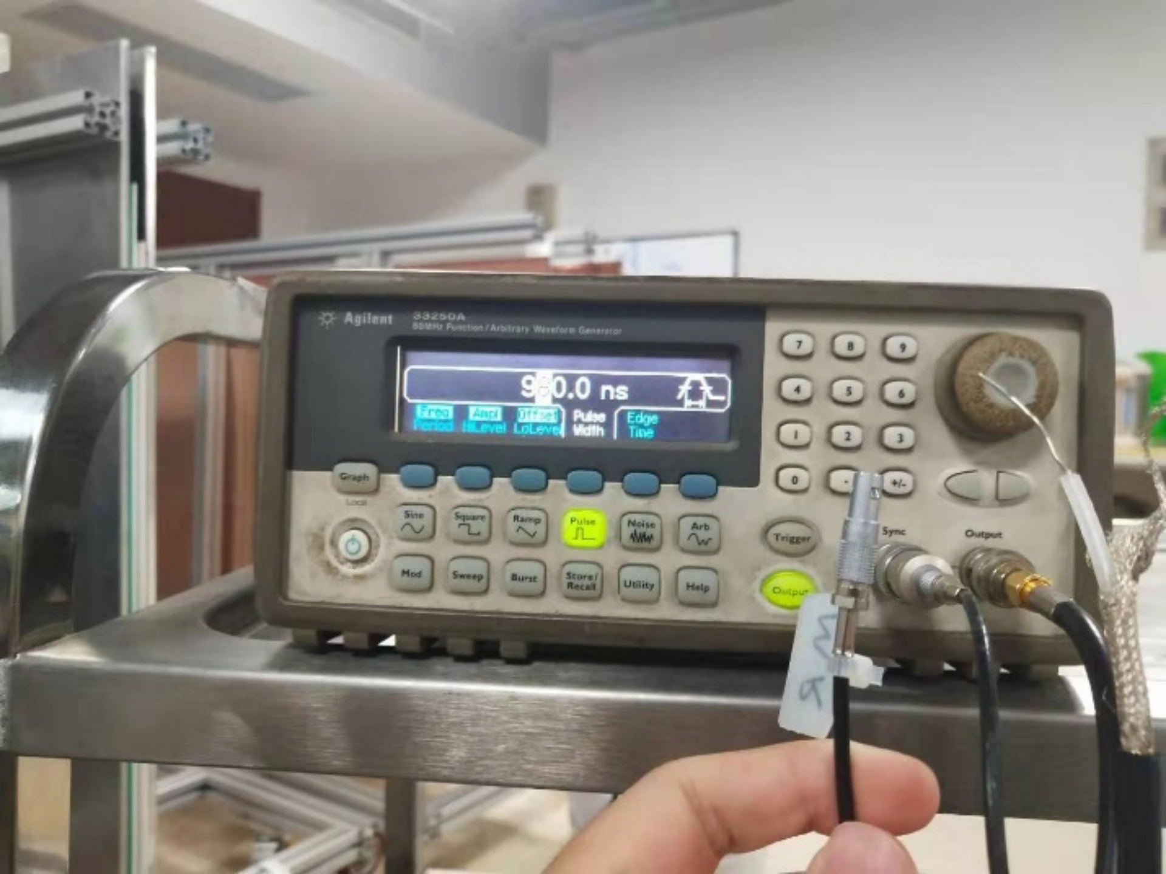
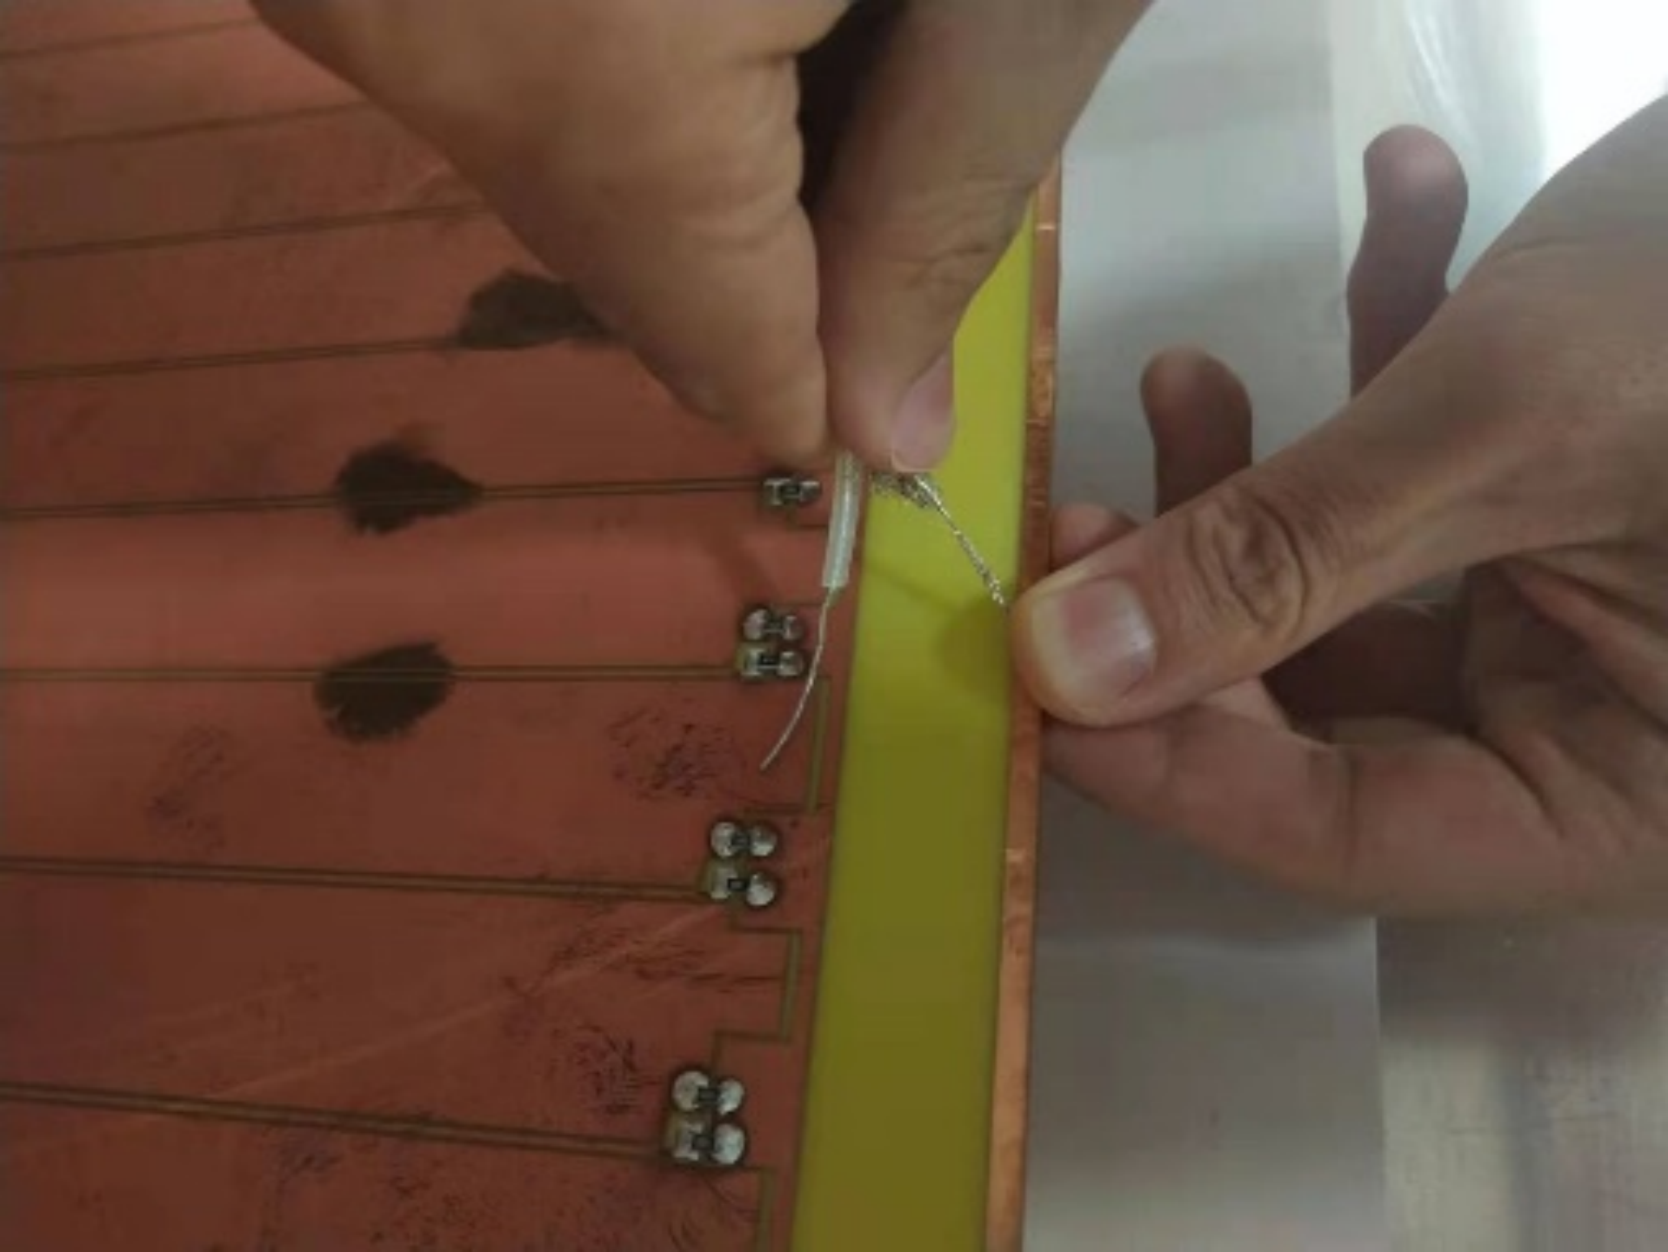
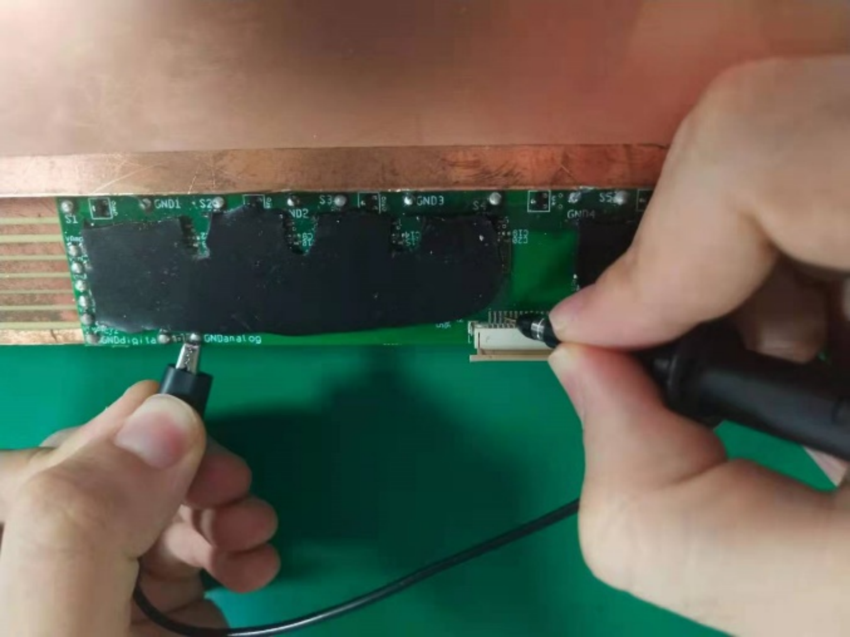
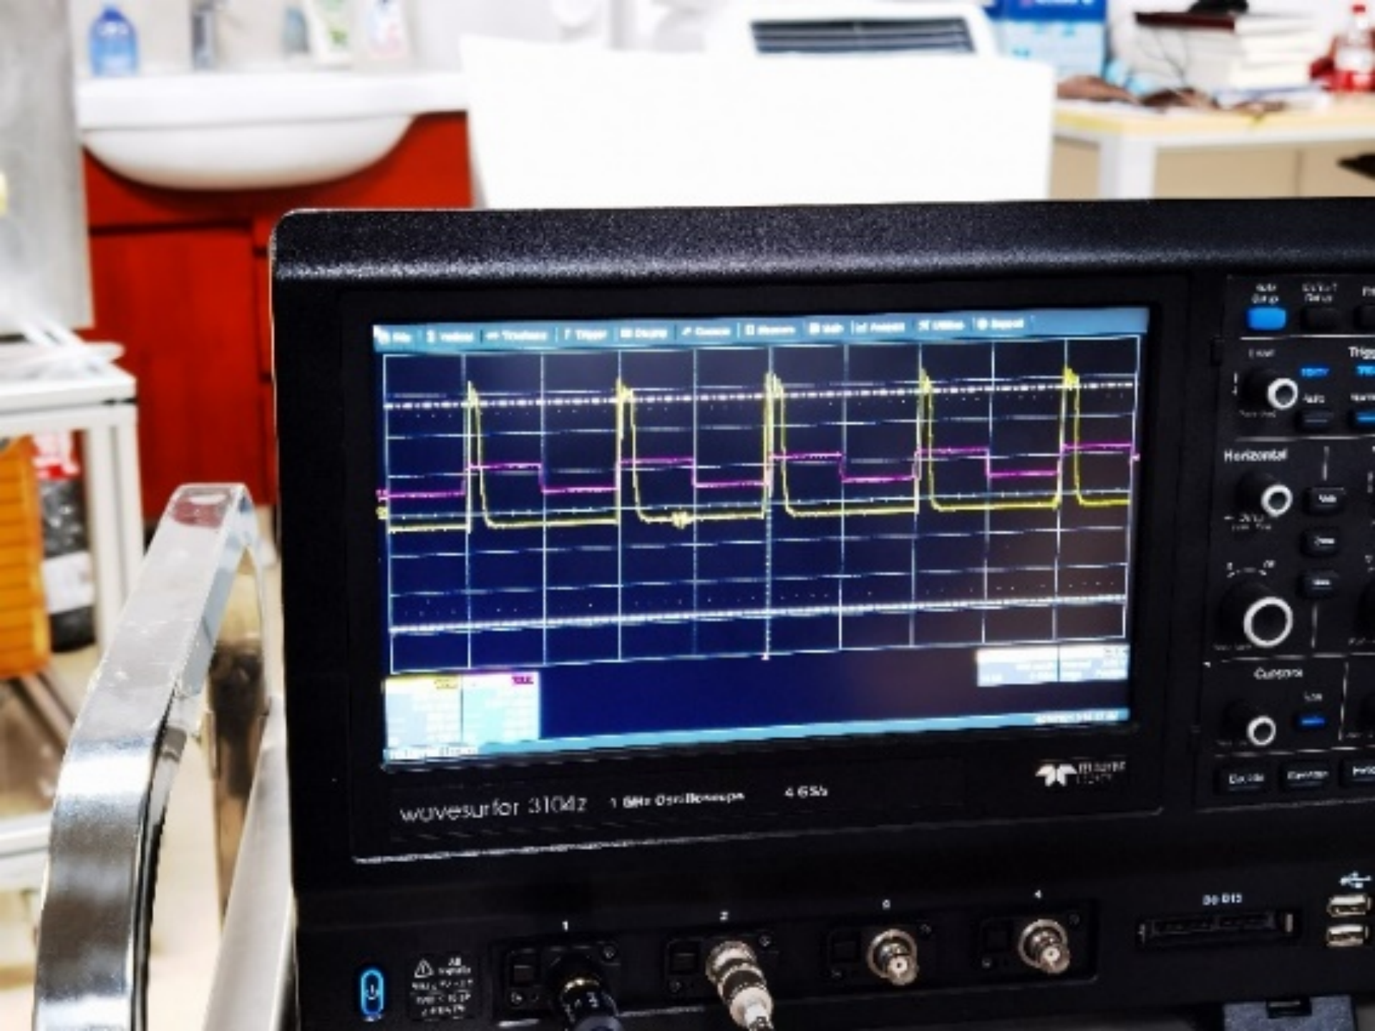
FE board connectivity test
Signal generator
To provide 2mV pulse signal and introduce to the strips
Connect the sync output of the signal generator to the oscilloscope as trigger.
Oscilloscope
Observe whether a voltage jump signal which is strongly relative to the sync signal or not
If yes, that means the FE board connect to the strips stably and is in a good condition

Slide 14
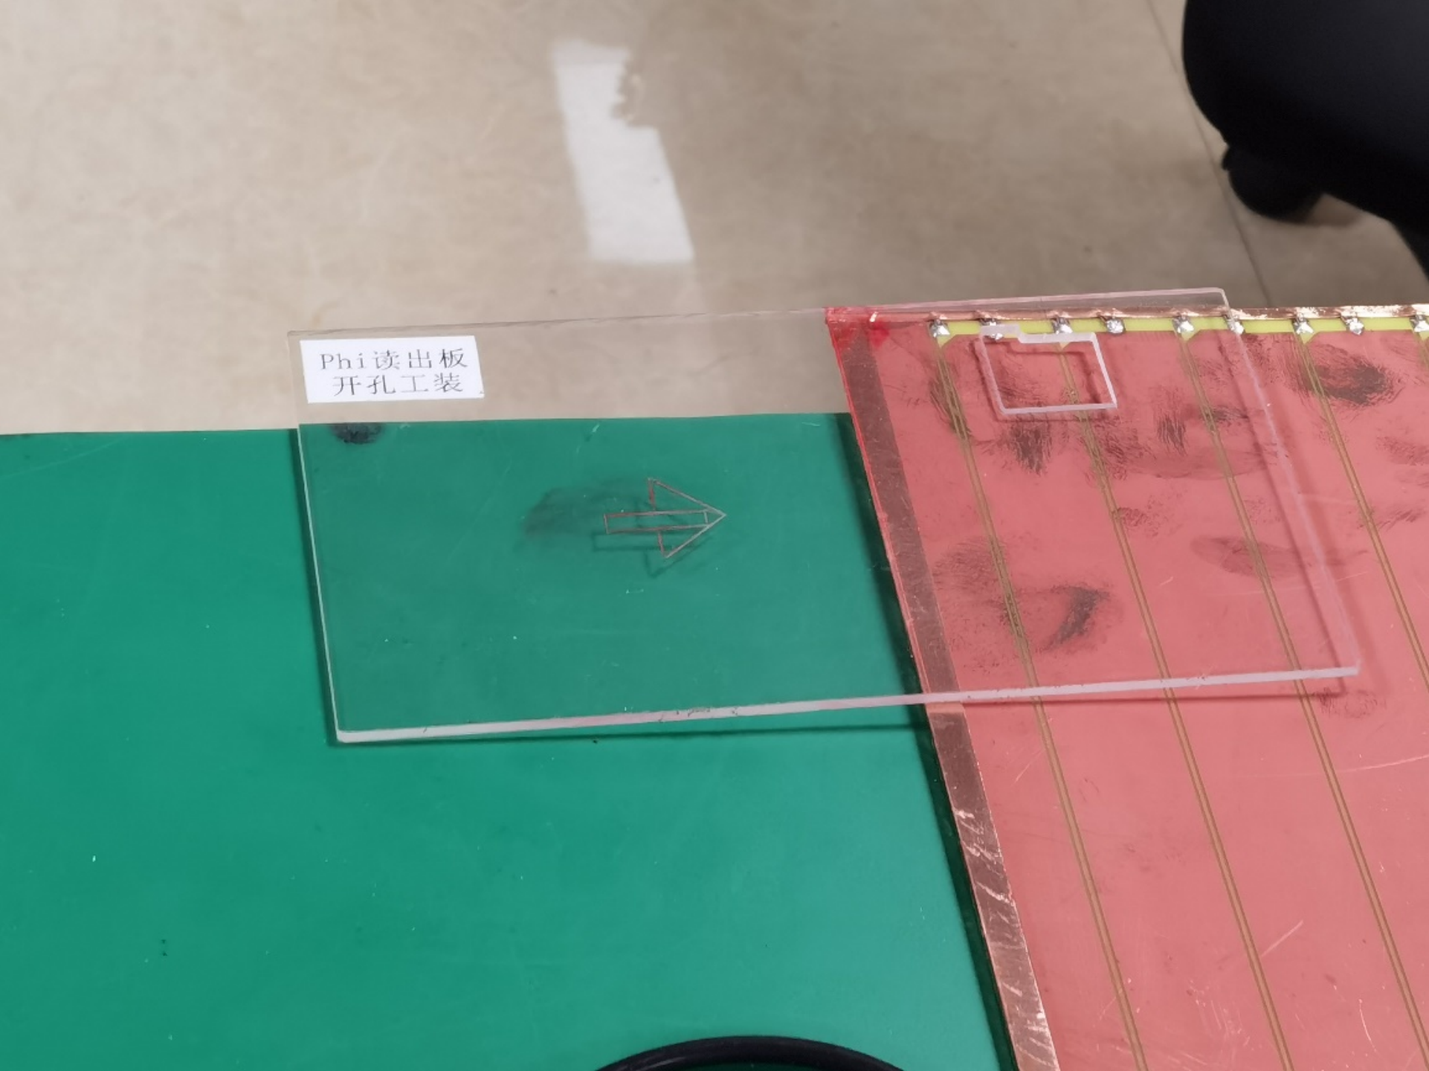
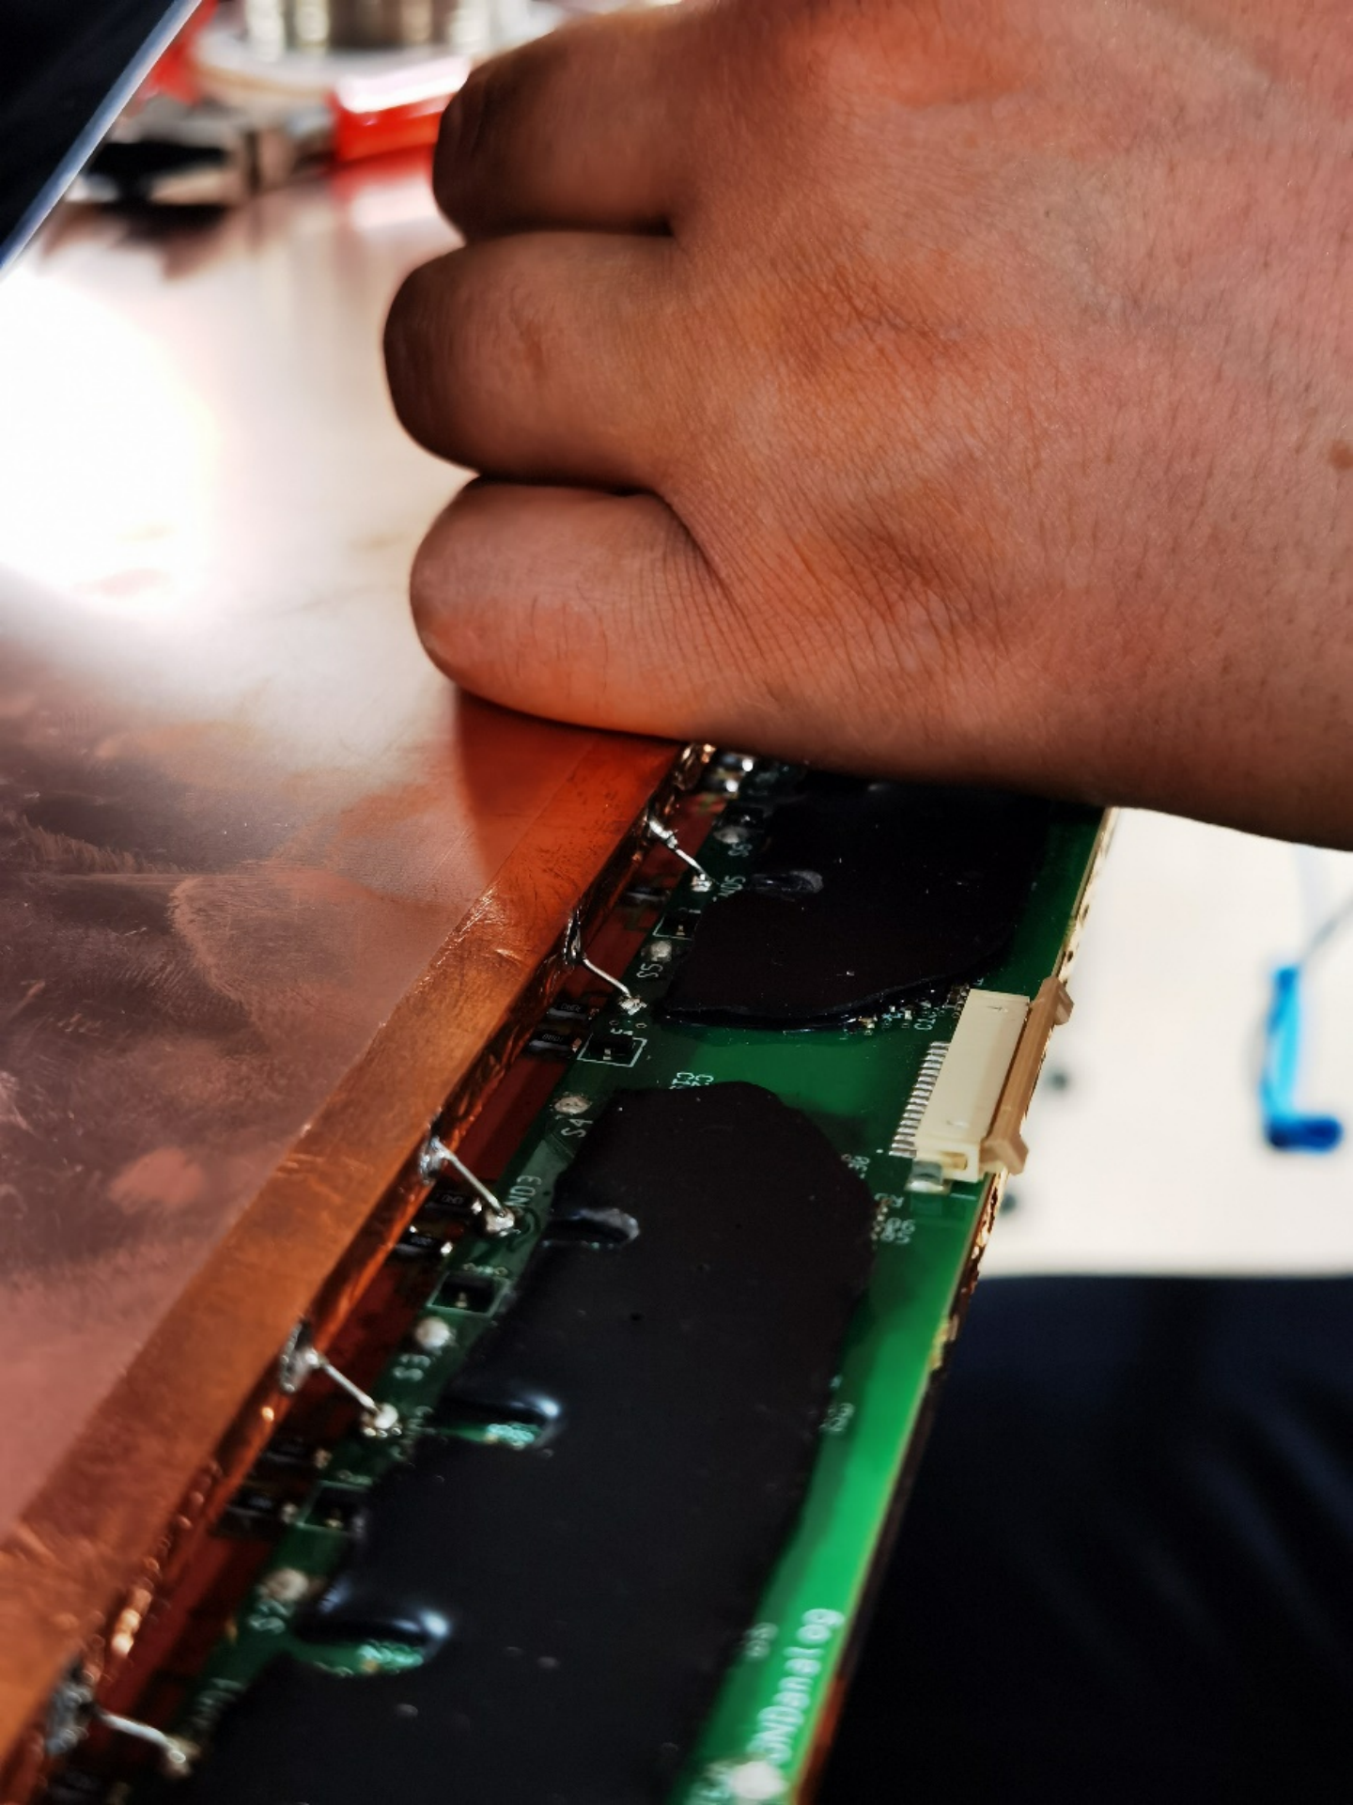
Assembly procedure
Positioning
Dig a hole on each readout panel
to leave space for the HV connection on the gas gap
Tape Forex strips along Eta and Phi strips
To align / limit the position of the gas gap
Assembling
Cover an additional insulating layer on the side connecting high voltage
Use copper tape to cove the edge of the singlet
Shielding
Connect the FE boards of one readout panel with the ground side of the other readout panel by soldering a wire

Slide 15
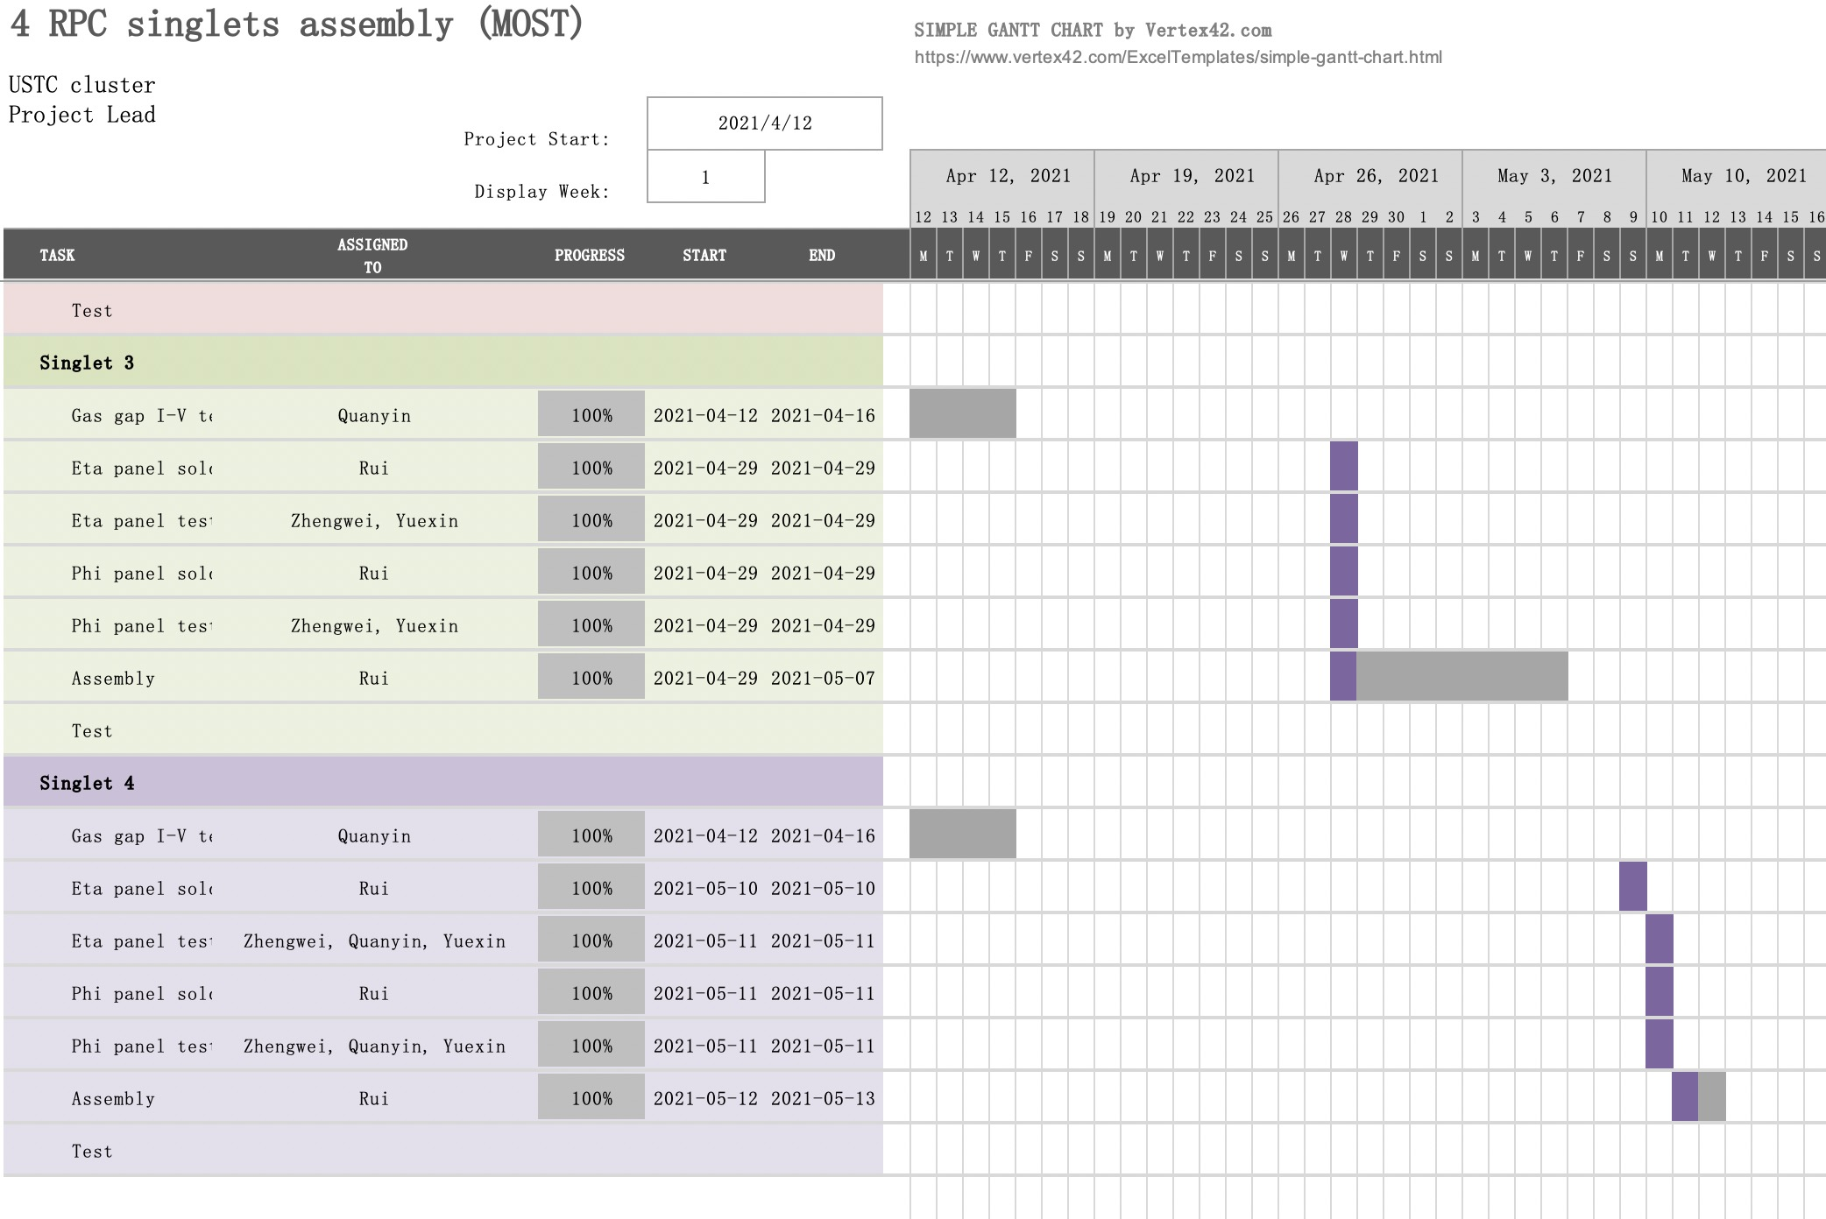
Gantt chart for assembly activity
Ramping up slowly at first
Mould making
Material purchasing
Warming up
2 days / singlet after ramped up

Slide 16
Document archives
Documents has been archived
Manuals have been written down

Slide 17
CONTENT
INTRODUTION
The ATLAS RPC model
Current RPC systems of the ATLAS detector and the Limitations
Upgrades of RPC detectors for HL-LHC
BIS78 and USTC-cluster’s responsibility
SINGLET ASSEMBLY
FE board and Soldering
Assembly Procedure
Assembly Checkout
TEST RESULTS
Experiment Setup
Efficiency-HV Curves、Cluster Size、Time Resolution
CONCLUSION

Slide 18
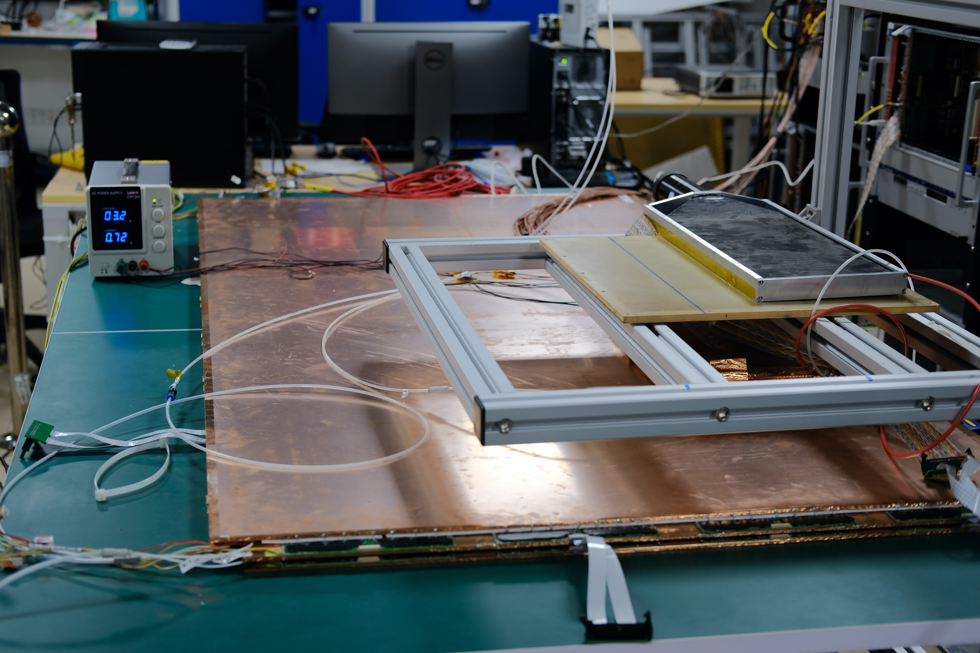
Experiment Setup
RPC singlet under tests
4 BIS7s RPC singlets, for efficiency-HV scan
Trigger system
The coincidence of two scintillators for trigger
One above RPCs, the other below RPCs
Along the long side covers 4 FE boards , along the short side covers 1 FE board
Data-taking system
TDC: V1190, 128-ch
Connecting with FE boards
cosmic ray
scintillator
RPC singlet
Simple structure of trigger system

Slide 19
Experiment Setup
Eta panel below the gap, facing positive HV side
Phi panel above the gap, facing the GND side
Eta FE #4
RPC Singlet (for testing)
1.8m * 1m large area
64 (Phi) + 32 (Eta) channels
Eta FE #3
Eta FE #2
Scintillator (for trigger)
0.8m * 0.2m Covering 32 channels
Eta FE #1
…….
Phi FE #1
Phi FE #2
Phi FE #3
Phi FE #4
Phi FE #8

Slide 20
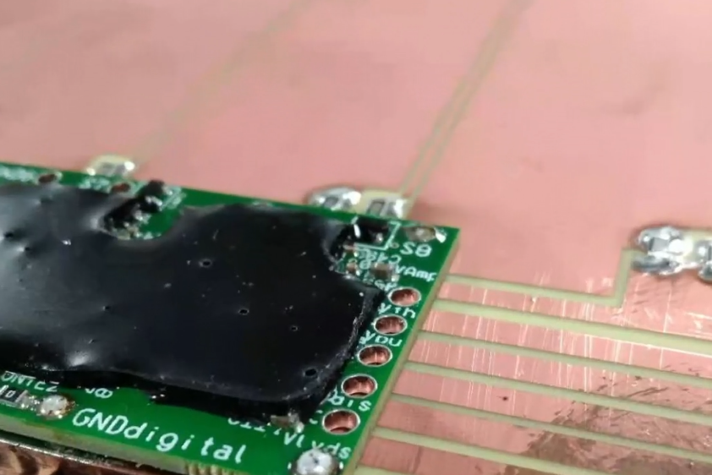
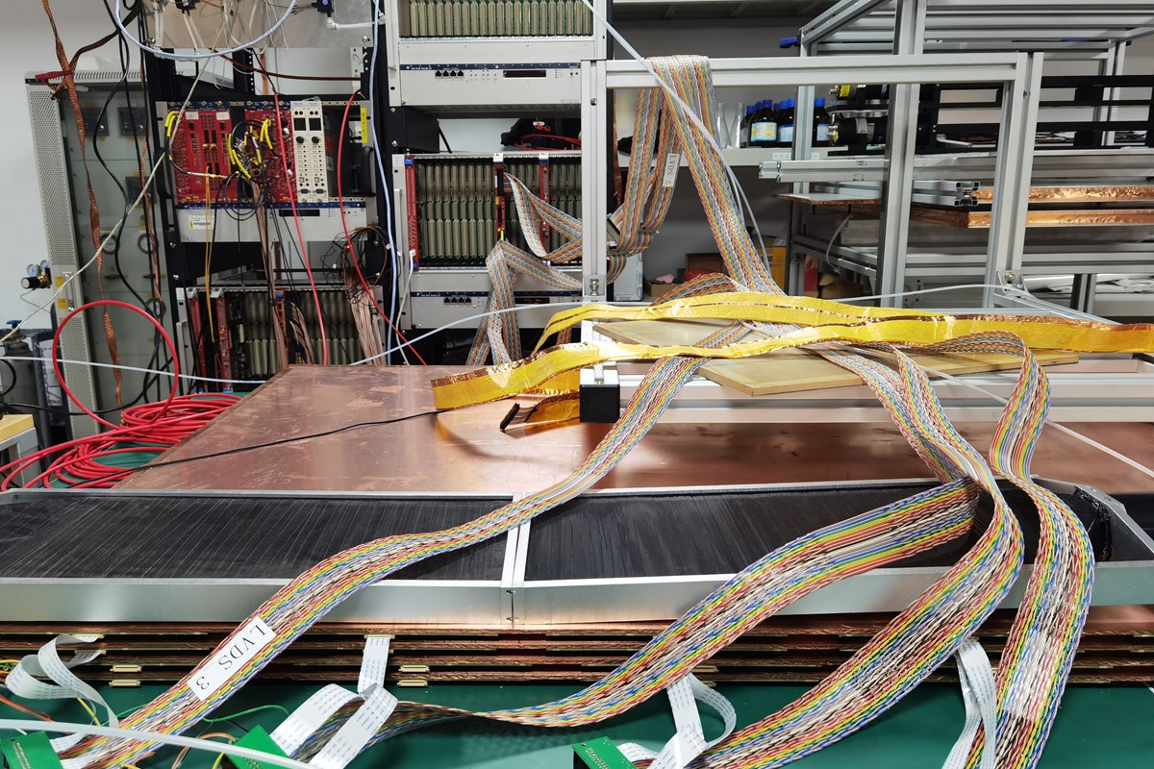
Process of signal transmission and data taking
RPC
Avalanche signal generate in the gas gap
Signals propagate along the readout strips
FE boards
Current signal → (matching resistor) → voltage signal
Amplification
Discrimination
TDC
To record the time of rising and trailing edges
To convert digital signals to data
PC
To control TDC
Data storage onto disks
Data processing
RPC →(resistor) → FE
FE → (FFC→LVDS) → TDC

Slide 21
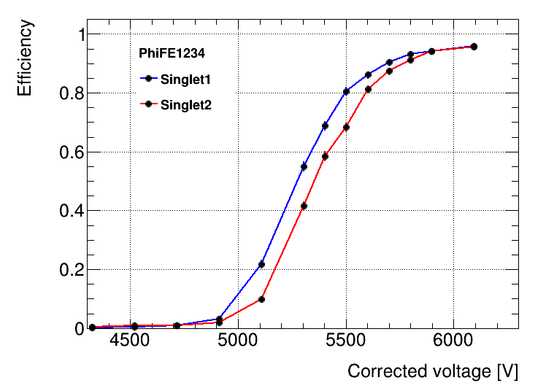
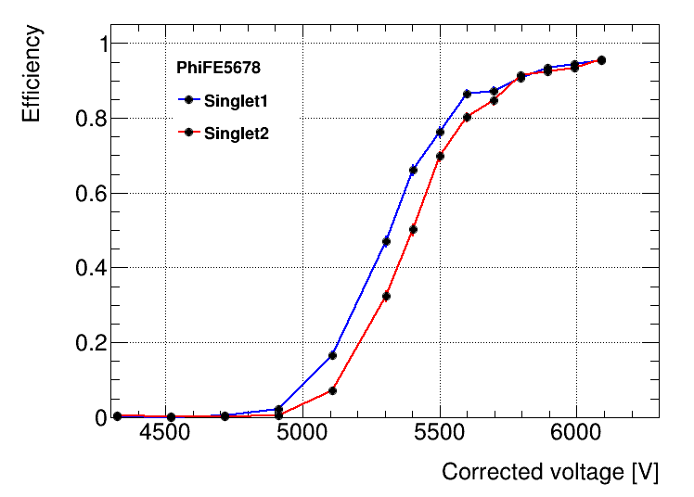
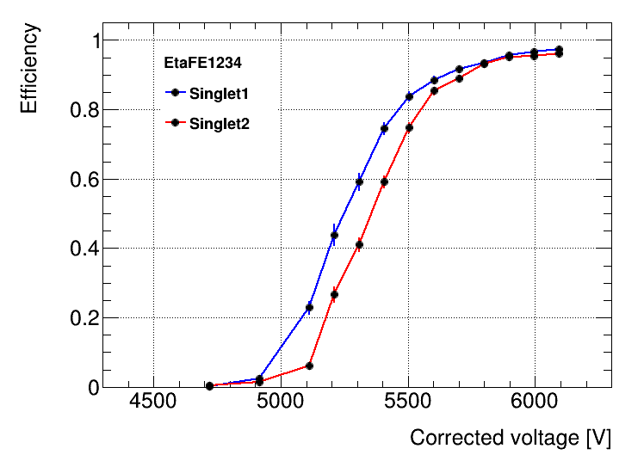
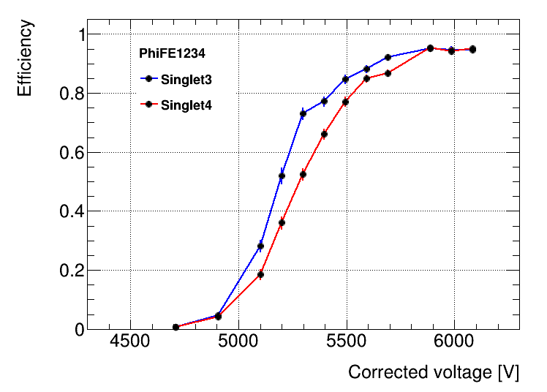
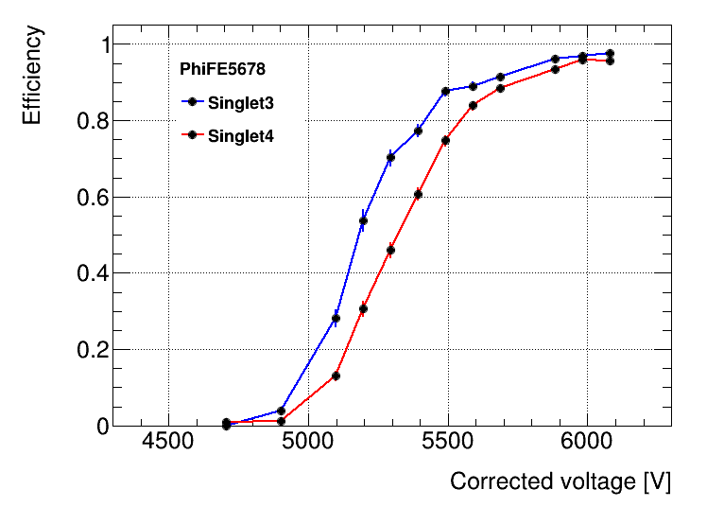
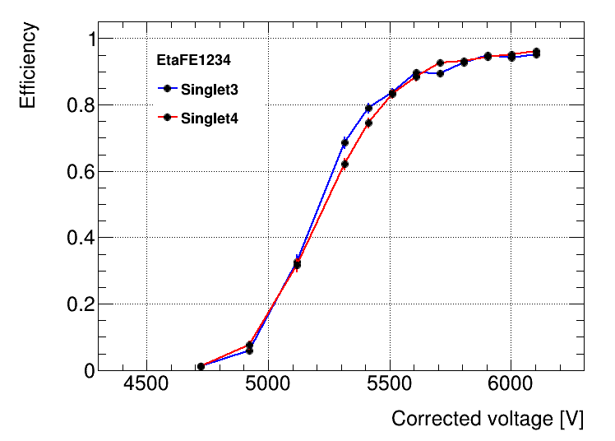
Efficiency-HV Curves
Criteria: Efficiency > 95% HV $≈$6200V

Slide 22
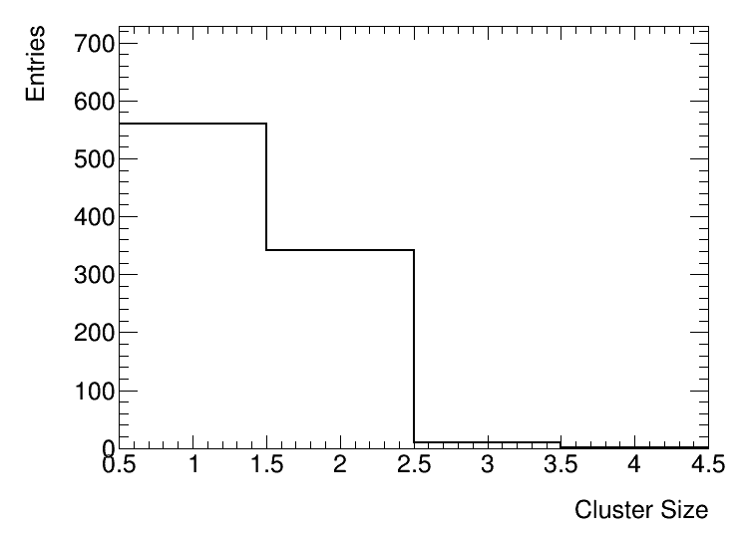
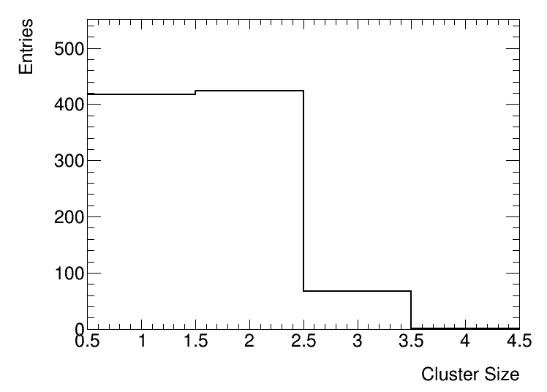
Cluster Size
Definition:
The number of strips fired by the same incoming muon
Criteria: average cluster size < 3
Phi panel
Eta panel

Slide 23
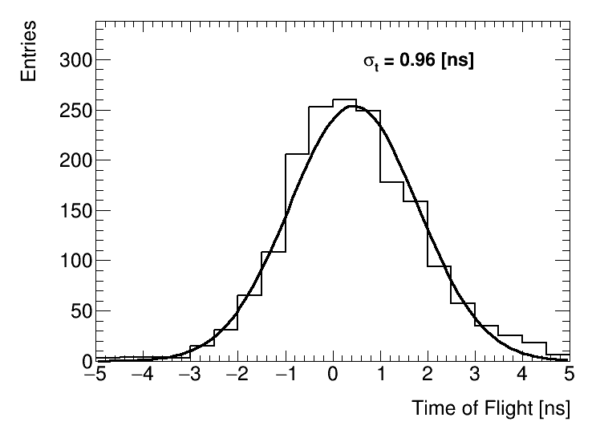
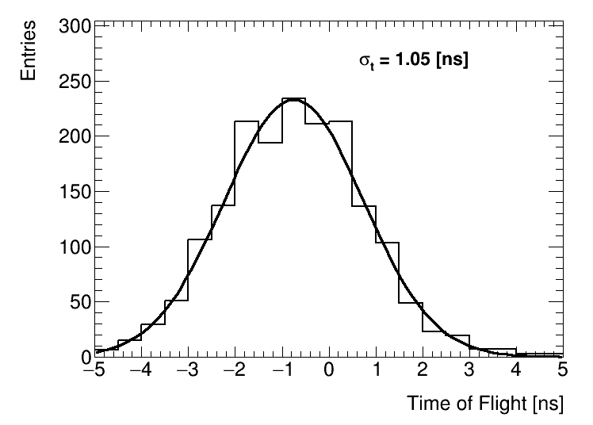
Time Resolution
$σ_{t}=σ(ToF)/\sqrt{2}$
HV = 6200 V
Including $σ_{t}$ from TDC, cables and FE boards
Phi
Eta

Slide 24
CONTENT
INTRODUTION
The ATLAS RPC model
Current RPC systems of the ATLAS detector and the Limitations
Upgrades of RPC detectors for HL-LHC
BIS78 and USTC-cluster’s responsibility
SINGLET ASSEMBLY
Gas gap training & test
FE board soldering & connectivity test
Assembly Procedure
TEST RESULTS
Experiment Setup
Efficiency-HV Curves、Cluster Size、Time Resolution
CONCLUSION

Slide 25
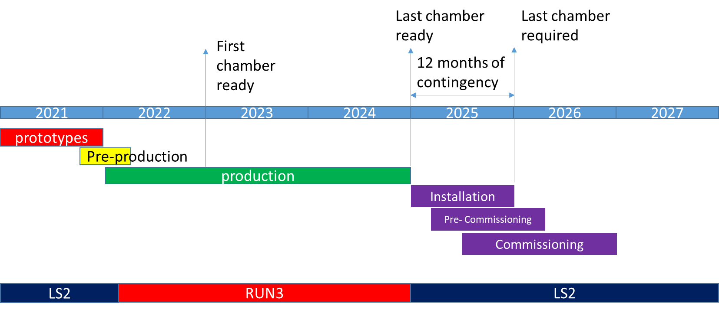
Conclusion
Four singlets assembled and tested
DAQ set up
Manuals written down
Data stored
Criteria reached
We have the assembly ability for the upcoming mass production

Slide 26
Thanks!

