Slide 1

Indirect search for new physic at LHCb
CP violation and rare decays of B mesons
谢跃红（华中师范大学）
第七届中国LHC物理研讨会
2021年11月25-28日

Slide 2
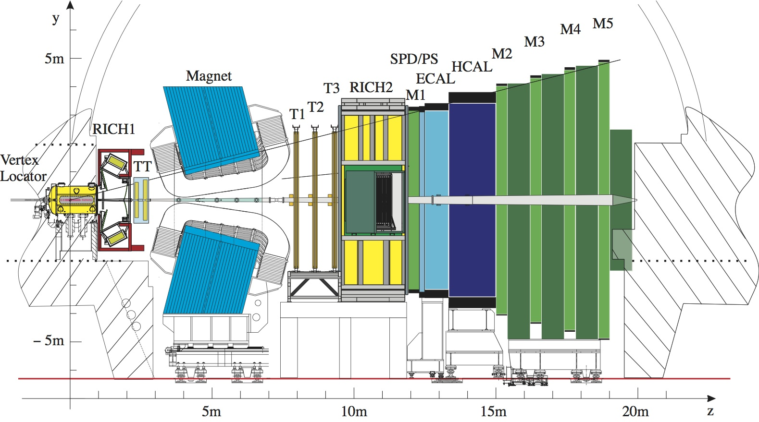
LHCb experiment
LHCb collaboration： 19 counties, 87 institutes, 1507 members
中国单位：
清华大学
华中师范大学
中国科学院大学
武汉大学
高能物理研究所
华南师范大学
湖南大学
北京大学
Understand matter-antimatter imbalance (CP violation)
Search for new physics (Rare decays)
Explore and understand QCD (Hadron properties, exotic hadrons)

Slide 3
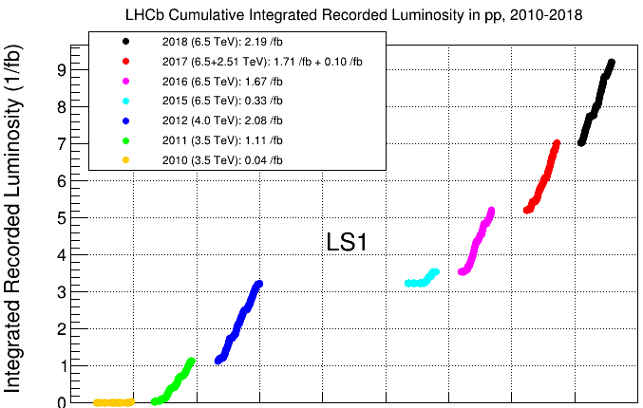
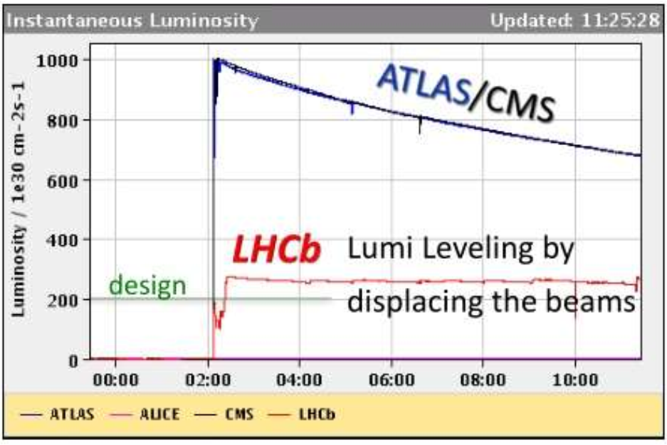
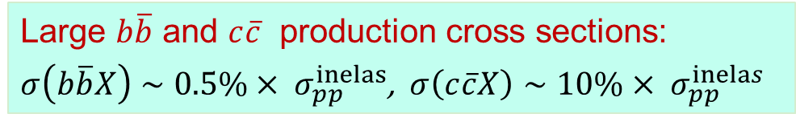

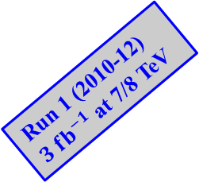
LHCb data samples
Luminosity levelling $L∼3×{10}^{32} cm^{−2}s^{−1}$
Run 1: 3 fb⁻¹, Run 2: 6 fb⁻¹
Run 1 (2010-12)
$3 fb^{−1}$ at 7/8 TeV
LS1
Run 2 (2015-18)
$6 fb^{−1}$ at 13 TeV
2010 2011 2012 2013 2014 2015 2016 2017 2018
Large $b\overline{b}$ and $c\overline{c}$ production cross sections:
$σ\left(b\overline{b}X\right)∼0.5\%× σ_{pp}^{inelas}$, $σ\left(c\overline{c}X\right)∼10\%× σ_{pp}^{inelas}$

Slide 4
CP violation

Slide 5
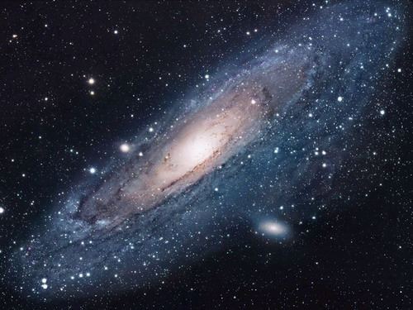
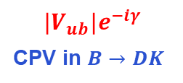

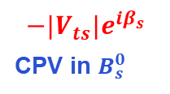
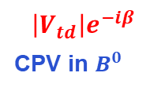

CKM mixing matrix
Origin of CPV in SM: nonzero CKM weak phase
（$η≠0$ in Wolfenstein parameterization）
CPV in charm
$$\left|V_{td}\right|e^{−iβ}$$
CPV in $B^{0}$
$$−|V_{ts}|e^{iβ_{s}}$$
CPV in $B_{s}^{0}$
$$|V_{ub}|e^{−iγ}$$
CPV in $B→DK$
CPV provided by the SM is short by $10^{10}$ to explain the Baryon Asymmetry in the Universe

Slide 6
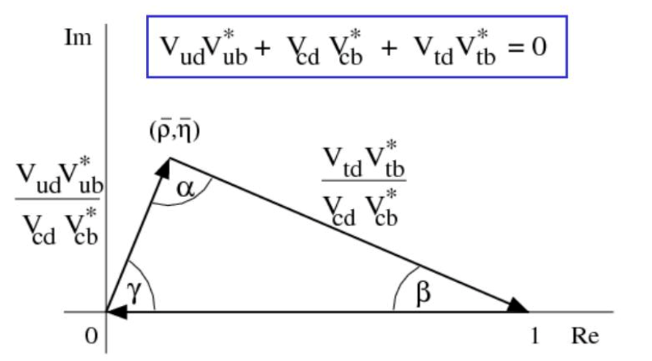
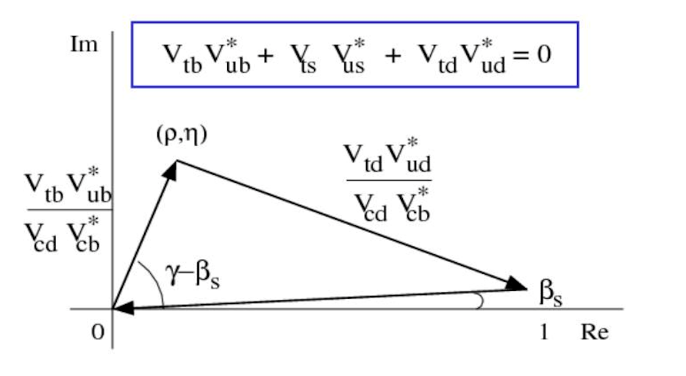
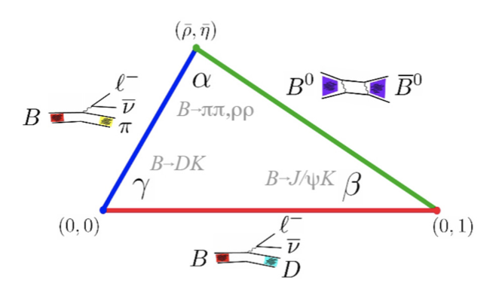
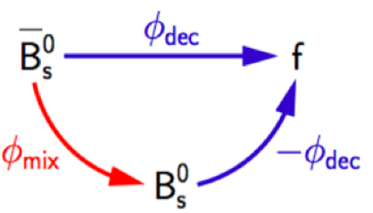

Unitarity triangles
Test unitarity by measuring sides (rates, $B_{q}^{0}$ mixing) and angles (CP asymmetries)
$J/ψφ$

Slide 7
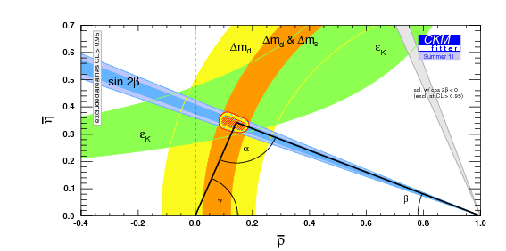
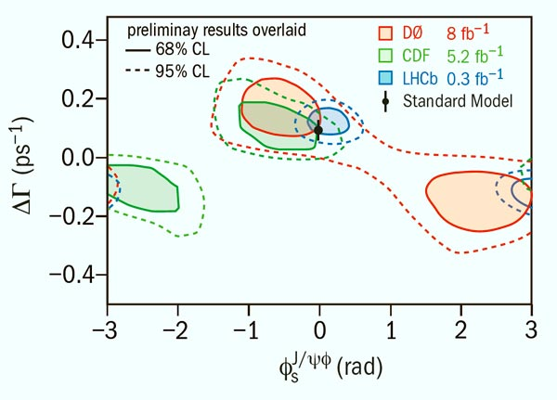
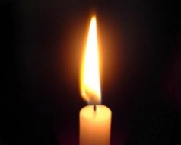
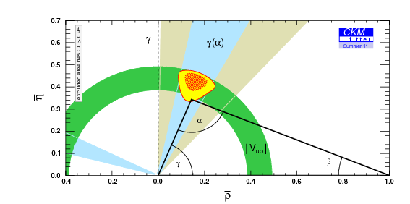
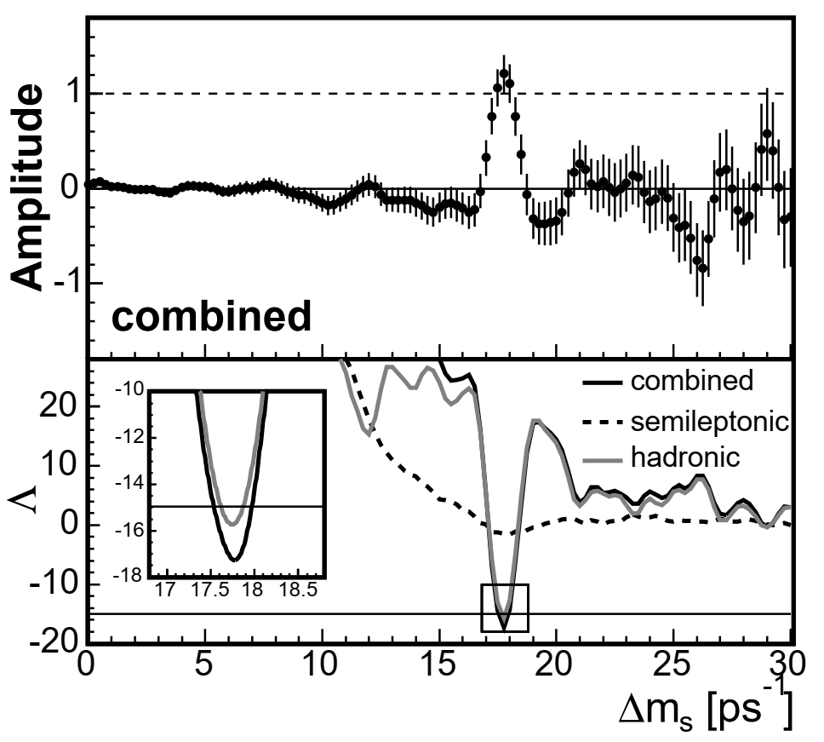

When LHC started
$B^{0}$ CPV and mixing well measured ($β$ and $Δm_{d}$)
$B_{s}^{0}$ system poorly constrained ($φ_{s}$ and $Δm_{s}$)
Standard candle
$−2β_{s}$=
Need significant improvement in $γ$ and $|V_{ub}|$

Slide 8
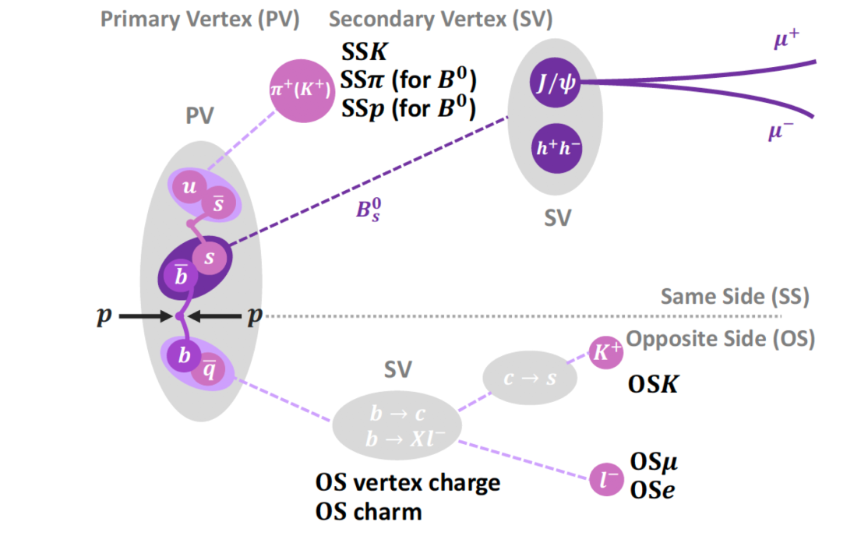
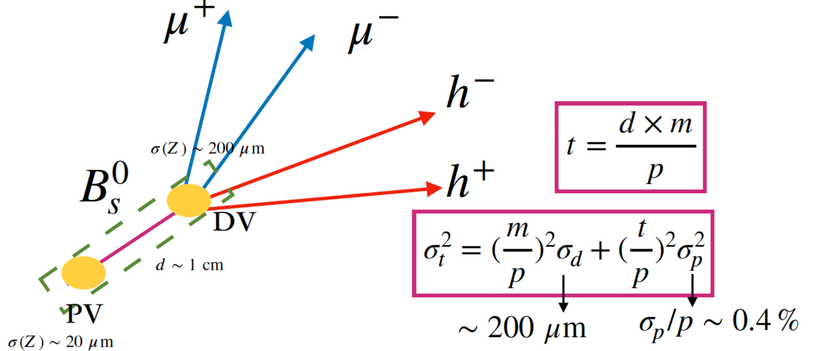
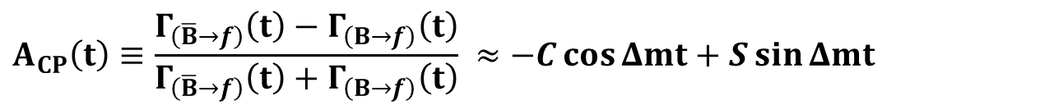
Challenges for CPV & mixing measurements
$$A_{CP}\left(t\right)≡\frac{Γ_{\left(\overline{B}→f\right)}\left(t\right)−Γ_{\left(B→f\right)}\left(t\right)}{Γ_{\left(\overline{B}→f\right)}\left(t\right)+Γ_{\left(B→f\right)}\left(t\right)} ≈−C\cos{Δmt}+S\sin{Δmt}$$
Flavor tagging: identify the initial $B/\overline{B}$ flavor & calibrate the mistag rate
Decay time reconstruction: estimate decay time, calibrate time resolution,
Detector efficiency: determine efficiency as a function of decay time
Nuisance asymmetries: control of production asymmetry, detection asymmetry
Fast $B_{s}^{0}$ oscillation: need excellent time resolution
CPV measurements usually have very long analysis cycle!

Slide 9
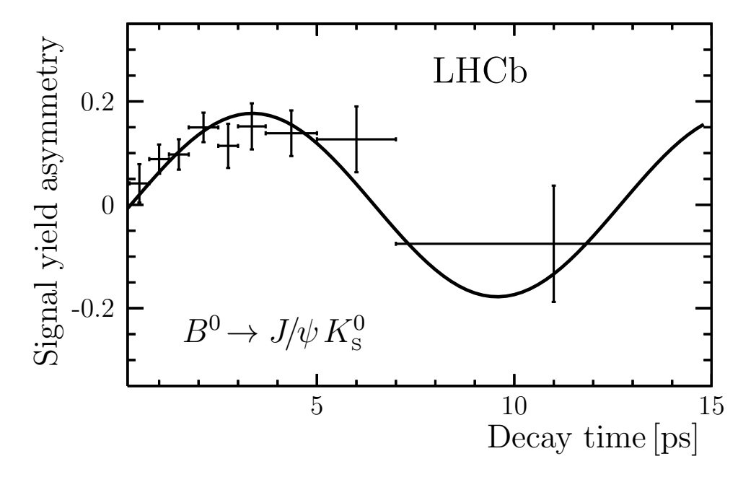
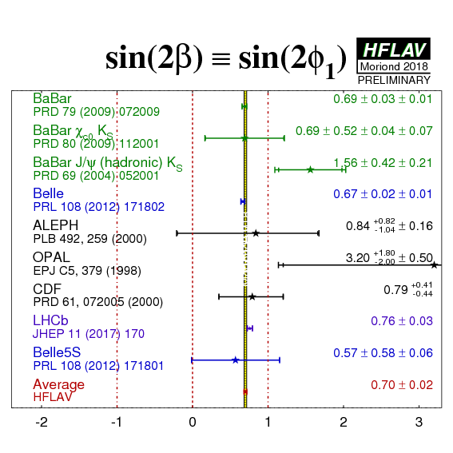
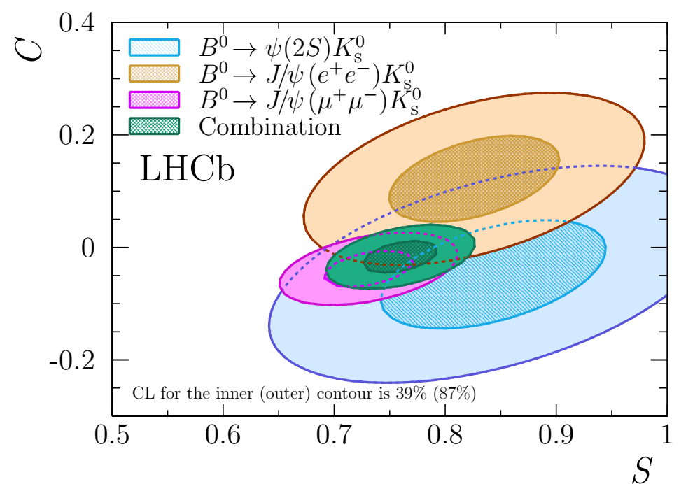


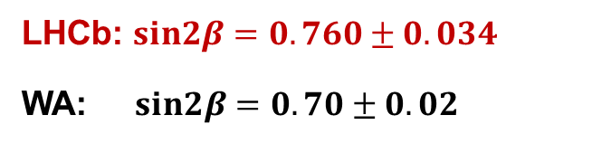
sin$2β$ from Run 1 data
JHEP 11 (2017) 170
$b→c\overline{c}s$combination
LHCb: $sin2β=0.760±0.034$
WA: $sin2β=0.70±0.02$
Run 2 analysis ongoing, precision expected to exceed B factories

Slide 10
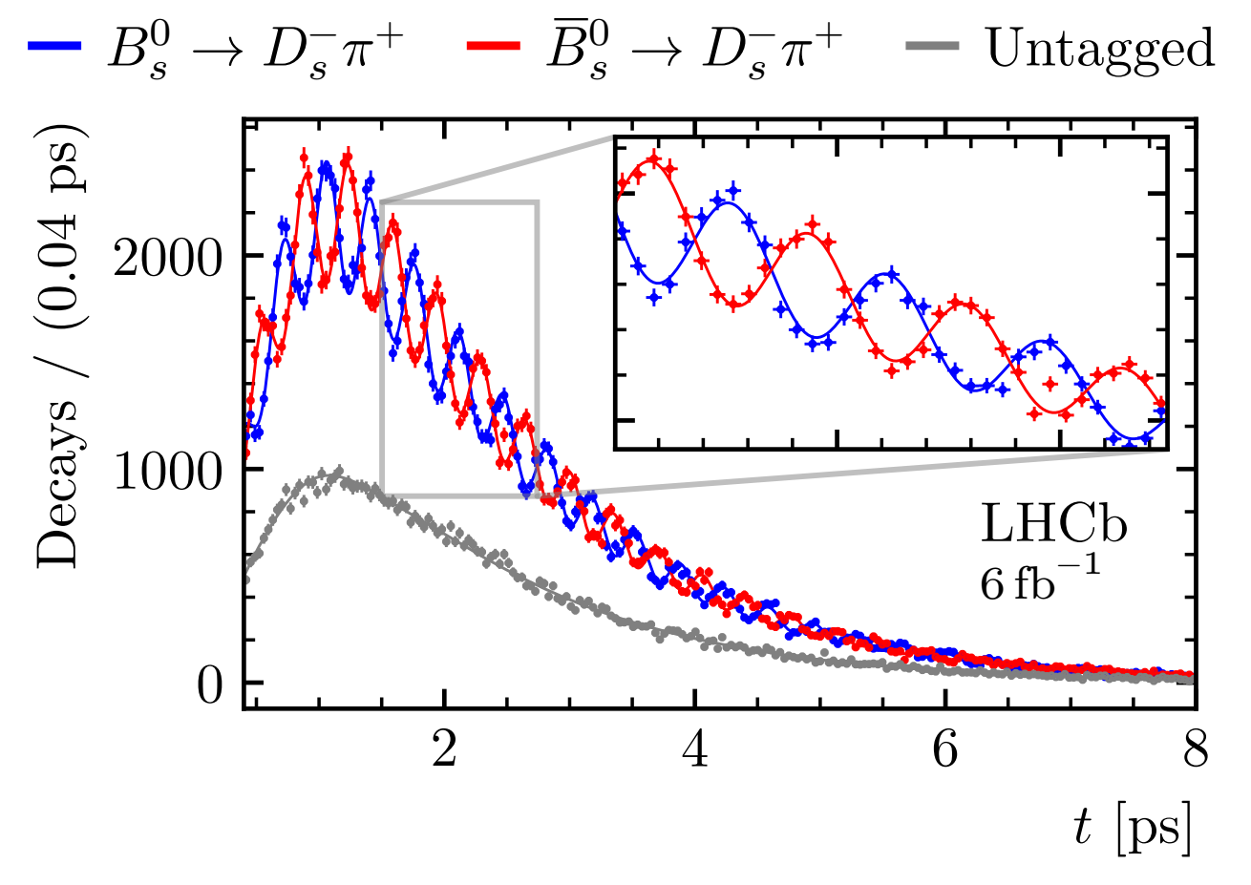
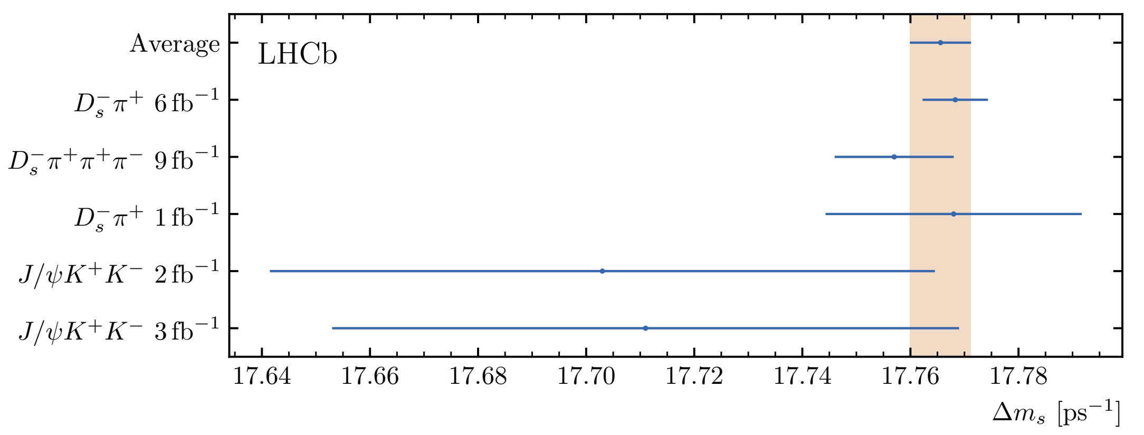

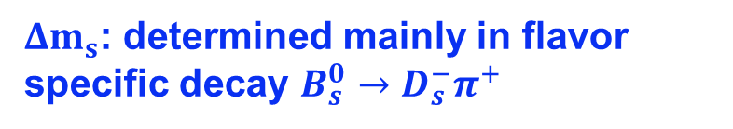

$B_{s}^{0}$ mixing frequency
arXiv:2104.04421
$Δm_{s}$: determined mainly in flavor specific decay $B_{s}^{0}→D_{s}^{−}π^{+}$
LHCb combination
$$Δm_{s}=17.7656±0.0057 ps^{−1}$$
$P\left(t\right)∼e^{−Γ_{s}t}\left[cosh\left(\frac{ΔΓ_{s}t}{2}\right)±cos\left(Δm_{s}t\right)\right]$
SM prediction: $Δm_{s}=18.4_{−1.2}^{+0.7} ps^{−1}$
Precise determination of $Δm_{s}$ paves the way for CPV measurements in $B_{s}^{0}$ decays

Slide 11
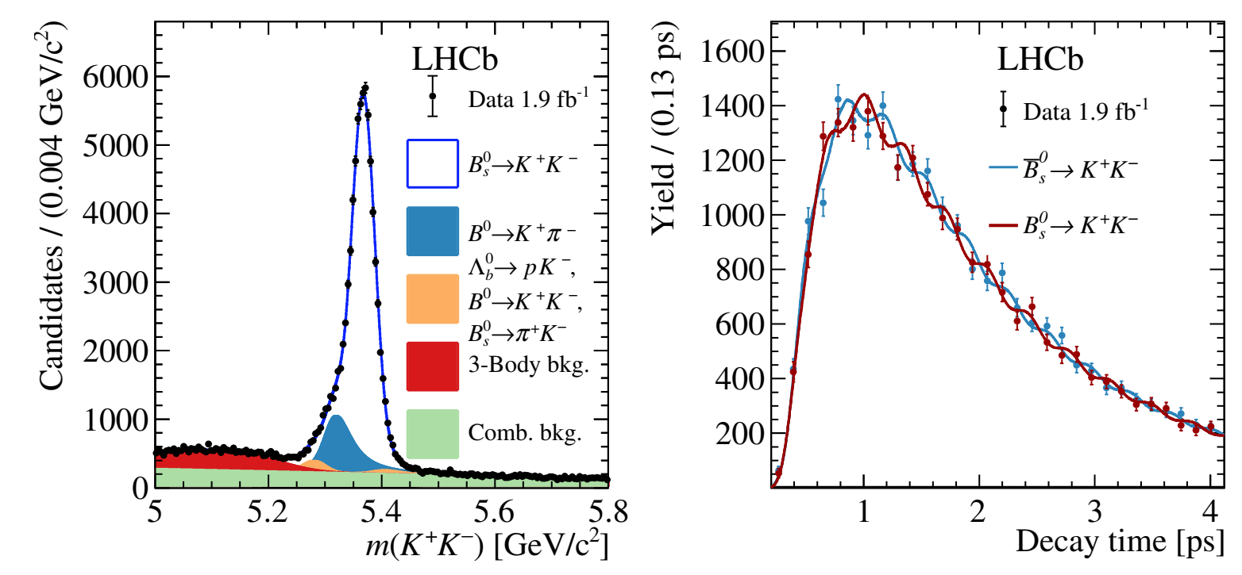
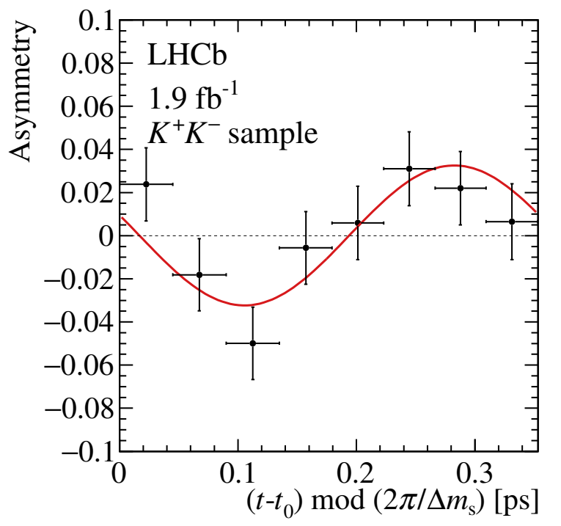

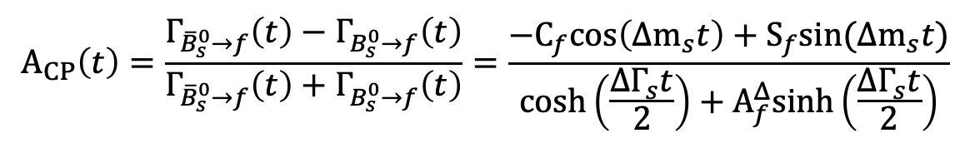
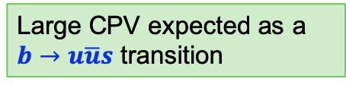
Observation of CPV in $B_{s}^{0}→K^{+}K^{−}$
JHEP 03 (2021) 075
Flavour-tagged time-dependent analysis with 2015+2016 data
$$A_{CP}\left(t\right)=\frac{Γ_{{\overline{B}}_{s}^{0}→f}\left(t\right)−Γ_{B_{s}^{0}→f}\left(t\right)}{Γ_{{\overline{B}}_{s}^{0}→f}\left(t\right)+Γ_{B_{s}^{0}→f}\left(t\right)}=\frac{−C_{f}cos\left(Δm_{s}t\right)+S_{f}sin(Δm_{s}t)}{\cosh\left(\frac{ΔΓ_{s}t}{2}\right)+A_{f}^{Δ}sinh\left(\frac{ΔΓ_{s}t}{2}\right)}$$
Large CPV expected as a $b→u\overline{u}s$ transition
$S_{KK}=0.123±0.034±0.015, C_{KK}=0.164±0.034±0.014$, $A_{KK}^{Δ}=−0.83±0.05±0.09$
First observation of time-dependent CP violation in $B_{s}^{0}$ decays!

Slide 12
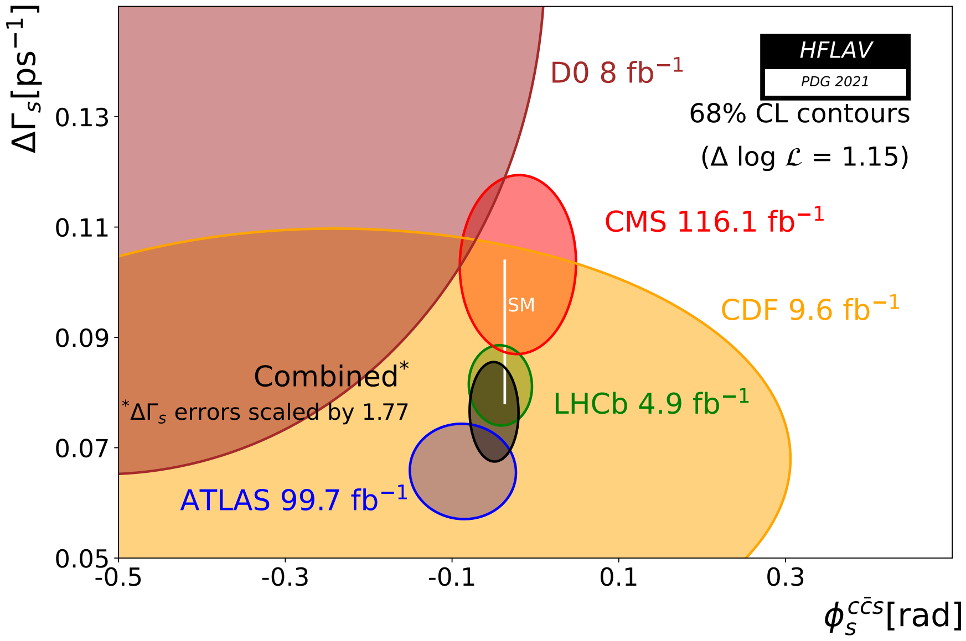

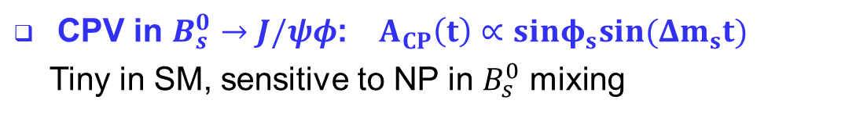
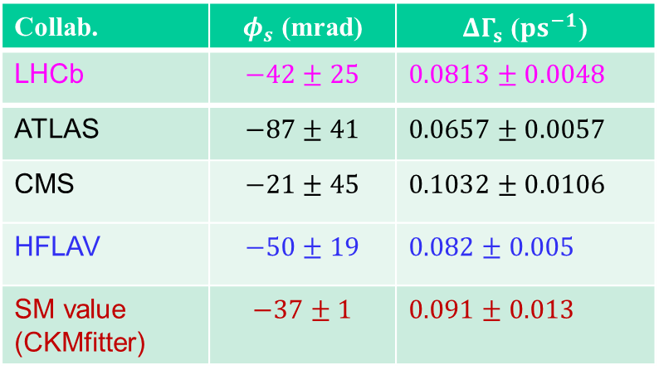
LHCb, EPJC 80 (2020) 601
ATLAS, EPJC 81 (2021) 342
CMS, PLB 816 (2021) 136188
$B_{s}^{0}$ mixing phase $φ_{s}=−2β_{s}^{eff}$
CPV in $B_{s}^{0}→J/ψφ$: $A_{CP}\left(t\right)∝sinφ_{s}sin(Δm_{s}t)$
Tiny in SM, sensitive to NP in $B_{s}^{0}$ mixing
NP?
Collab. | $φ_{s}$ (mrad) | $ΔΓ_{s}$ ($ps^{−1}$)
LHCb | $$−42±25$$ | $$0.0813±0.0048$$
ATLAS | $$−87±41$$ | $$0.0657±0.0057$$
CMS | $$−21±45$$ | $$0.1032±0.0106$$
HFLAV | $$−50±19$$ | $$0.082±0.005$$
SM value (CKMfitter) | $$−37±1$$ | $$0.091±0.013$$
Consistent with SM prediction and CP invariance
LHCb-China team has played a leading role. Results with full Run 2 data coming soon

Slide 13
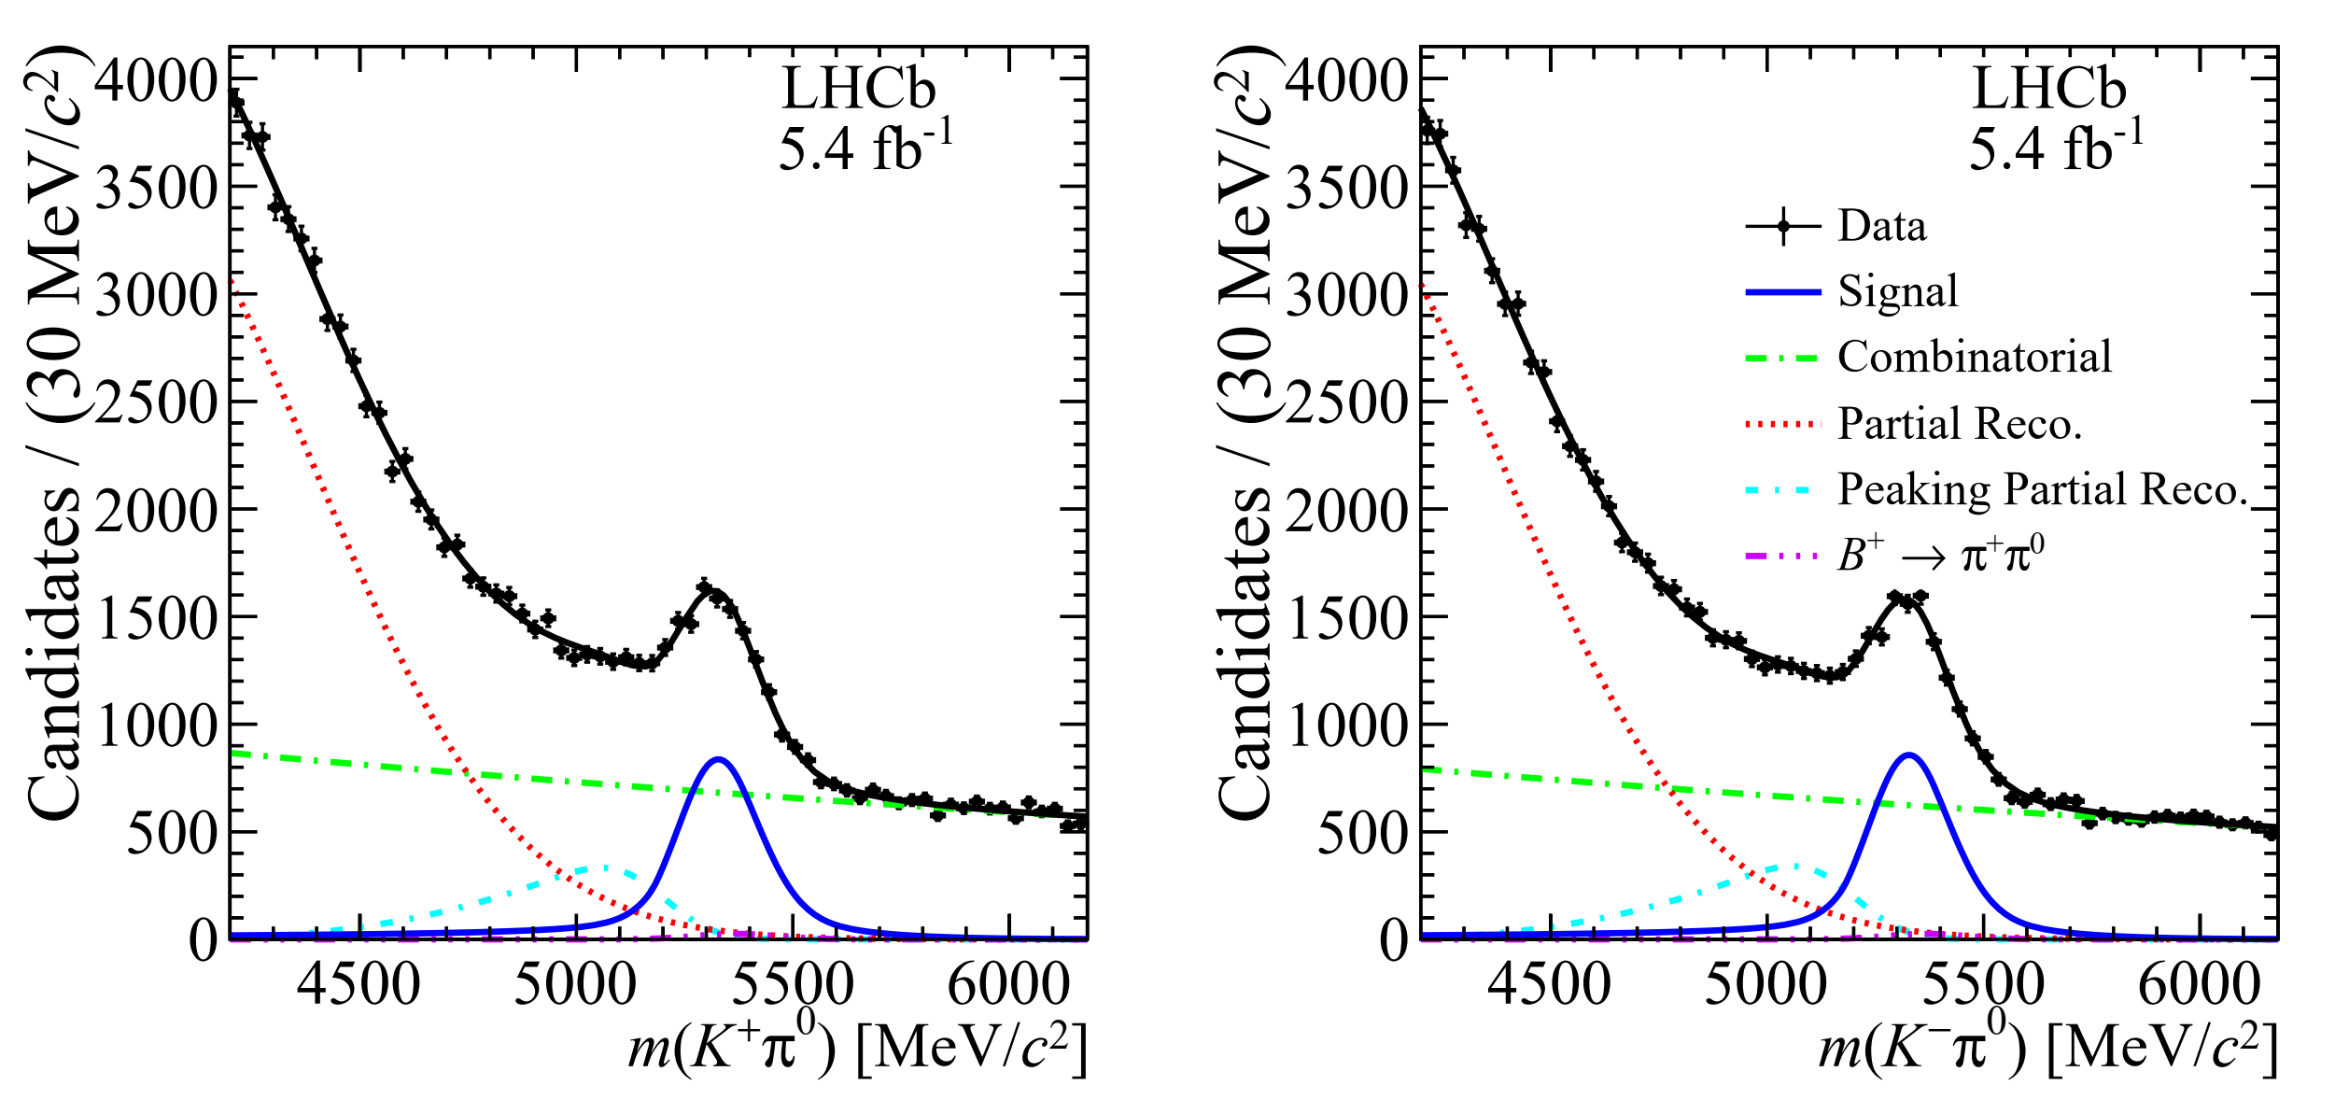






$B→Kπ$ puzzle confirmed
PRL 126 (2021) 091802
Anomaly in CP asymmetries of $B→Kπ$ decays
SM prediction
$${ΔA}_{CP}\left(Kπ\right)=A_{CP}\left(K^{+}π^{0}\right)−A_{CP}\left(K^{+}π^{−}\right)≈0$$
Experiments
$${ΔA}_{CP}\left(Kπ\right)≈0.124±0.021$$
5.5$σ$ discrepancy from zero
Improved measurement of $A_{CP}\left(K^{+}π^{0}\right)$ with LHCb Run2 data
$A_{CP}\left(K^{+}π^{0}\right)=0.025±0.015±0.006±0.003$
WA: ${ A}_{CP}\left(K^{+}π^{0}\right)=0.040±0.021$
$A_{CP}\left(K^{+}π^{0}\right)=0.031±0.013$
New WA
$${ΔA}_{CP}\left(Kπ\right)=0.115±0.014$$
8$σ$ discrepancy from zero
More complete examination of the SM prediction is needed

Slide 14
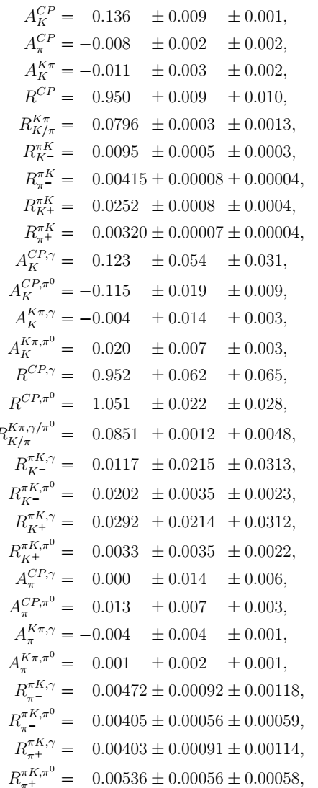
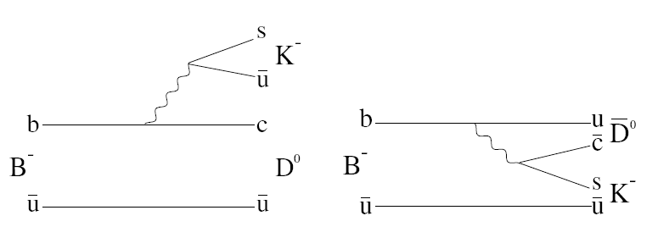
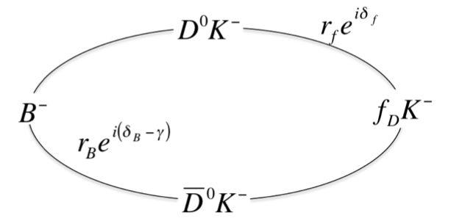
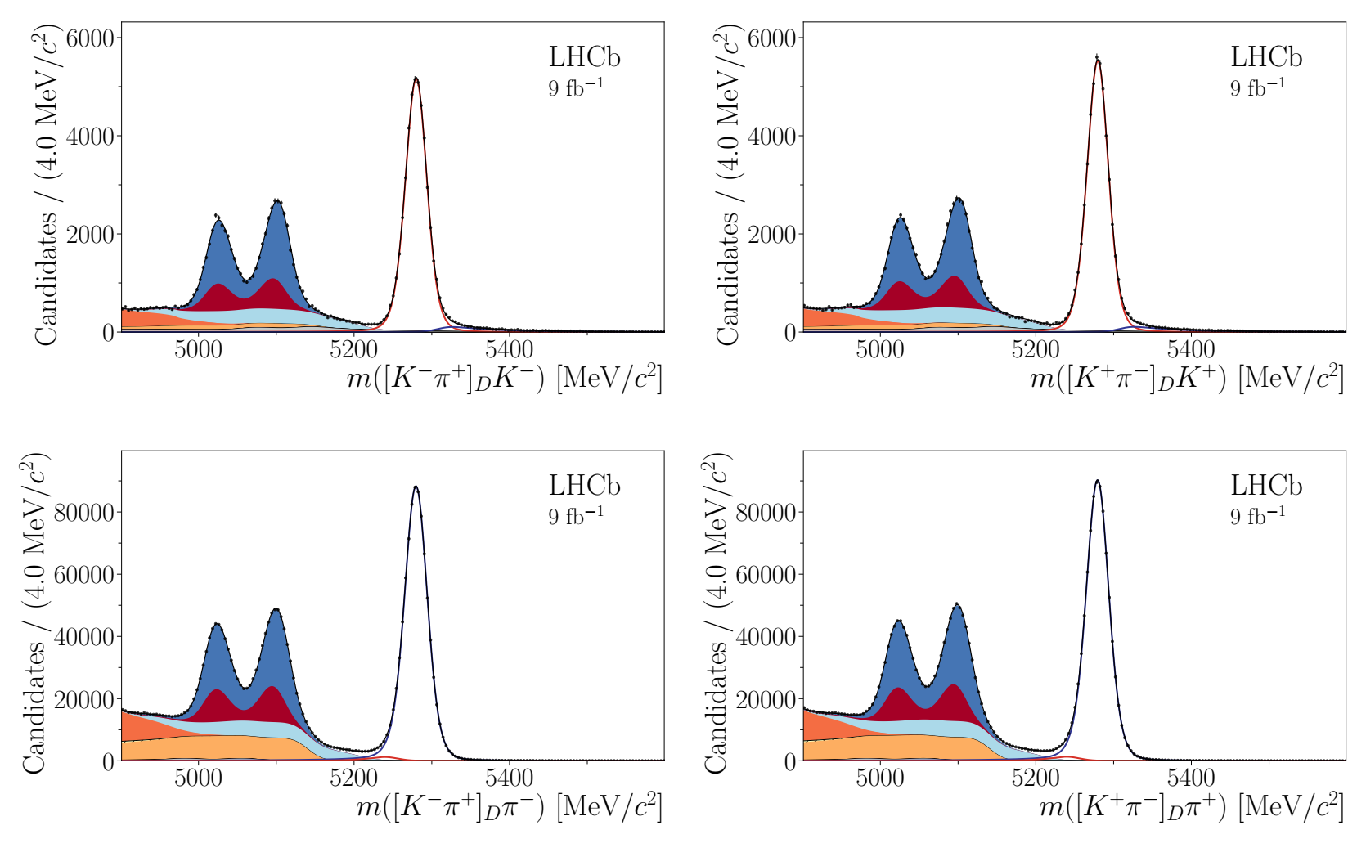
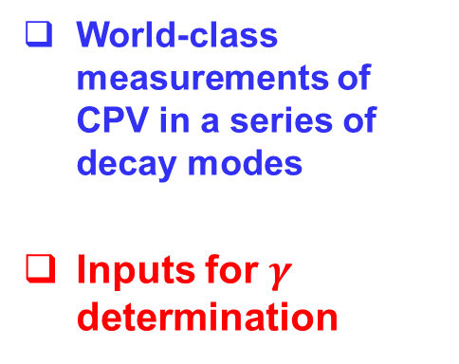

JHEP 04 (2021) 081
CPV in $B^{±}→D^{0}K^{±}, D^{0}π^{±}$
CP violation due to interference of diagrams involving $V_{cb}$and $V_{ub}$
World-class measurements of CPV in a series of decay modes
Inputs for $γ$ determination

Slide 15
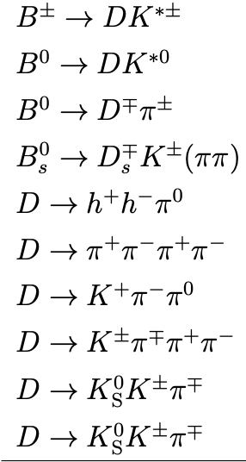
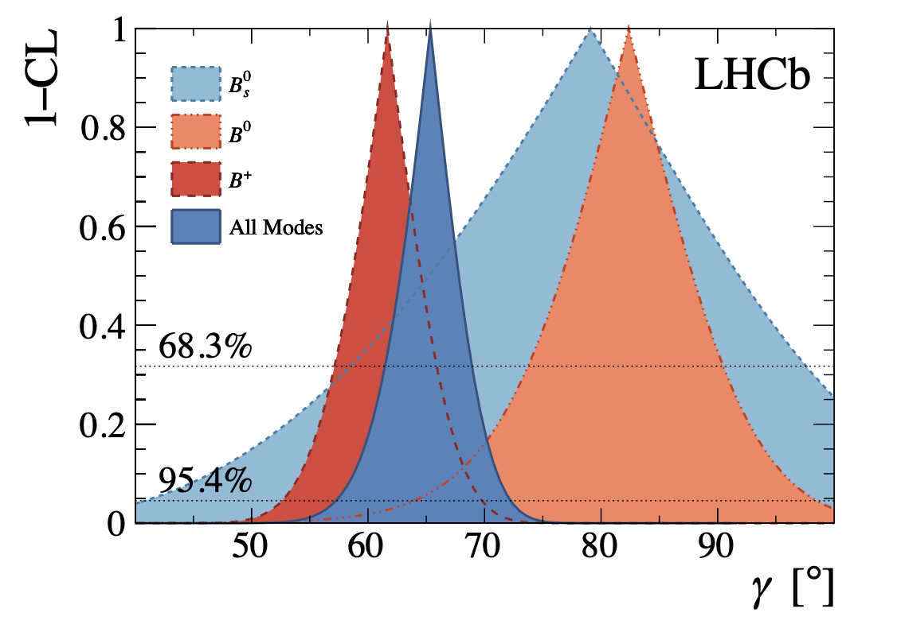
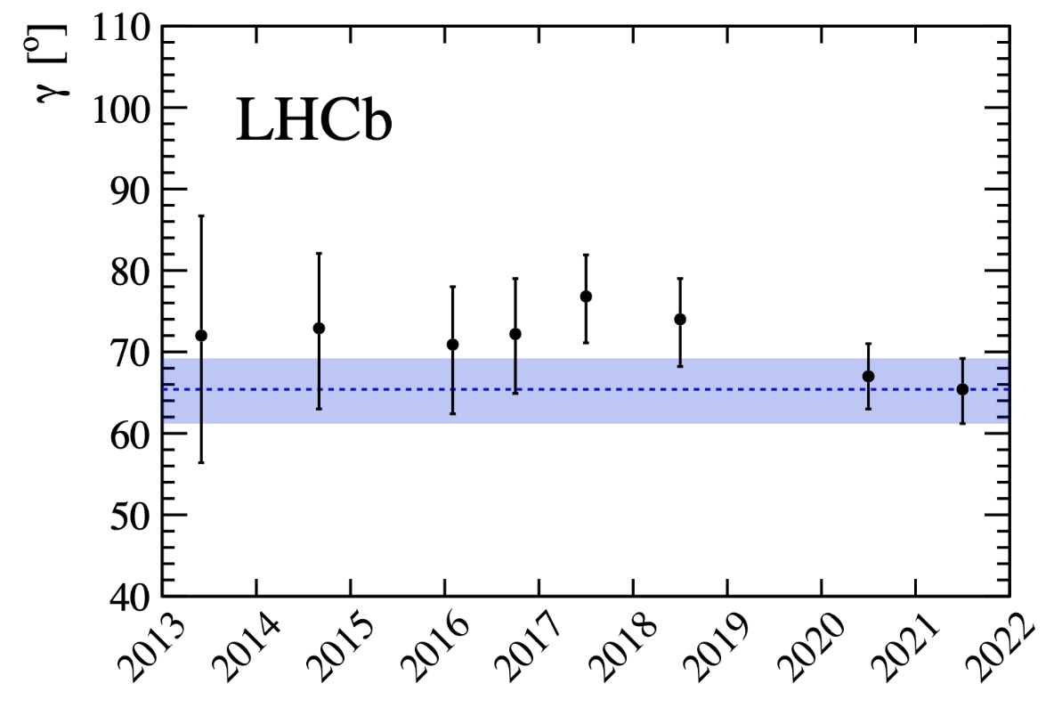

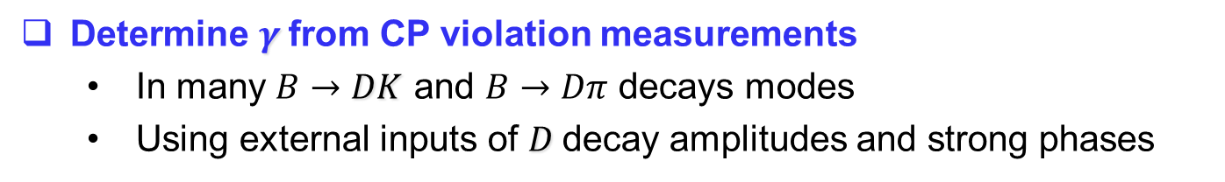

Huge improvement in $γ$
arXiv:2110.02350
Determine $γ$from CP violation measurements
  In many $B→DK$ and $B→Dπ$ decays modes
  Using external inputs of $D$decay amplitudes and strong phases
LHCb: $γ=\left(65.4_{−4.2}^{+3.8}\right)°$ Babar: $γ=\left(70±18 \right)°$ BELLE: $γ=\left(73_{−15}^{+13} \right)$
CKM fit prediction: $γ=\left(65.7_{−2.7}^{+0.9}\right)°$

Slide 16
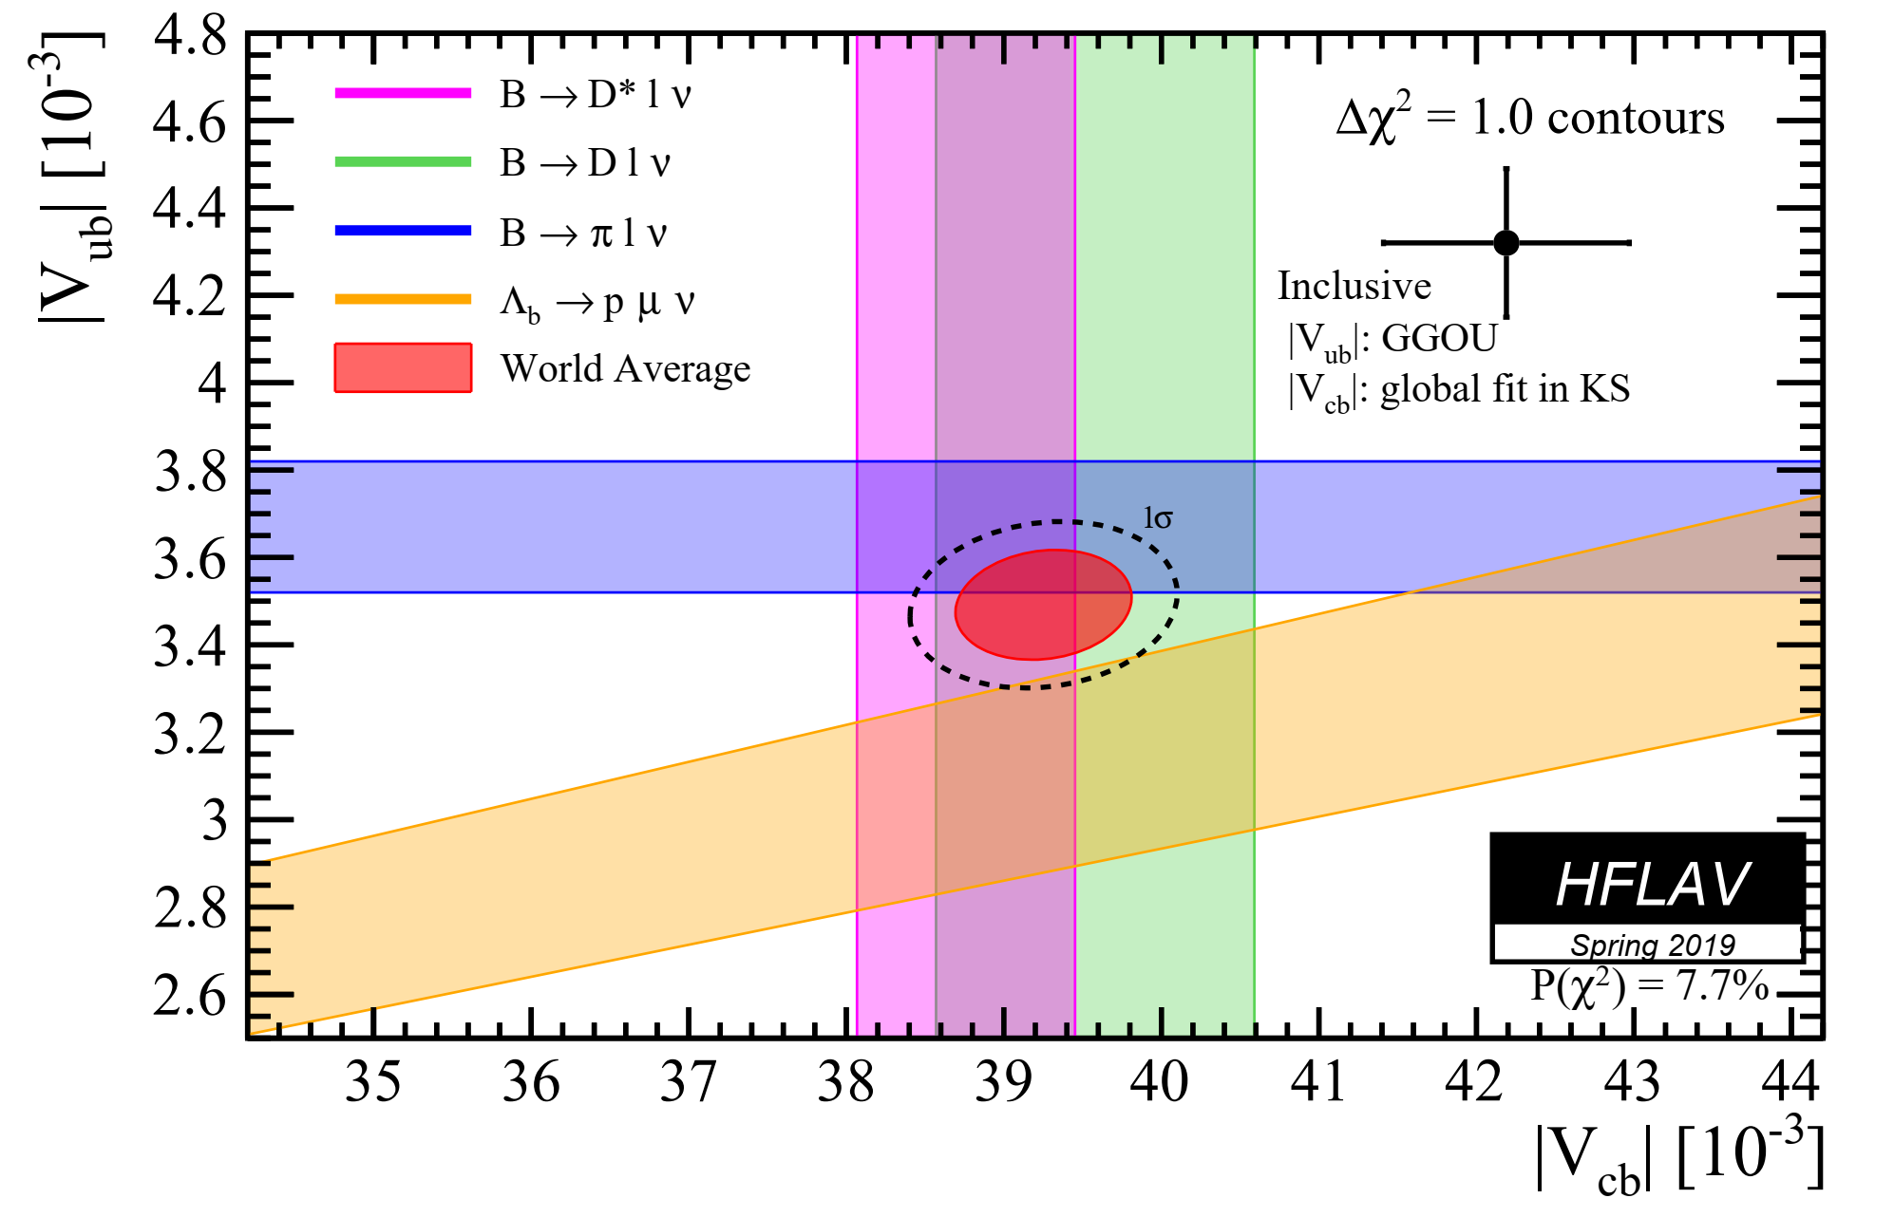
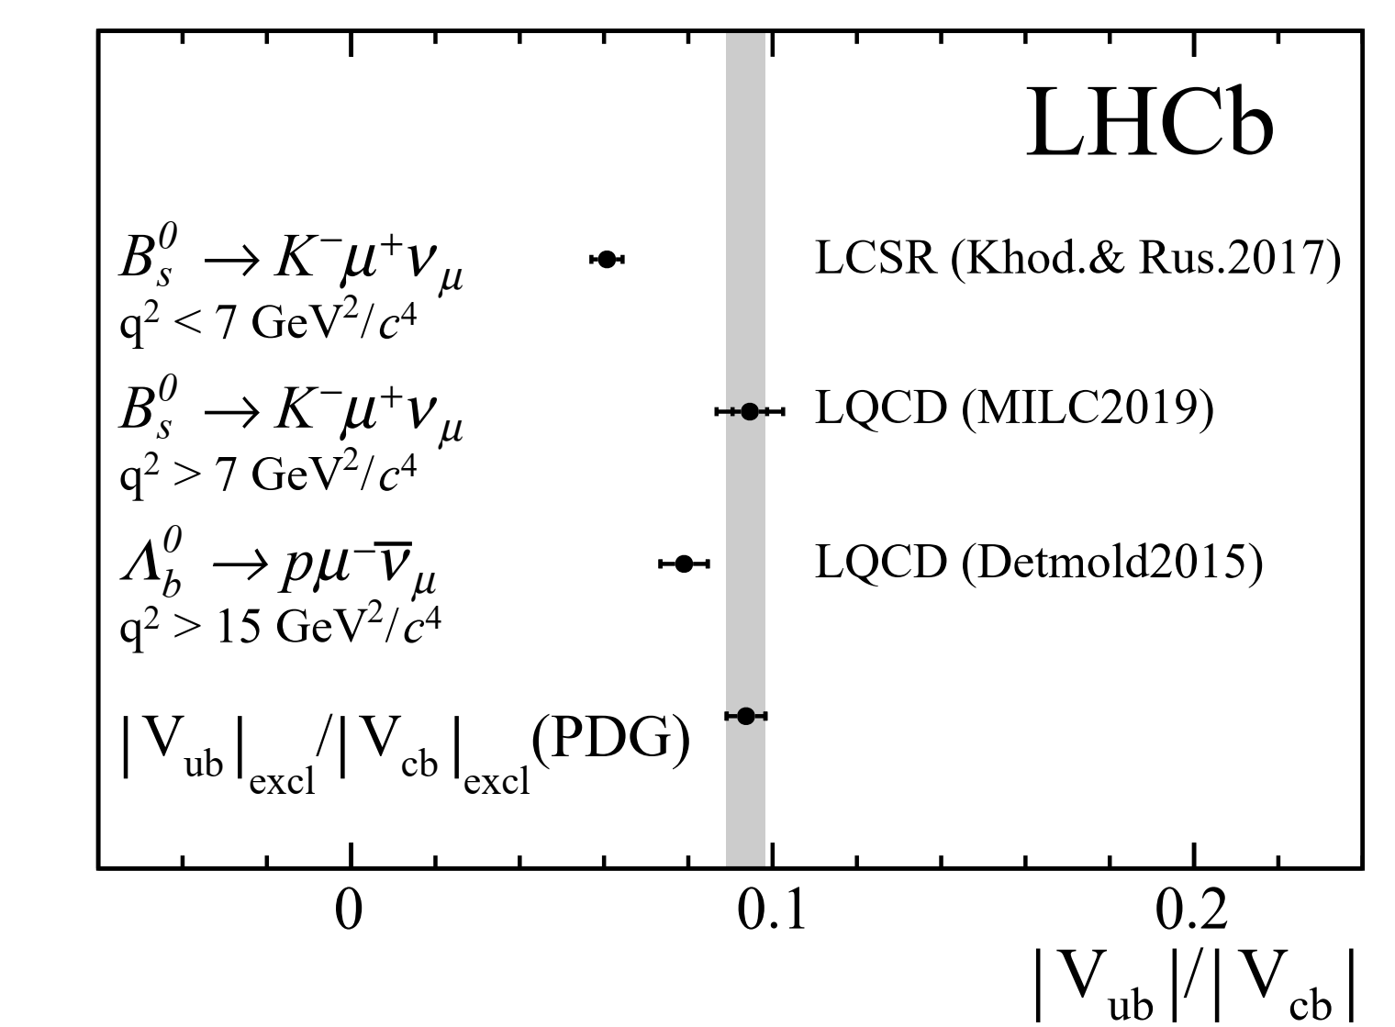





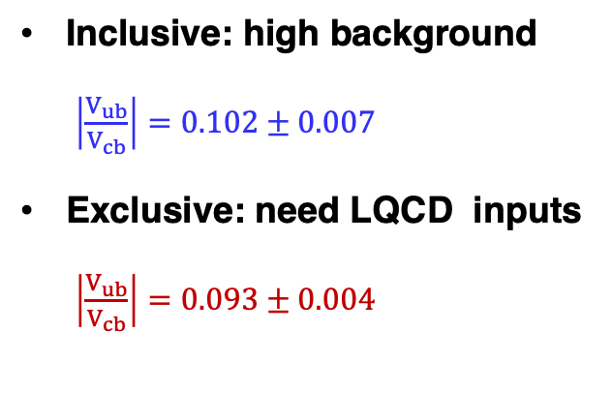


$V_{ub}/V_{cb}$ measurements
PRL 126 (2021) 081804
Nature Physics 11 (2015) 743
b$→ulν$
b$→clν$
Tension between inclusive and exclusive determinations
LHCb exclusive measurements
Inclusive: high background
$\left|\frac{V_{ub}}{V_{cb}}\right|=0.102±0.007$
Exclusive: need LQCD inputs
$\left|\frac{V_{ub}}{V_{cb}}\right|=0.093±0.004$
$|V_{ub}/V_{cb}|$ in ${ Λ}_{b}^{0}→pμ^{−}{\overline{ν}}_{μ}$
$\left|\frac{V_{ub}}{V_{cb}}\right| =0.083±0.004±0.004$
$|V_{ub}/V_{cb}|$ in $B_{s}^{0}→K^{−}μ^{+}ν_{μ}$
Low $q^{2}$: LCSR ${FF}_{K} \left|\frac{V_{ub}}{V_{cb}}\right| =0.061±0.004$
High $q^{2}$: LQCD ${FF}_{K}$ $\left|\frac{V_{ub}}{V_{cb}}\right|=0.095±0.008$
Demonstration of LHCb’s ability to study semi-leptonic B decays.

Slide 17
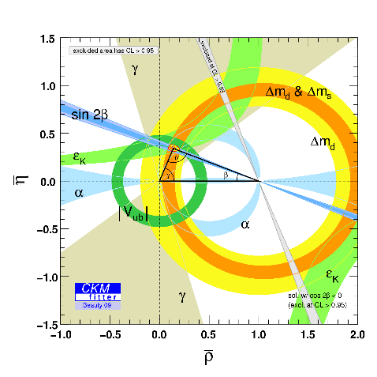
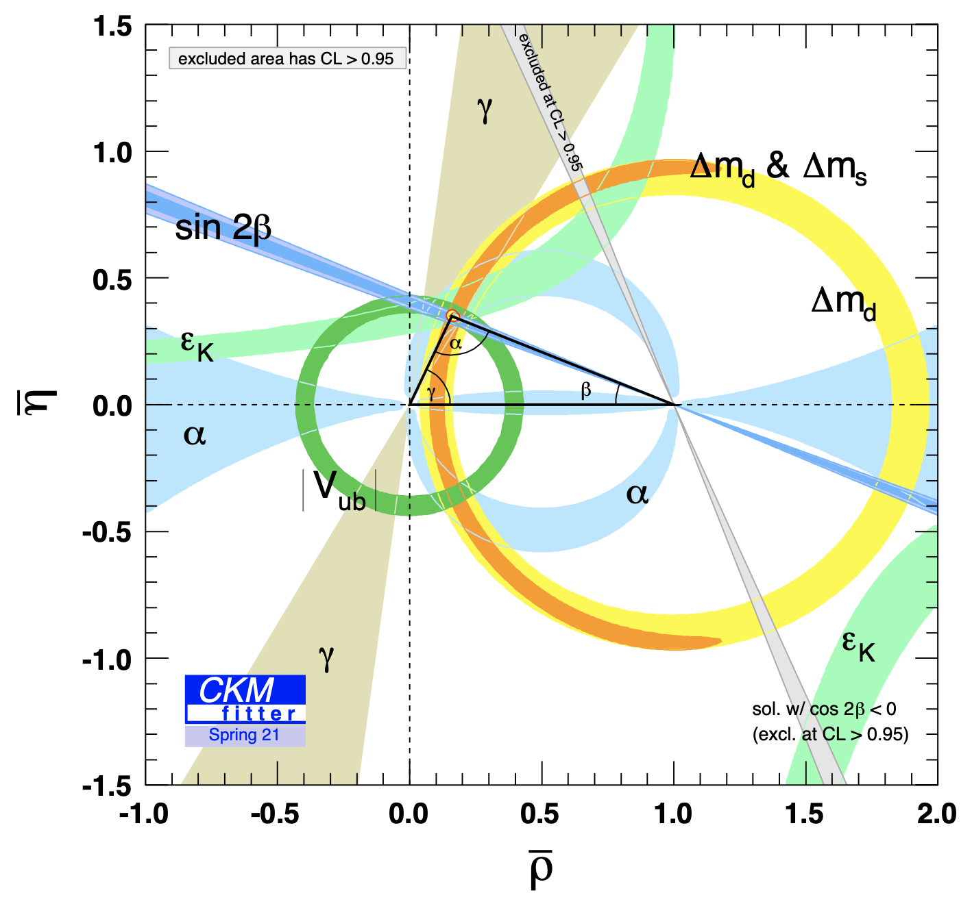
Global fit
When LHC started
Current picture
p-value ~ 29%
Presented by 钱文斌 at CKM 2021
Flavour and CP violation in quark sector well described by CKM mechanism!

Slide 18
Rare decays & lepton flavour universality

Slide 19







FCNC $b→sl^{+}l^{−}$ decays
$b→sl^{+}l^{−}$ decays described by effective Hamiltonian
$H=−\frac{4G_{F}}{\sqrt{2}}V_{tb}V_{ts}^{∗}\sum_{i}{C_{i}{ O}_{i}}+ \frac{K}{{ Λ}_{NP}^{2}}O_{j}^{(6)}$
New physics can
affect Wilson coefficients $C_{i}$ or add new operators $O_{j}$
Sensitivity to Wilson coefficients
7: photon penguin; 9,10: EW penguin; S,P: （pseudo-）scalar penguin
Theoretically clean probes of NP
  Pure leptonic decays
  Special angular observables
  Ratio between $e/μ/τ$

Slide 20








$$B_{(s)}^{0}→μ^{+}μ^{−}$$
arXiv:2108.09283,
arXiv:2108.09284
JHEP 04 (2020) 188
JHEP 04 (2019) 098
 | $$B\left(B_{s}^{0}→μ^{+}μ^{−}\right)$$ | $$B\left(B^{0}→μ^{+}μ^{−}\right)$$
LHCb (11-18) | $$\left({3.09}_{−0.43 −0.11}^{+0.46 +0.15}\right)×10^{−9}$$ | $$<2.6×{10}^{−10}$$
CMS (11-16) | $$\left(2.9±0.7±0.2\right)×{10}^{−9}$$ | $$<3.6×{10}^{−10}$$
ATLAS (11-16) | $$\left({2.8}_{−0.7}^{+0.8}\right)×{10}^{−9}$$ | $$<2.1×{10}^{−10}$$
SM | $\left(3.66±0.14\right)×{10}^{−9}$ | $$(1.03±0.05)×{10}^{−9}$$
LHCb and CMS results agree with SM. ATLAS has no clear observation of $B_{s}^{0}→μ^{+}μ^{−}$ yet

Slide 21










$b→sl^{+}l^{−}$ branching fractions
Measurements consistently below SM predictions at low $q^{2}$
Caveat: significant theory uncertainties from hadronic form factors
$$B^{+}→K^{+}μ^{+}μ^{−}$$
$$B_{s}^{0}→φμ^{+}μ^{−}$$
JHEP 06(2014)133
PRL 127 (2021) 151801
$$B^{0}→K^{∗0}μ^{+}μ^{−}$$
$$Λ_{b}^{0}→Λ^{0}μ^{+}μ^{−}$$
JHEP 04(2017)142
JHEP 06(2015)115

Slide 22











Angular analysis: $B^{0}→K^{∗0}μ^{+}μ^{−}$
θ
_{μ}+
_{K}-
K*
θ
W
2
K
_{μ}-
q
B
_{π}+
8 independent CP-averaged observables: F_{L,} A_{FB,} S_{3,4,5,7,8,9}
Form factors cancel at leading order: $P_{i}^{′}=S_{i}/\sqrt{F_{L}(1−F_{L})}$

Slide 23




$B^{0}→K^{∗0}μ^{+}μ^{−}$ angular distributions
PRL 125 (2020) 011802
$P_{5}^{′}$in tension with SM predictions with 2011-2016 data
 | Run 1 | Run1+2016
$4.0<q^{2}<6.0 GeV^{2}$ | 2.8$σ$ | 2.5$σ$
$6.0<q^{2}<8.0$ $GeV^{2}$ | 3.0$σ$ | 2.9$σ$

Slide 24




$$B^{+}→K^{∗+}μ^{+}μ^{−}$$
PRL 126 (2021) 161802
First analysis of $B^{+}→K^{∗+}μ^{+}μ^{−}$ using full Run1+Run2 sample
$P_{5}^{′}$: pattern consistent with that seen in $B^{0}→K^{∗0}μ^{+}μ^{−}$
$P_{2}=\frac{2}{3}A_{FB}/(1−F_{L})$: tension with SM in $6.0<q^{2}<8.0 GeV^{2}$
($3.0σ$ from SM)

Slide 25



Lepton flavor universality test
$$R_{K^{(∗)}}=\frac{B(B→K^{\left(∗\right)}μ^{+}μ^{−} )}{B(B→K^{(∗)}e^{+}e^{−})}=\frac{B\left(B→K^{(∗)}μ^{+}μ^{−}\right)/B\left(B→K^{(∗)}J/ψ\left(→μ^{+}μ^{−}\right) \right)}{B\left(B→K^{(∗)}e^{+}e^{−}\right)/B\left(B→K^{(∗)}J/ψ\left(→e^{+}e\right) \right)}$$
$R_{K^{(∗)}}=1.000±0.001$in the SM, with uncertainties related to form factors largely cancelled
Challenge: electron Bremstrahlungs
Double ratio technique
Difficult to recover
Electron Bremstrahlungs recovery

Slide 26




arXiv:2105.14007
$R_{K}$ in $B^{+}→K^{+}l^{+}l^{−}$
New result with full Run1+Run2 sample
$$R_{K}\left(1.1<q^{2}<6.0 GeV^{2}\right)={0.846}_{−0.039 −0.012}^{+0.042 +0.013}$$
($3.1σ$ from SM)

Slide 27







$R_{pK}$, $R_{K^{∗0}}$, $R_{K^{∗+}}$and $R_{K_{S}^{0}}$
JHEP 05 (2020) 040
$Λ_{b}^{0}→pK^{−}l^{+}l^{−}$ (Run1+2016)
$$R_{pK}\left(0.1<q^{2}<6.0 GeV^{2}\right)={0.86}_{−0.11}^{+0.14}±0.05$$
(1.0$σ$ below SM)
JHEP 08 (2017) 055
$B^{0}→K^{∗0}l^{+}l^{−}$ (Run1)
$$R_{K^{∗0}}\left(0.045<q^{2}<1.1 GeV^{2}\right)={0.66}_{−0.07}^{+0.11}±0.05$$
$$R_{K^{∗0}}\left(1.1 <q^{2}<6.0 GeV^{2}\right)={0.69}_{−0.07}^{+0.11}±0.05$$
(2.1-2.3$σ$ below SM)
(2.4-2.5$σ$ below SM)
arXiv:2110.09501
$B^{0}→K_{S}^{0}l^{+}l^{−}$ and $B^{+}→K^{∗+} l^{+}l^{−}$ (Run1+Run2)
$${ R}_{K_{S}^{0}}\left(1.1<q^{2}<6.0 GeV^{2}\right)={0.66}_{−0.14 −0.04}^{+0.20 +0.02}$$
(1.5$σ$ below SM)
$$R_{K^{∗+}}\left(0.045<q^{2}<6.0 GeV^{2}\right)={0.70}_{−0.13 −0.04}^{+0.18 +0.03}$$
(1.4$σ$ below SM)

Slide 28







More rare decays (1)
arXiv:2111.11339
Search for $B_{(s)}^{0}→μ^{+}μ^{−}μ^{+}μ^{−}$
$B\left(B_{s}^{0}→μ^{+}μ^{−}μ^{+}μ^{−}\right)<8.6×{10}^{−10}$ at 90% CL
$B\left(B^{0}→μ^{+}μ^{−}μ^{+}μ^{−}\right)<1.8×{10}^{−10}$ at 90% CL
arXiv:2111.10194
Photon polarization in $Λ_{b}^{0}→Λγ$
$$\frac{dΓ}{dcosθ_{p}}∝1−α_{Λ}λ_{γ}\cos{θ_{p}}$$
SM prediction: $λ_{γ}≈1$
$$λ_{γ}={0.82}_{−0.26 −0.13}^{+0.17+0.04}$$

Slide 29





More rare decays (2)
(by LHCb-China members)
CPC 45 (2021) 043001
Search for annihilation decay $B^{0}→J/ψφ$
$B\left(B^{0}→J/ψφ\right)<1.1×{10}^{−7}$ at 90% CL
$$2.8σ$$
LHCb-PAPER-2021-042
Search for annihilation decay $B^{0}→φμ^{+}μ^{−}$
$B\left(B^{0}→φμ^{+}μ^{−}\right)<3.2×{10}^{−9}$ at 90% CL
No signal

Slide 30


Summary and prospects
There is no sign of CP violation beyond the SM source yet, despite the continuous and significant improvements on key parameters
Coherent anomalies are seen in low $q^{2}$ region of $b→sl^{+}l^{−}$ decays
  $R_{K,K^{∗},K_{S}}<1, P_{5}^{′}$ puzzle, ${b→sμ}^{+}μ^{−}$ differential rates below SM calculations
  Plausible scenario: new physics contribution to ${b→sμ}^{+}μ^{−}$
Opportunities with Run 3 (20-30 $fb^{−1}$)
  Higher precision in benchmark measurements: $γ, β, φ_{s}, B_{s/d}^{0}→μ^{+}μ^{−},$angular distributions and LFU tests in $b→sl^{+}l^{−}$ decays, …
  Wider scope for exploitation: LFU tests in $b→dl^{+}l^{−}$ decays, CPV in baryon decays, CPV in rare decays,…
LHCb-China team is currently focusing on CP violation measurements, meanwhile extending our study to rare decays.

Slide 31
Backup

Slide 32




$$B_{(s)}^{0}→μ^{+}μ^{−}$$
Very rare, theoretically clean, with high sensitivity to NP
Beneke, Bobeth, JHEP 10 (2019 232)
$$B^{SM}\left(B_{s}^{0}→μ^{+}μ^{−}\right)=\left(3.66±0.14\right)×10^{−9}$$
$$B^{SM}\left(B^{0}→μ^{+}μ^{−}\right)=\left(1.03±0.05\right)×10^{−10}$$
More than 30 years of pursuit
LHC 2011-2016 combination
LHCb Run2 update

Slide 33





$B_{s}^{0}→φμ^{+}μ^{−}$ BF update
arXiv: 2105.14007
BF from Run 1+2 data, with $B_{s}^{0}→J/ψφ$ for normalization
$$B\left(B_{s}^{0}→φμ^{+}μ^{−}\right)=\left(8.14±0.21±0.16±0.13±0.09±0.39\right)×10^{−7}$$
Differential rate
$1.1<q^{2}=m^{2}(μμ)<6.0$ $GeV^{2}$:
$3.6σ$below SM prediction based on LQCD+LCSR

Slide 34






$B_{s}^{0}→φμ^{+}μ^{−}$ angular analysis
arXiv:2107.13428
Angular observables
Results in general consistent with SM expectations
CP average: $F_{L}, S_{3}, S_{4}, S_{7}$
CP asymmetries: $A_{FB}^{CP}, A_{5}, A_{8}, A_{9}$
34

Slide 35




$B_{s}^{0}$ mixing phase $φ_{s}=−2β_{s}^{eff}$
$φ_{s}$: sensitive to new physics in $B_{s}^{0}$ mixing.
Golden channel: $B_{s}^{0}→J/ψφ(→K^{+}K^{−})$
NP?
$$A_{CP}\left(t\right)=\frac{Γ_{{{\overline{B}}_{s}}^{0}→f}\left(t\right)−Γ_{{B_{s}}^{0}→f}\left(t\right)}{Γ_{{{\overline{B}}_{s}}^{0}→f}\left(t\right)+Γ_{{B_{s}}^{0}→f}\left(t\right)}≈−η_{f}sinφ_{s}\sin\left(Δm_{s}t\right)$$
Good flavor tagging & time reconstruction performance essential
 | tagging power | $$σ_{t}$$ | Signal yields | features
ATLAS | 1.75% | 70 fs | 453k | new Inner B-Layers improve $σ_{t}$
CMS | ~10% | 75 fs | 48.5k | new DNN OS muon tagger
LHCb | 4.73% | 45 fs | 117k | excellent K/$π$ separation & vertex reconstruction
35

