Slide 1
夸克胶子等离子体的寻找与QCD相图研究
刘 峰
华中师范大学粒子物理研究所
Thanks to X.F. Luo, S.S. Shi and N. Xu for exciting discussions !
2021年5月29日 新乡

Slide 2
Outline
  Introduction
  Perfect Liquid
  Energy loss
  Elliptic flow v₂
  QCD Critical Point and Phase Boundary
  Higher moments
  Summary and Outlook

Slide 3

Two Puzzles of Modern Physics
-- T.D.Lee
Missing Symmetry – all present theories are based on symmetry, but most symmetry quantum numbers are NOT conserved.
Unseen Quarks – all hadrons are made of quarks, yet NO individual quark has been observed.
强作用的夸克
和胶子禁闭在
核子内
nucleus
-
atom
matter

Slide 4
Structure of an atom
Atom>nucleus>proton/neutron>quarks/gluons
10⁻¹⁰m 10⁻¹⁴m 10⁻¹⁵m (1fm) <10⁻¹⁹m
Where is the strong force most relevant ?

Slide 5
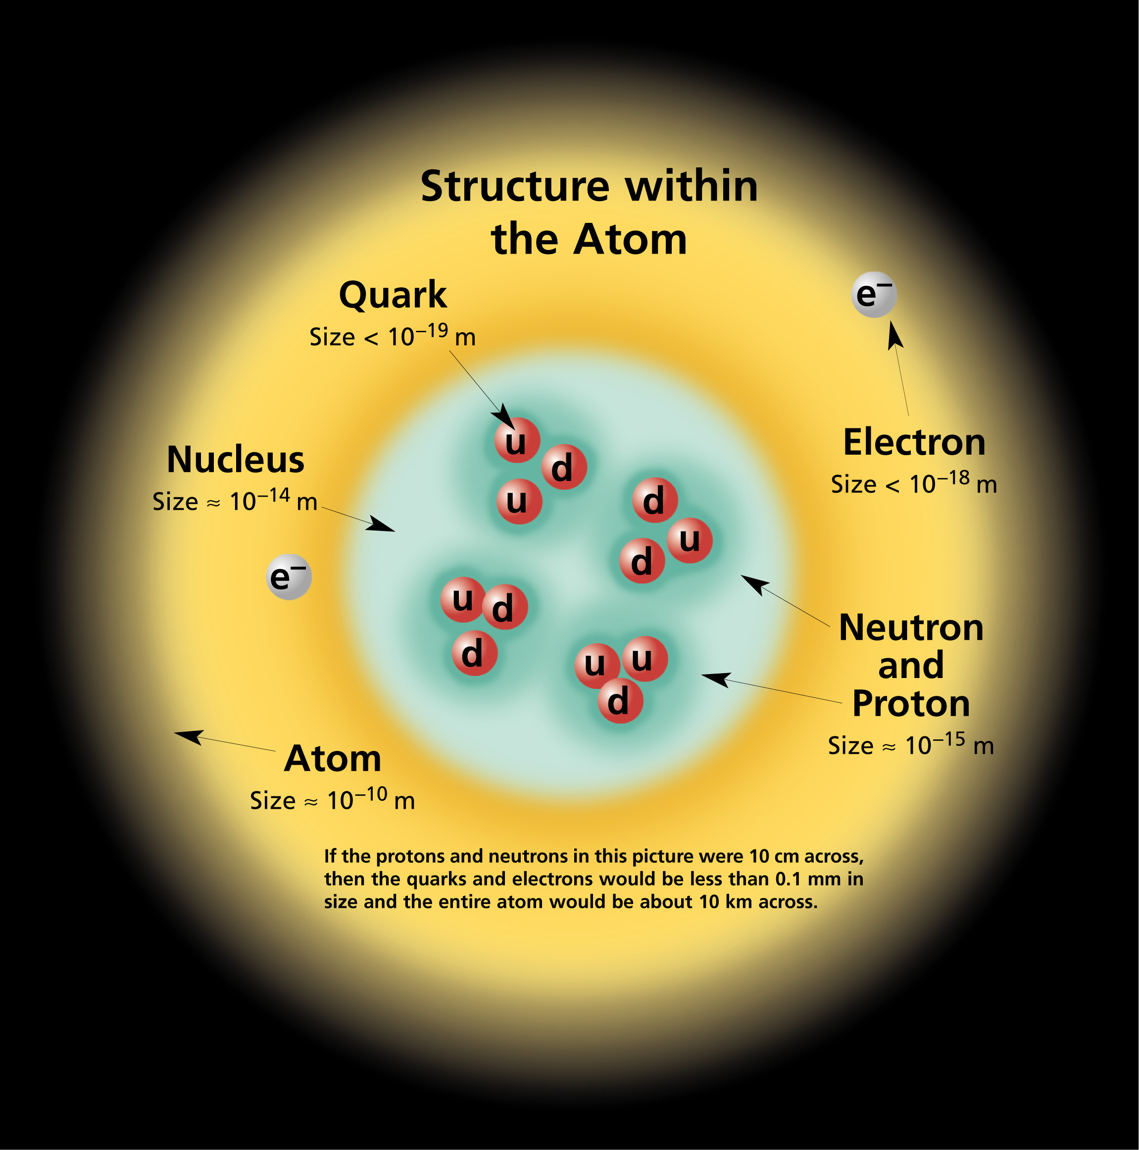
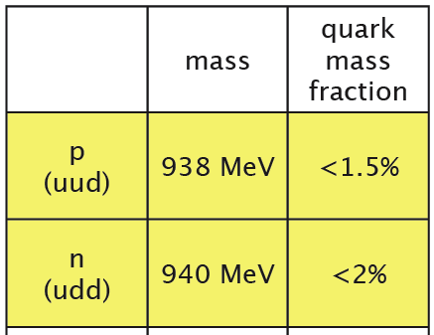
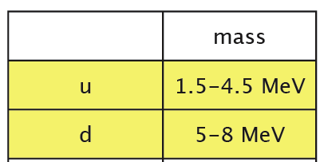
Observations in Nature
Such a big difference is not seen in molecules, atoms and nuclei.
Quarks are confined
inside hadrons
Valence quarks acquire dynamical masses via strong interaction- Constituent Quark
Mass ~ 300 MeV
Can we have deconfined matter ?
Review of particle physics (PDG), Phys. Lett. B 592 (2004)

Slide 6
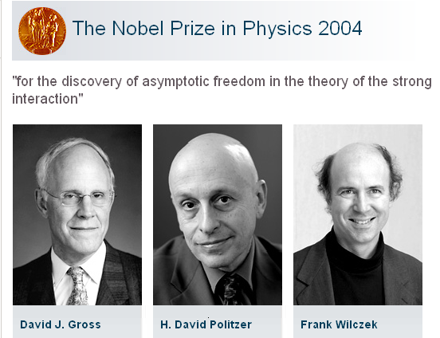
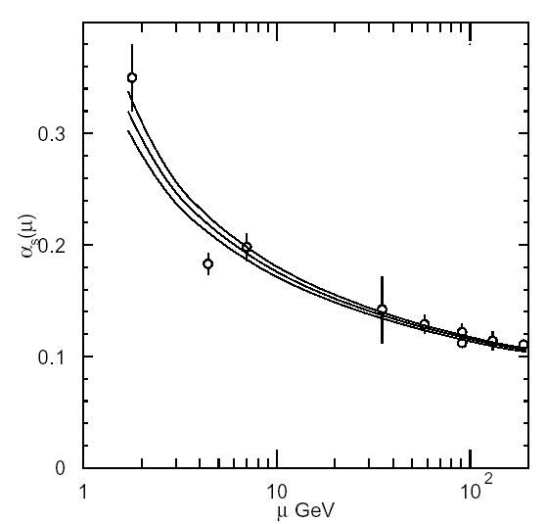
Theory of strong interaction : Quantum Chromodynamics (QCD)
Quark Confinement:
庄子天下篇 ~ 300 B.C.
一尺之棰，日取其半，万世不竭
Take half from a foot long stick each day,
You will never exhaust it in million years.
Asymptotic Freedom
q
q
QCD
Coupling Strength
q
q
q
q
Shorter distance →
Quark pairs can be produced from vacuum
No free quark can be observed
(GeV)
Momentum Transfer

Slide 7
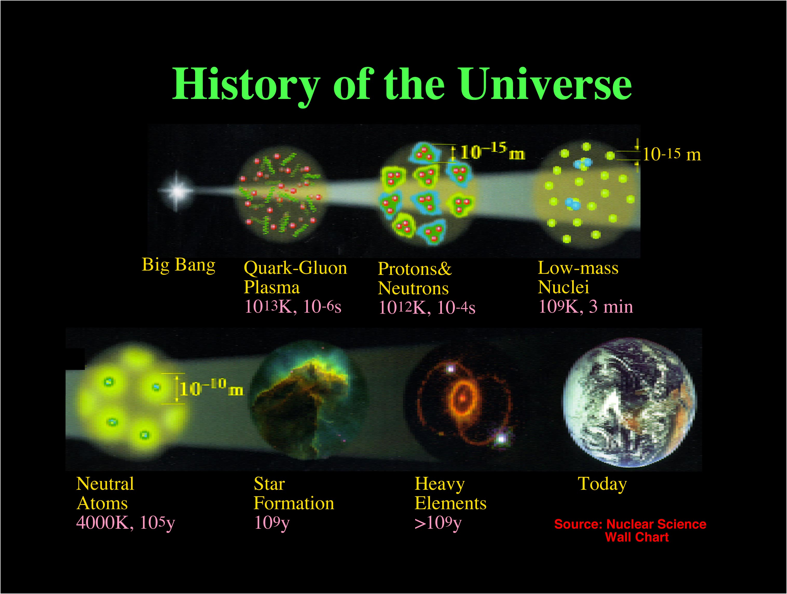

Slide 8
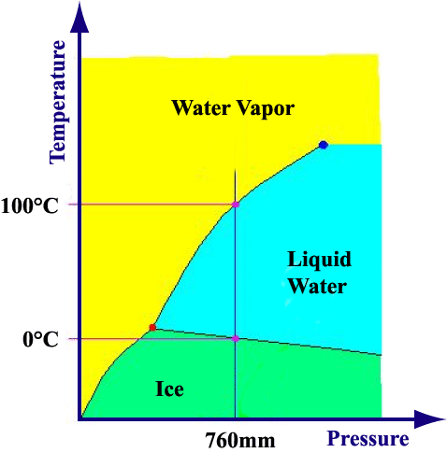
物质的四种形态
相图:
固态 T < 0度 冰
液态 0<T<100 水
气态 T> 100 气态
等离子体态：
等离子体就是被激发电离气体，达到一定的电离度(>10⁻⁴),气体处于导电状态，这种状态的电离气体就表现出集体行为，即电离气体中每一带电粒子的运动都会影响到其周围带电粒子，同时也受到其他带电粒子的约束。由于电离气体整体行为表现出电中性，也就是电离气体内正负电荷数相等，称这种气体状态为等离子体态。由于它的独特行为与固态、液态、气态都截然不同，所以称为物质第四态。
等离子体是由大量自由电子和离子及少量未电离的气体分子和原子组成，且在整体上表现为近似于电中性的电离气体。
显示对于确定自由度的系
统，在给定的外部条件下，
物质如何自组织的规律。
H₂O

Slide 9
等离子体
固态、液态、气态，物质第四态 等离子体态
原子当被加热到足够高的温度或其他原因，外层电子摆脱原子核的束缚成为自由电子，电子离开原子核，这个过程就叫做“电离”。
物质就变成了由带正电的原子核和带负电的电子组成的。电子和离子带的电荷相反,但数量相等。
等离子体：正离子和电子的密度大致相等的电离气体
高温等离子体：高度电离，通过加热高度电离的等离子体,离子温度和电子温度都很高
低温等离子体：轻度电离，外加电压达到击穿电压时，
气体分子被电离，离子温度一般远低于电子温度，如荧光灯、霓虹灯
Notes:
将气体加热,当其原子达到几千甚至上万摄氏度时,电子就会被原子“甩”掉,原子变成只带正电荷的离子.此时,电子和离子带的电荷相反,但数量相等,这种状态称做等离子态.
大家常见的霓虹灯,在它点亮以后,灯管里的气体就被电离了,成为电子与离子的混合物——等离子体.极光,是我们看见的大自然里的等离子体.
轻度电离的等离子体,离子温度一般远低于电子温度,称之为“低温等离子体”(如：射流低温等离子放电到等离子体中心温度达数千度,是“热”等离子体.).高度电离的等离子体,离子温度和电子温度都很高,称为“高温等离子体”（等离子体工艺中操作温度约为5000-20000 K）
冰升温至0℃会变成水，如果继续使温度上升至100%，那么水就会沸腾成为水蒸气。我们知道，随着温度的上升，物质的存在状态一般会呈现出固态→液态→气态三种物态的转化过程，我们把这三种基本形态称为物质的三态。那么对于气态物质，温度升至几千度时，将会有什么新变化呢? 由于物质分子热运动加剧，相互间的碰撞就会使气体分子产生电离，这样物质就变成由自由运动并相互作用的正离子和电子组成的混合物(蜡烛的火焰就处于这种状态)。我们把物质的这种存在状态称为物质的第四态，即等离子体(plasma)。因为电离过程中正离子和电子总是成对出现，所以等离子体中正离子和电子的总数大致相等，总体来看为准电中性。反过来，我们可以把等离子体定义为：正离子和电子的密度大致相等的电离气体。
在人工生成等离子体的方法中，气体放电法比加热的办法更加简便高效，诸如荧光灯、霓虹灯、电弧焊等等。.
当外加电压达到击穿电压时，气体分子被电离，产生包括电子、离子、原子和原子团在内的混合体。

Slide 10
夸克胶子等离子体
由夸克和胶子组成的等离子体。
夸克、胶子： 组成物质的最基础单元
Temperature, MeV ~ 1.16 x 10¹⁰ K
10⁻⁶ second after the Big Bang T~10¹³ K

Slide 11
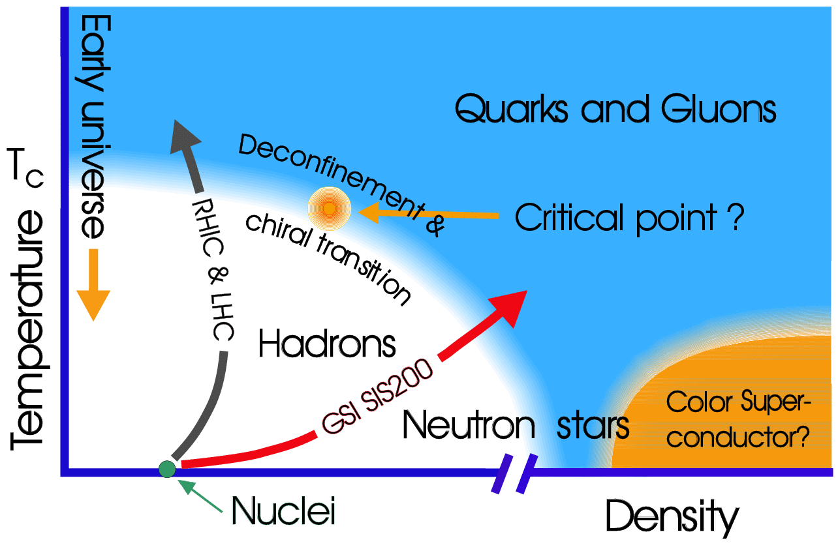
Quark-Hadron Phase Transition

Slide 12
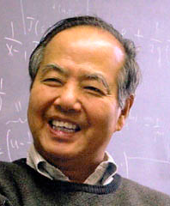
How to Address the Problem?
The confinement:
Quarks are the basic building blocks of matter.
No free quarks are seen, confined within hadron:
Δv₀ ~ 1 fm³, ρ₀ ~ 0.16 fm⁻³, ε₀ ~ 0.15 GeV/fm³
重要的科学问题：
夸克能否解除禁闭，产生新物质形态—夸克胶子等离子体（QGP）？
QCD 相结构 ？相变临界点是否存在 ？
Heavy ion collisions: Large, hot/dense system
Δv ~ 1000 fm³ = 1000 v₀
ρ >> 3 fm⁻³ ~ 20 ρ₀ ⇒ Quark Gluon Plasma (QGP)
ε >> 3 GeV/fm³ ~ 20 ε₀
QGP: Quarks and gluons are ‘freely’ moving in a large volume
New form of matter with partonic degrees of freedom
QCD Phase Structure
- Connection with other fields
cosmology, origin of the universe, evolution of the universe
quantum statistics with partons
T.D. Lee

Slide 13
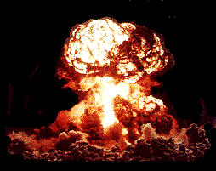
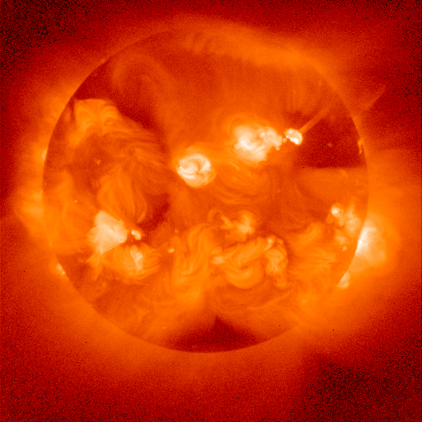
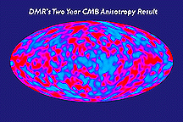
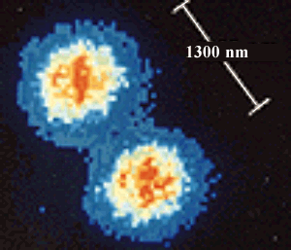
Perspective on Temperature
~10¹² K
Nucleus-Nucleus collisions
~ 120 MeV
~10⁹ K
Neutron Star Thermonuclear Explosion
~10⁶ K
Solar Interior
~6000 K
Solar Surface
Room Temperature ~ 1/40 eV
~300 K
Cosmic Microwave Background
~3 K
~10⁻⁶ K
~10⁻¹⁰ K
Rhodium metal spin cooling (2000)
(Low-T World Record!)
Trapped Ions

Slide 14
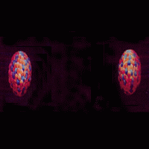
The Melting of Quarks and Gluons
-- Quark-Gluon Plasma --
Matter Compression: Vacuum Heating:
Deconfinement
High Baryon Density
-- low energy heavy ion collisions
-- neutron star→quark star
High Temperature Vacuum
-- high energy heavy ion collisions
-- the Big Bang

Slide 15
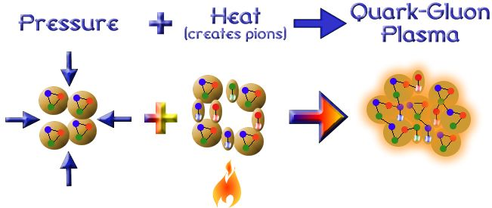
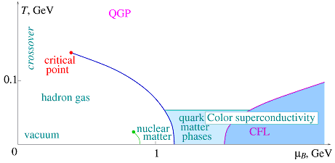
Experimentally Explore the QCD Phase Diagram
Heating
Method:
Colliding two nuclei to create QCD transitions between hadronic and partonic matter.
-- De-confinement
-- Chiral Symmetry Restoration ?
Compressing
Aims:
1. Study the QGP Phase and Hadronic Phase.
2. Establish the Phase Boundary.
3. Find the QCD Critical Point.

Slide 16
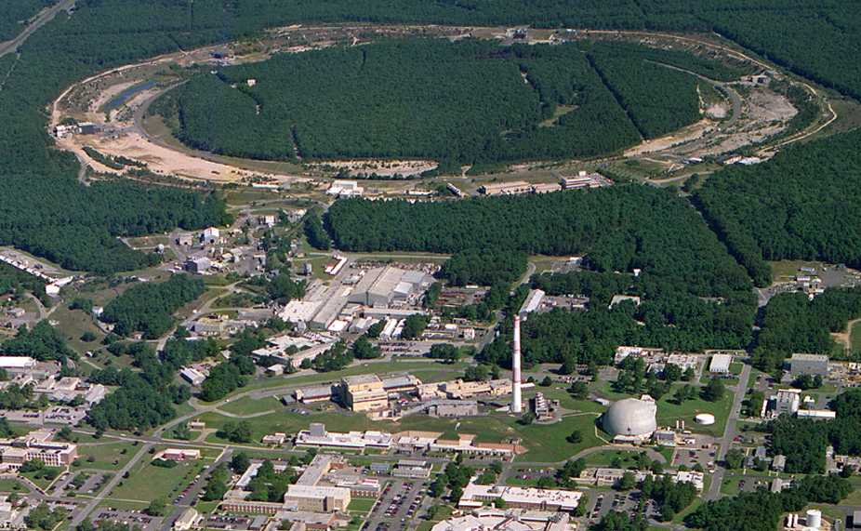
Relativistic Heavy Ion Collider
Brookhaven National Laboratory (BNL), Upton, NY
PHOBOS
BRAHMS
RHIC
PHENIX
STAR
v = 0.99995⋅c = 186,000 miles/sec
Au + Au at 200 GeV
RHIC: The high-energy heavy-ion collider
(i) Dedicated QCD collider
(ii) √s_{NN} = 200 - 5 GeV
(iii) U, Pb, Au, Cu, d, p
RHIC: The highest energy
polarized proton collider!
√s = 200, 500 GeV
AGS
Au+Au Head-on Collisions → 40x10¹² eV ~ 6 micro-Joule
Human Ear Sensitivity ~ 10⁻¹¹ erg = 10⁻¹⁸ Joule
A very loud Bang, indeed, if E→ Sound……
TANDEMS
Animation M. Lisa

Slide 17





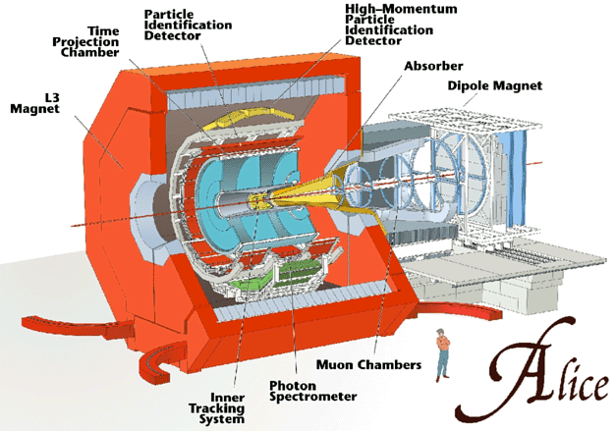
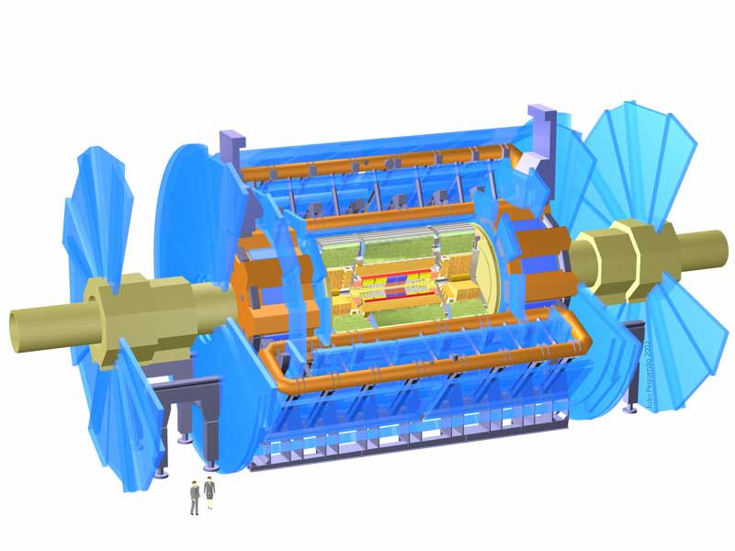
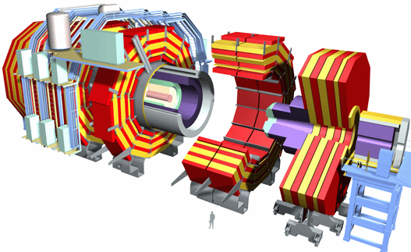
One dedicated HI experiment: ALICE
Two pp experiments with HI program:
ATLAS and CMS

Slide 18
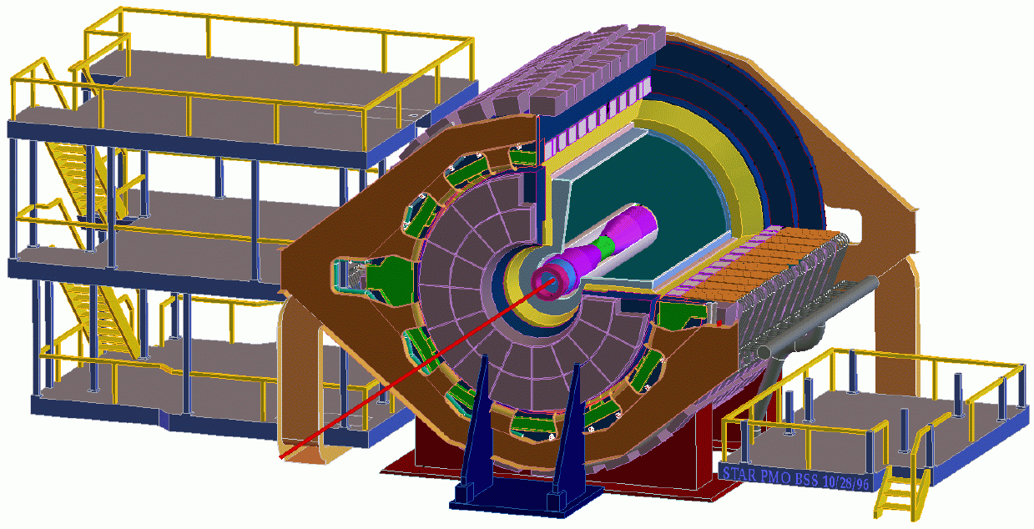
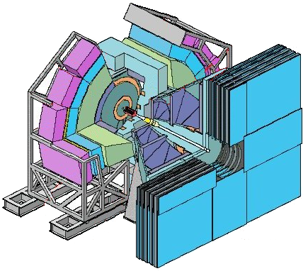
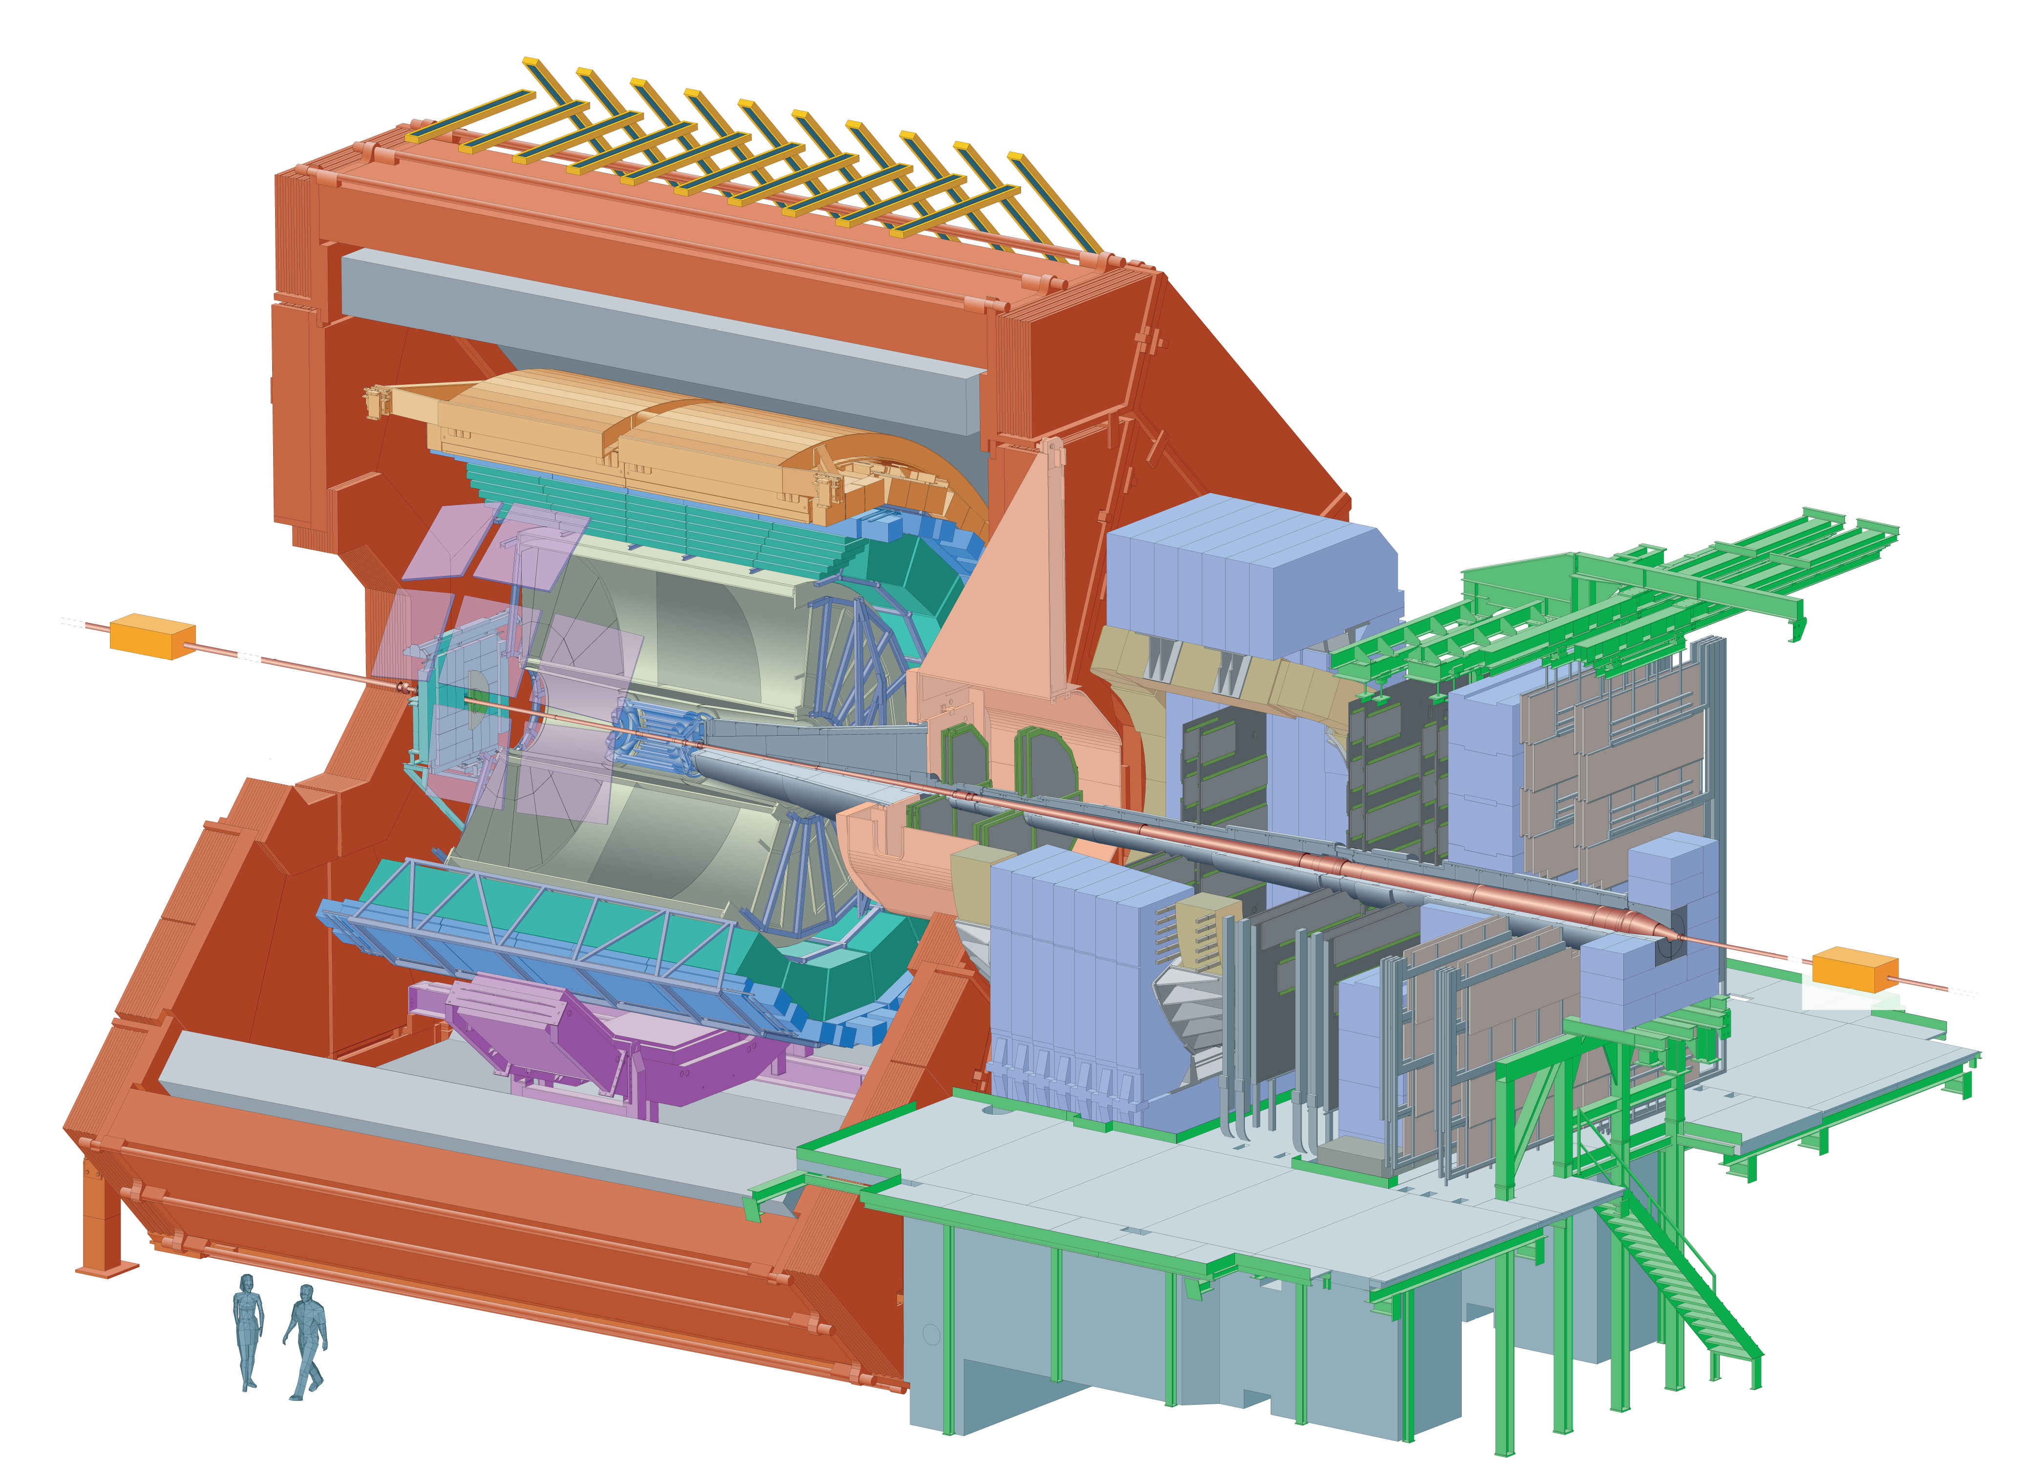
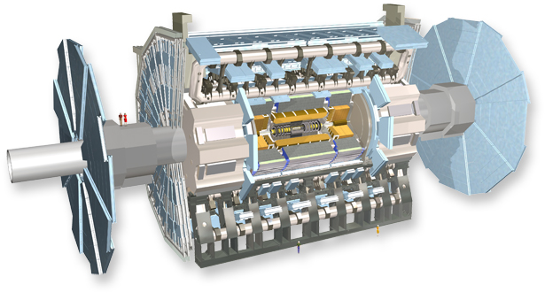
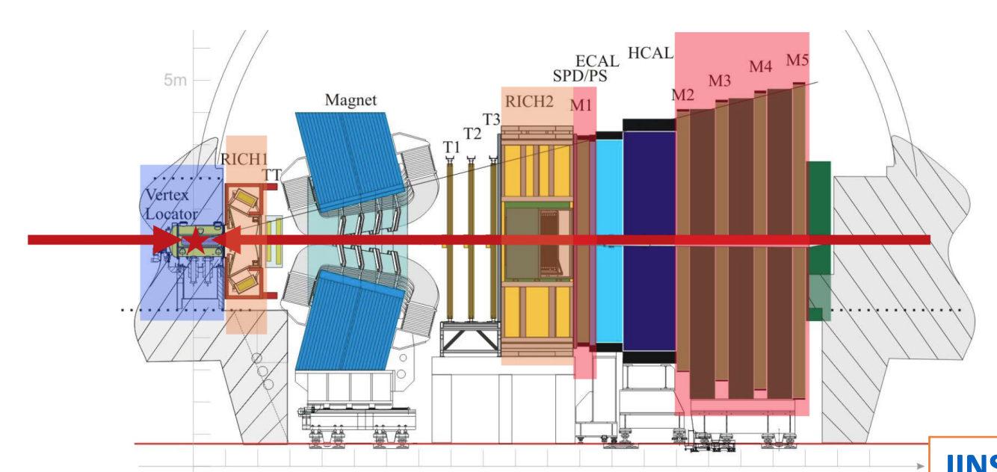
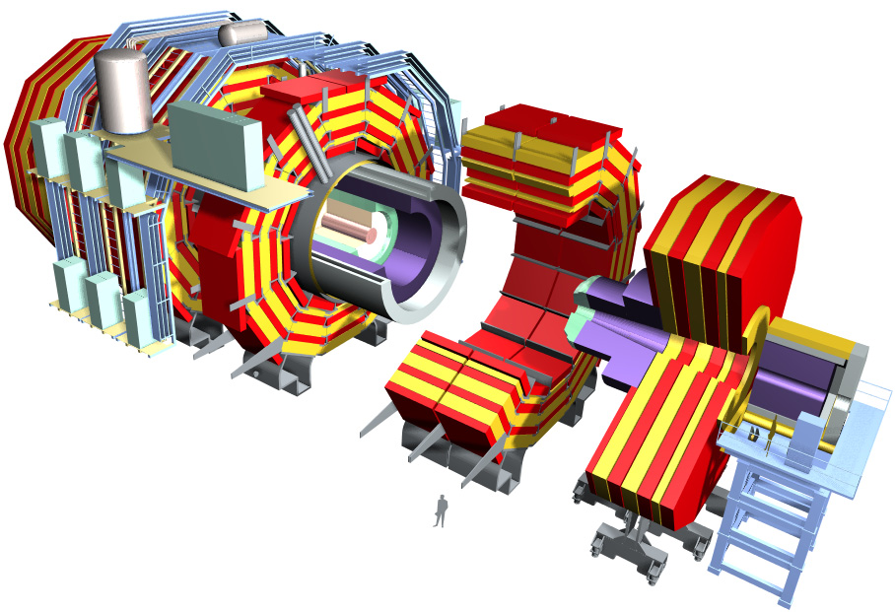
High-Energy Nuclear Collider Experiments
PHENIX (Pioneering High Energy
Nuclear Ion Experiment)
STAR (Solenoidal Tracker At RHIC)
ALICE (A Large Ion Collider Experiment)
ATLAS (A Toroidal LHC Apparatus)
LHCb
CMS (Compact Muon Solenoid)

Slide 19
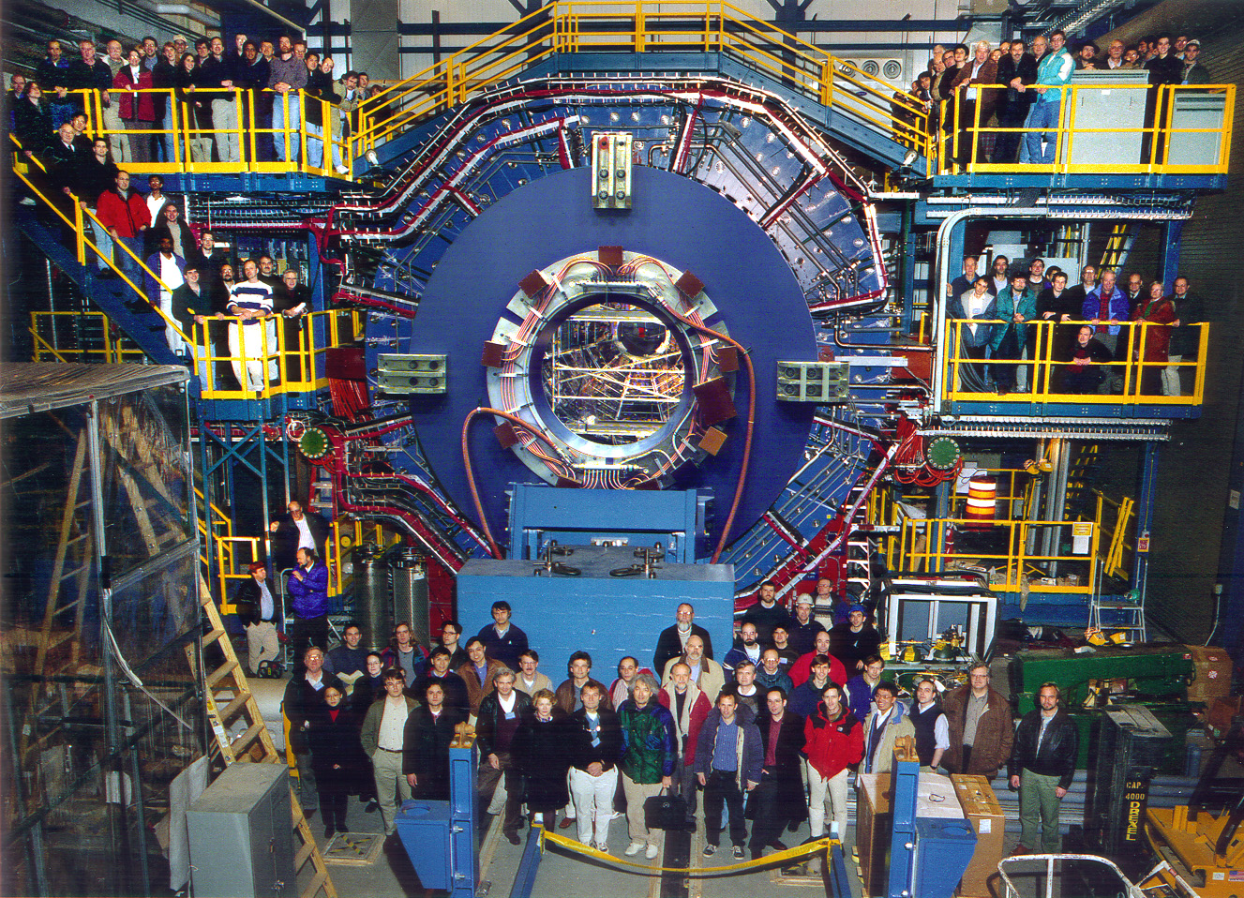
STAR Collaboration

Slide 20
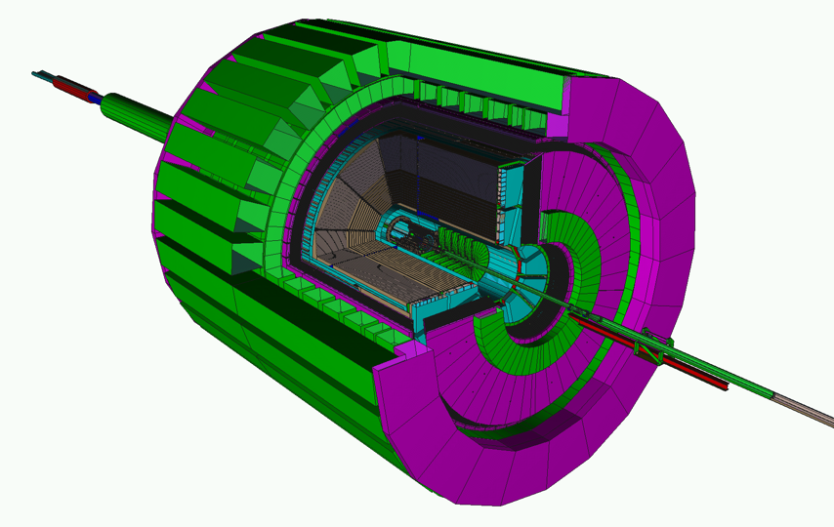
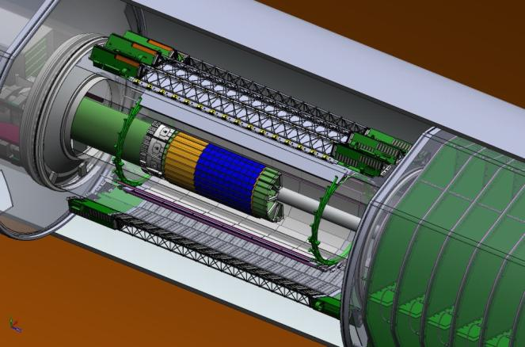
STAR Detectors Fast and Full azimuthal particle identification
MRPC Time Of Flight
EMC+EEMC+FMS
(-1 ≤ η ≤ 4)
MTD 2013
Time Projection Chamber (TPC)
DAQ1000
Heavy Flavor Tracker (HFT) 2013
FGT 2011

Slide 21
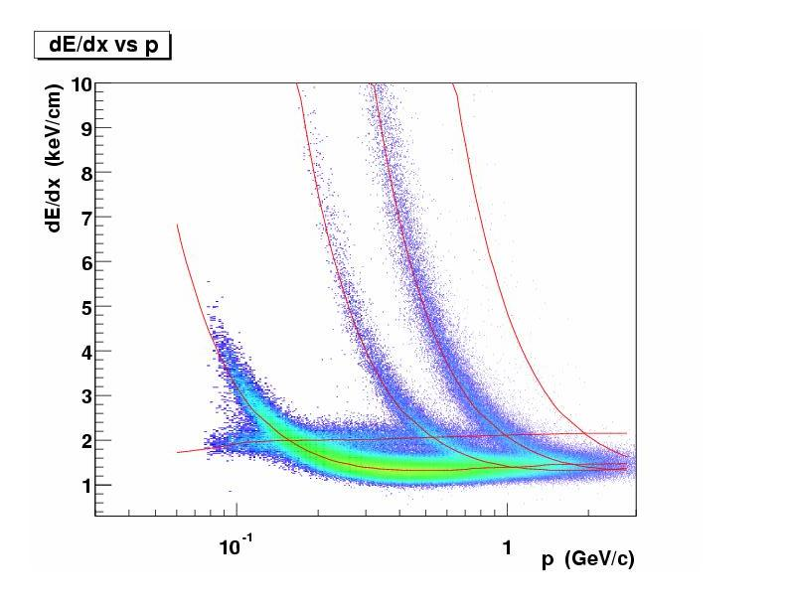
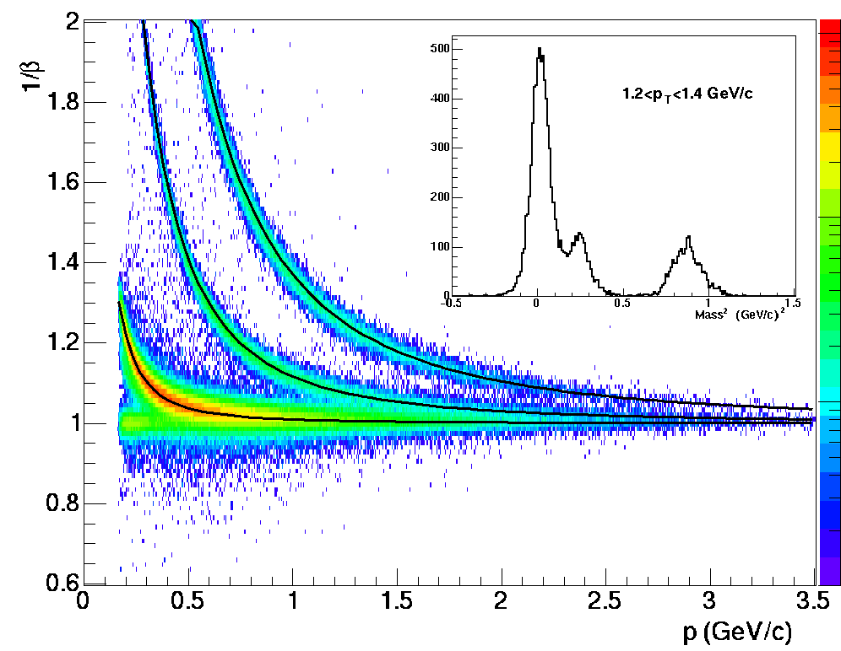
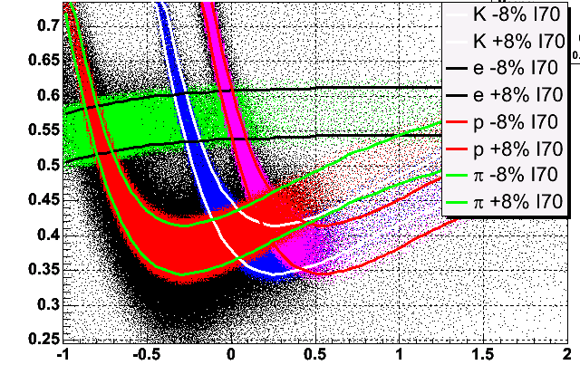
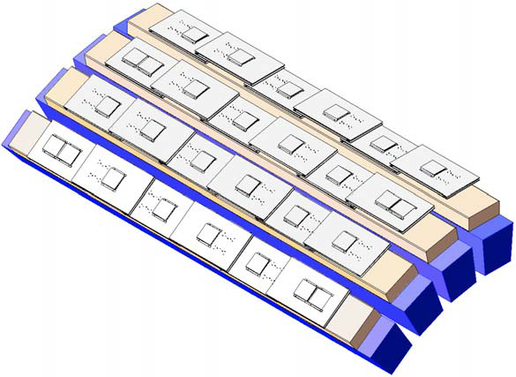
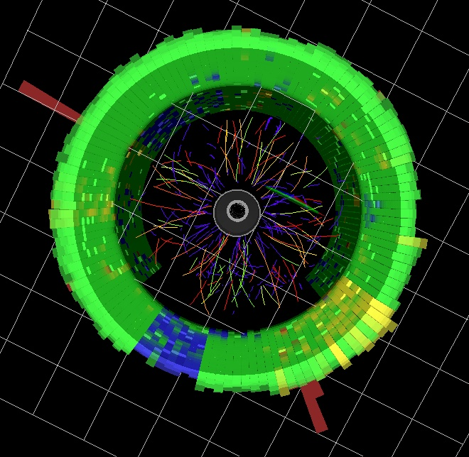
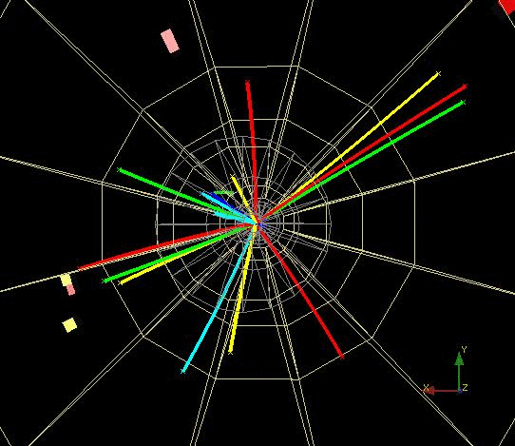
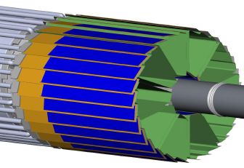
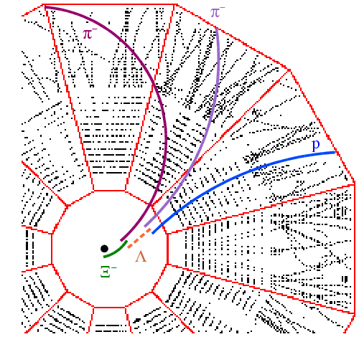
Particle Identification at STAR
TPC ToF TPC
STAR TPC
K p d
π
e, μ
STAR ToF
Log₁₀(p)
STAR MTD
STAR HFT
STAR EMC
Neutral particles Strange Jets Heavy Quark
hyperons Hadrons

Slide 22
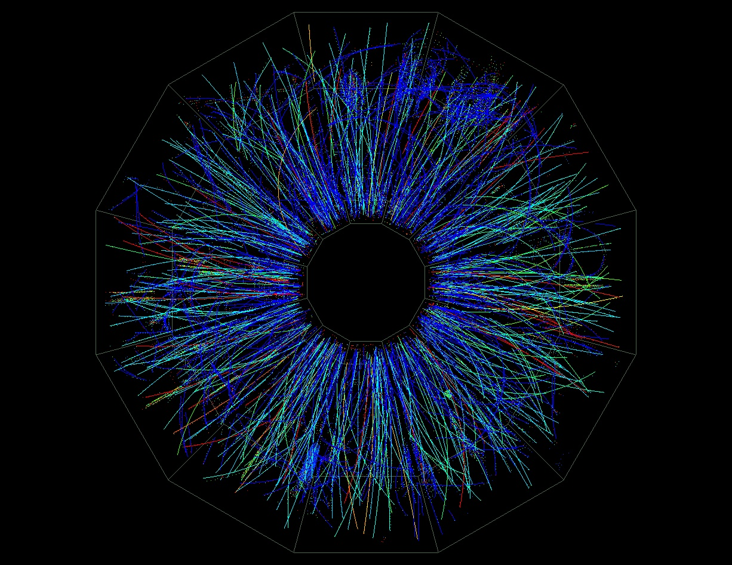
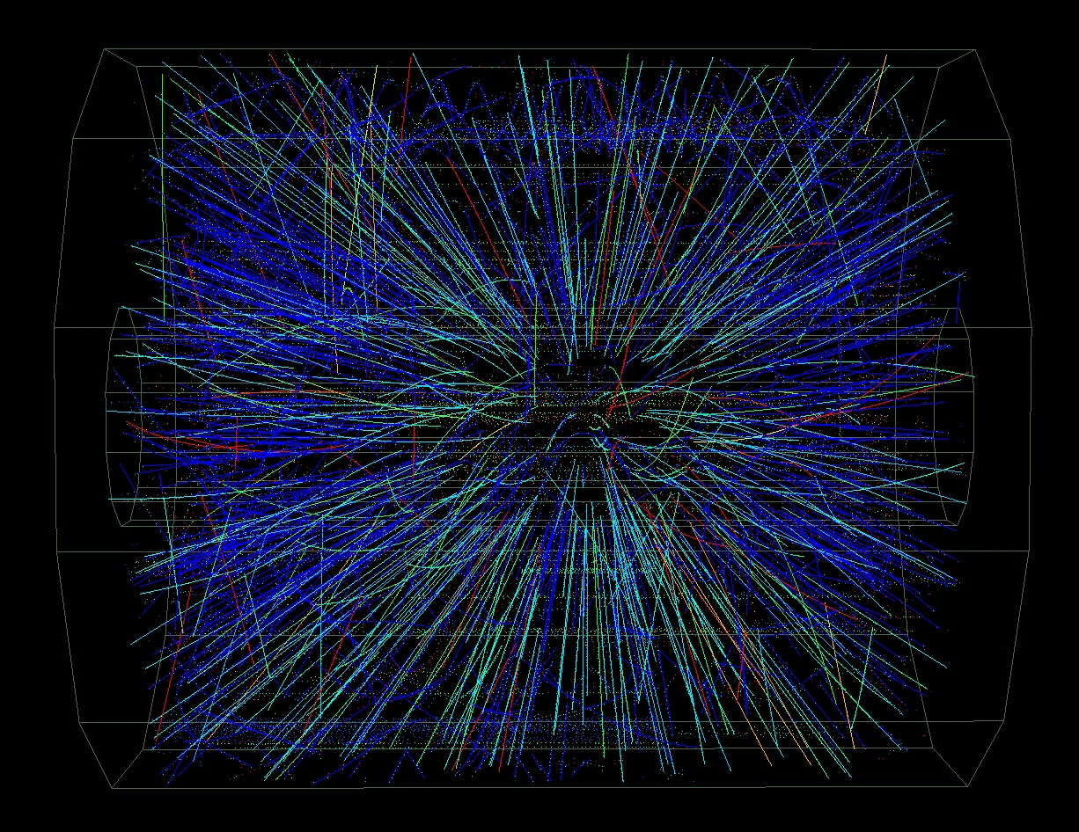
Au + Au Collisions at 130 GeV
Peripheral Event
STAR
(real-time Level 3)

Slide 23
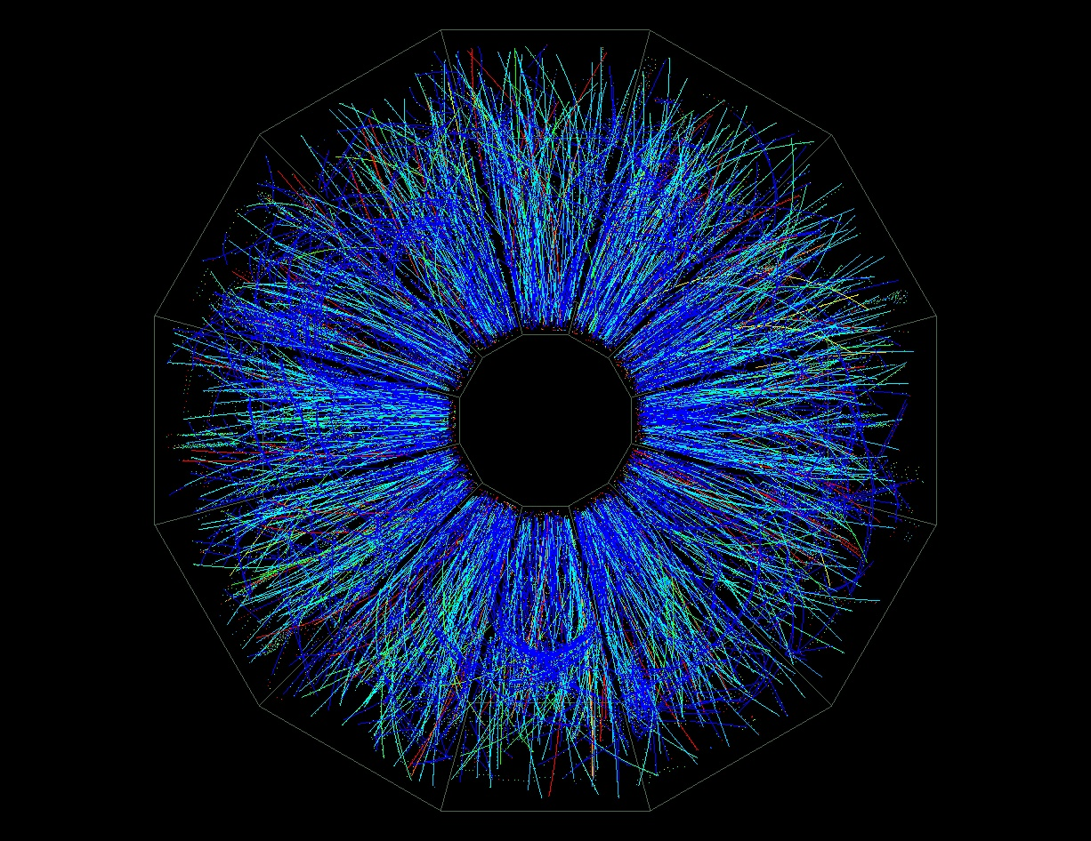
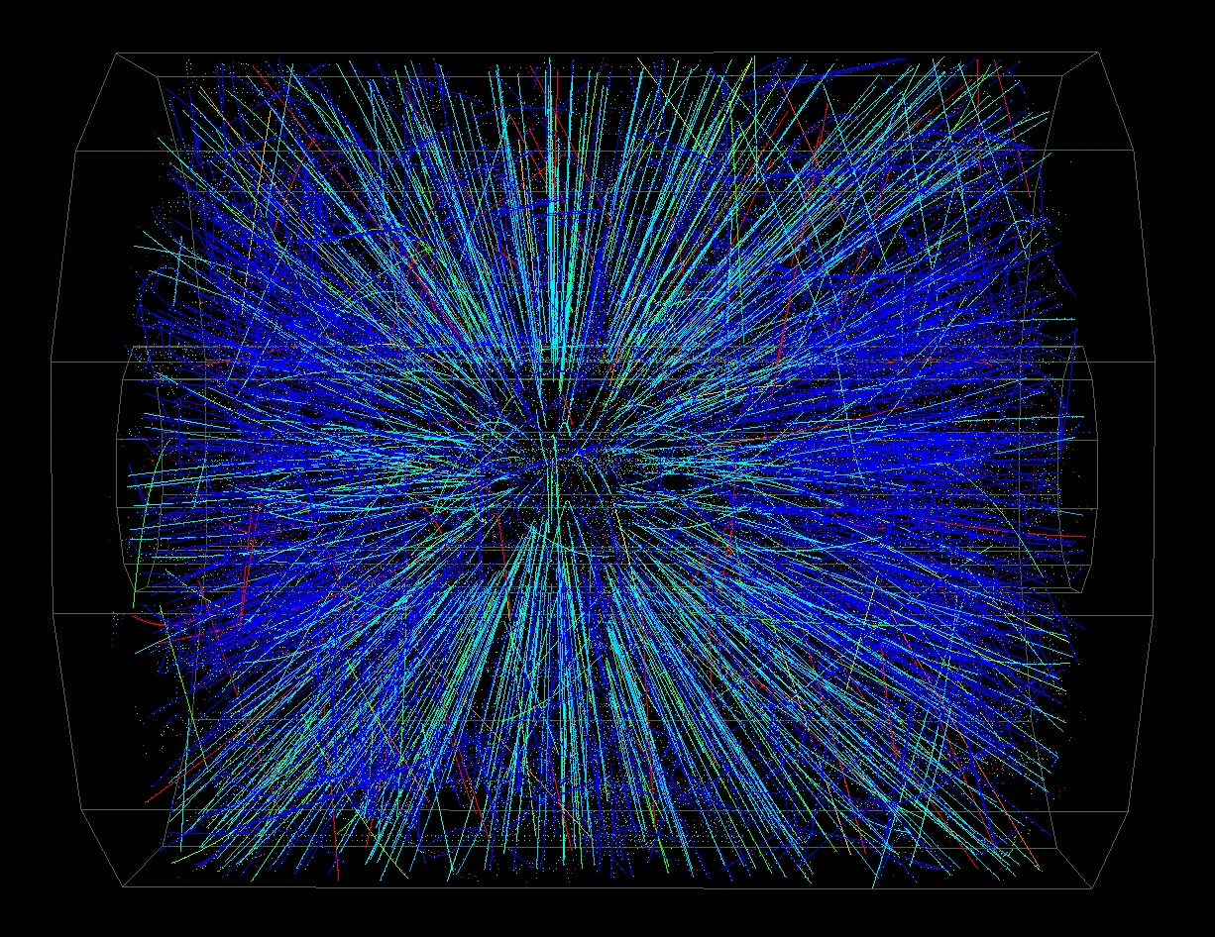
Au + Au Collisions at 130 GeV
Mid-Central Event
STAR
(real-time Level 3)

Slide 24
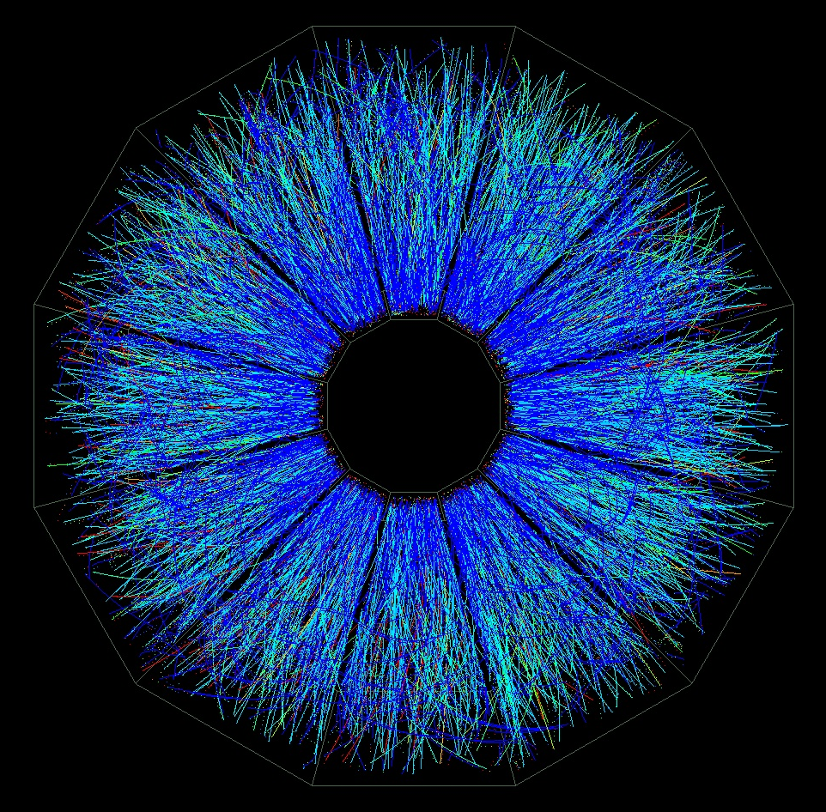
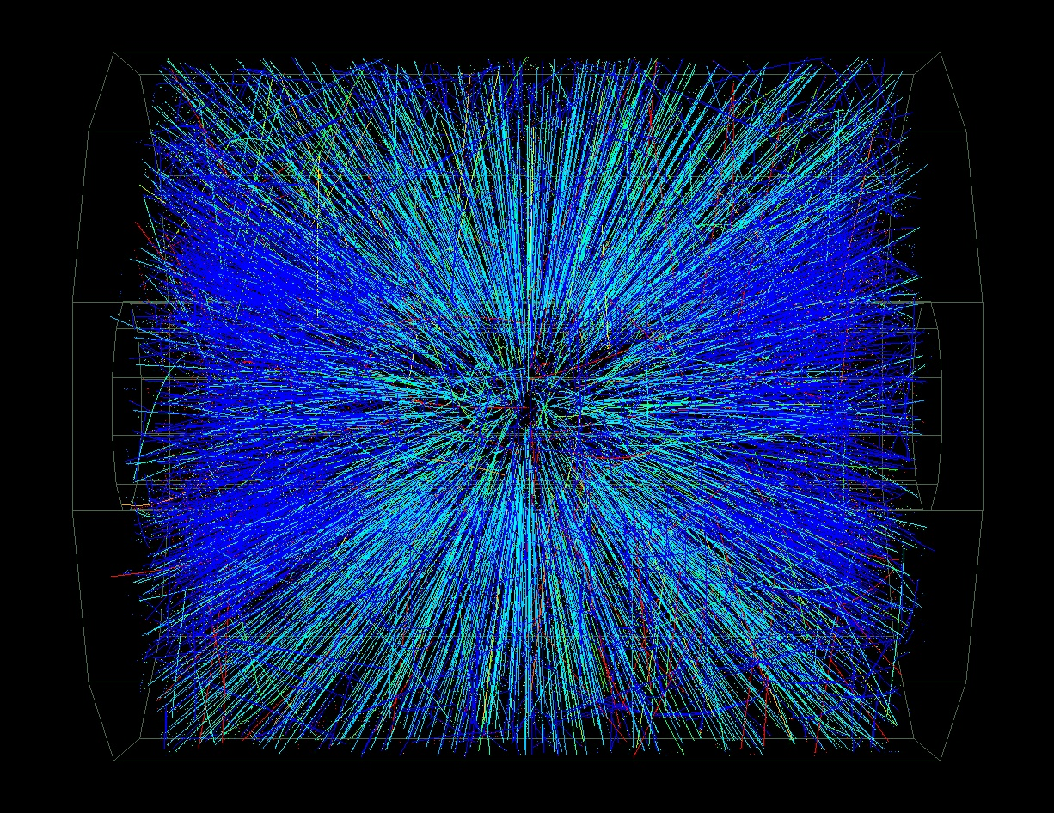
Au + Au Collisions at RHIC
Central Event
STAR
(real-time Level 3)

Slide 25
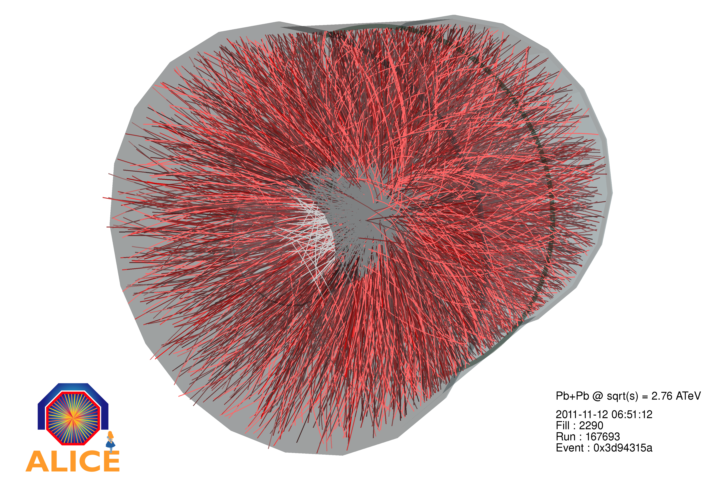

Pb-Pb Event Display

Slide 26
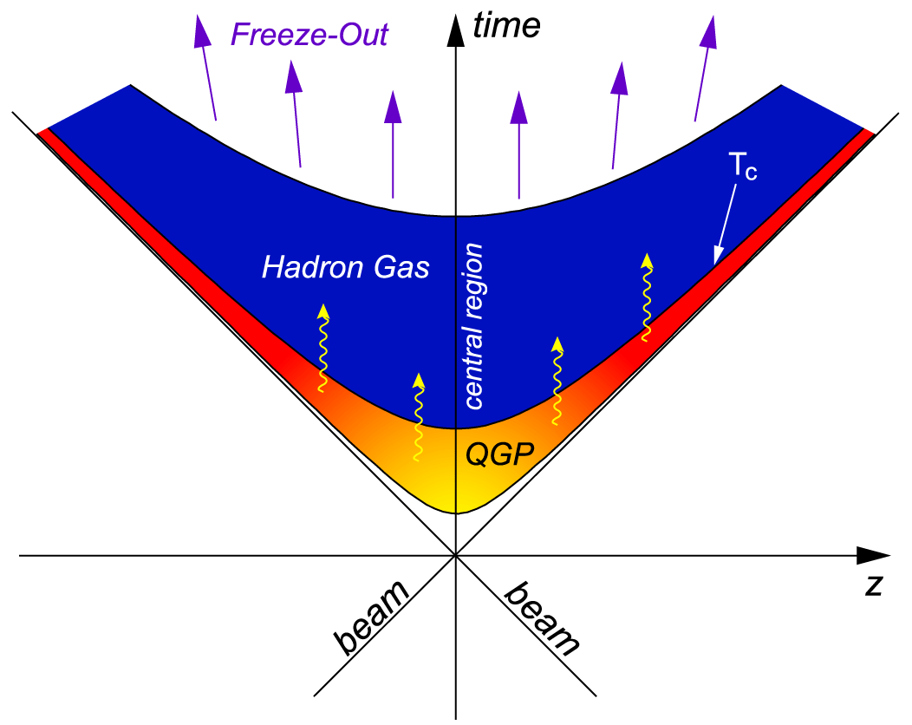
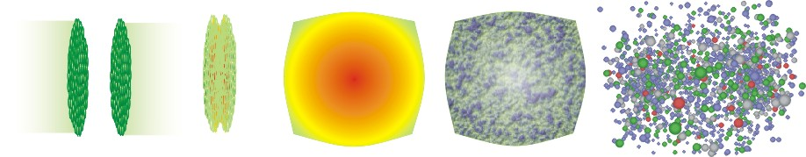
Evolution of High Energy Heavy Ion Collisions
Freeze out Stage: ~10-15fm/c
Chemical freeze out: Inelastic scatt. cease.
Kinetic freeze out: Elastic scatt. cease.
QGP thermal and Expansion Stage: 1-10fm/c
Collective expansion, Parton energy loss et al.,
Hadronization: Recombination and coalescence.
Pre-equilibrium parton hard scattering.
Experimental probes:
1) Penetrating probes: “jets” Energy loss
2) Bulk probes :Elliptic flow, radial flow
3) Fluctuation:
arxiv:0809.2482, hep-ph/0407360
QGP and
hydrodynamic expansion
hadronic phase
and freeze-out
initial state
pre-equilibrium
hadronization
Notes:
下面我们展示一下重离子对撞的各个演化阶段。
首先，高速运动的重离子由于相对论收缩，成为一个圆盘。
然后，碰撞初期动量传递很大，主要物理过程是硬散射，比如夸克的对产生， Jet的产生与碎裂。
能量的沉积，导致系统迅速热化，解禁闭的夸克胶子形成QGP。并逐渐向外膨胀冷却。当系统冷却到一定温度，
系统进入强子阶段，夸克合并成强子。
4. 接下来，强子会发生化学冻结，这时候非弹性散射停止，强子的产额不再改变。然后是热冻结，也就是弹性散射停止，粒子的动量谱不再改变。

Slide 27
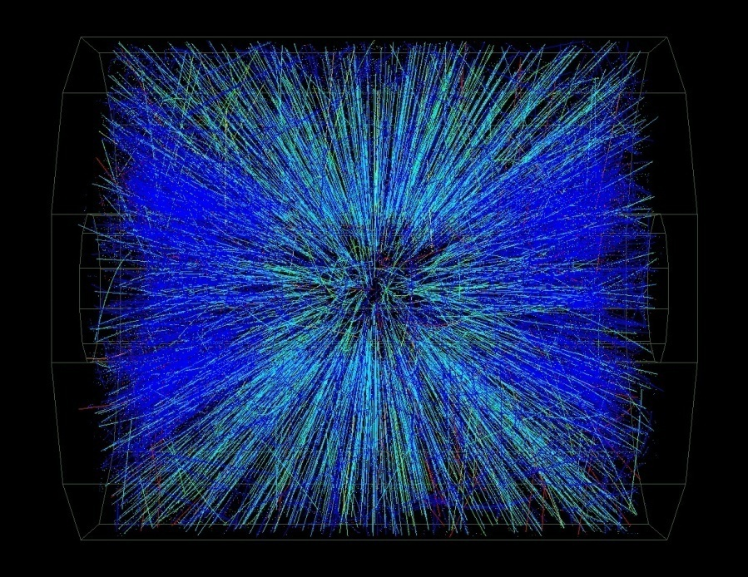
Frequently used Kinematics Variable and Expression
Relativistic Energy : E = ( p² + m₀² )^{1/2}
Transverse mass:
Rapidity:
Pseudo-rapidity：
P_{T} = P sinθ
Questions:
1. What’s the mathematical relation between y and η ?
2. Derive the invariant p_{T} spectra expression.
Proof the identity：
p_{T}
p
p_{z}
z

Slide 28
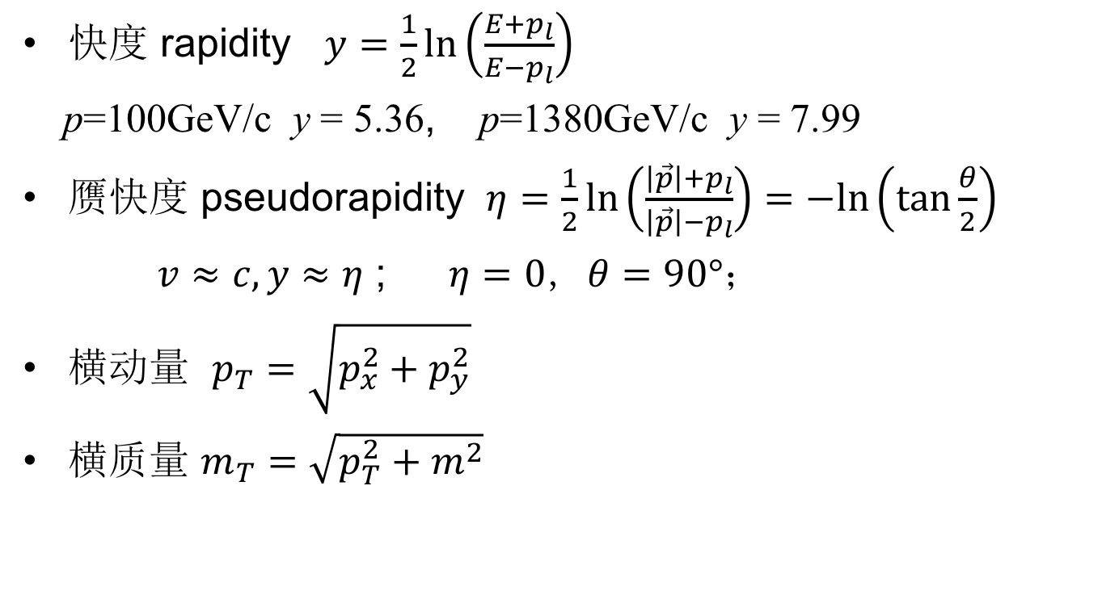

Slide 29

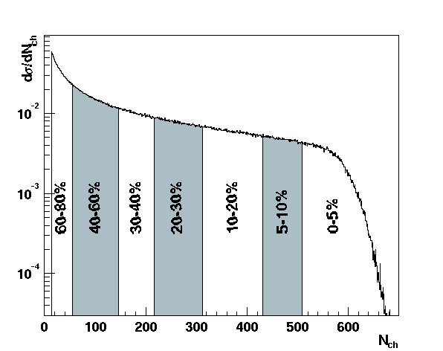
Collision Geometry
z
Au + Au √s_{NN} = 200 GeV
x
beam
Non-central Collisions
Number of participants: number of incoming nucleons in the overlap region
Number of binary collisions: number of inelastic nucleon-nucleon collisions
Charged particle multiplicity ⇔ collision centrality
Reaction plane: x-z plane

Slide 30
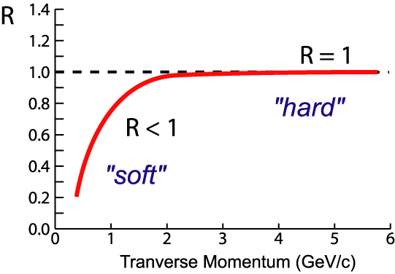
Energy Loss in A+A Collisions
leading particle suppressed
back-to-back jets disappear
p+p Au + Au
Nuclear Modification Factor:

Slide 31


Hadron Suppression at RHIC
Binary Collision scaling
Factor 5 suppression: large effect
pQCD+energy loss: initial density ~30 times cold nuclear matter

Slide 32


Nuclear Modification Factor
PHENIX: PRC69, 034910(04)
STAR: PRL91, 172302(03)
At LHC(2.76TeV), the energy loss is stronger than that from RHIC (0.2TeV)
➔ hotter/denser medium created at higher collision energy
2) pQCD predictions consistent at larger p_{T} region: > 10 GeV/c

Slide 33


Energy Loss and Equilibrium
Leading hadrons
Medium
In Au +Au collision at RHIC:
Suppression at the intermediate p_{T} region - energy loss
The energy loss leads to progressive equilibrium in Au+Au collisions
STAR: nucl-ex/0404010

Slide 34
d+Au Collisions
q
q
q
q
Au+Au Geometry
d+Au Geometry
d+Au collisions:
Little energy loss from the dense medium created, But
Parton saturation from Au nuclei persists!

Slide 35

Data from d+Au collisions
Initial scatterings:
Cronin effect
Parton re-scatterings:
Final stage effect
No high p_{T} suppression !

Slide 36

e⁺e⁻ annihilation to hadrons 2-Jet
the reconstruction of an event recorded at the e⁺e⁻ collider PETRA at the DESY laboratory. Charged and neutral mesons are produced and appear in the form of two oppositely directed 'jets' These are interpreted as due to a two-stage process involving the production and subsequent 'fragmentation' of a
quark-antiquark pair:

Slide 37


Jets Observation at RHIC
Δϕ
p+p collisions at RHIC
Jet like events observed
Au+Au collisions at RHIC
Jets?

Slide 38


Jets
p+p → dijet
trigger: highest p_{T} track, p_{T}>4 GeV/c
Δφ distribution: 2 GeV/c<p_{T}<p_{T}^{trigger}
normalize to number of triggers
Phys Rev Lett 90, 082302
trigger

Slide 39


Dihadrons in Au+Au vs p+p
Au+Au peripheral
(large impact parameter)
Au+Au central (head-on)
Phys Rev Lett 90, 082302
Strong suppression of back-to-back correlations in central Au+Au

Slide 40

Suppression and Correlation
In central Au+Au collisions: hadrons are suppressed and back-to-back ‘jets’
are disappeared. Different from p+p and d+Au collisions.
Energy density at RHIC: ε > 5 GeV/fm³ ~ 30ε₀
Parton energy loss: Bjorken 1982
(“Jet quenching”) Gyulassy & Wang 1992
…

Slide 41

Di-hadron Measurements at Higher p_{T}
STAR preliminary
8 < p_{T}(trig) < 15 GeV/c
Recoil jet peak emerges above background but at suppressed rate:
⇒ differential measurement of partonic energy loss

Slide 42

Energy Loss in A+A Collisions
Initial scatterings:
Cronin effect
Parton re-scatterings:
Final stage effect
No high p_{T} suppression from d+Au!
Energy Loss at LHC

Slide 43
Summary : Energy Loss
Large suppression observed for p_{T} ≥ 5 GeV/c indicating hot and dense medium produced in central Au+Au collisions
The estimated energy density in central collisions is about 30 times larger than ε₀
Very dense matter has been created in central Au+Au collisions!
This dense matter is responsible for the disappearance of back-to-back correlation and the suppression of high pT particles !

Slide 44

Transverse Flow Observables
As a function of particle mass:
Radial flow – integrated over whole evolution
Elliptic flow (v₂) – early
Directed flow (v₁) – early
Note on collectivity:
Effect of collectivity is accumulative – final effect is the
sum of all processes.
2) Thermalization is not needed to develop collectivity - pressure
gradient depends on density gradient and interactions.

Slide 45


Hadron Spectra From RHIC
mid-rapidity, p+p and Au+Au collisions at 200 GeV
5%
10-20%
20-40%
40-60%
60-80%
STAR:NPA757,102(05) ,
(F. Wang) NPA715, 466c (03) ,
JPG30, S693(04) .
PHENIX: PRC 69 , 034909(04) .
(Huang, Long) PRL 89, 092301(02);
F. Wang) PLB 595, 143(04).
(Nu) PRC 70,041901(04),
Hadron spectra reflect the properties of the bulk of the matter at kinetic freezeout
Notes:
重离子碰撞产生强子的多重数、产额、动量谱和关联， 特别是由横动量小于1.5 GeV/c 粒子组成的软区反应了碰撞产生系统的整体性质。特别是我们希望通过测量软强子能够推断出碰撞的初始条件、它的热化程度及其状态方程。
测得的强子谱反映了强子之间的弹性碰撞停止后，物质在动力学冻结状态下的整体性质。在这一阶段，系统已经相对稀释并“冷”。但是从动力学冻结时强子谱的详细性质，可以得到碰撞早期更热和更密阶段的信息。早期阶段的更直接的信息可以从不同强子组分的积分产额中推导出来，这些粒子组分的变化只有通过非弹性碰撞得到。这些非弹碰撞在动力学冻结以前已经在化学冻结时停止。

Slide 46

Yields Ratio Results
1) Chemical fits well for all
hadron ratios at RHIC:
T_{ch} = 160 ± 10 MeV
μ_{B} = 25 ± 5 MeV
γ_{S} = 1 ± 0.05
Necessary for QGP!
2) The temperature parameter
T_{ch} is close to the critical
temperature T_{C} predicted by
LGT calculations ⬇
chemical equilibrium at the
phase boundary (?)
Review: P. Braun-Munzinger et al. nucl-th/0304013
In central collisions, thermal model fit well with γ_{S} = 1.
→ The system is thermalized at RHIC.
Short-lived resonances show deviations.
→ There is life after chemical freeze-out.
RHIC white papers - 2005, Nucl. Phys. A757, STAR: p102; PHENIX: p184.

Slide 47

Hadron abundances and predictions of the statistical hadronization model.
A. Andronic, P. Braun-Munzinger, K. Redlich, J. Stachel
Nature 561(2018) 321

Slide 48
pbar/p ratio at 130 GeV
STAR: (F. Wang, Nu ) PRL 86, 4778(01). [90,119903(03) ]
Baryon number transport is close related to the initial conditions .
At RHIC energy, the midrapidity region is not yet net-baryon free.
At midrapidity pbar/p ratio in heavy-ion collisions increases significantly with the collision energy
Notes:
QGP的产生依赖于重离子碰撞早期产生物质的初始条件。 重子数的输运（或阻止）（Baryon number transport (or stopping)）是高能核核碰撞中的一个重要观测量，因为degree of baryon stopping 影响碰撞中的整个动力学演化。它对初态部分子的平衡、粒子产生、热与化学平衡、集体膨胀的演化都有影响。重子数的输运可以通过测量反质子与质子之比得到。

Slide 49
Thermal Model Fits (Blast-Wave)
Source is assumed to be:
  Local thermal equilibrated
  Boosted radically
boosted
  E.Schnedermann, J.Sollfrank, and U.Heinz, Phys. Rev. C48, 2462(1993)
random
Extract thermal temperature T_{fo} and velocity parameter ⟨β_{T}⟩
Notes:
At first, I want to show a short explanation of a model to describe the pt distribution.
This model is established to describe particle mass dependence of pt distribution in low pT region.
The source is in local thermal equilibration and it s boosted.
Simply take boltzmann distibution and take enregy term as four momentum with flow effect.
Here we consider transverse direction and then the transverse momentum distribution is described this formula.
The parameters to characterized the system is temperature and flow velocity.

Slide 50

Thermal fits: T_{fo} vs. < β_{Τ} > at 200GeV
1) π, K, and p change
smoothly from peripheral
to central collisions.
2) At the most central
collisions, <β_{T}> reaches
0.6c.
3) Multi-strange particles φ,
Ω are found at higher T_{fo}
(T~T_{ch}) and lower <β_{T}>
Sensitive to early partonic stage!
How about v₂?
STAR:NPA757,102(05) , (F. Wang) NPA715, 466c (03) ;
P. Braun-Munzinger, J. Stachel, J. Wessels, N. Xu, Phys. Lett. B 344 (1995) 43;
P. Braun-Munzinger, I. Heppe, J. Stachel, Phys. Lett. B 465 (1999) 15.

Slide 51

Compare with Model Results
Model results fit to π, K, p spectra well, but over predicted <p_{T}> for multi-strange hadrons - Do they freeze-out earlier?
Phys. Rev. C69 034909 (04); Phys. Rev. Lett. 92, 112301(04); 92, 182301(04); P. Kolb et al., Phys. Rev. C67 044903(03)

Slide 52


Tests with Transport Model
Feng Liu, Zhixu Liu, Lu Yan et al.
The <pt> increases vs. centrality ⇒ collective expansion
Hadronic transport model RQMD calculations reproduced the collectivity for copiously produced hadrons π, K, p.
Re-scatterings are import for collectivity !

Slide 53

Tests with Transport Model
Hadronic transport model RQMD can not reproduced the anti-proton over proton ratios as a function of centrality.
RQMD underestimates pbar yield due to large annihilation X-section
⇒ re-scattering at earlier pre-hadronic stage?

Slide 54
Anisotropy parameter v₂
Sensitive to initial/final conditions and equation of state (EOS) !
coordinate-space-anisotropy ⇔ momentum-space-anisotropy
y
p_{y}
x
p_{x}
v₂ : a probe of the dynamics governing the system’s evolution
Flow : represents the collective motion of particles.

Slide 55

Space-momentum correlation
Jingbo Zhang, J. Yang, et al.-LBNL
RQMD(v2.4) Au+Au at 200 GeV
1) Spatial anisotropy leads to momentum
space anisotropy.
2) At early time, the anisotropy is the strongest
3) Space part can be tested via two-particle
correlation function measurements
4) Anisotropy in space is not totally ‘quenched’
at later time.

Slide 56

v₂ at Low p_{T} Region
P. Huovinen, private communications, 2004
Minimum bias data! At low p_{T}, model result fits mass hierarchy well!
- Details does not work, need more flow in the model!

Slide 57






Particle Identification
Rest are constructed: Invariant Mass + Decay Topology
Resonances in
invariant mass spectra
D⁰
^{ρ0} f₀ K⁰_{S}
_{ω}
K^{*0}
Au+Au
40% to 80%
0.2 < p_{T} < 0.9 GeV/c
Κ_{S}
Ξ
Φ
Ω
Electron ID via
p/E in EMC
Λ
M² = E² - p²

Slide 58

Elliptic Flow v₂
PRL 92 (2004) 052302; PRL 91 (2003) 182301
Hydro calculations break-down at higher p_{T} (as expected).
How is v₂ established at p_{T} above 2 GeV/c?
Why is baryon v₂ so large?

Slide 59


Constituent Quark Degree of Freedom
Hadronization Scheme for
Bulk Partonic Matter:
K_{S} – two quark coalescence
– three quark coalescence
from the partonic matter surface?!
Particle v₂ may be related to
quark matter anisotropy !!

Slide 60


Centrality Dependence of NQ Scaling
m_{T} -n_{q} scaling is observed at all centrality bins.

Slide 61
Partonic Collectivity at RHIC
STAR: preliminary
QM09: arXiv 0907.2265
Low p_{T} (≤ 2 GeV/c): hydrodynamic mass ordering
High p_{T} (> 2 GeV/c): number of quarks scaling
➔ Partonic Collectivity, necessary for QGP!
➔ De-confinement in Au+Au collisions at RHIC!

Slide 62

Almost zero.Even though
initial space anisotropy exists,momentum anisotropy can’t be converted into.
Reproduce the trend of experiment but have smaller value than experiment’s.
Re-scatterings only among hadrons are not enough.
1 Re-scatterings are necessary.
2 Re-scatterings at partonic level are essential.
Originates from at partonic stage?

Slide 63


System 、Energy and Centrality Dependence
STAR Au + Au 62.4 GeV : PRC75, 054906 (2007), PRC81, 044902 (2010),
ε_{part}{2}: J. Y. Ollitrault, A. M. Poskanzer and S. A. Voloshin, PRC80, 014904 (2009)
Minimum bias events
Au+Au and Cu+Cu at 200 GeV Scaled by eccentricity remove the initial geometry
  NQ scaling for each centrality bin
Collective flow: depends on the number of participants
  Larger v₂/ε_{part} indicates stronger collective flow in more central collisions.
Notes:
63
63
Glauber model has been used to calculate the eccentricities, but it is similar in the case of CGC model.
(i) There is a clear number of quark (NQ) scaling for all systems and beam energies
studied here. (Due to the limited statics, this test is not done for Cu+Cu collisions at
√𝑠𝑁𝑁 = 62.4 GeV.) It indicate the partonic collectivity has been built up at RHIC.
(ii) After removing the initial geometry by eccentricity, stronger collective flow can be observed in the larger system.

Slide 64
Energy Dependence
STAR, ALICE:
v₂{4} results
Centrality: 20-30%
An increasing
trend is observed for
p_{T} integrated v₂ from
AGS to LHC
STAR Preliminary
ALICE: Phys. Rev. Lett. 105, 252302 (2010); PHENIX: Phys. Rev.Lett. 98, 162301 (2007).
PHOBOS: Phys. Rev.Lett. 98, 242302 (2007). CERES: Nucl. Phys. A 698, 253c (2002).
E877: Nucl. Phys. A 638, 3c(1998). E895: Phys. Rev. Lett. 83, 1295 (1999).
STAR 130 and 200 GeV: Phys. Rev. C 66,873 034904 (2002); Phys. Rev. C 72,790 014904 (2005); QM2012,Nucl. Phys. A904-905(2013)895C=909C

Slide 65

Nuclear Modification Factor
1) Baryon vs. meson effect!
2) Hadronization via coalescence
3) Parton thermalization (model)
- (K⁰, Λ): PRL92, 052303(04); NPA715, 466c(03);
- R. Fries et al, PRC68, 044902(03)

Slide 66



QGP性质：组分夸克标度性
Pb + Pb 5.02 TeV
ALICE: ICHEP 2018, ATHIC 2018
STAR: Phys. Rev. Lett. 118, 212301(2017)
RHIC最高能量重离子碰撞，LHC: 5.02 TeV
组分夸克标度性：误差范围之内符合； 粲夸克集体运动

Slide 67


Perfect Liquid at RHIC
v₂/ε approaches the limit of ideal hydrodynamics
Small value of specific viscosity over entropy η/s
Model uncertainty dominated by initial eccentricity ε
Model: Song et al. arXiv:1011.2783
1/S dNch/dy (fm⁻²)

Slide 68


Viscosity and the Perfect Fluid
H₂O
N₂
He
hadronic
partonic
η/s ≥ 1/4π
2) η/s(QCD matter) < η/s(QED matter)
Caption: The viscosity to entropy ratio versus a reduced temperature.
Lacey et al. PRL 98:092301(07)
hep-lat/0406009
hep-ph/0604138

Slide 69
Summary II sQGP formed at 200 GeV
  (1) Parton energy loss - QCD at work
  High density matter has been created
  (2) Collectivity -
Hydrodynamic Description of Bulk Particle
Properties – v₂ and Spectra Shape – Successful.
Constituent Quark scaling work for v₂ and R_{AA} (R_{CP})
3) The matter behavior like a quantum liquid with small η/s
Search for QCD cretical point and phase boundary

Slide 70


Slide 71
QCD相变 临界点的寻找
2000 – 2012: RHIC、LHC
（1）椭圆流组分夸克的标度性
（2）大横动量粒子的能量损失
强耦合夸克胶子等离子体(sQGP)产生，其物理性质类似于粘滞系数与熵密度之比接近于零的理想液体。
在μ_{B}＝0附近的相变是平滑过渡
重离子碰撞的研究任务：
1）寻找QCD临界点和相边界
2）研究极端条件下sQGP的性质
QCD临界点的寻找和状态方程的研究已成为国际研究热点

Slide 72

Beam Energy Scan (I) at RHIC
Observables:
1st order phase transition
(1) Azimuthally sensitive HBT
(2) Directed flow v₁
Partonic vs. hadronic dof
(3) R_{AA}: N.M.F.
(4) Charge separation
(5) v₂ - NCQ scaling
Critical point, correl. length
(6) Fluctuations
Chiral symmetry restoration
(7) Di-lepton production
Study QCD Phase Structure
- Signals for onset of sQGP
- Signals for phase boundary
- Signals for critical point
BES-I: √s_{NN} = 7.7, 11.5, 14.5, 19.6, 27, 39GeV

Slide 73




RHIC
Neutron stars
Neutron stars
Neutron stars
QCD Phase Diagram (1953)
E. Fermi: “Notes on Thermodynamics and Statistics ” (1953)
E. Fermi

Slide 74


QCD Phase Diagram (1983)
(1, 2, 5-10)ρ₀
1983 US Long Range Plan - by Gordon Baym
Gordon Baym

Slide 75



Proton Identification with TOF
Published net-proton results: Only TPC used for proton/anti-proton PID.
TOF PID extends the phase space coverage.
Au+Au ➔ protons
STAR Preliminary
TOF
TOF
TPC
TPC
Acceptance: |y| ≤ 0.5, 0.4 ≤ p_{T} ≤ 2 GeV/c
Efficiency corrections:
TPC (0.4 ≤ p_{T} ≤ 0.8 GeV/c): ε_{TPC} ~ 0.8
TPC+TOF (0.8 ≤ p_{T} ≤ 2 GeV/c): ε_{TPC}*ε_{TOF} ~ 0.5

Slide 76
RHIC BES-I 数据样本
7.7 GeV 39 GeV 200 GeV
√s_{NN} (GeV) | Events (10⁶) | Year
200 | 350 | 2010
62.4 | 67 | 2010
39 | 39 | 2010
27 | 70 | 2011
19.6 | 36 | 2011
14.5 | 20 | 2014
11.5 | 12 | 2010
7.7 | 4 | 2010
π
K
p
Transverse Momentum (GeV/c)
Particle Rapidity
不同碰撞能量最大的数据样本
STAR: 大并且均匀接收度, 良好的粒子鉴别能力
为开展临界点的寻找和状态方程的研究提供了可能
μB, T : J. Cleymans et al., PRC 73, 034905 (2006)
μB, T : J. Cleymans et al., PRC 73, 034905 (2006)
μB, T : J. Cleymans et al., PRC 73, 034905 (2006)
μB, T : J. Cleymans et al., PRC 73, 034905 (2006)
μB, T : J. Cleymans et al., PRC 73, 034905 (2006)
μB, T : J. Cleymans et al., PRC 73, 034905 (2006)

Slide 77
Bulk Properties at Freeze-outs
Chemical Freeze-out: (GCE)
- Weak temperature dependence
- Centrality dependence μ_{B}!
- LGT calculations indicate Critical
region above μ_{B} ~ 300 MeV?
Kinetic Freeze-out:
Central collisions => lower value of
T_{fo} and larger collectivity β_{T}
Stronger collectivity at higher energy, even for peripheral collisions
- ALICE: B.Abelev et al., PRL109, 252301(12); PRC88, 044910(2013).
- STAR: J. Adams, et al., NPA757, 102(05); X.L. Zhu, NPA931, c1098(14); L. Kumar, NPA931, c1114(14)
- S. Mukherjee: Private communications. August, 2012

Slide 78

Energy Dependence of NCQ-scaling
AMPT model results:
Scaling in v₂: partonic dof dominant;
No scaling in v₂ : hadronic dof dominant
=> A tool to search for the possible phase boundary!
The beam energy
dependence of the partonic cross sections will not affect the v₂ scaling argument.
=> Important for Beam Energy Scan program.
Partonic
Hadronic
AuAu@9.2
J.Phys.G,37-094029 (2010)
Notes:
78

Slide 79




ϕ-meson v₂ vs. √s_{NN}
- The φ-meson v₂ falls off trend from other hadrons at 11.5 GeV
- An effect of 2.6σ

Slide 80

Particles vs. Anti-particles
Beam energy ≥ 39 GeV
Δv₂ for baryon and anti-baryon
within 10%
Almost no difference for mesons
Beam energy < 39 GeV
The difference of baryon and anti-baryon v₂
→ Increasing with decrease of beam energy
v₂(K⁺)>v₂(K⁻) at 7.7-19.6 GeV
v₂(π⁻) >v₂(π⁺) at 7.7-19.6 GeV
Possible explanation
Baryon transport to mid-rapidity?
ref: J. Dunlop et al., PRC 84, 044914 (2011)
Hadronic potential?
ref: J. Xu et al., PRC 85, 041901 (2012)
STAR: Phys. Rev. Lett. 110
142301 (2013);
arXiv:1301.2348
The difference between particles and anti-particles is observed
Notes:
80

Slide 81
BES v₂ and Model Comparison
Hydro + Transport: consistent with baryon data.
[J. Steinheimer, V. Koch, and M. Bleicher PRC86, 44902(13).]
(b) NJL model: Hadron splitting consistent. Sensitive to vector-coupling, CME, net-baryon density dependent. [J. Xu, et al., arXiv:1308.1753/PRL112.012301]

Slide 82

Searching for QCD Critical Point
observable
Enhanced Fluctuations
near Critical Point
CO₂ near
liquid-gas
transition
√s
T. Andrews. Phil. Trans. Royal Soc., 159:575, 1869
Long wavelength fluctuations comparable with the light wavelength: Critical Opalescence.
Conserved number fluctuations
- Higher moments of net-protons, net-charge,..

Slide 83


Status on Predictions
Lattice QCD
DSE
Lattice QCD：
1): Fodor&Katz, JHEP 0404,050 (2004):
(μ^{E}_{B}, T_{E} )= (360, 162) MeV (Reweighting)
2): Gavai&Gupta, NPA 904, 883c (2013):
(μ^{E}_{B}, T_{E} )= (279, 155) MeV (Taylor Exp.)
3): F. Karsch (μ^{E}_{B}/ T_{E} >2, CPOD2016)
DSE:
1): Y. X. Liu, et al., PRD90, 076006(2014):
(μ^{E}_{B}, T^{E} ) = (372, 129 ) MeV
2): Hong-shi Zong et al., JHEP 07, 014(2014):
(μ^{E}_{B}, T_{E} )= (405, 127) MeV
3): C. S. Fischer et al., PRD90, 034022(2014):
(μ^{E}_{B}, T^{E} ) = (504, 115) MeV
μ^{E}_{B} = 300 ~ 504 MeV, T_{E} = 115~162, μ^{E}_{B}/ T_{E} =1.8~4.38
Notes:
In my talk, I will focus on how we search for the QCD critical point by using fluctuation observable in heavy-ion experiment. Due lattice QCD

Slide 84
Susceptibilities and Moments
Pressure:
Susceptibility:
(Conserved Quantum Number)
Thermodynamic function ⬄ Susceptibility ⬄ Moments
Model calculations, e.g. LGT, HRG ⬄ Measurements

Slide 85


Higher Moments and Criticality
1) Higher moments of conserved quantum numbers: Q, S, B, in high-energy nuclear collisions
2) Sensitive to critical point (ξ correlation length):
3) Direct comparison with calculations at any order:
Extract susceptibilities and freeze-out temperature. An independent/important test of thermal equilibrium in heavy ion collisions.
References:
- STAR: PRL105, 22303(10); ibid, 112, 032302(14)
- S. Ejiri, F. Karsch, K. Redlich, PLB633, 275(06) // M. Stephanov: PRL102, 032301(09) // R.V. Gavai and S. Gupta, PLB696, 459(11) // F. Karsch et al, PLB695, 136(11),
- A. Bazavov et al., PRL109, 192302(12) // S. Borsanyi et al., PRL111, 062005(13) // V. Skokov et al., PRC88, 034901(13)
- PBM, A. Rustamov, J. Stachel, arXiv:1612.00702
μ_{B} = 0

Slide 86


Higher Moments : Sensitive to the Correlation Length
Skewness:
C_{n}: n^{th} order cumulants
Kurtosis:
S<0
S>0
Ideal probe of non-gaussian fluctuations.
Sensitive to the correlation length (ξ).
Search for CP in Heavy Ion Collisions (ξ~2-3 fm)
< (δN)²> ~ ξ²
< (δN)³> ~ ξ^{4.5}
M. A. Stephanov,
Phys. Rev. Lett. 102, 032301 (2009);
Phys. Rev. Lett. 107, 052301 (2011);
< (δN)⁴> - 3 < (δN)²>² ~ ξ⁷

Slide 87


Observable: Higher Moments of Net-proton Distributions
Net-proton fluctuations can reflect the diverges of baryon number fluctuations at CP and can be used to search for the CP.
Y. Hatta, et al., P.R.L. 91, 102003 (2003).
STAR: Physical Review Letters 105, 022302 (2010).
First measurement of the higher moments of net-proton distributions at RHIC.
High order fluctuation results consistent with thermalization.
There has no evidence for the existence of QCD critical point with μ_{B} <200 MeV.

Slide 88


Scale of Hot/Dense Matter on LGT
June, 2011
“Scale for the Phase Diagram of Quantum Chromodynamics”
Science, 332, 1525(2011)
1) Central collisions at RHIC, the high moments measurements are consistent with thermal equilibrium assumption
2) Scale of LGT, determined with the data, is: T_{C}=175⁺¹₋₇ (MeV)
STAR, PRL105, 22303(2010); S. Gupta, X.F. Luo, B. Mohanty, H.G. Ritter, NX, Science, 332, 1525(2011); F. Karsch and K. Redlich, PLB695, 136(2011); R.V. Gavai and S. Gupta, PLB696, 459(2011).

Slide 89

Net-proton Higher Moments in RHIC BES
STAR: X.F. Luo; QM2012
Nucl. Phy。A 904 911c（2013）
STAR net-proton results:
All data show deviations below Poisson beyond statistical and systematic errors in the 0-5% most central collisions for κσ² and Sσ at all energies.
UrQMD model show monotonic behavior
Higher statistics needed for collisions at √s_{NN} < 20 GeV
STAR Preliminary

Slide 90
Higher Moments of Net-Q, -K, -p
In STAR:
σ(Q) > σ(K) > σ(p)
特邀综述文章:
罗晓峰 and 许怒, Nucl. Sci. Tech. 28, 112 (2017).
STAR Paper writing in progress (long and short paper).
STAR net-kaon: Phys. Lett. B 785 (2018) 551
The results of net-Q and net-Kaon show flat energy dependence.
Net-p shows non-monotonic energy dependence in the most central Au+Au collisions starting at √s_{NN} < 27 GeV!

Slide 91





能量扫描中净质子数分布的高阶矩子
𝜅𝝈²
1
0
净质子高阶矩 κσ²
UrQMD and AMPT
STAR Preliminary
质心系能量 √s_{NN} (GeV)
输运模型不能描述实验观测到的非单调能量依赖，特别是低能量上升且大于1的现象。
STAR: Phy. Rev. Lett. 105, 022302 (2010).
STAR: Phy. Rev. Lett. 112, 032302 (2014).
STAR: PoS CPOD2014 (2015) 019.
J.Xu, S. Yu, F. Liu, X. Luo, Phys. Rev. C 94, 024901 (2016).
S. He, X. Luo, S. Esumi, Y. Nara, N. Xu, Phys. Lett. B762, 296 (2016).
S. He，X. Luo，Phys. Lett. B774, 623 (2017).
首次观测到净质子数4阶涨落显示出对能量的明显的非单调依赖行为，暗示系统进入临界区。
BESII : 低能量点的精确测量

Slide 92
QCD Phase Structure: Critical Point
Theory: Lattice QCD calculations have uncertainties.
Experiment: If signal survives hadronization then ruled out for beam energies > 39 GeV
Promising prospects below 39 GeV.
High statistics data set needed below 39 GeV.
Theory+Experiment: Need quantitative dynamical theory calculations with realistic correlation lengths to compare to data.
  Hybrid model (hydro+UrQMD) ?
  Need equation of state at finite μ_{B}.

Slide 93

高能核核碰撞中的QCD相结构示意图
高温QCD
LHC, RHIC
2
QCD临界点
RHIC, FAIR
3
QCD相变边界
FAIR, CSR
1
“高压缩重子物质的物理”
（高重子密度、低温）
QCD 临界点
QCD 一级相变边界
夸克素物质 (quarkyonic matter)
早期宇宙
发展演化
1
2
3
部分子物质
温度 T (MeV)
Quarkyonic matter?
强子物质
重子化学势μ_{B} (MeV)

Slide 94
2019-2020: BES II at RHIC
√s_{NN} (GeV) | Events (10⁶) | BES II / BES I | Weeks | μ_{B} (MeV) | T_{CH} (MeV)
200 | 350 | 2010 |  | 25 | 166
62.4 | 67 | 2010 |  | 73 | 165
39 | 39 | 2010 |  | 112 | 164
27 | 70 | 2011 |  | 156 | 162
19.6 | 400 / 36 | 2019/ 2011 | 3 | 206 | 160
14.5 | 300 / 20 | 2019/ 2014 | 2.5 | 264 | 156
11.5 | 230 / 12 | 2019/ 2010 | 5 | 315 | 152
9.2 | 160 / 0.3 | 2020 / 2008 | 9.5 | 355 | 140
7.7 | 100 / 4 | 2020 / 2010 | 14 | 420 | 140
Precision measurements, map the QCD phase diagram 200 < μ_{B} < 420MeV

Slide 95


相结构：净质子数六阶涨落
PQM model
STAR: ATHIC2018
Net-proton
B. Friman et al., Eur. Phys. J. C 71 (2011) 1694
Toshihiro Nonaka
当化学冻结接近相变温度时重子数六阶矩涨落为负值：可能的平滑过度的实验信号
金金200GeV的边缘至中心的碰撞中，净质子C₆/C₂的值由正值变为负值，强子模型UrQMD不能描述。
Bielefeld-BNL-CCNU, Phys.Rev. D95 (2017) no.5, 054504

Slide 96

研究强相互作用QCD相结构
STAR: CPOD2021
STAR: Phys.Rev.Lett.126, 092301(2021)

Slide 97




寻找QCD临界点
－ 美国RHIC: 2019－2021年能量扫描 < 20GeV
－ 德国FAIR: 计划2025年开始新加速器 < 10GeV
NICA 科技部国际专项
CBM 973
GSI FAIR
CEE
国家基金委
HIRFL-CSR

Slide 98





Facility for Antiproton and Ion Research: FAIR
FAIR计划2024年出束流，耗资～€15亿
初级束流
10¹²/s; 1.5 GeV/u; ²³⁸U²⁸⁺
10¹⁰/s ²³⁸U⁷³⁺ up to 35 GeV/u
3x10¹³/s 30 GeV protons
p-Linac
SIS18
次级束流
UNILAC
range of radioactive beams up to
1.5 - 2 GeV/u; up to factor 10 000 higher in intensity than presently antiprotons 3 - 30 GeV
HESR
冷却储存环
radioactive beams
10¹¹ antiprotons 1.5 - 15 GeV/c,
stored and cooled
CR &
RESR
(1)最新高科技加速器群
(2)强子物理；天体物理；
放射性束流物理；
高重子密度物理(CBM)
APPA
NESR
100 m

Slide 99
The Compressed Baryonic Matter Experiment: CBM
径迹探测器
飞行时间探测器
电磁量能器
零度角量能器
硅探测器
超导二极磁铁
FAIR将是未来20年亮度最高的加速器群，√s_{NN} ≤12 GeV, 2018出束
CBM将采用中国组研制的高计数率和高时间精度飞行时间探测器（TOF）

Slide 100
兰州重离子加速器冷却储存环(HIRFL-CSR）
N
SFC: ≤ 10 AMeV (H.I.)
SSC: ≤ 100 AMeV (H.I.)
CSRm: ≤ 1000 AMeV (H.I.)
SSC
SFC
CSRe
RIBLL2
RIBLL1
外靶实验
装置(CEE)
CSRm
冷却储存环

Slide 101

兰州重离子加速器上CEE的研制
低温高密核物质测量谱仪（CEE）
超导二极磁铁
飞行时间探测器
多丝漂移室
微像素
定位探测器
靶
零度角量能器
重离子束
T₀探测器
时间投影室
内飞行时间探测器
完成物理目标对仪器的要求
1) 精确的束流定位 2)高精度的位置测量
3)良好的粒子分辨 4) 新型数据获取系统
5) 大接收度超导二极磁铁
Notes:
3）新型电子计算机技术运用于数据获取系统。

Slide 102
Summary and Outlook
（I）2000 - 2012: RHIC, LHC
强耦合夸克胶子等离子体产生，其物理性质类似于粘滞系数与熵密度之比接近于零的理想液体。
在μ_{B}＝0附近的相变是平滑过渡。
（II）2010 - 2014: RHIC BES-I (20≤μ_{B}≤400 MeV, 200≥√s_{NN} ≥7.7 GeV)
√s_{NN} ≤15 GeV, μ_{B}≥300 MeV,夸克胶子等离子体(QGP)信号逐渐消失，强子相互作用主导。
集体流和涨落实验结果有相变迹象。但是需要更高精度的数据来进一步证明。
（III）2018 – QCD相变临界点及相边界的寻找
1）RHIC BES-II: focus at √s_{NN} ≤ 20 GeV region
2）FAIR CBM (√s_{NN} ≤12 GeV,μ_{B}≥300 MeV)
最新高科技加速器群(FAIR)，第四代固定靶实验(CBM)，亮度高

Slide 103
Thanks!

Slide 104

守恒量（重子数，电荷数，奇异数）高阶矩的分析
M. Stephanov, J.PG: 38,124147(11)
1) 守恒量对相变边界、临界点敏感。强相互作用中：B,S,Q。QCD格点预言相变可能。临界点 ➔ 临界区！
2) RHIC BES-I 结果有相变迹象。
3) √s_{NN} ≤12 GeV，对撞机亮度有限，需要新的加速器和探测器

Slide 105

相结构：能量扫描直接流
碰撞能量小于14.5 GeV：除ϕ介子之外的所有介子和产生的重子v₁相对于快度的斜率均小于零
碰撞所产生介质性质的差异? 需要更高精度的数据。
STAR: Phys. Rev. Lett. 120, 062301(2018)

Slide 106
High-energy Nuclear Collisions
time
Initial conditions
and interactions
Hot and Dense
Cooling down
freezing out
Chemical/kinetic freezing out
Experimental probes:
1) Penetrating probes: “jets” Energy loss
2) Bulk probes :Elliptic flow, radial flow
3) Fluctuation:

Slide 107
Low η/s QCD Matter Created at RHIC
RHIC results
Heavy Ion Collisions at RHIC: “Strongly Interaction
Matter” with small η/s ≤ 1/4π, at the quantum limit.

Slide 108
Higher Moments of Net-Q, -K, -p
In STAR:
σ(Q) > σ(K) > σ(p)
The results of net-Q and net-Kaon show flat energy dependence.
Net-p shows non-monotonic energy dependence in the most central Au+Au collisions starting at √s_{NN} < 27 GeV!

Slide 109

How Perfect ?
S. A. Voloshin (STAR) : J. Phys. G34, S883 (2007)
D. Teaney, PRC 68 034913 (2003)
1/S dNch/dy (fm⁻²)
v₂/ε approaches the limit of ideal hydrodynamics
Viscosity reduces v₂
Viscosity needs to be small in order to explain data
Almost nothing can be more liquid-like than it !

Slide 110

Bulk Properties at Freeze-out
Collective velocity <β> (c)
Chemical Freeze-out: (GCE)
- Central collisions.
- Centrality dependence of T_{ch} and μ_{B}!
Kinetic Freeze-out:
Central collisions => lower value of
T_{kin} and larger collectivity β
Stronger collectivity at higher energy

Slide 111
Suppression and Correlation
In central Au+Au collisions: hadrons are suppressed and back-to-back ‘jets’
are disappeared. Different from p+p and d+Au collisions.
Energy density at RHIC: ε > 5 GeV/fm³ ~ 30ε₀
Parton energy loss: Bjorken 1982
(“Jet quenching”) Gyulassy & Wang 1992
…

Slide 112

Model Comparison
1) The <p_{t}> increases vs. centrality ⇒ collective expansion
2) RQMD describes transverse motion ⇒ hadronic re-scattering
3) RQMD underestimates pbar yield due to large annihilation X-section
⇒ re-scattering at earlier pre-hadronic stage?

Slide 113


Baryon Ratios
At RHIC pbar/p, lbar/pbar ~ constant vs. centrality
At AGS, factor ~100 / SPS factor ~ 2 variation
=> re-scatterings at hadronic stage reduced at RHIC !

