Slide 1

Revisit X(17) production
at BESIII
JIANG Jun (蒋 军)
Shandong University
2021-11-05 @ 青岛
Jun Jiang, Peng-Cheng Lu (SDU), Cong-Feng Qiao (UCAS), In preparation

Slide 2

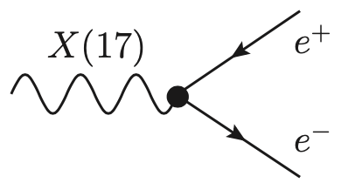
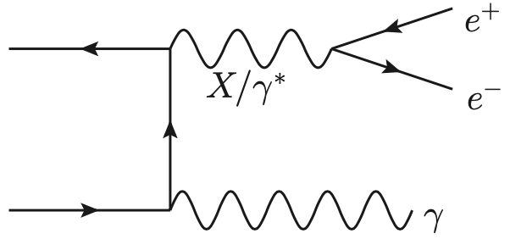

CONTENTS
Motivation &
Backgrond
Constrains on
Xe⁺e⁻ coupling
Revisit X(17) production @ BESIII
Summary

Slide 3
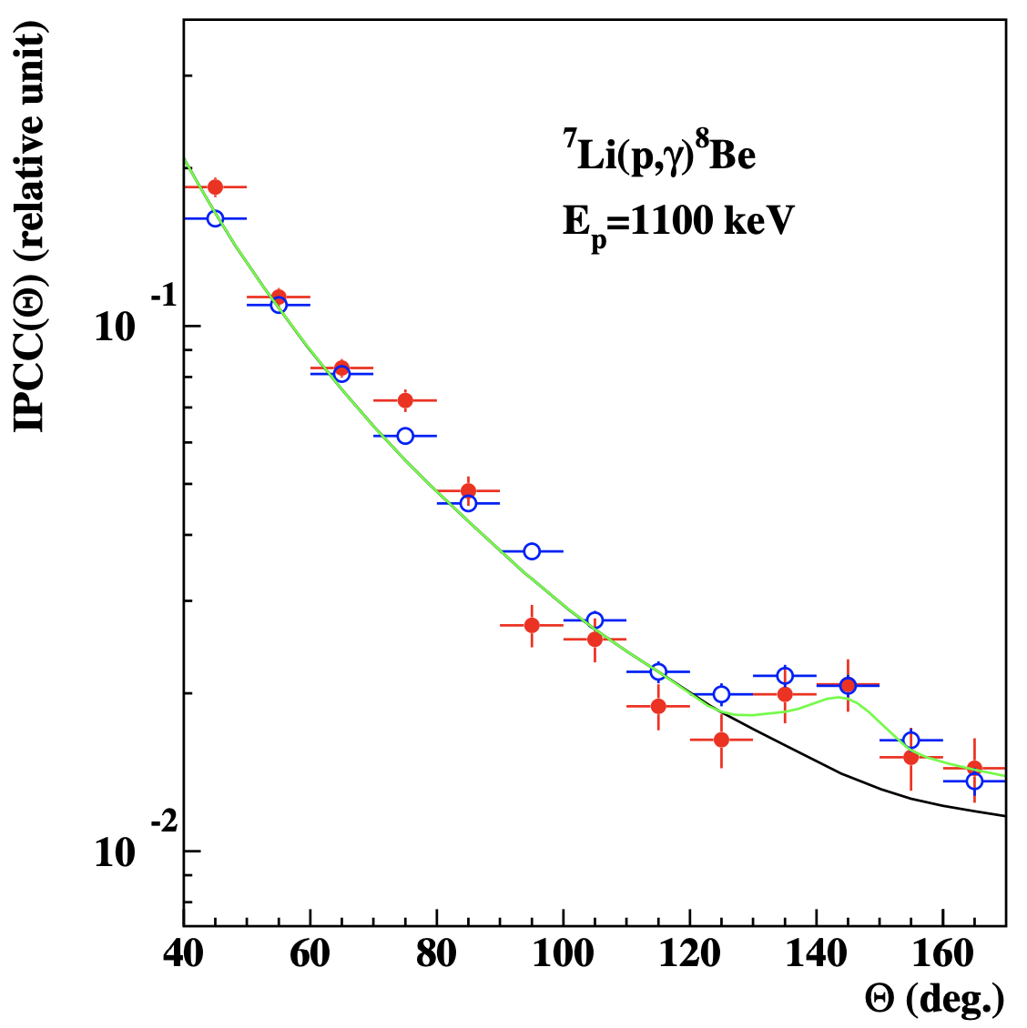
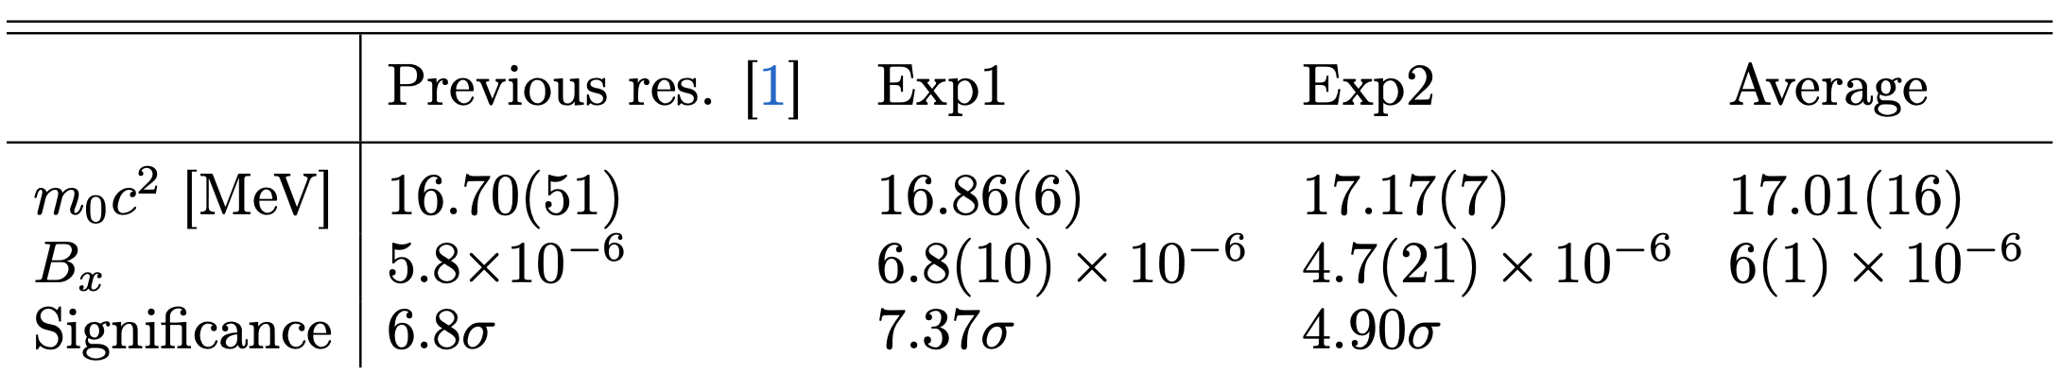
1 Motivation & Background
A. J. Krasznahorkay et al., [1] Phys. Rev. Lett. 116, no.4, 042501 (2016) [arXiv:1504.01527].
inSpires citations: 236
[2] J. Phys. Conf. Ser. 1056, no.1, 012028 (2018).
[3] Acta Phys. Polon. B 50, no.3, 675 (2019).
1.1 Motivation
New Physics (NP) must be somewhere and hides her light under the SM anomalies.
A. J. Krasznahorkay et al.: “Observation of Anomalous Internal Pair Creation in Be8 : A Possible Indication of a Light, Neutral Boson”
J. L. Feng et al.: “Protophobic Fifth-Force Interpretation of the Observed Anomaly in
Be8 Nuclear Transitions”
Measured angular correlations published previously [1] (blue circles) and the present results (full red dots) of the e⁺e⁻ pairs originated from the decay of the 18.15 MeV ground state transition in ⁸Be.
J. L. Feng et al., Phys. Rev. Lett. 117, no.7, 071803 (2016), [arXiv:1604.07411].
inSpires citations: 162
A. J. Krasznahorkay et al.: “New evidence supporting the existence of the hypothetic X17
particle,” [arXiv:1910.10459].

Slide 4
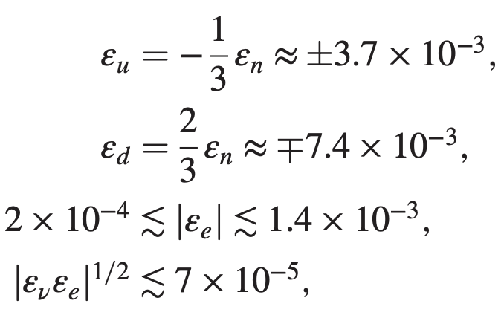
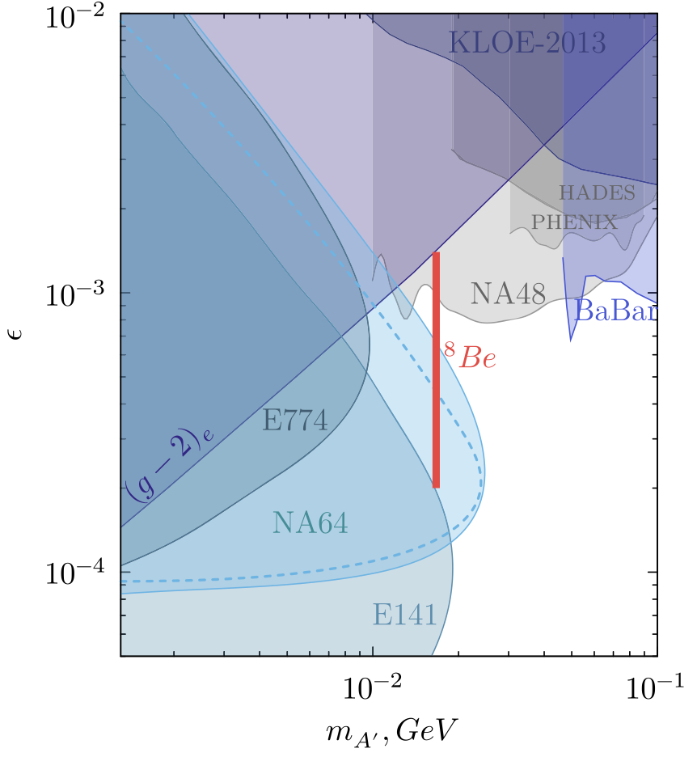
1 Motivation & Background
1.2 Background on X(17)
[1] J. L. Feng et al., Phys. Rev. Lett. 117, no.7, 071803 (2016), [arXiv:1604.07411].
[2] Phys.Rev.D 95 (2017) 3, 035017 [arXiv:1608.03591].
[3] Phys.Rev.D 102 (2020) 3, 036016 [arXiv: 2006.01151].
J. L. Feng et al.: dynamical models (scalar, pseudoscalar, vector, axial vector, etc.), kenetic properties, constrains based on Nuclear Effective Theory.
Protophobic Fifth-Force Interpretation:
NA64 collaboration:
explore the proposal of J. L. Feng et al.
[1] D. Banerjee et al., Phys. Rev. Lett. 120, no.23, 231802 (2018), [arXiv:1803.07748].
[2] Phys. Rev. D 101 (2020) 7, 071101, [arXiv: 1912.11389].
[3] Eur. Phys. J. C (2020) 80:1159, [arXiv: 2009.02756]

Slide 5
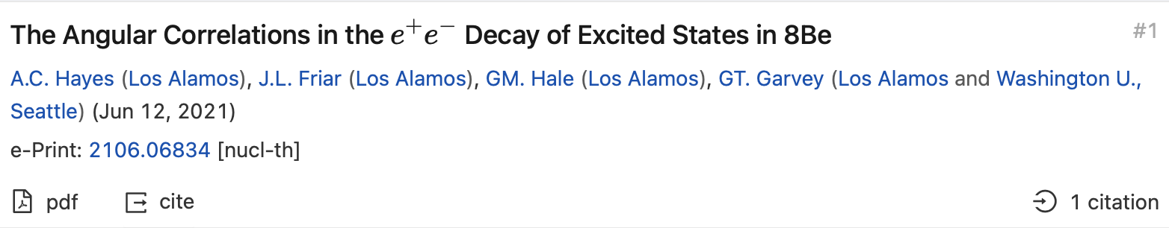
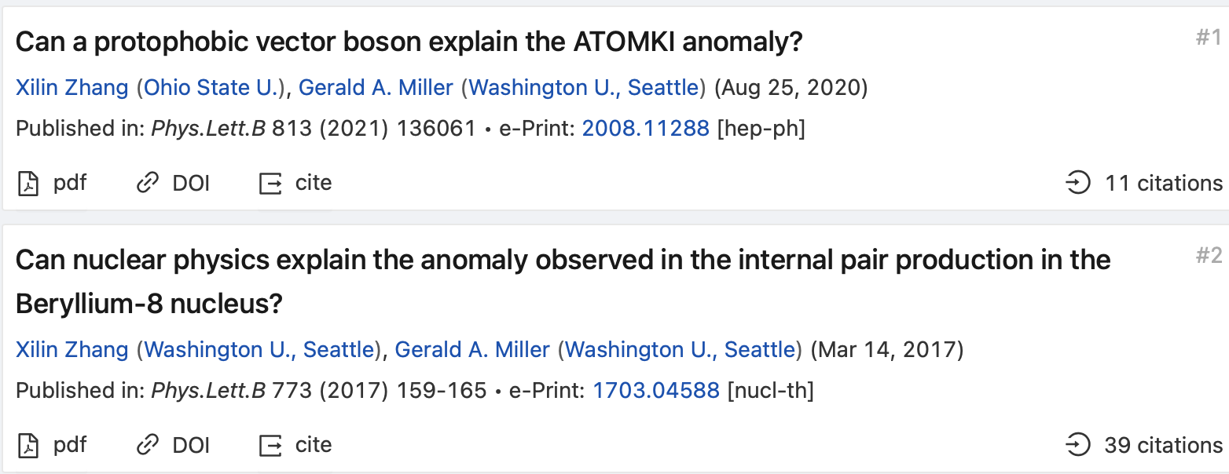
1 Motivation & Background
1.2 Background on X(17)
Battle: Trump or Biden ?
“We find that this resonance is dominated by M1 and E1 decay, and that the ratio of M1 to E1 strength is a strong function of energy. This is in contract to the original analysis of the e⁺e⁻ angular distributions, where the M1/E1 ratio was assumed to be a constant over the energy region Ep = 0.8~1.2 MeV. We find that the existence of a ‘bump’ in the measured angular distribution is strongly dependent on the assumed M1/E1 ratio, with the present analysis finding the measured large-angle contributions to the e⁺e⁻- angular distribution to be lower than expectation. Thus, in the current analysis we find no evidence for axion decay in the 18.15 MeV resonance region of ⁸Be.”
reexamine angular distribution
“The net result is that X production is dominated by direct transitions induced by E1^{X} and L1^{X} (transverse and longitudinal electric dipoles) and C1^{X} (charge dipole) without going through any nuclear resonance (i.e. Bremsstrahlung radiation) with a smooth energy dependence that occurs for all proton beam energies above thresh- old. This contradicts the experimental observations and invalidates the protophobic vector boson explanation.”
“...We then study the possibility of using the nuclear transition form factor to explain the anomaly.”

Slide 6
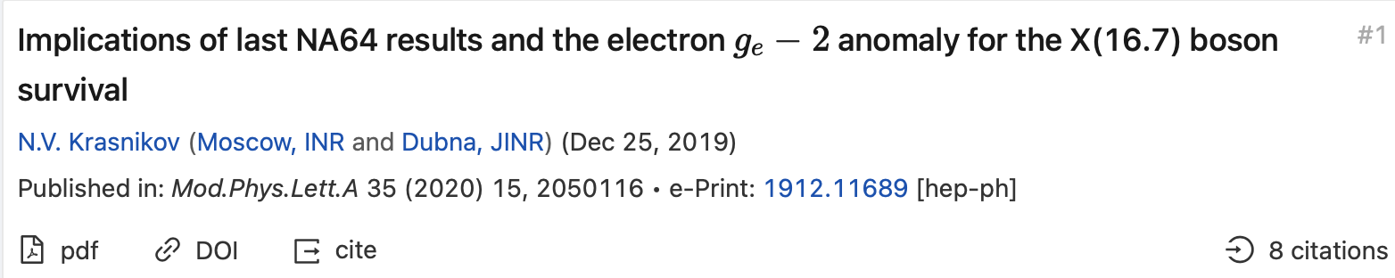
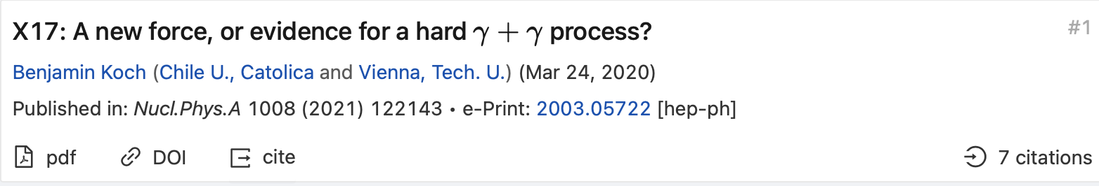
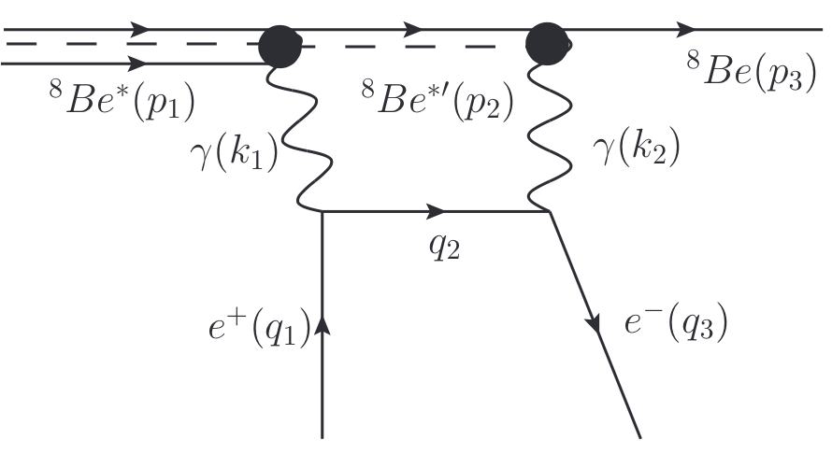
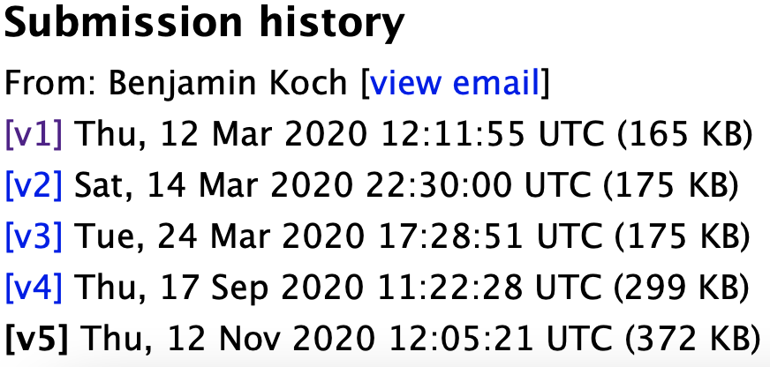
1 Motivation & Background
1.2 Background on X(17)
Battle: Trump or Biden ?
We point out that last NA64 bound on coupling constant of hypothetical X(16.7 MeV) vector boson with electrons plus the recent value of the anomalous electron magnetic moment exclude at 90% C.L. purely vector or axial–vector couplings of X(16.7) boson with electrons. Models with nonzero 𝑉±𝐴 coupling constant with electron survive and they can explain both the electron and muon 𝑔−2 anomalies.
V1:This would be the first experimental evidence for inelastic scattering of two highly energetic photons.
V5: It is found that the corresponding kinematics fits perfectly to the experimental result. Also the conversion rates of this process are reasonable. However, the assumed nuclear chain reaction is not favored in the established nuclear models and no explanation for the isospin structure of the signal can be given. Thus, it has to be concluded that the process studied in this paper does not give a completely satisfying explanation of the "X17 puzzle".

Slide 7
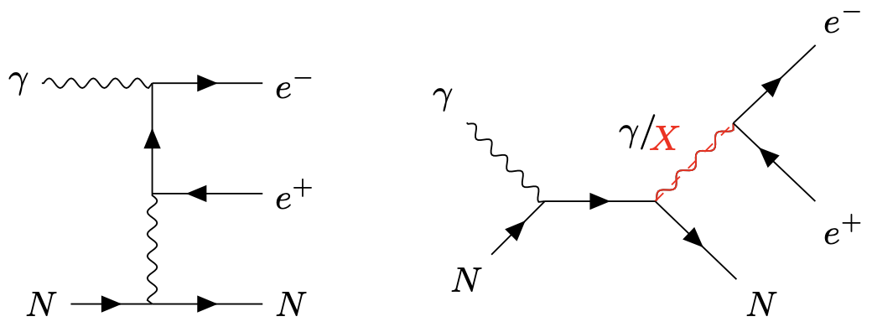
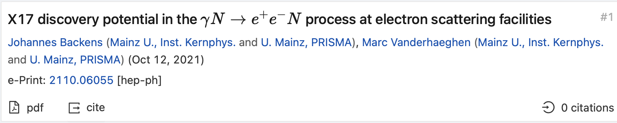
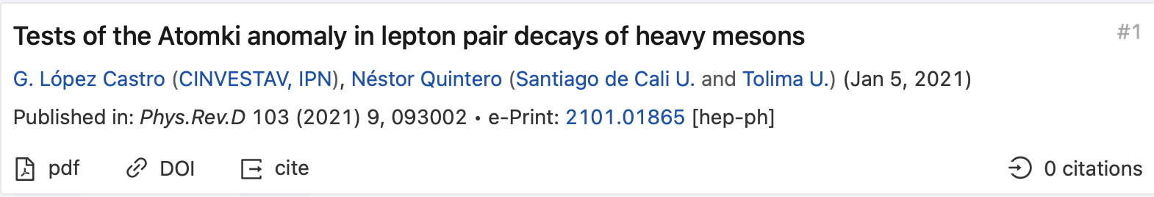
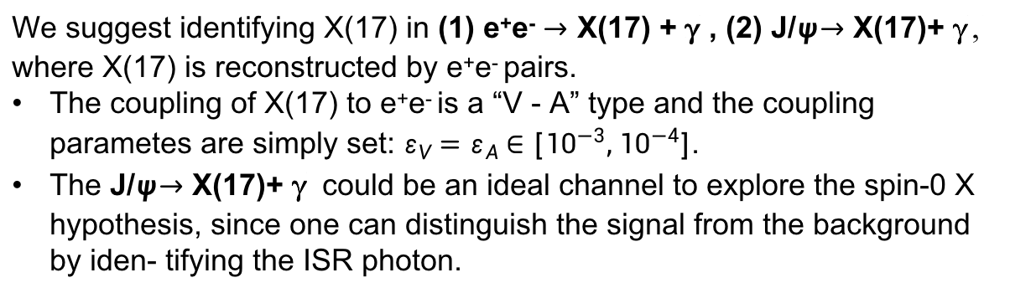
1 Motivation & Background
1.2 Background on X(17)
Battle: Trump or Biden ?
Decays of D*⁺ and Ds*⁺ mesons can be importantly enhanced relative to the dominant photon-mediated contributions.
And other proposals/explainations ...
We suggest identifying X(17) in (1) e⁺e⁻ $→$ X(17) + g , (2) J/$ψ$ $→$ X(17)+ g, where X(17) is reconstructed by e⁺e⁻ pairs.
The coupling of X(17) to e⁺e⁻ is a “V - A” type and the coupling parametes are simply set: $ε_{V}=ε_{A}∈[{10}^{−3},{10}^{−4}]$.
The J/$ψ$ $→$ X(17)+ g could be an ideal channel to explore the spin-0 X hypothesis, since one can distinguish the signal from the background by iden- tifying the ISR photon.
J. Jiang, L. B. Chen, Y. Liang and C. F. Qiao: Eur. Phys. J. C 78, no. 6, 456 (2018), [arXiv:1607.03970];
J. Jiang, H. Yang and C. F. Qiao, Eur. Phys. J. C 79, no. 5, 404 (2019), [arXiv:1810.05790].

Slide 8


1 Motivation & Background
1.3 New force mediator search @ BESIII
BESIII experiment works at C.M.S energy 2~4.6 GeV, and has accumulated 10 billion J/Ψ's, 0.5 billion Ψ(3686)'s, 2.9 fb⁻¹ at Ψ(3773).
Dark photon (U) search
[1]
[1] arXiv:2002.07486;
[2] PRD 99, 012006 (2019) [arXiv:1810.03091];
[3] PRD 99, 012013 (2019) [arXiv:1809.00635];
[4] PLB 774, 252 (2017).
Upper limts for mixing parameters $ε$:
[2]
[3] 3.4×10⁻³ to 2.6×10⁻² for 0.1 < m_{γ ′} < 2.1 GeV.
[4] 10⁻³ to 10⁻⁴ for 1.5 < m_{γ ′} < 3.4 GeV.
CP-odd Higgs-like paritcle (A⁰) search
[5] PRD 85, 092012 (2012);
[6] PRD 93, 052005 (2016);
[7] arXiv: 2109.12625.
[5] 4×10⁻⁷ near threshold to 2.1×10⁻⁵ near 3 GeV
Upper limts for the product-branching
fractions of :
[6]
[7]

Slide 9
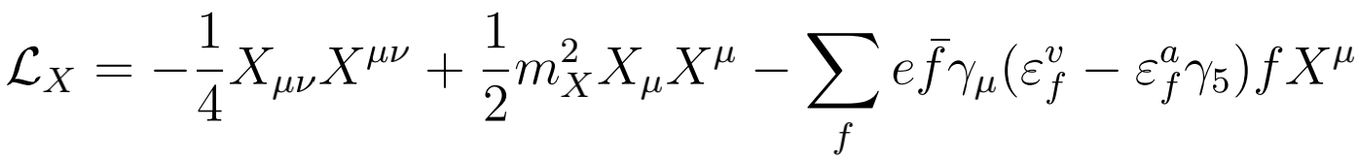
2 Constrains on Xe⁺e⁻ Coupling
2.1 Lagrangian added to Standard Model
Mixing of V & A:
The combination of latest NA64 experiment and recent value of the electron anomalous magnetic momentum exclude the pure vector and axial-vector couplings of X(17) boson to electrons at the 90% C.L.,
but the model with“V ± A” interaction still survives and can further explains both the electron and muon anomalous magnetic momentum.
N. V. Krasnikov, Mod.Phys.Lett.A 35 (2020) 15, 2050116 [arXiv:1912.11689].

Slide 10
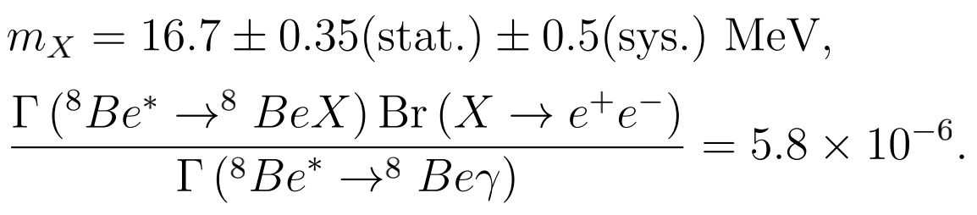

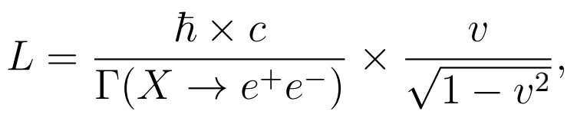
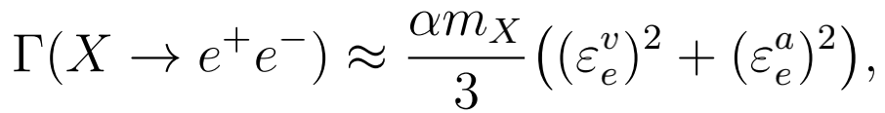
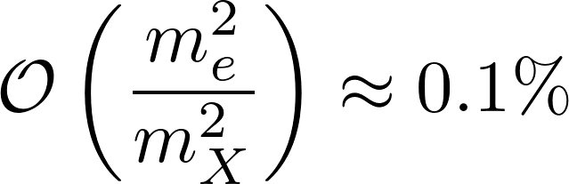
2 Constrains on Xe⁺e⁻ Coupling
2.2 Constrains on Xee coupling from experiments
Two Atomki experiments
A. J. Krasznahorkay et al., Phys. Rev. Lett. 116, no.4, 042501 (2016) [arXiv:1504.01527].
2016
With
Tilley et al., Nucl. Phys. A 745, 155 (2004).
We obtain
With J^{P} of ⁸Be*: 1⁺, J^{P} of ⁸Be: 0⁻, we have J^{P} of X(17): 1⁺ or 0⁻ with orbital angular momentum L=0 or 1, respectively.
Decay length
Requiring L < 1 cm gives

Slide 11
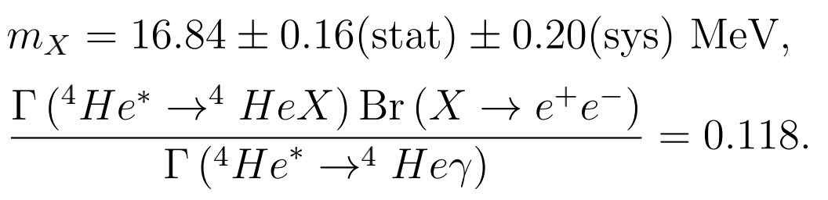

2 Constrains on Xe⁺e⁻ Coupling
Two Atomki experiments
2019
A. J. Krasznahorkay et al., arXiv:1910.10459.
With
T. Walcher, Phys. Lett. B 31, 442-444 (1970).
We obtain
With J^{P} of ⁸He*: 0⁻, J^{P} of ⁸He: 0⁺, we have J^{P} of X(17): 1⁺ or 0⁻ with orbital angular momentum L=1 or 0, respectively. Same implications with the Be experiment.
Decay length
Requiring L < 1 cm gives

Slide 12

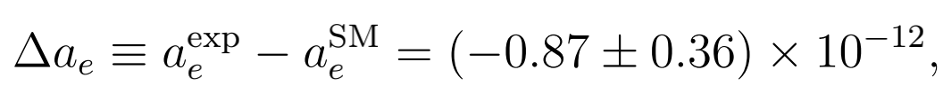
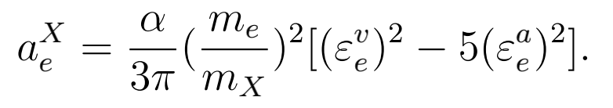
2 Constrains on Xe⁺e⁻ Coupling
Electron anomalous magnetic momentum
The new force mediator X(17) will contibute to the electron anomalous magnetic momentum (AMM).
The latest improved fine structure constant
R. H. Parker et al., Science 360, 191 (2018). [arXiv:1812.04130].
H. Davoudiasl and W. J. Marciano, Phys. Rev. D 98, no. 7, 075011 (2018), [arXiv:1806.10252 ].
leads to 2.4σ discrepancy of electron AMM
The X(17) boson would contribute to electron AMM of ∆a_{e} through the leading one-loop triangle diagram
J. P. Leveille, Nucl. Phys. B 137, 63-76 (1978).
Requiring that this contribution can diminish the 2.4σ discrepancy between the measurement and SM prediction
The pure vector hypothesis of X(17) boson will enlarge the discrepancy of electron AMM!

Slide 13


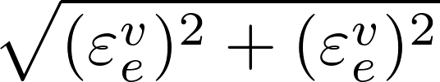

2 Constrains on Xe⁺e⁻ Coupling
Beam dumb experiments
Bremsstrahlung reaction , X(17) is produced by initial or final state radiation off a single electron.
Within the errors of , the production rate depends on the coupling parameters only through the argument
Recently, the NA64 collaboration searched for the X(17) boson twice and set limits on the Xee coupling parameter ε_{e}, i.e., at the 90% C. L.
D. Banerjee et al., Phys. Rev. Lett. 120, no.23, 231802 (2018), [arXiv:1803.07748].
D. Banerjee et al., Phys. Rev. D 101 (2020) 7, 071101, [arXiv: 1912.11389].
Excluded region:
Excluded region:
(2017&2018 data combined)
Around 17 MeV, E137, E144 Beam dumb experimets Excluded region:
Survival region (lower limit):

Slide 14


2 Constrains on Xe⁺e⁻ Coupling
KLOE-2 experiment
The KLOE-2 experiment searched for a low-mass vector boson U in
and set a upper bound on Xee coupling around 17 MeV at the 90% C. L.,
Within the errors of , the production rate depends on the coupling parameters only through the argument

Slide 15
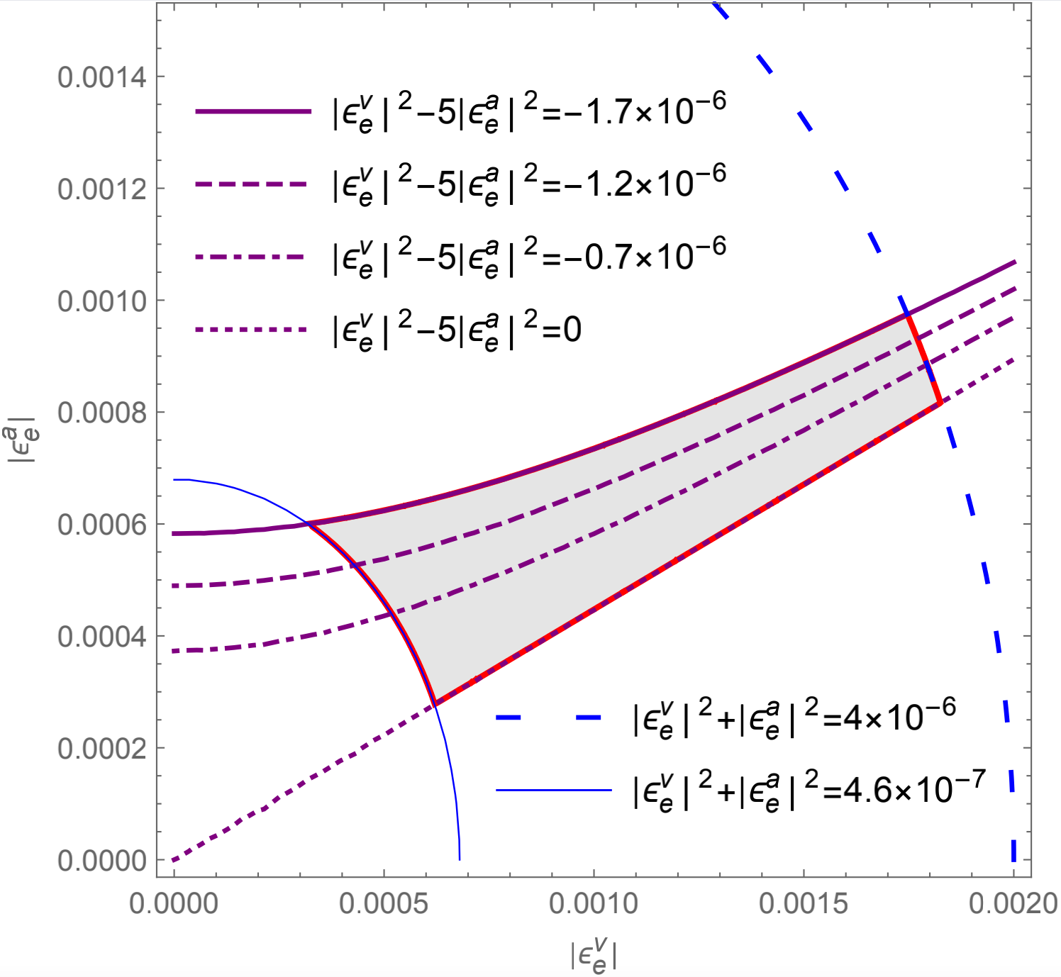
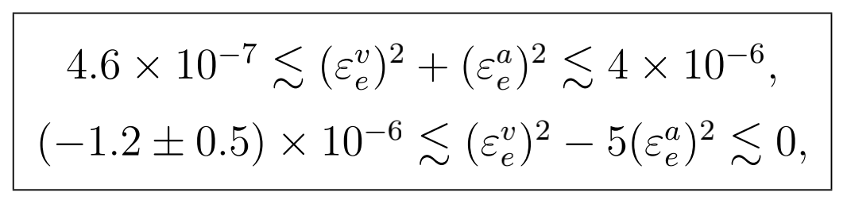
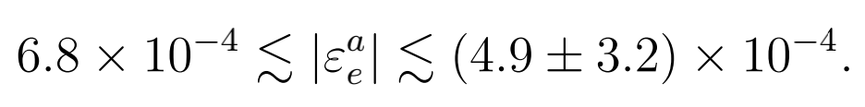
2 Constrains on Xe⁺e⁻ Coupling
Survival regions for Xe⁺e⁻ coupling
Combining above constrains,
Beam dumb
experiments
KLOE-2
experiment
Electron AMM.
Pure V hypothesis: disfavored by Electron AMM.
Pure A hypothesis:
Upper and lower bounds almost overlap with each other.

Slide 16
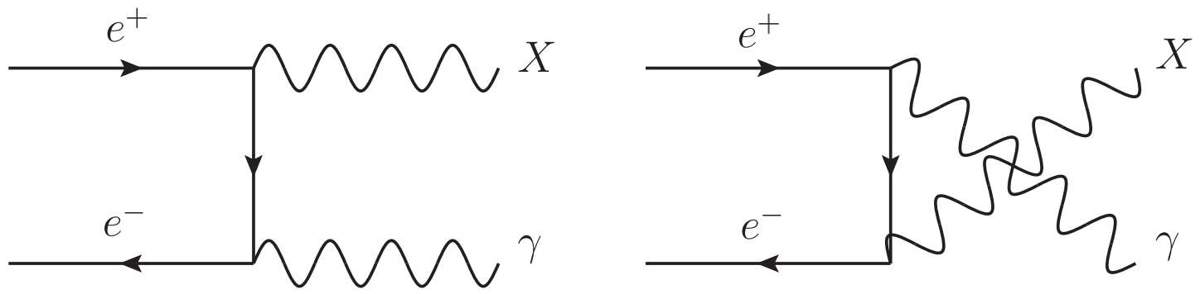

3 Revisit X(17) production @ BESIII
3.1 X(17) + g production
Within the errors of , the
differential cross section depends on the
coupling parameters only through the
argument
The integrated cross section:
The leading order results are the argument times the differential and total cross sections of

Slide 17
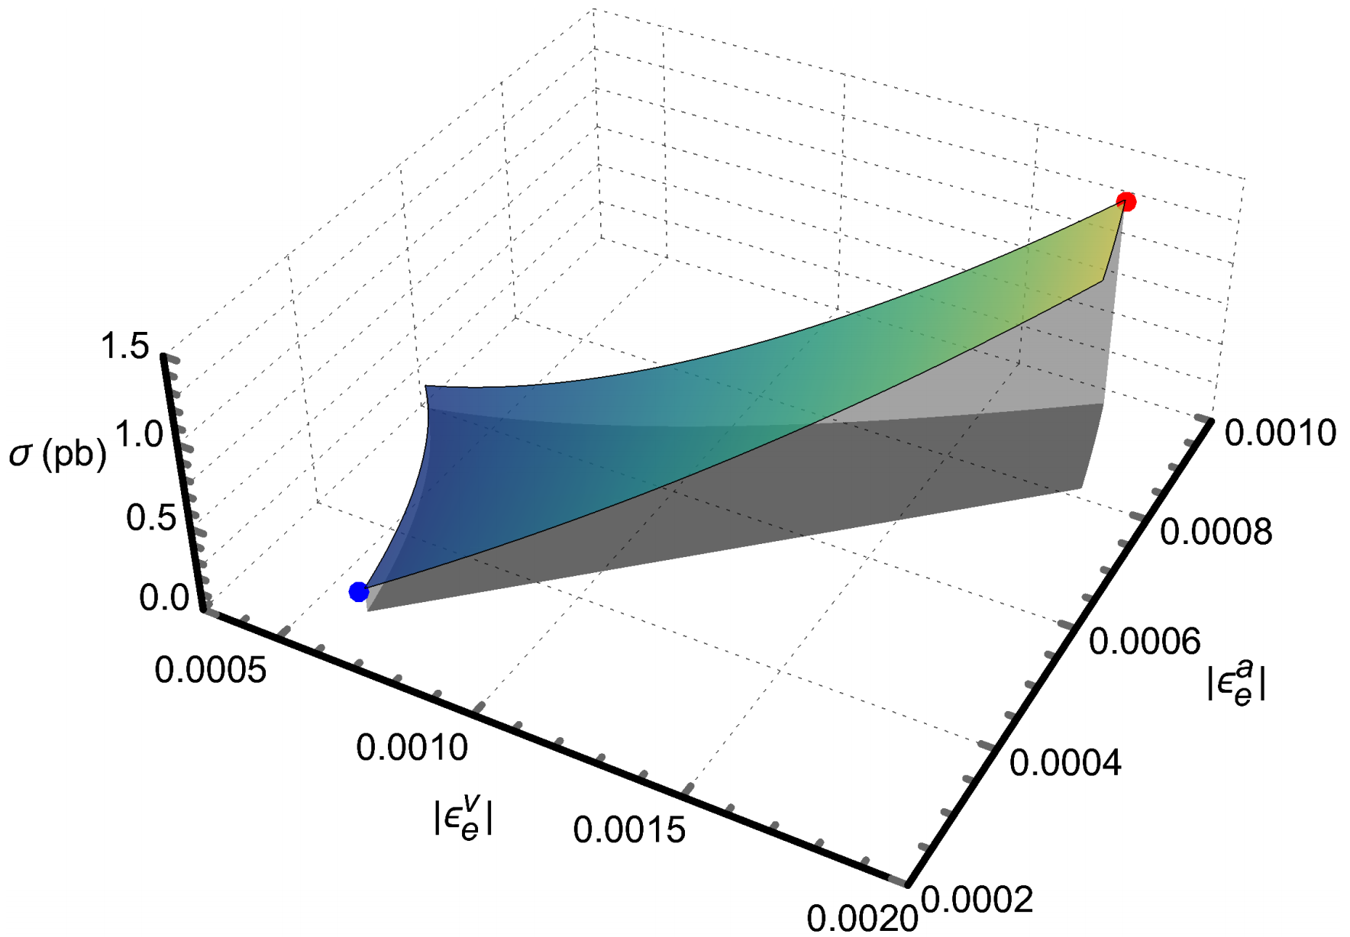
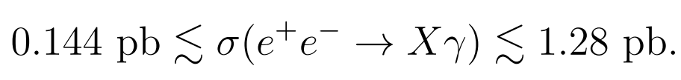
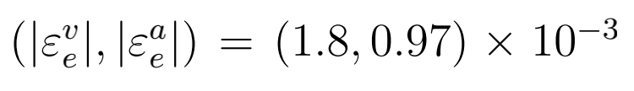
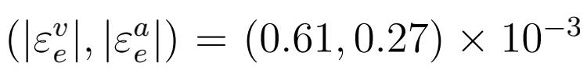

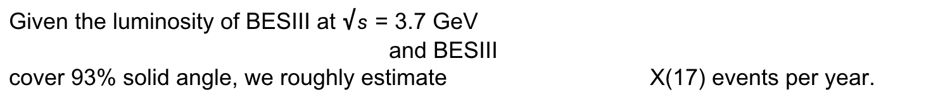
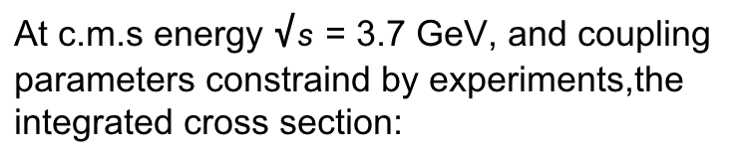
3 Revisit X(17) production @ BESIII
3.1 X(17) + g production
At c.m.s energy $√s$ = 3.7 GeV, and coupling parameters constraind by experiments,the integrated cross section:
The maximum and minimum cross sections are located at the coupling points
Given the luminosity of BESIII at $√s$ = 3.7 GeV
and BESIII
cover 93% solid angle, we roughly estimate X(17) events per year.

Slide 18
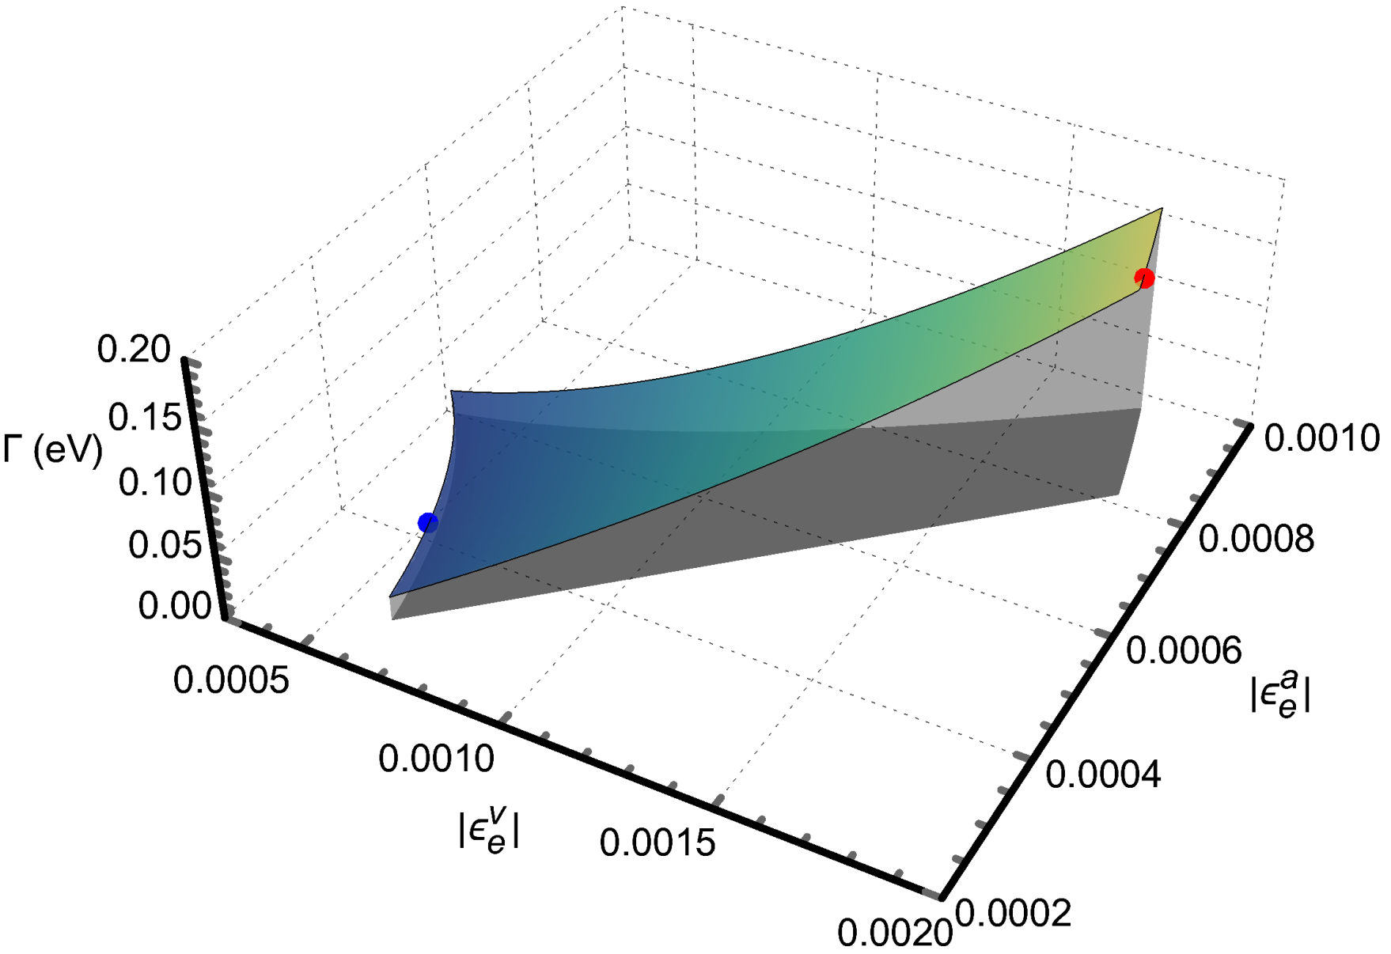
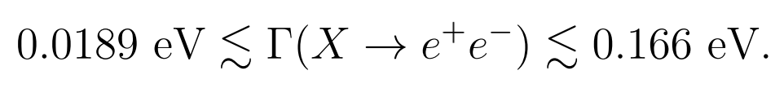
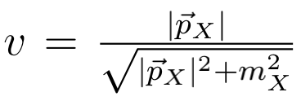
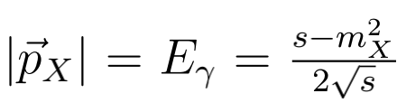
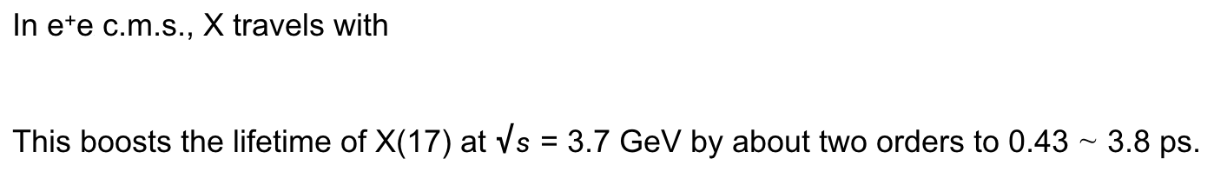

3 Revisit X(17) production @ BESIII
3.2 Reconstruction of X(17) in X $→$ e⁺e⁻ decay
X $→$ e⁺e⁻ decay
The decay width,
The maximum and minimum are located at
Assuming
the the lifetime of X(17) boson would be 4.0 ∼ 35 fs.
In e⁺e- c.m.s., X travels with
This boosts the lifetime of X(17) at $√s$ = 3.7 GeV by about two orders to 0.43 ∼ 3.8 ps.
This gives the decay length of X(17): L $≈$ (0.13 ~ 1.1) mm, which implies X created at the primary vertex in
BESIII chamber.

Slide 19
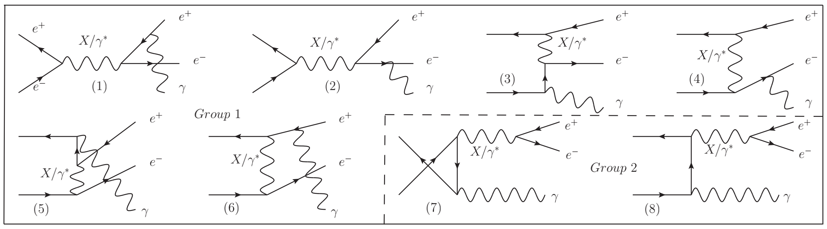
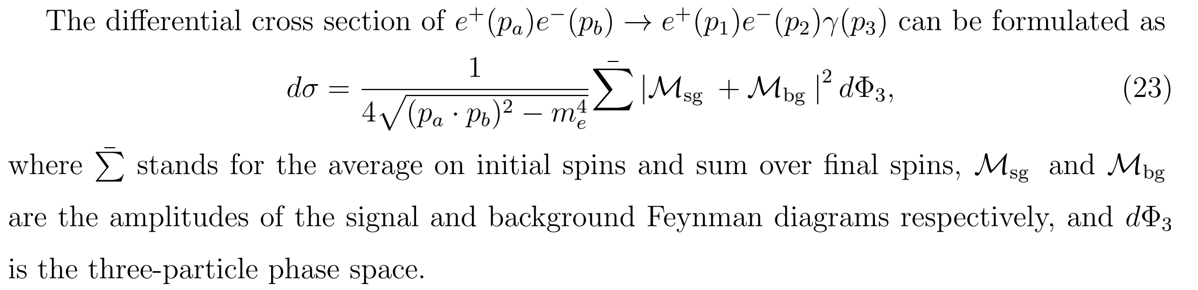

3 Revisit X(17) production @ BESIII
3.2 Reconstruction of X(17) in X $→$ e⁺e⁻ decay
Identify X in e⁺e⁻ $→$ e⁺e⁻ g
Signal diagrams of Group 2 dominate near the resonance due to the tiny decay width in the Breit-Wigner propagator for X(17).

Slide 20
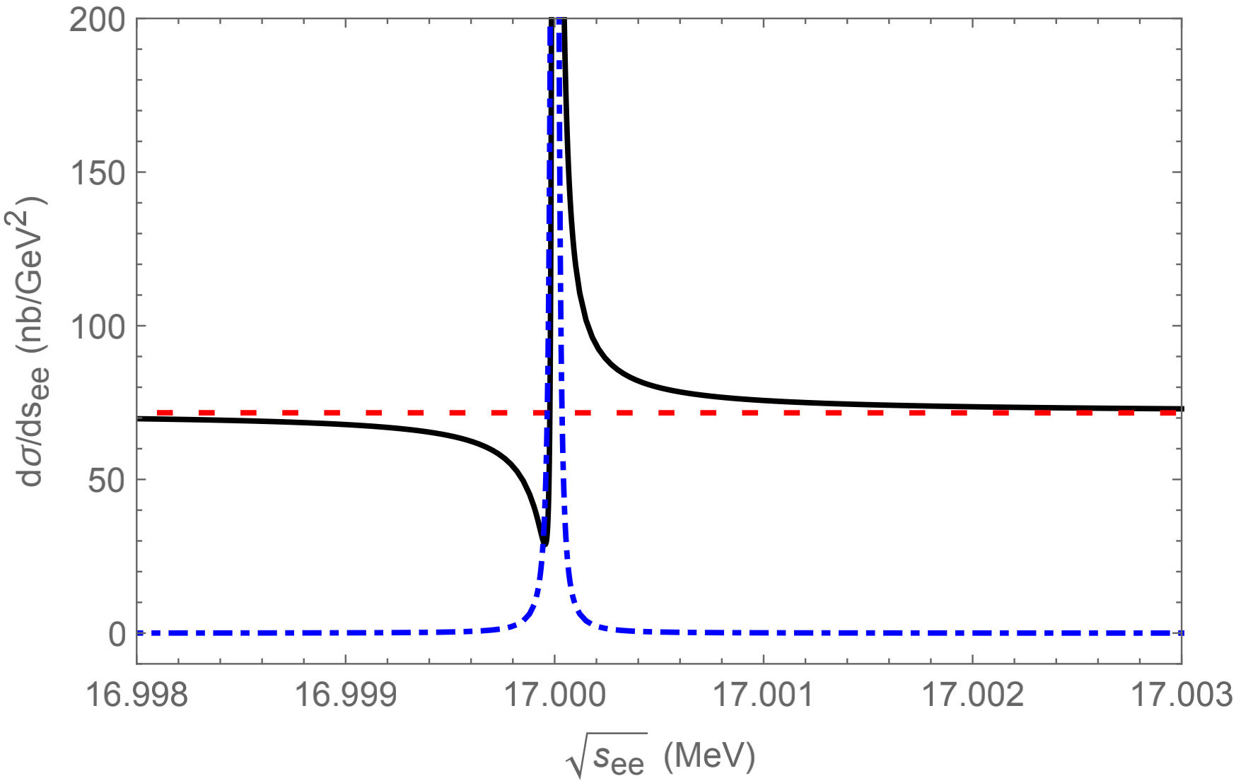
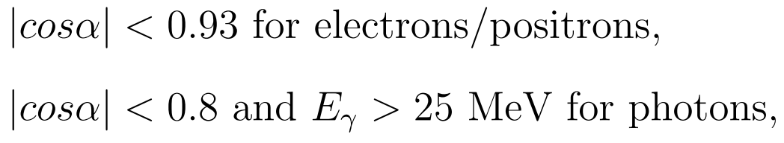
3 Revisit X(17) production @ BESIII
3.2 Reconstruction of X(17) in X $→$ e⁺e⁻ decay
Identify X in e⁺e⁻ $→$ e⁺e⁻ g
The differential distribution vs
the invariant mass of e⁺e⁻
The coupling parameters for
maximum cross section of Xg are adopted,
The basic BESIII cuts are also assumed,

Slide 21


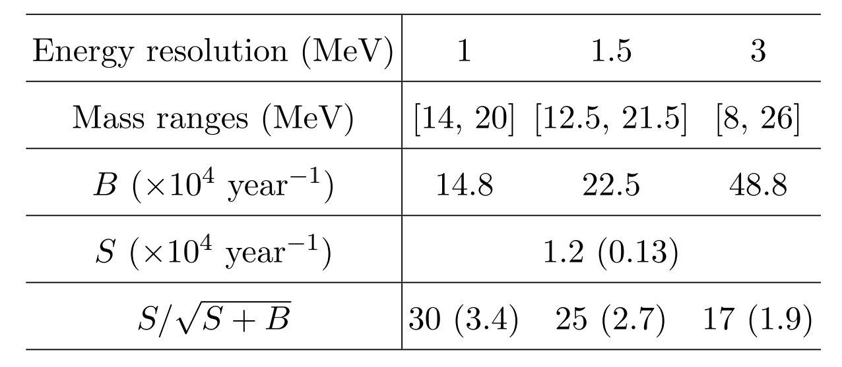
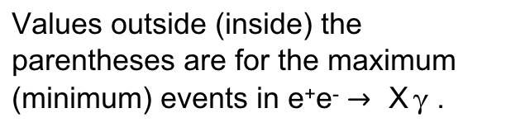
3 Revisit X(17) production @ BESIII
3.2 Reconstruction of X(17) in X $→$ e⁺e⁻ decay
Identify X in e⁺e⁻ $→$ e⁺e⁻ g
M. Ablikim et al., Nucl. Instrum. Meth. A 614 (2010), 345-399, [arXiv:0911.4960]
The energy resolution at 20 MeV:
For the Gaussian distribution, 3σ deviation away from the expectation account for 99.73% of the set.
Values outside (inside) the parentheses are for the maximum (minimum) events in e⁺e⁻ $→$ X g .
The SNR differs by one order of magnitude at the maximum and minimum coupling points.

Slide 22
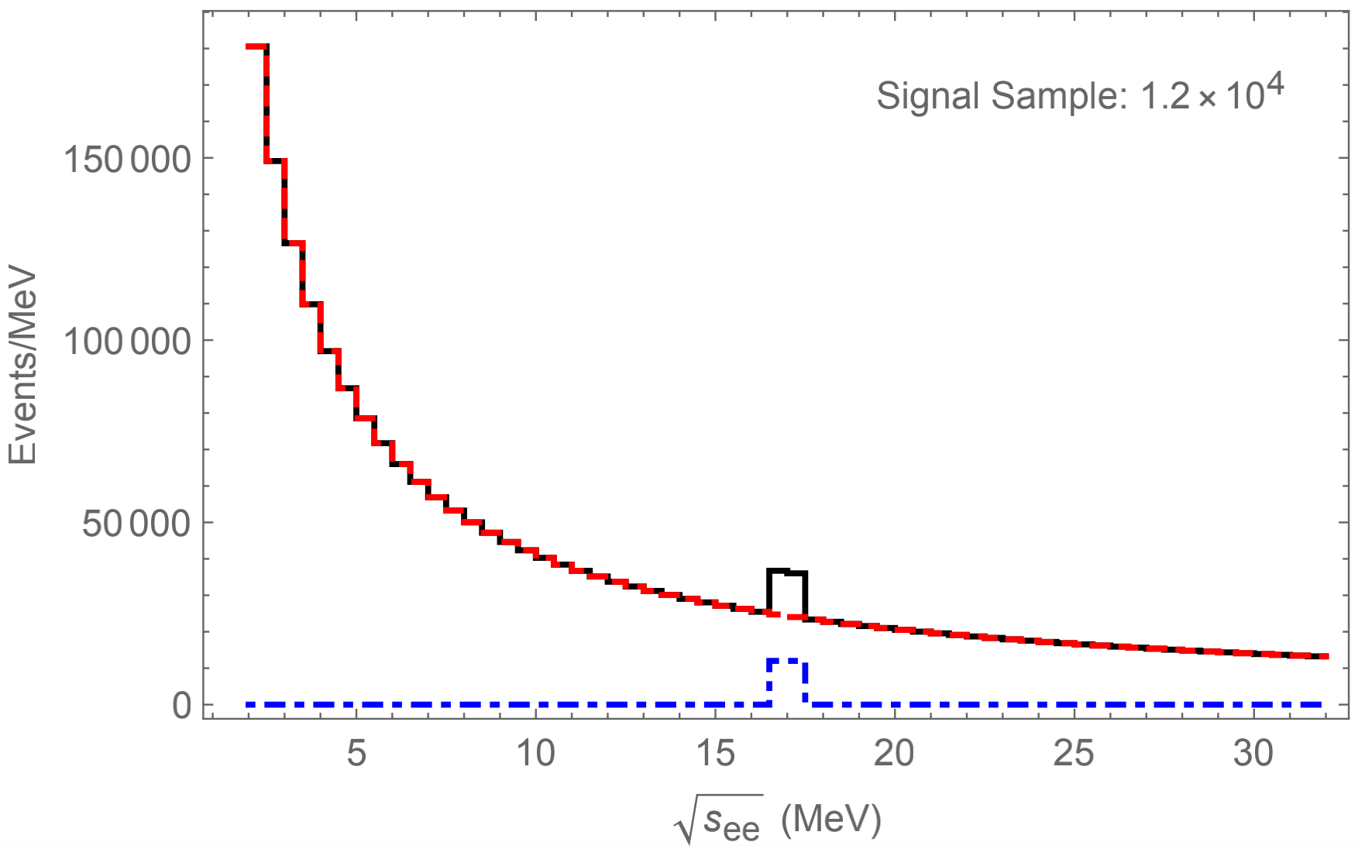
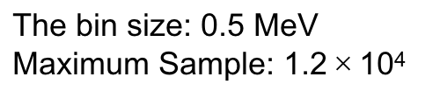
3 Revisit X(17) production @ BESIII
3.2 Reconstruction of X(17) in X $→$ e⁺e⁻ decay
Identify X in e⁺e⁻ $→$ e⁺e⁻ g
The invariant mass spectrum
distribution before smearing
The bin size: 0.5 MeV
Maximum Sample: 1.2$×$10⁴
If the minimum sample (0.13 ×10⁴) was adopted, the
height of X(17) bump will be about 10% of that and become a shoulder unless we adopt smaller bin size.

Slide 23
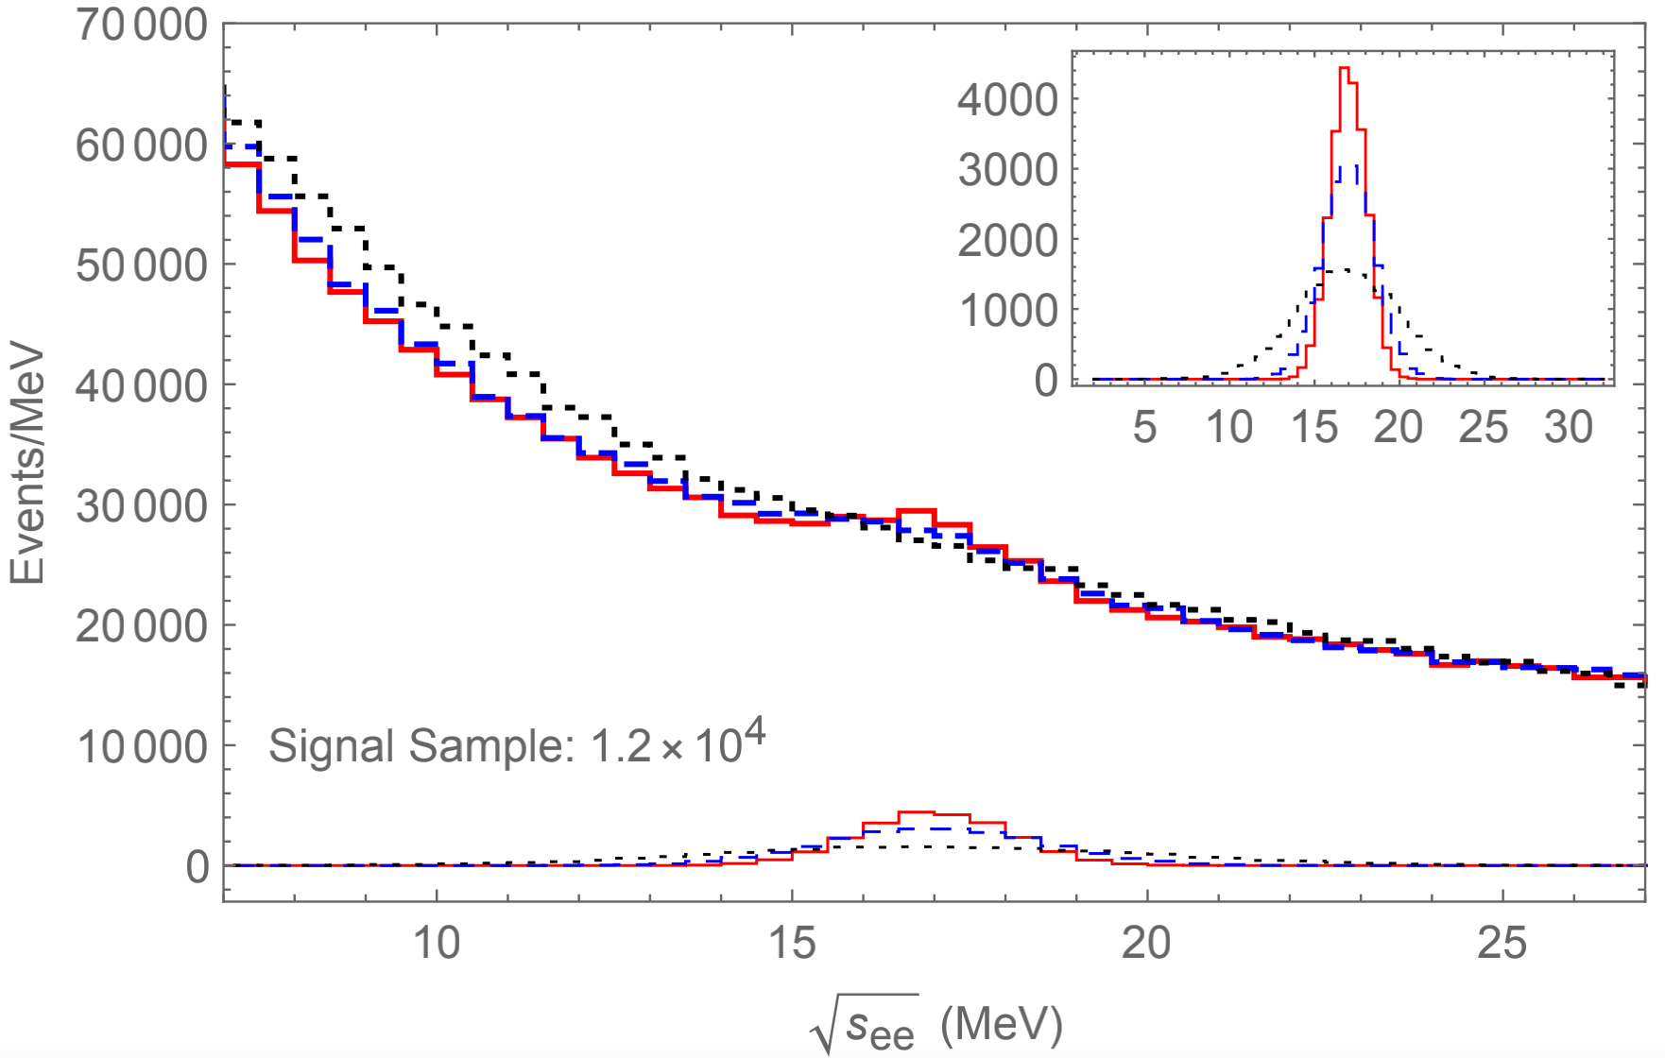
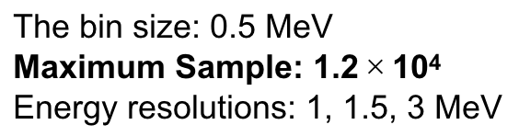
3 Revisit X(17) production @ BESIII
3.2 Reconstruction of X(17) in X $→$ e⁺e⁻ decay
Identify X in e⁺e⁻ $→$ e⁺e⁻ g
The invariant mass spectrum
distribution After smearing
The bin size: 0.5 MeV
Maximum Sample: 1.2$×$10⁴
Energy resolutions: 1, 1.5, 3 MeV
Only the 93% coverange of solid angle is considered. The efficiencies etc. are not taking into account.
Modifying the bin size will not make the bump sharper
after smearing.

Slide 24


3 Revisit X(17) production @ BESIII
3.2 Reconstruction of X(17) in X $→$ e⁺e⁻ decay
Identify X in e⁺e⁻ $→$ e⁺e⁻ g
The invariant mass spectrum
distribution After smearing
The bin size: 0.5 MeV
Minimum Sample: 0.13$×$10⁴
Energy resolutions: 1, 1.5, 3 MeV
The height of the bump decreases by about 90% in comparison with the maximum sample, and we can not identify the X(17) signals over the background events.

Slide 25

4 Summary
The ⁸Be/⁴He anomalies reported by Atomki experiments can be explained by introducing the
X(17) boson with “Vector ± Axial-vector” (V±A) interaction with quarks and leptons.
With the exiting experimental data, we give the constrains on the couplings of X(17) to the first generation of leptons within this V± A model.
Under the constrains, we revisit the X(17) production accompanied by a photon at BESIII experiment, where X(17) is reconstructed by e⁺e⁻ mass spectrum.
The SNR, the invariant mass spectrum distribution before and after smearing within maximum and minimum samples are analyzed.
BESIII experiment has the ability to give a decisive conclusion on X(17) by confirm or exclude the constrain region of X(17).

Slide 26
Thank You!
JIANG Jun (蒋 军)
Shandong University
2021-11-05 @ 青岛

Slide 27

Appendix
1. The differential distribution vs the invariant mass of e⁺e⁻

Slide 28

Appendix
2. The invariant mass spectrum
distribution After smearing (maximum sample)

Slide 29

Appendix
3. The invariant mass spectrum
distribution After smearing (minimum sample)

