Slide 1


Tests of Lepton Flavor Universality
at BESIII
Huijing Li (李惠静)^{1*}
Henan Normal University
* lihuijing@htu.edu.cn
(On behalf of BESIII Collaboration)
Nov. 6 th, 2021
2021年BESIII新物理研讨会
2021年11月5日-7日，青岛

Slide 2
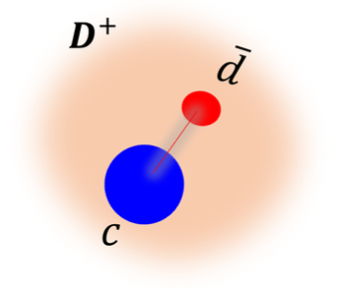
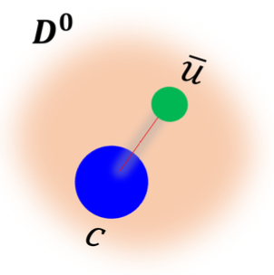
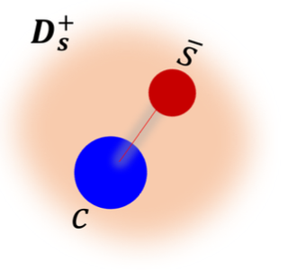
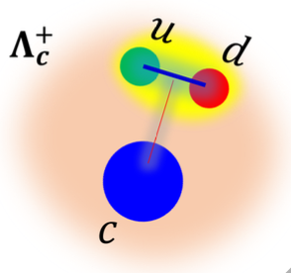
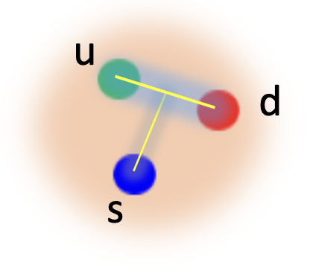
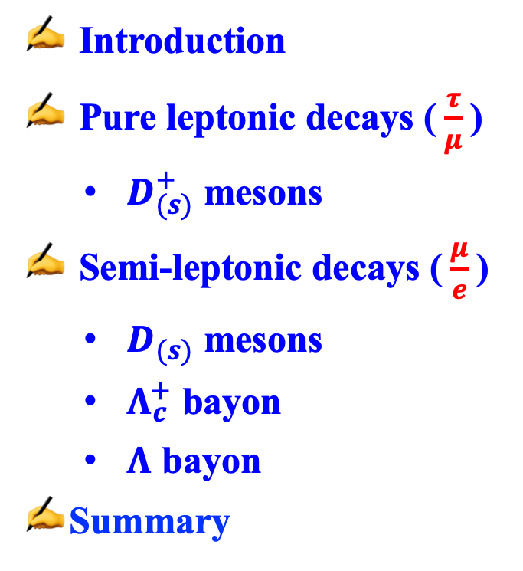

Outline
Introduction
Pure leptonic decays ($\frac{τ}{μ}$)
  $D_{(s)}^{+}$ mesons
Semi-leptonic decays ($\frac{μ}{e}$)
  $D_{(s)}$ mesons
  $Λ_{c}^{+}$ bayon
  $Λ$ bayon
Summary
$$Λ$$

Slide 3
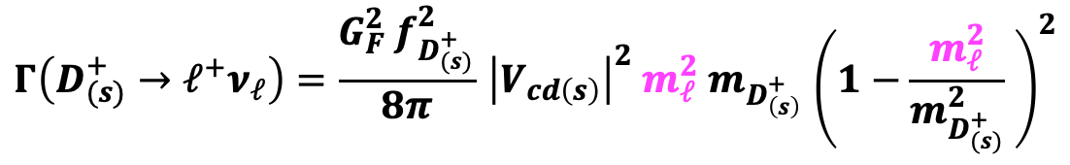
Lepton flavor universality (LFU)
In the SM, ignoring radiative corrections, the decay width of pure leptonic $D_{(s)}^{+}$ decay $(ℓ=e, μ, τ)$ is given by a simple form [1,2]:
$$Γ\left(D_{(s)}^{+}→ℓ^{+}ν_{ℓ}\right)=\frac{G_{F}^{2}{ f}_{D_{(s)}^{+}}^{2}}{8π}{ \left|V_{cd\left(s\right)}\right|}^{2}{ m}_{ℓ}^{2}{ m}_{D_{\left(s\right)}^{+} }{\left(1−\frac{m_{ℓ}^{2}}{m_{D_{(s)}^{+}}^{2}} \right)}^{2}$$
[1] D. Silverman, and H. Yao, Phys. Rev. D 38, 214 (1988).
[2] H. B. Li, and X. R. Lyu, arXiv:2103.00908 [hep-ex].
Notes:
因为CKM矩阵是复数的，这个顶点的矩阵元对应的就是复共轭的那个
In the decay process Ds+ → l+νl, thecharmquark(c)andanti-strangequark(s ̄)annihi- late through a virtual W boson to a charged and neutral lepton pair.
De- cay constant characterizes the strong-interaction physics at the quark-annihilation vertex
Decay constant for B meson also appears in the evaluation of box diagrams, and limits theoretical preci- sion in calculating the neutral B meson mixing.
Thus, lack of knowledge of the B0 and Bs decays constants limits the usefulnessofprecisemeasurementsofB −B andBs−Bs
oscillations
These mixing data are our best source of in- formation on the CKM matrix elements Vtd and Vts
which are difficult to measure directly in top decay. The leptonic decay of charm meson presents an opportunity to check LQCD results for decay constants against precision mea- surements
characterizes the strong-interaction physics at the quark-annihilation vertex,

Slide 4
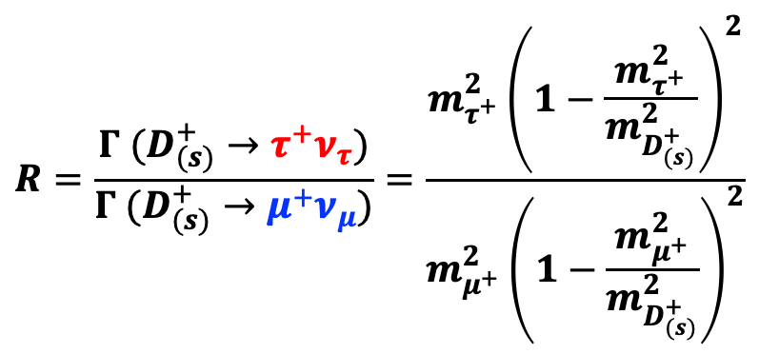
Ratio:
$$R=\frac{Γ (D_{(s)}^{+}→τ^{+}ν_{τ})}{Γ (D_{(s)}^{+}→μ^{+}ν_{μ})}=\frac{m_{τ^{+}}^{2}{\left(1−\frac{m_{τ^{+}}^{2}}{m_{D_{(s)}^{+}}^{2}}\right)}^{2}}{m_{μ^{+}}^{2}{\left(1−\frac{m_{μ^{+}}^{2}}{m_{D_{(s)}^{+}}^{2}}\right)}^{2}}$$
Expectations in the SM:
$$R\left(D^{+}→τ^{+}ν_{τ}: μ^{+}ν_{μ}: e^{+}ν_{e}\right)=2.67: 1: 2.35×10^{−5}$$
$$R\left(D_{s}^{+}→τ^{+}ν_{τ}: μ^{+}ν_{μ}: e^{+}ν_{e}\right)=9.75: 1: 2.35×10^{−5}$$
Any deviation from experimental measurements potentially indicates the existence of New Physics beyond SM.
SM predicted: $B(D_{\left(s\right)}^{+}→e^{+}ν_{e})<10^{−8}$, not yet experimentally observed.

Slide 5
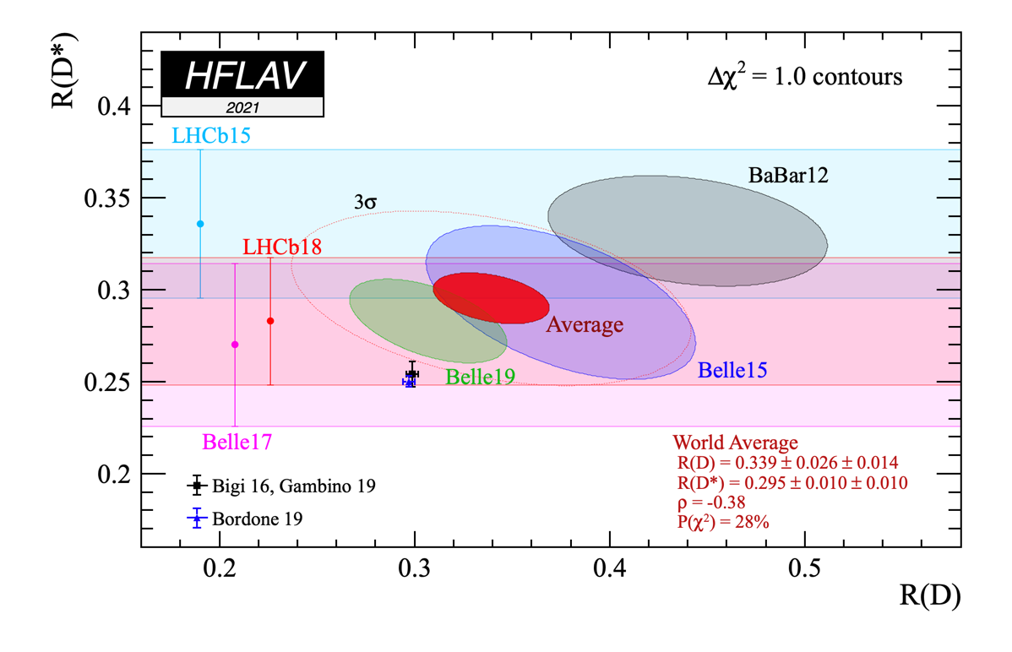

Hints of LFU violation in $B$ decays
$$R\left(D^{∗}\right)=BF(B→D^{\left(∗\right)}τν_{τ})/BF(B→D^{\left(∗\right)}ℓν_{ℓ})$$
(predication)
(predication)
Notes:
Combine R(D*)和R(D)一起拟合。黑色/蓝色的数据点是SM预期的，红色的average是实验平均值，有3.4\sigma的偏差。
Combine the two lattice calculations, with the experimental Form Factor of B-> D l nu from BaBar(2010)
R(D) and R(D*) exceed the SM predictions given above, by 1.4σ and 2.9σ respectively. Considering the R(D)-R(D*)) correlation of -0.38, the resulting combined χ² is 15.02 for 2 degree of freedom, corresponding to a p-value of 0.54 x 10⁻³. The difference with the SM predictions reported above, corresponds to about 3.4σ.

Slide 6
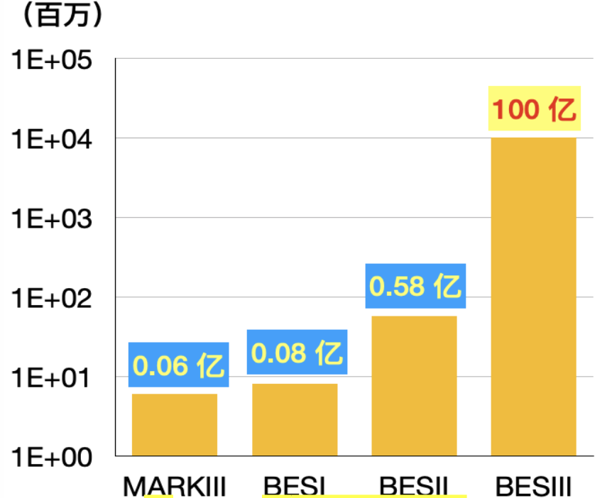
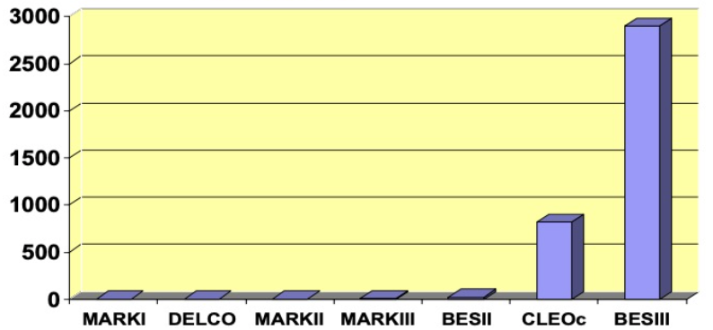
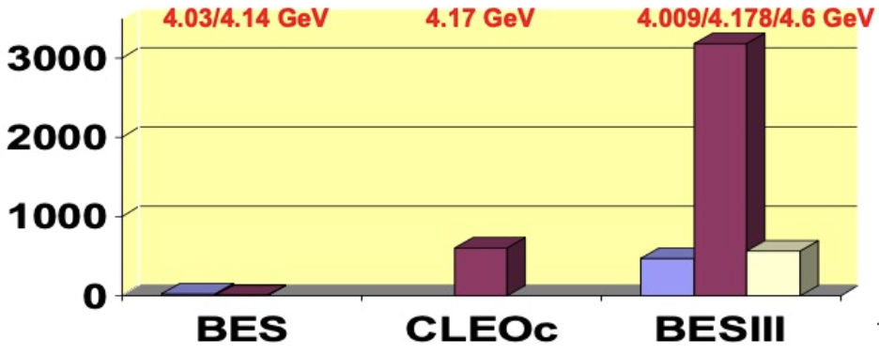


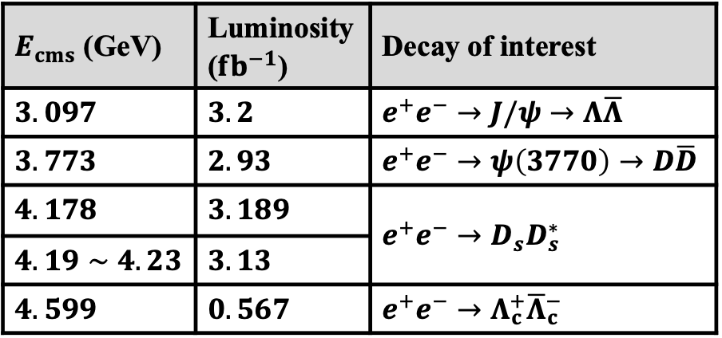

Data sets
$E_{cms}$ (GeV) | Luminosity ($fb^{−1}$) | Decay of interest
$$3.097$$ | $$3.2$$ | $$e^{+}e^{−}→J/ψ→Λ\overline{Λ}$$
$3.773$ | $2.93$ | $e^{+}e^{−}→ψ\left(3770\right)→D\overline{D}$
$4.178$ | $3.189$ | $$e^{+}e^{−}→D_{s}D_{s}^{∗}$$
$4.19∼4.23$ | $3.13$
$$4.599$$ | $0.567$ | $$e^{+}e^{−}→Λ_{c}^{+}{\overline{Λ}}_{c}^{−}$$
$J/ψ$ sample
$ψ(3770)$ sample
$D_{s}^{+}$/ $D_{s}^{+}$/ $Λ_{c}^{+}$ sample

Slide 7
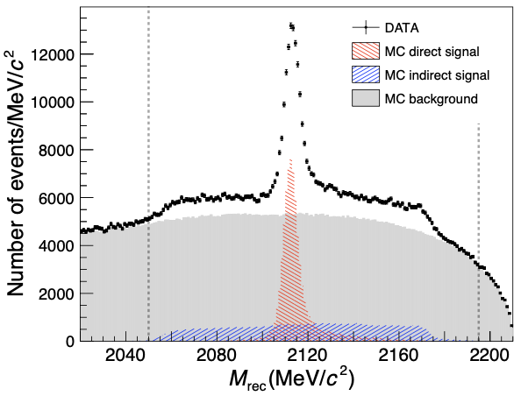
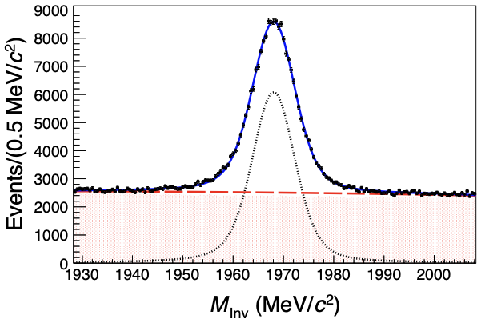

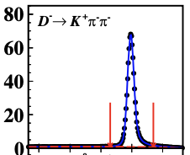
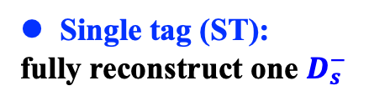

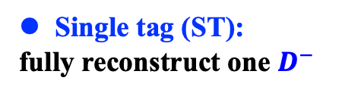























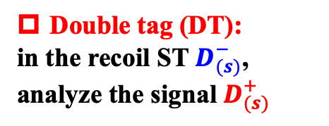





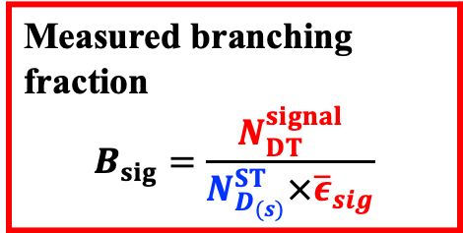


Analysis technique
$$π^{−}$$
$$K^{+}$$
$$K^{−}$$
Tag
$$π^{−}$$
Tag
$$π^{−}$$
Charge conjugated processes are implied
$$D_{s}^{−}$$
$$D^{−}$$
$$K^{+}$$
$$e^{+}$$
4.178 GeV
Measured branching fraction
$$B_{sig}=\frac{N_{DT}^{signal}}{N_{D_{(s)}}^{ST}×{\overline{ε}}_{sig}}$$
$$e^{+}$$
$$ψ\left(3770\right)$$
$$e^{−}$$
$$e^{−}$$
$$D^{+}$$
Signal
$$D_{s}^{∗+}$$
Signal
$$D_{s}^{+}$$
$$γ(π^{0})$$
$$X$$
$$X$$
Single tag (ST):
fully reconstruct one $D^{−}$
Double tag (DT):
in the recoil ST $D_{(s)}^{−}$, analyze the signal $D_{(s)}^{+}$
Single tag (ST):
fully reconstruct one $D_{s}^{−}$
$$ΔE=E_{D^{−}}−E_{beam}$$
$$M_{rec}=\sqrt{{\left(E_{cm}−\sqrt{{\left|{\vec{p}}_{D_{s}^{−}}\right|}^{2}+m_{D_{s}^{−}}^{2}}\right)}^{2}−{\left|−{\vec{p}}_{D_{s}^{−}}\right|}^{2}}$$
$$M_{BC}=\sqrt{E_{beam}^{2}−{\left|{\vec{p}}_{D^{−}}\right|}^{2}}$$
$$MM^{2}=E_{miss}^{2} −{\left|{\vec{p}}_{miss}\right|}^{2}$$
PRD104(2021)052009
PRD 104 (2021) 012003
PRL124(2020)231801
$$E_{miss}=E_{cm} −\sqrt{{\left|{\vec{p}}_{D_{(s)}^{−}}\right|}^{2}+M_{D_{(s)}}^{2}}−E_{X}$$
$$K^{+}K^{−}π^{−}$$
$$K^{+}K^{−}π^{−}$$
$${\vec{p}}_{miss}=−{\vec{p}}_{D_{(s)}^{−}}−{\vec{p}}_{X}$$
$$U_{miss}=E_{miss} −\left|{\vec{p}}_{miss}\right|$$
or other variables
$$M_{rec}(MeV/c^{2})$$
$$M_{Inv}(MeV/c^{2})$$
$$M_{BC}^{tag}(GeV/c^{2})$$

Slide 8

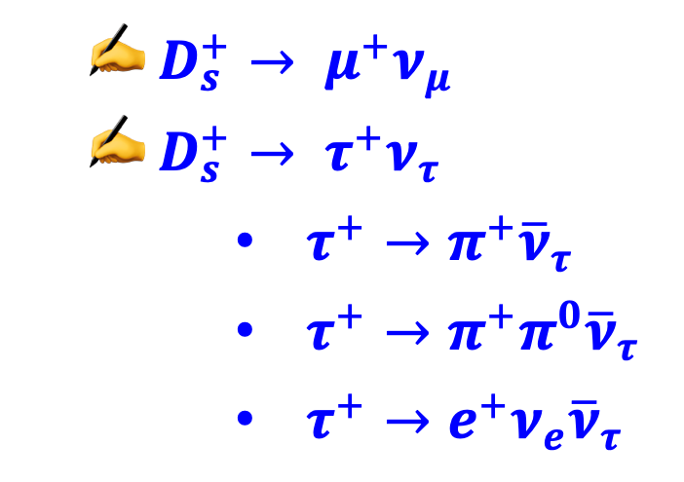
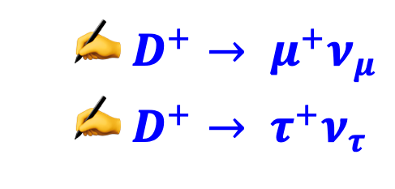
Pure leptonic decays
  $D^{+}→ μ^{+}ν_{μ}$
  $D^{+}→ τ^{+}ν_{τ}$
PRD 89 (2014) 051104(R)
PRL 123 (2019) 211802
  $D_{s}^{+}→ μ^{+}ν_{μ}$
  $D_{s}^{+}→ τ^{+}ν_{τ}$
      $τ^{+}→π^{+}{\overline{ν}}_{τ}$
      $τ^{+}→π^{+}π^{0}{\overline{ν}}_{τ}$
      $τ^{+}→e^{+}ν_{e}{\overline{ν}}_{τ}$
PRL 122 (2019) 071802
PRD 104 (2021) 052009
PRD 104 (2021) 052009
PRD 104 (2021) 032001
PRL 127 (2021) 171801

Slide 9
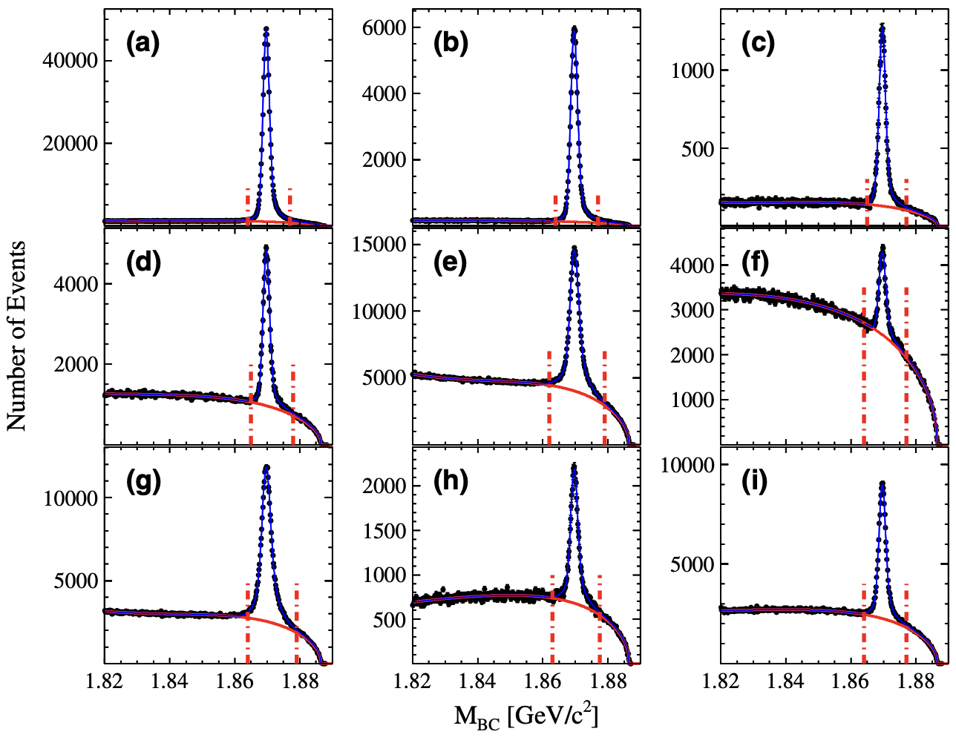






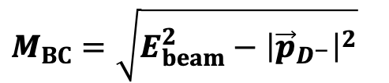




  $$D^{+}→ μ^{+}ν_{μ}$$
$$M_{BC}=\sqrt{E_{beam}^{2}−{\left|{\vec{p}}_{D^{−}}\right|}^{2}}$$
$$N_{D_{tag}^{−}}=1703054±3045$$
PRD 89 (2014) 051104(R)
$$K^{+}π^{−}π^{−}$$
$$K_{S}^{0}π^{−}$$
$$K_{S}^{0}K^{−}$$
$$K^{+}K^{−}π^{−}$$
$$K^{+}π^{−}π^{−}π^{0}$$
$$π^{+}π^{−}π^{−}$$
$$K_{S}^{0}π^{−}π^{0}$$
$$K^{+}π^{+}3π^{−}$$
$$K_{S}^{0}π^{−}π^{−}π^{+}$$

Slide 10
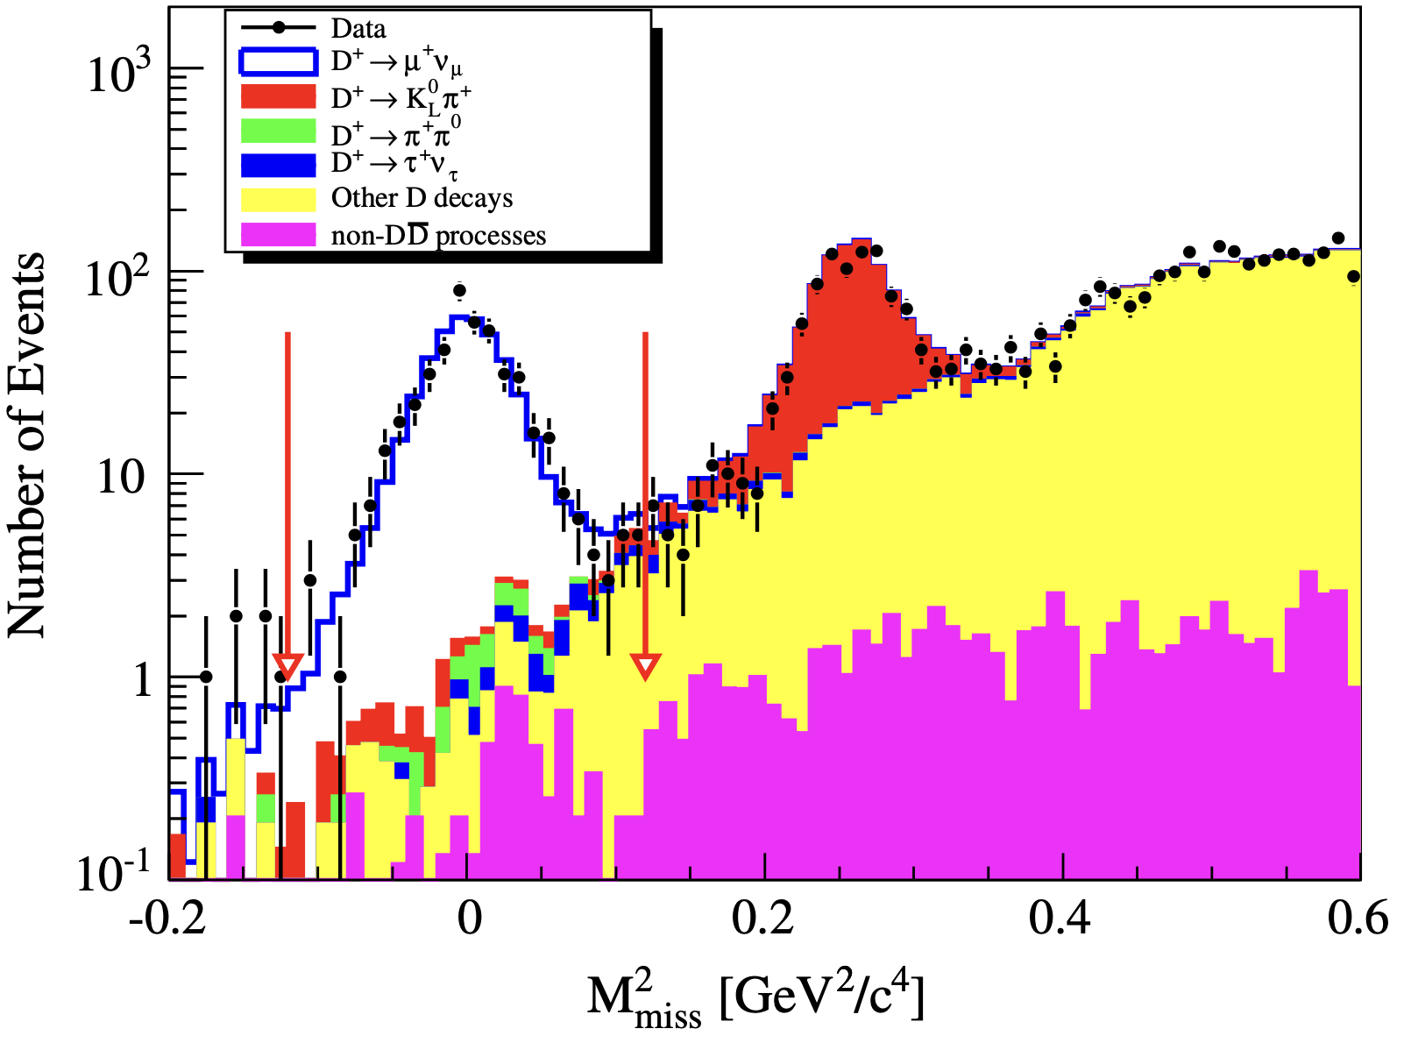

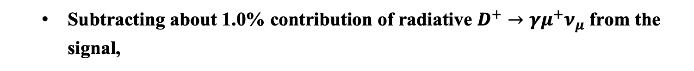
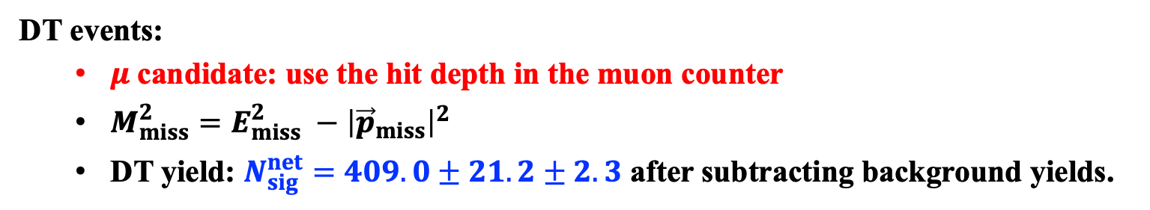
PRD 89 (2014) 051104(R)
DT events:
  $μ$candidate: use the hit depth in the muon counter
  $M_{miss}^{2}=E_{miss}^{2} −{\left|{\vec{p}}_{miss}\right|}^{2}$
  DT yield: $N_{sig}^{net}=409.0±21. 2±2.3$ after subtracting background yields.
$E_{miss}=E_{beam} − E_{μ}$,
$${\vec{p}}_{miss}=−{\vec{p}}_{D^{−}}−{\vec{p}}_{μ}$$
  Subtracting about 1.0% contribution of radiative $D^{+}→γμ^{+}ν_{μ}$ from the signal,
$$B_{D^{+}→μ^{+}ν_{μ}}=\left(3.71±{0.19}_{stat.}±0.06_{syst.} \right)×10^{−4}$$

Slide 11
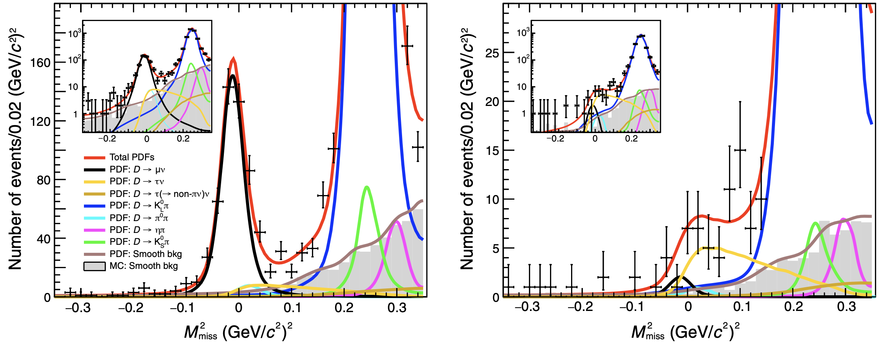
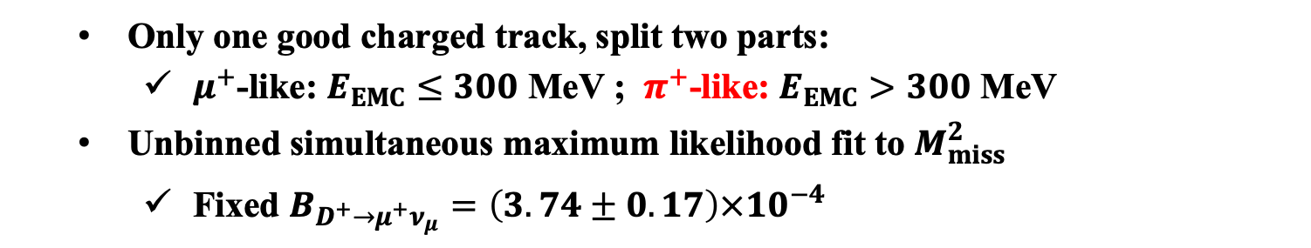



  $$D^{+}→τ^{+}ν_{τ} via τ^{+}→π^{+}{\overline{ν}}_{τ}$$
PRL 123 (2019) 211802
  Only one good charged track, split two parts:
    $μ^{+}$-like: $E_{EMC}≤300$ MeV ; $π^{+}$-like: $E_{EMC}>300$ MeV
  Unbinned simultaneous maximum likelihood fit to $M_{miss}^{2}$
    Fixed $B_{D^{+}→μ^{+}ν_{μ}}=\left(3.74±0.17\right)×10^{−4}$
$μ^{+}$-like
$$N_{DT}^{τ^{+}}=137±27$$
$π^{+}$-like
Notes:
为了增加统计显著性，固定了D+ -> mu nu的分支比，如果不固定，也可以，分支比是1.21+/-0.24.The first portion includes 99% of the muon tracks from Dþ → μþνμ, while the second has 44% of the pion tracks from Dþ →τþν , τþ →πþν ̄

Slide 12
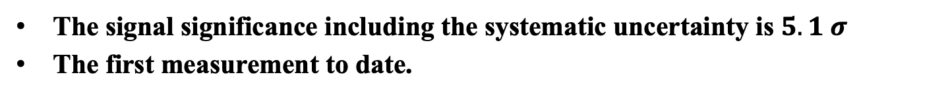
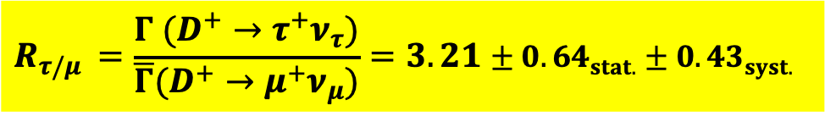
PRL 123 (2019) 211802
The signal significance including the systematic uncertainty is $5.1 σ$
The first measurement to date.
$$B_{D^{+}→τ^{+}ν_{τ}}=\left(1.20±{0.24}_{stat.}±0.12_{syst.} \right)×10^{−3}$$
$$R_{τ/μ }=\frac{Γ (D^{+}→τ^{+}ν_{τ})}{\overline{Γ}(D^{+}→μ^{+}ν_{μ})}=3.21±{0.64}_{stat.}±0.43_{syst.}$$
Consistent with the SM predicted value of 2.67, and no LFU violation in $τ−μ$ flavors with the current precision.

Slide 13
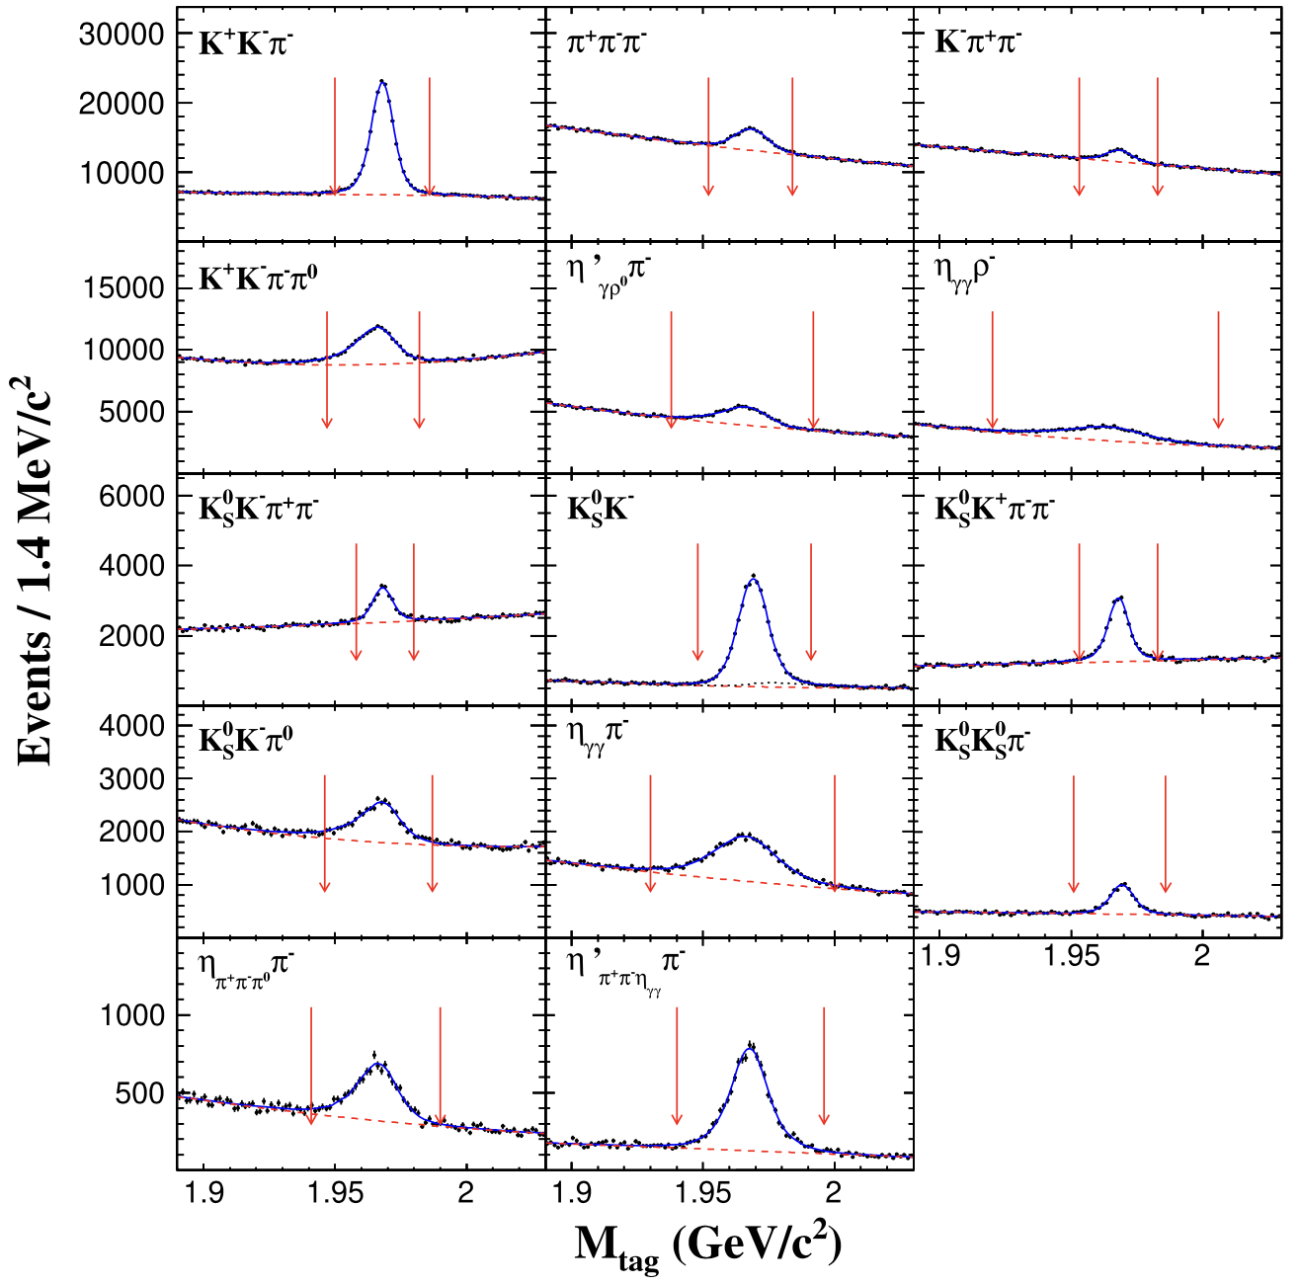


  $$D_{s}^{+}→ μ^{+}ν_{μ}$$
$@4.178$ GeV
$$N_{D_{s}^{−}}=388660±2592$$
PRL 122 (2019) 071802

Slide 14
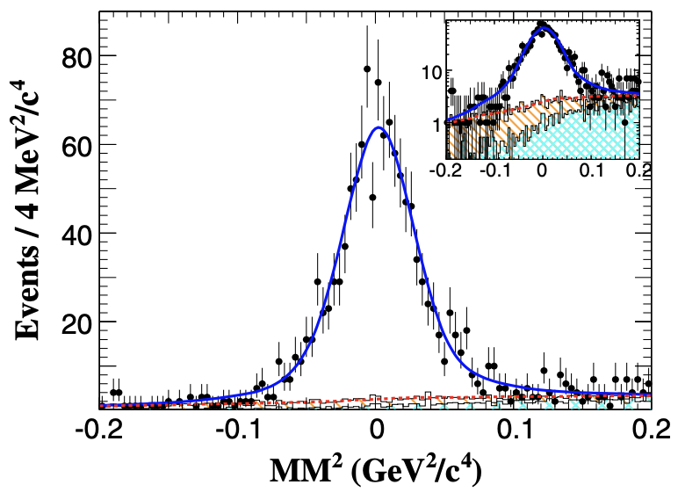
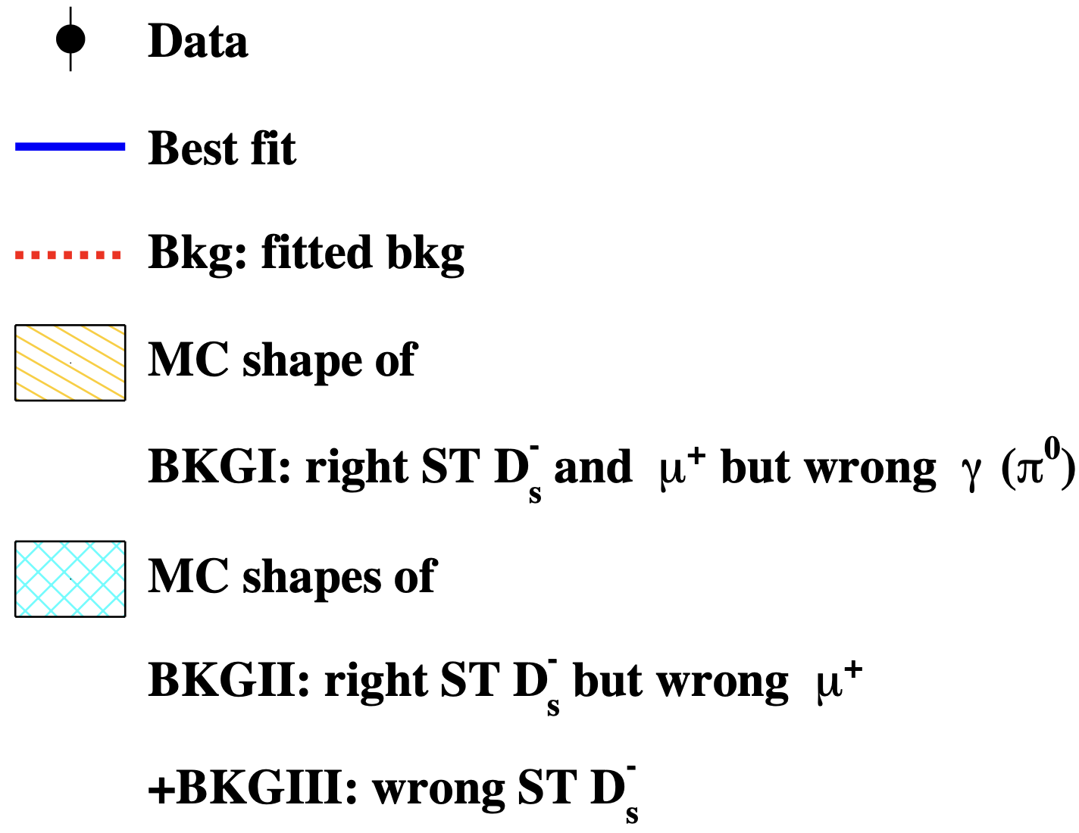
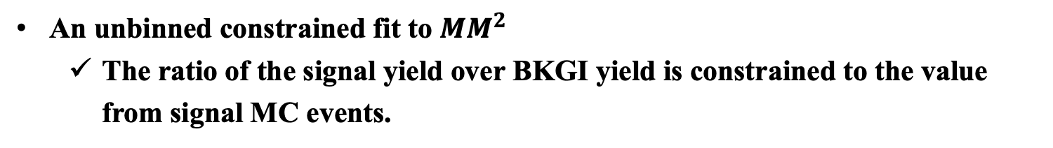


$μ$candidate: use the hit depth in the muon counter
PRL 122 (2019) 071802
An unbinned constrained fit to $MM^{2}$
  The ratio of the signal yield over BKGI yield is constrained to the value from signal MC events.
$$N\left(D_{s}^{+}→μ^{+}ν_{μ}\right)=1135.9±33.1$$
$@4.178$ GeV
$$B_{D_{s}^{+}→μ^{+}ν_{μ}}=\left(5.49±0.16_{stat.}±0.15_{syst.} \right)×10^{−3}$$

Slide 15
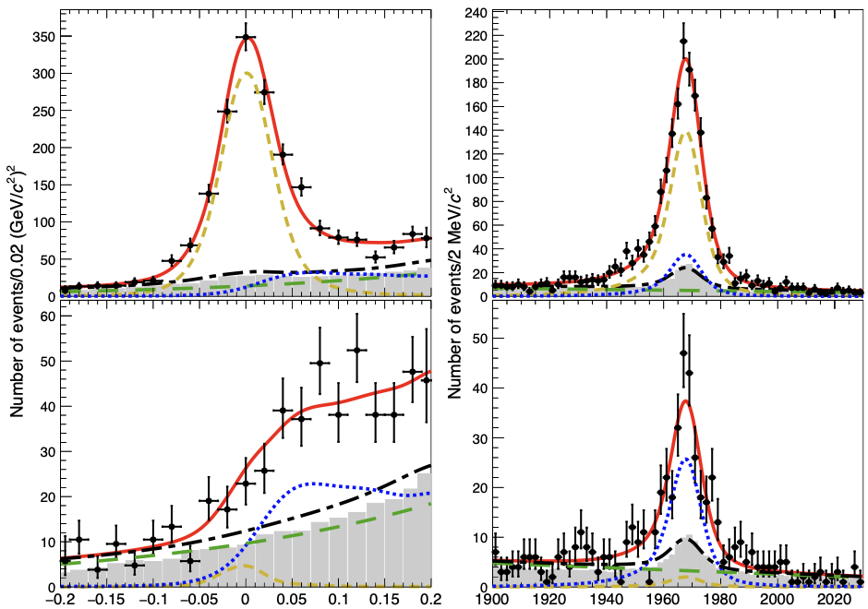
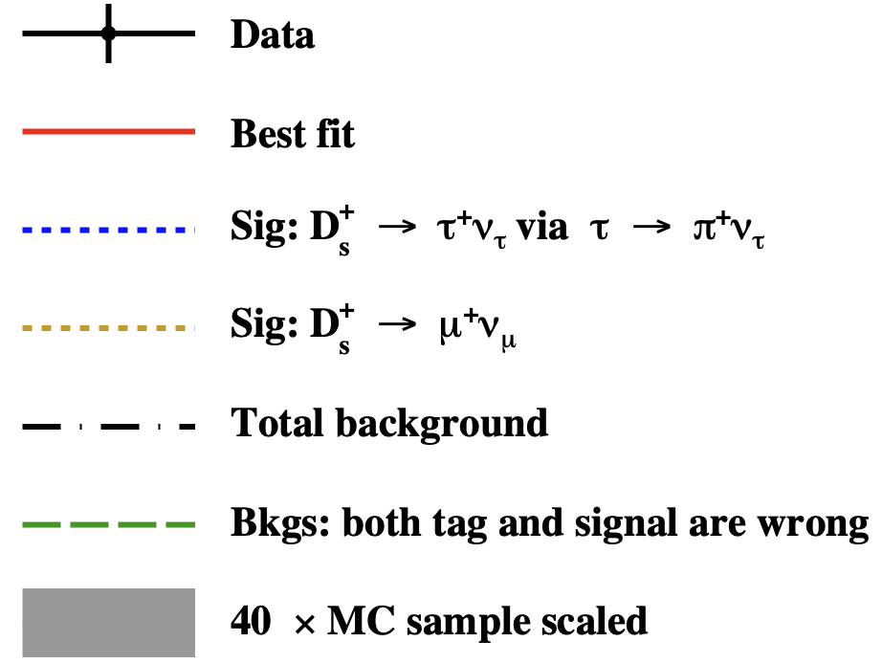




$D_{s}^{+}→τ^{+}ν_{τ} via τ^{+}→π^{+}{\overline{ν}}_{τ}$ and $D_{s}^{+}→μ^{+}ν_{μ}$
$@4.178∼4.23$ GeV
PRD 104 (2021) 052009
$$N\left(D_{s}^{+}→τ^{+}ν_{τ}\right)=946_{−45}^{+46}$$
$$B_{D_{s}^{+}→τ^{+}ν_{τ}}=\left(5.21±{0.25}_{stat.}±0.17_{syst.} \right)×10^{−2}$$
Simultaneous unbinned maximum likelihood
μ-like
Only show @ 4.178 GeV
π-like
$$M_{inv}\left(D_{s}^{−}\right) MeV/c^{2}$$
$$M_{miss}^{2} {\left(GeV/c^{2}\right)}^{2}$$

Slide 16
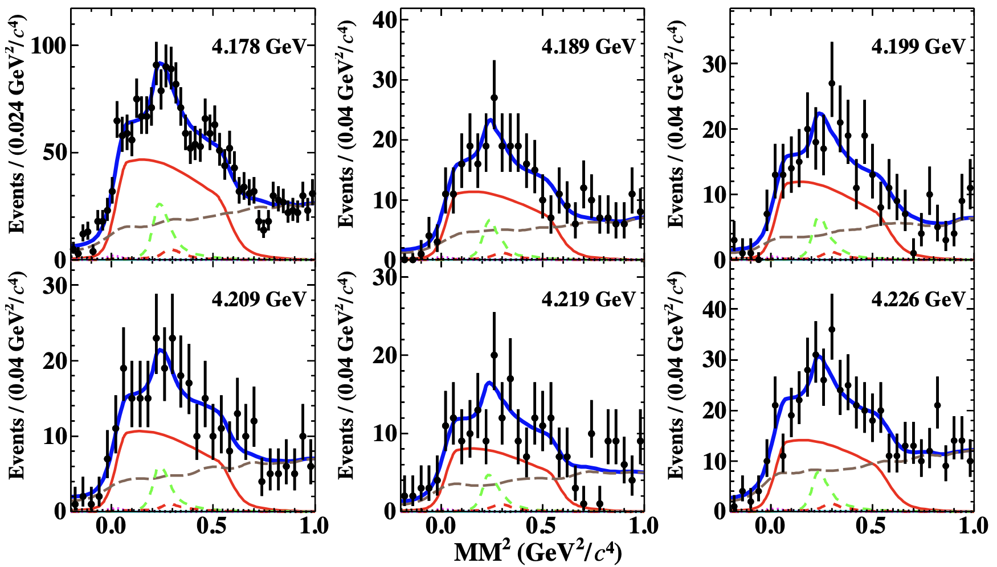
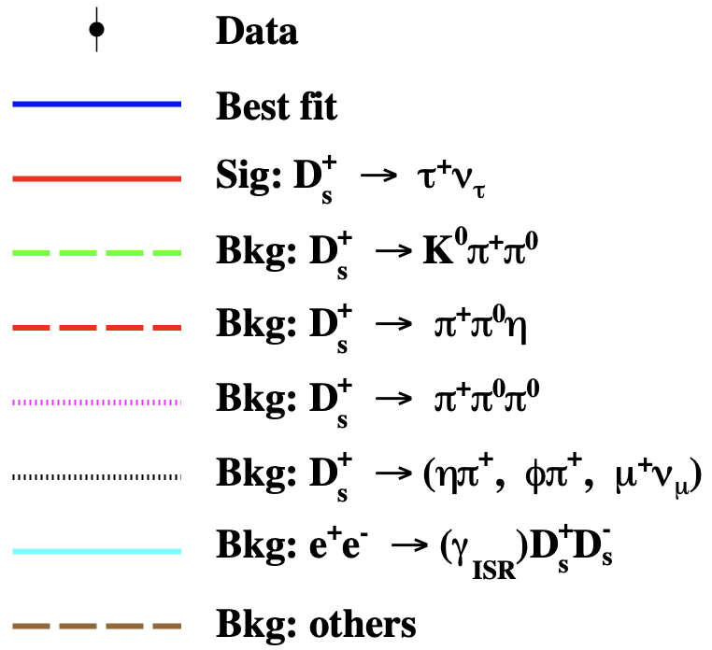


$$D_{s}^{+}→τ^{+}ν_{τ} via τ^{+}→π^{+}π^{0}{\overline{ν}}_{τ}$$
$@4.178∼4.23$ GeV
PRD 104 (2021) 032001
A simultaneous fit to the $MM^{2}$ for six energy points shared with a common leptonic branching fraction.
$$N\left(D_{s}^{+}→τ^{+}ν_{τ}\right)=1745±84$$
$B_{D_{s}^{+}→τ^{+}ν_{τ}}=\left(5.29±0.25_{stat.}±0.20_{syst.}\right)\%$

Slide 17
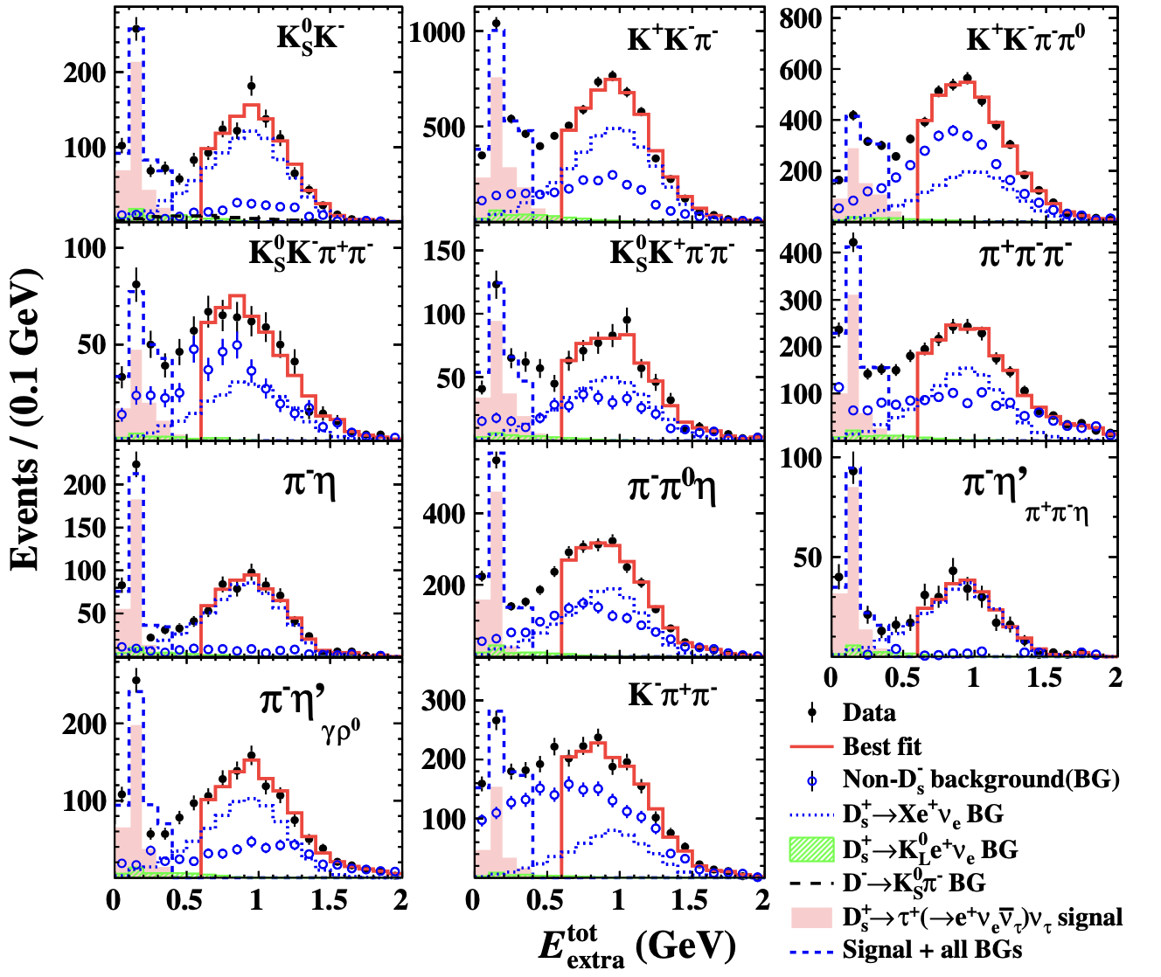

$$D_{s}^{+}→τ^{+}ν_{τ} via τ^{+}→e^{+}ν_{e}{\overline{ν}}_{τ}$$
PRL 127 (2021) 171801
$B_{D_{s}^{+}→τ^{+}ν_{τ}}=\left(5.27±0.10_{stat.}±0.12_{syst.}\right)\%$
$@4.178∼4.23$ GeV

Slide 18
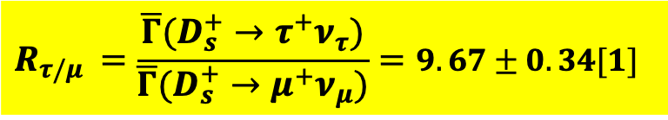
Combine results from BESIII measurements with $6.32 fb^{−1}$ and PDG2021
$$R_{τ/μ }=\frac{\overline{Γ}(D_{s}^{+}→τ^{+}ν_{τ})}{\overline{Γ}(D_{s}^{+}→μ^{+}ν_{μ})}=9.67±0.34[1]$$
Consistent with the SM predicted value of 9.75
No LFU violation in $τ−μ$ flavors with the current precision.
[1] X. Y. Shen, Charm Physics at BESIII/BEPCII Experiment, talk at Charm 2020, Mexico City, Mexico, May 18-22, 2021.

Slide 19
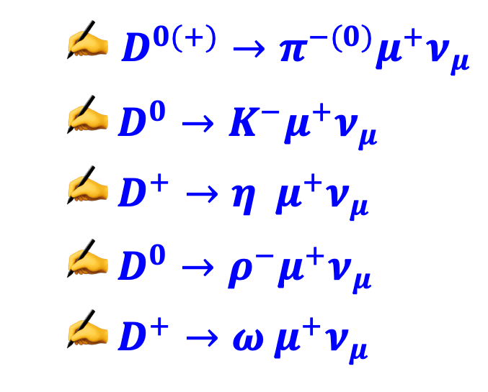
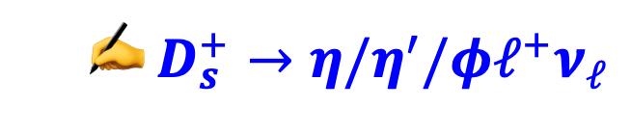
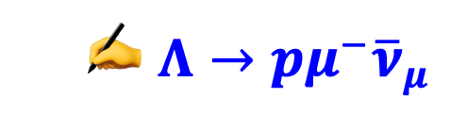
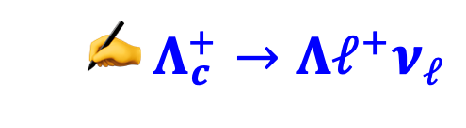
Semi-leptonic decays
  $D^{0(+)}→π^{−(0)}μ^{+}ν_{μ}$
  $D^{0}→K^{−}μ^{+}ν_{μ}$
  $D^{+}→η μ^{+}ν_{μ}$
  $D^{0}→ρ^{−}μ^{+}ν_{μ}$
  $D^{+}→ω μ^{+}ν_{μ}$
PRL 121 (2018) 171803
PRL 122 (2019) 011804
PRL 124 (2020) 231801
arXiv:2106.02292 [hep-ex], accepted by PRD
PRD 101 (2020) 072005
  $D_{s}^{+}→η/η^{′}/φℓ^{+}ν_{ℓ}$
PRD 97 (2018) 012006
PRL 122 (2019) 121801
  $Λ_{c}^{+}→Λℓ^{+}ν_{ℓ}$
PRL 115 (2015) 221805
PLB 767 (2017) 42
  $Λ→pμ^{−}{\overline{ν}}_{μ}$
PRL 127 (2021) 121802

Slide 20
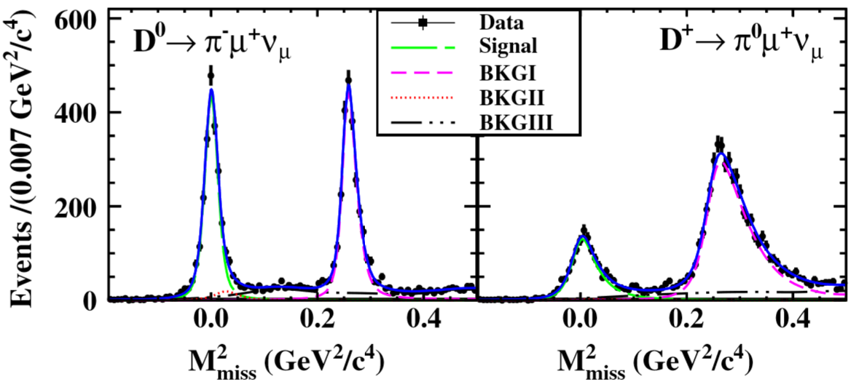
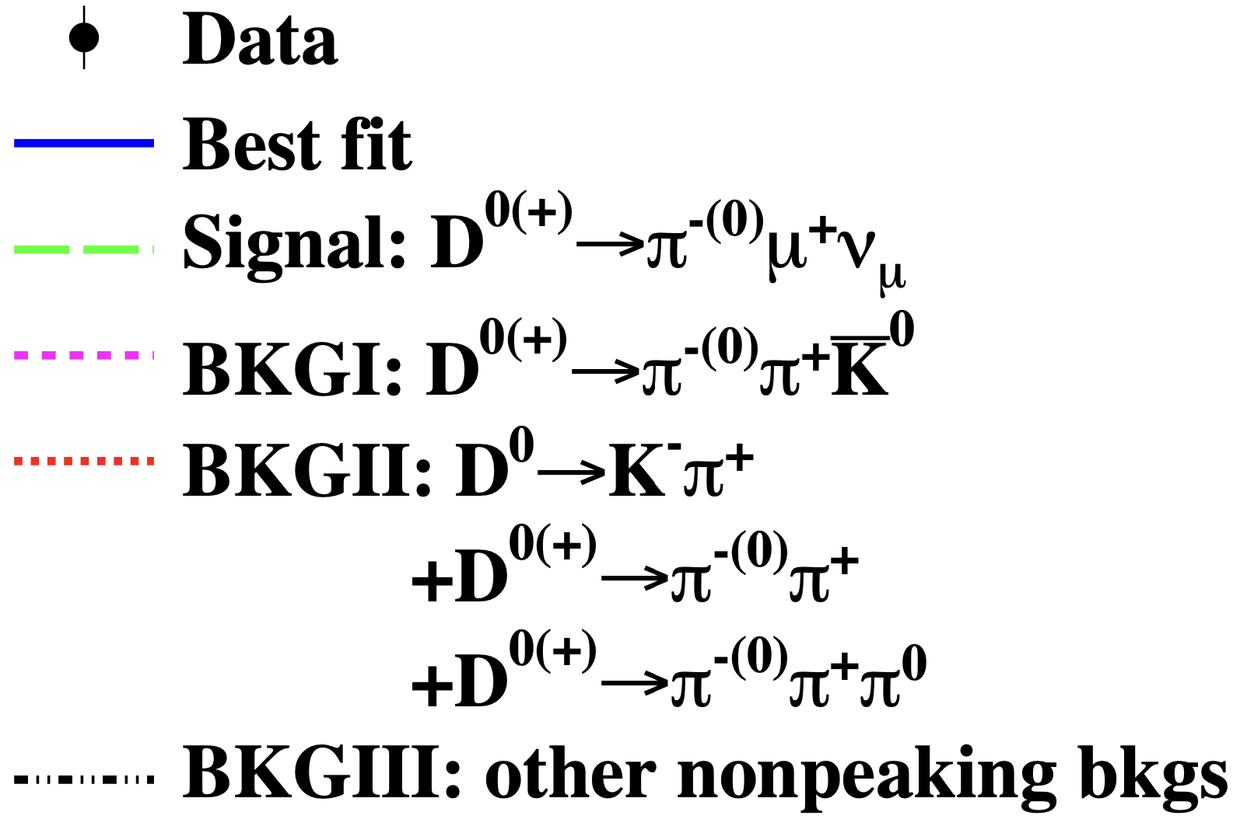


$$D^{0(+)}→π^{−(0)}μ^{+}ν_{μ}$$
Unbinned maximum likelihood fit
PRL 121 (2018) 171803
$$N\left(D^{0}→π^{−}μ^{+}ν_{μ}\right)=2265±63$$
$$N\left(D^{+}→π^{0}μ^{+}ν_{μ}\right)=1335±42$$
$B_{D^{0}→π^{−}μ^{+}ν_{μ}}=\left(0.272±0.{008}_{stat.}±0.{006}_{syst.}\right)\%$
$B_{D^{+}→π^{0}μ^{+}ν_{μ}}=\left(0.350±0.{011}_{stat.}±0.{010}_{syst.}\right)\%$

Slide 21
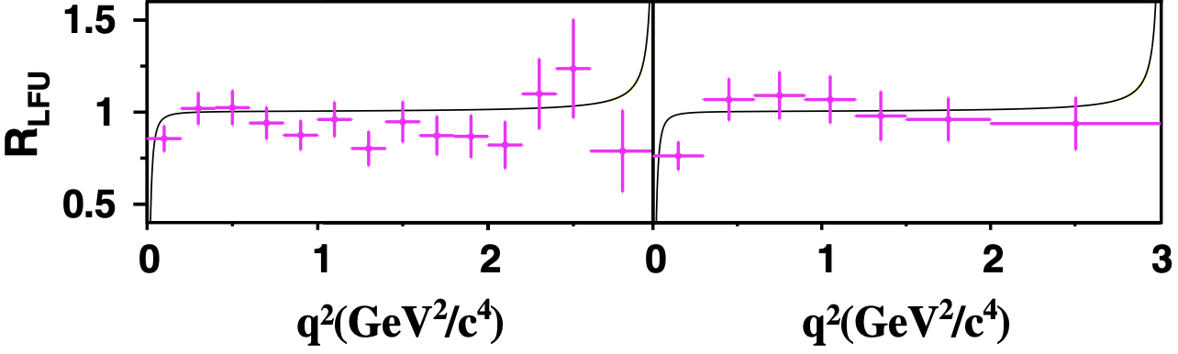

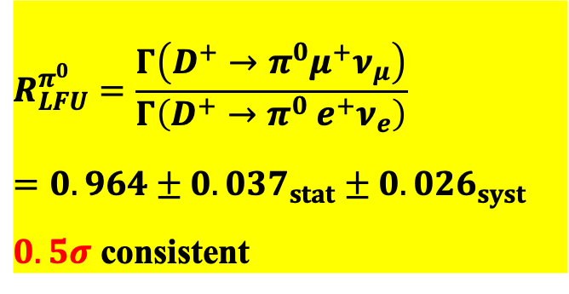

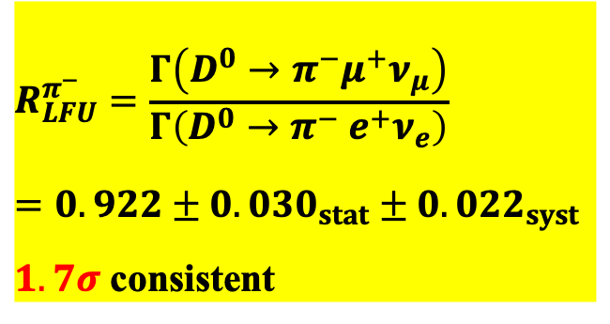

SM expectation: $0.985±0.002$[1]
PRL 121 (2018) 171803
Overall
$$R_{LFU}^{π^{−}}=\frac{Γ\left(D^{0}→π^{−}μ^{+}ν_{μ}\right)}{Γ\left(D^{0}→π^{−} e^{+}ν_{e}\right)}=0.922±0.030_{stat}±0.022_{syst}$$
$1.7σ$ consistent
$$R_{LFU}^{π^{0}}=\frac{Γ\left(D^{+}→π^{0}μ^{+}ν_{μ}\right)}{Γ\left(D^{+}→π^{0} e^{+}ν_{e}\right)}=0.964±0.037_{stat}±0.026_{syst}$$
$0.5σ$ consistent
Local
Consistent within 2σ
$$D^{0}→π^{−}ℓ^{+}ν_{ℓ}$$
$$D^{+}→π^{0}ℓ^{+}ν_{ℓ}$$
[1] L. Riggio, G. Salerno, and S. Simula, EPJC 78, 501 (2018).
Notes:
Combining the BD0ðþÞ→π−ð0Þμþνμ measured in this work with previous BESIII measurements d-> pi e nu

Slide 22







$$D^{0}→K^{−}μ^{+}ν_{μ}$$
$$N\left(D^{0}→K^{−}μ^{+}ν_{μ}\right)=47100±259$$
PRL122(2019)011804
$$U_{miss}=E_{miss} −|{\vec{p}}_{miss}|$$
Local
$B_{D^{0}→K^{−}μ^{+}ν_{μ}}=\left(3.413±0.{019}_{stat.}±0.{035}_{syst.}\right)\%$
$$R_{μ/e}= \frac{Γ\left(D^{0}→K^{−}μ^{+}ν_{μ}\right)}{Γ\left(D^{0}→K^{−} e^{+}ν_{e}\right)}=0.974±0.007_{stat}±0.012_{syst}$$
Overall
SM expectation: $0.975±0.001$[1]
[1] L. Riggio, G. Salerno, and S. Simula, EPJC 78, 501 (2018).
Notes:
Below q2 1⁄4 0.1 GeV2=c4, Rμ=e is signifi-
cantly lower than 1 due to smaller phase space for D0 → −þ
K μ νμ with nonzero muon mass that cannot be neglected

Slide 23








$$D^{+}→ημ^{+}ν_{μ}$$
PRL124(2020)231801
Verification of LFU via $c→d l^{+}ν_{l}$
$η→γγ$
$$Sig.>10σ$$
Unbinned fit to $U_{miss}$
$$Events/(6 MeV)$$
$$N_{DT}^{signal}=234±22$$
$$B_{D^{+}→ημ^{+}ν_{μ}}=\left(10.4±{1.0}_{stat.}±{0.5}_{syst.}\right)×10^{−4}$$
$$−0.1$$
$$0.0$$
$$0.1$$
$$R_{μ/e}=\frac{B_{D^{+}→ημ^{+}ν_{μ}}}{B_{D^{+}→ηe^{+}ν_{e}}^{PDG}}=0.91±0.13$$
$$U_{miss} (GeV)$$
SM prediction: $(0.97−1.00)$
No LFU violation within current sensitivity.
Notes:
Using the world averaged BFs, the difference between the BF ratio of D-> pi l+ nu_l decays which are mediated via c->d l+ nu_l (D-> pi mu+ nu_mu / D-> pi e+ nu_e) and the SM prediction is below 2sigma.Verification of R(c->d)_mu/e with D+ -> eta l+ nu_l decays, which is also mediated via c-> d l+ nu_l decays, is key to clarifying these situations.
The BF obtained will also be important for the determination of the eta-eta’ mixing angle, which will benefit the understanding of nonperturbative quantum-chromodynamics effects.
The vector hadronic FF of the SL decay D+ -> eta mu+ nu_mu is simulated with the modified-pole model, where the parameter alpha of the vector hadronic FF is set to be that of D+ -> pi0 e+ nu_e measured by BESIII, the pole mass is set at the nominal D*+ mass.
Only one muon candidate, and eta candidates with 1C,and perform an unbinned fit to the Umiss distribution;
Dots with error bars: data; the blue solid curve: fit result, the black dotted curve is the fitted nonpeaking bkg, and the difference between red dashed and black dotted curves is the peaking bkg of D+ -> eta pi+ pi0.
The peak bkg of D+ -> eta pi+ pi- and the nonpeaking bkgs(including a small contribution from wrongly reconstructed ST candidates) are described by the conrresponding MC simulated shapes. The yields of the signal and nonpeaking bkg are free parameters of the fit, while the yield of the peaking bkg rom D+ -> eta pi+ pi0 decays is fixed based on MC simulation.
The statistical significance, calculated by \sqrt{-2ln(L_0/L_max)}, is found to be greater than 10 sigma. L_max and L_0 are the maximal likelihood of the nominal fit and that of the fit without signal component, respectively.
To verify the reliability of the efficiency determination, we have compared distributions of momenta and costheta of the eta and mu+ of the selected D+ -> eta mu+ nu_mu candidate events between data and MC simulation, and they are in good agreement.
0.13: is the sum in quadrature of the statistical and systematic error, but dominated by the statistical error.
SM prediction: QCD light cone sum rules (LCSR), covariant confined quark model(CCQM),convariant light-front quark model
The efficiency is 37.52\pm0.13 %

Slide 24







$$D^{0}→ρ^{−}μ^{+}ν_{μ}$$
$ρ^{−}→π^{−}π^{0}$
arXiv:2106.02292 [hep-ex], accepted by PRD
$$N_{DT}^{signal}=570±40$$
$$B_{D^{0}→ρ^{−}μ^{+}ν_{μ}}=\left(1.35±{0.09}_{stat.}±{0.09}_{syst.}\right)×10^{−4}$$
$$Sig.>10σ$$
$$R_{μ/e}=\frac{B_{D^{0}→ρ^{−}μ^{+}ν_{μ}}}{B_{D^{0}→ρ^{−}e^{+}ν_{e}}^{PDG}}=0.90±0.11$$
consistent
SM prediction: $(0.93−0.96)$

Slide 25






$$D^{+}→ω μ^{+}ν_{μ}$$
$ω→π^{+}π^{−}π^{0}$
PRD 101 (2020) 072005
$$N_{DT}^{signal}=194±20$$
$$B_{D^{+}→ωμ^{+}ν_{μ}}=\left(17.7±{1.8}_{stat.}±{1.1}_{syst.}\right)×10^{−4}$$
$$R_{μ/e}=\frac{B_{D^{+}→ωμ^{+}ν_{μ}}}{B_{D^{+}→ωe^{+}ν_{e}}^{PDG}}=1.05±0.14$$
consistent
SM prediction: $(0.93−0.99)$

Slide 26











$$D_{s}^{+}→η/η^{′}/φℓ^{+}ν_{ℓ}$$
PRD 97 (2018) 012006
PRL 122 (2019) 121801
$@4.009$ GeV, 0.482 fb⁻¹
$@4.178$ GeV, 3.189 fb⁻¹
$$φe^{+}ν_{e}$$
$$φμ^{+}ν_{μ}$$
$$ημ^{+}ν_{μ}$$
$$η′μ^{+}ν_{μ}$$
$$\frac{B_{D_{s}^{+}→φμ^{+}ν_{μ}}}{B_{D_{s}^{+}→φe^{+}ν_{e}}}=0.86±0.29$$
$$\frac{B_{D_{s}^{+}→η′μ^{+}ν_{μ}}}{B_{D_{s}^{+}→η′e^{+}ν_{e}}}=1.29±0.67$$
$$\frac{B_{D_{s}^{+}→ημ^{+}ν_{μ}}}{B_{D_{s}^{+}→ηe^{+}ν_{e}}}=1.04±0.21$$
Consistent with unity within uncertainty, no obvious LFU violation is observed.

Slide 27













$$Λ_{c}^{+}→Λℓ^{+}ν_{ℓ}$$
$@4.599$ GeV, 0.567 fb⁻¹
PRL 115 (2015) 221805
PLB 767 (2017) 42
$$N_{{\overline{Λ}}_{c}^{−}}=14415±159$$
$$K^{+}$$
$$\overline{p}$$
Tag
$$π^{−}$$
$${\overline{Λ}}_{c}^{−}$$
$$e^{+}$$
4.599 GeV
$$e^{−}$$
$$Λ_{c}^{+}$$
Signal
$$Λ$$
$$ν_{ℓ}$$
$$ℓ^{+}$$

Slide 28








PRL 115 (2015) 221805
PLB 767 (2017) 42
$$N_{Λ_{c}^{+}→Λe^{+}ν_{e}}^{signal}=103.5±10.9$$
$$N_{Λ_{c}^{+}→Λμ^{+}ν_{μ}}^{signal}=78.7±10.5$$
$$Λ_{c}^{+}→Λe^{+}ν_{e}$$
$$Λ_{c}^{+}→Λμ^{+}ν_{μ}$$
$$\frac{B_{Λ_{c}^{+}→Λμ^{+}ν_{μ}}}{B_{Λ_{c}^{+}→Λe^{+}ν_{e}}}=0.96±0.16_{stat}±0.04_{syst}$$
Consistent with unity.
Notes:
Lambdac -> lambda pi+ pi0 bkg

Slide 29







$$Λ→pμ^{−}{\overline{ν}}_{μ}$$
10 billion $J/ψ$ events
PRL 127 (2021) 121802
$$N_{Λ→pμ^{−}{\overline{ν}}_{μ} }^{signal}=64±9$$
$$N_{\overline{Λ}}=14,609,800±7,117$$
$$\frac{Γ_{Λ→pμ^{−}{\overline{ν}}_{μ}}}{Γ_{Λ→pe^{−}{\overline{ν}}_{e}}^{PDG}}=0.178±0.028$$
Consistent
$0.153±0.008$(SM expectation)

Slide 30

Summary
With data samples of 2.93 $fb^{−1}$ @ 3.773 GeV, 6.32 fb⁻¹ from 4.178-4.23 GeV, 0.567 fb⁻¹ from 4.599 GeV, and 10 billion $J/ψ$ events, BESIII have tested the LFU.
BESIII Signal | Ratio $( \frac{μ}{e} )$ |  | Deviation
Signal | Measurement | Expectation
$$D^{0}→π^{−}μ^{+}ν_{μ}$$ [PRL121(2018)171803] | $$0.922±0.030±0.022$$ | $$0.985±0.002$$ | $$1.7σ$$
$$D^{+}→π^{0}μ^{+}ν_{μ}$$ [PRL121(2018)171803] | $$0.964±0.037±0.026$$ |  | $$0.5σ$$
$$D^{0}→K^{−}μ^{+}ν_{μ}$$ [PRL122(2019)011804] | $$0.974±0.007±0.012$$ | $$0.975±0.001$$ | $$0.1σ$$
$$D^{+}→η μ^{+}ν_{μ}$$ [PRL124(2020)231801] | $$0.91±0.13$$ | $$0.97−1.00$$ | $$0.7σ$$
$$D^{0}→ρ^{−}μ^{+}ν_{μ}$$ arXiv:2106.02292 [hep-ex], accepted by PRD | $$0.90±0.11$$ | $$0.93−0.96$$ | $$0.5σ$$
$$D^{+}→ω μ^{+}ν_{μ}$$ [PRD101(2020)072005] | $$1.05±0.14$$ | $$0.93−0.99$$ | $$0.9σ$$

Slide 31

BESIII Signal | Ratio $(R)$ |  | Deviation
Signal | Measured | SM Expected
$$D^{+}→ℓ^{+}ν_{ℓ}$$ [PRL123(2019)211802] [PRD89(2014)051104(R)] | $$\frac{τ}{μ}=3.21±0.64±0.43$$ | $$2.67$$ | $$0.7σ$$
$$D_{s}^{+}→ℓ^{+}ν_{ℓ}$$ [PRL122(2019)071802] [PRL127(2021)171801] [PRD104(2021)032001] [PRD104(2021)052009] | $$\frac{τ}{μ}=9.67±0.34$$ | $$9.75$$ | $$0.2σ$$
$$D_{s}^{+}→ηℓ^{+}ν_{ℓ}$$ [PRL122(2019)121801] [PRD97(2018)012006] | $$\frac{μ}{e}=1.04±0.21$$ | $$1.0$$ | $$0.2σ$$
$$D_{s}^{+}→η′ℓ^{+}ν_{ℓ}$$ [PRL122(2019)121801] [PRD97(2018)012006] | $$\frac{μ}{e}=1.29±0.67$$ | $$0.975±0.001$$ | $$0.4σ$$
$$D_{s}^{+}→φℓ^{+}ν_{ℓ}$$ [PRD97(2018)012006] | $$\frac{μ}{e}=0.86±0.29$$ | $$0.985±0.002$$ | $$0.5σ$$
$$Λ→pμ^{−}{\overline{ν}}_{μ}$$ [PRL127(2021)121802] | $$\frac{μ}{e}=0.178±0.028$$ | $$0.153±0.008$$ | $$0.9σ$$
$$Λ_{c}^{+}→Λ ℓ^{+}ν_{ℓ}$$ [PRL115(2015)221805] [PLB767(2017)42] | $$\frac{μ}{e}=0.96±0.16±0.04$$ | $$1.0$$ | $$0.1σ$$

Slide 32

No obvious LFU violation is observed with the current precision.
In the near future, BESIII will collect 20 $fb^{−1}$@ 3.773 GeV data sample, another 3 fb⁻¹ @ 4.178 GeV, and 15 $fb^{−1}$@ 4.6-4.9 GeV, the single precisions for $D_{(s)} and Λ_{c}$ decays will be further improved.
Thanks for your attention!

Slide 33
Backup

Slide 34

From Prof. Beijiang Liu

Slide 35





$D^{+}→{\overline{K}}^{0}μ^{+}ν_{μ}$
EPJC 76(2016) 369
Simultaneous fit: The double tag production yield has been constrained to be same for the two modes, which is corrected by the detector efficiency and daughter decay branching fractions:
$${signal: \overline{K}}^{0}→π^{+} π^{−}$$
$$N^{obs}= 16516±130$$
$$N_{DT}^{prd}=132712±1041$$
$$B\left(D^{+}→{\overline{K}}^{0} μ^{+} {ν_{μ}}_{ }\right)=\left(8.72±0.07±0.18\right)\%$$
$$D^{+}→{\overline{K}}^{0}π^{+}π^{0}$$
$${signal: \overline{K}}^{0}→π^{0} π^{0}$$
Lepton universality:
$N^{obs}=4198±$33
Others
$$\frac{Γ\left(D^{+}→{\overline{K}}^{0}μ^{+}ν_{μ}\right)}{Γ\left(D^{+}→{\overline{K}}^{0} e^{+}ν_{e}\right)}=0.988±0.033$$
consistent
$B(D^{+}→{\overline{K}}^{0} e^{+} ν_{e})$ is from PDG
$$U_{miss}(GeV)$$

