Slide 1
UT status
Xiaokang Zhou
2021.06.01

Slide 2
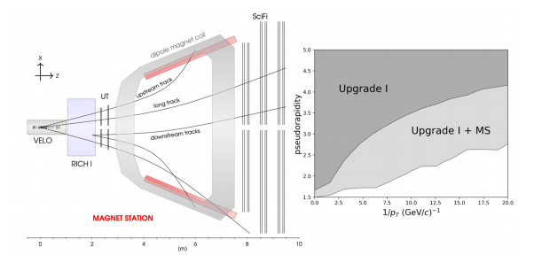
Motivation
Increase the UT acceptance (x axis) to see the efficiency increase of the reconstructed tracks?

Slide 3
Method
Add staves (now 16 for UTa and 18 for UTb)
25 bit constraint, more staves may cause problem
Enlarge stave/sensor width
Upgrade/UTv4r2-newUTID

Slide 4
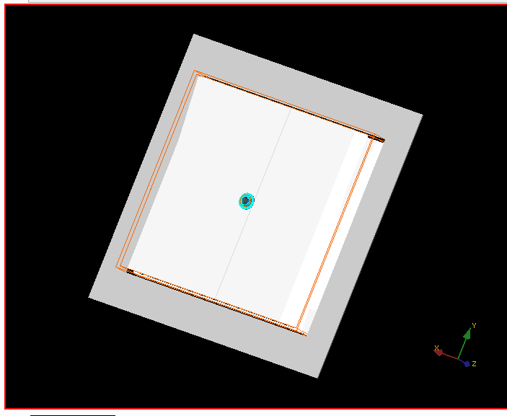
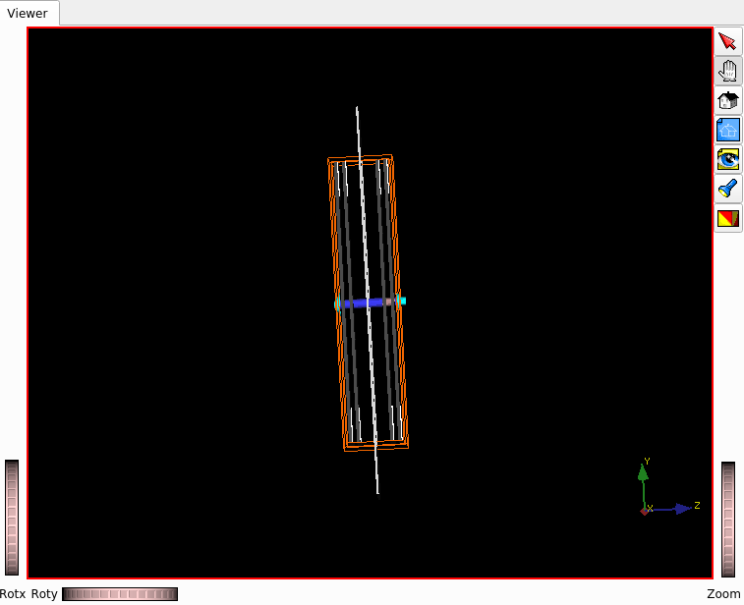
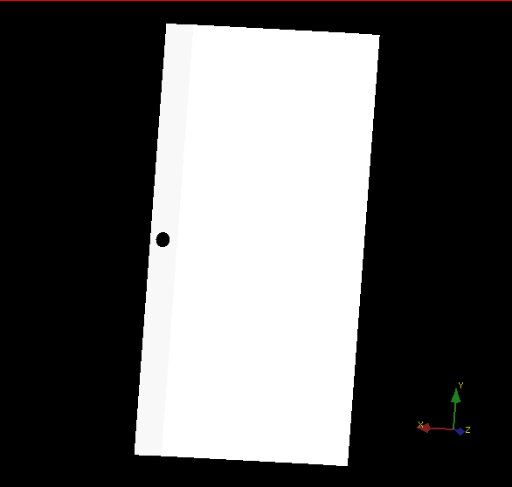
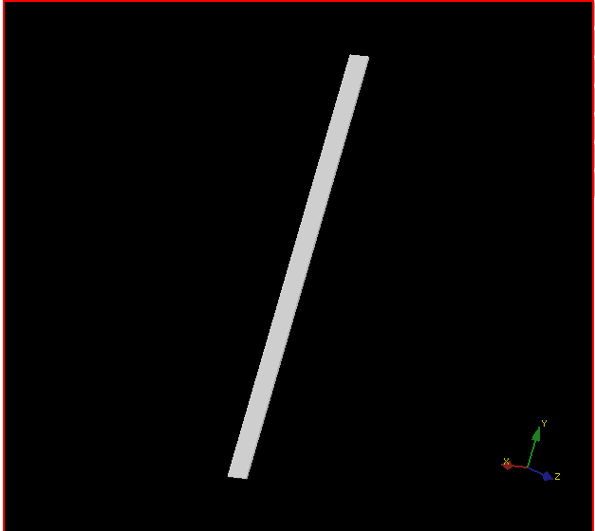
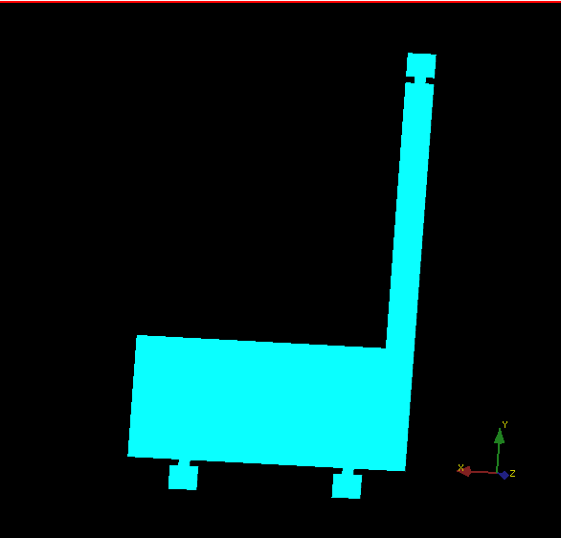
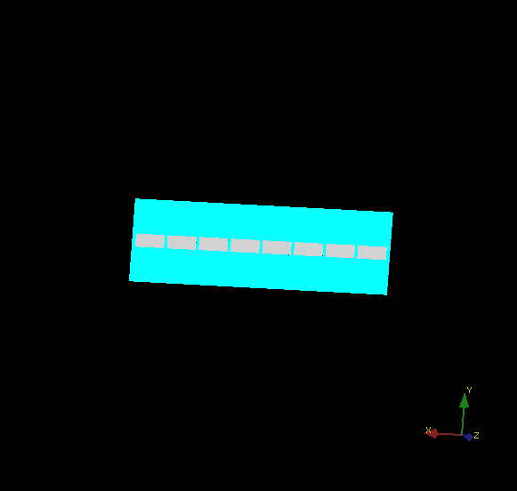
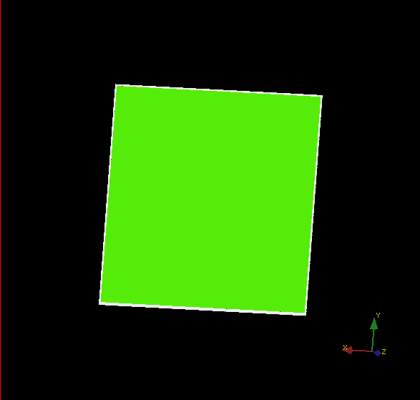
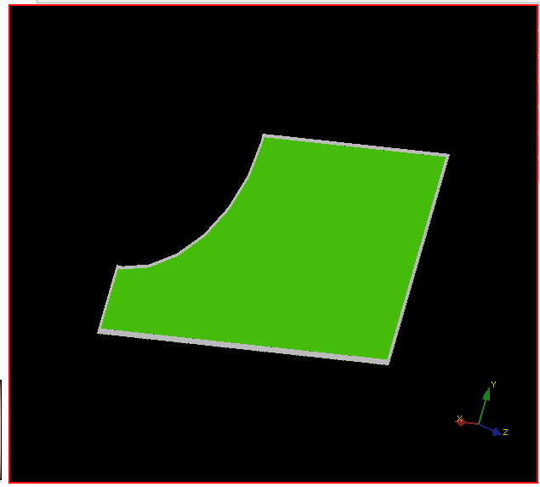
Origin performance

Slide 5
Parameters
UTSensorWide : 97.5→195 mm
Do not change overlap
UTSensorGRWideSide
UTAsicWide : 10.9→21.8 mm
UTAnchorWide : 10→20 mm
UTMegArrayWide : 55→110 mm
UTHVConnectorWide : 20→40 mm
UTBoxOuterWide : 2040→4080 mm
UTVirtualBoxWide : 2586→5172 mm
Pitch : 0.1873/0.09365→0.3746/0.1863 mm

Slide 6
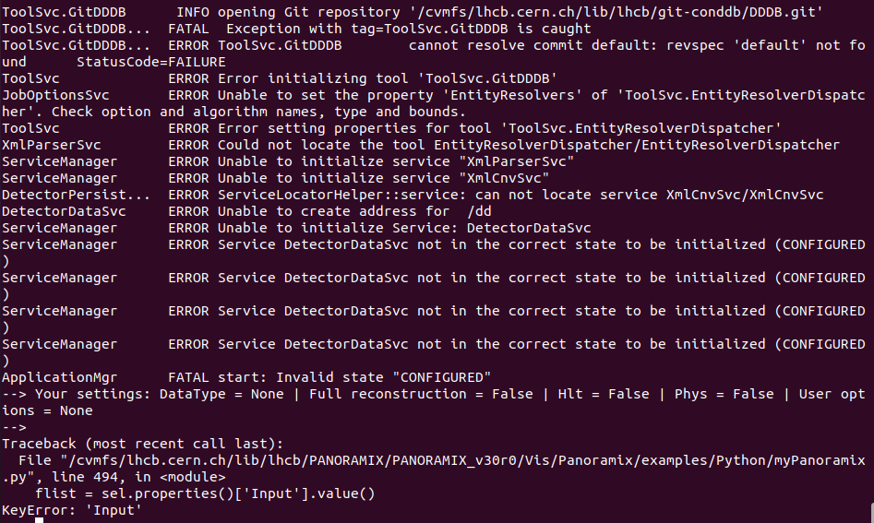
Problem
Local test
Replace the “git:” to local directory
Add ”DDDBConf().DbRoot = ‘~/xxx/DDDB/lhcb.xml’” in python script
export GITCONDDBPATH=$(pwd)
Git test
Do not know how to use upgrade/master

