Slide 1
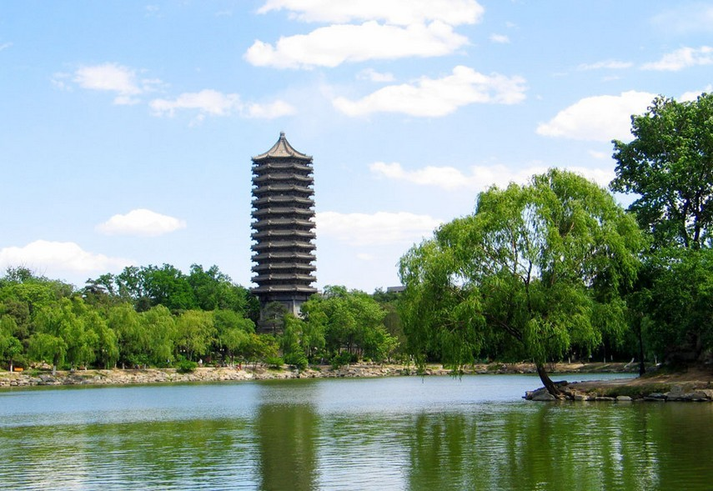
Spin polarization within the hydrodynamic approach
宋慧超
北京大学 物理学院
“量子色动力学的相结构和新颖拓扑效应研究”年度学术交流会
山东青岛 2022年7月29-31
July 30 2022

Slide 2
A brief history for spin polarization
The earlier but very pioneering work:
Spin-orbital coupling
Global polarization of Λ and spin alignment of vector mesons from spin-orbital coupling
Global polarization of quarks
Z. T. Liang, X. N. Wang, Phys. Rev. Lett. 94
(2005) 102301, Phys.Lett.B 629 (2005) 20-26
Polarization of final hadron
(recombination/fragmentation)
Motivate the spin polarization measurements in experiments!

Slide 3
Global polarization measurements in heavy ion collisions

Slide 4
Spin polarization within the statistical approach
Mean spin vector with thermal vorticity:
F. Becattini,et al, Annals Phys. 338, 32 (2013）
obtained with density operator with
thermal vorticity:

Slide 5
Spin Polarization within hydrodynamics
Mean spin vector with thermal vorticity:
F. Becattini,et al, Annals Phys. 338, 32 (2013）
Spin polarization within hydrodynamics (Spin Cooper-Fryer):
Boost to particle rest frame:

Slide 6
Spin Polarization within hydrodynamics
Spin vector with thermal vorticity:
F. Becattini,et al, Annals Phys. 338, 32 (2013）
Spin polarization within hydrodynamics (Spin Cooper-Fryer):
Boost to particle rest frame:

Slide 7
Calibrated hydro for polarization study
B. Fu, K. Xu, X-G, Huang, H. Song, Phys.Rev.C103 2, 024903 (2021)
Polarization from
hydrodynamics
Boost to particle
rest frame

Slide 8
Global Λ Polarization with thermal vorticity
B. Fu, K. Xu, X-G, Huang, H. Song, Phys.Rev.C103 2, 024903 (2021)
-Decrease with the collision energy; increase with centrality;
-Roughly describe the data within error bars

Slide 9
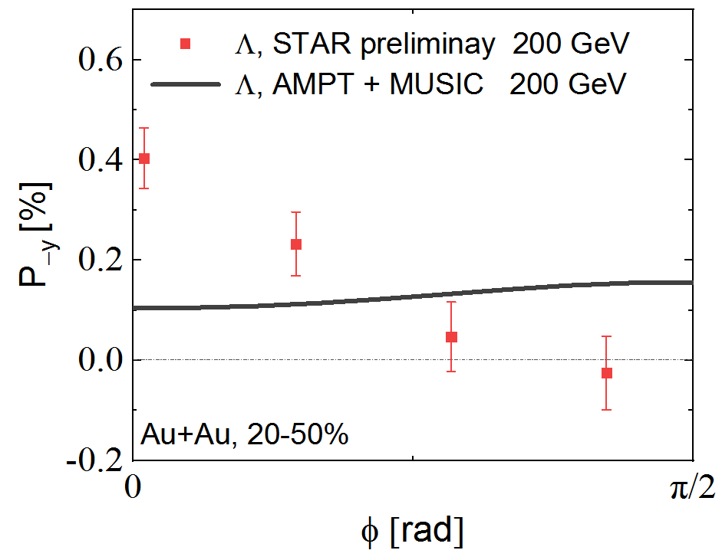
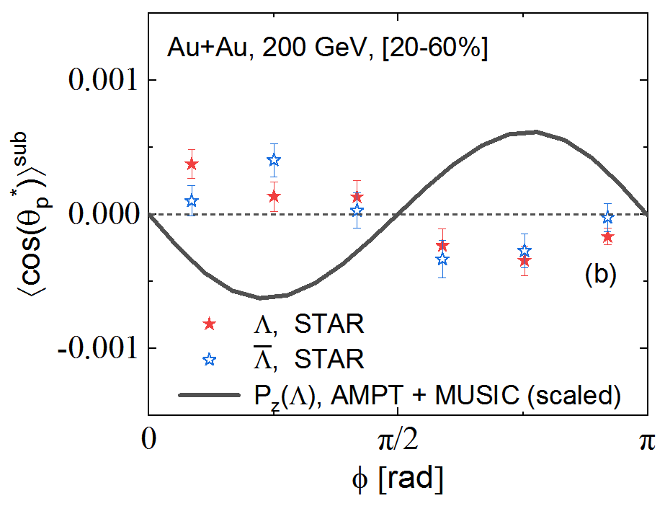
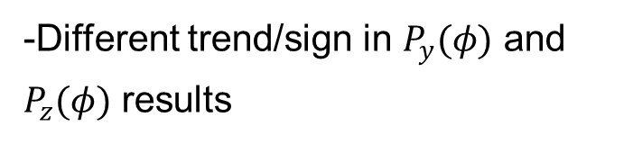


Local Λ Polarization puzzle with thermal vorticity
B. Fu, K. Xu, X-G, Huang, H. Song, Phys.Rev.C103 2, 024903 (2021)
$$P^{y}(φ)$$
$$P^{z}(φ)$$
-Different trend/sign in $P_{y}(φ)$ and $P_{z}(φ)$ results
See also:
Karpenko, Becattini, EPJC 77 (2017) 4, 213
D. Wei, et al., PRC 99 (2019) 014905
-Local Λ Polarization Puzzle！
X. Xia, et al., PRC 98 (2018) 024905
Becattini, Karpenko, PRL 120 (2018) 012302

Slide 10
Efforts to Solve the Local Polarization Puzzle
Feed-down effects (Xia, Li, Huang, Huang, PRC 2019, Becattini, Cao, Speranza, EPJC 2019) [no obvious effects]
Other spin chemical potential (Wu, Pang, Huang, Wang, PRR 2019) [extra assumption]
Polarization from projected thermal vorticity (Florkowski, Kumar, Ryblewski, Mazeliauskas, PRC 2019) [extra assumption]
Side-jump in CKT (Liu, Ko, Sun, PRL 2019) [massless limit/ extra assumption]
Spin as a dynamical d.o.f: [under development]
spin hydrodynamics (Florkowski, et al., PRC2017, Hattori, et al., PLB 2019, Shi, et al,
PRC 2021, …)
spin kinetic theory (Gao and Liang, PRD 2019, Weickgenannt ,et al PRD 2019, Hattori,
et al PRD 2019, Wang, et al, PRD 2019, Liu, et al, CPC 2020, Hattori, et al, PRD 2019)
Final hadronic interactions (Xie and Csernai, ECT talk 2020, Csernai, Kapusta, Welle,
PRC 2019)
… … … …

Slide 11
Shear induced polarization
& the Local polarization puzzle
B. Fu, S. Liu, L. -G. Pang, H. Song, Y. Yin, Phys.Rev.Lett. 127 14, 142301(2021）

Slide 12
Re-evaluate mean spin vector
F. Becattini, et al. Annals Phys. 338 32 (2013)
[Strain induced polarization]
In crystal physics:
Crooker and Smith, PRL (2005) 94, 236601；Kissikov, et al., Nature Comm. (2018) 9, 1058
Traditional mean
spin vector

Slide 13
Shear Induced Polarization
B. Fu, S. Liu, L. -G. Pang, H. Song, Y. Yin, Phys.Rev.Lett. 127 14, 142301(2021）
Axial Wigner function from CKT
Chen, Son, Stephanov, PRL 115 (2015) 2, 021601
Expand $𝒜^{μ}$ to 1st order gradient of the fields:
-Identical form by linear response theory with arbitrary mass
S.Y.F.Liu and Y.Yin, JHEP07, 188 (2021).
-No free parameter
-Different mass sensitivity of each term

Slide 14
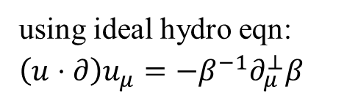

Shear Induced Polarization
B. Fu, S. Liu, L. -G. Pang, H. Song, Y. Yin, Phys.Rev.Lett. 127 14, 142301(2021）
Expand $𝒜^{μ}$ to 1st order gradient of the fields:
using ideal hydro eqn:
$$\left(u⋅∂\right)u_{μ}=−β^{−1}∂_{μ}^{⊥}β$$
$$π_{μν}=\frac{1}{2}(∂_{ν }β_{μ}−∂_{μ}β_{ν})$$
Thermal vorticity
Spin Cooper-Frye

Slide 15

‘$Λ$ equilibrium’ vs. ‘S-quark memory’
B. Fu, S. Liu, L. -G. Pang, H. Song, Y. Yin, Phys.Rev.Lett. 127 14, 142301(2021）
Spin polarization on the freeze-out surface

Slide 16
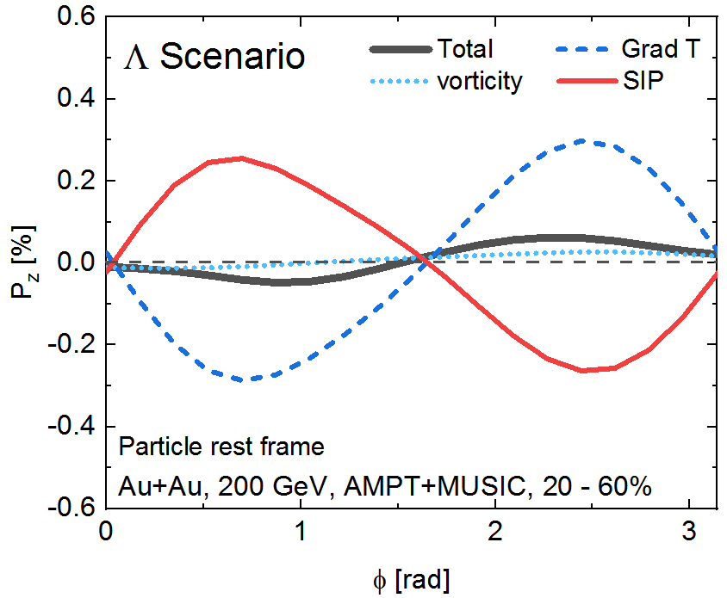
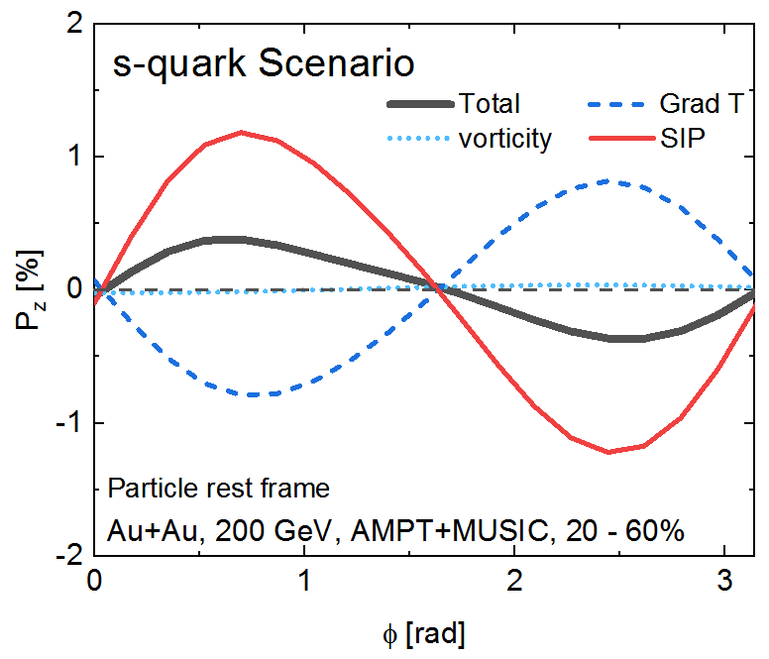
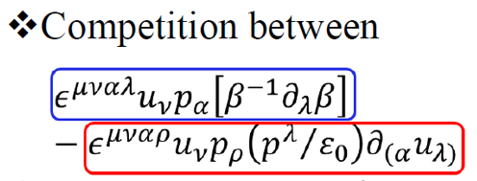


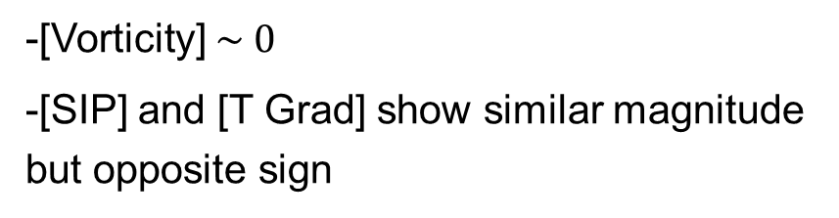
$P_{z}\left(φ\right):$ competition between T-gradient and shear (SIP) effects
B. Fu, S. Liu, L. -G. Pang, H. Song, Y. Yin, Phys.Rev.Lett. 127 14, 142301(2021）
$$m_{Λ}=1.116 GeV$$
$$m_{s}=0.3 GeV$$
Total $P^{μ}$= Vorticity + T gradient + Shear (SIP) =Thermal vorticity + Shear effects
-[Vorticity] $\sim 0$
-[SIP] and [T Grad] show similar magnitude but opposite sign
Notes:
expressed as a competition between

Slide 17
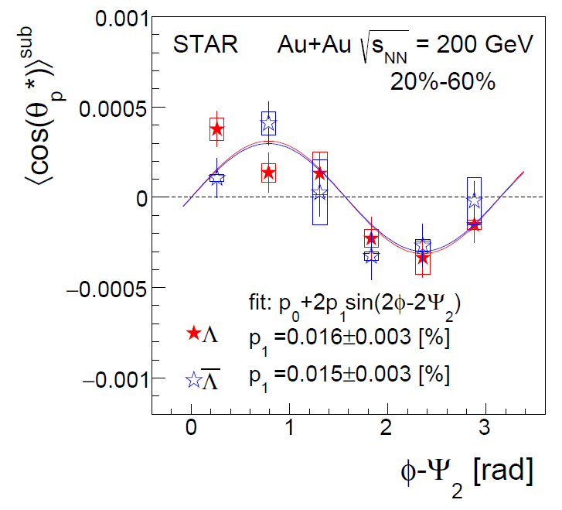
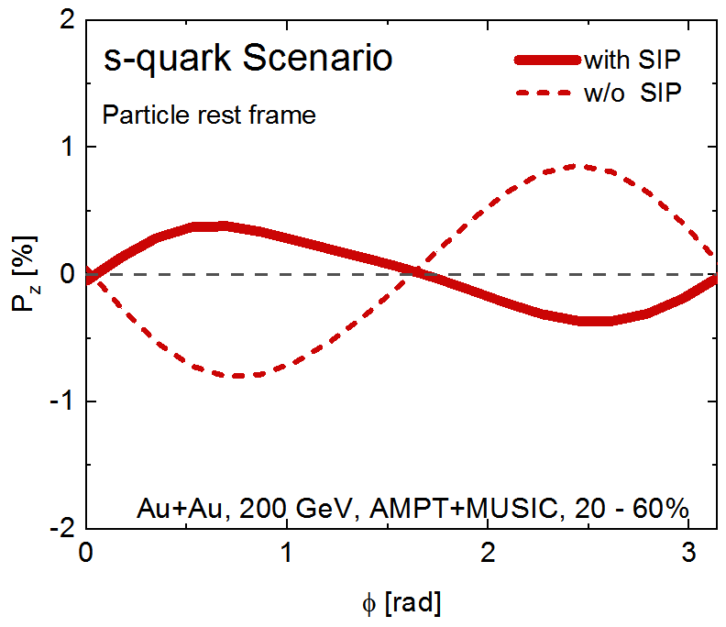
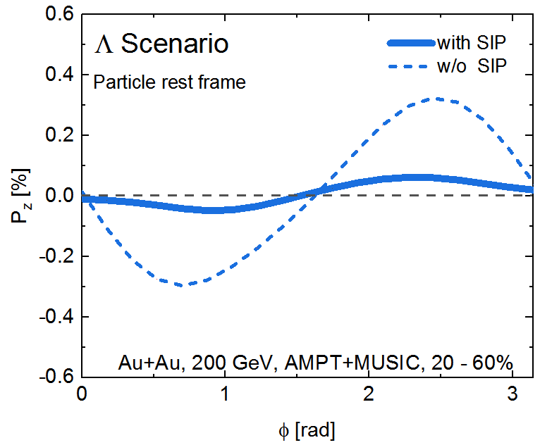


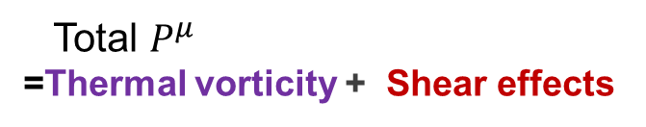
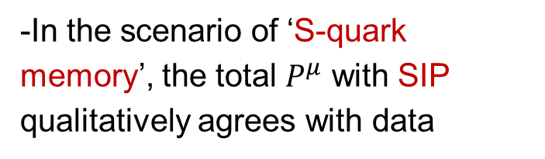
Compare with exp data: $P_{z}\left(φ\right)$ with & without SIP
B. Fu, S. Liu, L. -G. Pang, H. Song, Y. Yin, Phys.Rev.Lett. 127 14, 142301(2021）
STAR, Phys.Rev.Lett. 123 (2019) 132301
$$m_{s}=0.3 GeV$$
Total $P^{μ}$
=Thermal vorticity + Shear effects
-In the scenario of ‘S-quark memory’, the total $P^{μ}$ with SIP qualitatively agrees with data
$$m_{Λ}=1.116 GeV$$

Slide 18
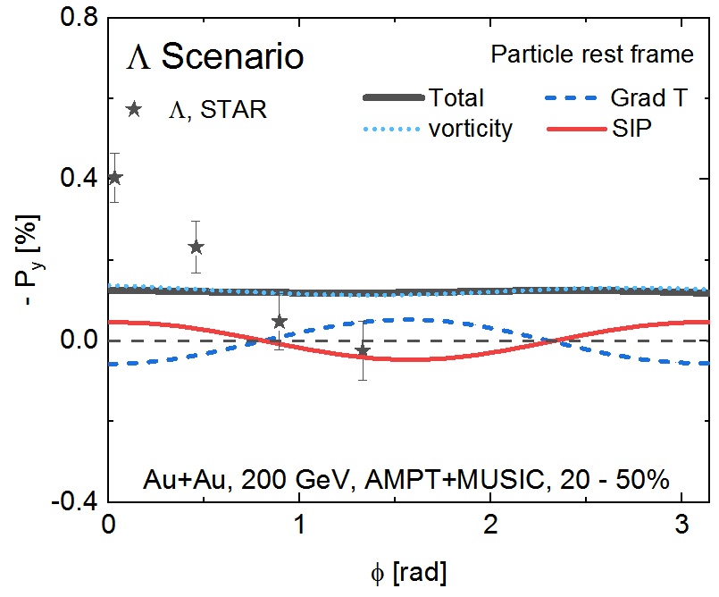
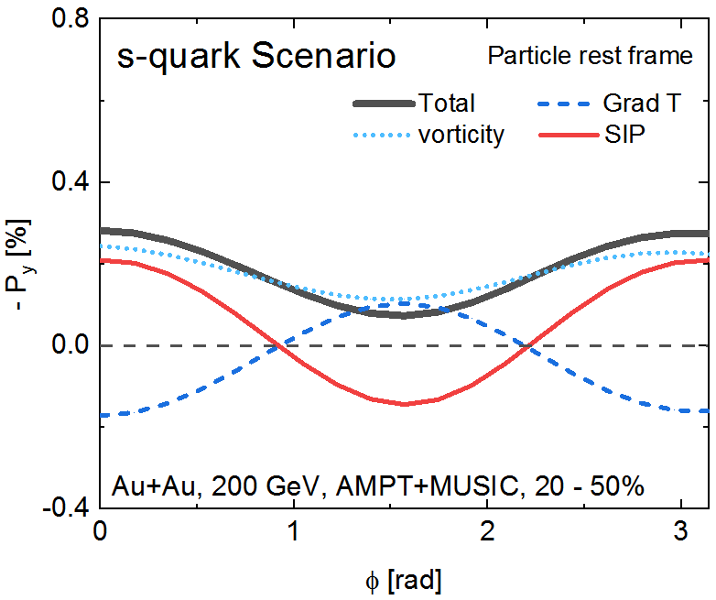


$P_{y}\left(φ\right):$ competition between T-gradient and shear (SIP) effects
B. Fu, S. Liu, L. -G. Pang, H. Song, Y. Yin, Phys.Rev.Lett. 127 14, 142301(2021）
$$m_{Λ}=1.116 GeV$$
$$m_{s}=0.3 GeV$$
Total $P^{μ}$= Vorticity + T gradient + Shear (SIP) =Thermal vorticity + Shear effects
-[Vorticity]: dominant, contribute most to the global polarization
-[SIP] and [T Grad] show similar magnitude but opposite sign

Slide 19
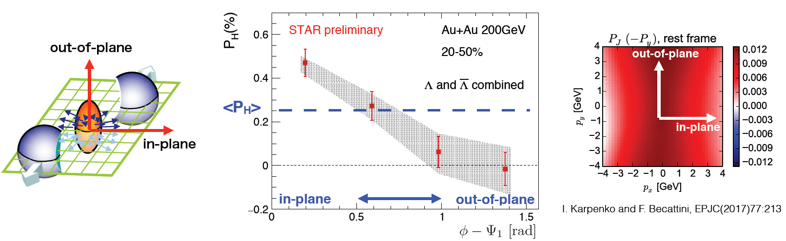
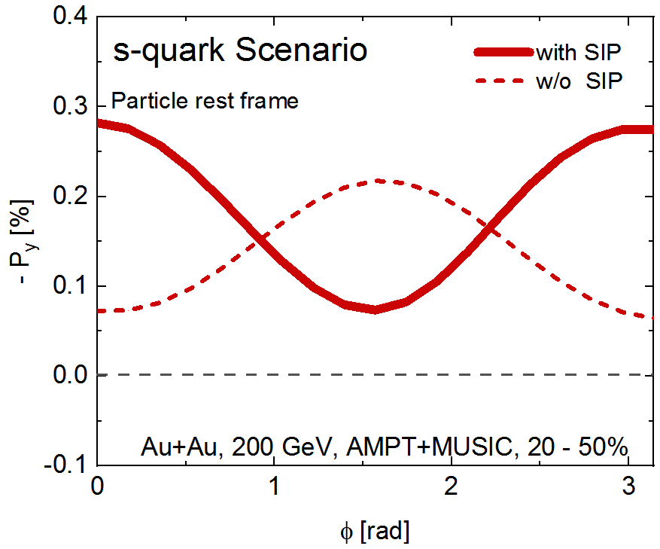
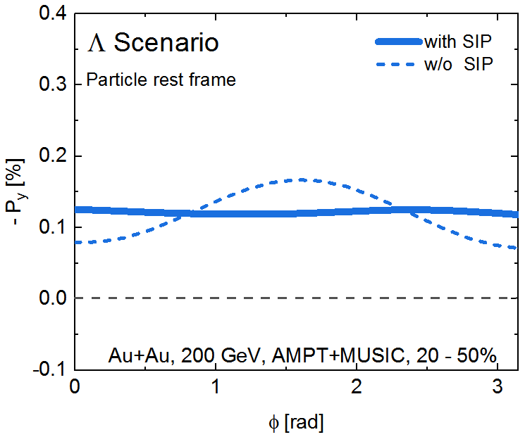

Compare with exp data: $P_{y}\left(φ\right)$ with & without SIP
B. Fu, S. Liu, L. -G. Pang, H. Song, Y. Yin, Phys.Rev.Lett. 127 14, 142301(2021）
STAR, NPA, 982 (2019) 511-514
$$m_{s}=0.3 GeV$$
Total $P^{μ}$
=Thermal vorticity + Shear effects
-In the scenario of ‘S-quark memory’, the total $P^{μ}$ with SIP qualitatively agrees with data
$$m_{Λ}=1.116 GeV$$

Slide 20
The 2nd order Fourier sine coefficients of $P_{z}$
-For the 2nd order Fourier since coefficients of PZ(centrality dependence & pT dependence ), Model calculations with shear (SIP) effects qualitatively agrees with data with the scenario of ‘S-quark memory’,
Figs are from [ALICE], arXiv:2107.11183 [nucl-ex]
AMPT+MUSIC results are from B.Fu & H.Song (private comm.), paper in preparation.

Slide 21
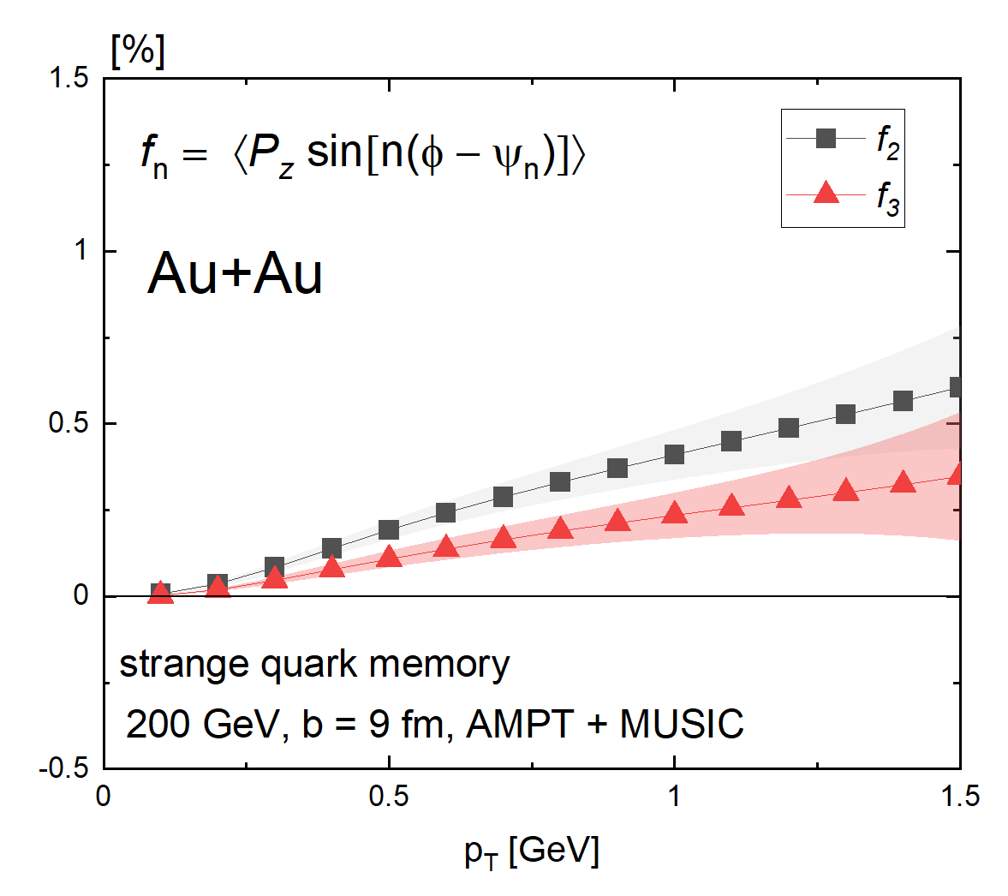
Prediction of the 3nd order Fourier coefficients of $P_{z}$
-Model calculations with shear (SIP) effects in ‘S-quark memory scenario
using event-by-event AMPT+MUSIC

Slide 22
Spin Hall effects at RHIC BES
B. Fu, L. -G. Pang, H. Song, Y. Yin, 2201.12970.

Slide 23
Spin Hall Effects (SHE)
SHE in condense matter
Meyer et al, Nature material 17’
-induced by electric filed; theory behind QED
-A hot research area in spintronics
-observed in various materials (semi-conductors, metals, insulators); not exceeding room temperature
J. Sinova Rev. Mod. Phys. 87, 1213 (2015)

Slide 24
Spin Hall Effects (SHE)
SHE in condense matter
Meyer et al, Nature material 17’
-induced by electric filed; theory behind QED
-A hot research area in spintronics
-observed in various materials (semi-conductors, metals, insulators); not exceeding room temperature
J. Sinova Rev. Mod. Phys. 87, 1213 (2015)
SHE for hot QCD matter
-induced by baryon density gradient; theory behind QCD
-Another Mechanism for spin polarization
Thermal vorticity
Shear induced polarization
Spin Hall effects(SHE) have not been fully explored
F. Becattini,et al, Annals Phys(2013）
& may hydro & Transport papers
Spin
polarization
Fu, et al PRL2021. Liu & Yin JHEP2021
Becattini, et al PLB2021, 2103.14621 & others

Slide 25
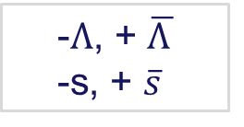
Spin Hall Effects in Heavy Ion Collisions
Can we observe and explore SHE in heavy ion collisions ?
SHE for hot QCD matter
-Induced by baryon density gradient
RHIC –BES & forward rapidity
-Sign dependence on baryon charge
Net Lambda Polarization
-Momentum dependence
Local polarization
(For global polarization, see arXiv:2106.08125)
Expand /decompose $𝒜^{μ}$ to 1st order gradient of the fields:
Spin Cooper-Fryer:
-$Λ$, + $\overline{Λ }$
-s, + $\overline{s}$
S. Y. F.Liu and Y. Yin, JHEP07, 188 (2021); Phys.Rev.D 104 5, 054043(2021); B. Fu, L. -G. Pang, H. Song, Y. Yin, 2201.12970.

Slide 26
Competition between different effects
B. Fu, L. -G. Pang, H. Song, Y. Yin, 2201.12970.
-SHE(${ μ}_{B}$ gradient effects): comparable to T-gradient and Shear (SIP) effects

Slide 27
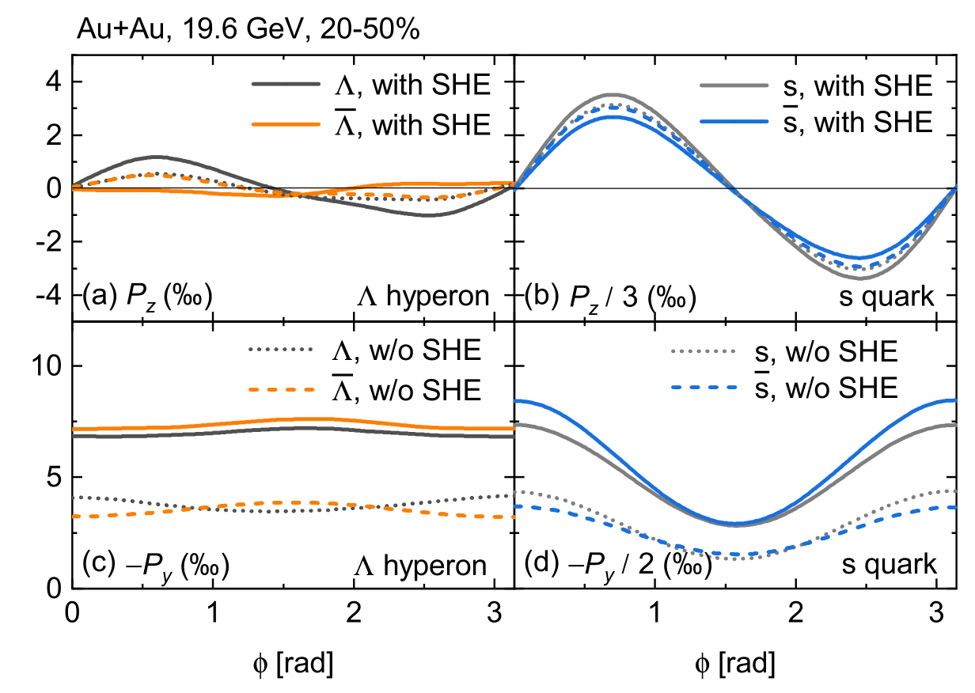
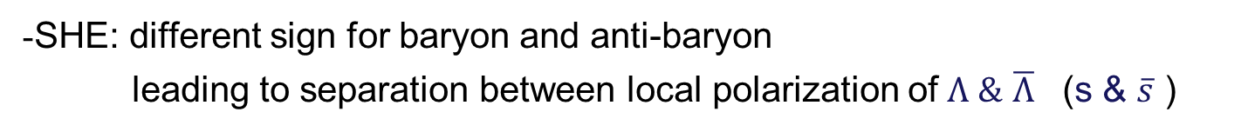
$P_{z}\left(φ\right)$ and $P_{y}\left(φ\right)$ without / with SHE
B. Fu, L. -G. Pang, H. Song, Y. Yin, 2201.12970.
-SHE: different sign for baryon and anti-baryon
leading to separation between local polarization of $Λ \&$ $\overline{Λ}$ (s & $\overline{s}$ )

Slide 28
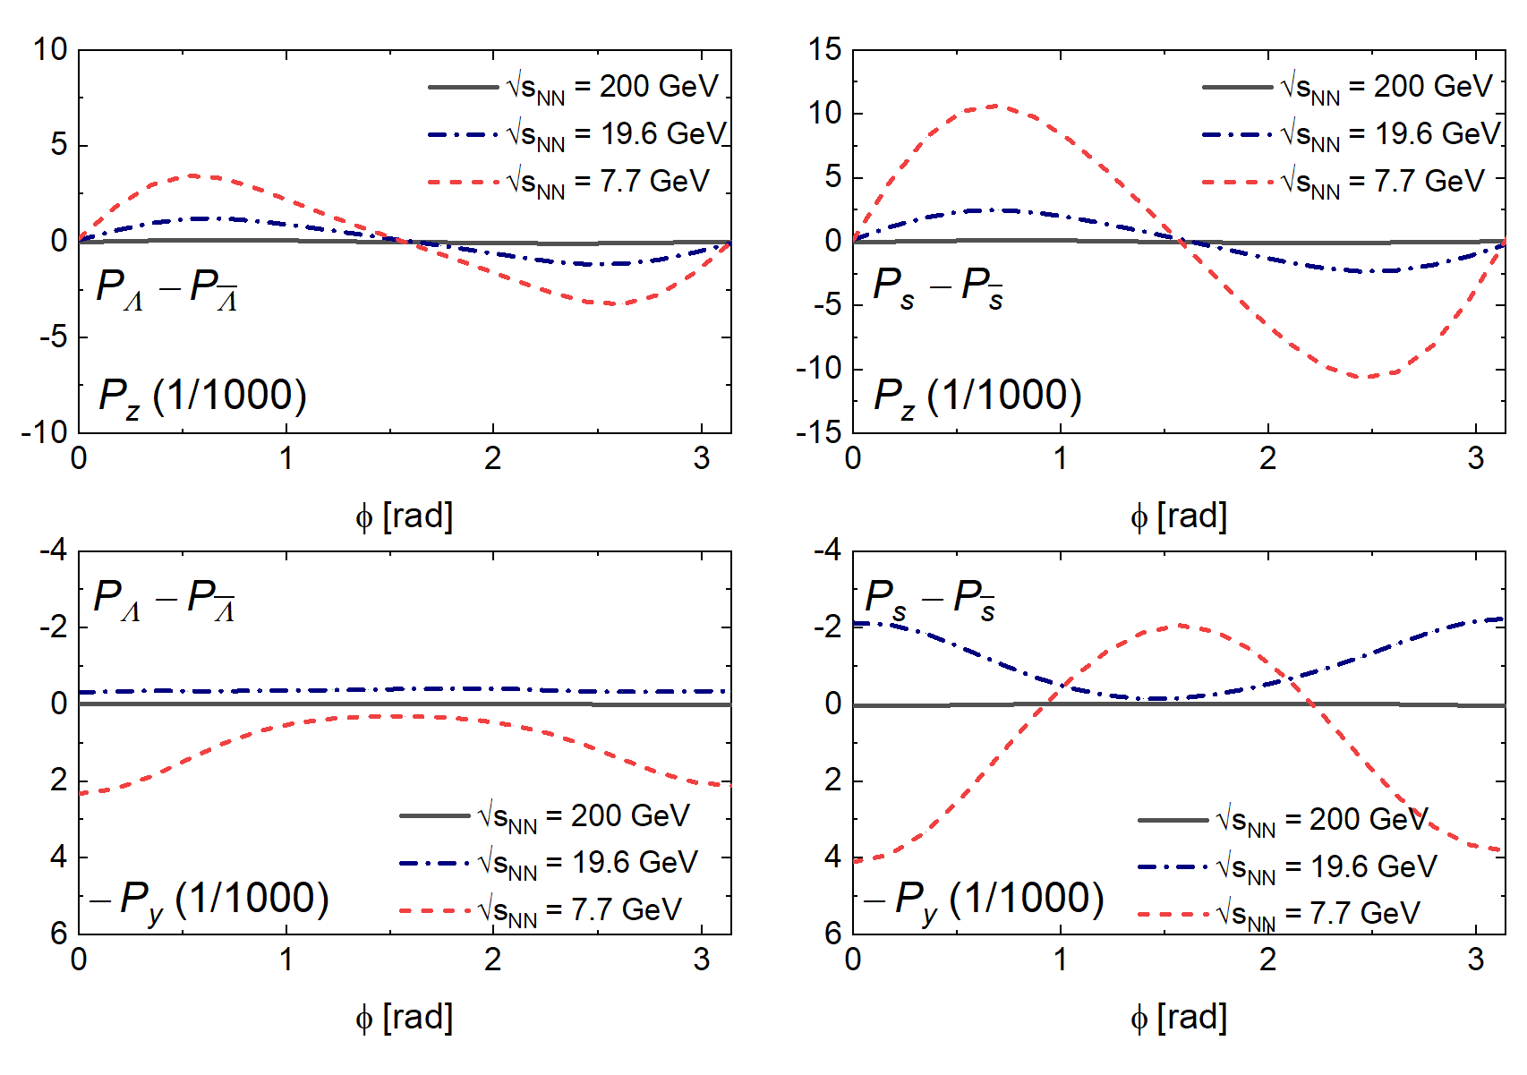
$P_{z}\left(φ\right)$ and $P_{y}\left(φ\right)$ for net Λ and net s
B. Fu, L. -G. Pang, H. Song, Y. Yin, 2201.12970.
-$P_{z}(Φ)$: larger SHE effects at lower collision energy
-$P_{y}\left(Φ\right):$ different Φ dependent behavior at 7.7 & 19.6 GeV due to SHE

Slide 29
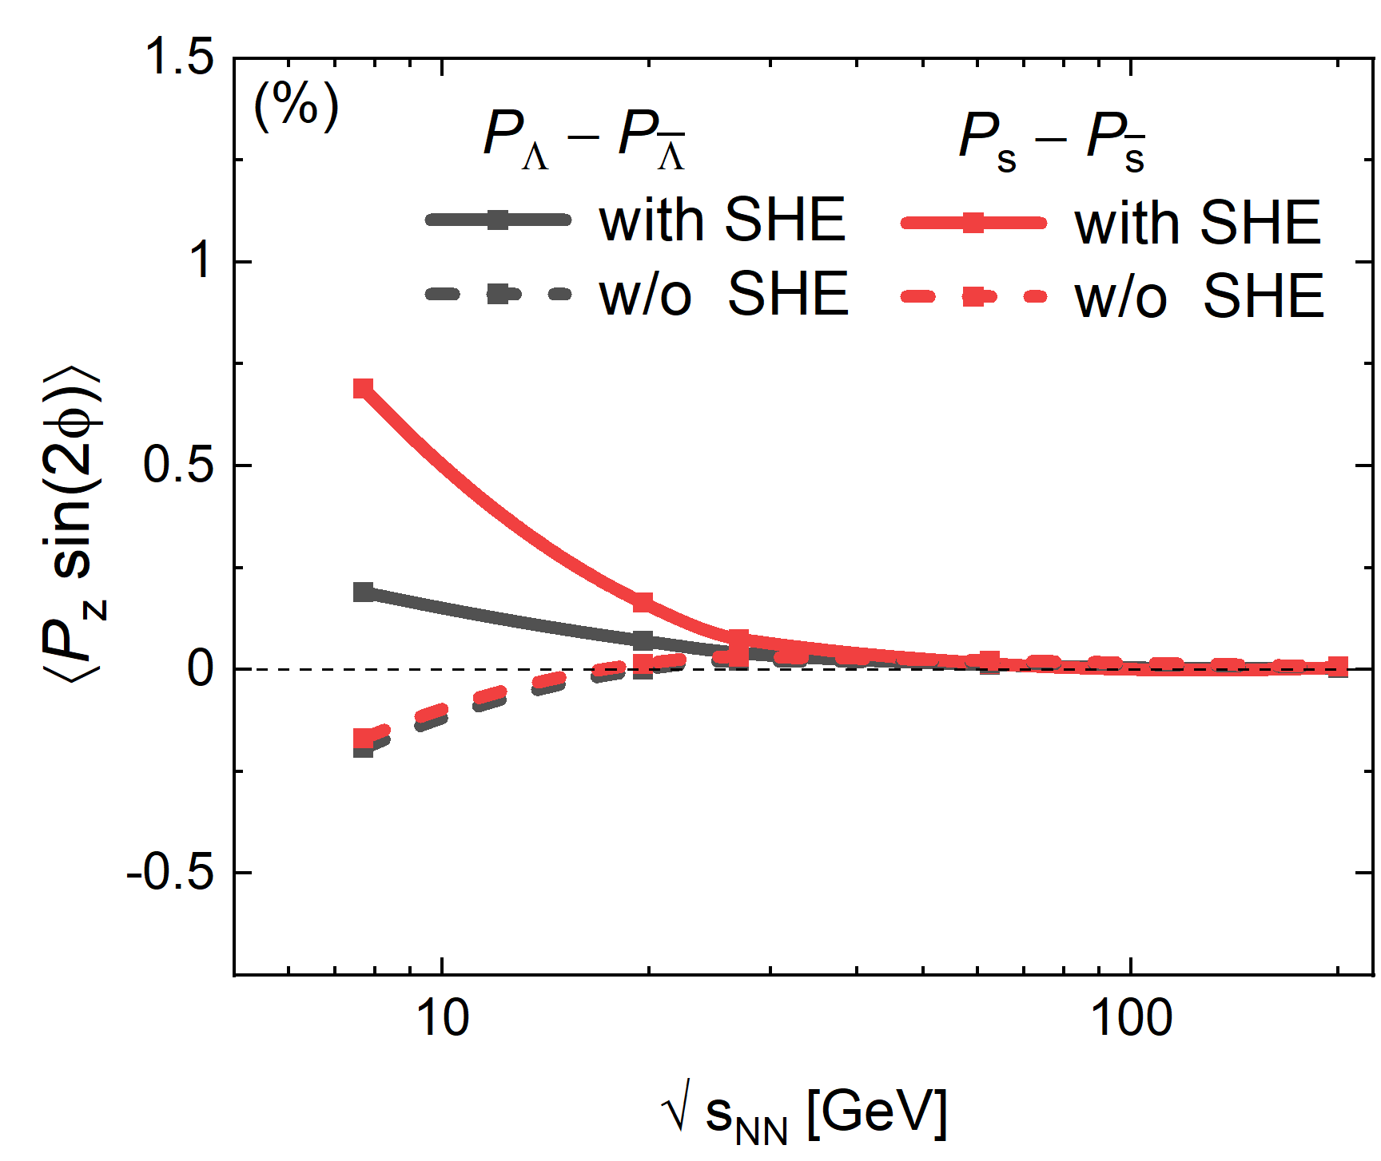
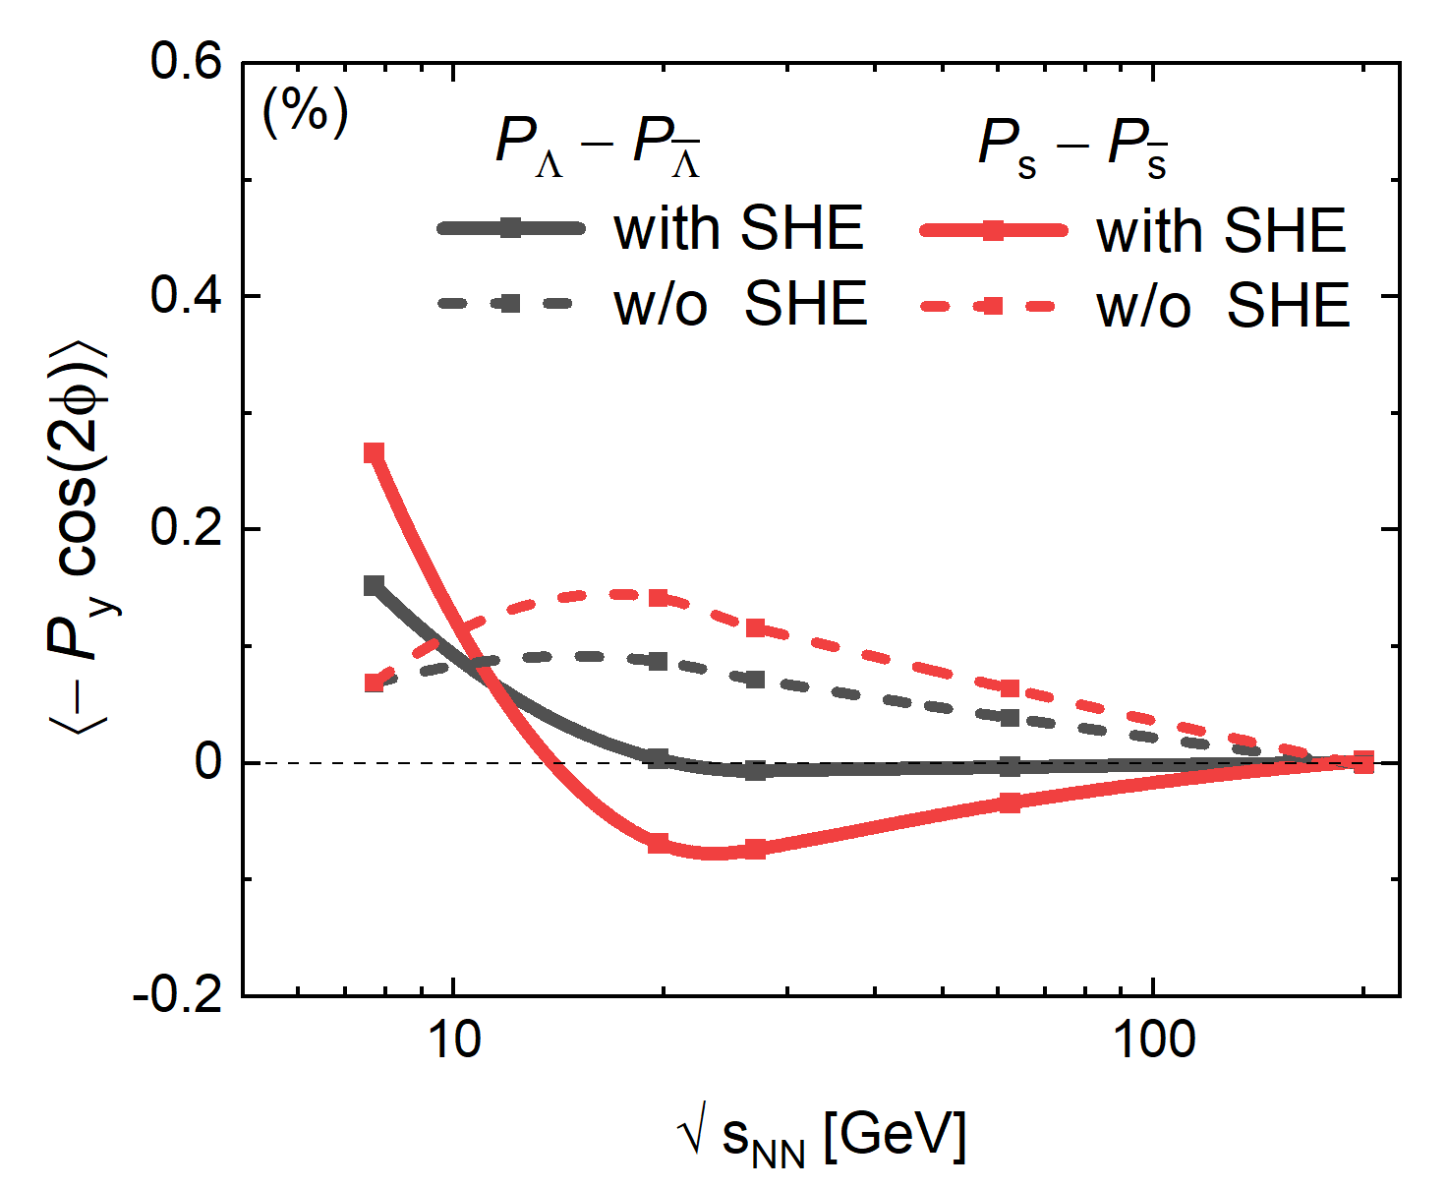
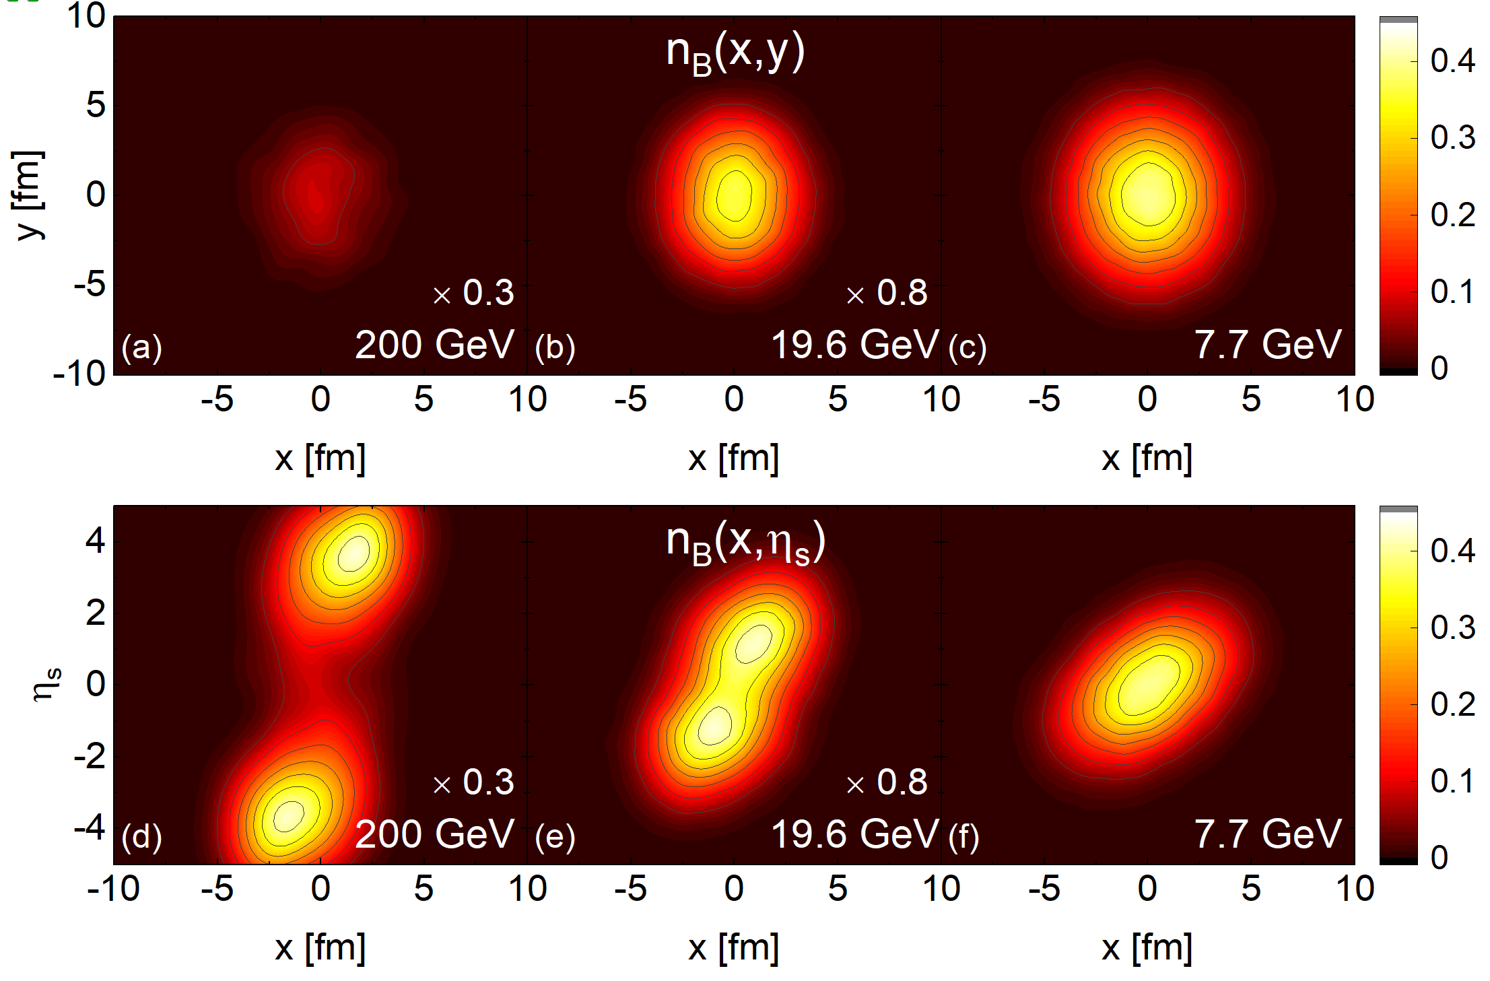
2nd order Fourier coeff. of $P_{z}$ and $P_{y}$
B. Fu, L. -G. Pang, H. Song, Y. Yin, 2201.12970.
$$<P_{z}sin⁡(2φ)>$$
Monotonic behavior
-With and without SHE: different sign for $<P_{z}sin⁡(2φ)>$
A signal to search the SHE at RHIC-BES

Slide 30

2nd order Fourier coeff. of $P_{z}$ and $P_{y}$
B. Fu, L. -G. Pang, H. Song, Y. Yin, 2201.12970.
$$<P_{y}cos⁡(2φ)>$$
Non-monotonic behavior
-With and without SHE: different sign for $<P_{y}cos⁡(2φ)>$
Another signal to search the SHE at RHIC-BES

Slide 31
Experimental efforts on SHE
S.Singha, SQM 2022 talk

Slide 32
Comparison between Groups
Theoretical Formula with shear induced polarization
S. Y. F.Liu and Y. Yin, JHEP07, 188 (2021).
B. Fu, S. Liu, L. -G. Pang, H. Song, Y. Yin, Phys.Rev.Lett.127 14, 142301(2021).
F.Becattini, M.Buzzegoli and A.Palermo, Phys. Lett. B 820, 136519 (2021).
F.Becattini, et al, Phys.Rev.Lett.127 27, 272302(2021).
… … … …
Numerical Simulations & local lambada Polar. Puzzle, etc
B. Fu, S. Liu, L. -G. Pang, H. Song, Y. Yin, Phys.Rev.Lett.127 14, 142301(2021).
F.Becattini, et al, Phys.Rev.Lett.127 27, 272302(2021).
C. Yi, S. Pu and D. L. Yang, Phys. Rev. C104, no.6, 064901 (2021).
X. Y. Wu, C. Yi, G. Y. Qin and S. Pu Phys. Rev. C 105, 064909 (2022).
S.Alzhrani, S.Ryu and C.Shen arXiv:2203.15718 [nucl-th].
… … … …

Slide 33
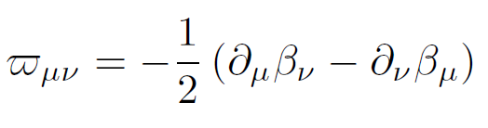
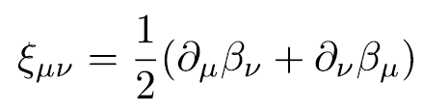


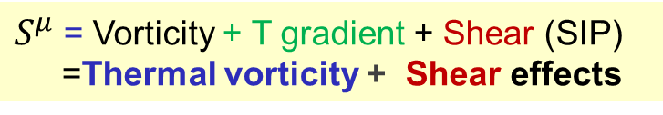
Comparison between the theoretical formula
Our group:
S.Y.F.Liu & Y.Yin, JHEP (2021); B. Fu, et al PRL (2021)
Vorticity T gradient Shear (SIP)
$$π_{μν}=\frac{1}{2}(∂_{ν }β_{μ}−∂_{μ}β_{ν})$$
$S^{μ}$= Vorticity + T gradient + Shear (SIP)
=Thermal vorticity + Shear effects
Thermal vorticity
Becattini group:
F.Becattini, et al, PLB(2021).
$$S^{μ}=S_{π}^{μ}+S_{ξ}^{μ}$$
=Thermal vorticity $π_{μν}$+ Thermal shear${ ξ}_{μν}$ effects

Slide 34


Comparison between the theoretical formula
Our group:
S.Y.F.Liu & Y.Yin, JHEP (2021); B. Fu, et al PRL (2021)
Vorticity T gradient Shear (SIP)
$$π_{μν}=\frac{1}{2}(∂_{ν }β_{μ}−∂_{μ}β_{ν})$$
$S^{μ}$= Vorticity + T gradient + Shear (SIP)
=Thermal vorticity + Shear effects
Thermal vorticity
Becattini group:
F.Becattini, et al, PLB(2021).
$$S^{μ}=S_{π}^{μ}+S_{ξ}^{μ}$$
=Thermal vorticity $π_{μν}$+ Thermal shear${ ξ}_{μν}$ effects
-If we change ${\hat{t}}_{ν}→ u_{ν}$ in Becattini’s eqn
$S^{μ}$=Thermal vorticity + Shear effects
similar but not exactly the same formula

Slide 35
Agreement: effects from SIP & T grad are comparable
B. Fu, S. Liu, L. -G. Pang, H. Song, Y. Yin, Phys.Rev.Lett. 127 14, 142301(2021）
F.Becattini, et al, Phys.Rev.Lett.127 27, 272302(2021)

Slide 36
Disagreement: Λ equilibrium or s quark memory ？
STAR, Phys.Rev.Lett. 123 (2019) 132301
STAR, Phys.Rev.Lett. 123 (2019) 132301
STAR, Phys.Rev.Lett. 123 (2019) 132301
B. Fu, S. Liu, L. -G. Pang, H. Song, Y. Yin, Phys.Rev.Lett. 127 14, 142301(2021）
Thermal vorticity + SIP roughly fit the data with s quark memory scenario
F.Becattini, et al, Phys.Rev.Lett.127 27,
272302 (2021)
- Kinetic shear + Kinetic vorticity roughly fits the data with Λ equilibrium scenario

Slide 37


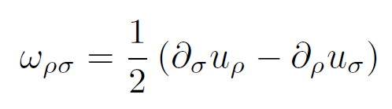
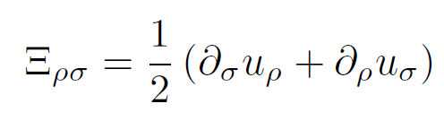



Comments on freeze-out (Becattini results)
Theoretical formula:
F.Becattini, et al, PLB(2021).
$$S^{μ}=S_{π}^{μ}+S_{ξ}^{μ}$$
=Thermal vorticity $π_{μν}$ + Thermal shear${ ξ}_{μν}$ effects
$β_{ν}$(y)= $β_{ν}$(x)+ ${∂_{λ}β}_{ν}(x){(y−x)}^{λ}$+ … ...
Revised formula for numerical simulations:
F.Becattini,et al
Isothermal frz:
$u_{ν}$(y)= $u_{ν}$(x)+ ${∂_{λ}u}_{ν}(x){(y−x)}^{λ}$+ … ...
Isothermal freeze-out
T-gradient is negligible
Thermal vorticity & shear
PLB(2021)
kinetic vorticity & shear
arXiv:2103.14621

Slide 38
Comments on freeze-out (Becattini results)
STAR, Phys.Rev.Lett. 123 (2019) 132301
B. Fu, S. Liu, L. -G. Pang, H. Song, Y. Yin, Phys.Rev.Lett. 127 14, 142301(2021）
Thermal vorticity + SIP
F.Becattini, et al, Phys.Rev.Lett.127 27,
272302 (2021)
Kinetic vorticity + Kinetic shear
+assumption on isothermal freeze-out

Slide 39
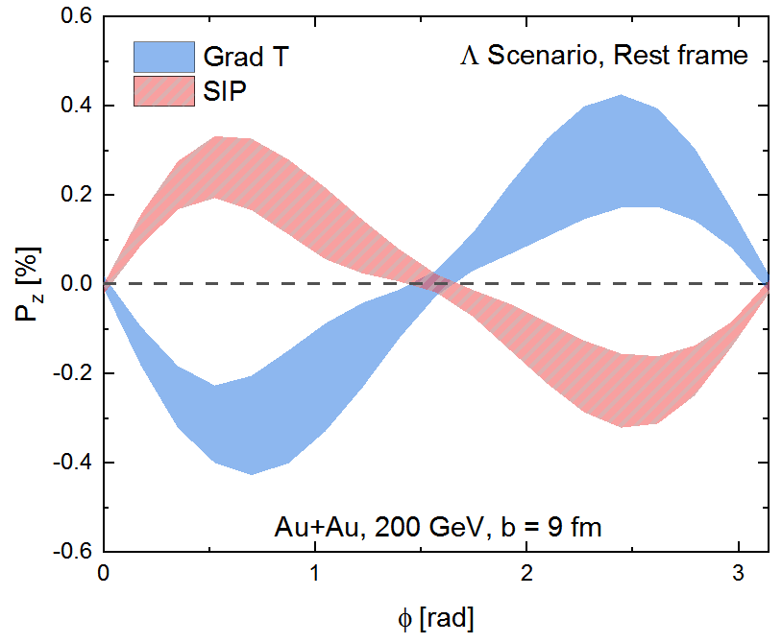
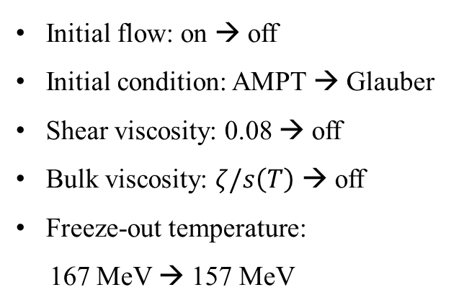
Sensitivity on other effects
Band: possible flexibility of [Grad T] and [SIP]
Initial flow: on → off
Initial condition: AMPT → Glauber
Shear viscosity: 0.08 → off
Bulk viscosity: $ζ/s\left(T\right)$ → off
Freeze-out temperature:
167 MeV → 157 MeV
-SIP also has some sensitivities to other factors: initial condition, viscosity,
EoS, freeze-out, etc
B. Fu, L. -G. Pang, H. Song, Y. Yin, in preparation.

Slide 40
Sensitivity on other effects
-SHE are sensitive to initial condition.
X. Y. Wu, C. Yi, G. Y. Qin and S. Pu Phys. Rev. C 105, 064909 (2022).

Slide 41
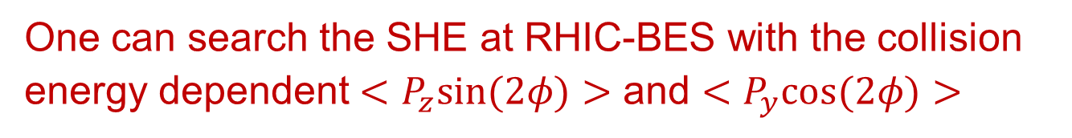
Summary
-Shear induced polarization (SIP)
SIP is important to solve the local polarization puzzle
-Spin Hall Effects (SHE)
One can search the SHE at RHIC-BES with the collision energy dependent $<P_{z}sin⁡(2φ)>$ and $<P_{y}cos⁡(2φ)>$
-Comparison between groups
It is important to reach agreement on formulism and calculation details for SIP

Slide 42
Back-Ups

Slide 43
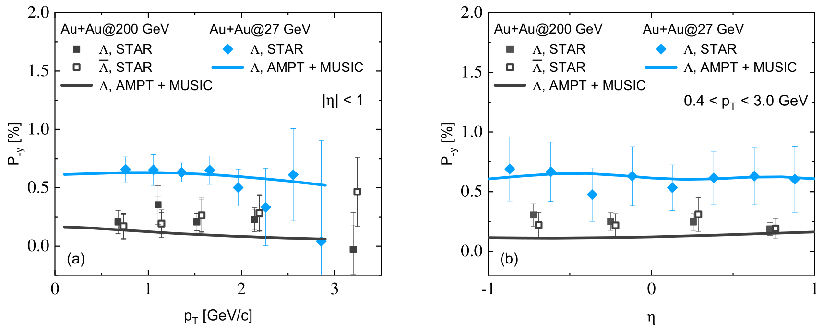
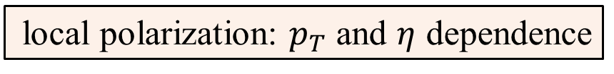

local polarization: $p_{T}$ and $η$ dependence
Total $P^{μ}$ = [thermal vorticity]
BF, K. Xu, X-G, Huang, H. Song, Phys.Rev.C 103 (2021) 2, 024903

Slide 44
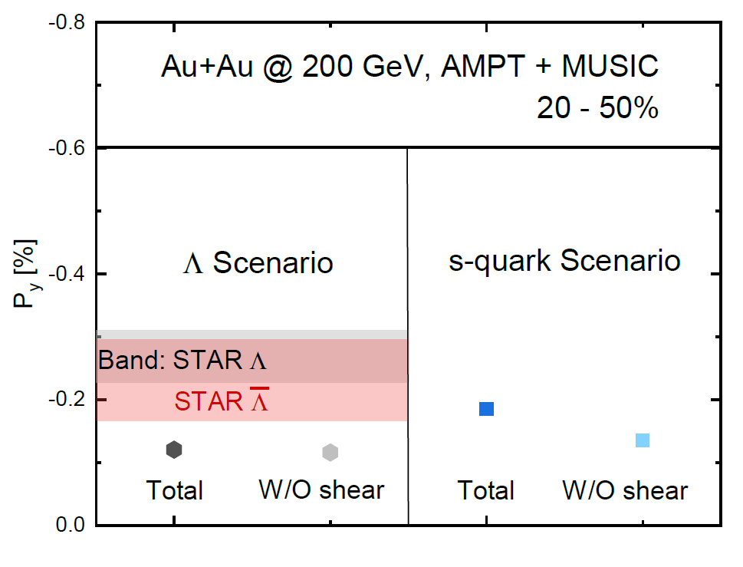
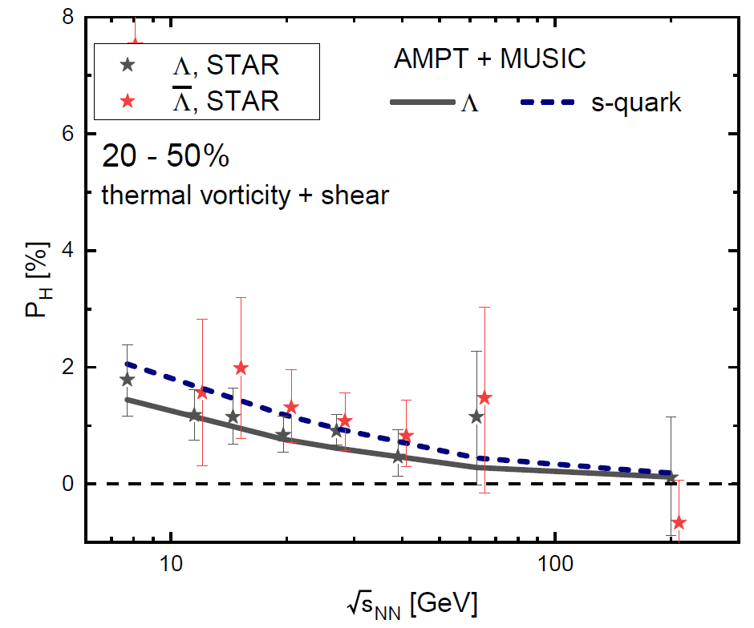

Global polarization with shear effect
Preliminary
Total $P^{μ}$ = [thermal vorticity] + [Shear]
B. Fu, S. Liu, L. -G. Pang, H. Song, Y. Yin, Phys.Rev.Lett. 127 14, 142301(2021）

Slide 45
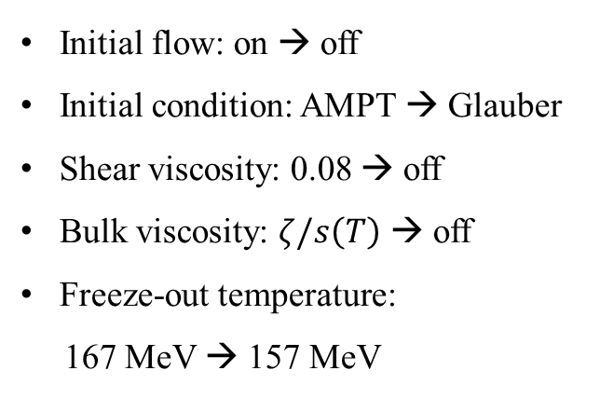
Robustness of the competition
Band: possible flexibility of [Grad T] and [SIP]
Initial flow: on → off
Initial condition: AMPT → Glauber
Shear viscosity: 0.08 → off
Bulk viscosity: $ζ/s\left(T\right)$ → off
Freeze-out temperature:
167 MeV → 157 MeV
B. Fu, S. Liu, L. -G. Pang, H. Song, Y. Yin, Phys.Rev.Lett. 127 14, 142301(2021）

Slide 46
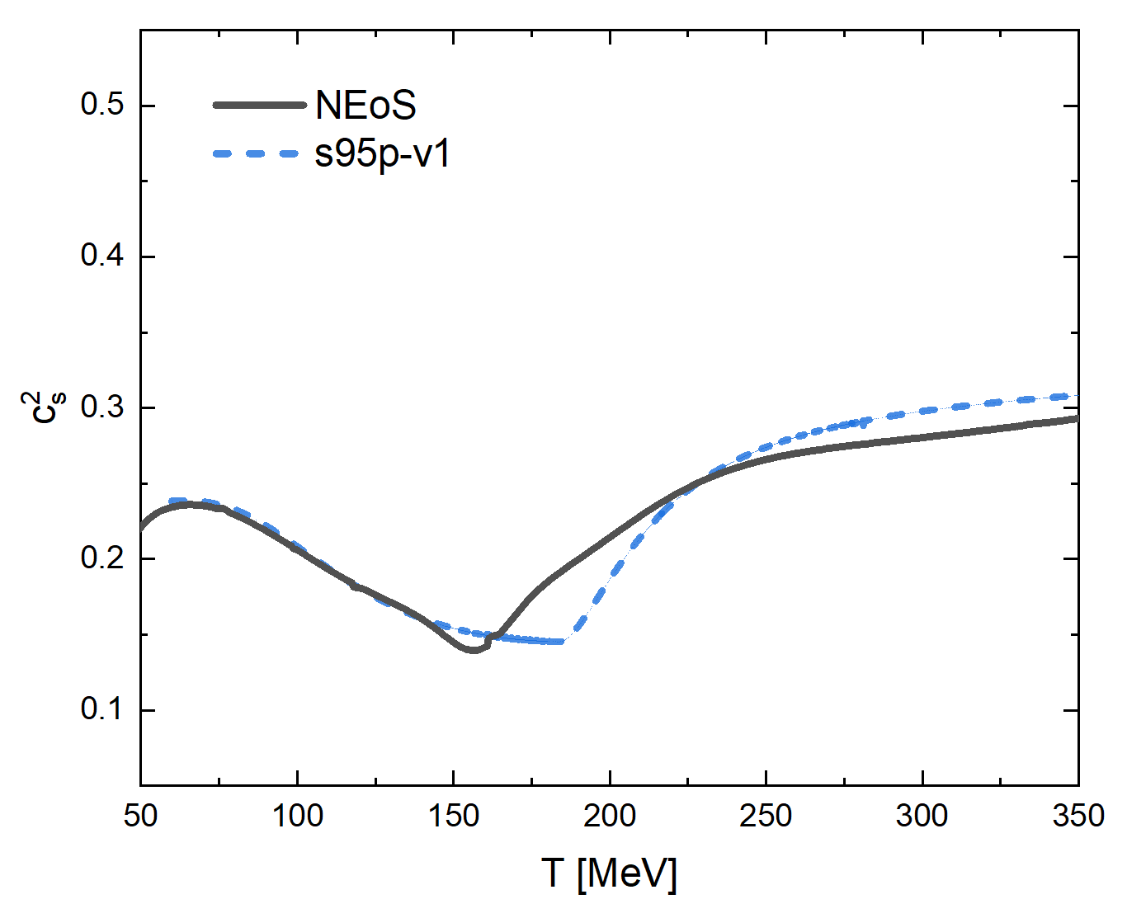
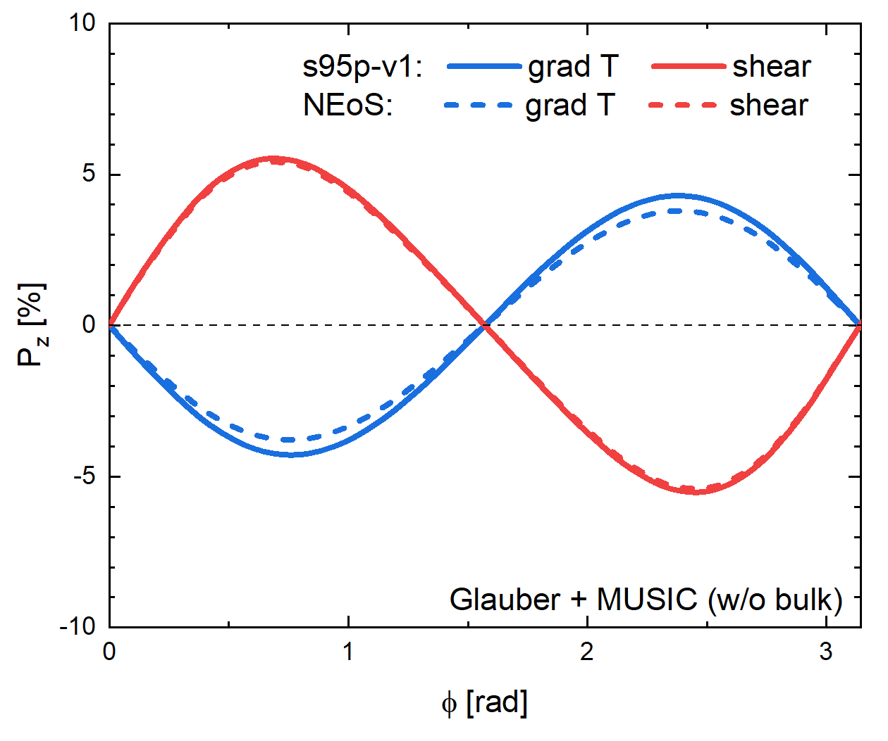
Dependence on EoS
s95p-v1 Vs. NEoS
NEoS:
A. Monnai, B. Schenke, C. Shen, Phys.Rev.C 100 (2019) 2, 024907
S95p-v1:
P. Huovinen, P. Petreczky, Nucl.Phys.A 837 (2010) 26-53

Slide 47
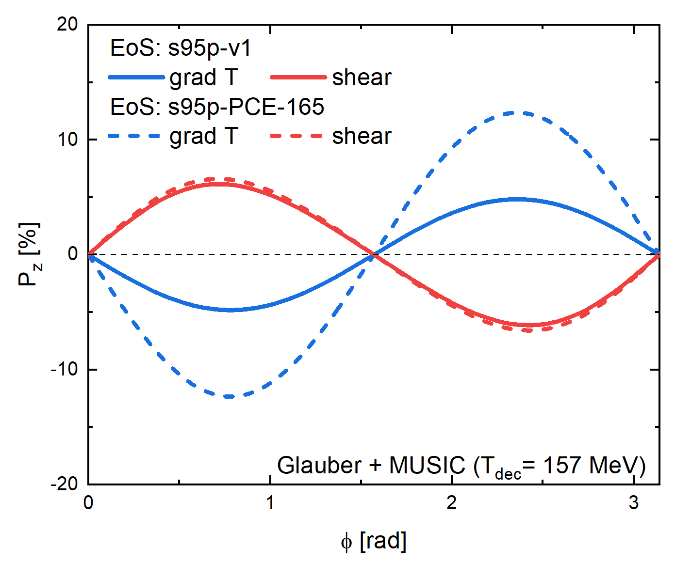
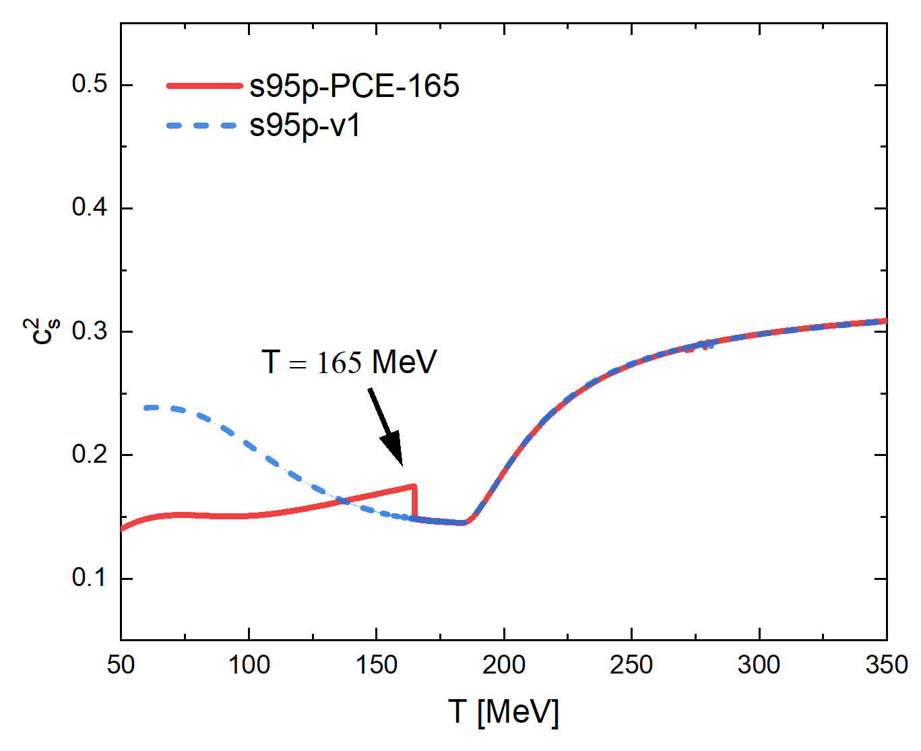
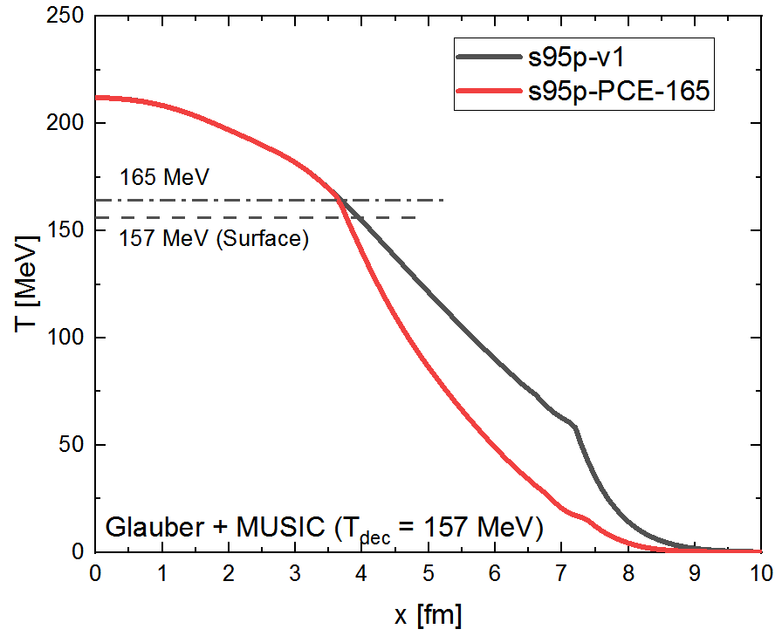
Dependence on EoS
-Do not use EoS-s95p-PCE
widely used in hydro calculations !
NEoS:
Monnai, B. Schenke, C. Shen, Phys.Rev.C 100
(2019) 2, 024907
S95p-v1:
P. Huovinen, P. Petreczky, Nucl.Phys.A 837 (2010) 26-53

