Slide 1

Status update for EF10
Weimin Song(宋维民)
Jilin University

Slide 2
LOI submitted
EF10-80: Dark Matter: Higgs portal (Xin Shi -> Weimin Song)
EF10-84: Dark Matter: Dark QCD Search (Mengchao Zhang)
EF10-85: Dark Matter: Lepton portal dark matter, gravitational waves and collider phenomenology (Ke-Pan Xie)
EF10-103: Dark Matter: Top + jet + missing Energy (Peiwen Wu)
EF10-144: Dark Matter: Dark Sector search via exotic Z decay (Jia Liu)

Slide 3
EF10-80: Higgs portal
1. The code transfering the Br(H->invisible) to dark matter limit is finished, and the plots is updated for CEPC
2. Results for SPPC is on going: do we have recommended detector performance parameters?

Slide 4
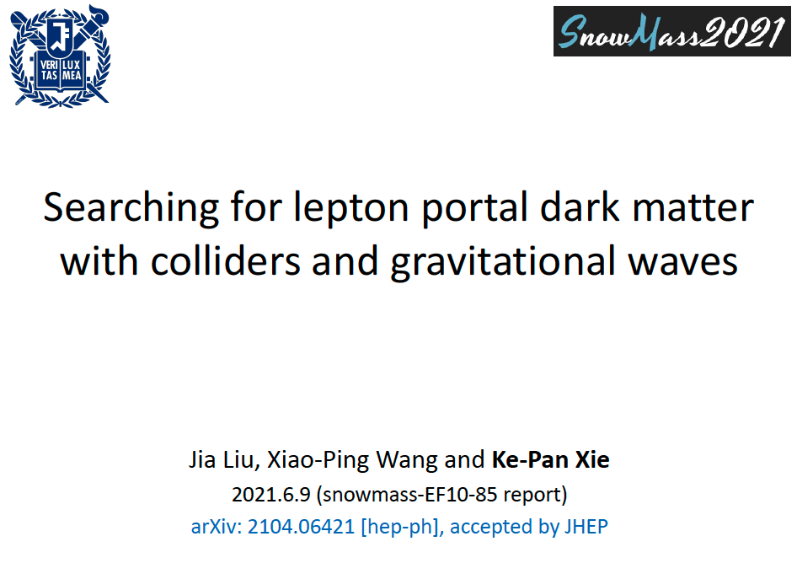
EF10-85: Lepton portal

Slide 5
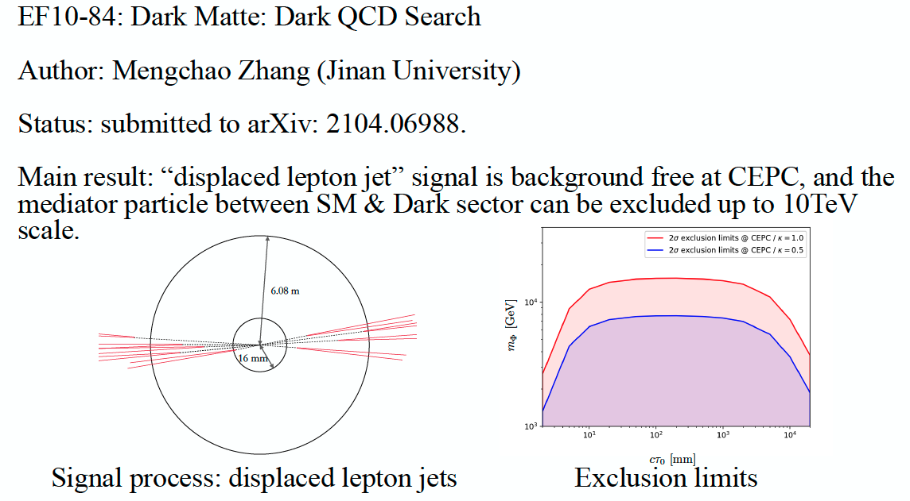
EF10-84: Dark QCD search

Slide 6
EF10-103: Top+Jet+Missing Energy
Peiwen is busy on some secret affairs this week, and I will contact him next week.

Slide 7
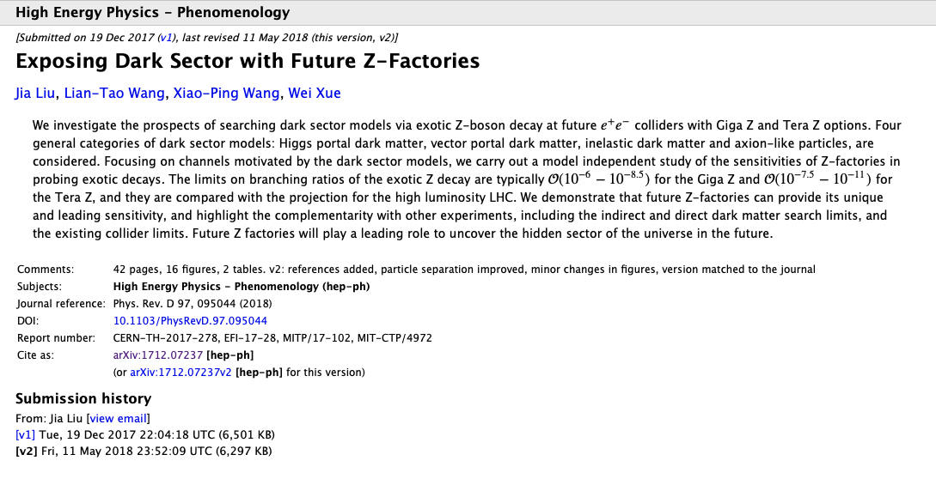
EF10-144: Exioc Z decay
Paper on Phys. Rev. D 97, 095044 (2018)

