Slide 1
The plan of international cooperation in control system
Presented by Li Gang
CEPC day
20210625

Slide 2
Outline
Why international cooperation
Contents of international cooperation
EPICS turn 30+ years
Organizations and committees
Potential cooperation

Slide 3
Why international cooperation is needed
Scale of accelerator
A few hundred meters
A few kilometers
A hundred kilometers
Scope of the control system
Hardware
Software
CS->ICS

Slide 4
Contents of international cooperation
Accelerator control software platform
EPICS, TANGO, FESA, DOOCS, TINE and so on
Design and develop “EPICS core and TOOLs”
EPICS BASE: ANL and LANL
EPICS Extensions
GUI: MEDM, DM2k, EDM，caQtDM，CSS，Alarm handle，Archiver Appliance，Databrowser, etc
Module
Hardware driver
Software management and configuration

Slide 5
EPICS turns 30+ years
From bob’s “EPICS turns 30” at ICALEPCS2019

Slide 6
Organizations and committees
Founder&volunteer
EPICS Council, 2016
Prioritize major EPICS upgrade projects for Base and Extensions to guide resource allocation decisions at investing facilities.
Develop a roadmap for future EPICS Core and Extensions development to facilitate planning for all EPICS sites. The roadmap will be developed using technical input from the chairs of relevant working groups (currently EPICS Core Working Group and CS-Studio Working Group).
Provide support to control system managers in promoting EPICS development efforts to their organization leadership.
Select semi-annual EPICS Collaboration Meeting sites and dates.
Ensure that EPICS continues to be an open collaboration and that contributions are open-source.

Slide 7
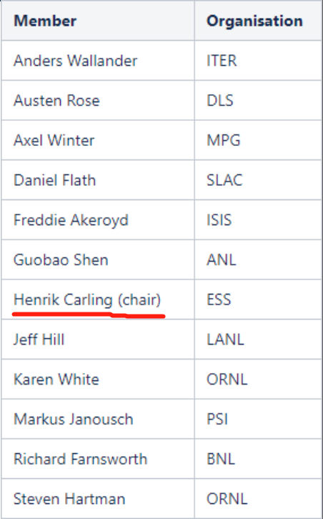
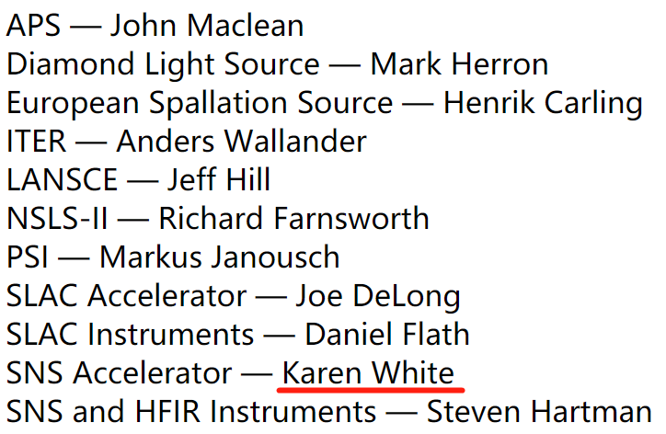
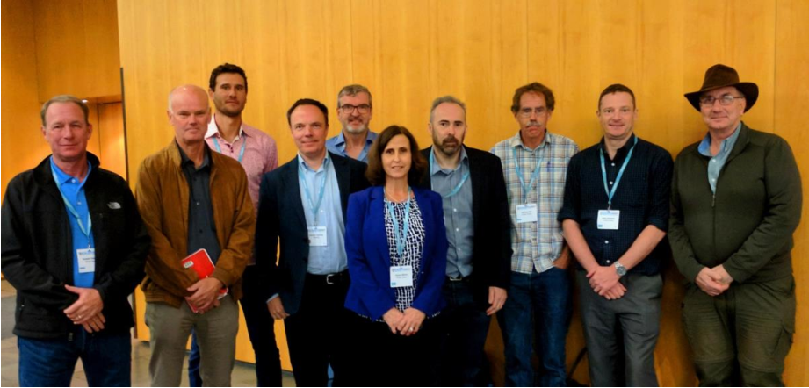
Organizations and committees
EPICS Council (contact: council@epics-controls.org)

Slide 8
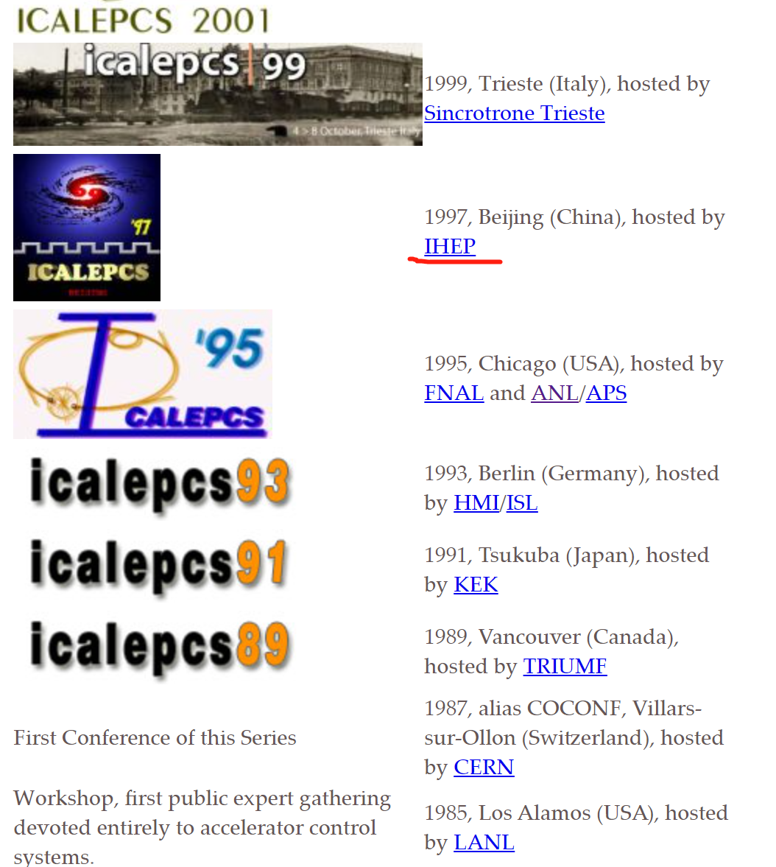
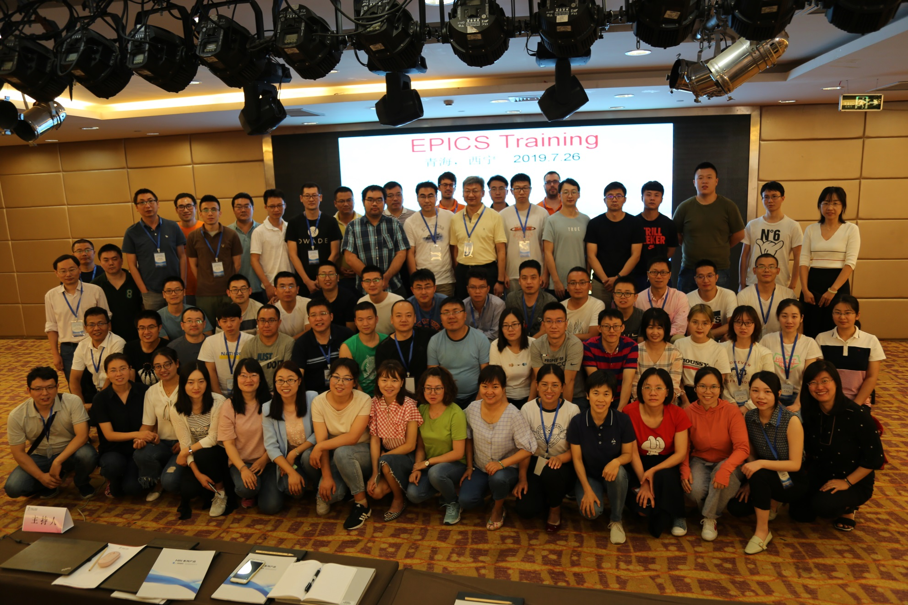
Conferences and seminar
ICALEPCS: International Conference on Accelerator and Large Experimental Physics Control Systems
Biennial
Asia, Europe and America
International workshop and EPICS training
Semi-annual
Asia, Europe and America

Slide 9
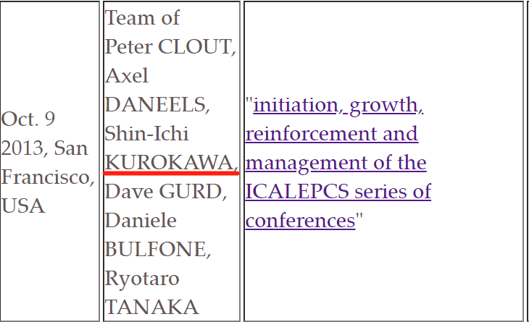
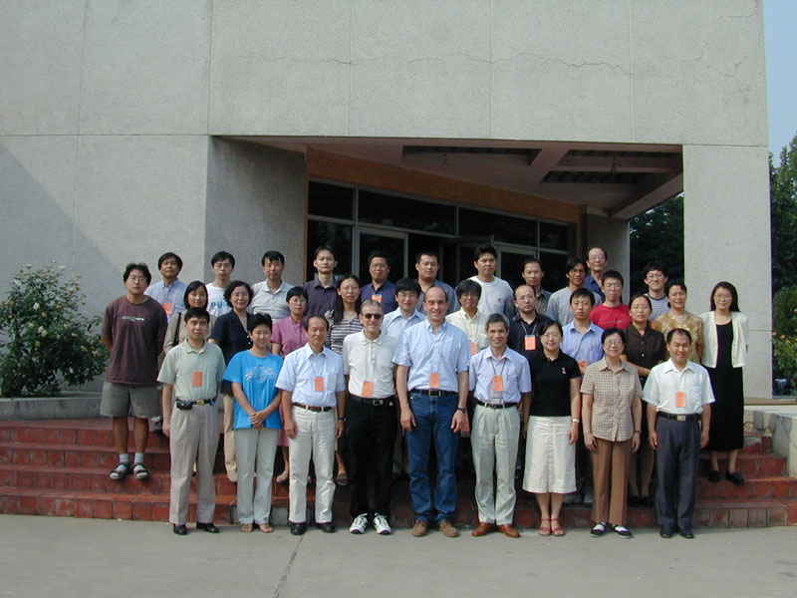
Conferences and seminar
From Web： ICALEPCS - EPS/EPCS Awardees
黑川真一：2012年度中华人民共和国国际科学技术合作奖

Slide 10
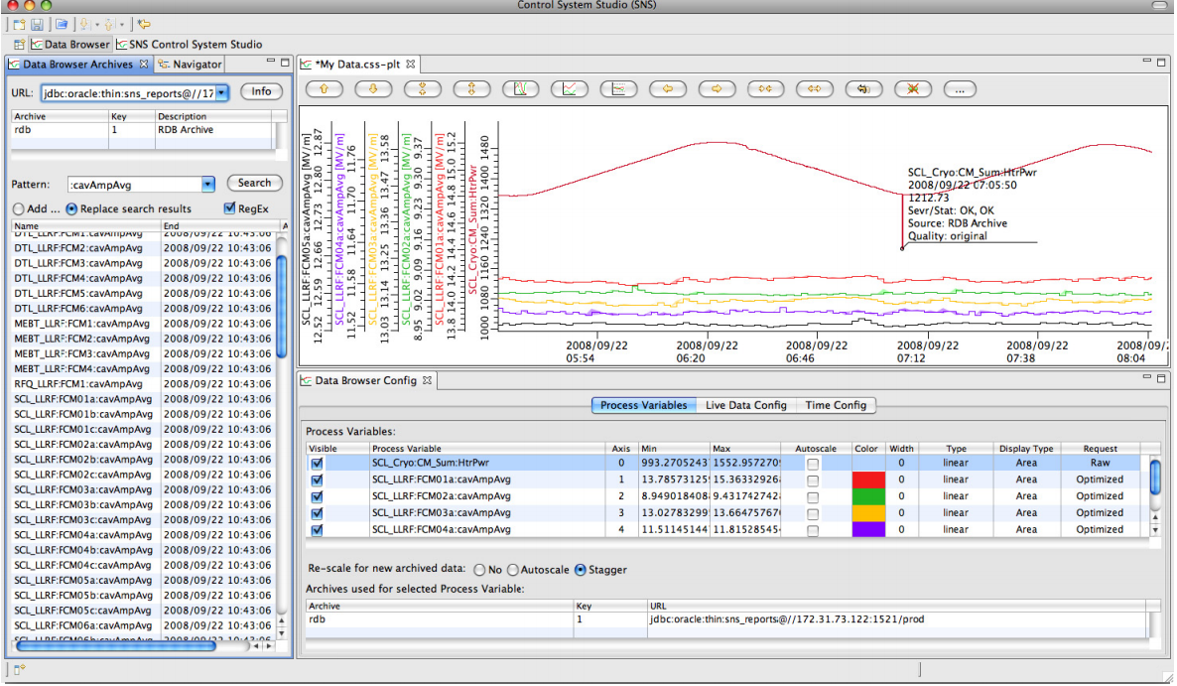
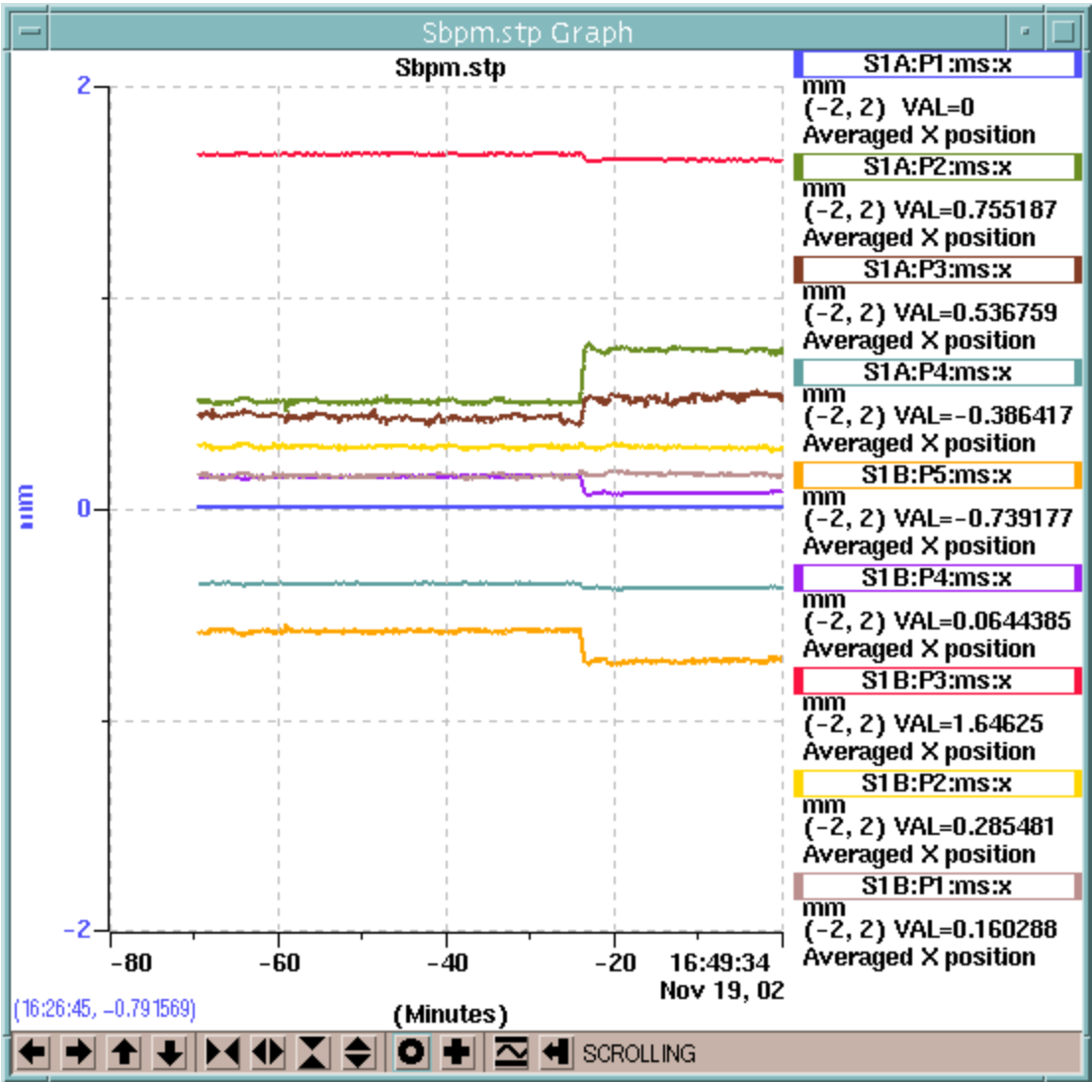
Past cooperation (Tools)
MEDM
“JPT, the Jefferson Plotting Toolkit, developed at the Thomas Jefferson National Accelerator Facility by Ge Lei, may also be used with the MEDM Cartesian Plot”, from “MEDM Reference Manual”
CSS
DESY,SNS(BOY),FRIB,ITER and ESS
Archive Appliance
XAL-Open XAL

Slide 11
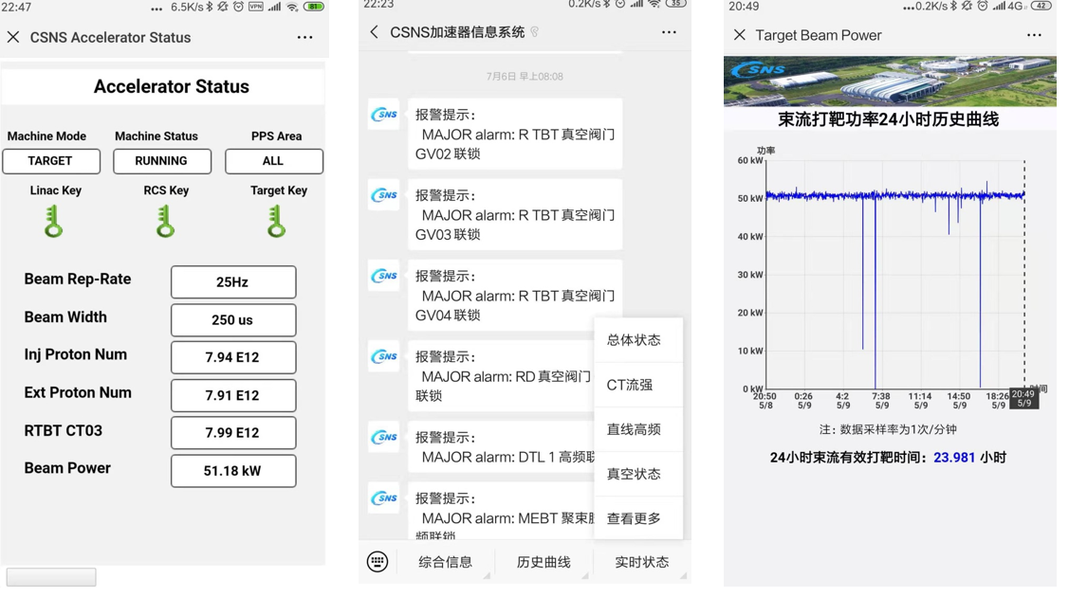
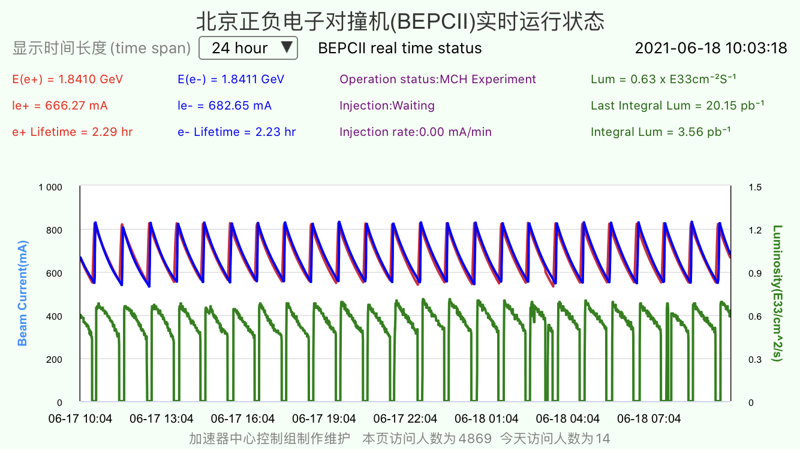
Potential cooperation
Hold ICALEPCS and international EPICS workshop
Be member of EPICS Council
Join in work group(Core, CSS and Python)
TOOLs or system design for CEPC specification
Apps and WeChat by IHEP
Etc

Slide 12
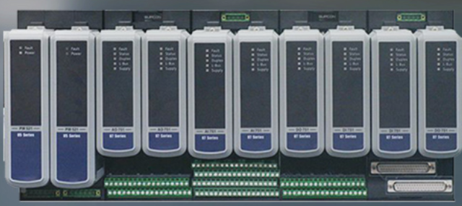
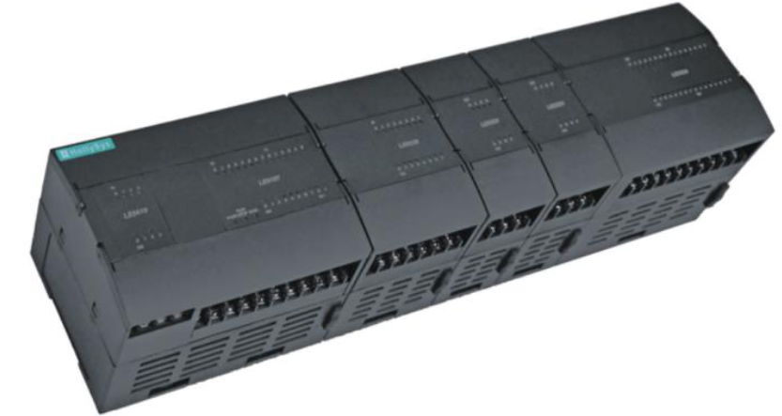
Potential cooperation
Timing system
EVG/EVR: Event+timestamp, VME->ATCA/uTCA
WhiteRabbit: Timestamp+Event
Domestic PLC
Siemens, Schneider, Allen Bradley, Yokogawa, Omron
Supcon, HollySys???

Slide 13
Potential cooperation
Database

Slide 14
Thank you
The closer the cooperation, the brighter the future

