Slide 1
The Consideration of
CEPC Cryogenic System Design
Ge Rui
On behalf of CEPC cryogenic system
June, 25th, 2021
Notes:
1

Slide 2
OUTLINE
Discussion and Comparison on CEPC SRF cryogenic system
Discussion and Comparison on SC magnets cryogenic system
Summary

Slide 3
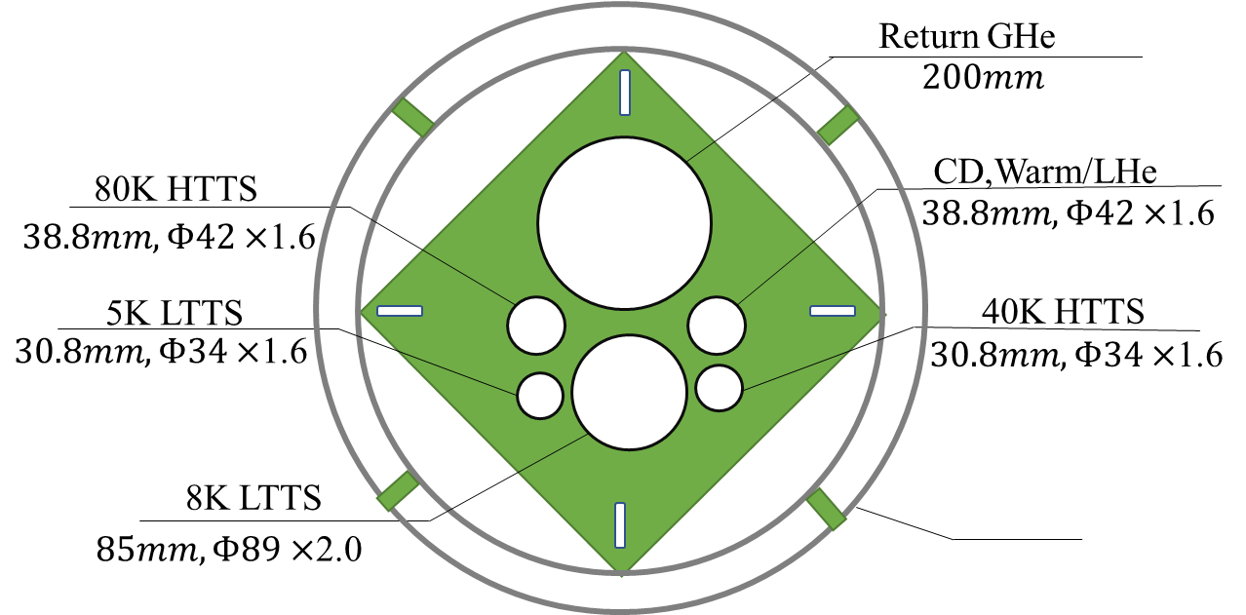
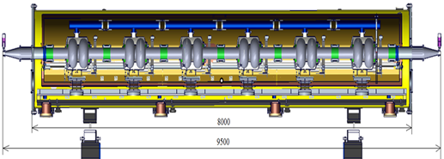
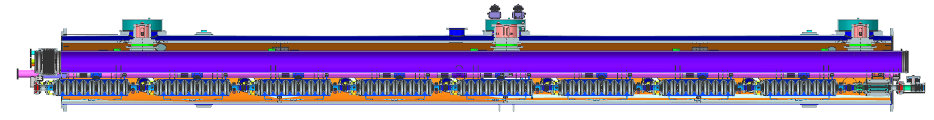
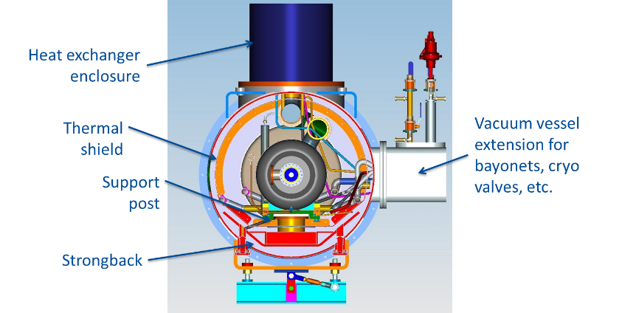
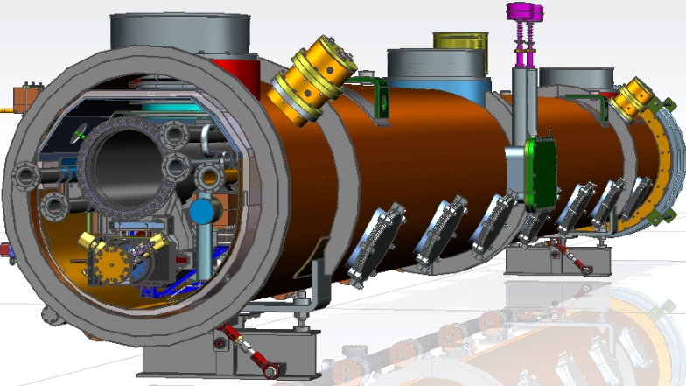
Flow chart of SRF CDR Scheme
24000
107000
Compressor group
Cold Box
Dewar
Main Distribution
Valve Box
Sub-tunnel
2K valve boxes
235000
80000
10 cryomodules, 6×650MHZ 2-cell cavities each
Collider Ring
3 cryomodules, 8×1.3GHZ 9-cell cavities each
Booster Ring
6
Cryomodules
8000
11000
5000
11000
5000
11000
11000
11000
11000
11000
5000
5000

Slide 4
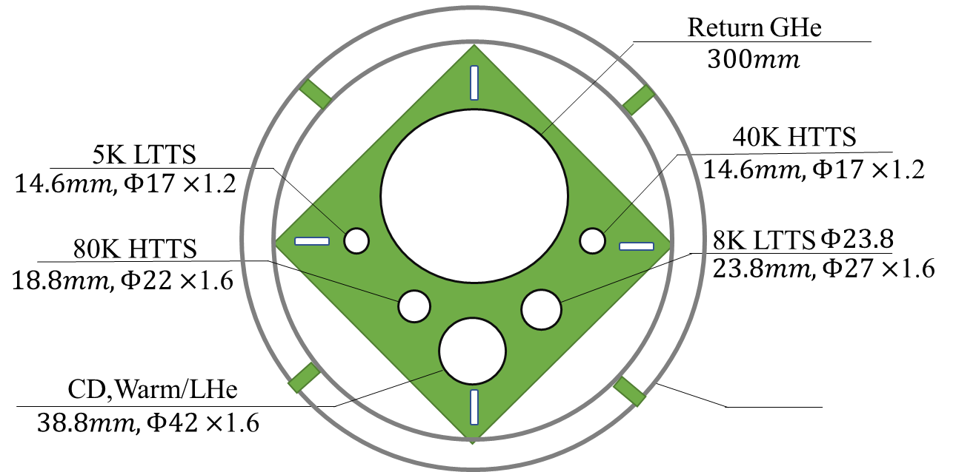
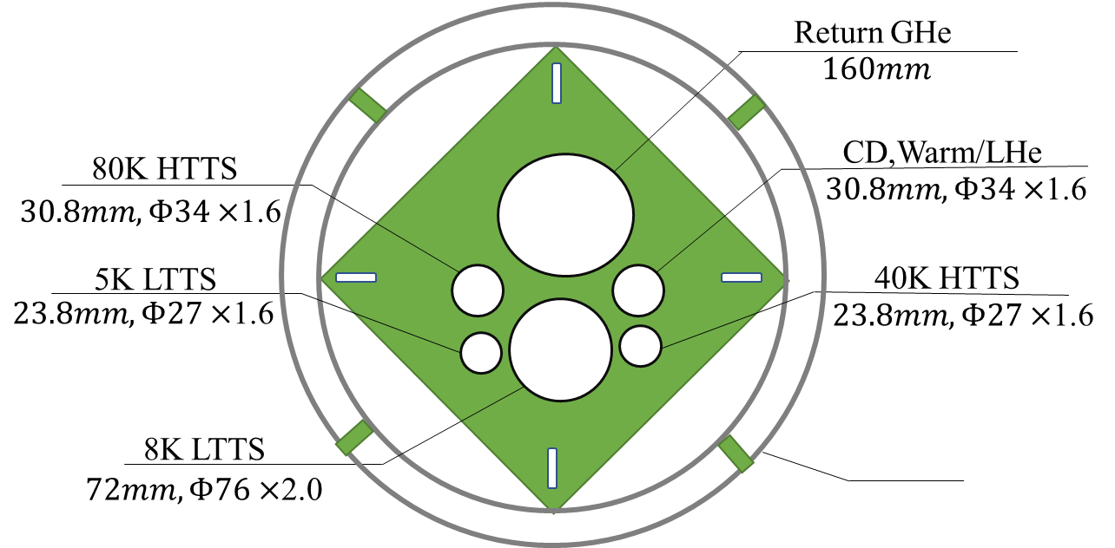
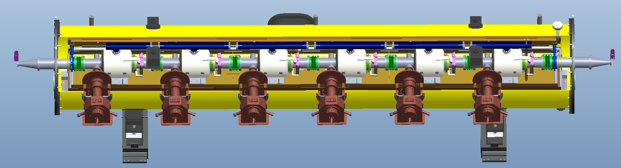
Flow chart of SRF Modif. Scheme
24000
107000
Smaller diameter
Compressor group
Cold Box
Dewar
Main Distribution
Valve Box
10 cryomodules, 6×650MHZ 2-cell cavities each
Collider Ring
3 cryomodules, 8×1.3GHZ 9-cell cavities each
Booster Ring
2K valve boxes
2K valve boxes
6
Cryomodules
11000
5000
11000
5000
11000
11000
11000
8000
11000
11000
5000
5000

Slide 5
Estimated heat loads for SC cavities-CDR Scheme
Higgs Mode | Unit | Collider |  |  | Booster
 |  | 40-80K | 5-8K | 2K | 40-80K | 5-8K | 2K
Predicted static heat load per cryomodule | W | 300 | 60 | 12 | 140 | 20 | 3
Cavity dynamic heat load per cryomodule | W | 0 | 0 | 153.59 | 0 | 0 | 13.98
HOM dynamic heat load per cryomodule | W | 20 | 12 | 2 | 2 | 1 | 1
Input coupler dynamic heat load per cryomodule | W | 60 | 40 | 6 | 40 | 3 | 0.4
Module dynamic heat load | W | 80 | 52 | 161.59 | 42 | 4 | 15.38
Each Module total heat load | W | 380 | 112 | 173.59 | 182 | 24 | 18.38
Cryomodule number | - | 40 | 40 | 40 | 12 | 12 | 12
EVB heat loss | W | 50 | 10 | 10 | 50 | 10 | 10
EVB number | - | 40 | 40 | 40 | 12 | 12 | 12
MDVB heat loss | W | 50 | 30 | 30 | 50 | 30 | 5
MDVB number | - | 4 | 4 | 4 | 4 | 4 | 4
Total cryogenic transfer line length | m | 1800 | 1800 | 1800 | 440 | 440 | 440
cryogenic transfer line heat loss per meter | W/m | 2 | 0.5 | 0.3 | 2 | 0.5 | 0.3
Total cryogenic transfer line heat loss | W | 3600 | 900 | 540 | 880 | 220 | 132
Total heat load | kW | 21 | 5.9 | 8.0036 | 3.864 | 0.748 | 0.49256
Total predicted mass flow | g/s | 82.42 | 152.26 | 373.72 | 13.34 | 12.73 | 18.324
Overall net cryogenic capacity multiplier |  | 1.54 | 1.54 | 1.54 | 1.54 | 1.54 | 1.54
4.5K equiv. heat load with multiplier | kW | 2.43 | 8.22 | 39.45 | 0.44 | 1.04 | 2.43
4.5K equiv. heat load with multiplier | kW | 50.10 |  |  | 3.92
Total 4.5K equiv. heat load with multiplier | kW | 54.02
Scheme1. 4station
Four individual refrigerators (4 × 18kW@4.5K) will be employed for the CEPC cavity cryogenic system.

Slide 6
Estimated heat loads for SC cavities-Modif. Scheme
Higgs Mode | Unit | Collider |  |  | Booster
 |  | 40-80K | 5-8K | 2K | 40-80K | 5-8K | 2K
Predicted static heat load per cryomodule | W | 300 | 60 | 12 | 140 | 20 | 3
Cavity dynamic heat load per cryomodule | W | 0 | 0 | 153.59 | 0 | 0 | 13.98
HOM dynamic heat load per cryomodule | W | 20 | 12 | 2 | 2 | 1 | 1
Input coupler dynamic heat load per cryomodule | W | 60 | 40 | 6 | 40 | 3 | 0.4
Module dynamic heat load | W | 80 | 52 | 161.59 | 42 | 4 | 15.38
Each Module total heat load | W | 380 | 112 | 173.59 | 182 | 24 | 18.38
Cryomodule number | - | 40 | 40 | 40 | 12 | 12 | 12
EVB heat loss | W | 50 | 10 | 10 | 50 | 10 | 10
EVB number | - | 4 | 4 | 4 | 4 | 4 | 4
MDVB heat loss | W | 50 | 30 | 30 | 50 | 30 | 5
MDVB number | - | 4 | 4 | 4 | 4 | 4 | 4
Total cryogenic transfer line length | m | 608 | 608 | 608 | 136 | 136 | 136
cryogenic transfer line heat loss per meter | W/m | 2 | 0.5 | 0.3 | 2 | 0.5 | 0.3
Total cryogenic transfer line heat loss | W | 1216 | 304 | 182.4 | 272 | 68 | 40.8
Total heat load | kW | 18.616 | 5.304 | 7.646 | 3.256 | 0.596 | 0.40136
Total predicted mass flow | g/s | 82.42 | 152.26 | 373.72 | 13.34 | 12.73 | 18.324
Overall net cryogenic capacity multiplier |  | 1.54 | 1.54 | 1.54 | 1.54 | 1.54 | 1.54
4.5K equiv. heat load with multiplier | kW | 2.15 | 7.39 | 37.69 | 0.37 | 0.83 | 1.98
4.5K equiv. heat load with multiplier | kW | 47.23 |  |  | 3.19
Total 4.5K equiv. heat load with multiplier | kW | 50.42
Scheme2. 4station
4 × 12.6 kW
Can reduce 3.6kW heat load compared scheme1
Four individual refrigerators (4 × 18kW@4.5K, for future ttbar mode) will be employed for the CEPC cavity cryogenic system.

Slide 7
RF Process calculation
0.15W/m single loop transfer line heat loss
Scheme1
Scheme2

Slide 8
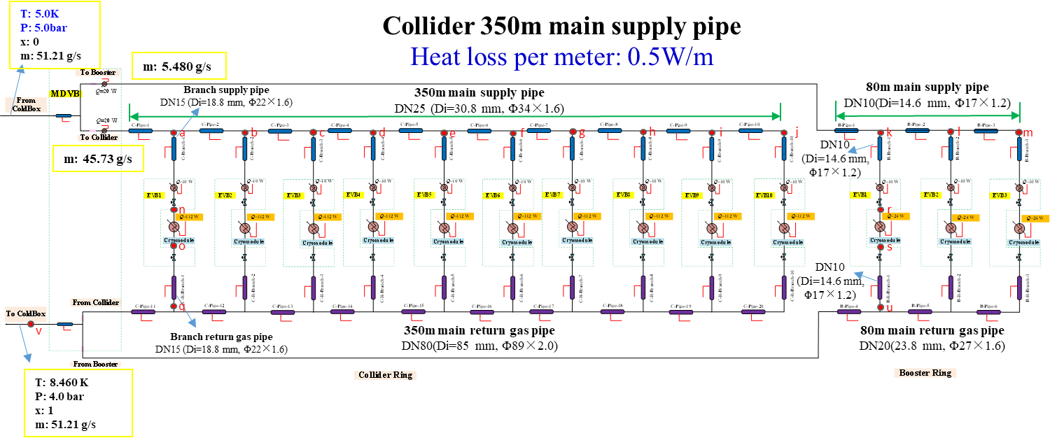
5K~8K TS calculation
Total main supply pipe length is 430 meters, and the heat loss per meter is 0.5 W.
The mass flow of liquid helium needs to be provided by the refrigerator is no less than 51.21 g/s .
Main supply pipe sizes: collider- Di=30.8 mm, Booster-Di=14.6 mm.
Main return gas pipe sizes: collider- Di=85 mm, Booster-Di=23.8 mm.
Branch supply pipe sizes: collider- Di=18.8 mm, Booster-Di=14.6 mm.
Branch return gas pipe sizes: collider- Di=18.8 mm, Booster-Di=14.6 mm.

Slide 9
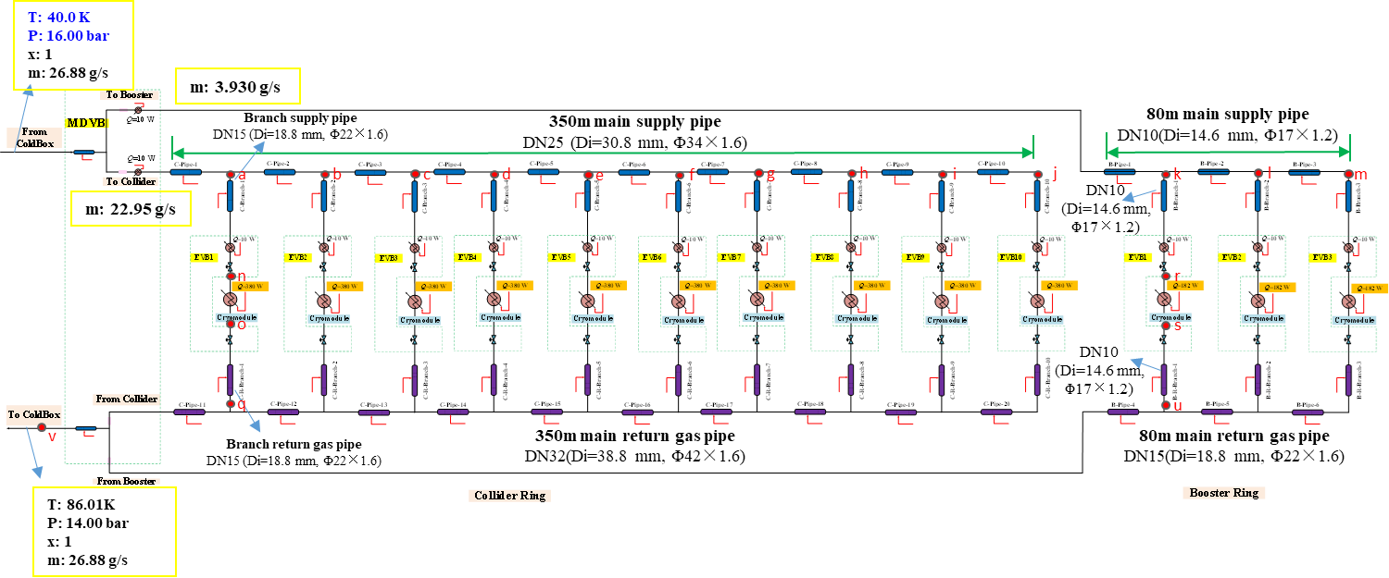
40K~80K TS calculation
Collider 350m main supply pipe
Heat loss per meter: 2.0 W/m
1.5w/M
Total main supply pipe length is 430 meters, and the heat loss per meter is 2.0 W.
The mass flow of liquid helium needs to be provided by the refrigerator is no less than 26.88 g/s .
Main supply pipe sizes: collider- Di=30.8 mm, Booster-Di=14.6 mm.
Main return gas pipe sizes: collider- Di=38.8 mm, Booster-Di=18.8 mm.
Branch supply pipe sizes: collider- Di=18.8 mm, Booster-Di=14.6 mm.
Branch return gas pipe sizes: collider- Di=18.8 mm, Booster-Di=14.6 mm.

Slide 10
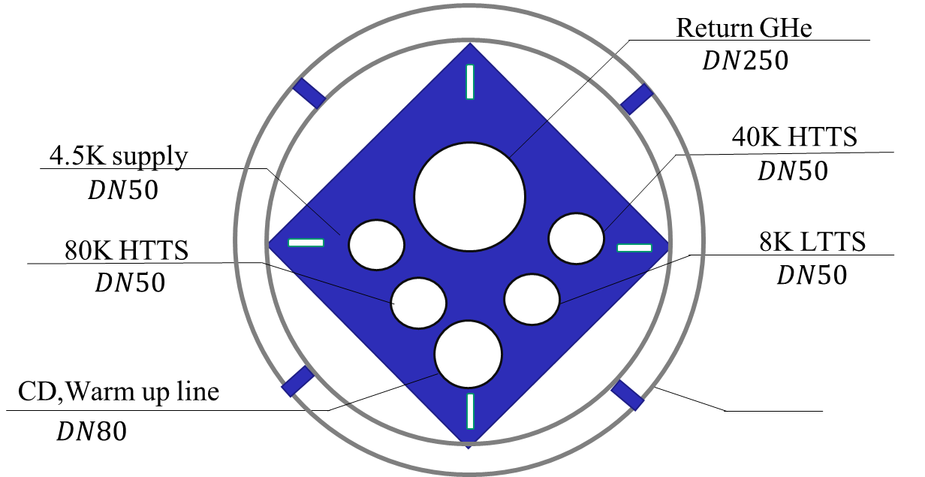
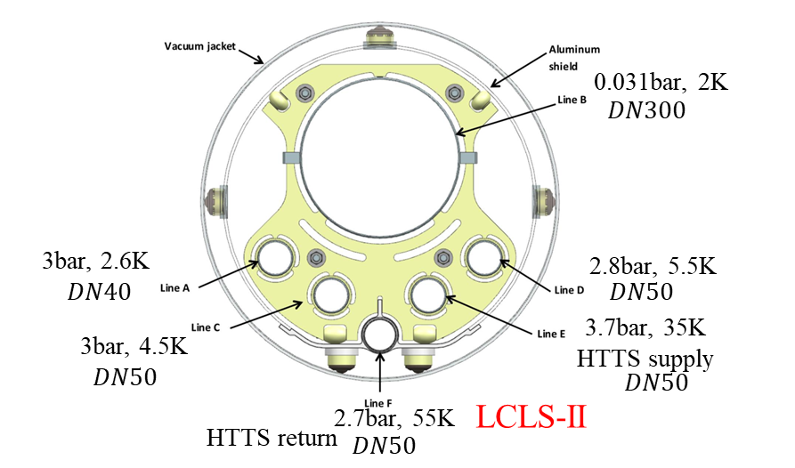

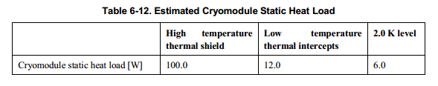
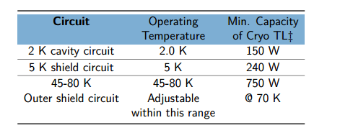
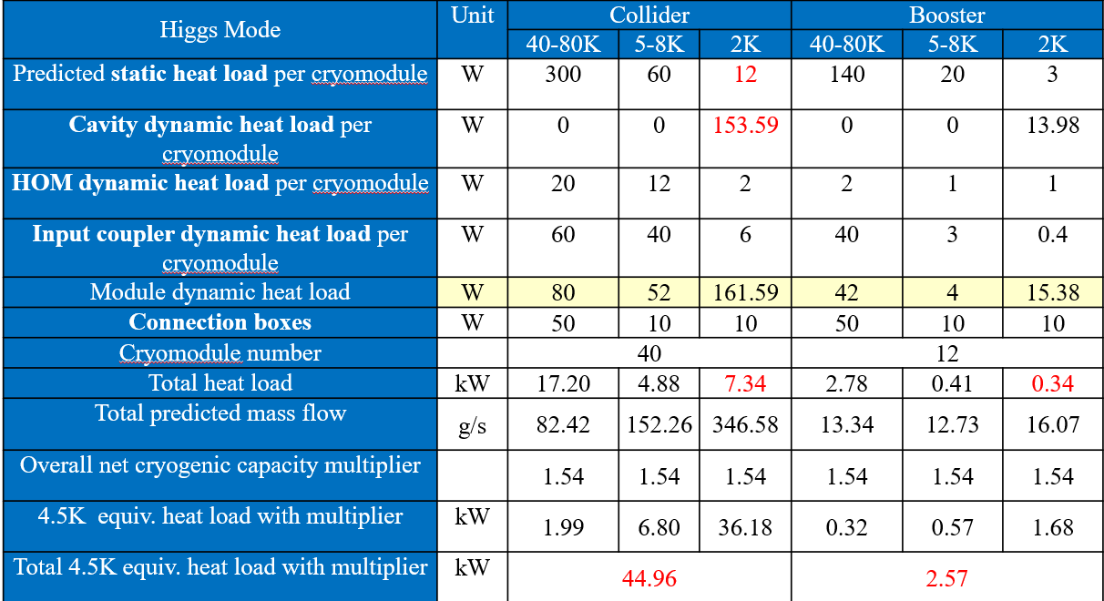
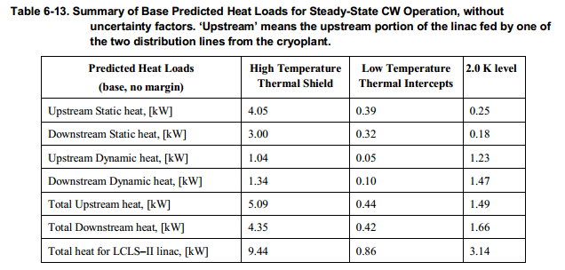
Multi-transfer line size comparison
At the premise of return gas transfer line pressure drop 0.4kPa
PIP-II
CEPC Collider ring cryogenic multi-transfer line

Slide 11
CEPC RF cryogenic system expenses
CEPC Higgs(50MW)
50 MW SR power per beam in Higgs mode
减少 2820.00万元
CEPC项目经费预算表(单位：万元)
编号 | 设备名称 | 规格型号 | 单位 | 数量 | 单价 （万元） | 总价（万元） 100公里 | 数量 | 单价 （万元） | 总价（万元） 100公里 | 差额（万元）
2.3 | 低温系统 |  |  |  |  | 92360.00 |  |  | 87140.00 | 2820.00
2.3.1 | 18KW@4.5K制冷机 | 18KW@4.5K | 台 | 4 | 14000 | 56000.00 | 4 | 14000 | 56000.00 | 0.00
2.3.2 | 液氦储罐 | 10000升 | 台 | 4 | 200 | 800.00 | 4 | 200 | 800.00 | 0.00
2.3.3 | 主分配阀箱 |  | 台 | 4 | 300 | 1200.00 | 4 | 800 | 3200.00 | -2000.00
2.3.4 | 连接阀箱 |  | 台 | 52 | 150 | 7800.00 | 52 | 40 | 2080.00 | 5720.00 | 恒温器辅助阀箱
2.3.5 | 多通道低温管线 | 多路 | m | 2240 | 1.5 | 3360.00 | 744 | 2.5 | 1860.00 | 1500.00
2.3.6 | 中压氦气储罐 | 20Bar，100m3 | 台 | 32 | 80 | 2560.00 | 32 | 80 | 2560.00 | 0.00
2.3.7 | 高压高纯氦气储罐 | 200Bar，25m3 | 组 | 4 | 350 | 1400.00 | 4 | 350 | 1400.00 | 0.00
2.3.8 | 高压不纯氦气储罐 | 200Bar，25m3 | 组 | 4 | 250 | 1000.00 | 4 | 250 | 1000.00 | 0.00
2.3.9 | 高压氦气回收压缩机 | 200bar，100m3/h | 台 | 8 | 230 | 1840.00 | 8 | 230 | 1840.00 | 0.00
2.3.10 | 高压氦气纯化器 | 200m3/h | 台 | 4 | 300 | 1200.00 | 4 | 300 | 1200.00 | 0.00
2.3.11 | 纯氦气 | 纯度5N9 | m3 | 80000 | 0.015 | 1200.00 | 80000 | 0.015 | 1200.00 | 0.00
2.3.12 | 控制系统 |  | 套 | 4 | 500 | 2000.00 | 4 | 500 | 2000.00 | 0.00
2.3.13 | 隔热真空系统 |  | 套 | 4 | 500 | 2000.00 | 4 | 500 | 2000.00 | 0.00
2.3.14 | 常温管路 |  | 套 | 4 | 1000 | 4000.00 | 4 | 1000 | 4000.00 | 0.00
2.3.15 | 工具，消耗品等 |  | 套 | 4 | 500 | 2000.00 | 4 | 500 | 2000.00 | 0.00
2.3.16 | 安装施工 |  | 套 | 4 | 1000 | 4000.00 | 4 | 1000 | 4000.00 | 0.00
2.3.17 | 设备2K阀箱 |  | 台 | 0 | 0 | 0.00 | 8 | 300 | 2400.00 | -2400.00
Notes:
For the Higgs mode, with the constraint of 30 MW, the design luminosity per IP is 3 × 1034 cm-2s-1 with 242 bunches and beam current of 17.4 mA. The horizontal and verticalβfunctions at the IP are 0.36 m and 1.5 mm respectively.

Slide 12
OUTLINE
Discussion and Comparison on CEPC SRF cryogenic system
Discussion and Comparison on SC magnets cryogenic system
Summary

Slide 13
Estimated heat loads for SC IR magnets
 |  | 4.5K main loop |  |  | Thermal Shielding 40~80K
Name | Unit | No. | Heat load for each | Heat load | Heat load for each | Heat load
IR SC sextupole magnet | W | 32 | 10 | 320 | 68 | 2176
Valve Box of IR SC sextupole magnet | W | 32 | 20 | 640 | 20 | 640
Current lead of IR SC sextupole magnet | g/s | 32 | 0.1 | 3.2 | 0.1 | 3.2
IR SC magnet | W | 4 | 30 | 120 | 180 | 720
Valve Box of IR SC magnet | W | 4 | 30 | 120 | 30 | 120
Current lead of IR SC magnet | g/s | 4 | 0.5 | 2 | 0.5 | 2
Main distribution valve box | W | 4 | 50 | 100 | 50 | 200
Cryogenic transfer-line | W | 4000 | 0.3 | 1200 | 2 | 8000
Total equiv. heat load @4.5K | W | 14356
Total equiv. heat load @4.5K | W | 14356W+10.4g/s
Total equiv. heat load @4.5K | W | 14478
Total equiv. heat load @4.5K with multiplier 1.5 | W | 21717
Cooling capacity of refrigerator@4.5K | W | 2 | 12kW@4.5K | 24kW@4.5K
Installed power (COP 300W/1W) | MW
 |  | 4.5K main loop |  |  | Thermal Shielding 40~80K
Name | Unit | No. | Heat load for each | Heat load | No. | Heat load for each | Heat load
IR SC sextupole magnet | W | 32 | 10 | 320
Valve Box of IR SC sextupole magnet | W | 32 | 20 | 640
Current lead heat load of IR SC sextupole magnet | W | 32 | —— | ——
IR SC magnet | W | 4 | 30 | 120
Valve Box of IR SC magnet | W | 4 | 30 | 120
Current lead of IR SC magnet | g/s | 4 | 0.5 | 2
Main distribution valve box | W | 4 | 50 | 100
Cryogenic transfer-line | W | 4000 | 0.3 | 1200 | 3424 | 1.5 | 5136
Total heat load @4.5K | W |  |  | 2500 |  |  | 5136
Total heat load @4.5K | W |  |  | 2500W+2g/s |  |  | 5136
Total heat load @4.5K | W |  |  | 2523.45 |  |  | 5136
Coefficient |  |  |  | 1 |  |  | 0.05
Total heat load @4.5K | W |  |  | 2523.45 |  |  | 256.8
Total equiv. heat load @4.5K | W | 2780.25
Total equiv. heat load @4.5K with multiplier 1.5 | W | 4170
Cooling capacity of refrigerator@4.5K | W | 2 | 4kW@4.5K | 8kW@4.5K
Two individual refrigerators (2 x 4kW@4.5K, optimized later) will be employed for the CEPC SC magnets cryogenic system.

Slide 14
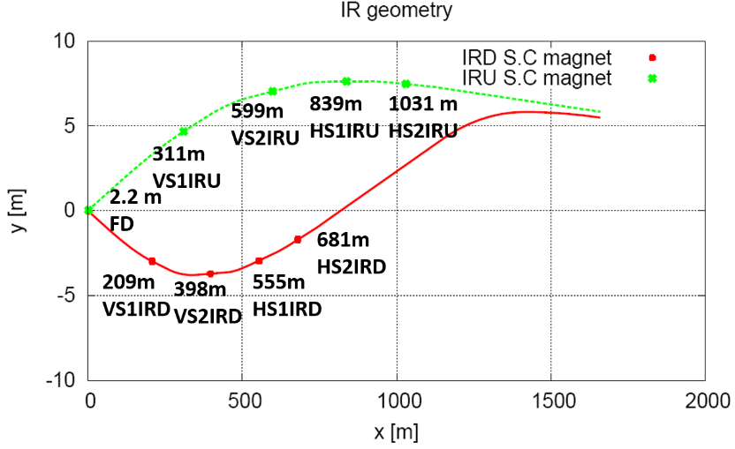
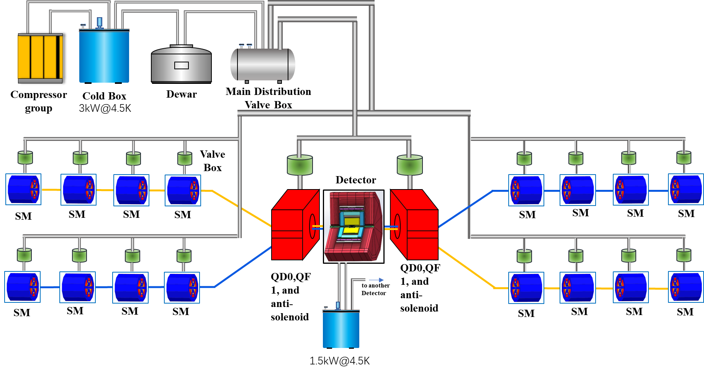
Flow scheme of SC magnets cryogenic system

Slide 15
SC magnets Process calculation
DN25(Di=30.8 mm, Φ34×1.6)
0.15W/m single loop transfer line heat loss
total 3424m cryogenic transfer lines
subcooled
DN40(Di=44.8 mm, Φ48×1.6)
Cooling method: subcooled supercritical helium.
3.0 bar@4.45K subcooled liquid helium is transferred, throttling at local equipment valve box, then return to the dewar.

Slide 16

SC magnets Process calculation
DN25(Di=30.8 mm, Φ34×1.6)
0.15W/m single loop transfer line heat loss
total 3424m cryogenic transfer lines
3bar@5K supercritical
DN40(Di=44.8 mm, Φ48×1.6)
3.0 bar@5K supercritical liquid helium is transferred, throttling at local equipment valve box, then return to the dewar.

Slide 17
CEPC SC magnets cryogenic system expenses
CEPC项目经费预算表(单位：万元)大型制冷机方案
编号 | 设备名称 | 规格型号 | 单位 | 数量 | 单价 （万元） | 总价（万元） 100公里 | 数量 | 单价 （万元） | 总价（万元） 100公里 | 差额（万元）
2.3 | 低温系统 |  |  |  |  | 24160.00 |  |  | 23296.00 | 864.00
2.3.1 | 3KW@4.5K制冷机 | 3KW@4.5K | 台 | 2 | 3000 | 6000.00 | 2 | 3000 | 6000.00 | 0.00
2.3.3 | 液氦储罐 | 3000升 | 台 | 2 | 100 | 200.00 | 2 | 100 | 200.00 | 0.00
2.3.4 | 主分配阀箱 |  | 台 | 2 | 200 | 400.00 | 2 | 200 | 400.00 | 0.00
2.3.5 | 连接阀箱 |  | 台 | 36 | 100 | 3600.00 | 36 | 100 | 3600.00 | 0.00
2.3.6 | 多通道低温管线 | 多路 | m | 4000 | 1.5 | 6000.00 | 3424 | 1.5 | 5136.00 | 864.00
2.3.7 | 中压氦气储罐 | 16Bar，100m3 | 台 | 8 | 80 | 640.00 | 8 | 80 | 640.00 | 0.00
2.3.8 | 高压高纯氦气储罐 | 200Bar，25m3 | 组 | 2 | 350 | 700.00 | 2 | 350 | 700.00 | 0.00
2.3.9 | 高压不纯氦气储罐 | 200Bar，25m3 | 组 | 6 | 250 | 1500.00 | 6 | 250 | 1500.00 | 0.00
2.3.10 | 高压氦气回收压缩机 | 200bar，100m3/h | 台 | 4 | 230 | 920.00 | 4 | 230 | 920.00 | 0.00
2.3.11 | 高压氦气纯化器 | 100m3/h | 台 | 2 | 150 | 300.00 | 2 | 150 | 300.00 | 0.00
2.3.12 | 纯氦气 | 纯度5N9 | m3 | 40000 | 0.015 | 600.00 | 40000 | 0.015 | 600.00 | 0.00
2.3.13 | 控制系统 |  | 套 | 2 | 400 | 800.00 | 2 | 400 | 800.00 | 0.00
2.3.14 | 隔热真空系统 |  | 套 | 2 | 300 | 600.00 | 2 | 300 | 600.00 | 0.00
2.3.15 | 常温管路及常温阀 |  | 套 | 2 | 300 | 600.00 | 2 | 300 | 600.00 | 0.00
2.3.16 | 工具，消耗品等 |  | 套 | 2 | 300 | 600.00 | 2 | 300 | 600.00 | 0.00
2.3.17 | 安装施工 |  | 套 | 2 | 350 | 700.00 | 2 | 350 | 700.00 | 0.00
SRF side and SC magnets: 减少 3684.00万元

Slide 18
Summary
Previous CDR and TDR works have laid a good foundation for the further design.
For the CEPC cryogenic system TDR design, almost relevant aspects have been considered , including process scheme, layout, and key equipment design.
For the RF side, scheme 2 can reduce construction expenses, and has the advantage of low heat loss and easier transfer line construction and flexible maintenance.
For the IR magnets, the process scheme has been decided, and the preliminary process calculation has been completed.
The heat loss is selected 0.15W/m single loop after reviewing the status, and a test platform for multi-channel transfer lines is being constructed to measure two important parameters of heat leakage and pressure drop.
Further TDR design is going on. Now it's just at the stage of scheme comparison, and there is still a long way to complete the whole TDR design. In the later time, the project team members need to work together to greatly push forward the work.

Slide 19
Thanks:
Previous hard work of group teammates.
Li Mei, and Zhou Jian-rong summarize the report.
Other colleagues providing the materials and put forward some good suggestion.

Slide 20
Backup

Slide 21
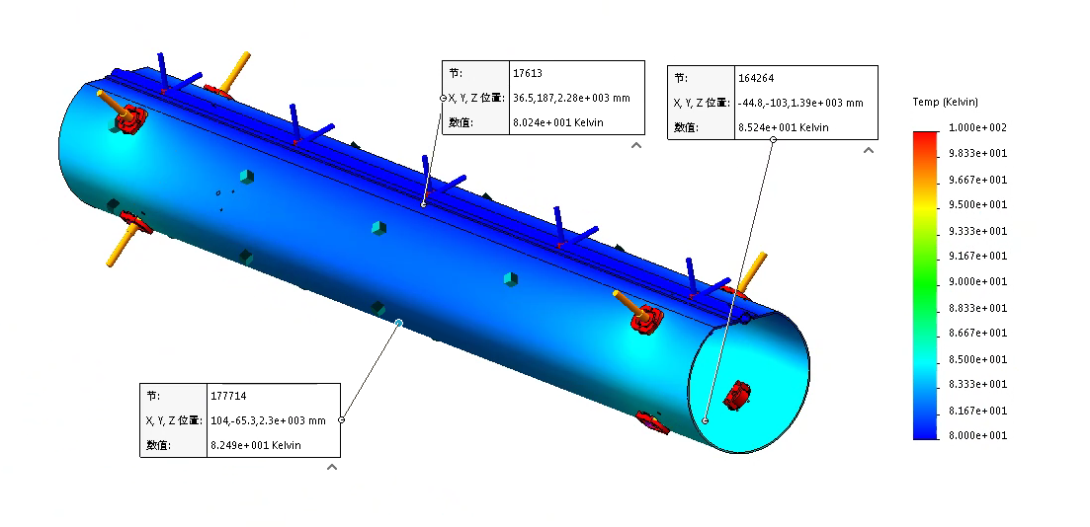
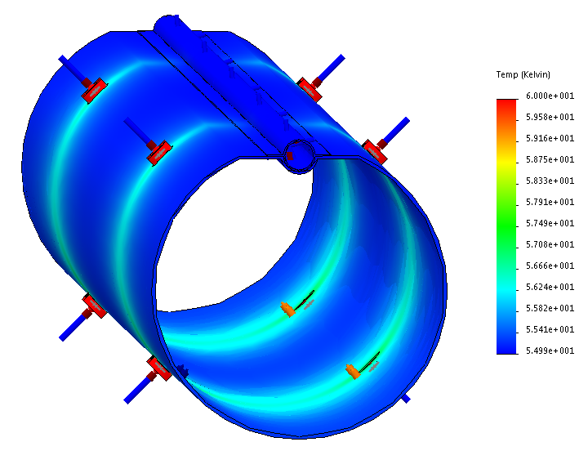
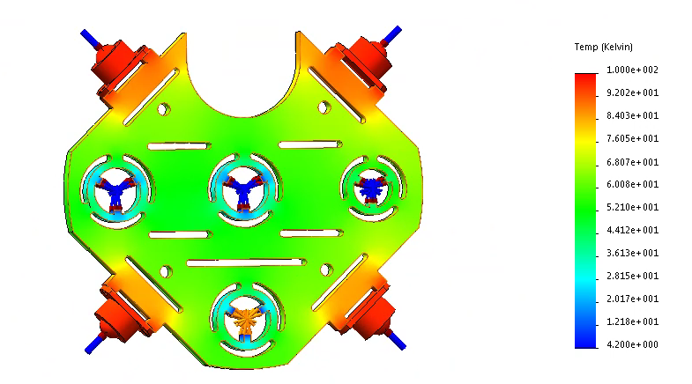
Cryogenic transfer-line heat loss review
Heat Leak Analysis of Thermal Shield and support
 | Cryogenic transfer-line heat loss /(W/m)
KEK TRISTAN | 0.3
KEKB | 0.1
LCLS-II | 0.5
LEP2 | 0.4
XFEL AMTF | 0.15
PAPS Transfer Lines simulation
0.15W/m single loop is selected
We do the best we can

Slide 22
CEPC RF cryogenic system expenses
原来上报经费
CEPC项目经费预算表(单位：万元)
编号 | 设备名称 | 规格型号 | 单位 | 数量 | 单价 （万元） | 总价（万元） 100公里 | 备注
2.3 | 低温系统 |  |  |  |  | 92200.00
2.3.1 | 18KW@4.5K制冷机 | 18KW@4.5K | 台 | 4 | 14000 | 56000.00 | 国产，研制
2.3.2 | 液氦储罐 | 10000升 | 台 | 4 | 200 | 800.00 | 国产，购置
2.3.3 | 主分配阀箱 |  | 台 | 4 | 300 | 1200.00 | 国产，研制
2.3.4 | 连接阀箱 |  | 台 | 52 | 150 | 7800.00 | 国产，研制
2.3.5 | 多通道低温管线 | 多路 | m | 4000 | 0.8 | 3200.00 | 国产，研制
2.3.6 | 中压氦气储罐 | 20Bar，100m3 | 台 | 32 | 80 | 2560.00 | 国产，购置
2.3.7 | 高压高纯氦气储罐 | 200Bar，25m3 | 组 | 4 | 350 | 1400.00 | 国产，购置
2.3.8 | 高压不纯氦气储罐 | 200Bar，25m3 | 组 | 4 | 250 | 1000.00 | 国产，购置
2.3.9 | 高压氦气回收压缩机 | 200bar，100m3/h | 台 | 8 | 230 | 1840.00 | 国产，购置
2.3.10 | 高压氦气纯化器 | 200m3/h | 台 | 4 | 300 | 1200.00 | 国产，购置
2.3.11 | 纯氦气 | 纯度5N9 | m3 | 80000 | 0.015 | 1200.00 | 国产，购置
2.3.12 | 控制系统 |  | 套 | 4 | 500 | 2000.00 | 国产，研制
2.3.13 | 隔热真空系统 |  | 套 | 4 | 500 | 2000.00 | 国产，购置
2.3.14 | 常温管路 |  | 套 | 4 | 1000 | 4000.00 | 国产，购置
2.3.15 | 工具，消耗品等 |  | 套 | 4 | 500 | 2000.00 | 其他
2.3.16 | 安装施工 |  | 套 | 4 | 1000 | 4000.00 | 其他

Slide 23
CEPC RF cryogenic system expenses
CEPC项目经费预算表(单位：万元)大型制冷机方案
编号 | 设备名称 | 规格型号 | 单位 | 数量 | 单价 （万元） | 总价（万元） 100公里 | 备注
2.3 | 低温系统 |  |  |  |  | 24360.00
2.3.1 | 3KW@4.5K制冷机 | 3KW@4.5K | 台 | 2 | 3000 | 6000.00 | 国产，研制
2.3.2 | 1.5kW@4.5K制冷机 | 1.5kW@4.5K | 台 | 2 | 1500 | 3000.00 | 国产，研制
2.3.3 | 液氦储罐 | 3000升 | 台 | 2 | 100 | 200.00 | 国产，购置
2.3.4 | 主分配阀箱 |  | 台 | 2 | 200 | 400.00 | 国产，研制
2.3.5 | 连接阀箱 |  | 台 | 36 | 100 | 3600.00 | 国产，研制
2.3.6 | 多通道低温管线 | 多路 | m | 4000 | 0.8 | 3200.00 | 国产，研制
2.3.7 | 中压氦气储罐 | 16Bar，100m3 | 台 | 8 | 80 | 640.00 | 国产，购置
2.3.8 | 高压高纯氦气储罐 | 200Bar，25m3 | 组 | 2 | 350 | 700.00 | 国产，购置
2.3.9 | 高压不纯氦气储罐 | 200Bar，25m3 | 组 | 6 | 250 | 1500.00 | 国产，购置
2.3.10 | 高压氦气回收压缩机 | 200bar，100m3/h | 台 | 4 | 230 | 920.00 | 国产，购置
2.3.11 | 高压氦气纯化器 | 100m3/h | 台 | 2 | 150 | 300.00 | 国产，购置
2.3.12 | 纯氦气 | 纯度5N9 | m3 | 40000 | 0.015 | 600.00 | 国产，购置
2.3.13 | 控制系统 |  | 套 | 2 | 400 | 800.00 | 国产，研制
2.3.14 | 隔热真空系统 |  | 套 | 2 | 300 | 600.00 | 国产，购置
2.3.15 | 常温管路及常温阀 |  | 套 | 2 | 300 | 600.00 | 国产，购置
2.3.16 | 工具，消耗品等 |  | 套 | 2 | 300 | 600.00 | 其他
2.3.17 | 安装施工 |  | 套 | 2 | 350 | 700.00 | 其他

Slide 24
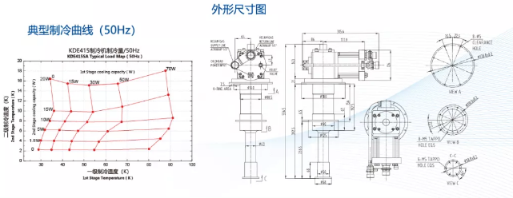
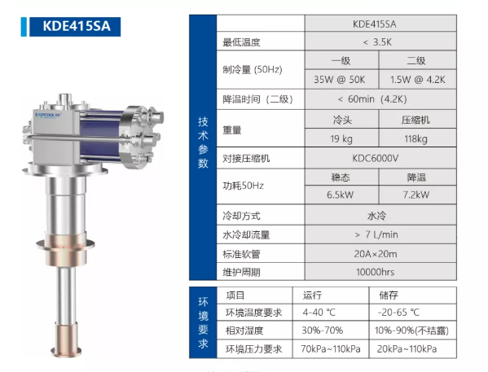
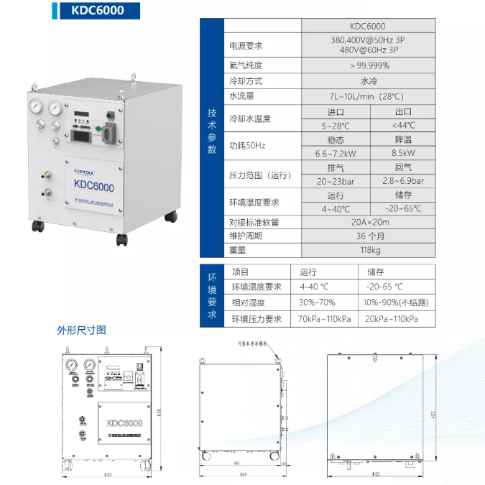
Parameters of GM refrigerator
GM refrigerator

Slide 25
CEPC项目经费预算表(单位：万元)小型制冷机方案
编号 | 设备名称 | 规格型号 | 单位 | 数量 | 单价 （万元） | 总价（万元） 100公里 | 备注
2.3 | 低温系统 |  |  |  |  | 20400.00
2.3.1 | 250W@4.5K制冷机 | 250W@4.5K | 台 | 4 | 800 | 3200.00 | 国产，研制
2.3.2 | 1.5kW@4.5K制冷机 | 1.5kW@4.5K | 台 | 2 | 1500 | 3000.00 | 国产，研制
2.3.2 | 液氦储罐 | 2000升 | 台 | 4 | 50 | 200.00 | 国产，购置
2.3.3 | 主分配阀箱 |  | 台 | 4 | 100 | 400.00 | 国产，研制
2.3.4 | 连接阀箱 |  | 台 | 4 | 80 | 320.00 | 国产，研制
2.3.5 | 小型制冷机 | 1.5W@4.5K | 台 | 224 | 15 | 3360.00 | 国产，研制
2.3.6 | 中压氦气储罐 | 16Bar，100m3 | 台 | 10 | 80 | 800.00 | 国产，购置
2.3.7 | 高压高纯氦气储罐 | 200Bar，25m3 | 组 | 2 | 350 | 700.00 | 国产，购置
2.3.8 | 高压不纯氦气储罐 | 200Bar，25m3 | 组 | 6 | 250 | 1500.00 | 国产，购置
2.3.9 | 高压氦气回收压缩机 | 200bar，100m3/h | 台 | 4 | 230 | 920.00 | 国产，购置
2.3.10 | 高压氦气纯化器 | 100m3/h | 台 | 2 | 150 | 300.00 | 国产，购置
2.3.11 | 纯氦气 | 纯度5N9 | m3 | 80000 | 0.015 | 1200.00 | 国产，购置
2.3.12 | 控制系统 |  | 套 | 2 | 400 | 800.00 | 国产，研制
2.3.13 | 隔热真空系统及辅助 |  | 套 | 2 | 600 | 1200.00 | 国产，购置
2.3.14 | 常温管路及常温阀 |  | 套 | 2 | 600 | 1200.00 | 国产，购置
2.3.15 | 工具，消耗品等 |  | 套 | 2 | 300 | 600.00 | 其他
2.3.16 | 安装施工 |  | 套 | 2 | 350 | 700.00 | 其他

