Slide 1
Sky localization and Parameter Estimation with Spaceborne Gravitational Wave detectors
龚云贵
华中科技大学物理学院
2021.6.9
Notes:
不同探测器构型对定位及参数估计的影响

Slide 2
Outline
Gravitational Waves and Detections
Antenna response
Constellations for spaceborne GW detectors
Sky localization for monochromatic source
Sky localization for merger and Ringdown sources
Conclusion
Liang, Gong, Weinstein, Zhang & Zhang 2019, PRD 99, 104027;
Zhang, Gao, Gong, Liang, Weinstein & Zhang 2019, PRD 100, 064033;
Zhang, Gao, Gong, Wang, Weinstein & Zhang 2020, PRD 101, 124027;
Zhang, Gong, Liu, Wang & Zhang 2021, PRD 103, 103013;
Zhang, Gong, Wang & Zhang 2021, PRD 103, 104066;
Zhang, Gong & Zhang, 2105.11279

Slide 3
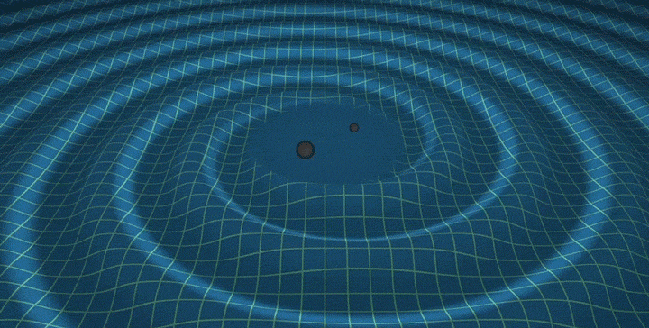
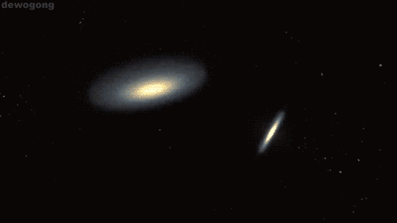
Motivation
The discovery of Gravitational Waves (GWs)
GW150914: PRL 116 (16) 061102

Slide 4
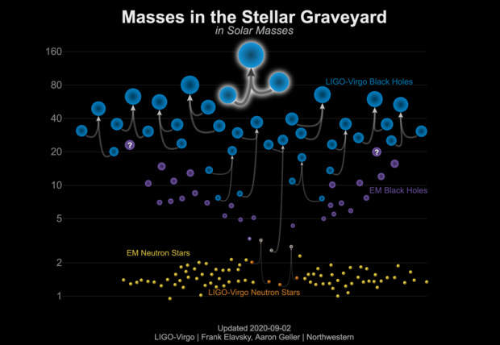
LIGO/Virgo Results
GWTC-1: 1811.12907
GWTC-2: 2010.14527
Tens of GWs

Slide 5

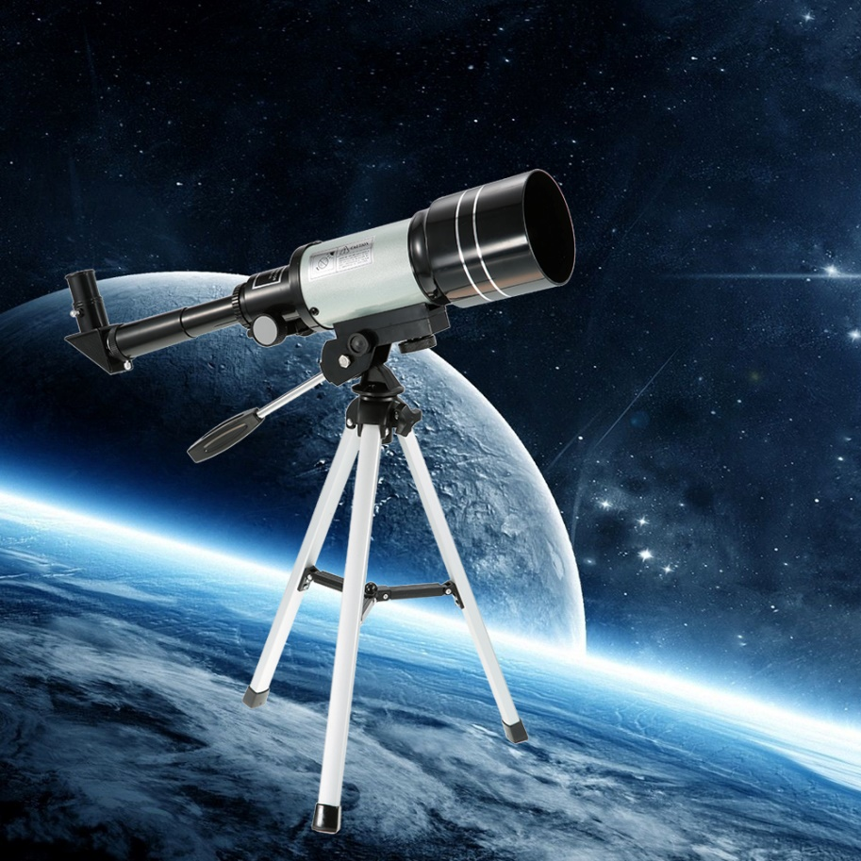

Gravitational Universe
Opens a new window to uncover the Universe
The dawn of multi-band/multi-messenger astronomy
eLISA, 1305.5720
Notes:
有了声音，人生更加丰富多彩

Slide 6
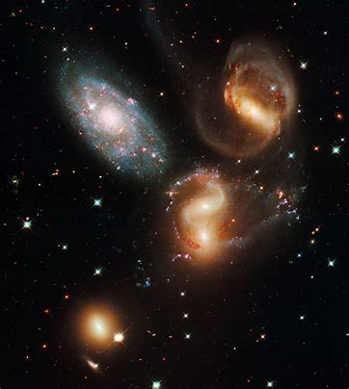
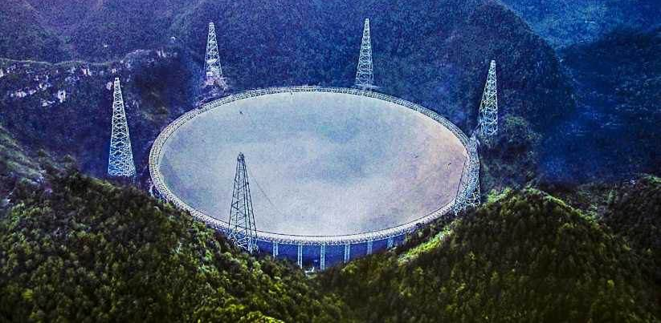
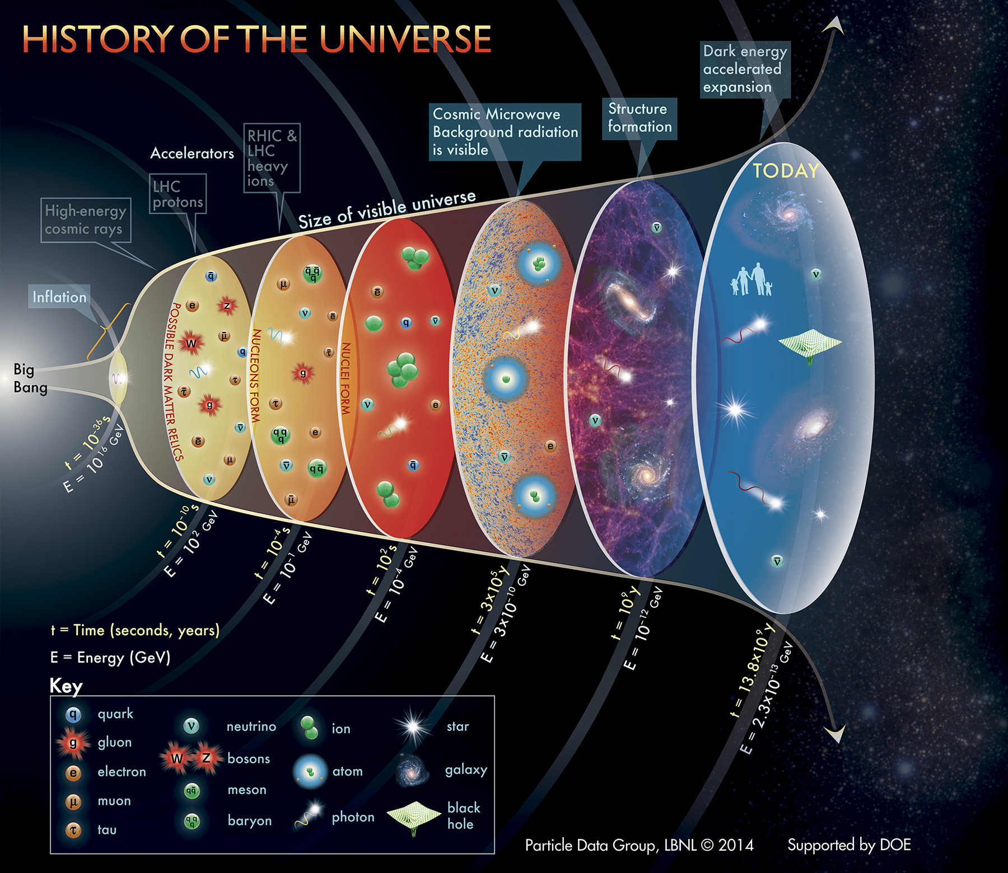
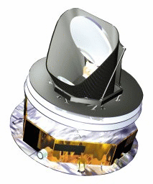
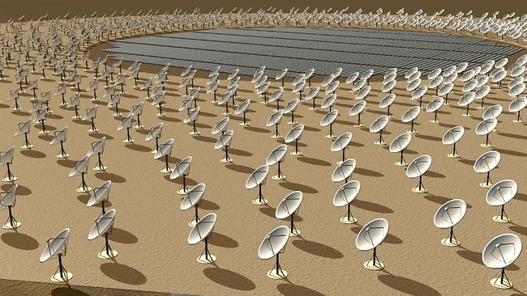
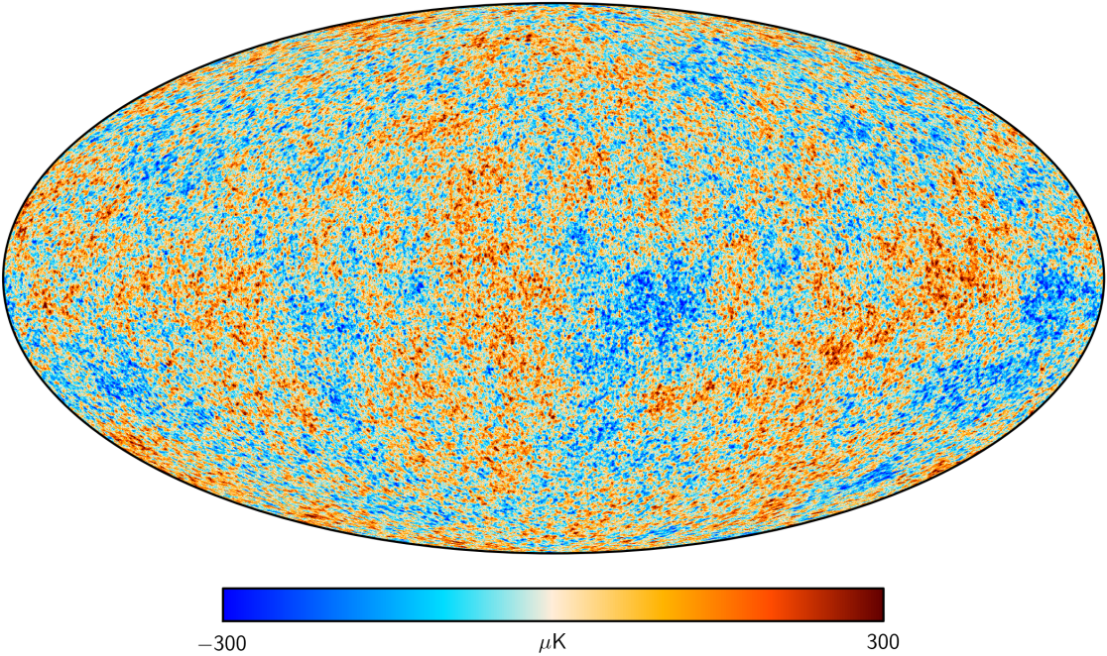
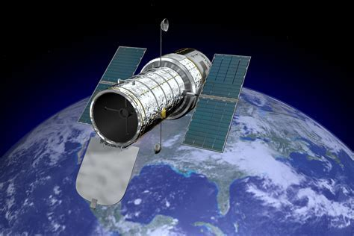
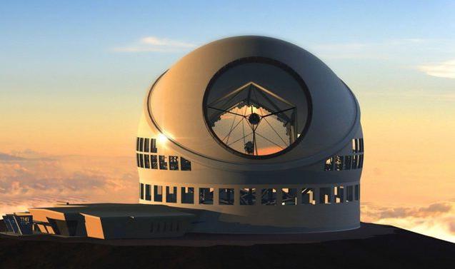
Seeing the Universe
Electromagnetic method

Slide 7
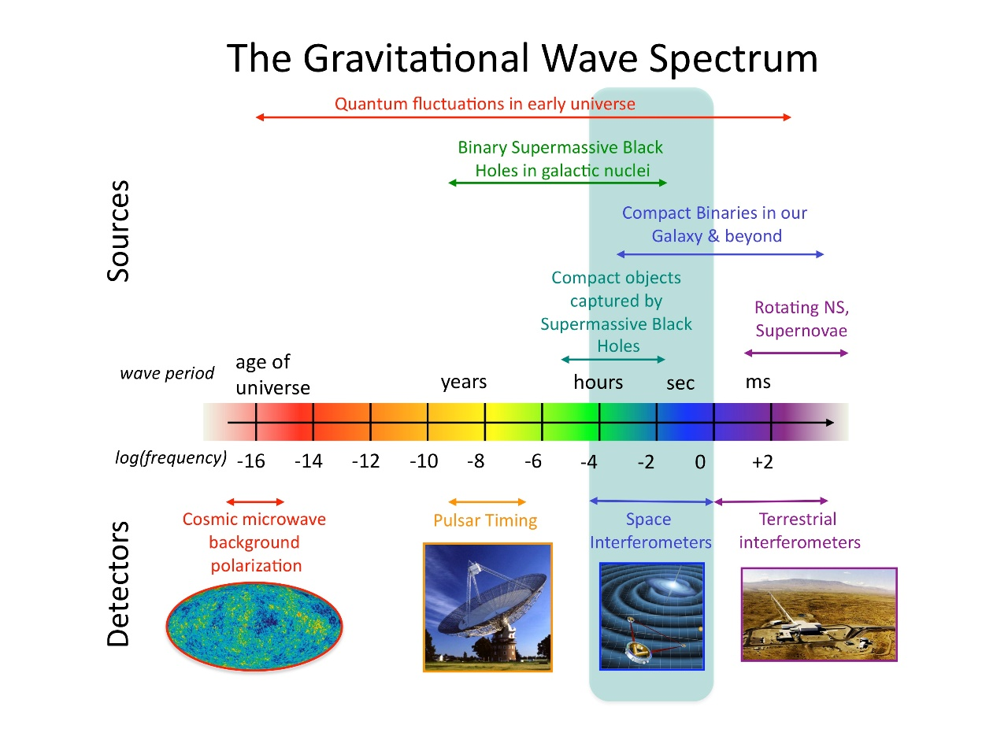
The spectrum of GWs
Used to probe the early universe
波长（米）24 22 20 18 16 14 12 10 8 6 （对数）

Slide 8
GW tools
Test of gravity in strong field and nonlinear regimes
Provides model independent measurement of distance
Ground-based detectors: source localization
  10-1000Hz frequency band
  A few seconds of signals
  Stellar mass black holes and neutron stars
GW170817/GRB170817A
Three or more detectors needed: Timing Triangulation

Slide 9
Hubble constant measurements
Mortsell etal,2105.11461

Slide 10
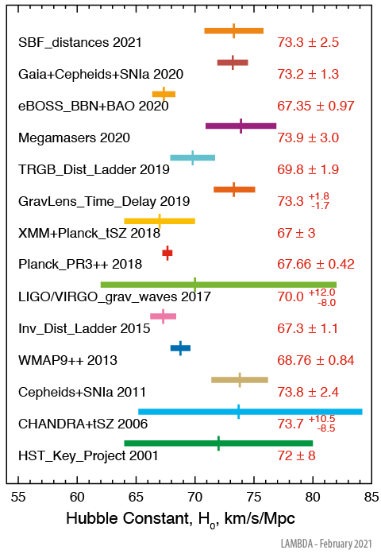
Hubble constant measurements
LIGO/Virgo
Sky localization
BNS, GW170817
https://lambda.gsfc.nasa.gov/education/graphic_history/hubb_const.cfm

Slide 11
Spaceborne detectors
Space-based detectors
  mHz band
  Last several years
  Early inspiral signals (monochromatic): months to years before merger
  Inspiral, merger and ringdown signals
  Massive and Supermassive BHs
  Extreme mass ratio inspiral (EMRI)
  Sky localization and polarization measurement
The motion of detectors: Doppler modulation

Slide 12
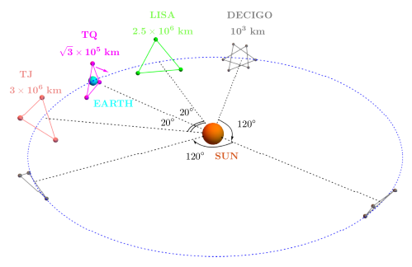
Space-based GW detectors
LISA/Taiji/TianQin/DECIGO (OMEGA)

Slide 13
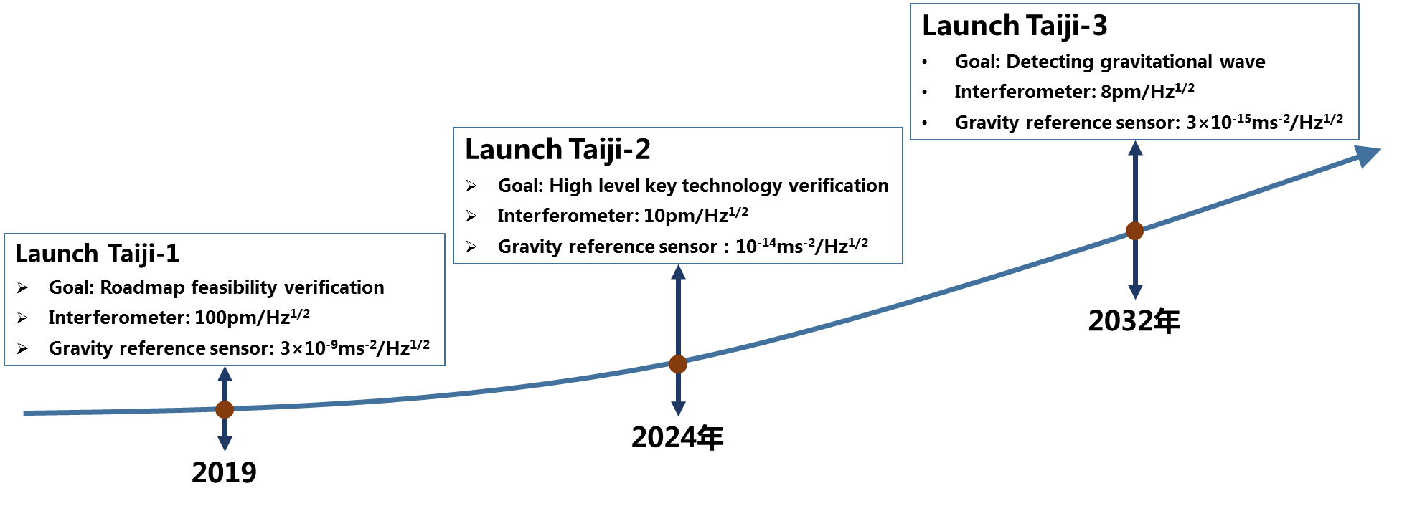
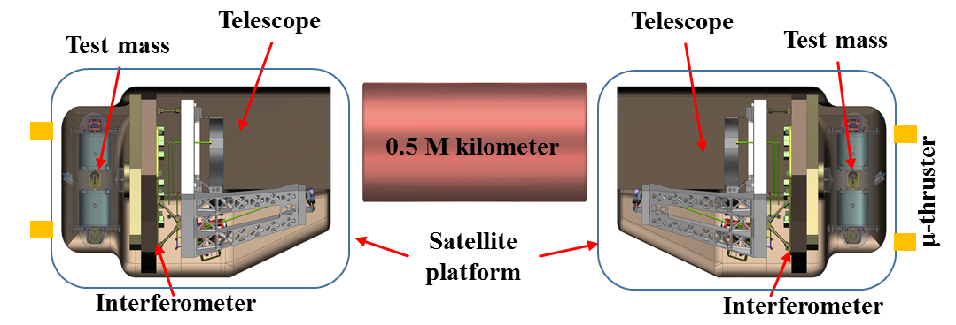
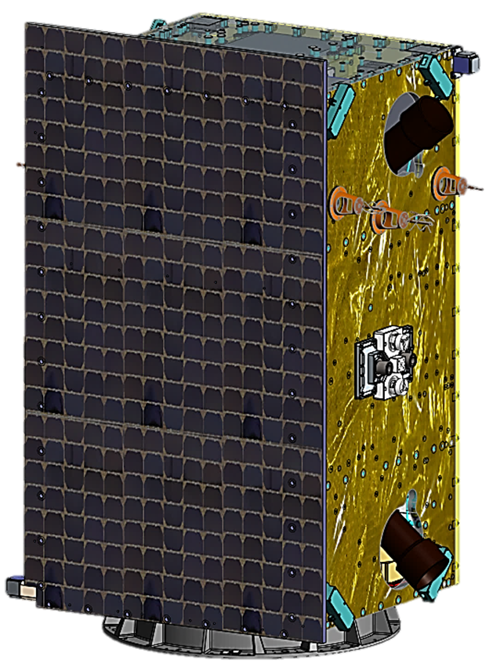
Taiji
Roadmap:
Taiji-1, single satellite, been launched in 2019;
Taiji-2, double satellites, to be launched in 2024;
Taiji-3, three satellites, to be launched in 2032.
Mission Accomplished !
2019.08.31
Taiji roadmap
Hu, W.-R. & Wu, Y.-L. Natl. Sci. Rev. 4, 685 (2017); Luo, Z., Guo, Z., Jin, G., Wu, Y. & Hu, W. Results in Phys. 16, 102918 (2020); Luo, Z., Wang, Y., Wu, Y., Hu, W. & Jin, G. PTEP. (2020)

Slide 14
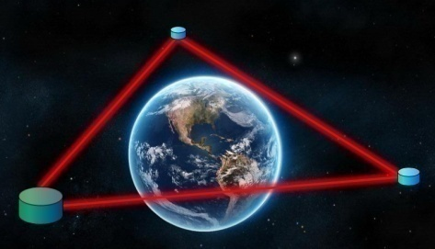
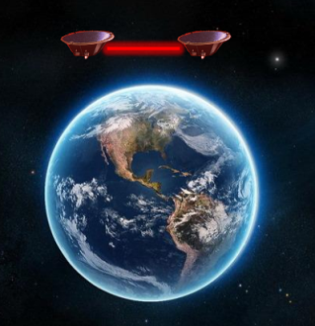
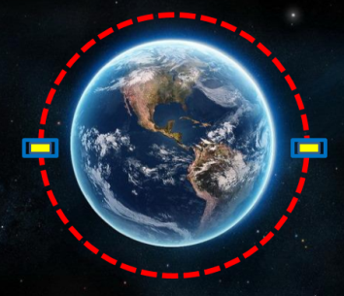
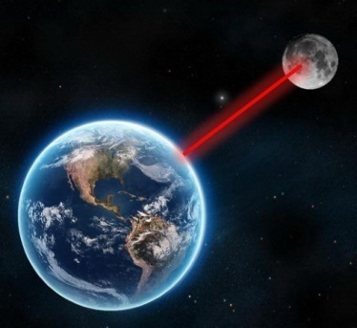
TianQin
Roadmap
3
2
Space-based GW detection
2019.12.20
2019.04.24
1
Inter-satellite laser interferometry
0
Inertial Reference
Lunar Laser Ranging
Everything together
OB, Laser, Freq. Stab., weak light phase locking, ATP, USO
Inertial sensor, micro-Newton thruster, dragfree control
Positioning of high orbit spacecraft
2015 --- --- --- --- --- --- --- --- --- --- --- --- --- 2035
Luo, J. et al. CQG 33, 035010 (2016); Luo, J. et al. 37, 185013 (2020)

Slide 15
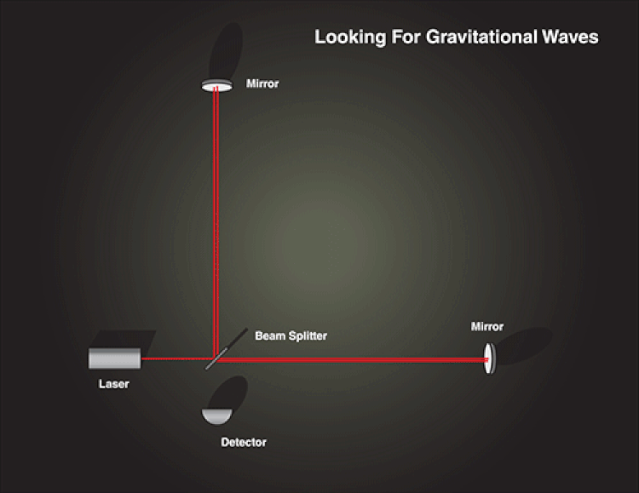
GW Interferometer

Slide 16
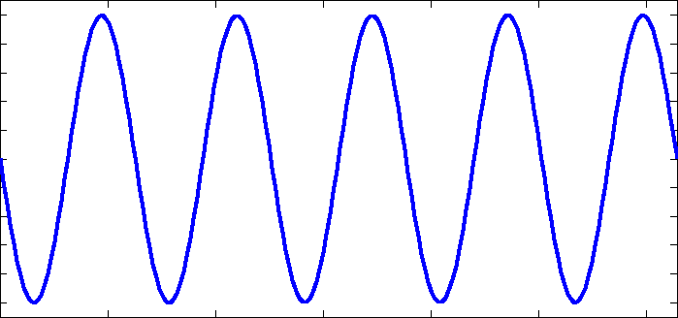



Light path
Forward trip
The direction of the arm has a tilt angle with the X-Y plane
GWs
$$z$$
$$θ$$
$$x$$

Slide 17
Light path
Sinusoidal gravitational wave
Round trip

Slide 18
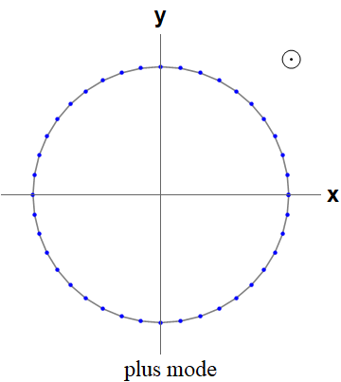
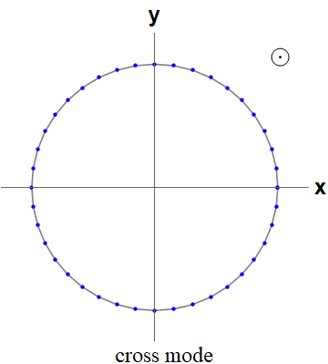
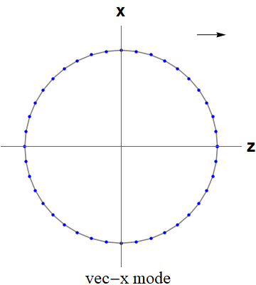
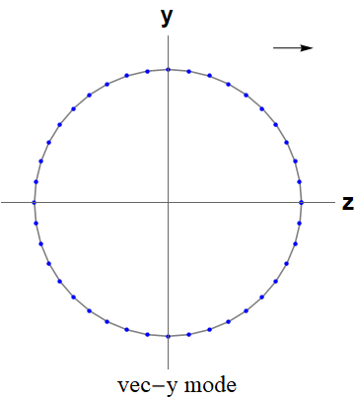
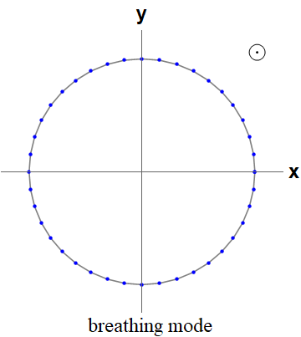
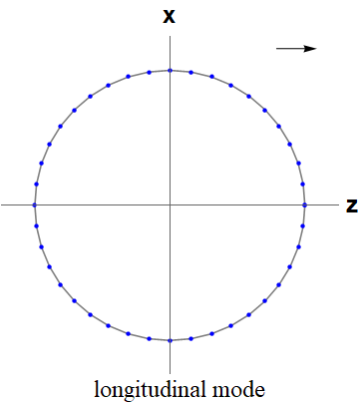
Polarizations
Six possible polarizations
Tensor
Vector
+/×模
Scalar

Slide 19
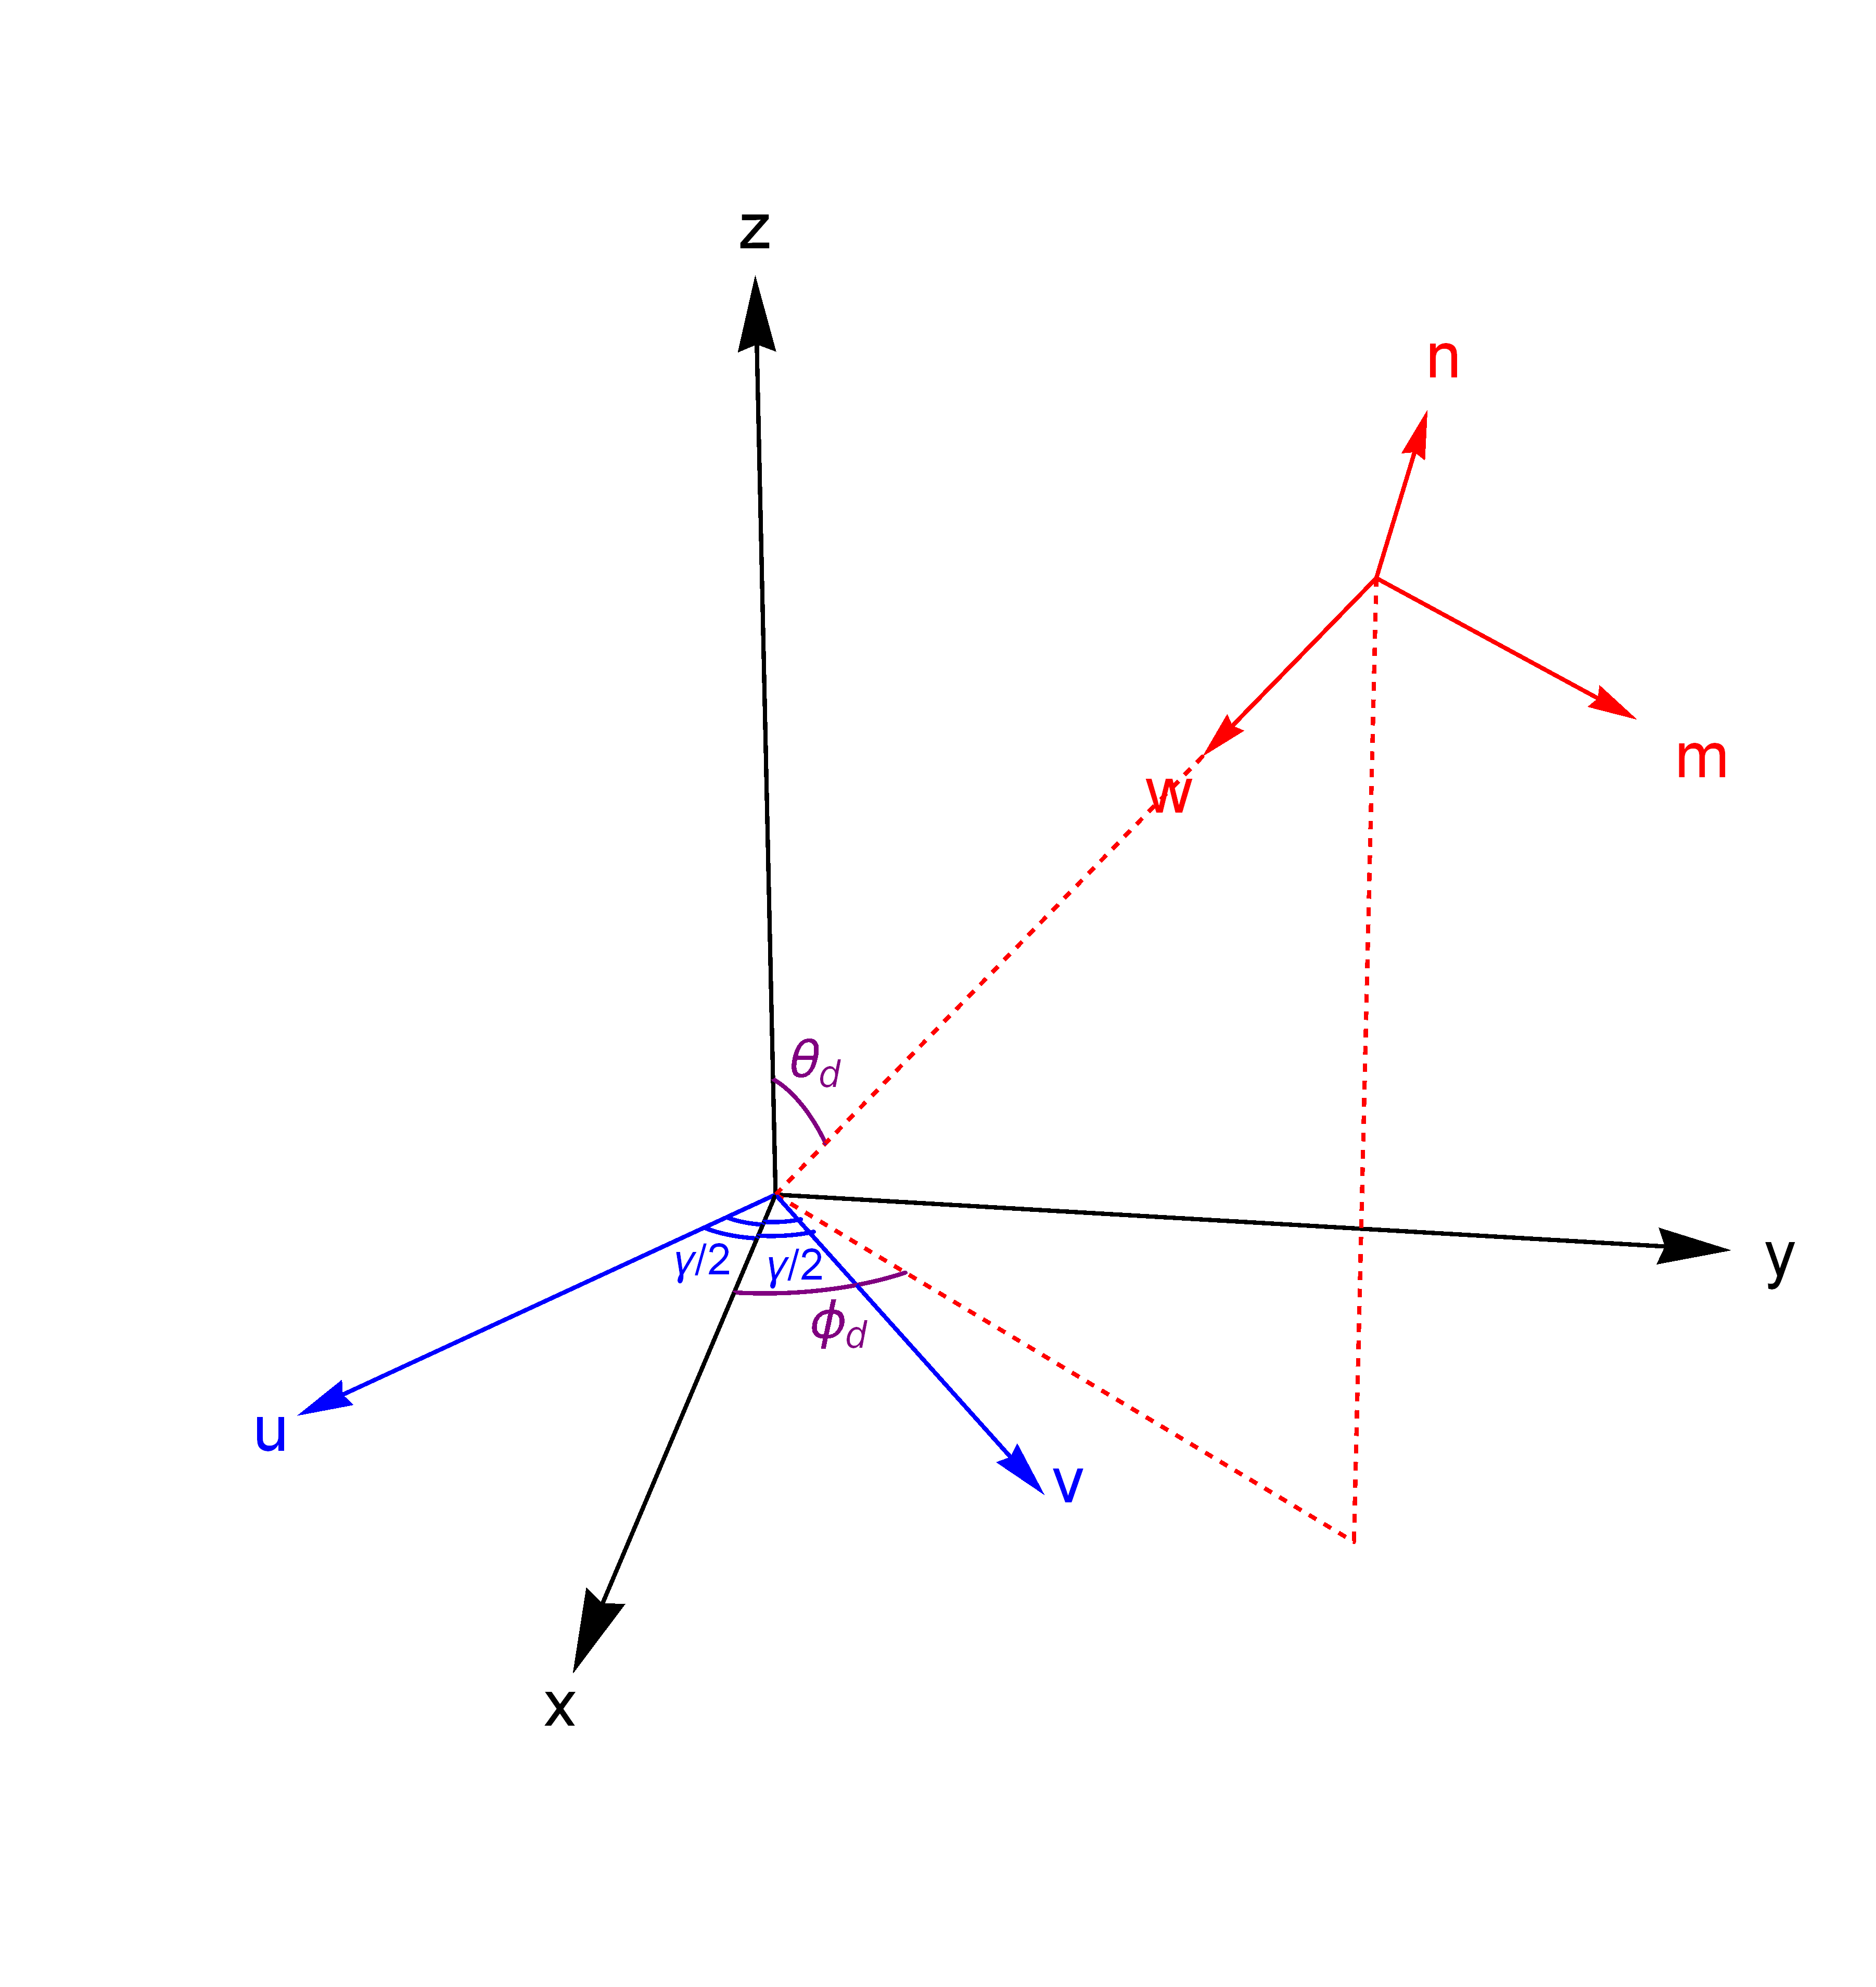
Six possible polarizations
Polarization tensor
Detector tensor
Transfer function

Slide 20
Interferometer
Detector tensor
Detector tensor
Response function
Transfer frequency

Slide 21
Antenna response function
Response function
The angle between two arms

Slide 22
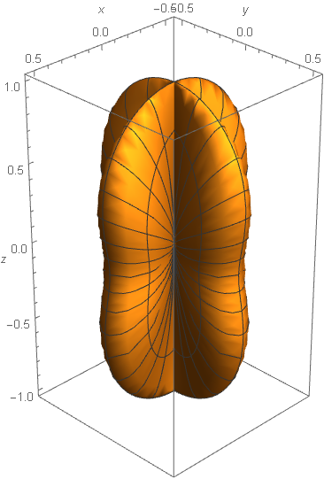
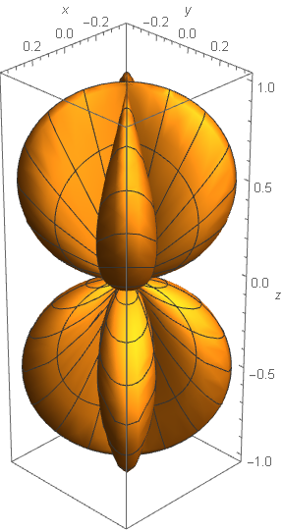
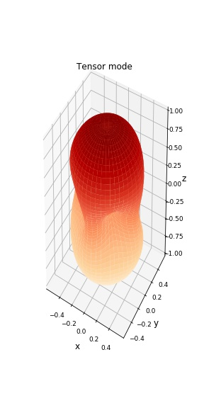
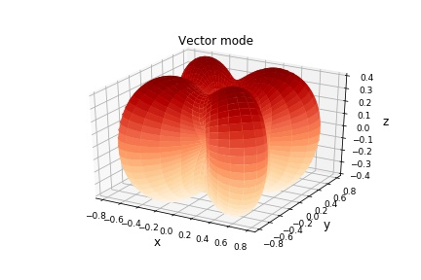
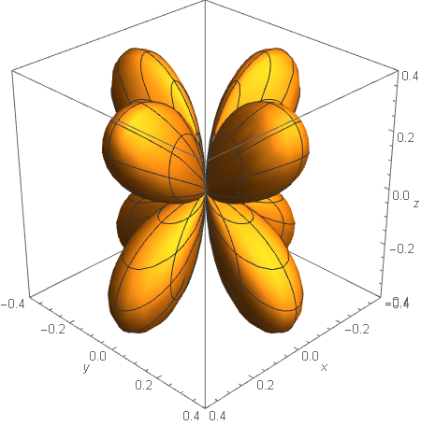
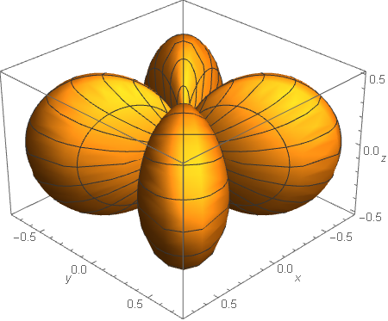
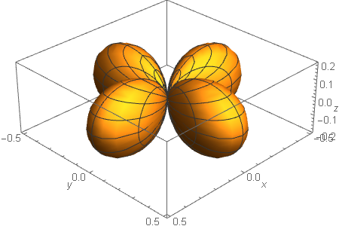
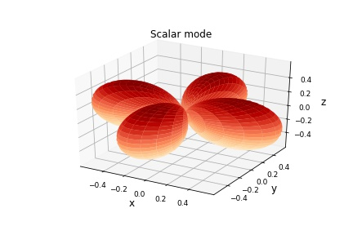
Low Frequency limit
Angular response
Plus
Cross
Vector-x
Vector-y
N. Christensen, PRD 46 (1992) 5250； B. Allen and J. D. Romano, PRD 59 (1999) 102001
Breathing/Longitudinal, degeneracy

Slide 23
Response function
Tensor
Vector
Scalar

Slide 24
Space-based GW detectors
The armlength is comparable or even larger than the wavelength of in-band GWs
The armlength is not equal (TDI needed)
Frequency dependence is important
Numerical simulation of the averaged frequency dependent response functions
Analytical formula for tensor polarization only
Blaut 2012, PRD 85, 043005, 1901.11268
Tinto & da Silva Alves 2010, PRD 82, 122003, 1010.1302
Larson, Hiscock, and Hellings 2000, PRD 62, 062001, gr-qc/9909080
Larson, Hellings, and Hiscock 2002, PRD 66, 062001, gr-qc/0206081

Slide 25
TDI combinations
Unequal arms

Slide 26
Approximate averaged response
For the convenience of evaluating detector and calculating SNR
Approximation 1
Approximation 2
Robson, Cornish & Liu 2019, CQG 36, 105011
Smith & Caldwell 2019, PRD 100, 104055

Slide 27
Analytical Results
Michelson interferometers
Tensor mode
Cross terms need to be integrated numerically
Local minimum
Larson, Hiscock, and Hellings 2000, PRD 62, 062001, gr-qc/9909080

Slide 28
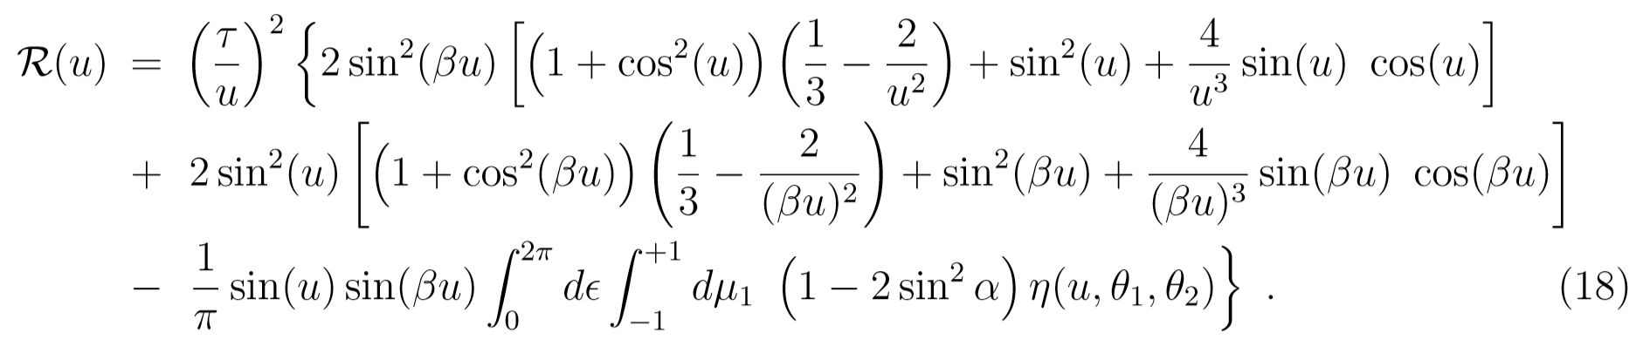
TDI X
Averaged response function: tensor mode
TDI X equal arms
Lost sensitivity at
TDI X unequal arms
Larson, Hiscock, and Hellings, PRD 62, 062001 (2000), gr-qc/9909080
Larson, Hellings, and Hiscock, PRD 66, 062001 (2002), gr-qc/0206081

Slide 29
Numerical Results
Michelson interferometers
Monte Carlo simulation. The sky location is assumed to be uniform distribution of sources, take 1000 points at each frequency
Blaut 2012, PRD 85, 043005, 1901.11268

Slide 30
Monte Carlo Simulations
TDI results
Equal arms
All polarizations
The averaging was done via Monte Carlo integration with 4000 source position polarization state pairs per Fourier frequency bin and 7000 Fourier bins across the LISA
band
Tinto & da Silva Alves 2010, PRD 82, 122003, 1010.1302

Slide 31
Transfer function: polarizations
Vector modes
Breathing mode

Slide 32
Longitudinal mode
Transfer function: average over orientation and polarizations of sources
Liang, Gong, Weinstein, Zhang & Zhang 2019, PRD 99, 104027

Slide 33
Full Analytical formula
Examples: Tensor and breathing modes
Zhang, Gao, Gong, Wang, Weinstein & Zhang 2020, PRD 101, 124027

Slide 34
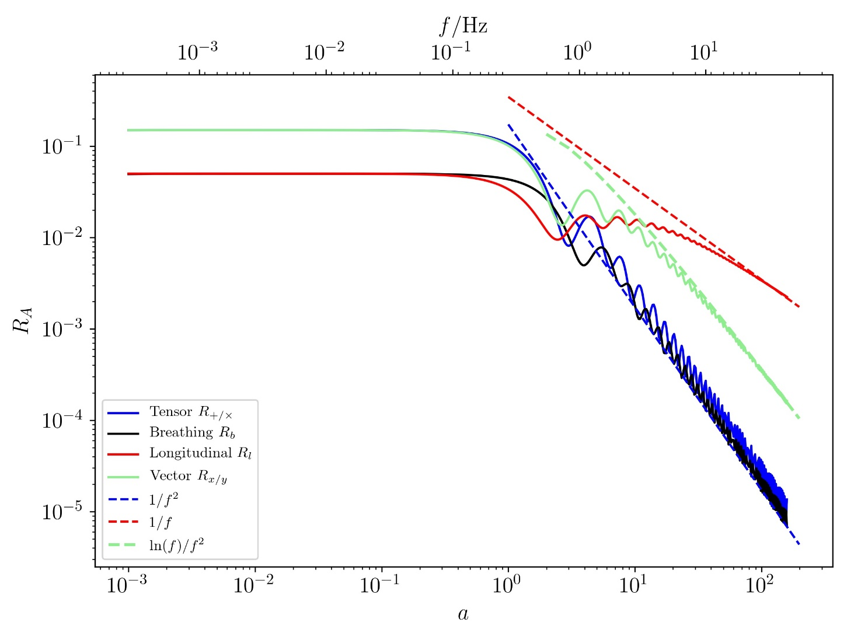
Response function
Frequency dependence
解析公式使得计算时间从几小时缩短为几秒
https://github.com/yggong/transfer_function

Slide 35
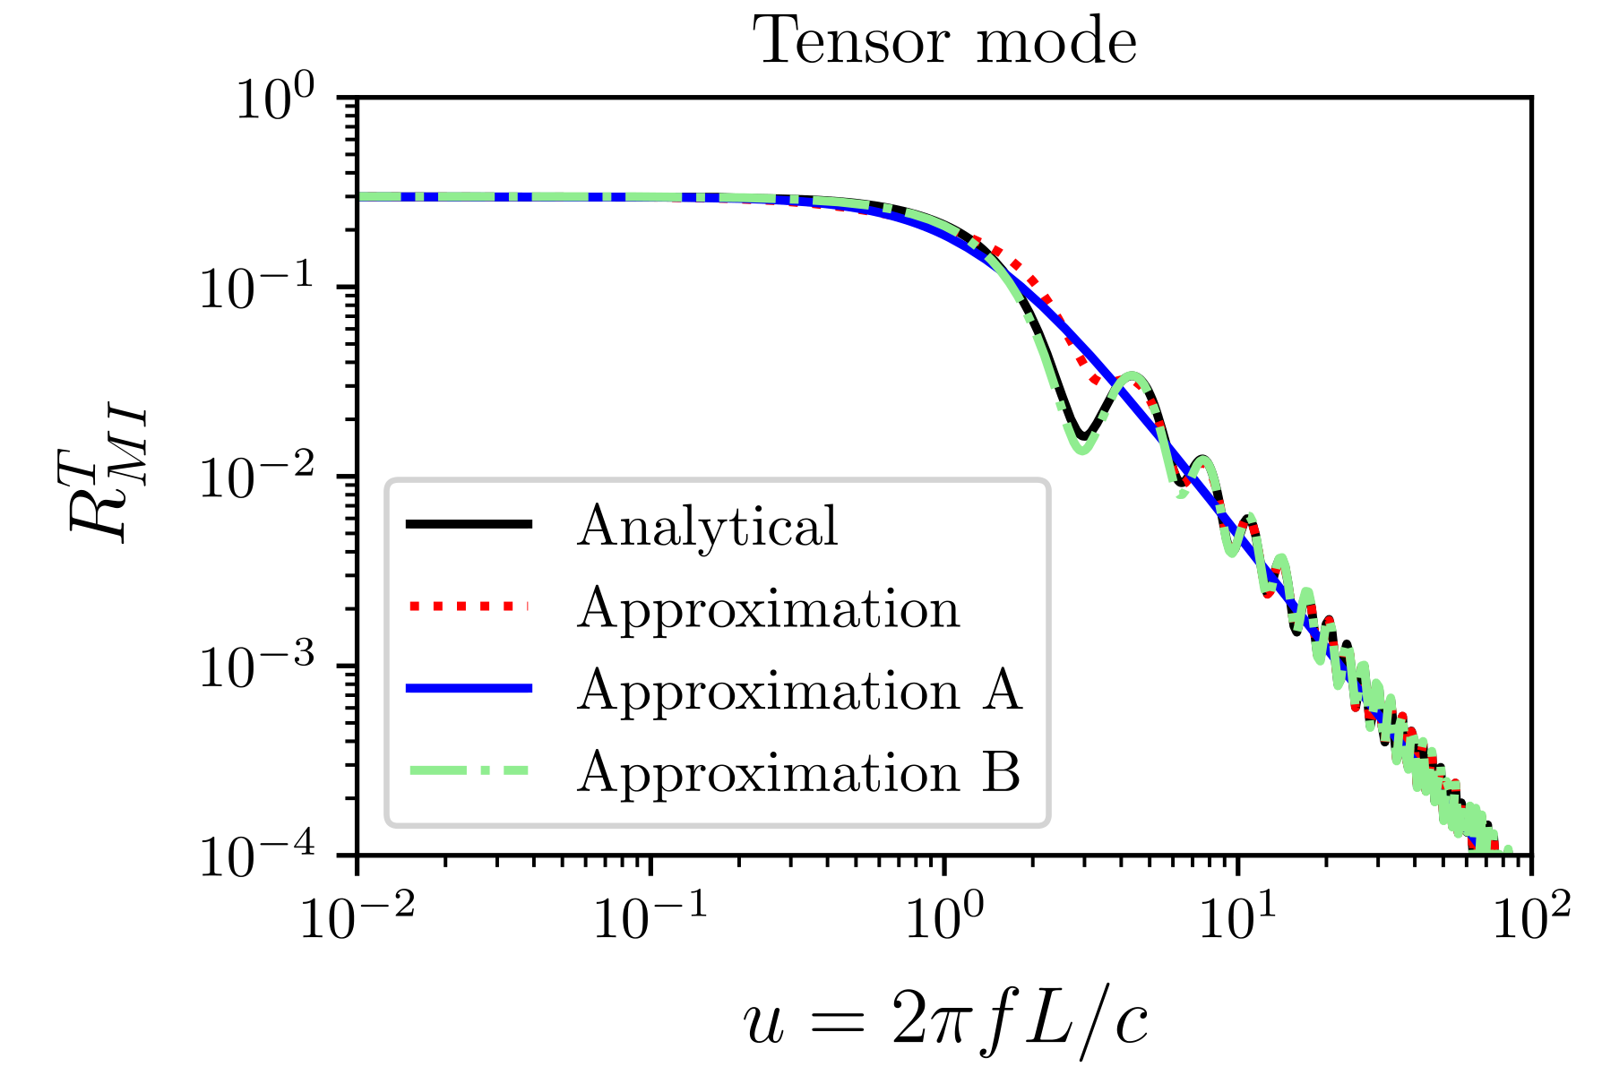
Antenna Response
Zhang, Gao, Gong, Wang, Weinstein & Zhang 2020, PRD 101, 124027

Slide 36
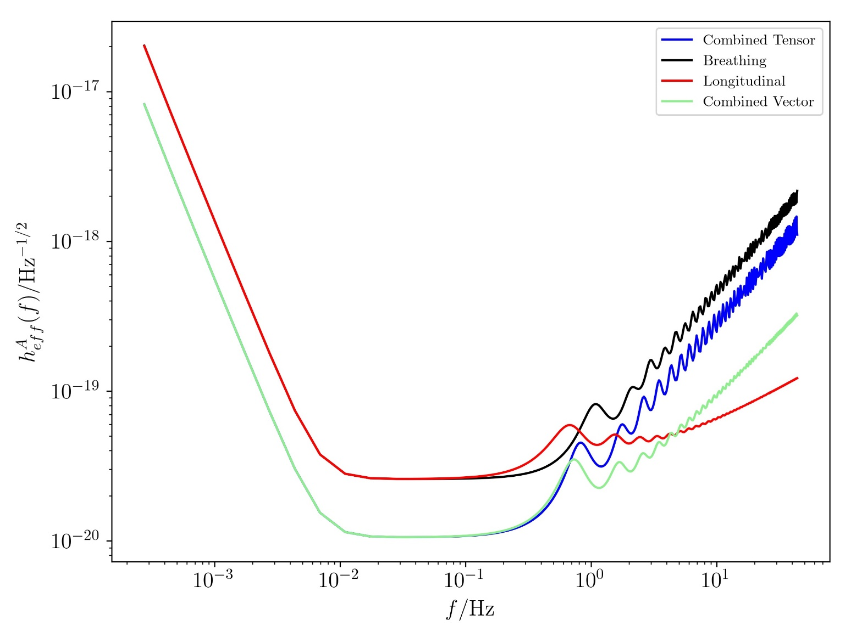
TianQin’s Sensitivity curve
https://github.com/yggong/transfer_function
Noise curve

Slide 37
TDI average response function
Semi-analytical expression
Zhang, Gao, Gong, Liang, Weinstein & Zhang 2019, PRD 100, 064033

Slide 38
TDI combinations
Averaged response functions
Zhang, Gao, Gong, Liang, Weinstein & Zhang 2019, PRD 100, 064033

Slide 39
LISA sensitivity Curves
All polarizations
Zhang, Gao, Gong, Liang, Weinstein & Zhang 2019, PRD 100, 064033

Slide 40
TianQin sensitivity Curves
All polarizations
Zhang, Gao, Gong, Liang, Weinstein & Zhang 2019, PRD 100, 064033

Slide 41
Massive GWs
Tensor
Zhang, Gao, Gong, Liang, Weinstein & Zhang 2019, PRD 100, 064033

Slide 42
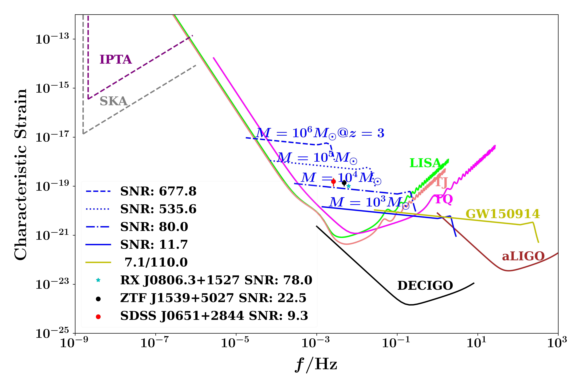
Sensitivity Curve

Slide 43
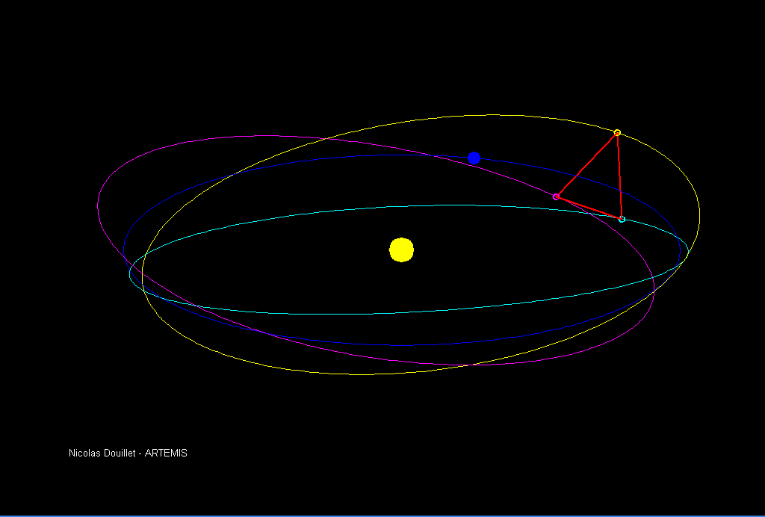
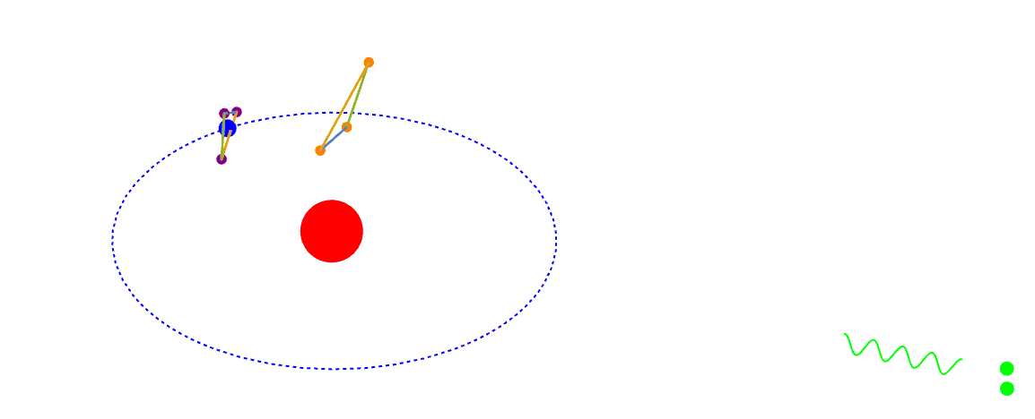
GW detectors
Heliocentric/Geocentric orbits
RX J0806.3+1527

Slide 44
Constellation
Noise: sensitivity
Armlength: sensitivity, transfer frequency
Heliocentric/Geocentric
  Doppler modulation: rotation around Sun
  Amplitude modulation: Heliocentric orbit only
The changing orientation of the detector plane for LISA and Taiji
TianQin points to the reference source,
no amplitude modulation

Slide 45
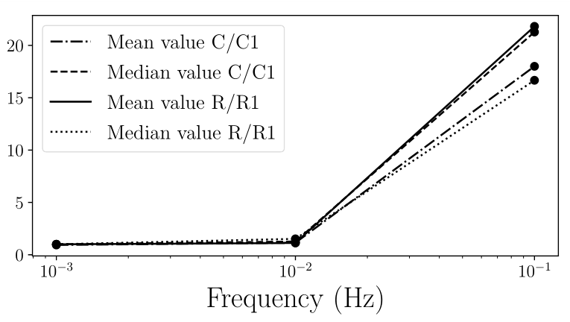
Armlength: transfer frequency
Detectors
R/R1: LISA like; C/C1: TianQin like
Detector | R | R1 | C | C1
Armlength(10⁸ m) | 37 | 1.7 | 37 | 1.7
Angular Resolution
At higher frequencies, shorter armlength better sky localization
Zhang, Gong, Liu, Wang & Zhang 2021, PRD 103, 103013

Slide 46
Phase modulation
Phase (Doppler) modulation
Frequency spread
location dependence
Higher frequencies, large SNR, better sky localization
Blaut 2011, PRD 83, 083006

Slide 47
Amplitude modulation
Frequency spread
Amplitude modulation vs Doppler modulation
No dependence on source location, fixed for LISA/Taiji constellation
Cutler 1998, PRD 57, 7089
Doppler modulation, at 1mHz,
Amplitude modulation is effective below mHz band

Slide 48
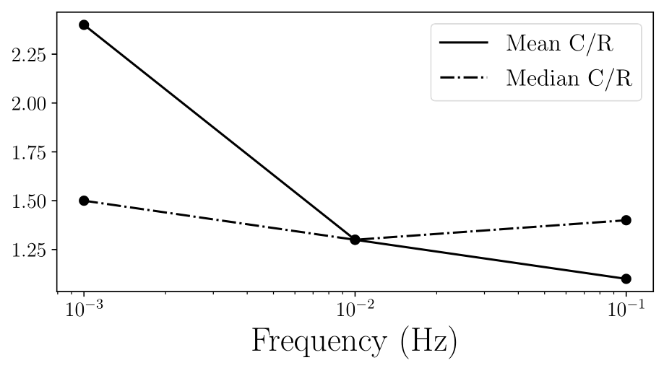
Doppler/Amplitude modulations
Detectors R and C
Angular Resolution
Same order of magnitude
Zhang, Gong, Liu, Wang & Zhang 2021, PRD 103, 103013

Slide 49
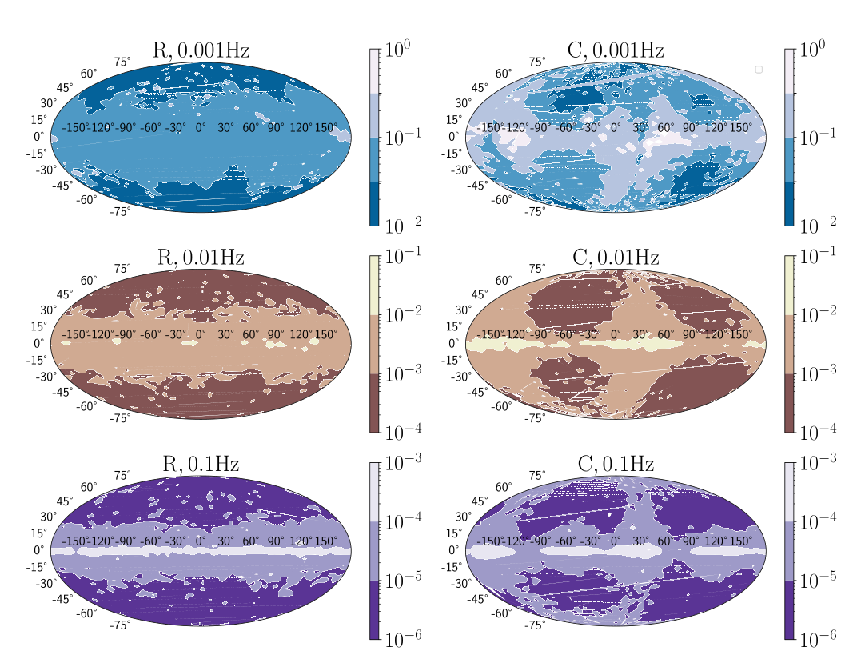
Doppler/Amplitude modulations
Sky map for angular resolutions
LISA-like
TianQin-like
Zhang, Gong, Liu, Wang & Zhang 2021, PRD 103, 103013

Slide 50
Parameter Estimation
Fisher information matrix (FIM): low frequency limit
LISA/Taiji:
M^{am} nonsingular
TianQin:
M^{am} singular
Zhang, Gong, Wang & Zhang 2021, PRD 103, 104066

Slide 51
Parameter Estimation cont
Amplitude modulation is independent of frequency, Doppler modulation mainly affects the sky localization
  LISA/Taiji
  TianQin
Low frequencies
Higher frequencies
Higher frequencies
Low frequencies
Zhang, Gong, Wang & Zhang 2021, PRD 103, 104066

Slide 52
Summary
Lower frequency band
  LISA/Taiji: amplitude modulation dominates, no frequency dependence and no location dependence
  TianQin: no amplitude modulation, both frequency and location dependence
Medium frequency band
  Angular resolution
  The other parameters
Zhang, Gong, Wang & Zhang 2021, PRD 103, 104066

Slide 53
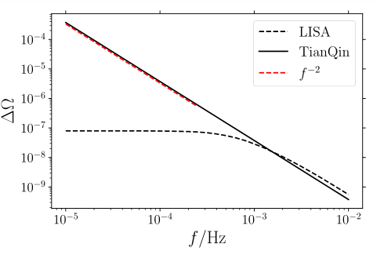
Angular resolution
Frequency dependence
Zhang, Gong, Wang & Zhang 2021, PRD 103, 104066

Slide 54

Parameter errors
Frequency dependence
Zhang, Gong, Wang & Zhang 2021, PRD 103, 104066

Slide 55

Bayesian analysis
Simulated source
Zhang, Gong, Wang & Zhang 2021, PRD 103, 104066

Slide 56

The network
Median/Mean
Mean angular resolution
Zhang, Gong, Wang & Zhang 2021, PRD 103, 104066

Slide 57

Sky map for the network
TianQin/LISA
Zhang, Gong, Wang & Zhang 2021, PRD 103, 104066

Slide 58

Sky map for the network
TianQin/Taiji

Slide 59

Coalescence sources
TianQin/Taiji

Slide 60



Ringdown signals
SNR: same distance, maximum SNR
Transfer frequency
Zhang, Gong & Zhang, 2105.11279

Slide 61

PE with ringdown signal
LISA-TianQin network
Median angular resolution error at z=1
Median angular resolution error at z=3
Zhang, Gong & Zhang, 2105.11279

Slide 62
Conclusion
解析的平均响应函数为快速评估探测器的性能及计算信噪比提供了可能
在1mHz及以下，幅度调制可以帮助LISA及太极提高源的定位能力及参数估计精度
在几十mHz以上，天琴的定位及参数估计能力更好
对于超大质量黑洞，铃宕信号可以用来定位和估计参数
天琴和太极互补，它们联合将极大增强探测能力

Slide 63
谢谢

