Slide 1
Search for Scintillation in
Doped Lead Fluoride Crystals for the HHCAL Detector Concept
Rihua Mao, Liyuan Zhang, Ren-yuan Zhu
California Institute of Technology

Slide 2
Introduction
A Fermilab team (A. Para et al.) has proposed a total absorption homogeneous HCAL detector concept for the International Linear Collider to achieve good jet mass resolution, where both Cherenkov and scintillation lights are measured for good hadronic energy resolution.
Requirements of Crystals:
High density.
Good UV transmittance.
Some scintillation light, not necessary bright and fast.
Cost-effective material (70 to 100 m³ !).

Slide 3
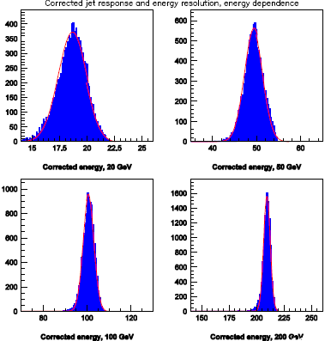
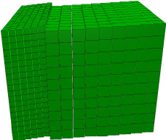
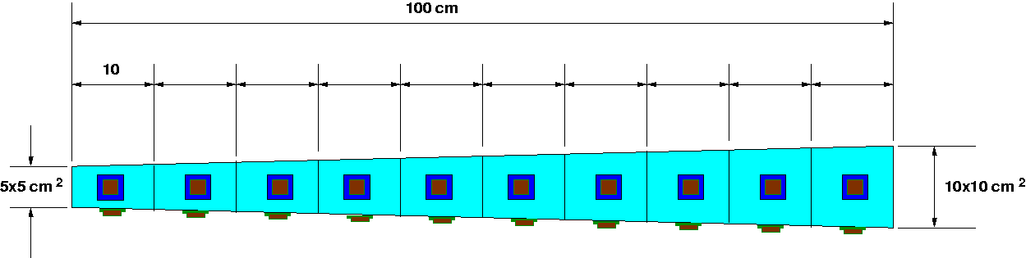
HHCAL Conceptual Design
A. Para, ILCWS08, Chicago: GEANT simulation shows jet energy resolution of about 22%/√E after corrections. This is much better than what has been achieved with PFA.
R.-Y. Zhu, ILCWS-8, Chicago: a HHCAL cell with pointing geometry

Slide 4
Comparison of Crystals for HHCAL
Parameters | Bi₄Ge₃O₁₂ (BGO) | Bi₄Si₃O₁₂ (BSO) | PbF₂ (PbF) | PbWO₄ (PWO) | NaBi(WO₄)₂ (NBW)
ρ (g/cm³) | 7.13 | 6.8? | 7.77 | 8.3 | 7.58
λ_{I} (cm) | 22.8 | 23.1 | 21.0 | 20.7 | 21.2
n @ λ_{max} | 2.15 | 2.06 | 1.82 | 2.2 | 2.15
τ_{decay} (ns) | 300 | 100 | ? | 10-30 /10-200 | ?
λ_{max} (nm) | 480 | 470 | ? | 420/512 | 440
Cut-off λ (nm) | 300 | 295 | 260 | 350/400 | 340
Light Output (%) | 100 | 20 | ? | 2 | <1
Melting point (°C) | 1050 | 1030 | 842 | 1123 | 923
Raw Material Cost (%) | 100 | 47 | 29 | 49 | 51

Slide 5
3 Candidates for HHCAL
Following 2/19/08 workshop at SICCAS,
5 x 5 x 5 cm³ samples evaluated

Slide 6
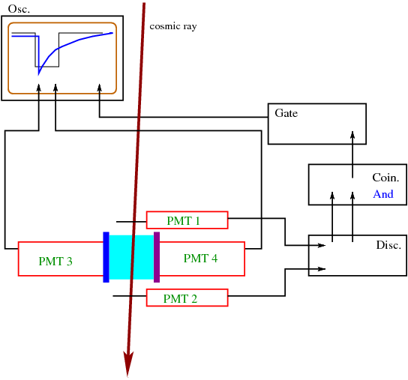
Cosmic Setup with Dual Readout
Agilent 6052A (500 MHZ) DSO with rise time 0.7 ns
Hamamatsu R2059 PMT (2500 V) with rise time 1.3 ns
UG11 and GG 400 used to select Cherenkov & scintillation

Slide 7
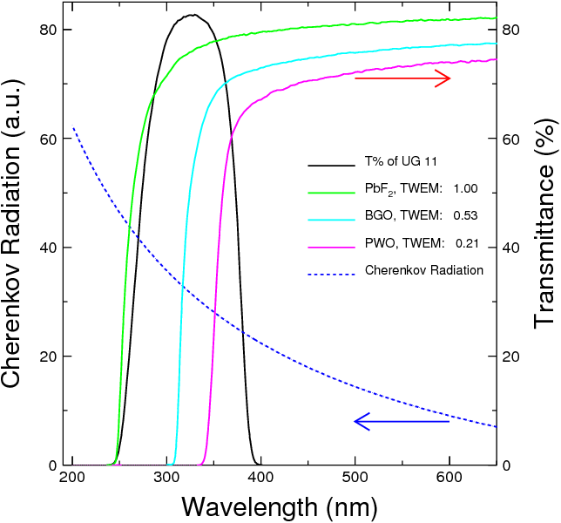
Cherenkov Needs UV Transparency
Cherenkov figure of merit
Using UG11 optical filter Cherenkov light can be effectively selected with negligible contamination from scintillation

Slide 8
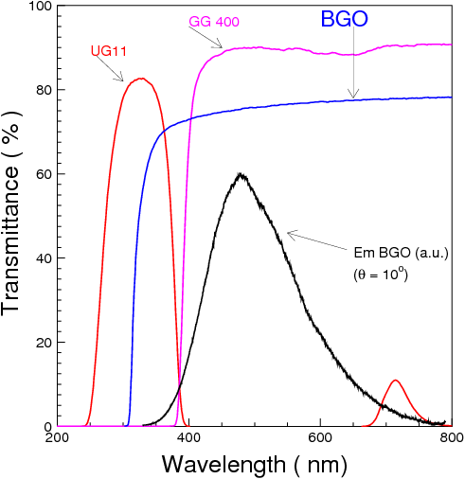
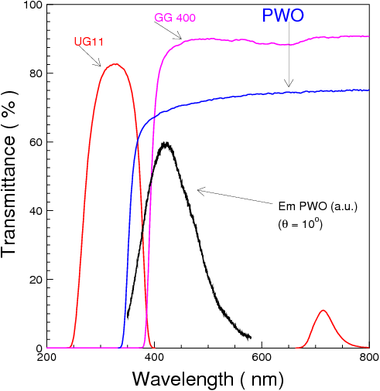
Scintillation Selected with Filter
GG400 optical filter effectively selects scintillation light with very small contamination from Cherenkov

Slide 9
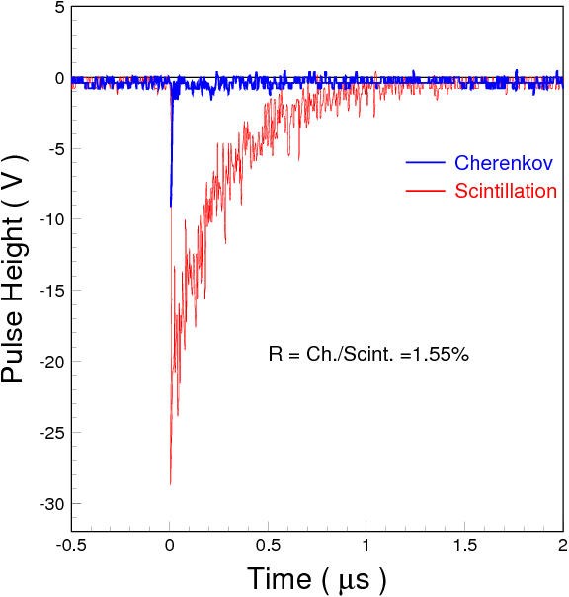
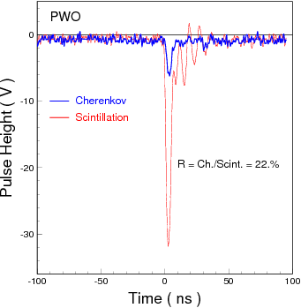
Ratio of Cherenkov/Scintillation
1.6% for BGO and 22% for PWO with
UG11/GG400 filter and R2059 PMT
BGO
PWO

Slide 10
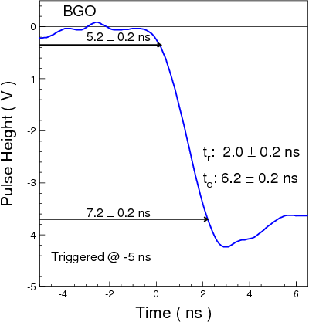
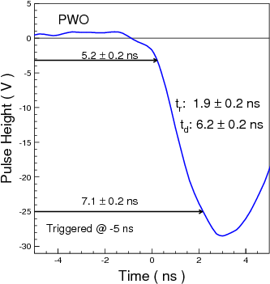
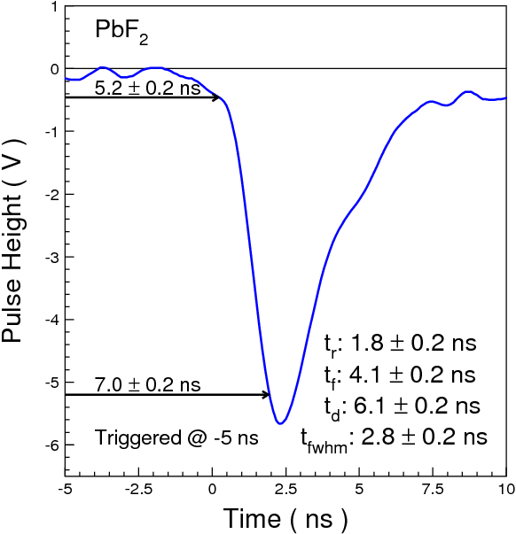
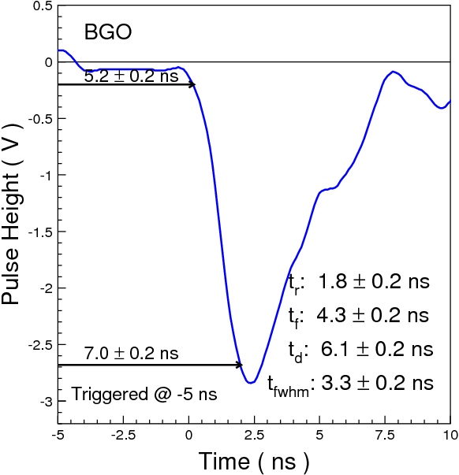
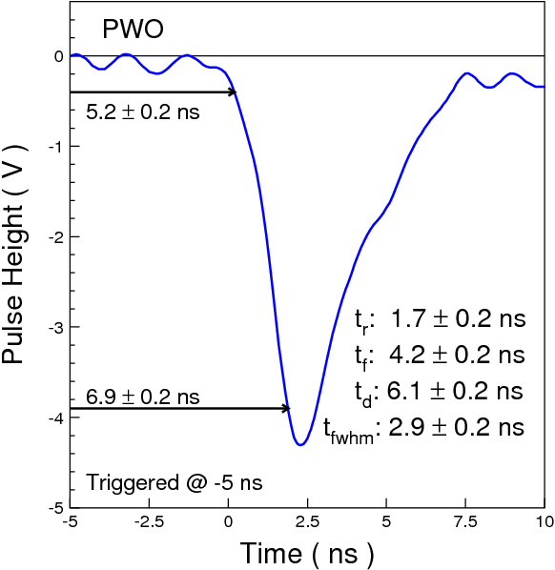
No Discrimination in Front Edge
Consistent timing and rise time for all Cherenkov and scintillation light pulses observed.
S
S
S
C
C
C

Slide 11
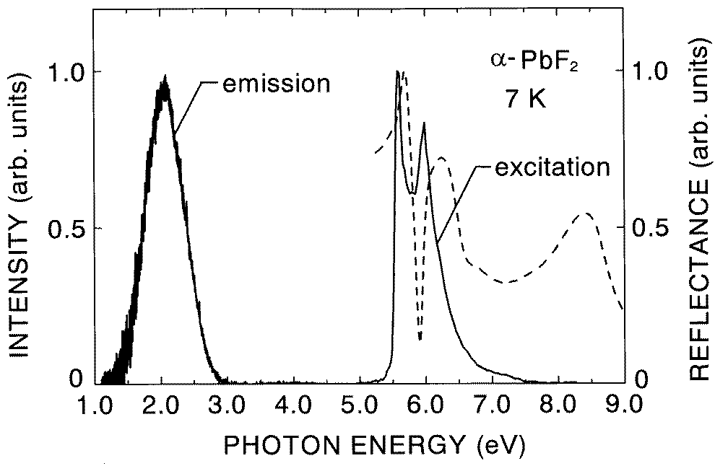
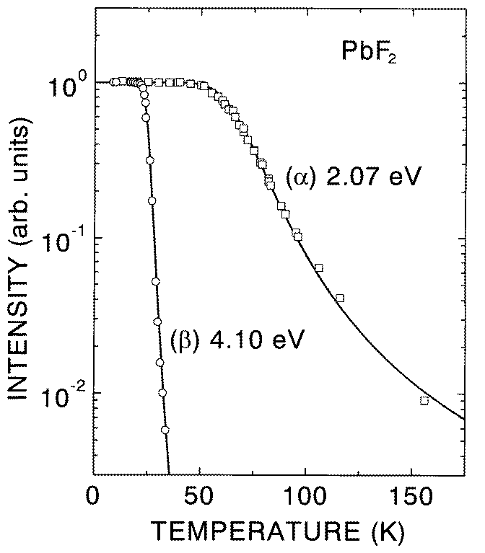
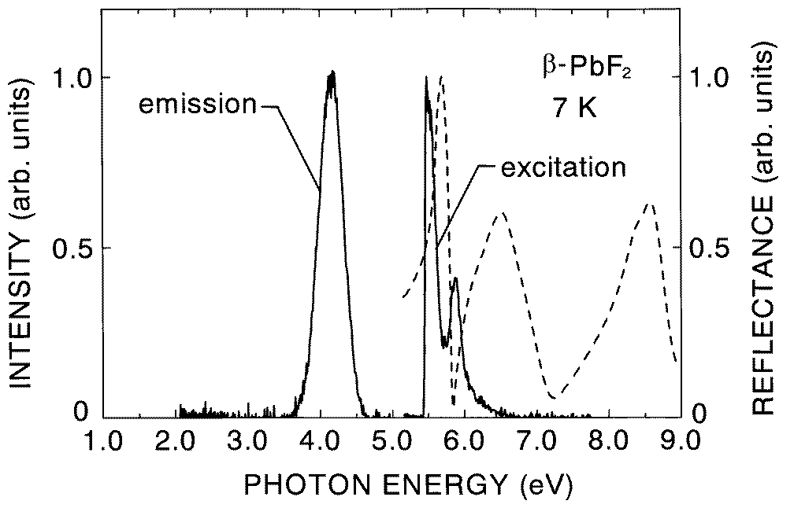
Luminescence of PbF₂ at Low Temperature
Luminescence Kinetics of PbF₂ Single Crystals , M. Nikl, K. Polak, Phys. Status Solidi, A117, pK89, 1990
Luminescence of orthorhombic PbF_{2,} D. L. Alov, S. I. Rybchenko, J. Phys.: Condens. Matter, vol 7, p1475, 1995.
Photoluminescence of orthorhombic and cubic PbF₂ single crystal, M. Itoh, H. Nakagawa, M. Kitaura, M. Fujita, D. Alov, J. Phys.: Condens. Matter, vol 11, p3003, 1999.
Othrorhombic
Cubic
Figs. of ref. 3

Slide 12
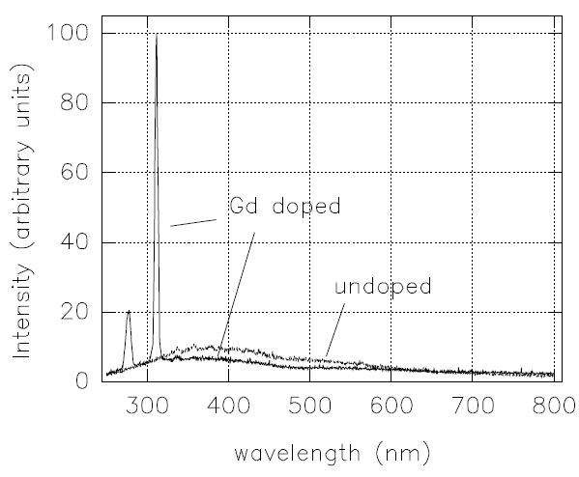
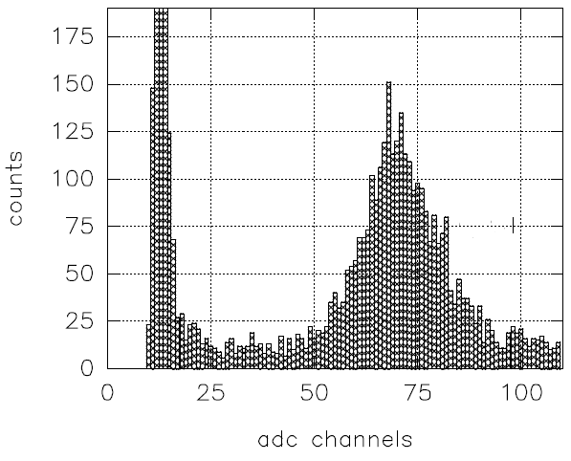
Luminescence / Scintillation of PbF₂ at Room T
Deformation and thermal treatment application to heavy scintillators production, S.N.Baliakin et. Al., proceedings of the Crystal 2000 Int. Conf. on Heavy scintillators for scientific and industrial applications, Chamonix, France, Sept. 22-26, 1992, p587.
A search for scintillation in doped and othrorhombic lead fluoride, D.F. Anderson, J.A. Kierstead, P. Lecoq, S. Stoll, C.L. Woody, NIM, A342, p473, 1994
Observation of fast scintillation light in a PbF₂:Gd crystal, C.L. Woody, S.P. Stoll, J.A. Kierstead, IEEE TNS, vol.43, p1303, 1996
Figs. of ref. 3
Radioluminescence of PbF₂(Gd)
PbF₂(Gd) Response to MIP of 1 GeV/c

Slide 13
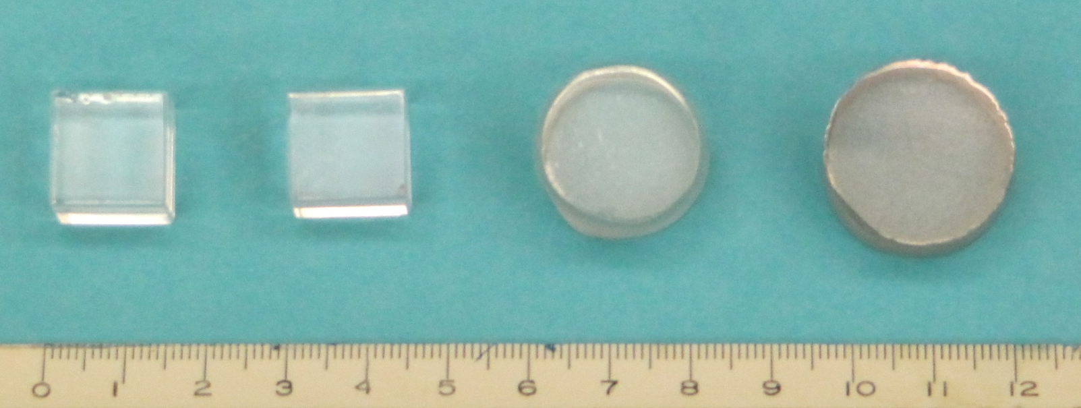
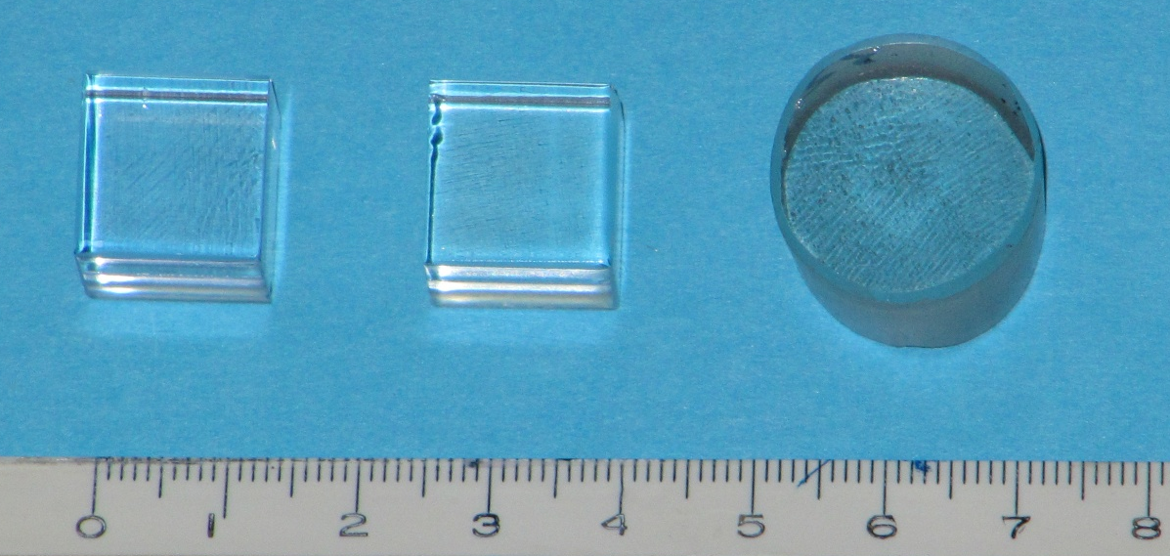
PbF₂ Samples
A total of 116 samples with various rare earth doping were grown by vertical Bridgman method at SIC and Scintibow.
SIC samples are of 1.5 X₀ (14 mm) cube, while most of the Scintibow samples are of Φ 22 x 15 mm.
Photo: SIC sample/Scintibow sample.

Slide 14
Photo- and X-luminescence
Photo luminescence was measured by using Hitachi F-4500 fluorescence spectrophotometer.
An AMTPEK portable X-ray tube (ECLIPSE-III) was used for the X-luminescence measurement.
Hitachi F-4500
UV lamp and monochromator
ϴ
Monochromator
and PMT
X-ray tube

Slide 15
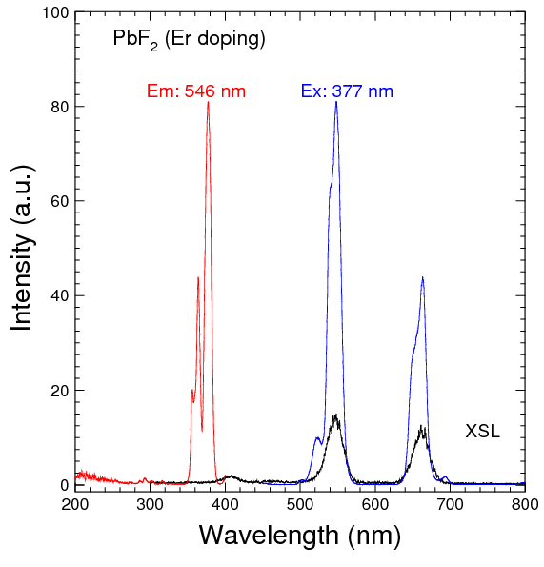
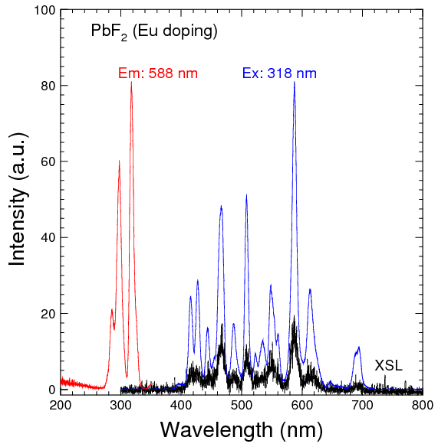
Luminescence: Er & Eu Doped PbF₂
Consistent Photo- and X-luminescence observed

Slide 16
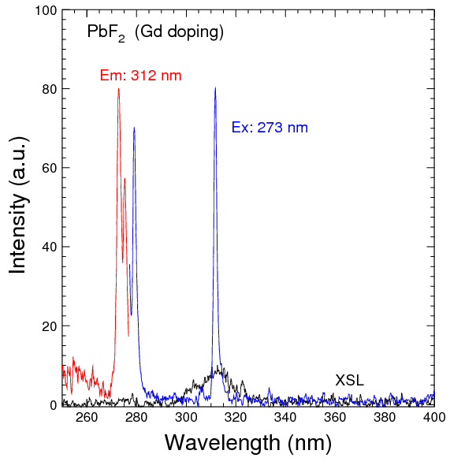
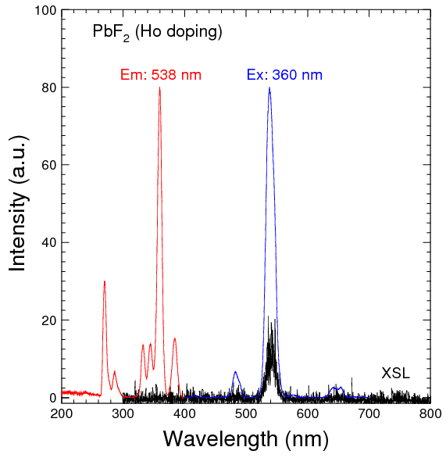
Luminescence: Gd & Ho doped PbF₂
Consistent Photo- and X-luminescence observed

Slide 17
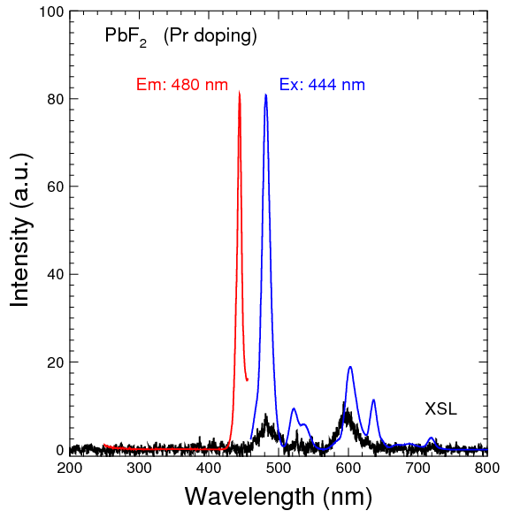
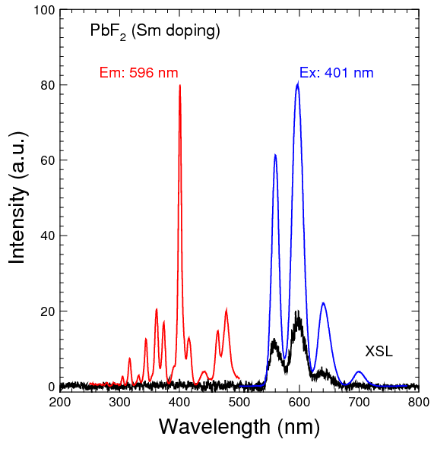
Luminescence: Pr & Sm Doped PbF₂
Consistent Photo- and X-luminescence observed

Slide 18
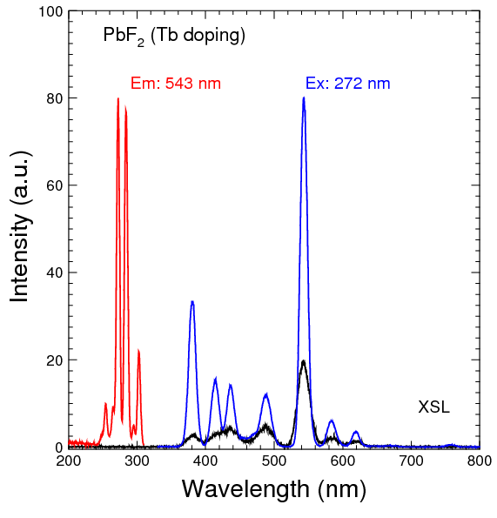
Luminescence: Tb doped PbF₂
While total 7 rare earth dopings show consistent Photo- and X-luminescence,
no broadband emission of d-f transition was observed.

Slide 19
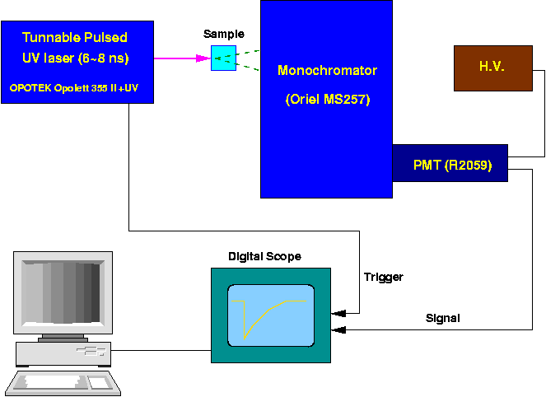
Decay Time Measurement

Slide 20
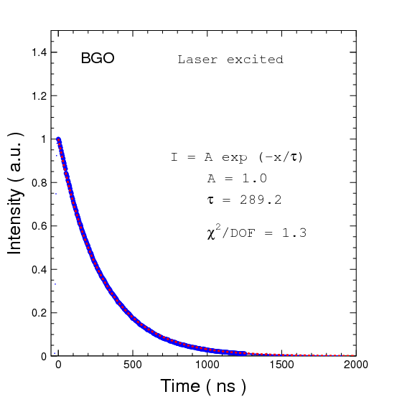
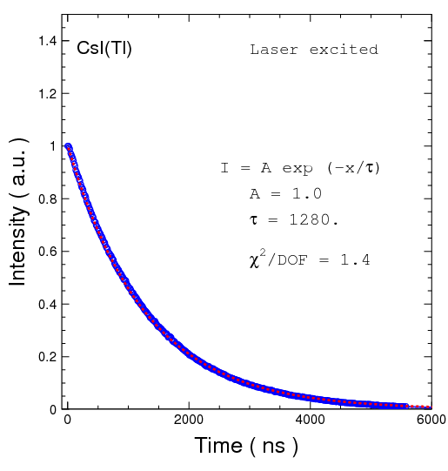
Verified with BGO & CsI(Tl)
Decay time consists with well known values
290 ns
1280 ns

Slide 21
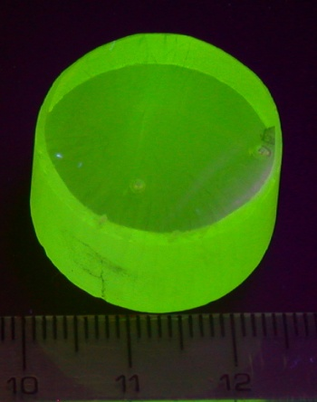
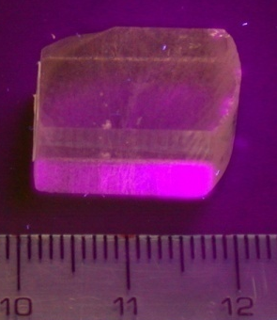
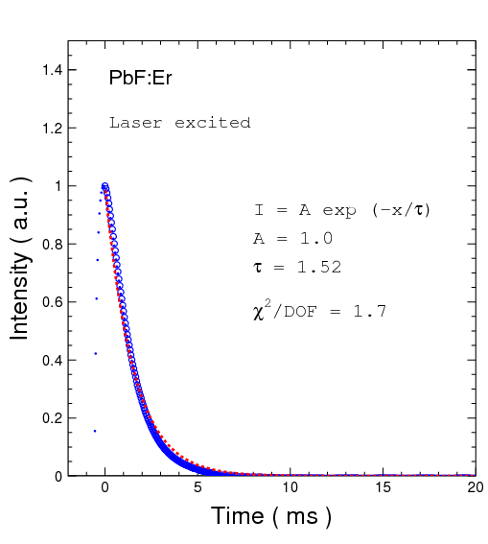
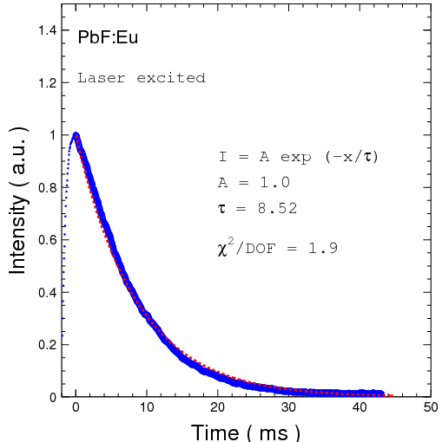
Decay Time: Er & Eu Doped PbF₂
8.5 ms
1.5 ms

Slide 22
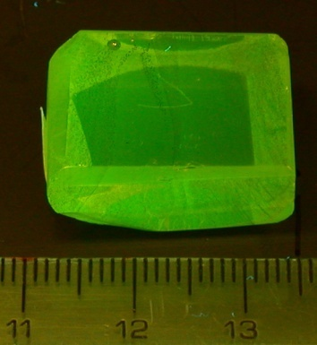
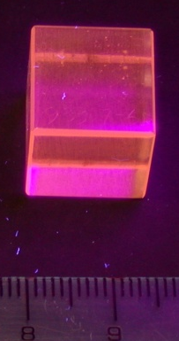
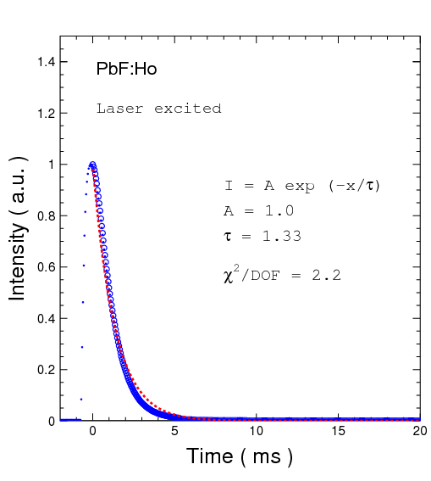
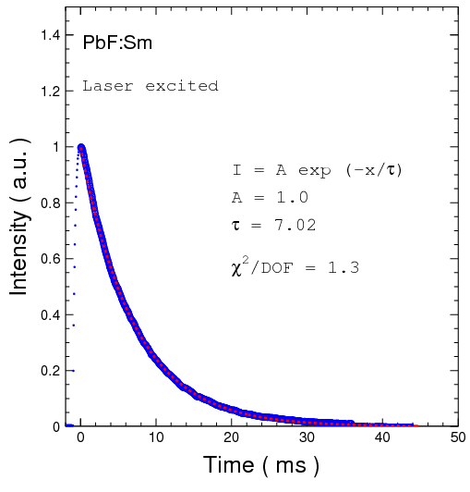
Decay Time: Ho and Sm Doped PbF₂
1.3ms
7.0 ms

Slide 23
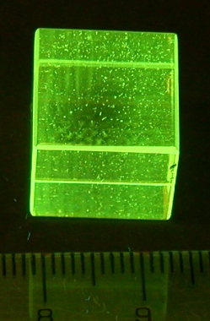
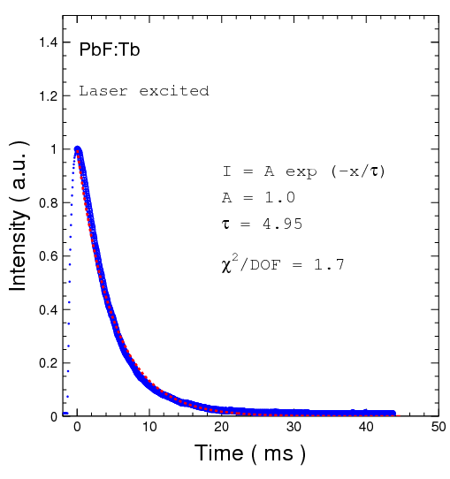
Decay Time: Tb Doped PbF₂
Under UV plused laser excitation, the luminescence decay time of Gd and Pr doped samples is too weak to be measured.
5.0 ms

Slide 24
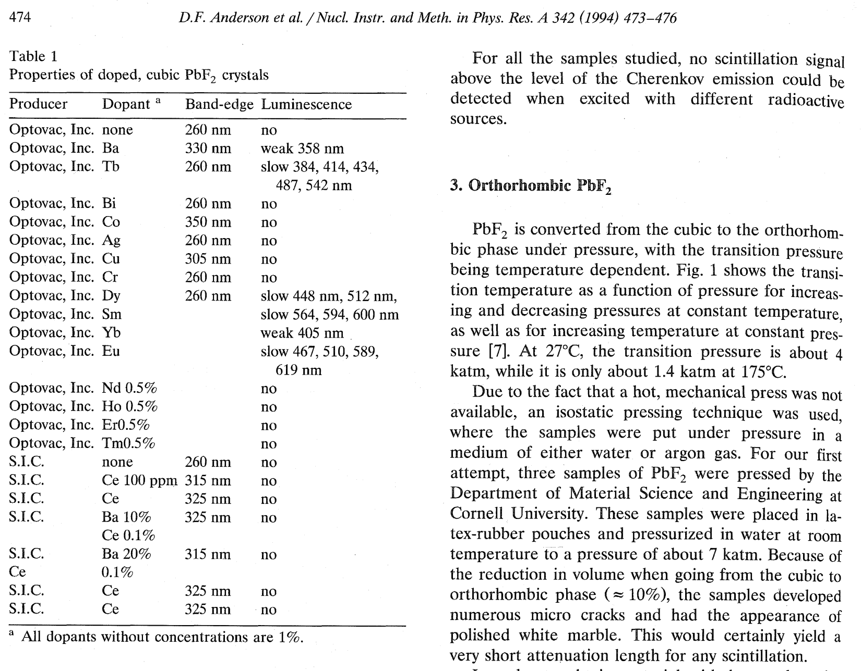
Comparison with the Ref-2
No fast luminescence of d-f transition was observed.
Dopant | Caltech | Ref-2
Sm | f-f | f-f
Eu | f-f | f-f
Tb | f-f | f-f
Tm | no | no
Ce | no | no
Nd | no | no
Ho | f-f | no
Er | f-f | no
Dy | no | f-f
Yb | no | f-f?
Pr | f-f | N/A
Gd | f-f ? | N/A

Slide 25
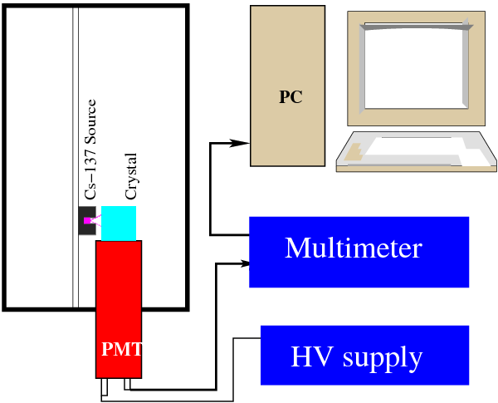
Anode Current Measurement
Distance between source and sample: 2 cm

Slide 26
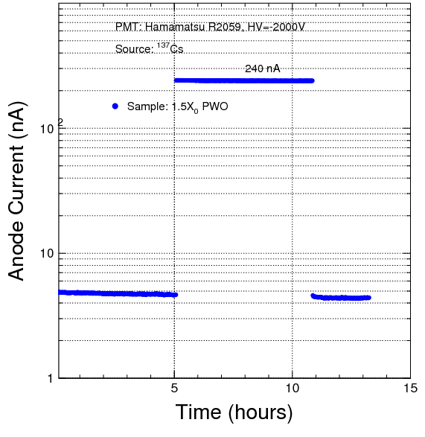
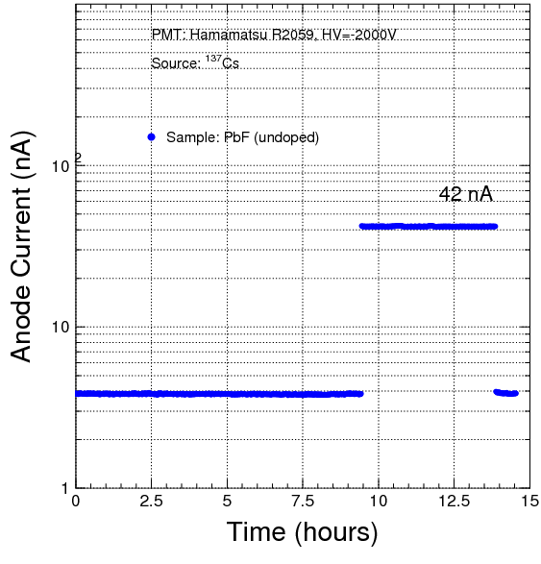
Anode Current: PWO & Un-doped PbF₂
PWO: L.O. = 20 p.e./MeV, anode current = 240 nA

Slide 27
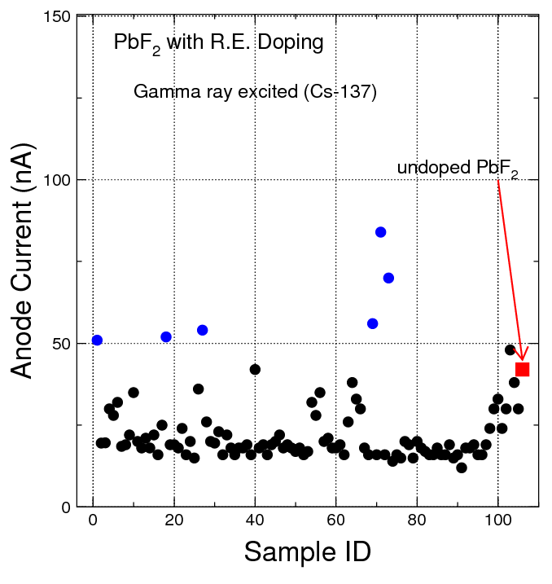
Anode Current: All Samples

Slide 28
Summary of Anode Current
ID | Anode current (nA) | Size (mm) | Doping
Scintibow-1 | 51 | 18 x12 x10 | Eu
Scintibow-18 | 52 | Φ22X15 | Eu/Gd
Scintibow-27 | 53 | Φ20X15 | Eu/Tb
Scintibow-B19 | 56 | Φ20X15 | Eu/Tb/Na
Scintibow-B21 | 83 | Φ22X15 | Eu/Bi/Na
Scintibow-B23 | 73 | Φ20X15 | Eu/Bi/Na
Undoped | 42 | 14 x 14 x14 | --

Slide 29
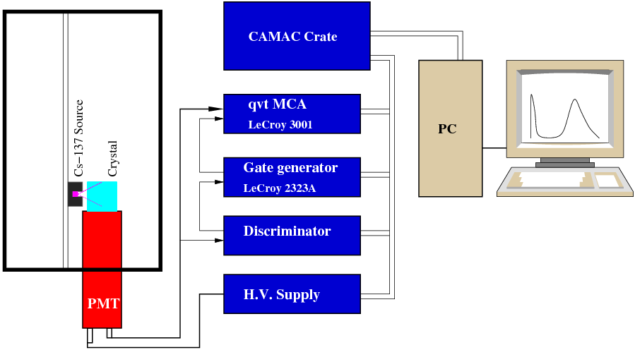
ɣ-ray Excited Pulse Height Spectrum

Slide 30
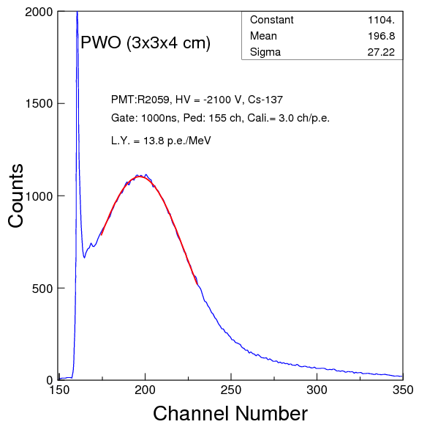
ɣ-ray Excited PHS: PWO

Slide 31
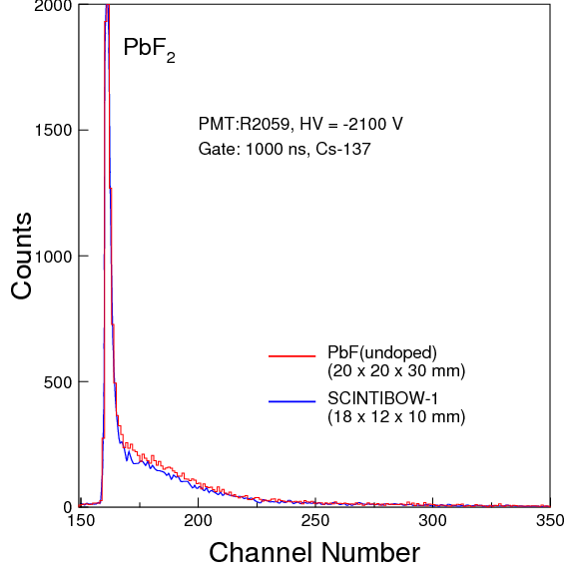

ɣ-ray Excited PHS: Doped PbF₂
No evident photopeak was observed with up to 4000 ns gate.
PbF₂: Eu
PbF₂: Eu/Bi/Na

Slide 32
Summary
Lead fluoride crystal samples doped with various rare earth dopant were grown by Bridgman method.
Consistent photo and x-ray luminescence found in samples with Er, Eu, Gd, Ho, Pr, Sm and Tb doping.
The decay time of doped samples was found to be very long at ms scale as expected from the f-f transition of the rare earth elements.
While some doped samples show anode current larger than the un-doped samples, their ɣ-ray excited pulse height spectra were found identical to un-doped sample, indicating no scintillation light.

Slide 33
Future Plan
Investigation will continue to search for scintillation in doped lead fluoride.
Rescan the dopants showing consistent photo and x-ray luminescence with samples of improved optical quality, i.e. grown in platinum crucibles.
Rescan these samples at low temperature to understand the quenching mechanism at the RT. A spectrophotometer capable of measuring luminescence in a cryostat system is being procured.
Looking into the other phase: othrorhombic. Can we get large size and good quality α-PbF₂ crystal?
Evaluate other potential candidate materials for the HHCAL detector concept, such as BSO, glasses and ceramics etc.

