Slide 1
SCintillating Materials for Hadron Calorimetry
Adam Para, Fermilab
Homogenous Hadron Calorimetry Workshop,
Beijing, May 9, 2010

Slide 2
PART1: WHY
The case for hadron calorimetry

Slide 3
Past 30 Years in High Energy Physics: A Success Story

Slide 4
Crystal Calorimetry: a Powerful Tool for Particles Spectroscopy. An Example
35 years ago two narrow states J/Ψ(3100) and Ψ’(3700) discovered. What were they???
Radiative decays/Photon spectroscopy the key: these are the radial excitation of the ccbar states
Excellent energy resolution of NaI crystals an enabling technology. Thanks, Hofstadter!
Note: One particle Ψ’(3700) and precisely measured inclusive photon spectrum sufficient to uncover several intermediate states and prove their physics interpretation

Slide 5
Future of High Energy Physics: a Possible? a Likely? Scenario
The Standard Model is a huge milestone in our quest to understand the Nature
Discovery of the Higgs boson will be the spectacular coronation (PbWO4 may be a critical agent), but… we are not done, yet..
Several indications of a possible new families of particles with masses at the hundreds of GeV- few TeV scale (related to dark matter?): new world to be explored
LHC is the discovery tool: expect many new heavy particles, complicated decay chains… Will know more in ~5 years.
These new particles will sequentially decay with emission of W/Z bosons and jets
Clean environment of the lepton collider (ILC? CLIC? Muon Collider?) and a very high resolution jet calorimetry will be the critical tools in the exploration of the new particles (remember charmonium!). Relevant scales: time ~15 – 20 years, cost ~ $10B (most for the accelerator)

Slide 6
PART 2: WHAT
The case for inorganic scintillators

Slide 7
Why Hadron Calorimeters are so Poor?
(ΔE/E)_{EM} can be as good as 0.01 for total absorption calorimeters . The best hadron calorimeters have (ΔE/E)~50%/√E for single particles, 70%-100%/ √E for jets. What’s wrong with hadrons???
Hadron calorimeters are sampling calorimeters
Sampling fluctuations (fluctuation of the energy sharing between passive and active materials)
Sampling fraction depend on the particle type and momentum (good example: a ‘neutrons problem’ in iron-scintillator calorimeter. SF ~ 0.02 at high energy, SF = 1 for thermal neutrons)
A fluctuating fraction of the hadron energy is lost to overcome nuclear binding energy.
Inhomogeneous calorimeters (typically: EM + HAD, with different responses)

Slide 8
From Single Hadrons to Jets
[Jet == collection of particles with composition, spatial and momentum distribution characteristic for QCD fragmentation process].
To achieve good energy resolution it is necessary to reduce the dependence of the calorimeter response on the jet fragmentation (particles composition and spectrum)
Response independent of the particle type (in particular R(π⁺)=R(πº)=R(e) )
Response linear with energy Resp = AE (No offset!!)
Good energy resolution for hadrons. Adequate energy resolution for electrons taken for granted.

Slide 9
Path to High Resolution Jet Calorimeter
Homogeneous Calorimeter (EM/HAD combined).
Total absorption calorimeter (No sampling fluctuations, SF = 1 for all particles and energies). This practically implies a light-collection based calorimeter.
Correct (on the shower-by-shower basis) for the nuclear binding energy losses. This can be done, for example, by dual readout of scintillation and Cherenkov light signals.
TAHCAL: Total Absorption Hadron Calorimeter

Slide 10
High Resolution Jet Calorimeter?
All the underlying principles are known/understood since a very long time (> 20 years). If it is so simple why we haven’t built good hadron/jet calorimeters??
Low density scintillators ➔ huge detector size for total absorption
Bulky photodetectors ➔ cracks to bring the light out or further increase of the detector size
No photodetectors in the magnetic field
No physics-driven requirements (in hadron collider environment)
Major advances in the detectors technology/enabling technologies:
High density scintillating crystals/glasses (λ~20 cm)
‘Silicon Photomultipliers’ ~ robust compact, inexpensive

Slide 11
TAHCAL Simulation and Analysis
Optical calorimeter option in SLIC (H. Wenzel, Fermilab)
“Test beam” calorimeter: 1 x 1 x 3 m³ volume subdivided into 1 cm³ ‘crystals’
SiD detector, version 1 (‘thin’)
Crystals composed of various materials (elements or isotopes) at fixed density of 8 g/cm³
Optical properties characterized by the refractive index n (relevant for Cherenkov)
All scintillation (==ionization) and Cherenkov light summed up from the entire volume. Total information about an event reduced to two variables : S and C.
Completely automatic reconstruction, no tuning/optimization. No use of the spatial distribution information (yet).
“Test beam” analysis (K. Genser/Fermilab): physics principles, linearity and resolution
“SiD” analysis (A. Driutti, G. Pauletta/Udine): containment, leakage fluctuations and their mitigation
Very early stages, much room for refinements and improvements.

Slide 12
Physics Principles of High Resoluion, Total Absorption Calorimetry
Total absorption: no sampling fluctuations and other sampling–related contrubtions. The dominant contribution to resolution: fluctuations of nuclear binding energy losses.
Cherenkov-to-scintillation ratio a sensitive measure of the fraction of energy lost for binding energy:
Electromagnetic (πº) showers do not break nuclei AND produce large amount of Cherenkov light (C/S~1)
Large ‘missing’ energy <-> large number of broken nuclei <-> small amount of energy in a form of highly relativistic particles <-> small C/S ratio
Low amount of ‘missing’ energy <-> small number of nuclei <-> large amount of energy in a form of EM showers <-> C/S ratio close to 1

Slide 13
Mechanics of Dual Readout Correction
S(cintillation)/B(eam Energy)
= fraction of energy detected
πº-rich showers: almost all energy detected
πº-poor showers: ~85% of the energy detected
Use C/S to correct every shower
The resulting resolution limited by the local width of the scatter plot
Cherenkov/Scintillation

Slide 14
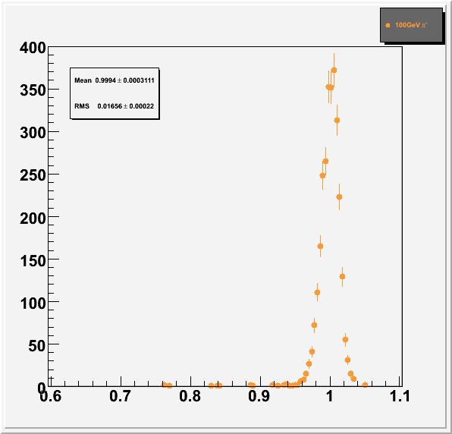
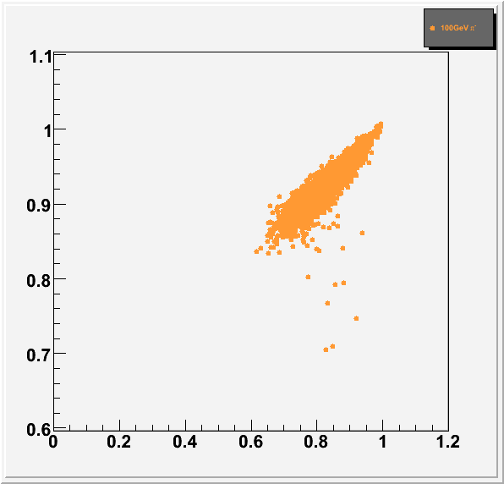
TAHCAL at Work: Single Particle Measurement
100 GeV π-
Full Geant4 simulation
Raw (uncorrected)
ΔE/E ~ 3.3%
but significant non-linearity, E~ 92 GeV
After dual readout correction, correction function (C/S) determined at the appropriate energy:
Linear response: S/B=1 for all energies
energy resolution ΔE/E~α/√E (no constant term)
α~12-15% or
ΔE/E=1.2-1.5% at 100 GeV
S/B
S/B
S/B
Recall: typical good HADCAL ΔE/E ~ 5-6%
C/S

Slide 15
From Single Particles to Jets
Single particles provide an over-optimistic estimate of the calorimeter performance. Jets contain many particles of different kinds and various energies. And the jet fragmentation function fluctuates from jet-to-jet.
In a segmented calorimeter jet energy measurement can be decomposed into several separated regions with the correction function optimized for the particles in this region
The pessimistic limit of the detector performance can be evaluated by applying the average corretion function (derived from the global fit to data at different beam energies) to the total amount of scintillation and Cherenkov light measured for a jet.

Slide 16
Dual Readout Correction at Different Energies
Correlation of the fraction of ‘missing energy’ and Cherenkov-to-scintillation ratio for showers of different energies: 10 – 200 GeV:
high energy showers contain more EM energy (range of C/S confined to higher and higher values)
overall shape quite similar, but significant differences present. They will lead to:
non-optimal energy resolution
non-linearity of the response
the latter will produce contribution to jet energy resolution
S/B
C/S

Slide 17
Response Linearity with Global Correction
Deviations from the linearity of the response (S-B)/B for different particles as a function of their energy:
global correction mechanism induces some non-linearity of the response for single particles and for jets.
For jets the induced non-linearity is of the order of 6% in the the energy range 50 – 1000 GeV
This response non-linearity can be corrected, on average.
Contribution of these non-linearites to the jet energy resolution cannot be, however, avoided
Jets

Slide 18
TAHCAL: The Energy Resolution with the Global Correction
With very crude reconstruction and non-optimal global correction function:
energy resolution shows no constant term and scales ΔE/E~1/ √E
stochastic term in the energy resolution is ~15% for single hadrons, 2% for electrons and ~22-23% for jets
there are several obvious ways to improve the energy resolution. At least in the simulated calorimeter .
But can we take the simulation seriously???
Jets

Slide 19
Compare Different Monte Carlo Models
Use two different physics lists: LCPhys and QGSP_BERT
Most of the interactions with matter is the same, only hadron production modeling is different
Surprisingly large difference between the overall response
But.. Reconstruction/analysis does not use any input from the Monte Carlo,it derives everything from the test beam data (self-consistent set)
Hence.. Treat one and the other simulated data set as a putative data and proceed with the calibration and reconstruction

Slide 20
Monte Carlo Dependence of the Calorimeter Response and Resolution
Use 10 GeV data sets simulated with two different GEANT4 Physics lists
Treat each set as a hypothetical ‘data’. Derive self-consistent calibrations and corrections
Correct the observed scintillation signal using the Cherenkov signal
Overall response is stable to about ~1%
Resolution vary by ~20% of itself (0.50 – 0.63 GeV@ 10 GeV, or (0.15-0.20)/√E)
OK.. Total absorption calorimeter may have very good jet energy resolution, but can one build one??

Slide 21
Conceptual Design of a TAHCAL
Four layers of 5 x 5 x 5 cm³ crystals (a.k.a. EM section): 72,000 crystals
three embedded silicon pixel layers (e/γ position, direction)
10/16 (barrel/endcap) layers of 10 x 10 x 10 cm³ crystals (a.k.a. hadronic section):70,000 crystals
4(8?) photodetectors per crystal. Half of the photodectors are 5x5 mm and have a low pass edge optical filters (Cherenkov)
No visible dead space.
6λ at 90º, 9λ in the endcap region
Signal routing avoiding projective cracks
Should not affect the energy resolution
500,000(1,000,000?) photodetectors
Total volume of crystals ~ 80-100 m³.

Slide 22
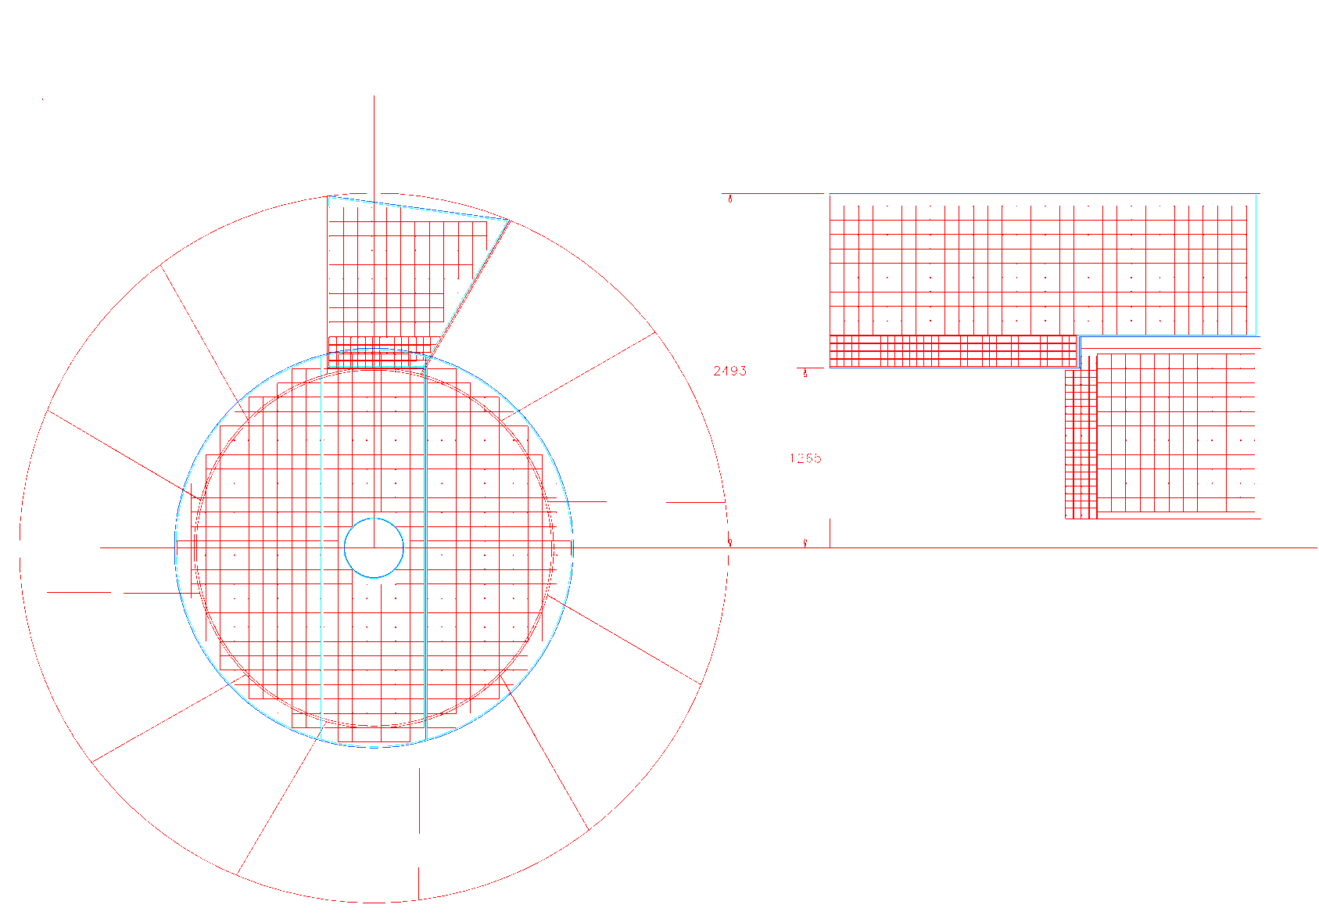
TAHCAL in SiD: Initial Engineering
K. Krempetz, Fermilab:
… the crystal calorimeter could easily be incorporated in the SiD detector. The design that is presented has many engineering challenges which will need to be prototyped and tested before a final design could be made.
6λ at 90º, 9 λ in the endcap
Good segmentation
silicon photodetectors with ASIC readout electronics
Significant imaging capabilities

Slide 23
Leakage
A realistic detector design may provide some 120-150 cm of radial space for calorimeters (between the tracker at the coil).
To minimize the leakage fluctuations it is important to maximize the average density of the calorimeter, including the readout. This is of particular importance in high resolution calorimeters.
Heavy scintillating crystals and compact silicon photodetectors offer a possibility for the average interaction length of the order of 20-21 cm
The leakage study (Udine):
‘thin’ calorimeter (120 cm)
“worst case”: single pions 100 GeV at 90º. [Note: This is not a 100 GeV jet! High energy single particles account for a relatively small fraction of high energy jet, but they maximize the leakage fluctuations.]

Slide 24
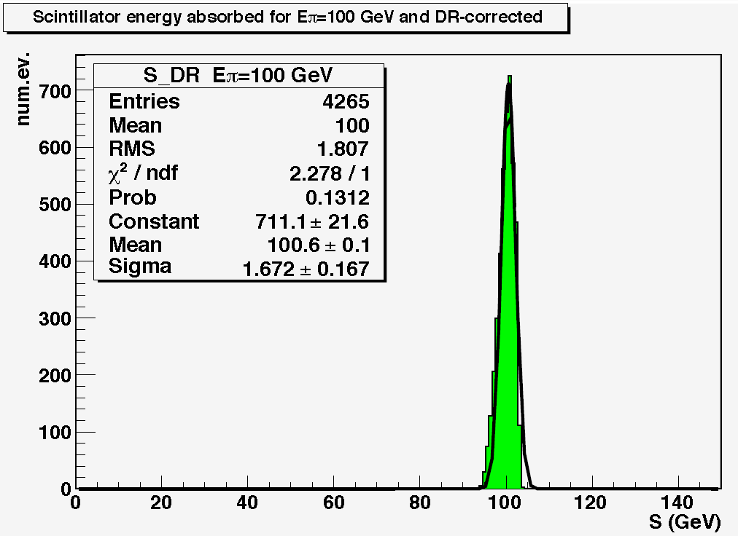
Leakage Studies: High Energy Single Particles
Corrected (or uncorrected) energy distribution shows major degradation of energy resolution: long tail towards low energies and a peak of punch-through pions.
This is primarily caused by hadrons which interact deep inside the calorimeter, and see even smaller thickness of the detector.
In a calorimeter with longitudinal segmentation the late showers can be recognized (for example by the energy deposition in the first of the last layers) and excluded from the analysis. Or they can be replaced by the measured momentum (PFA used in the right proportional may be beneficial).

Slide 25
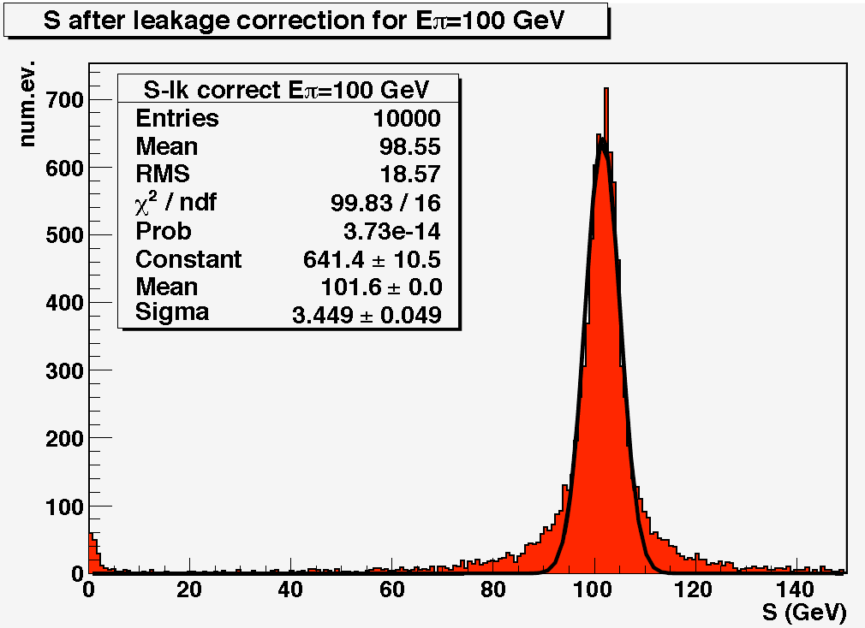
Correcting for Leakage?
Longitudinal segmentation of a calorimeter provides information which can be used to identify and correct the leaking showers. For example (left): fraction of the observed energy of a shower correlates with the amount of the leaking energy
Using the information about the longitudinal shower development one can restore the symmetric form of the resolution function and improve the energy resolution.
Further improvement, especially for punching-through pions can be accomplished by using the information from the muon system (a.k.a. tail catcher).

Slide 26
PART3: HOW
A cry for help
How can we make it happen?

Slide 27
A Collection of ‘Fun to Solve’ Challenges
Demonstrate separate detection of Cherenkov and scintillation light:
Done with phototubes, but for hadron calorimeter need a compact photodetector working in a strong magnetic field. APD? MPPC/SiPM? Novel, inexpensive MPC
Spectral matching of photodetectors
Getting the light out: photonic crystals? Light collectors?
Determine the light yield, collection uniformity, angular dependence
The bottom line: need to detect more than 200 photons/GeV from scintillation, more than 10 photons/Gev of Cherenkov. GeV! Not a typo!
Invent a method of calibration of the scintillation and Cherenkov light collection channels
Demonstrate the light yield, calibration in the test beam (small size prototype). Measure possible saturation effects.
Demonstrate high resolution for hadrons with a test beam ptototype

Slide 28
A “Real Challenge”
All the previous problems can be addressed/solved with some of the existing crystals.
A realistic detector for the future lepton collider is possible if new optical media (a.k.a. crystals) are developed
The requirements:
Sintillation properties (decay time, spectrum) must allow separation of the scintillations and Cherenkov component. Very modest light yield: >200/GeV scintillation, >10/GeV Cherenkov detected. Combined requirement on crystals, photodetectors, geometry, system aspects.
Good transmission of the Cherenkov light
Inexpensive!! 50-100 m3 required ➔ cost (in large scale production) must not exceed ~2$/cc
Short interaction length 20-22 cm.
Mechanically stable
NOT a requirement:
Speed of the response, absence of long components (1-10 μs fine, 1 ms too long)
Radiation resistance
Available immediately. 3-4 years will be fine, in time for the detector design

Slide 29
Road to the New Crystals? Ignorant Physicist’s Naïve Vision
Review the existing data. Search the rejects of the searches for heavy, bright, fast radiation resistant scintillators.
Systematic search for new heavy scintillating crystals with cheap raw materials and low melting temperature
Try to find a way to make lead fluorite scintillate (without loosing the transparency for Cherenkov)
Explore heavy scintillating ceramics (do not need much light)
Explore new meta-materials. Scintillating nanomolecules for doping lead fluorite? Glasses?
Heavy scintillating glasses?
The HHCAL series of workshops

Slide 30
Summary
High Energy Physics is at the threshold of new exciting discoveries
Understanding of the newly discovered physics will require construction of new lepton colliders. The expected time scale is ~ 15 years
Hadron/jet energy resolution may a key to the understanding of the new physics
Dense scintillating materials offer an unique possibility for construction of very high energy resolution hadron calorimeters
Development of new inexpensive crystals/glasses is of critical importance
The challenges are numerous, but a successful R&D program can have a huge impact for our quest to understand the Nature

