Slide 1
Study of beam energy measurement for CEPC
Jianyong Zhang
on behalf of BEMC group

Slide 2
BEMC group
Huang Yongsheng, Tang Guangyi, Chen Shanhong, Si Meiyu, Mo Xiaohu, Zhang Jianyong ……
1, Experiment physics divisions, IHEP, CAS
Duan Zhe, Wang Yiwei, Chen Yuan ……
2, Accelerator center, IHEP, CAS
Shen Zhongtao, Luo Laifu, Yu Hanlin, Liu Shubin ……
3, University of science and technology china
Cividec ……

Slide 3
Outline
Motivation
Design of diamond micro strip detector
Manufacture of diamond micro strip detector
Preliminary performance test
Design and test of readout electronics
Next to do

Slide 4
Motivation
In order to determine the M_{Higgs} at the level of σ_{MHiggs}~ 1 MeV ，the beam energy should be determined at σ_{EBeam} ~ 1 MeV.
It is an international problem to calibrate the beam energy accurately (10⁻⁵) at the energy level of 100 GeV. There is no successful experience to learn from.

Slide 5
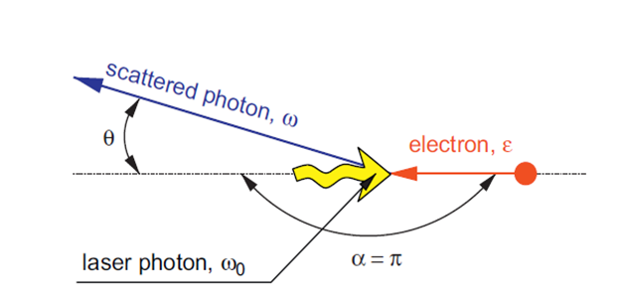
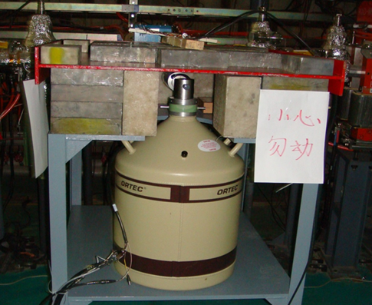
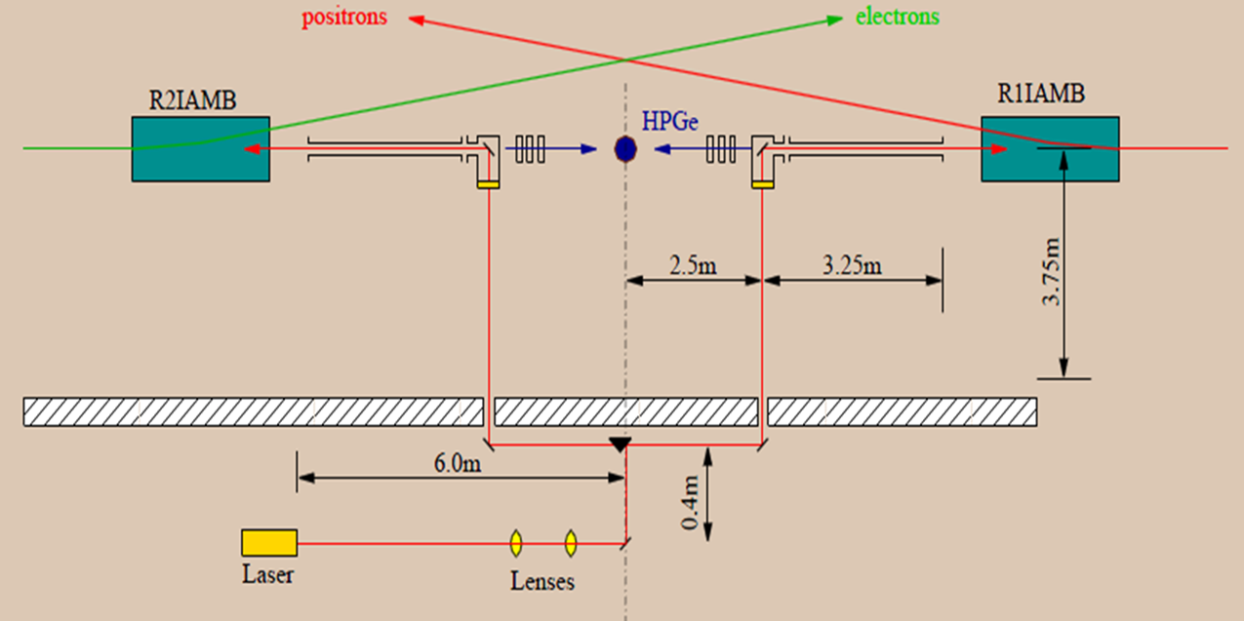
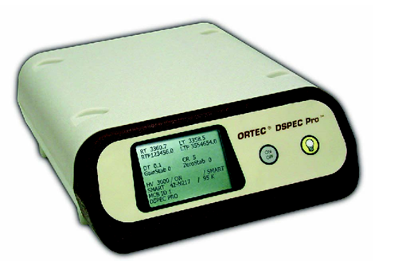
BEMS@BEPCII
E_{beam}：1 ~ 2.3 GeV
Co₂ Wave Length，10.59 μm
ORTEC HPGe detector, ~30%
ORTEC Dspec Pro

Slide 6
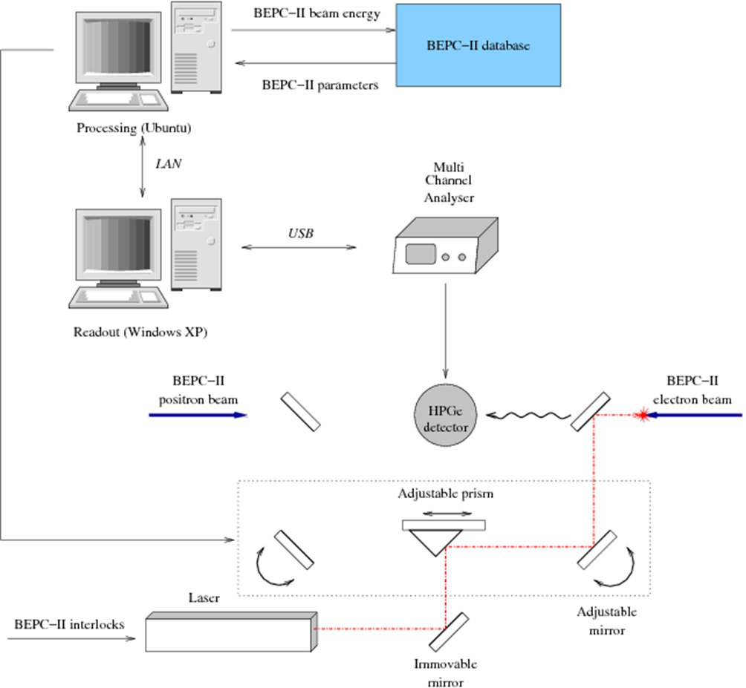
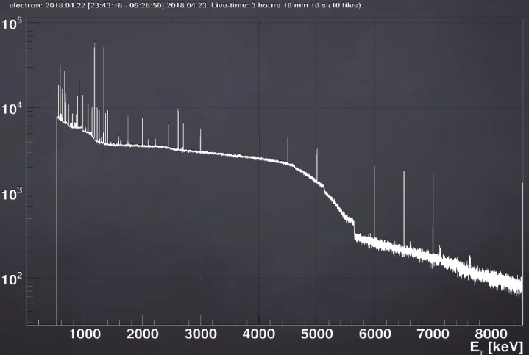
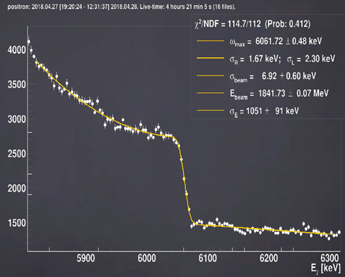
BEMS@BEPCII（II）

Slide 7
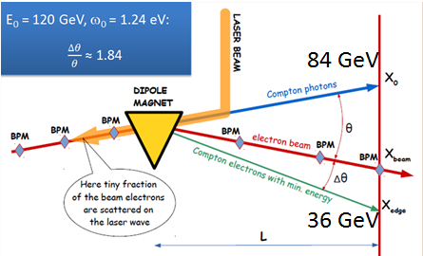
BEM@CEPC
Plan to use laser Compton Scattering method
Assuming E_{bm}=120GeV, ω₀=1.24ev,
E_{γ}=84GeV, E_{sbm}=36GeV, No energy detector can
measure such high energy accurately
Accurately measure beam position and accurately determine
beam energy
The new detectors were investigated :
Silicon micro strip detector,
Silicon pixel detector,
Diamond micro strip detector
The beam energy of CEPC is high, the performance of silicon detector is significantly reduced at 10¹⁷n/cm², and the radiation resistance of diamond microstrip detectors is one order of magnitude higher
Diamond micro strip detector should be studied carefully
10⁵/bunch
$$E_{beam}=\frac{me^{2}}{4ω_{0}}\frac{x_{edge}−x_{beam}}{x_{beam}−x_{γ}}$$
10³/bunch

Slide 8
Design of diamond micro strip detector
According to our simulation, If the position resolution of the diamond micro strip detector is 10 microns, the CEPC beam energy accuracy is about 1.2╳10⁻⁵
Select diamond micro strip samples with a width of 50 microns and a gap of 50 microns for research

Slide 9
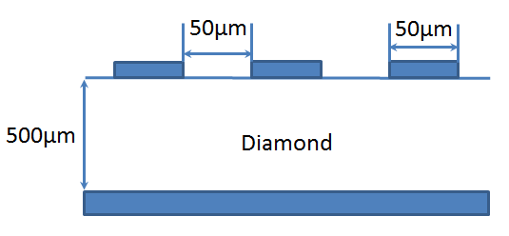
Design of diamond micro strip detector
Single crystal diamond plate, CVP
40 channels

Slide 10
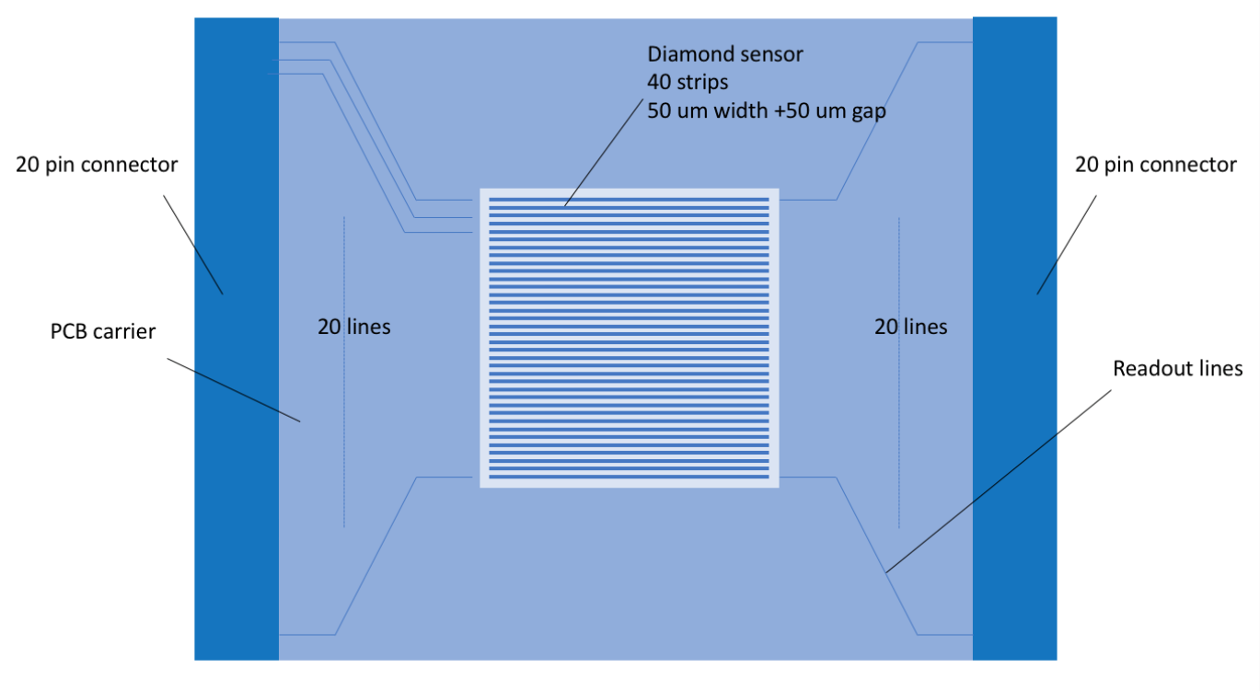
Design of diamond micro strip detector

Slide 11
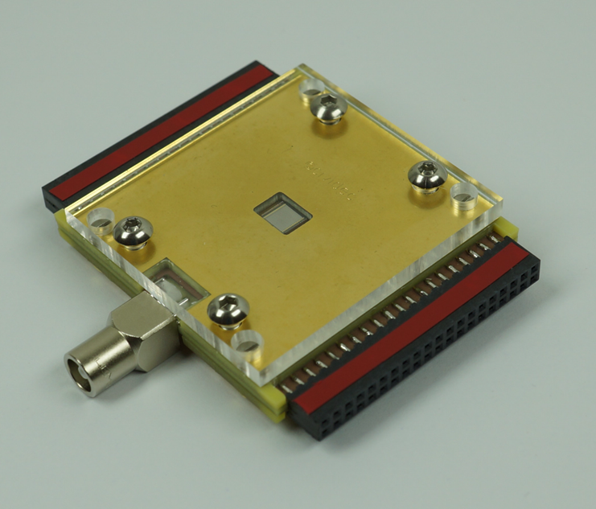
Manufacture of diamond micro strip detector
Cooperate with Cividec (Austrian)to help us manufacture diamond micro strip detectors
Specifications
60╳60╳8mm³
HV: 250V
HV
Signal readout

Slide 12
Preliminary performance test
L.V. power supply：GWINSTK-GPD3303S
H.V. power supply：CAEN 4ch NIM/Desktop Programmable
Oscilloscope：Tektronix MDO 3034
Radioactive source：Am-241
Test process
R. source
Diamond
Amp.
Oscil.
H.V.
L.V.

Slide 13
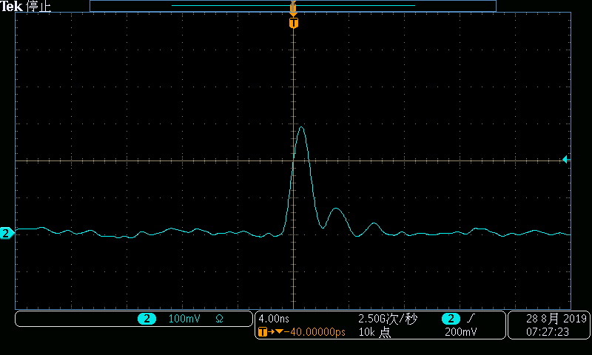
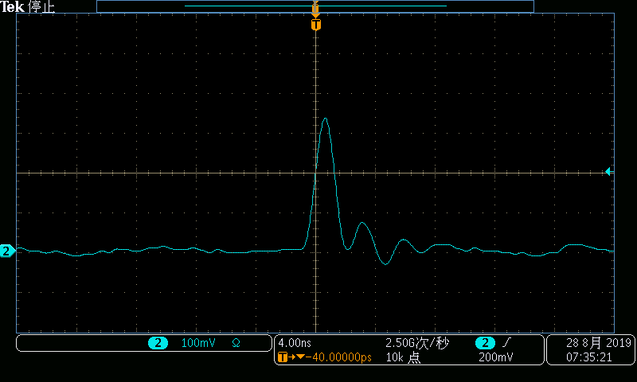
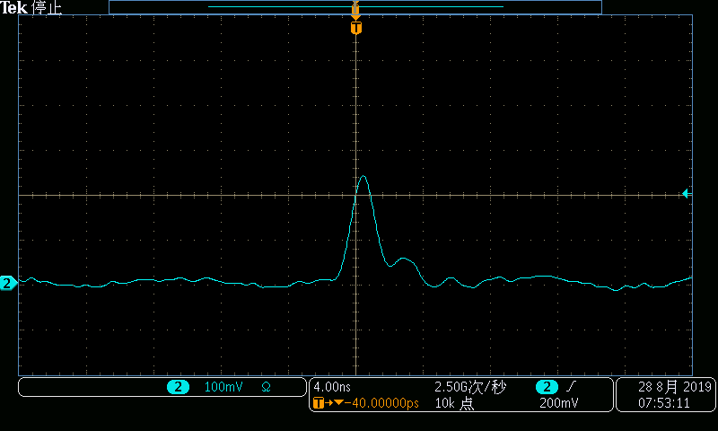
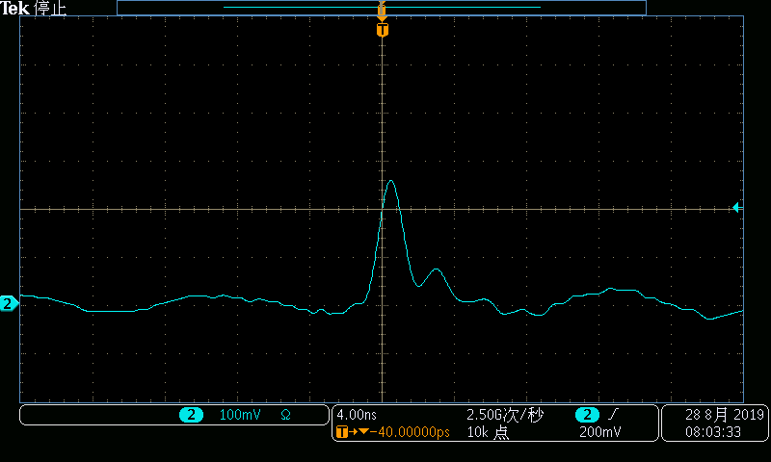
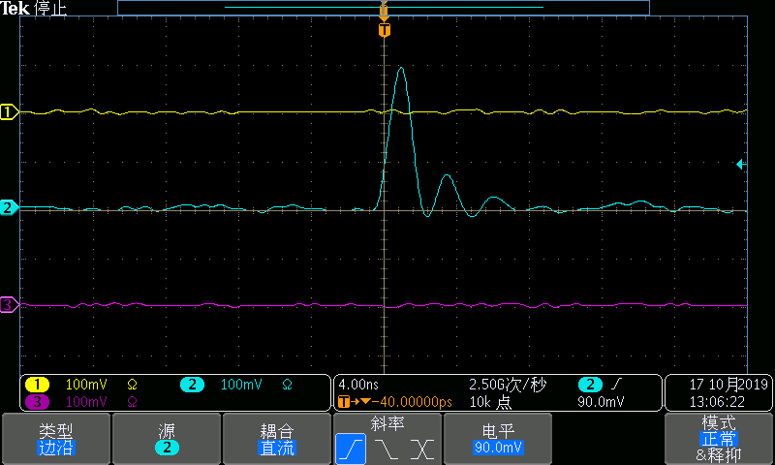
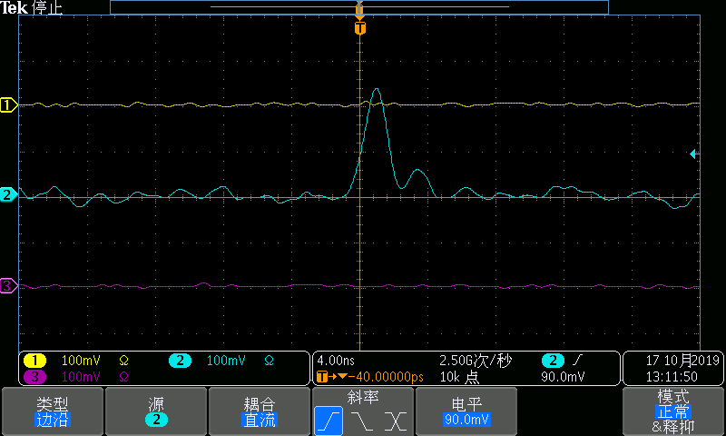
Single channel
Detector :10204，Amplifier：141
1
3
5
7
2
4
6
8

Slide 14
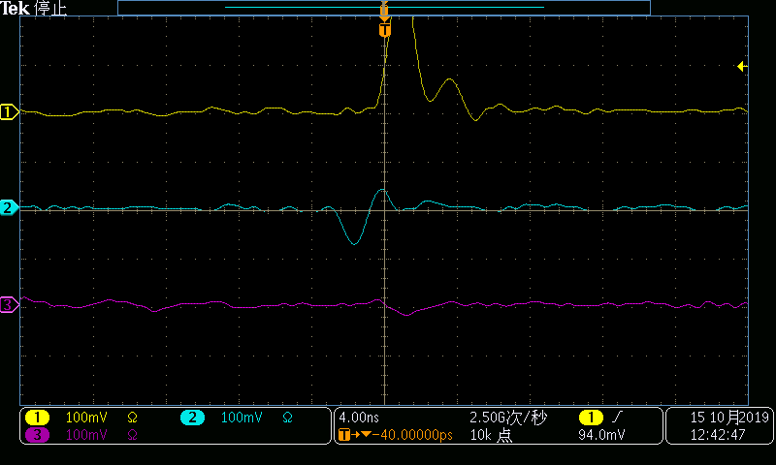
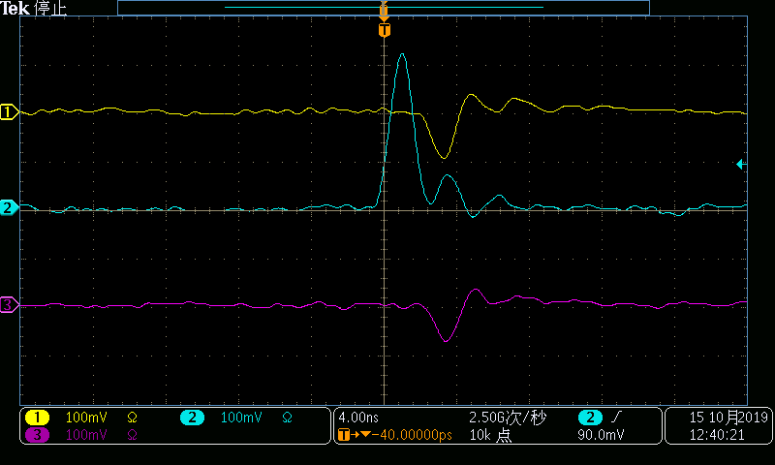
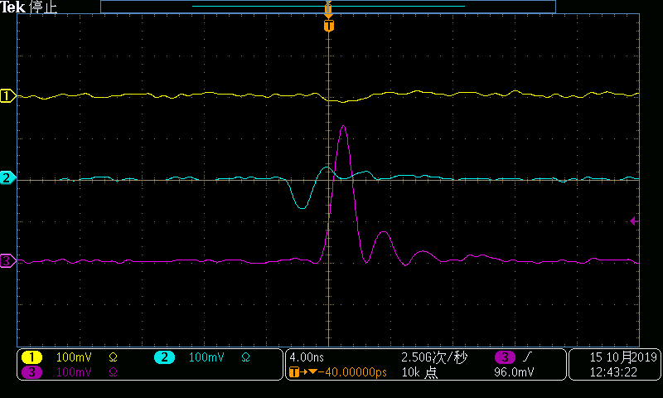
Cross talk
Cross talk in adjacent 3 channels
Channel 1 trigger
Channel 2 trigger
Channel 3 trigger

Slide 15
Design and test of readout electronics
Luo Laifu from USTC
The amount of charge corresponding to the minimum deposition energy :
$$Q_{min}=306keV/13.1eV≈3.7fC$$
$$I_{min}≈1.48uA$$
Current signal readout scheme
Charge sensitive
Trans-impedance amplification
High power consumption, high digital requirements
Resistance-voltage conversion and voltage-voltage amplification
The first stage conversion gain is low and the signal-to-noise ratio is poor

Slide 16
Design and test of readout electronics
The overall scheme of charge sensitive readout
To improve s/n ratio，Front End Board and Back End Board

Slide 17
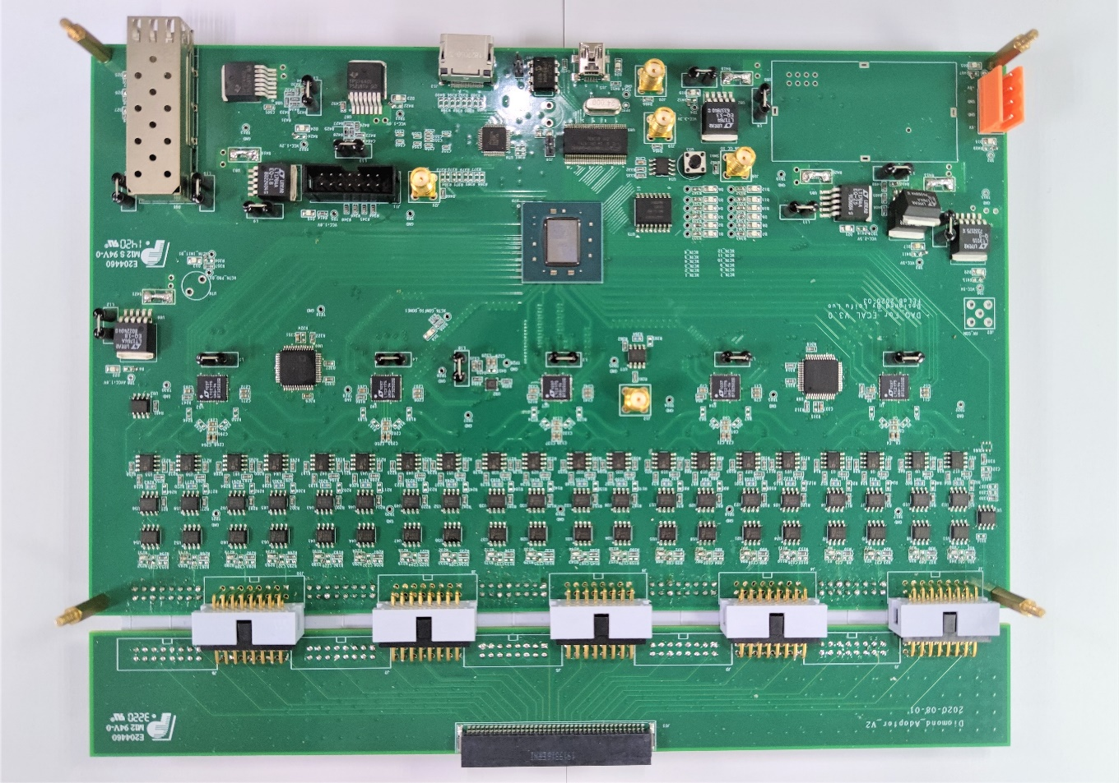
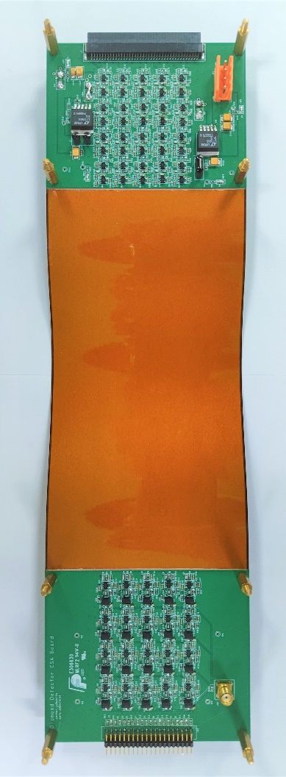
Design and test of readout electronics
Front End Board
Back End Board

Slide 18
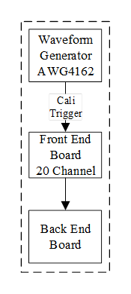
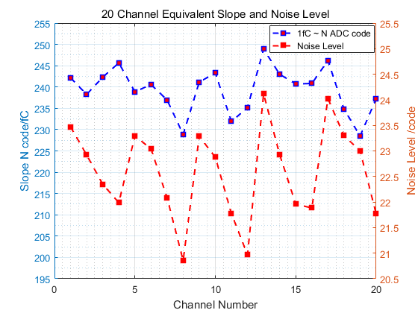
Electronics debugging
14-bit ADC, 40MSPS sample rate
Noise at output stage: ~23 ADC Code;
Slope between output amplitude and input charge: $\sim 240 ADC Code/fC$
Slope difference between channels $±10 ADC Code/fC\left(5\%\right)$
Calibration、noise test

Slide 19
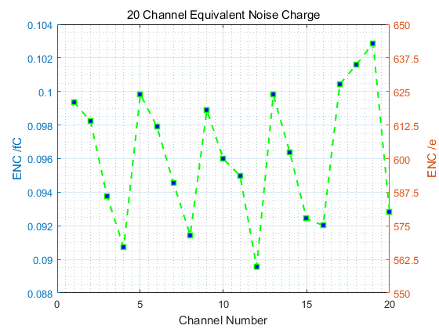
Electronics debugging
Equivalent noise charge （ENC）
The ENC of all channels is about $0.1fC$

Slide 20
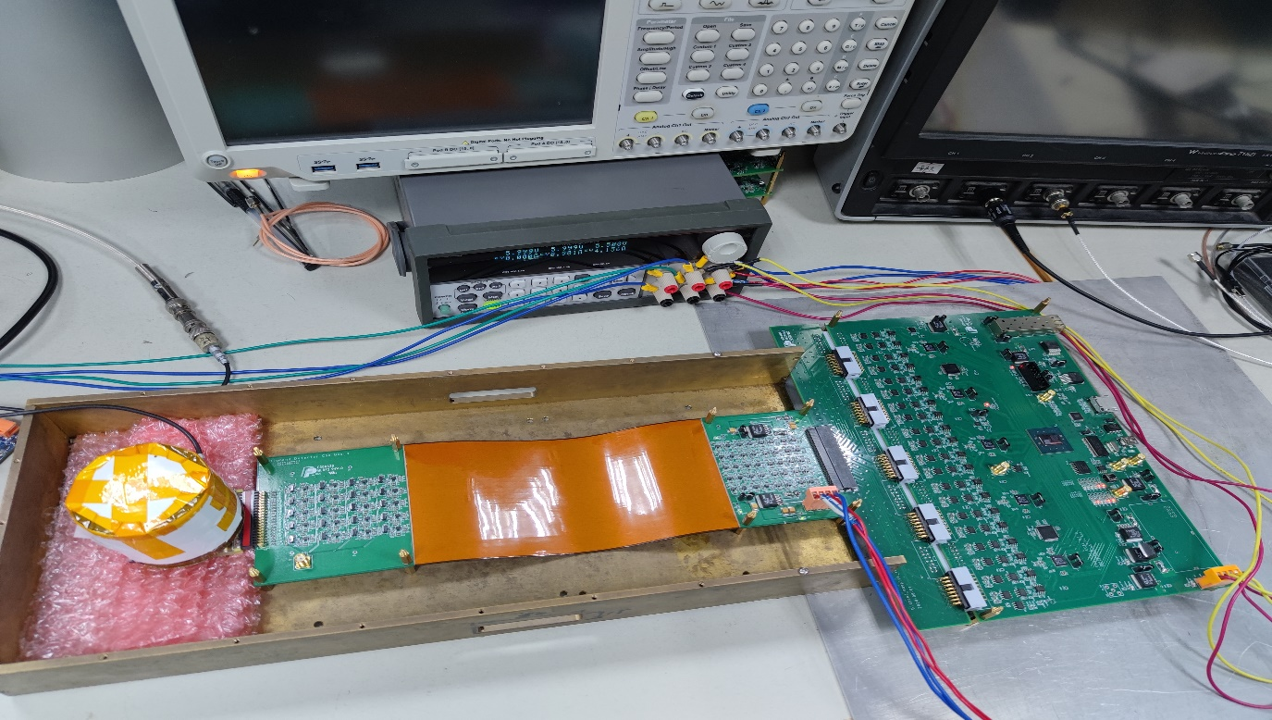
Detector electronics joint debugging
Beta rays using 90-Sr radiation source
L.V.
H.V.
90-Sr
BEB
FEB

Slide 21
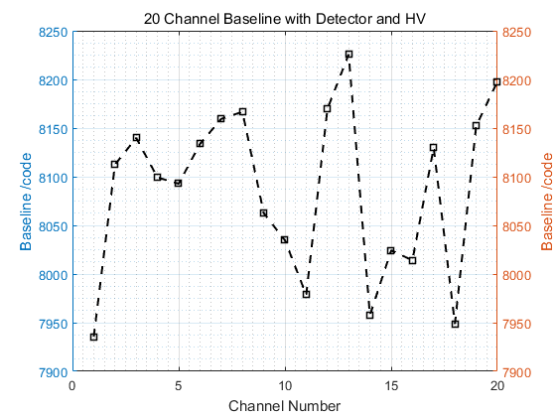
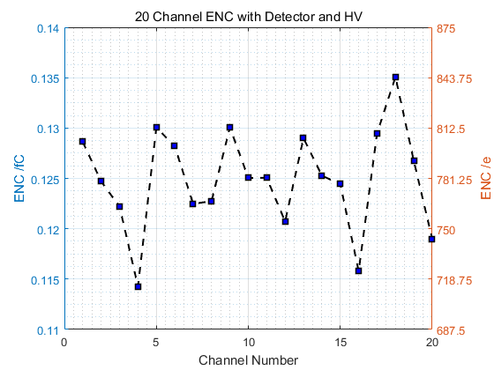
Detector electronics joint debugging
Pedestal and noise
Pedestal: about 8100 ADC Code, half of full range (14bit, 16383 ADC Code)
The equivalent noise increases by ~$200e$、~$0.03fC$
Pedestal of 20 channels
Noise of 20channels

Slide 22
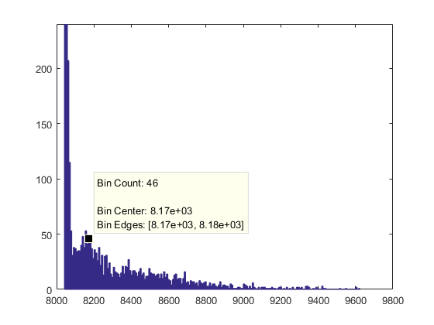
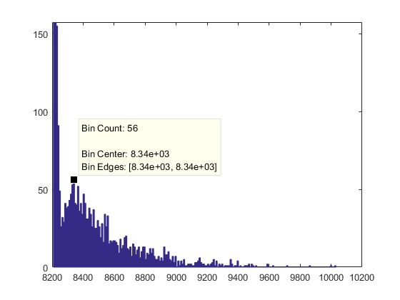
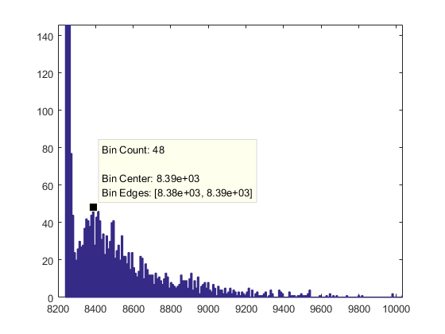
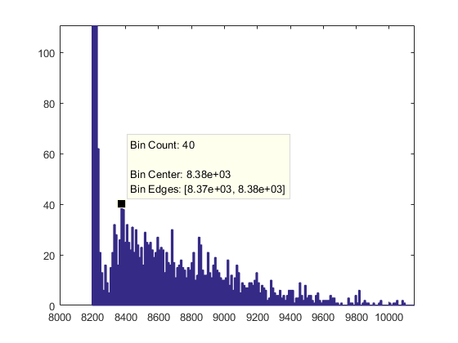
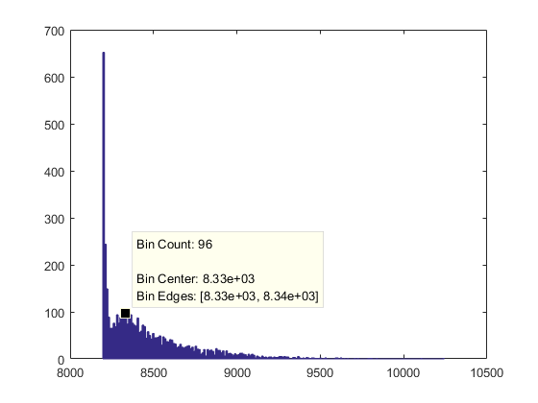
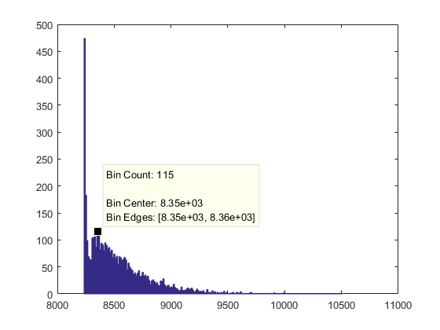
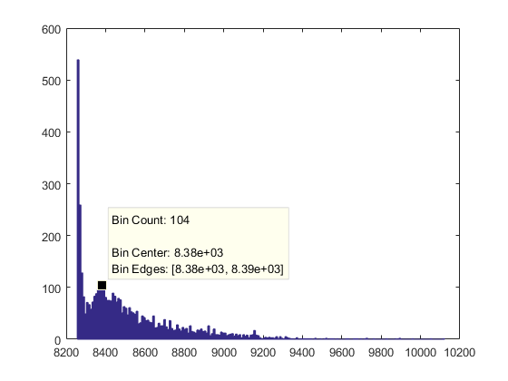
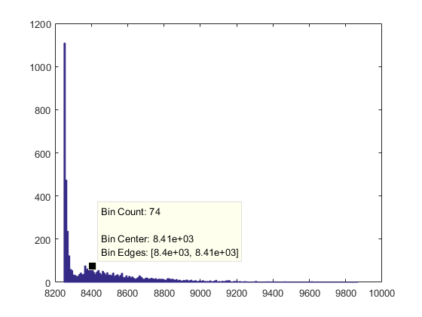
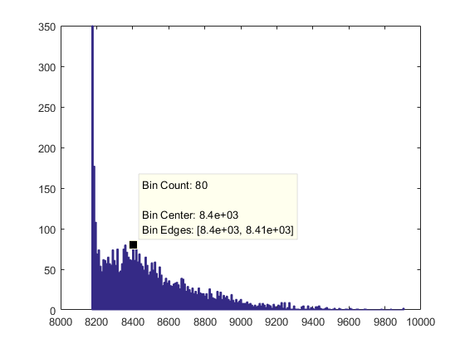
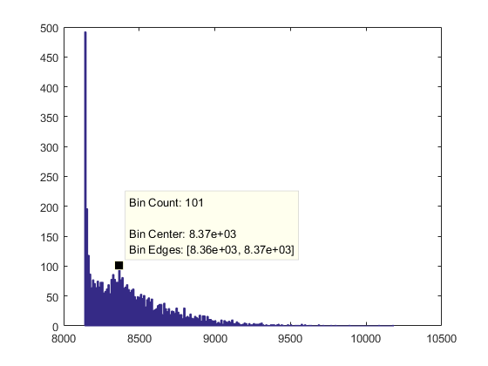
Detector electronics joint debugging
Ch1
Ch2
Ch3
Ch4
Ch5
Ch6
Ch7
Ch8
Ch9
Ch10

Slide 23
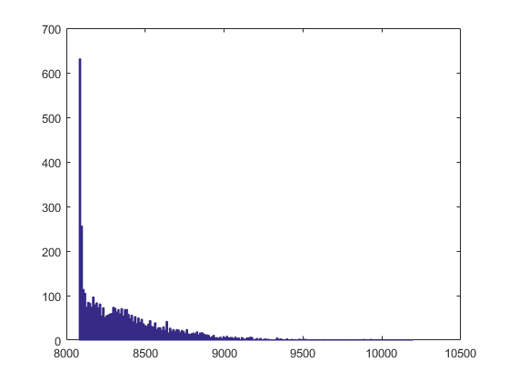
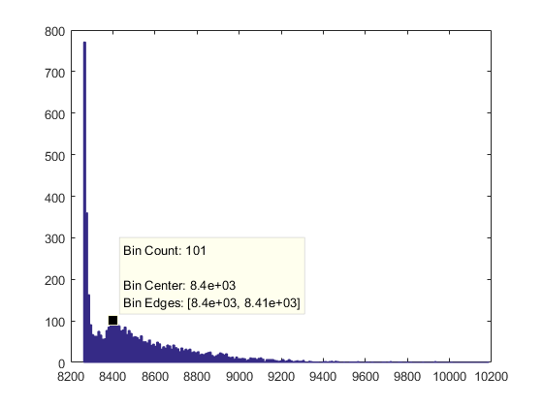
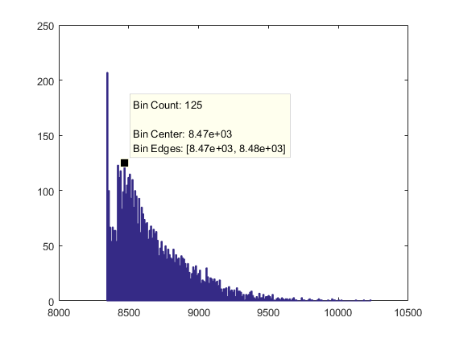
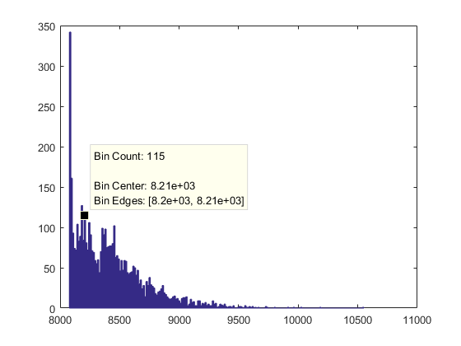
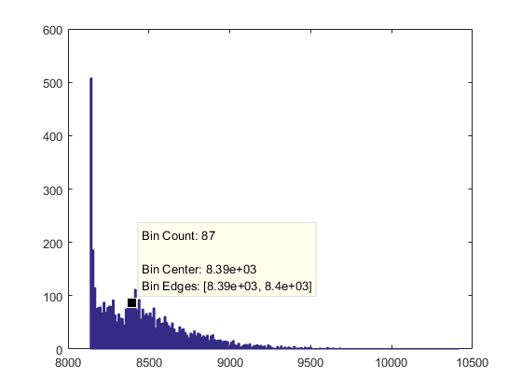
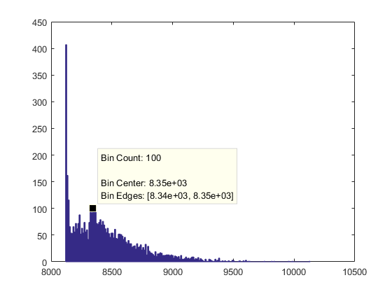
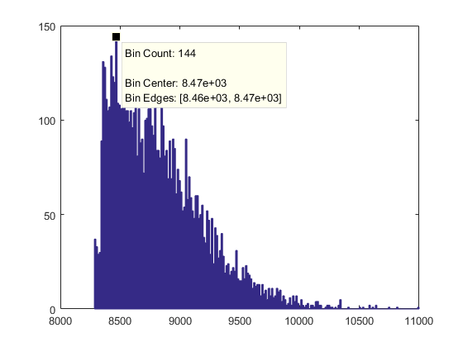
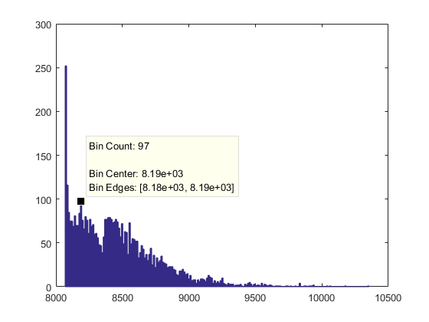
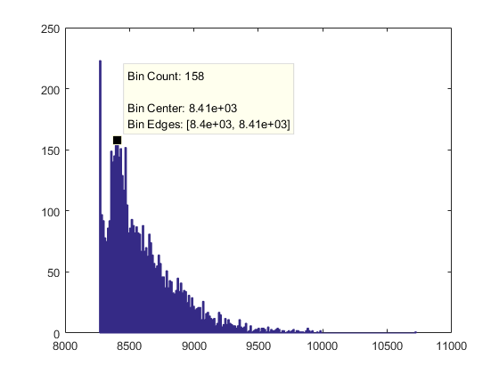
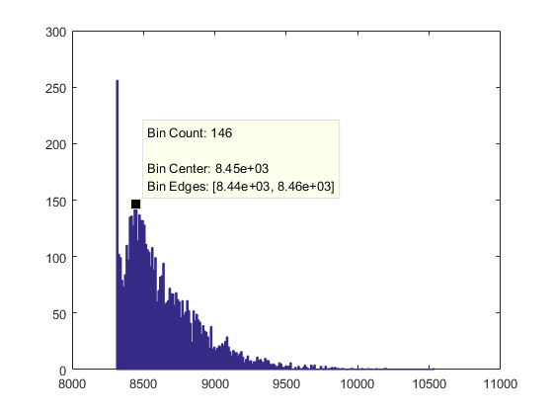
Detector electronics joint debugging
Ch11
Ch12
Ch13
Ch14
Ch15
Ch16
Ch17
Ch18
Ch19
Ch20

Slide 24
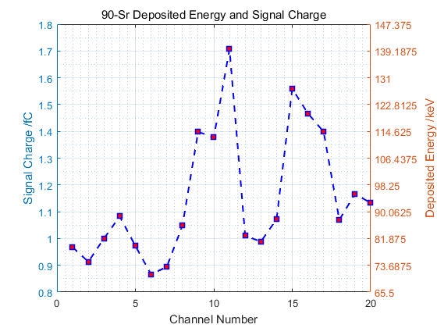
Detector electronics joint debugging
90-Sr test results
E$nergy deposit at single channel less than 2fC$，a$bout half of theoretic calculation.$
Deposited energy shared among multi-channels

Slide 25
Next to do
Make the new board to ensure a 40-channel readout system
Prepare a new trigger algorithm according to the actual situation
Investigate the situation where the deposited energy of a single case is shared among multiple strips
Position measurement related experiments
… …
Thank you for your attention!

Slide 26
90-Sr理论沉积能量
90-Sr β衰变释放$β^{−}$的最大能量为0.546MeV，由此得：
$βγ ≈1.81$
其在碳中的电离能损：
$\frac{dE}{dx}≈1.9MeV∙g^{−1}∙{cm}^{2}$
在500um厚的金刚石中，损失能量：
$∆E≈332keV$
对应电荷量：
$Q=\frac{332}{13.1}∗1000/e≈4fC$

