Slide 1
基于HEPS的多园区异地统一身份认证系统设计
罗齐, luoq@ihep.ac.cn
中国科学院高能物理研究所,
计算中心
2023-07
Notes:
hello everyone ,I am honored to be here to give this report,my name is luoqi ,i from The Institute of High Energy Physics of the Chinese Academy of Sciences,computing center.The topic of my report today is’The design of the unified identity authentication system for IHEP’Let's start now.

Slide 2
大纲
统一认证平台 @IHEP
基于HEPS统一认证挑战&目标
基于HEPS的多园区异地统一身份认证系统
总结 & 计划
Notes:
my report outline is .

Slide 3
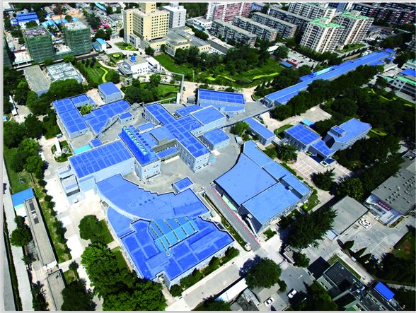
IHEP-中科院高能物理研究所
高能所在高能物理领域主持或参加了15个以上的实验
从多种实验产生海量数据 (~PB/year)
多学科交叉研究，实验方法学→数据格式多样，元数据复杂
Notes:
The Institute of High Energy Physics (IHEP) is China’s biggest laboratory for the study of particle physics. As well as theoretical and experimental research into particle and astroparticle physics, we have a broad range of research in related fields such as accelerator technologies and nuclear analysis techniques. The Institute also provides beam facilities for researchers in other fields of study. Now ~~~~~~~ exceed 15.PB level of data are produced every year.Therefore, the security of personnel information and data is particularly important.

Slide 4
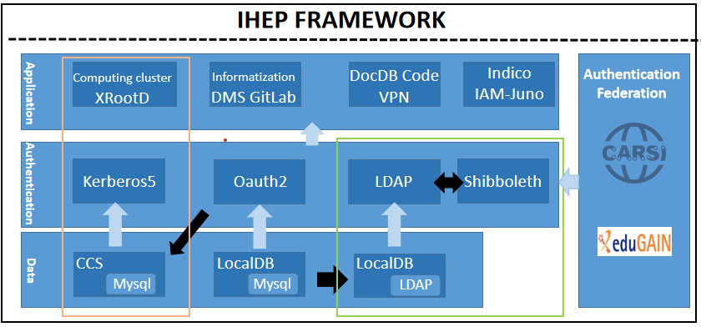
统一认证平台 @IHEP
IHEP SSO 现状
支持多种认证协议 Kerberos5、OAuth2 and Shibboleth
支持多种数据源，mysql and LDAP
支持 OAuth2、LDAP and Shibboleth 应用接入 :260~
接入CARSI、EduGAIN认证联盟
当前状态
总用户数 : 25000~
VPN 组: 27~
合作组 : 160~
计算集群用户: 4100~
计算集群组: 130~
Notes:
As you can see from these page,This is IHEP sso platform framework,It is divided three layers,data \Authentication and application. At the data layer we have localdb(mysql) to IHEP user accounts informations,CCS to use storage computing cluster user accounts informations and mysql synchronization user informations to LDAP database. At the Authrntication layer,we support We support multiple authentication protocols there are kerberos5 、Oauth2 and Shibboleth.They all play an important role in this system.Finally the application layer,We not only have our own developed application systems, but also support the access of each experimental group's own systems.We also have access to the Authentication federation,CARSI(CERNET Authentication and Resource Sharing Infrastructure) and Edugain.Facilitate experimental cooperation. now the cirrent status is Support OAuth2、LDAP and Shibboleth applications :260~ greater than~~~~~

Slide 5
基于IEPS统一认证挑战
IHEP 异地、多园区认证
IHEP 承担异地、多园区大装置运行任务
大量交叉学科实验需求
各学科科学家将会加入
动态权限管理
学科深度交叉
交叉学科实验日益增多
不同的实验需要不同的操作权限
计算集群账号管理
创建延时长，大约5分钟
账号信息写入系统本地文件，对想信息修改时工作量大
账号、数据安全
每年产生海量实验数据
科学家在实验中需要扮演多种身份
远程操作实验需求
Notes:
IHEP also have many challenges.

Slide 6
目标
IHEP 异地、多园区认证
不同站点之间实现内网互通
唯一账号绑定多种实验角色
加入CARSI和EduGAIN认证联盟
动态权限管理
可随时申请权限变动
IHEP内部和外部用户有不同的权限申请流程
用户在不同实验具有不同的权限
计算集群账号管理
重构计算集群架构，优化申请、修改流程
账号、数据安全
收集用户全部登录日志，实现登录报警
异常用户监测
全自动处理异常登陆请求
Notes:
so We will achieve these goals 读题目 make scientists can Interworking between different sites ~~~~~~~~~~~~~~~~~We do our best to facilitate scientists.

Slide 7
基于HEPS的多园区异地统一身份认证系统
HEPS FRAMEWORK
高能同步辐射光源(HEPS)
New Features:
实现高能所内部认证联盟
计算集群认证迁移至ldap
利用深度学习网络进行异常检测报警
全自动异常检测
Exception
handle
Authentication Federation
Application
Computing Cluster XRootD
Informatization DMS
DocDB Code VPN
Indico IAM-Juno
Alert
Detection
Deep learning detection login exception
Authentication
Lock
Kerberos5
Oauth2
LDAP
Shibboleth
Data
CCS
LocalDB
LocalDB
Logout
Mysql
Mysql
LDAP
Facilities
CSTCloud
CSNS
IHEP
HEPS
Notes:
Take HEPS as an example,Besa on IHEP framework,We designed and implemented HEPS framework.Look at the green part,this is update function .We have integrated user information from four campuses , build a Internal authentication Alliance.Realize accessible login for all users.HEPS also use mysql and ldap database to stroge user information.Also support kerberos5 、Oauth2 and shibboleth protocols .Here, we have added a new detection layer,Collect login information, network request information, and system logs . We will use Deep learning algorithm to automatically detect exception.The exception Will be divided into three types include alert 、lock and logout.Different types correspond to different solution processes,Can unlock accounts that have been locked.It will also support our own developed application systems and each experimental group's own application systems and unitid CARSI and EduGain. Ti will fir our needs.

Slide 8
HEPS统一认证访问流程
VPN
HEPS 统一认证访问流程
园区外科学家使用VPN进行资源访问
异常检测功能收集登录、计算等相关日志分析
实现四个园区用户信息统一
实现全自动异常登陆报警与处理
Campus Net
Exception Handle
Computing
cluster
Applications
Experment
resources
Exception Detection
Authentication Function
User Informations
Unify authentication systems
Notes:
This is UASF function diagram,As we can see ,If Scientists visit experimental resources outside the campus,he connect Campus net need use VPN.Exception Detection will collect Computing cluster、Applications
(develpment or experment Group’s) and Experment resource all login infeomations,it will use deep learning arithmetic to handle,If have any exceptions,It will automatically categorize the alarm.Authentication Function
will authenticating login request by user informations.The user informations Collect personnel information of the four site.This system will provide a safe and reliable way When a scientist wants to visit experment resource or application .

Slide 9
异地、多园区认证
IHEP
HEPS 异地、多园区认证
建立一个内部认证联盟
使 中国科学院高能物理研究所 (IHEP)、中国散裂中子源(CSNS)、高能同步辐射光源(HEPS) and 中国科学院(CSTCloud) 人员信息联动
实现一个账号登录多园区功能
Multi-site Multi-source
HEPS
CSNS
添加文字
CST
Cloud
Notes:
This is what I said above. ~~~Realize the experimental needs of scientists in different campus

Slide 10
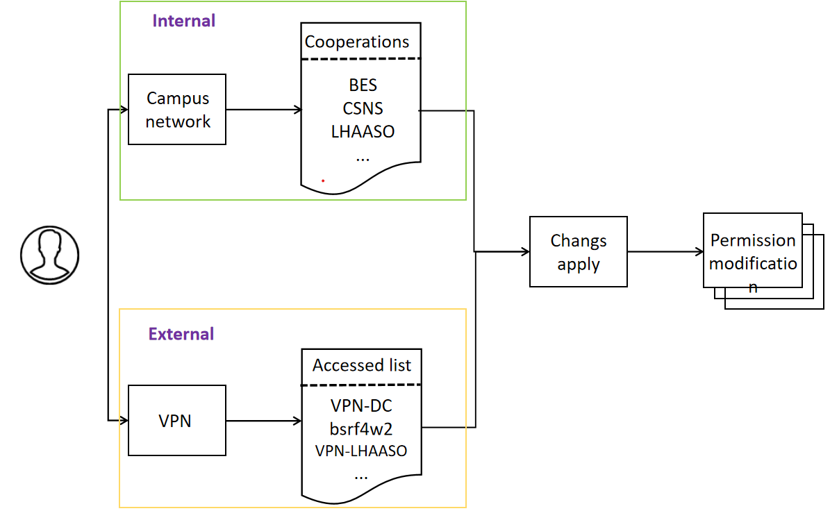
动态权限管理
IHEP用户
实验相关权限全部放入内网使用
每个实验设立对应的权限分组
一个账号可以拥有多个实验组权限
修改实验权限，需要实验管理员同意后才能修改
IHEP所外用户
使用VPN接入内部网络
用户账号对应VPN不同授权的访问列表
修改VPN权限，需要实验管理员同意后才能修改
Notes:
This is Dynamic authority management process.You can apply for them at any time.It is divided two parts Internal and External.Internal is has local account such as IHEP account.When you have a IHEP account,and~

Slide 11
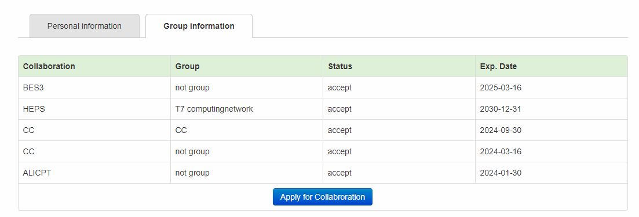
动态权限管理-- IHEP用户
IHEP 用户
可以选择自己的合作组
自动发送申请邮件给合作组管理员
可以拥有多个实验组访问权限
Notes:
As you can see in this Internal user example,When user apply his collabroration,he just click apply for collabrotarion and choose he want join collaboration. When the collaborate administrators accpect it ,you can use this group resource and Can also have multiple cooperation group permissions at the same time. As shown above,IThis account have BES3、HEPS and so on,you can apply collabroration at ant time.

Slide 12
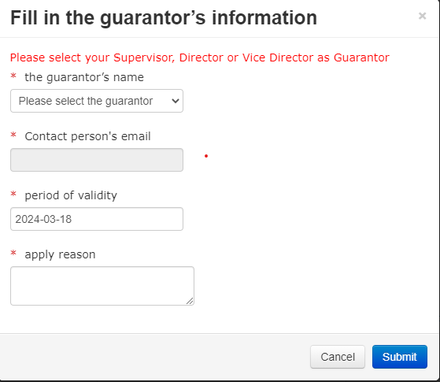
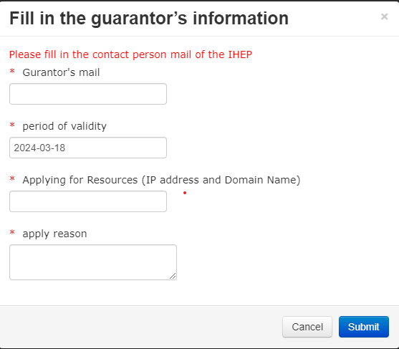
动态权限管理-- VPN申请
VPN IHEP 邮箱
选择本部门领导
填写申请原因
自动发送申请审批邮件
邮件将会发送本部门领导，同意后VPN生效
VPN 所外邮箱
填写高能所相关联系人
填写申请理由
I邮件将会自动发送高能所联系人
IHEP user
External
Notes:
As you can see in this VPN example,When IHEP user apply VPN. ~when Guarantor accpect it,you can use vpn to connect experiment resource.

Slide 13
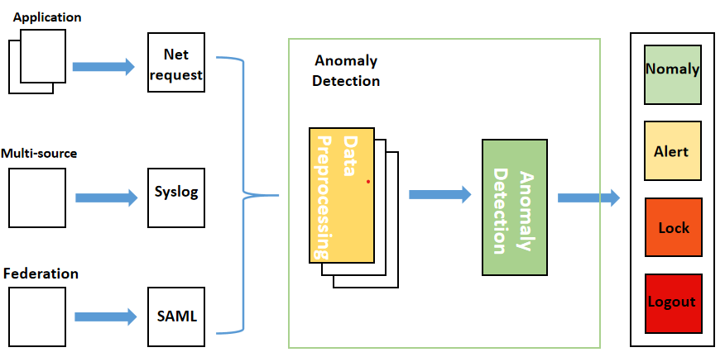
异常检测
监测& 报警
收集多种日志数据
网络请求、系统日志和SAML 登录日志信息
使用深度学习网络自动处理登录异常
自动分类异常等级
自动对不同级别报警启用不同处理流程
警告、锁定、登出
对于不同级别的告警，有相应的解锁策略
Notes:
for Exception Detection we will use deep learing algorithm to detect expection

Slide 14
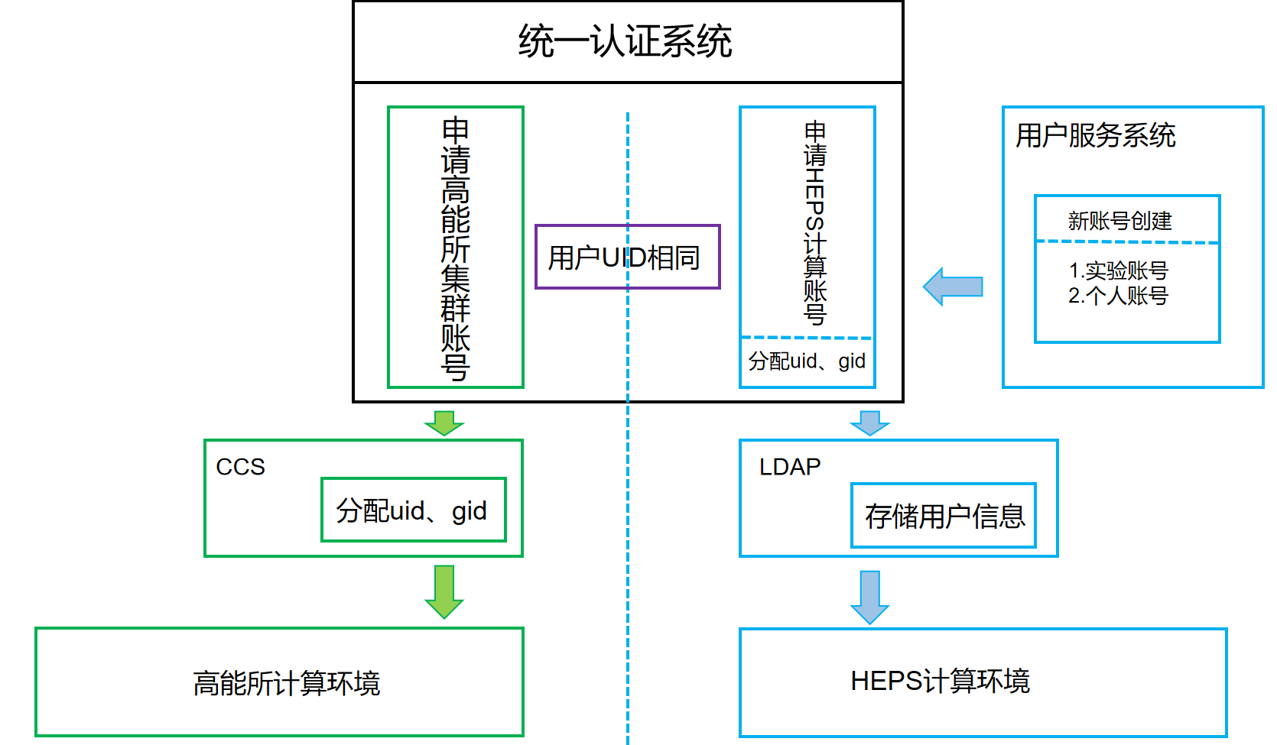
计算集群认证迁移
IHEP 计算账号流程
使用高能所统一认证进行申请
通过计算账号管理系统（CCS），进行账号创建
自动发送申请审批邮件给计算组管理员
管理员同意后，统一创建uid、gid，写入高能所计算环境
HEPS 计算账号流程
实现用户服务系统和高能所统一认证申请双入口
管理员同意后，由高能所统一认证进行uid、gid分配
账号信息全部由LDAP进行存储管理
由SSSD模块+KRB5对计算集群账号认证
实现账号创建、修改时延为秒级
Notes:
As you can see in this VPN example,When IHEP user apply VPN. ~when Guarantor accpect it,you can use vpn to connect experiment resource.

Slide 15
扩展性、兼容性
标准化接接口
以获得更好的可扩展性和访问应用程序
这些模块使用标准的Restful API相互通信
支持实验组自建应用可以通过Oauth2, Shibboleth协议接入统一认证系统
Applications
Illegal Login detection
Server API
API
MySQL
API
CSTCloud
HEPS
IHEP
CSNS
Notes:
The entire system use a standard interface design,From the database to the application, all calls are made using interfaces.It will~~~~

Slide 16
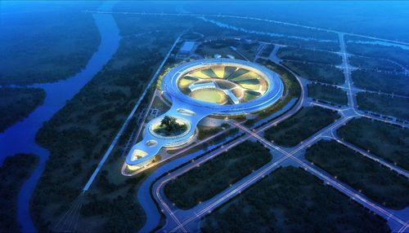
总结
建立异地、多源认证联盟
实现多园区人员信息联动
多园区内部网络无障碍通信
动态资源管理
实验个人动态权限管理
简单、高效申请流程
基于深度学习异常检测
实现一个统的监控大数据平台
使用深度学习算法自动检测账号异常
细粒度异常管理和解锁规范
标准化接口，更好地扩展和访问应用程序
Notes:
This report mainly covers four aspects.

Slide 17
下一步计划
下一步计划
2023.8实现第一版HEPS即统一身份认证系统
支持HEPS第一批14个线站使用
联动多站点帐号数据，实现一个帐号的多功能
动态权限管理
计算集群账号迁移LDAP
Notes:
August 2023

Slide 18
Thanks for your attentions!

