Slide 1
PANDA实验 EMC软件进展
孙胜森
2021年PANDA中国组夏季会议
天津 2021.7.6.

Slide 2

FAIR —— Facility for Antiproton and Ion Research in Europe
FAIR Site in April 2021
“Report from the Technical Coordinator” Lars Schmitt, PANDA Collab Meeting 21/2

Slide 3
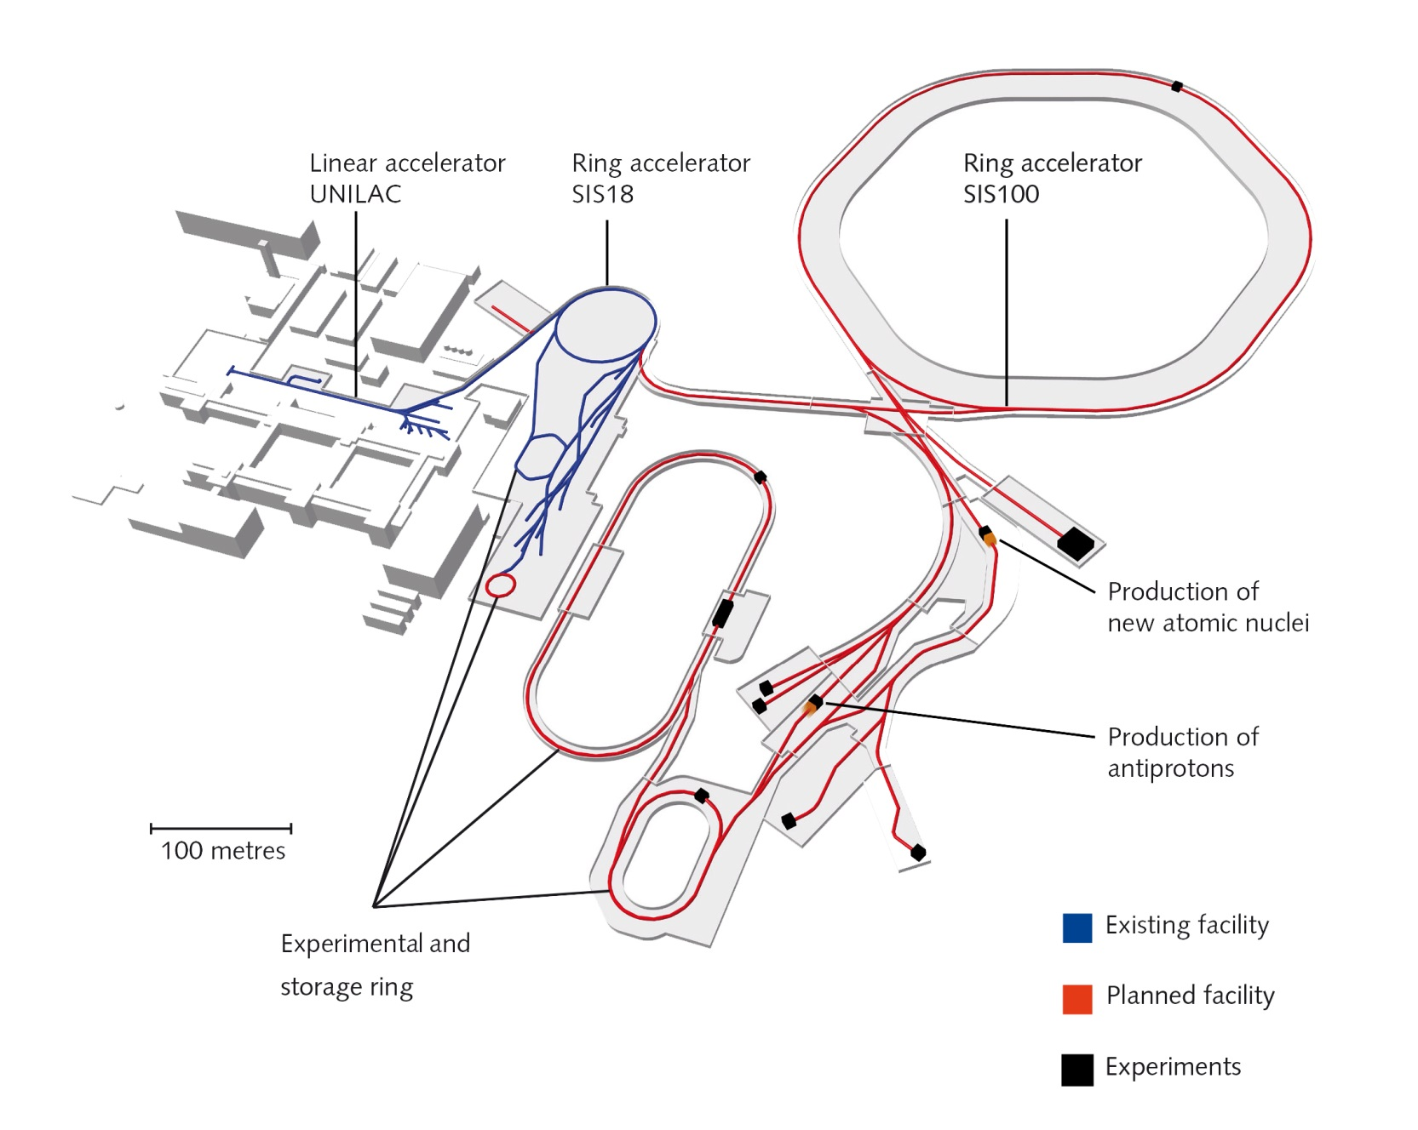

Antiproton Production at FAIR
p-Linac
Proton Linac 68 MeV
Accelerate p in SIS 18 / 100
Produce $\overline{p}$ on Ni/Cu target
Collection in CR. fast cooling
Full FAIR
  Accumulation in RESR, slow cooling
  Storage in HESR
  PANDA luminosity < $2×{10}^{32}{cm}^{−2}s^{−1}$
FAIR MSV
  Accumulation in HESR
  Luminosity ${10}^{31}{cm}^{−2}s^{−1}$
HESR
PANDA
CR
RESR

Slide 4
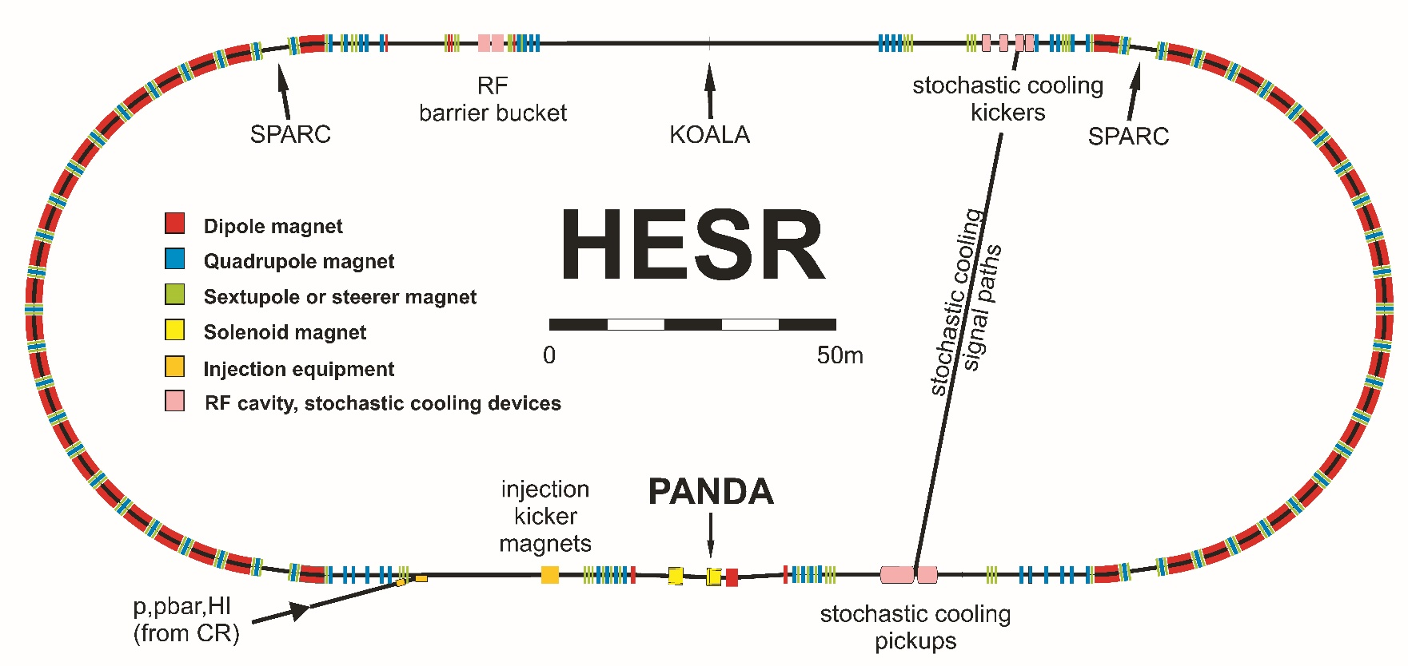
HESR — High Energy Storage Ring
Injection momentum 3.8GeV/c
Storage ring with internal target
Mode | High Resolution | High Luminosity
Momentum range Energy range Stored antiprotons Peak luminosity Δp/p | 1.5 – 15 GeV/c 2.3 – 5.5 GeV 10¹⁰ 2·10³¹ cm⁻²s⁻¹ 5·10⁻⁵ | 1.5 – 15 GeV/c 2.3 – 5.5 GeV 10¹¹ 2·10³² cm⁻²s⁻¹ 1·10⁻⁴

Slide 5
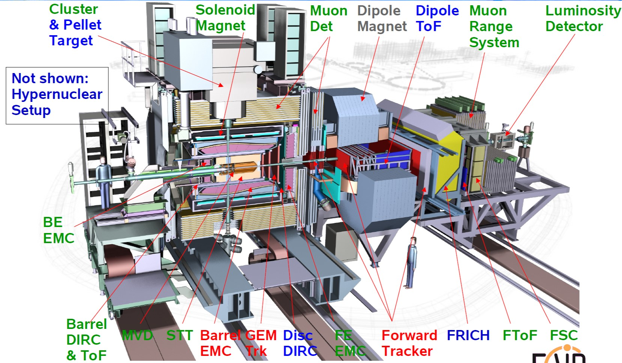
PANDA Day-1/Phase 1/Phase 2
Tracking System
Particle identification
Electromagnetic calor
Target System
Magnet

Slide 6
PANDA Schedule
Current Status
Construction of many Phase 1 systems has started
Integration and infrastructure planning progressing
Delays in several parts due to delayed funding or contracting
Covid-19 needs to be accounted still
Installation periods according to present plans
Installation period 1: solenoid, dipole, supports etc. in parallel with installation of technical building infrastructure
Installation period 2: all other systems after building completed.
Boundary conditions for plan revision
Completion of PANDA hall 2 years later than initially planned
Start of installation period 1 on June 6 2024
Mitigation: testing and pre-assembly of parts at other sites, storage
Ready for beam end 2026

Slide 7
PANDA Progress Scorecard

Slide 8
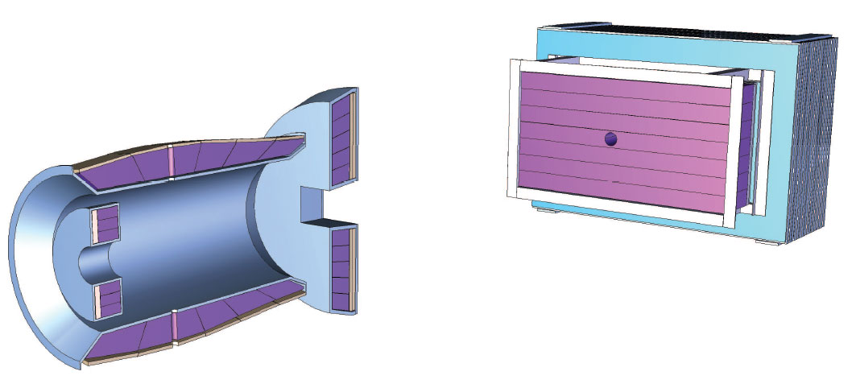
Electromagnetic Calorimetry
PANDA physics: Complete reconstruction of multi-photon and lepton-pair channels of importance
Good energy and spatial resolution for photons up to 15 GeV
High yield and background rejection
Target spectrometer: Homogenius barrel part plus two endcaps
Forward spectrometer: Sample calorimeter

Slide 9
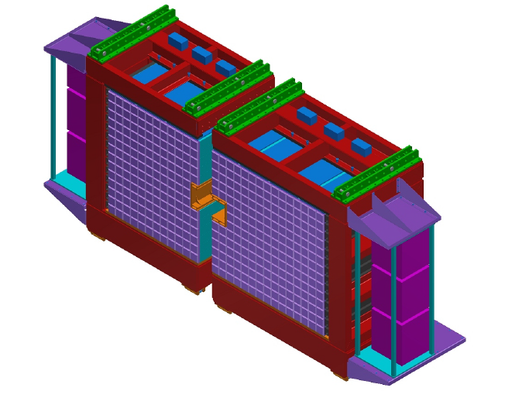
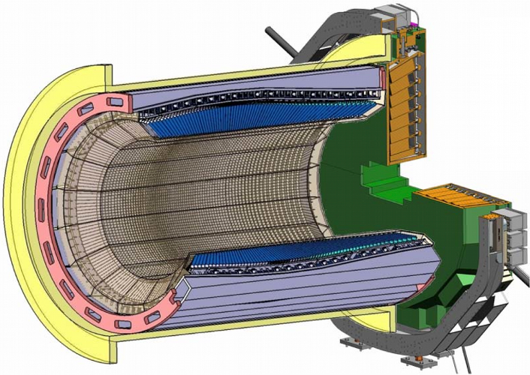
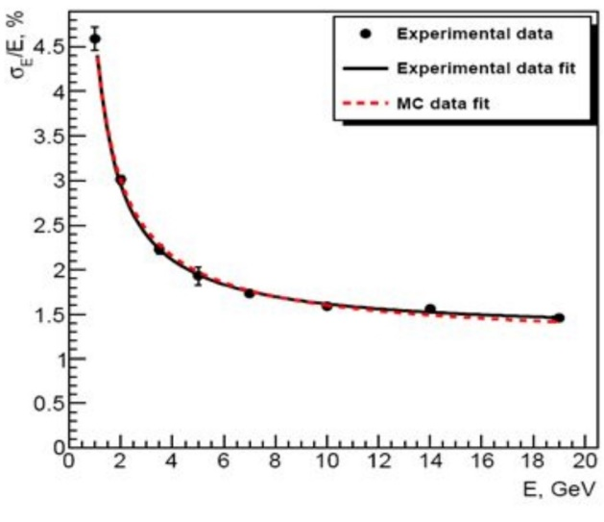
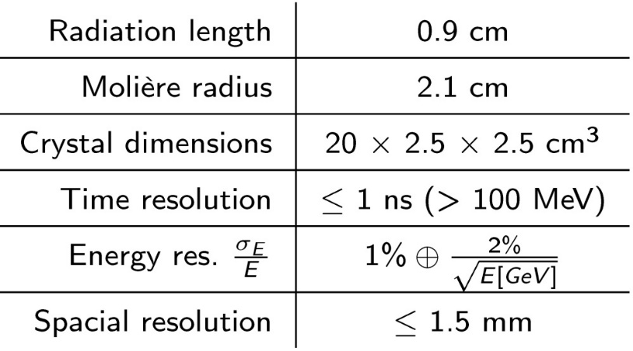
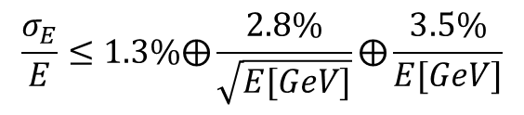
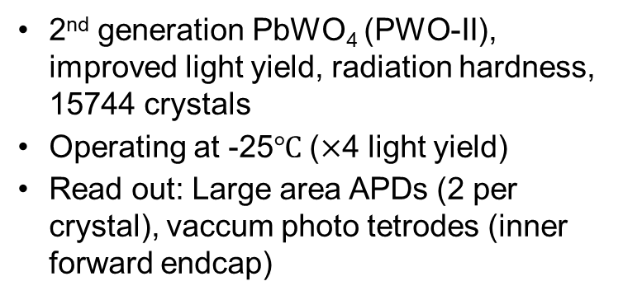
Electromagnetic Calorimetry
2nd generation PbWO₄ (PWO-II), improved light yield, radiation hardness, 15744 crystals
Operating at -25$℃$ ($×$4 light yield)
Read out: Large area APDs (2 per crystal), vaccum photo tetrodes (inner forward endcap)
Shashlik type sampling calorimeter:
Lead absorbers, plastic scintillators, light collection by wavelength shifting fibers, PMT readout
$$\frac{σ_{E}}{E}≤1.3\%⨁\frac{2.8\%}{\sqrt{E[GeV]}}⨁\frac{3.5\%}{E[GeV]}$$

Slide 10
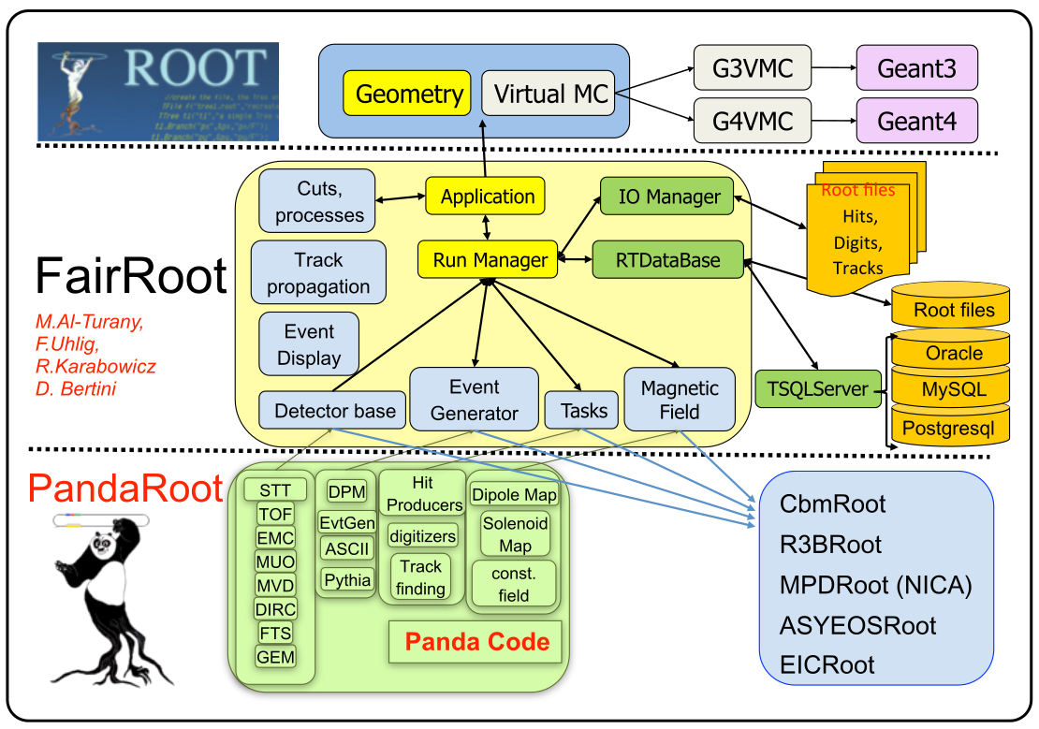
Structure of Code

Slide 11
PANDA Data Flow
* Dual parton Model
** Ultra Relativistic Quantum
Molecular Dynamics
Event Generator
EvtGen
DPM*
Pythia6/8
UrQMD **
FTF
Transport
GEANT3/GEANT4
Digitizer
MVD
STT
FTS
GEM
TOF
DIRC
MUON
EMC
Tracking
Charged Track
Charged Candidate
Neutral Candidate
Particle
Identification
PID Probability
Analysis
Analysis

Slide 12
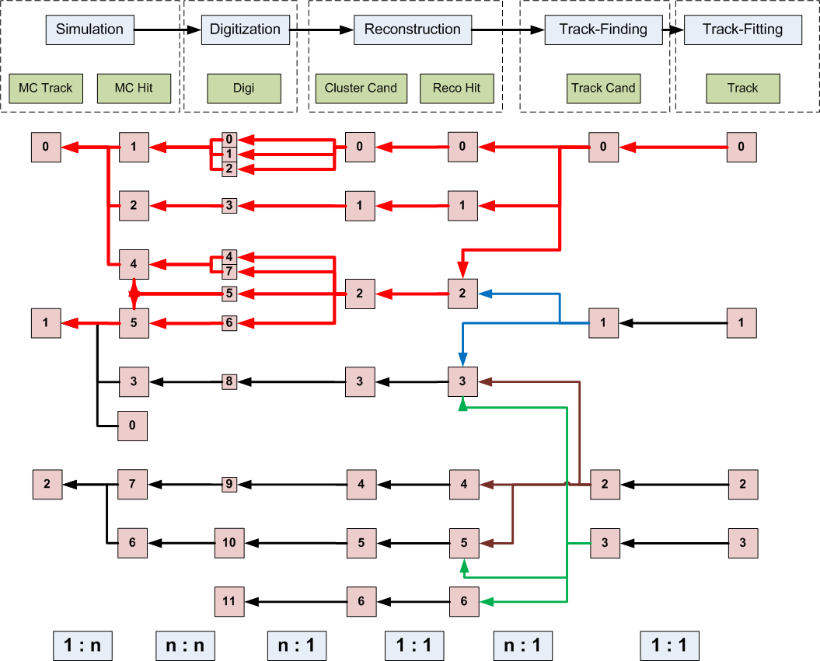
MC Truth Propagation

Slide 13
Event Structure / Time Based Simulation
ev 1
ev 2
ev 3
time
SciTil
EMC
MVD
STT
= detector hits from different events

Slide 14
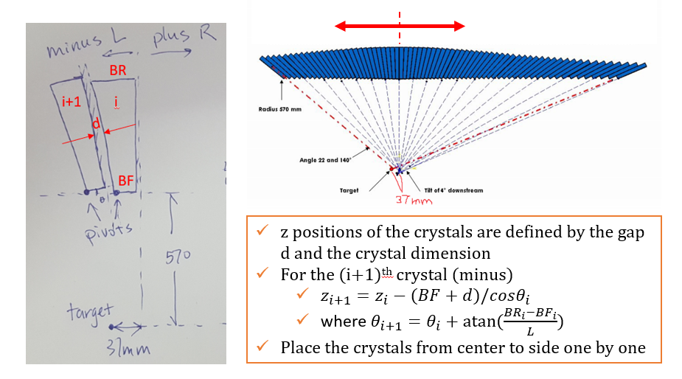
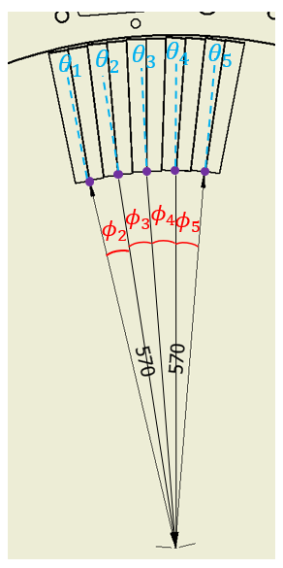
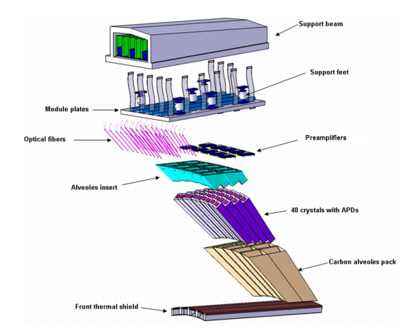
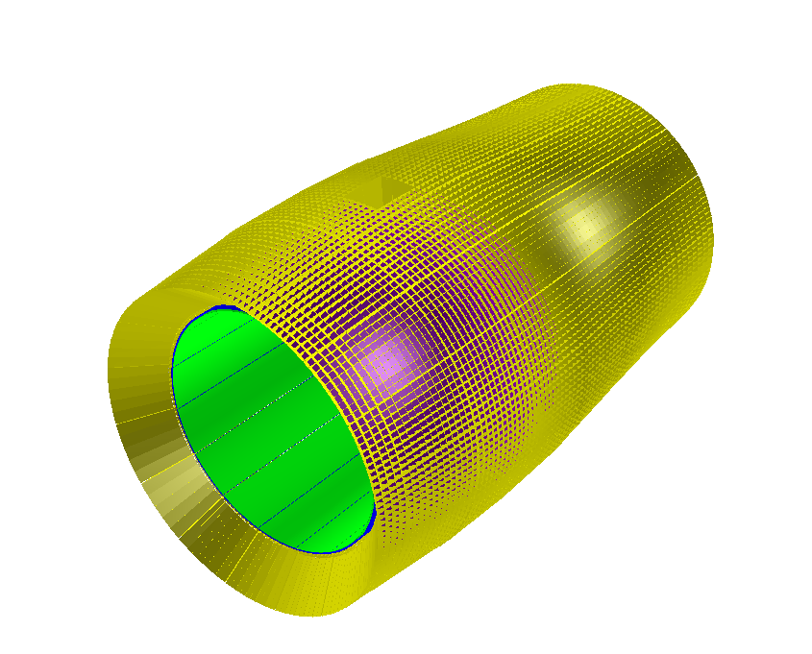


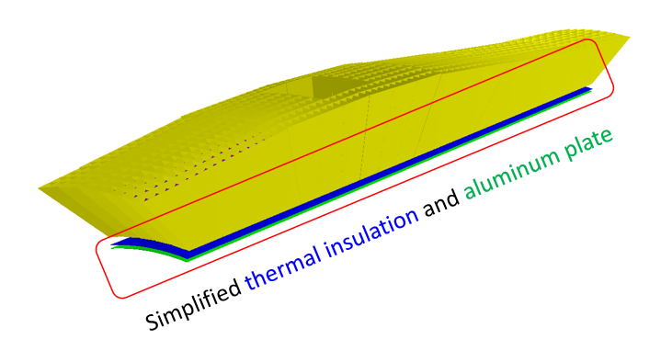
Barrel EMC Geometry Description
根据最新硬件设计，详细构建了桶部量能器的晶体和非灵敏物质。
完成所有几何相关的代码，发布在PandaROOT正式版本18dec

Slide 15
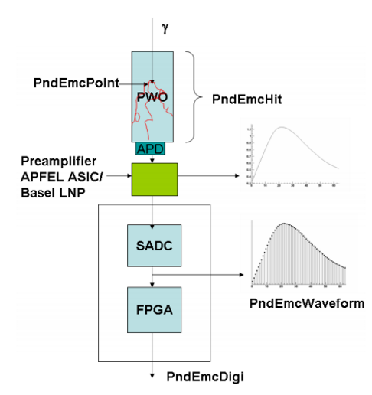
Digitization
Event
Generation
Detector
Simulation
Digitization
Reconstruction
Rootification
EVTGEN
HITS
DIGITS
SHOWERS
TTree/THist
Signal Generator (SG)
Analog waveforms creation
Noises generation
Digitization
Pile-up waveforms creation
PulseShape
Feature Extraction (FE)
Hit detection
Amplitude/time extraction
Pile-up recovery
Time-based simulation
数字化：提供包含探测器和电子学真实响应的击中信息

Slide 16
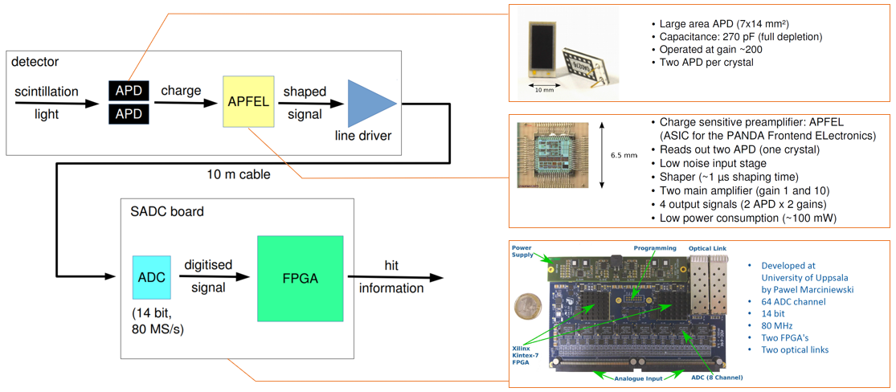
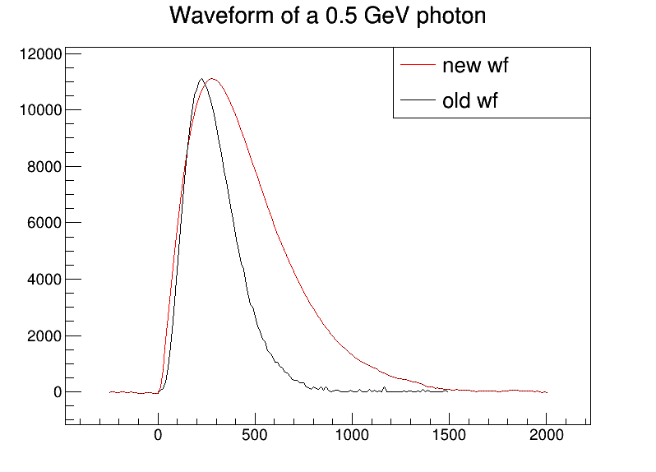
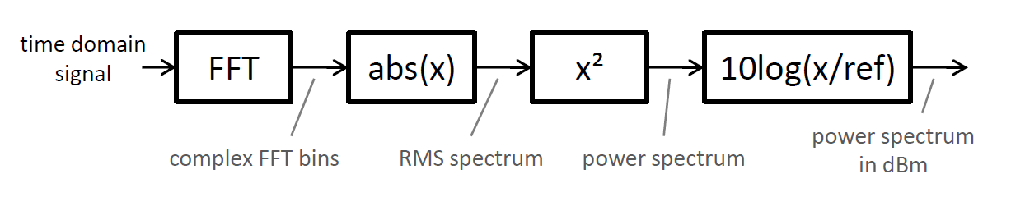
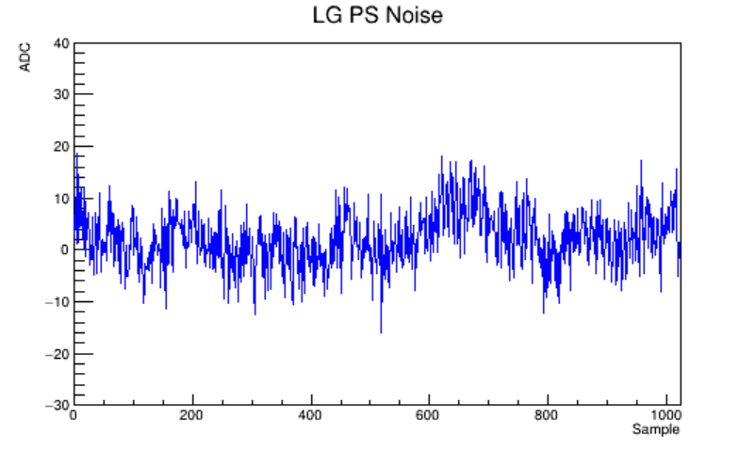
Backward EC / Barrel EMC Digitization
Duo APD readout
readout*4
Two-gain amplifier
与Mainz合作
64 ADC channel
FPGA*2
数字化：信号产生 + 特征提取
信号产生：
真实波型的产生
噪声的模拟
  基于FFT频谱分析
  重点优化了软件速度（复杂度O(n) -> O(1))
实现了4个读出的模拟
FFT
波形
噪声

Slide 17
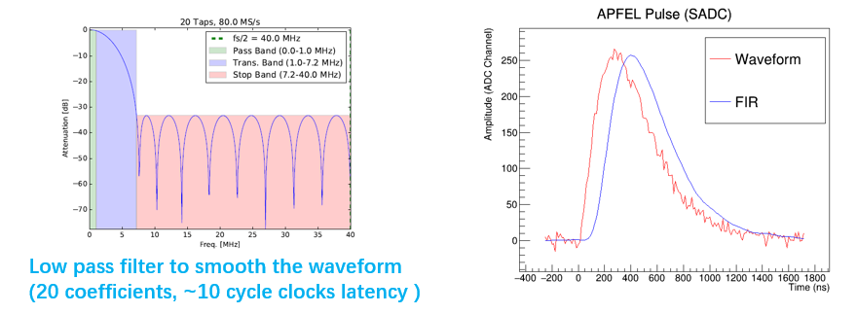
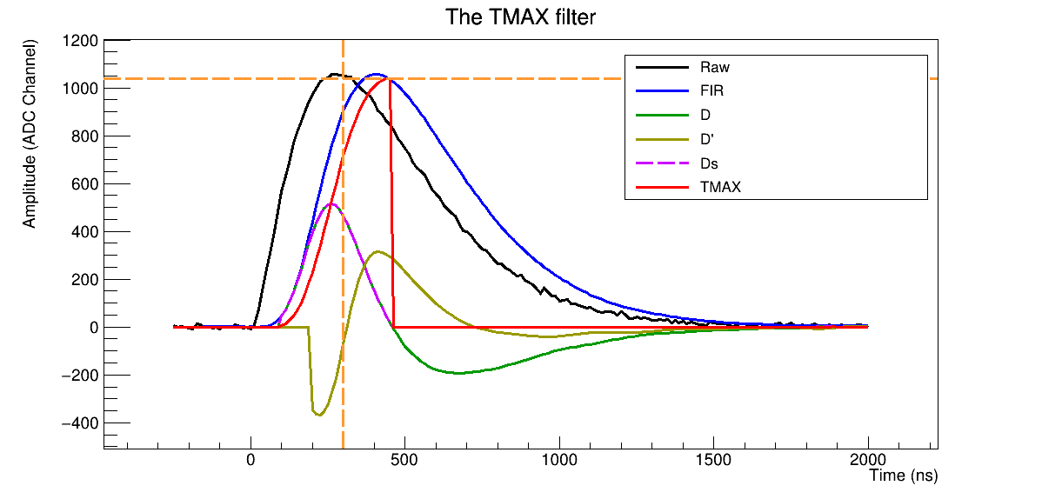
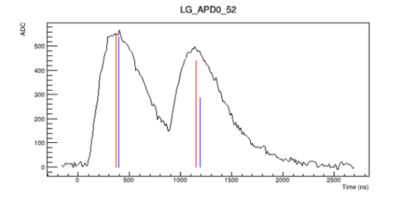
Backward EC / Barrel EMC Digitization
光滑
特征提取：
低通滤波器对波形进行光滑
通过FPGA算法
  提取波形的时间和幅度
  以及分离交叠信号
时间/幅度提取
分离交叠信号
小结：
该工作与Mainz的硬件专家Oliver Noll合作
后端盖/桶部EMC数字化开发已完成，通过测试，代码发布到了官方离线软件PandaRoot

Slide 18
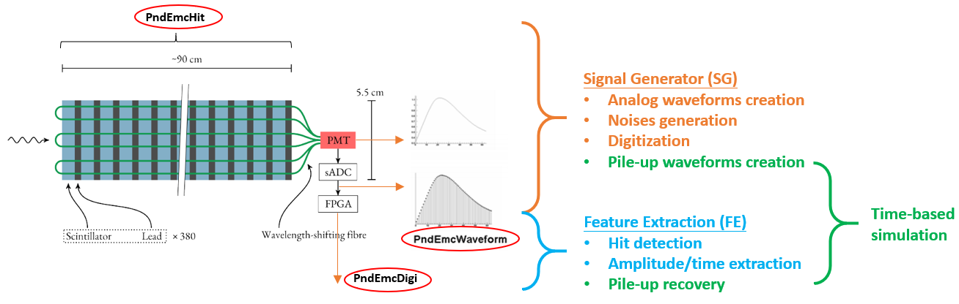
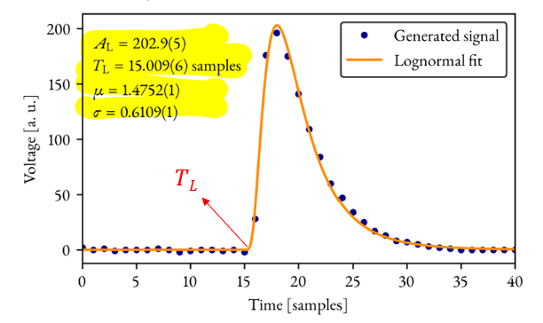
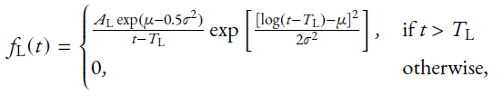
Digitization of Shashlyk Calorimeter
Signal Generator (信号产生)
Idea pulse shape:
Noise and digitizing:
Adding electronics noise: 1 ADC
Digitizing: 125 MHz

Slide 19
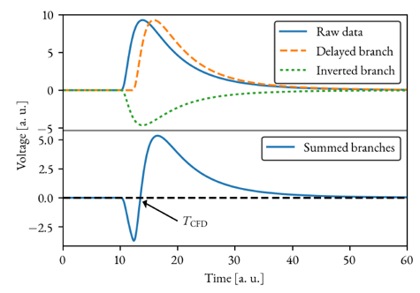
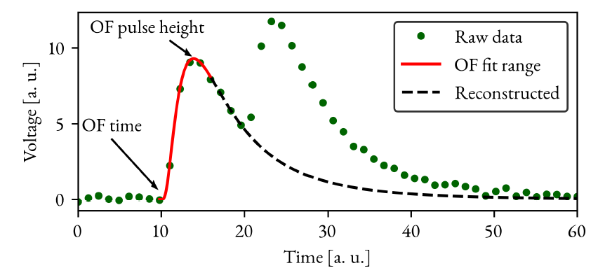
Digitization of Shashlyk Calorimeter
Feature Extraction (特征提取)
恒比定时: 确定起始时间
最优滤波: 精确提取时间和幅度，处理堆积信号
该工作与Stockholm University的硬件专家Markus Preston合作完成
所有基于束流实验的结果和固件的数字化算法，均已在Panda离线软件PandaRoot中实现

Slide 20
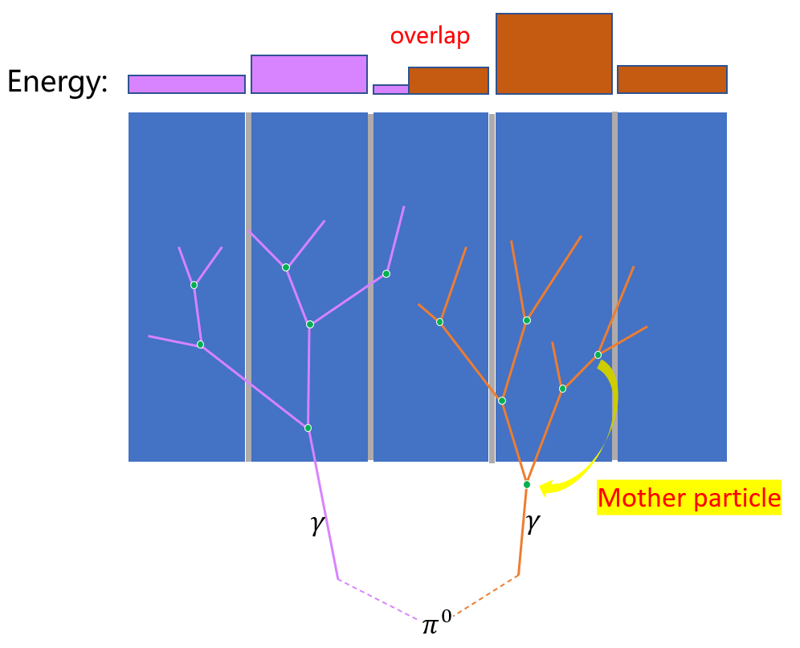
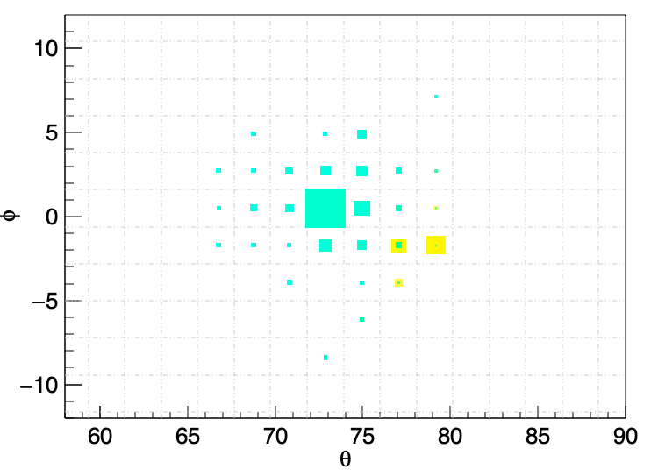
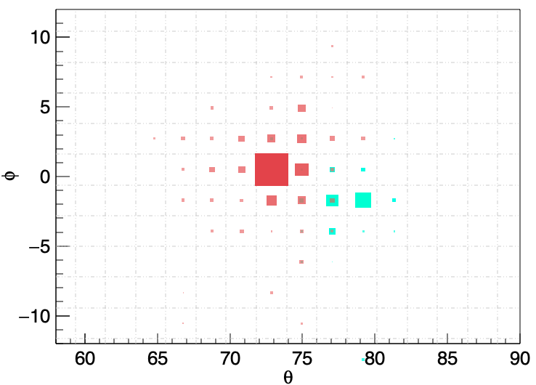
MC Truth Match
Reconstruction
MC truth (NEW)
实现了step级别能量和母粒子信息的存储
更方便用户进行“重建簇团-MC真实粒子”的匹配
能够区分“有多簇团能量沉积晶体”的能量来源➔簇团劈裂算法的研究
已经发布到PandaRoot

Slide 21
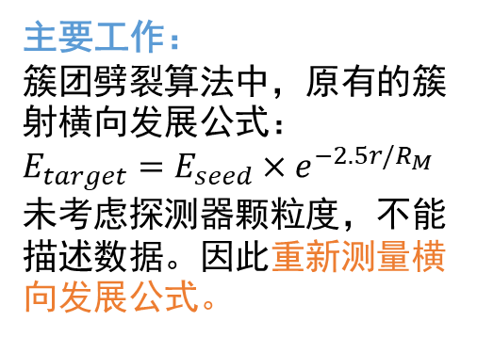
Study of Energy Splitting
簇团劈裂算法是量能器重建的核心算法之一
簇团劈裂的性能尤其影响高动量pi0的重建，从而影响物理事例的重建
新公式
主要工作：
簇团劈裂算法中，原有的簇射横向发展公式：
$E_{target}=E_{seed}×e^{−2.5r/R_{M}}$未考虑探测器颗粒度，不能描述数据。因此重新测量横向发展公式。
数据点
原公式

Slide 22
Study of Energy Splitting
小夹角两个光子事例的能量分辨
pi0的质量分辨
Development of energy splitting algorithm
Significant improvement of pi0 mass resolution for high momentum range

Slide 23

Calibration Algorithm
Based on $π^{0}$ mass

Slide 24
Calibration Algorithm
Input / Output check: output consistent with input gain fluctuations
Multi-threads implementation

Slide 25
Summary and Plan
Geometry / Digitization / Reconstruction / Calibration
Extend the energy splitting algorithm from barrel to whole EMC
Boundary effect is close to be solved of calibration algorithm for barrel part, and calibration algorithms for two Endcaps and Shashlyk
Update and optimize reconstruction algorithm
Time-based simulation
Thank you !

