Slide 1
The 2nd MTCA/ATCA Workshop for Research and Industry
Li Xiao (IHEP)
On behalf of Programme Committee Chair Li Jingyi (IHEP)

Slide 2
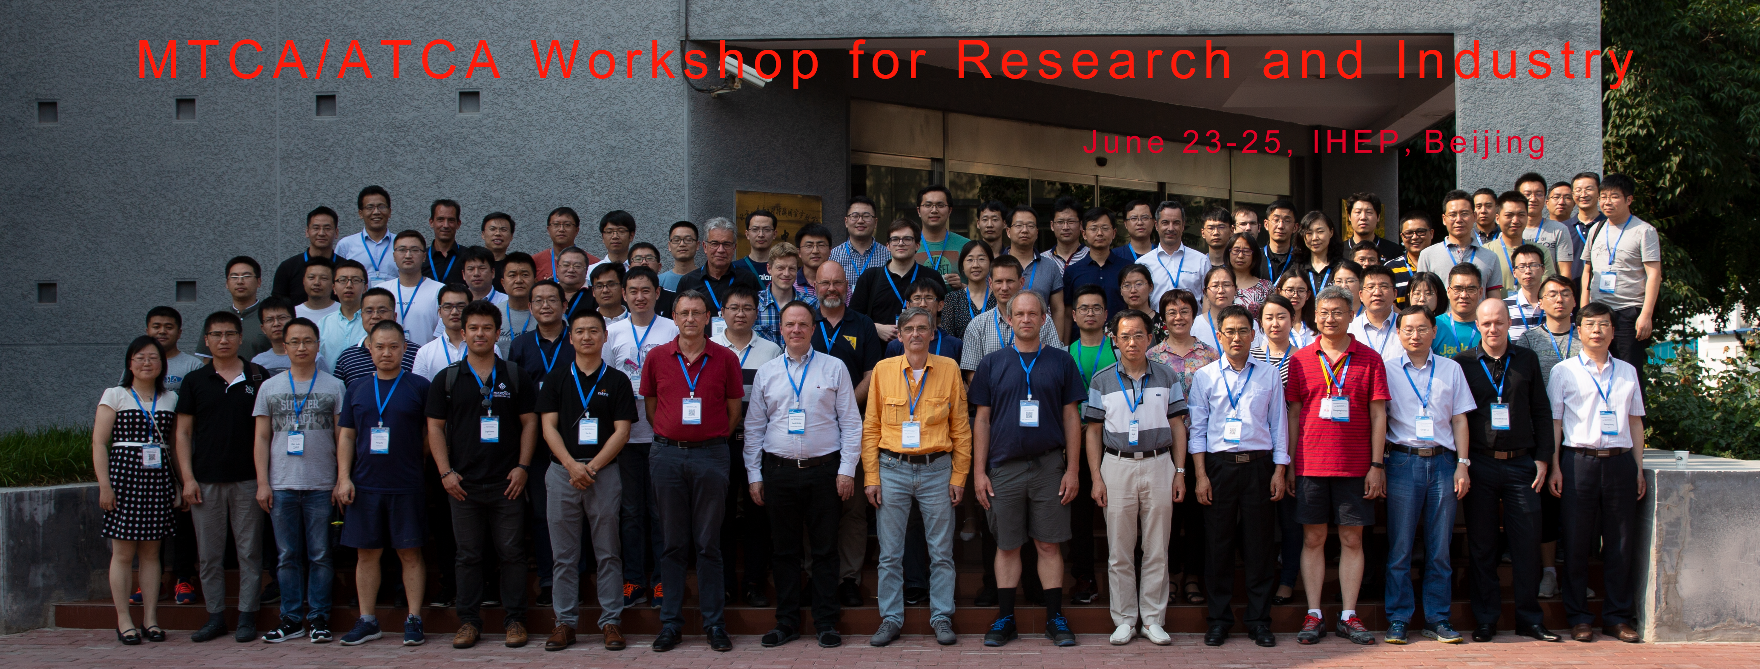
Background
The 1st MTCA/ATCA Workshop was held in 2019.
2 months ago, we planned to hold the 2nd MTCA/ATCA Workshop off-line. But in the end the workshop was switched to on-line, due to the epidemic control.

Slide 3
Background
In the past 2 years, MicroTCA/ATCA kept on going in China.
The workshop will provide a platform to discuss technology, idea, and cooperation, and promote development of MTCA/ATCA standard and system in Accelerator, High Energy Physics, Photon/Neutron Science, Plasma Fusion, High Power Laser, and Industry.
With everyone's help, we will try to keep, as much as possible, the interactive spirit of a physical conference.

Slide 4
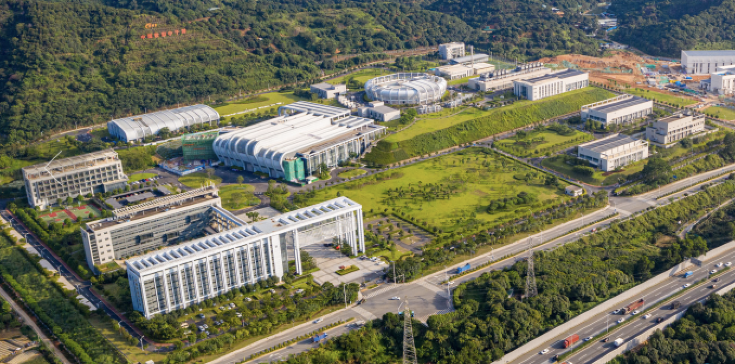
MicroTCA/ATCA in IHEP
HEPS (High Energy Photon Source)
is under construction.
CSNS (China Spallation Neutron Source)
is about to upgrade soon. (CSNS-II)

Slide 5
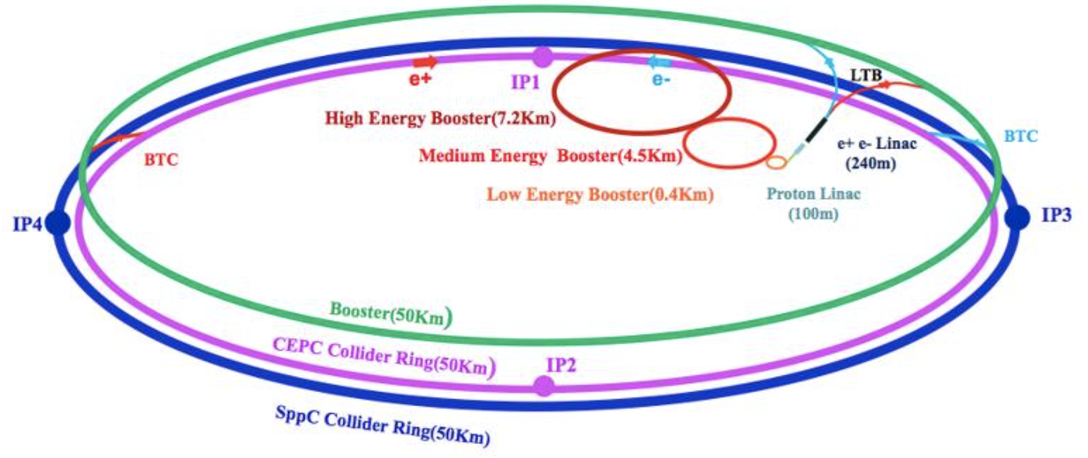
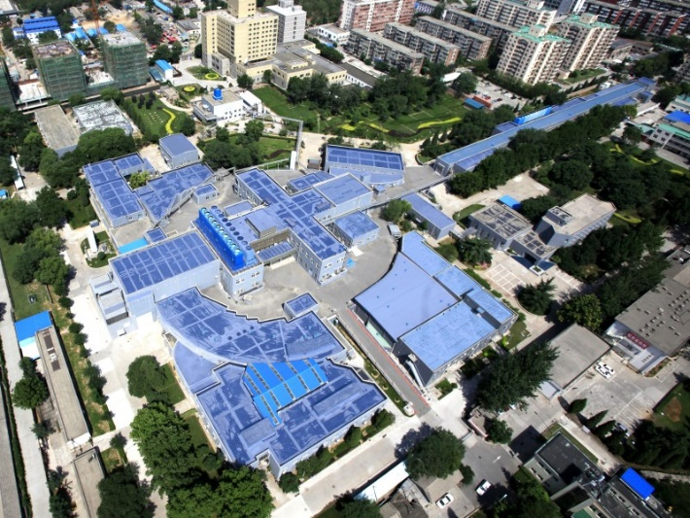
MicroTCA/ATCA in IHEP
Plan：
BEPCII-U (Beijing Electron Positron Collider II- Upgrade）
SAPS (Southern Advanced Photon Source)
Future:
CEPC (Circular Electron Positron Collider)
SPPC (Super Proton Proton Collider)

Slide 6
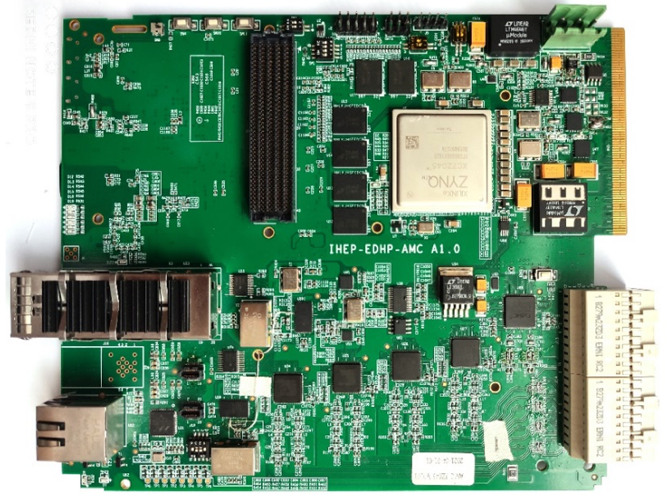
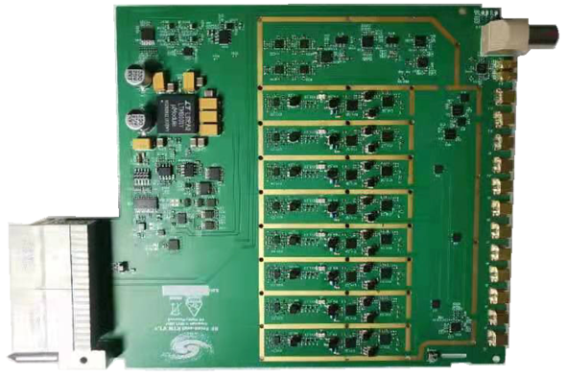
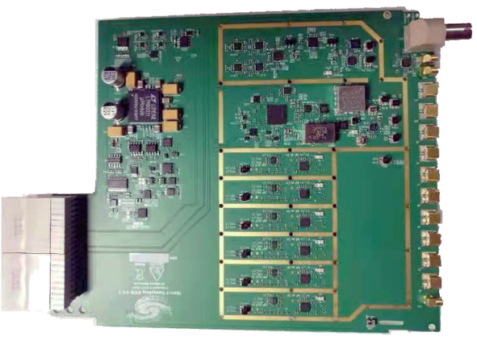
MicroTCA/ATCA in IHEP
AMC（IHEP-EDHP-AMC）
RTM（DWC8VM1 200MHz~4GHz）
RTM（DS6VM1 DC~650MHz）

Slide 7
Virtual meeting by ZOOM
Participants: please make sure microphone and camera OFF,
please make sure your name is “Name (Institute/company)”.
Speakers: please make sure camera ON and slide sharing,
and share the whole desktop (the first screen).
Questions: switch microphone and camera ON, raise hand OR type
questions in the chat room.
raise hand
microphone
chat
share desktop
camera

Slide 8
Workshop Timetable
https://indico.ihep.ac.cn/event/14765/other-view?view=standard
Talk duration: tutorial: 45min (40min talk + 5min Q&A),
invited talk: 30min (26min talk + 4min Q&A),
contribution talk: 20min (17min talk + 3min Q&A),
mini-contribution talk is 15min (12min talk + 3min Q&A)
The video will be recorded when the talk is going, and uploaded on the indico page during the workshop, please let us know if you don't want to.

Slide 9
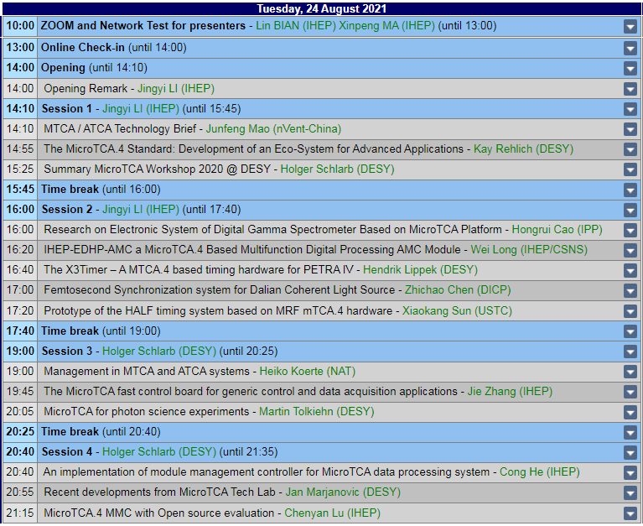
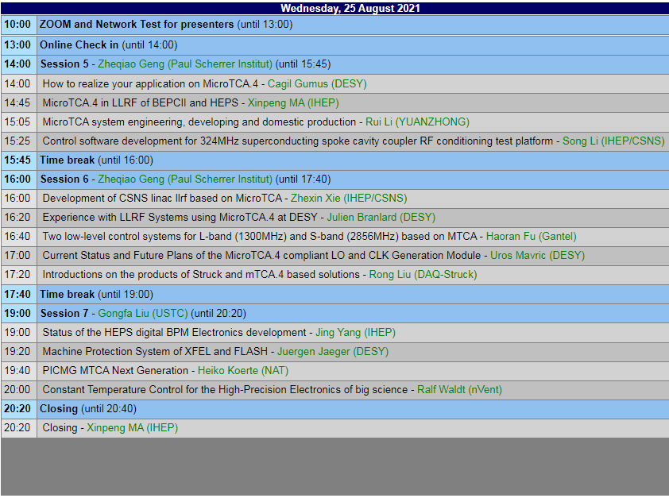
Time is UTC+8 China, take photo at first time break, so turn camera on.

Slide 10
Special thanks to
Programme Committee:
Jingyi Li (Chair) IHEP
Holger Schlarb DESY
Gongfa Liu USTC
Xiao Li IHEP/CSNS
Xinpeng Ma IHEP
Local Organizing Committee:
Xinpeng Ma IHEP
Lin Bian IHEP
Nan Gan IHEP
Chenyan Lu IHEP

Slide 11
Thank you for coming!

