Slide 1
IHEP-EDHP-AMC a MicroTCA.4 Based Digital Processing AMC Module
Long Wei
Project group of domestic MTCA.4 platform
MTCA Workshop, Beijing 2021.8
China Spallation Neutron Source

Slide 2
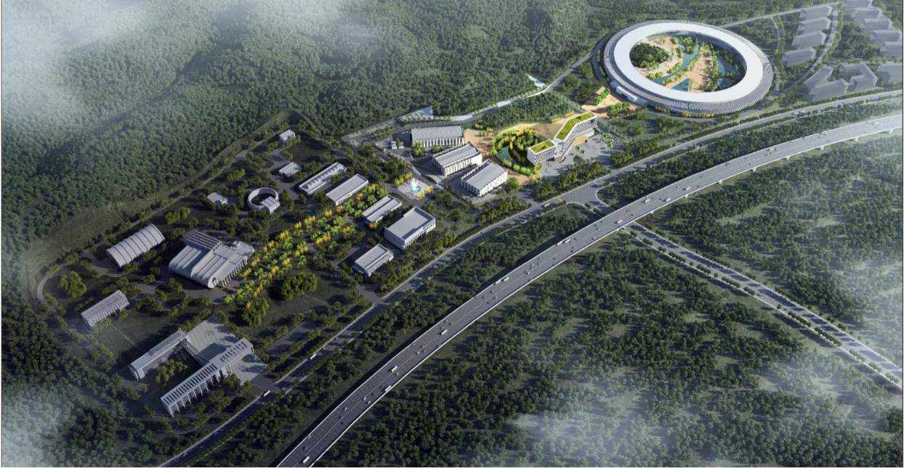
IHEP-EDHP-AMC Overview
Introduction to our facilities.
SAPS
Will be built
SAPS-TP
CSNS & CSNS II
Dongguan City, Guangdong Province, China

Slide 3
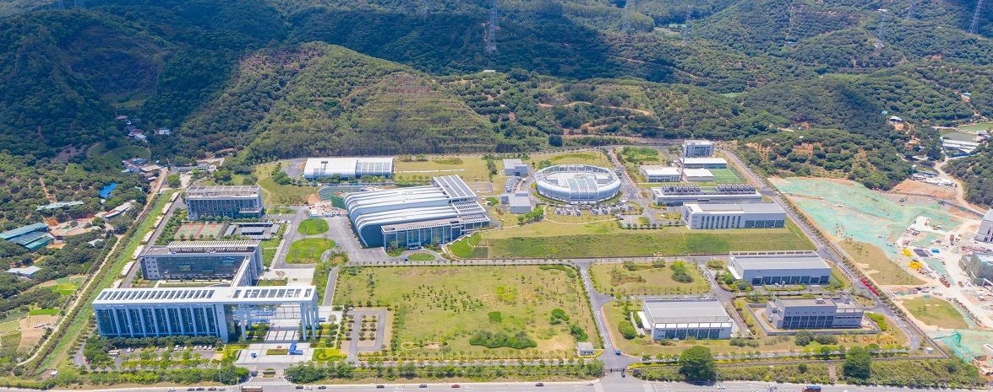
IHEP-EDHP-AMC Overview
CSNS (China Spallation Neutron Source) – China’s first pulsed neutron source.
80 MeV H- Linac
1.6 GeV RCS
Phase | CSNS I | CSNS II
Beam power on target | 100 kW | 500 kW
Linac energy | 80MeV | 300MeV
Extraction beam energy | 1.6GeV | 1.6GeV
Average Beam current | 62.5µA | 312.5µA
Repetition | 25Hz | 25Hz
Protons per pulse | 1.56E13 | 7.8E13
Target station
CSNS II upgrade

Slide 4
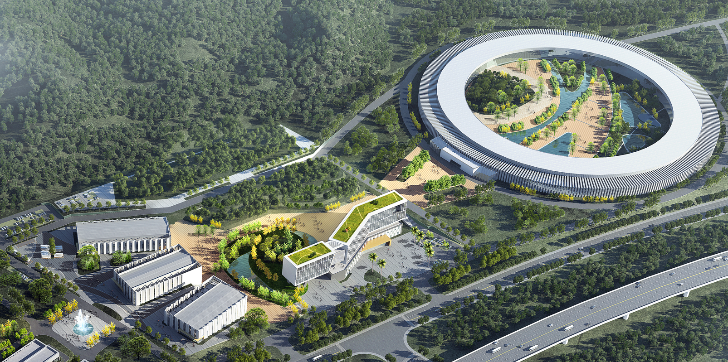
IHEP-EDHP-AMC Overview
SAPS Southern Advanced Photon Source
4th generation medium energy synchrotron radiation source
SAPS-TP Southern Advanced Photon Source Test platform
SAPS
Storage ring Beam energy | 3.5GeV
emittance | 31.7pm·rad
circumference | 1080m
RF frequency | 166.6MHz
SAPS
SAPS-TP
SAPS-TP
Superconducting RF Hall
optical experiment Hall
low temperature Hall
High-accuracy measurement Hall
Comprehensive laboratory

Slide 5
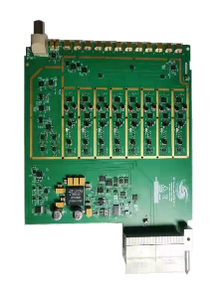
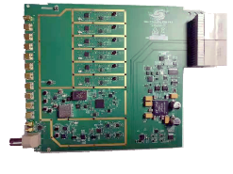
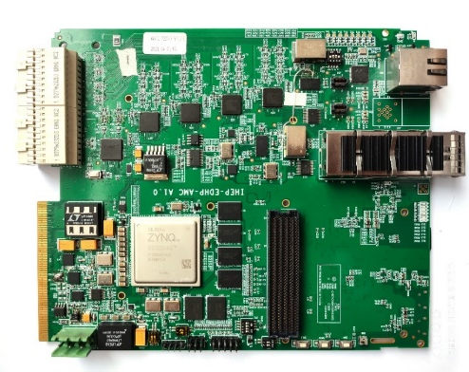
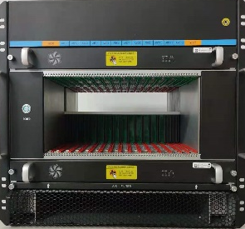
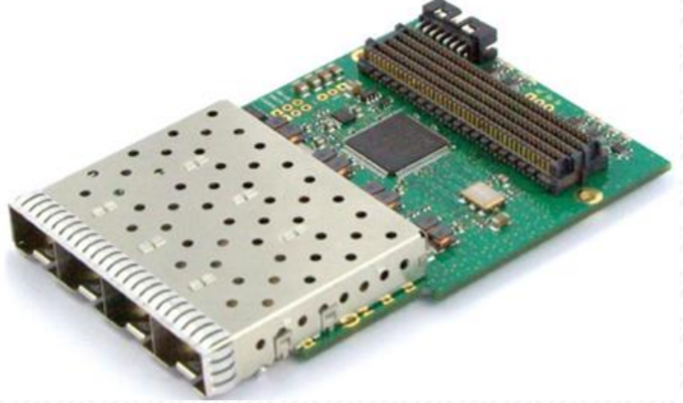
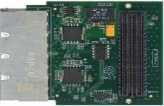
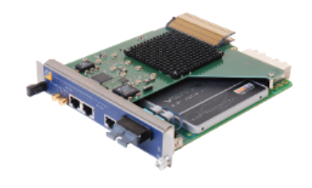
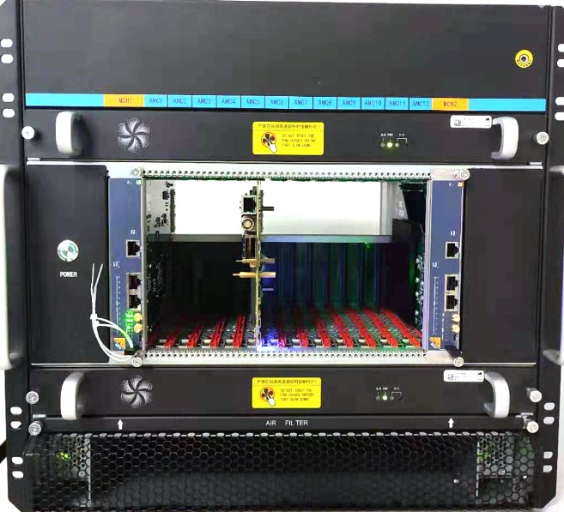
IHEP-EDHP-AMC Overview
A domestic multifunction digital processing AMC module is developed.
Different types of RTMs
CSNS II and SAPS
RF system & Control system & Beam diagnostics system
SAPS-TP
superconducting cavity Vertical Test / Horizontal Test
Other applications
Chassis
FMCs
MCH
implement
Multifunction digital processing AMC Module
Setup
Standard universal MTCA.4 Embedded digital hardware platform

Slide 6
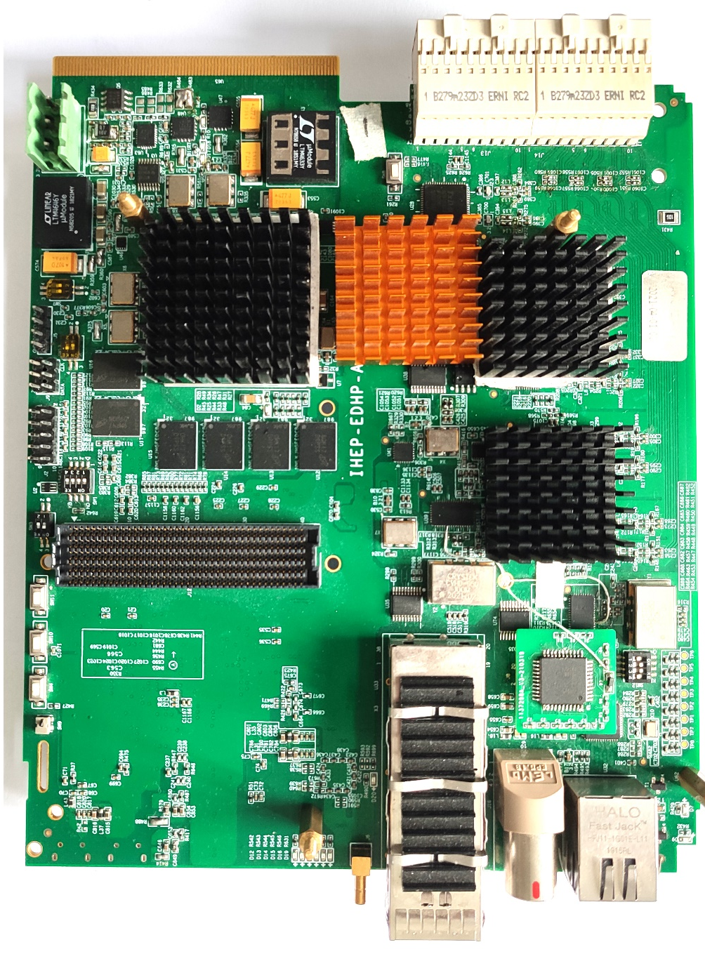
functionality
MTCA.4 standard & μRTM ZONE3 Class A1.1CO
Double-width mid-size
8 Channels 125 MSPS 16-bit ADC
2 Channels 500 MSPS 16-bit DAC
XC7Z045 Zynq-7000 SoC
2GBytes DDR3 memory size
1 FMC LPC Slot (VITA 57.1)
A 4 lanes QSFP cage
Front panel digital I/O (10 pins LVTTL)
A Gigabit Ethernet interface
Front panel Clock input
A front-panel USB provides console DisplayPort
FMC
ETH
USB
SD
CLK
DIO
QSFP

Slide 7
IHEP-EDHP-AMC Block Diagram & Overall Design
A goal: one AMC board can constitute a complete system and can implement complete project applications.
Ext Clock source
Ext Clock, SMA
Clock Distribution
Dual ADC
RTM Module
Down-Converter
Up-Converter
Direct Sampling
…
Dual ADC
USB
Zone3 Connector
Network communication
Remote monitoring
OPI
…
Dual ADC
E-Net RJ45
Dual ADC
Trigger Signals
Inter-Lock Signals
…
JTAG
ZYNQ SOC
Dual DAC
ARM Cortex-A9
Digital I/O
EPICS IOC
Timing & Interlock
Timestamp…
AXI GP&HP bus
QSFP
Kintex-7
FPGA
FMC Board
Motor Controller
Piezo Controller
optical fiber communication
…
FMC LPC
LLRF
Algorithm
AMC Connector
LED
Hot-swap SW
MMC Connector

Slide 8
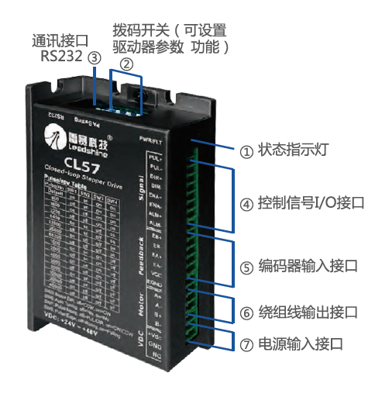
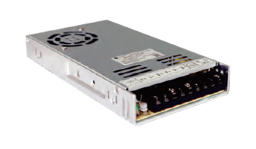
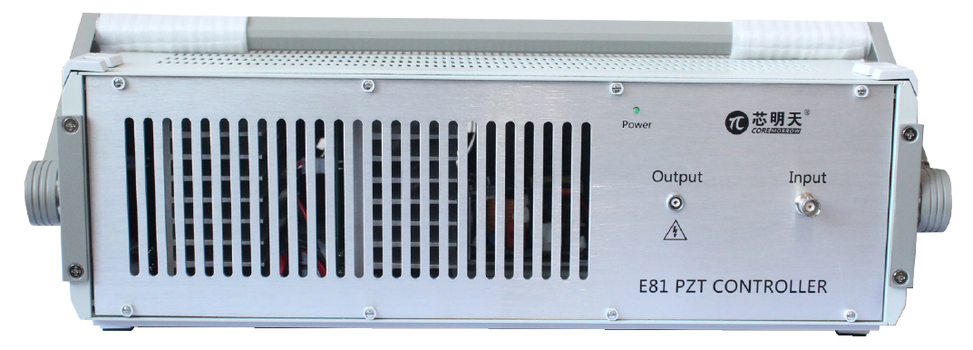
IHEP-EDHP-AMC Block Diagram & Overall Design
SAPS-TP 648MHz Elliptical Cavities Single Cavity Regulation based on MicroTCA.4
Cavity detuning control
LLRF system
5V pulse signal
MTCA.4 AMC
MTCA.4 RTM
Down & UP
Converter
Motor Driver
Level conv.
ZYNQ
FPGA
ARM
0~10V
LP
16bits DAC 2Ch
LP
Piezo Driver
FMC
Only one IHEP-EDHP-AMC module + 1 RTM + 1 FMC

Slide 9
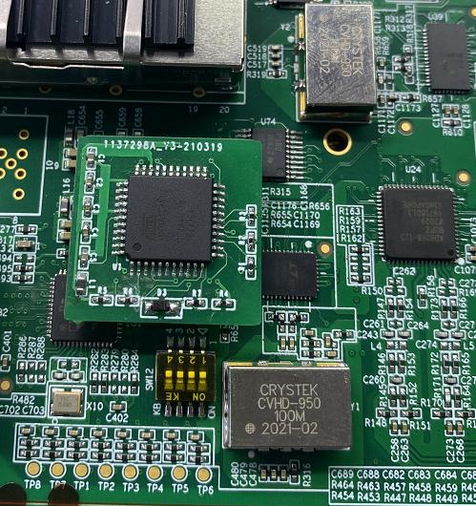
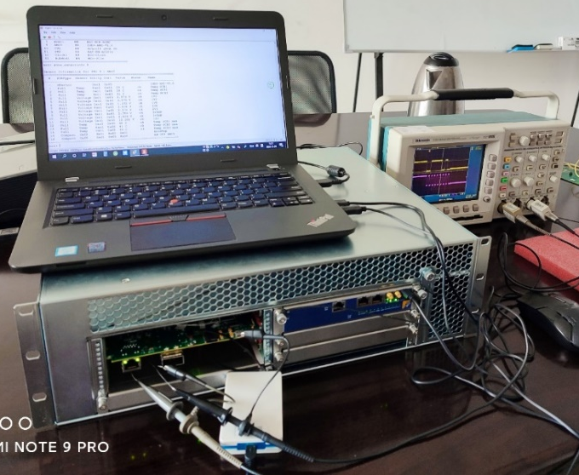
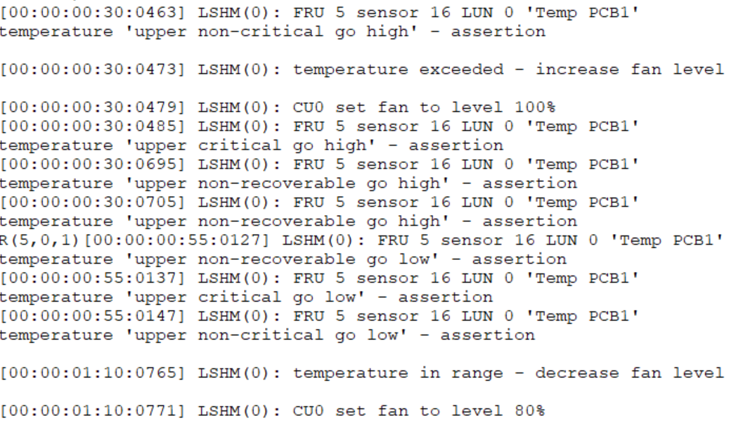
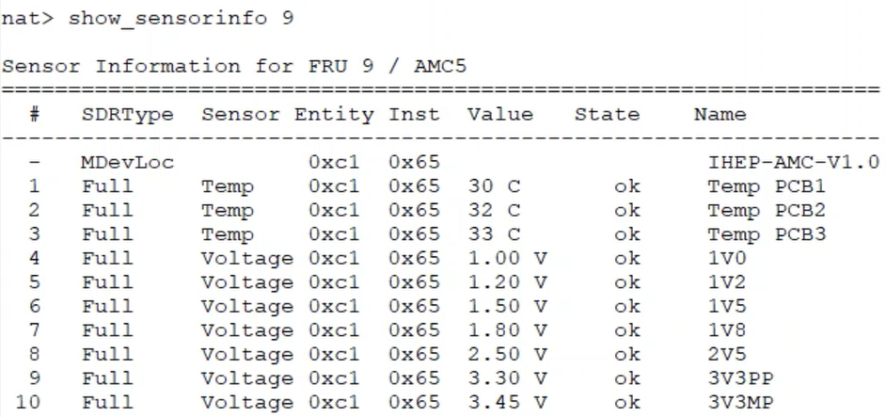
IHEP-EDHP-AMC MMC
MMC Controller
Based on N.A.T NAMC-MMC-RefDesign
Developed MMC controller mezzanine Card
3 phases of development:
HW SW based on N.A.T MMC RefDesign
Develop our own Software
Design our own MMC (HW SW)
Test environment:
Commercial nVent MTCA.4 chassis
N.A.T NAT-MCH-PHYS80 MCH card
Temperature threshold event Test
82℃
MMC Controller in AMC
MMC Controller Test
Fan speed increase
Sensor Reading Test
30℃
Module operational state management
Fan speed decrease
Hot swap management works well.

Slide 10
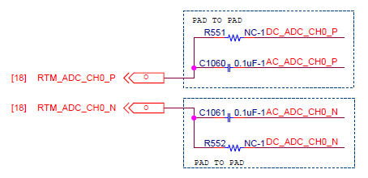
IHEP-EDHP-AMC AD/DA
AD: Analog Devices AD9268
125MSPS 16bit
Bandwidth: 650MHz
Output Interface: DDR LVDS
Compatible analog front-end circuit design
Intermediate frequency range: 5-100MHz
Direct Sampling: 5-400MHz (650MHz? Try)
DC coupled
DA: Analog Devices AD9783
500MSPS 16bit
Output Interface: DDR LVDS
DC/AC coupled is optional
2 channels DA 8 channels AD

Slide 11
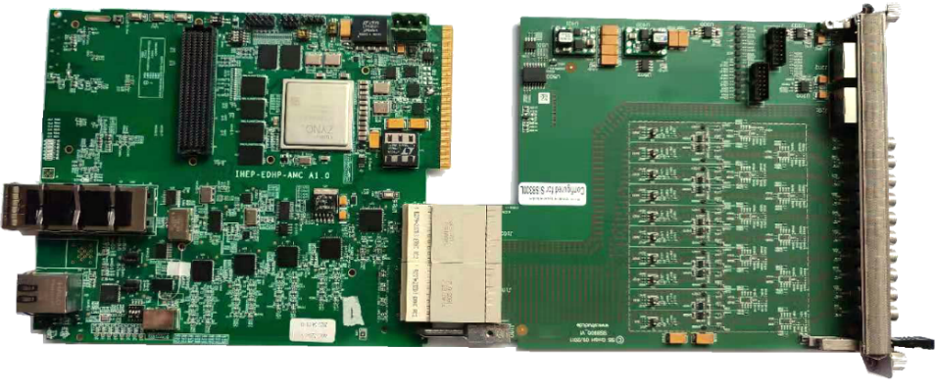
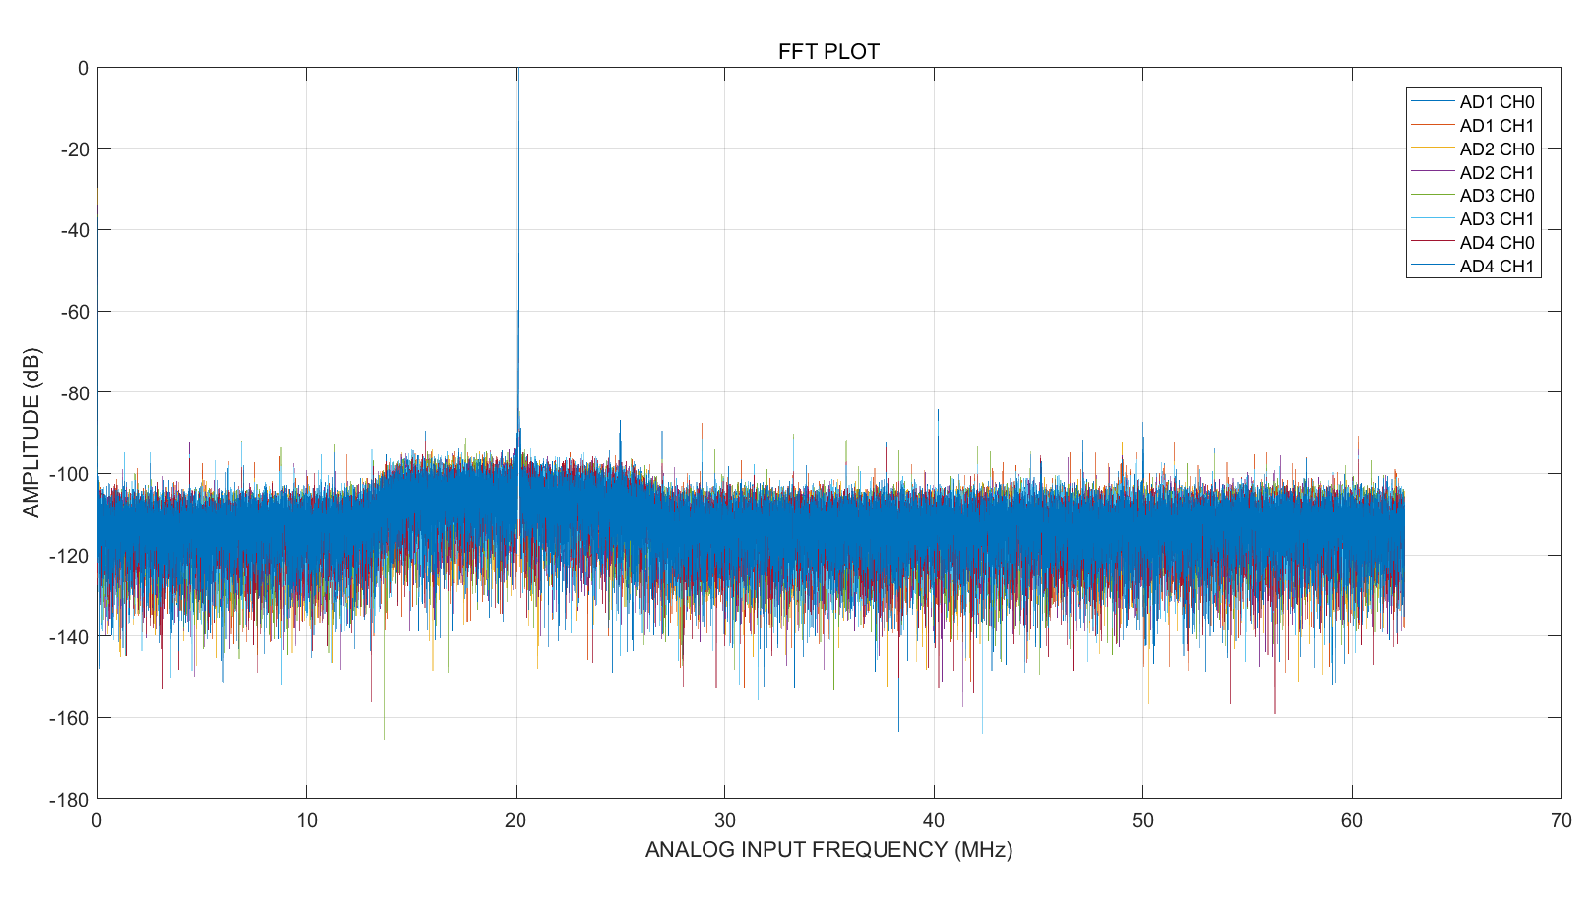
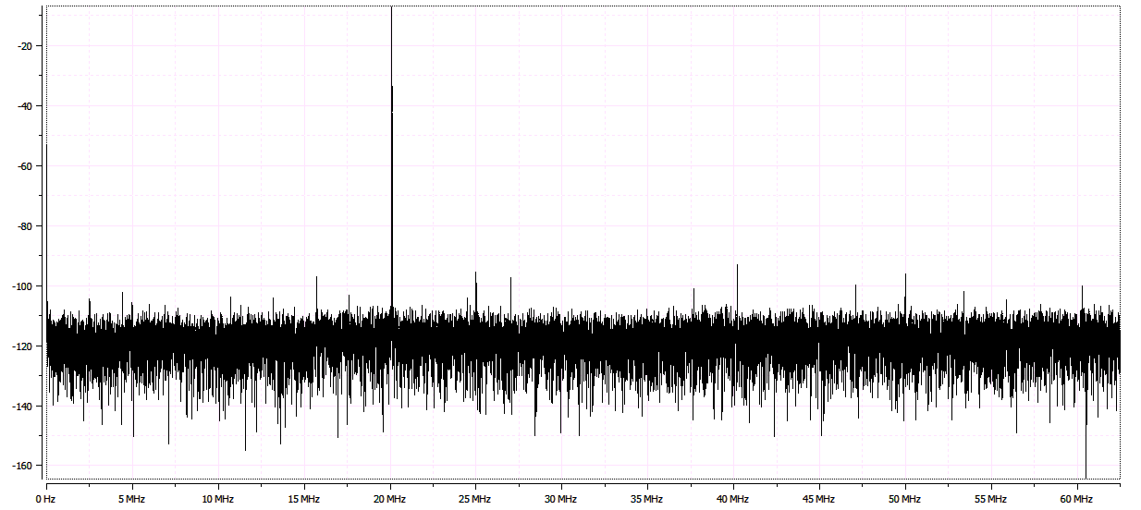
IHEP-EDHP-AMC AD/DA
AD Test
IHEP-EDHP-AMC + SIS8900 RTM
Signal Source: 20MHz 3dBm
125MSPS
8 Chs FFT
SNR: 75.9~76.2dBFS > 74dBFS
SFDR: 86.2~92.1dBFS > 75dBFS
FFT

Slide 12
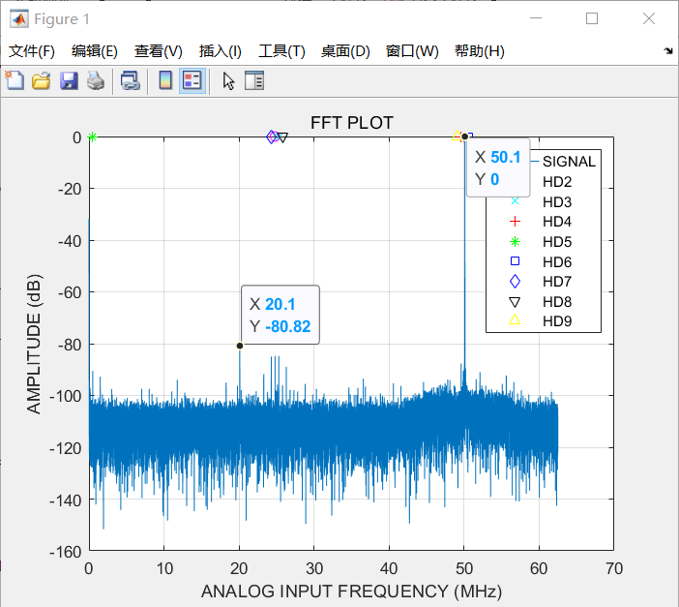
IHEP-EDHP-AMC AD/DA
Channel isolation
 | AD1_CH0 | AD1_CH1 | AD2_CH0 | AD2_CH1 | AD3_CH0 | AD3_CH1 | AD4_CH0 | AD4_CH1
AD1_CH0 |  | 74.95
AD1_CH1 | 84.32 |  | 80.89
AD2_CH0 |  | 75.22 |  | 77.1
AD2_CH1 |  |  | 82.16 |  | 80.82
AD3_CH0 |  |  |  | 87.3 |  | 79.46
AD3_CH1 |  |  |  |  | 78.89 |  | 85.59
AD4_CH0 |  |  |  |  |  | 94.8 |  | 85.13
AD4_CH1 |  |  |  |  |  |  | 78.1
Isolation of adjacent channels
DA Spectrum
+ Adaptor RTM
Isolation Test
DA output signal: 10MHz
SNR: 78.1 dB
some larger harmonic component

Slide 13
IHEP-EDHP-AMC Clock Distribution
ultra-low clock jitter
648MHz direct sampling LLRF 0.1° jitter (<423fs pp)
Jitter attenuator + Low phase noise clock generator
Theoretical clock jitter ≈ 240fs pp (170fs RMS)
Front panel
Clock input
IN0
IN1
IN3
Jitter
attenuator
IN3
backplane
TCLKA
ADC1
RTM CLK0
ADC2
Clock
generator
Quartz
Clock MUX
ADC3
Backplane
TCLKB
ADC4
RTM CLK1-4

Slide 14
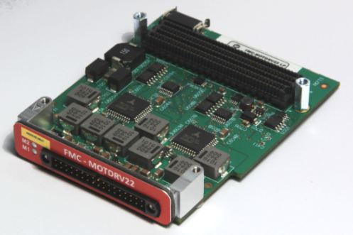
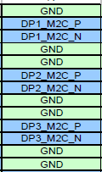
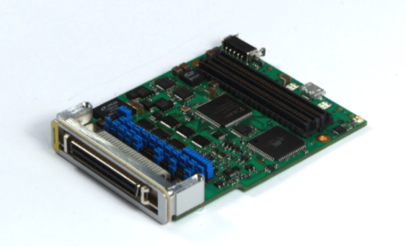
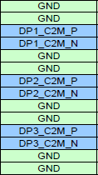
IHEP-EDHP-AMC FMC
Compatible with FMC LPC standard & 4 high-speed serial transceiver pairs.
DFMC-MD22
DFMC-AD16
DFMC-UNI-IO
DFMC-SFP4
Compatible commercial FMC cards
FMC LPC引脚

Slide 15
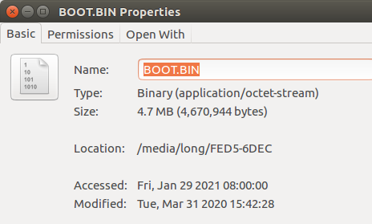
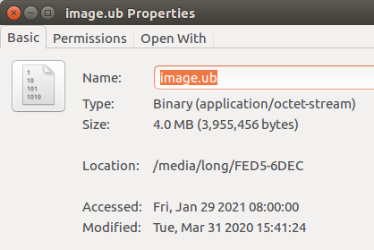
IHEP-EDHP-AMC Software
Embedded Linux Development for ZYNQ chip
Linux Boot Image
Linux Kernel Image
ZYNQ
Open source Linux kernel
ARM
Embedded Linux
23MB
Tool: Xilinx petalinux
EPICS IOC
45MB
DMA Proxy Driver
FPGA
AXI DMA
EPICS IOC Demon
PV: AI AO Waveform

Slide 16
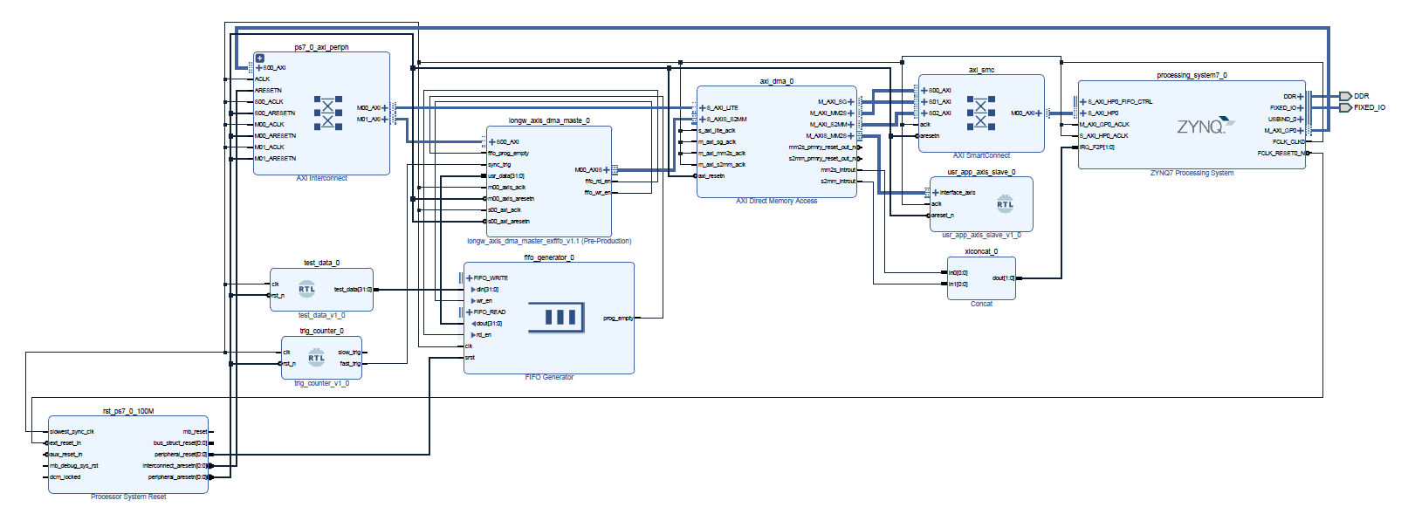
IHEP-EDHP-AMC Software
Embedded Linux Development for ZYNQ chip
AXI Master
User data
AXI DMA IP
FIFO

Slide 17
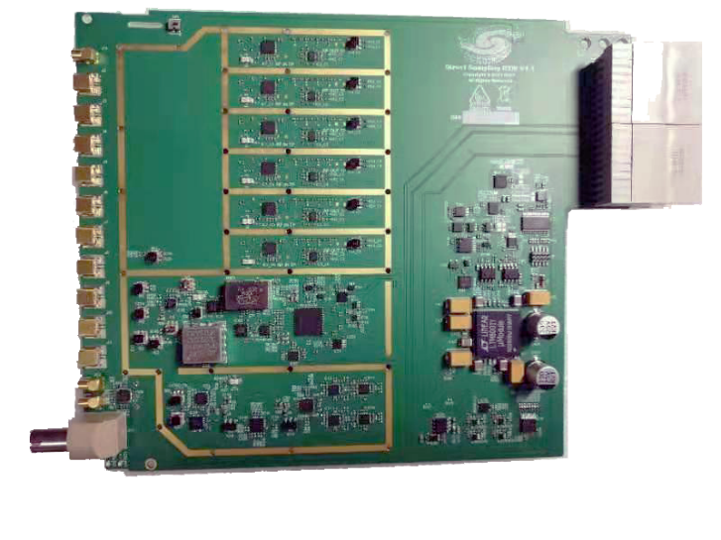
Others
The domestic Down and up converter RTM and Direct sampling RTM is developed by the colleagues in the project group.
Based on the requirement of SAPS and CSNS II.
Provided by: Xinpeng Ma and nan Gan
The details will be shown in a later report by Dr. Ma
“MicroTCA.4 in LLRF of BEPCII and HEPS”

Slide 18
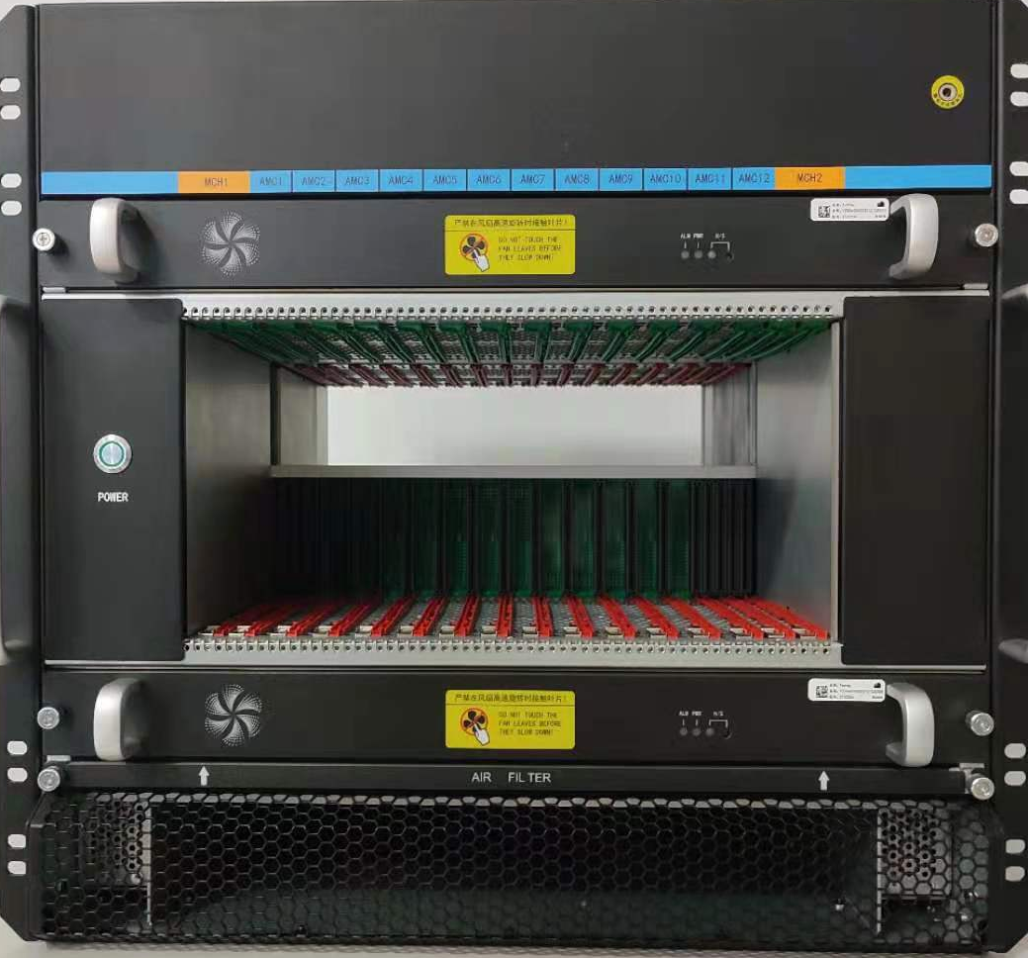
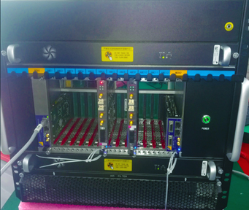
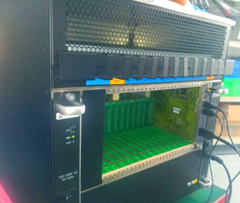
Others
The domestic MTCA.4 chassis is developed
Cooperation manufacturer - Yzitech company.
Demostic MTCA.4 chassis
Demostic MTCA.4 chassis test
Provided by: Yzitech
The details will be shown in a later report by Yzitech company
“MicroTCA system engineering, developing and domestic production”

Slide 19
Thanks for your attention!

