Slide 1
Prototype of the HALF timing system based on MRF mTCA.4 hardware
Xiaokang Sun
USTC
2021.08.24

Slide 2
01
HALF Timing system
CONTENTS
Prototype of the HALF
timing system
02
System test and
development plan
03

Slide 3
HALF
Hefei Advanced Light Facility (HALF)
proposed by the National Synchrotron Radiation Laboratory
Diffraction limit storage ring, 2.2Gev, VUV and soft X-ray synchrotron radiation
Now: Some key technology research

Slide 4
HALF-Global Design
Parameters | HALF
Eng/Gev | 2.2
Perimeter/m | 480
Periods | 20
SS | 40
Natural emittance/pm· rad | <100
Current/mA | 350
Average brightness/10² 1 | >1
HALF-layout
HALF Design Parameters
Consists of a linac, a beam transport line and a storage ring

Slide 5
HALF Timing System
E-Gun
Linac
Injection system
HALF Timing System
RF
Beamline Station
Beam Instrumentation
MPS
FOFB

Slide 6
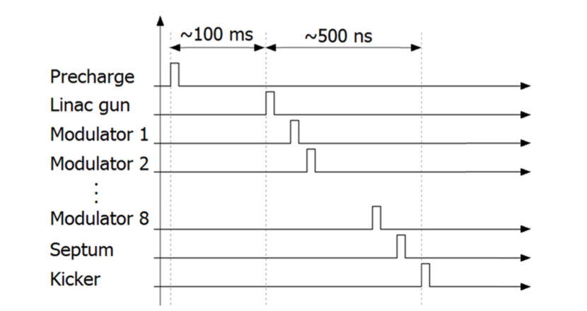
HALF Timing System Requirement
High performance synchronizing triggers and clocks for accelerator systems
Generate accurate timing sequences to trig eGun, LINAC RF, Injection, etc.
Synchronizing clock signals to beam instrumentations, etc.
Accepts external events as interrupts or trigger sources
signal from MPS、Post-mortem system
Global timestamps function
High time precision and high degree of stability
Some critical equipments should be reach 10 ps
High performance RF reference system

Slide 7
Technical Route
Event-driven system, EVG/EVR architecture
Multimode fiber, Fiber optic network, multi-level star structure
EVG transmit event codes, synchronizing clocks and timestamps to EVRs by the multimode fiber
Accepts external events as interrupts or trigger sources
EVG has seqRAMs to generate injection sequence event codes
EVRs use event codes to generate
Hard triggers, for injections control, DAQ, post mortem,etc.
Synchronizing clocks includes machine clocks, instrumentation clocks
DBUS funtion

Slide 8
01
HALF Timing system
CONTENTS
Prototype of the HALF
timing system
02
System test and
development plan
03

Slide 9
Prototype of the HALF timing system
MRF mTCA Hardware
The establishment of the prototype system
The problem during the hardware installation

Slide 10
MRF mTCA.4 hardware
Why choose MRF mTCA hardware？
mTCA：High performance、open standard、more and more applications in Accelerator、High energy physical control 、Industry field…
MRF mTCA hardware can be integrated with low-level RF systems, Beam Instrument system device under the mTCA hardware platform, it is better to transmit synchronization and interlock signals.

Slide 11
MRF mTCA.4 hardware
mTCA.4 Industrial PC
11850-026QD shelf
NAT PM-AC600D
NAT MCH-PHYS
AMG64/471-41 CPU
Event Master mTCA-EVM-300
Event Receiver mTCA-EVR-300U
Rear Transition Module for EVM and EVR
Universal I/O modules
Event Receiver mTCA-EVR-300RF
plan to purchase

Slide 12
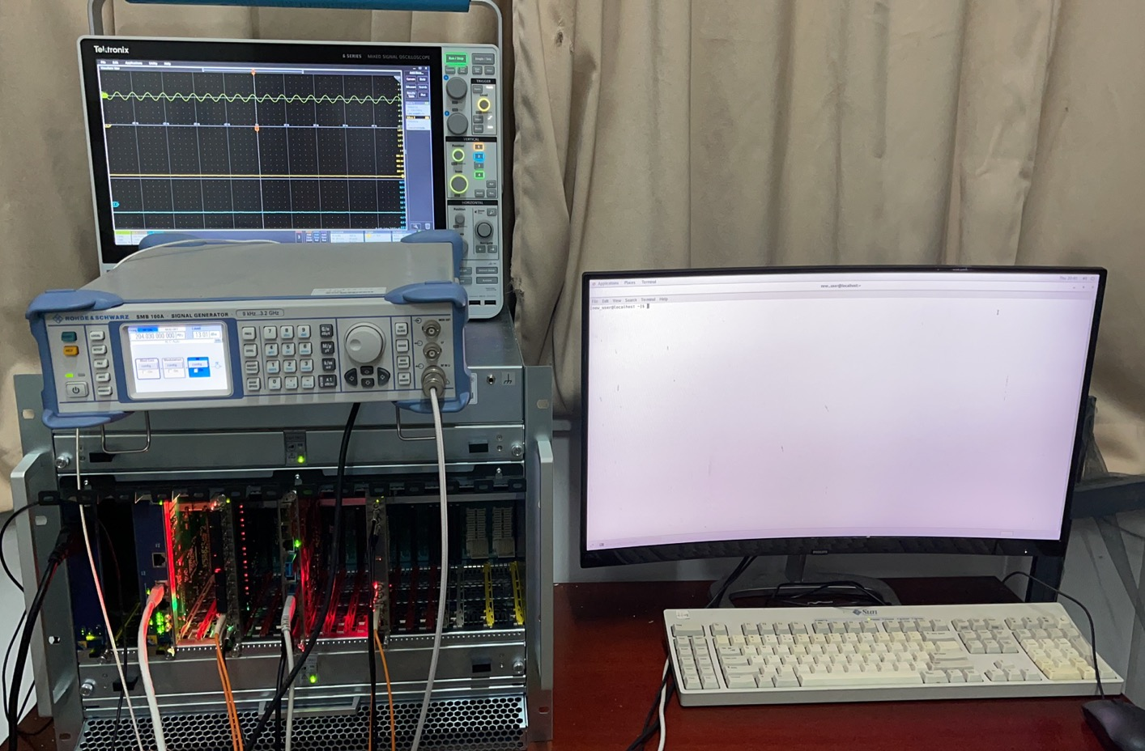
The establishment the prototype system
Hardware test platform: based on one EVG and one EVR
Oscilloscope
Signal generator
MCH
EVM
CPU
fiber optic
EVR

Slide 13
The establishment the prototype system
MCH Configuration
Link Status
Host AMC6

Slide 14
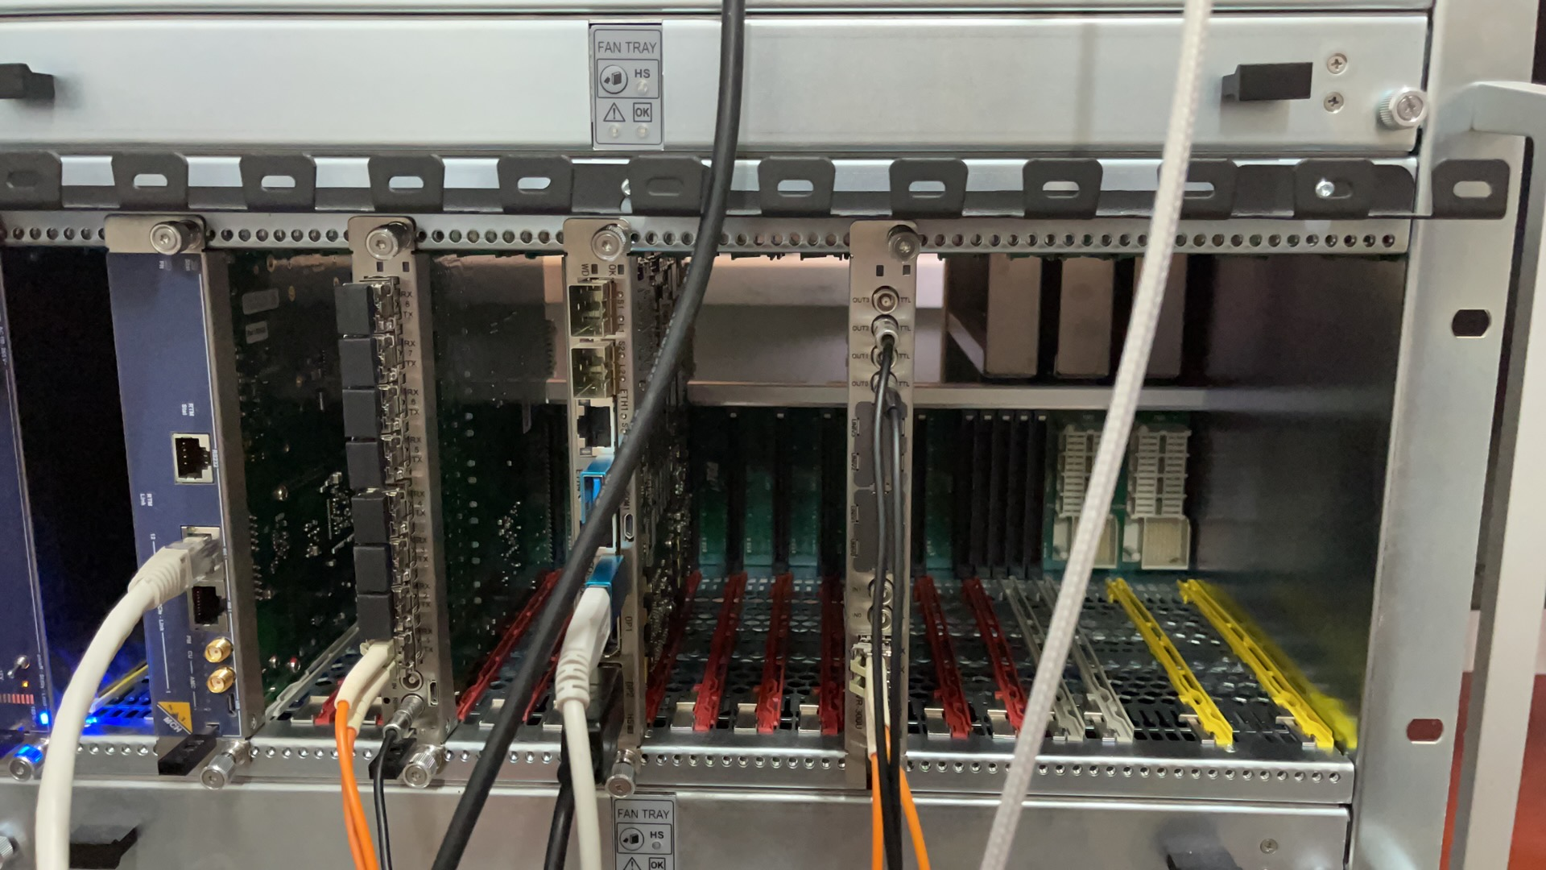
The problem during the hardware installation
MCH1 slot
MCH2 slot
The MCH was installed in the MCH2 right slot during the first installation
MRF Hardware not found

Slide 15
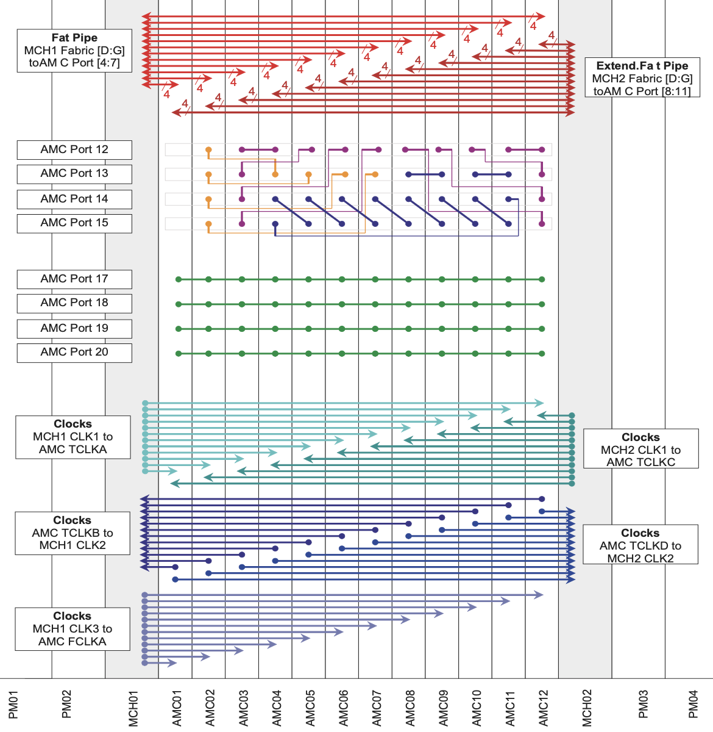
The problem during the hardware installation
AMC port[8:11]port link with MCH2
AMC port[4:7]port link with MCH1
MRF hardware only use port[4:7]
Only MCH1 slot can be used, MRF hardware cannot be recognized
mTCA Shelf Backplane Topology

Slide 16
01
HALF Timing system
CONTENTS
Prototype of the HALF
timing system
02
System performance test
and development plan
03

Slide 17
System performance test and development plan
System Performance Test Plan
DBUS function test
Event function test
Global timestamps function
Delay Compensation test
System software development Plan
EPICS Drivers

Slide 18
DBUS function test
The important synchronizing clock signal can be passed via the DBUS function, such as RF frequency、Injection repetition frequency、Storage Ring revolution frequency.
Test plan:
Use RF signal as input frequency for the EVM
The accuracy of the DBUS signals
The RMS jitter between DBUS signals and RF signal

Slide 19
Event function test
Events with different functions are sent through the timing system
Injection event
Beam instrument event
MPS event、Post-mortem event
For EVR, the width, delay and other specifications of the output pulses can be independently adjusted.
EVG has seqRAMs to generate sequence event code, EVRs use event codes to generate trigger signals
Test plan:
RMS jitter between event signal and RF signal
The control function for the width and delay of the output pulse on the EVR.

Slide 20
Timestamp function test
Global Timestamps for post-mortem system
The Event System provides a global timebase to attach timestamps to collected data and performed actions.
The time stamping system consists of a 32-bit timestamp event counter and a 32-bit second counter.
Test plan:
Global Timestamps function for event（1us resolution）

Slide 21
Delay Compensation function test
Active Delay Compensation
Ensure the stability and accuracy long-distance long-term signal transmission
Delay compensation is achieved in measuring the propagation delay of events from the delay compensation master EVM through the distribution network up to the Event Receivers.
New function to be test

Slide 22
Software Development Plan
The control system of the HALF is proposed to be a distributed system based on EPICS
Device supports and drivers will be developed for EPICS records to access the registers on the MRF hardware timing modules.
Development plan：
General Record, based on the scheme proposed by Eric Bjo ̈rklund
Git：http://epics.sourceforge.net/mrfioc2/

Slide 23
EPICS drivers
Experience in developing EPICS drivers based on MRF CPCI Hardware
Use general record：ai、ao、bi、bo、mbbi…
Convenient for collaborative development
INP/OUT filed maps the address of the register，expressed as #Cx Sy @parm
X：Card number
Y：Different channel numbers
Parm：function, such as delay, width and polarity of the output pulse
Classification of records：Card Init，Event，Pulse，Output
Device-oriented：alias record

Slide 24
Summary
Requirement has been discussed. We will track the progress of relevant groups.
The Hardware technical route is clear.
The hardware platform of simple prototype system is established, the System scale will be further improved.
The system performance test and the development of EPICS drivers are in progress.

Slide 25
THANKS

