Slide 1
CEPC new damping ring design status
Dou Wang, Cai Meng, Jingru Zhang, Xiaohao Cui, Yudong Liu, Jinhui Chen, Daheng Ji, Jie Gao, Chenghui Yu, Yuhui Li

Slide 2
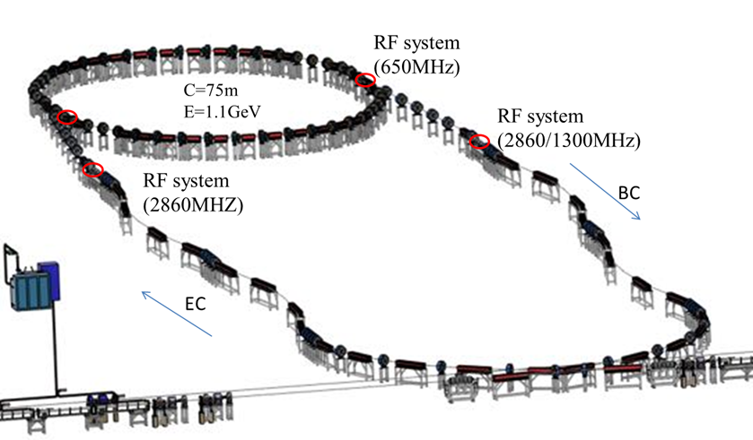
Damping ring layout (CDR)
Linac repetition: 100Hz
Only for positron beam
Storage time: 20 ms
Emittance (norm.): 2500→ 530 mm.mrad
e +

Slide 3
Requirements update for the Damping ring
Cai Meng
Emittance
  High luminosity of Higgs (lower emittance collider → lower emittance booster)
    Lower emittance Linac:10nm@20GeV → Norm. RMS emittance is 392mm⋅mrad
    DR emittance requirement: < 200mm⋅mrad
      Keep the margin for emittance growth
        -- high bunch charge
        -- C-band accelerating structure
      Could use C-band accelerating structure just after the Damping Ring (@1.1GeV)
Damping time
100Hz Linac & two-train scheme→ storage time: 20ms
Requirement for damping time: <13ms
Bunch length
  RMS bunch length after DR <1mm
    -- a bunch length compressor was introduced after the DR for electron and positron beam

Slide 4
Comparison of damping ring design requirement
 | CDR | New | remark
Energy (GeV) | 1.1 | 1.1
Inj. Emittance (mm⋅mrad) | 2500 | 2500
Ext. emittance (mm⋅mrad) | 530 | <200 | 1) Linac lower emittance: 10nm@20GeV, 2)use C band acc. structure as early as possible
Storage time (ms) | 20 | 20
Damping time (ms) | 15 | <13 | 1) Smaller ext. emittance with same storage time
Circumference (expected) (m) | 75 | ~150 | 1) Smaller nature emittance for DR

Slide 5
Design scheme for CEPC new damping ring
Option 1: damping with reversed bending magnet
Option 2: damping with wigglers

Slide 6
Option 1: parameters
Four-bunch storage scheme
Storage time: 20 ms
Emittance: 2500→ 166 (123) mm.mrad
Flexibility for extr. emittance
 | DR V3.0
Energy (Gev) | 1.1
Circumference (m) | 147
Number of trains | 2
Number of bunches/trian | 2
Total current (mA) | 12.4
Bending radius (m) | 2.87
Dipole strength B₀ (T) | 1.28
U₀ (kev/turn) | 94.6
Damping time x/y/z (ms) | 11.4/11.4/5.7
Phase/cell (degree) | 60/60 | 75/75
Momentum compaction | 0.013 | 0.007485
Storage time (ms) | 20
δ₀ (%) | 0.056
ε₀ (mm.mrad) | 94.4 | 56.7
injection σ_{z} (mm) | 5 | 5
Extract σ_{z} (mm) | 5.6 | 4.2
ε_{inj} (mm.mrad) | 2500 | 2500
ε_{ext x/y} (mm.mrad) | 166/75 | 123/68
δ_{inj} /δ_{ext} (%) | 0.18 /0.056 | 0.18 /0.056
Energy acceptance by RF(%) | 1.4 | 1.8
f_{RF} (MHz) | 650
V_{RF} (MV) | 1.5
Longitudinal tune | 0.0299 | 0.0224

Slide 7
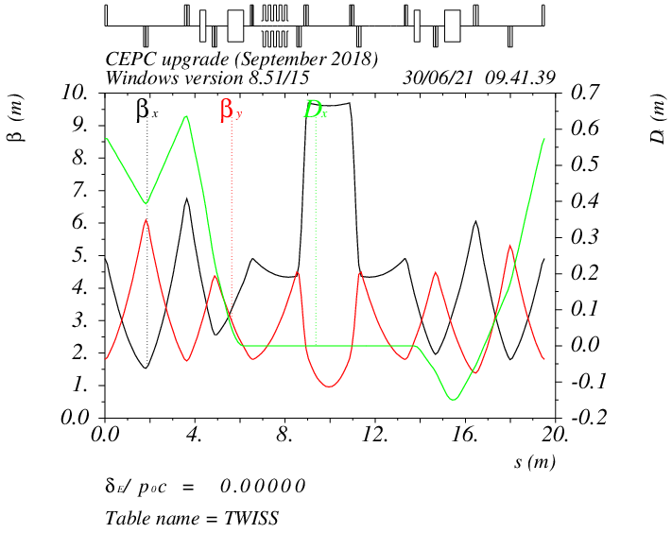
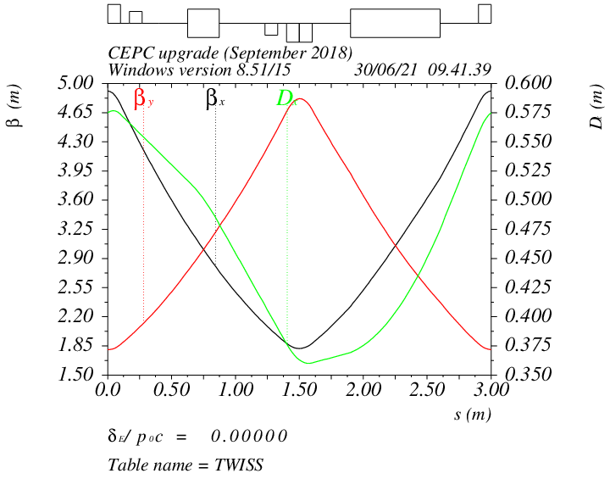
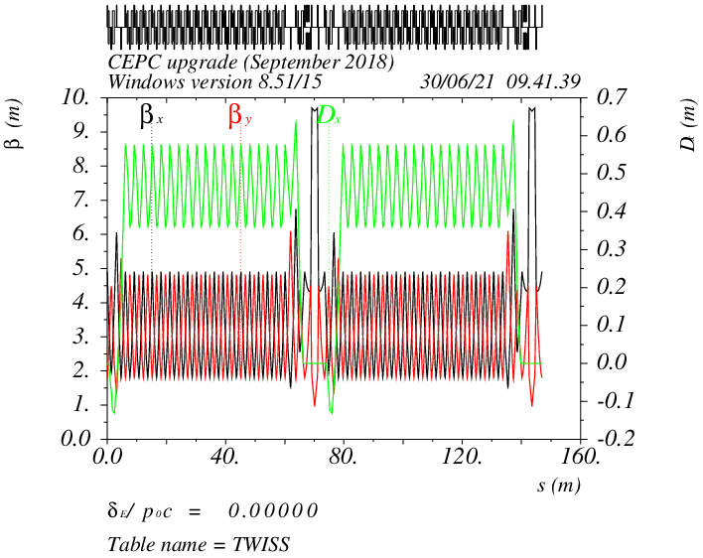
Option 1: optics
Phase/cell: 60°/60° ~ 90°/90° FODO
Interleave sextupole scheme
2 sex. families
Straight
Arc

Slide 8
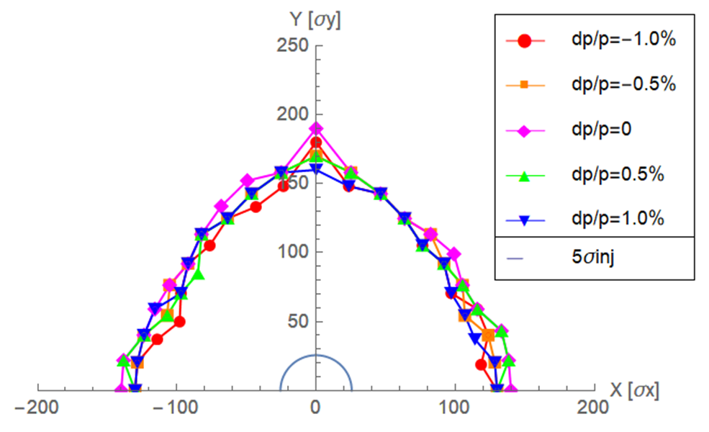
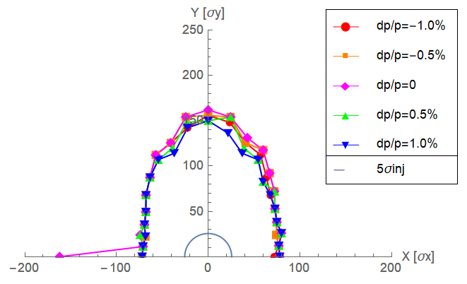
Option 1: DA
Large trans. acceptance→ inj. efficiency
- DA > 5 inj. beam size
Phase/cell: 60°/60°
Phase/cell: 75°/75°

Slide 9
Option 2: parameters
Four-bunch storage scheme
Storage time: 20 ms
Emittance: 2500→ 87 mm.mrad
Strong damping from wigglers
 | DR V4.0
Energy (Gev) | 1.1
Circumference (m) | 145
Number of trains | 2
Number of bunches/trian | 2
Total current (mA) | 12.4
Bending radius (m) | 3.44
Dipole strength B₀ (T) | 1.07
U₀ (kev/turn) | 98.0
Damping time x/y/z (ms) | 10.9/10.9/5.4
Momentum compaction | 0.015
Storage time (ms) | 20
δ₀ (%) | 0.061
ε₀ (mm.mrad) | 25.1
injection σ_{z} (mm) | 5
Extract σ_{z} (mm) | 5.7
ε_{inj} (mm.mrad) | 2500
ε_{ext x/y} (mm.mrad) | 87.3/62.8
δ_{inj} /δ_{ext} (%) | 0.18 /0.061
Energy acceptance by RF(%) | 1.5
f_{RF} (MHz) | 650
V_{RF} (MV) | 2.0
Longitudinal tune | 0.037

Slide 10
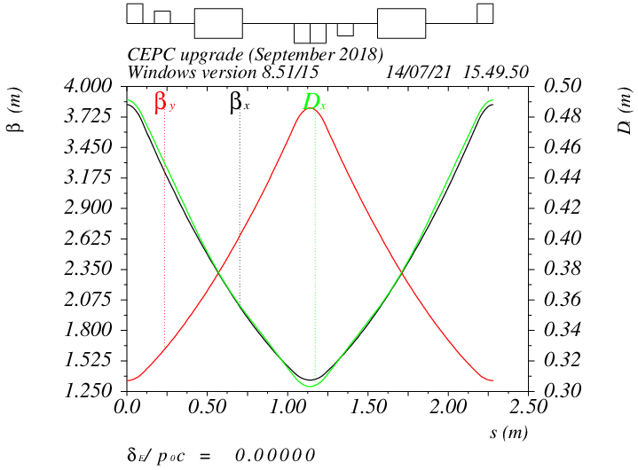
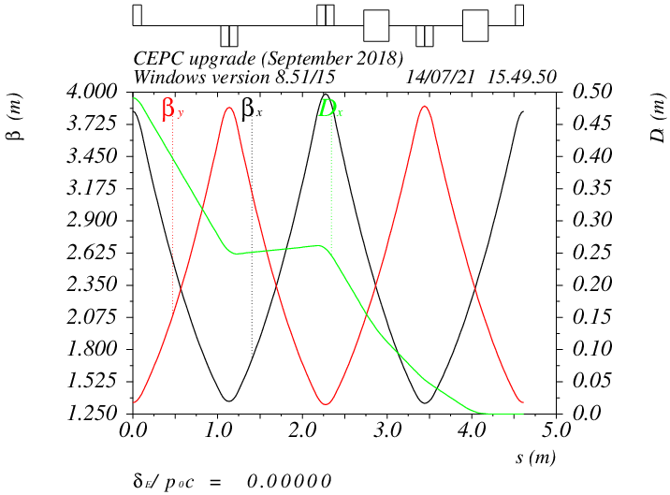
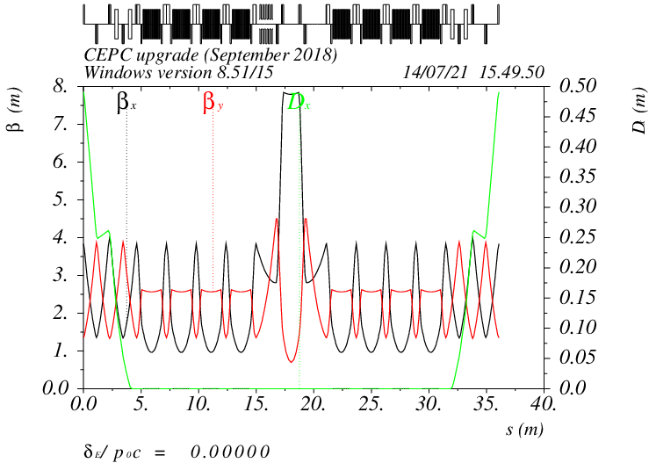
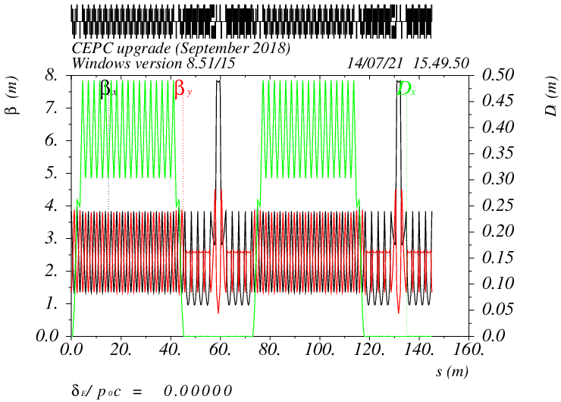
Option 2: optics
Phase/cell: 60°/60° FODO
Interleave sextupole scheme
Arc
Dis. suppressor
Straight

Slide 11
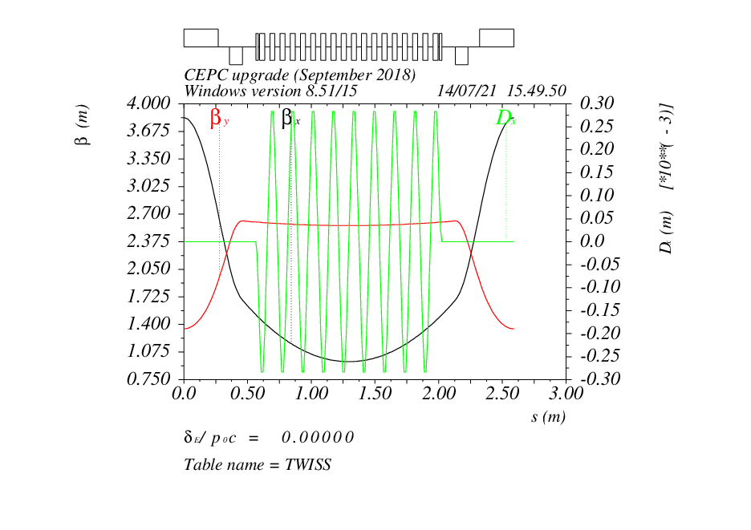
Option 2: wiggler parameters
Reduce horizontal beta in wiggler section to control emittance
- average βx: 1.3m
wiggler | value
B_{w} (T) | 1.8
ρ_{w} (m) | 2.0
λ_{w} (m) | 0.16
L_{w} (m) | 1.5
N_{w} | 16
F_{w} (U_{0w}/U_{0arc}) | 1.6

Slide 12
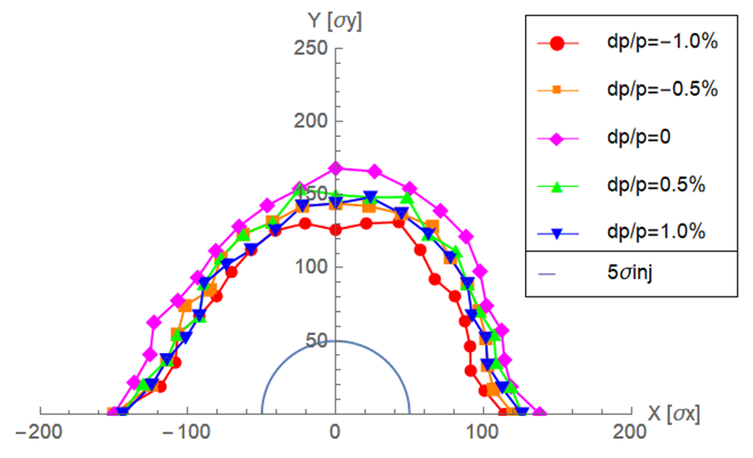
Option 2: DA
DA > 5 inj. beam size

Slide 13
Injection/extraction scheme and time structure
High lum. Z mode: 4-bunch storage → most demanding case for DR Inj./ext.
J. H. Chen, D. Wang, X. H. Cui, C. H. Yu…
Double bunch
200Hz
Inj. scheme: two by two
Inj. scheme: bunch by bunch
Kicker repetition: 100Hz
Flat top: 87ns
Rise up/down: 168ns
Pulse duration: 423ns
Kicker repetition: 200Hz
Rise up/down: 125ns
Pulse duration: 250ns

Slide 14
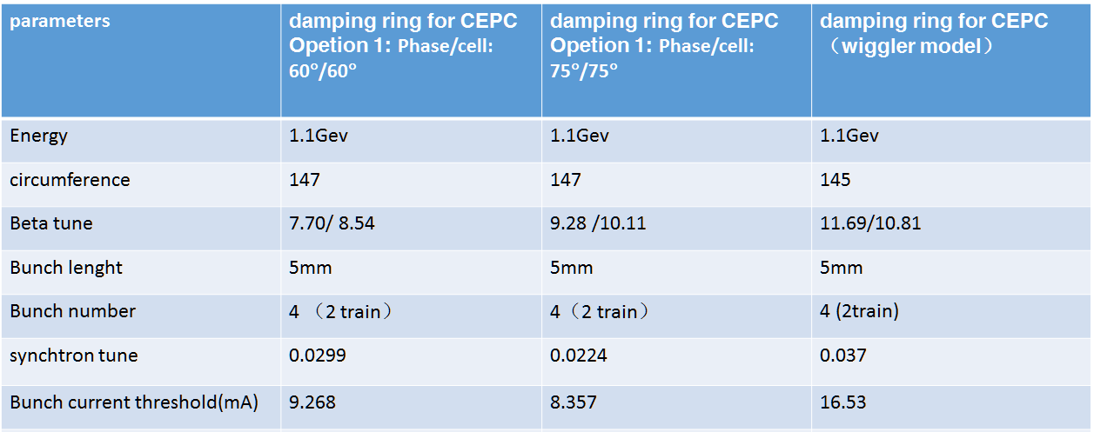
Impedance Instabilities
Yudong Liu
Resistive wall impedance was considered *.
Design bunch current: 3.1mA < threshold due to TMCI
* Circular Al pipe with 30mm inner diameter

Slide 15
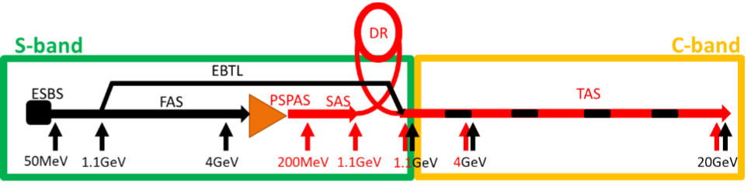
Transport lines between DR and Linac
Dou Wang, Xiaohao Cui
Linac→DR | EC
E₀ (Gev) | 1.1
δ₀ (%) | 0.6
σ_{z0} (mm) | 1.5
f_{RF} (MHz) | 2860
V_{RF} (MV) | 22.0
Length of acc. Structure (m) | 0.82
φ_{RF} (degree) | 89.7
R₅₆ (m) | -0.833
E_{f} (Gev) | 1.1
δ_{f} (%) | 0.18
σ_{zf} (mm) | 5
DR→Linac | BC
E₀ (Gev) | 1.1
δ₀ (%) | 0.061
σ_{z0} (mm) | 5.7
f_{RF} (MHz) | 2860
V_{RF} (MV) | 16
Length of acc. Structure (m) | 0.6
φ_{RF} (degree) | 89.6
R₅₆ (m) | -1.15
E_{f} (Gev) | 1.1
δ_{f} (%) | 0.50
σ_{zf} (mm) | 0.7

Slide 16
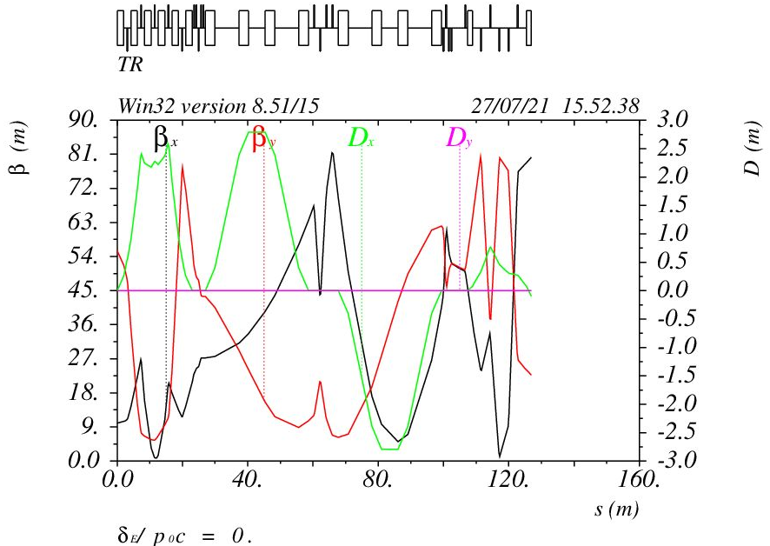
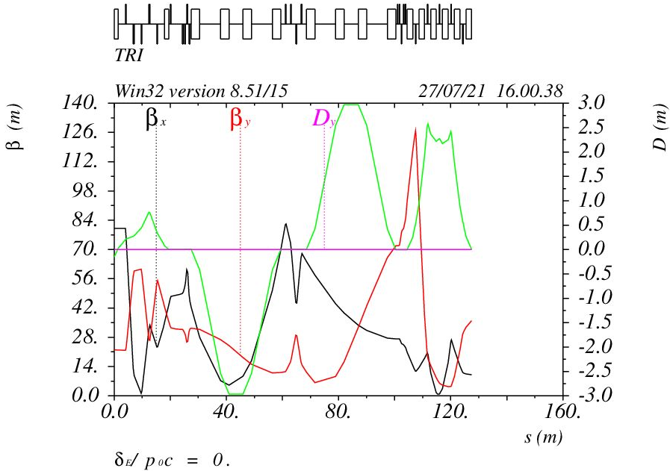
Optics for the transport lines
Xiaohao Cui
Linac→DR
DR→Linac

Slide 17
Damping ring cost estimation
Cost (ten thousand) | CDR | New (reversed bend) | New (wiggler)
Magnets | 1164 | 1750 (1.5) | 2910 (2.5)
RF | 800 | 800 | 800
RF Power Source | 385 | 385 | 385
Vacuum | 200 | 390 | 390
magnet supports | 237 | 360 (1.5) | 590 (2.5)
power supply | 313 | 470 (1.5) | 780 (2.5)
BI device | 600 | 800 | 1200
Injection & extraction | 160 | 160 | 160
wiggler | - | - | 8000
Total | 3859 | 5115 | 15215

Slide 18
Summary
Damping ring update is the requirement of higher luminosity goal for TDR.
- lower emittance collider → lower emittance booster → lower emittance linac
New DR needs to damp the positron beam stronger and faster during 20ms storage
emittance: 530mm⋅mrad (CDR) → under 200mm⋅mrad (new)
Damping time: 15ms (CDR) → 11ms (new)
So far, two kinds of DR were developed. Both can fulfill the requirement.
circumference: 150m, energy: 1.1GeV
Option 1: reversed bending, extracted emittance=120~166 mm⋅mrad
Option 2: wigglers, extracted emittance=87mm ⋅mrad
Transport lines almost same as CDR

