Slide 1
Summary to the recent study of the cryogenic system
Ge Rui
On behalf of CEPC cryogenic system
July, 29th, 2021
Notes:
1

Slide 2
OUTLINE
Discussion and Comparison on CEPC SRF cryogenic system
Discussion and Comparison on SC magnets cryogenic system
Summary

Slide 3
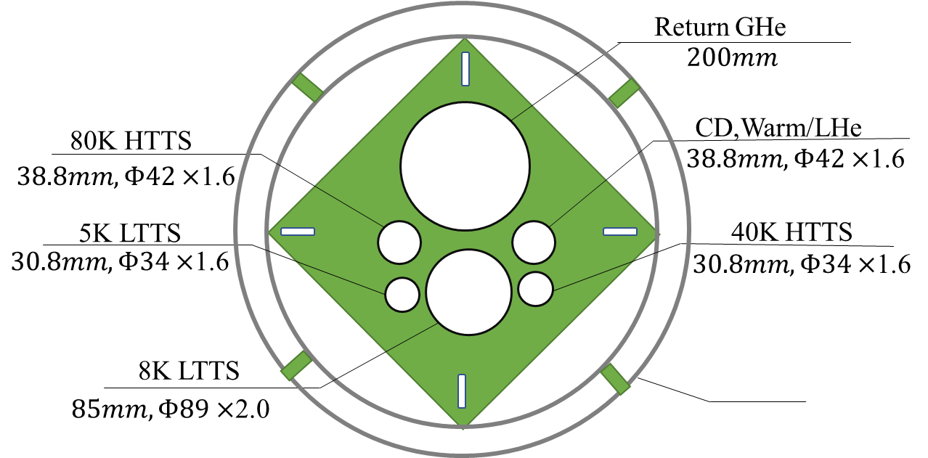
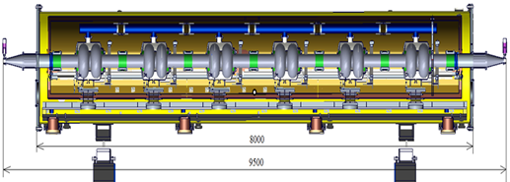
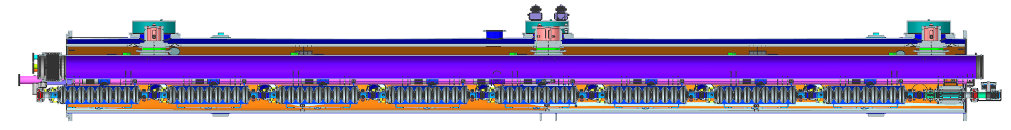
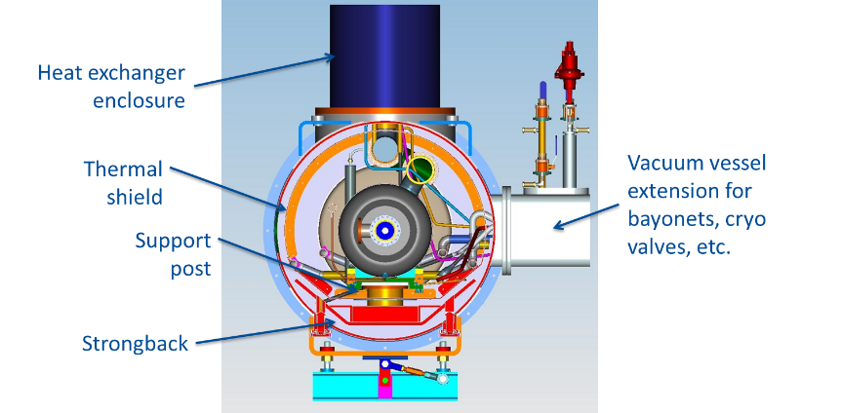
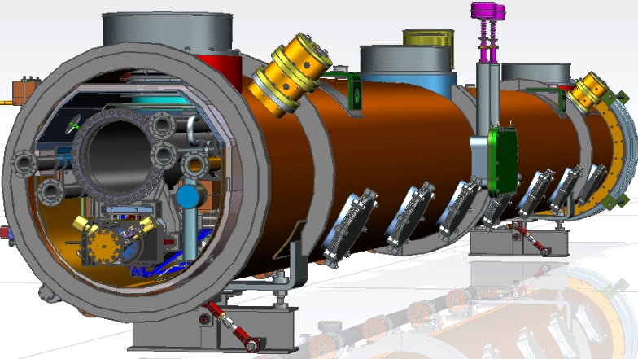
Flow chart of SRF CDR Scheme
24000
107000
Compressor group
Cold Box
Dewar
Main Distribution
Valve Box
Sub-tunnel
2K valve boxes
235000
80000
10 cryomodules, 6×650MHZ 2-cell cavities each
Collider Ring
3 cryomodules, 8×1.3GHZ 9-cell cavities each
Booster Ring
6
Cryomodules
8000
11000
5000
11000
5000
11000
11000
11000
11000
11000
5000
5000

Slide 4
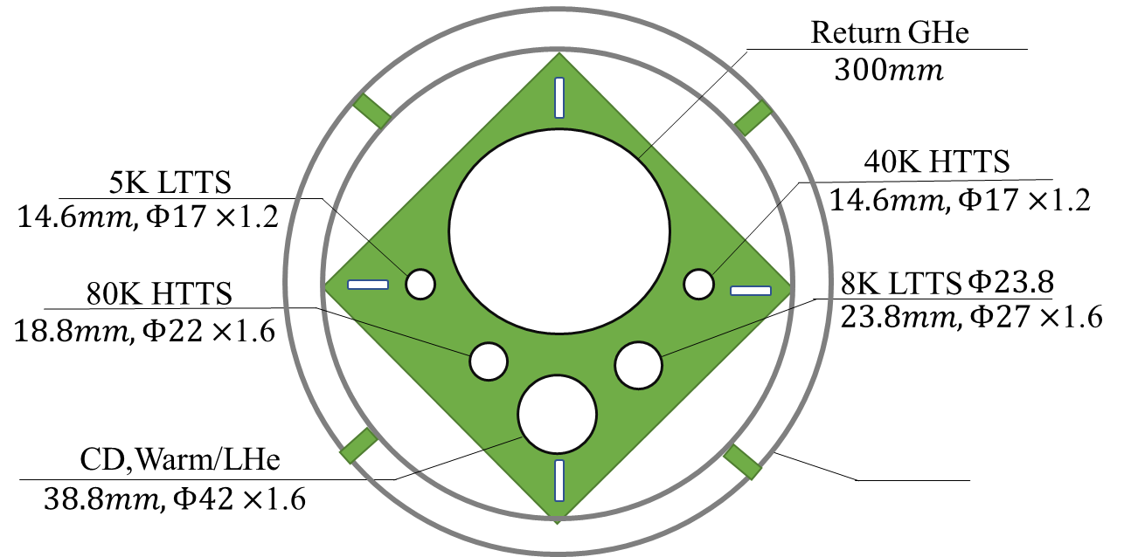
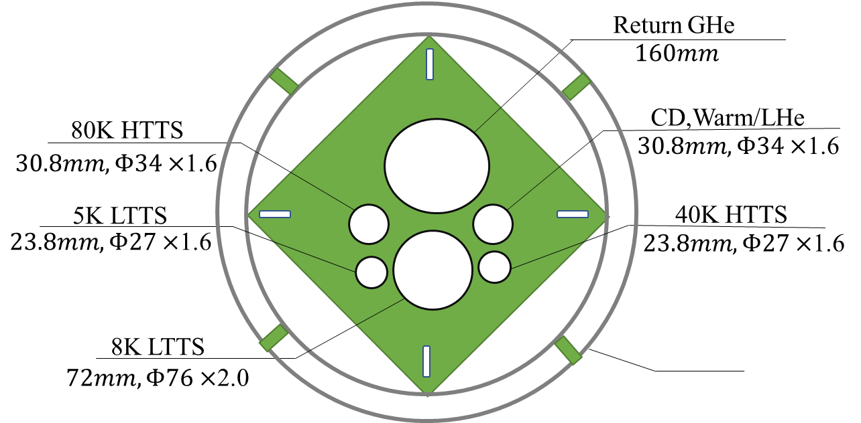
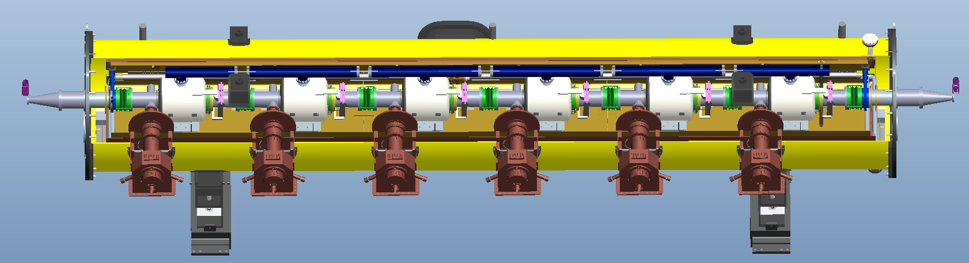
Flow chart of SRF Modif. Scheme
24000
107000
Smaller diameter
Compressor group
Cold Box
Dewar
Main Distribution
Valve Box
10 cryomodules, 6×650MHZ 2-cell cavities each
Collider Ring
3 cryomodules, 8×1.3GHZ 9-cell cavities each
Booster Ring
2K valve boxes
2K valve boxes
6
Cryomodules
11000
5000
11000
5000
11000
11000
11000
8000
11000
11000
5000
5000

Slide 5
Estimated heat loads for SC cavities-CDR Scheme
Higgs Mode | Unit | Collider |  |  | Booster
 |  | 40-80K | 5-8K | 2K | 40-80K | 5-8K | 2K
Predicted static heat load per cryomodule | W | 300 | 60 | 12 | 140 | 20 | 3
Cavity dynamic heat load per cryomodule | W | 0 | 0 | 153.59 | 0 | 0 | 13.98
HOM dynamic heat load per cryomodule | W | 20 | 12 | 2 | 2 | 1 | 1
Input coupler dynamic heat load per cryomodule | W | 60 | 40 | 6 | 40 | 3 | 0.4
Module dynamic heat load | W | 80 | 52 | 161.59 | 42 | 4 | 15.38
Each Module total heat load | W | 380 | 112 | 173.59 | 182 | 24 | 18.38
Cryomodule number | - | 40 | 40 | 40 | 12 | 12 | 12
EVB heat loss | W | 50 | 10 | 10 | 50 | 10 | 10
EVB number | - | 40 | 40 | 40 | 12 | 12 | 12
MDVB heat loss | W | 50 | 30 | 30 | 50 | 30 | 5
MDVB number | - | 4 | 4 | 4 | 4 | 4 | 4
Total cryogenic transfer line length | m | 1800 | 1800 | 1800 | 440 | 440 | 440
cryogenic transfer line heat loss per meter | W/m | 2 | 0.5 | 0.3 | 2 | 0.5 | 0.3
Total cryogenic transfer line heat loss | W | 3600 | 900 | 540 | 880 | 220 | 132
Total heat load | kW | 21 | 5.9 | 8.0036 | 3.864 | 0.748 | 0.49256
Total predicted mass flow | g/s | 82.42 | 152.26 | 373.72 | 13.34 | 12.73 | 18.324
Overall net cryogenic capacity multiplier |  | 1.54 | 1.54 | 1.54 | 1.54 | 1.54 | 1.54
4.5K equiv. heat load with multiplier | kW | 2.43 | 8.22 | 39.45 | 0.44 | 1.04 | 2.43
4.5K equiv. heat load with multiplier | kW | 50.10 |  |  | 3.92
Total 4.5K equiv. heat load with multiplier | kW | 54.02
Total:2240m
Scheme1. 4station
Four individual refrigerators (4 × 18kW@4.5K) will be employed for the CEPC cavity cryogenic system.

Slide 6
Estimated heat loads for SC cavities-Modif. Scheme
Higgs Mode | Unit | Collider |  |  | Booster
 |  | 40-80K | 5-8K | 2K | 40-80K | 5-8K | 2K
Predicted static heat load per cryomodule | W | 300 | 60 | 12 | 140 | 20 | 3
Cavity dynamic heat load per cryomodule | W | 0 | 0 | 153.59 | 0 | 0 | 13.98
HOM dynamic heat load per cryomodule | W | 20 | 12 | 2 | 2 | 1 | 1
Input coupler dynamic heat load per cryomodule | W | 60 | 40 | 6 | 40 | 3 | 0.4
Module dynamic heat load | W | 80 | 52 | 161.59 | 42 | 4 | 15.38
Each Module total heat load | W | 380 | 112 | 173.59 | 182 | 24 | 18.38
Cryomodule number | - | 40 | 40 | 40 | 12 | 12 | 12
EVB heat loss | W | 50 | 10 | 10 | 50 | 10 | 10
EVB number | - | 4 | 4 | 4 | 4 | 4 | 4
MDVB heat loss | W | 50 | 30 | 30 | 50 | 30 | 5
MDVB number | - | 4 | 4 | 4 | 4 | 4 | 4
Total cryogenic transfer line length | m | 608 | 608 | 608 | 136 | 136 | 136
cryogenic transfer line heat loss per meter | W/m | 2 | 0.5 | 0.3 | 2 | 0.5 | 0.3
Total cryogenic transfer line heat loss | W | 1216 | 304 | 182.4 | 272 | 68 | 40.8
Total heat load | kW | 18.616 | 5.304 | 7.646 | 3.256 | 0.596 | 0.40136
Total predicted mass flow | g/s | 82.42 | 152.26 | 373.72 | 13.34 | 12.73 | 18.324
Overall net cryogenic capacity multiplier |  | 1.54 | 1.54 | 1.54 | 1.54 | 1.54 | 1.54
4.5K equiv. heat load with multiplier | kW | 2.15 | 7.39 | 37.69 | 0.37 | 0.83 | 1.98
4.5K equiv. heat load with multiplier | kW | 47.23 |  |  | 3.19
Total 4.5K equiv. heat load with multiplier | kW | 50.42
Total:2240m
Total:744m
Scheme2. 4station
4 × 12.6 kW
Can reduce 3.6kW heat load compared scheme1
Four individual refrigerators (4 × 18kW@4.5K) will be employed for the CEPC cavity cryogenic system.

Slide 7
CEPC RF cryogenic system expenses
超导腔侧优化后方案可减少 2820.00万元
CEPC Higgs(50MW)
50 MW SR power per beam in Higgs mode
CEPC项目经费预算表(单位：万元)
编号 | 设备名称 | 规格型号 | 单位 | 数量 | 单价 （万元） | 总价（万元） 100公里 | 数量 | 单价 （万元） | 总价（万元） 100公里 | 差额（万元） | 备注
2.3 | 低温系统 |  |  |  |  | 92360.00 |  |  | 87140.00 | 2820.00
2.3.1 | 18KW@4.5K制冷机 | 18KW@4.5K | 台 | 4 | 14000 | 56000.00 | 4 | 14000 | 56000.00 | 0.00
2.3.2 | 液氦储罐 | 10000升 | 台 | 4 | 200 | 800.00 | 4 | 200 | 800.00 | 0.00
2.3.3 | 主分配阀箱 |  | 台 | 4 | 300 | 1200.00 | 4 | 800 | 3200.00 | -2000.00
2.3.4 | 连接阀箱 |  | 台 | 52 | 150 | 7800.00 | 52 | 40 | 2080.00 | 5720.00 | 恒温器辅助阀箱
2.3.5 | 多通道低温管线 | 多路 | m | 2240 | 1.5 | 3360.00 | 744 | 2.5 | 1860.00 | 1500.00
2.3.6 | 中压氦气储罐 | 20Bar，100m3 | 台 | 32 | 80 | 2560.00 | 32 | 80 | 2560.00 | 0.00
2.3.7 | 高压高纯氦气储罐 | 200Bar，25m3 | 组 | 4 | 350 | 1400.00 | 4 | 350 | 1400.00 | 0.00
2.3.8 | 高压不纯氦气储罐 | 200Bar，25m3 | 组 | 4 | 250 | 1000.00 | 4 | 250 | 1000.00 | 0.00
2.3.9 | 高压氦气回收压缩机 | 200bar，100m3/h | 台 | 8 | 230 | 1840.00 | 8 | 230 | 1840.00 | 0.00
2.3.10 | 高压氦气纯化器 | 200m3/h | 台 | 4 | 300 | 1200.00 | 4 | 300 | 1200.00 | 0.00
2.3.11 | 纯氦气 | 纯度5N9 | m3 | 80000 | 0.015 | 1200.00 | 80000 | 0.015 | 1200.00 | 0.00
2.3.12 | 控制系统 |  | 套 | 4 | 500 | 2000.00 | 4 | 500 | 2000.00 | 0.00
2.3.13 | 隔热真空系统 |  | 套 | 4 | 500 | 2000.00 | 4 | 500 | 2000.00 | 0.00
2.3.14 | 常温管路 |  | 套 | 4 | 1000 | 4000.00 | 4 | 1000 | 4000.00 | 0.00
2.3.15 | 工具，消耗品等 |  | 套 | 4 | 500 | 2000.00 | 4 | 500 | 2000.00 | 0.00
2.3.16 | 安装施工 |  | 套 | 4 | 1000 | 4000.00 | 4 | 1000 | 4000.00 | 0.00
2.3.17 | 设备2K阀箱 |  | 台 | 0 | 0 | 0.00 | 8 | 300 | 2400.00 | -2400.00
Notes:
For the Higgs mode, with the constraint of 30 MW, the design luminosity per IP is 3 × 1034 cm-2s-1 with 242 bunches and beam current of 17.4 mA. The horizontal and verticalβfunctions at the IP are 0.36 m and 1.5 mm respectively.

Slide 8
超导腔侧小结
接下来，超导腔侧还需要确定以下事情：
进行低温系统更为详细的流程计算和优化，以回气△P=0.4kPa压降为条件进行管径优化；
恒温器结构设计优化（接口尺寸、走向等），恒温器之间常温磁铁的结构确认，与高频组、磁铁组一起协商对接方案
高性能的多通道低温传输管线的设计与测试研究
多通道低温管线真空隔断的优化设计
……

Slide 9
OUTLINE
Discussion and Comparison on CEPC SRF cryogenic system
Discussion and Comparison on SC magnets cryogenic system
Summary

Slide 10
Estimated heat loads for SC IR magnets
 |  | 4.5K main loop |  |  | Thermal Shielding 40~80K
Name | Unit | No. | Heat load for each | Heat load | Heat load for each | Heat load
IR SC sextupole magnet | W | 32 | 10 | 320 | 68 | 2176
Valve Box of IR SC sextupole magnet | W | 32 | 20 | 640 | 20 | 640
Current lead of IR SC sextupole magnet | g/s | 32 | 0.1 | 3.2 | 0.1 | 3.2
IR SC magnet | W | 4 | 30 | 120 | 180 | 720
Valve Box of IR SC magnet | W | 4 | 30 | 120 | 30 | 120
Current lead of IR SC magnet | g/s | 4 | 0.5 | 2 | 0.5 | 2
Main distribution valve box | W | 4 | 50 | 100 | 50 | 200
Cryogenic transfer-line | W | 4000 | 0.3 | 1200 | 2 | 8000
Total equiv. heat load @4.5K | W | 14356
Total equiv. heat load @4.5K | W | 14356W+10.4g/s
Total equiv. heat load @4.5K | W | 14478
Total equiv. heat load @4.5K with multiplier 1.5 | W | 21717
Cooling capacity of refrigerator@4.5K | W | 2 | 12kW@4.5K | 24kW@4.5K
Installed power (COP 300W/1W) | MW
 |  | 4.5K main loop |  |  | Thermal Shielding 40~80K
Name | Unit | No. | Heat load for each | Heat load | No. | Heat load for each | Heat load
IR SC sextupole magnet | W | 32 | 10 | 320
Valve Box of IR SC sextupole magnet | W | 32 | 20 | 640
Current lead heat load of IR SC sextupole magnet | W | 32 | —— | ——
IR SC magnet | W | 4 | 30 | 120
Valve Box of IR SC magnet | W | 4 | 30 | 120
Current lead of IR SC magnet | g/s | 4 | 0.5 | 2
Main distribution valve box | W | 4 | 50 | 100
Cryogenic transfer-line | W | 4000 | 0.3 | 1200 | 3424 | 1.5 | 5136
Total heat load @4.5K | W |  |  | 2500 |  |  | 5136
Total heat load @4.5K | W |  |  | 2500W+2g/s |  |  | 5136
Total heat load @4.5K | W |  |  | 2523.45 |  |  | 5136
Coefficient |  |  |  | 1 |  |  | 0.05
Total heat load @4.5K | W |  |  | 2523.45 |  |  | 256.8
Total equiv. heat load @4.5K | W | 2780.25
Total equiv. heat load @4.5K with multiplier 1.5 | W | 4170
Cooling capacity of refrigerator@4.5K | W | 2 | 4kW@4.5K | 8kW@4.5K
Two individual refrigerators (2 x 4kW@4.5K, optimized later) will be employed for the CEPC SC magnets cryogenic system.

Slide 11
Cooling scheme for SC Magnets
One Cryo-station will supply the cooling for 16 sextupole magnets and 2 IR magnets .
The cryomodule has one 40K~80K helium thermal shielding.
Helium from coldbox will be supplied for the magnets, then throttling through a JT valve at the end valve box, and is returned to the Dewar.

Slide 12
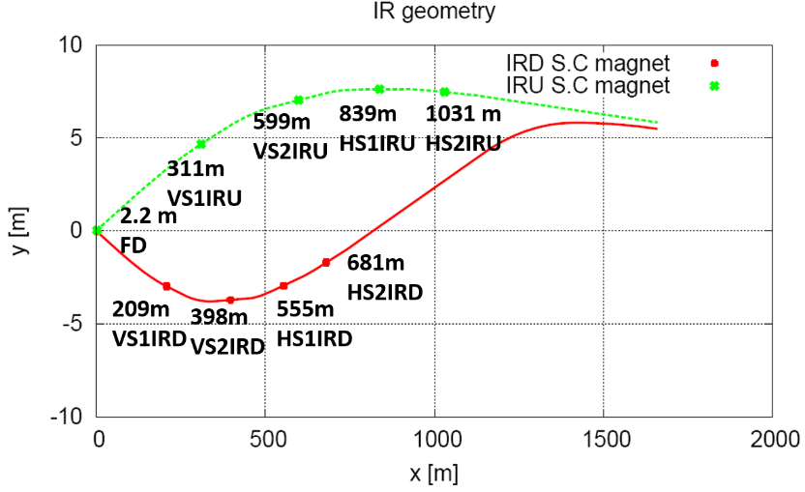
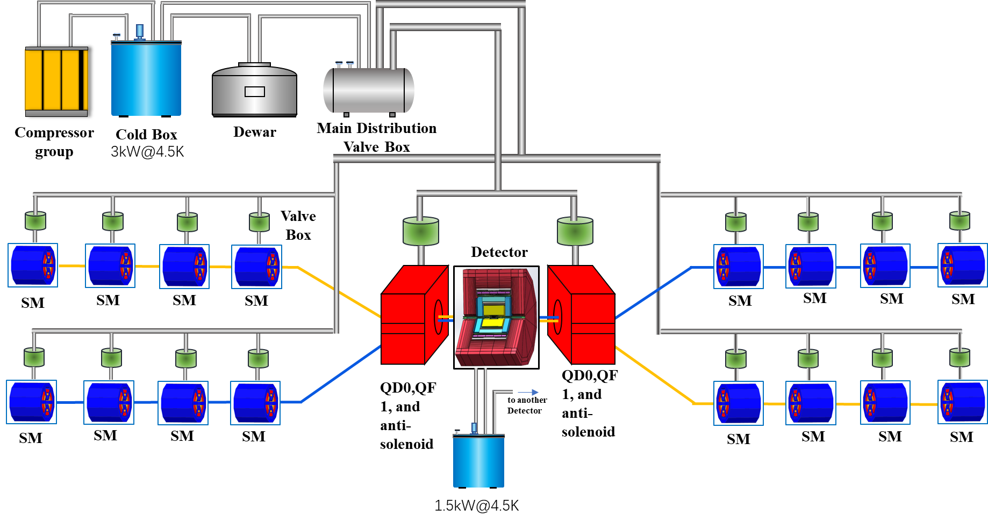
Flow scheme of SC magnets cryogenic system

Slide 13
CEPC SC magnets cryogenic system expenses
CEPC项目经费预算表(单位：万元)大型制冷机方案
编号 | 设备名称 | 规格型号 | 单位 | 数量 | 单价 （万元） | 总价（万元） 100公里 | 备注
2.3 | 低温系统 |  |  |  |  | 29320.00
2.3.1 | 4KW@4.5K制冷机 | 4KW@4.5K | 台 | 2 | 4000 | 8000.00 | 国产，研制
2.3.2 | 液氦储罐 | 10000升 | 台 | 2 | 300 | 600.00 | 国产，购置
2.3.3 | 主分配阀箱 |  | 台 | 2 | 600 | 1200.00 | 国产，研制
2.3.4 | 连接阀箱 |  | 台 | 36 | 100 | 3600.00 | 国产，研制
2.3.5 | 多通道低温管线 | 多路 | m | 4000 | 1.5 | 6000.00 | 国产，研制
2.3.6 | 中压氦气储罐 | 16Bar，100m3 | 台 | 10 | 80 | 800.00 | 国产，购置
2.3.7 | 高压高纯氦气储罐 | 200Bar，25m3 | 组 | 2 | 350 | 700.00 | 国产，购置
2.3.8 | 高压不纯氦气储罐 | 200Bar，25m3 | 组 | 6 | 250 | 1500.00 | 国产，购置
2.3.9 | 高压氦气回收压缩机 | 200bar，100m3/h | 台 | 4 | 230 | 920.00 | 国产，购置
2.3.10 | 高压氦气纯化器 | 100m3/h | 台 | 2 | 150 | 300.00 | 国产，购置
2.3.11 | 纯氦气 | 纯度5N9 | m3 | 80000 | 0.015 | 1200.00 | 国产，购置
2.3.12 | 控制系统 |  | 套 | 2 | 400 | 800.00 | 国产，研制
2.3.13 | 隔热真空系统及辅助 |  | 套 | 2 | 600 | 1200.00 | 国产，购置
2.3.14 | 常温管路及常温阀 |  | 套 | 2 | 600 | 1200.00 | 国产，购置
2.3.15 | 工具，消耗品等 |  | 套 | 2 | 300 | 600.00 | 其他
2.3.16 | 安装施工 |  | 套 | 2 | 350 | 700.00 | 其他

Slide 14

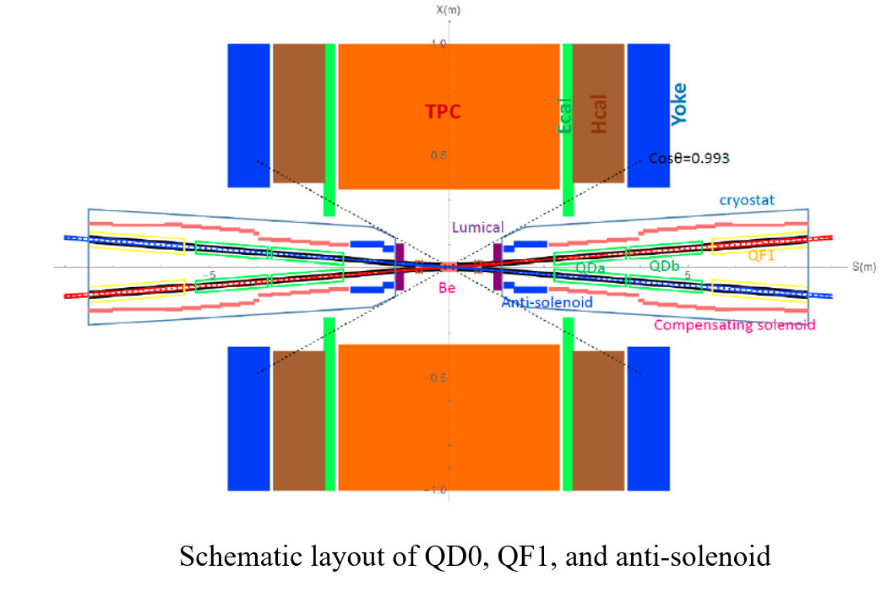
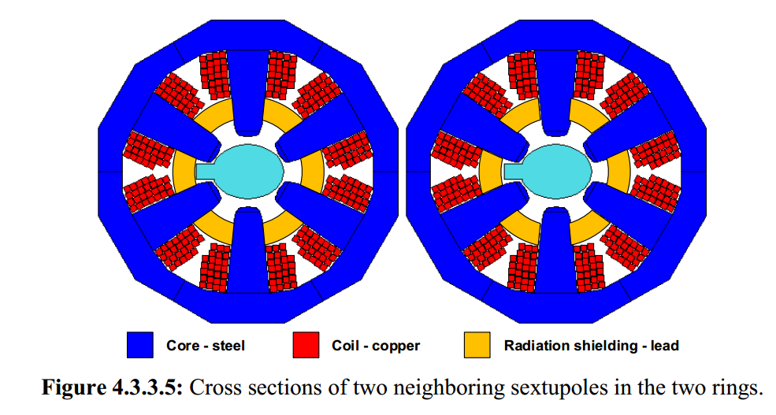
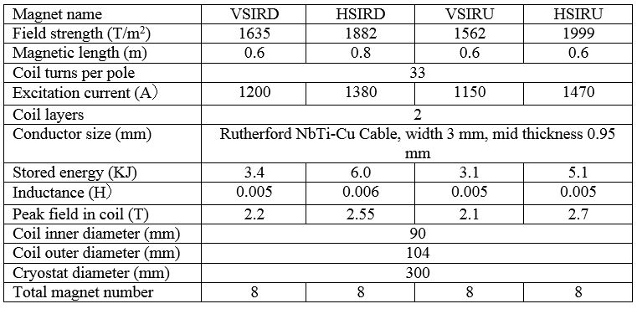
  Distribution and strength of the SC sextupoles magnets
From Wang Yiwei
From Zhu Ying-shun
Increase the number of turns of the coil to reduce the current to 600~700A? (to Zhu Yingshun)
If the current lead is reduced from 1.5kA to 600~700A, the cooling method for current leads is changed from helium vapor cooling to conduction cooling.
because helium vapor cooling means that many pairs of flow controllers are presented in the module, and the flow distribution and maintenance are very troublesome.

Slide 15
超导磁体侧小结
接下来，超导磁体侧还需要确定以下事情：
需跟进磁铁多条技术路线进展，方案确定后可进行更为详细的低温系统设计
是否可以增加线圈匝数来降低磁铁电流，从而改变电流引线冷却方式、降低磁铁热负荷，还需和磁铁组讨论
组合型磁铁和插入六级磁体低温恒温器需要进行结构设计，以及针对低温恒温器进行流动传热仿真计算，分析流场进而指导优化结构设计，形成闭环设计思路。
……

Slide 16
Summary
Previous CDR and TDR works have laid a good foundation for the further design.
For the CEPC cryogenic system TDR design, relevant aspects have been considered , including process scheme, layout, and key equipment design.
For the RF side, scheme 2 can reduce construction expenses, and has the advantage of low heat loss and easier transfer line construction and flexible maintenance.
For the IR magnets, the preliminary process calculation has been completed. Further detailed design is ongoing.
The heat loss is selected 0.15W/m single loop after reviewing the status, and a test platform for multi-channel transfer lines is being constructed to measure two important parameters of heat leakage and pressure drop.
Further TDR design is going on. Now it‘s just at the stage of scheme comparison, and there is still a long way to complete the whole TDR design. In the later time, the project team members need to work together to greatly push forward the work, and complete the TDR design on time.

