Slide 1
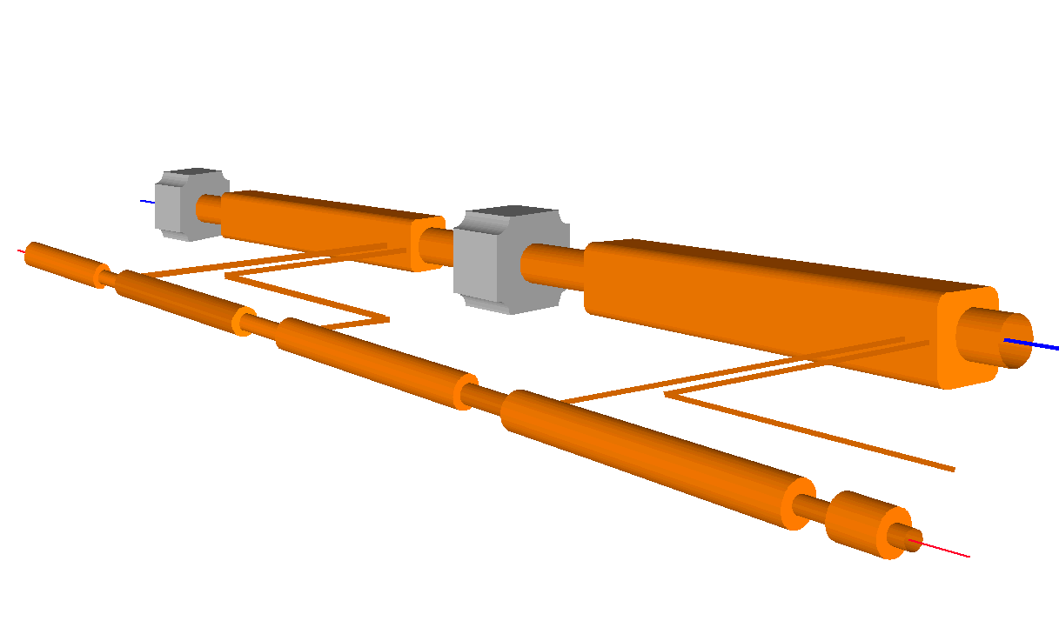

CLIC Status
D. Schulte for the CLIC study team
http://clic-study.web.cern.ch/CLIC-Study/

Slide 2






















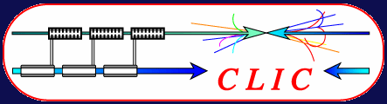

World-Wide CLIC&CTF3 Collaboration
http://clic-meeting.web.cern.ch/clic-meeting/CTF3_Coordination_Mtg/Table_MoU.htm
33 Institutes involving 22 funding agencies from 18 countries
Aarhus University (Denmark)
Ankara University (Turkey)
Argonne National Laboratory (USA)
Athens University (Greece)
BINP (Russia)
CERN
CIEMAT (Spain)
Cockcroft Institute (UK)
Gazi Universities (Turkey)
Helsinki Institute of Physics (Finland)
IAP (Russia)
IAP NASU (Ukraine)
INFN / LNF (Italy)
Instituto de Fisica Corpuscular (Spain)
IRFU / Saclay (France)
Jefferson Lab (USA)
John Adams Institute (UK)
JINR (Russia)
Karlsruhre University (Germany)
KEK (Japan)
LAL / Orsay (France)
LAPP / ESIA (France)
NCP (Pakistan)
North-West. Univ. Illinois (USA)
Patras University (Greece)
Polytech. University of Catalonia (Spain)
PSI (Switzerland)
RAL (UK)
RRCAT / Indore (India)
SLAC (USA)
Thrace University (Greece)
University of Oslo (Norway)
Uppsala University (Sweden)
Notes:
2

Slide 3
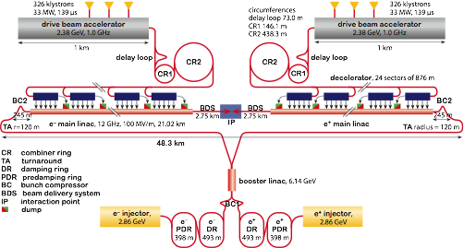
Reminder: The CLIC Layout

Slide 4
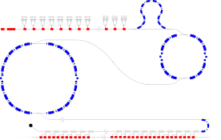
CLIC Power Source Concept
Delay Loop × 2
gap creation, pulse compression & frequency multiplication
Drive Beam Accelerator
efficient acceleration in fully loaded linac
RF Transverse Deflectors
Combiner Ring × 3
pulse compression &
frequency multiplication
Combiner Ring × 4
pulse compression &
frequency multiplication
CLIC RF POWER SOURCE LAYOUT
Drive Beam Decelerator Section (2 × 24 in total)
Power Extraction
Drive beam time structure - initial
Drive beam time structure - final
240 ns
240 ns
5.8 μs
140 μs train length - 24 × 24 sub-pulses
4.2 A - 2.4 GeV – 60 cm between bunches
24 pulses – 101 A – 2.5 cm between bunches

Slide 5
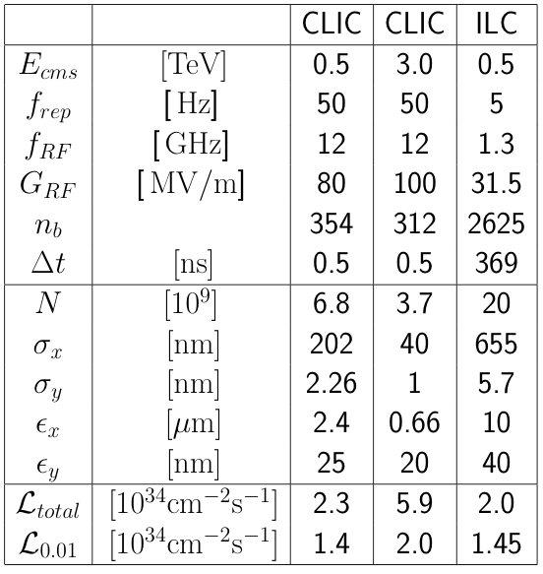
CLIC Main Parameters
http://cdsweb.cern.ch/record/1132079?ln=fr http://clic-meeting.web.cern.ch/clic-meeting/clictable2007.html
High gradient to reduce cost
Break down of structures at high fields and long pulses
  Pushes to short pulses
  and small iris radii (high wakefields)
High luminosity
Improve wall plug to RF efficiency
Push RF to beam efficiency
  Push single bunch charge to beam dynamics limit
  Reduce bunch distance to beam dynamics limit
Push specific luminosity -> High beam quality
  Beam-based alignment and tuning
  Excellent pre-alignment
  Component stabilisation

Slide 6
CLIC Plan
Divided the identified critical issues into three categories (endorsed by ACE)
  Failure to solve a feasibility issue implies that the CLIC technology is fundamentally not suited to build a machine of interest for high energy physics
  Performance issues can compromise the performance
  Cost issues have significant impact on cost
For the CDR concentrate on addressing feasibility issues (mid 2011 to council)
  Targeted conclusion: It is worth to make a technical design of such a machine
  A baseline is being developed, involving many new experts
  Will have turned the feasibility issues mostly into performance issues
    Programme is in place and needs some continuation afterwards
  A number of important performance issues addressed
  A number of important cost issues addressed
In the TDR phase more detail is needed (2016)
  Targeted conclusion: One can propose this machine as a project
  Something that is not a feasiblity issue could kill a project
  Addressing the performance issues
  Reducing cost
  A workplan for the TDR phase is being finalised

Slide 7
10 CLIC Feasibility Issues
RF Structures (gradient + power generation):
  Accelerating Structures (CAS)
  Power Production Structures (PETS)
Two Beam Acceleration (power generation and machine concept):
  Drive beam generation
  Two beam module
  Drive beam deceleration
Ultra low beam emittance and beam sizes (luminosity):
  Emittance preservation during generation, acceleration and focusing
  Alignment and stabilisation
Detector (experimental conditions):
  Adaptation to short interval between bunches
  Adaptation to large background at high beam collision energy
Operation and Machine Protection System (robustness)

Slide 8
Gradient Limitations
Structure gradients are limited by breakdowns, depending on
  Surface electric field
  Surface magnetic field
    Pulsed surface heating
  RF power flow
    RF power flow through iris aperture
  Have empiric limits for these values but no full theory
    Experiments are vital
Structures can generally achieve higher gradients if the aperture is reduced
  But higher wakefields ⇒ beam stability
  Can focus the beam more ⇒ tight tolerances on misalignments and jitters
  Need to find a compromise ⇒ performed full parameter optimisation

Slide 9
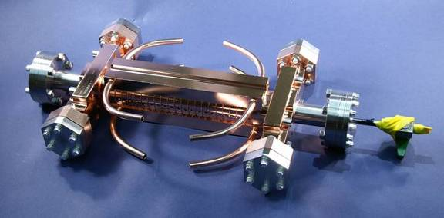
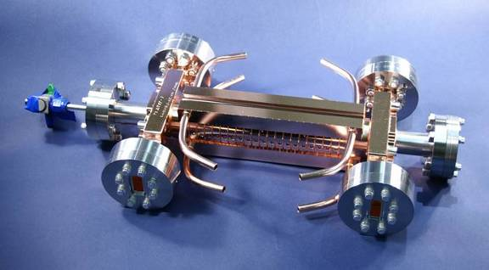
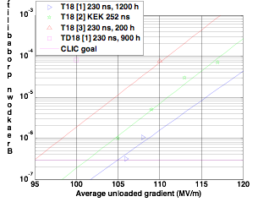
Results Obtained To Date
T18 and TD18 built and tested at SLAC and KEK
real prototypes with improved design are TD24
Goal: 3 10⁻⁷/m at 100 MV/m loaded at 230 ns
S. Doebert et al.
T18 reaches 95-105 MV/m
Damped TD18 reaches an extrapolated 85MV/m
Second TD18 under test at KEK
Pulsed heating expected to be above limit
Will test TD24 this year
expect similar or slightly better performance

Slide 10
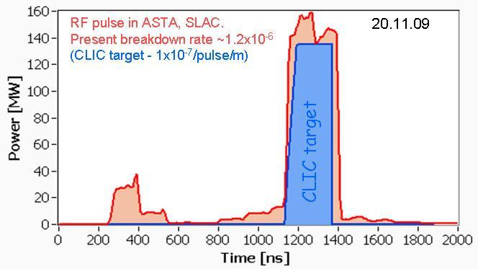
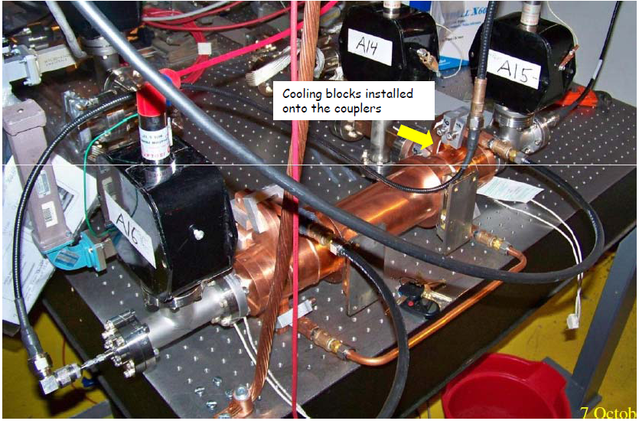
PETS Results
Klystron based (SLAC):
achieved: 137 MW/266 ns/1.2 10⁻⁶
target: 132MW/240ns/10⁻⁷
Beam based (with recirculation):
Power
  130 MW peak at 150 ns
  Limited by attenuator and phase shifter breakdowns
  Power production according to predictions
Structures had damping slots but no damping material
Novel design of on-off mechanism
will be tested this year
More testing is needed, conditions should be improved

Slide 11
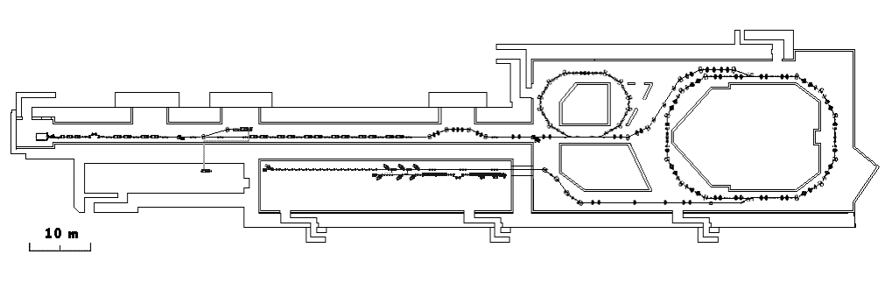
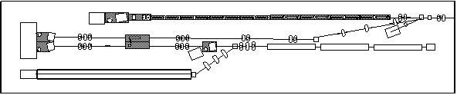
Two-Beam Acceleration:
CLIC Test Facility (CTF3)
Demonstrate Drive Beam generation
(fully loaded acceleration, beam intensity and bunch frequency multiplication x8)
Demonstrate RF Power Production and test Power Structures
Demonstrate Two Beam Acceleration and test Accelerating Structures
PULSE COMPRESSION
FREQUENCY MULTIPLICATION
magnetic chicane
150 MeV e-linac
30 GHz test stand
3.5 A - 1.4 μs
Delay Loop
Combiner Ring
CLEX (CLIC Experimental Area)
TWO BEAM TEST STAND
PROBE BEAM
Test Beam Line
Photo injector tests,
laser
28 A - 140 ns
Infrastructure from LEP
total length about 140 m

Slide 12
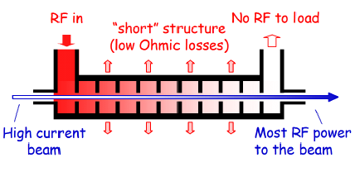
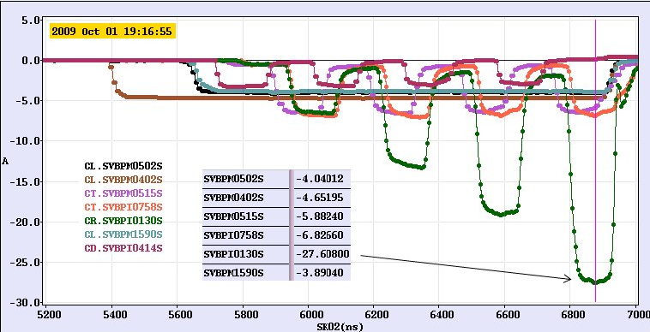
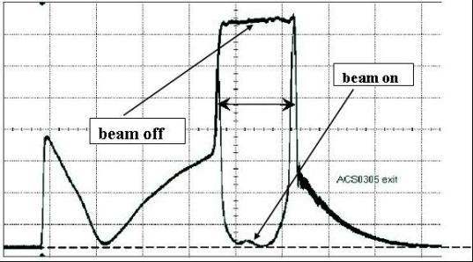
Drive Beam Generation
Full beam loading operation demonstrated
Current stability in drive beam accelerator close to target (1.5 10⁻³ vs. 0.75 10⁻³)
Further improvement possible
  simulated feedback: 0.6 10⁻³
Delay loop and combiner ring worked
some improvements remain to be done
  slight increase in current
  optimisation of beam transport in combiner ring
S. Bettoni et al.
CERN

Slide 13
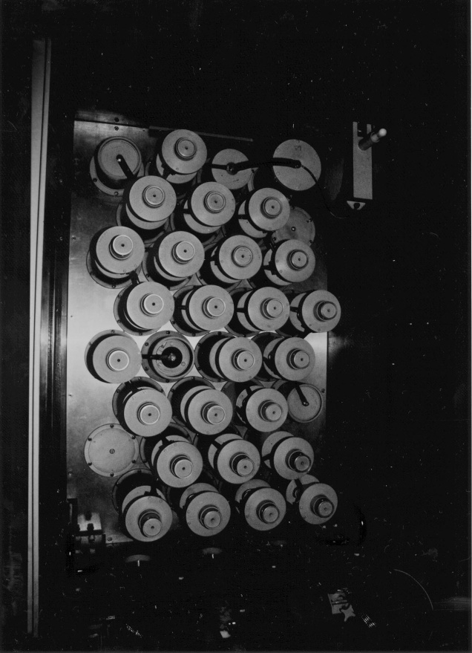
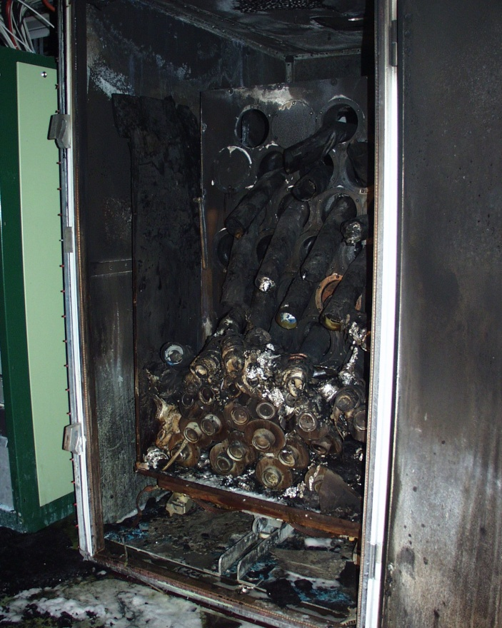
Fire in CTF3 Klystron Gallery
On March 4 a fire destroyed the pulse forming network in the faraday cage of MKS13
Cleaning of components is needed to prevent corrosion
=> a couple of months delay

Slide 14
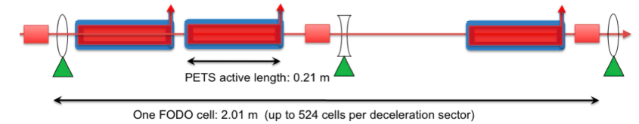
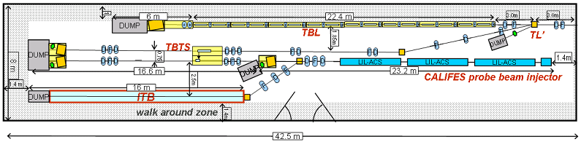
Drive Beam Deceleration and Module: CLEX
Decelerator sector: ~ 1 km, 90% of energy extracted
Two-beam Test Stand:
Single PETS with beam
Accelerating structure with beam
  wake monitor
  kick on beam from break down
Integration
Test Beam Line:
Drive beam transport (16 PETS)
  beam energy extraction and dispersion
  wakefield effects

Slide 15
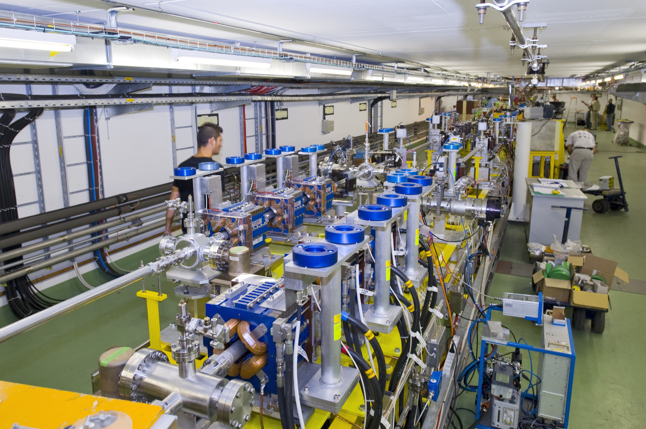
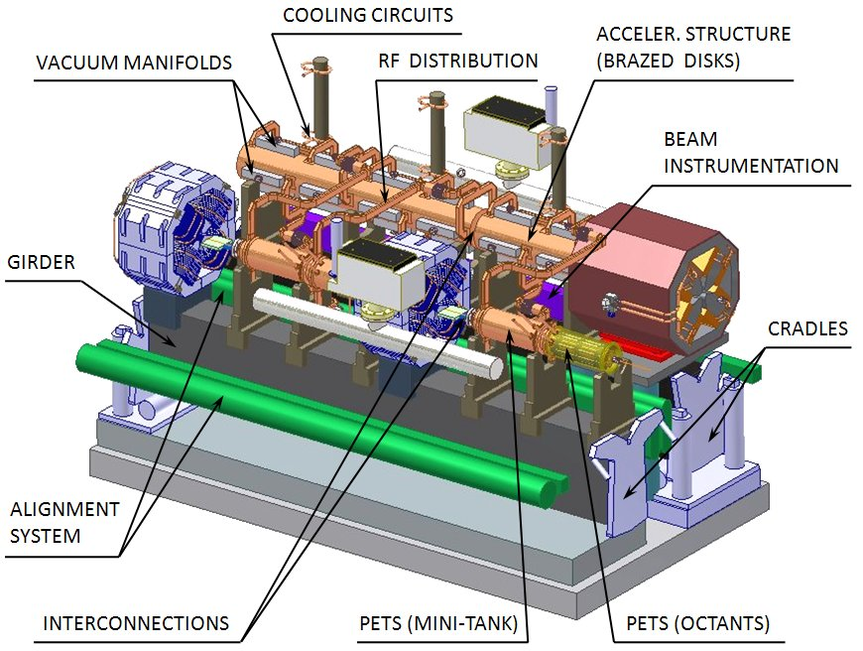
Two Beam Module
Integration aspects are important
  alignment
  vacuum
  transport
  cabling
  …
Principle of two-beam acceleration had been established in CTF and CTF2
Beam tests of PETS are ongoing
  accelerating structure installed
  wake kick measurements
Some tests after 2010
  e.g. wake monitors, design exists
Later full modules will be tested
G. Riddone et al.

Slide 16
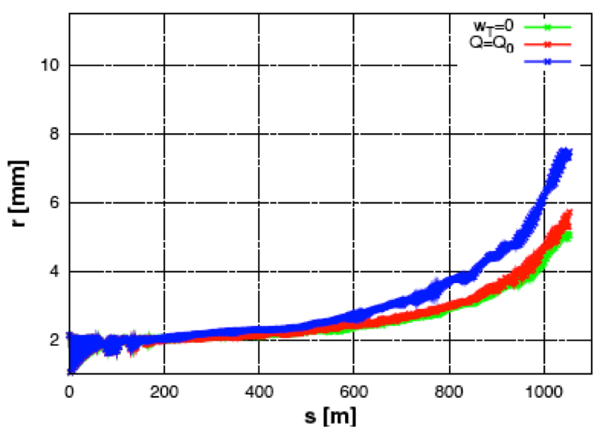
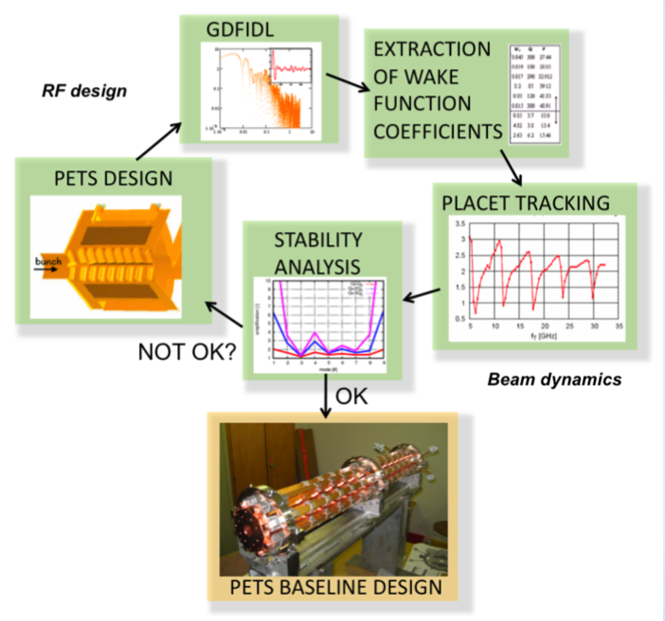
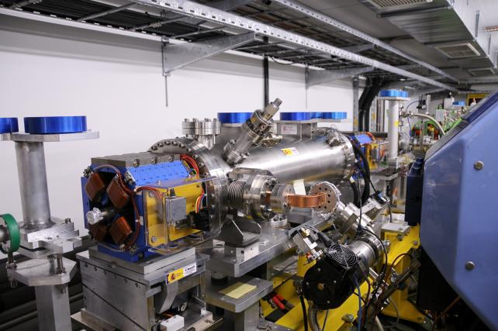
Drive Beam Deceleration
Drive beam has high current (100A) and large energy spread (factor 10)
  Simulations show that the beam is stable
  Several iterations of PETS design
Test Beam Line (TBL) under construction will increase confidence
  the first PETS installed (8 for end 2010)
  beam to the end
E. Adli et al.Oslo Univ. / CERN
D. Schulte
16

Slide 17
Ultra Low Beam Emittances/Sizes
Designs for critical lattices exist achieving target performances
  Recent improvements
    Predamping ring design (-> Y. Papaphilippou)
    Improved damping ring design (-> Y. Papaphilippou)
    RTML design, bunch compressors, turn-around loops, spin rotator (F. Stulle, -> A. Latina)
    Beam delivery system with L*=6m as alternative (R. Tomas)
    Drive beam phase stabilisation concept (-> D.S.)
    Low energy running concept (-> D.S.)
    …
  Design and tests of key components are ongoing (DR wigglers, ML quadrupoles, final doublet, instrumentation …)
  Main issue are imperfections
    Beam-based alignment algorithms developed for main linac, BDS, key RTML components, which show good to satisfying performances
    Integrated stability studies ongoing
    Key issue are the hardware performances

Slide 18
Ultra Low Beam Emittances/Sizes
A number of issues are being addressed by R&D
  Electron cloud -> beam pipe design and other mitigation
  Fast beam-ion instability -> excellent vacuum
  RF stability -> phase stabilisation and feedforward
  Pre-alignment imperfections -> beam-based alignment, wake monitors and precision pre-alignment
  Dynamic imperfections -> feedback, feedforward, mechanical component stabilisation
  ...
Detailed design issues are also addressed
  Baseline design needed
  Cabling and power supplies
  Magnets
  Instrumentation
  …

Slide 19
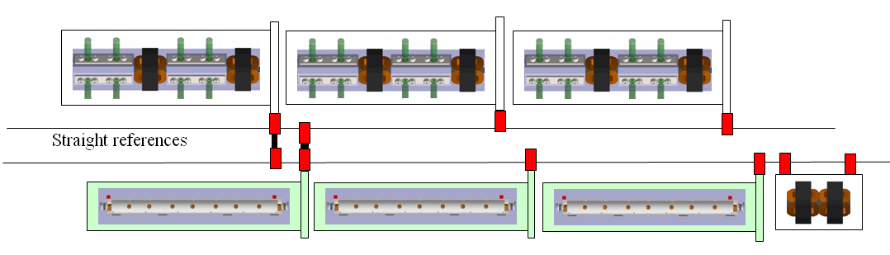

Main Linac Alignment Concept
Pre-alignment O(10um)
  with wire system
  detailed model in simulations
Dispersion free steering
  aligns BPMs and quadrupoles
Move girders onto the beam
  use wakemonitors
  removes wakefield effects
Straight reference line defined by overlapping wires
Girders are aligned to these wires
Detailed work ongoing on module integration, mechanical alignment in module, wire system test, sensor cost reduction, use of laser system
H. Mainaud-Durand et al. CERN

Slide 20
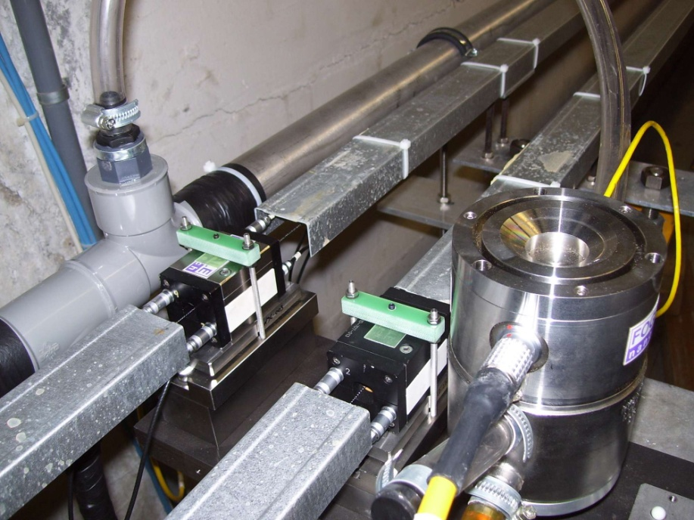
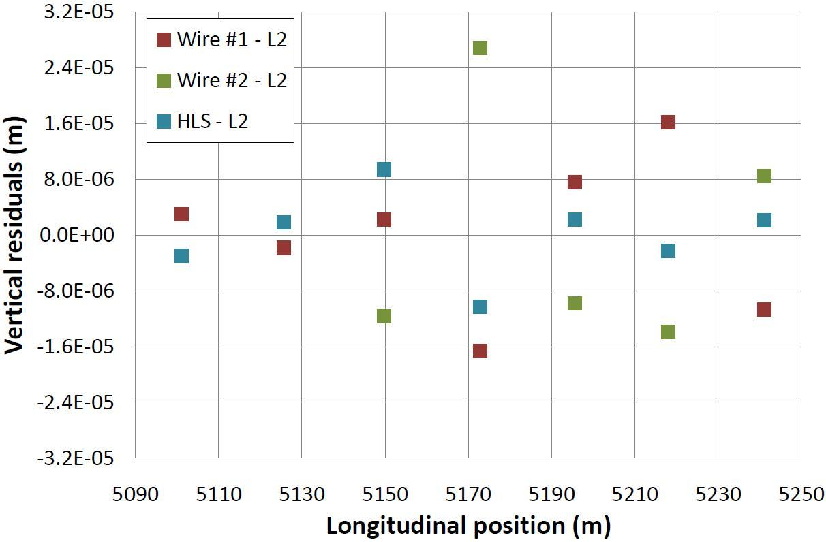
TT1 Alignment Results
Wire #1
Wire #2
Wire #3
Hydrostatic network
Legend
WPS
Invar metrological plate
Tiltmeter
HLS
RMS error of 11μm found
  Target is 10μm
More work remains to be done
  Found two bad points due to mechanical problem
  Stake-out error needs to be determined
Th Touze et al., CERN

Slide 21
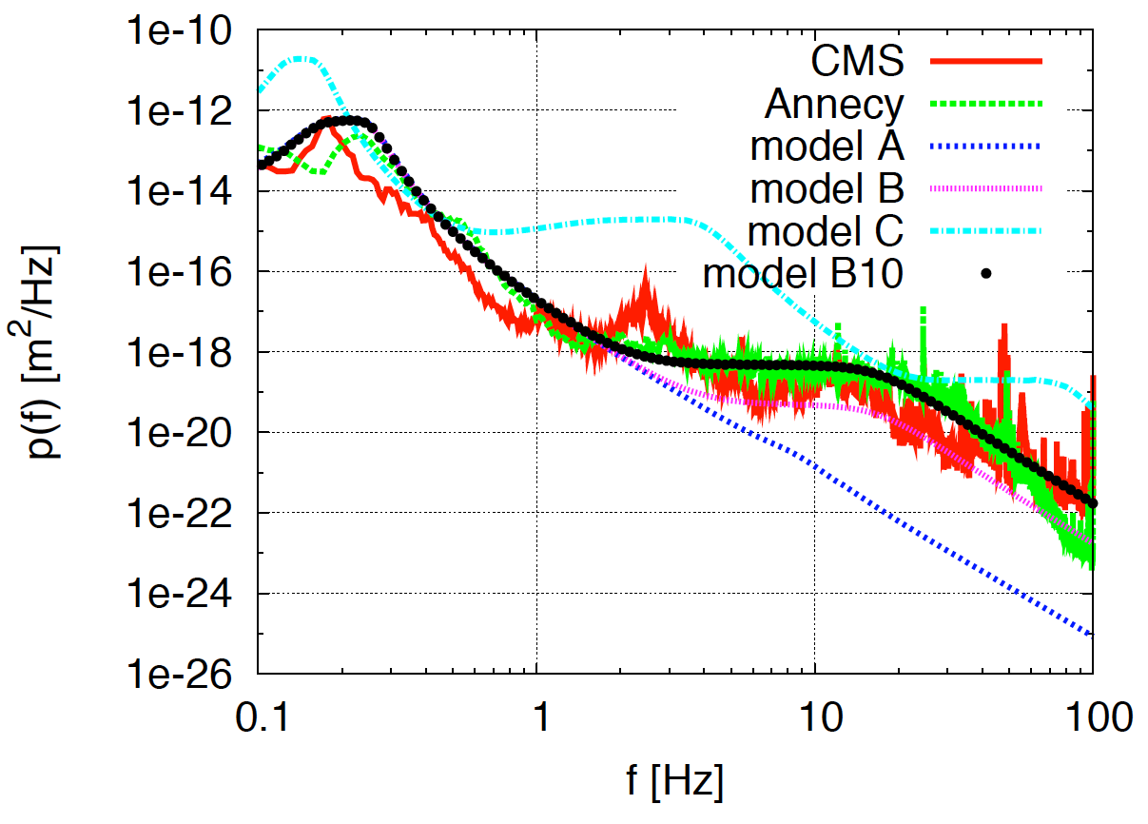
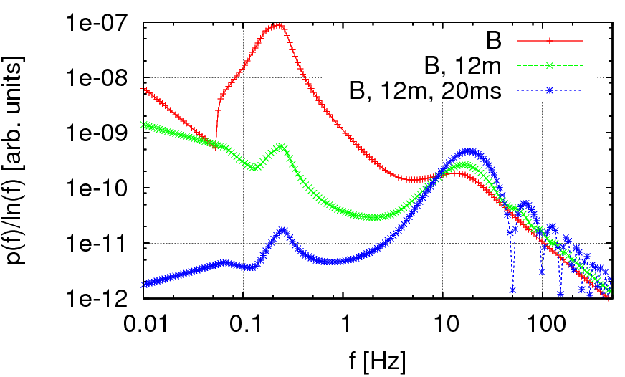
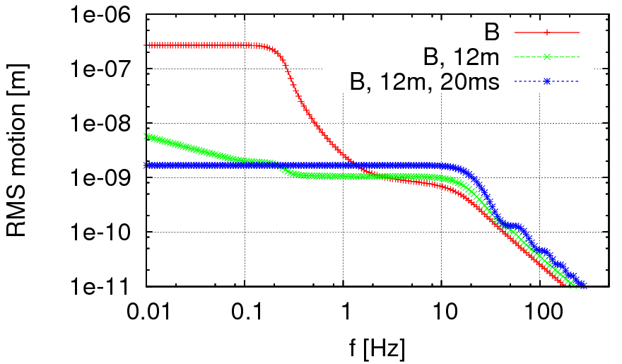
Element Stabilisation
Elements move due to ground motion and technical noise
  Two dimensional power spectrum P(f,s)
  Focus on main linac (O(1nm)) and final doublet (O(0.2nm))
Tolerances depend on correlation and frequency spectrum
  Model A (LEP tunnel) would only need beam-based feedback
  Beam-beam jitter tolerance 0.3nm

Slide 22
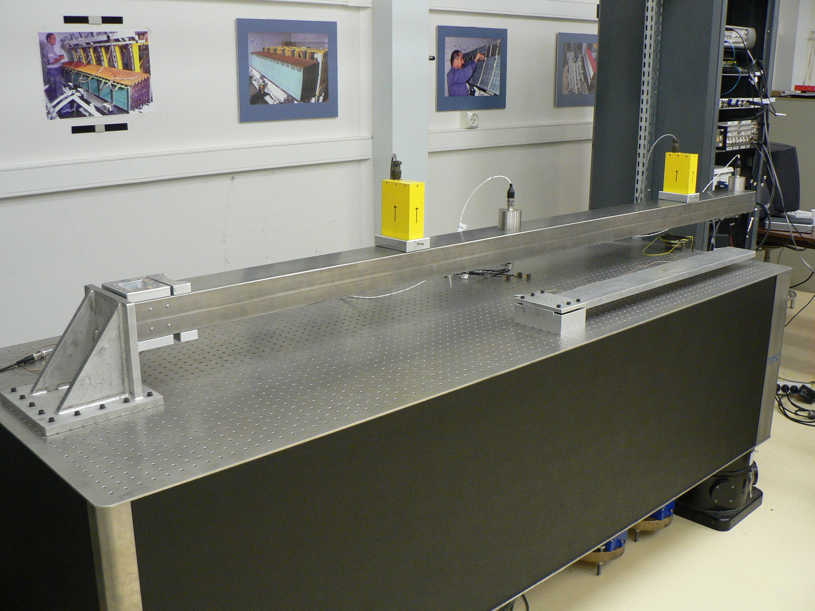
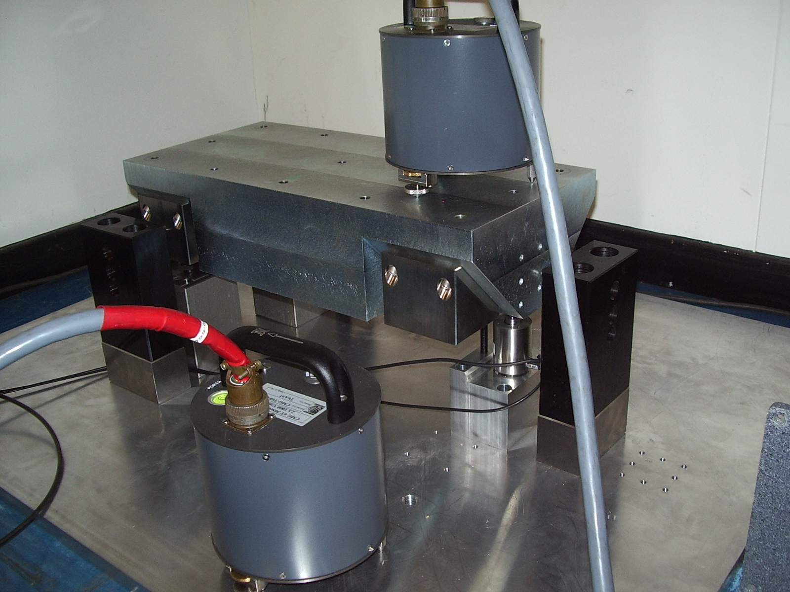
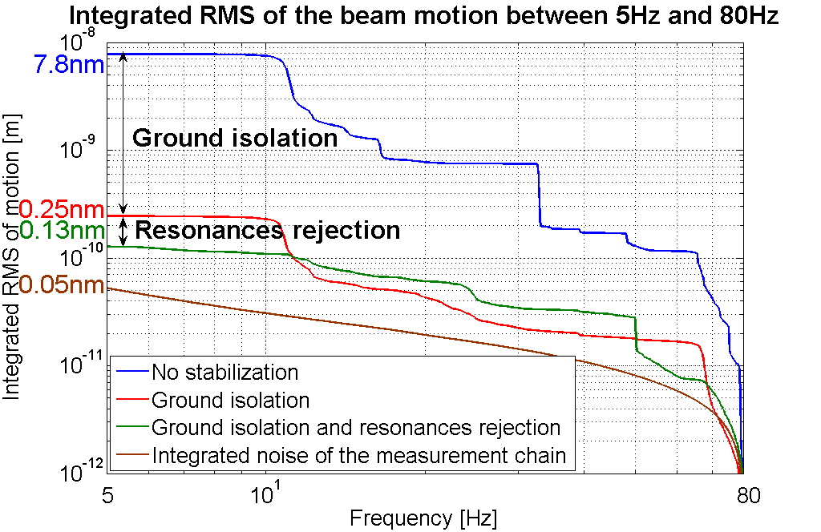
Element Stabilisation (cont.)
Minimise impact of motion by
  identification and minimisation of technical noise
  mechanical support and component design
  active mechanical stabilisation
  motion sensor based feed-forward on the beam
  beam-based orbit feedback
  intra-pulse IP feedback
Main linac quadrupole support
L.Brunetti et al
K. Artoos et al

Slide 23
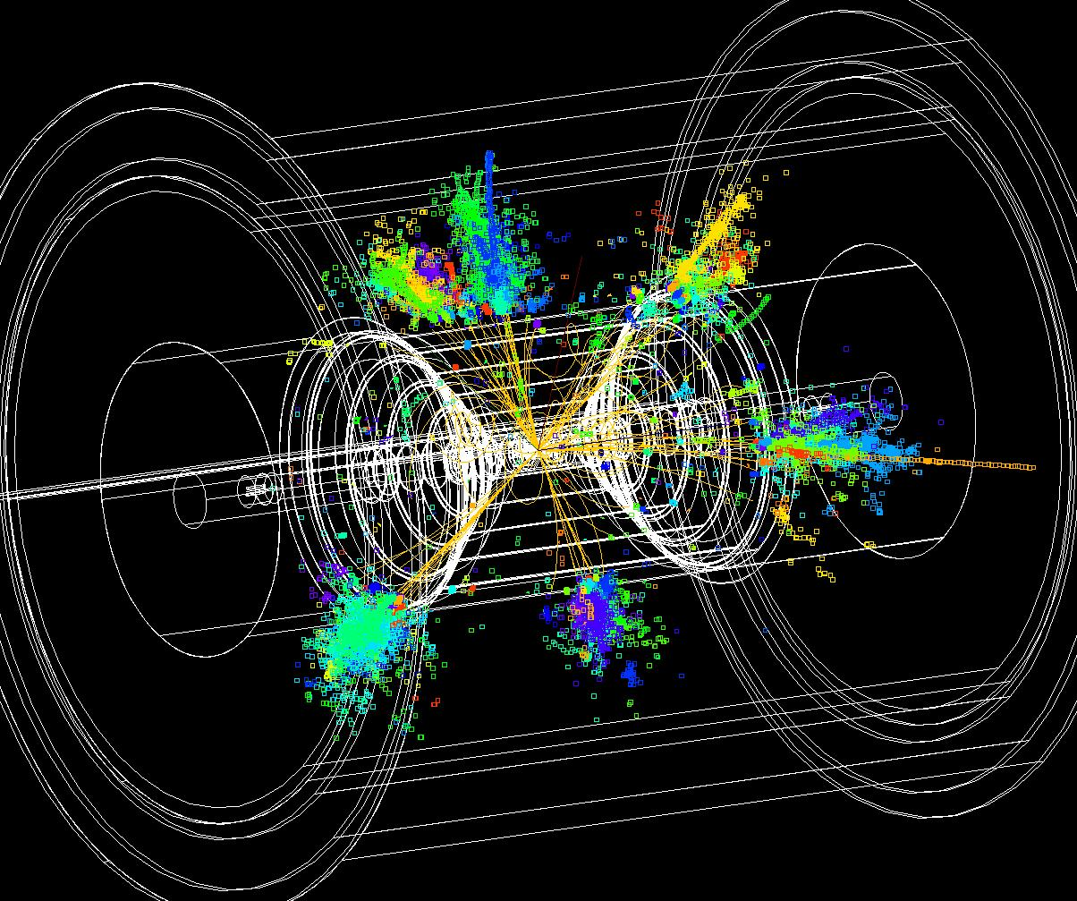
CLIC Detector Issues
Detector requirements are close to those for ILC detectors
  First studies indicate that ILC performances are sufficient
  Adapt ILD and SID concepts for CLIC
  Close collaboration with validated ILC designs
Differences to ILC
  Larger beam energy loss
  Time structure (0.5ns vs. ~300ns)
  Higher background
    High energy
    Small bunch spacing
  Other parameters are slightly modified
    Crossing angle of 20 mradian (ILC: 14 mradian)
  Larger beam pipe radius in CLIC (30mm)
  Slightly denser and deeper calorimetry
Linear collider detector study has been established at CERN beginning of 2009 (led by L. Linssen, see http://www.cern.ch/lcd)

Slide 24
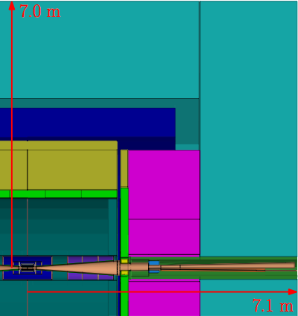
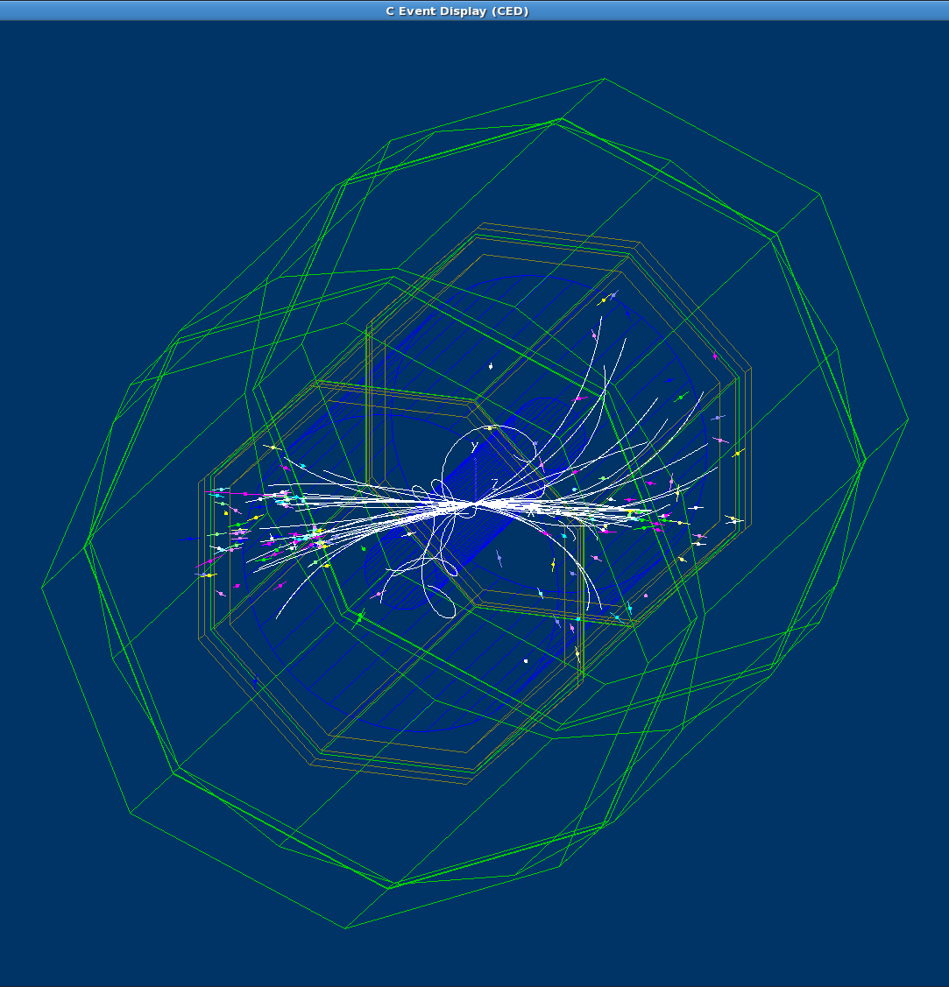
ILD concept adapted to CLIC
Changes to the ILD detector:
20 mrad crossing angle
Vertex Detector to ~30 mm inner radius, due to Beam-Beam Background
HCAL barrel with 77 layers of 1 cm tungsten
HCAL endcap with 70 layers of 2 cm steel plates
Forward (FCAL) region adaptations
Fully implemented in Mokka/Marlin
CLIC_ILD
Andre Sailer
Berlin Humboldt /CERN

Slide 25
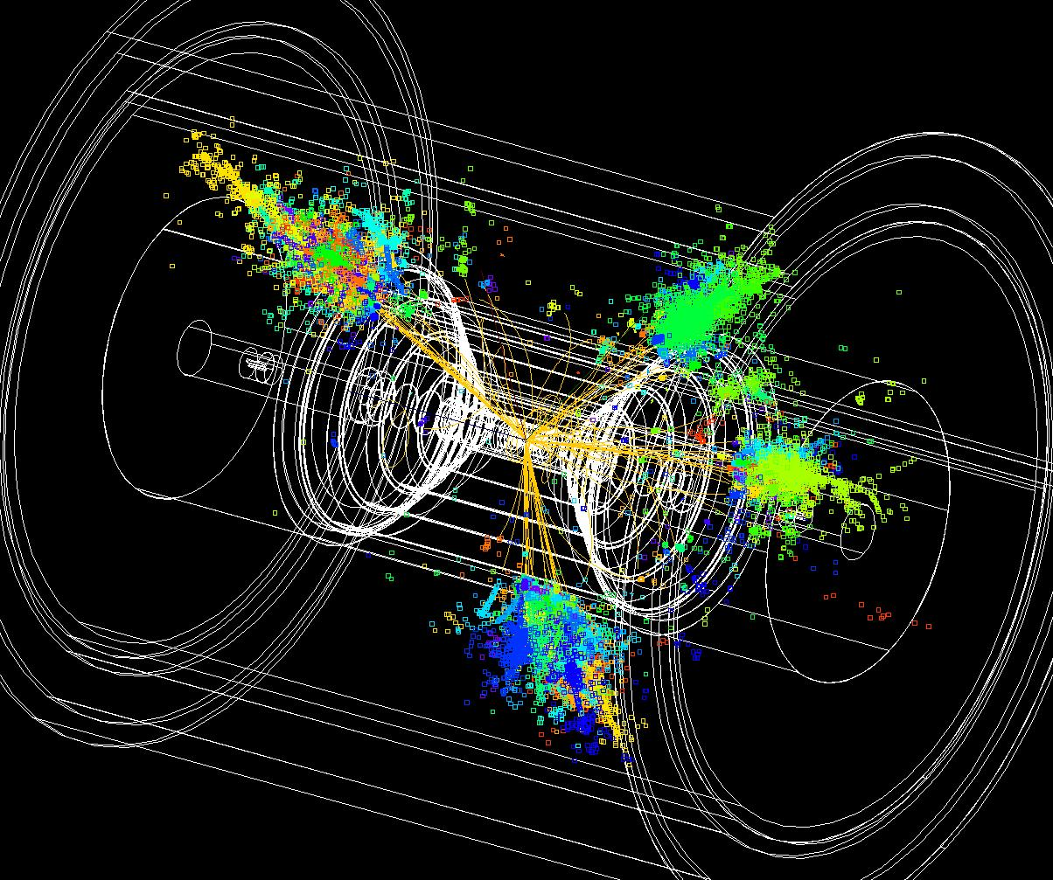
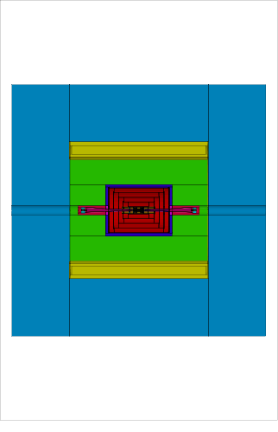
SiD concept adapted to CLIC
Changes to the SiD detector:
20 mrad crossing angle
Vertex Detector to ~30 mm inner radius, due to Beam-Beam Background
HCAL barrel with 77 layers of 1 cm tungsten
HCAL endcap with 70 layers of 2 cm steel
Inner bore of cryostat moved to 2.9 m radius
Forward (FCAL) region adaptations
Fully implemented in SiD SLiC software
6.9 m
CLIC_SiD
6.9 m
Christian Grefe
Bonn Univ. / CERN

Slide 26
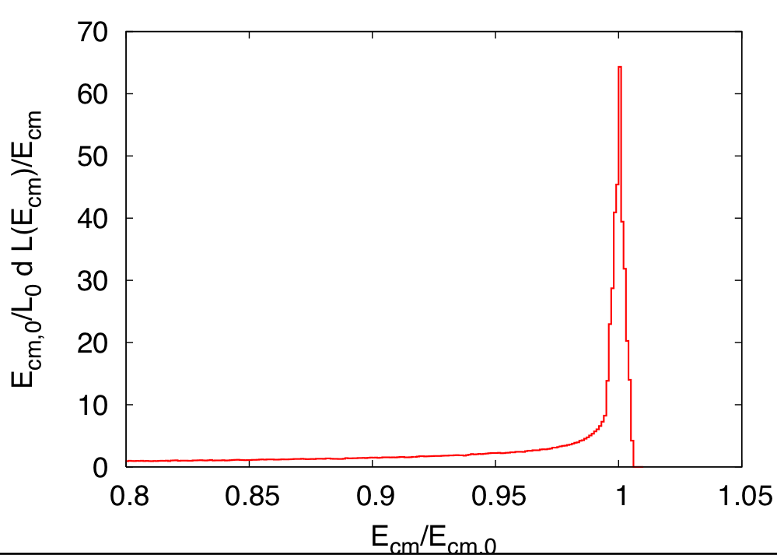
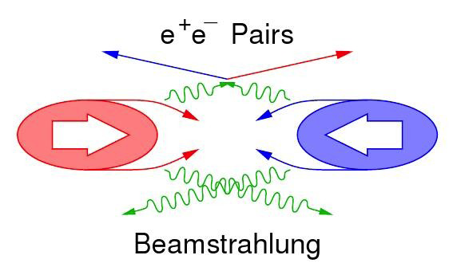
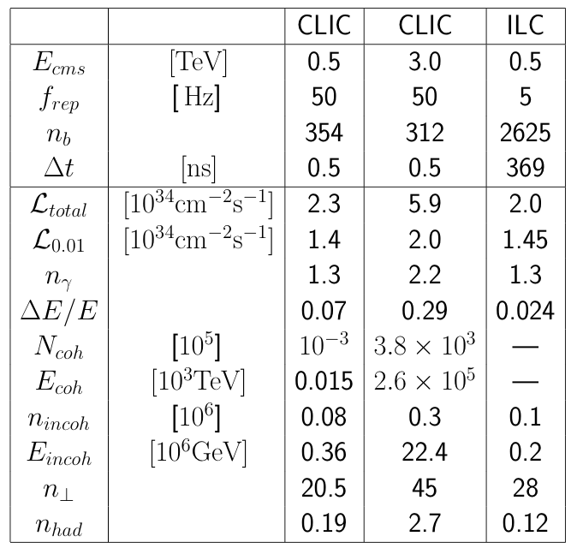
Beam-Induced Background
Beamstrahlung
  Disappear in the beam pipe
Coherent pairs
  Disappear in beam pipe
Incoherent pairs
  Suppressed by strong solenoid-field
Hadronic events
  Impact reduced by time stamping
Muon background from upstream linac

Slide 27
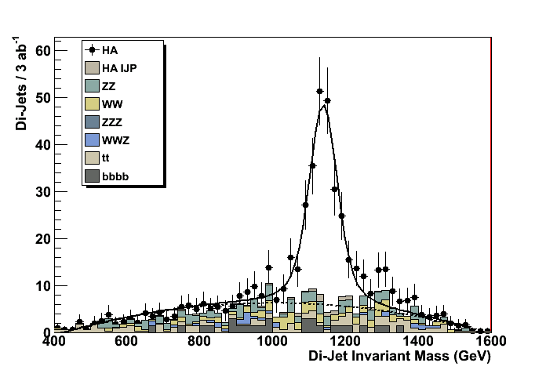
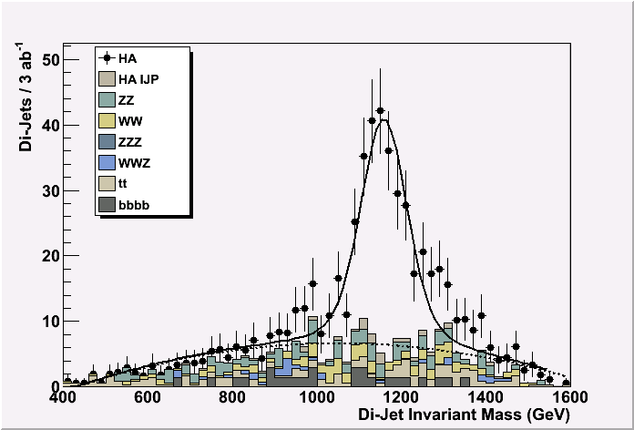
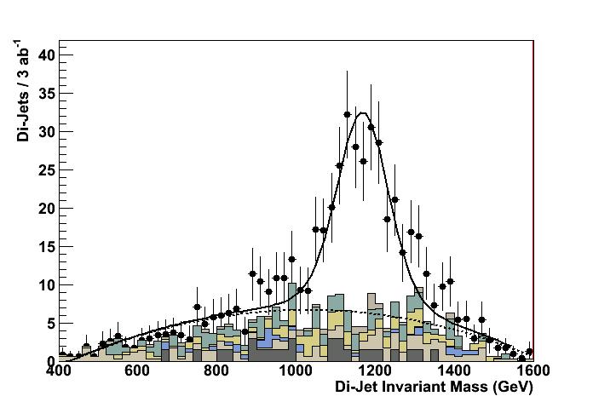
Beam-Induced Background and Time–Stamping
About 3 γγ=> hadron events per bunch crossing
energy goes mostly in the forward region
Simulation example of heavy Higgs doublet H⁰A⁰ at ~1.1 TeV mass (supersymmetry K’ point)
e+e- ➔ H⁰A⁰ ➔ bbbb
Signal + full standard model background + γγ=>hadron background
CLIC-ILD detector: Mokka+Marlin simulation, reconstruction + kinematic fit.
Zero bunch crossings
M_{A} mass resol. 3.8 GeV
20 bunch crossings
M_{A} mass resol. 5.6 GeV
40 bunch crossings
M_{A} mass resol. 8.2 GeV
Marco Battaglia
UCSC / CERN

Slide 28
Jet Energy Resolution and PFA
Is an ILD-sized detector based on PFA suitable for CLIC ?
Defined modified ILD⁺ model:
  B = 4.0 T (ILD = 3.5 T)
  HCAL = 8 Λ_{I} (ILD = 6 Λ_{I})
Jet energy resolution
  using unmodified algorithm
PFA
E_{JET} | σ_{E}/E = α/√E_{jj} |cosθ|<0.7 | σ_{E}/E_{j}
45 GeV | 25.2 % | 3.7 %
100 GeV | 28.7 % | 2.9 %
180 GeV | 37.5 % | 2.8 %
250 GeV | 44.7 % | 2.8 %
375 GeV | 71.7 % | 3.2 %
500 GeV | 78.0 % | 3.5 %
Mark Thomson
Cambridge
Meet “LC jet energy resolution goal [~3.5%]” for 500 GeV jets

Slide 29
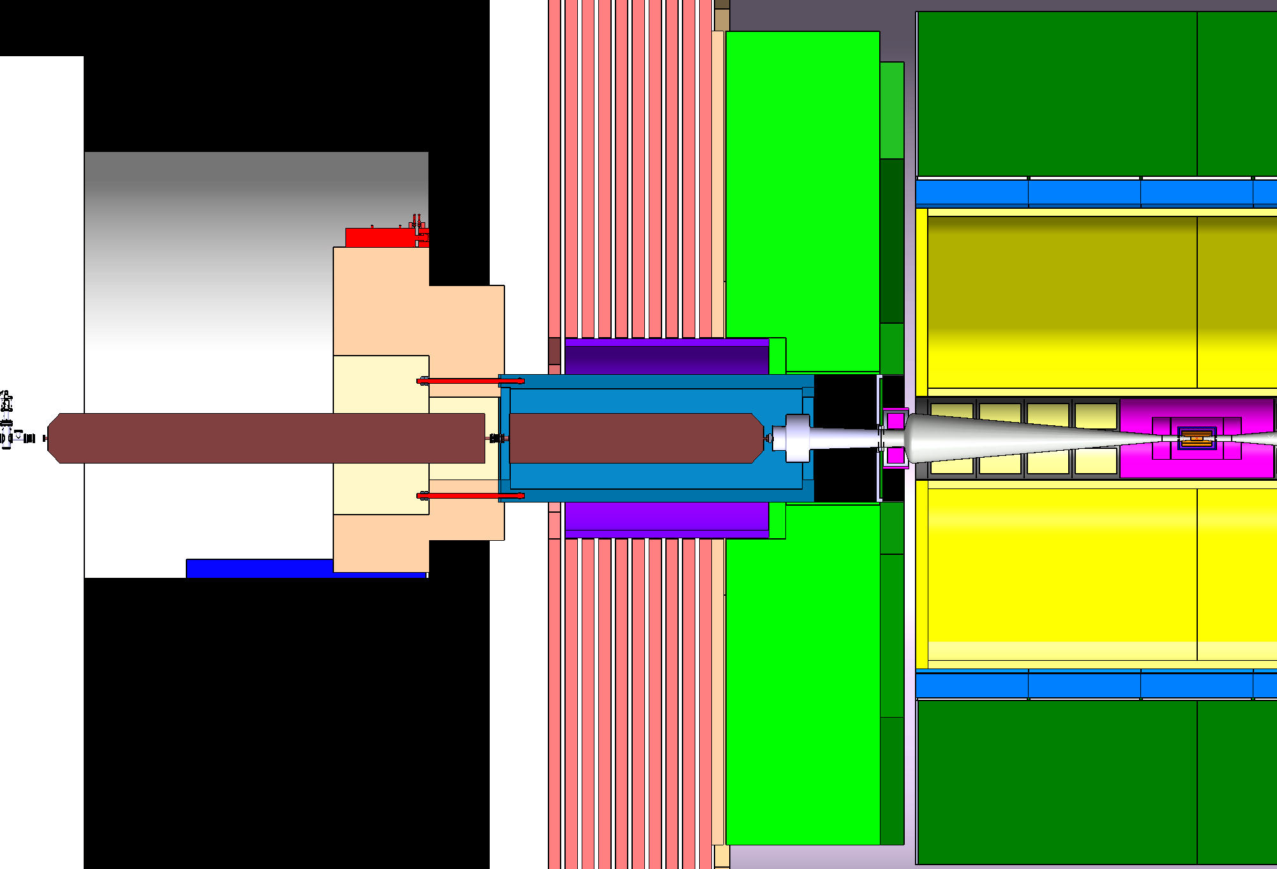
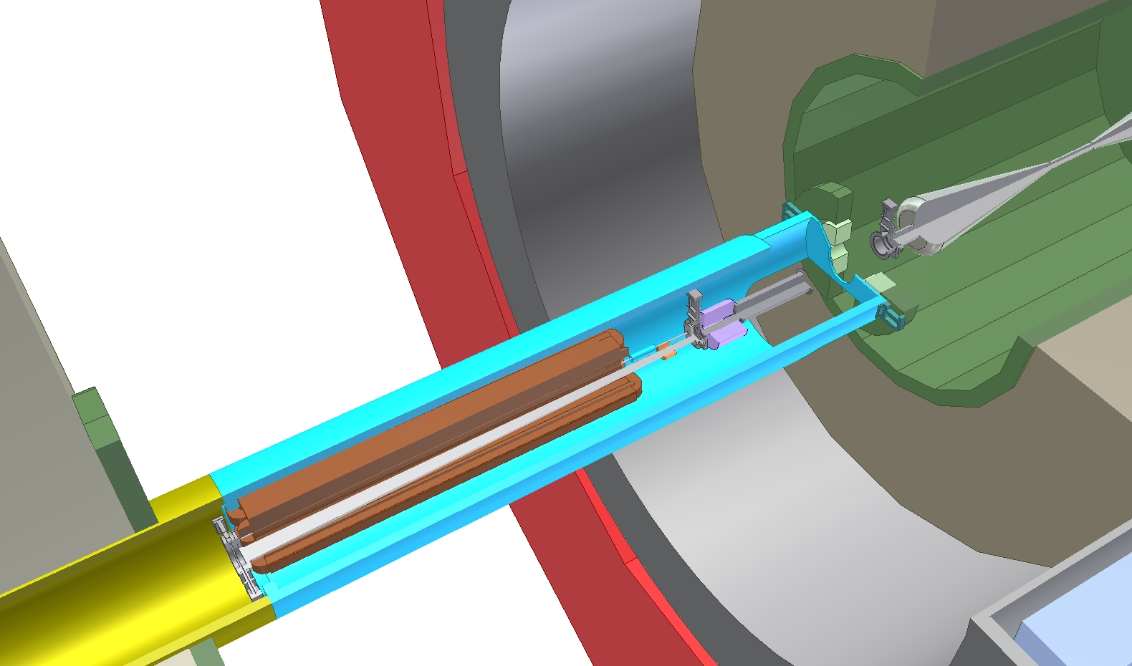
Engineering Issues
Focus on critical issue of providing a stable environment for QD0.
Support QD0 from tunnel with cantilever (A. Herve et al.)
  first studies indicate small jitter amplification
QD0 design exists (M. Modena et al.)
Intra-pulse interaction point feedback integration worked out (Ph. Burrows et al.)
Feedback and stability under study
Other practical issues are also studied
profit from LHC experience
Alain Herve (ETHZ), Hubert Gerwig (CERN)
experiment
tunnel

Slide 30
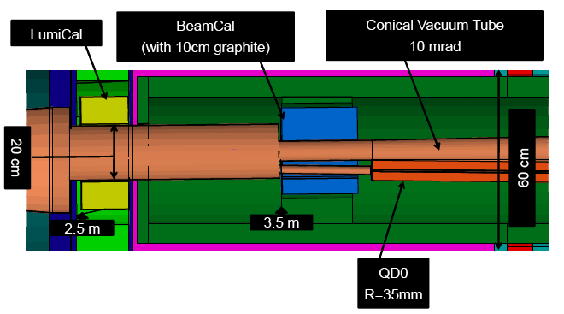
Current LCD Activities
Current activities: preparation for physics/detector CDR, due April 2011
Mostly simulation studies:
  Demonstrate that CLIC physics potential can be extracted from detector
  Propose ILD-like and SiD-like detectors that can do the job
Concentrate on critical issues
  Propose ways to reduce impact of background on the performance
  Redesign of the very forward region
  Take engineering aspects, cost etc into account
Preparing a targeted
hardware R&D plan
Andre Sailer (CERN)

Slide 31
Hardware/Engineering/Software Development
LCD hardware/engineering R&D (for CLIC, beyond ILC developments):
Time stamping
  Most challenging in vertex detector: trade-off between pixel size, amount of material and timing resolution
Hadron calorimetry
  Tungsten-based HCAL (PFA calo, beam tests in preparation, within CALICE)
Solenoid coil
  Large high-field solenoid concept and reinforced conductor R&D
Power pulsing
  In view of the 50 Hz CLIC time structure => allows for low-mass detectors
Engineering developments
  For tungsten-based HCAL calorimeter
  For sub-nm stability for FF quadrupoles within experiment volume
In addition: Collaboration with ILC on Core Software Development

Slide 32
Operation & Machine Protection System
Basic concept is being developed (M. Jonker et al.)
  based on LHC experience
Loss monitoring/control
Startup scenarios
Accidental beam losses
  Slow drifts
    e.g. temperature
    Next pulse permit (if pulse is OK next pulse is allowed otherwise safe beam operation)
  Slow trips
    e.g. magnet failure
    interlock 2ms before pulse
  Fast trips
    e.g. RF or kickers
    reduce incidence frequency and impact
    protective masks

Slide 33
Project Preparation
Project cost, schedule, site, integration aspects and many technical details are critical part of a project
Analytic cost estimate is being prepared (Ph. Lebrun et al.)
  To verify previous synthetic cost estimate
  To identify cost drivers
  In collaboration with ILC to exploit synergy and provided comparable basis for cost estimate
Schedule is being developed (K. Foraz et al.)
Other technical issues are being addressed
  To provide base line for conceptual design
    A number of changes have been implemented
  To make sure that we did not overlook an issue
  To prepare for the TDR phase
Potential sites are being explored (-> J. Osborn et al.)
  Strong synergy with ILC site studies and common ILC-CLIC working group
Close collaboration with ILC

Slide 34
Conclusion
Conceptual design is advancing well
  Last baseline choices are being finalised
  Strong involvement of expert groups
Feasibility issues are being addressed
  Overall good progress but will have to continue after CDR
Cost study is ongoing
  Feedback on design issues
The TDR phase is being prepared
Thanks to all the people from whom I stole slides
  Jean-Pierre Delahaye, L.Linssen, Alexej Grudiev, Frank Tecker, Walter Wuensch …

Slide 35
Reserve

Slide 36
CLIC Main Parameters
http://cdsweb.cern.ch/record/1132079?ln=fr http://clic-meeting.web.cern.ch/clic-meeting/clictable2007.html
Center-of-mass energy | CLIC 500 G |  | CLIC 3 TeV
Beam parameters | Conservative | Nominal | Conservative | Nominal
Accelerating structure | 502 |  | G
Total (Peak 1%) luminosity | 0.9(0.6)·10³⁴ | 2.3(1.4)·10³⁴ | 1.5(0.73)·10³⁴ | 5.9(2.0)·10³⁴
Repetition rate (Hz) | 50
Loaded accel. gradient MV/m | 80 |  | 100
Main linac RF frequency GHz | 12
Bunch charge10⁹ | 6.8 |  | 3.72
Bunch separation (ns) | 0.5
Beam pulse duration (ns) | 177 |  | 156
Beam power/beam (MWatts) | 4.9 |  | 14
Hor./vert. norm. emitt (10⁻⁶/10⁻⁹) | 3/40 | 2.4/25 | 2.4/20 | 0.66/20
Hor/Vert FF focusing (mm) | 10/0.4 | 8 / 0.1 8 / 0.3 |  | 4 / 0.07
Hor./vert. IP beam size (nm) | 248 / 5.7 | 202 / 2.3 | 83 / 2.0 | 40 / 1.0
Hadronic events/crossing at IP | 0.07 | 0.19 | 0.57 | 2.7
Coherent pairs at IP | 10 | 100 | 5 10⁷ | 3.8 10⁸
BDS length (km) | 1.87 |  | 2.75
Total site length km | 13.0 |  | 48.3
Wall plug to beam transfer eff | 7.5% |  | 6.8%
Total power consumption MW | 129.4 |  | 415

Slide 37
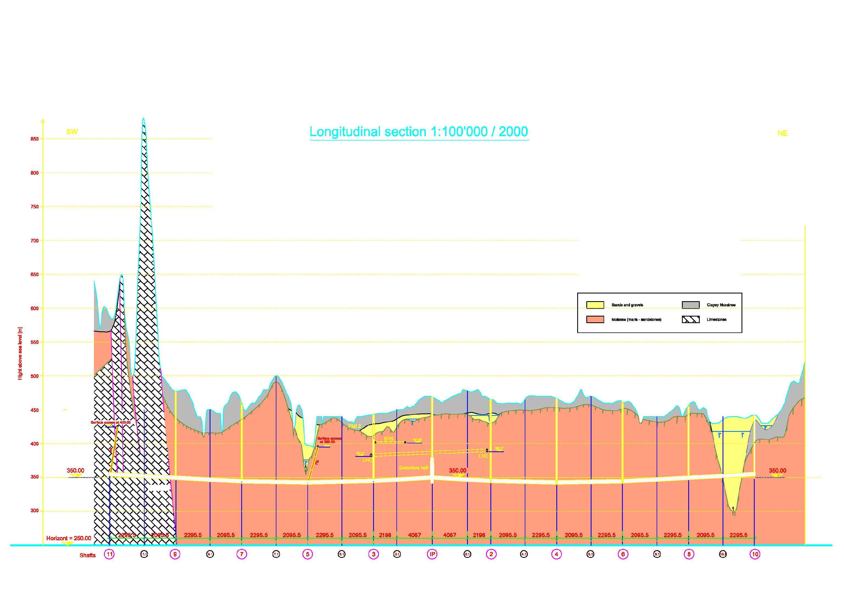
Example Site at CERN
IP under CERN Prevessin site
Phase 1: 0.5 TeV extension 13 km
Phase 2: 3 TeV extension 48.5 km
CERN site
Prevessin
Detectors and
Interaction Point
0.5TeV = 13 Km
3 TeV = 48.5 Km

Slide 38
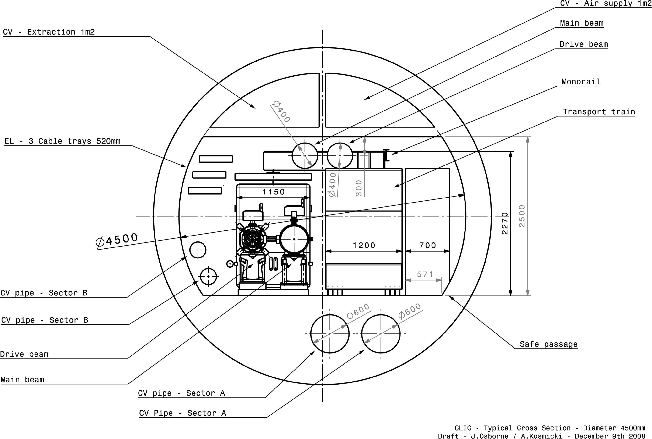
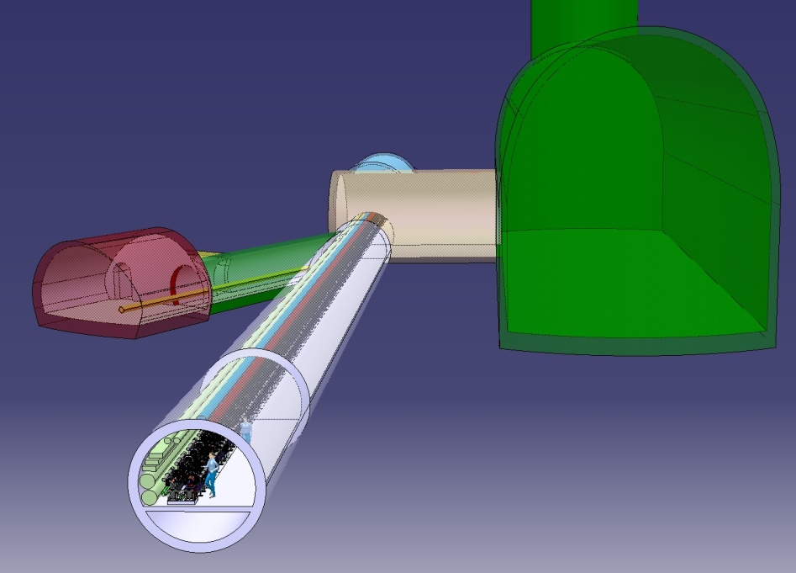

Tunnel Integration
DB turn-around
DB dump
UTRA
cavern
Standard tunnel
with modules
38

Slide 39
CLIC Machine Installation (based on LHC experience)
3 TeV
3 additional years
500 GeV
7 years ready for HW commisioning
Civil engineering
Transport
Interconnections
Tunnel installation

Slide 40


CLIC Two Beam Acceleration Module
Main Beam
Drive Beam
Transfer lines
RF power is generated by 100A drive beam
Drive Beam
Main Beam
40

Slide 41

Parameter Optimisation
A. Grudiev et al.

Slide 42

Optimisation Results
Optimisation - figure of merit:
  Minimum project cost for 3TeV with L_{0.01}=2 10³⁴cm⁻²s⁻¹
Structure limits
  RF breakdown – scaling
  (E_{surf}<260MV/m , P/Cτ^{1/3} limited)
  RF pulse heating (ΔT<56°K)
Beam dynamics
  Beam-beam effects
  Damping rings, BDS
  Main linac emittance preservation – wake fields
Cost model
Merged into one big model
Chose 100MV/m and 12GHz
A.Grudiev, H. Braun, D. Schulte, W. Wuensch.

Slide 43
Two-Beam Concept
The drive-beam concept is important because it provides the necessary flexibility in parameter space
  For optimum cost and gradient CLIC needs short RF pulses with very high power
    240ns long 64MW pulse for each 23cm long structure
X-Band klystrons
  Less than 100MW
  Need one klystron per structure (140,000 klystrons) or pulse compression
  Klystrons are vital for structure tests
Drive beam scheme
  140us long 1GHz RF pulses are transformed into 240ns long 12GHz RF pulses
    Very efficient klystrons can be used
    No need to have klystrons in main linac tunnel (or to use long over-moded waveguides)

Slide 44

CLIC Main Parameters
http://cdsweb.cern.ch/record/1132079?ln=fr http://clic-meeting.web.cern.ch/clic-meeting/clictable2007.html
High gradient to reduce cost
Break down of structures at high fields and long pulses
  Pushes to short pulses
  and small iris radii (high wakefields)
High luminosity
Improve wall plug to RF efficiency
Push RF to beam efficiency
  Push single bunch charge to beam dynamics limit
  Reduce bunch distance to beam dynamics limit
Push specific luminosity -> High beam quality
  Beam-based alignment and tuning
  Excellent pre-alignment
  Component stabilisation

Slide 45

Luminosity Limitations

Slide 46

Experimental Condition Limitations

Slide 47

Horizontal Beam Size Optimisation

Slide 48

Damping Ring Design
PARAMETER | NLC | CLIC (3TeV)
bunch population (10⁹) | 7.5 | 4.1
bunch spacing [ns] | 1.4 | 0.5
number of bunches/train | 192 | 316
number of trains | 3 | 1
Repetition rate [Hz] | 120 | 50
Extracted hor. normalized emittance [nm] | 2370 | <500
Extracted ver. normalized emittance [nm] | <30 | <5
Extracted long. normalized emittance [keV.m] | 10.9 | <5
Injected hor. normalized emittance [μm] | 150 | 63
Injected ver. normalized emittance [μm] | 150 | 1.5
Injected long. normalized emittance [keV.m] | 13.18 | 1240
Present CLIC DR design for 3TeV achieves goals for transverse emittances with a 20%-30% margin (380nm horizontal and 4.1nm vertical)
Conservative DR output emittances (2.4μm horizontal, 10nm vertical) for CLIC @ 500GeV scaled from operational or approved light source projects (NSLSII, SLS)
Route to lower emittances to be defined

Slide 49

Main Linac Design
Main linac uses strong focusing to maximise bunch charge that can be transported in stable fashion
About 10% of the linac are magnets
Leads to tight alignment tolerances (O(10μm))
Leads to tight stability tolerances (O(1nm) for quadrupoles)
D. Schulte
49

Slide 50

CLIC Physics up to 3 TeV
What can CLIC provide in the 0.5-3 TeV range?
In a nutshell…
Higgs physics:
Complete study of the light standard-model Higgs boson, including rare decay modes (rates factor ~5 higher at 3 TeV than at 500 GeV)
  Higgs coupling to leptons
  Study of triple Higgs coupling using double Higgs production
Study of heavy Higgs bosons (supersymmetry models)
Supersymmetry:
Extensive reach to measure SUSY particles
And in addition:
Probe for theories of extra dimensions
New heavy gauge bosons (e.g. Z’)
Excited quarks or leptons
50
D. Schulte
ILC meeting Beijing March 26, 2010

Slide 51

(S)LHC, ILC, CLIC reach
Gian Giudice CLIC09
51
D. Schulte
ILC meeting Beijing March 26, 2010

