Slide 1
2010 (and beyond) Plans & Milestones
Nick Walker
Marc Ross
Akira Yamamoto

Slide 2
2010 – A Year of Transition
Phase 1 ends – Phase 2 begins
This is our last meeting in Phase 1
Seamless transition
No major re-structuring etc.
Adiabatic “shift in emphasis” needed
Beginning plan for producing TDR (end 2012)
Consolidation (results) of risk mitigating R&D
Collider design work → updated cost estimate
Documentation!
A good opportunity to take stock and review where we are

Slide 3
TD Phase Goals – A Reminder
TDR deliverables:
Results from Risk Mitigating R&D
Updated Reference Design
Updated VALUE estimate
Project Implementation Plan
General Goals
Risk Mitigating R&D
Main Linac SCRF [gradient, cavity yield, mass-production and industrialisation]
Beam Test Facilities [ATF/ATF2, CESRTA, TTF/FLASH, DAPHNE…]
Sources…
Accelerator Design & Integration
Integrated, robust and simplified design
Cost containment

Slide 4
Where do we stand?
Published milestones in R&D Plan
Pay attention!
Part of Workshop Charge: Review these milestones & goals
Expect status report as part of WG summaries
PM are planning major update for Release 5
Due June 2010
Your input will be required

Slide 5
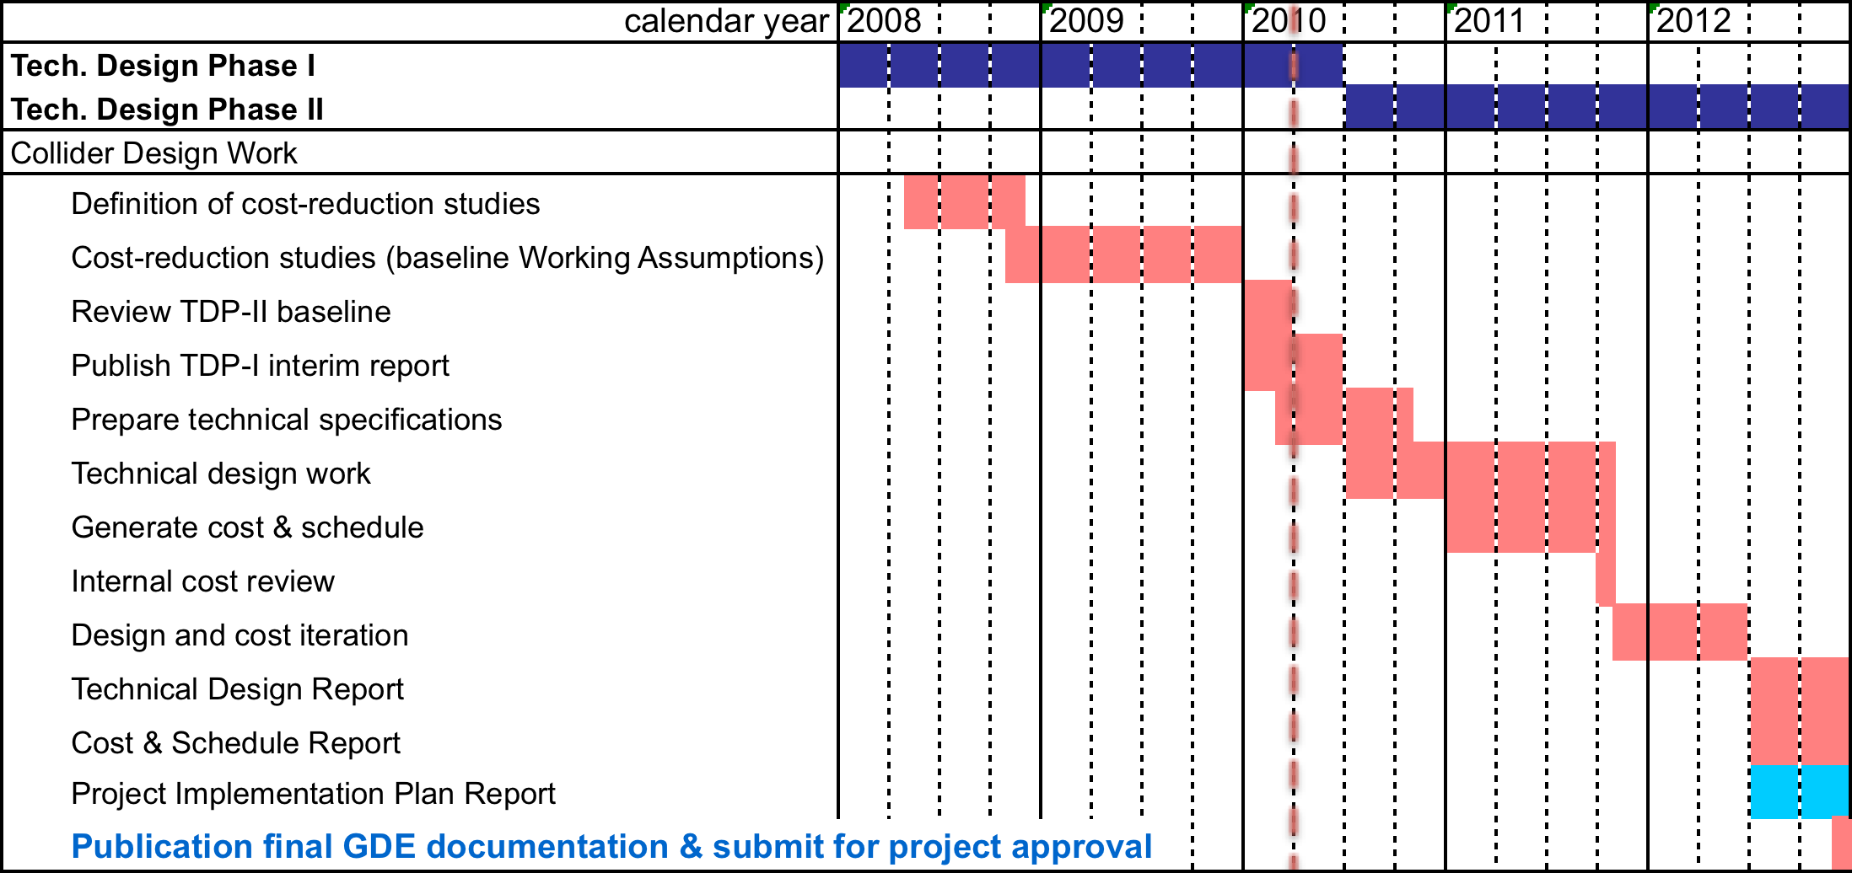
Collider Design Work (ADI)
✔
✔
Impact of re-baseline delay requires schedule review
Notes:
Cost reduction studies == SB2009
Use this slide to emphasise there is not too much time left for TDR.

Slide 6
Collider Design Work (ADI)
✔
✔
CC process
Impact of re-baseline delay requires schedule review
Notes:
Cost reduction studies == SB2009
Use this slide to emphasise there is not too much time left for TDR.

Slide 7
Collider Design Work (ADI)
✔
✔
CC process
Impact of re-baseline delay requires schedule review
Notes:
Cost reduction studies == SB2009
Use this slide to emphasise there is not too much time left for TDR.

Slide 8
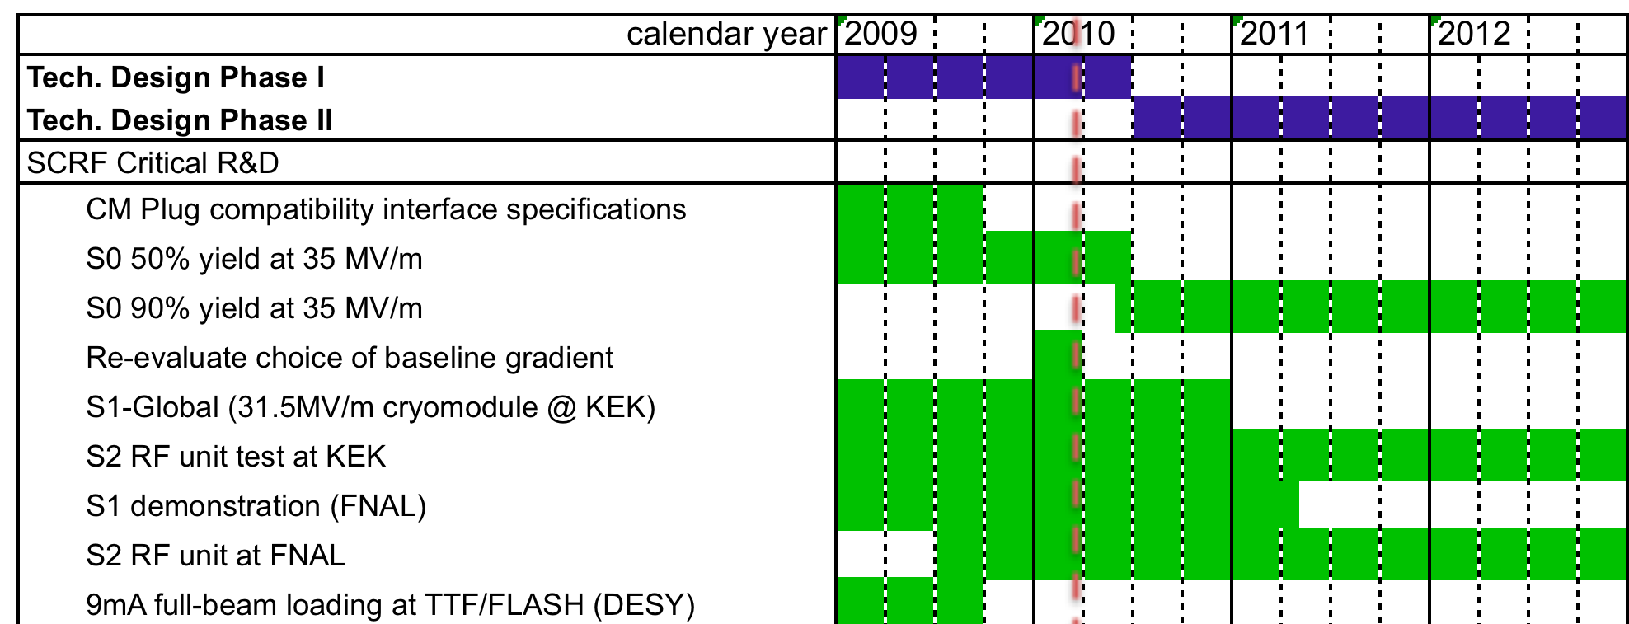
R&D: SCRF
?
CC process
✔
Required: strategy and plans for producing an updated cryomodule cost (early 2012?)
Notes:
Mention database activities for yield calculation (first highlight bubble)
Discuss gradient re-evaluation – three aspects: fabrication yield (VT acceptance); margin for CM assembly; margin for operations (LLRF)
All these aspects affect the cost of the Main Linac.

Slide 9
R&D: SCRF HLRF
Milestones for RDR Alternatives:
Marx modulator development / demonstration 2010
Demonstration of circulator-less distribution 2010 system (with VTO)
Klystron Cluster System (KCS)
Initial high-power tests of WG components 2010
EM modelling of components (VTO etc) 2010
FMEA / operations study 2010
Full-power tests of WG components 2012
Distributed RF System (DRFS)
Prototype of 700kW Mod. Anode Klystron 2010
Prototype of Mod. Anode Modulator 2010
Design for manufacture (cost!) 2012
MAK/MAM lifetime demonstration 2012

Slide 10
R&D: SCRF HLRF
Milestones for RDR Alternatives:
Marx modulator development / demonstration 2010
Demonstration of circulator-less distribution 2010 system (with VTO)
Klystron Cluster System (KCS)
Initial high-power tests of WG components 2010
EM modelling of components (VTO etc) 2010
FMEA / operations study 2010
Full-power tests of WG components 2012
Distributed RF System (DRFS)
Prototype of 700kW Mod. Anode Klystron 2010
Prototype of Mod. Anode Modulator 2010
Design for manufacture (cost!) 2012
MAK/MAM lifetime demonstration 2012
→ CC (re-baseline)

Slide 11
R&D: SCRF HLRF
Milestones for RDR Alternatives:
Marx modulator development / demonstration 2010
Demonstration of circulator-less distribution 2010 system (with VTO)
Klystron Cluster System (KCS)
Initial high-power tests of WG components 2010
EM modelling of components (VTO etc) 2010
FMEA / operations study 2010
Full-power tests of WG components 2012
Distributed RF System (DRFS)
Prototype of 700kW Mod. Anode Klystron 2010
Prototype of Mod. Anode Modulator 2010
Design for manufacture (cost!) 2012
MAK/MAM lifetime demonstration 2012
?
→ CC (re-baseline)

Slide 12
Accelerator Systems R&D
Electron Source:
Proof of principle system 2008 (?)
Reliable 200 kV load-locked gun prototype 2009 (?)
Prototype laser system 2010
Generation of beam with ILC spec. 2010
Reliable 350 kV load-locked gun prototype 2011
Required: plans for polarised cathode fundamental R&D
Notes:
Note cathode charge-limit could be ILC performance bottleneck.
Cathode R&D requires ILC spec. laser.

Slide 13
Accelerator Systems R&D
Positron Source:
SC Helical undulator prototype 2009 ✔
Feasibility studies and design of a high-field 2009 (2010) flux concentrator
Feasibility study and design of a lithium lens 2010 with possible beam tests
Engineering design of rotating target system 2010 with appropriate lifetime
Feasibility studies and beam tests of 2010 liquid Pb target
Feasibility studies and beam tests of 2010 a hybrid crystal target
In addition: SB2009 parameters/specifications and associated ADI work → CC (re-baseline)
Notes:
Believe LLNL studies on FC and target will be end US FY 2010 – check.
New R&D: FC prototype module and target prototype including vacuum seal.
Mention the need for thorough review, including performance specifications.

Slide 14
Accelerator Systems R&D
Damping Ring – ATF:
Demonstration of 2pm vertical emittance 2010
Damping Ring - DAφNE
Fast kicker demonstrations 2010
Damping Ring – CesrTA:
Reconfiguration of machine 2008 ✔ incl. instrumentation and test sections; First measurements of ecloud building up.
Reduced emittance operation; 2009 ✔ e-cloud build-up in wiggler chambers
Characterisation of e-cloud build-up and 2010 instability thresholds as a function of low vertical emittance (≤20 pm)
Final recommendations on e+ DR configuration (including possible 3km ring) → CC (re-baseline)

Slide 15
Accelerator Systems R&D
RTML
Experimental demonstration of the bunch 2011 compressor RF phase stability, and beam- (FLASH) loading compensation
Results of beam dynamics simulation, 2010? demonstrating the required emittance tuning techniques
Further studies of single-stage compressor option for SB2009 (compression limits)

Slide 16
Accelerator Systems R&D
BDS– ATF2:
Demonstration of design beam size 2010
Demonstration of the beam stability 2012
Evaluation of performance of SC FD and permanent magnet FD 2012
BDS
Demonstration of the required phase ? stability of the prototype crab cavity system
Many other ADI related studies listed in Appendix B

Slide 17
Accelerator Systems R&D
Simulation:
Answers to critical beam-dynamics questions arising during the TD Phase (engineering driven)
Overall (simulated) demonstration of emittance preservation from the Damping Rings to the interaction point
Modelling of halo generation, transport and collimation
Software tools (simulation codes)
Specific studies resulting from SB2009 studies to be defined → CC (re-baseline)

Slide 18
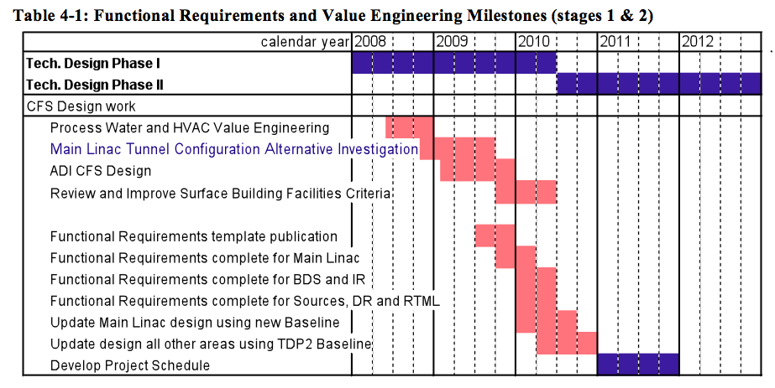
CFS
Focus has been on ADI (SB2009) in 2009 Schedule needs re-work for proposed CC (re-baseline)

Slide 19
Planning for the TDR
 | 2010 | 2011 | 2012
Risk Mitigating R&D
Re-Baseline (CC)
AD&I
SCRF
CFS
Update VALUE estimate
Document baseline
Write TDR report(s)
More detail required
Definition of milestones & critical path
AD&I, SCRF and CFS are focus activities and need definition
Notes:
Use this to show there is not so much time as people think to achieve the TDR goals.

Slide 20
TDR – what is it?
Provides traceability
Released documentation
All relevant design documentation over next two years

Slide 21
Two Imminent Reports
TD Phase Interim Report
To be published ~July 2010
General status report
Terse!
Upbeat publication (outreach)
Photos
Results
..
TD Phase R&D Plan Release 5
To be published in June 2010
Resource tables update in May for FALC RG
More detailed planning for TD Phase 2
Major update (re-write) expected
Main report body – PMs
Appendix B sections – TAG leaders
Considerable amount of work which will require careful planning.

Slide 22
This Workshop
What’s expected from the WG
Review of the R&D status (esp. R&D Plan milestones)
How will R&D results factor into ILC baseline?
And when?
ADI activities – how mature are the current designs
Special attention to SB2009 themes
Catalogue outstanding decisions
What remains to be done for the TDR?
Overall planning and milestone updates
R&D plan release
What’s expected from the PMs
Better defined overall schedule and goals (2010+)
Change control procedure (SB2009)
Outline for Interim Report
Schedule/requirements for R&D Plan Update
Detailed planning (action items) for next 6 months → October GDE meeting (Geneva)
Top-level planning towards TDR

