Slide 1
Workshop charge F. Richard for the WWS-OC
Wor
The Hall of Supreme Harmony 太和殿

Slide 2
Outline
Where we are
What are the next steps to be discussed at LCWS10
Influence of LHC start up
LC Strategy

Slide 3
Introduction
The LoI validation by IDAG has required a ‘tour de force’ from the community with beautiful results illustrating the physics potential of ILC
We are now entering in the DBD phase which requires a careful optimization of efforts given the limited resources
SiD and ILD are defining a strategy in common with detector R&D collaborations to achieve their base line detectors (with options for some sub-detectors)
During this workshop these aspects will be discussed with IDAG which intends to accompany these efforts till 2012
Also the SB2009 proposal has illustrated the need to tighten our links to GDE and this workshop will be an important step in this process

Slide 4
Beyond the LoIs
Questions are :
Improved realism on detector studies (background, engineering aspects)
How and when to restart physics analysis ?
Consequences of SB2009 on physics
Physics scenarios in 2010-2012 ?
What happens after 2012 ?

Slide 5
Improved realism
Realism of DBD will require engineering: detector integration, credible push-pull together with alignment issues
Realism means understanding time stamping strategy, pulsing issues, influence of magnetic field, material, cooling, dead zones and this work is part of the ongoing R&D effort
More realistic studies of backgrounds (not only beamstrahlung but also underlying γγ evts SR, neutrons from the dump, µ halo… which are very demanding for our software
Very large efforts which, given limited resources requires careful prioritization
Note that lab Directors at ILCSC have reacted positively to RD demand for help
Don’t miss this opportunity !

Slide 6
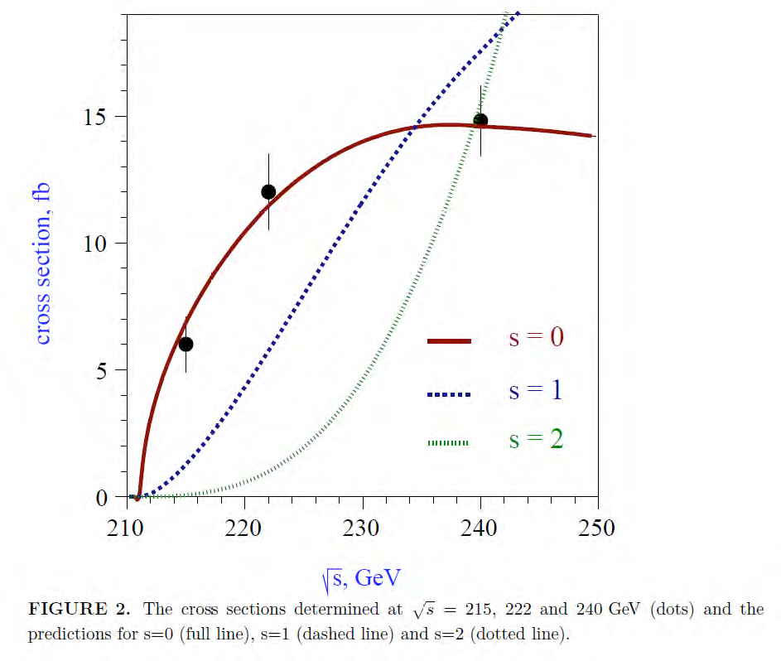
SB2009
Important event for this workshop: a process requiring tight connection between the Physics/ Detector community and GDE
Again, realism: being cost-effective and least damaging to physics
See plenary meeting with J. Brau et al tomorrow and MDI special session (on Sunday )
We need to think carefully on possible tradeoffs
Two issues :
threshold scan or spin parity ? Plot shows dominance of sin²θ_{Z} over 1+cos² θ_{Z}
How important is the accuracy on mH ? (40MeV-> 100 MeV)

Slide 7
Thresholds scans
SUSY or other scenarios may require time consuming threshold scans at low energy to get the ultimate accuracy but it all depends on which physics will pop out LHC
ILC should remain flexible to face real scenarios
One issue is tradeoff between running time and construction investment (see LHC !)
Examples of accuracies from TESLA with scans on δm

Slide 8
Physics Analysis
When and how to restart physics studies? Again, issue is limited manpower and hard work needed to complete such analyses
While R&D on subdetectors will go on till 2012 and beyond, a choice of a stable and realistic baseline detector needs to be finalized soon to re-start physics studies (long process for full simulation/reconstruction)
This does not mean of course that we need to freeze our choices since R&D will go on providing new elements. More than one sub-detector type can/will be allowed.
Which type of Physics analysis ?
Select reference reactions for their interest and to test detector performances: e.g. cover 1 TeV physics (parameters ?)
Proposal from Physics panel (see talk of Keisuke Fujii) to be discussed between IDAG and the concepts
Find an efficient way to provide fast responses: while full simulation of SM needed for reliable studies, simplification is possible for simple channels e.g. Hµµ

Slide 9
What can we expect to happen during 2010-2011 ?

Slide 10
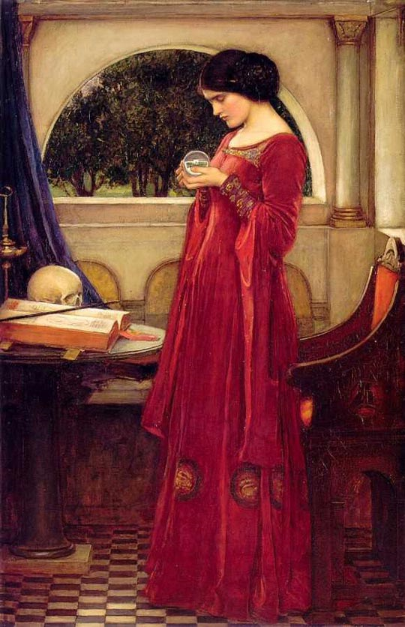
Scenario at LHC
A successful start of LHC plays an essential role in our roadmap
What can we expect in 2010-2011 ?
Hopes at LHC: discovering CMSSM or an extra generation of quarks (mt’<500 GeV) is possible with low luminosity
Moriond 2010: ATLAS/CMS have a discovery potential for SUSY signatures with gluino and squark masses up to 600 / 700 GeV for 200 pb-1 at √S= 10 TeV (≈ 700/800 pb-1 for √S= 7TeV) to be compared to 300-400 GeV at Tevatron
This covers a large fraction of the so-called CMSSM/ NUHM1 predicted spectrum (fit from observables)
Also sensitivity to Z’ up to 1.5 TeV

Slide 11
LHC

Slide 12
Higgs
LHC will reach the appropriate sensitivity on Higgs
~end 2013
TeVatron can exclude or hint a light Higgs end 2011

Slide 13
Strategy for DBD
Strategy of SiD and ILD for DBD in 2012 reported to RD and discussed with IDAG
Limitation in resources, regional unbalance are serious concerns
Sharing of resources at all levels is mandatory
It is important to have the best ILD-SiD connections (Harmony !) to set up common goals and share efforts (software, engineering, MDI)
Careful planning of R&D efforts, test beam strategy
CLIC-ILC connections for mutual benefits e.g. coil, software effort (physics > 1 TeV) , R&D, engineering here also avoiding duplication of efforts
CLIC-ILC panel will start at this meeting

Slide 14
The international landscape
What comes after 2012 after machine TDR and Detector DBDs ?
Questions debated at ILCSC/ICFA/FALC but the community should manifest its opinions through RD and the WWS co-chairs
See report J. Bagger at the end of this workshop + presentations of A. Suzuki and R. Heuer
Major ongoing effort in the preparatory phase for a machine and also siting, governance…
How to go from the present political stage (FALC) to a higher one, of the intergovernmental type ( comparable to the ITER approval process) ?
Etc…
These issues are vital to insure a credibility of our project

Slide 15
Conclusions
Major effort in front of us to reach our objectives by 2012
This workshop is important to define an optimum strategy given our limited resources
Our community needs clear messages about the future ASAP
LHC may provide early messages in spite of a slow startup
ILC should not miss this opportunity

Slide 16
Back up slides

