Slide 1
Status of the MICROMEGAS semi-DHCAL
M. Chefdeville
LAPP, Annecy, France
LCWS, 27th March 2010, Beijing

Slide 2
Overview
The 1 m³ semi-DHCAL project & MICROMEGAS
Simulation
Test beam and ASIC
DAQ
The 1 m² MICROMEGAS prototype

Slide 3
The 1 m³ semi-DHCAL
Calorimetry based on Particle Flow
Granularity more important than resolution → digital option
Loss of linearity at high energy (100 GeV/c) → 2 bit readout → semi-digital HCAL
1 m³ semi-DHCAL project in France
Funded by CNRS/IN2P3 + “Agence Nationale de la Recherche” (ANR) + Rhone-Alpes region (chip development)
Several labs involved LAL (Orsay) → HARDROC LLR (Palaiseau) → CALICE DAQ IPNL (Lyon) → RPC LAPP (Annecy) → MICROMEGAS
Choice of active media (required by ANR schedule)
3 physicist committee
RPC favored but production of MICROMEGAS m² planes should be pursued

Slide 4
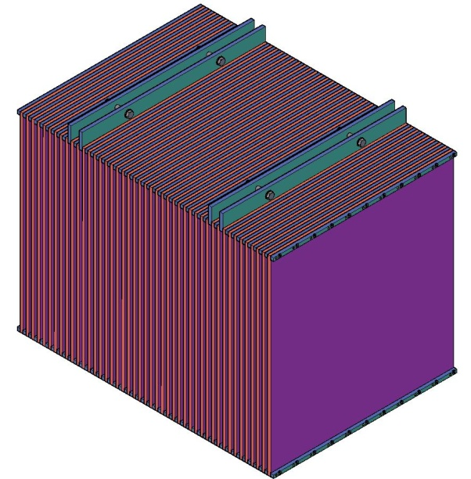
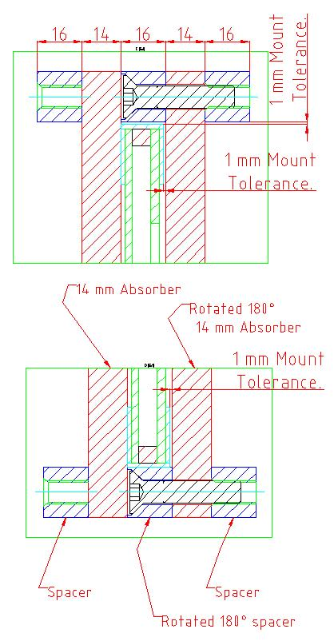
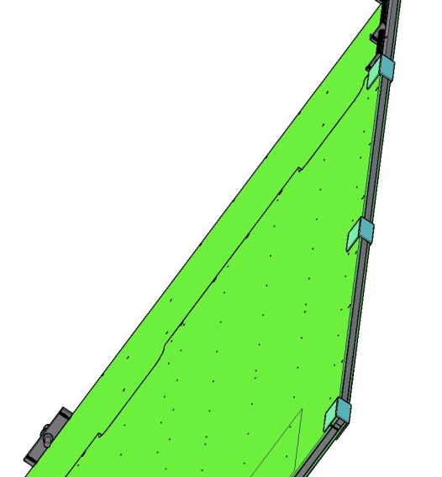
The 1 m³ structure
Design proposed by CIEMAT group
In collaboration with LAPP engineer
2 different mechanical pieces minimum machine operation on each piece
Deformation and stress simulation
From Enrique Calvo Alamillo talk, Madrid, 1st March 2010
Compatible with RPC and MICROMEGAS
44 planes
16 mm between absorbers 1 mm tolerances

Slide 5
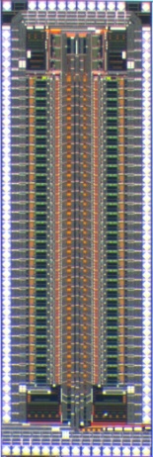
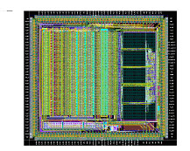
Detector planes
RPC VS MICROMEGAS
Large VS small signals, low VS high rate capability
Limited proportionality VS proportional mode → MICROMEGAS best suited for semi-DHCAL
Semi-digital readout
HARDROC or DIRAC ASIC (3 thresholds)
What should the threshold be? → detailed simulation

Slide 6
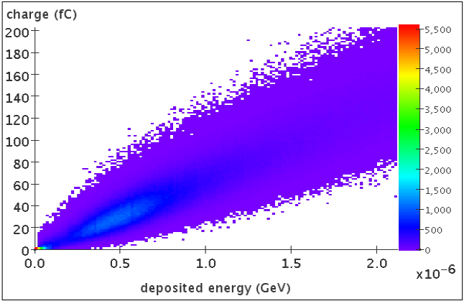
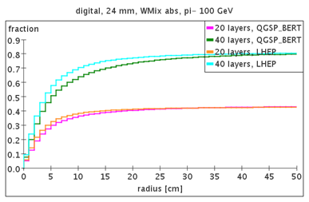
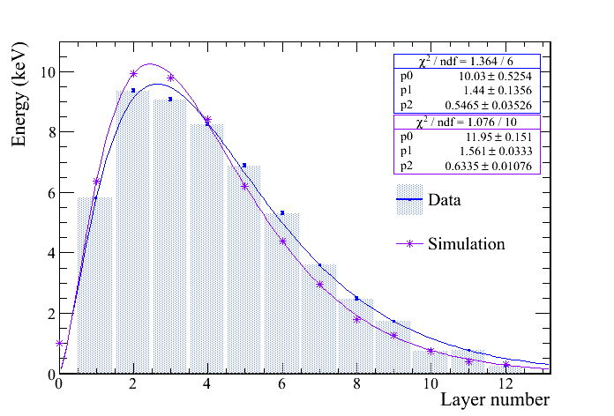
Simulation (I)
Comparison analogue/digital readout for 1 m³ steel, applying 1 energy threshold
Energy resolution, linearity, shower shapes → 2009 JINST 4 P11009
Digitization, from GEANT4 energy deposits in gas layers to hits, applying charge thresholds
Simulation for CLIC:
Definition of HCAL;
Definition of small prototype for beam test: → J. Blaha, CLIC Physics and Detector Meeting, 15 Sep. 2009, CERN
TB setup simulation and comparison with data → shower profile study to be published
TB: 2 GeV/c electron shower profile

Slide 7
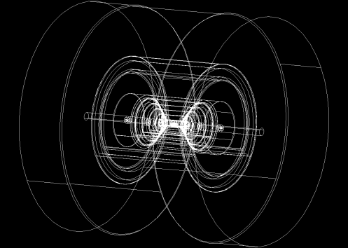
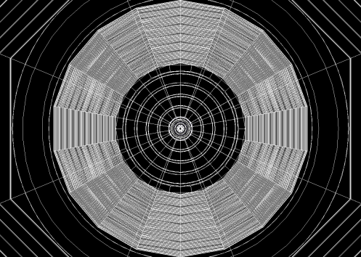
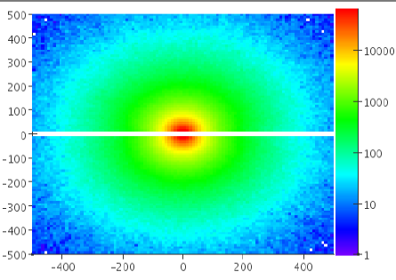
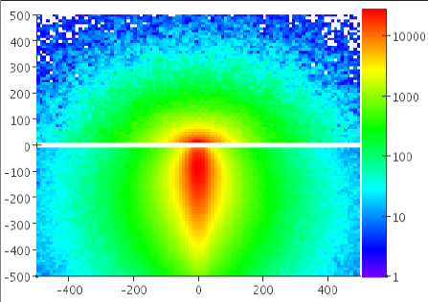
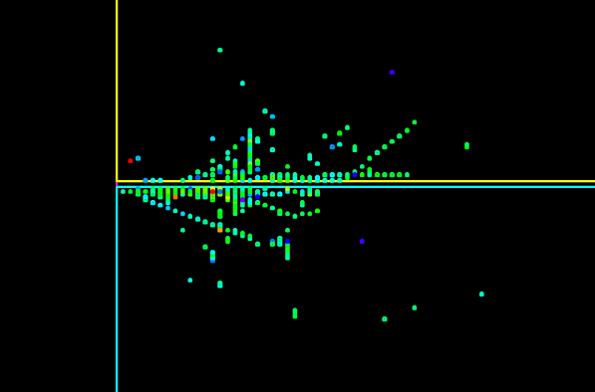
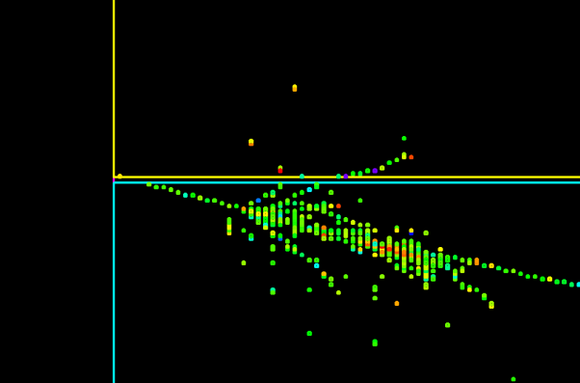
Simulation (II)
Implementation of MICROMEGAS DHCAL in CLIC and SiD detector geometry
Study of crack effects on HCAL performance
Projective and tilted geometries

Slide 8
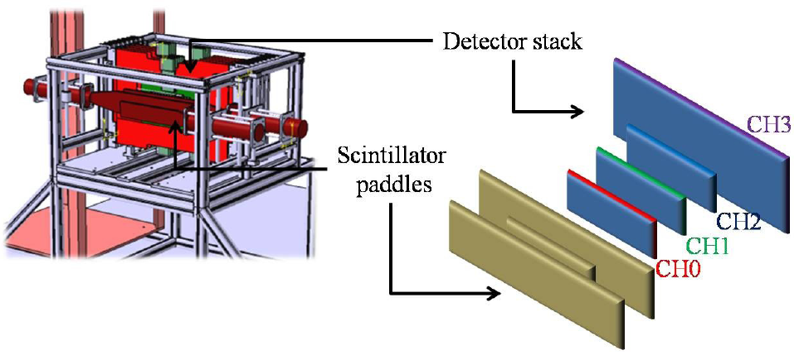
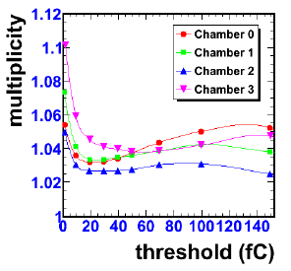
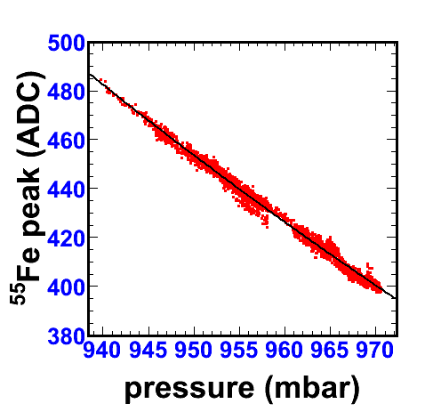
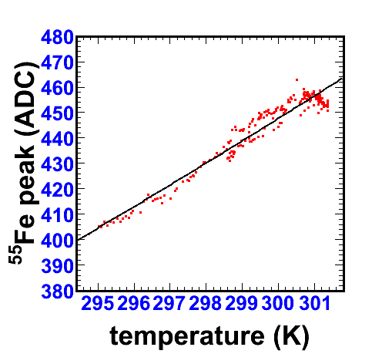
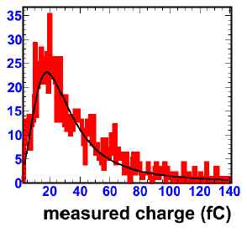
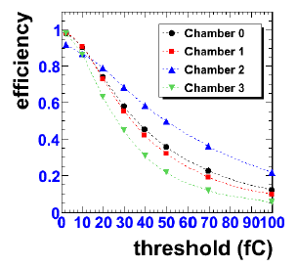
TB and ASIC developments
Detector characterisation done with analogue readout prototype (GASSIPLEX)
Carried out with Irfu collaborators
→ 2009 JINST 4 P11023
Signal MPV of 20 fC (with 10 % variations)
Sensitivity to P, T (2 % / K & -0.6 % / mbar)
At a threshold of 1.5 fC
97 % efficiency with variations < 1 %
Hit multiplicity below 1.12

Slide 9
TB and ASIC developments
Now focus on test of digital readout prototypes with embedded electronics
ASIC and spark protection components on PCB
Bulk lamination on PCB using a mask at CERN workshop
RD51 collaboration (http://rd51-public.web.cern.ch/RD51-Public) asked for a new location: increased production capability
2 different chips (64 channel each)
HARDROC (LAL/Omega group), asynchronous functioning, shape signals
DIRAC (IPNL/LAPP), synchronous functioning, integrate signals

Slide 10
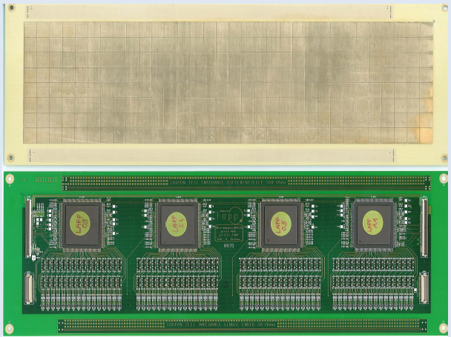
2009 TB with HARDROC1
3 chambers of 32x8 cm² (3 mm gas gap) 4 chips & 1 DIF / board
May 09 @ PS/T10
Hard times with DAQ: DIF synchronicity no acquisition software expert available USB data readout problems…
No quantitative study: beam profile → it works
Sep 09 @ PS/T10 (DAQ OK)
Very low efficiency (5-10 %)
Understood as too short shaping time
32x8 cm² ASU with 4 HARDROC
Hadron beam profile in one chamber

Slide 11
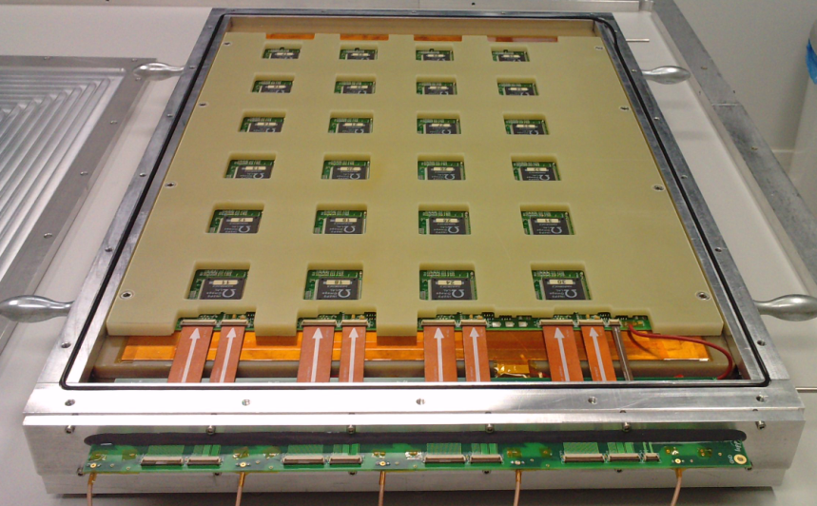
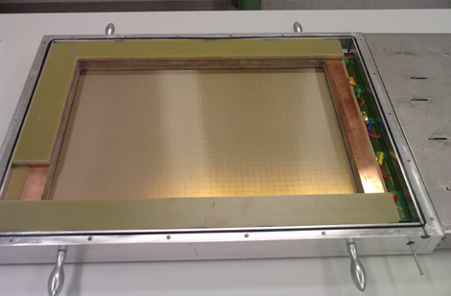
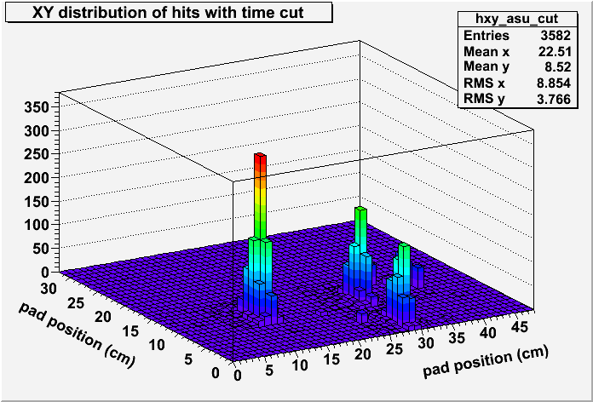
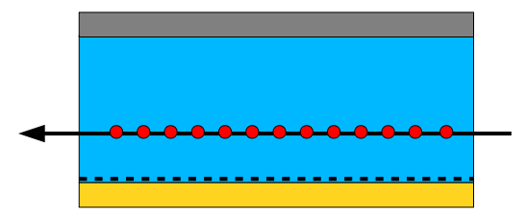
2009 TB with HARDROC2
1 board of 48x32 cm² (unit of future 1 m²) inside a gas test box with 3 cm gas gap, equipped with 24 chips & 1 DIF
Test with chamber (perpendicular and) // to beam
Faster signals at the pads
Larger signals (1 cm)
Efficiency between 10-90 % depending on chip threshold

Slide 12
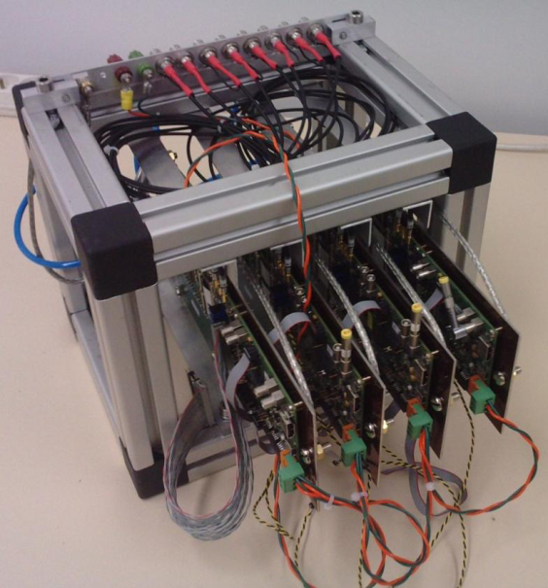
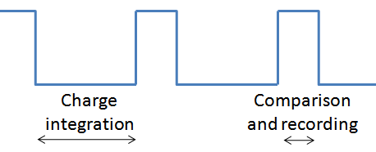
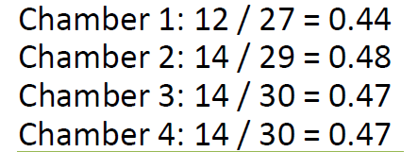
2008-09 TB with DIRAC
Synchronous chip functioning (ILC-like)
First chamber with embedded ASIC (ASU)
8x8 cm² tested in SPS beam in 2008
Stack of 4 chambers (8x8 cm²)
PS/T9 in Nov. 2009
Short life-time in beam → chip design improvement
Small statistics but promising results → multiplicity 1.06-1.13 → efficiency 45-50 %
To be corrected for synchronous functioning

Slide 13
Future plans for front end electronics
HR input stage not suited for the detection of MICROMEGAS signals
Promising results obtained with DIRAC chip
→Development of a new chip from existing ones, in collaboration with LAL/Omega group → Work on spark protection spark proofness test setup @ LAPP innovative solutions studied within RD51

Slide 14
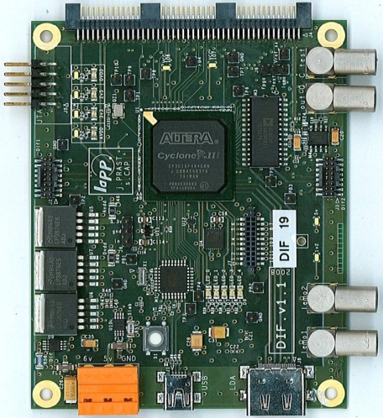
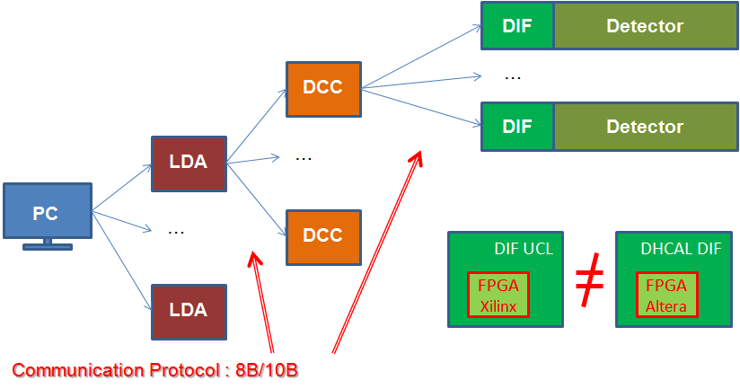
Contribution to CALICE DAQ
Detector Interface (DIF) developed at LAPP is ready for production
A batch of 20 DIF should be available end of March
150 board production planned for this summer, all available in Sept.
Important milestones
8B/10B communication protocols validated (LAPP/LLR)
CCC (Clock and Control Card) integration in work at LAPP

Slide 15
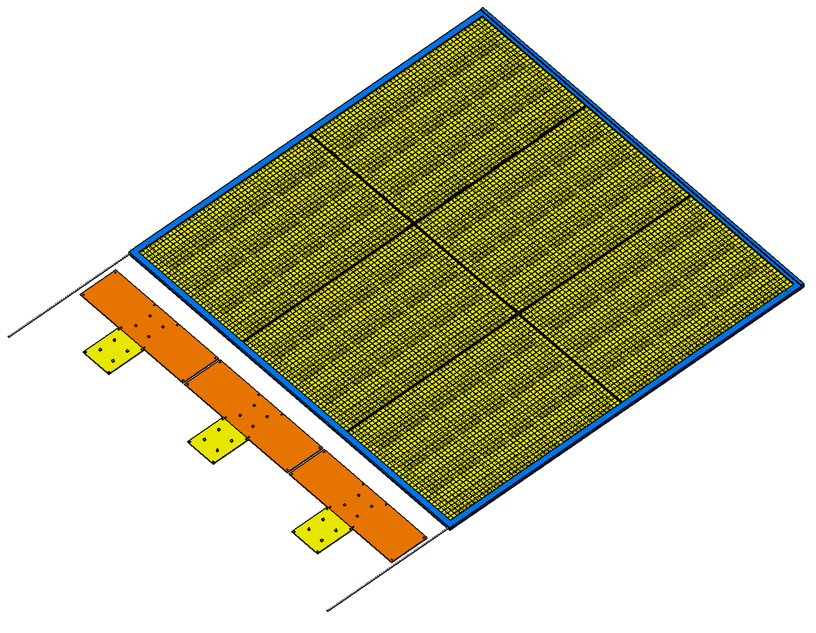
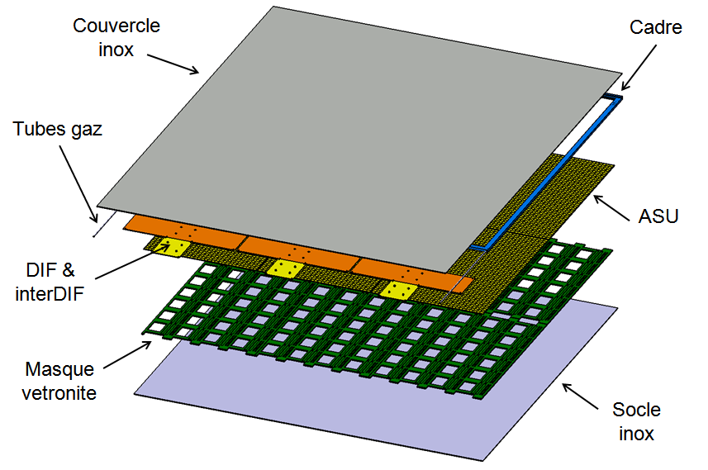
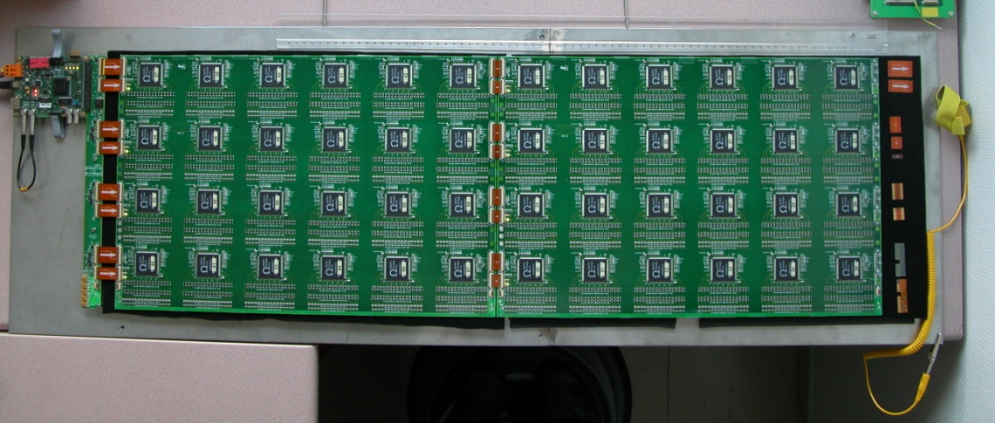
The 1 m² MICROMEGAS prototype
Features
6 ASU of 48x32 cm²
24 ASIC / ASU → 1536 * 6 = 9216 channels
Dead areas < 10 %
Total thickness of 1.15 cm (incl. steel covers)
3 DIF boards
Test of each ASU separately
Assembly procedure validated

Slide 16
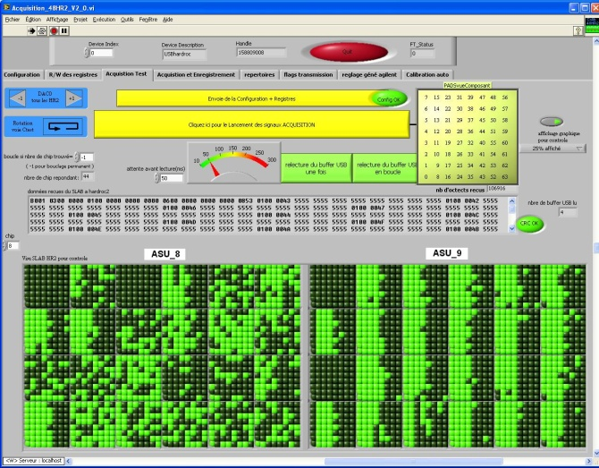
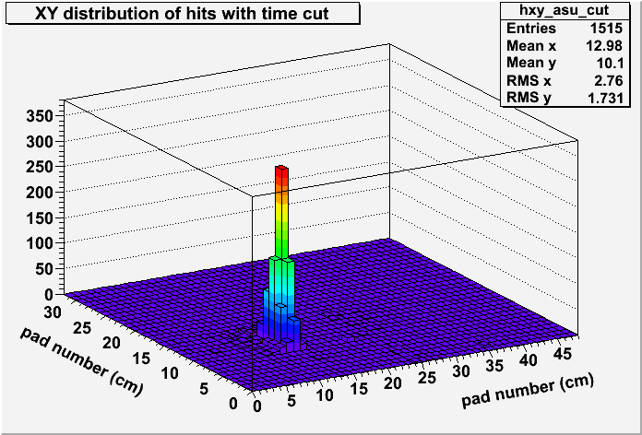
Status and future plans
ASU test on-going
Measurement of ASIC performance
Noise, gain, uniformity, equalization
Response to ⁵⁵Fe X-rays and cosmics in gas box @ LAPP
4 ASU with HR2, 1 ASU with HR2b + 1 dummy Assembly foreseen in April Cosmics tests @ LAPP until June
2-3 weeks of beam in SPS/H4 end of June
Efficiency, multiplicity, uniformity
Spark study (beam intensity)

Slide 17
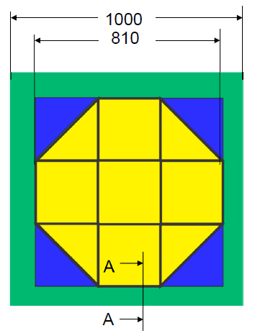
Test inside W-structure
The LCD-CERN, CALICE-DESY and LAPP groups agreed to work together and construct a W-HCAL prototype starting 2010
LAPP contribution on simulation + MICROMEGAS layers → see W. Klempt talk at CALICE meeting, Arlington, 12/03/10
Start with a small prototype
20 W-layers of 81x81 cm², 1 cm thick
2 weeks of beam inside W-structure with AHCAL in PS/T9 starting mid November 2010
Test of scintillator layers + 1 or more MICROMEGAS planes

Slide 18
Conclusions
MICROMEGAS, as proportional detector, is well suited for a semi-DHCAL
Very good basic performance for a DHCAL but strongly depends on electronics
HARDROC input stage not optimized for MICROMEGAS signals Work on a new ASIC on-going
Several options for spark protection are being investigated
First 1 m² MICROMEGAS prototype available end of April 2010 and ready for beam test at the end of June
Equipped with HR2, so limited performance expected However, a lot to learn for next 1 m² prototypes
Next prototypes should be equipped with a different chip
One plane with DIRAC if spark protection issue solved
Next planes with a new chip, probably resulting from the collaboration between LAL and LAPP

Slide 19
Acknowledgments
collaborators
the LAPP group
David Attié
Enrique Calvo Alamillo
Paul Colas
Christophe Combaret
Mary-Cruz Fouz Iglesias
Wolfgang Klempt
Lucie Linsen
Rui de Oliveira
Dieter Schlatter
Nathalie Seguin
Christophe de la Taille
Wemxing Wang
Catherine Adloff
Jan Blaha
Jean-Jacques Blaising
Sébastien Cap
Maximilien Chefdeville
Alexandre Dalmaz
Cyril Drancourt
Ambroise Espargilière
Laurent Fournier
Renaud Gaglione
Nicolas Geffroy Jean Jacquemier Yannis Karyotakis Fabrice Peltier Julie Prast
Guillaume Vouters

