Slide 1
AAP Review on SCRF to be prepared
Akira Yamamoto, Marc Ross, and Nick Walker
ILC-GDE Project Managers
To be presented at ILC-10, Beijing, March 26, 2010

Slide 2
Global Plan for SCRF R&D
Year | 07 | 2008 |  | 2009 |  | 2010 |  | 2011 | 2012
Phase | TDP-1 |  |  |  |  |  | TDP-2
Cavity Gradient in v. test to reach 35 MV/m | → Yield 50% |  |  |  |  |  | → Yield 90%
Cavity-string to reach 31.5 MV/m, with one-cryomodule |  | Global effort for string assembly and test (DESY, FNAL, INFN, KEK)
System Test with beam acceleration |  |  | FLASH (DESY) , NML (FNAL) STF2 (KEK, extend beyond 2012)
Preparation for Industrialization |  |  |  |  | Production Technology R&D

Slide 3
What to be reviewed?
Fundamental Research to improve ‘Gradient’
  R&D status and understanding of limit
  Strategy for improvement
Preparation for ‘Industrialization’
  Cost effective production and quality control
    90 % (9-cell cavity) corresponding to ~ 99 % (1-cell cavity)
  Balance between R&D and ILC operation parameters with beam,
System Design and Engineering
  Integration (compatibility, alignment, accuracy)
  Optimization with other components,
    CFS, HLRF/LLRF, Beam handling, and others,
    Best Operation Gradient to be determined

Slide 4
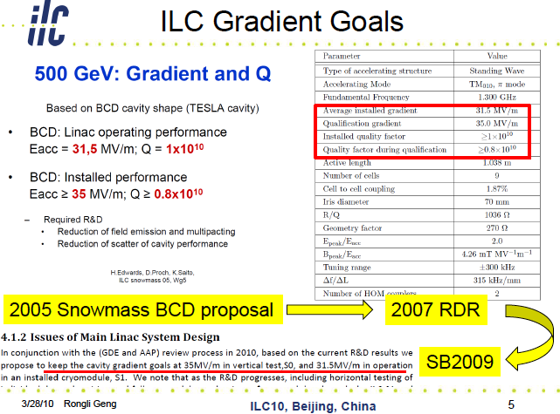

Slide 5
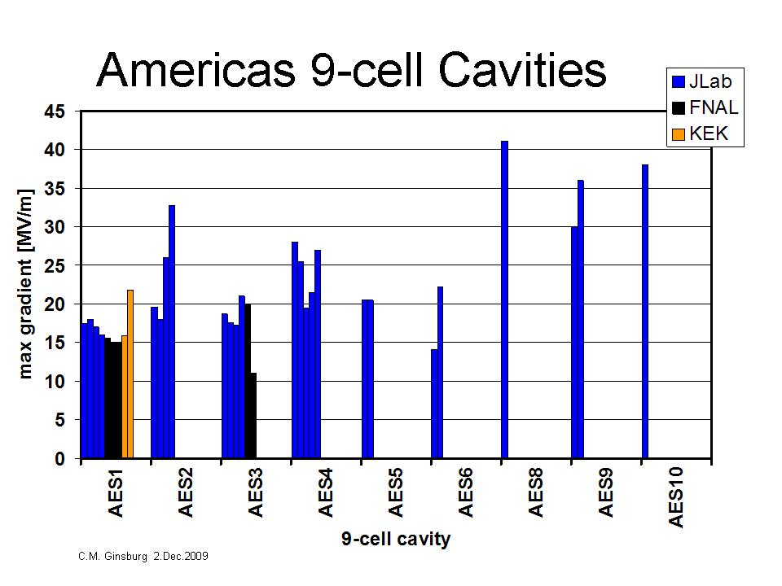
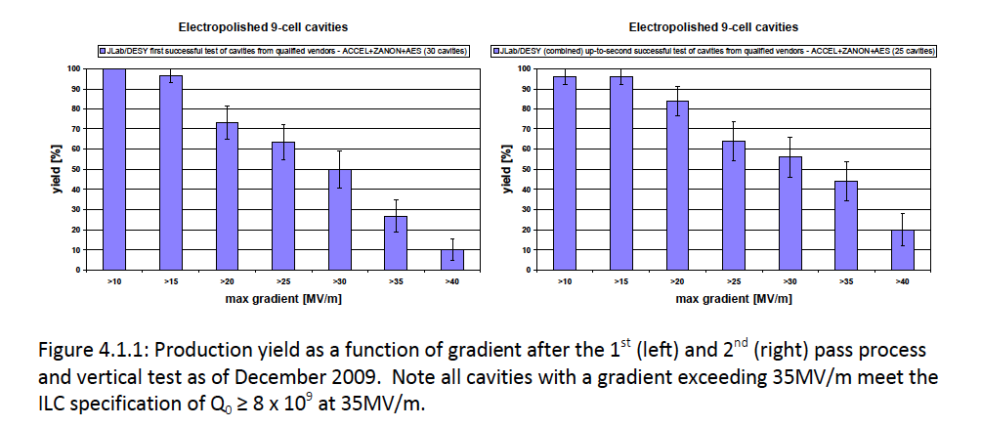
Production Yield as of Dec. 2009 after 1st and 2nd Pass (RF) Test
Reported by C. Ginsburg
at AD&I meeting, DESY, Dec. 2009
Yield at 35 MV/m: 22>>> ~ 27 % at 1st pass
33 >> ~ 44 % at up to 2nd pass

Slide 6
Alternative Yield Plot Analysis originated by N. Walker and updated by J. Kerby
>35MV/m
35-41.8MV/m
44% yield
<36MV/m>
27.9-41.8MV/m
64% yield
Yield: estimated assuming a specific lower cut-off in cavity performance, below which cavities are assumed 'rejected’.
- Error bar: +/- one RMS value (standard deviation of the population) of the remaining (accepted) cavities (gradient above cut-off).
- Additional bars (min, max) indicated the minimum and maximum gradients in the remaining cavities.

Slide 7
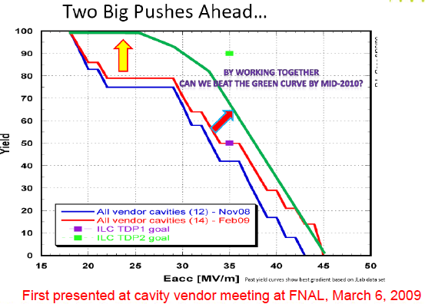
Improvement of Cavity Gradient in two ways
More discussed by R. Geng in parallel session

Slide 8
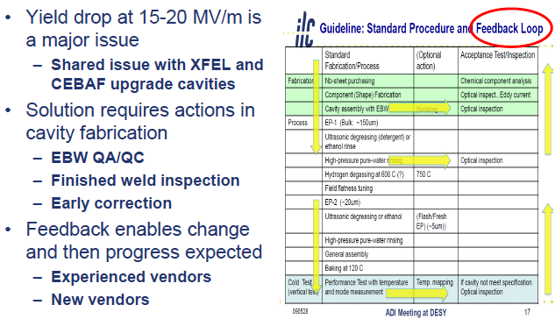
How we may improve
Gradient ?
More discussed in parallel session

Slide 9
SCRF Gradient in ‘R&D’ and ‘Project’
R&D Goals set in RDR
  9-cell cavity: to reach 35 MV/m at Q0 = 8E-9 at the vertical test, with the production yield at > 90 %
  Cryomodule: to reach <31.5 MV/m> at Q0 = 1 E10,
Project Goal/Parameter set in RDR
  ILC operational gradient set at < 31.5 MV/m> including cavity operational margin to the quench/field-emission limit and also accelerator control/operational margin for HLRF/LLRF
Seek for reasonable balance between ‘R&D goals’ and the ‘Project Parameters’ in TDP
  Understanding the status with the global data base
  Re-optimization of the parameters in system design

Slide 10
Current R&D Goals &
ILC Operational Gradient
The RDR has a gradient goal of 35MV/m such that a machine performance based on 31.5MV/m (-10%) may be achieved
The S1 and S2 goals are both set at 31.5MV/m
This 10% reduction was assumed (in Snowmass, 2005)
  to include limitations due to both ‘final assembly problems’ and required ‘machine operational overhead associated with HLRF/LLRF and beam-loading’
Further efforts on cavity performance, TDP-2 gives several opportunities to further investigate and quantify the actual required value, and thus the machine design
  FLASH at DESY
  NML at FNAL
  STF2 at KEK
  Horizontal cavity tests

Slide 11

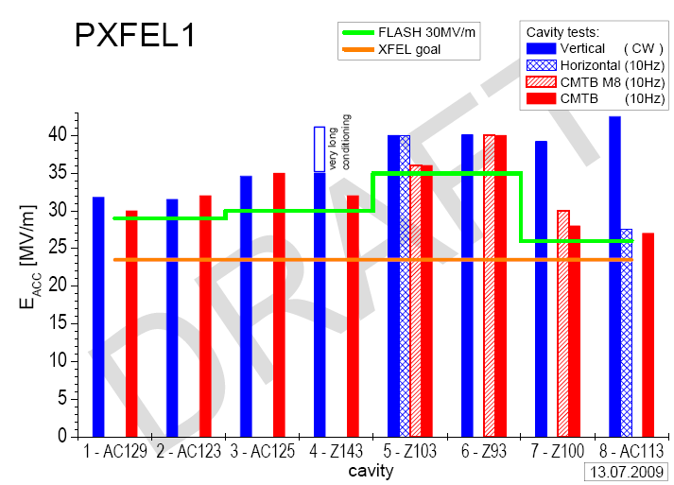
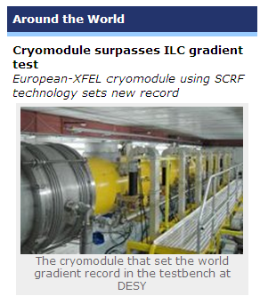
S1 Goal: Achieved at DESY/XFEL
- PXFEL1 gradient at CMTB achieved
< 32 MV/m>
- FLASH plan to operate it at 30 Mv/m
First XFEL prototype module exceeds 31.5 MV/m average
- Module will see beam in FLASH in 2010 (av. of 30MV/m)
- Cryostat (cryomodule cold-mass) contributed by IHEP, in cooperation with INFN

Slide 12
What we need to study in TDP-2
- Balance between R&D target values and Operational parameters
Will be reviewed after S1 experience
System design should require reasonable margin for the individual component and the system operation
S1 (~ Component performance) > ILC-Acc. Operational Gradient
 | RDR/SB2009 | Re-optimization required with cautious, systematic design
R&D goal: S0 | 35 (> 90%) | 35 MV/m (> 90 %) Keep it, and forward looking
S1 (w/o beam) | 31.5 in av. | need: > 31.5 in av., to be further optimized | 31.5 in av.
S2 (w/ beam acc.) | 31.5 in av. | > 31.5 in av. | 31.5 in av.
ILC: operational gradient | 31.5 in av. | 31.5 in av. (+/- 10 ~ 20 %) | or: < 31.5 in av,, to be further optimized

Slide 13
What to be reviewed?
As Summary
Fundamental Research to improve ‘Gradient’
  R&D status and understanding of limit
  Strategy for improvement
Preparation for ‘Industrialization’
  Cost effective production and quality control
    90 % (9-cell cavity) corresponding to ~ 99 % (1-cell cavity)
  Balance between R&D and ILC operation parameters with beam,
System Design and Engineering
  Integration (compatibility, alignment, accuracy)
  Optimization with other components,
    CFS, HLRF/LLRF, Beam handling, and others,
    Best Operation Gradient to be determined

Slide 14
backup
TBD

Slide 15
Summary
In SB2009, ILC operational field gradient left unchanged
  CF&S study enables to stay at 31 km in ML tunnel length
SCRF cavity gradient R&D Goal
  Being kept: 35 MV/m (at Q0 = 8E9) with the production yield of 90 %,
  Spread of cavity gradient effective to be taken into account
    to seek for the best cost effective cavity production and use,
Re-optimization to establish ILC operational gradient
  Necessary adequate balance/redundancy between the ‘R&D gradient-milestone’ and the ‘ILC operational gradient’ including sufficiently high ‘availability’ with risk mitigation.
  Necessary engineering and cost balance b/w Cavity and HLRF/LLRF
Further optimization for design parameters & construction.
  Cryomodule/cryogenics, Quadrupoles, plug-compatibility, and industrialization

Slide 16
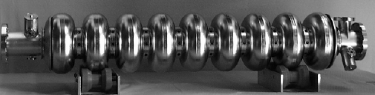
SCRF Technology Required
Parameter | Value
C.M. Energy | 500 GeV
Peak luminosity | 2x10³⁴ cm⁻²s⁻¹
Beam Rep. rate | 5 Hz
Pulse time duration | 1 ms
Average beam current | 9 (or 4.8) mA (in pulse)
Av. field gradient | 31.5 MV/m
# 9-cell cavity | 14,560
# cryomodule | 1,680

Slide 17
TDP Goals of ILC-SCRF R&D
Cavity Field Gradient (S0)
  35 MV/m in vertical test
Cavity-string Assembly in Cryomodule (S1)
  <31.5 MV/m> in cavity string test in cryomodule
    To be re-evaluated in preparation for SB-2009 proposal.
  Efficient R&D with “Plug-compatibility” for
    improvement and ‘creative work’ in R&D (TDP) phase
Accelerator System with SCRF (S2)
  Beam Acceleration with SCRF Accelerator Unit
    Need to discuss an reliable, operational field gradient including adequate HLRF/LLRF control margin for stable operation
Industrial Production R&D
  Preparing for production, quality control, cost saving
    “Plug compatibility” for global sharing in production phase

Slide 18
Cavity Gradient Study - Summary
Yield at 35 MV/m (w/ established vendors: RI, Zanon)
  22 % >> 27 at 1st pass (statistics 22 >> 31 )
  33 >> 42 % at 2nd pass (statistics 21 >> 25 )
    Average Gradient reaching 33 >> 36 MV/m (with in 64 %)
  DESY Prod-4 AES data added, (4 more statistics)
New statistics coming (w/ potential vendors)
  MHI/KEK: to be counted once after reaching 35 MV/m
Statistics for ‘Production Yield’ limited/constrained
  Clear definition and rule needed to evaluate readiness of industrialization and cost
Note: Numbers of Cavities for ‘gradient research’: need to be separately counted ( ~ 25 % of cavities)

Slide 19
Standard Process Selected in
Cavity Production and the Yield
 | Standard Cavity Recipe
Fabrication | Nb-sheet (Fine Grain)
 | Component preparation
 | Cavity assembly w/ EBW (w/ experienced venders)
Process | 1st Electro-polishing (~150um)
 | Ultrasonic degreasing with detergent, or ethanol rinse
 | High-pressure pure-water rinsing
 | Hydrogen degassing at > 600 C
 | Field flatness tuning
 | 2nd Electro-polishing (~20um)
 | Ultrasonic degreasing or ethanol
 | High-pressure pure-water rinsing
 | Antenna Assembly
 | Baking at 120 C
Cold Test (vert. test) | Performance Test with temperature and mode measurement (1st / 2nd successful RF Test)

Slide 20
Improved Understanding in Quench Limit
Routine 9-cell T-mapping and optical inspection
  New insights from pre-cursor heating studies at JLab
  First predictive defect study at DESY
  Cornell 2nd sound sensors will be available for labs
  Many labs use “Kyoto camera” (JLab just received a loan unit)
New finding: many 9-cell is quench limited at 20-25 MV/m by only one defect in one cell with other superior cells already reaching 30-40 MV/m
  There may or may not be observable flaw in quench site
  This seems to suggest we need to address material aspect besides processing and fabrication in TDP-2
  This also suggests some local repairing is needed for efficient raise of 2nd pass gradient yield

Slide 21
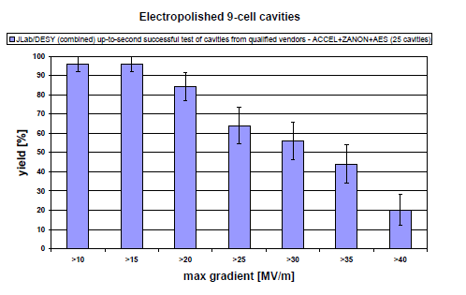
A Major Next Battle:
Eliminate Yield Drop near 20 MV/m
Despite increased acceptance thanks to more flexible HLRF
31.5+/-20%

Slide 22
Another Next Battle:
Further Reduce Field Emission up to 40 MV/m
Flexible HLRF opens up possibility of
some individual cavity operates up to 38 MV/m
31.5+/-20%
Operation at >35 MV/m significantly raises the bar for FE suppression.
Recent R&D has shown proof of existence of “FE-free” 40 MV/m in 9-cell vertical test – further R&D is needed for reliable FE suppression
FE suppression

Slide 23
New Production Yield after 1st and 2nd Pass (RF) Test
Yield at 35 MV/m:
22 % at 1st pass
33 % at up to 2nd pass
1st pass
2nd pass
improvement
degradation
ILC Operation at <31.5 MV/m>
Yield reaching ~ 40 %
Reported by C. Ginsburg and GDB team

Slide 24
Progress and Prospect of
Cavity Gradient Yield Statistics
 | PAC-09 Last/Best 2009-05 | FALC 1st Pass 2009-07 | ALCPG 2nd Pass 2009-10 | To be added (2009-11) | Coming Prod. Y. (2010-06) | Research cavities
DESY | 9 (AC) 16 (ZA) | 8 (AC) 7 (ZA) | 14 (AC/ZA) | 4 (Prod-4) | 5 | 8 (large G.)
JLAB FNAL/ANL/Cornell | 8 (AC) 4 (AE) 1 (KE-LL5) 1 (JL-2) | 7 (AC) | 7 (AC) | 5 (AE) | 12 (AC) 6 (AE) 2 (AC) | 6 (NW) (including large-G)
KEK/IHEP |  |  |  | 0 (MH) | 2 (MH) | ~5 (LL) 1 (IHEP)
Sum | 39 | 22 | 21 | 10 | 25 | ~ 20
G-Sum |  |  |  | 31 | 57
Statistics for Production Yield in Progress to reach ~ 60, within TDP-1.
We may need to have separate statistics for ‘production’ and for ‘research’,

