Slide 1
LCWS 2010
CONVENTIONAL FACILITIES
AND SITING GROUP
Parallel Session Overview
A. Enomoto, V. Kuchler, J. Osborne

Slide 2
Primary CFS Goals for LCWS10
Single Tunnel Solution for Main Linac
Joint Parallel Sessions with Main Linac and HLRF Working Groups
Klystron Cluster System (KCS)
Distributed RF System (DRFS)
Update Criteria for Physical Equipment Size and Spacing
Cyromodule and RF Support Equipment
Waveguide Configuration
Installation and Maintenance Access
Electrical Support, Cable Trays
Electronics Racks Location, Spacing and Shielding
Update Criteria for Cooling and Electrical Requirements
Cooling Water Temperature and DT
Electrical Loading and Access to Connections

Slide 3
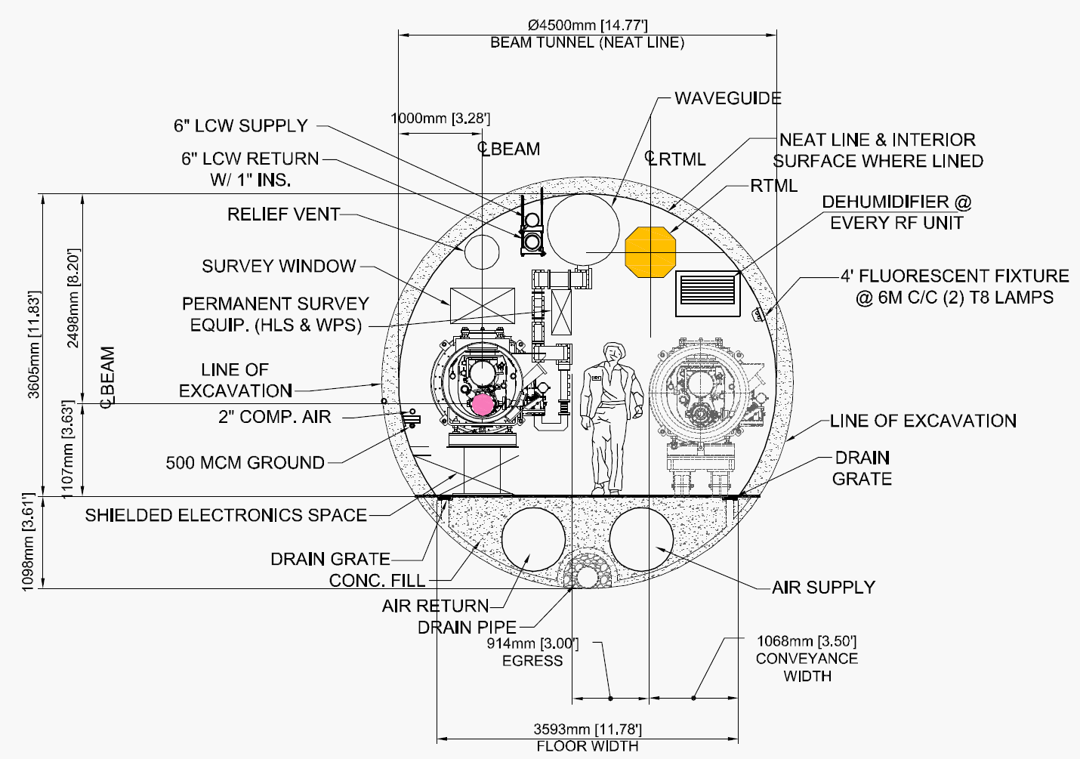
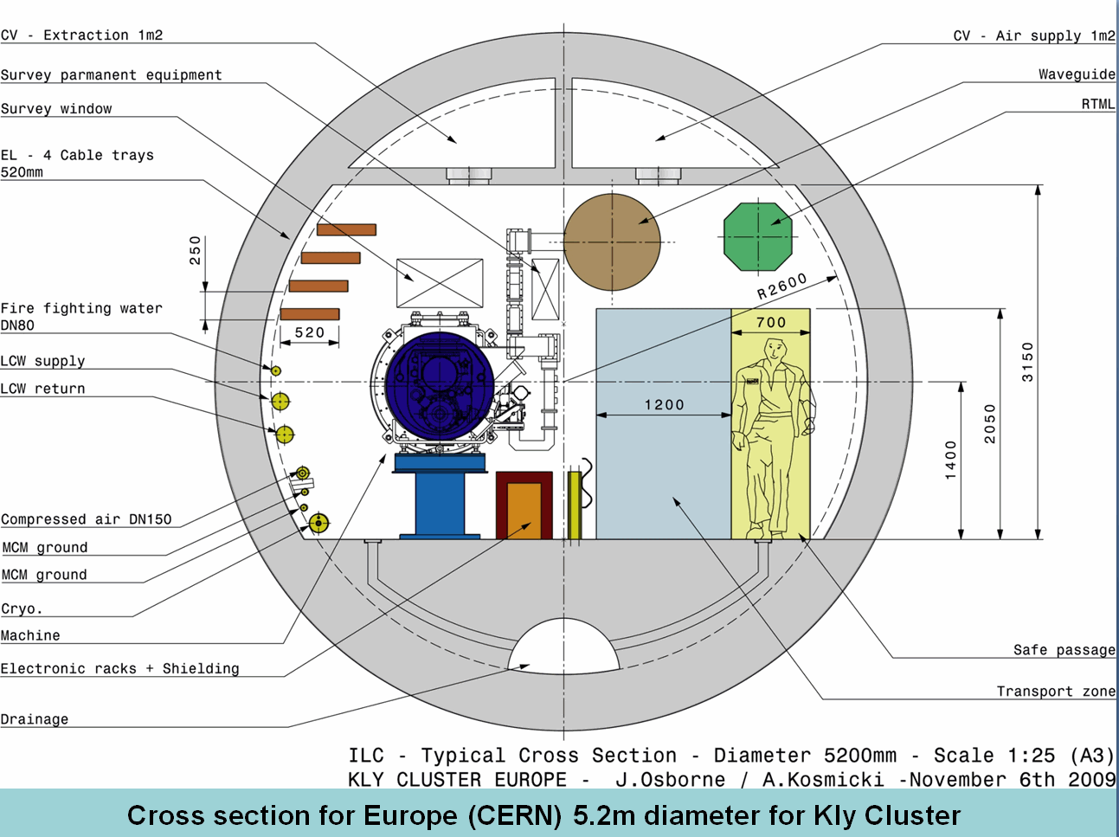
Current ML KCS Tunnel Cross Sections
Americas Region 4.5 m Dia.
European Region 5.2 m Dia.

Slide 4
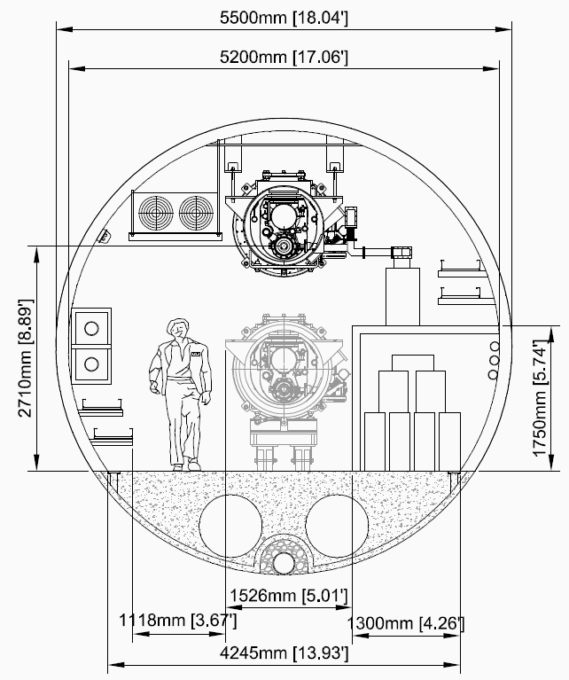
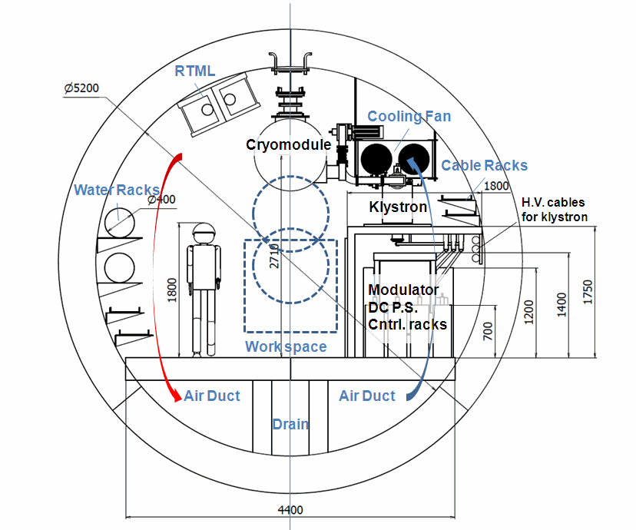
Current ML DRFS Tunnel Cross Sections
Americas Region 5.2 m Dia.
Asian Region 5.2 m Dia.

Slide 5
Primary CFS Goals for LCWS10
Central Region SB 2009 Layout
Joint Parallel Sessions with Sources, RTML, Damping Ring and BDS Working Groups
Update Criteria for Physical Equipment Size and Spacing
Area System Beam Lattices and Equipment Layout
Aisle Spacing and Required Clearances
Installation and Maintenance Access
Electrical Support, Cable Trays
Electronics Racks Location and Spacing in Support Tunnel
Absorber and Dump Locations and Requirements
Update Criteria for Cooling and Electrical Requirements
Cooling Water Temperature and DT
Temperature Stability Requirements in Common Areas
Electrical Loading and Access to Connections

Slide 6
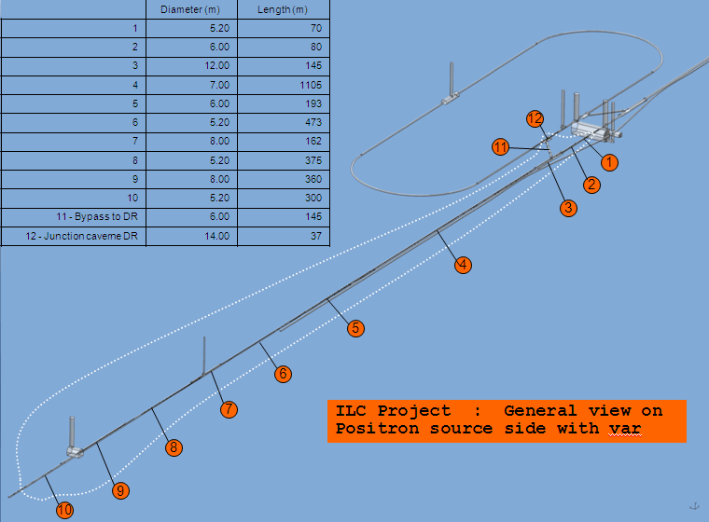
3D Examples
Of Central
Region Layout

Slide 7
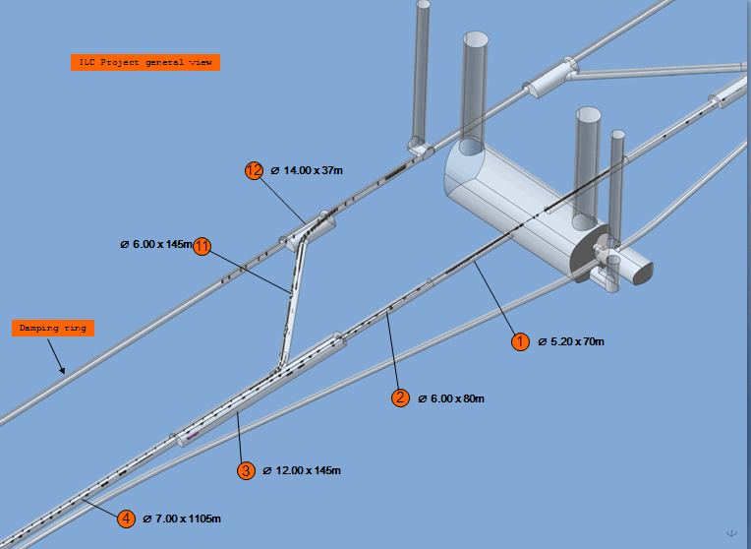
3D Examples
Of Central
Region Layout

Slide 8
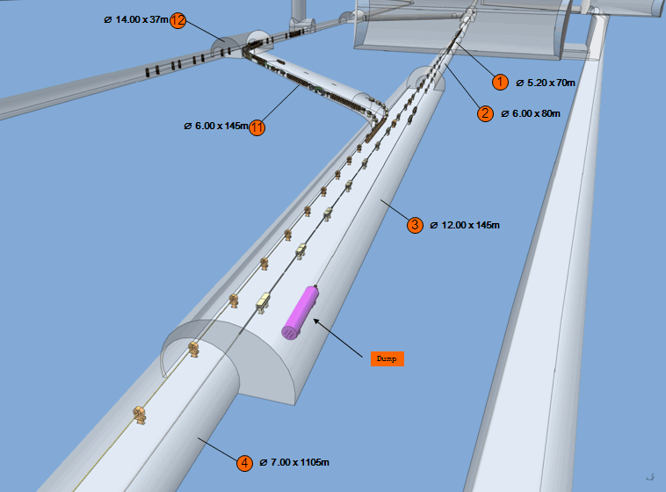
3D Examples
Of Central
Region Layout

Slide 9
Specific Goals for CFS Working Group
General CFS Topics
Re-establish Area System Contact Network
Joint Session with MDI
Distributed CFS Attendance at Area System Parallel Sessions
Planning for CFS Regionally Specific Utility Design
Finalize Dubna Site Investigation Report
Discussion and Assignment of 2D and 3D Regional Drawing Efforts
Review of Regional Single Tunnel Life Safety and Egress Solutions and Future Work
CFS TDP II Planning Including Resource Availability and Allocation

Slide 10
Specific Goals for CFS Working Group cont.
CFS Focused Workshops – Summer 2010
CFS w/Area Systems at SLAC
CFS w/Area Systems at Daresbury (?)
CFS w/ MDI and Detector – TBD
At LCWS 2010
Verify Locations
Verify Dates
Re-establish Participation and POC’s

