Slide 1

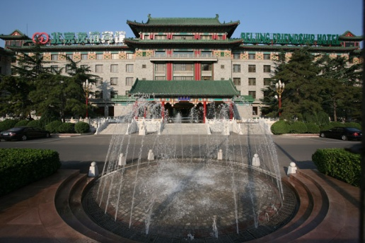


Test Beams Summary
K. Kawagoe (Kobe-U)
30-Mar-2010
LCWS10 in Beijing

Slide 2
The Test Beam Session
A compact session with five talks in a very compact “VIP” room.
Fermilab Test Beam Facility (M. Demarteau)
ESTB SLAC Test Beam Project (J. Jaros)
Asian Test Beam Facilities (S. Uozumi)
AIDA Framework (M. Vos)
Report on LCTW09 at Orsay (R. Pöschl, phone)
Some highlights will be shown in this talk.
See original slides for details.

Slide 3
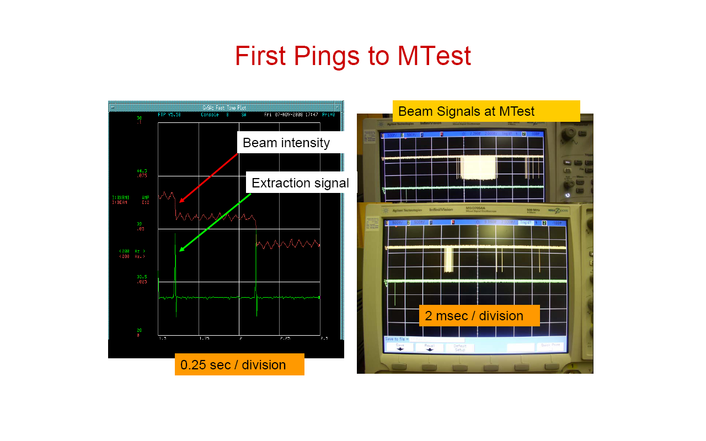

ILC-like ‘Train’ Structure
The ILC is a 5 Hz machine: 1 ms train with a 199 ms inter-train quiet period
The Accelerator Division has installed pulsed quadrupole extraction hardware that can deliver beam within 1 to 5 ms short spills, or ‘pings’ (=train)
Several of these pings can be delivered within the assigned 1 second spill time
Two or more groups of protons (3-7 bunches each ) can be coalesced with 400 ns spacing
5 ms
extraction
1 ms
extraction

Slide 4
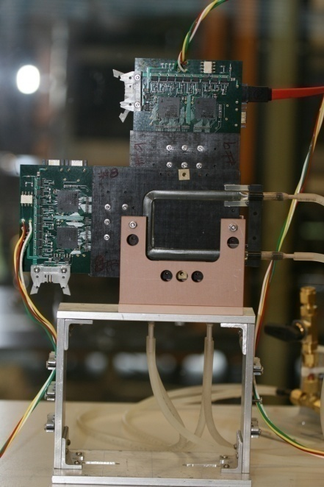
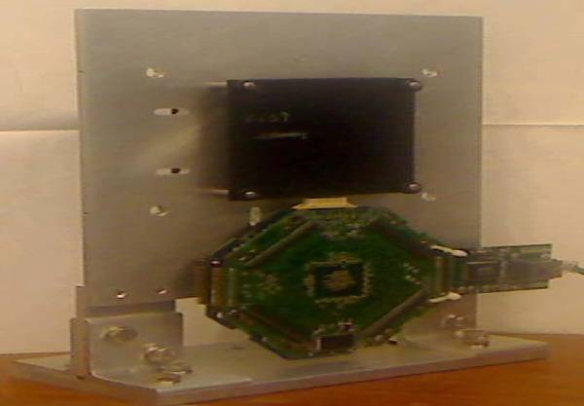
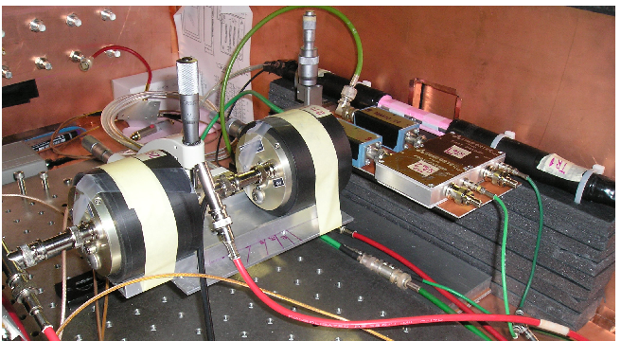
New test beam facilities at MTest
PHENIX pixel
CMS pixel
Two stations of PHENIX pixel tracker
  Pixel size is 50 x 400 μm²
  Active area per 6x6 cm²
Four stations of CMS pixel tracker
  Pixel size 100x150 μm²
  Overlap area 2x2 cm²
  “CAPTAN” DAQ system
Fast timing detector
  Quartz bar + PHOTEK MCP
  Time resolution 6ps

Slide 5
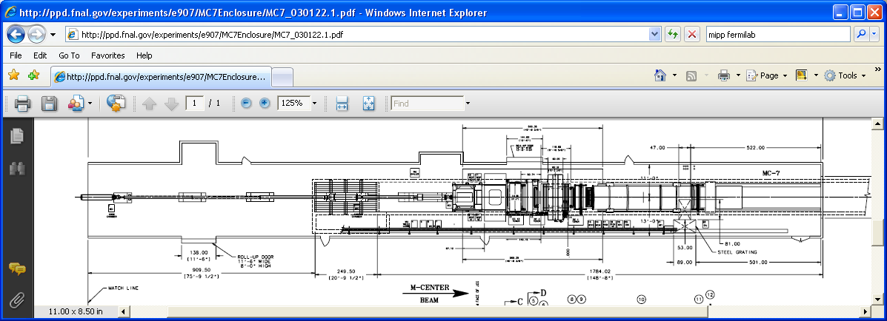
Proposal for a Small Test Beam Area in MCenter
The proposal has been approved. To be available after 2010 Summer shutdown ?
A small control room in the MWest alcove
MTest control room
Have test beam users use this walkway
Small, temporary stand for users who need Cerenkov i.d.
Cable route
For users
Make this section of beam pipe easily removable.
Put concrete blocks for user stands there.

Slide 6
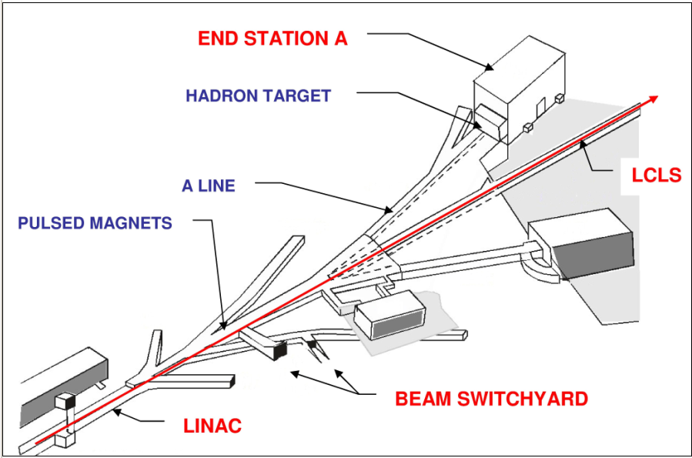
ESA Test Beams Can Provide Electrons/Hadrons up to 13.6 GeV, from single particles to full beam intensity
Kick 13.6 GeV LCLS beam to ESA
5 Hz, 2 x 10⁹ e⁻/ pulse primary beam
Clean secondary electrons/positrons
p<13.6 GeV, 0.1/pulse to 2 x 10⁹ e⁻/pulse
Secondary hadrons
~1 π / pulse < 12 GeV/c
Secondary Particle Yields

Slide 7
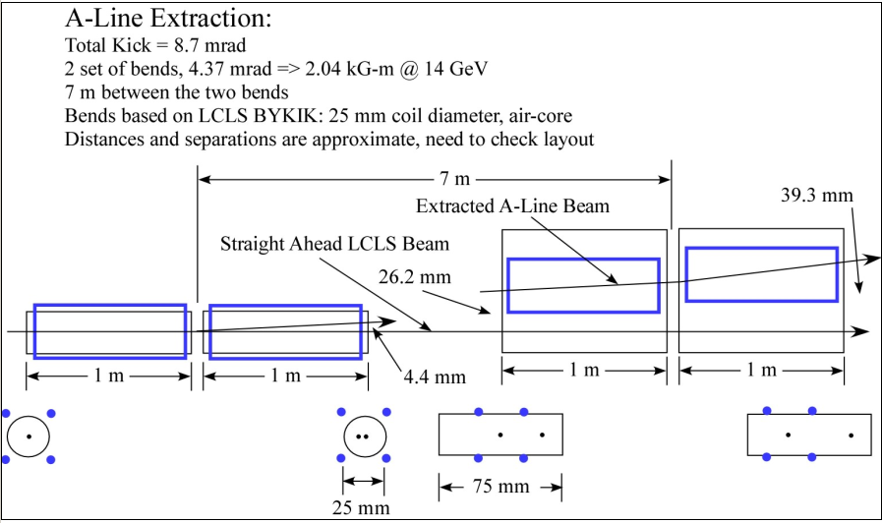
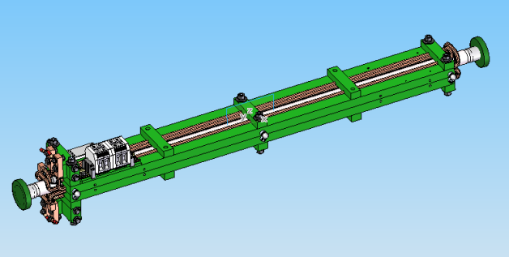
ESTB Stage I
Construct kicker magnets and vacuum chamber for BSY
Update PPS System and install new beam dump for ESA
Update MPS and Controls as needed
Schedule: Construction 2010, Beams by ~Spring 2011.
Use LCLS Kicker Magnets in BSY

Slide 8
ESTB Stage II Hadron Production
Add Be target, beam dump, analyzing magnet, momentum slit, and
quadrupole doublets to produce a secondary hadron beam in ESA.
Production angle = 1.5º and Acceptance = 10 μsr
Energy 0.1–12 GeV
Particles per pulse 0.1–10 π/ nC
Bunch repetition rate 5 Hz
Precise beam trigger Yes
rms x, y spot size 1-2 mm
Momentum analysis Δp/p ~ 1%
X,y,z space available 5 m, 5 m, 15 m
Rate for p, K, μ 0.1-0.01/π

Slide 9
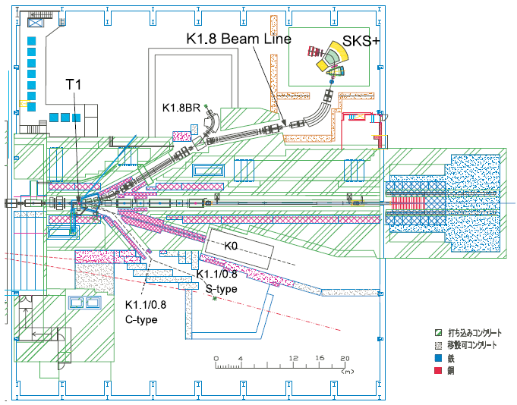
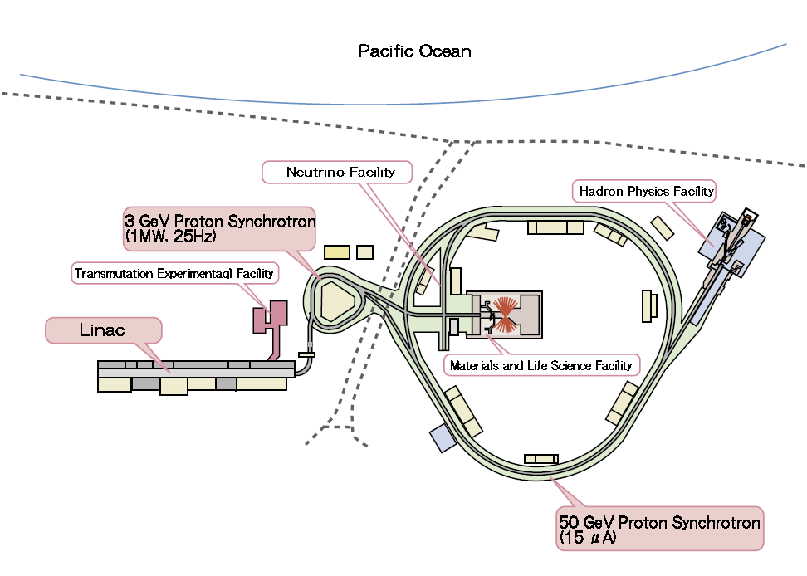
J-PARC test beam facility
Available beams : pions, protons of 0.5-1.5 GeV
K1.8 beamline
K1.1 beamline
Two areas being prepared :
K1.8 … expected to be the main test beam facility.
K1.1 … Tentative facility until K1.8 is ready (available Fall 2010)

Slide 10
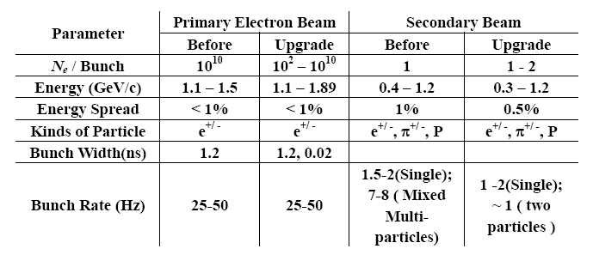
IHEP Beijing Test Beam Facility
2008.07-2010. 12 Shut down for the upgrade
and has a short-term running of E2 line;
2011.01 Commission

Slide 11
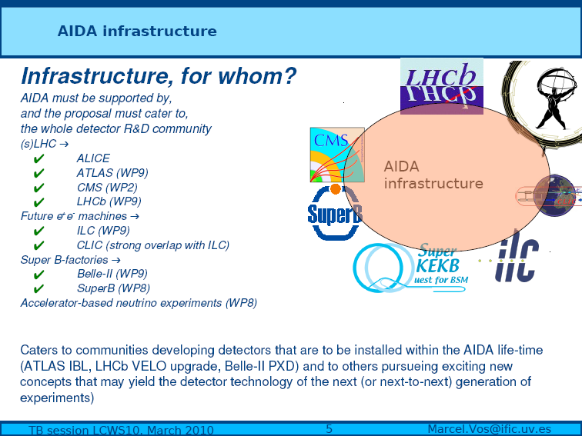
AIDA is an infrastructure aiming to boost European detector R&D for accelerator-based experiments

Slide 12
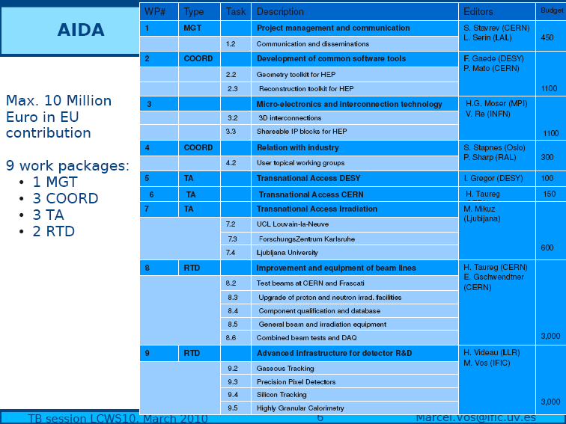

Slide 13
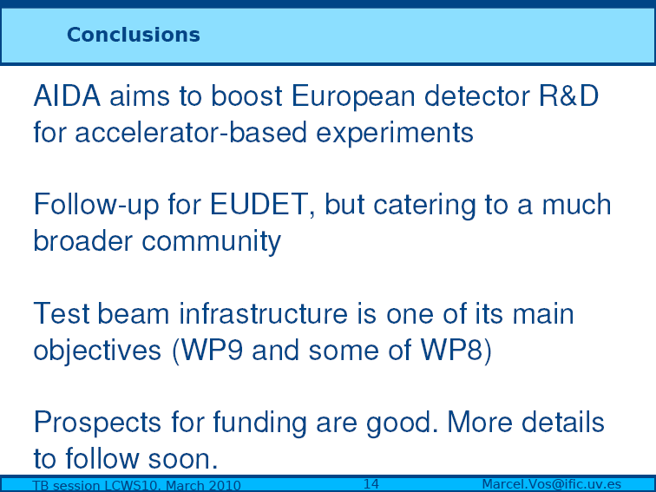
AIDA passed 1st selection with a high score.
Started negotiation for final approval.

Slide 14
Idea/Charge of the Workshop
LCTW09
- Dates and Location: 3.11.09 – 5.11.09 at LAL Orsay
- Successor of 1st workshop of this kind at FNAL in Jan. 07
https://conferences.fnal.gov/idtb07/
Three year rhythm looks appropriate
- Review achievements/developments since FNAL workshop
- Assure that necessary R&D for DBDs can be conducted
- Sharpen the view of community to identify synergies in R&D programs (particularly)‏
testbeam efforts
Common tools, common reservation of testbeam areas, common application for
beam time
- “Remind” Testbeam operators of our needs
- The workshop will render a document where the testbeam plans are listed and
explained
For more info on LCTW09 see:
http://events.lal.in2p3.fr/conferences/LCTW09

Slide 15
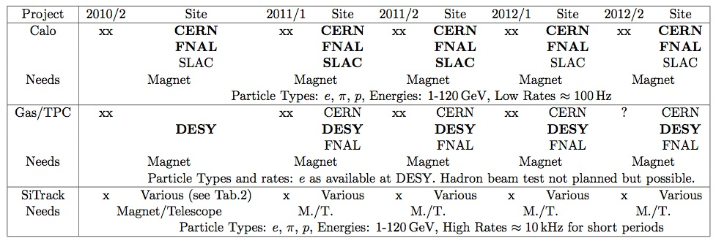
Summary Table of Projects
LCTW09
- Try to combine projects, needs and preferred sites
- Difficult to summarize wealth of activities in short and concise table
- Question to operators: What kind of information would you need?
- Availability of beam lines
Shutdown of FNAL in 2012 can be harmful to progress in view of DBDs
The same is true if CERN needs to shutdown testbeam lines due to LHC issues

Slide 16
Summary and Conclusion
LCTW09
- LCTW09 witnessed the wealth of highly challenging R&D actvities
How can Testbeam activities accompany the R&D needed for DBDs
- Right time to make up our minds on what we want and how to organise ourselves
- Still in the phase of sharpening conclusions
Beam structure
Request for Semi-Permanent beam lines
Organisation among R&D groups
- Workshop document in preparation
Good progress
Publication planned for 30/4/2010
Document will benefit from further input at LCWS10
- Publication to the Detector Community (LC-Note) and Site Managers

Slide 17
Summary
First of all, we deeply appreciate the laboratories for providing us new (and existing) test beam facilities for these years.
Definitely we still need (new, upgraded) test beam facilities to continue detector R&D studies for the ILC experiments (for DBD and beyond).
To keep the test beam activity, good communication between the users and the facility staffs is essential… we are preparing a document as a result of LCTW09.

Slide 18
Backup

Slide 19
Summary
The MTest facility continues to support a large variety of advanced detector tests
The beamline is quite versatile, delivering secondary beams from 1 to 64 GeV, and a primary beam of 120 GeV protons. Electrons are dominant at low energies. Wide-band muons can be selected with a beam stop.
A new tertiary beam has been developed, which delivers tagged pions down to 300 MeV/c.
Two new pixel telescope systems have been created for the facility, with resolutions of 5-10 microns.
A new TOF system has been tested, with a resolution of 24 psec. Individual measurements on a 4 cm MCP/PMT show 6 psec resolution
A proposal has been approved at Fermilab to support test beam activities in the MCenter beamline.
Can support irradiation tests for thin detectors
We welcome user feedback

Slide 20
SLAC Test Beam Conclusions
SLAC is restoring test beam capability to ESA, making use of pulses borrowed from LCLS.
ESTB’s high energy primary electron beam will allow unique studies of LC beam instrumentation and MDI.
An extremely clean electron/positron beam can be delivered over all the available energies (<13.6 GeV) and a very wide range of intensities, suitable for detector R&D.
A hadron beam is planned for the future, with energies up to 12 GeV, suitable for tracker, vertex detector, and calorimeter R&D.
Electron beams should be available by Spring, 2011.

Slide 21
Summary
Working (or will be working) beamlines in Asia and Russia :
J-PARC … 0.5-1.1 GeV π, p beams with rate ~ 10⁷ per spill.
K1.1 line will be available since ~ Oct 2010.
K1.8 will be set up in future, it will provide beams
in wider energy range.
Tohoku LNS … 0.1-0.95 GeV e⁺ with rate ~kHz available
Small facility, may be difficult to support
international team.
IHEP Beijing … e⁺ (1.1-1.9 GeV) and π⁺/p (0.3-1.2 GeV) beams
Upgrade will be finished in this year.
Protovino Russia … e⁻(1-45 GeV), h⁺(1-60 GeV), μ⁻(1-55 GeV)
Available ~2 months / year (April, Nov-Dec)

