Slide 1
Summary of Machine Detector Interface
Guinyun Kim (KNU, Korea)
International Linear Collider Workshop 2010
Beijing, China, March 2010

Slide 2
Summary of SiD MDI
By Philip Burrows, JAI, Oxford Univ.
SiD + ILD working together to understand and solve common IR hall issues for push-pull mode of operation
Common solution for Pacman plug shielding
Detector support scheme being addressed quantitatively via vibration studies
MDI concepts being adapted for CLIC

Slide 3


Summary of ILD MDI
By Matthieu Jore, LAL, IN2P3
Important steps have been made :
Better understanding of the QD0 support and the vacuum
A first idea of a push pull scenario and mechanism
Integration of both detectors in the hall seems possible even if their philosophy is different
BUT the common effort between detectors concepts and BDS people have to be reinforced in the hottest topics :
IR Hall design
Engineering studies on the push pull mechanism including the platform design
Supporting QD0 (Do we need a common solution with SiD?)
Etc….

Slide 4

MDI engineering issues for the CLIC Detector
By H. Gerwig, CERN
• Stable and precise support of QD0
• Beampipe sectorisation, Vacuum valves, pumps & access
• Kicker & BPM and its electronics
• Crossing angle and split beam pipe
• Opening of the detector
• Push‐pull, moving platform, connection tunnel/cavern
• Alignment issues
• Self‐shielding detector, safety
• Experimental cavern, access, services, cranes, safety
Satisfy all the requirements in a way that it just works fine!

Slide 5
Vibration Issues
The mechanical stability requirements of the QD0 are set by the capture range of the IP fast feedback, as written in the “Functional Requirements” document, ILC-Note-2009-050
“ The QD0 mechanical alignment accuracy and stability after beam-based alignment and the QD0 vibration stability requirement are set by the capture range and response characteristics of the inter-bunch feedback system.
• QD0 alignment accuracy: ± 200 nm and 0.1 μrad from a line determined by QF1s, stable over the 200 ms time interval between bunch trains
• QD0 vibration stability: Δ(QD0(e+)-QD0(e-)) < 50 nm within 1ms long bunch train “

Slide 6
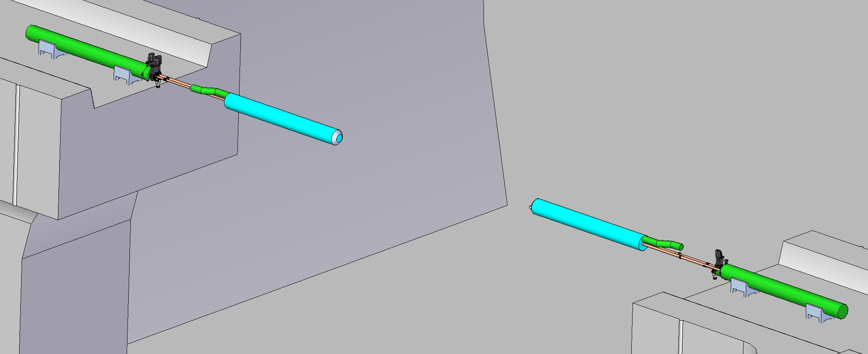
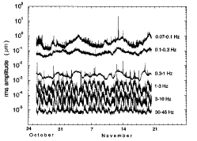
Vibration Studies for SiD
Sub-nanometric stability of the focusing system is required to maintain the luminosity to within a few percent of the design value.
Ground motion is a source of vibrations which would continuously misaligning the focusing elements.
The design of the support of the QD0 is a fundamental issue
640 nm
5.7 nm
By Marco Oriunno, SLAC
QF⁻
QD0⁻
QD0⁺
IP plane
QF⁺

Slide 7
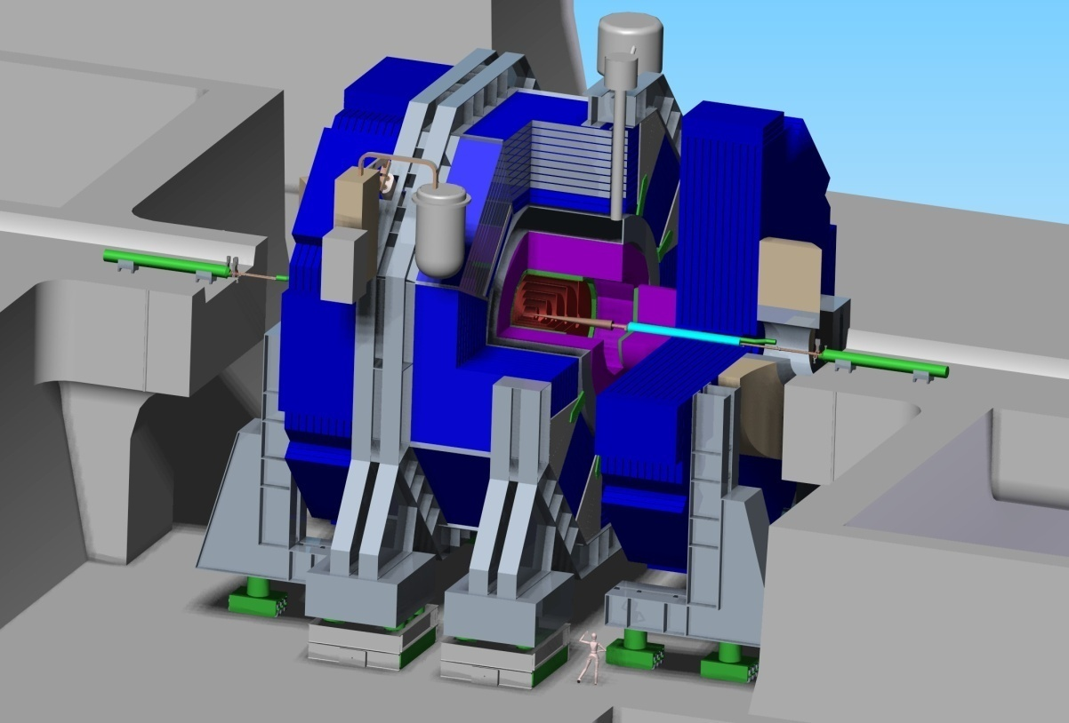
QD0 supports for ILD and SiD
IP
QD0
IP
QD0
door
door
Barrel
Pillar
Pillar
Barrel
IP
QD0
IP
wall
QD0
wall
Platform
Platform
PSD
door
PSD
ground
PSD
ground
PSD
ground
ground
PSD
PSD
ground
ground
Rods
Door
QD0
Pillar
Cavern wall
ILD
Platform
SiD
By Marco Oriunno, SLAC

Slide 8
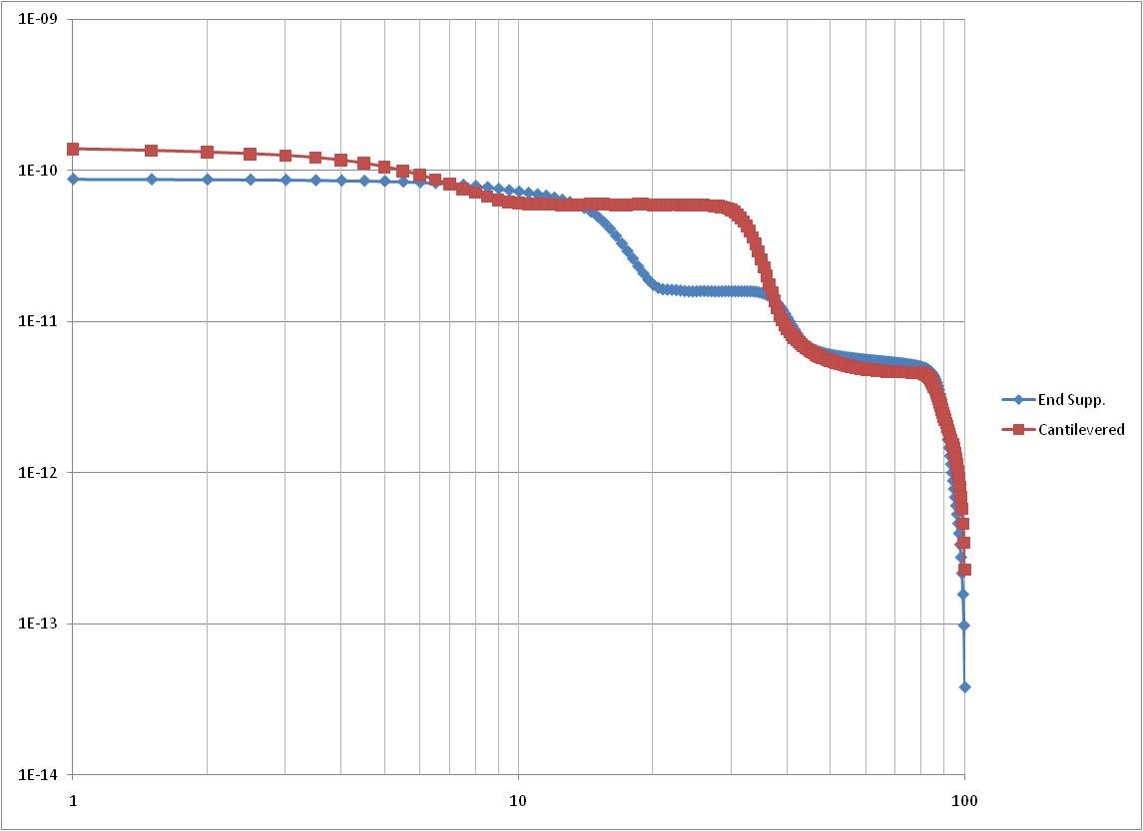
Comparison of Relative Displacement
Ends supported
Cantilevered
L=20 m
L=12 m
L=20 m
L=12 m
QD0
QD0
wall
QD0
δ_{rel}
wall
QD0
QD0
wall
QD0
δ_{rel}
wall
PSD
door
door
PSD
ground
ground
PSD
ground
PSD
PSD
PSD
ground
PSD
PSD
ground
ground
PSD
ground
ground
By Marco Oriunno, SLAC
0.14 nm
0.087 nm
r.m.s. meters
δ_{rel}
Hertz

Slide 9
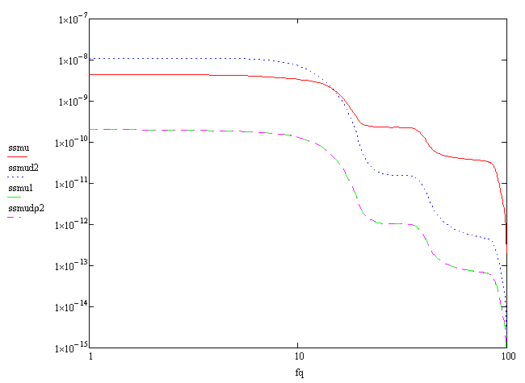
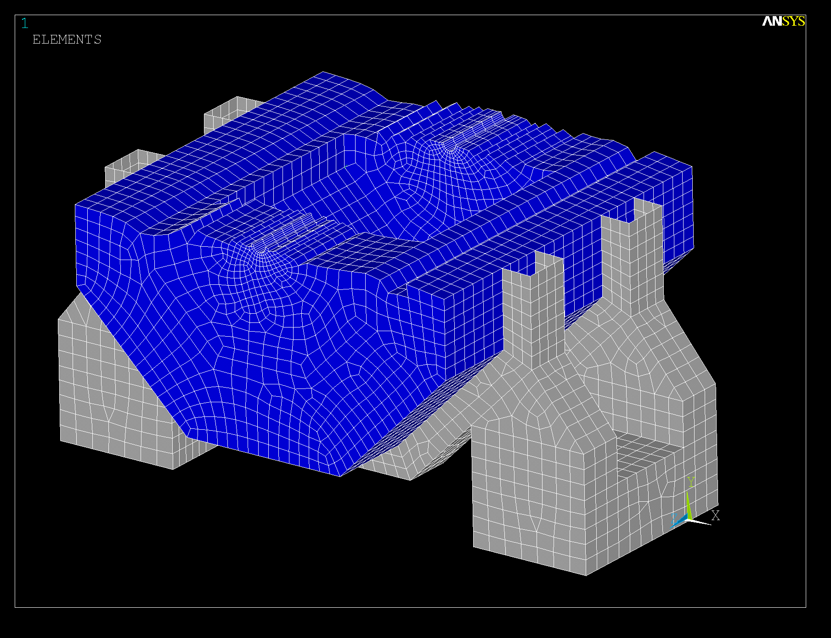
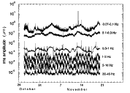
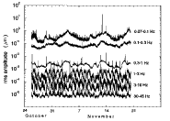
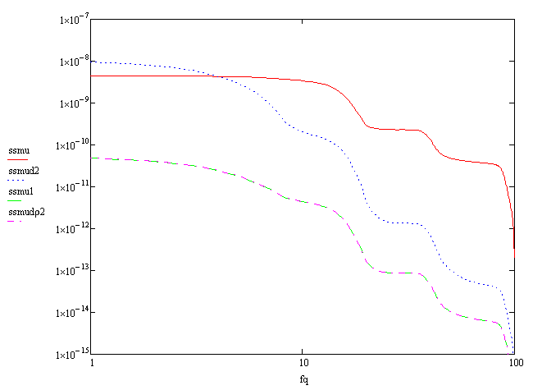
Harmonic Analysis
By Marco Oriunno, SLAC
Frequency Response Function
Abs. from the door
10 Hz
Abs. from ground
1 ns
Relative
Integrated r.m.s. response (mm)
Abs. from the door
3 Hz
Abs. from ground
1 ns
Relative
Integrated r.m.s. response (mm)
De-rated Floppy Supports (worst case)

Slide 10
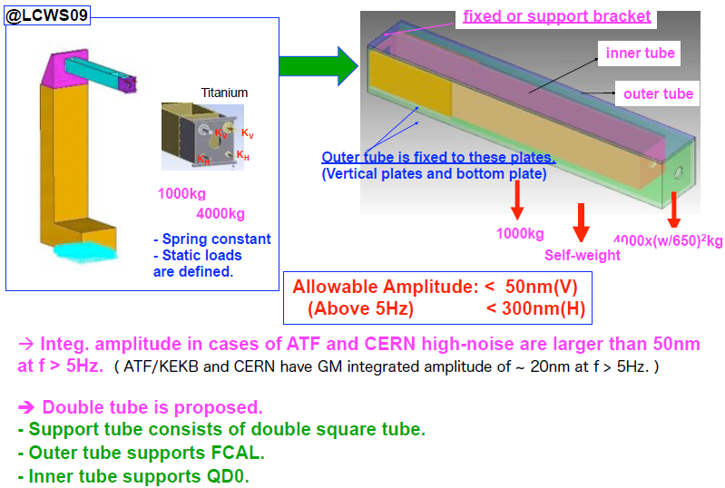
Vibration Studies for ILD
By Hiroshi Yamaoka, KEK
1) Design of Supporting Structure
Stiff support structure was changed from single tube to double tube

Slide 11
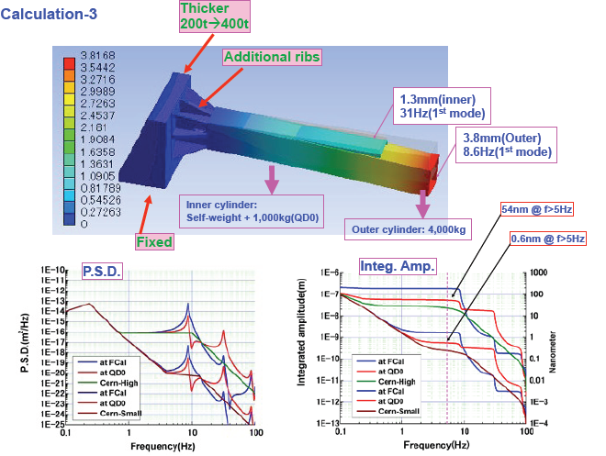
2) Calculation
By Hiroshi Yamaoka, KEK

Slide 12
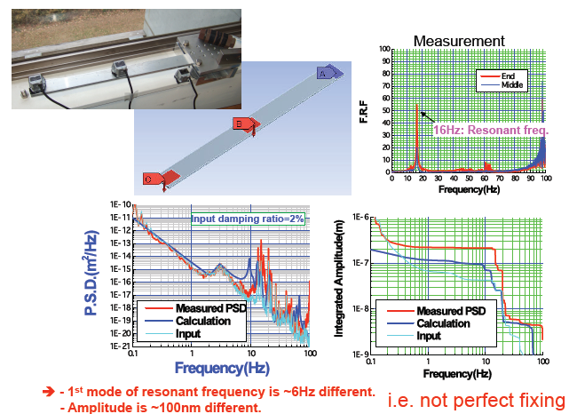
3) Consistency check between calculations and measurements
By Hiroshi Yamaoka, KEK

Slide 13
Vibration Issues at CLIC
By H. Gerwig, CERN
1) Limit vibration by construction !
• Abandon opening on IP thus making the QD0 support short (L³)
• Use a two‐in‐one support tube scheme (idea of H. Yamaoka)
• Tune tube’s eigenfrequency ( train repetition rate ‐ 50Hz)
• Avoid cooling liquids (permanent magnet)
• Keep also the end‐caps compact in Z (with endcoils )
• Reduce to the max. gap between detector & tunnel (no pacman)
• Support QD0 from a passive low frequency pre‐isolator in the tunnel
2) Limit vibration by active intervention
• Active stabilisation with piezo ‐ actuators
• BPM – beam kicker feedback loop

Slide 14
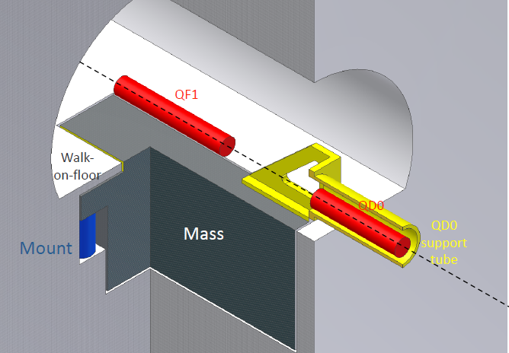
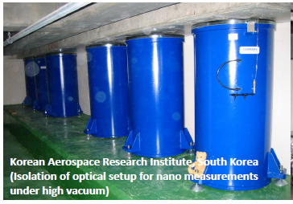
Proposing a pre‐isolator system with Low natural frequency (around 1 Hz) and Large mass (50 to 200 ton)
By H. Gerwig, CERN
This system will act as a low‐pass filter for ground motion
that is able to withstand external disturbances (air flow, acoustic pressure, etc.)

Slide 15
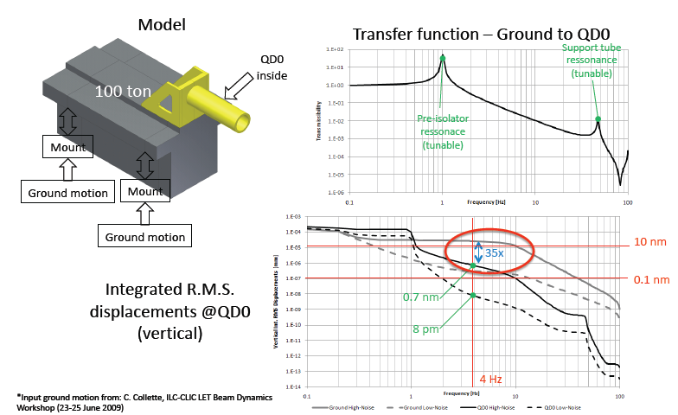
FEM Simulations of gain
By H. Gerwig, CERN

Slide 16
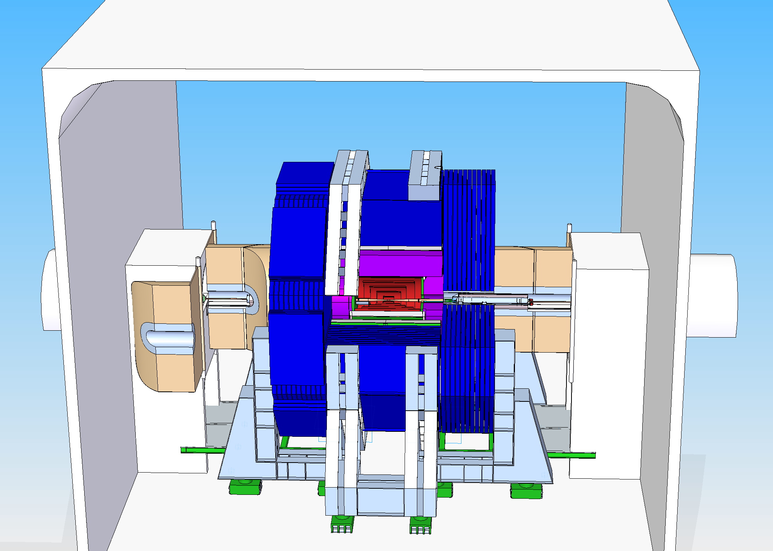
Shielding between detector and tunnel
Electrical motor, low friction hinges
Oriunno

Slide 17
SiD / ILD compatible PACman
19 m
ILD
SiD
ILD
SiD
Herve
Herve
Interface pieces carried by each experiment

Slide 18
Monte Carlo tools and methods
Radiation Protection studies for SiD
By Mario Santana, SLAC
FLUKA Intra Nuclear cascade code
Deq99 fluence to dose conversion routine
FLAIR GUI
PARALLEL simulations at SLAC farm: about 76000 CPU-hour
Beam and accident conditions
500 GeV / beam and 9 MW / beam
Typical accidents:
  Beam1 AND beam2 hit thick target at IP-14 m
    Weakness cavern-pacman interface?
  Beam1 AND beam2 hit thick target at IP-9 m
    Pacman is sufficiently thick? Weakness in penetration.
  Beam1 hits tungsten mask at IP-3 m (unsteered)
    SiD is sufficiently shielded?
Beam aborted after one train = up to 3.6 MJ

Slide 19
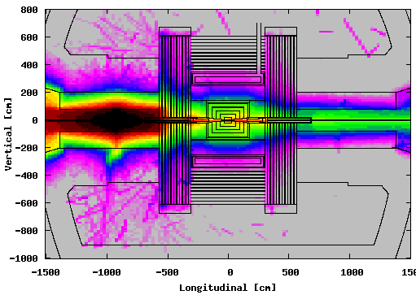
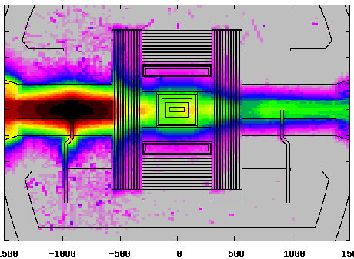
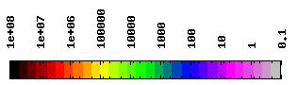
20 R.L. Cu target in IP-9 m. Large pacman.
By Mario Santana, SLAC
BEAM PLANE
PENETRATION PLANE
9 MW
9 MW
9 MW
9 MW
10 µSv/event
180 mSv/h
µSv/event

Slide 20
Provisional conclusions for SiD
By Mario Santana, SLAC
Small pacman and pacman-cavern interface are sufficient in terms of dose per event.
However, the dose rates for the small pacman are very high:
  Proven mechanisms should be installed to:
    avoid these accidents to occur
    shut off beam after 1 train (200 mS)
  Possible Debates
The large pacman complies with all criteria.
The penetrations in the pacman don’t require local shielding.
The shielding of the detector may be insufficient to comply with dose rate limit. Exclusion area?
More studies ongoing (mis-steering…)

Slide 21
Detector Motion
Main issues:
Height difference (~1.7 m)
Preferred detector support mechanism
- SiD: legs
- ILD: platform
Preferred detector motion mechanism
Interface to machine tunnel
…

Slide 22
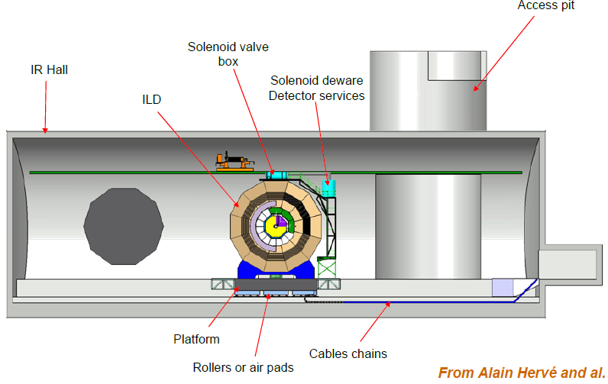
ILD on Platform in IR Hall

Slide 23
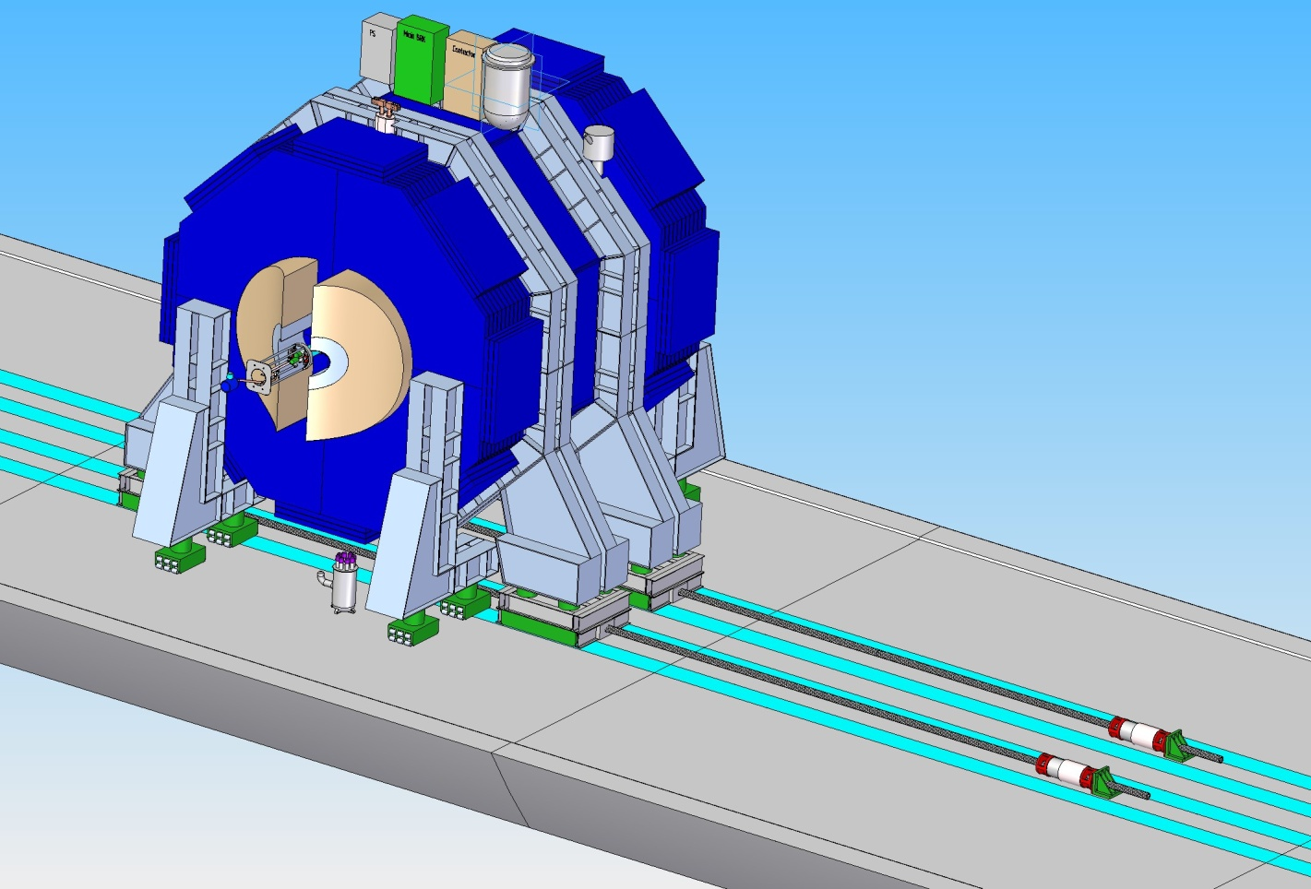
Push pull mechanism for SiD
By Philip Burrows, JAI, Oxford Univ.
Move on hardened steel rails, grouted and locked to the floor
Rail sets for transverse motion (push pull) and door opening in both the beamline and garage positions will be needed
Hilman roller supports, strand jacks provide locomotion
If ILC is built in a seismically active location, provision may be needed for locking SiD down in both the beamline and garage positions
strand jacks
Hilman rollers
Oriunno

Slide 24
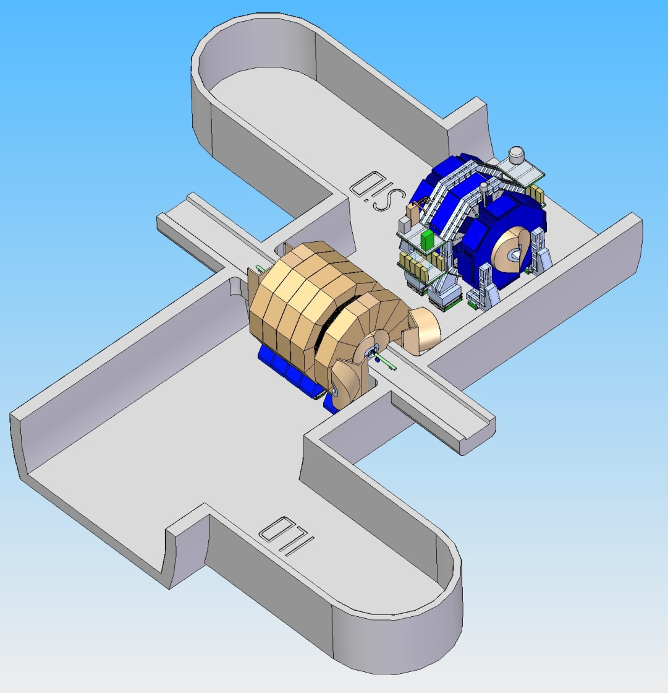
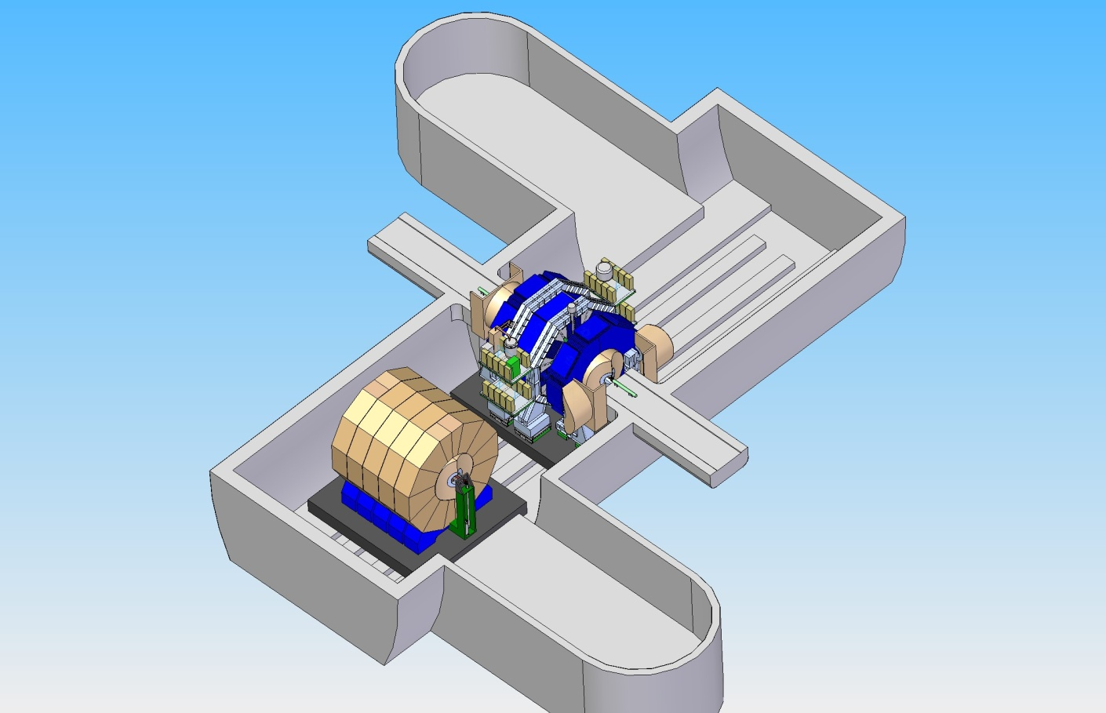
Both detectors on platform or legs?
By Philip Burrows, JAI, Oxford Univ.
Herve

Slide 25
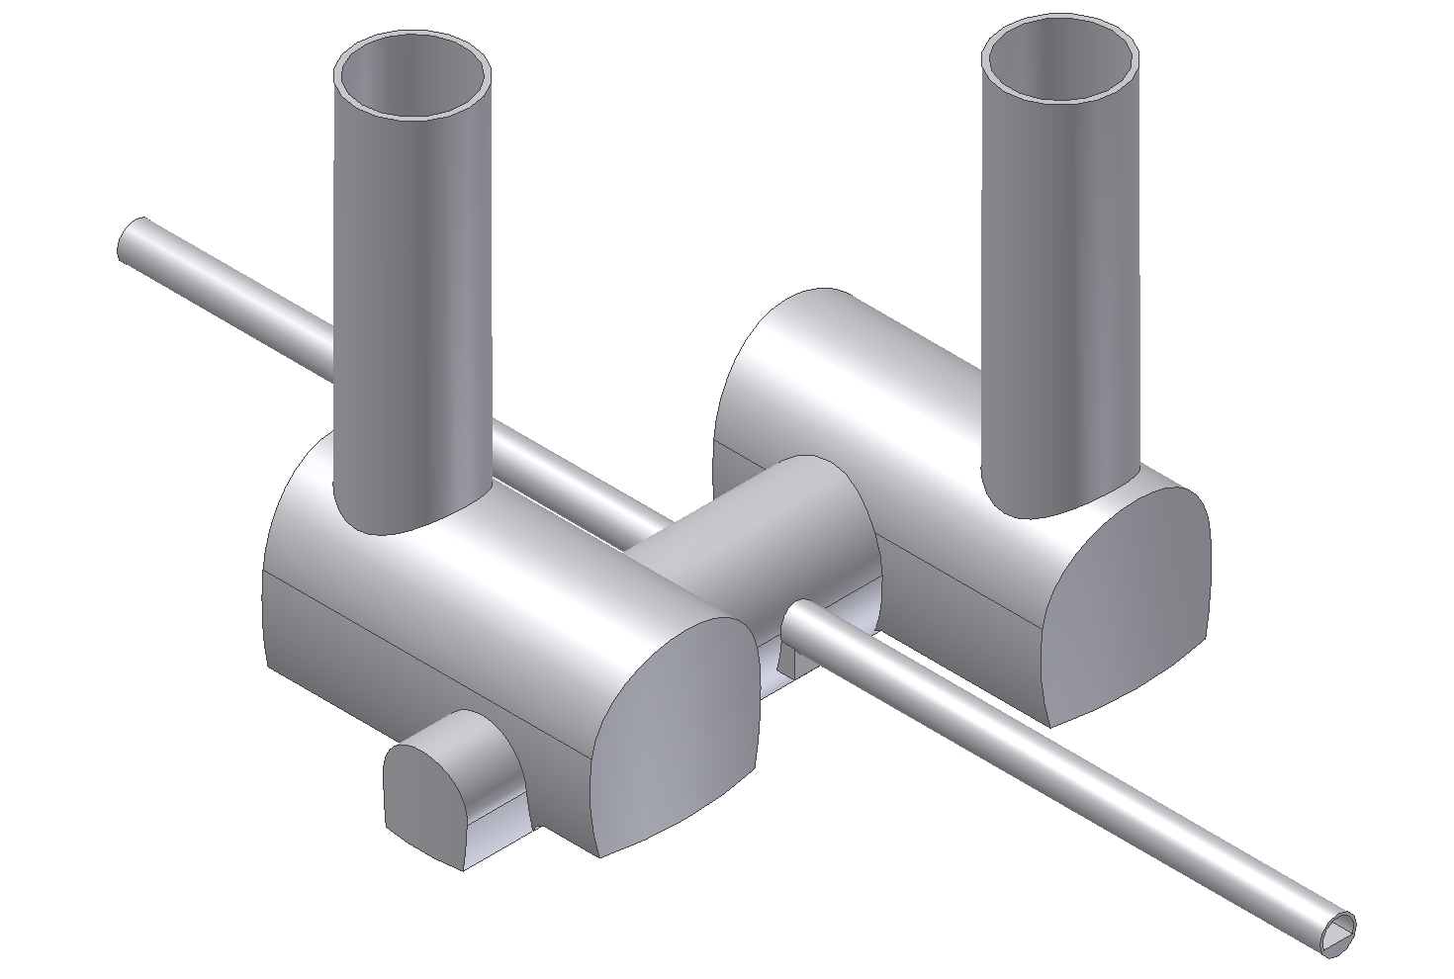
Proposed Experimental Area
– no pacman shielding – instead chicanes between endcap/tunnel
– Very smooth end‐wall of tunnel
– Longer experiment adapts via end‐coils to shorter experiment
– Radiation shielding1 is a ring chicane on the endcap
– Radiation shielding2 is a sliding concrete wall integrated into cavern
– Provision of 2 x 75 m^3 volumes in the tunnel to house a possible
massive pre‐isolator of up to 200 tons each
Cavern 2
accelerator
Cavern 1
transfer
Technical
alcove
Hubert Gerwig
CERN

Slide 26
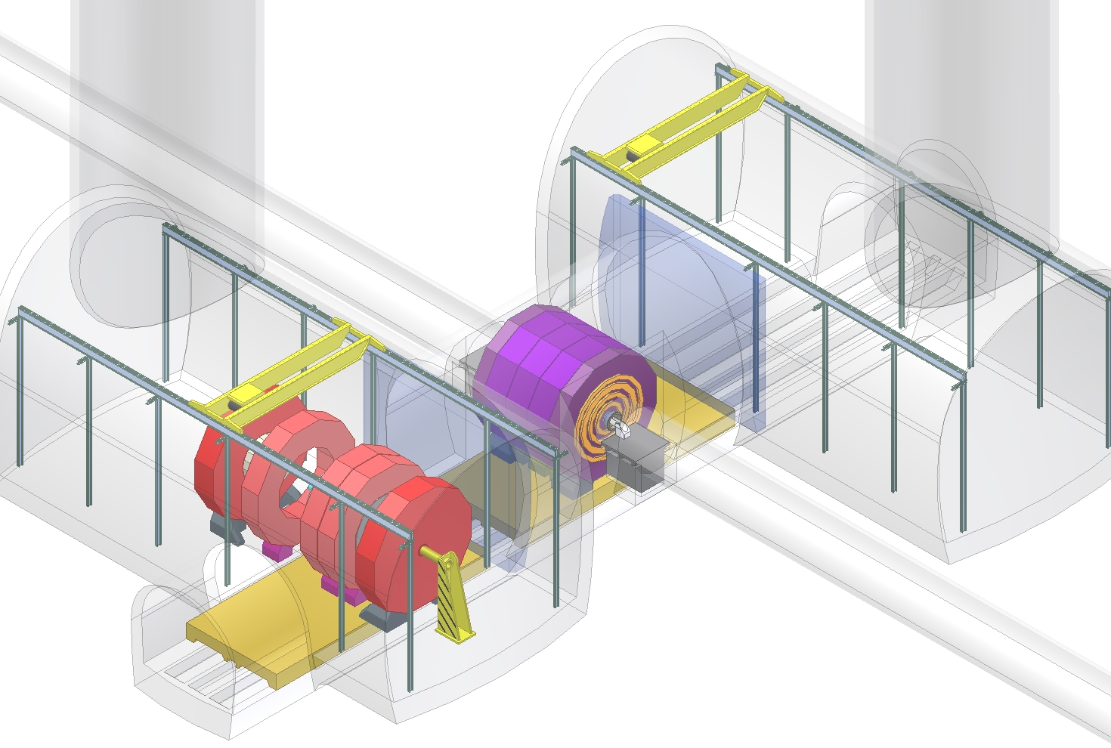
Experimental Area (looking inside)
Experiment 2 sliding on IP, shielding walls closed
Sliding concrete shielding walls in closed position
Hubert Gerwig
CERN

Slide 27
Other “MDI” Topics Not Discussed
Vacuum studies at ILD (M. Jore)
Simulation of beam-beam background at CLIC (A. Sailer)
Testbeam Measurements with a Prototype Cherenkov Detector (D. Kaefer)
IP feedback prototype status and engineering considerations for implemention in the MDI (P. Burrows)
What could we learn at ATF2 concerning ILC backgrounds (G. Hayg)
Status of Beamcal Readout Chip (A. Abusleme, T. Markiewicz)
SI sensor Radiation Testing (T. Markiewicz, B. Schumm)
SID Field Maps for Various Iron Configurations (T. Markiewicz, W. Craddock)
Luminosity Measurement at ILC (I. Bozovic-Jelisavcic)
……

