Slide 1
LHC Beam Operations
Past, Present and Future
K. Foraz – CERN
(Acknowledgement : R. Bailey)

Slide 2
LHC Beam Operation
Operation envelope
Progress with beam in 2009
2010-2011

Slide 3
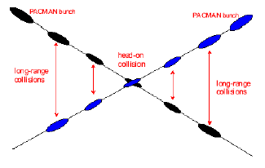
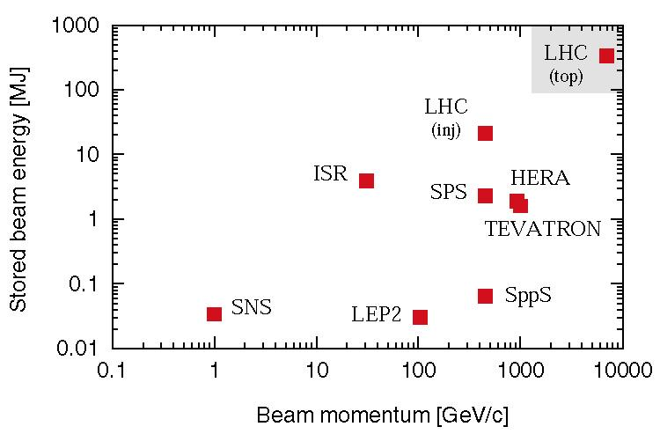
LHC nominal performance
Operation envelope
Progress with beam in 2009
2010-2011
Nominal settings
Beam energy (TeV) | 7.0
Number of particles per bunch | 1.15 10¹¹
Number of bunches per beam | 2808
Crossing angle (μrad) | 285
Norm transverse emittance (μm rad) | 3.75
Bunch length (cm) | 7.55
Beta function at IP 1, 2, 5, 8 (m) | 0.55,10,0.55,10
Derived parameters
Luminosity in IP 1 & 5 (cm⁻² s⁻¹) | 10³⁴
Luminosity in IP 2 & 8 (cm⁻² s⁻¹)* | ~5 10³²
Transverse beam size at IP 1 & 5 (μm) | 16.7
Transverse beam size at IP 2 & 8 (μm) | 70.9
Stored energy per beam (MJ) | 362
* Luminosity in IP 2 and 8 optimized as needed

Slide 4
Instantaneous luminosity
Operation envelope
Progress with beam in 2009
2010-2011
“Thus, to achieve high luminosity, all one has to do is make (lots of) high population bunches of low emittance to collide at high frequency at locations where the beam optics provides as low values of the amplitude functions as possible.” PDG 2005, chapter 25
Nearly all the parameters are variable (and not independent)
  Number of particles per bunch Ν
  Number of bunches per beam k_{b}
  Relativistic factor (E/m₀) γ
  Normalized emittance ε_{n}
  Beta function at the IP β *
  Crossing angle factor F
    Full crossing angle θ_{c}
    Bunch length σ_{z}
    Transverse beam size at the IP σ*
Intensity
Energy
Interaction Region

Slide 5
LHC performance drivers
Operation envelope
Progress with beam in 2009
2010-2011
Intensity
Injector chain
Electron cloud effect
Collimation
Machine protection
Nominal
Energy
Interconnects
Training
Machine protection
Interac. region (β*, F)
Optics
Aperture
Machine protection

Slide 6
Energy : Evolution of target
Operation envelope
Progress with beam in 2009
2010-2011
When
Why
7 TeV
2002-2007
Summer 2008
Winter 2008
Summer 2009
Autumn 2009
Design ….. Magnets commissioning
Detraining …. During hardware
Commissioning
Splices …. Sept. 08 incident
Stabilizers
QPS connectors
Breakdown at operational voltage
    Connector quality
12 kA
5 TeV
9 kA
R< 1nΩ
3.5 TeV
R< 10μΩ
(after quench)
6 kA
1.18 TeV
2 kA
450 GeV

Slide 7
Energy: the way back
Operation envelope
Progress with beam in 2009
2010-2011
When
What
7 TeV
2014 ?
2013
2012
2010 – 2011
January 2010
Train magnets
Should be easy to get to 6TeV….
7 TeV will take time
Long shut-down:
Interconnections & completion
of pressure relief system
Run @ 3.5TeV
Connectors fixed
Commission nQPS system
Commission circuits to 6kA
6 TeV
3.5 TeV
450 GeV
3/26/2010

Slide 8
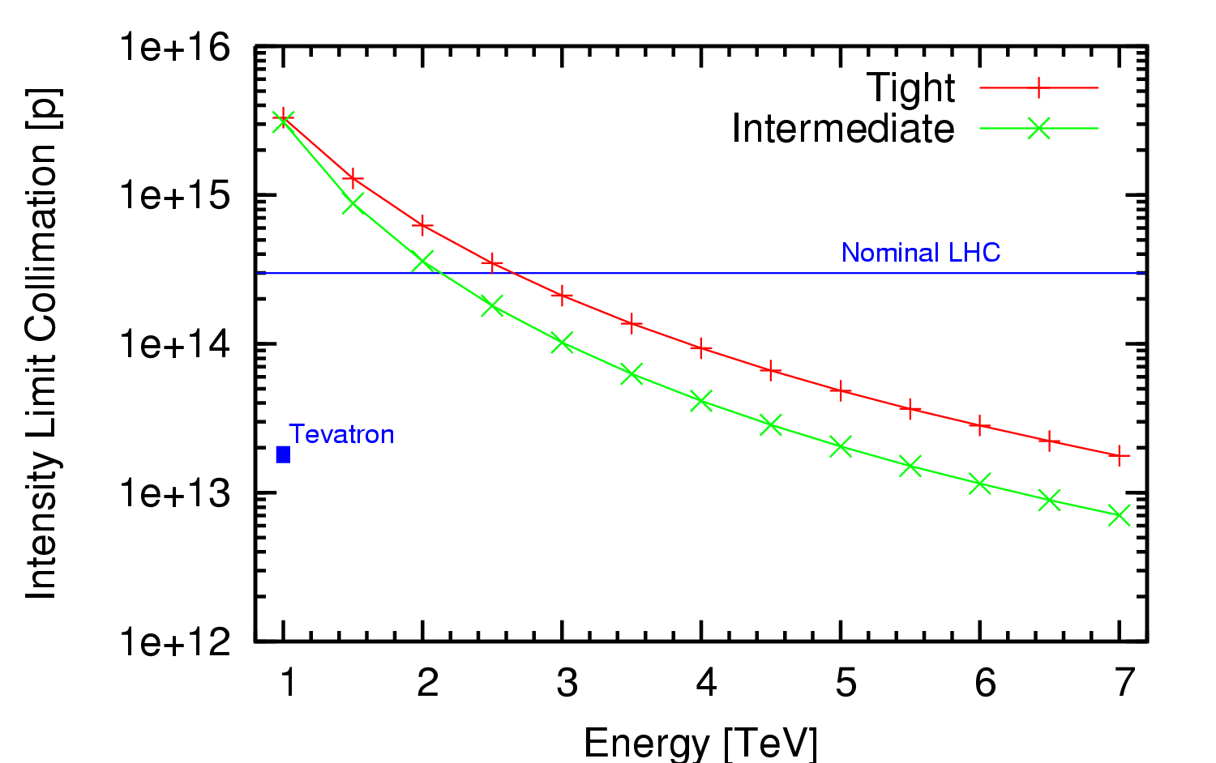
Intensity: limits 2010 2011
Operation envelope
Progress with beam in 2009
2010-2011
Collimation system conceived as a staged system
  First stage to allow 40% of nominal intensity at 7 TeV
Imperfections bring this down
Machine stability and reproducibility also play a role
Cleaning gets easier at lower energies
0.2%/s assumed
Fix I_{max} to 6 10¹³ protons per beam at 3.5TeV
(about 20% nominal intensity)
30MJ stored beam energy

Slide 9
Higher intensities
Operation envelope
Progress with beam in 2009
2010-2011
With experience assume that we can
  Move to tight settings
  Achieve 0.1% loss rates
Then need to install something more
  Proposal exists for next phase of collimation

Slide 10
β* and F: 2010 2011
Operation envelope
Progress with beam in 2009
2010-2011
Lower energy means bigger beams
  Less aperture margin
  Higher β*
> 150 bunches requires crossing angle
  Requires more aperture
  Higher β*
Targets for 3.5TeV
  2 m no crossing angle
  3m with crossing angle

Slide 11
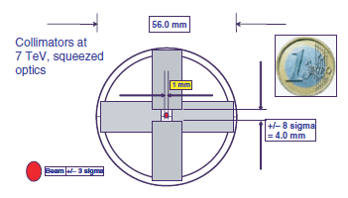
β*: Evolution
Operation envelope
Progress with beam in 2009
2010-2011
As energy increases, lower β* gets easier
The squeeze is always going to be challenging
  Optics
  Collimator
With experience, should be easier, but still …

Slide 12
LHC performance drivers at start
Operation envelope
Progress with beam in 2009
2010-2011
Intensity
will start low and simple
Collimation
Injector chain
Electron cloud effect
Machine protection
Energy
will run at highest energy safely possible
Nominal
Start
Interconnects
Training
Machine protection
Interac. region (β*, F)
will start simple
&modest
Optics
Aperture
Machine protection

Slide 13
Early beam operation
Operation envelope
Progress with beam in 2009
2010-2011
2009 | 2010 | 2011
Repair of Sector 34 | 1.18 TeV | nQPS 6kA | 3.5 TeV I_{safe} < I < 0.2 I_{nom} β* > 2 m | Ions |  | 3.5 TeV ~ 0.2 I_{nom} β* ~ 2 m | Ions
No Beam | B |  | Beam |  | Beam
Energy limited to 3.5 TeV by the stabilizers
2010
  Intensity carefully increased to collimation limit
  β* pushed as low as possible
2011
  Run at established limits

Slide 14
LHC Beam Operation
Operation envelope
Progress with beam in 2009
2010-2011

Slide 15
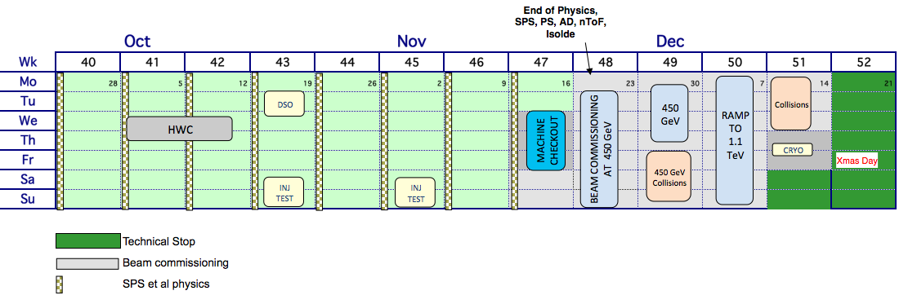
Targets with beam 2009
Operation envelope
Progress with beam in 2009
2010-2011
AIMS
450 GeV collisions
10⁶ events
Ramp to 1.18 TeV
Collisions at 1.18 TeV
Do this with SAFE BEAMS
10¹² at 450 GeV → 2 10¹¹ at 1.18 TeV
LIMITS
2 on 2 with 5 10¹⁰ per bunch at 1.18 TeV
4 on 4 with 2 10¹⁰ per bunch at 1.18 TeV

Slide 16
Milestones reached
Operation envelope
Progress with beam in 2009
2010-2011
Date | Day | Achieved
Nov 20 | 1 | Each beam circulating. Key beam instrumentation working.
Nov 23 | 4 | First collisions at 450 GeV. First ramp (reached 560 GeV).
Nov 26 | 7 | Magnetic cycling established (reproducibility).
Nov 27 | 8 | Energy matching done.
Nov 29 | 10 | Ramp to 1.18 TeV.
Nov 30 | 11 | Experiment solenoids on.
Dec 04 | 15 | Aperture measurement campaign finished. LHCb and ALICE dipoles on.
Dec 05 | 16 | Machine protection (Injection, Beam dump, Collimators) ready for safe operation with pilots.
Dec 06 | 17 | First collisions with STABLE BEAMS, 4 on 4 pilots at 450 GeV, rates around 1Hz.
Dec 08 | 19 | Ramp colliding bunches to 1.18 TeV
Dec 11 | 22 | Collisions with STABLE BEAMS, 4 on 4 at 450 GeV, > 10¹⁰ per bunch, rates around 10Hz.
Dec 13 | 24 | Ramp 2 bunches per beam to 1.18 TeV. Collisions for 90mins.
Dec 14 | 25 | Collisions with STABLE BEAMS, 16 on 16 at 450 GeV, > 10¹⁰ per bunch, rates around 50Hz.
Dec 16 | 27 | Ramp 4 on 4 to 1.18 TeV. Squeeze to 7 m. Collisions.

Slide 17
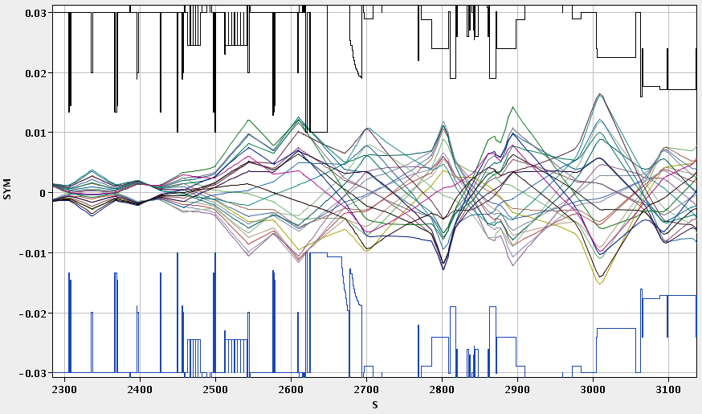
Injection
Operation envelope
Progress with beam in 2009
2010-2011

Slide 18
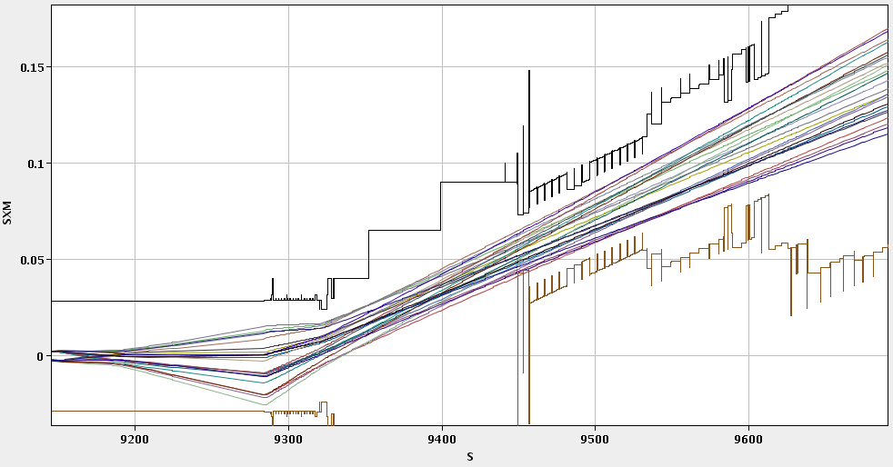
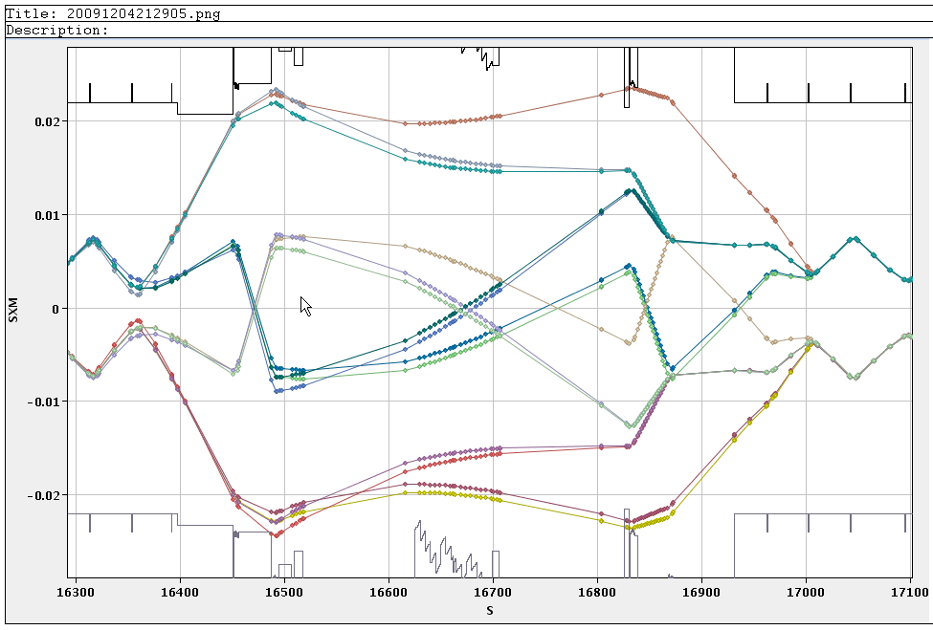
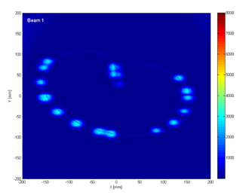
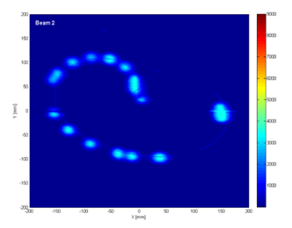
Beam dump
Operation envelope
Progress with beam in 2009
2010-2011
IR6 H Beam2, extracted
IR6 H Beam2, circulating

Slide 19
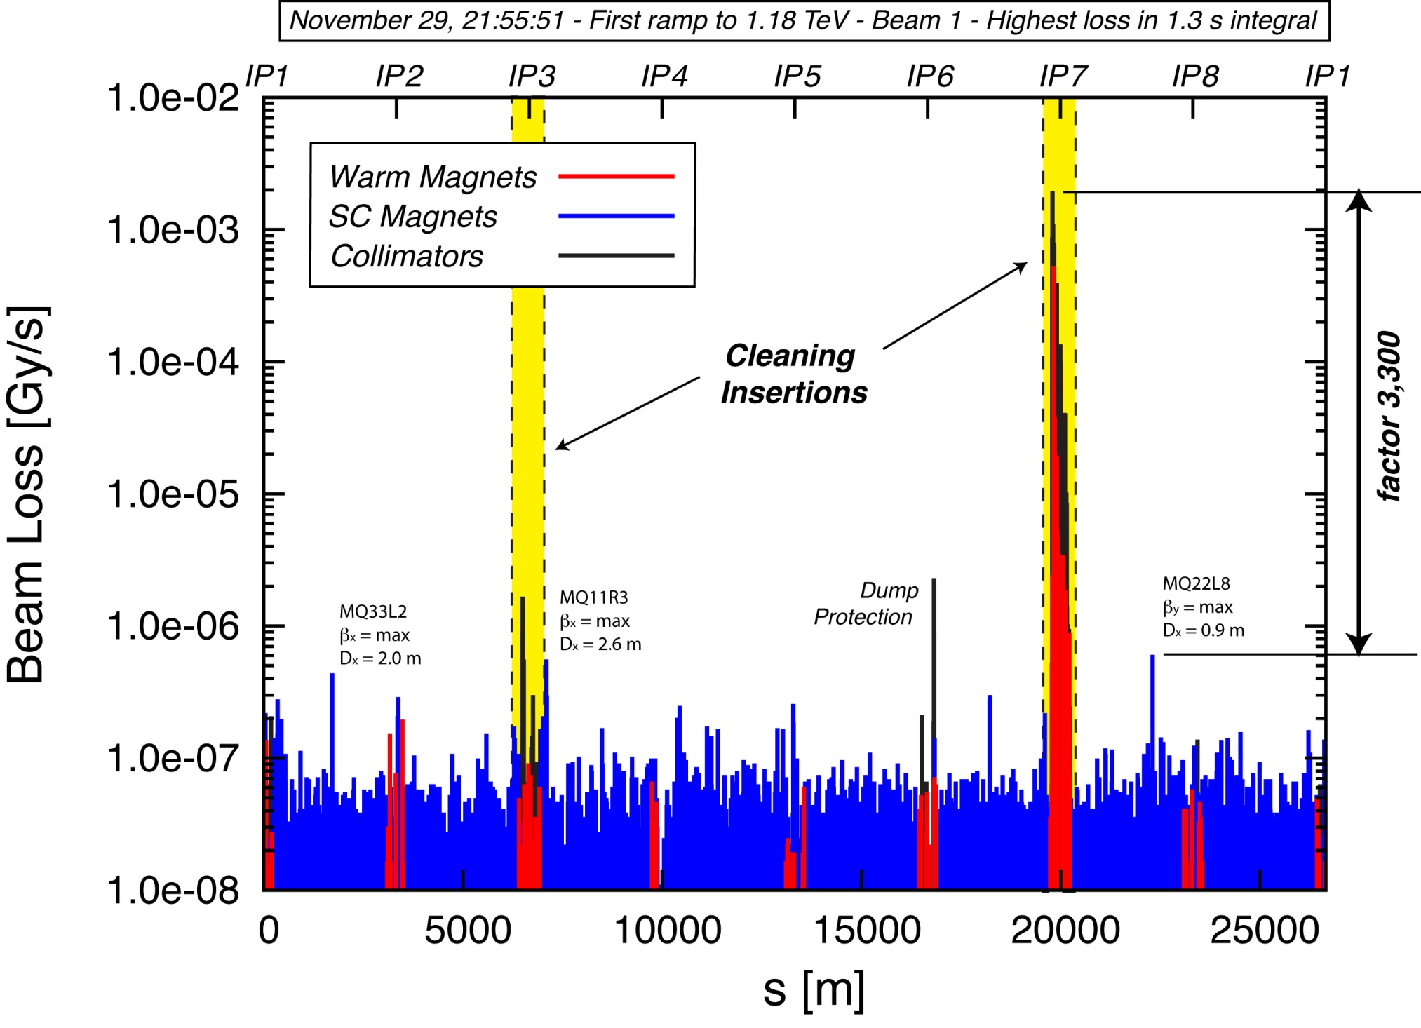
Collimation after beam based set up (Ralph)
Operation envelope
Progress with beam in 2009
2010-2011
Efficiency: > 99.9%

Slide 20
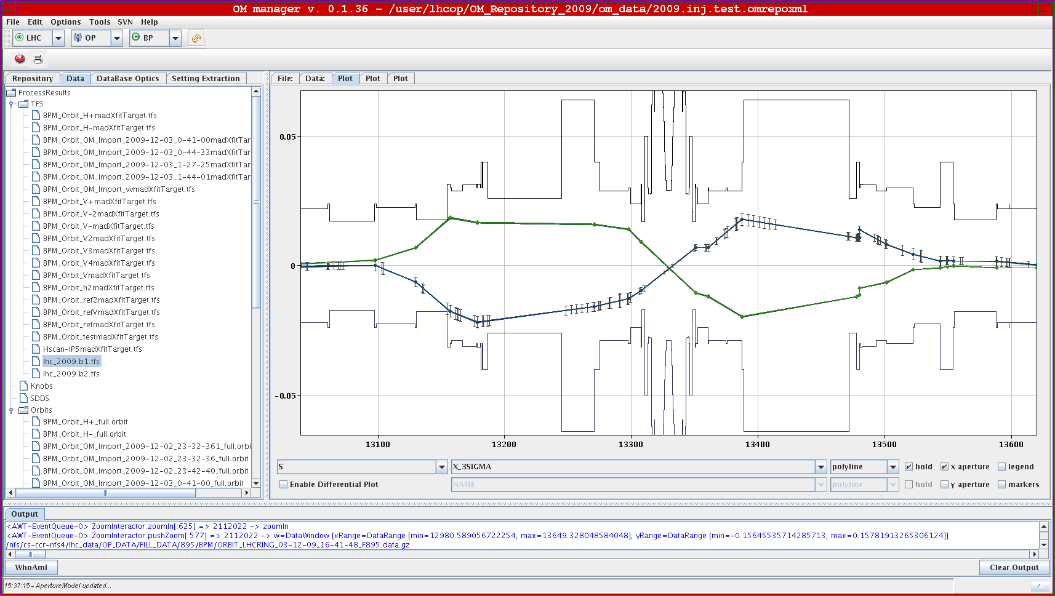
Aperture scans – IR5 H shown
Operation envelope
Progress with beam in 2009
2010-2011

Slide 21
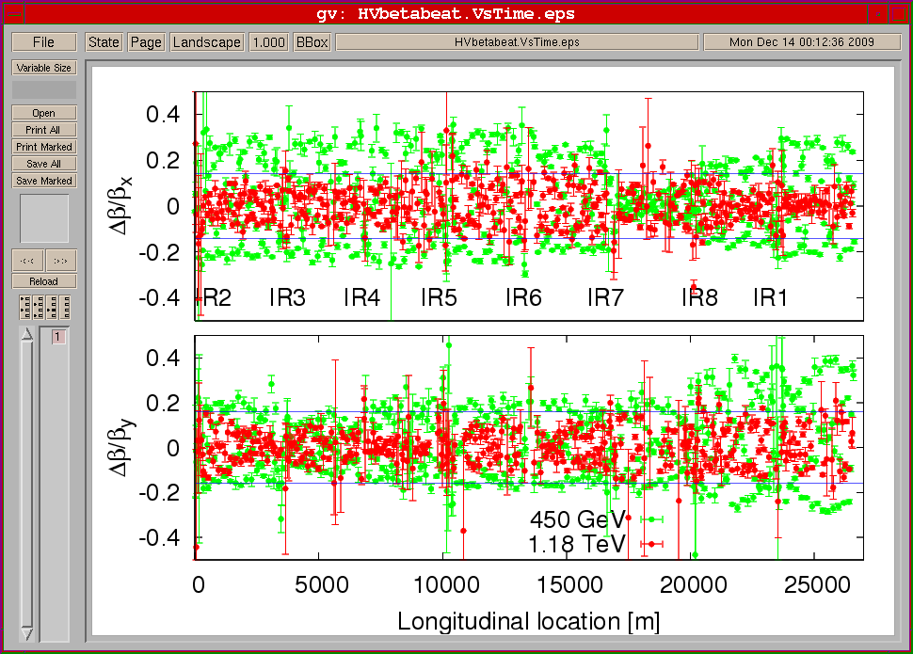
Beta-beat comparison 450 GeV and 1.18 TeV
Operation envelope
Progress with beam in 2009
2010-2011

Slide 22
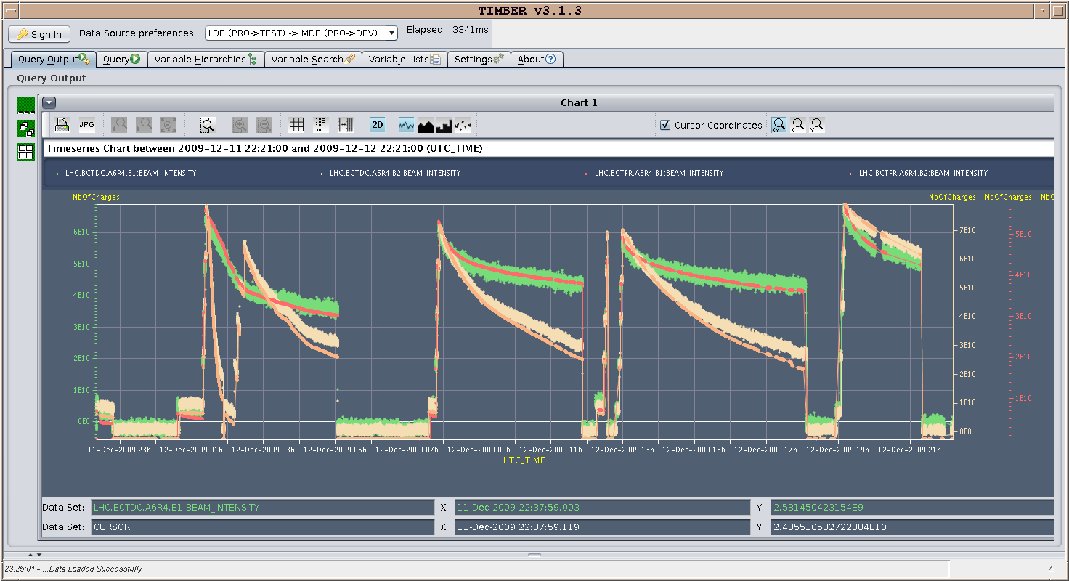
Production !
Operation envelope
Progress with beam in 2009
2010-2011

Slide 23
Data recorded
Operation envelope
Progress with beam in 2009
2010-2011
“stage” Total hours
4x4 5e9 p/bch 16 hrs
4x4 1.5e10 p/bch 26 hrs
16x16 1e10 p/bch 1.5 hrs
43.5 hrs
Estimated numbers of pp interactions recorded by experiments
 | Not stable beams (detectors partly on) |  | Stable beams (full detector on)
 | 450GeV | 1.18 TeV | 450 GeV
ALICE | 40k | 33k | ~ 400k
ATLAS | ~ 320k | ~ 34k | ~ 540k
CMS | ~ 100k | ~18k | ~ 410k
LHCB |  | ~ 40k | ~ 250k

Slide 24
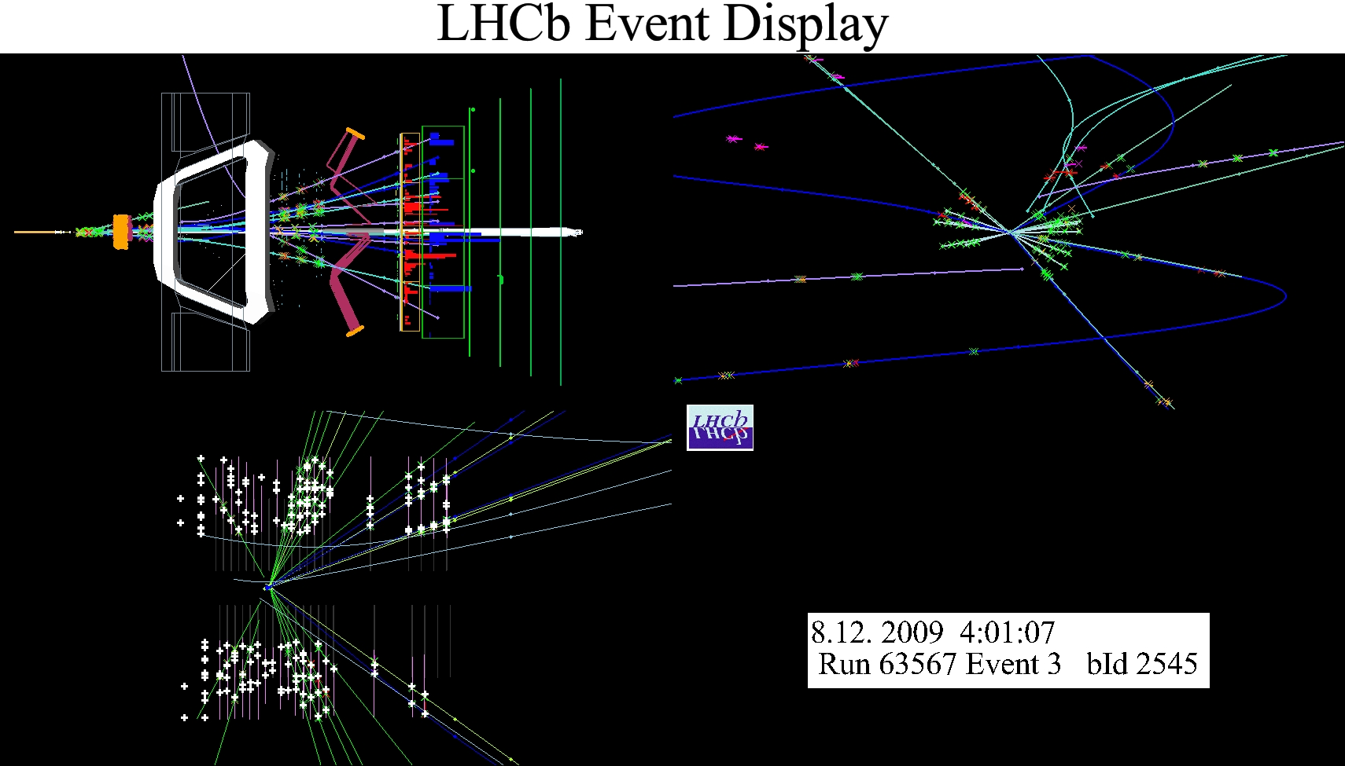
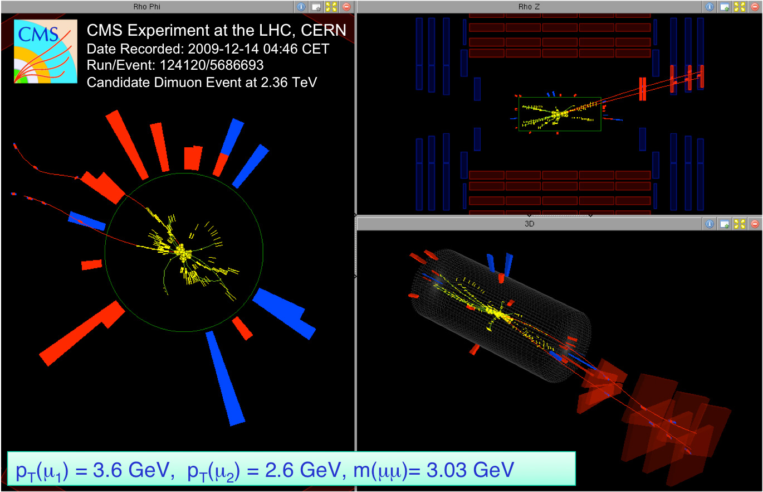
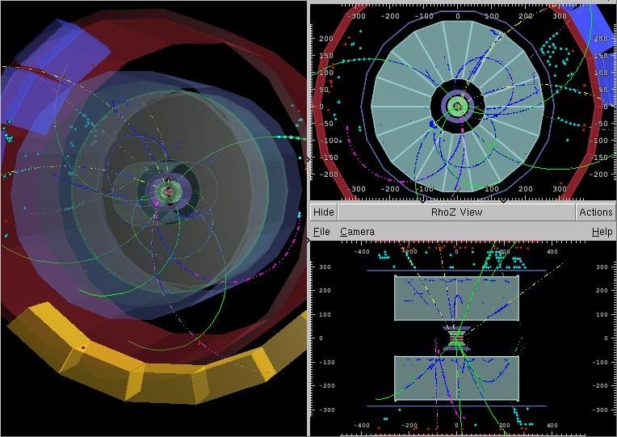
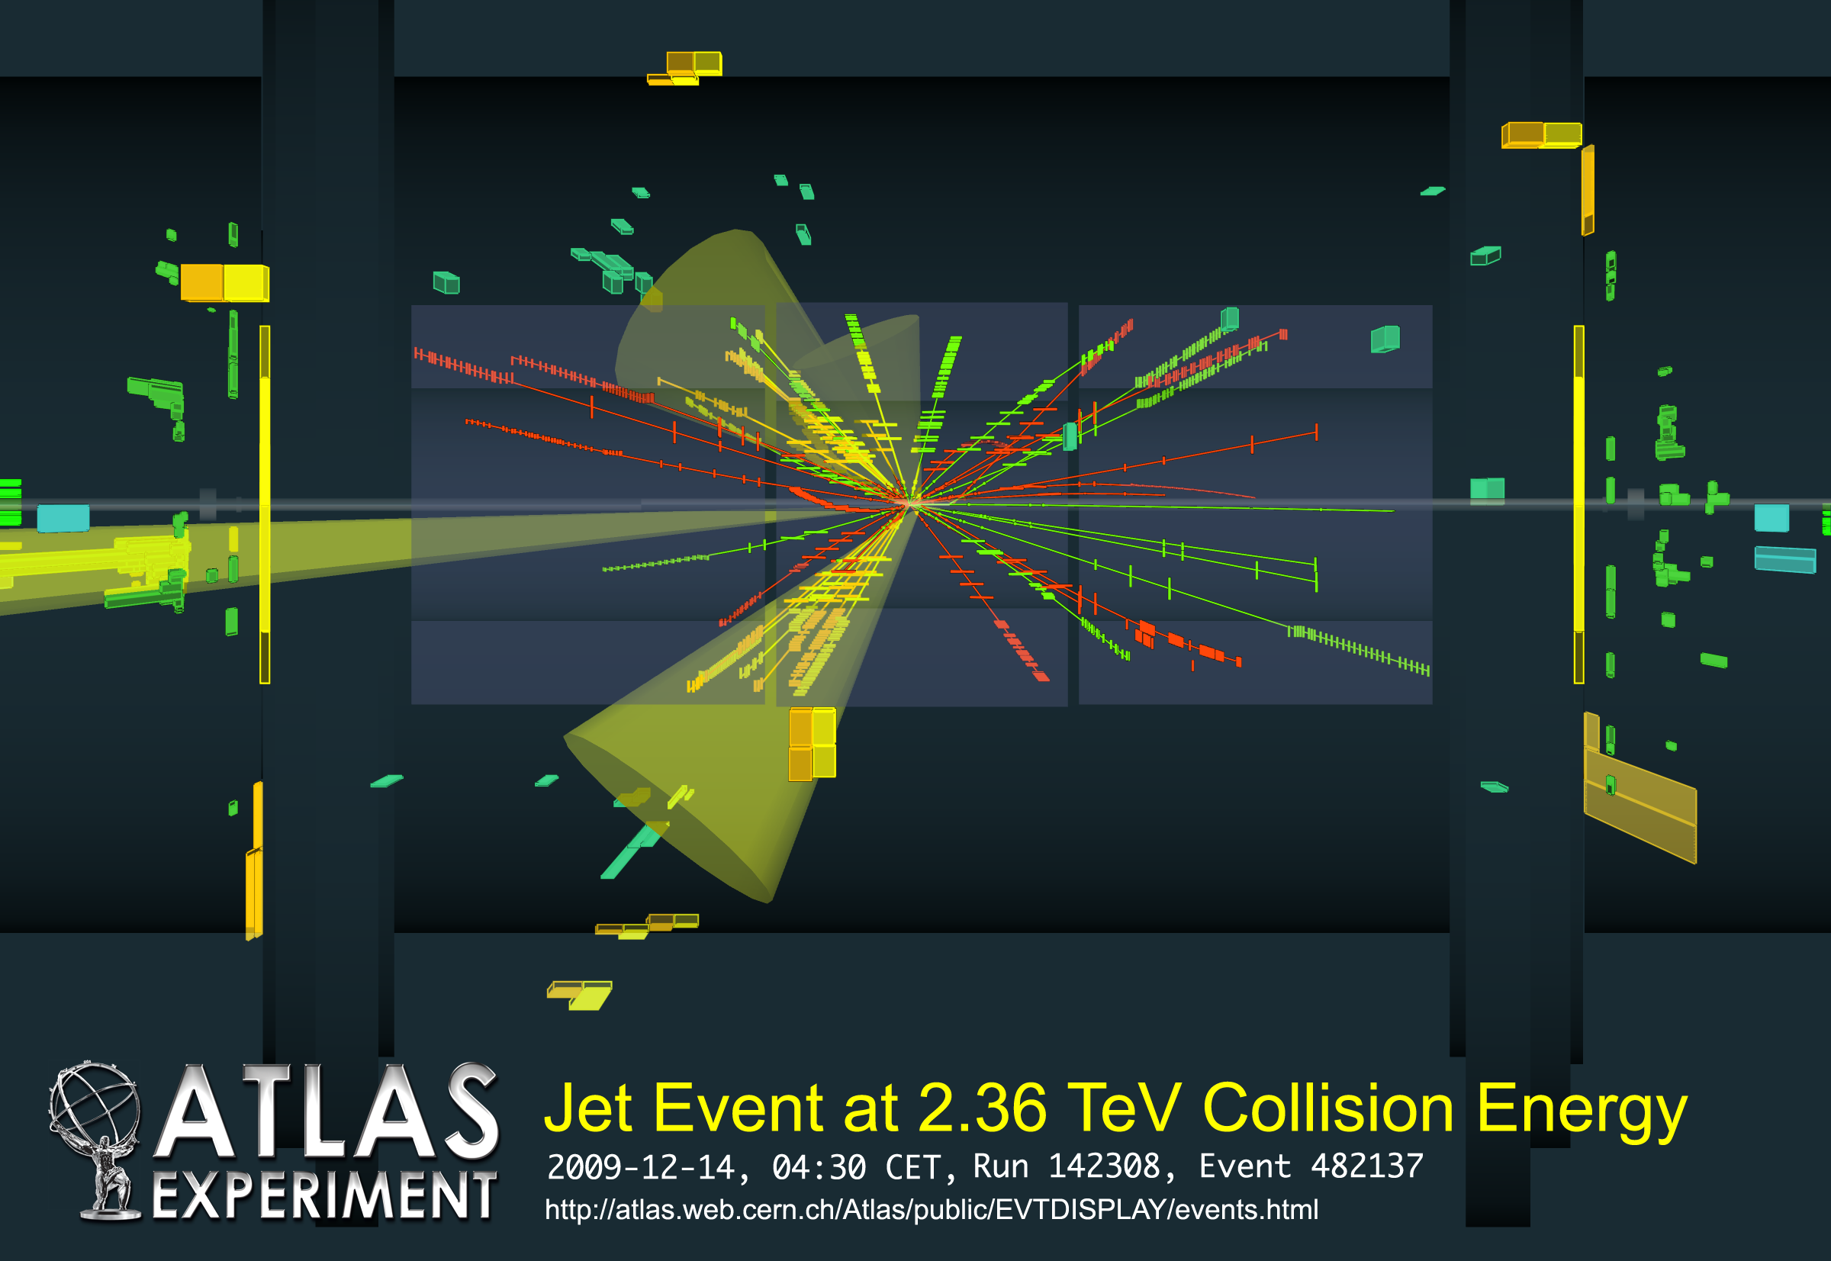
Experiments events
Operation envelope
Progress with beam in 2009
2010-2011
ALICE event at 900 GeV

Slide 25
Summary of progress with beam 2009
Operation envelope
Progress with beam in 2009
2010-2011
Excellent machine availability
Excellent performance of all accelerator systems
Huge amount achieved in 4 weeks
All targets met and more
All done with safe beams
Minimum changes made in the interest of expediency
Plenty to think about
Great collaboration between machine and experiments

Slide 26
LHC Beam Operation
Operation envelope
Progress with beam in 2009
2010-2011

Slide 27
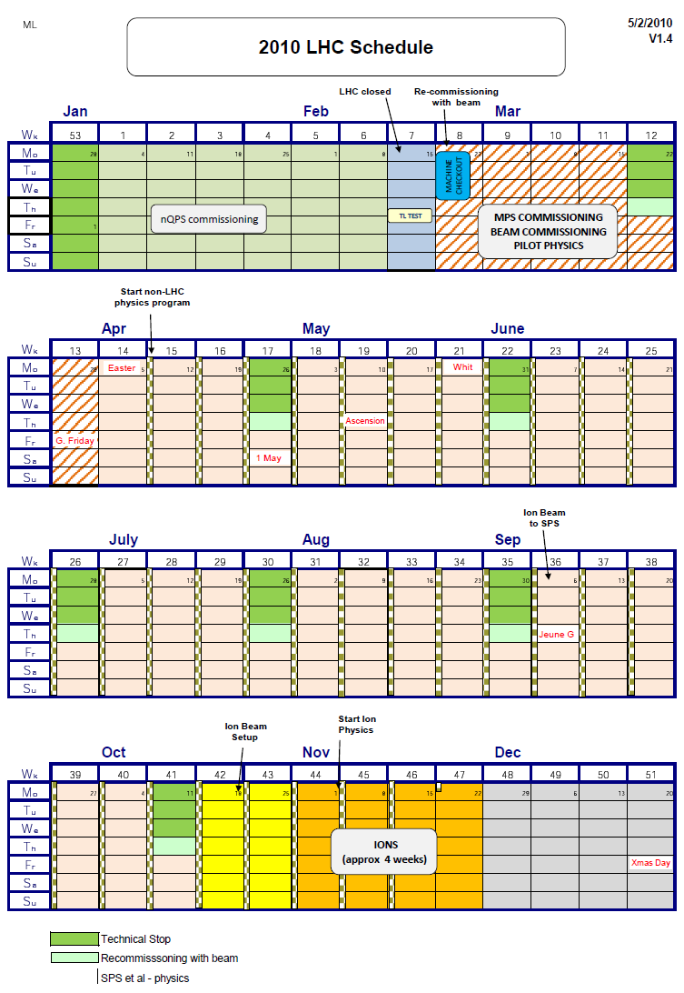
2010 plan
Operation envelope
Progress with beam in 2009
2010-2011
  450 GeV phase 1 / Ramp to 3.5 TeV
  450 GeV phase II / Ramp to 3.5 TeV
  Collide / Squeeze / Collide
  Colliding, safe, stable, squeezed beams
  Increase intensity in steps x2
  Week of running after each step
  No crossing angle
  43 on 43 at 2m
  Increase stored energy in steps of 2MJ
  Week of running after each step
  Bunch trains and crossing angle
  10³² cm⁻² s⁻¹
  Ions (early scheme, 62 bunches per beam)
  Same magnetic machine as for protons
  2 weeks to switch
  4 weeks ion run

Slide 28
2010 strategy
Operation envelope
Progress with beam in 2009
2010-2011
In 2009
  We corrected Q Q’ coupling orbit
  Otherwise optics were frozen
  Reference orbit established
  Protection devices set up and fixed
In 2010
  We correct everything we can with safe beams
  Then establish references
  Then set up protection devices
  Any further change will require another iteration

Slide 29
2010 progress with safe beams
Operation envelope
Progress with beam in 2009
2010-2011
Some difficulties to get new QPS operational
450 GeV work completed to date
  Q Q’ coupling orbit measured and corrected
  Optics (beta-beating) measured and corrected
  Established references
  Collimation set up
  Injection and associated protection
  Extraction and associated protection
  RF
Ramp to 3.5 TeV done last week
  Optics
  Collimation set-up…
Target for first colliding stable 3.5 TeV beams March 30th

Slide 30
Rates in 2011
Operation envelope
Progress with beam in 2009
2010-2011
Energy | TeV | 3.50 | 3.50 | 3.50 | 3.50 | 3.50 | 3.50 | 3.50 | 3.50
Month |  | Mar | Apr | May | Jun | Jul | Aug | Sep | Oct
Bunch intensity | 1.E+10 | 7 | 9 | 9 | 9 | 9 | 9 | 9 | 9
Bunches / beam |  | 432 | 432 | 560 | 720 | 720 | 720 | 720 | 720
Emittance | µm | 3.75 | 3.75 | 3.75 | 3.75 | 3.75 | 3.75 | 3.75 | 3.75
β* | m | 2 | 2 | 2 | 2 | 2 | 2 | 2 | 2
Luminosity 1 & 5 | cm-2 s-1 | 9.2E+31 | 1.5E+32 | 2.0E+32 | 2.5E+32 | 2.5E+32 | 2.5E+32 | 2.5E+32 | 2.5E+32
Protons |  | 3.0E+13 | 3.9E+13 | 5.0E+13 | 6.5E+13 | 6.5E+13 | 6.5E+13 | 6.5E+13 | 6.5E+13
% nominal |  | 9.4 | 12.0 | 15.6 | 20.1 | 20.1 | 20.1 | 20.1 | 20.1
Current | mA | 54.4 | 70.0 | 90.7 | 116.6 | 116.6 | 116.6 | 116.6 | 116.6
Stored energy | MJ | 16.9 | 21.8 | 28.2 | 36.3 | 36.3 | 36.3 | 36.3 | 36.3
Beam size 1 & 5 | um | 44.8 | 44.8 | 44.8 | 44.8 | 44.8 | 44.8 | 44.8 | 44.8
Initial luminosity | cm-2s-1 | 9.17E+31 | 1.52E+32 | 1.97E+32 | 2.53E+32 | 2.53E+32 | 2.53E+32 | 2.53E+32 | 2.53E+32
Integrated/month | pb-1 | 52.37 | 86.58 | 112.23 | 144.30 | 144.30 | 144.30 | 144.30 | 144.30
Integrated | pb-1 | 52.37 | 138.95 | 251.18 | 395.48 | 539.78 | 684.07 | 828.37 | 972.66

Slide 31
Summary
LHC is up and running with beam in 2009
  Excellent performance with safe beams
In 2010 & 2011
  Limited in energy due to interconnects …. Fixed in 2012
  Limited in intensity by collim. cleaning syst.…. Solution proposed
  Limited in β* because of lower energies …. target 2m
“Prudent step-by-step approach…. LHC is not a turnkey machine….”
R. Heuer
“We can take satisfaction in what we have achieved to date, while reminding ourselves, that we are breaking new ground technologically as well as scientifically” . R. Heuer

