Slide 1
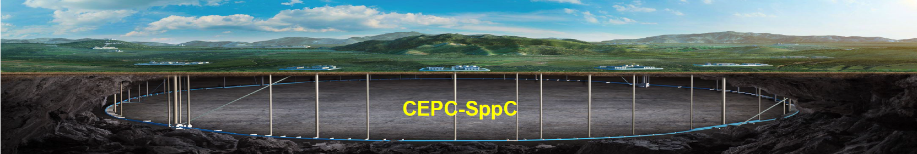

Progress of the High Field Magnet R&D
for CEPC-SPPC
Qingjin Xu
Nov 10, 2021
中国科学院高能物理研究所
Institute of High Energy Physics, CAS

Slide 2

Outline
SPPC high field magnet design scope
Status of the high field IBS coils by IHEP & IEE
Status of the high field model dipole magnets
Development of a novel HTS transposed cable
Status of the China-CERN HL-LHC CCT project
Summary

Slide 3
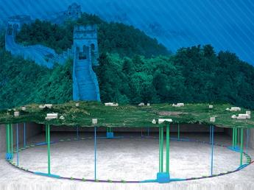
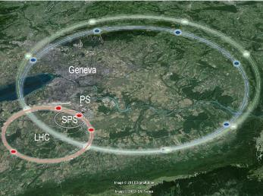
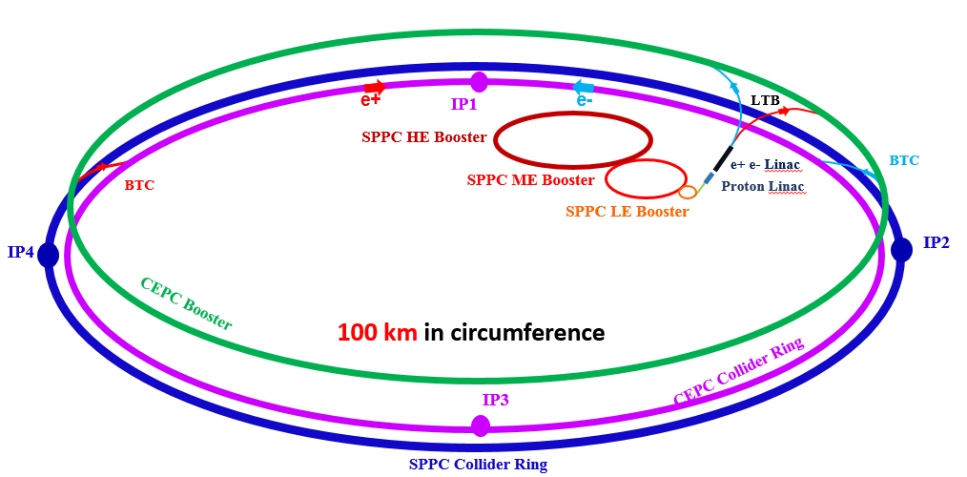
Magnet Design Scope for SPPC
High Energy Circular Colliders for next decades | SPPC | FCC
Proposed institution | IHEP-CAS, China | CERN, Europe
Proposed dates | 2012 | 2014
Site of the project | China | Europe
Baseline technology | IBS 12~24 T to reach 75-150 TeV, Nb₃Sn etc as options | Nb₃Sn 16 T to reach 100 TeV
Timeline | Construction at 2040s | Construction at 2050-60s
Cost | * | **

Slide 4

J_{e} of Practical Superconductors Presently
500A/mm²
IBS 2021 100-m tape
IBS 2018 100-m tape
IBS 2016
(short sample)

Slide 5
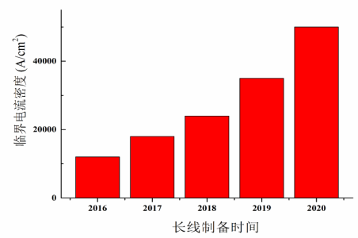
100-m Long Ba122 Tapes by Rolling Process
In 2020, J_{c} of a 100-m 7-core tape using the new fabrication technique reached 500 A/mm² @ 4.2 K, 10 T.
Tape width 4.8 mm, tape thickness 0.3 mm. I_{c} > 260 A, J_{e}>180 A/mm².
In 2018, J_{c} of such tape is 300 A/mm² @ 4.2 K, 10 T.
Prof. Y. Ma’s
Group, IEE-CAS

Slide 6
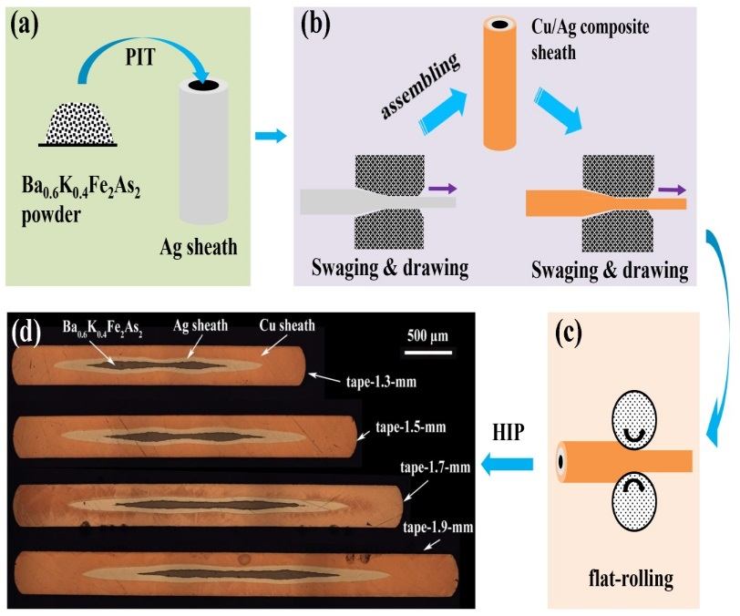
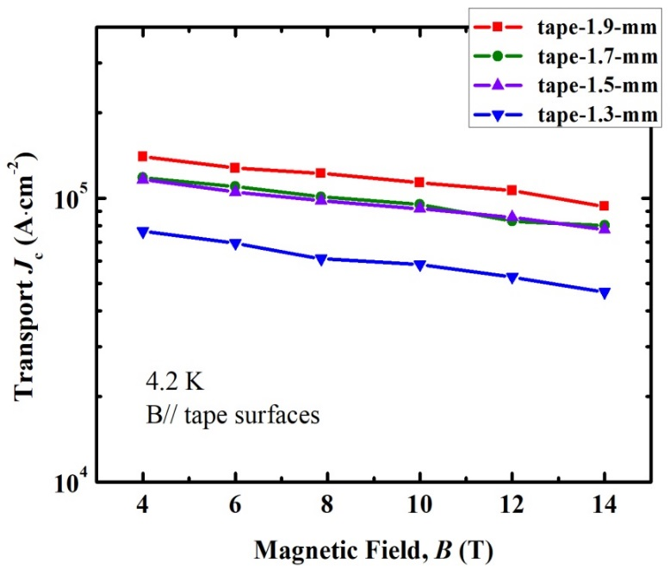
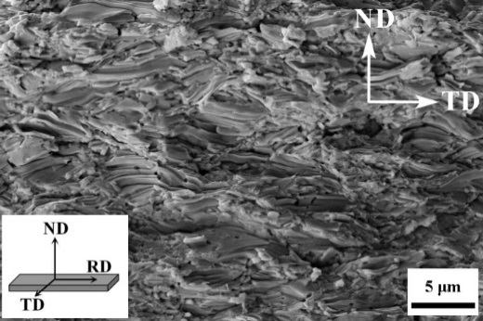
Performance of HIP Ba122 Tapes with Cu/Ag Sheath
4.2 K, 10 T (short sample): J_{c}=1100 A/mm²
Prof. Y. Ma’s
Group, IEE-CAS
Liu 2021 Sci. China Mater.
Doi:10.1007/s40843-020-1643-1
Size of the grains was around 0.5 um, smaller than that in the Hot-pressed samples.
The J_{c} may be improved with the increase the grain size.

Slide 7
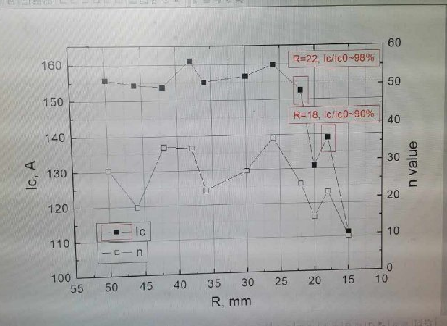
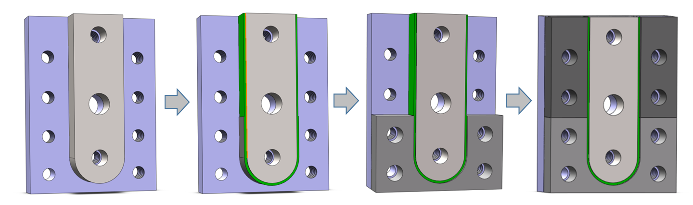
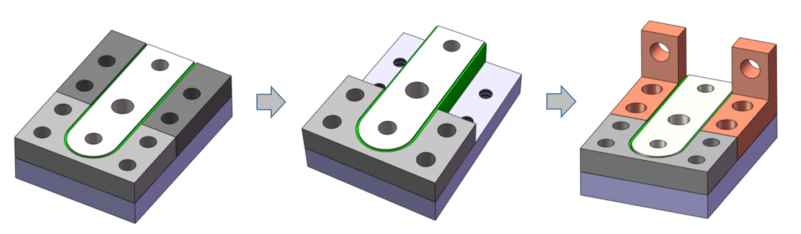
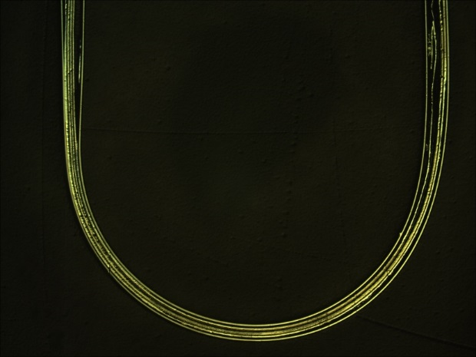
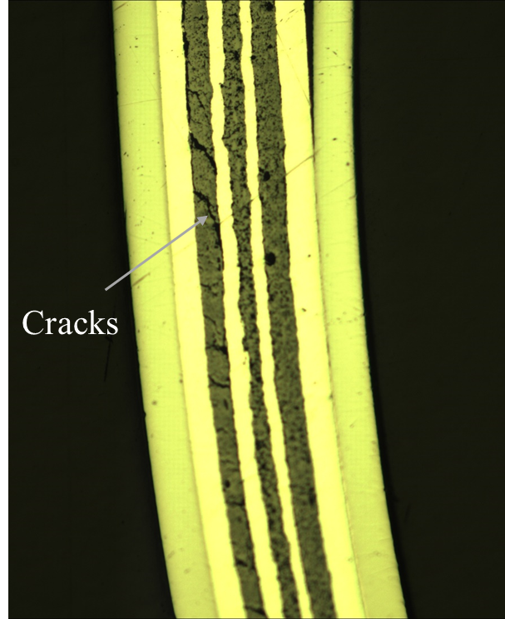
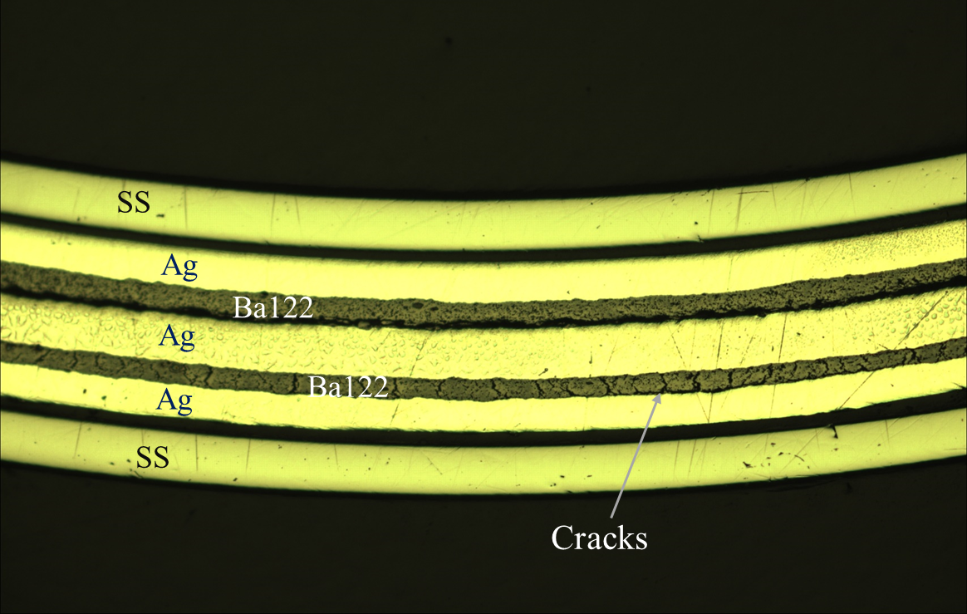
J_{c} of Bent IBS Tapes
Preparition of bent IBS tape
Sample results by ASIPP in 2018
Sample results by IHEP in 2021
OMI of D10 bent tape
Cracks appear regularly in part of the superconducting cores under tensile stress !
I_{c} of bent IBS tapes decreases with smaller bending diameters.

Slide 8
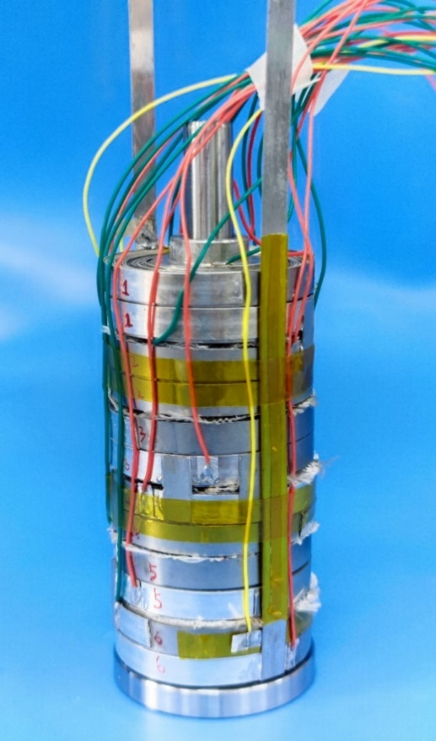
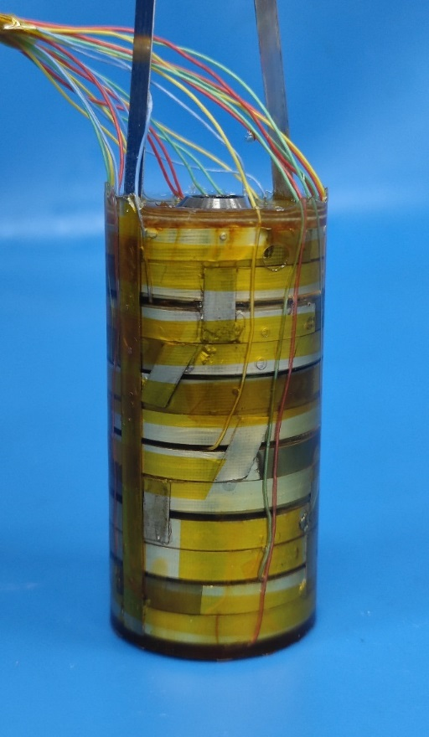
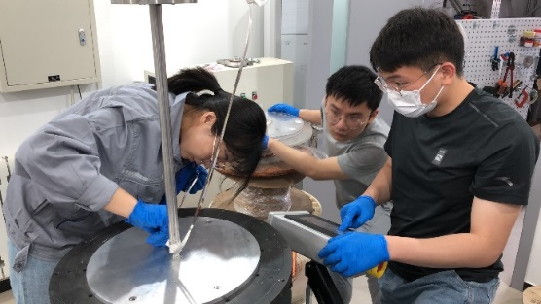
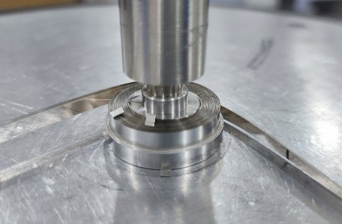
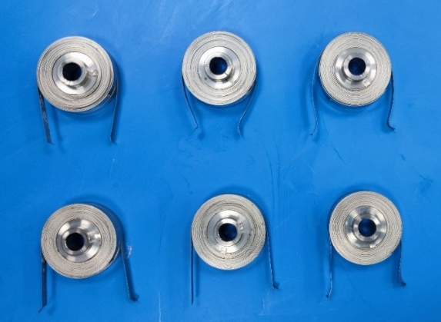
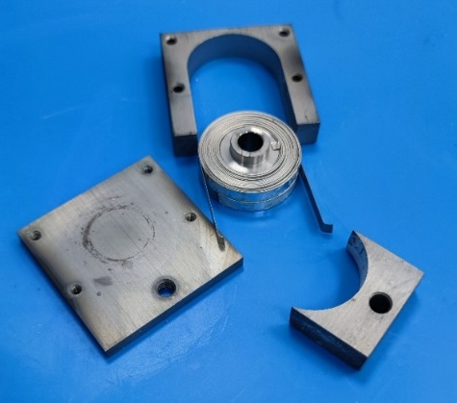
High Field IBS Insert Solenoids
Fabrication of D20-17 turn-double pancake coils with IBS tapes
Coil winding of the IBS double pancake solenoids with 20-mm inner diameter
IBS double pancake solenoids after heat reaction
Series IBS double pancake solenoids
Impregnated Series IBS solenoids

Slide 9
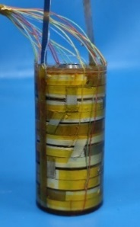
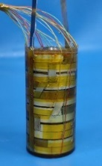
High Field IBS Insert Solenoids
Performance test of the series IBS solenoids at 20 T background field
34mm inner diameter,
17 turn double pancake,
6 coils in series.
34mm inner diameter, 17turn double pancake, 6 coils in series.
Quench Criteria
100A hold 80s
80A hold 100s
0.5A/s ramp rate
I_{c} of the series IBS solenoids reached 75 A at 20 T, and stable operation with 100 A.

Slide 10
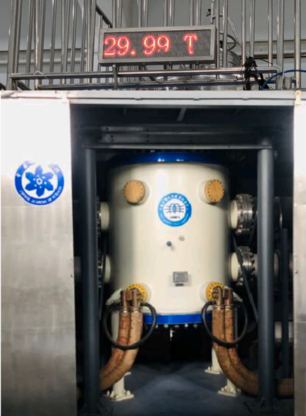
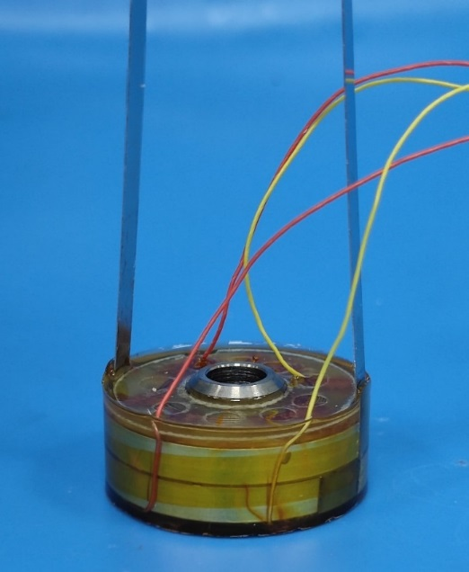
High Field IBS Insert Solenoids
Performance test of the double pancake IBS solenoid at 30 T background field
34mm inner diameter, 17turn double pancake coil
30T background magnet @ Hefei
D20-17turn-IBS double pancake coil
I_{c} of the IBS solenoid reached 67 A at 30 T. New world record!

Slide 11
Racetrack Coils with 100-m Long IBS Tapes
Parameter | Value
Background field | 0-10 T
Rate | 1 A/s
Maximum pressure on IBS | 120 MPa

Slide 12
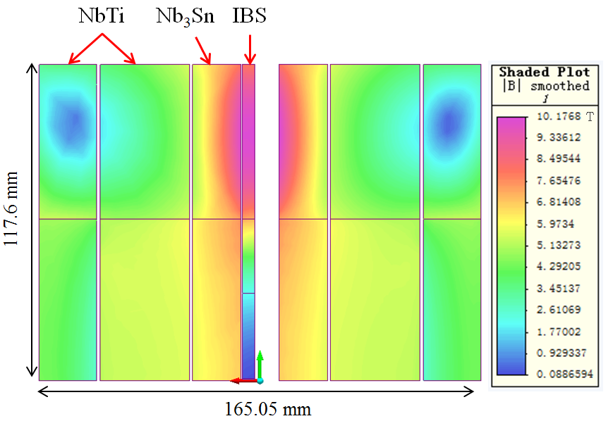
Racetrack Coils with 100-m Long IBS Tapes
Two racetrack coils have been made using the 100 m length IBS tapes.
The coils reached 86.7% of critical current of the short sample at 4.2 K and 10 T.
with highest compressive stress of 120 MPa.
Zhang, et al., SuST,. 34 (2021) 035021
Comments from SUST reviewers：
…the new results that can have a strong impact on the conductor and magnet community.
…demonstrated the great potential of Iron-Based Superconductor in the development of next-generation accelerators.
It is of certain significance in the path of applications of Iron-Based Superconductor…

Slide 13
Challenges and Outlook of the IBS Magnets
100-m 7-core IBS tape fabricated
IBS solenoid at 30 T
Racetrack at 10 T
T_{c} reached 55K
2008.02
2008.04
2008.09
2016
2018
2020
2022
Discovery of IBS
Discovery of
122 phase IBS
IBS solenoid at 24 T
Racetrack at 8 T
The engineering current density of the long-length IBS still needs a significant improvement, to reach the similar level as ReBCO or Bi-2212 conductors.
The materials of stabilizer should be shifted to copper or any other low-cost metals to realize the low cost of IBS.
Structure and fabrication methods of IBS and corresponding coils should be further optimized to minimize the J_{c} degradation at high field and high stress.
And many other issues like detailed magnetic and mechanical properties study of IBS, quench detection and protection of the IBS coils / magnets and etc.

Slide 14
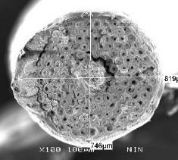
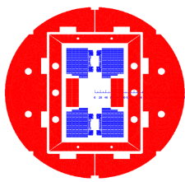
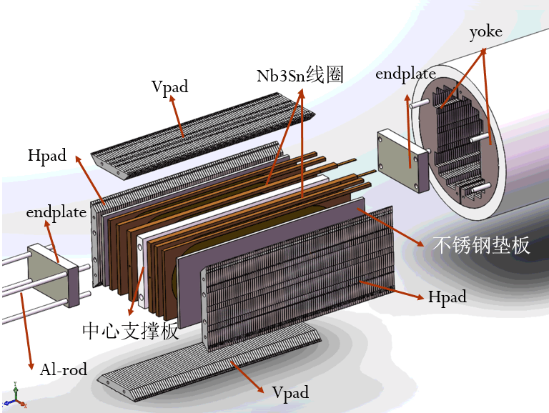
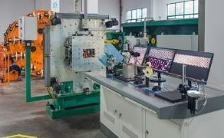
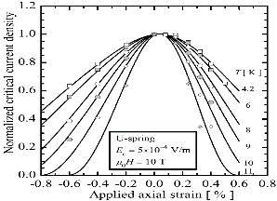
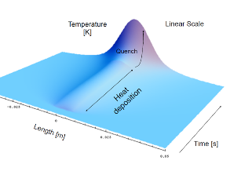
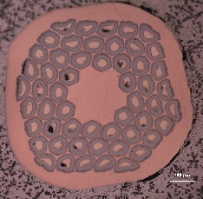
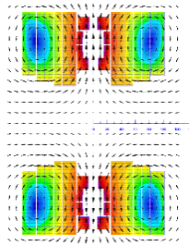
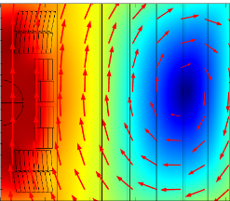
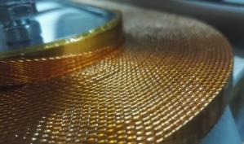
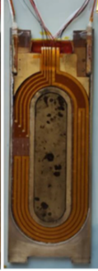
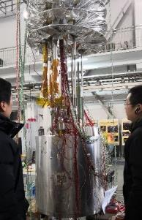
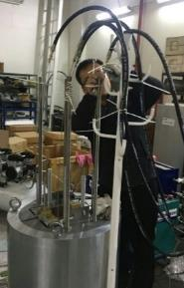
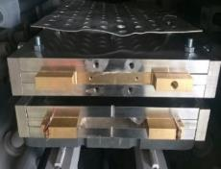

R&D Route for High-field Accelerator Magnets
J_{c,} RRR, Cu ratio,
Filament size,
Magnetic field strength,
EM force, quench protection,…
J_{c} and RRR degradation
Stress and dimension control
J_{c} & strain curve of the superconductor
Quench protection
Hot spot, voltage,…
Superconductor
Coil Fabrication
Magnet
Assembly
Performance
Qualification
Magnet Design
Material,
Cross section, Processing,…
Magnetic field quality,
Persistent current effect,
Coil stress,…
Impregnation quality control
Thermal stress control
Mechanical strength and stability
Pre-stress control
Dimension control,
Mechanical Stability
Training, Thermal-magnetic instability,
Thermal cycle,…

Slide 15
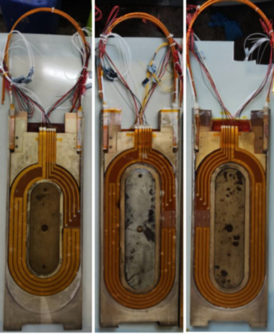
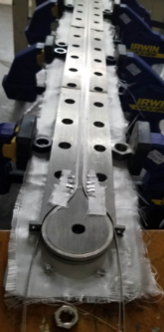
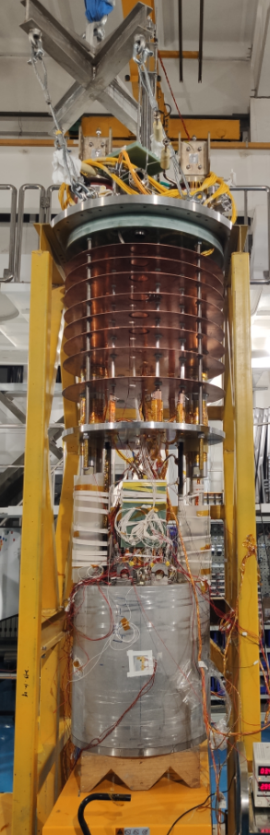
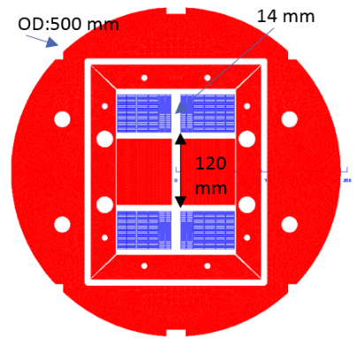
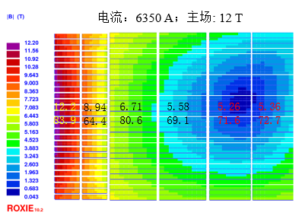
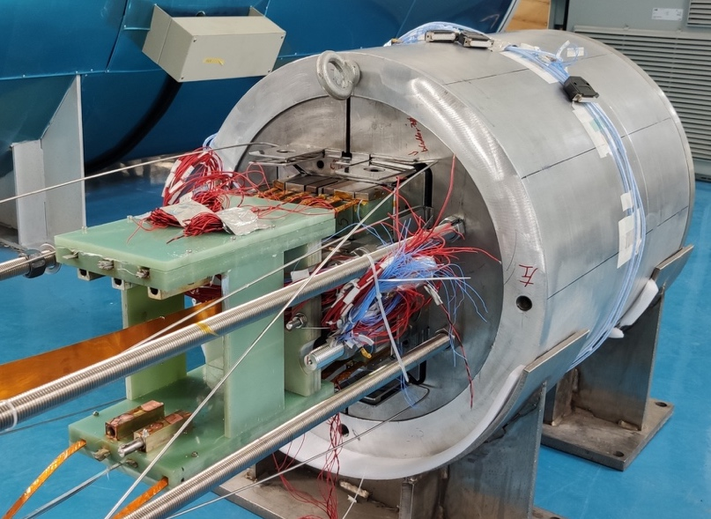
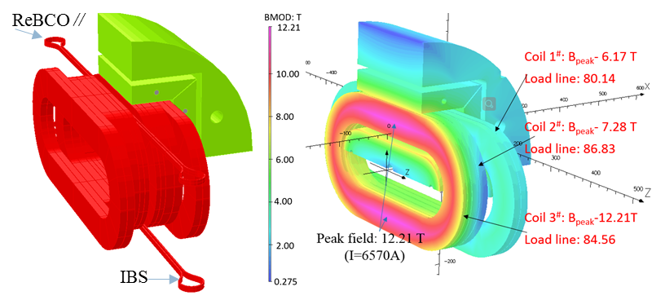
R&D of the 1st NbTi+Nb₃Sn Model Dipole Magnet
Development of the LPF1 NbTi+Nb₃Sn dual-aperture model dipole magnet from 2017.
Dipole field reached 12 T in 2*Φ14 mm apertures in May 2021 and 12.47 T in July after a thermal cycle.

Slide 16
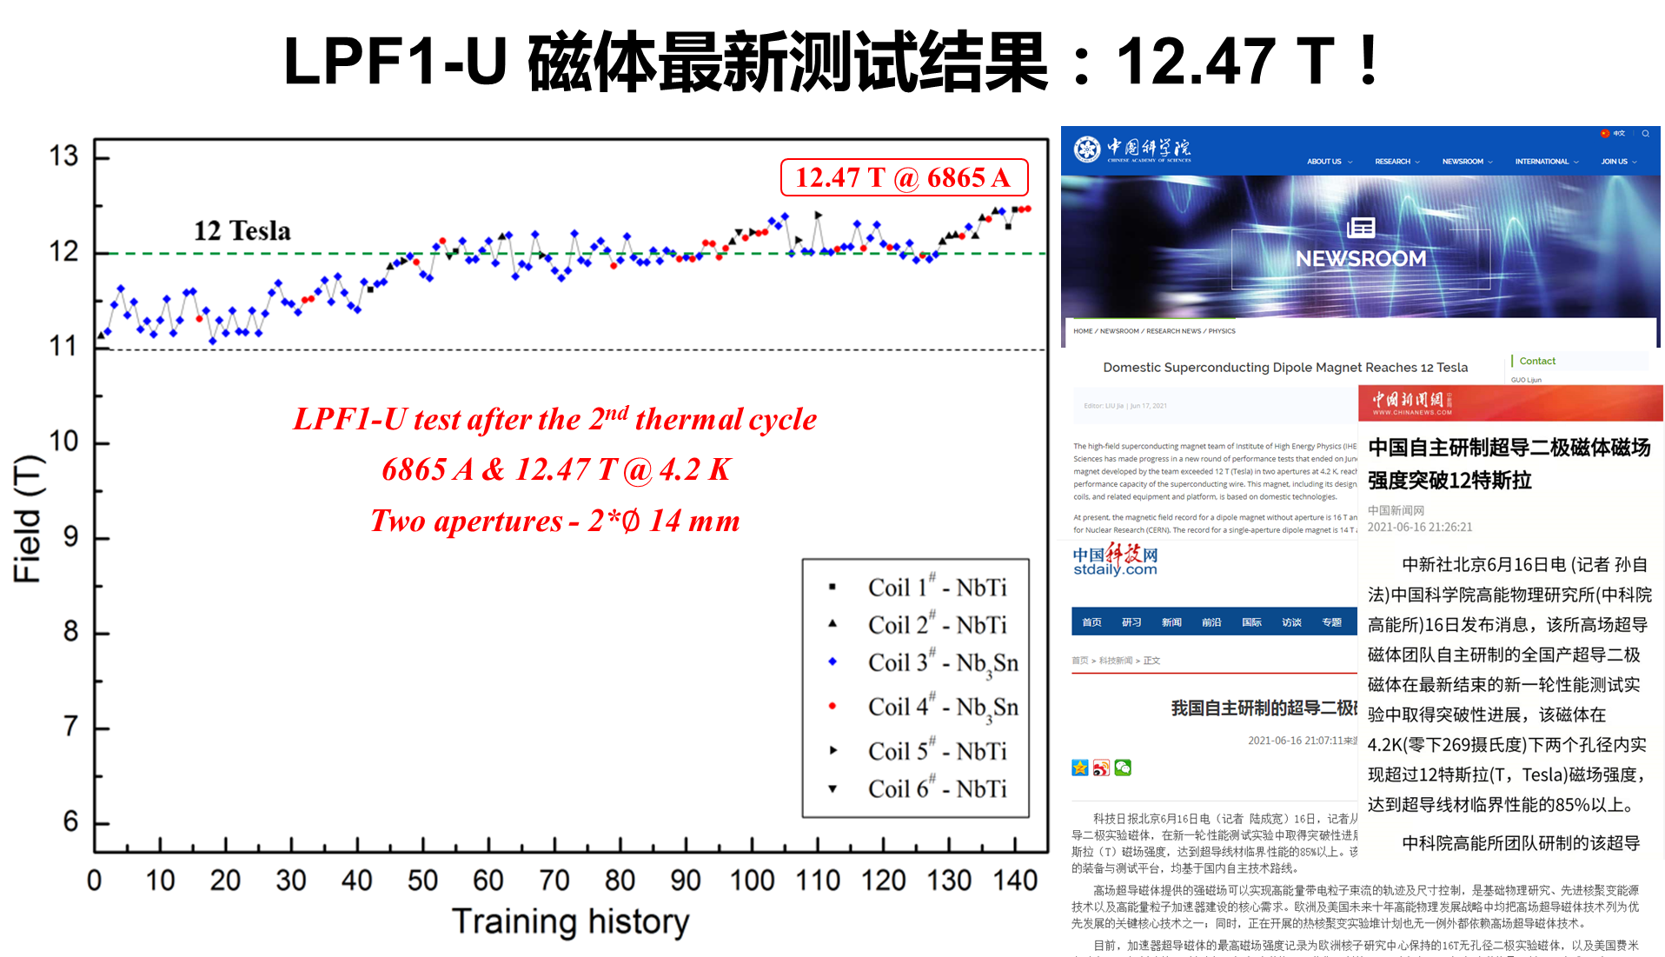
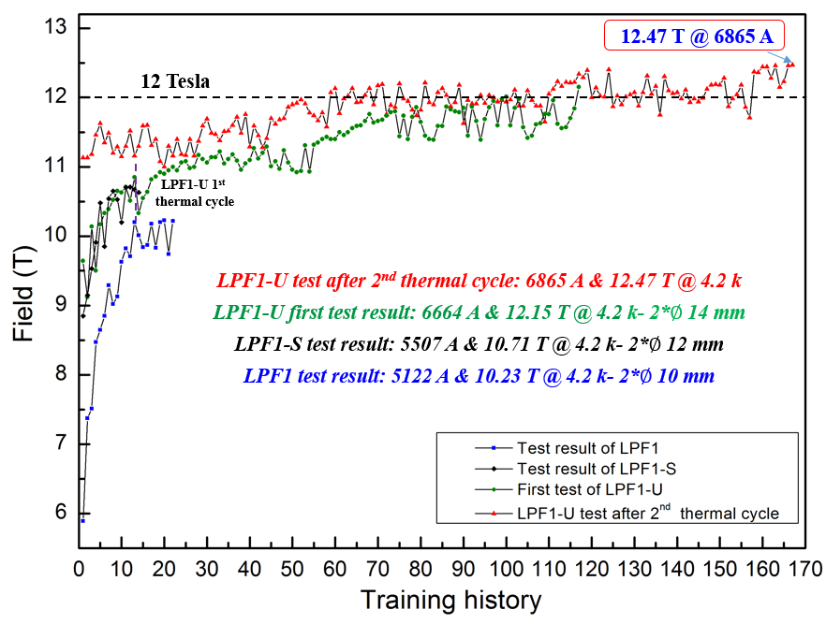

Slide 17
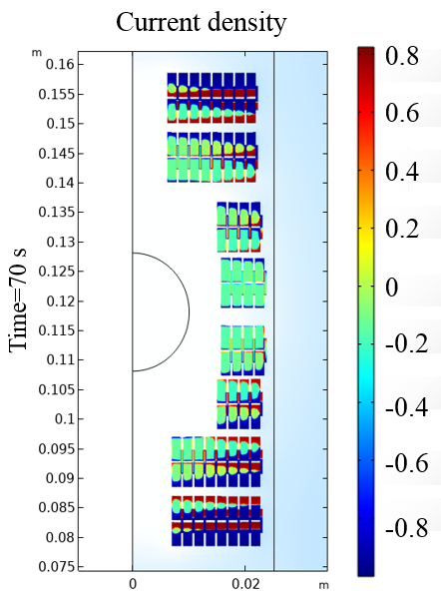
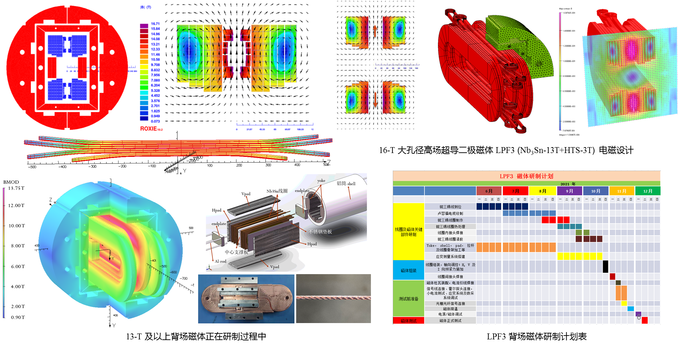


Ongoing: Development of the 16-T Hybrid Dipole Magnet
Nb₃Sn 12~13 T + HTS 3~4 T

Slide 18

Ongoing: Development of the 16-T Hybrid Dipole Magnet
Development of a NOVEL HTS Transposed Cable
The 1st prototype cable
The 2nd prototype cable

Slide 19

Ongoing: Development of the 16-T Hybrid Dipole Magnet
Development of a NOVEL HTS Transposed Cable
Iron Based Superconductor
Hastelloy
Cross section of the cable
IBS prototype cable
Cable length: 5 m
Pitch length: 200 mm
Cable thickness: 10.5 mm
Reaction temp.: 860°C
Test radius: 200 mm

Slide 20

R&D Roadmap for next years

Slide 21















Status of the China-CERN HL-LHC CCT Project
Layout of the HL-LHC Magnets and Contributors
  Performance of the 1st full-length prototype magnet from China: Fabrication completed in May 2020, and the performance test at 4.2K completed in August 2020. both apertures reached the ultimate current.

Slide 22








Status of the China-CERN HL-LHC CCT Project
The 1st series magnet
02-Aperture 1
02-Aperture 2
The 1st series magnet passed all the performance test at 4.2K!
02-Aperture-1
02-Aperture-2
Practice coil
1-Aperture-02
1-Aperture-01

Slide 23






Status of the China-CERN HL-LHC CCT Project
Field quality measurement results of the 1st series magnet
All field errors are within the requirement, less than 5 units for most cases.

Slide 24






Status of the China-CERN HL-LHC CCT Project
The 1st magnet Packed and delivered to Sweden Uppsala University on Oct. 18 for the performance qualification at 1.9K

Slide 25
Summary
Strong domestic collaboration in China for the advanced superconductor R&D (HTS & Nb₃Sn): to significantly raise their performance and lower their cost.
J_{c} of 100-m long 7-core Iron-Based Superconducting tape has reached 500 A/mm² @ 4.2 K, 10 T, corresponding to I_{c} >200 A, J_{e}>140 A/mm².
Quench current of the Iron-Based Superconducting double pancake solenoid coil reached 67 A at 30 T, new world record!
10+ T dual-aperture model dipoles being developed at IHEP, reached 12.47 T at 4.2 K in July 2021, aiming to reach 16 T (Nb₃Sn+HTS) in 3 years, and 20 T in 10 years.
HL-LHC CCT magnet project: the 1st series CCT magnet has passed all the performance test at 4.2 K, to be shipped to EU in October 2021. China & CERN Collaboration on accelerator technology started with HL-LHC CCT magnets, to be expanded in future.

Slide 26
Thanks for your attention!
Team Members & Collaborators
IHEP-CAS: Chengtao Wang, Yingzhe Wang, Juan Wang, Chunyan Li, Rui Kang, Huanli Yao, Zhen Zhang, Jinrui Shi, Ze Feng, Wei Li, Ao Feng, Ling Zhao, Zhilong Hou, Huan Yang, Zhongxiu Liu, Quanling Peng,…
IEE-CAS: Dongliang Wang, Xianping Zhang, Yanwei Ma,…
HIPS-CAS: Huajun Liu, Tao Zhao, Yanlan Hu,…
IMP-CAS: Wei Wu, Yu Liang, Wenjie Liang, Dongsheng Ni,…
WST: Bo Wu, Yanmin Zhu, Xiang Guo, Jianwei Liu, Jianfeng Li, Meng Li, Chao Li, …
Toly Electric: Yu Zhao, Hean Liao, Bingxing Lu,…
Baoding Tianwei Electric: Tao Xing, Xiongzhuang Li, Jun Jiao,…
CERN：Ezio Todesco, Glyn Kirby, Andrea Musso, Arnaud Devred,…
*Work supported by the Strategic Priority Research Program of the Chinese Academy of Sciences (CAS) Grant No. XDB25000000, the National Key Research and Development Program of China No. 2018YFA0704200, and National natural Science Foundation of China Grant No. 11675193, 11575214, 11604335.

