Slide 1
HOM Heating in IR region of MDI for CEPC
Liu Yu dong, Shi Hao Yu, Wang Na, Wang Hai Jing, Bai Sha, Wang Dou
2021 international workshop on the high energy Circular Electron-Positron Collider (CEPC) , Nov 8-12, 2021

Slide 2
outline
Beam parameters in CDR and high luminosity Z for CEPC
Position and Layout of IR pipe
Impedance results and power deposition for different IR pipe model
Summary

Slide 3
Parameters for CDR and High Luminosity Z
 | ttbar | Higgs | W | Z | Z(High Luminosity）
Number of Ips | 2
Circumference [km] | 100.0
SR power per beam [MW] | 30
Half crossing angle at IP [mrad] | 16.5
Bending radius [km] | 10.7
Energy [GeV] | 180 | 120 | 80 | 45.5 | 45.5
Energy loss per turn [GeV] | 9.1 | 1.8 | 0.357 | 0.036 | 0.037
Piwinski angle | 1.21 | 5.94 | 6.08 | 23.8 | 24.68
Bunch number | 35 | 249 | 1297 | 12000 | 11951
Bunch population [10^10] | 20 | 14 | 13.5 | 8.0 | 14
Beam current [mA] | 3.3 | 16.7 | 84.1 | 461 | 803.5
Momentum compaction [10^-5] | 0.71 | 0.71 | 1.43 | 1.11 | 1.43
Beta functions at IP (bx/by) [m/mm] | 1.04/2.7 | 0.33/1 | 0.21/1 | 0.2/0.001 | 0.13/0.9
Emittance (ex/ey) [nm/pm] | 1.4/4.7 | 0.64/1.3 | 0.87/1.7 | 0.18/0.0016 | 0.27/1.4
Beam size at IP (sigx/sigy) [um/nm] | 39/113 | 15/36 | 13/42 | 4/79 | 6/35
Bunch length (SR/total) [mm] | 2.2/2.9 | 2.3/3.9 | 2.5/4.9 | 8.5 | 2.5/8.7
Energy spread (SR/total) [%] | 0.15/0.20 | 0.10/0.17 | 0.07/0.14 | 0.08 | 0.04/0.13
Energy acceptance (DA/RF) [%] | 2.3/2.6 | 1.6/2.2 | 1.2/2.5 | 0.6/1.7 | 1.3/1.7
Beam-beam parameters (ksix/ksiy) | 0.071/0.1 | 0.015/0.11 | 0.012/0.113 | 0.004/0.093 | 0.004/0.127
RF voltage [GV] | 10 | 2.2 | 0.7 | 10 | 0.12
RF frequency [MHz] | 650 | 650 | 650 | 650 | 650
HOM power per cavity (5/2/1cell)[kw] | 0.4/0.2/0.1 | 1/0.4/0.2 | -/1.8/0.9 | -/-/1.94 | -/-/5.8
Qx/Qy/Qs | 0.12/0.22/0.078 | 0.12/0.22/0.049 | 0.12/0.22/ | 0.12/0.22/ | 0.12/0.22/
Beam lifetime (bb/bs)[min] | 81/23 | 39/18 | 60/717 | 80/182202 | 80/182202
Beam lifetime [min] | 18 | 12.3 | 55 | 120/120 | 80
Hour glass Factor | 0.89 | 0.9 | 0.9 | 0.97 | 0.97
Luminosity per IP[1e34/cm^2/s] | 0.5 | 5.0 | 16 | 32.1 | 115
Beam current almost doubled
Luminosity above 100 *10³⁴

Slide 4
Total impedance budget @3mm
Components | Number | Z||/n, mΩ | k_{loss}, V/pC | ky, kV/pC/m
Resistive wall | - | 6.2 | 363.7 | 11.3
RF cavities | 60 | 0.5 | 101.2 | 0.5
Flanges | 37714 | 5.2 | 37.3 | 5.2
BPMs | 1808 | 0.04 | 9.5 | 0.2
Bellows | 15949 | 2.9 | 87.4 | 3.9
Gate Valves | 500 | 0.2 | 14.5 | 0.4
Pumping ports | 5316 | 0.3 | 2.3 | 0.2
Collimators | 8 | 0.02 | 11.7 | 0.3
IP chambers | 2 | 0.004 | 0.3 | 0.05
Electro-separators | 20 | -0.1 | 34.5 | 0.1
Taper transitions | 48 | 0.04 | 2.5 | 0.09
Total |  | 15.3 | 664.9 | 22.2
IP chamber length: 22ppm of ring circumference
IP chamber power loss: 0.45%
Most Critical component!

Slide 5
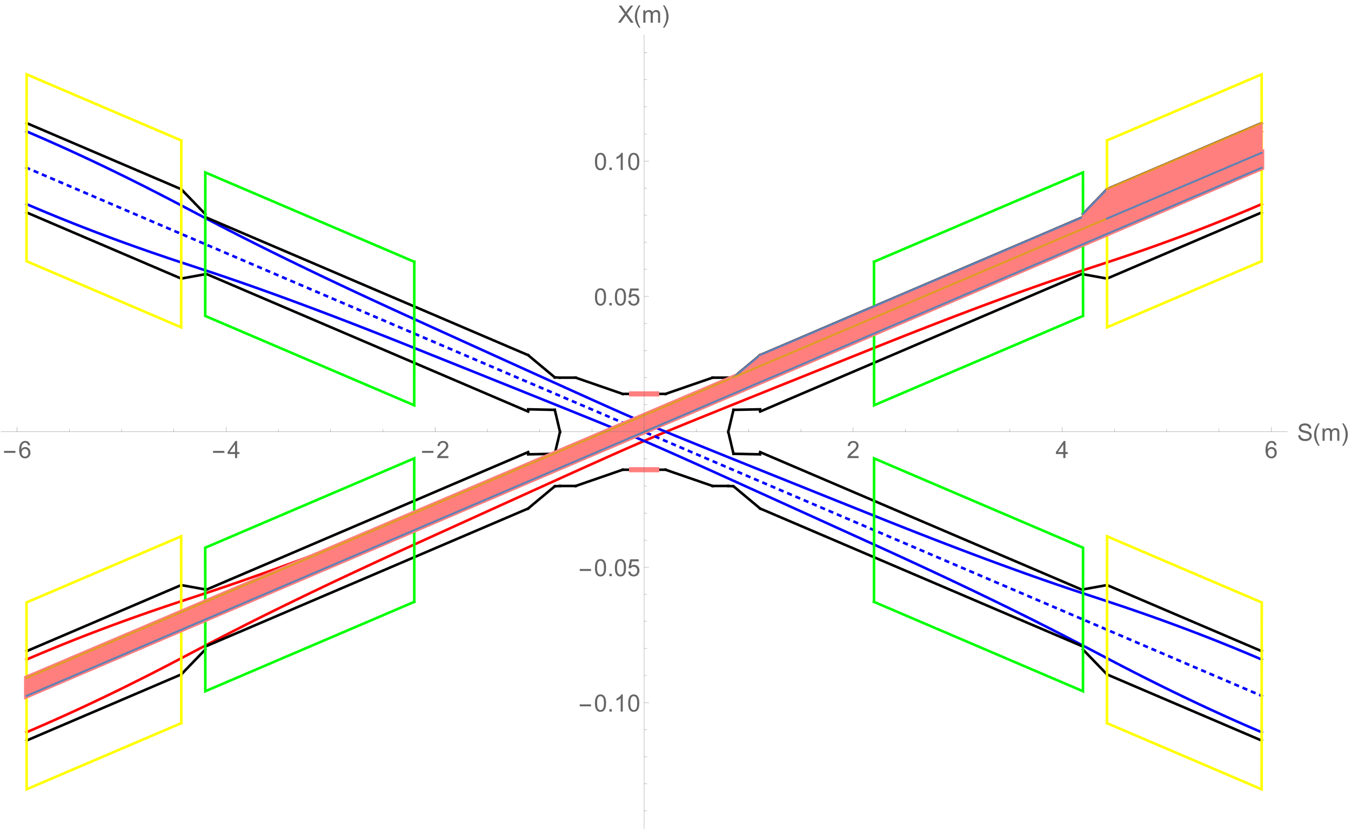
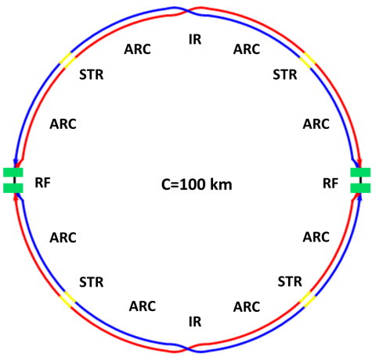
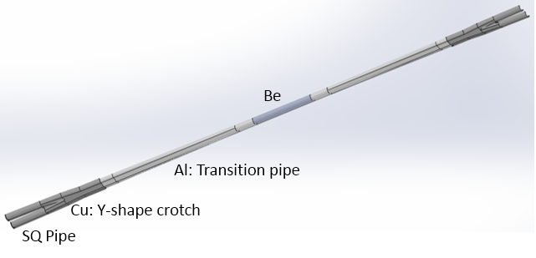
Position and Layout of IR pipe
Talk in Y. W Wang

Slide 6
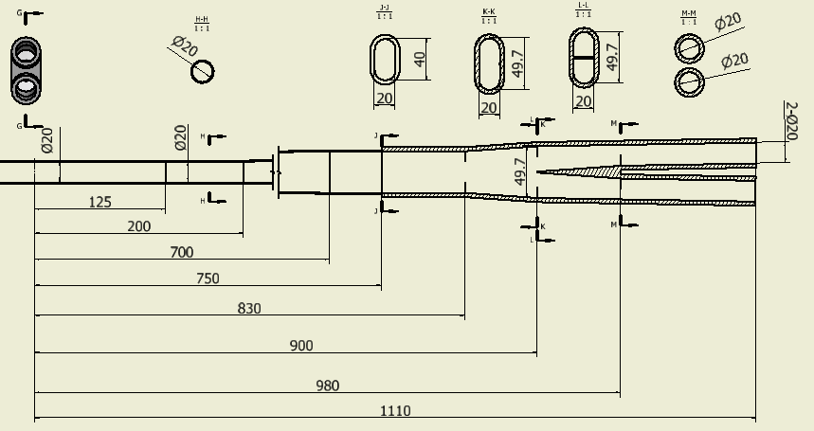
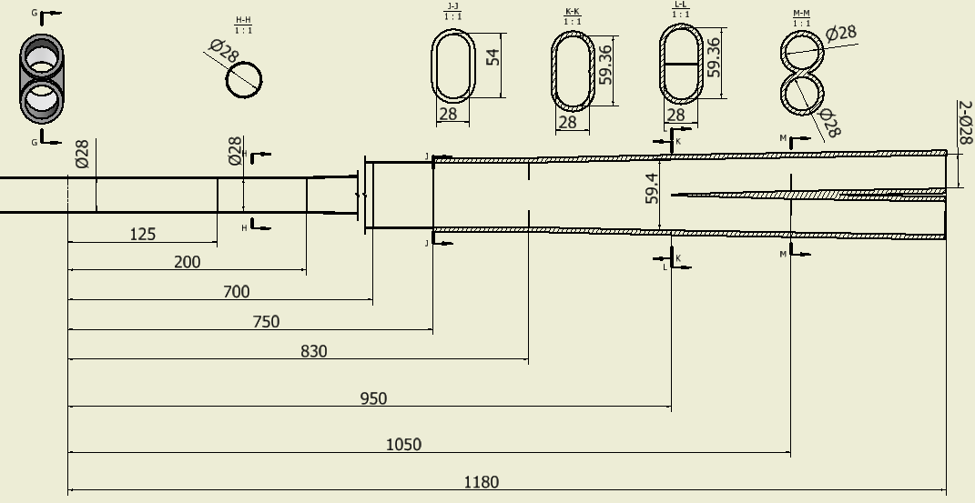
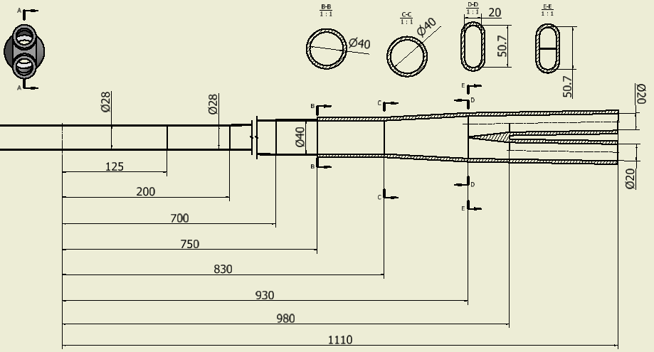
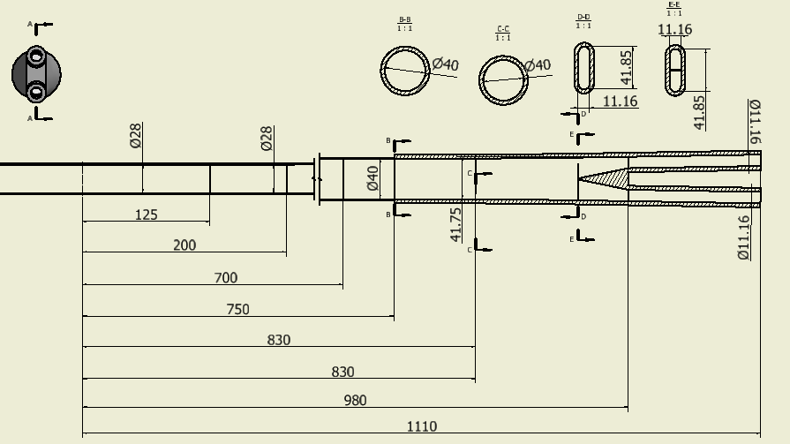
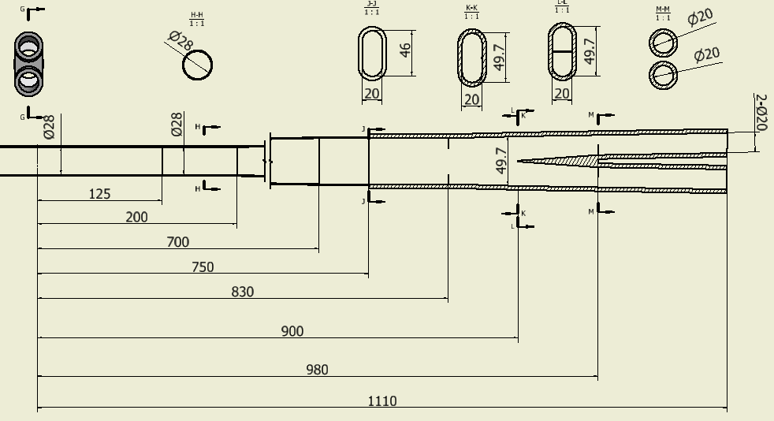
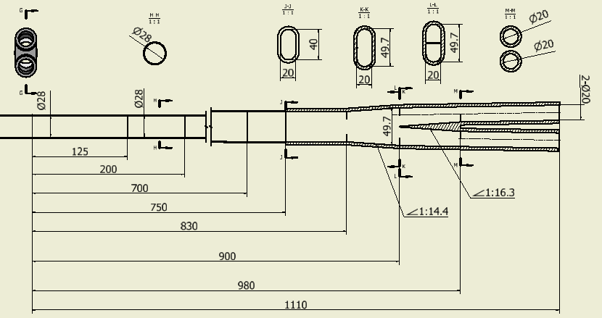
Evolution map on IR pipe design
P_{total}: 279.3w(Z)
Primary structure
Shrink Be pipe:28->20
√
Length:1180->1120
Q aperture: 28->20
P_{total}: 974.6w (Z)
X
Shrink Be pipe:28->11
P_{total}: 319.7w(Z)
Crotch Optimization: shape; slope…
X
P_{total}: 31.9kw(Z)
Crotch aperture
√
46mm->40mm
P_{total}: 288.4w
P_{total}: 313.5w

Slide 7
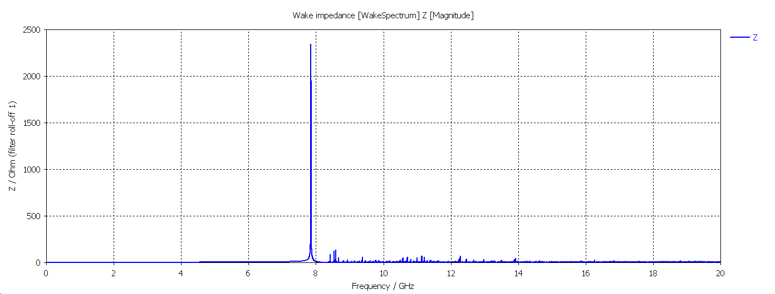
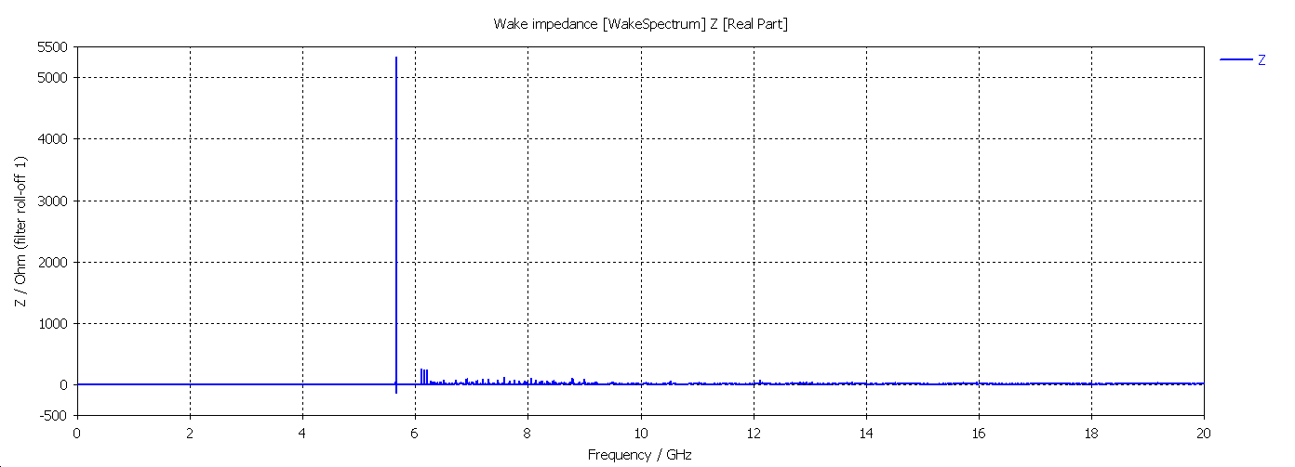
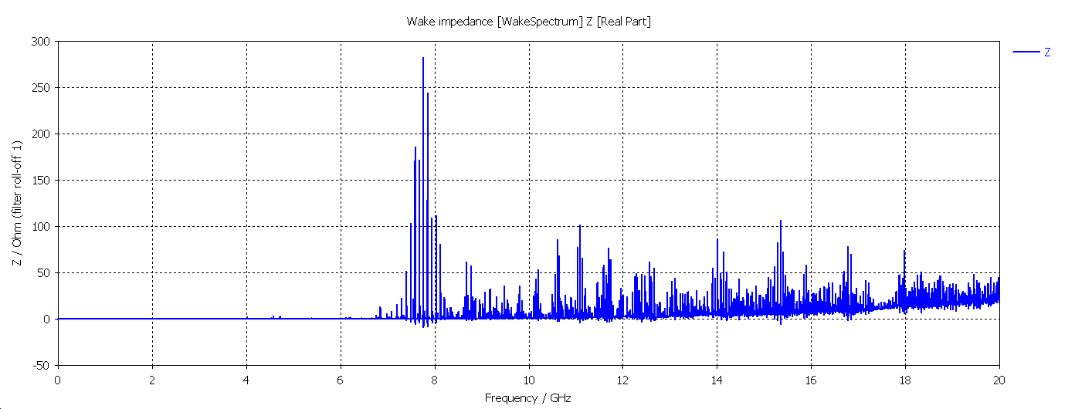
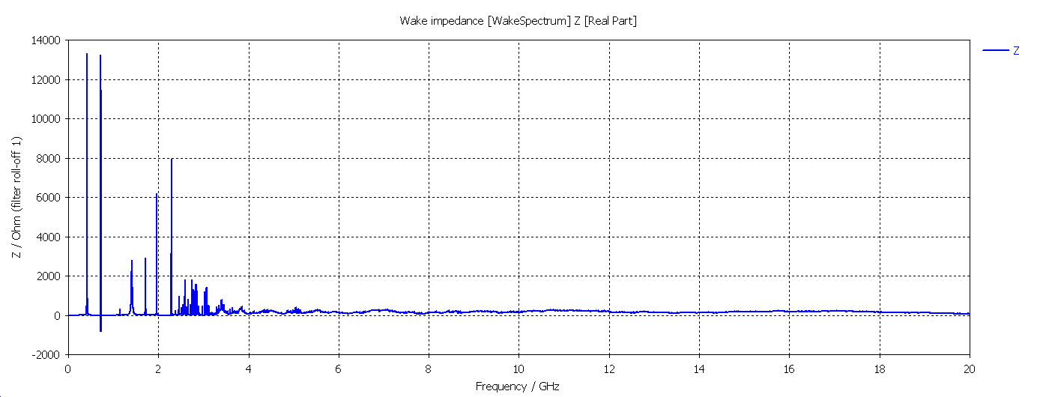
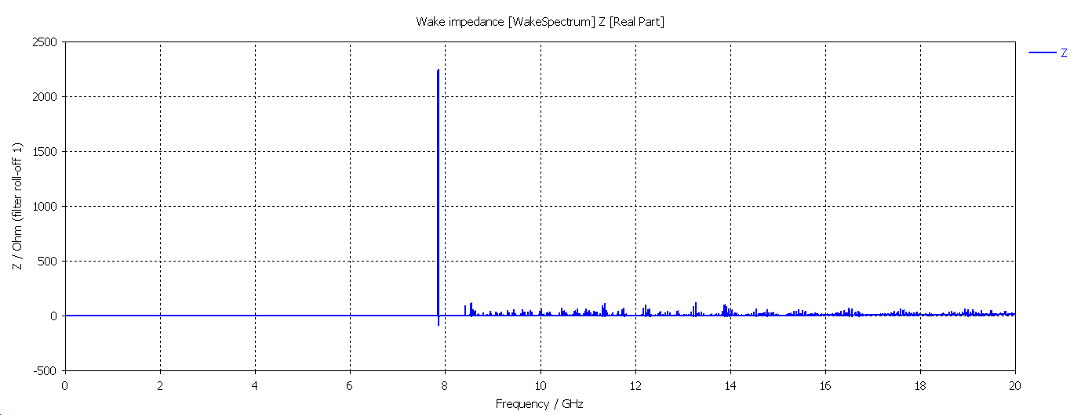
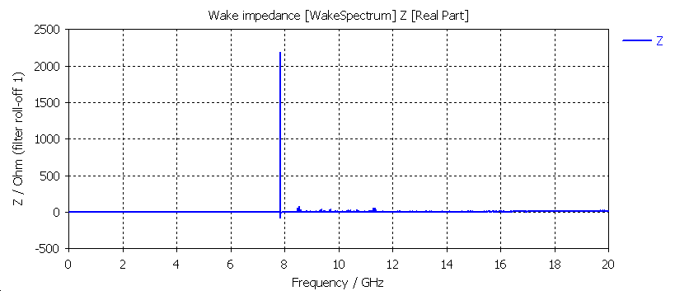
Evolution map on longitudinal impedance
√
Shrink Be pipe:28->20
X
Length:1180->1120
Q aperture: 28->20
X
Shrink Be pipe:28->11
Crotch Optimization: shape; slope…
√
Crotch aperture
46mm->40mm

Slide 8
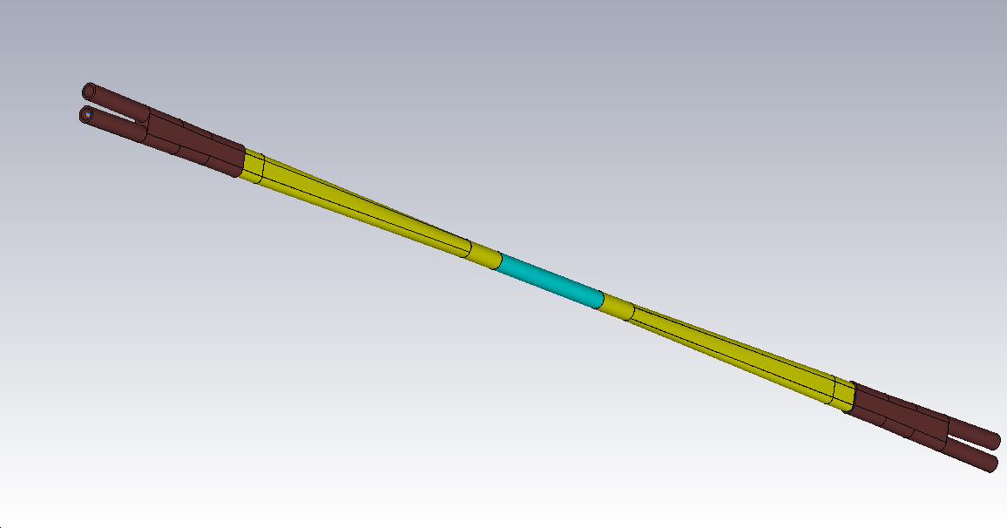
Total Power deposition in different region of IR pipe
The final choice on IR pipe
Total length:2220mm
Cu: 360mm
Al: 625mm
Be: 250mm
Total Power:
Ohmic loss
Power trapped in IR pipe
HOM from other part of the ring

Slide 9
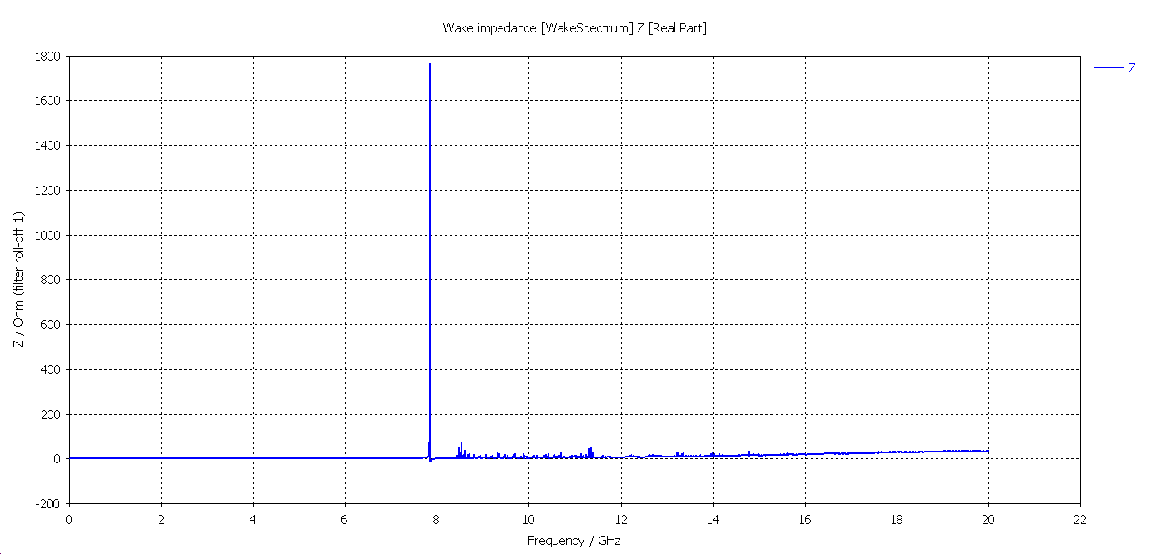
Power deposition in different region of IR
Z &CDR parameters Ib&461mA&σ_{z}@5mm
Be pipe: 43.24W
Al: Transition pipe: 342.2w
Cu: Y-shape crotch: 207.1w
Total power : 592.94w
Z &High Luminosity Ib&803mA&σ_{z}@6.2mm
Be pipe: 136.9W
Al: Transition pipe: 1097.22w
Cu: Y-shape crotch: 664.48w
Total power : 1898.6w

Slide 10
Power density in different region of IR
 | CDR beam parameters |  | High Luminosity beam parameters
Power | HOM power(w) | power density（w/cm²） | HOM power(w) | power density(w/cm²）
Be pipe (w) | 25 | 0.227 | 68.45 | 0.622
Al: Transition pipe (w) | 171 | 0.316 | 548.5 | 1.012
Cu: Y-shape crotch (w) | 103.5 | 0.158 | 332 | 0.507
Total power in IR pipe (w) | 296 | 0.234 | 949 | 0.714
This structure seems feasible !
Total length:2220mm
Be: 136.9w
Cu: 332w
Al: 548w

Slide 11
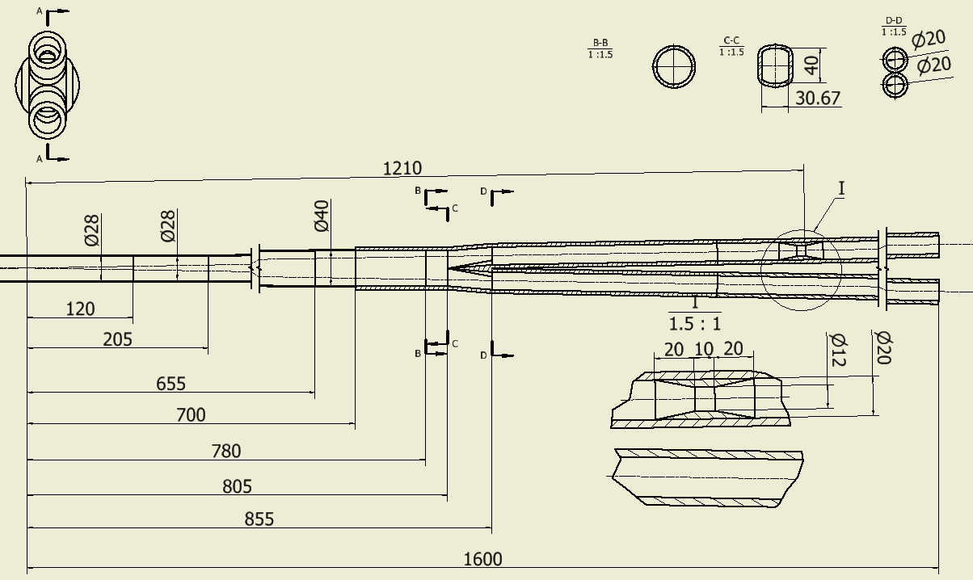
The IR pipe with photon maskers
Any synchrotron radiation from dipole including scattered photons should be stopped out of the IR region.
Photon Maskers will be installed in the pipe
The aperture was shrunk to 12mm
Much more HOM maybe trapped!

Slide 12
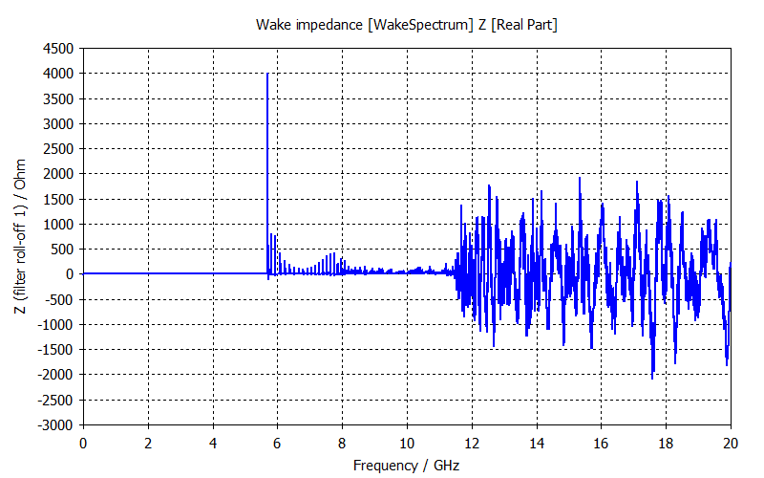
masker
masker
Position | Length(mm) | Higgs(w) | W (w) | Z(w) | High Luminosity Z(w)
Be pipe (w) | 120 | 6.28 | 23.51 | 97.12 | 292.52
Al: Be pipe transition(w) | 85 | 4.45 | 16.65 | 68.79 | 207.20
Al: Transition pipe (w) | 495 | 44.05 | 164.71 | 680.25 | 2048.9
Cu: Y-shape crotch (w) | 155 | 13.79 | 51.57 | 213 | 641.58
Al: Y crtothch to masker | 325 | 19.25 | 72.01 | 297.40 | 895.77
Cu：masker(w) | 50 | 0.063 | 0.238 | 0.984 | 2.964
Al: maser to pipe end | 370 | 0.47 | 1.76 | 7.28 | 21.93
Total | 1600 | 88.353 | 330.448 | 1364.824 | 4110.864

Slide 13
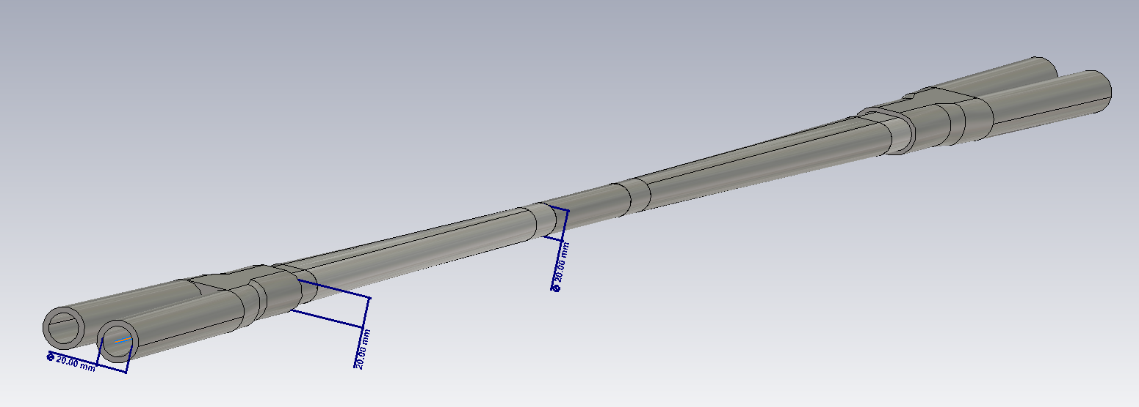
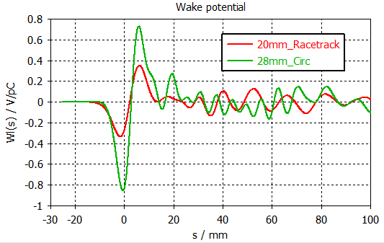
Another solution:
shrink the central aperture to 20mm
Inner diameter at IP: 20 mm
X: 20-35-(2-20)mm; Y: 20-20-20mm
Primary studies show that the loss factor is reduced by a factor of 3.
More detailed studies are under going.

Slide 14
Summary
With CDR beam current, One feasible IR chamber was derived which can meet the requirements on HOM power and synchrotron radiation.
With beam current for High Luminosity Z, the HOM power will be 3 times higher.
The smaller aperture of beryllium tube may be one choice for lower HOM.
The position, shape and structure for photon maskers need to be optimize carefully.
Thanks for your attention!

